Slide 1



Analysis of $φ\text{(1020}\text{) }$production in the BM@N experiment
Ramin Barak
28th International Scientific Conference of Young Scientists and Specialists, Dubna, October 27 – November 1, 2024

Slide 2
Introduction
Collisions of heavy relativistic ions allow us to study nuclear matter at extreme density and temperature.
At sufficiently high temperature and energy density, the so-called Quark-Gluon Plasma (QGP) is formed [1]:
  Formation of strange particles.
Theoretical models offer different descriptions [2],[3]:
  New experimental data is needed for clarification.
[1] Kapishin.M, “Studies of baryonic matter at the BM@N experiment (JINR).” Nuclear Physics A 982 (2019) 967–970.
[2] J. A. et al Nucl. Phys., vol. A 757, pp. 102–183, 2005.
[3] K. A. et al Nucl. Phys., vol. A 757, pp. 184–283, 2005.

Slide 3
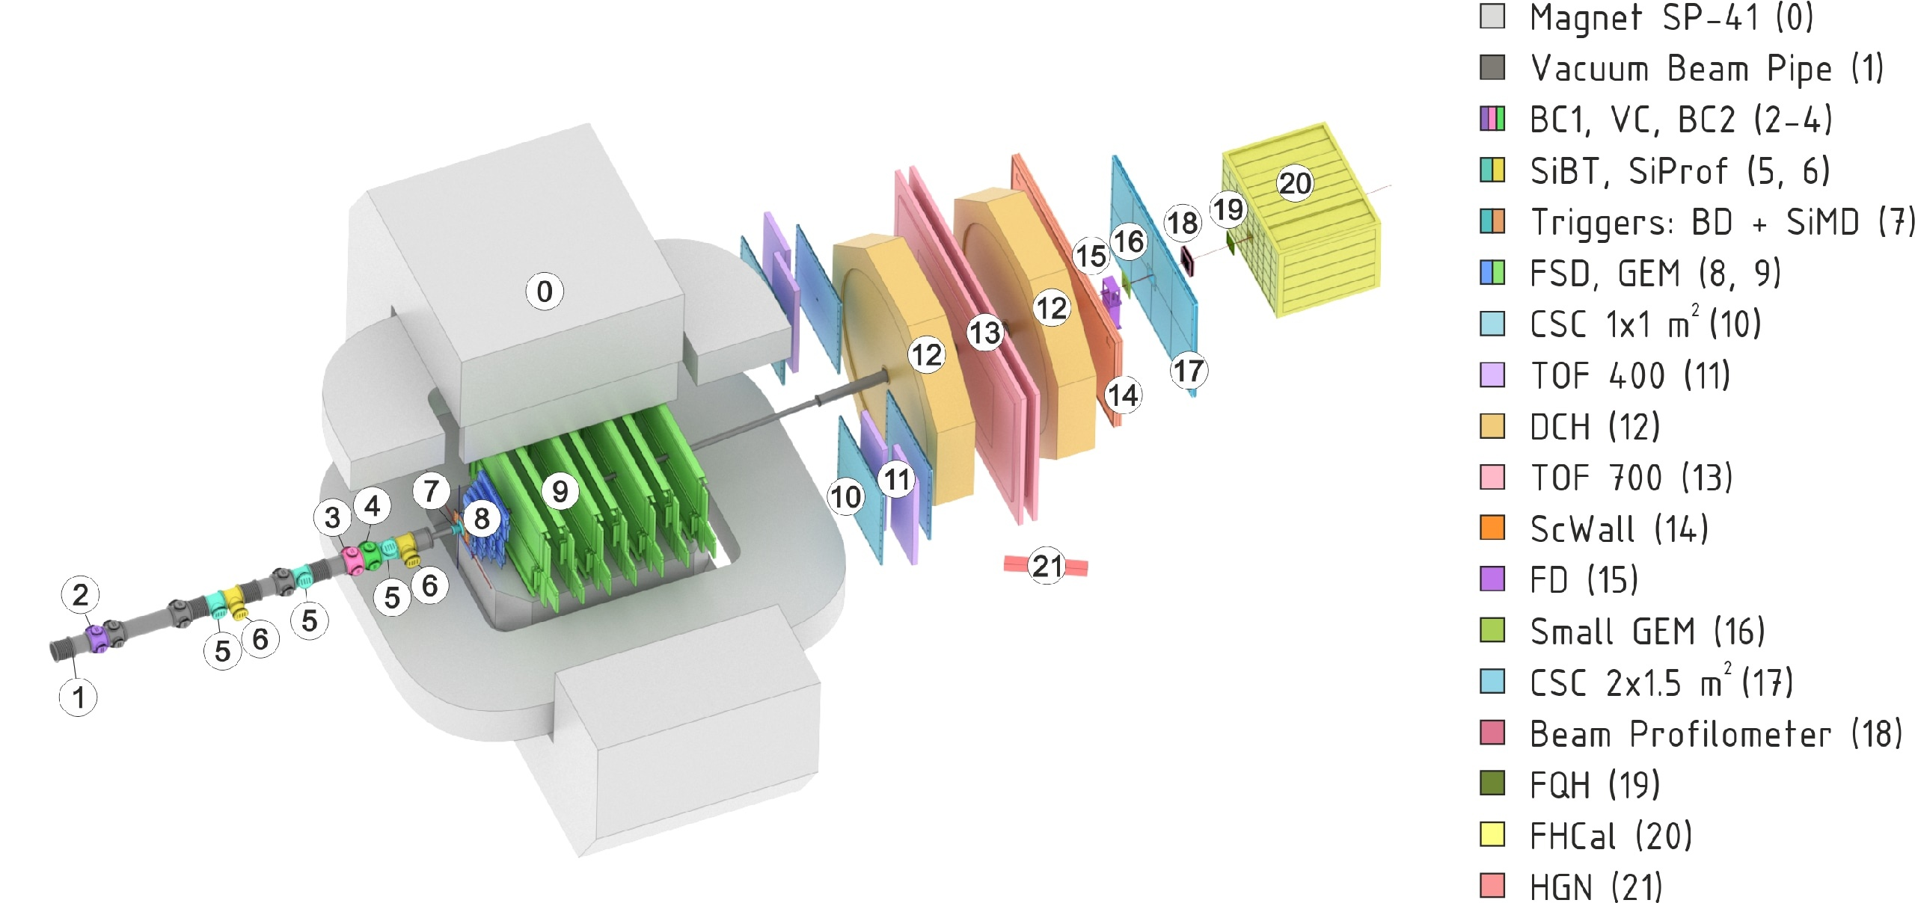
BM@N experiment at the NICA complex
Collisions of elementary particles and ions with a stationary target at energies up to 4 GeV per nucleon.
Studying the properties of dense baryonic matter, the formation of hypermatter, the equation of state of symmetric and asymmetric nuclear matter, collective phenomena...
NICA accelerator complex
Experimental setup of BM@N

Slide 4

Goal
Observation of $φ\text{(1020}\text{)}$signal in the MC and experimental data.

Slide 5
Data
Experimental data obtained in the physical session at the beginning of 2023 with a beam energy of 3.8 AGeV, a CsI target and Xe beam.
Dubna Cascade Model - Statistical Multifragmentation Model (DCM-SMM) and BOX Monte Carlo generators were used to model the data.
About 0.8 million Monte Carlo and 22 million experimental events were analyzed.

Slide 6
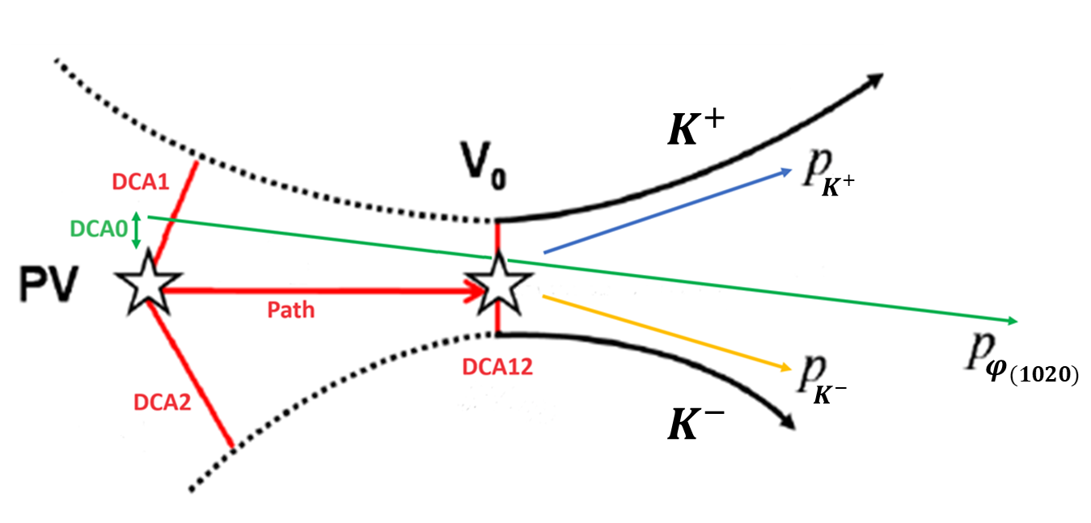
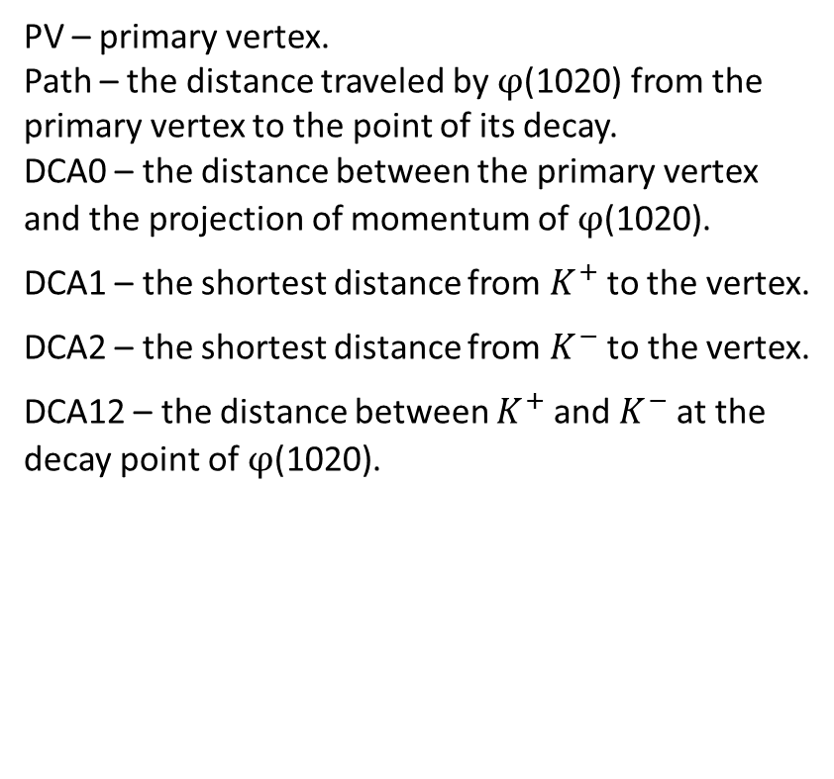
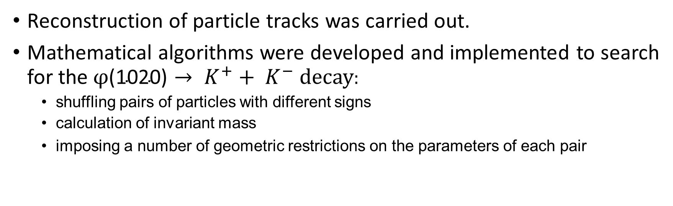
Data processing procedure
Reconstruction of particle tracks was carried out.
Mathematical algorithms were developed and implemented to search for the$φ\text{(1020}\text{)}→ K^{+}+ K^{−}$decay:
  shuffling pairs of particles with different signs
  calculation of invariant mass
  imposing a number of geometric restrictions on the parameters of each pair
PV – primary vertex.
Path – the distance traveled by $φ\text{(1020}\text{)}$ from the primary vertex to the point of its decay.
DCA0 – the distance between the primary vertex and the projection of momentum of $φ\text{(1020}\text{)}$.
DCA1 – the shortest distance from $K^{+}$to the vertex.
DCA2 – the shortest distance from $K^{−}$ to the vertex.
DCA12 – the distance between $K^{+}$and $K^{−}$at the decay point of$φ\text{(1020}\text{)}$.
Event topology

Slide 7
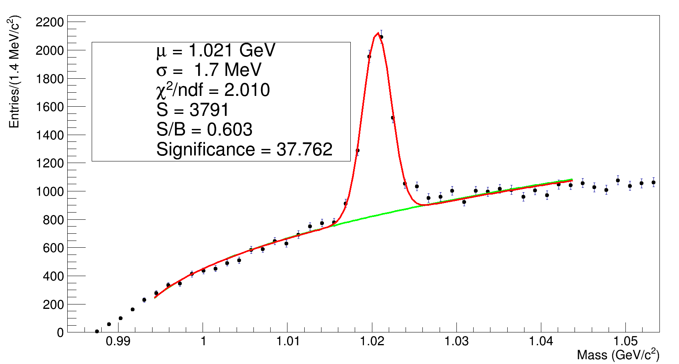
Results
MC
Efficiency = 0.47 %

Slide 8
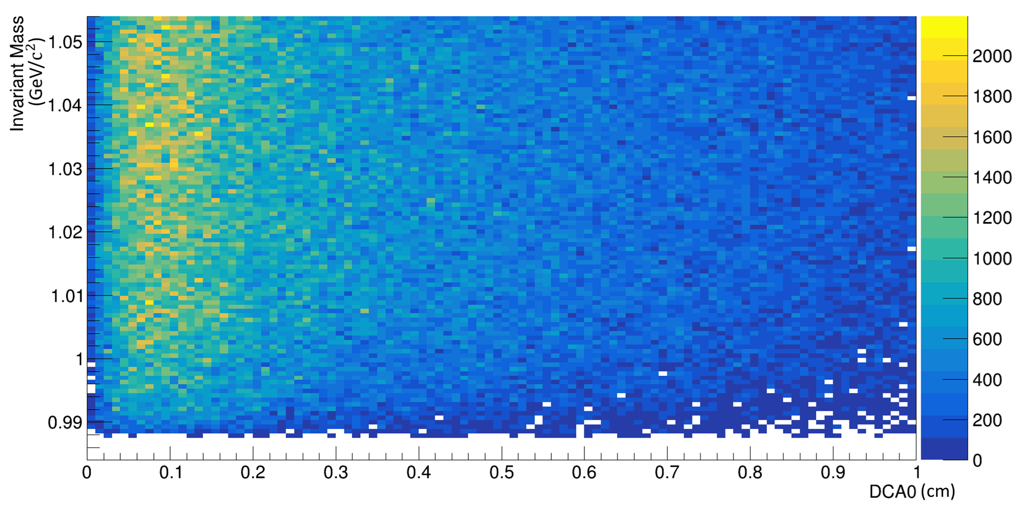
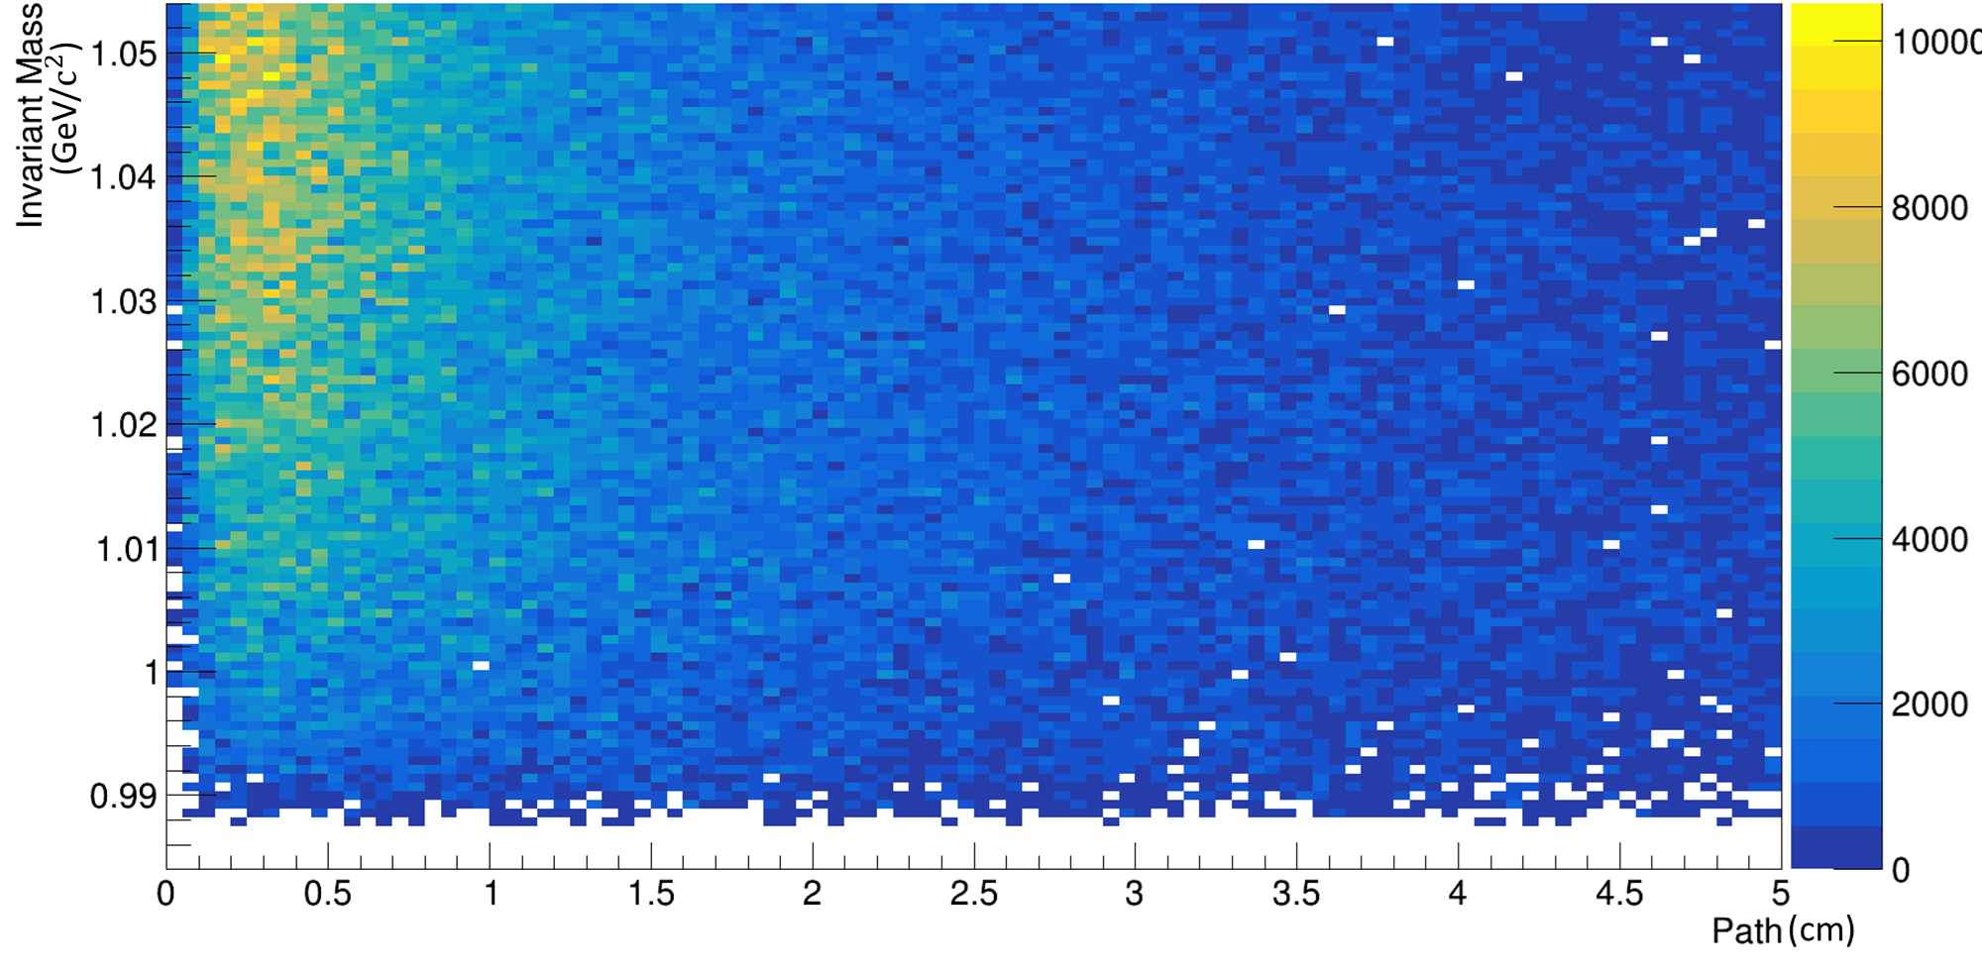
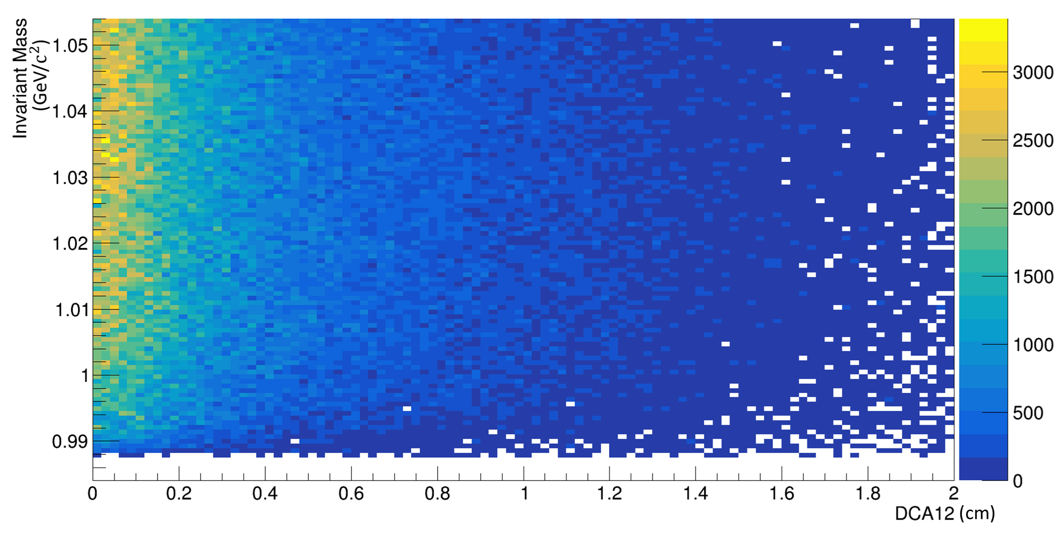
Results

Slide 9
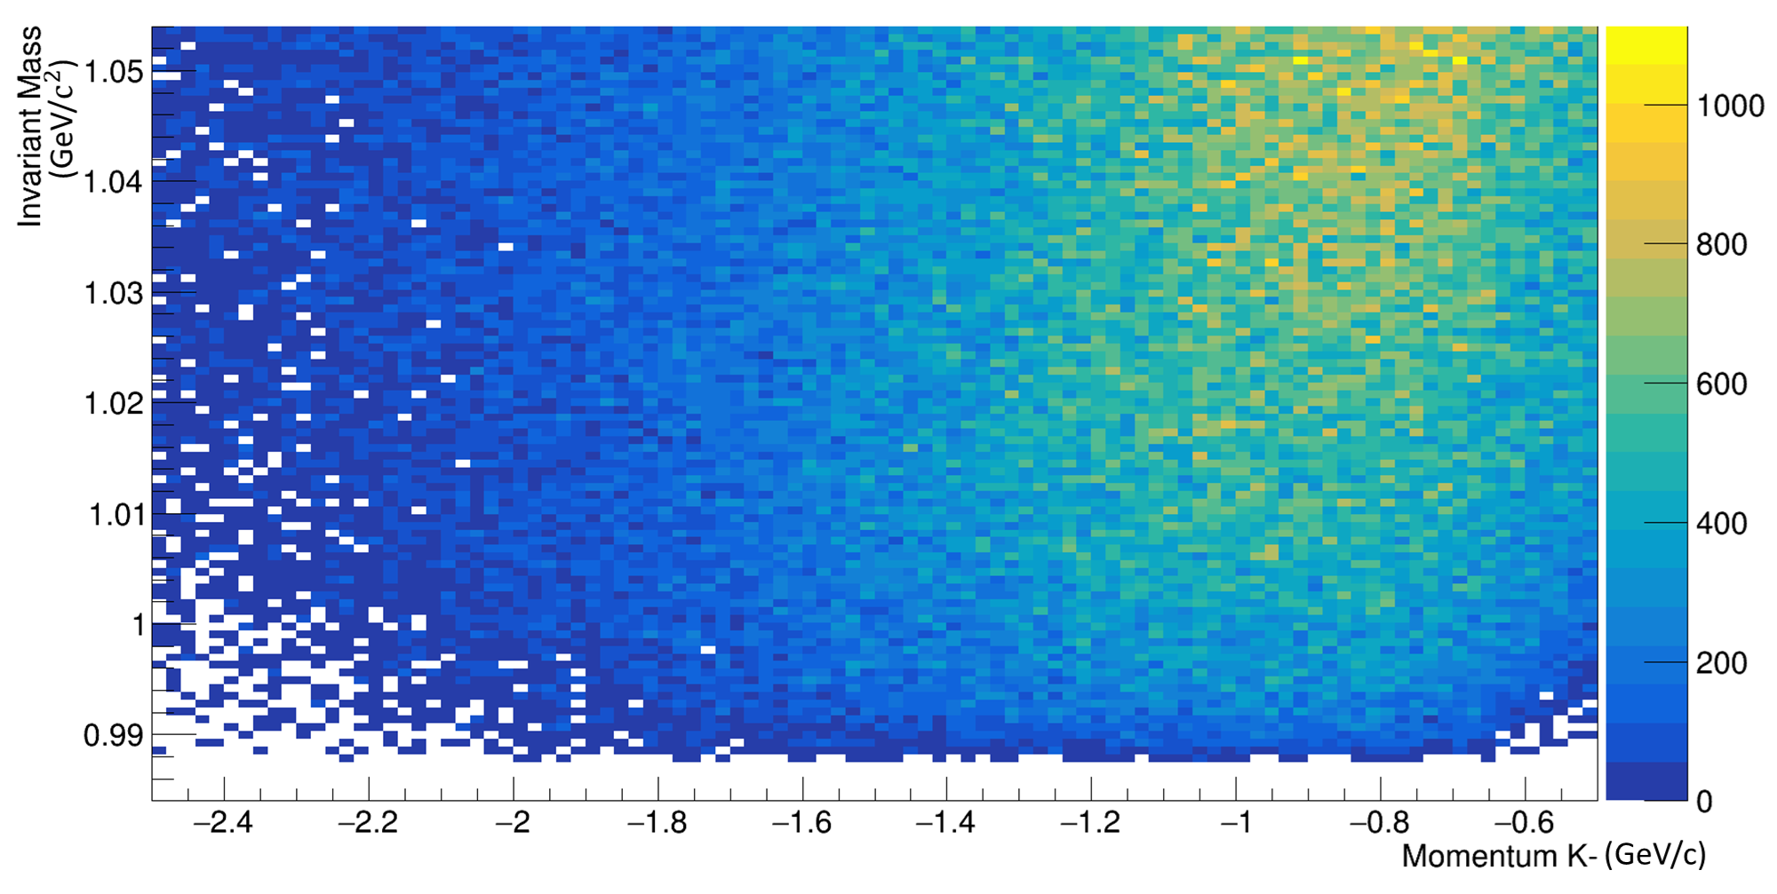
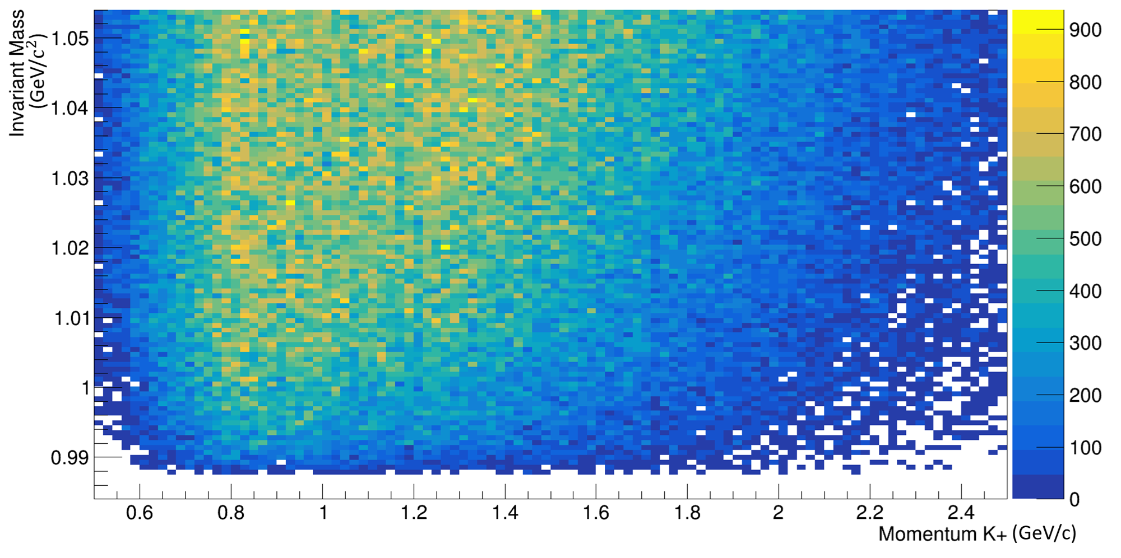
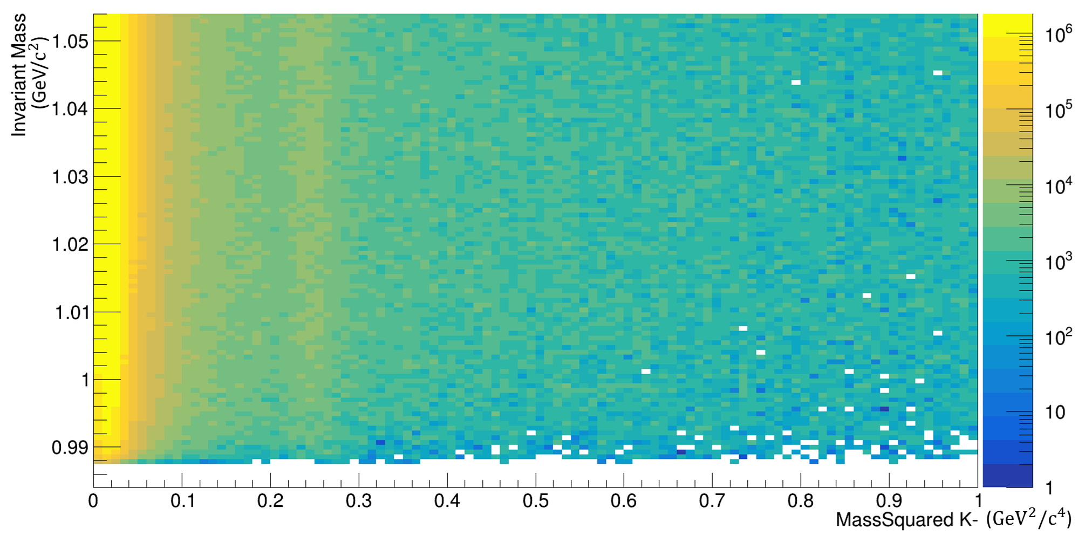
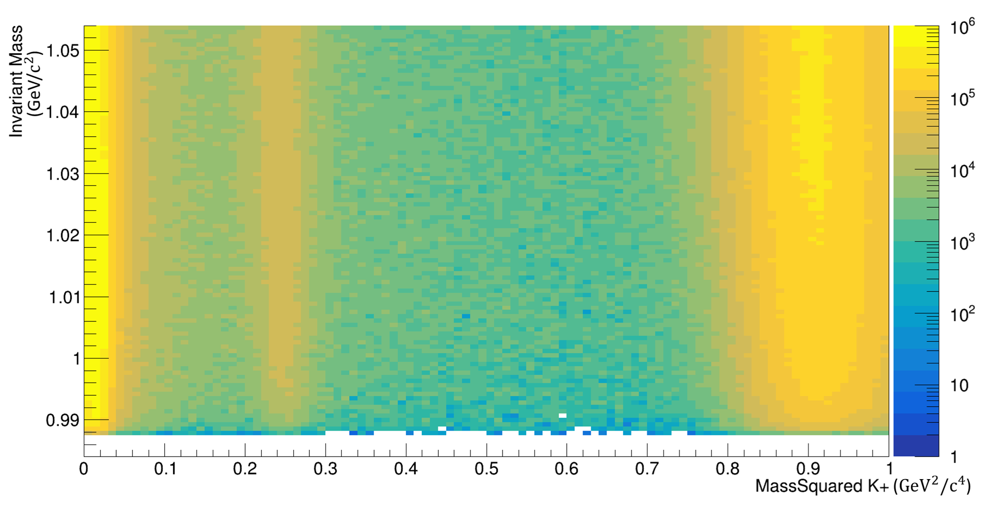
Results

Slide 10
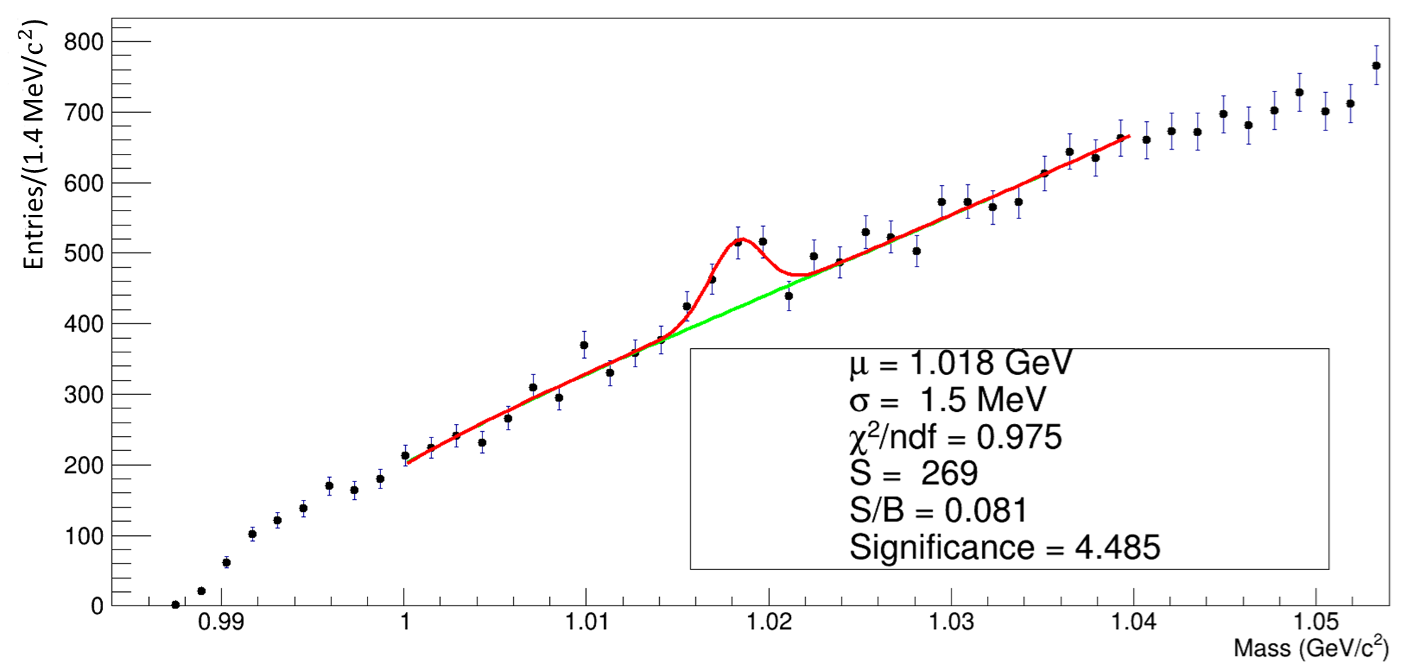
Results
EXP

Slide 11
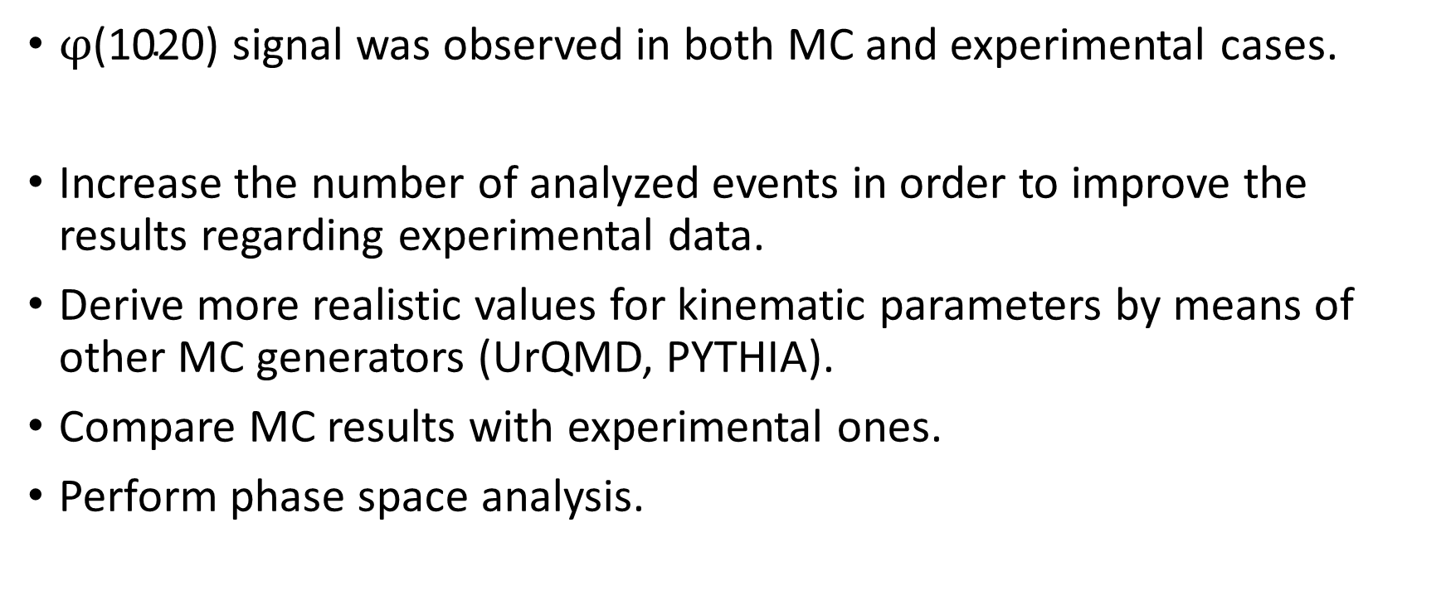
Conclusion and future work
$φ\text{(1020}\text{) }$signal was observed in both MC and experimental cases.
Increase the number of analyzed events in order to improve the results regarding experimental data.
Derive more realistic values for kinematic parameters by means of other MC generators (UrQMD, PYTHIA).
Compare MC results with experimental ones.
Perform phase space analysis.

Slide 12
Backup

Slide 13
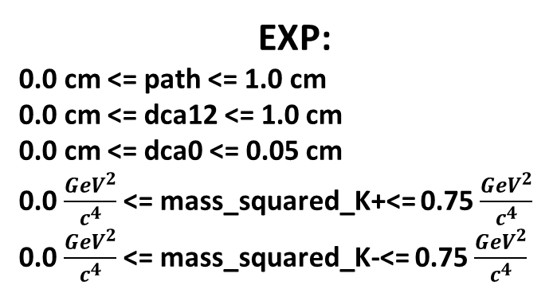
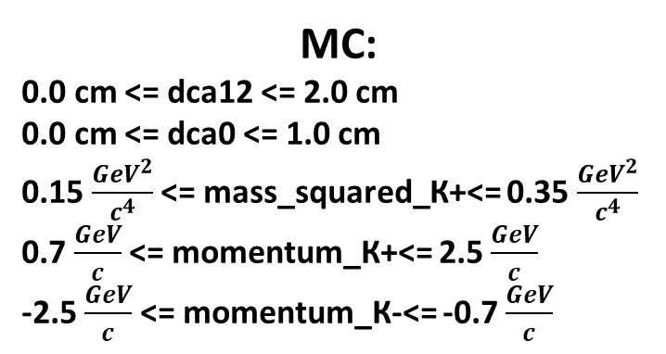
Cuts
MC:
0.0 cm <= dca12 <= 2.0 cm
0.0 cm <= dca0 <= 1.0 cm
0.15 $\frac{{GeV}^{2}}{c^{4}}$ <= mass_squared_К+<= 0.35 $\frac{{GeV}^{2}}{c^{4}}$
0.7 $\frac{GeV}{c}$ <= momentum_К+<= 2.5 $\frac{GeV}{c}$
-2.5 $\frac{GeV}{c}$ <= momentum_К-<= -0.7 $\frac{GeV}{c}$
EXP:
0.0 cm <= path <= 1.0 cm
0.0 cm <= dca12 <= 1.0 cm
0.0 cm <= dca0 <= 0.05 cm
0.0 $\frac{{GeV}^{2}}{c^{4}}$ <= mass_squared_K+<= 0.75 $\frac{{GeV}^{2}}{c^{4}}$
0.0 $\frac{{GeV}^{2}}{c^{4}}$ <= mass_squared_K-<= 0.75 $\frac{{GeV}^{2}}{c^{4}}$

