Slide 1
Simulation and Optimization of Resistive Plate Chamber (RPC) Performance using Garfield++
Tahany Abdelhameid (Helwan University, Egypt)
Email: Tahany.Abdelhameid@cern.ch

Slide 2
Outlines
Introduction
Overview of Resistive Plate Chamber
Simulation tools
Results and Conclusion

Slide 3
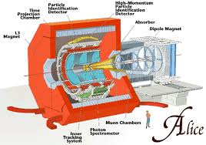
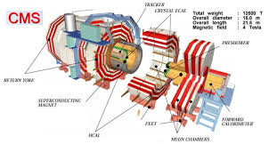
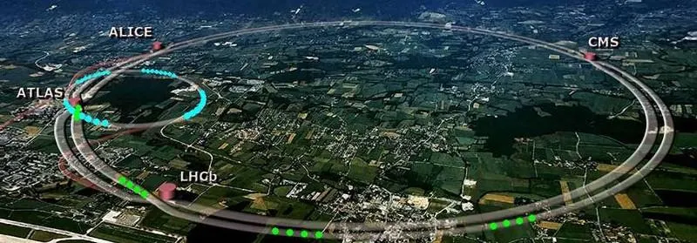
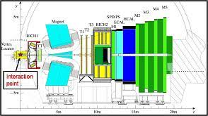
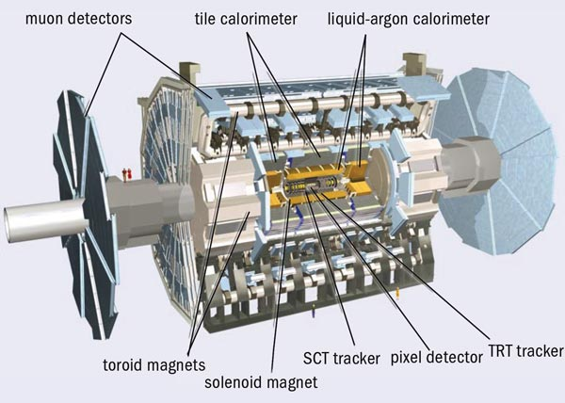
Introduction
Large Hadron Collider (LHC)
P-P collision
Luminosity of 1* 10³⁴ cm⁻² s⁻¹

Slide 4
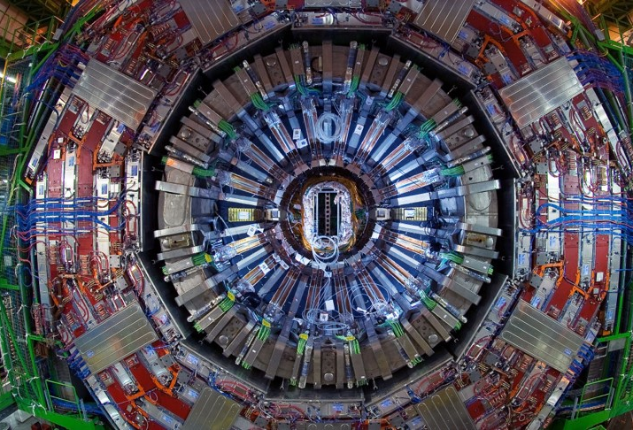
Compact Muon Solenoid (CMS)
Tracker
Electromagnetic Calorimeter (ECAL)
Hadronic Calorimeter (HCAL)
Magnet
Muon detectors

Slide 5
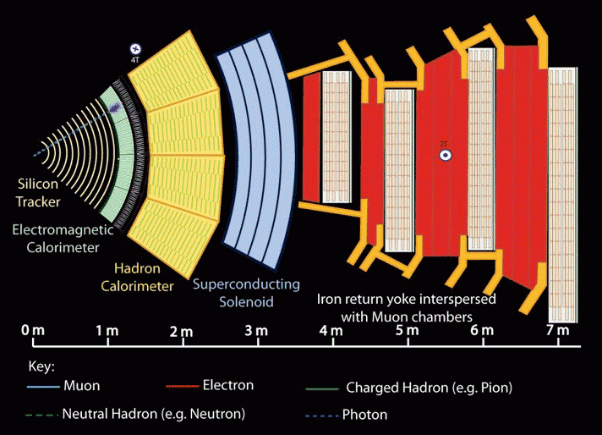
Motion of charged particle inside CMS

Slide 6
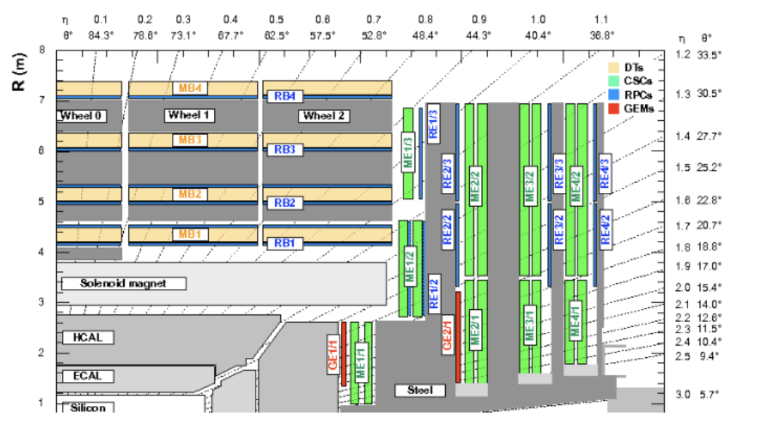
Quadrant CMS Cross Section
Drift Tubes (DTs)
Cathode Strip Chambers (CSCs)
Resistive Plate Chambers (RPCs)
Gas Electron Multiplier (GEM)

Slide 7
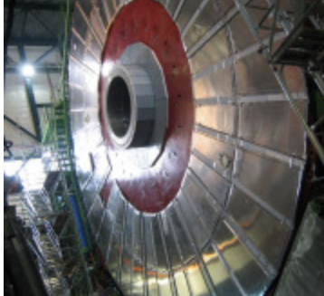
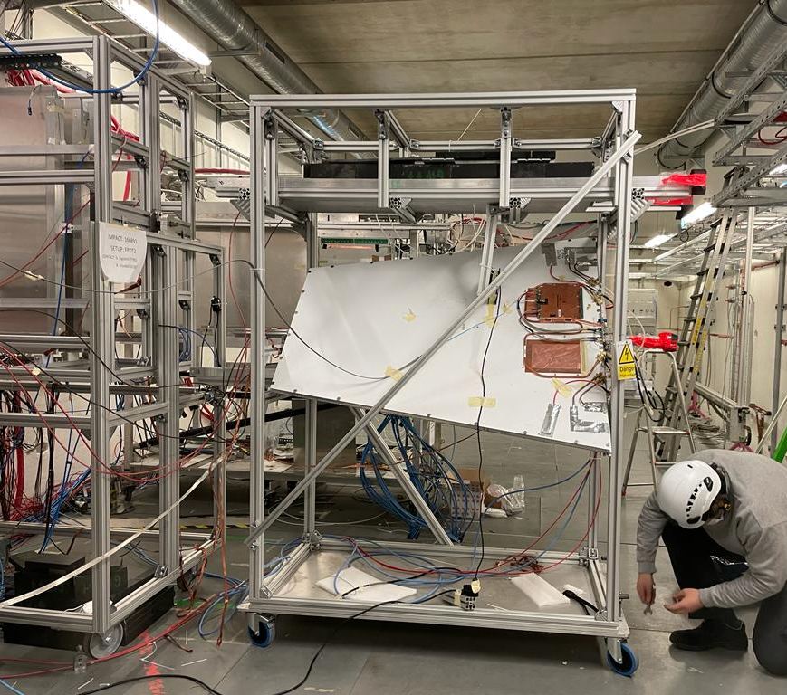
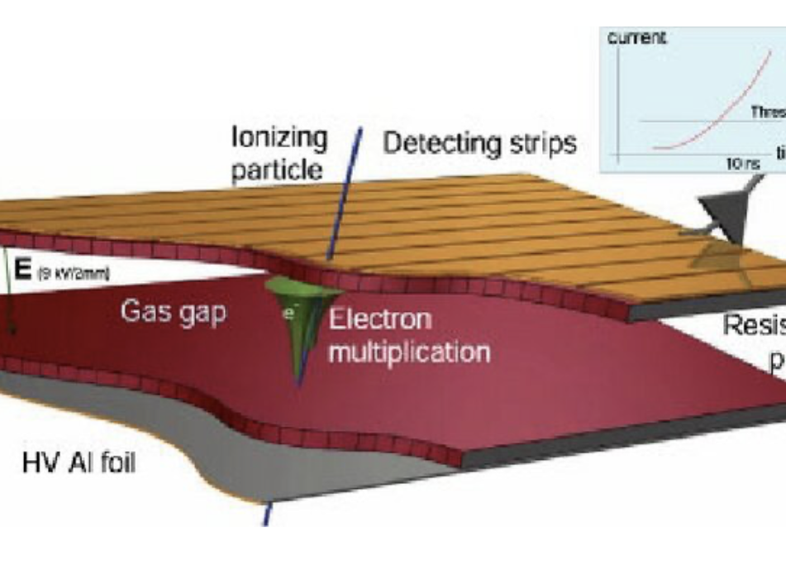
Resistive plate chamber (RPC) composition
Two layers of high resistive Bakelite:
Thickness= 2mm.
ρ = 10¹⁰ - 10¹¹ Ωcm.
Coated with graphite layers to
applied H.V ~ 10kV.
Gas gap:
Gap width= 2mm.
Gas mixture (Freon(95.2%)/isobutan(4.5%)/ SF6 (0.3%))
Readout strips

Slide 8
Applications of RPC Detector
Trigger in particle experiments
Medical Imaging
Muography Applications

Slide 9
Aim of the work
To identify the optimal operating conditions for Resistive Plate Chambers (RPCs) to enhance their performance in muon detection studies.
Examine how different temperature influence RPC parameters, including electron transport characteristics (Townsend coefficient, diffusion, and drift velocity).

Slide 10
Simulation tool
Garfield++
A toolkit for a detailed simulation of particle detectors that use
gas and semi-conductors as sensitive medium.
It makes an interface with different packages like:
Magboltz
HEED (High Energy ElectroDynamics)
neBEM (nearly exact Boundary Element Method)

Slide 11
Magboltz
solves the Boltzmann transport equations for electrons in gas mixtures under the influence of electric and magnetic fields.
The transport parameters like:
Townsend Coefficient: Measure of ionization per unit distance.
Drift Velocity: Speed of electrons moving in the electric field.
Diffusion Coefficient: Spread of electrons due to collisions with gas molecules.

Slide 12
Characteristics of the simulation:
Type of the incident particle is Muon
10000 events with 2 GeV energy
pass through 2 mm gas gap
containing a gas of C2H2F4 (100%).
At 1 atm pressure and various temperature

Slide 13
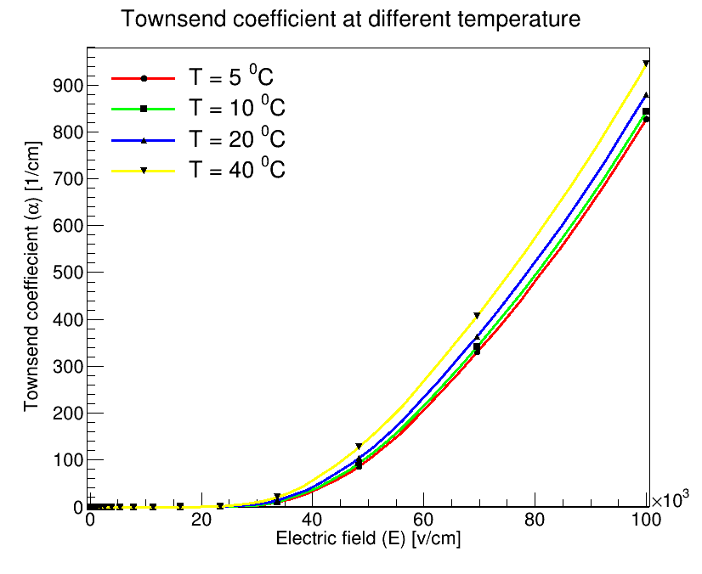
Drift velocity and Townsend coefficient at different temperature

Slide 14
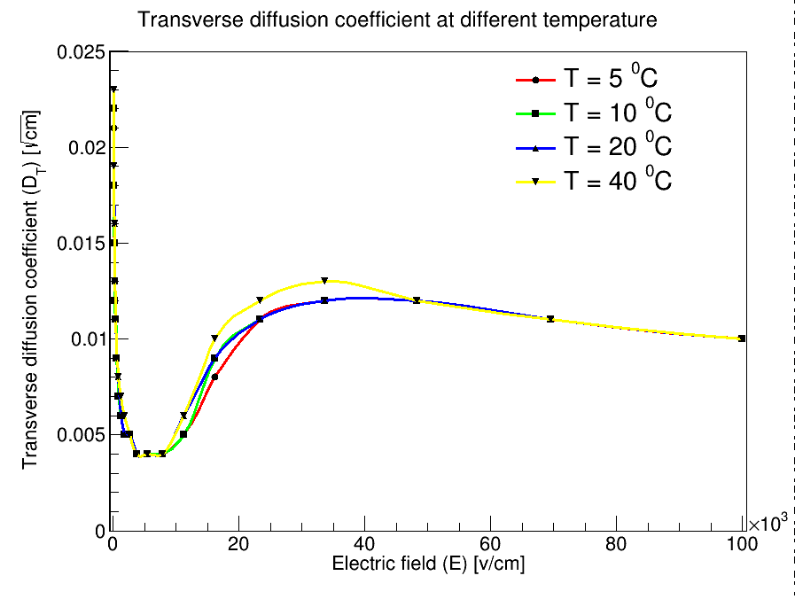
Transverse and longitudinal diffusion coefficient

Slide 15
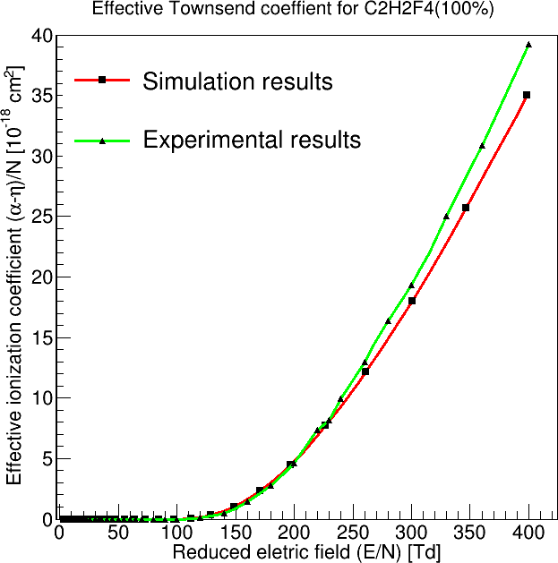
Comparison between the experimental and simulation results
The experimental results from de Urquijo, J., Juárez, A., Basurto, E. et al. Electron swarm coefficients in 1,1,1,2 tetrafluoroethane (R134a) and its mixtures with Ar. Eur. Phys. J. D 51, 241–246 (2009)

Slide 16
Heed (High Energy ElectroDynamics)
Heed is used for the calculations of:
Energy loss of the incident particle in a gas gap.
Primary electron number

Slide 17
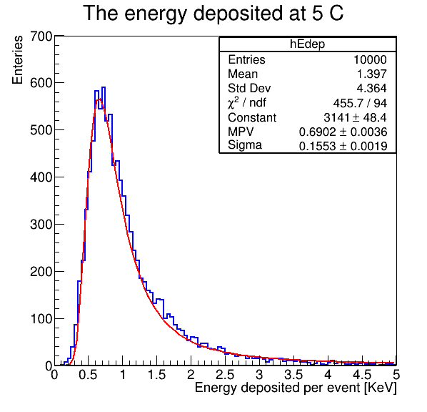
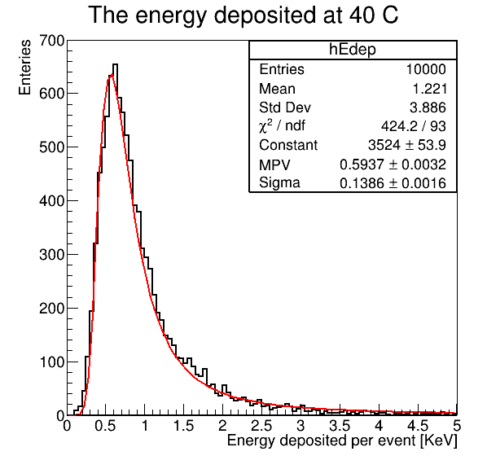
Energy loss at different temperature
From 5C to 40C the energy loss decreased by 100ev

Slide 18
Comparison of the energy loss at different temperature

Slide 19
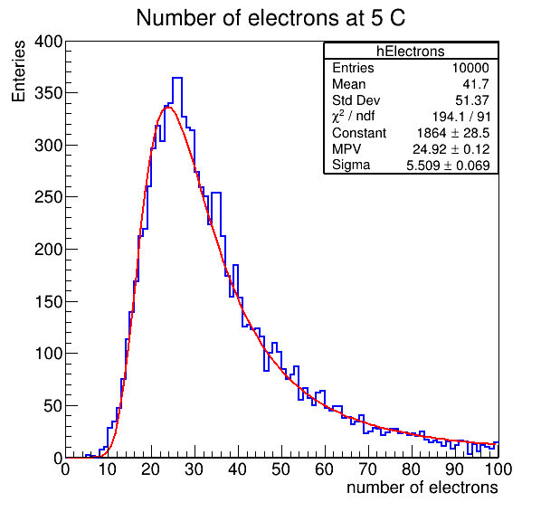
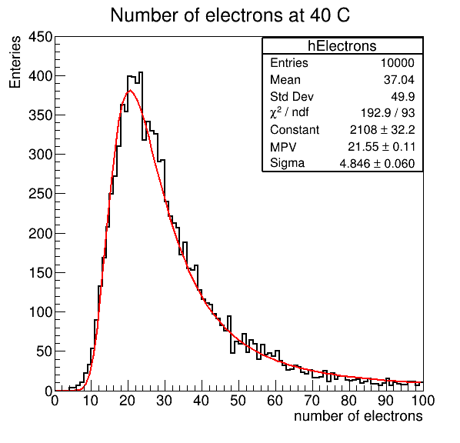
Number of electrons at different temperature
From 5C to 40C the primary electrons decreased by 3 elecrons

Slide 20
Comparison between the number of electrons at different temperature

Slide 21
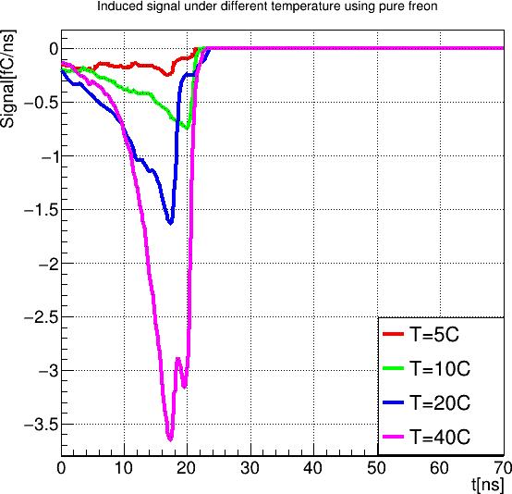
neBEM (nearly exact Boundary Element Method)
It computes the electric field and potential in nearly arbitrary.
3-dimensional geometries taking the presence of conductors and dielectric media into account.
RPC induced signal under different temperature

Slide 22
Conclusion
The performance of the RPC under different temperature was studied using Garfield++ software with pure Freon.
As the temperature changed, all the transport parameters have changed.
The drift velocity and Townsend coefficient have increased with the temperature, while the longitudinal diffusion coefficient shows unstable behavior.
The number of primary electrons decreased by 3 electrons and the energy loss decreased by a factor 100 eV as the temperature raised from 5 ⁰C to 40 ⁰C.
The amplitude of the induced signal increase by the raise of the temperature.

Slide 24
Backup

Slide 25
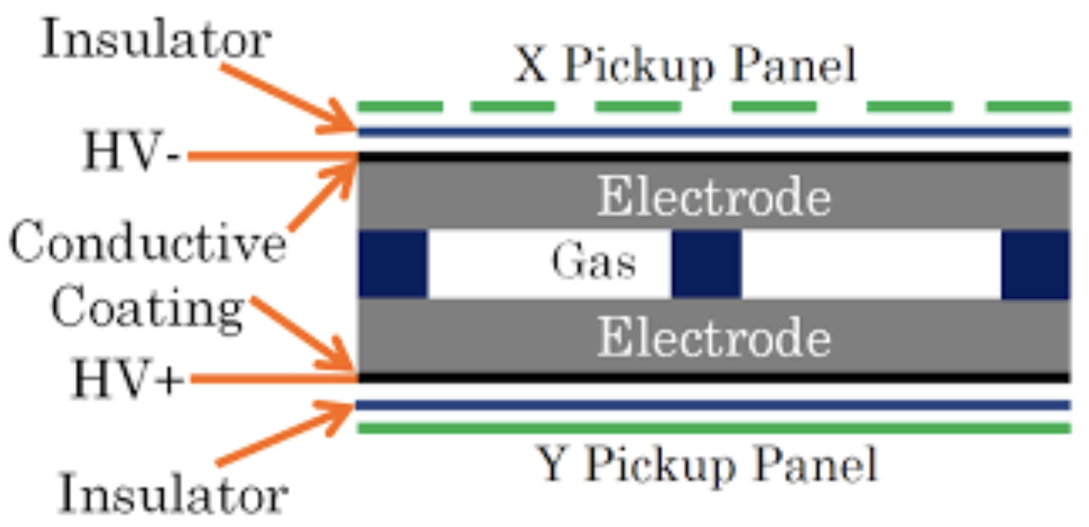
Overview of Resistive Plate Chamber (RPC)
It’s one of the gaseous detectors.
Invented in 1981 by R. Santonico and R. Cardarelli.
Key component in high-energy physics experiments.
Used for precise timing and muon detection in cosmic ray studies.
Fast response enables accurate time-of-flight measurements.
Affordable and robust, ideal for large-scale experiments.

Slide 26
Heed (High Energy ElectroDynamics)
Heed used for the calculations of:
Energy loss of the incident particle in a gas gap.
Primary electron number.
Type of the incident particle is Muon
Characteristics of the simulation:
At 1 atm pressure and various temperature
With 2 GeV energy.
pass through 2 mm gas gap
containing a gas of C2H2F4 (100%).

Slide 27
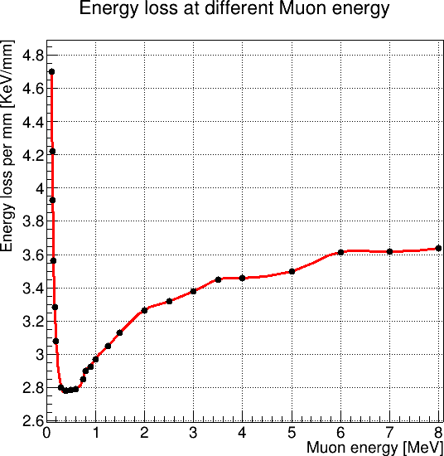
heed
The relation between the kinetic energy of the incident muon and its energy loss is measured by heed package

