Slide 1
Athenkosi Siyalo
A comparative study of the effect of the sol-gel, combustion, and solid-state reaction methods on the photoluminescence properties of Zn₄B₆O₁₃:Eu³⁺ nanophosphors.
PhD Physics (UWC)
Supervisor: Prof. Sylvain Halindintwali (UWC)
Co-supervisor: Prof. Leelakrishna Reddy (UJ)

Slide 2
Presentation outline
Introduction
Aims &Objectives
Applications
Synthesis
Results and discussion
Conclusion and future work
References
Acknowledgements

Slide 3
Introduction
Zn₄B₆O₁₃
Conduction band
Highly crystalline
Photoluminescent
Zn₄B₆O₁₃
Importance of synthesis methods for structural and photoluminescence properties.
Eu³⁺
EG
~ 5.73 eV
Wide bandgap
Intrinsic impurities
Valence band
Why these materials?
Zn₄B₆O₁₃: Eu³⁺
Successful incorporation
In host
Conduction band
Eu 5d
Tunable colour emission
EG
Eu 4f
~ 5.73 eV
Intense colour emission
Improve life-time decay
Valence band

Slide 4
Luminescence
Fluorescence
Cathodoluminescence
Thermoluminescence
Photoluminescence
Electroluminescence
Phosphorescence

Slide 5
Aim
The study aims to compare sol-gel, combustion, and solid-state methods to understand their influence on structural and photoluminescent properties.
Objective
To synthesize pure, singly doped Dy³⁺ Zn₄B₆O₁₃ nanophosphors via sol-gel, chemical combustion, solid-state methods.
To identify crystal phase structure of the prepared phosphor materials.
To examine the surface morphology and chemical composition of the materials
To identify the most effective synthesis method for enhancing luminescent efficiency.

Slide 6
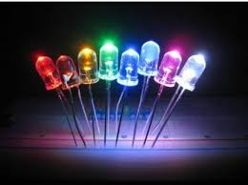
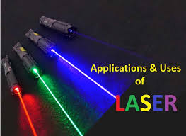
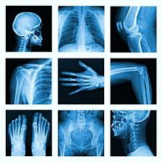
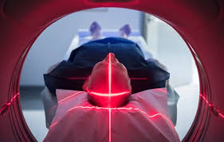
Applications
LEDS
Laser
Solid state lighting
Color display
X-ray imaging
Phototherapy
[1-5]

Slide 7
Synthesis methods
Sol-gel
Combustion
Solid- state
Highly pure materials
Uniform size
Expensive
Allow control of morphology
It can be done at small scales
Time consuming
Fast Preparation
Fast crystallites growth
Conducted under low-
pressure and temperature
Allow control of morphology
Low preparation cost
Simple
Pestle and Mortar
Homogeneous materials
Low cost
Allow control of morphology
[1-3]
Characterization : XRD, SEM & EDS, PL, and CIE

Slide 8
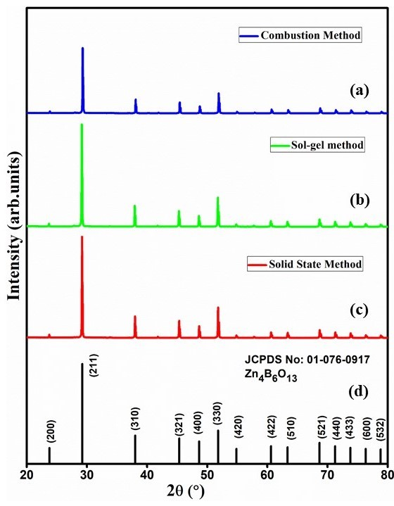
X-ray diffaction
XRD results for Zn₄B₆O₁₃:1% Eu³⁺
Cubic crystal structure:
The Debye-Scherrer equation
$$D=\frac{kλ}{βcosθ}$$
S.No | Sample Zn₄B₆O₁₃:Eu³⁺ | Crystallite size (nm) | Lattice Parameters | Lattice angles
1 | (Sol-gel) | 98.05 | 7.47407 Å | 90º
2 | (Combustion) | 95.93 | 7.47547 Å | 90º
3 | (Solid state) | 96.81 | 7.47148 Å | 90º

Slide 9
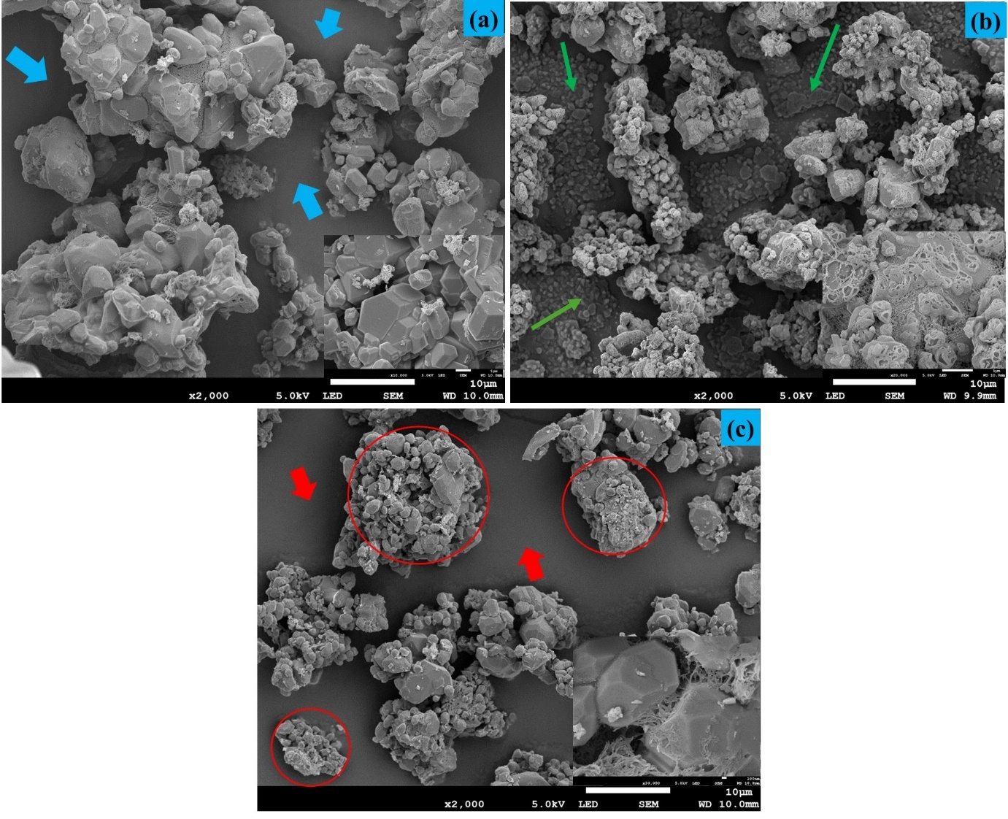
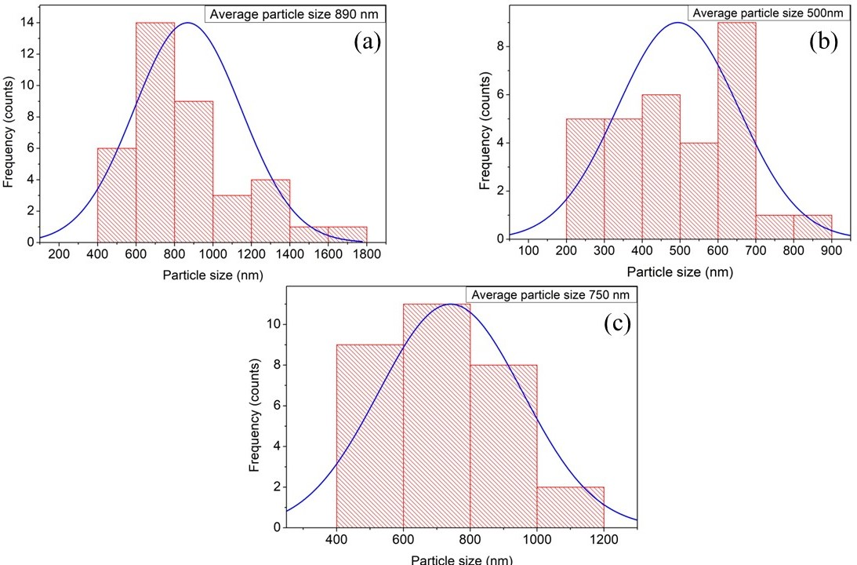
Scanning Electron Microscopy
Micrographs for phosphors prepared by (a) Sol-gel, (b) Combustion, and (c) Solid-state reaction methods.
890 nm
500 nm
750 nm
Histograms for phosphors prepared by (a) Sol-gel, (b) Combustion, and (c) Solid-state reaction methods.

Slide 10
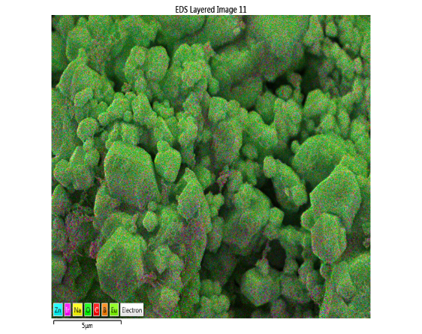
Energy Dispersive Spectra

Slide 11
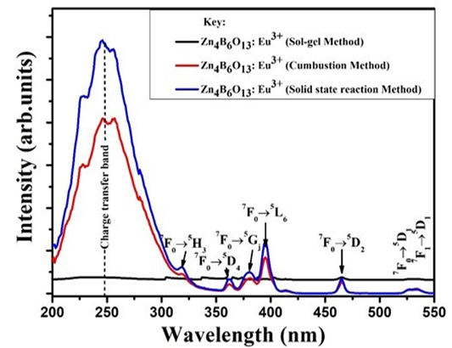
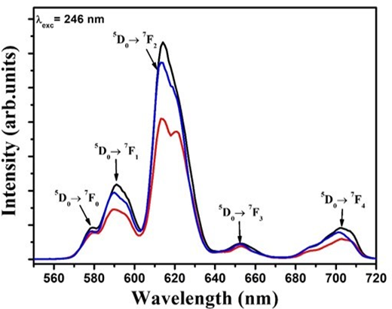
Photoluminescence Spectroscopy
Excitation spectra
Emission Spectra
Average lifetime decay
λ_{exc} = 246 nm
λ_{emi} = 614 nm

Slide 12
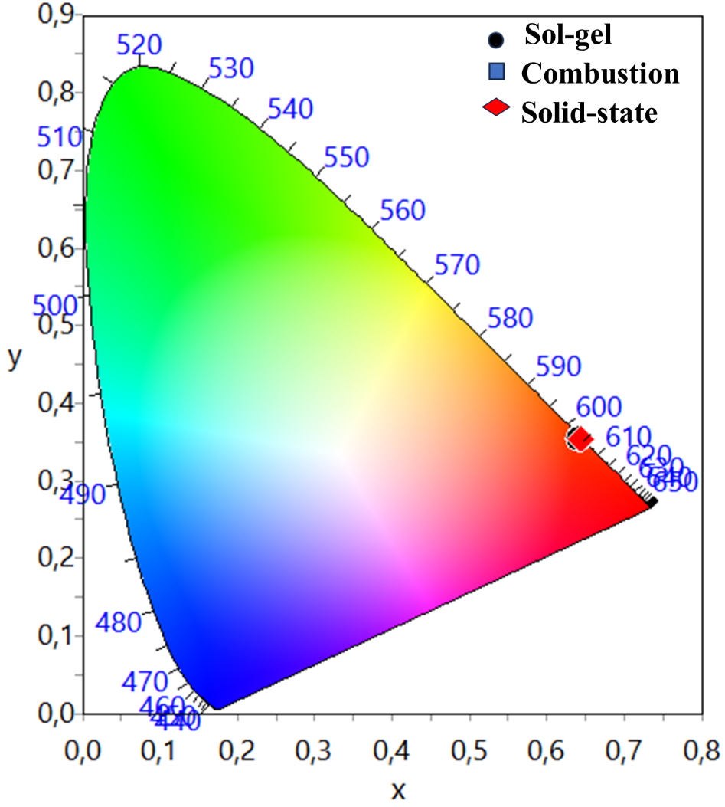
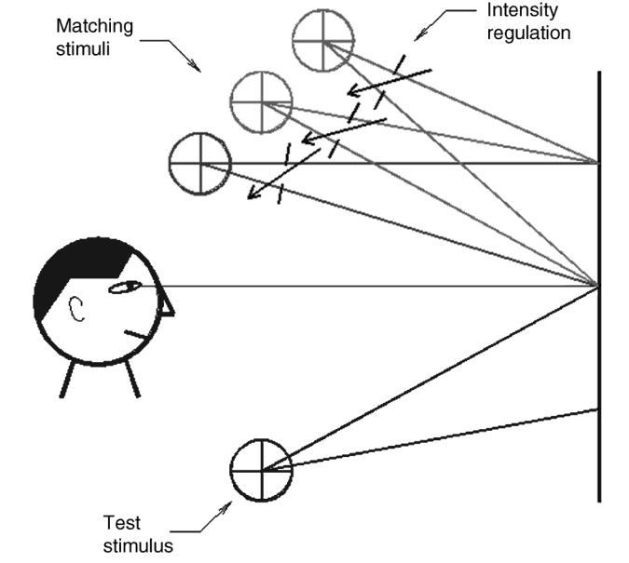
Colour chromaticity
S.No. | Sample ID | CIE-coordinates
1 | Zn₄B₆O₁₃:Dy³⁺ (Sol-gel) | (0.642, 0.353)
2 | Zn₄B₆O₁₃:Dy³⁺ (Combustion) | (0.641, 0.352)
3 | Zn₄B₆O₁₃:Dy³⁺ (Solid state) | (0.644, 0.354)

Slide 13
Conclusion
Zn₄B₆O₁₃:Eu³⁺ phosphor successfully synthesized
All samples resembled cubic crystal structure.
Intense photoluminescence emission at ${\text{λ}}_{emi}=620 nm$.
Sol-gel exhibited intense PL emission at ${\text{λ}}_{exc}$= 245 $nm$
All synthesis methods yielded phosphors with red colour emissions.
Potential applications in Red LEDs.
For future work new strategy of studying the impact of co-doping the host material with rare earth ions.

Slide 14
References
LIANG, P., Mingzhen, W.A.N.G. and Zhihong, L.I.U., 2017. Synthesis and spectroscopic studies of Zn4B6O13 and Eu/Tb single-doped Zn4B6O13 phosphors. Journal of Rare Earths, 35(5), pp.441-445.
Shrivastava, R., Kaur, J., Dubey, V. and Jaykumar, B., 2015. Luminescence studies on europium-and dysprosium-doped di-strontium magnesium silicate phosphor. Research on Chemical Intermediates, 41, pp.3699-3708.
Shrivastava, R., Kaur, J., Dubey, V., Jaykumar, B. and Loreti, S., 2015. Photoluminescence and thermoluminescence investigation of europium-and dysprosium-doped dibarium magnesium silicate phosphor. Spectroscopy Letters, 48(3), pp.179-183.
Zatsepin, D.A., Zatsepin, A.F., Boukhvalov, D.W., Kurmaev, E.Z., Pchelkina, Z.V. and Gavrilov, N.V., 2016. Electronic structure and photoluminescence properties of Zn-ion implanted silica glass before and after thermal annealing. Journal of Non-Crystalline Solids, 432, pp.183-188.

Slide 15
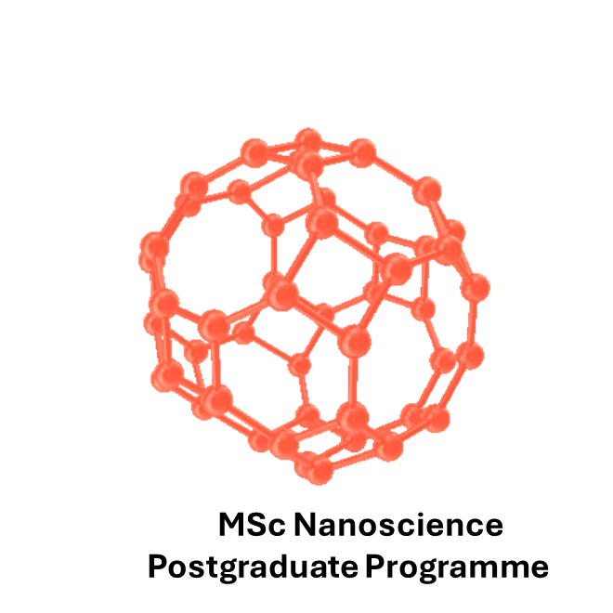
Acknowledgements

Slide 16
Thank you!

