Slide 1
28th International Scientific Conference of Young Scientists and Specialists (AYSS-2024)
Dubna, October 28 – November 2, 2024
X-ray diffraction study and modeling of damaged layers in Y₃Al₅O₁₂ ceramics after swift heavy ions irradiation.
Artem Alexandrovich Nazarov¹, P.A. Yunin¹, A.V. Nokhrin², L.S. Alekseeva²
¹ IPM RAS, Nizhniy Novgorod
² UNN, Nizhniy Novgorod
e-mail: nazarov.artem@ipmras.ru
Notes:
The topic of my presentation is…

Slide 2
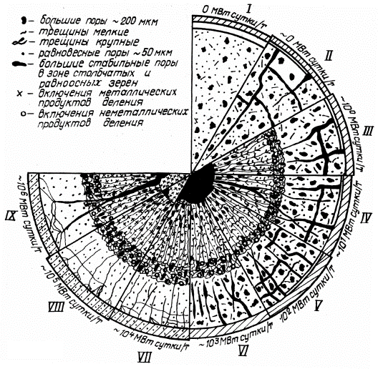
Motivation
To solve the problem of implementing a closed fuel cycle, ceramics based on mineral-like compounds are considered as promising ceramic matrices for the immobilization of components of radioactive waste (mainly long-lived minor actinoids Np, Am, Cm);
To study the stability of such materials, tests are carried out by external radiation impact;
A diagnostic technique is required to assess the degree of resistance of ceramics to various types of impact;
The X-ray diffraction method is non-destructive and allows analyzing the phase composition of near-surface layers at depths up to tens of microns;
To test and generalize the results of experimental data, we will use methods of mathematical modeling of structures at the atomic level.
Схематическое изображение эволюции структуры керамического топлива в процессе его выгорания
(I – исходная структура;
II – растрескивание топлива при выходе реактора на мощность;
IV и IX – трещины в структуре топлива после остановки реактора;
III и V – VIII – структура топлива при указанных выгораниях)
Получаем «нарушенный» слой
α
Y₃Al₅O₁₂ – the initial matrix composition
Al
Am
Internal irradiation and defect formation as a result of radioactive decay
Y_{2.5}Am_{0.5}Al₅O₁₂ – matrix composition after «immobilization»
How to explore?
Np
Al
In this work
Am ≡ Nd
Nd – the simulator element
An unit cell of an inert matrix with a long-lived fission product
E_{Np} ~ 10-100 MeV !
2|14
Notes:
Such ceramics are considered as promising materials for the radioactive wastes immobilization. Therefore, to check the ceramics durability, tests are carried out by external radiation impact. That is, it is supposed to study samples that include radioactive isotope, which change the structure of the sample due to defect formation through radioactive decay. At the same time, the energies of the fission products can reach hundreds of megaelectronvolts. To study such system a diagnostic method is required that allows qualitative and quantitative analysis of irradiated samples. In this work, we will use X-ray diffraction method and mathematical modeling methods.

Slide 3
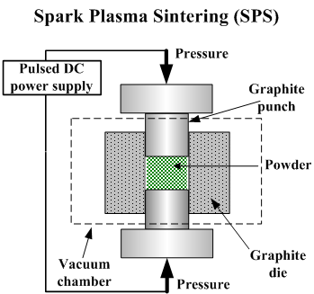
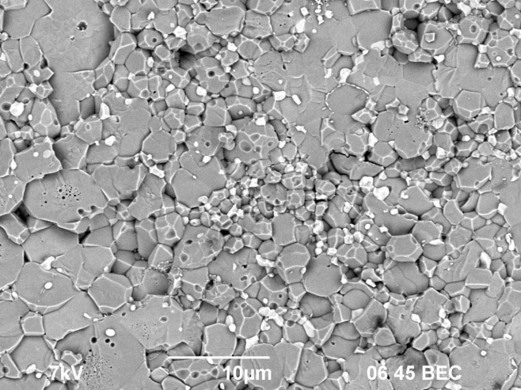
Objects of research
The paper presents an X-ray diffraction study of yttrium aluminum garnet ceramics (Y_{2.5}Nd_{0.5}Al₅O₁₂, YAG) made by the ЫЗS method. Three series of samples (13 samples in total) were studied: YAG, YAG + Mo (40 vol. %), YAG + SiC (40 vol. %). To simulate the radiation effect, samples were irradiated with swift heavy ions (Xe, 160 MeV, Φ = 10¹² -10¹³ cm⁻²) at JINR in Dubna on the IC-100 cyclotron.
Xe 160 MeV Φ = 10¹² -10¹³ см⁻²
Y_{2.5}Nd_{0.5}Al₅O₁₂ (+ Mo / SiC)
3-4 mm
8 mm
Xe (160 MeV) 10¹³ cm⁻²
10 mkm
SEM-photo of a cross-section of a sample irradiated with Xe (160 MeV) ions with a fluence of 10¹³ cm⁻²
3|14
Notes:
However, our ceramics do not contain radioactive atoms, we use a heavy imitator atom – neodymium. To simulate the radiation effect the samples were irradiated with swift heavy ions it was Xe with 160 MeV energy and with various fluence. In total , three series of samples were studied: pure YAG and Yag with thermally conductive additives – Molybdenium and silicon carbide.

Slide 4
Research objectives
1) X-ray diffraction analysis of samples (in symmetric and grazing incidence geometry)
We get:
- Phase compositions;
- Degree amorphization value; - Radiation-induced deformations;
- Crystallite sizes estimations.
2) Mathematical modeling of the ion implantation process (the Monte-Carlo and the molecular dynamics methods)
We get:
- Lateral track dimensions in different phases particles;
- The unit cell parameters estimation of deformed crystalline phases;
- Stress fields distribution in the simulation cell.
4|14
Notes:
To study these samples, we use an approach based on two stages of work. The first stage consist in XRD experiments in bregg-Brentano and grazing incidence geometry. From here, a number of structural characteristics of samples can be obtained. The second stage consist in conducting mathematical modeling of the interaction of a SHI with target atoms. From here, among over things, it is possible to obtain the track size in the lateral direction, also calculate deformations and stress fields in the modeling cell.

Slide 5
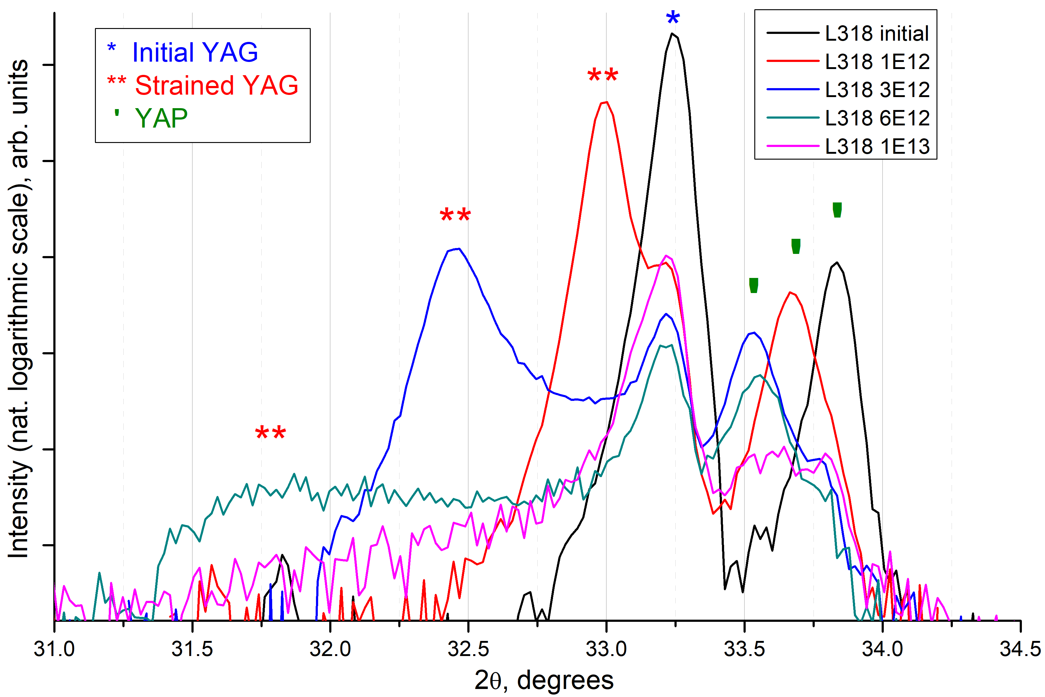
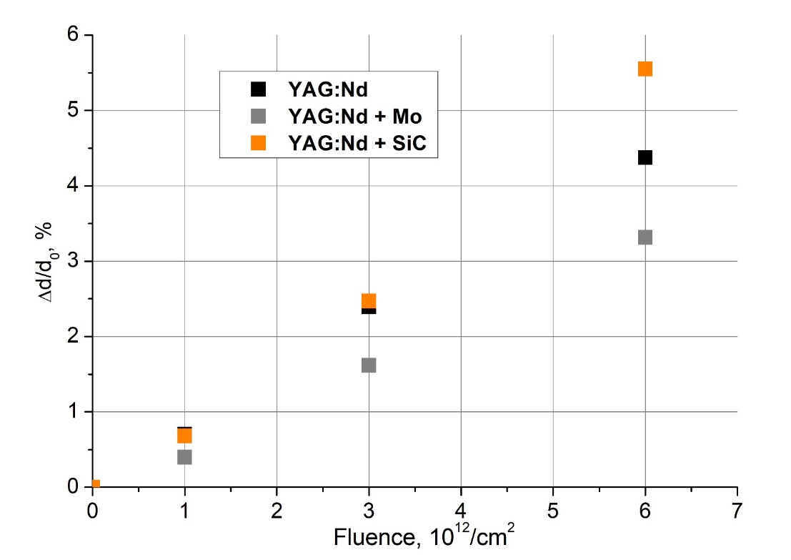
The results of the experiment. XRD analysis
1. Initial samples – YAG and YAP phase system (+Mo/SiC in series with additives);
2. In the irradiated samples, there is another YAG phase with an increased unit cell volume;
3. As the fluence increases, the deformed phase volume increases.
5|14
Notes:
As a result of XRD experiments, a set of diffractograms corresponding to their irradiation fluence was obtained. You can see that the initial samples consist of a two phases system – YAG and YAP. The irradiated samples consist of a three phases system, in which a phase of deformed YAG is added.
The peaks of deformed phase are shifted relative to initial one and the shift increases with increasing fluence. You can see from the dependence of deformation on fluence that samples with the molibdenium additive have the least deformation.

Slide 6
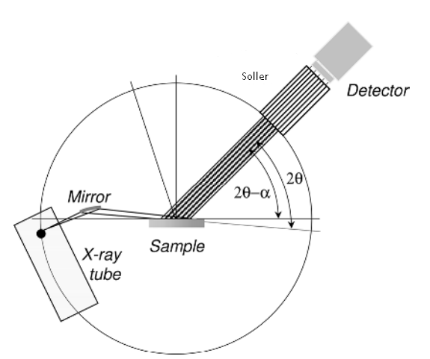
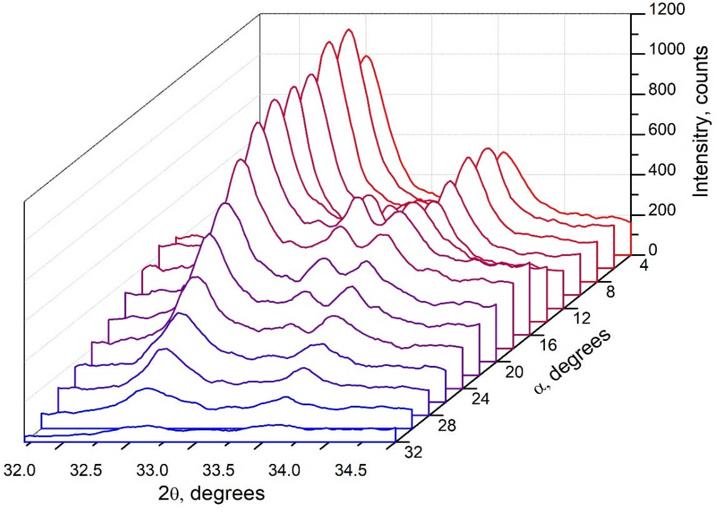
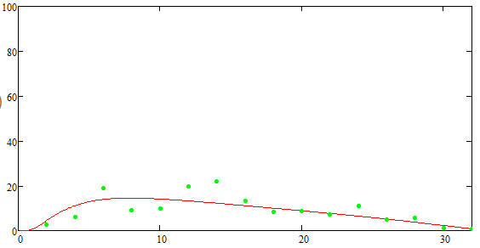
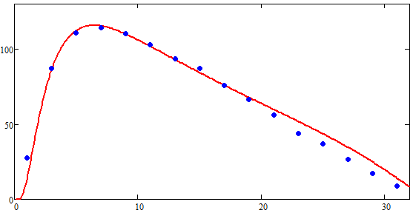
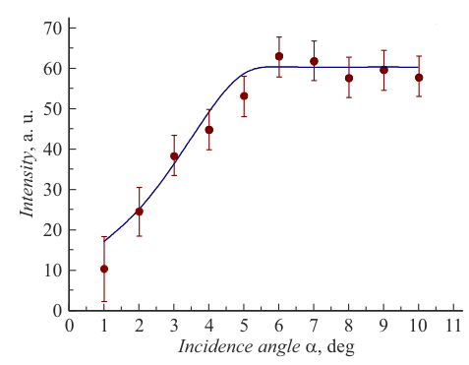
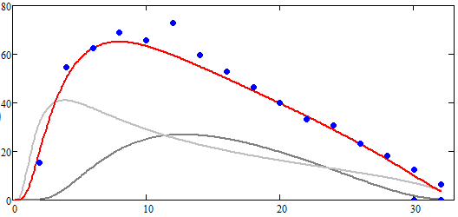
GIXRD-analysis. Setting the task
Аморфная фаза
Obtained as a series of GIXRD experiments
t1
t = ?
t2
Parallel beam geometry (grazing incidence X-ray diffraction, GIXRD)
I = f(α, t)
Деф. YAG
Исходный YAG
Fit curve
Initial YAG 1E12
t = 6 mkm
Str. YAG + Mo 1E12
t = 5 mkm
I = f(α, t)
α₁
α₂
α₃
Str. YAG 1E12
t = 6 mkm
t = 2 mkm
t = 10 mkm
6|14
Notes:
To calculate the depth of damaged layer, experiment carried out in the grazing incidence geometry. It consist in conducting XRD experiments with a constant angle of x-ray beam incidence on the sample and 2TETA scan by detector in certain range of angles. By varying the angle on incidence the depth of the sample under study can be changed. Therefore, as a result of such experiments, we obtain a set of difractograms.
And idea of a damaged layer depth calculation is to approximate the experimental dependencies with a predetermined function, in which consist the value of the damaged layer depth would be as a variable.

Slide 7
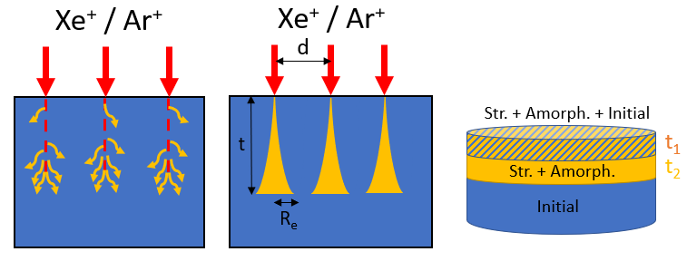
GIXRD-analysis. Building an approximant
Аморфная фаза
The proposed model of the irradiated samples structure
t1
t = ?
t2
Деф. YAG
Исходный YAG
S_{n} < S_{e}
Damaged
layer
depth
t
S_{n} > S_{e}
Fit curve
Initial YAG 1E12
t = 6 mkm
Str. YAG + Mo 1E12
$${I\left(z,α,β\right)}_{tf}=\int_{0}^{t}{I\left(z,α,β\right)dz} −intensity for the layer on the substrate$$
t = 5 mkm
$fp(α\text{,}\text{ω}\text{,}\text{L}\text{) = }\left\{\begin{aligned}\frac{l}{h}\sin{α}, \frac{h}{\sin{α}}≥1 \\ &1, \frac{h}{\sin{α}}<1\end{aligned}\right.$
$T\left(n,α\right) =\frac{2\sin{α}}{\sin{α} \sqrt{{(sin{α)}}^{2}−2δα}}$
$$\text{τ}\text{(}α\text{)}\text{ = }\frac{\sin{α}}{μ}$$
Str. YAG 1E12
t = 6 mkm
$T\left(n,α\right)$ - Fresnel transmission coefficient
$fp(α\text{,}\text{ω}\text{,}\text{L}\text{)}$ – accounting for the beam trace effect
$α$ – beam incidence angle
t = 2 mkm
$μ$ – linear transmission coefficient [1/cm]
$\text{τ}\text{(}α\text{)}$– X-ray penetration depth
$l, h$- sample sizes
t = 10 mkm
The system is two-layered, so the intensity will be reduced by an amount$exp\left(−μt_{1}\right)$
$${I\left(z,α,β\right)}_{Str.YAG}=exp\left(−μt_{1}\right){I\left(z,α,β\right)}_{tf}$$
7|14
Notes:
So, let’s try to build such an approximant. From general reasons, we consider that the sample is a two-layer system on a substrate. The substrate it is an initial undeformed YAG, layer on substrate is a deformed YAG, there are more nuclear energy loses and deformed areas overlap. On top is a layer in which electronic energy loses dominate, therefore there are areas with initial undeformed YAG.
Well, let’s construct an approximant for the deformed phase layer. The type of dependence of diffracted radiation for a layer on a substrate is known. If the system is two-layered, then the intensity will be reduced by another exponent which characterizes the absorption by the upper layer.

Slide 8
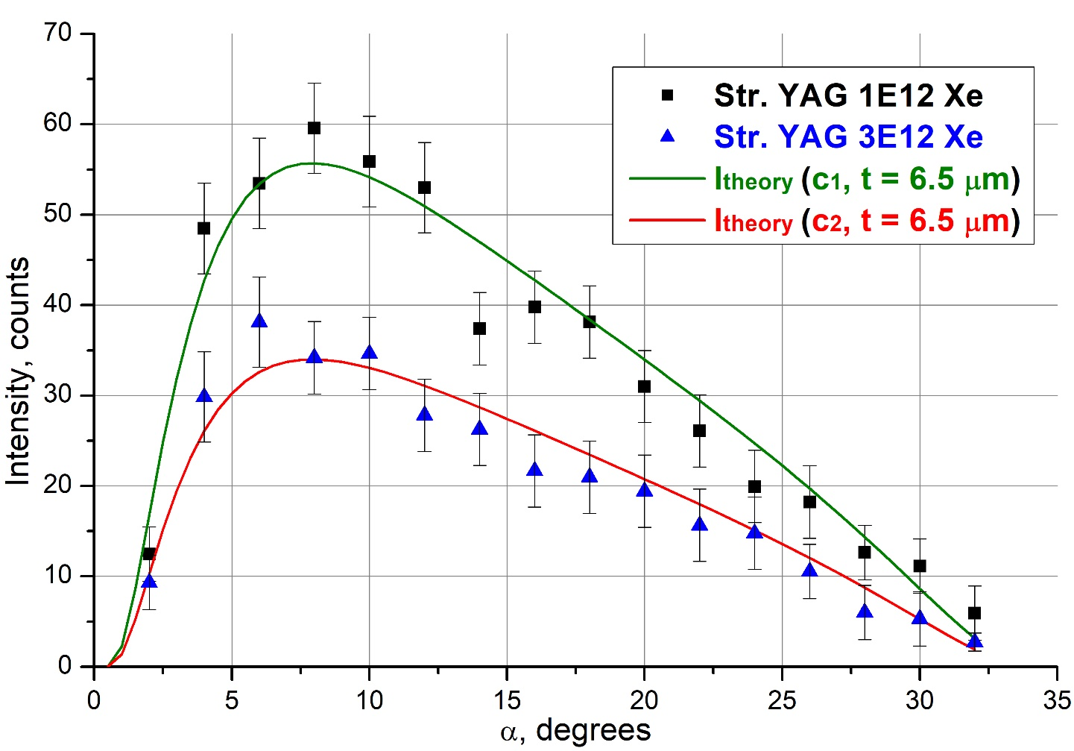
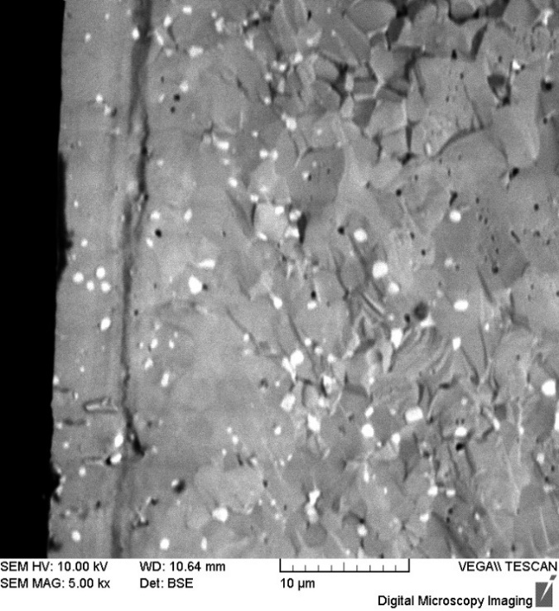
GIXRD-analysis. Calculation results
Аморфная фаза
t1
${I\left(c,t\right)}_{Str.YAG}=C\text{·}T\left(n,α\right)\text{·}fp(α\text{,}\text{ω}\text{,}\text{L}\text{)·}\text{τ}\text{(}α\text{)}\frac{sinβ}{sinα+sinβ}\left[1−exp\left(−μt_{2}\left(\frac{1}{sinα}+\frac{1}{sinβ}\right)\right)\right]$ $exp\left(−μt_{1}\left(\frac{1}{sinα}+\frac{1}{sinβ}\right)\right)$
t = ?
t2
Деф. YAG
Исходный YAG
Fit curve
Initial YAG 1E12
t = 6 mkm
Str. YAG + Mo 1E12
Str. YAG 1E12
t = 5 mkm
t = 6 mkm
~6 mkm
t = 2 mkm
t = 10 mkm
Cross section of YAG 3E12 Xe.
8|14
Notes:
If the describe such an approximant in detail, we can obtain in this large form. After approximating our experimental dependences, we obtained a value of the damaged layer depth about 6.5 microns. This value can be compared with SEM images. This is a cross section of the sample. You can see that the sample has broken differently in the near-surface layer than in the volume. This is believed to be a damaged layer, its depth is about 6 microns.
Si there is a good correlation with XRD experiments.

Slide 9
Modeling. Setting the task
Energy transferred distribution by the ion to the target atoms is obtained from the Monte-Carlo simulation (MC), which is implemented in TREKIS*;
As the main modeling method, we will use the molecular dynamics (MD) method, which is implemented in LAMMPS;
The analysis and interpretation of the data obtained as a result of modeling will be carried out by comparing experimental and theoretical diffractograms (built using Debyer**)
Debye scattering equation ->
* R. Rymzhanov, N. A. Medvedev, A. E. Volkov, J. Phys. D. Appl. Phys. 50 (2017) 475301
** https://debyer.readthedocs.io, дата обр. 24.05.2024
9|14
Notes:
XRD is a good method and we really like it, but it is quite approximately method. Therefore, in order to understand what happens to structure at the atomic level, we will use modelling methods.
We will calculate the energy transferred from the SHI to atomic matrix using the MC method in TREKIS. Then we will set this energy distribution in the MD method in LAMPS and start the MD calculation. The output in LAMMPS is a set of atoms since we know their coordinates, we can calculate the theoretical diffractogram and compare it with the experimental patterns. The theoretical diffractograms was obtained using the debyer code.

Slide 10
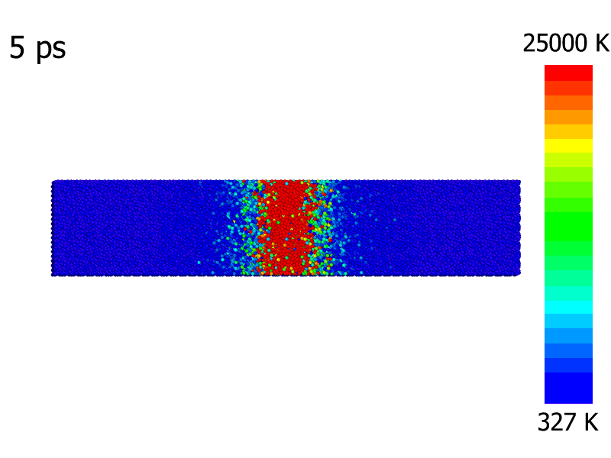
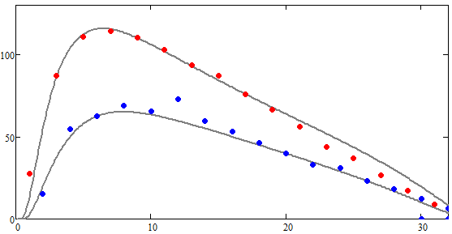
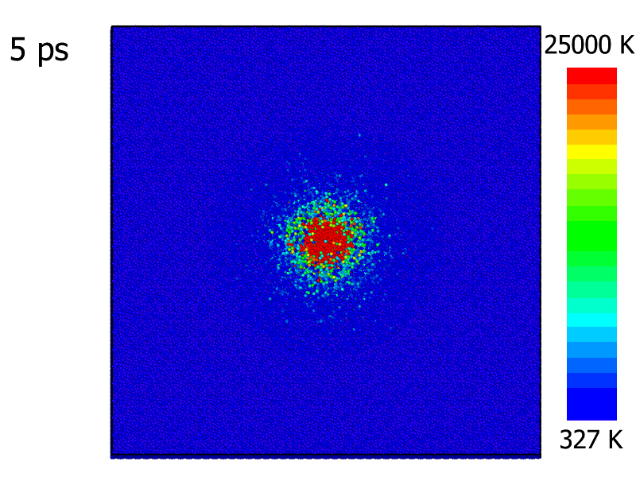
MC- and MD-modeling. Energy distribution transferred by the ion to matrix atoms
1. MC-modeling in TREKIS
2. MD-modeling in LAMMPS
Input:
Target atoms type (Y, Al, O);
Ion type and energy (Xe, 160 MeV);
Target temperature (300 K); The size of modeling layer (depth – 5 nm);
Number of iterations (1000);
+CDF parameters!
Output: Energy distribution transferred by the ion to matrix atoms.
Input :
A set of atoms arranged in a certain structure (YAG structure);
Boundary conditions (periodic);
Interatomic potential;
Speed distribution (from МC).
Output:
Relaxed irradiated super-cell diffraction pattern
z
Str. YAG + Mo 1E12
Str. YAG 1E12
t = 5 mkm
x
t = 6 mkm
6 nm
Str. YAG + Mo 1E12
t = 5 mkm
Area
track
radius
y
x
10|14
Notes:
The slides show the MC simulation. In this case we represent the track as a cylinder. You can see that at the initial moment of time all the energy is concentrated in the center of the cylinder and during the simulation this energy transferred to other cylindrical layers. The temperature dependence on the simulation time shows that at a simulation time of about 100 ps, the energy seases to change significantly, and such energy distribution we will use as initial conditions in further simulations by the molecular dynamics method.

Slide 11
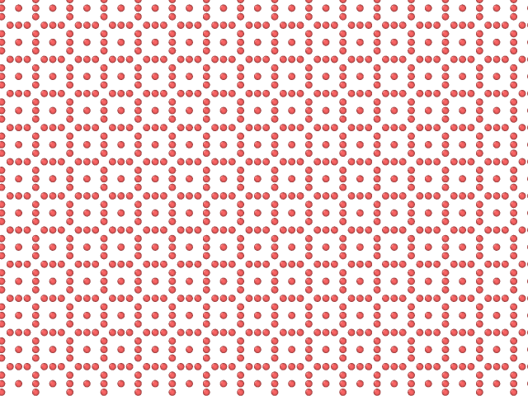
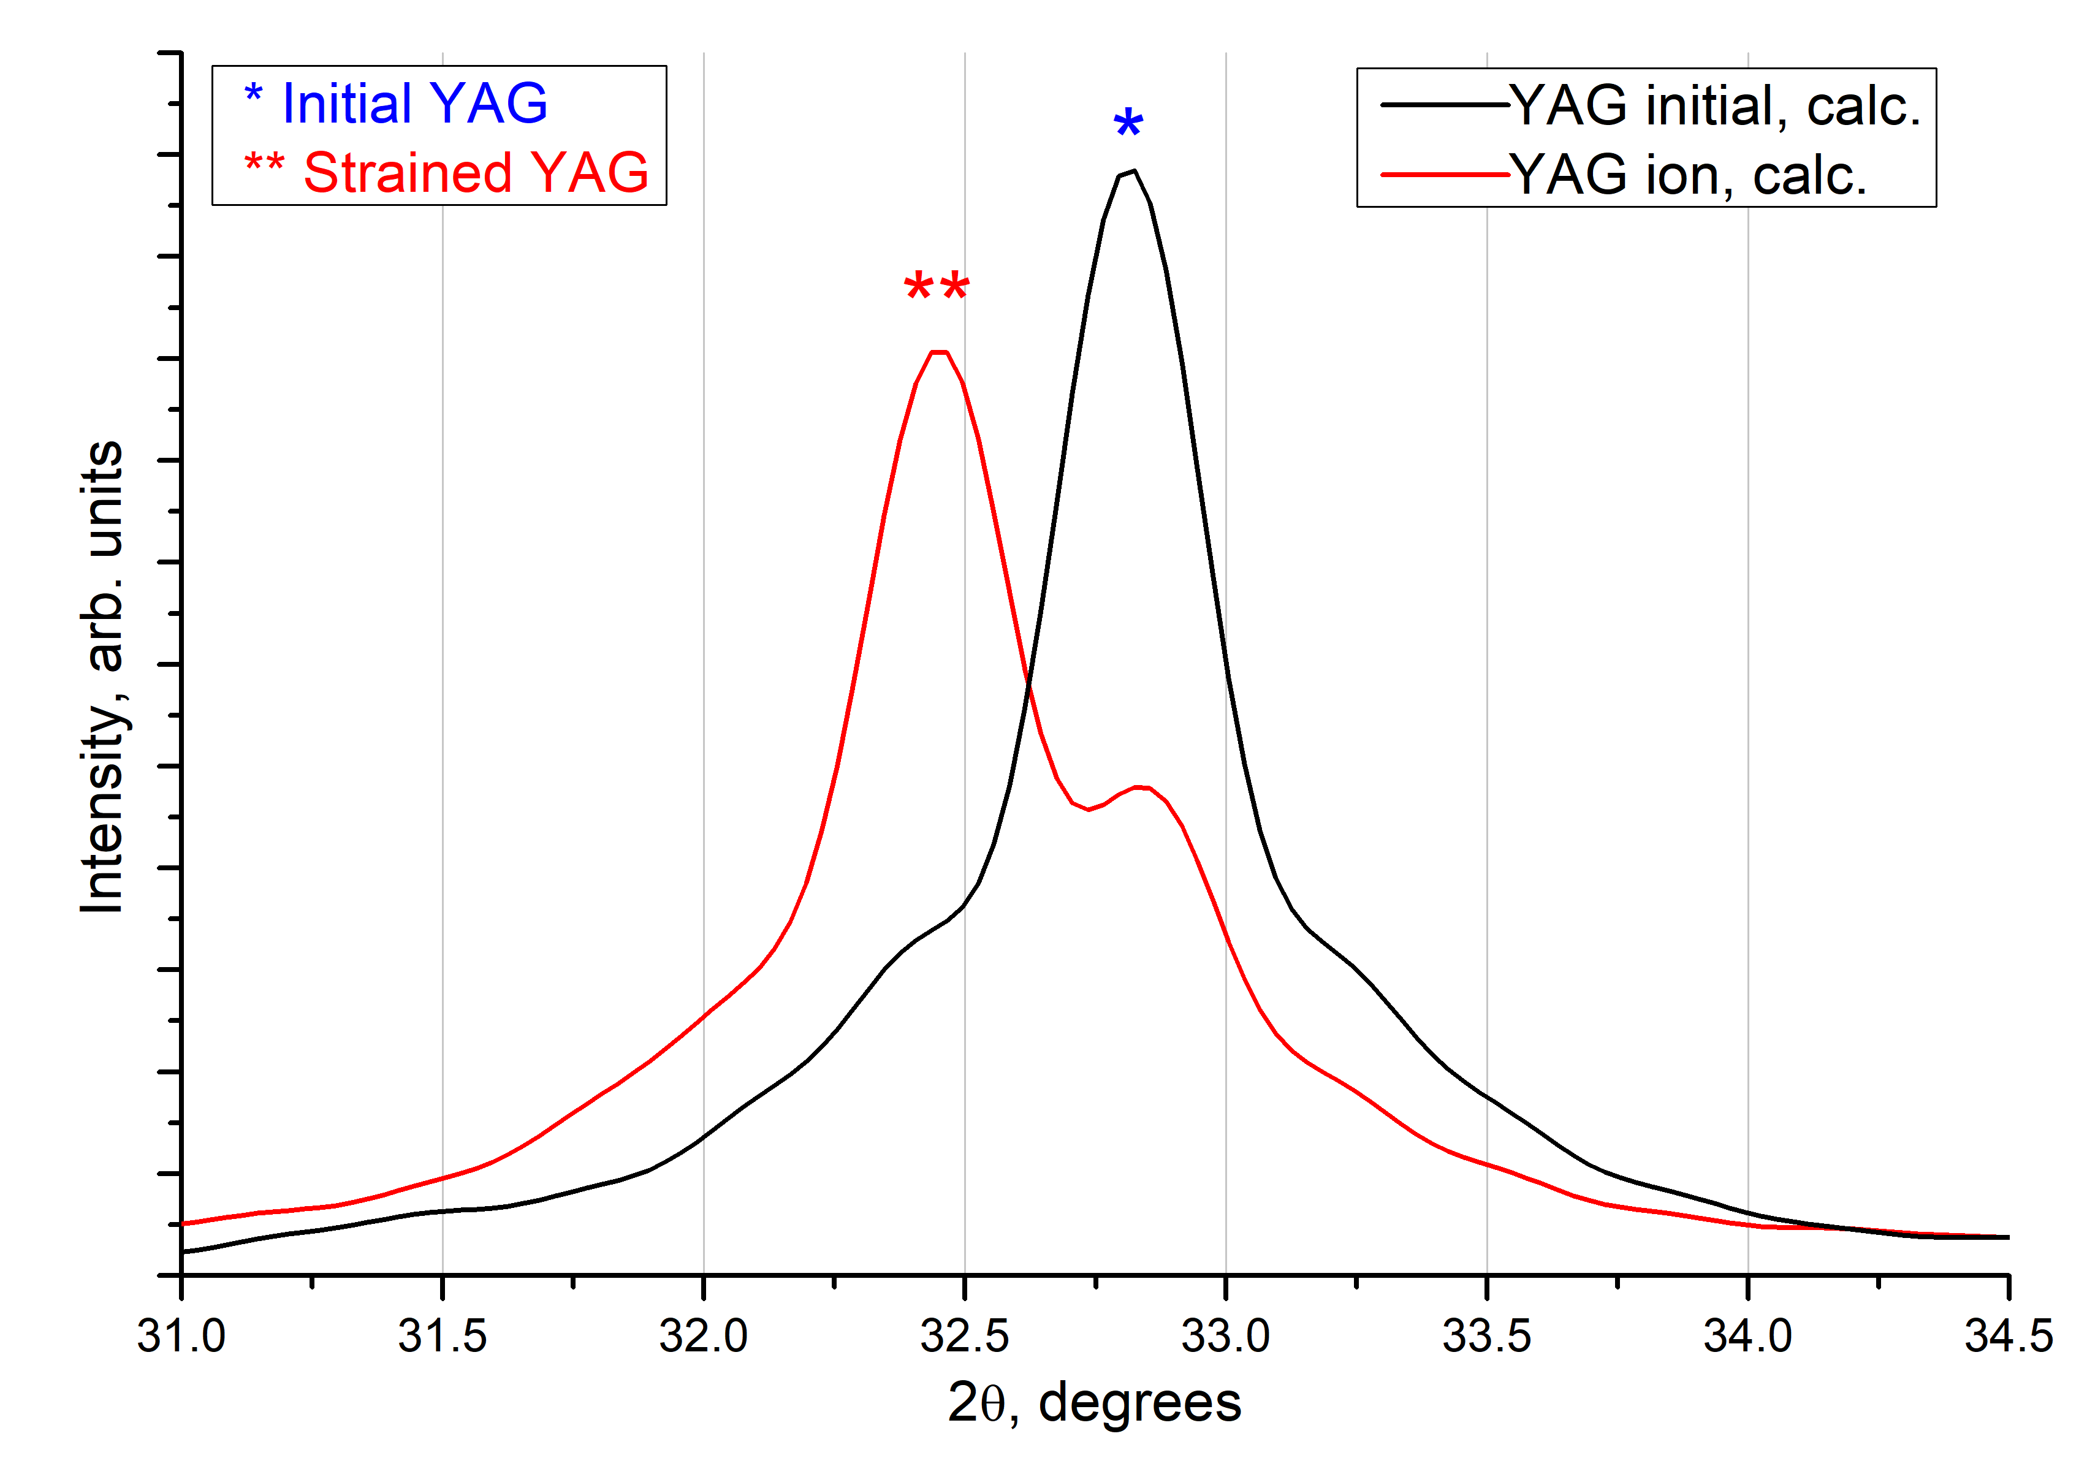
MD modeling. «Molted» YAG-cell relaxation.
MD modeling
Φ ≈ 10¹² cm⁻² t = 15 ns
3 nm
Lateral track size is 6 nm;
The presence of a deformed phase in the cell as a result of modeling is ~ 70% (in the experiment ~ 60%);
Deformation as a result of modeling is 0.8% (in the experiment 0.6%).
XRD experiment
11|14
Notes:
Molten cell relaxation modeling and theoretical diffractogram from a cell are presented on the slide. From here you can see a peak of initial YaG phase and deformed YAG phase. The presence of deformed phase in such cell is about 70 percent and the deformation reaches 0.8 per cent. So, there is a very accurate correlation between the experiment and modeling. To be honest we were very surprised by this fact.

Slide 12
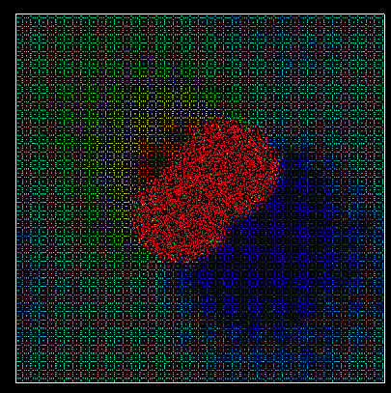
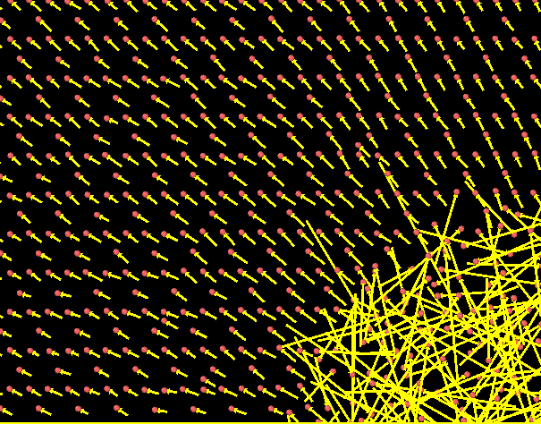
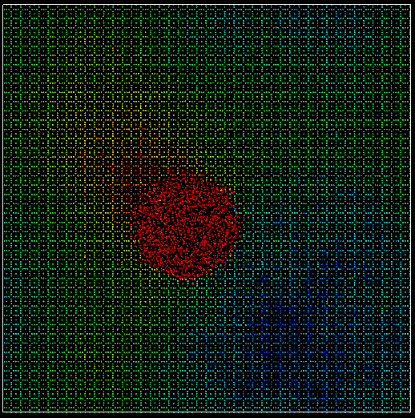
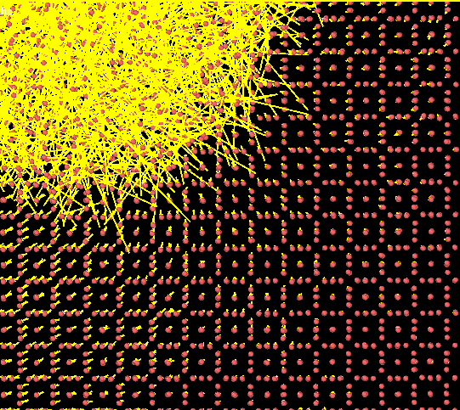
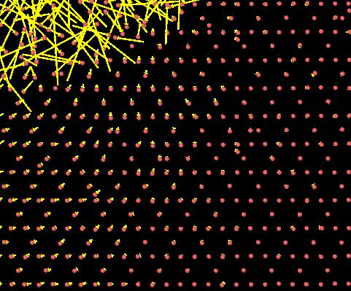
MD modeling. The displacement of atoms. A deformed phase
Atomic displacement vectors
$$Dis. Magn.=\sqrt{{Δx}^{2}+{Δy}^{2}+{Δz}^{2}}$$
12|14
Notes:
So, since we see the peak of the deformed and initial phase we can see what in the atomic level gives this result. For this task the distribution of displacement of atoms from their initial position was calculated. This distribution has a non-uniform character. According to the atomic displacement vectors it can be ssen that the deformed phase occurs at the nucleation stage of the amorphized region this is confirmed by the GIXRD experiment.
As the irradiation fluence increases, the strain and peak shift of the deformed phase increases.

Slide 13
Conclusions
Structural changes in the surface layers of ceramics after irradiation were revealed: amorphization of crystalline phases, the appearance of a phase with a deformed YAG lattice;
A method for quantifying the disturbed near-surface layer thickness is proposed. For YAG system ceramics (when irradiated with Xe 160 MeV), it was 6 microns;
The developed methods make it possible to assess the radiation resistance of ceramic matrices for the disposal of radioactive waste and characterize structural changes in the near-surface layers. As well as predict the behavior and characteristics of new matrix formulations and additives.
13|14
Notes:
The conclusions are presented in the slide. It was possible to develop a method for the study of irradiated YAG ceramics based on XRD. Also obtained a good correlation with mathematical modeling data.
Итого 11 минут 30 секунд

Slide 14
Question for you
Hydrolytic stability test
~200 hours in liquid
Irradiated YAG sample
Y-
Nd+
Nd-
Nd-
H₂O / HCl
Y+
Y+
Ion, fluence, 1/cm² | Leaching rate (LR), g/day
 | Y | Nd
Xe, 10¹² | 8.33・10⁻⁶ | 2.26・10⁻⁶
Xe, 3・10¹² | 5.24・10⁻⁶ | 1.36・10⁻⁶
$${LR}_{Y(Nd)}\text{\sim }\frac{m_{ Y(Nd)}}{t}$$
Why???
Thanks for your attention
Notes:
it is not the end. i have one more slide. there is question for you, colleges. in our recent research of hydrolytically stability of our samples. we have obteined that for samples with GREATER irradiation fluence the leaching rate was LOWEST than for samples with smallest irradiation fluence. it is a strange result, so if you have any ideas or hypothesis please let me know

Slide 15
Thanks for attention

Slide 16
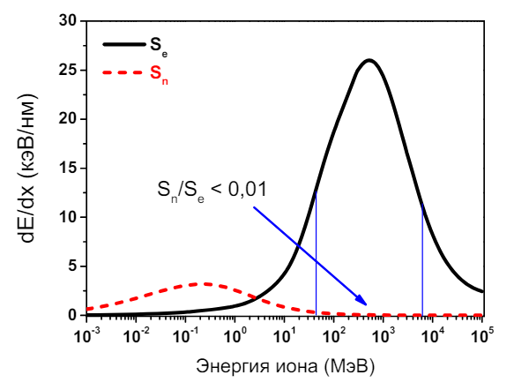
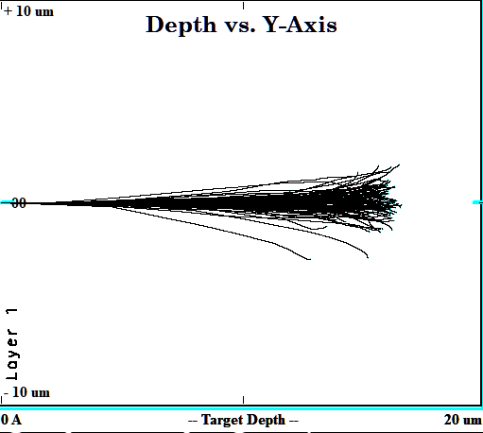
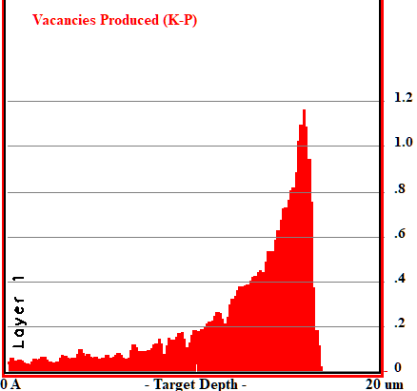
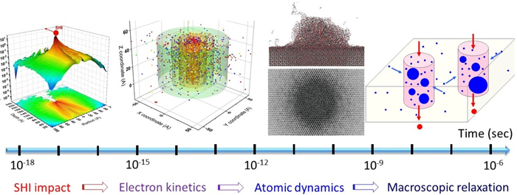
Почему TREKIS?
Быстрый тяжелый ион – E_{i} > 1 MeV, m_{i} > 20 а.е.м;
95 % энергии БТИ тратит на электронное торможение;
$\frac{dE}{dX}$, keV/nm
$${\left[\frac{dE}{dx}\right]}_{e}<{\left[\frac{dE}{dx}\right]}_{n}$$
$${\left[\frac{dE}{dx}\right]}_{e}>{\left[\frac{dE}{dx}\right]}_{n}$$
Метод Монте-Карло - взаимодействие иона с атомом – случайное событие
E_{i}, MeV
TRIM & SRIM – бинарные столкновения
TREKIS – моделирование многомасштабного процесса
X, ρ[X], E_{d} – начальные параметры
P, 𝛳 – случайные величины
*
$σ(E)=σ_{e}(E)+σ_{n}(E)$
TREKIS моделирует процессы, вызванные распространением высокоэнергетических электронов через твердое тело от траектории БТИ.
Классический закон Бете-Блоха с поправками на электронное торможение
$$\frac{dE}{dx}={\left[\frac{dE}{dx}\right]}_{n}+{\left[\frac{dE}{dx}\right]}_{e}$$
Рис. 5. Моделирование процесса ионной имплантации. Характерный вид траекторий ионов.
TREKIS
LAMMPS
Рис. 6. Характерная гистограмма количества зарожденных вакансий в зависимости от глубины.
E_{i} > E_{d}
E_{i} = E_{d}
E_{i} < E_{d}
Расчеты проводятся с использованием сечений $σ$ на основе комплексной диэлектрической функции $ε(ω,q)$ (CDF):
end
TRIM не учитывает перенос энергии вторичными электронами, что первостепенно важно для расчета БТИ
*Medvedev, N., Volkov, A. E., Rymzhanov, R., et al. “Frontiers, challenges, and solutions in modeling of swift heavy ion effects in materials,” Journal of Applied Physics, V. 133, No. 10, 2023.
Notes:
Но всё -таки почему ТРЕКИС, а не, например, ТРИМ, который зачастую используют в задачах ионной имплантации?
Быстрые тяжелые ионы, которые мы рассматриваем в данной работе – ионы с энергией > 1 MeV. Такие ионы наибольшее количество своей энергии тратят на электронное торможение. И в ТРЕКИС, и в ТРИМ реализован расчет методом Монте-Карло, однако в ТРИМ нет модели, учитывающей перенос энергии вторичными электронами. ТРЕКИС же предлагает моделирование многомасштабного процесса взаимодействия БТИ с мишенью. Сначала в ТРЕКИС рассчитываются процессы, вызванные распространением высокоэнергетичных электронов через твердое тело от траектории БТИ, затем предлагается проводить дальнейшее моделирование уже на атомной уровне, например, методом МД.
Метод монте-карло заключается в генерировании случайных значений величин пробегов ионов и прицельных параметров столкновений двух частиц, после каждого столкновения расcчитывается потеря энергии за счёт электронного и ядерного торможения, задача о взаимодействии частиц решается до тех пор, пока энергия имплантируемого иона не будет меньше энергии межатомной связи в материале. Результат работы программы показан в виде гистограммы количества зарожденных вакансий от глубины на рисунке 6.

Slide 17
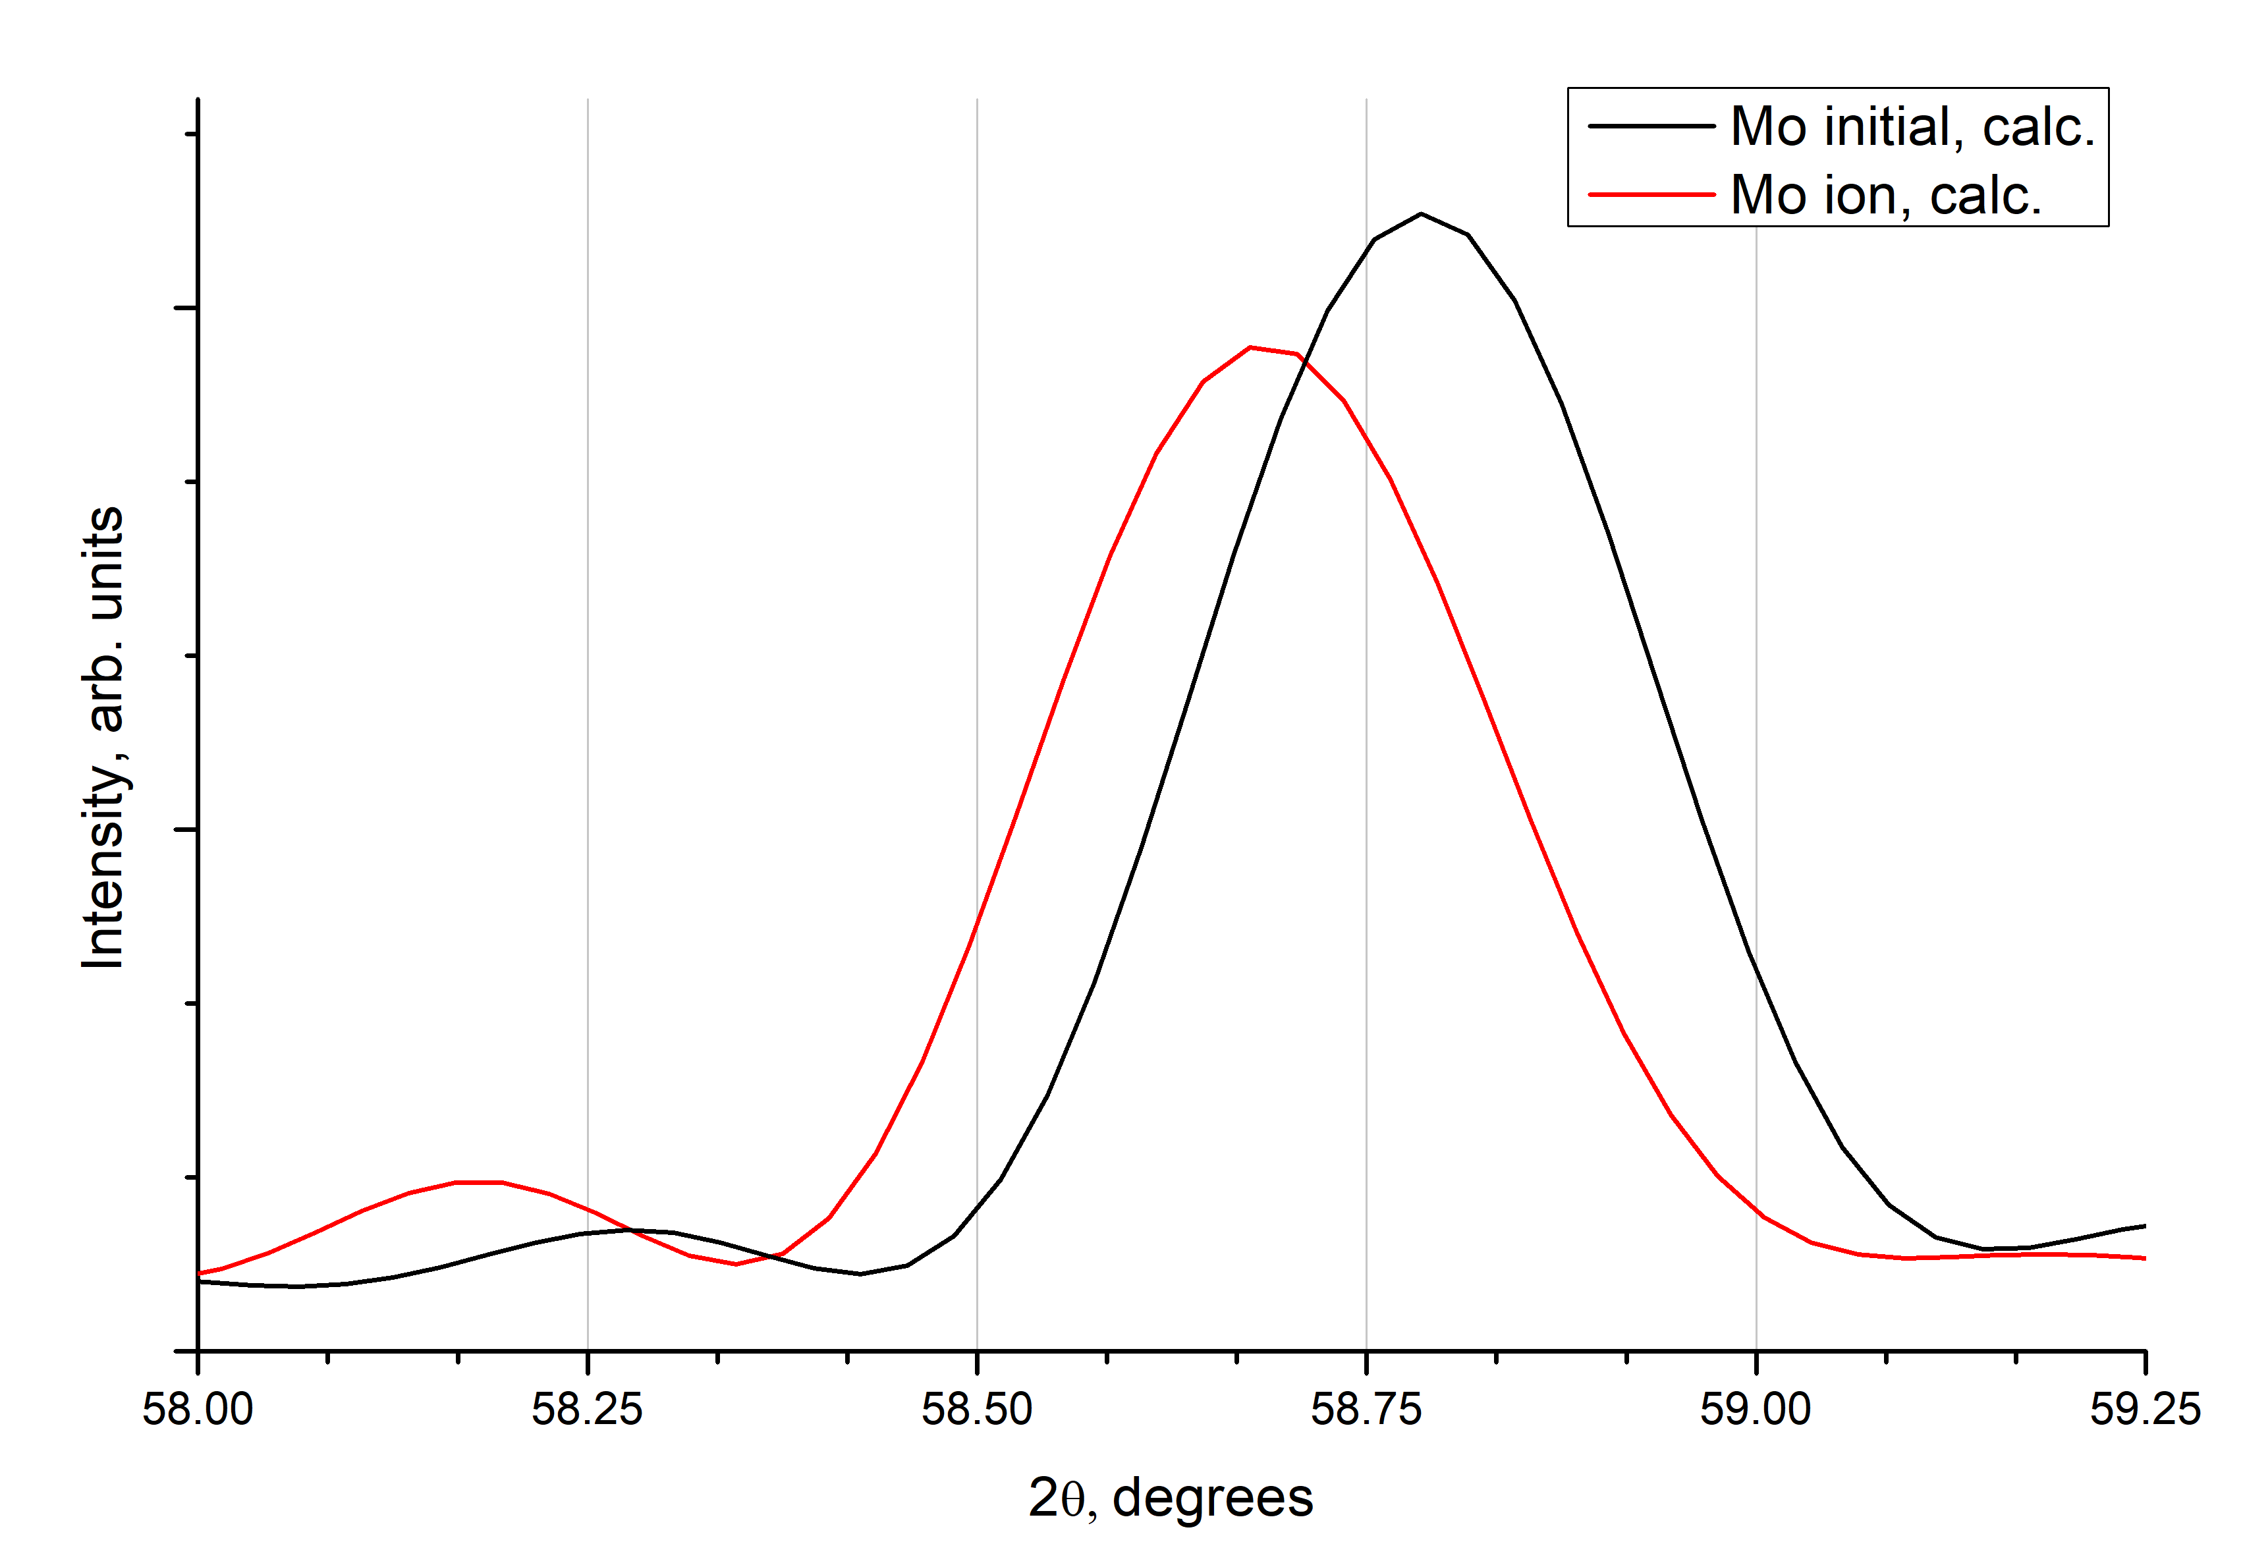
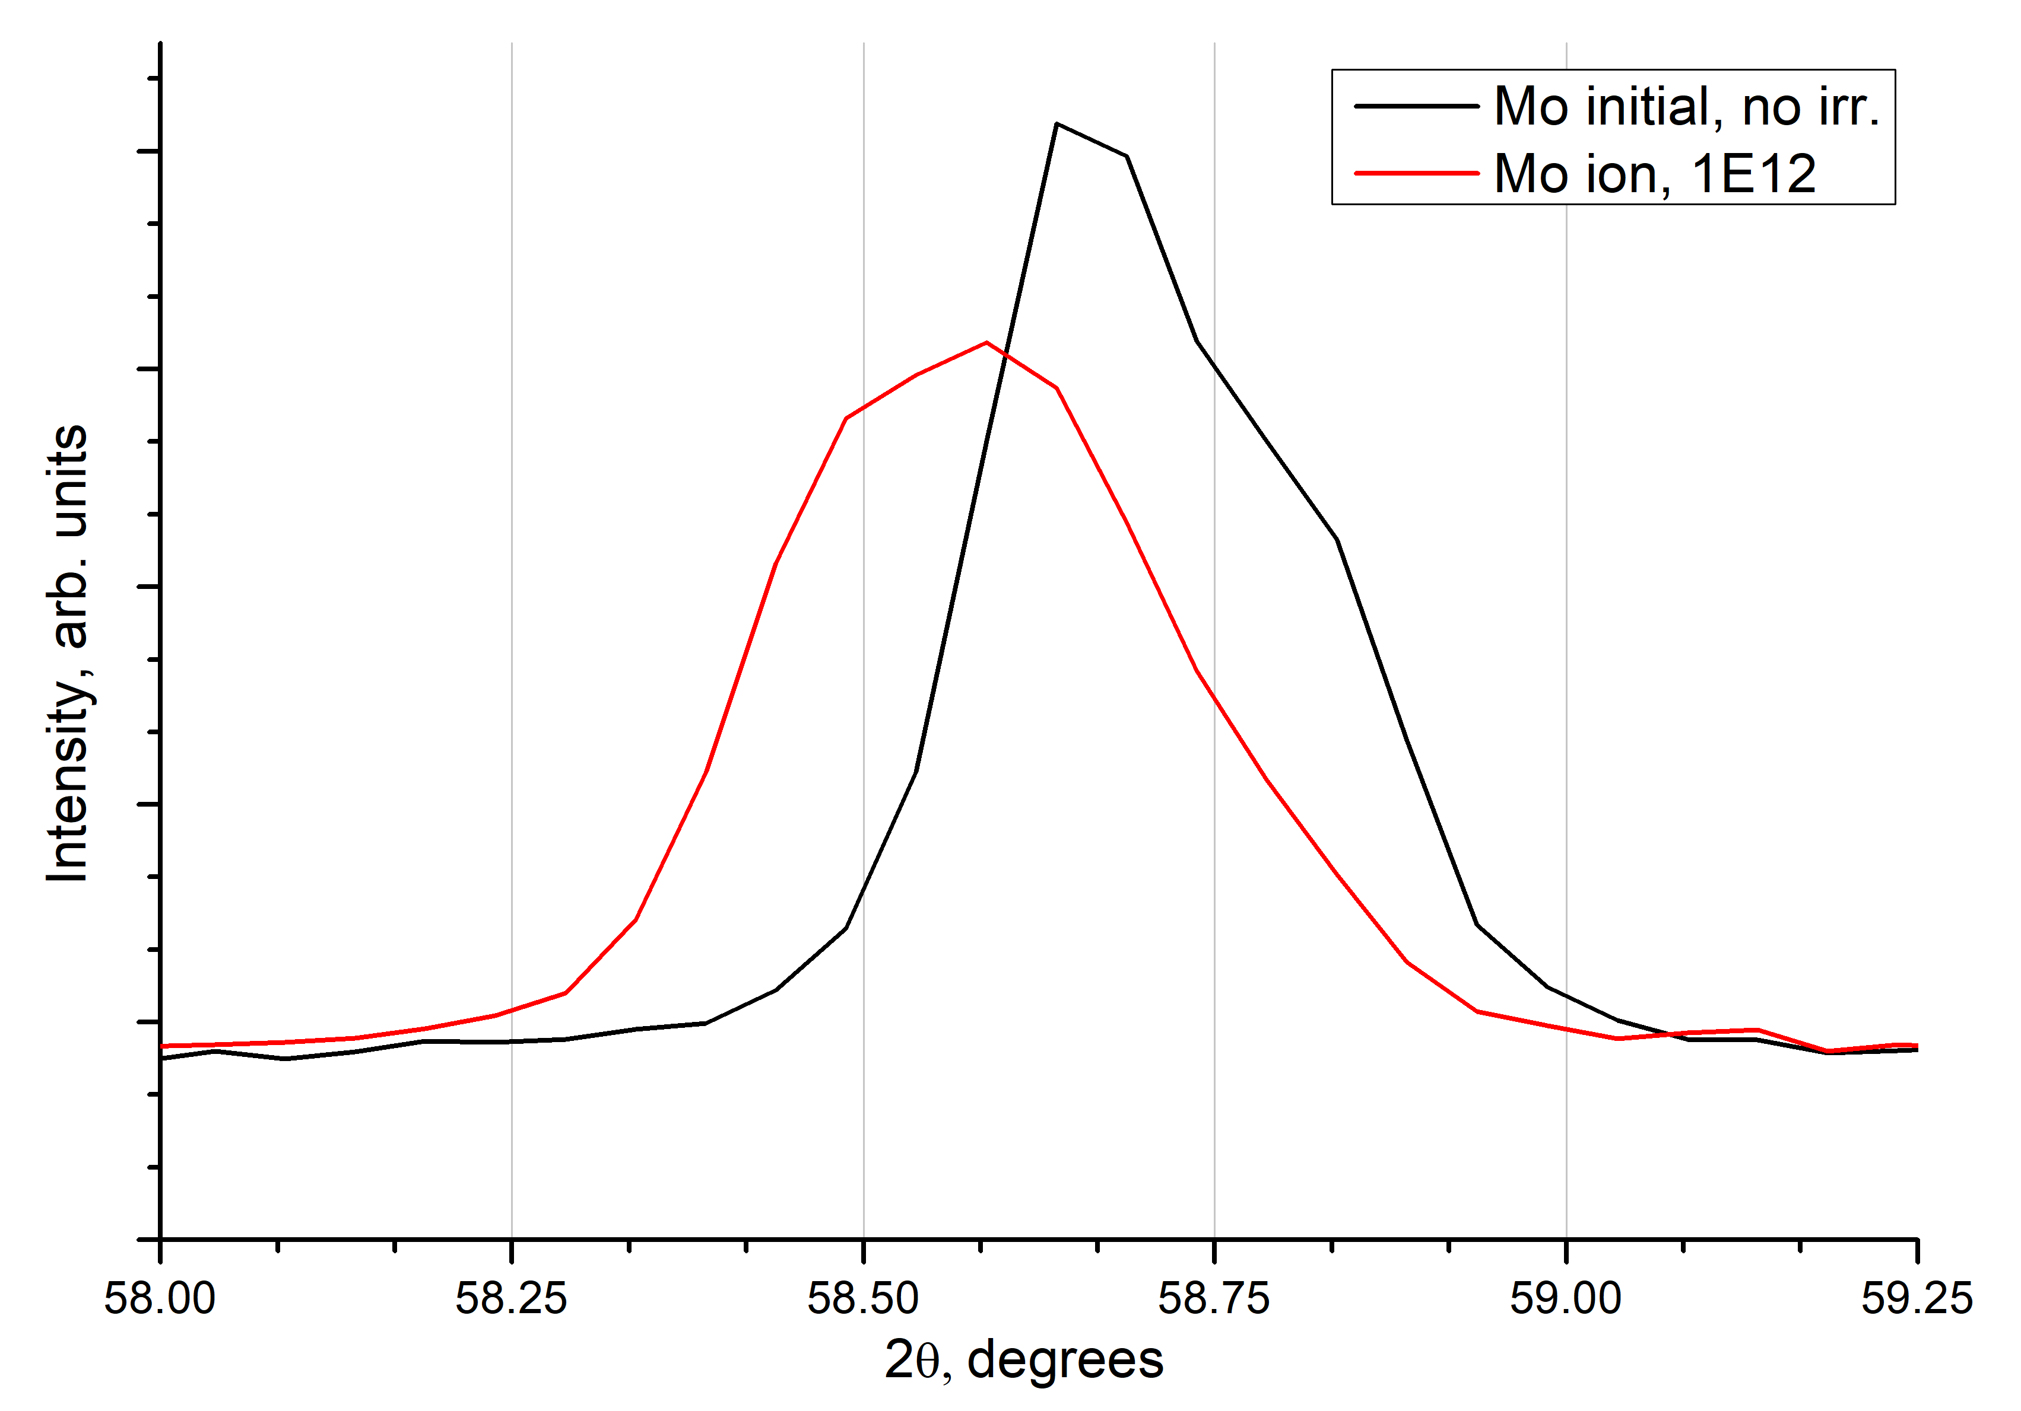
MD modeling
XRD experiment
Φ ≈ 10¹² cm⁻² t = 15 ns
4 nm

Slide 18
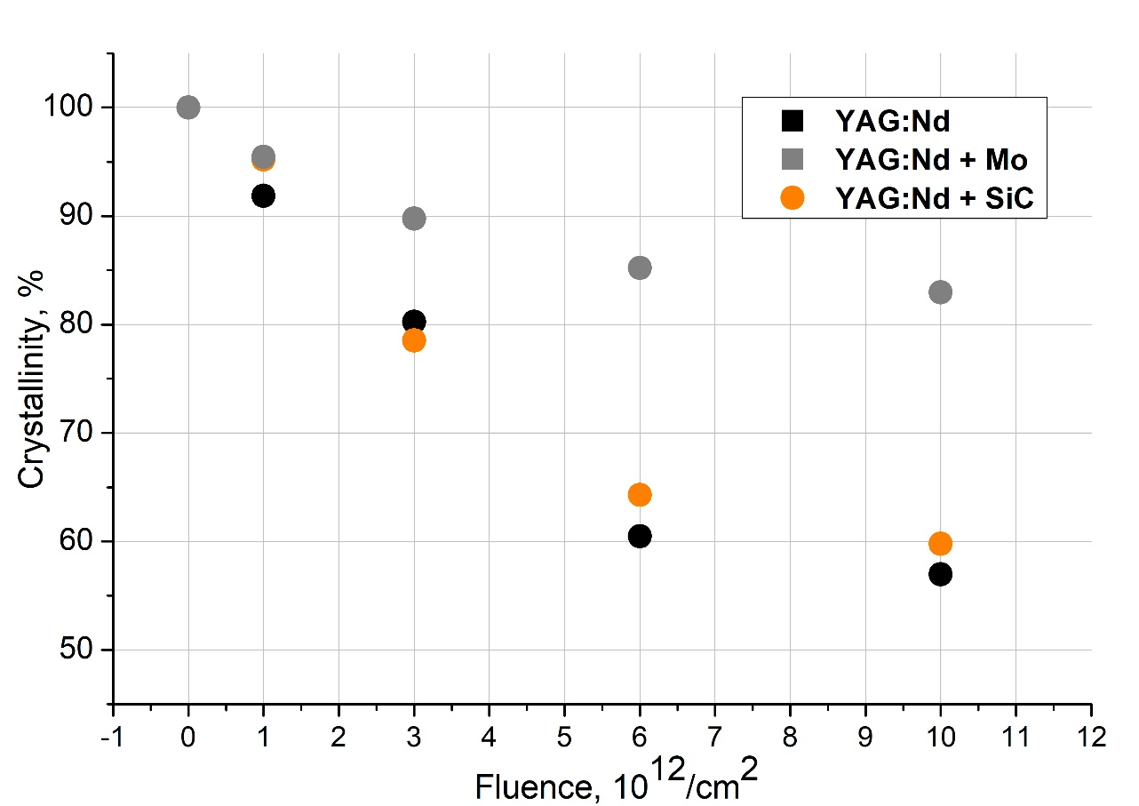
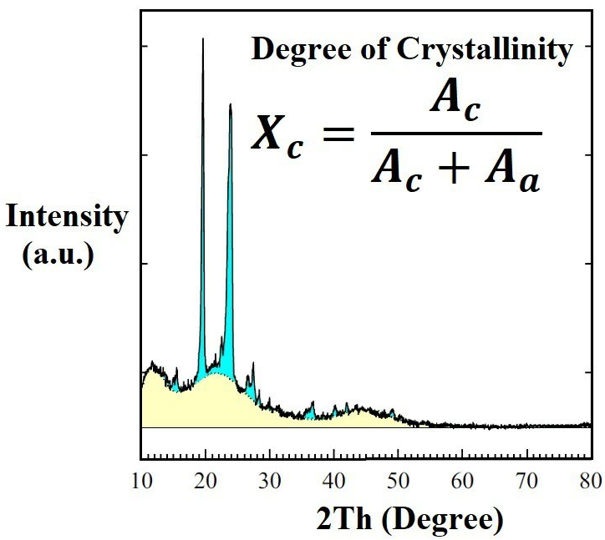
Оценка радиационной стойкости. Степень аморфизации
Как сильно нарушился порядок в структуре?
Анализируем изменение интенсивности
Дислокации + точечные дефекты + поры + аморфная фаза ... =
степень аморфизации.
$$Crystallinity=\frac{Reduced area}{Global area}×100\%$$
$Reduced area−$ интенсивность без учета аморфной составляющей;
$Global area−$ суммарная интенсивность спектра.
$$Amorph.=1−Cryst.$$
Notes:
Также можно анализировать степень кристалличности образцов
Если говорить про сравнение образцов, то идеология тут такая: Mo берёт часть повреждений на себя, в результате YAG менее деформирован, глубина слоя меньше должна быть. Поскольку Мо – металл, в нём хорошо отжигаются рад. дефекты, отсюда почти не снижающаяся интенсивность на q-2q. Отсюда и кристалличность выше. Почему нет графиков для деформаций в случае Мо? Потому что деф. Фаза сливается с не деформированной и расчёт затруднён.

Slide 19
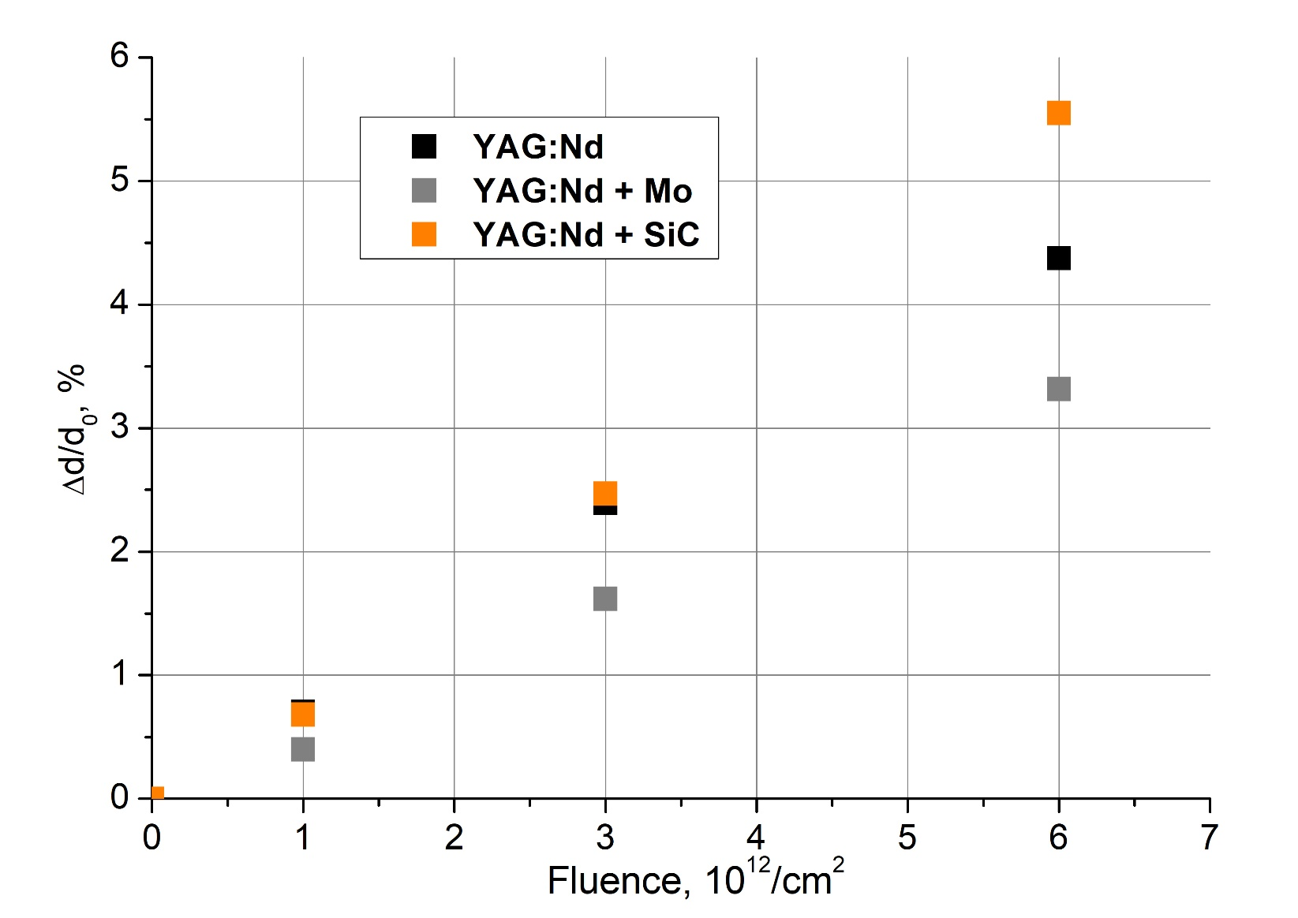
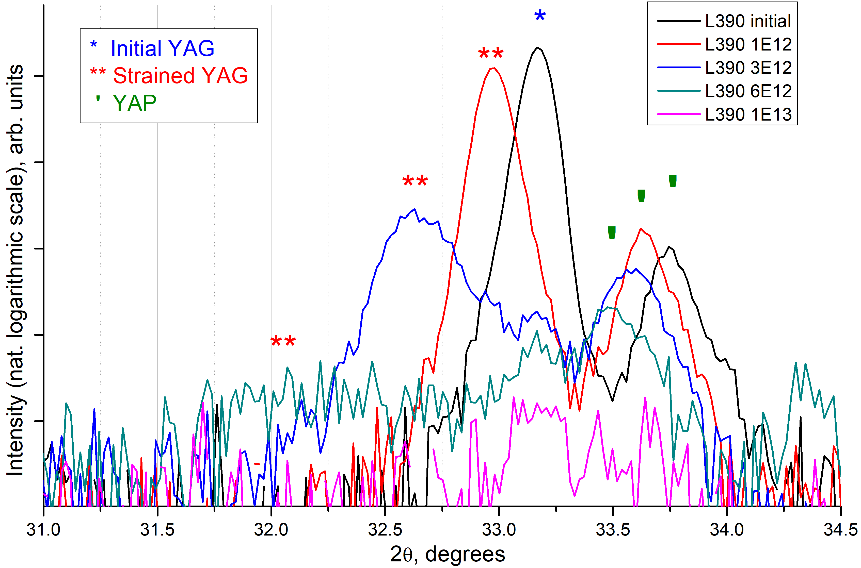
YAG
𝚫d
YAG + Mo
𝚫d
Относительное изменение величины межплоскостного расстояния семейств плоскостей YAG (420) зависимости от флюенса ионов Xe
Notes:
Из экспериментов в симметричной геометрии можно рассчитать ряд структурных параметров, например, по положению пиков можно оценить параметр элементаной ячейки. На картинке слева изображены дифрактограммы образцов, полученных при разных потоках ионов. Видно характерное раздвоение пиков YAG, при этом сдвиг пика деформированого YAG увеличивается в сторону меньших углов, это говорит об увеличении параметра эл. ячейки. Отсюда можно рассчитать деформацию эл. Ячейки. Зависимость приведена справа на слайде.

Slide 20
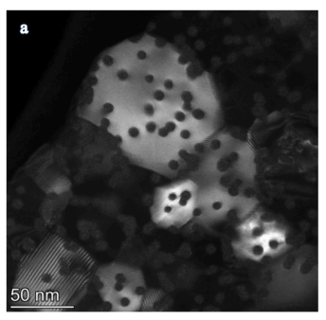
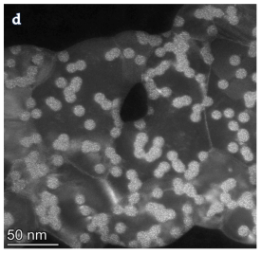
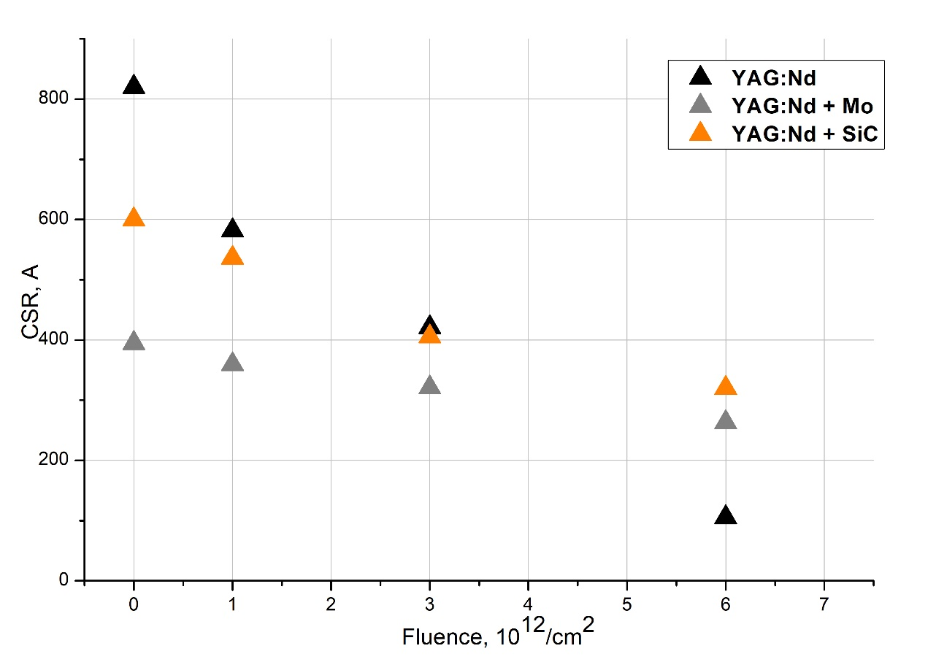
Оценка радиационной стойкости. Влияние плотности потока ионов
Как флюенс влияет на структуру?
Анализируем сдвиг и уширение пиков
Деформация, размеры ОКР
В результате облучения зерно разбивается на области, которые отражают РИ когерентно (ОКР).
$D=\frac{Kλ}{βcos(θ)}−$ размер ОКР.
Xe
(160 MeV / 10¹² cm⁻²)
Xe
(160 MeV / 10¹³ cm⁻²)
*Порошок YAM (Y₄Al₂O₉), облученный Xe (156 MeV).
*A. Ibrayeva et. al, Swift heavy ion tracks in nanocrystalline Y4Al2O9, Nuclear Materials and Energy, 30, 2022.
Notes:
Помимо того, можно анализировать это и то, в результате получаем вот такие зависимости
Если говорить про сравнение образцов, то идеология тут такая: Mo берёт часть повреждений на себя, в результате YAG менее деформирован, глубина слоя меньше должна быть. Поскольку Мо – металл, в нём хорошо отжигаются рад. дефекты, отсюда почти не снижающаяся интенсивность на q-2q. Отсюда и кристалличность выше. Почему нет графиков для деформаций в случае Мо? Потому что деф. Фаза сливается с не деформированной и расчёт затруднён.

Slide 21
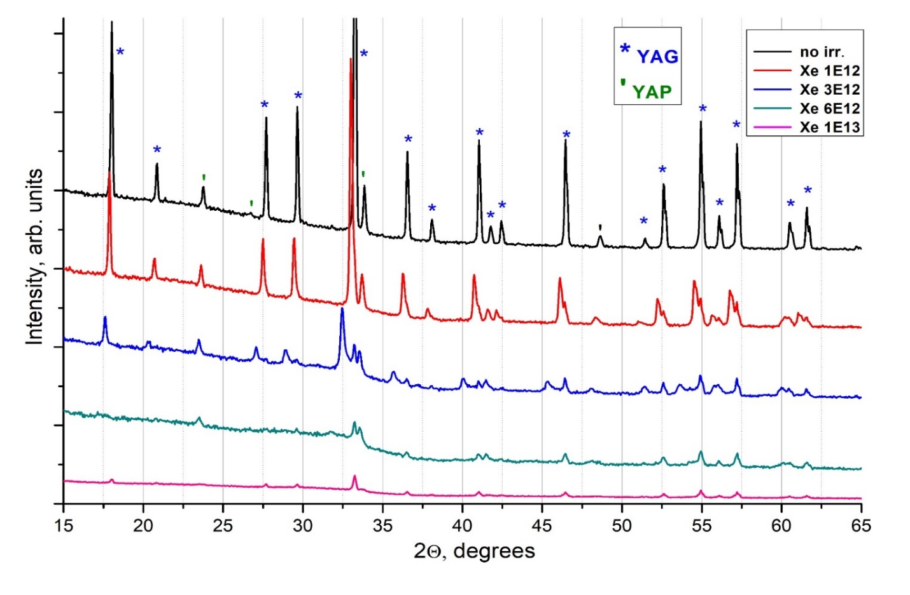
YAG
𝚫d

Slide 22
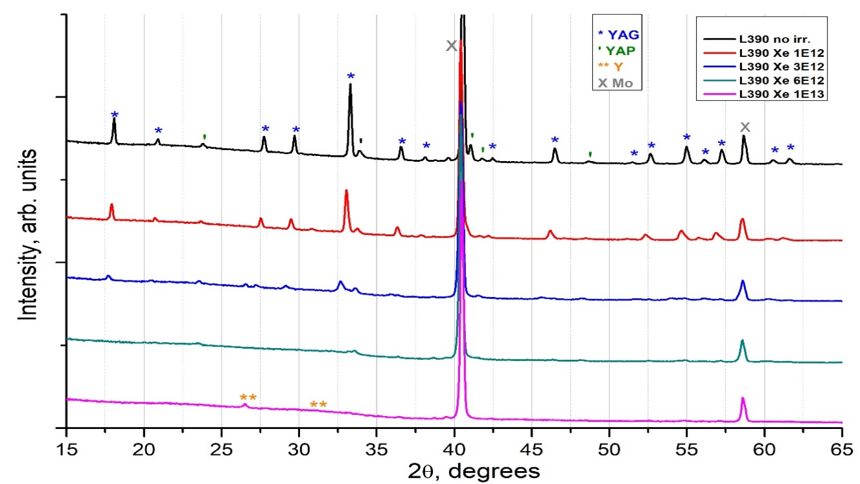
YAG + Mo
𝚫d

Slide 23
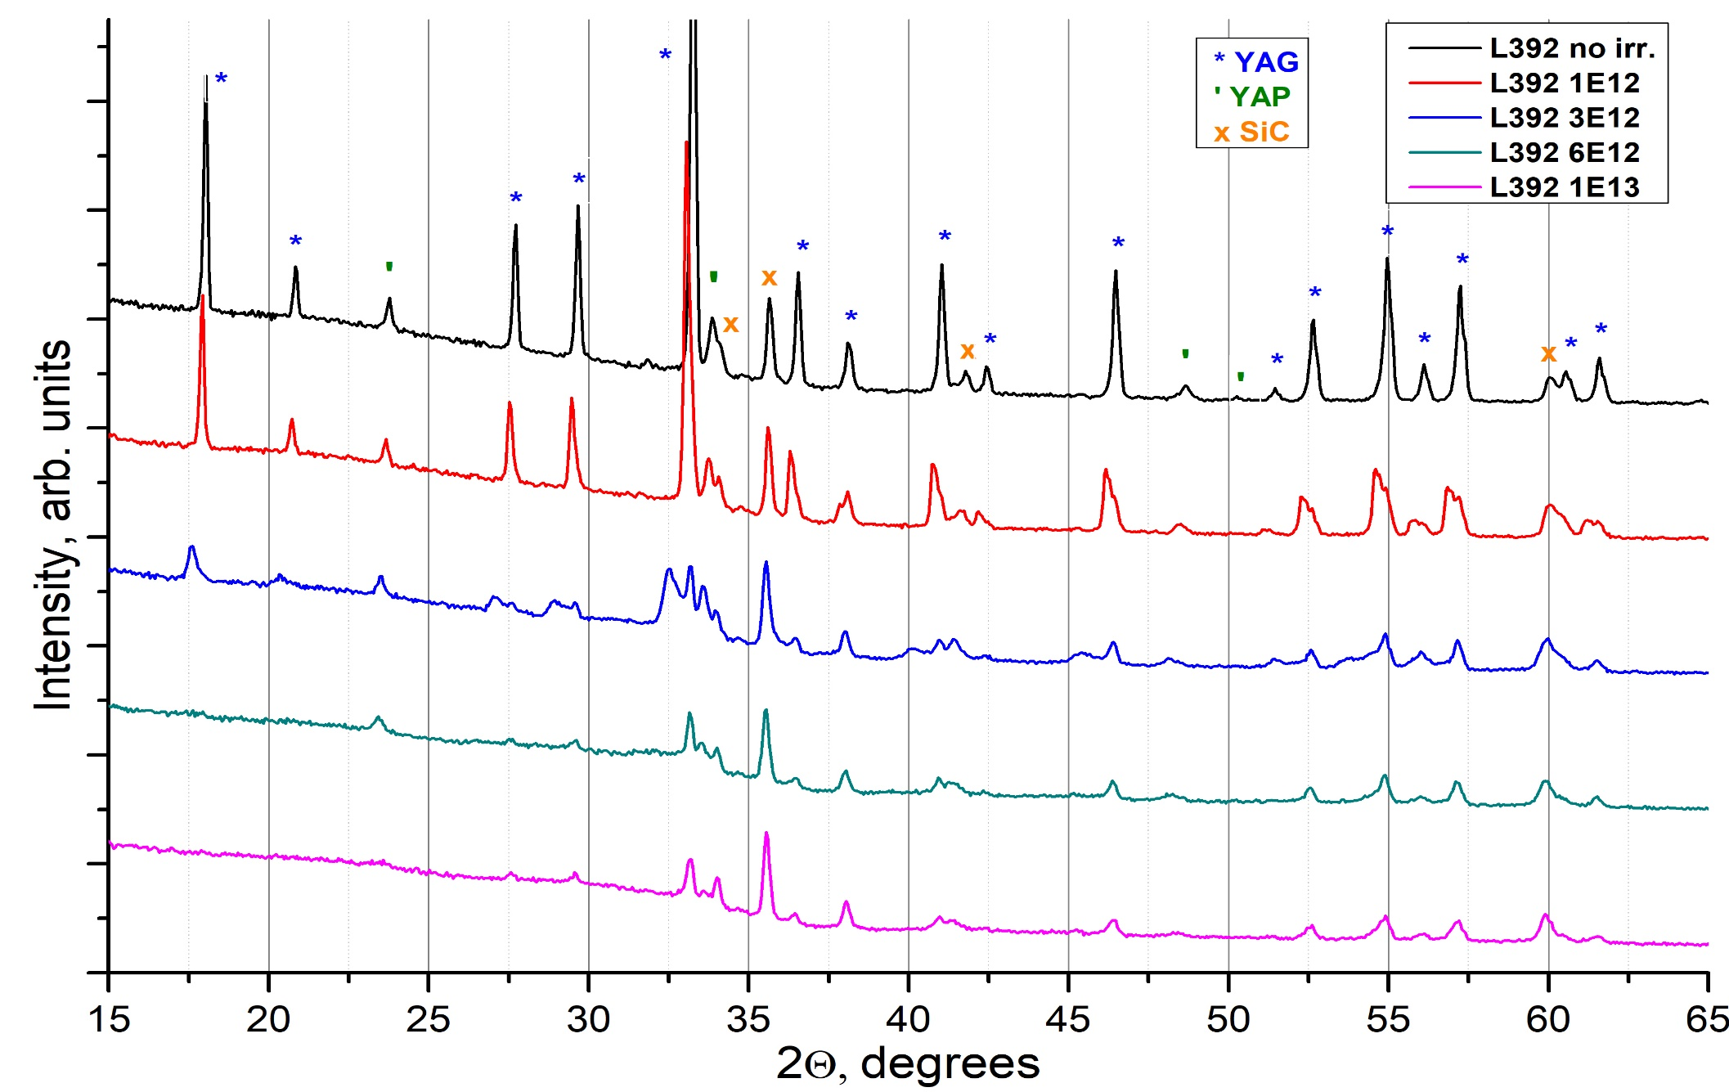
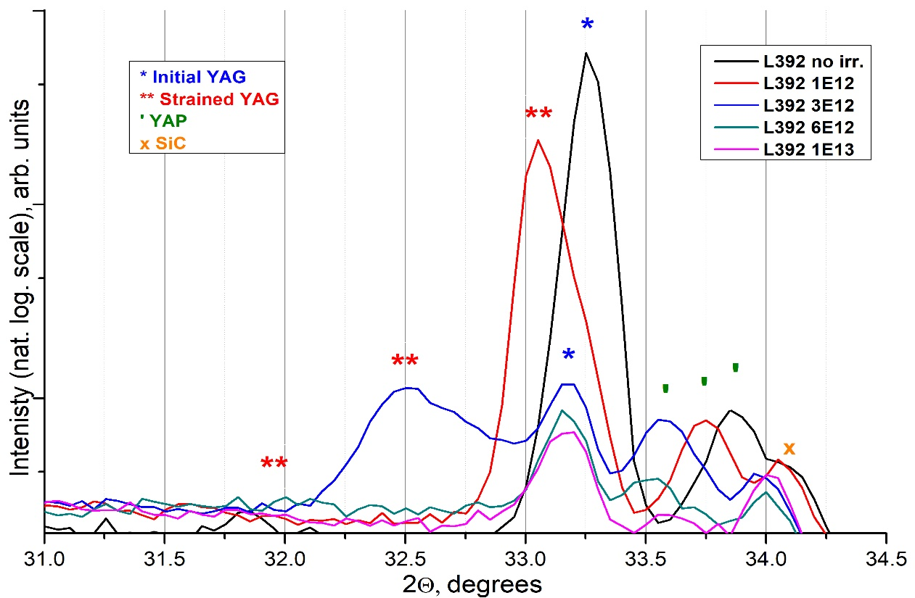
YAG + SiC

Slide 24
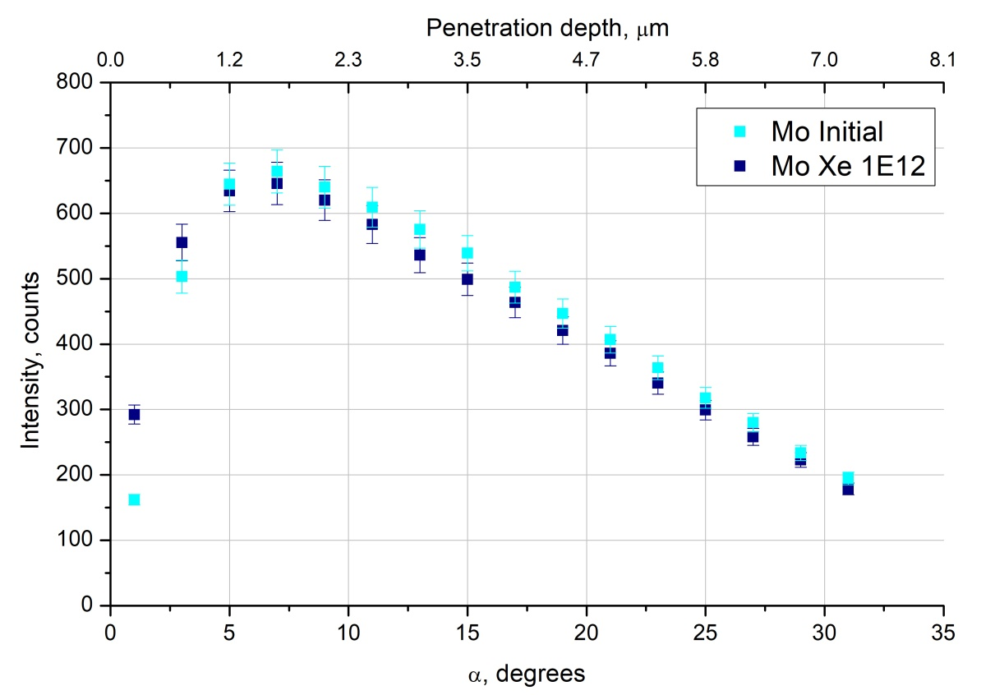

Slide 25
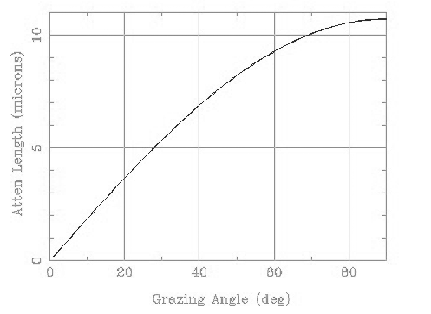
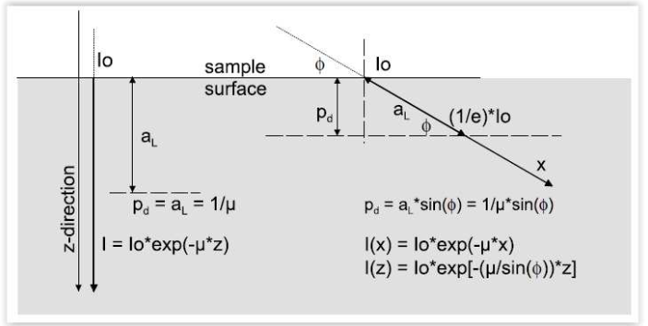
$α_{0}=\sqrt{2δ}$ ̶ угол полного внешнего отражения
$α<α_{0:}$:
$$τ(α)=\frac{sin⁡(α)}{μ}$$
$α>α_{0}$:
Рис. 9. Зависимости глубины проникновения пучка РИ от угла падения. Характерный вид
Notes:
Расчёт глубины проникновения РИ в материал осуществлялся с использованием двух формул, изображённых на слайде. В пределах угла ПВО глубина проникновения РИ в материал зависит от оптических параметров самого материала. В результате построения, зависимости получаются вида рис. 8.

