Slide 1
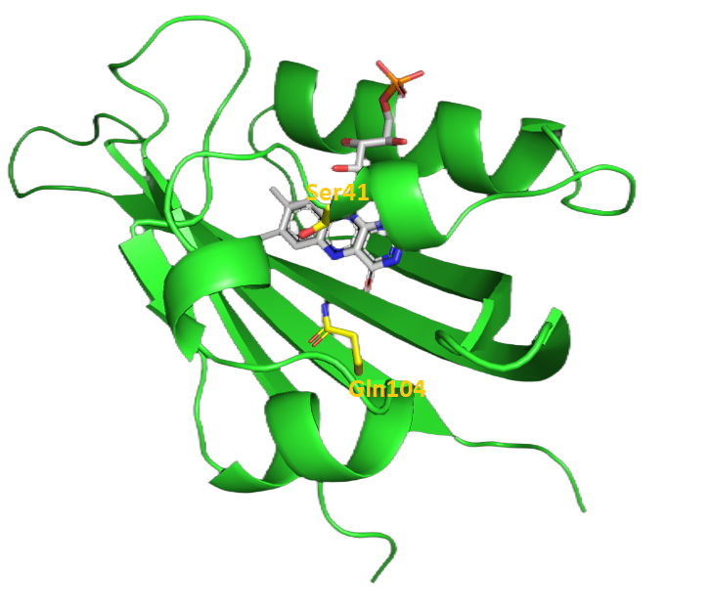
Functional studies of archaeal cysteine-less LOV domain
Natarov I.I.¹, Semenov O.Y.¹, Remeeva A.A.¹, Gushchin I.Y.¹
¹Research Center for Molecular Mechanism of Aging and Age-Related Diseases, Moscow Institute of Physics and Technology, MIPT, Dolgoprudny 141701, Russia

Slide 2
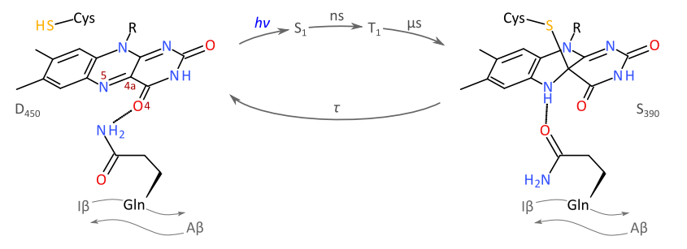
Canonical photocycle of LOV domains
Canonical LOV domains photocycle: photon absorption leads to adduct formation between conserved cysteine and flavin cofactor, followed by protonation of N5 flavin atom and downstream signaling through conserved glutamine rotation, finally spontaneous adduct dissociation returns LOV domain to the dark-adapted state.
(Dietler J. et al. Nature communications, 2022.)

Slide 3
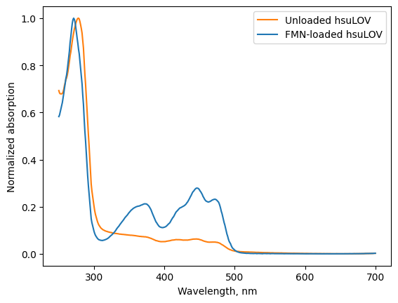
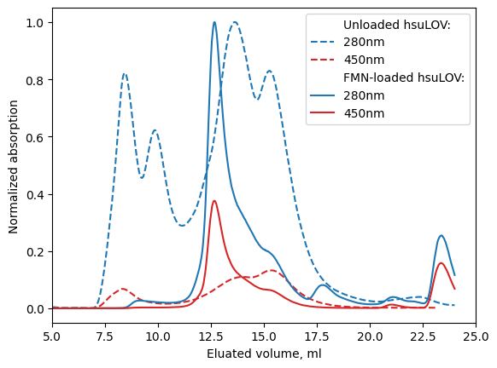
Chromophore loading
Absorption spectra of hsuLOV samples before (orange line) and after (blue line) chromophore loading. Purified protein was incubated with excess FMN in 3M NaCL buffer. Unbound flavin was removed by dialysis.
Chromophore loading changed SEC chromatogram of hsuLOV. Samples before (dashed line) and after (solid line) chromophore loading are presented.

Slide 4
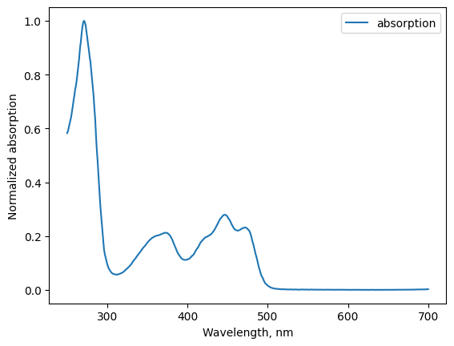
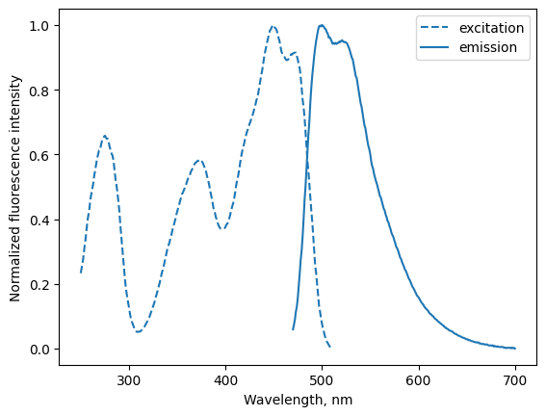
Spectral properties of hsuLOV
Chromophore loaded hsuLOV exhibited characteristic LOV domain spectra, with the fluorescence maxima at 449 nm (excitation) and 500 nm (emission). Fluorescence properties of LOV domains enable their application as genetically encoded reporters in optogenetics and microscopy.

Slide 5
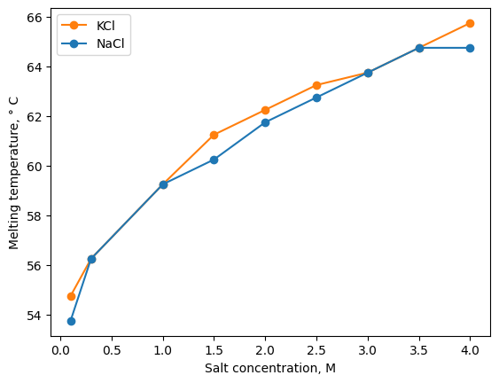
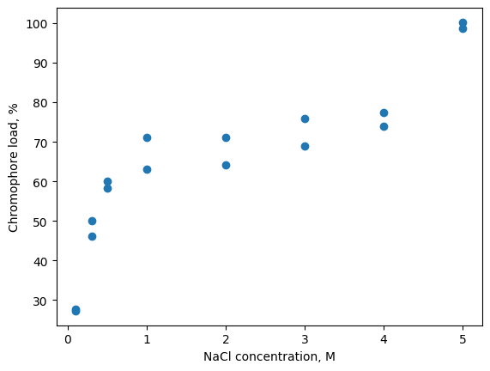
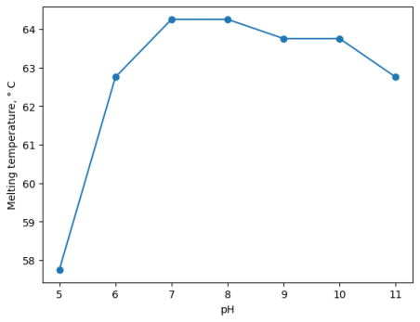
Thermal stability
Thermal stability of hsuLOV in buffers with different salt concentration and pH values: increase in salt concentration leaded to increase in the protein melting temperature to maximum value Tmax ≈ 65°C
Dependence of hsuLOV chromophore load on salt concentration used for hsuLOV incubation with excess FMN during chromophore loading experiment.

Slide 6
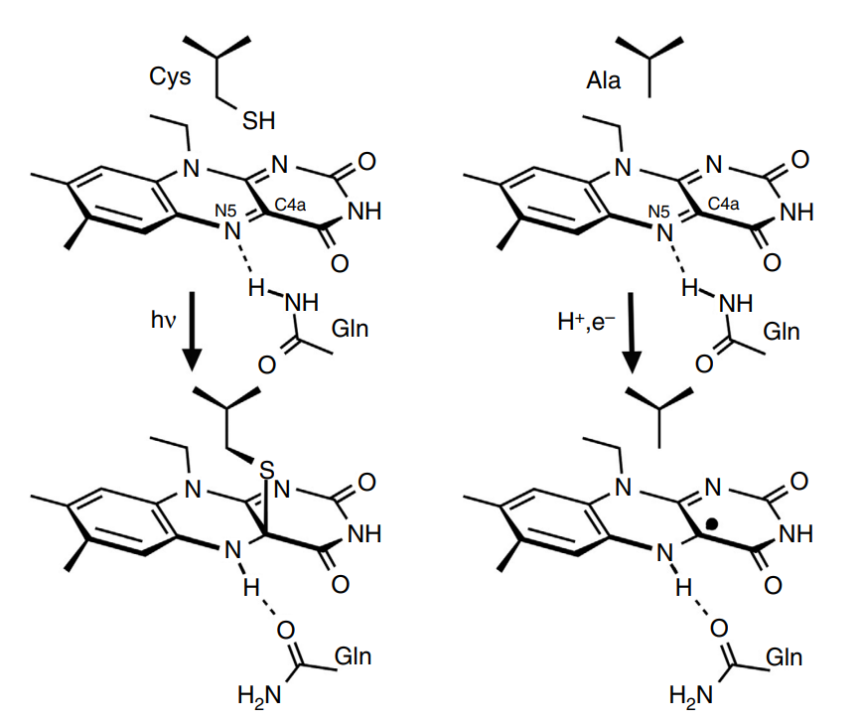
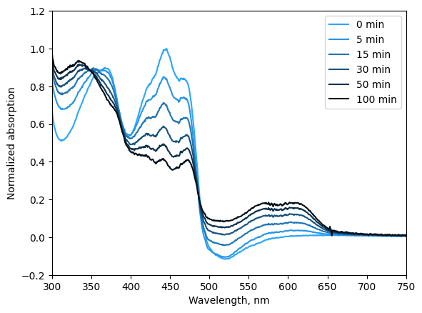
Photoreduction
Recent research specifies that natural cysteine-less LOV domains are able to signal via photoreduction of flavin to the neutral semiquinone radical state. (Yee, E. F. et al. Nature communications, 2015.)
Photoreduction of hsuLOV flavin chromophore during continuous illumination with 455nm LED. Neutral semiquinone radical state was detected due to characteristic absorption peak at 610nm.

Slide 7
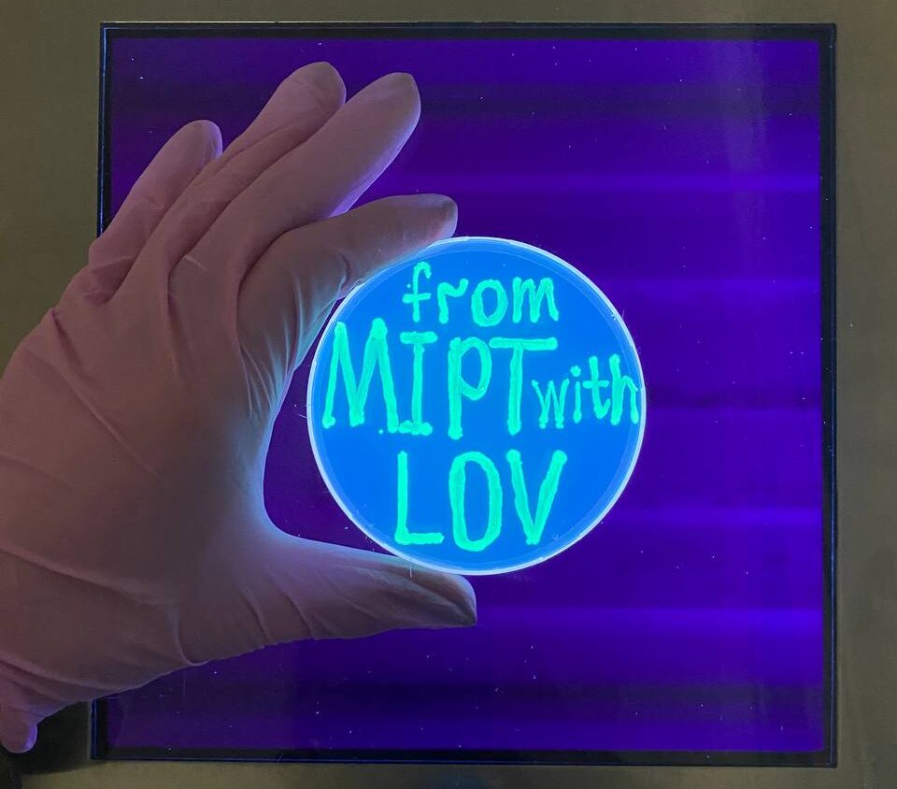
Thank you for your attention!

