Slide 1
Cytoskeletal perspective on mitochondrial stress in Huntington’s disease
Lomonosov Moscow State University
A. N. Belozersky Research Institute of Physico-Chemical Biology MSU
Department of Electron Microscopy
Speaker
Viacheslav Pasko
Co-authors
Aleksandra Churkina
Dr Irina Alieva
Lilia Belikova
AYSS, Dubna, 2024
Notes:
Перевести название института, добавить лого мгу и белозера, добавить авторов. Указать сокращенное название конференции

Slide 2
Huntington’s disease (HD)
Neurodegenerative autosomal dominant disease
Characterized by cognitive and behavioral impairment
Caused by expansion of CAG trinucleotide repeats in the HTT gene
The mutation leads to the formation of an abnormally long poly-Q N-terminal domain, followed by the accumulation of defective proteins

Slide 3
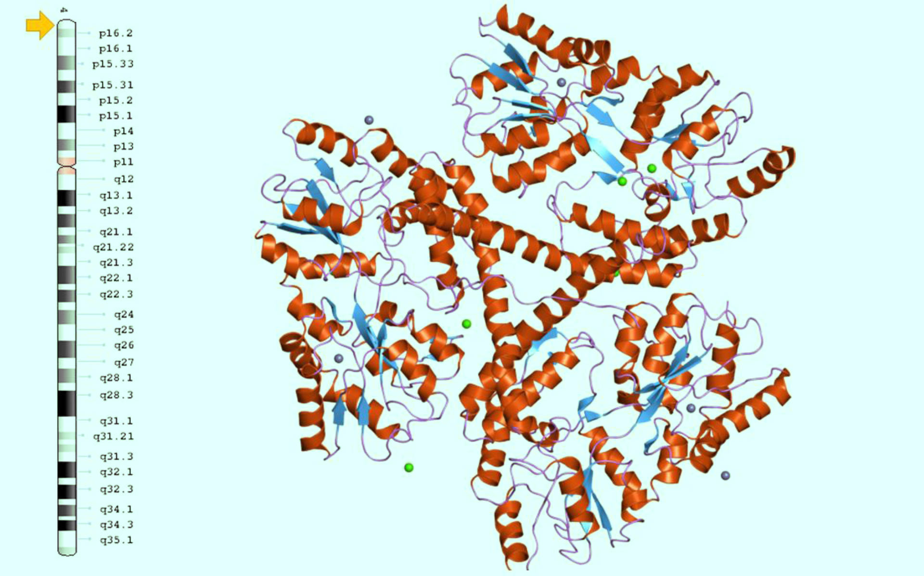
Globular structure of huntingtin disrupted by CAG repeat expansion
The mutation leads to the formation of an abnormally long poly-Q N-terminal domain, followed by the accumulation of defective proteins
Warner et al., 2017.
Notes:
Рассказать о перекрывающихся альфа-спиралях и концевом домене

Slide 4
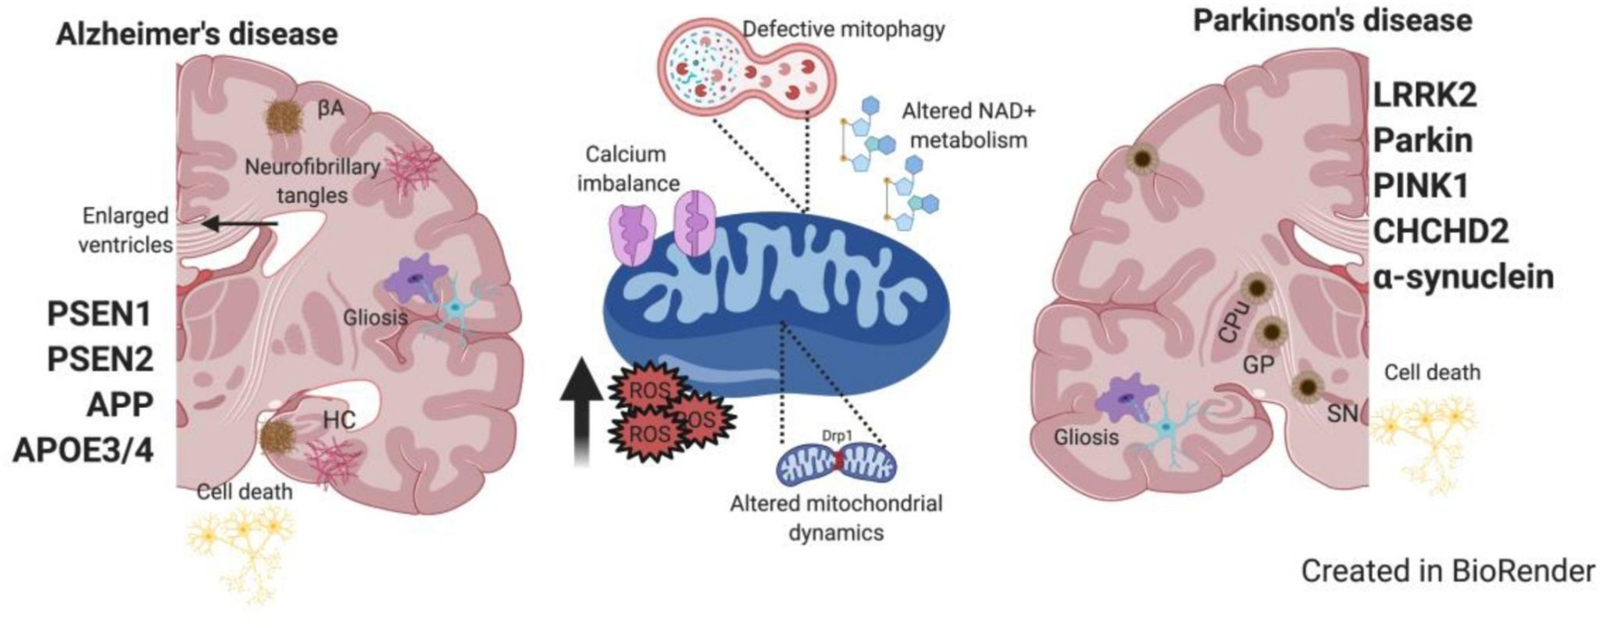
The role of mitochondrial dysfunction in the neurodegeneration development
Mitochondria might be the potential link between huntingtin mutation and neurodegeneration
Trombetta-Lima et al., 2021

Slide 5
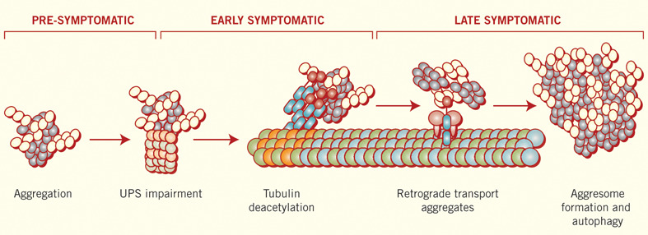
Mutant huntingtin aggresomes affect the cytoskeleton both directly and through motor proteins
d'Ydewalle et al., 2012
Millecamps et al., 2013

Slide 6
Aims of the research
Mitochondrial morphology and movement pattern analysis in HD patients cells
Optimization of model cell systems analysis methods based on biopsy material from HD patients (including its juvenile form of the disease) to study the morphology and mobility of mitochondria
Mitochondrial morphology investigation in HD patients cells
Speed and direction of intracellular mitochondria migration differences characterization in HD patients cells

Slide 7
Model systems
Primary fibroblasts obtained from skin biopsies of healthy donors and patients with HD with different numbers of CAG repeats in the huntingtin gene, and neurons obtained from iPSCs isolated by transdifferentiation
Donor | CAG repeat count | Age | Gender
HD42 | 42 | 45 | ♂
HD47 | 57 | 46 | ♀
HD76 | 76 | 17 | ♂

Slide 8
Materials and methods
Visualization of mitochondria using voltage-sensitive fluorescent probes
Intravital observations using wide-field fluorescence microscopy
Analysis of mitochondrial dynamics using ImageJ with standard and modified plugins
Immunocytochemical staining to identify cytoskeletal components and mitochondria
Super-resolution microscopy for analysis of morphology and colocalization of cytoskeletal components with mitochondria

Slide 9
Steps
Selection of conditions for studying mitochondrial dynamics in cells of patients with HD and healthy donors.
Selection and comparison of the effectiveness of automatic plugins for analyzing the dynamic properties of mitochondria.
Fluorescent labeling of mitochondria and intravital monitoring of their dynamics in skin fibroblasts of a patient with juvenile HD and a healthy donor.
Cell fixation at the end of intravital observations and immunofluorescence analysis to identify cytoskeletal components associated with mitochondria.
Comparison of results and statistical analysis of observed differences.
Notes:
HD patients исправить

Slide 10
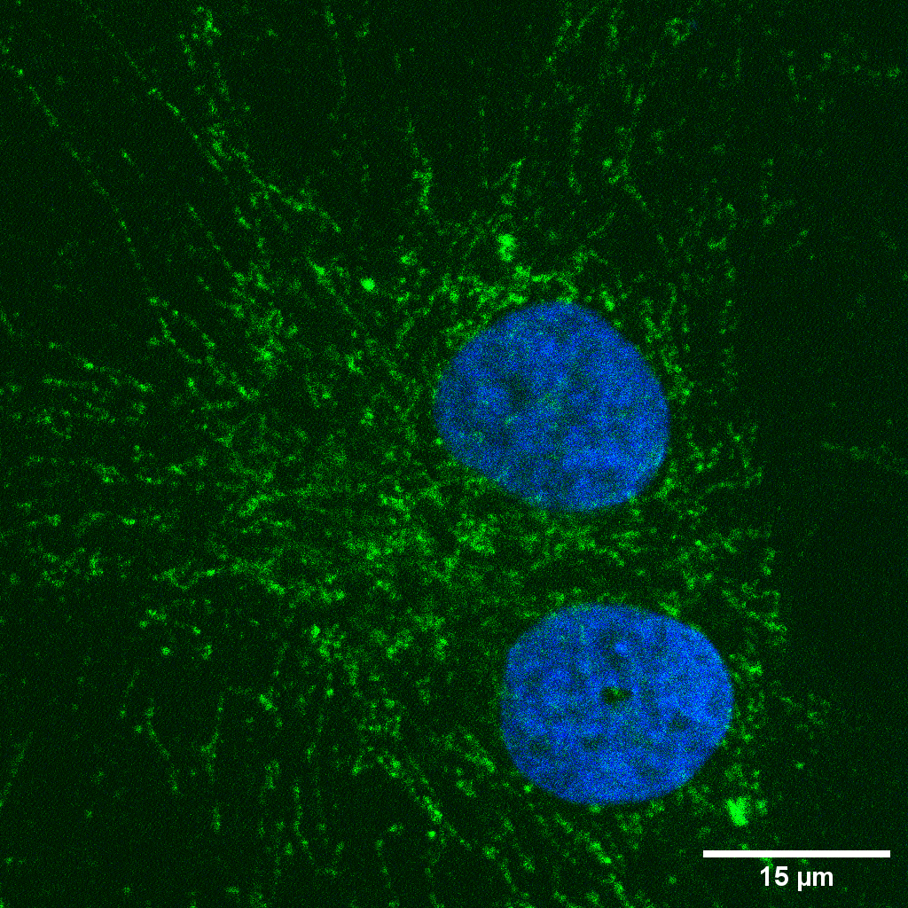
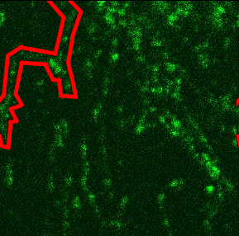
Analysis of mitochondrial morphology in fibroblasts

Slide 11
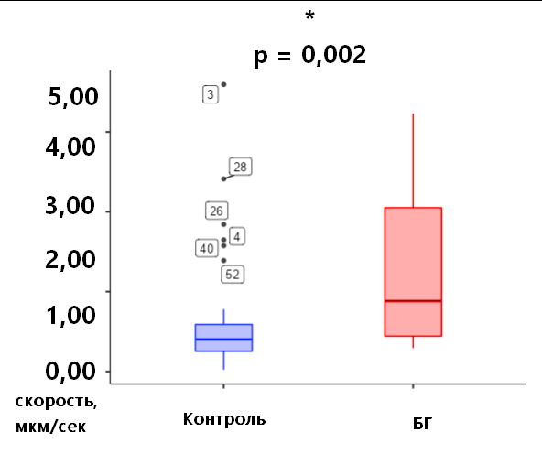
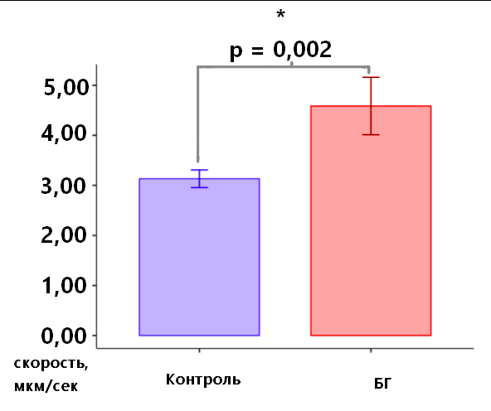
The mitochondrial branching degree is different in fibroblasts from healthy donors and HD patients
degree of branching, arb. units
degree of branching, arb. units
Control
HD
Control
HD

Slide 12
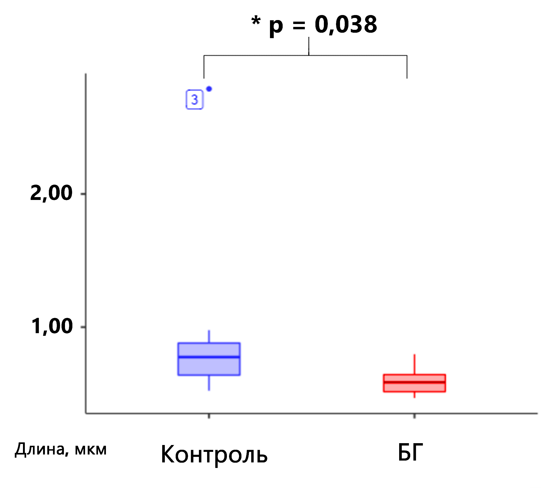
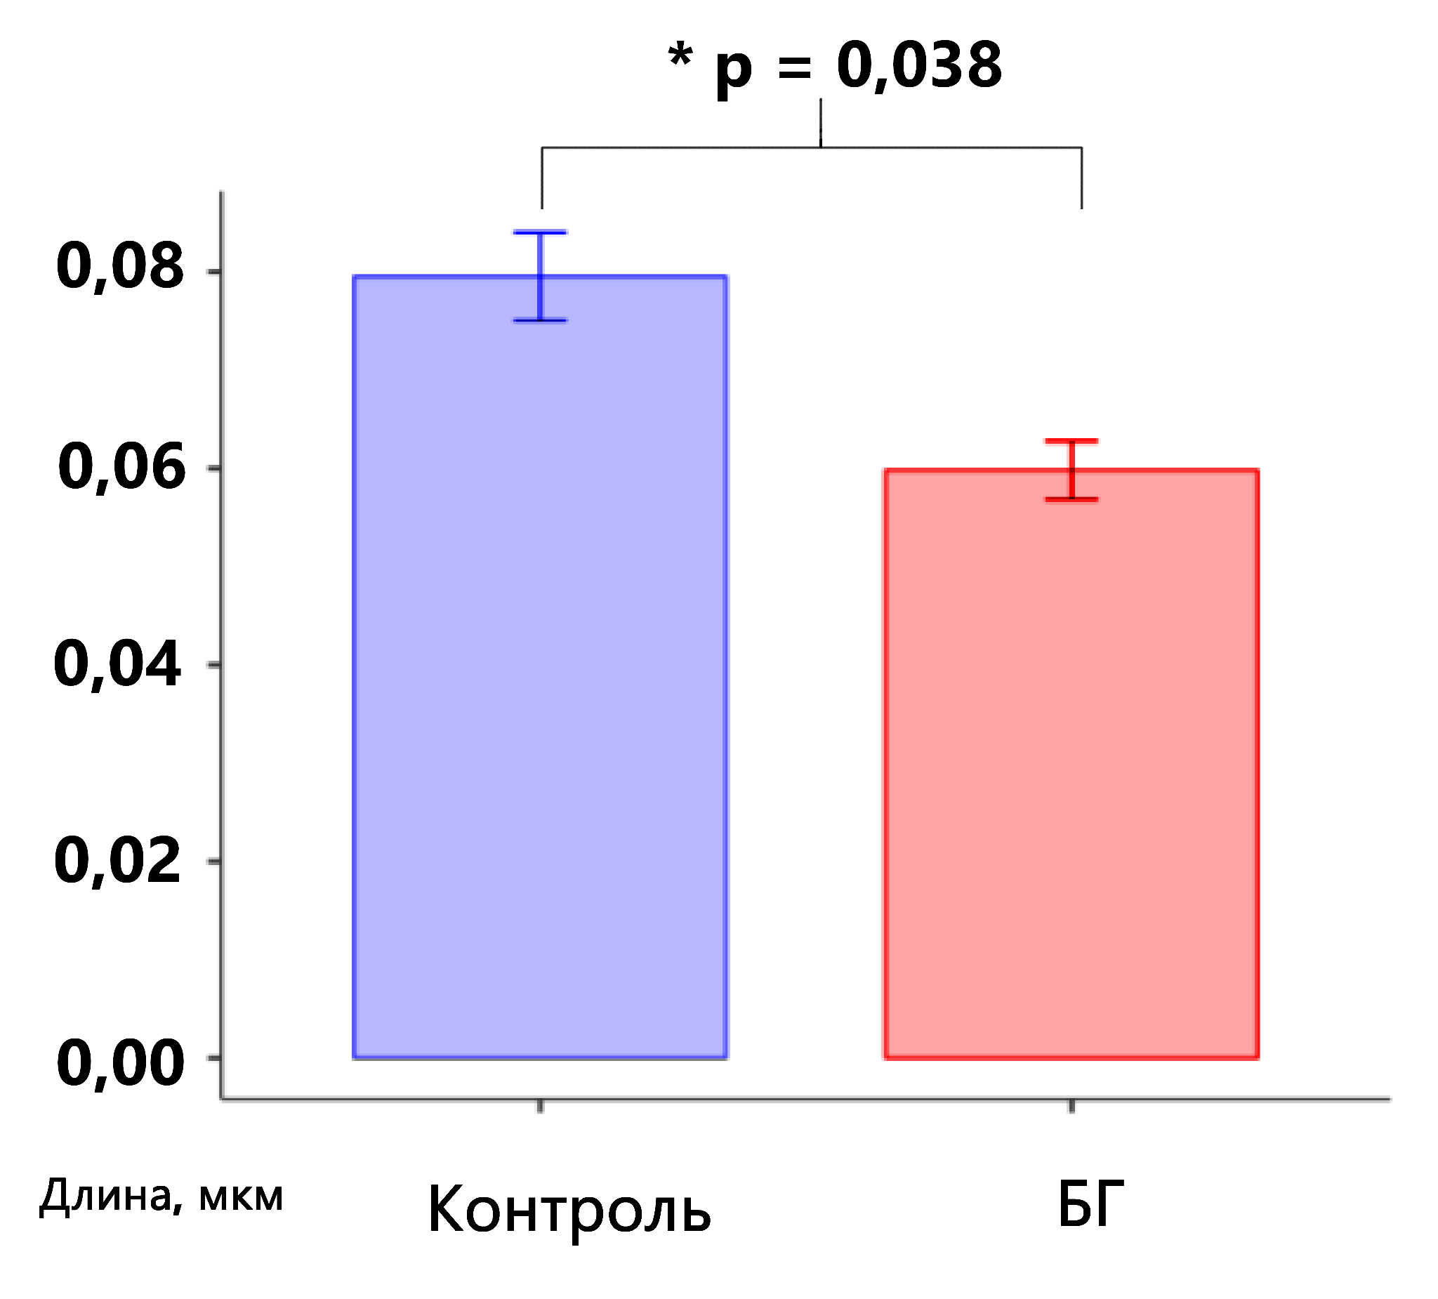
The mitochondrial branches lengths are different in fibroblasts from healthy donors and HD patients
length, µm
Control
HD
length, µm
Control
HD

Slide 13
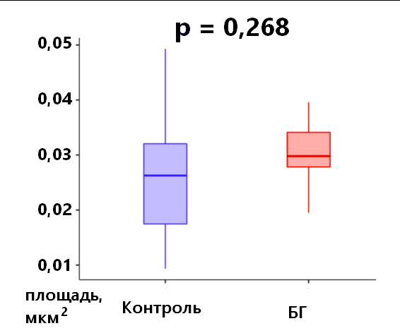
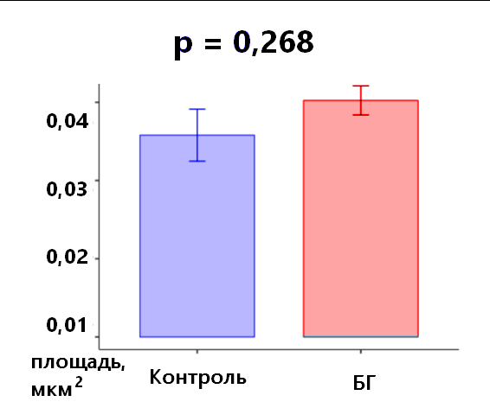
Mitochondrial areas are not different in fibroblasts from healthy donors and HD patients
area, µm^2
area, µm^2
Control
Control
HD
HD

Slide 14
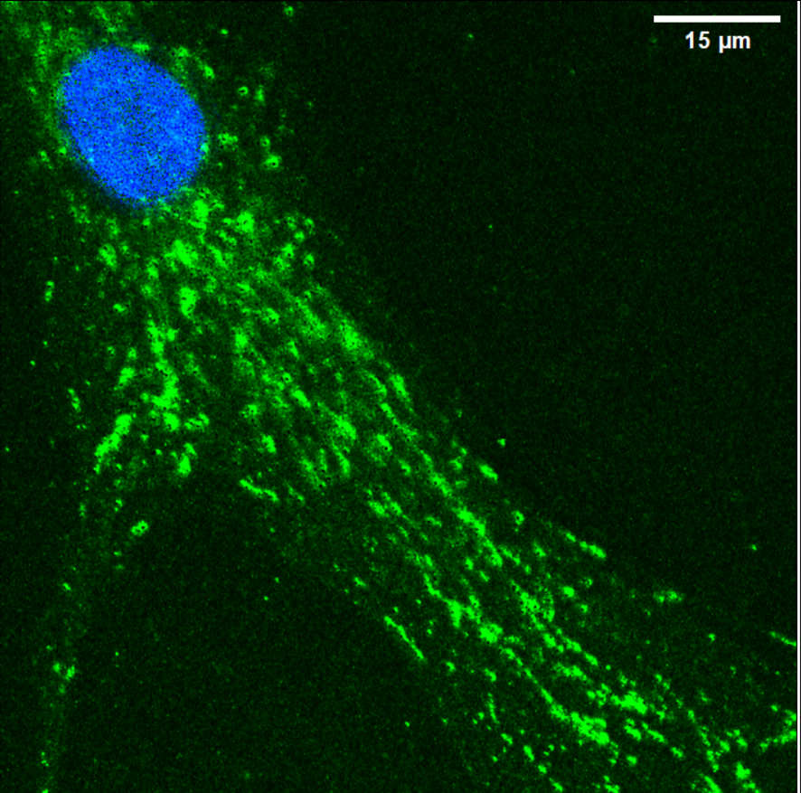
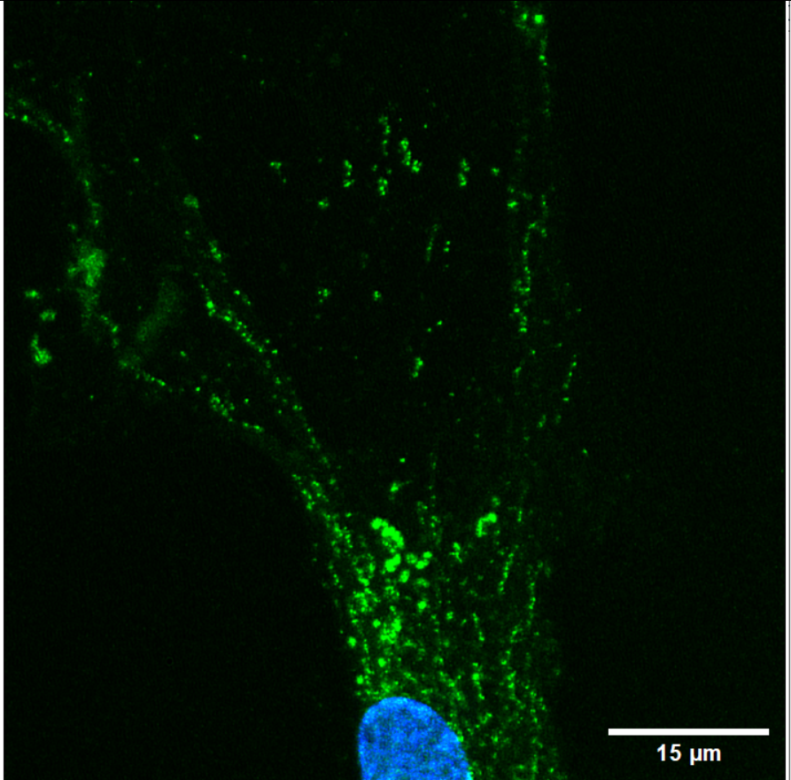
Analysis of mitochondrial dynamics in neurons
Axon
Dendrites

Slide 15
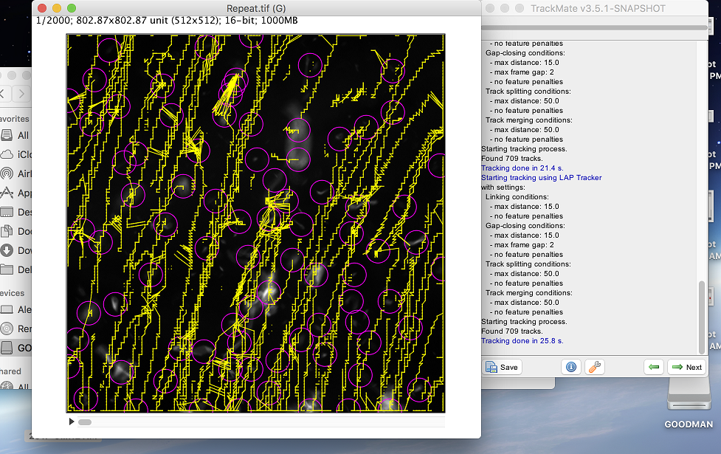
TrackMate was chosen as an optimal tool for mitochondria tracking
Suitable for working with both 3D and 2D objects.
After setting the parameters of the detected objects, it automatically subtracts the background and builds tracks.
Ershov et al., 2022

Slide 16
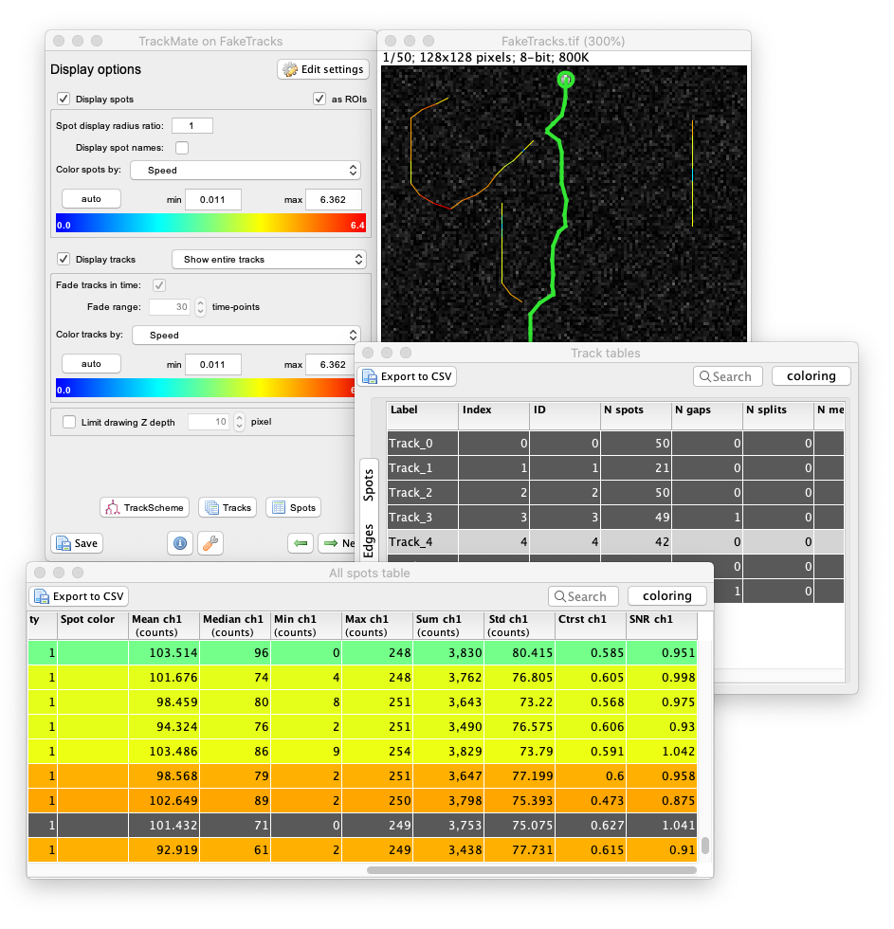
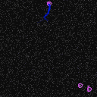
TrackMate is capable of not only evaluating tracks, but also detecting phenomena such as fission or merging
Ershov et al., 2022

Slide 17
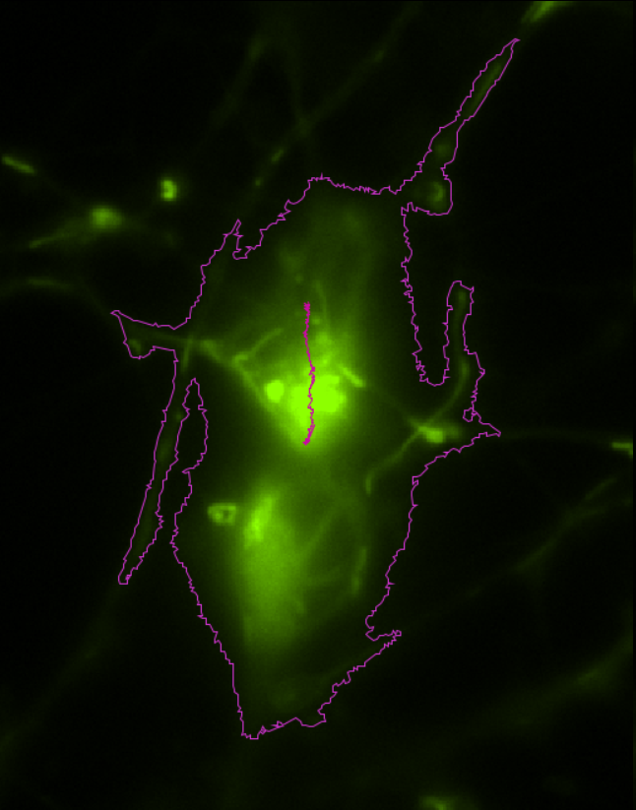
Comparison of manual and automatic measurement
MTrackJ
TrackMate

Slide 18
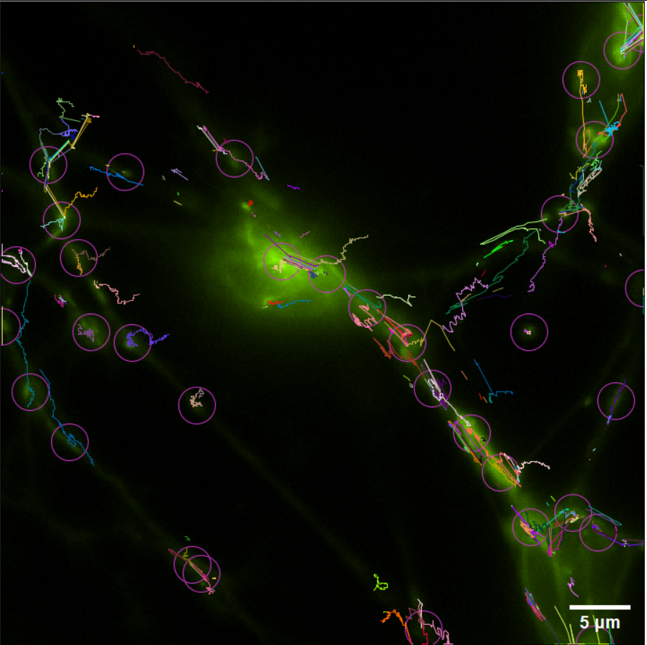
Automatic calculation of mitochondrial migration tracks using TrackMate

Slide 19
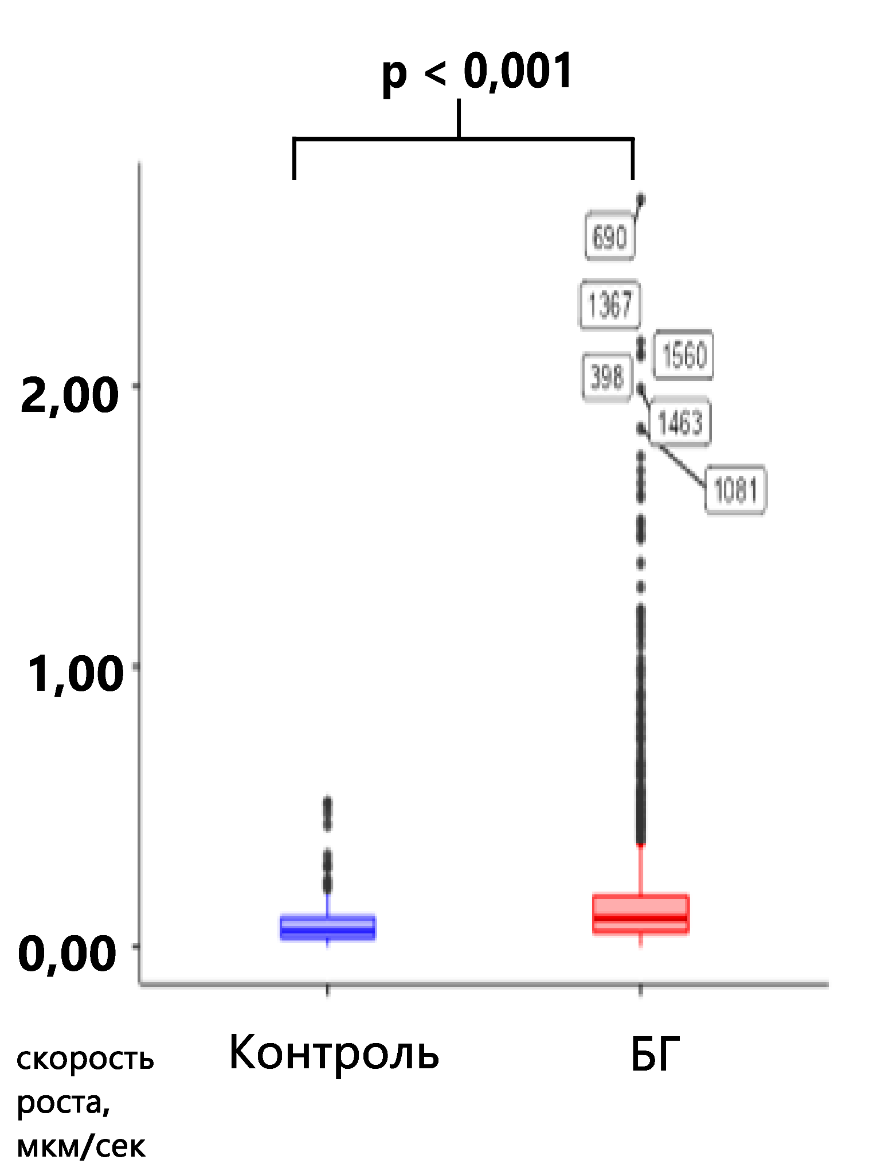
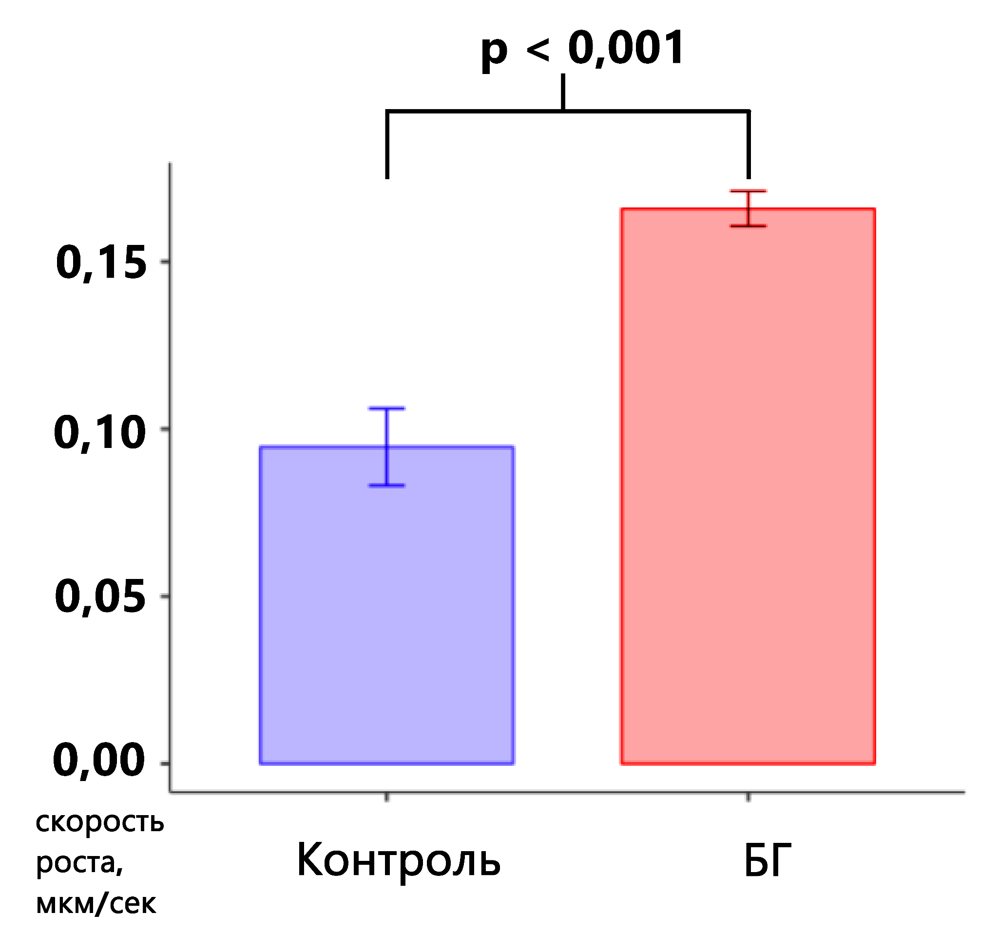
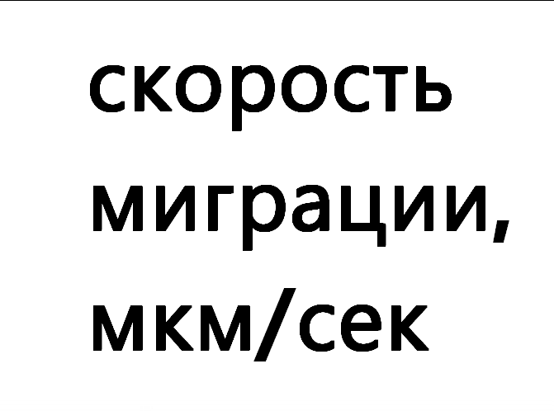
The mitochondrial migration speed in the axons increased in HD patients
migration
speed,
µm/second
migration
speed,
µm/second
Control
HD
HD
Control

Slide 20
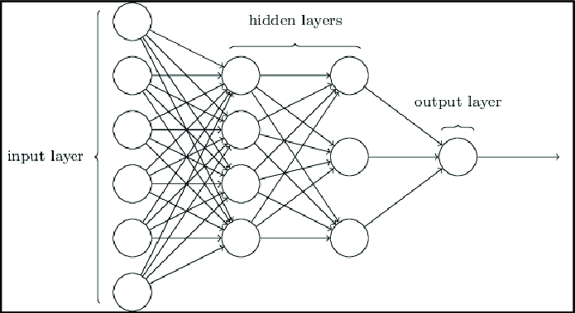
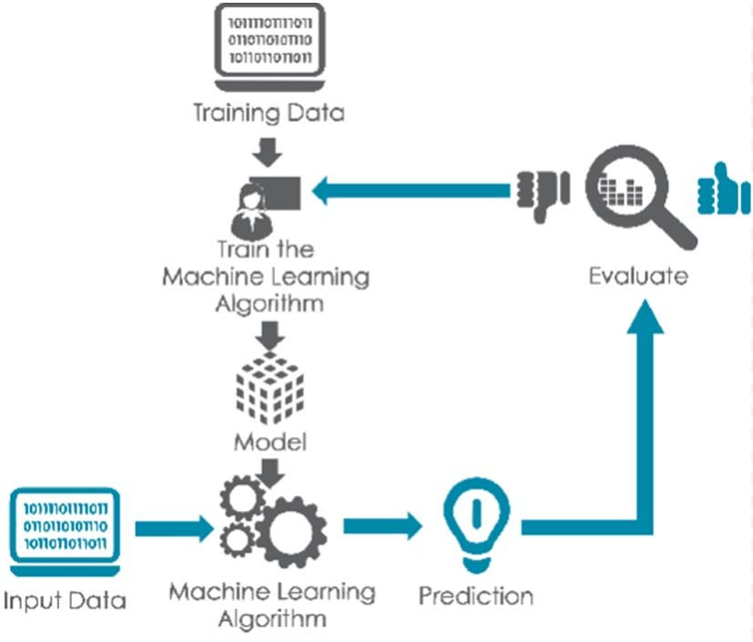
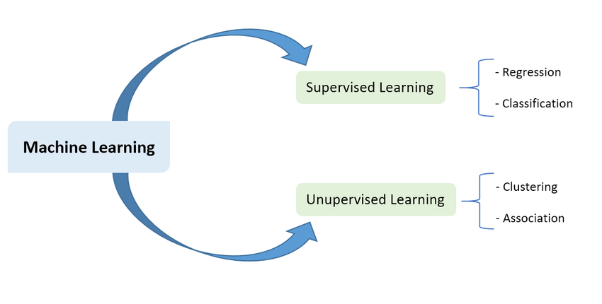
Application of artificial intelligence methods in image analysis

Slide 21
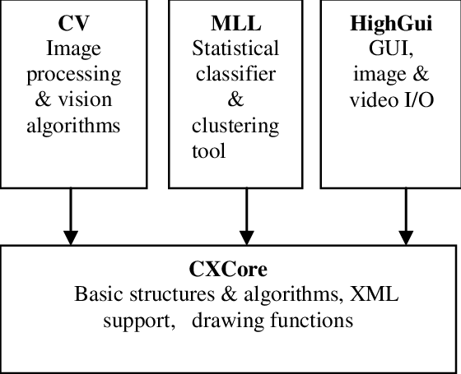
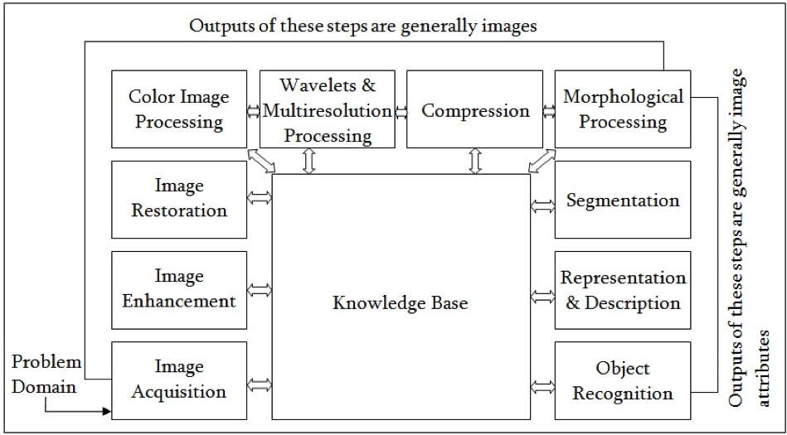
Application of OpenCV and other AI algorithms for image processing

Slide 22
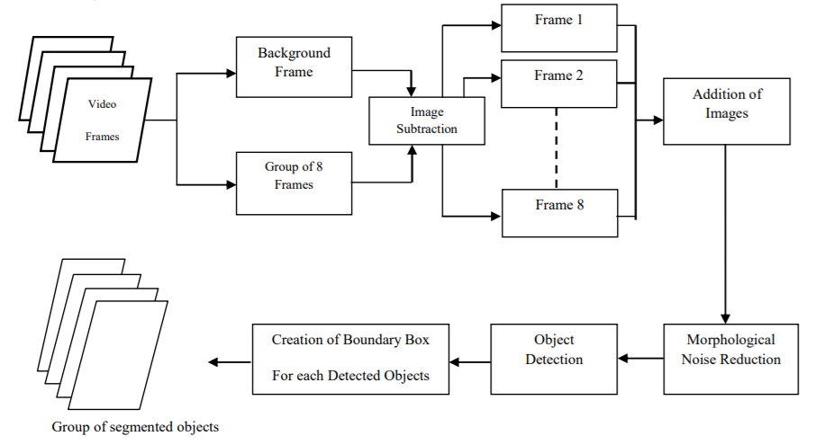
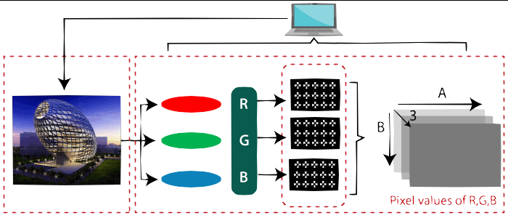
OpenCV application for mitochondria tracking

Slide 23
Hypothesis
Mutant huntingtin, by binding to structural components of the cytoskeleton, motor proteins and cytoskeletal regulatory proteins, affects the intracellular transport of mitochondria.
The increase in the rate of mitochondrial movement in HD patients may be due to a decrease in the integrity of the cytoskeletal organization under the influence of mutant huntingtin, which leads to an acceleration of the transport of mitochondria along microtubules at the cost of a decrease in the accuracy of delivery. This can also explain the formation of a pool of mitochondria with particularly high migration rates.
Notes:
Сделать графическое саммари, схема того как нарушения цитоскелета влияют на митохондрию. Сделать слайд про колокализацию с разными элементами цитоскелета, и про блеббинг, и слайд про OpenCV

Slide 24
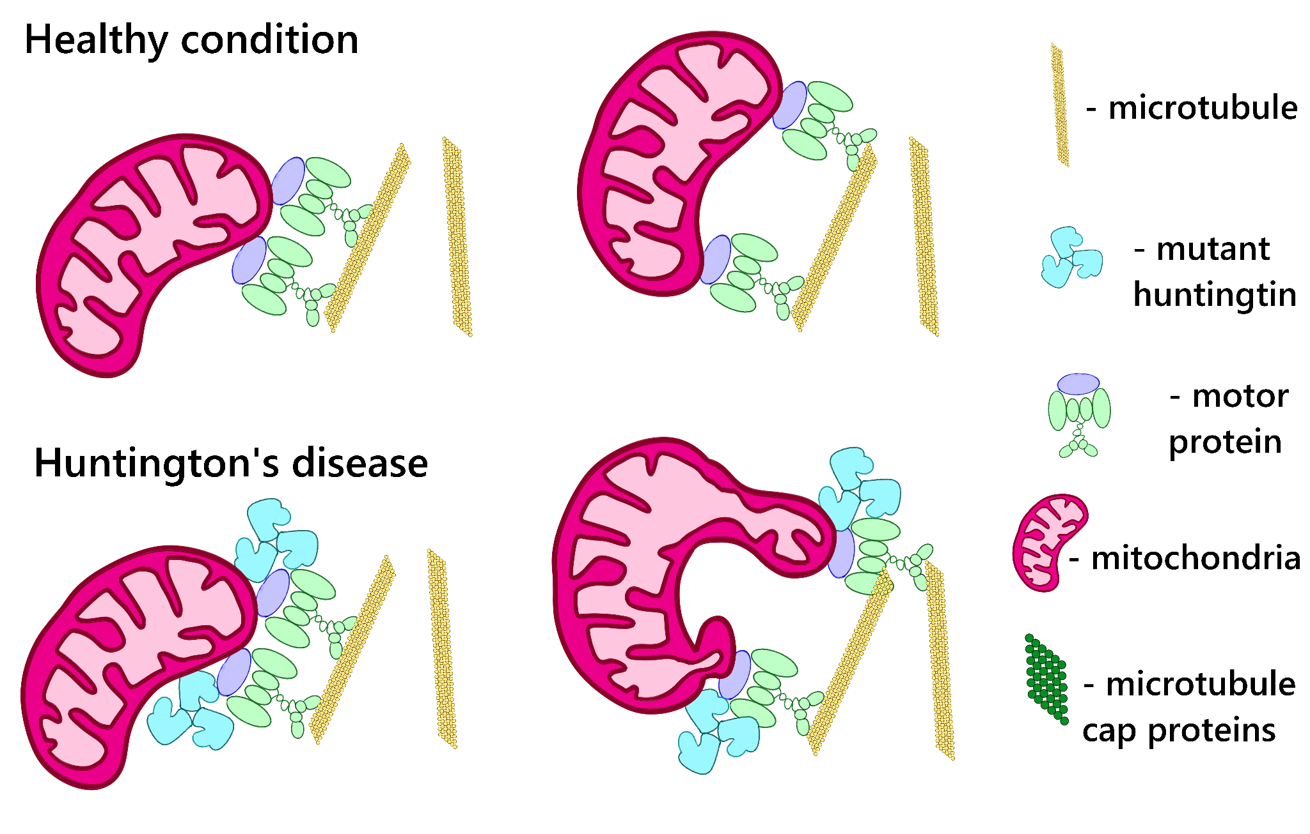
Model 1 - interaction of mutant huntingtin with cytoskeleton motors
Notes:
Убрать кэп белки из условных обозначений

Slide 25
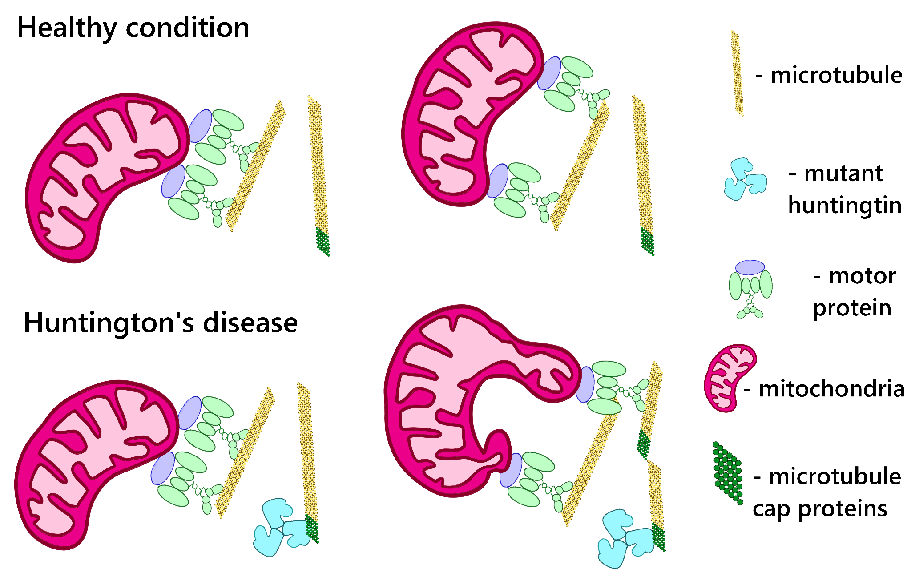
Model 2 - interaction of mutant huntingtin with cytoskeleton itself

Slide 26
Acknowledgements
Scientific supervisors: DSc I. B. Alieva, Aleksandra Churkina
A. N. Belozersky Research Institute:
DSc I. I. Kireev
S. V. Lavrushkina
A. S. Shakhov
U. M. Lopukhin Federal Research and Clinical Center of Physical-Chemical Medicine of Federal Medical Biological Agency:
Prof. DSc M. A. Lagarkova
L. D. Belikova
The work is supported by the MSU Development Program (PNR 5.13.)
Notes:
Добавить в подвал слайд с тем, что такое микротрубочки

