Slide 1
Novel structure-based transglutaminase 2 inhibitors
Presenter:
Sergey Ivashchenko
Authors:
S. Ivashchenko, A. Alexandrova, D. Shulga, V. Ivashchenko, E. Zinovev, A. Vlasov

Slide 2
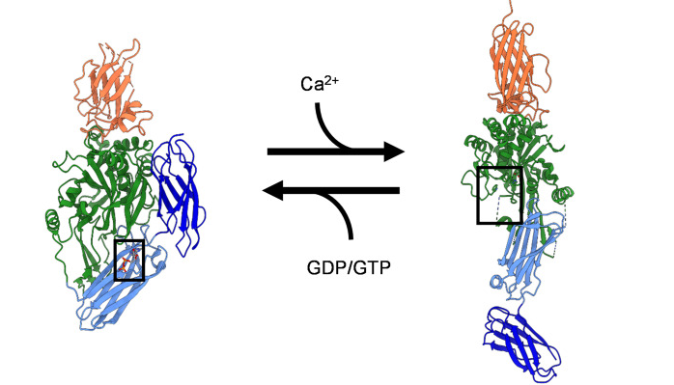
The protein of interest – transglutaminase 2
Closed conformation
Intracellular state
Open conformation
Extracellular state
Katt, W. P., Aplin, C., & Cerione, R. A. (2022). Exploring the Role of Transglutaminase in Patients with Glioblastoma: Current Perspectives. OncoTargets and therapy, 15, 277–290. https://doi.org/10.2147/OTT.S329262.

Slide 3
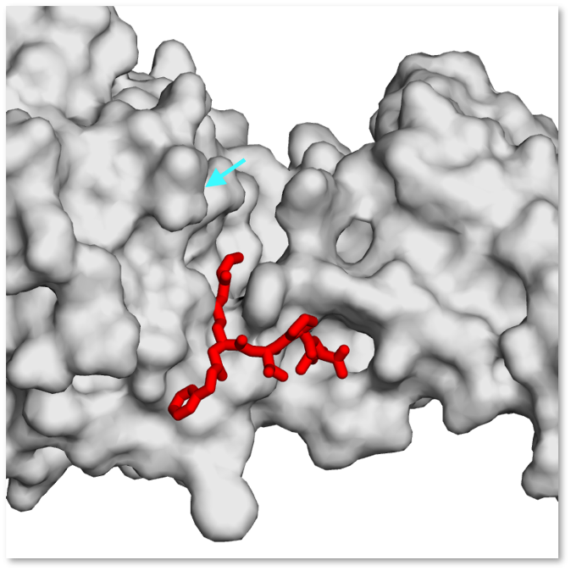
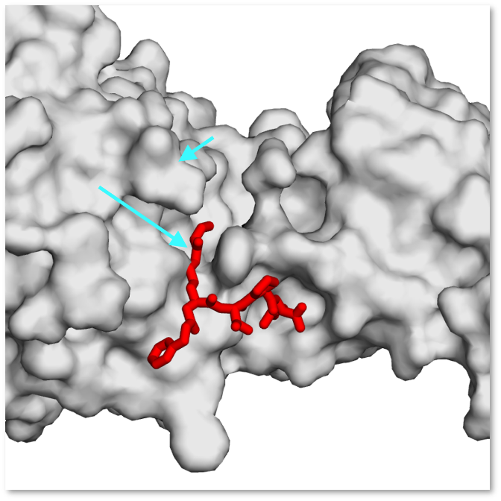
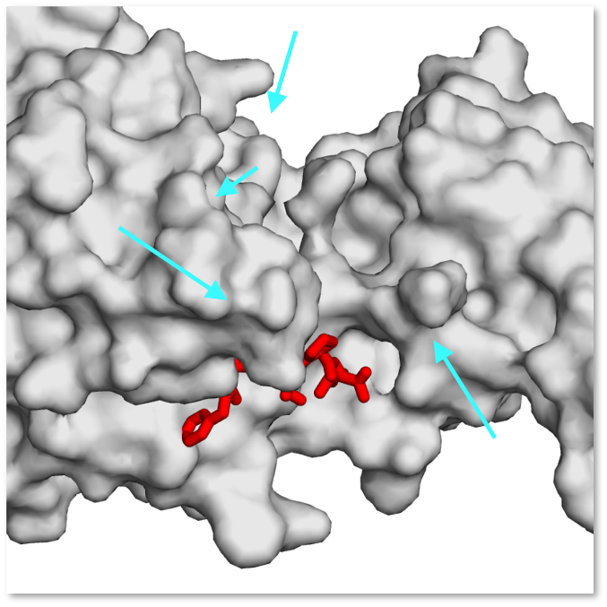
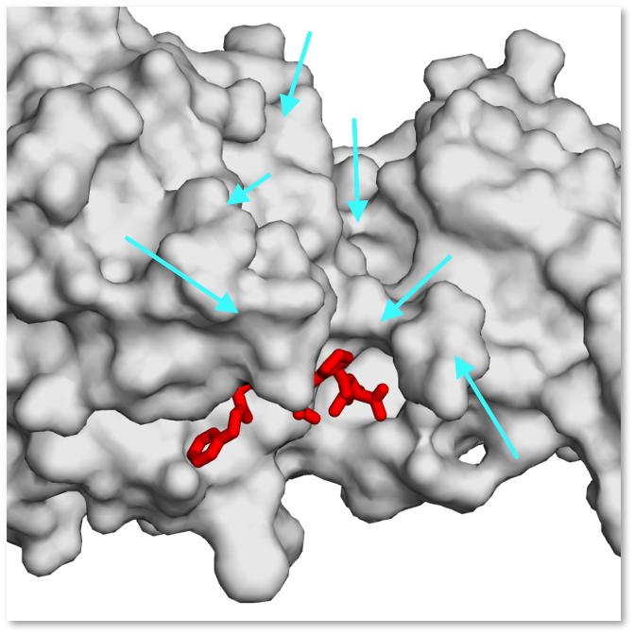
Open form tTG active site is not fully resolved
PDB:3s3s
PDB:3s3p
PDB:3s3j
PDB:2q3z

Slide 4
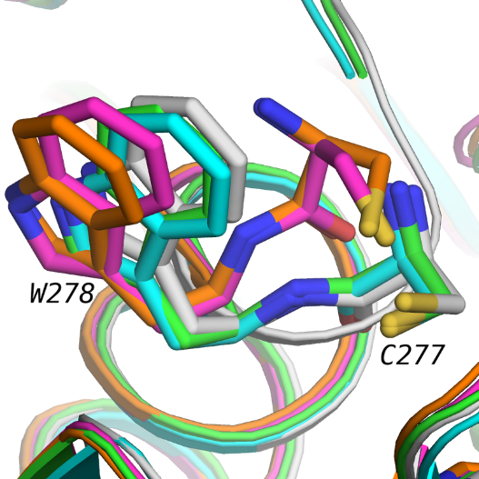
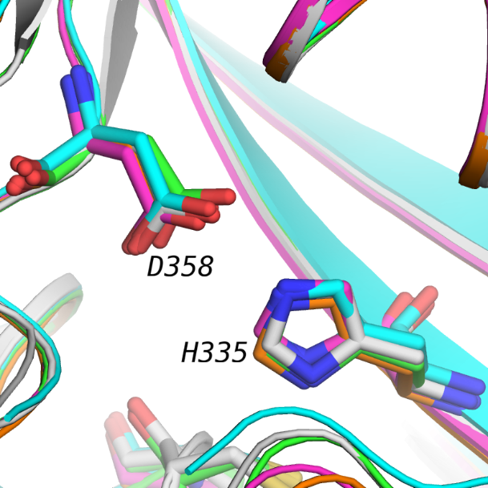
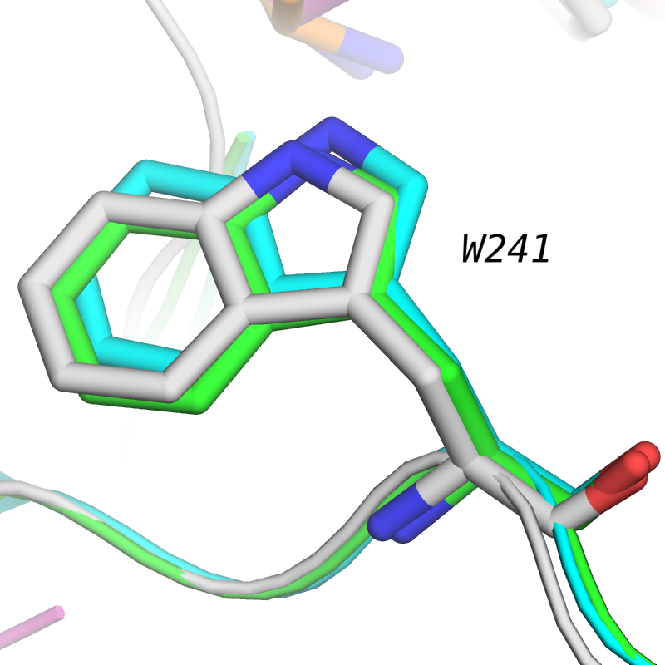
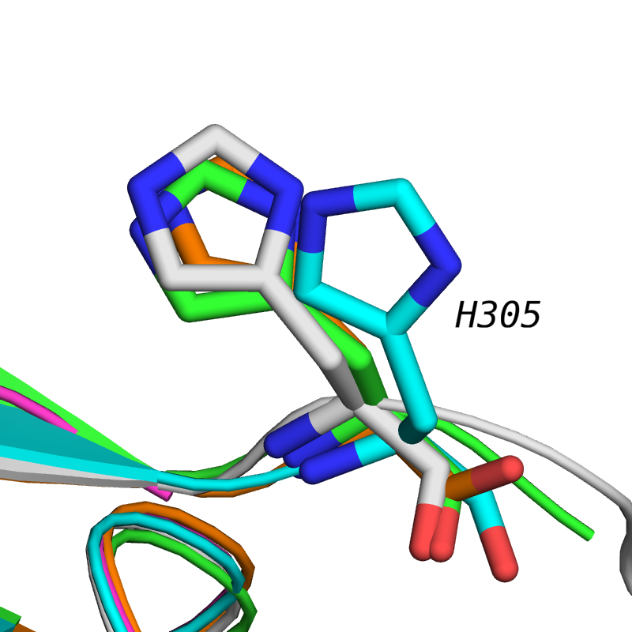
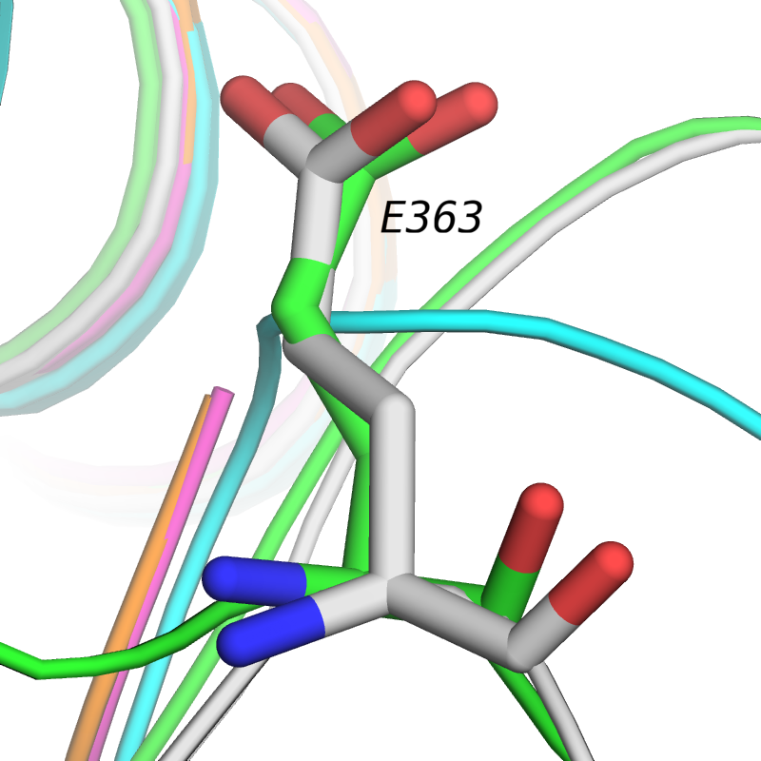
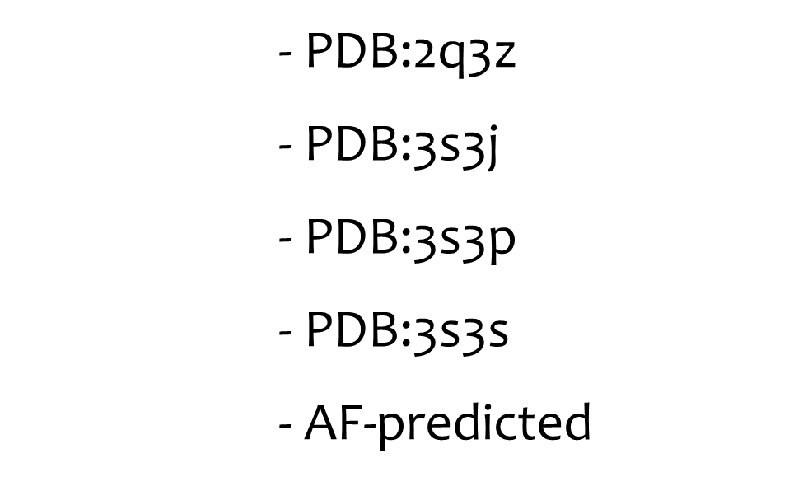
AlphaFold-based full structure prediction

Slide 5
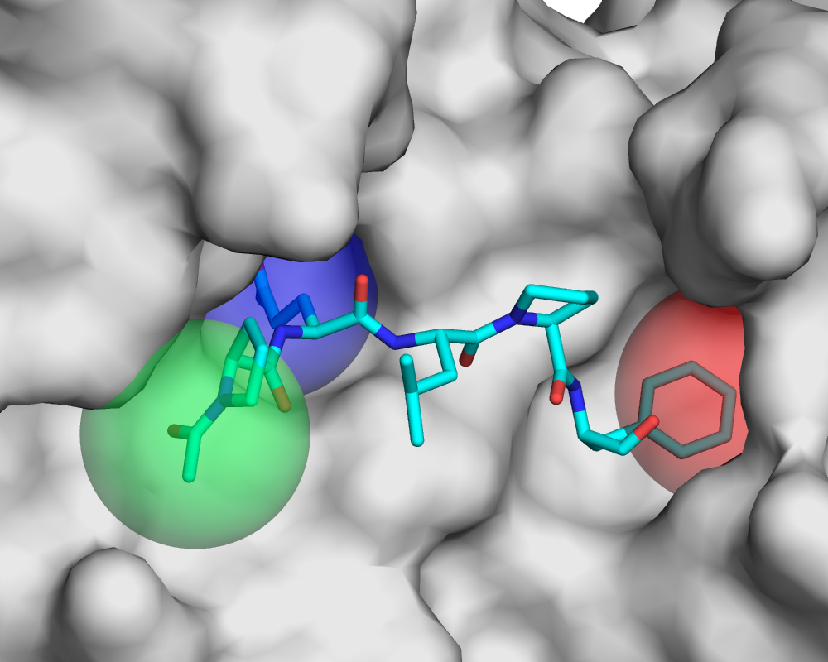
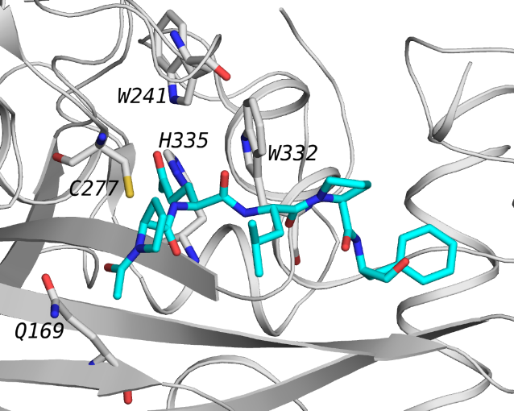
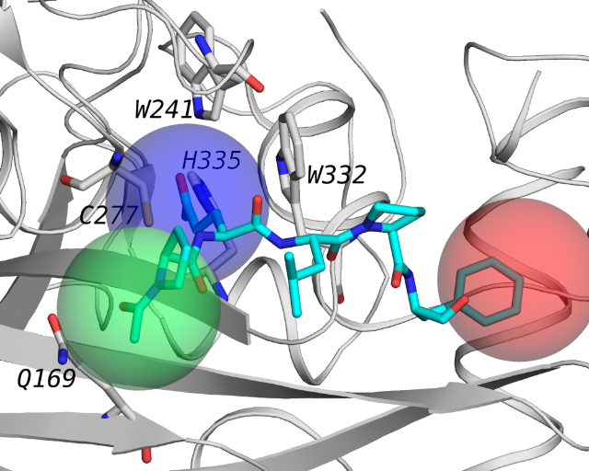
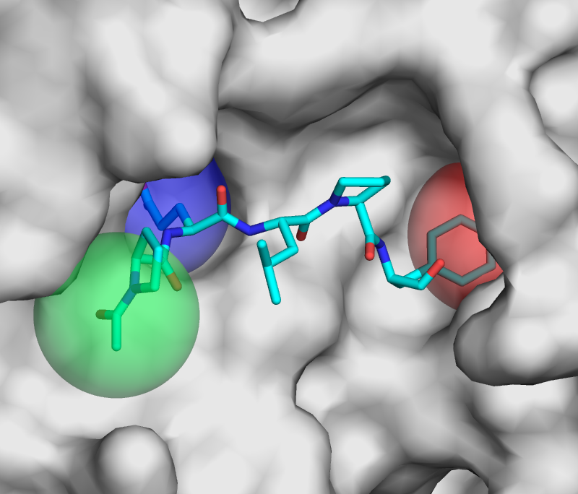
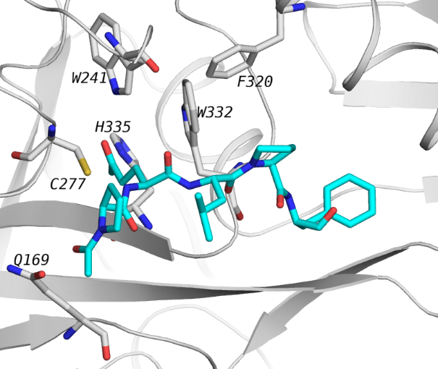
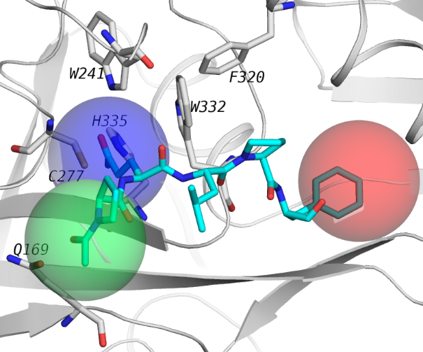
New structural features of tTG active site

Slide 6
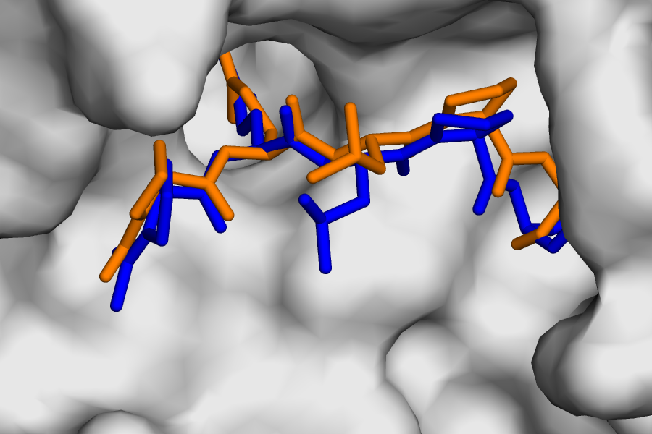
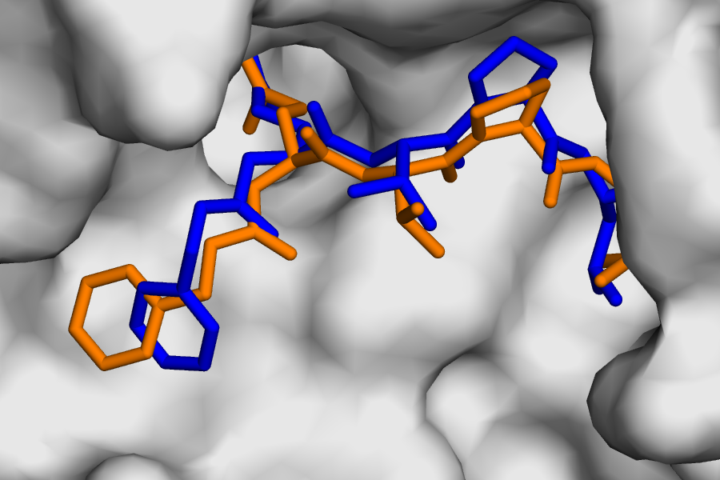
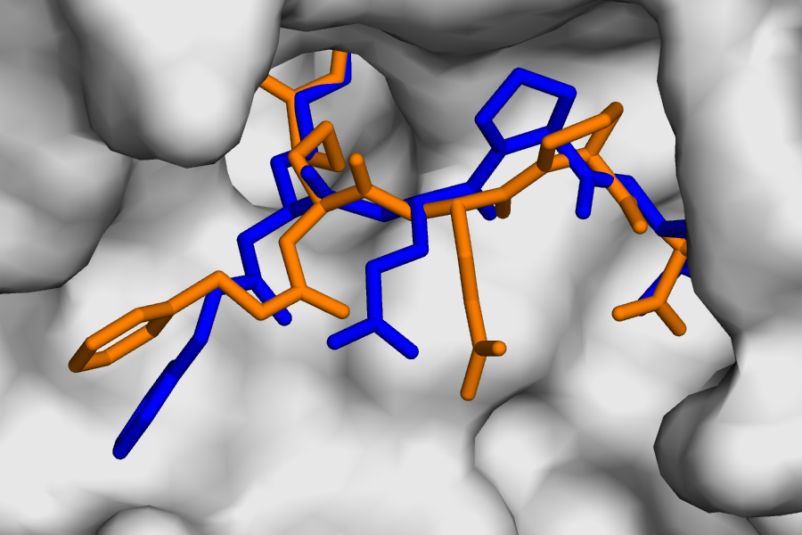
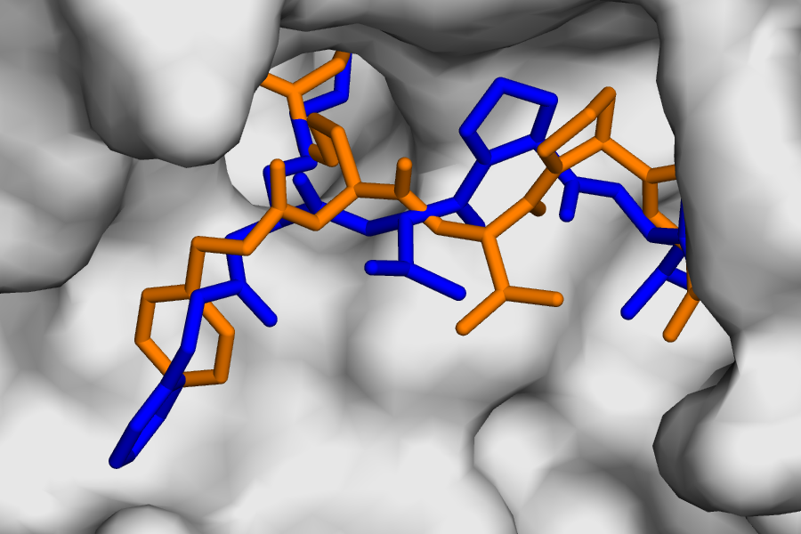
Molecular cross-docking of ligands from PDB
2q3z
3s3j
Experiment
Docking
3s3p
3s3s

Slide 7
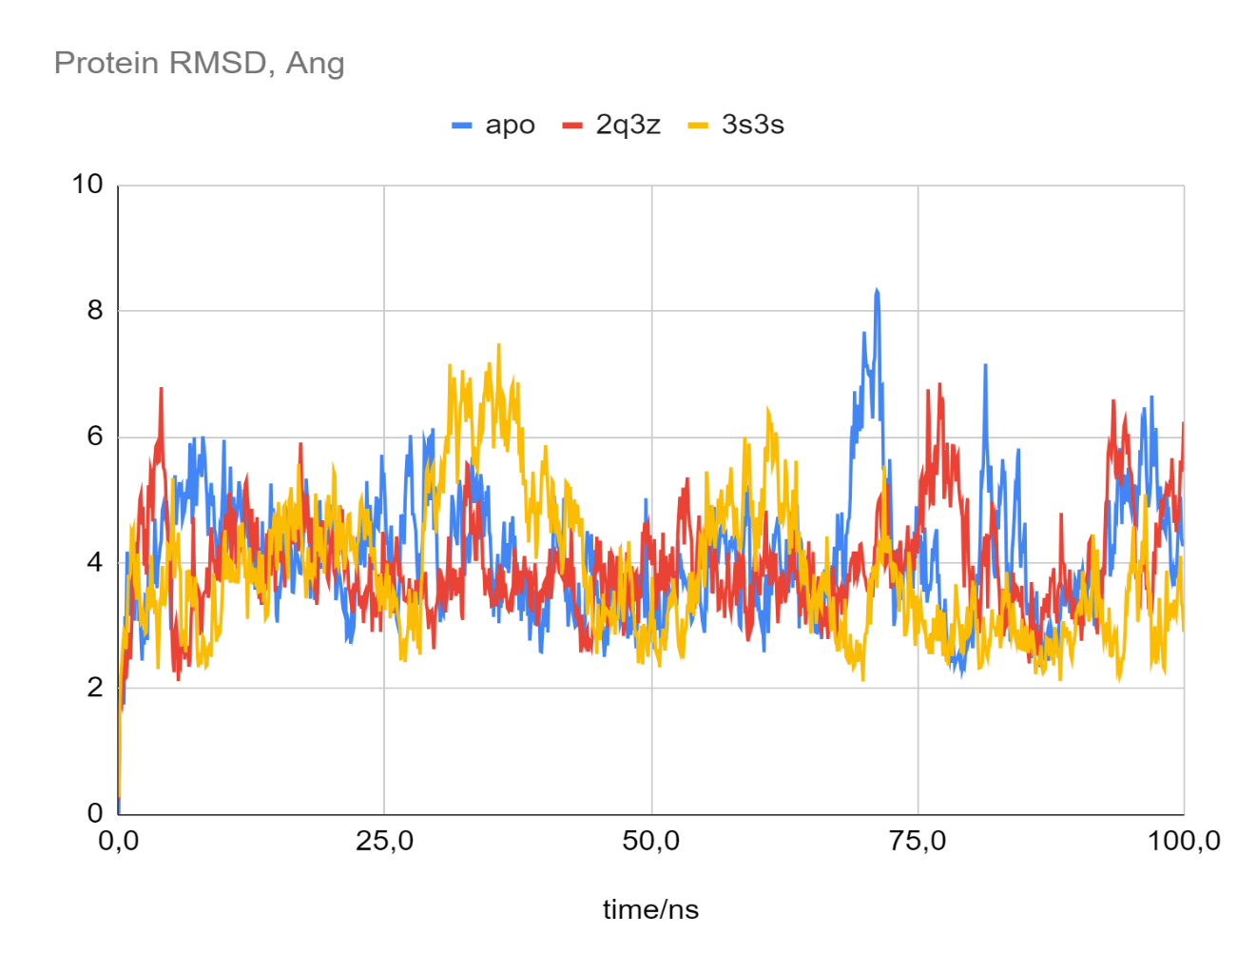
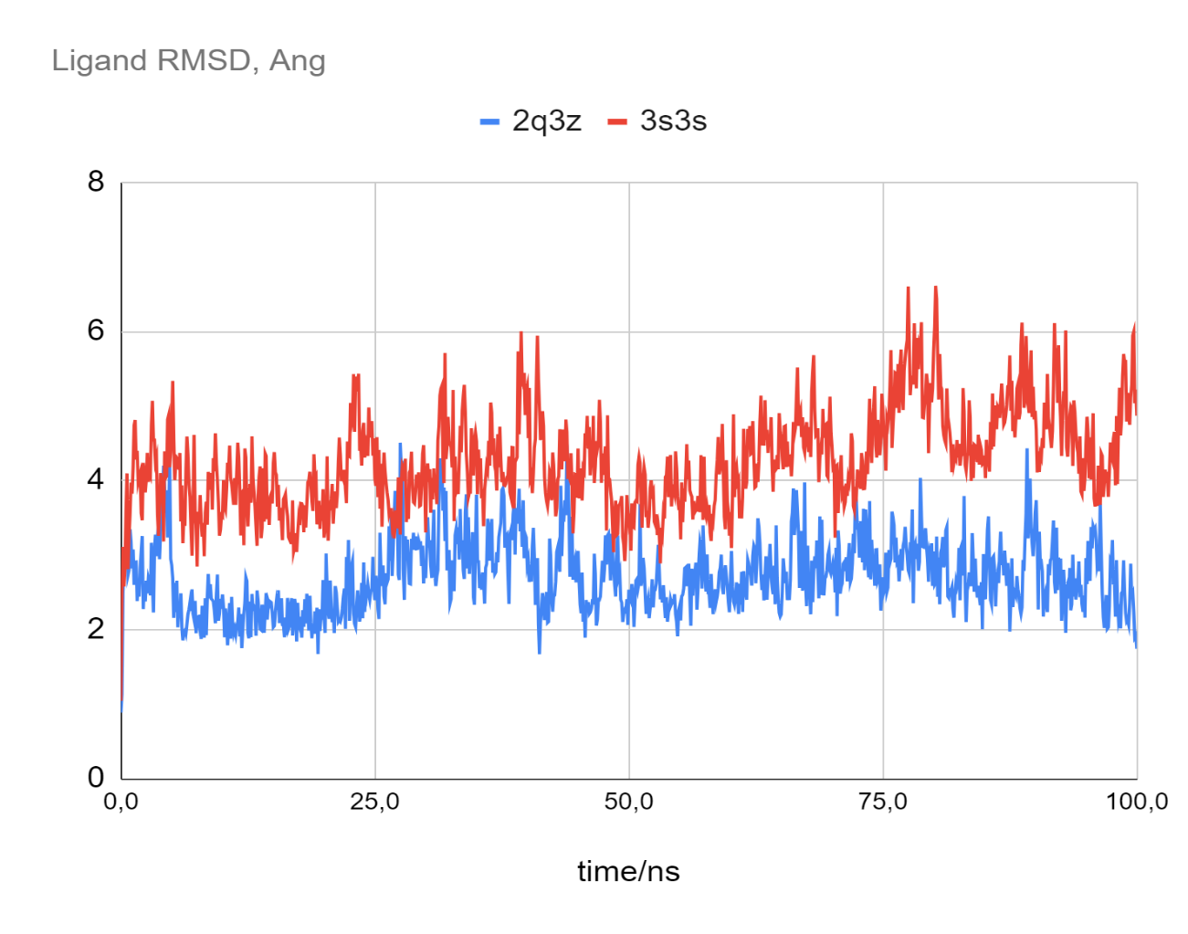
Molecular dynamics simulations
Protein RMSD
Ligand RMSD
apo
2q3z
3s3s
2q3z
3s3s
RMSD, Å
RMSD, Å
Time, ns
Time, ns

Slide 8
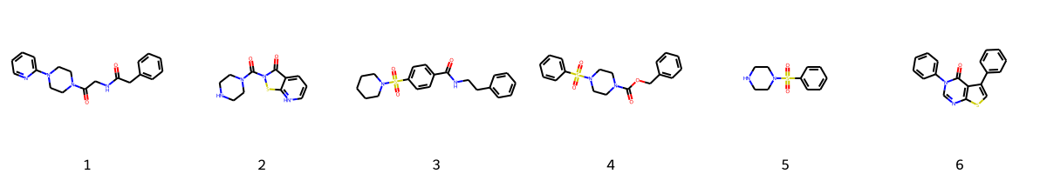
ChEMBL database ligand clustering
169 compounds from ChEMBL with target protein tTG and IC50 < 500 nM were obtained
6 of the most frequent molecular scaffolds:

Slide 9
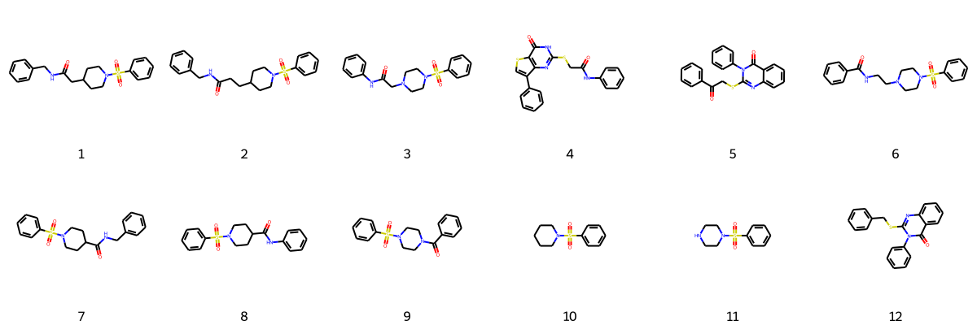
Search for compounds in ChemRar database
2066 chemical compounds potentially targeting tTG were obtained
12 of the most frequent molecular scaffolds:

Slide 10
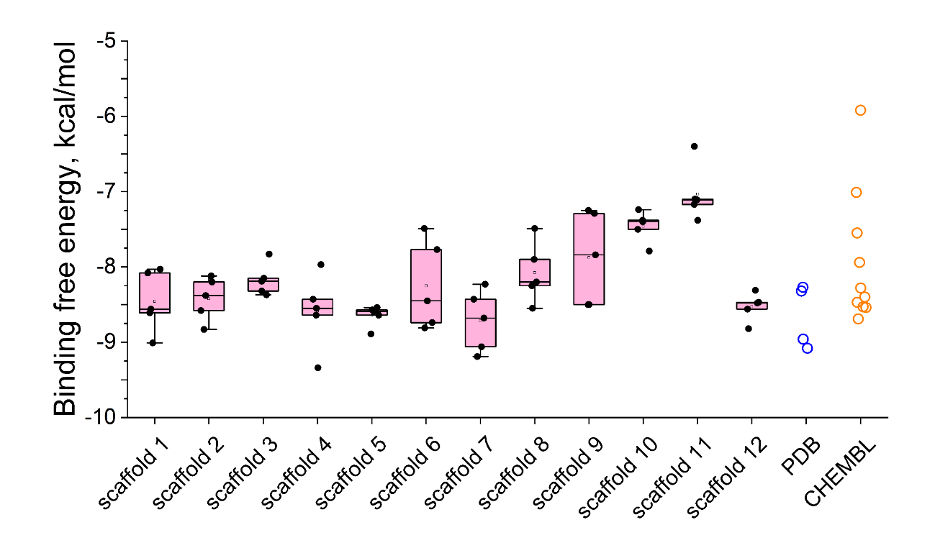
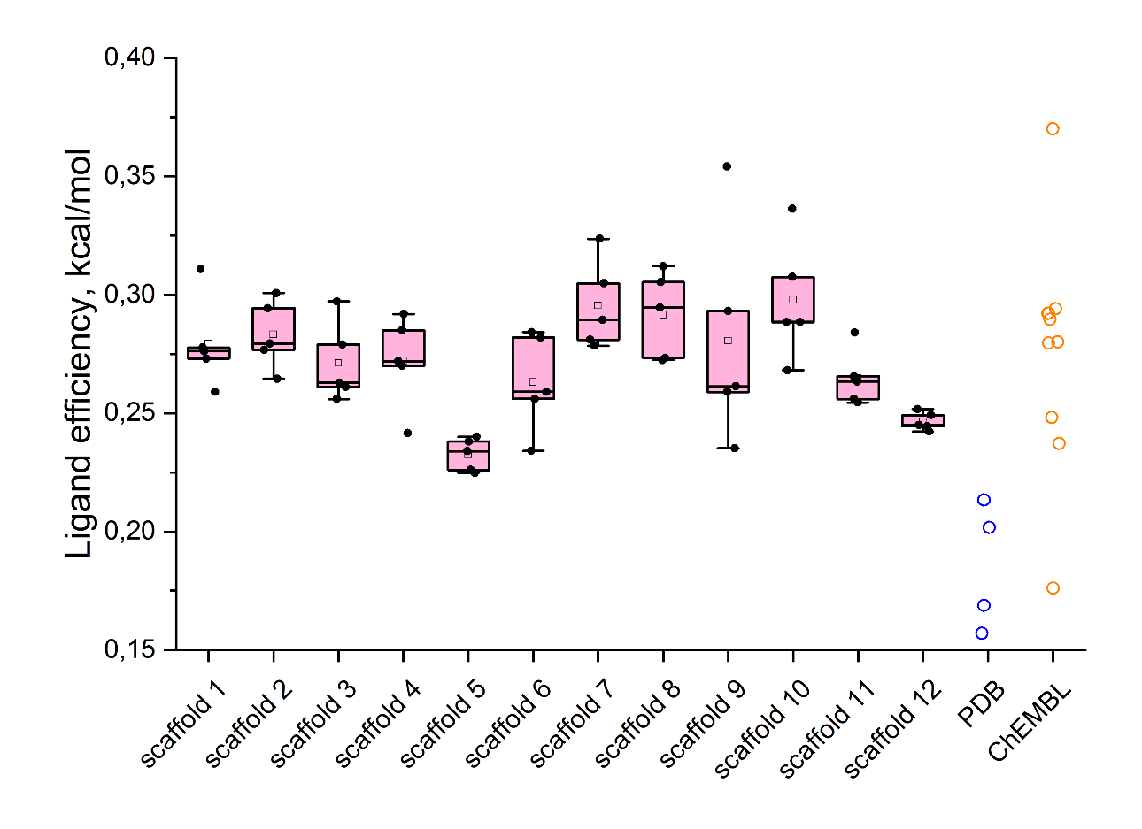
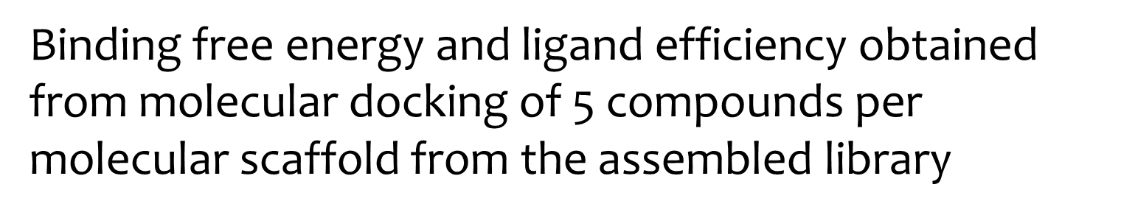
Molecular docking

Slide 11
Most promising compounds
Exceptional binding affinity (scaffold 4)
Outstanding ligand efficiency (scaffold 9)

Slide 12
Results
Scaffolds 4, 5 and 12 are more favorable for binding with tTG
Scaffolds 7, 8 and 10 exhibit the highest binding efficiency
All scaffolds contain the sulfonic fragment

Slide 13
Thanks for attention

