Slide 1
28th International Scientific Conference of Young Scientists and Specialists October-November, 2024
Biological efficiency of different quality X-rays estimated by mFISH analysis of chromosome aberrations induced in vitro in human lymphocytes
E.A. Shipilova, E.A. Nasonova, L.A. Melnikova, I.S. Gordeev,
P.N. Lobachevsky

Slide 2
Biological efficiency of ionizing radiation of different quality
standard radiation
(reference radiation)
photon radiation
Relative
Biological
Effectiveness
(RBE)
Dose_{photon}
=
Dose_{ion}
Radionuclides
ɣ-rays ⁶⁰Co
X-ray radiation
wide energy
spectrum
1.17 MeV
1.33 MeV
installations are difficult to use
high level of danger
more accessible for use
2

Slide 3
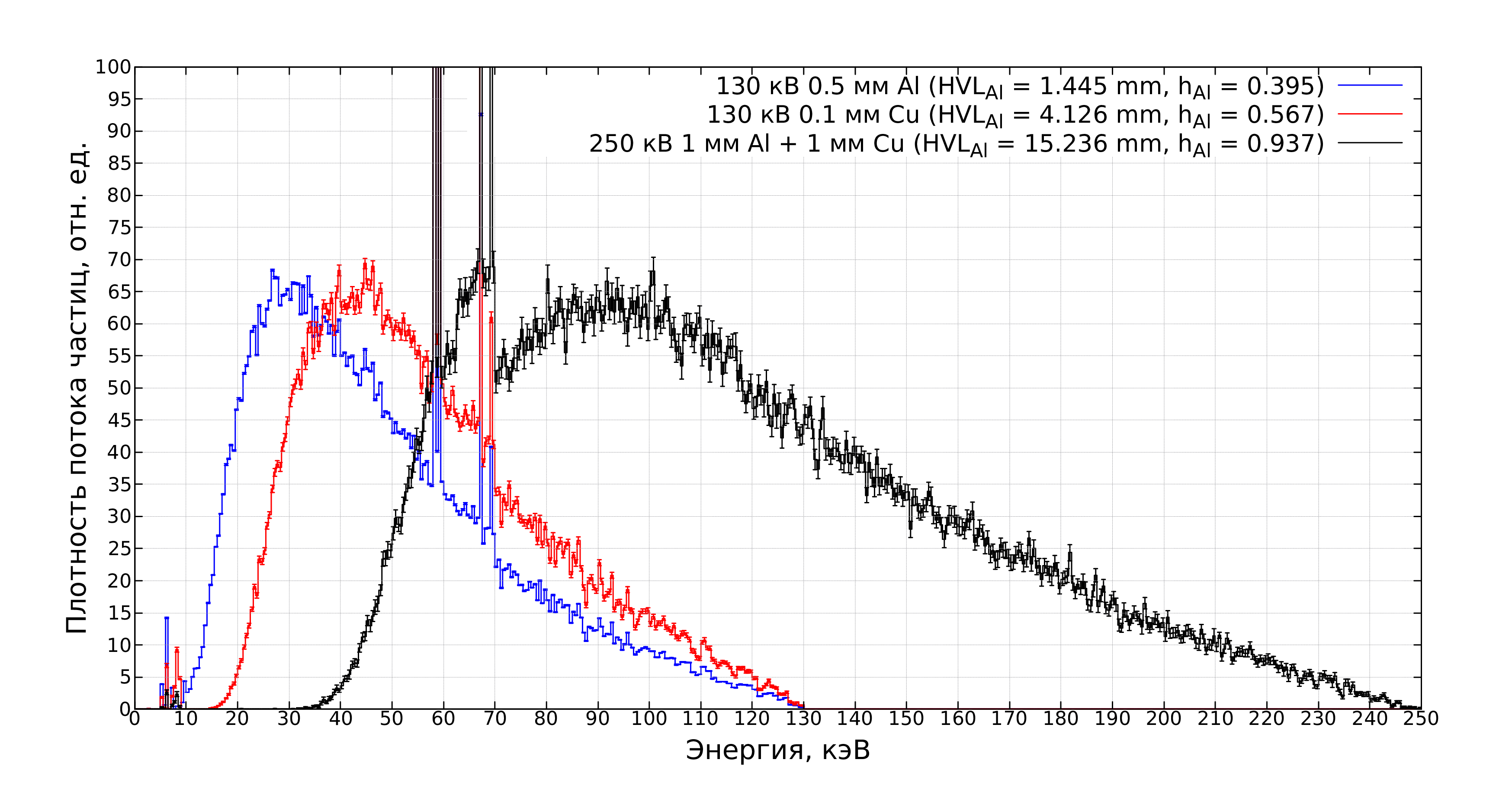
X-ray radiation – wide energy spectrum
Standard X-ray radiation:180-250 kVp
Spectra of CellRad 130 kVp X-rays with different types
of added filtration and 250 kVp X-rays (Seifert, GSI)
LRB, JINR: CellRad
Max. voltage – 130 kVp
130 kVp 0.5 mm Al
130 kVp 0.1 mm Cu
250 kVp 1 mm Al+1 mm Cu
LRB, JINR: SARRP
Small Animal Radiation Research Platform
Max. voltage – 220 kVp
Particle flux density, relative unit
Energy, keV
I.S. Gordeev
spectrum with
a significant soft radiation component (20-30 keV)
Goal: by means of mFISH analysis of chromosomal aberrations, to investigate the biological efficiency of 130kVp and 220kVp X-rays from the CellRad and SARRP units and their possible use as a reference radiation in radiobiological research.
3

Slide 4
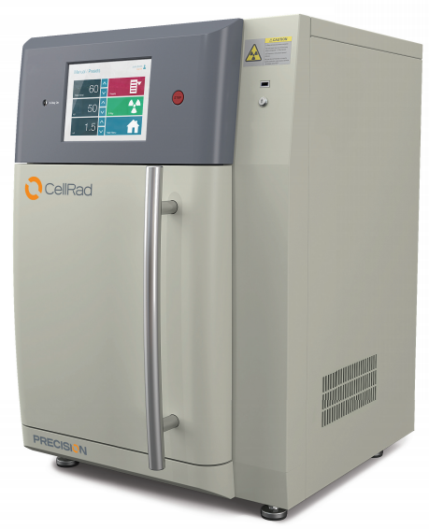
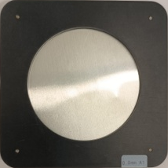
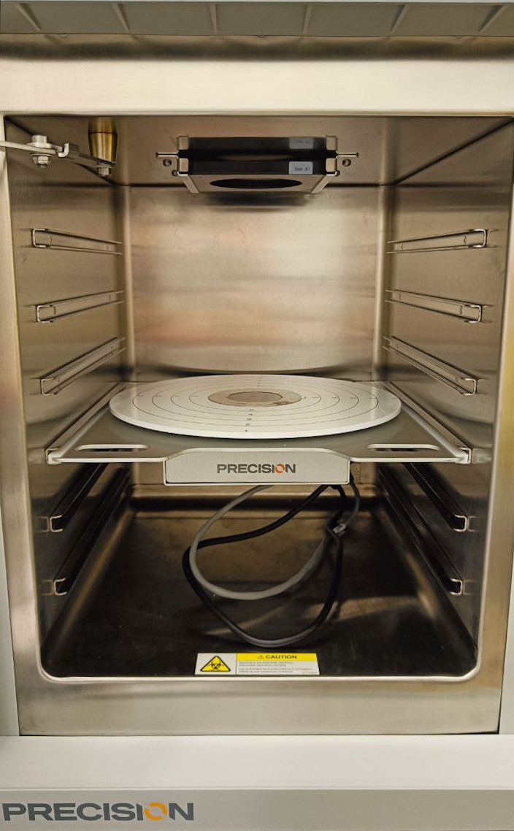
X-ray radiation – wide energy spectrum
LRB, JINR: CellRad
Max. voltage – 130 kVp
Spectra of CellRad 130 kVp X-rays with different types
of added filtration and 250 kVp X-rays (Seifert, GSI)
130 kVp 0.5 mm Al
130 kVp 0.1 mm Cu
250 kVp 1 mm Al+1 mm Cu
Filters
Particle flux density, relative unit
0.5 mm Al
built-in
Energy, keV
I.S. Gordeev
0.1 mm Cu
Image source: LRB
custom-made
4
Notes:
For reference X-ray radiation - spectrum range is about 180-250 kV.
In LRB we used Co60 γ-ray unit ROKUS-M but last year it was closed out.
Insead, we bought CellRad and SARRP X-ray unit
CellRad has a maximum voltage of 130 kV
In order to harden the beam spectrum additional Cu filter was made
The graph shows X-ray spectra of CellRad beams with built-in Aluminum filter
And with a custom-made Copper filter
and for comparison the spectrum of 250 kV Seifert X-ray machine at GSI Germany
So our goal was by means of cytogenetics methods investigate the biological efficiency of 130 kVp X-rays of different quality (added filtrations) and their possible use as a reference radiation in radiobiological research.

Slide 5
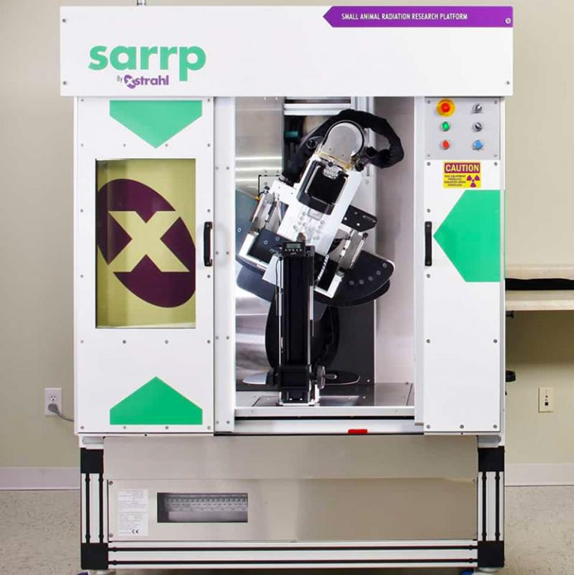
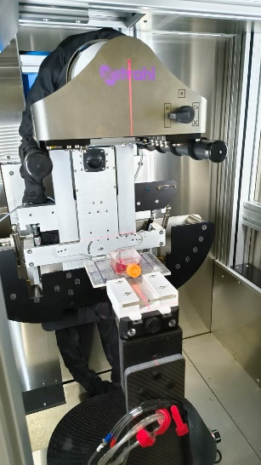
X-ray radiation – wide energy spectrum
LRB, JINR: SARRP
Small Animal Radiation Research Platform
Max. voltage – 220 kVp
Spectra of SARP 130 kVp and 220 kVp X-rays with different types of added filtration
130 kVp 1.0 mm Al
220 kVp 0.15 mm Cu
Filters
Particle flux density, relative unit
Particle flux density, relative unit
Particle flux density, relative unit
1.0 mm Al
built-in
Energy, keV
I.S. Gordeev
0.15 mm Cu
Image source: LRB
built-in
5

Slide 6
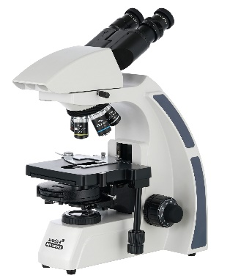
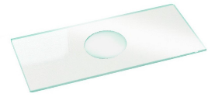
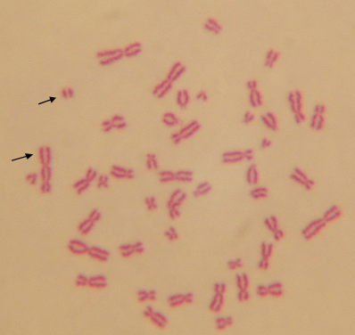
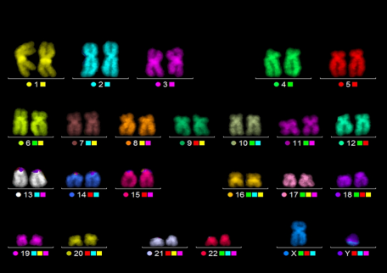
Cytogenetics: metaphase analysis
Structural rearrangements of chromosomes - chromosome aberrations are originated from the most severe radiation-induced DNA lesions – DNA double-strand breaks (DSB) and are considered as a marker of radiation exposure
Blood drawing from healthy donor
Isolation of lymphocytes
Irradiation
Incubation at 37°C in medium containing PHA
Accumulation of mitotic cells by the use of colcemid
Cell fixation 48 h after exposure
Staining by standard method and mFISH
Scoring of aberrations in first-cycle metaphase cells
Analysis of the spectrum and frequency of chromosome aberrations
Standard metaphase analysis
mFISH
Giemsa Staining
IAEA, 2011
6

Slide 7
Metaphase analysis: Multicolor fluorescence in situ hybridization – mFISH
The most advanced method of molecular cytogenetics - allows the identification of each pair of human chromosomes (22, X, Y)
Based on reassociation of DNA single strands with specific DNA probes labeled with 5 different fluorochromes
FITC SpO TR Cy5 DEAC and DAPI-counterstaining
Unique color signature for each chromosome
Images are captured at fluorescence microscope using a specific filter set and analyzed by computer program ISIS (MetaSystems, Germany)
mFISH enables analysis of all chromosome aberrations including complex aberrations and symmetric exchanges (translocations)
mFISH karyogramm
7

Slide 8
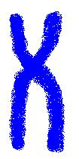
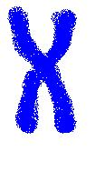
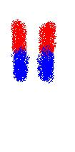
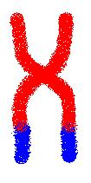
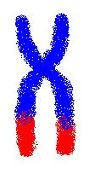
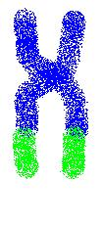
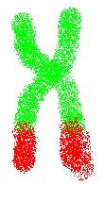
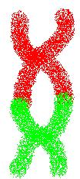
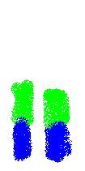
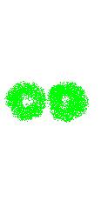
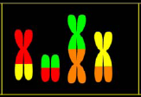
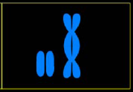
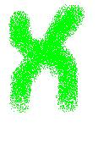
m-FISH classification (Cornforth, Rad.Res., 2001)
Simple aberrations:
one break aberrations: acentrics
two-break aberrations: simple exchanges (dicentrics, rings, translocations )
1 DSB DNA
2DSBs
Complex aberrations:
≥3 breaks in ≥2 chromosomes
– can be visualized only by mFISH
8

Slide 9
Radiation parameters
Radiation type | Used filters | Dose rate, Gy/min | Voltage, kVp | Mean E, keV | Eff. E, keV | Dose, Gy | Equipment
⁶⁰Co γ-rays | - | 0.4 |  |  |  | 1-4 | ROKUS-M (JINR)
X-rays | 0.5 mm Al | 1.5 | 130 | 48.8 | 25.4 | 1-4 | CellRad (JINR)
 | 0.1 mm Cu | 0.7 | 130 | 57.7 | 38.5 | 1-4
X-rays | 1.0 mm Al | 1.48 | 130 | 54.35 | 33.5 | 1-4 | SARRP (JINR)
 | 0.15 mm Cu | 1.45 | 220 | 78.01 | 66.4 | 1-4
X-rays | 1 mm Al +1 mm Cu | 0.7 | 250 | 109 | 102.2 | 1-4 | Seifert (GSI)*
*Data for 250kV are taken from: Lee R., Sommer S., Hartel C., Nasonova E., Durante M., Ritter S. Mutat. Res. 2010, 701:52–59.
9

Slide 10
Results – mFISH analysis
Statistical analysis
GraphPad Prism 8.0.1
Analysis
Nonlinear Regression
Linear-Quadratic
1) All X-ray regimes have the higher biological efficiency than γ-⁶⁰Co
10
Notes:
Структурные перестройки хромосом – хромосомные аберрации (ХА) – являются наиболее чувствительным маркером радиационного воздействия. Анализ ХА в метафазных клетках лимфоцитов периферической крови является основным методом биодозиметрии человека. Он позволяет определить дозу излучения, полученную индивидом при радиационных авариях, лучевой терапии и профессиональном облучении.
Для проведения биодозиметрии необходимо иметь точные калибровочные кривые, полученные после воздействия референсного фотонного излучения (как правило это γ- или рентгеновское излучение с энергией 250 кВ). В последнее десятилетие в исследовательских учреждениях по всему миру радионуклидные источники γ-излучения заменены рентгеновскими установками с более низкой энергией, например 130 кВ, которые дают рентгеновский спектр с существенной составляющей мягкого излучения (20-30 кВ). Учитывая многочисленные данные о том, что низкоэнергетические фотоны обладают более высокой биологической эффективностью, мы поставили перед собой цель сравнить действие рентгеновского излучения 130 и 220-250 кВ путем подсчета ХА после облучения и построения кривых «доза — эффект».

Slide 11
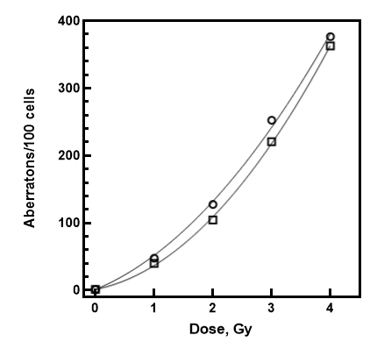
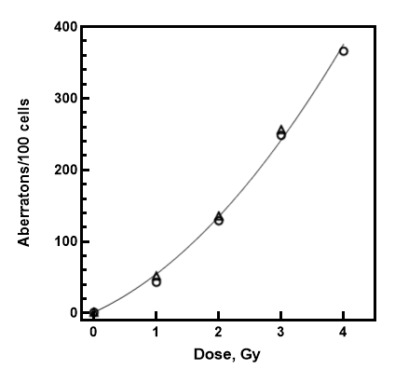
Results – mFISH analysis
CellRad 130 kV Cu
CellRad 130kV Al
SARRP 130 kV Al
38.5 keV
SARRP 220 kV Cu
CellRad 130 kV Cu
SARRP 220 kV Cu
66.4 keV
Seifert 250 kV
102.2 keV
25.6 keV
33.5 keV
38.8 keV
66.4 keV
P-value = 0,137
P-value = 0,143
P-value = 0,008
P-value = 0,142
2) We found no statistically significant difference in biological efficiency of 250 kVp X-rays compared to 130 kVp + 0.1 mm Cu and (p = 0.137) and 220 kVp SARRP (p = 0.143)
3) 130 kVp X-rays filtered with 0.5 mm Al have the higher biological efficiency than filtered with 0.1 mm Cu with RBE = 1.11 ± 0.04
4) No statistically significant difference, however, was found between 220 kVp
+ 0.15 mm Cu and and 130 kVp filtered
+1 mm Al (X-rays, SARRP irradiator)
11
Data for 250kV are taken from: Lee R., Sommer S., Hartel C., Nasonova E., Durante M., Ritter S. Mutat. Res. 2010, 701:52–59.

Slide 12
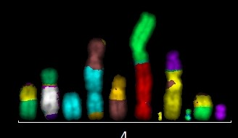
Conclusion
As a result, our data show that X-rays from both units, 220 kVp SARRP and 130 kVp + 0.1 mm Cu CellRad may be used as a reference radiation in radiobiological research.
The aberration spectra induced by all radiation types used were shown to be similar.
~20 % simple break,
60% simple exchanges and
20% complex aberrations
CellRad
SARRP
3 Gy
Seifert
20%
ROKUS-M
60%
Dose 3Gy
20%
Complex aberration
14 breaks in 9 chromosomes
12
Data for 250kV are taken from: Lee R., Sommer S., Hartel C., Nasonova E., Durante M., Ritter S. Mutat. Res. 2010, 701:52–59.

Slide 13
Thank you for your attention!
28th International Scientific Conference of Young Scientists and Specialists
October-November, 2024
Notes:
The Error bars were calculated according to Pauisson’s statistics – standard error

