Slide 1
Data Processing at the LHC. Corrections & Systematic Effects
V. Shalaev
(vladislav.shalaev@cern.ch)
Dubna, 1 November 2024
28th International Scientific Conference of Young Scientists and Specialists (AYSS-2024)

Slide 2
Stages of Data Analysis
Based on CMS-SMP-23-007 and CMS-AN-20-220
Event Collection

Slide 3
Stages of Data Analysis
Based on CMS-SMP-23-007 and CMS-AN-20-220
Event Collection
Data Certification
Simulation

Slide 4
Stages of Data Analysis
Based on CMS-SMP-23-007 and CMS-AN-20-220
Event Collection
Data Certification
Simulation
Event selection

Slide 5
Stages of Data Analysis
Based on CMS-SMP-23-007 and CMS-AN-20-220
Event Collection
Data Certification
Simulation
Event selection
Data and modeling
corrections

Slide 6
Stages of Data Analysis
Based on CMS-SMP-23-007 and CMS-AN-20-220
Event Collection
Data Certification
Simulation
Event selection
Data and modeling
corrections
Measurement

Slide 7
Stages of Data Analysis
Based on CMS-SMP-23-007 and CMS-AN-20-220
Event Collection
Data Certification
Simulation
Event selection
Data and modeling
corrections
Measurement
Uncertainty estimation

Slide 8
Stages of Data Analysis
Based on CMS-SMP-23-007 and CMS-AN-20-220
Event Collection
Data Certification
Simulation
Event selection
Data and modeling
corrections
Measurement
Uncertainty estimation

Slide 9
Stages of Data Analysis
Based on CMS-SMP-23-007 and CMS-AN-20-220
Event Collection
Pileup
Misalignment
Efficiency
Prefiring
Integral Luminosity
PDF and ${α }_{S}$
Simulation Cross section
QCD Scale Factors
Data Certification
Simulation
Event selection
Data and modeling
corrections
Measurement
Uncertainty estimation

Slide 10
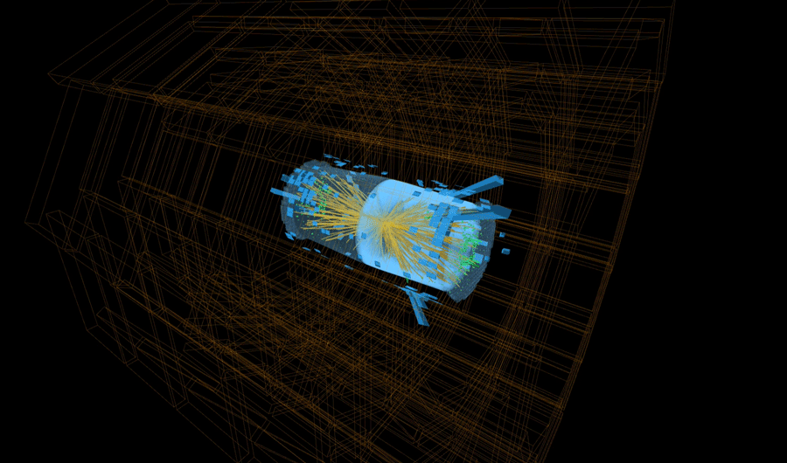
Pileup
Origin: $L_{inst} \sim {10}^{34}$ ${cm}^{−2}s^{−1}$
Bunch crossing (BX) every 25 ns
~ 60-70 pp-collisions per BX
$\sim$ 60 charged particles per pp-collision
$\sim$1500-2000 charged particles per BX or ${10}^{11}$ per second

Slide 11
Pileup
Origin: $L_{inst} \sim {10}^{34}$ ${cm}^{−2}s^{−1}$
Bunch crossing (BX) every 25 ns
~ 60-70 pp-collisions per BX
$\sim$ 60 charged particles per pp-collision
Correction: Average pileup is reweighted in MC in according with Data
$\sim$1500-2000 charged particles per BX or ${10}^{11}$ per second

Slide 12
Pileup
Origin: $L_{inst} \sim {10}^{34}$ ${cm}^{−2}s^{−1}$
Bunch crossing (BX) every 25 ns
~ 60-70 pp-collisions per BX
$\sim$ 60 charged particles per pp-collision
Correction: Average pileup is reweighted in MC in according with Data
Uncertainty: Variation of Minimum biased events XS
$\sim$1500-2000 charged particles per BX or ${10}^{11}$ per second

Slide 13
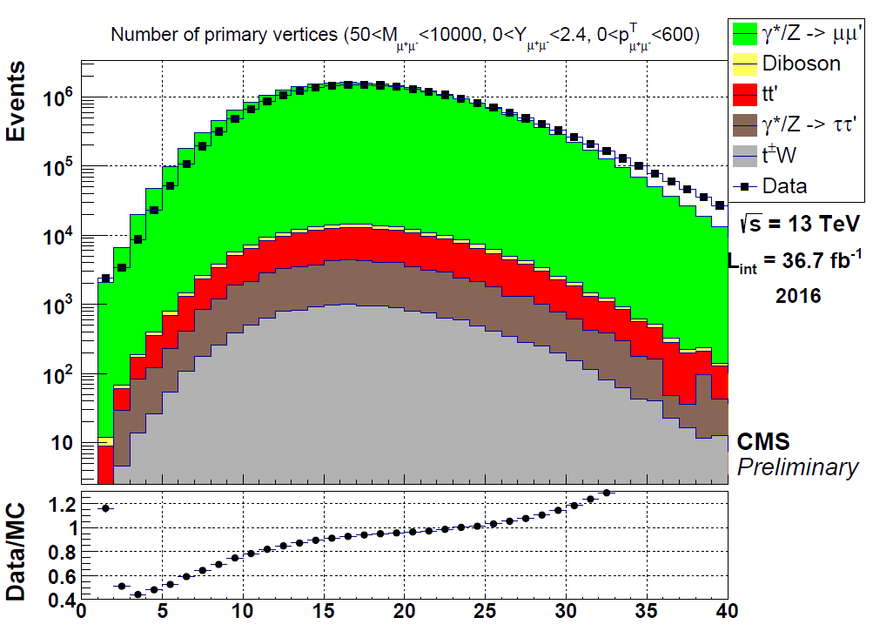
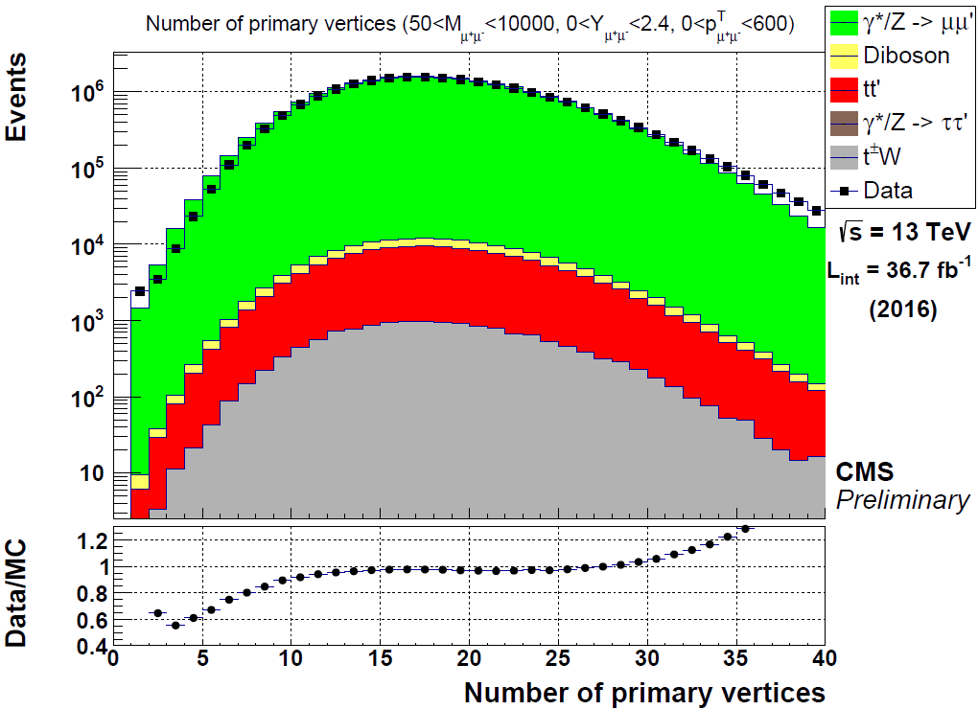
Pileup
Origin: $L_{inst} \sim {10}^{34}$ ${cm}^{−2}s^{−1}$
Bunch crossing (BX) every 25 ns
~ 60-70 pp-collisions per BX
$\sim$ 60 charged particles per pp-collision
Correction: Average pileup is reweighted in MC in according with Data
Uncertainty: Variation of Minimum biased events XS
$\sim$1500-2000 charged particles per BX or ${10}^{11}$ per second
Before
After

Slide 14
Efficiency
Origin: Different efficiency values in the real experiment and simulation
Efficiency is probability:

Slide 15
Efficiency
Origin: Different efficiency values in the real experiment and simulation
Efficiency is probability:
Correction: Tag & Probe , event reweighting

Slide 16
Efficiency
Origin: Different efficiency values in the real experiment and simulation
Efficiency is probability:
Correction: Tag & Probe , event reweighting
$$µ^{−}$$
M ~ 91 GeV/$c^{2}$
$p_{T}$~ 40-50 GeV/$c^{}$
$$Z^{0}$$
$p_{T}, η$ dependence!
$p_{T}$~ 40-50 GeV/$c^{}$
$$µ^{+}$$

Slide 17
Efficiency
Origin: Different efficiency values in the real experiment and simulation
Efficiency is probability:
Correction: Tag & Probe , event reweighting
Tag
$$µ^{−}$$
M ~ 91 GeV/$c^{2}$
$p_{T}$~ 40-50 GeV/$c^{}$
$$Z^{0}$$
$p_{T}, η$ dependence!
$p_{T}$~ 40-50 GeV/$c^{}$
$$µ^{+}$$
Probe

Slide 18
Efficiency
Origin: Different efficiency values in the real experiment and simulation
Efficiency is probability:
Correction: Tag & Probe , event reweighting
Tag
$$µ^{−}$$
Uncertainty: Variation each of weights. Sum in quadrature
M ~ 91 GeV/$c^{2}$
$p_{T}$~ 40-50 GeV/$c^{}$
$$Z^{0}$$
$p_{T}, η$ dependence!
$$∆= \sqrt{\sum_{k}^{N}{δ_{k}^{2}}}$$
$A_{i}^{k}$ - Variated value of $A_{i}^{}$ coefficients results from variation of uncertainty source
$A_{i}^{0}$ - central value of $A_{i}^{}$ coefficient
$p_{T}$~ 40-50 GeV/$c^{}$
$$µ^{+}$$
Probe
Most significant type of uncertainty!

Slide 19
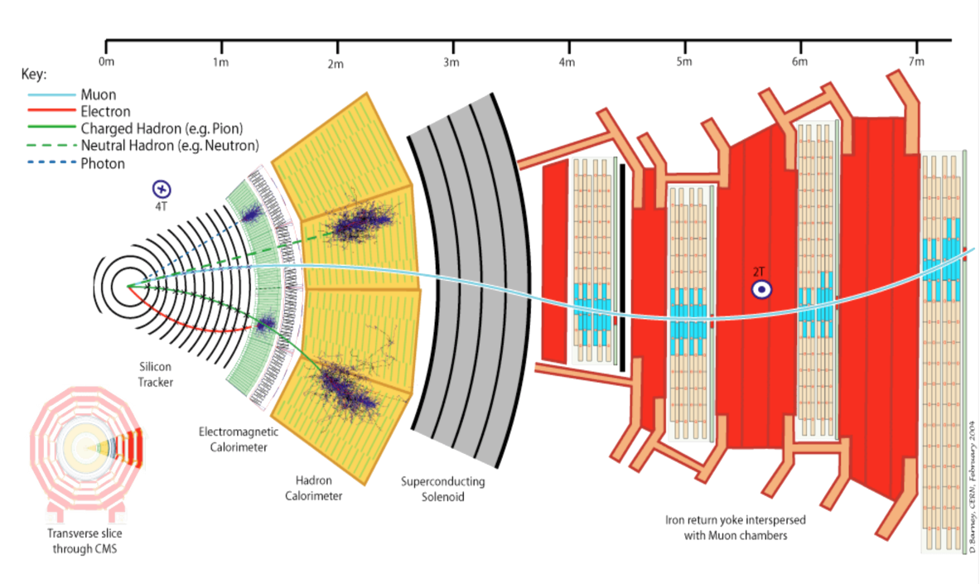
Misalignment
Origin: Non-accuracy of detector model

Slide 20
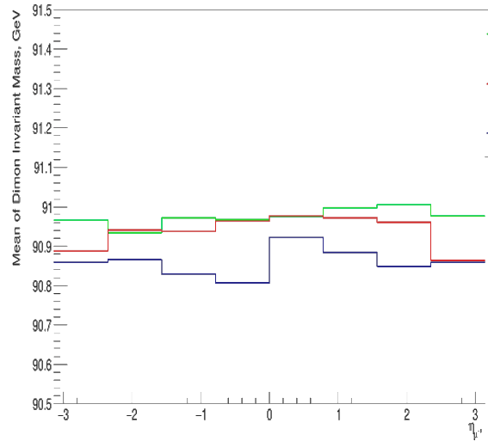
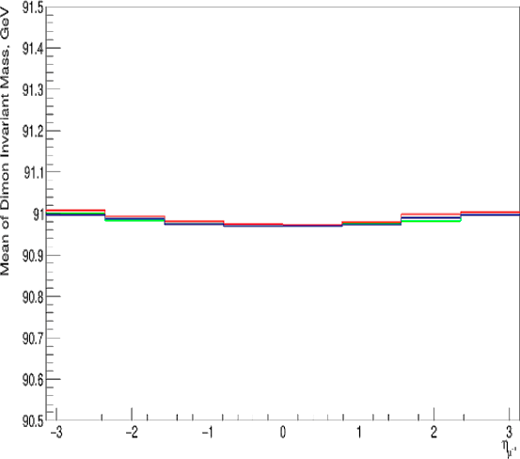
Misalignment
Before
Origin: Non-accuracy of detector model
After
Correction: Tag & Probe with Rochester correction (Eur. Phys. J. C 2012. V. 72, P.)

Slide 21
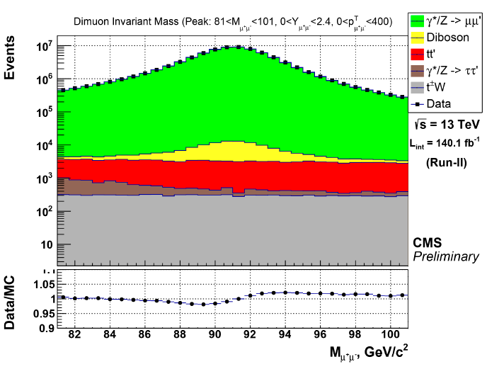
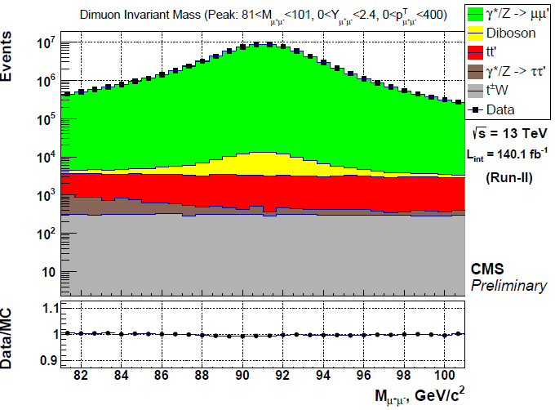
Misalignment
Origin: Non-accuracy of detector model
Before
After
Correction: Tag & Probe with Rochester correction (Eur. Phys. J. C 2012. V. 72, P.)

Slide 22
Misalignment
Origin: Non-accuracy of detector model
Before
After
Correction: Tag & Probe with Rochester correction (Eur. Phys. J. C 2012. V. 72, P.)
Uncertainty: 100 “toys” and RMS calculation

Slide 23
Conclusions
Effects of difference between data and simulation are constantly being studied and could be successfully corrected.
In analysis SMP-23-007 this steps are successfully done. Good agreement between data and MC is observed

Slide 24
Prefiring
Origin: $L_{inst} \sim {10}^{34}$ ${cm}^{−2}s^{−1}$ and L1 Trigger time desynchronization
Normal Case:
$$t$$
BX[-2]
BX[-1]
BX[0]
BX[1]
BX[2]

Slide 25
Prefiring
Origin: $L_{inst} \sim {10}^{34}$ ${cm}^{−2}s^{−1}$ and L1 Trigger time desynchronization
Normal Case:
$$t$$
BX[-2]
BX[-1]
BX[0]
BX[1]
BX[2]
Bug:
Probability:0.5 - 1.5%
$$t$$
BX[-2]
BX[-1]
BX[0]
BX[1]
BX[2]

Slide 26
Prefiring
Origin: $L_{inst} \sim {10}^{34}$ ${cm}^{−2}s^{−1}$ and L1 Trigger time desynchronization
Normal Case:
$$t$$
BX[-2]
BX[-1]
BX[0]
BX[1]
BX[2]
Bug:
Probability:0.5 - 1.5%
$$t$$
BX[-2]
BX[-1]
BX[0]
BX[1]
BX[2]
Correction: Unprefireble Events
$$t$$
BX[-3]
BX[-2]
BX[-1]
BX[0]
BX[1]
BX[2]

Slide 27
Prefiring
Origin: $L_{inst} \sim {10}^{34}$ ${cm}^{−2}s^{−1}$ and L1 Trigger time desynchronization
Normal Case:
$$t$$
BX[-2]
BX[-1]
BX[0]
BX[1]
BX[2]
Bug:
Probability:0.5 - 1.5%
$$t$$
BX[-2]
BX[-1]
BX[0]
BX[1]
BX[2]
Correction: Unprefireble Events
Uncertainty: variation within unc.
$$t$$
BX[-3]
BX[-2]
BX[-1]
BX[0]
BX[1]
BX[2]

