Slide 1
A RANGE SYSTEM PROTOTYPE GEOMETRY AND CLUSTERING
Osetrov Aleksandr
National Research Nuclear University MEPhI.
Scientific supervisor - Verkheev Alexander

Slide 2
OUTLINE
Description of the geometric model of the muon system prototype
Clustering algorithm implementation
2

Slide 3
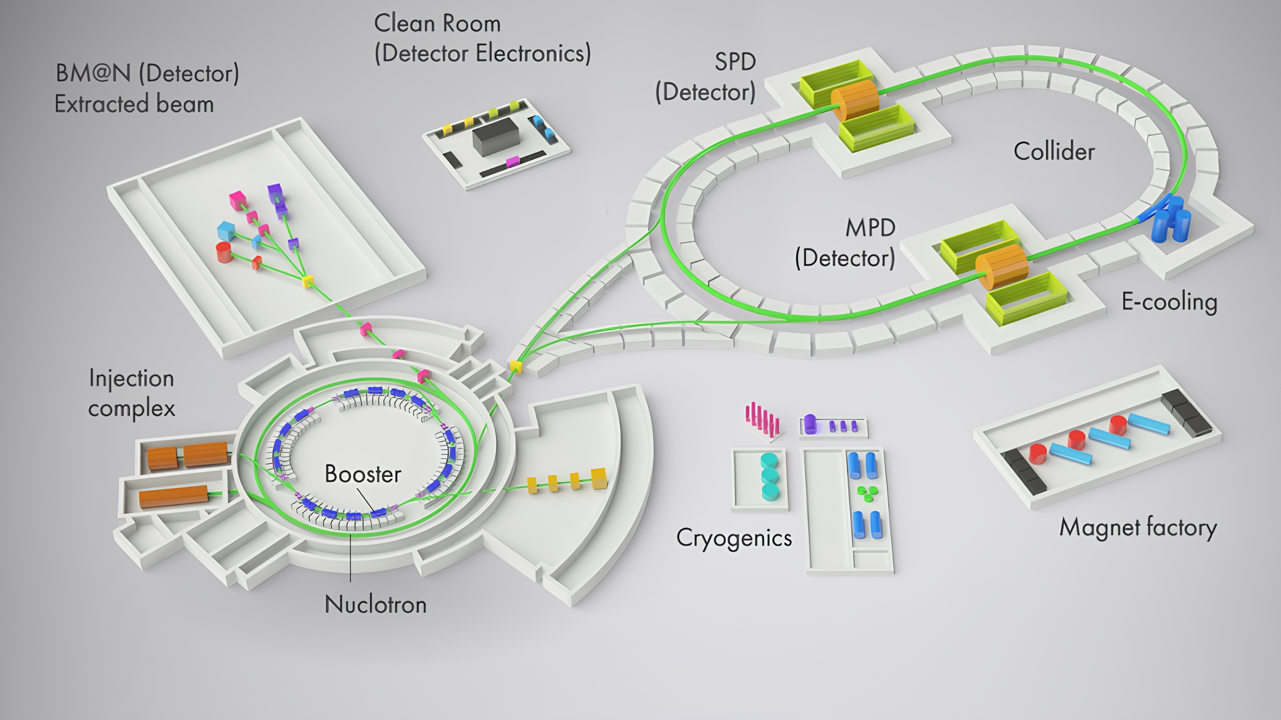
SPD EXPERIMENT
The purpose - to study the spin structure of the proton and deuteron and other spin phenomena.
The installation is planned to be placed at one of two beam collision points of the NICA collider.
Fig. 1 NICA accelerating complex
3

Slide 4
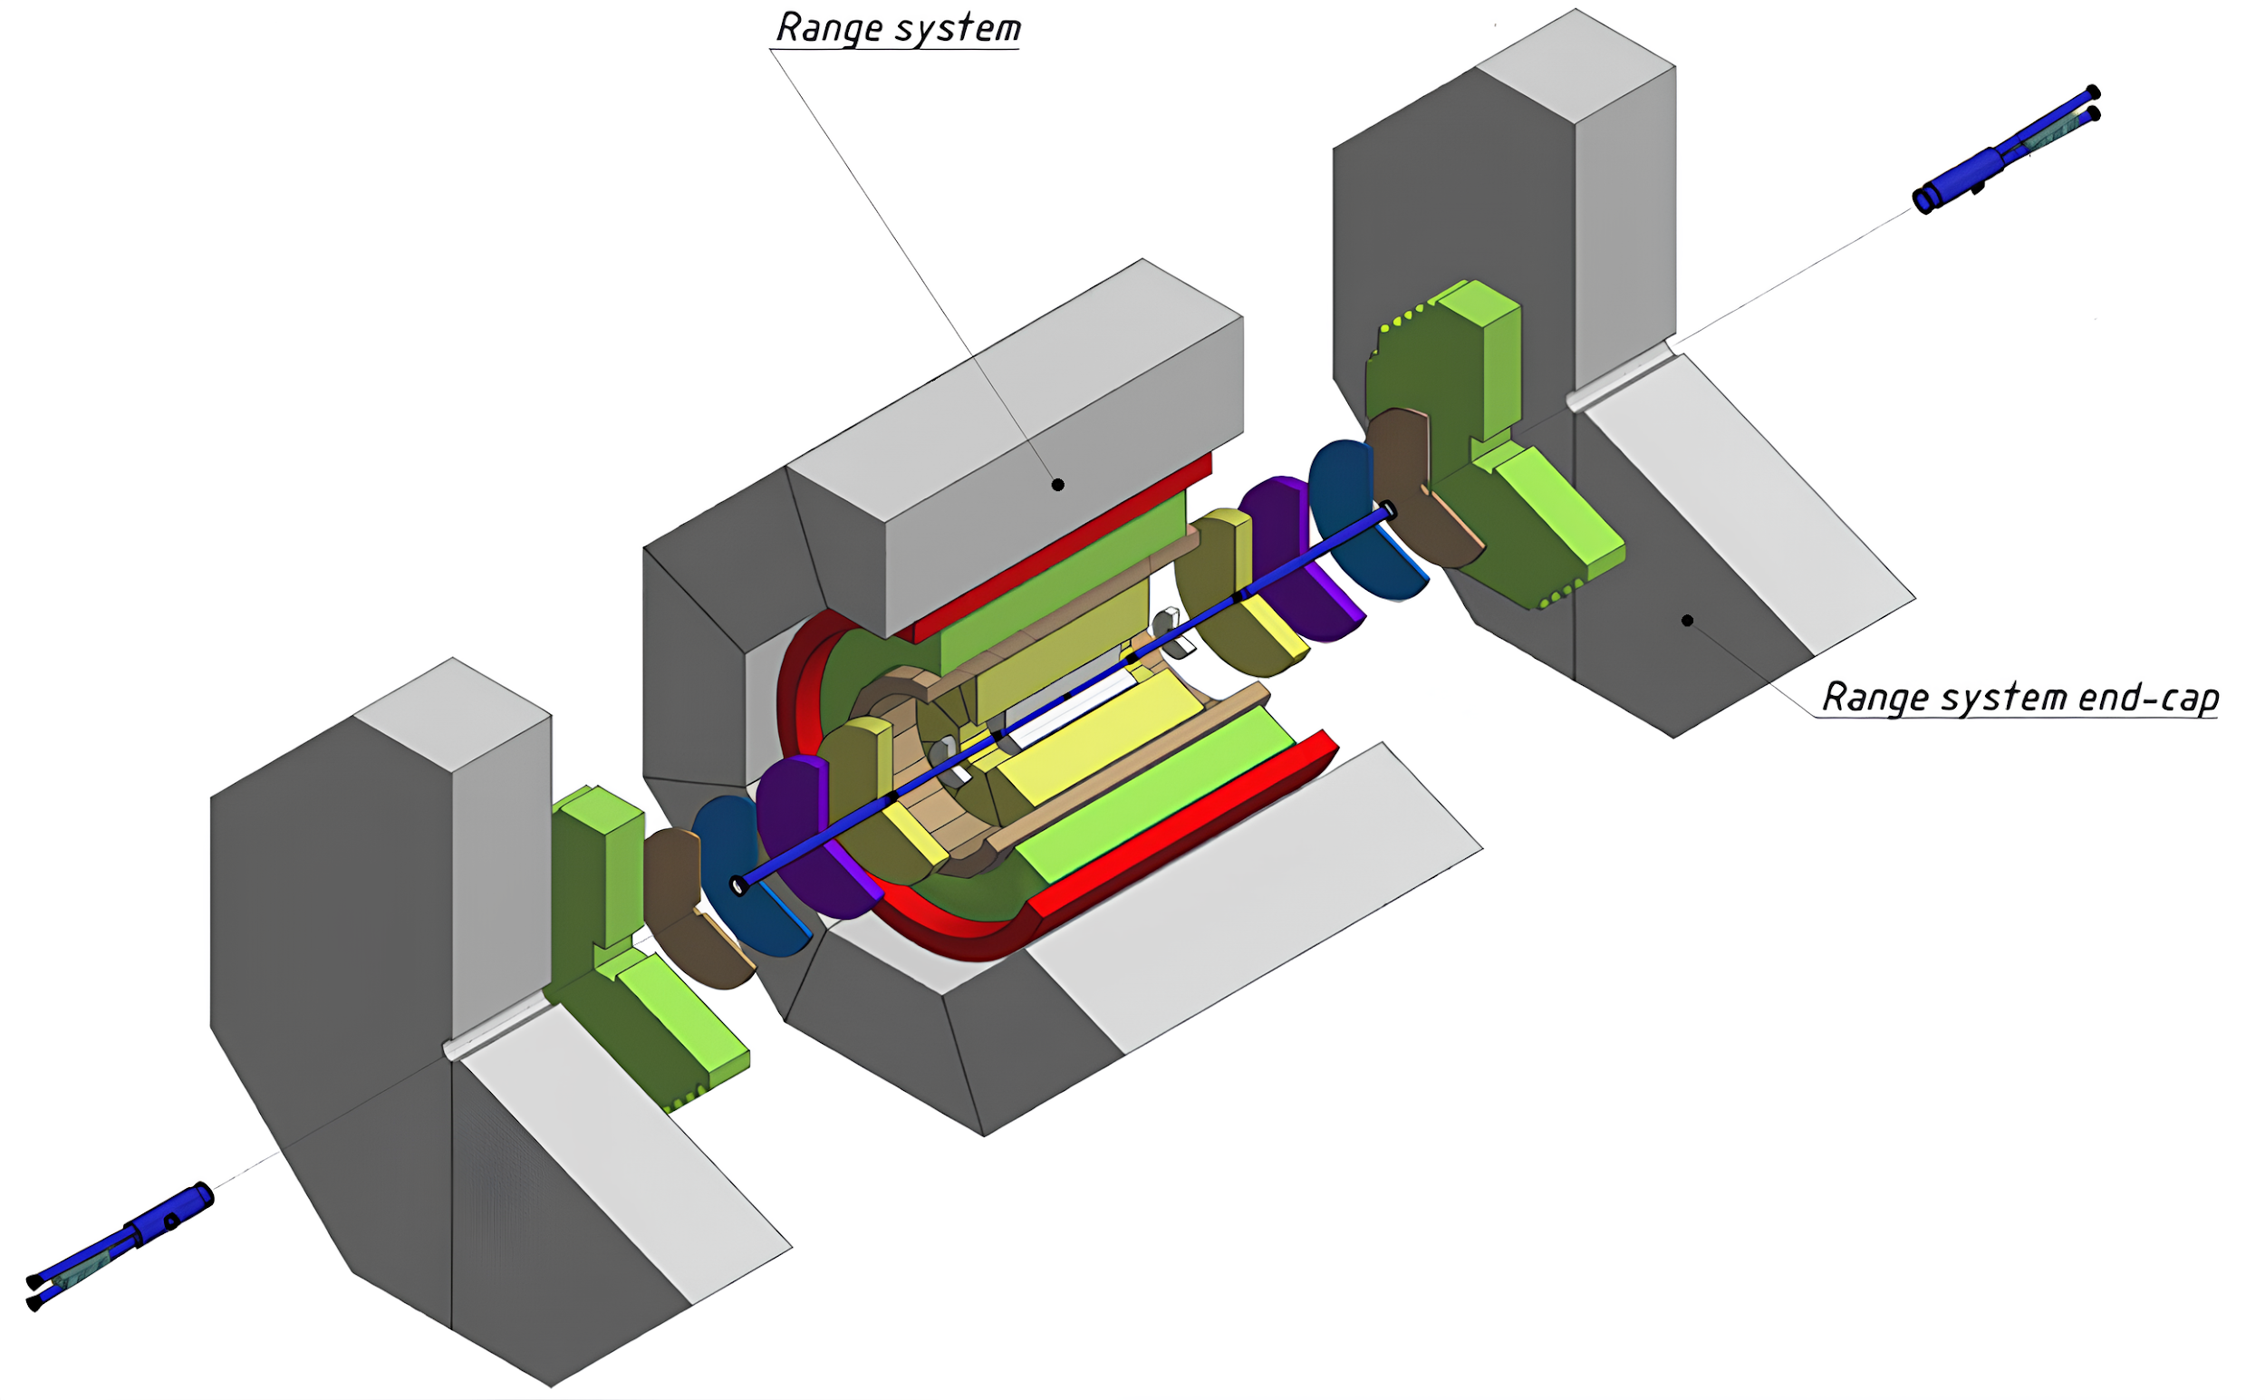
MUON (RANGE) SYSTEM
The goal – to identify muons in the presence of a significant hadron background and estimate hadron energy.
Fig. 2 The range system in the SPD setup
4

Slide 5
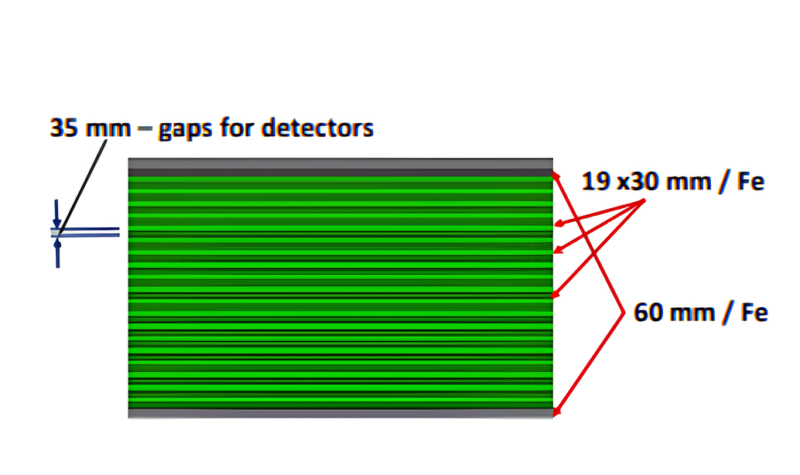
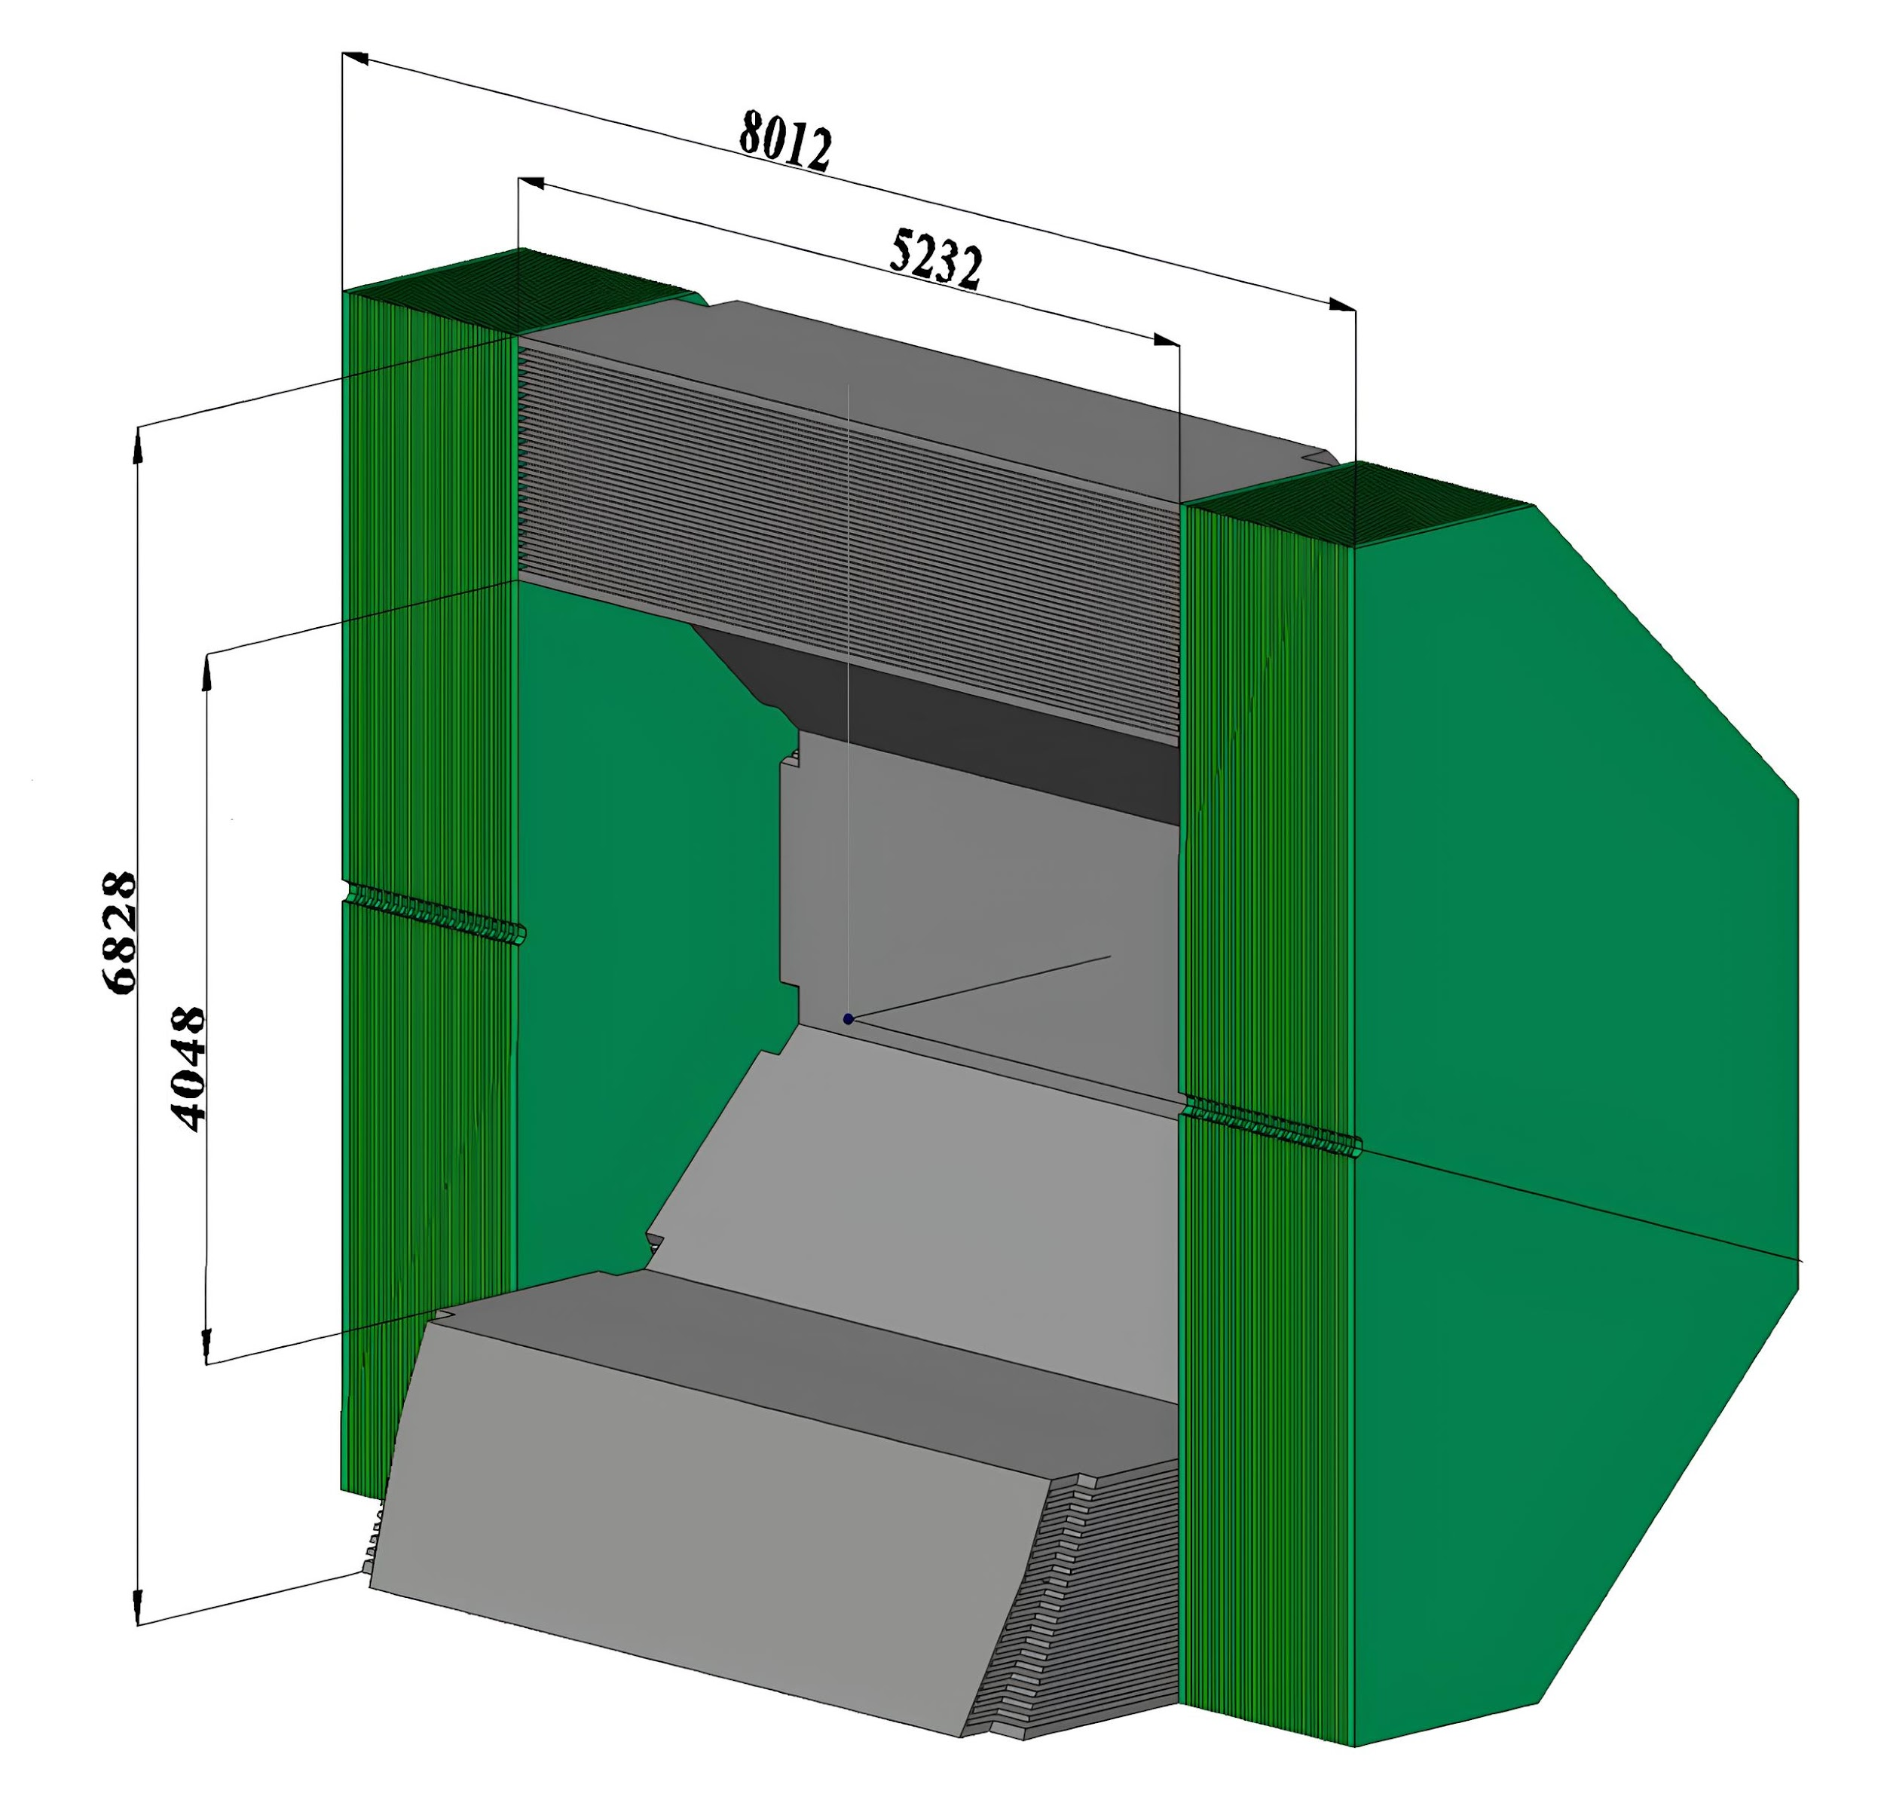
MUON (RANGE) SYSTEM
Consists of an eight-module barrel and two endcaps.
Mini Drift Tubes (MDT) detectors and readout electronics are placed in the interlayer gaps.
Fig. 3 Left - cross section of the detecting parts of the range system,
right - schematic view of the system
5

Slide 6
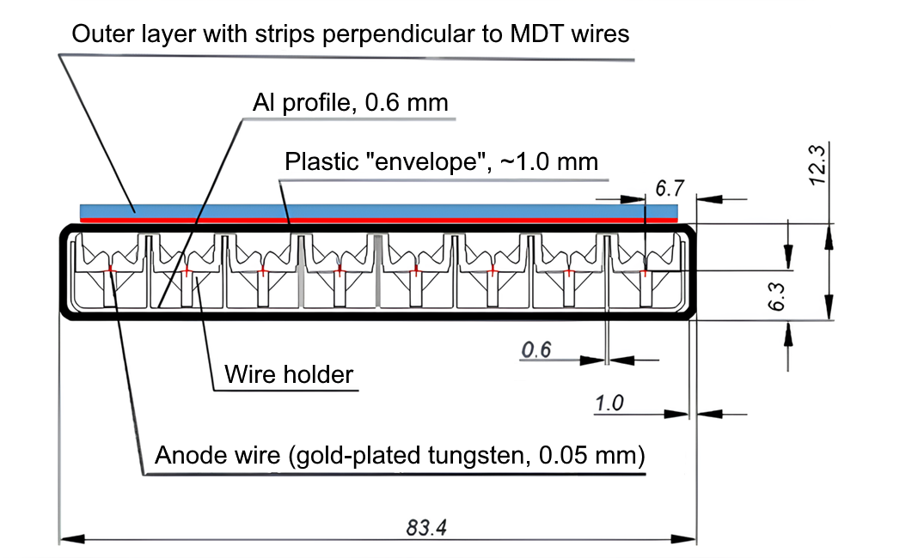
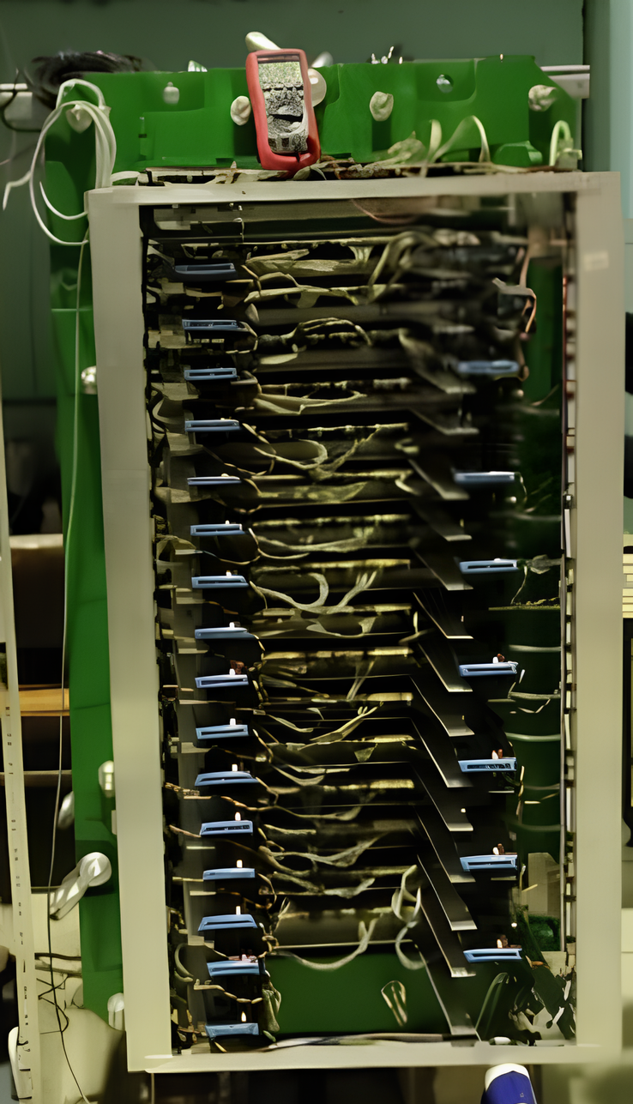
RANGE SYSTEM PROTOTYPE
Fig. 4 Left - cross section of the MDT detector, right – the real prototype
6

Slide 7
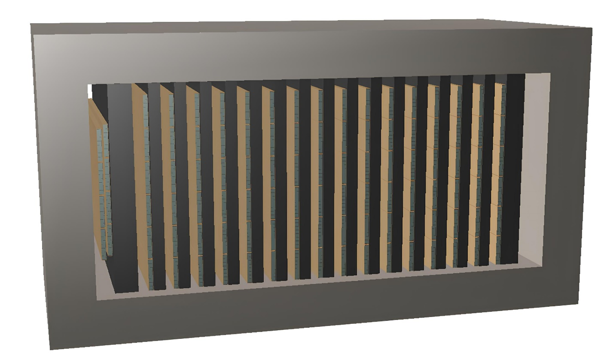
RANGE SYSTEM PROTOTYPE MODEL
The range system prototype’s geometric model has been created.
Active interaction zones are located in detector planes, iron absorbers and the body.
The model was integrated into the SpdRoot software package.
Fig. 5 The geometric model of the prototype range SPD system
7

Slide 8
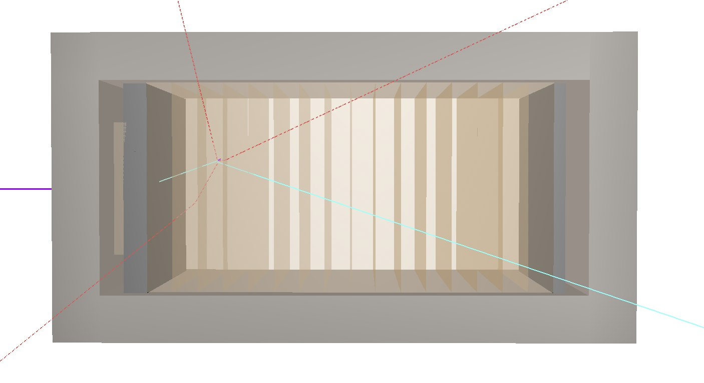
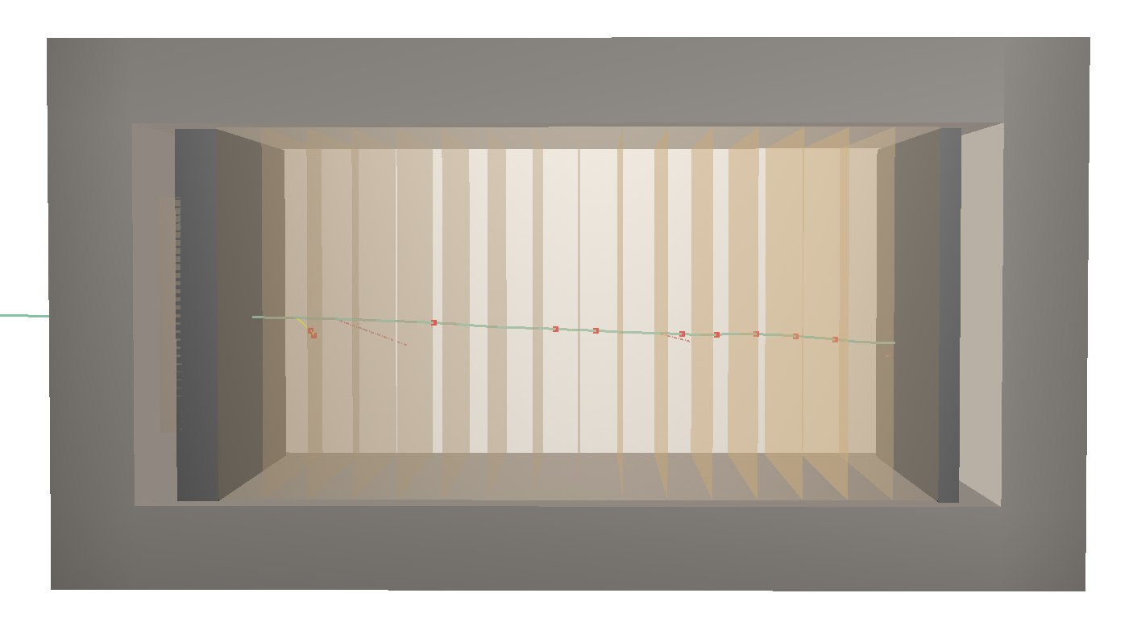
EVENT SIMULATION
Fig. 6 Passage of a proton and a muon with an energy of 1 GeV through the prototype
Left – proton, right – muon
8

Slide 9
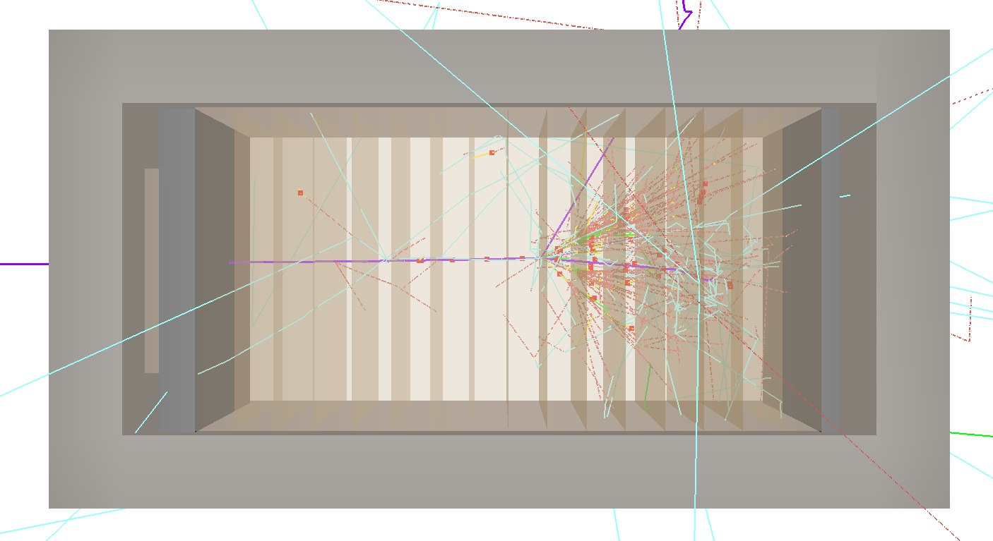
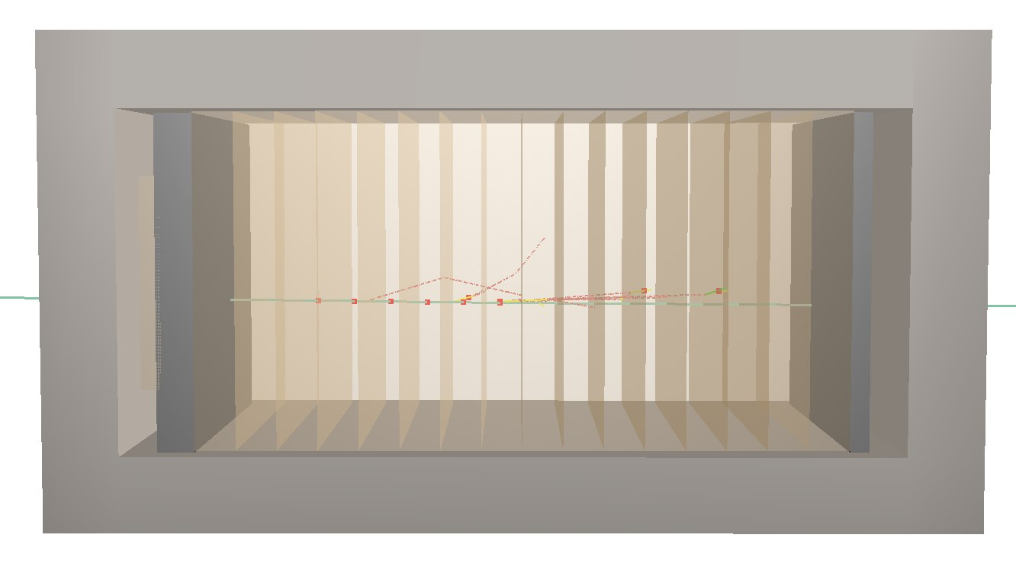
EVENT SIMULATION
Fig. 7 Passage of a proton and a muon with an energy of 10 GeV through the prototype
Left – proton, right – muon
9

Slide 10
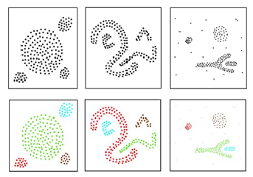
DBSCAN CLUSTERING ALGORITHM
A clustering method that identifies clusters based on spatial density of points. It works particularly well with free-form clusters and deals with noise in the data.
Fig. 8 Illustration of how DBSCAN works
Above is the original set of points, below is the result of the DBSCAN algorithm
10

Slide 11
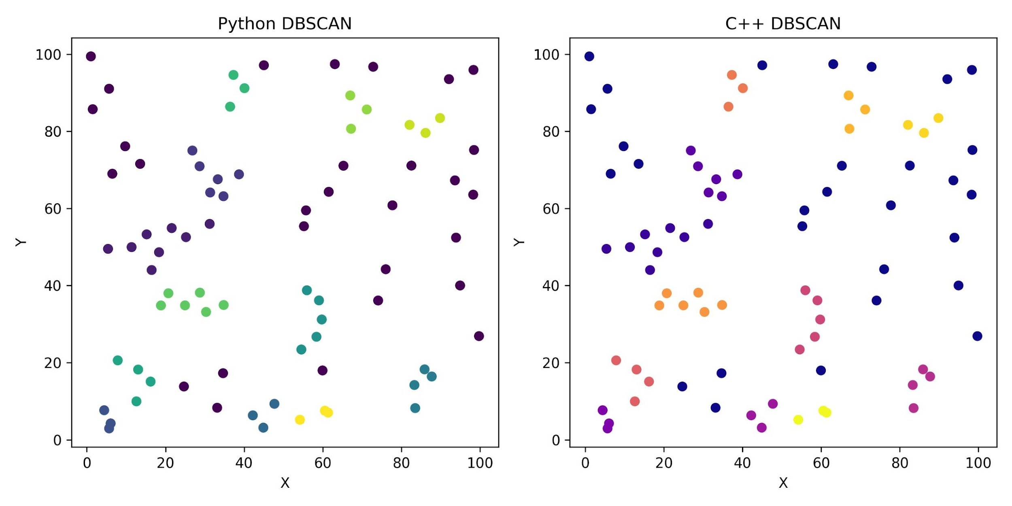
DBSCAN CLUSTERING ALGORITHM
Since there is no DBSCAN algorithm in the standard C++ library, it was implemented in this language for further integration into SpdRoot.
The results of the DBSCAN algorithm from the Python library sklearn and the algorithm implemented in C++ were compared.
Fig. 9 Results of the DBSCAN algorithm in python and C++ implementations compared
11

Slide 12
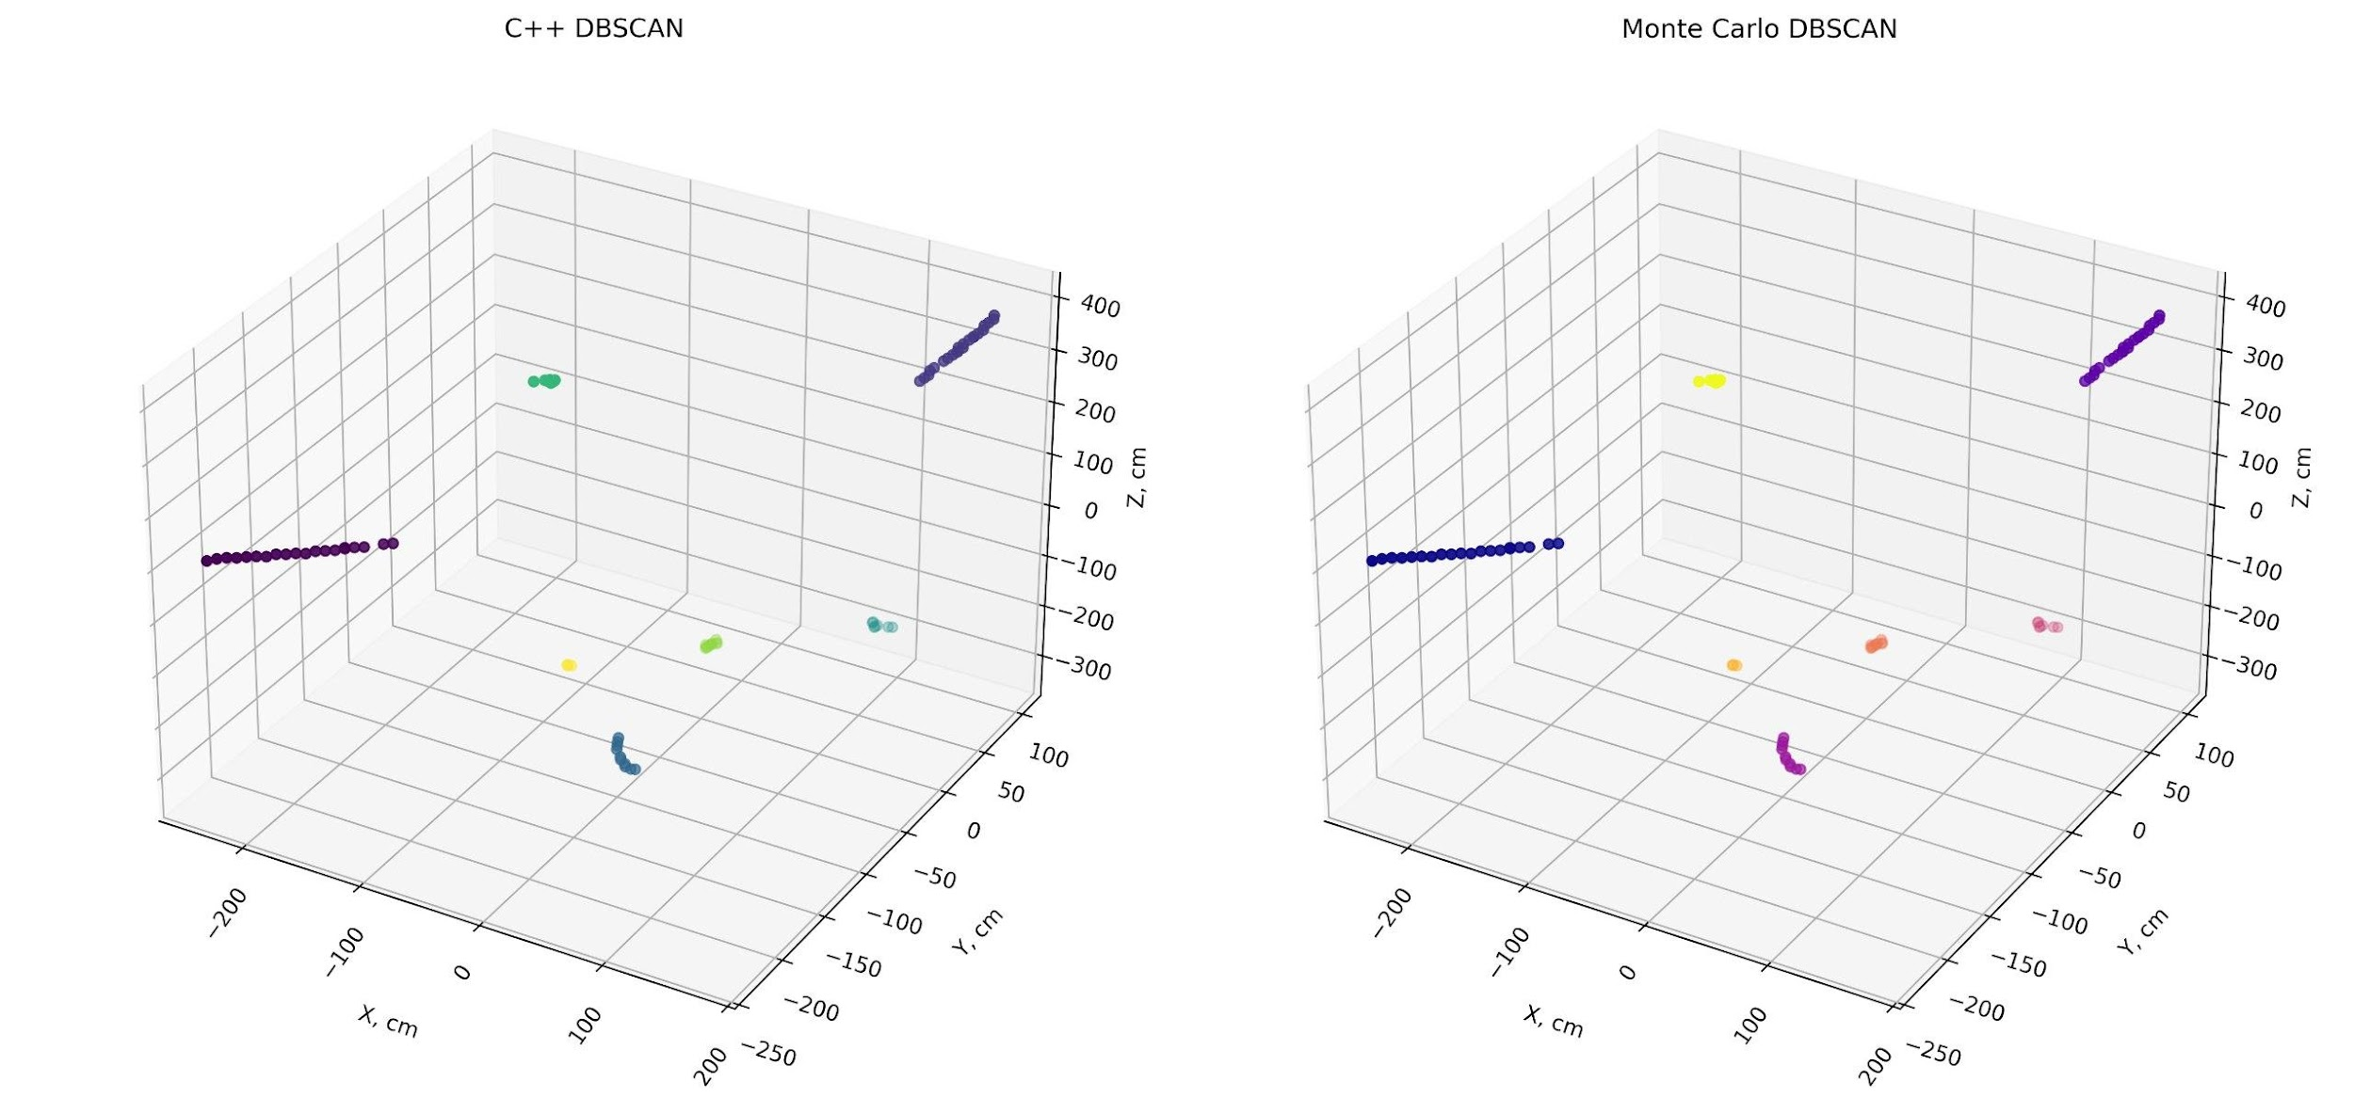
EXAMPLE OF AN EVENT FOR A J/Ψ MESON
Fig. 10 Visualization of point clustering in one of the events for J/ψ
12

Slide 13
CONCLUSION AND PLANS
Conclusion
- geometry model of the range system prototype is done, implemented into SpdRoot
- DBSCAN algo rewritten using C++, implemented into SpdRoot too
Plans
It is necessary to select the input parameters of the algorithm to create clusters from previously received hits.
It is also necessary to evaluate the correctness of the cluster creation using parameters such as V-measure and clustering purity.
13

