Slide 1



STUDY OF MECHANICAL PROPERTIES AND FRACTURE FEATURES OF FERRITE-MARTENSITIC STEEL EP-450 IRRADIATED BY NEUTRONS IN THE BN-350 REACTOR
Merezhko M.S., Merezhko D.A., Tsai K.V., Kislitsin S.B., Short M.P
Junior Researcher
Of Laboratory of Radiation Materials Science
Institute of Nuclear Physics, Kazakhstan
Kim Yelena Radikovna
Scientific supervisor: The head of the laboratory of RM INP
PhD, Merezhko Mickhail Sergeevich

Slide 2
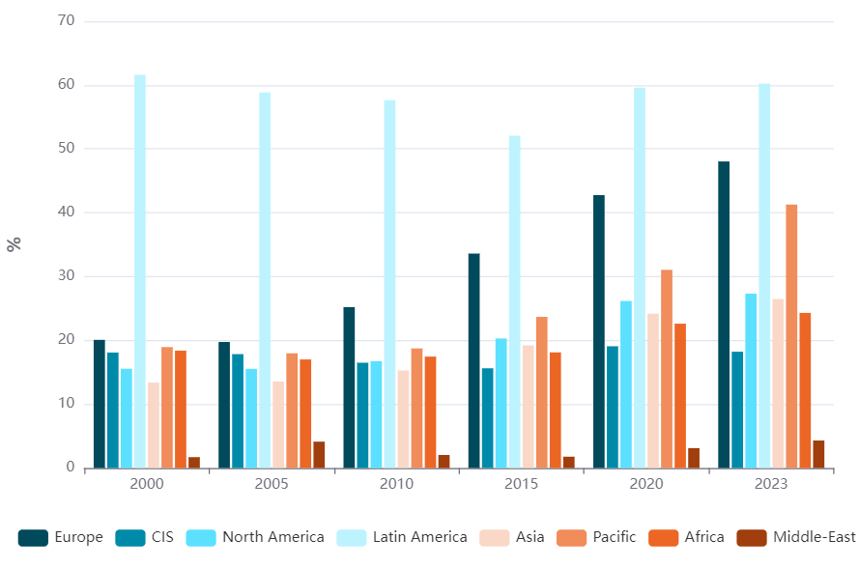
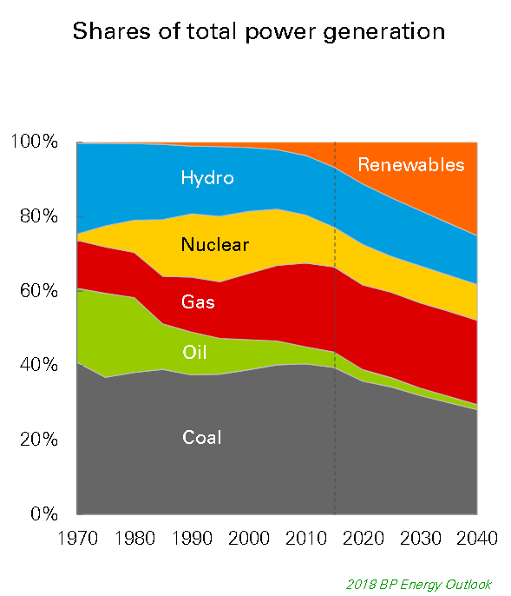
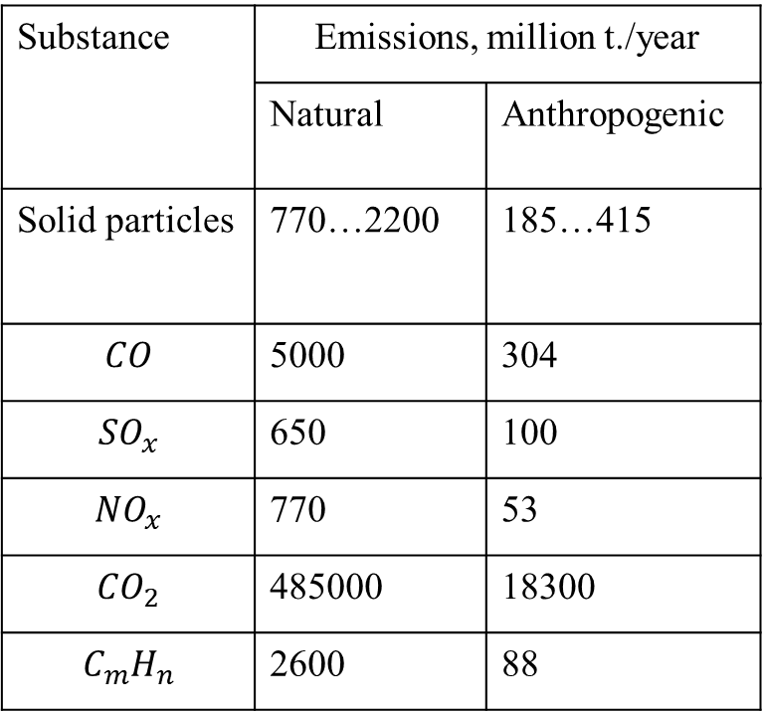
The ratio of natural and anthropogenic emissions into the atmosphere
Nuclear energy as a transitional form to green energy
Share of renewable sources in electricity production - %
Substance | Emissions, million t./year
 | Natural | Anthropogenic
Solid particles | 770…2200 | 185…415
$$CO$$ | 5000 | 304
$${SO}_{x}$$ | 650 | 100
$${NO}_{x}$$ | 770 | 53
$${CO}_{2}$$ | 485000 | 18300
$$C_{m}H_{n}$$ | 2600 | 88
Nuclear energy structure to reach 20% by 2030
https://triptonkosti.ru/12-foto/vybrosy-vrednyh-veschestv-v-atmosferu-prezentaciya-85-foto.html
https://energystats.enerdata.net/renewables/renewable-in-electricity-production-share.html
2
https://telegra.ph/Doklad-po-teme-EHnergetika-09-13

Slide 3
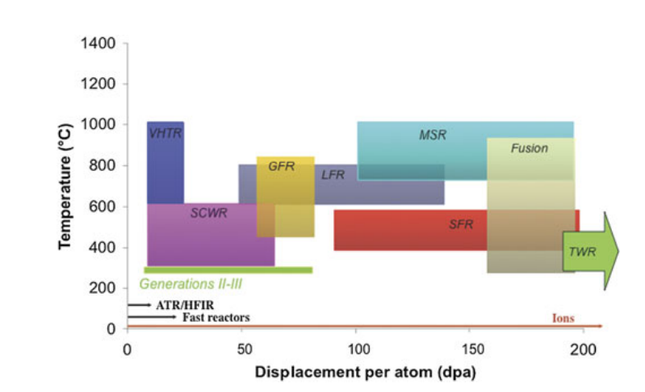
High requirements for structural materials of nuclear
power plants
VHTR – Helium-cooled, graphite-moderated reactor
SCWR - Supercritical water-cooled reactors
GFR - graphite moderated reactor
LFR - Lead cooled fast reactor
MSR - Molten salt reactors
SFR - sodium cooled reactors
Fusion – thermonuclear reactors
TWR - Traveling Wave Reactor
Expected temperatures and damaging doses for different nuclear reactors
Challenges to the use of ion irradiation for emulating reactor irradiation GS Was Journal of Materials Research 30 (9), 1158-1182
3
28th International Scientific Conference of Young Scientists and Specialist

Slide 4
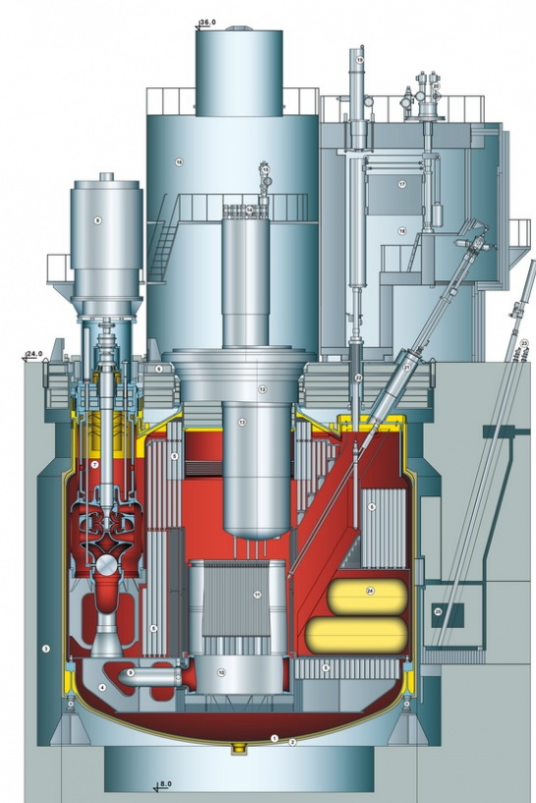
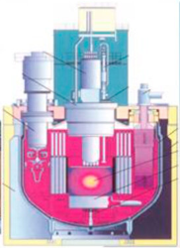
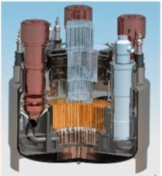
BN series reactors
BN – 600 BN-800 BN-1200
4
28th International Scientific Conference of Young Scientists and Specialist

Slide 5
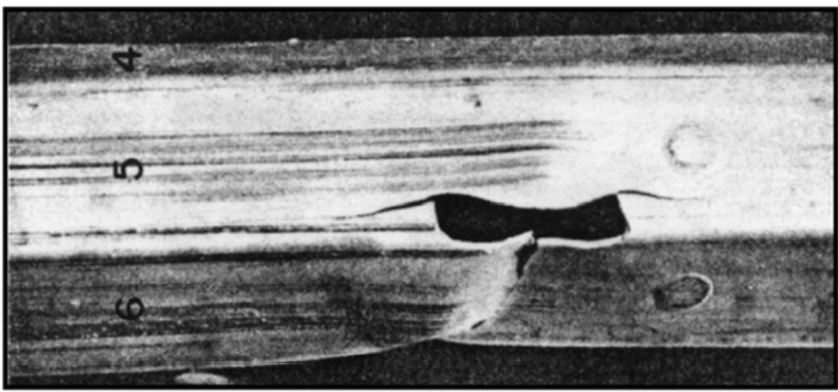
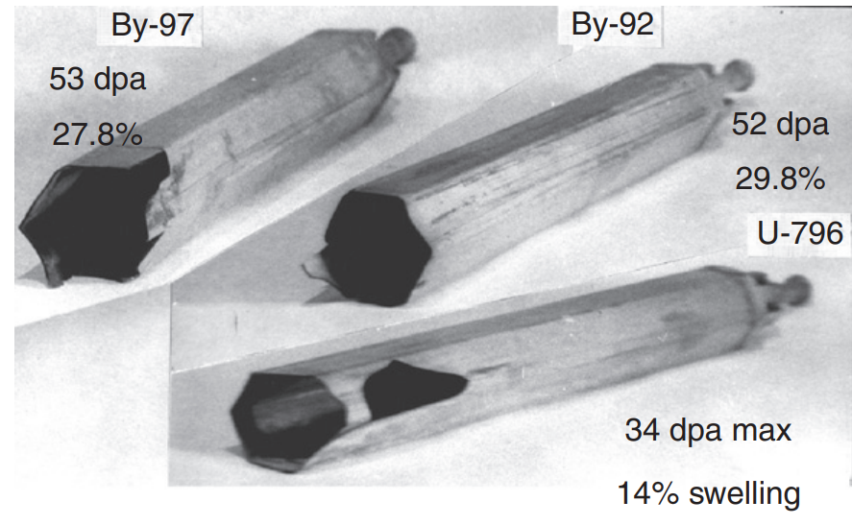
Problems of radiation materials science
Swelling and embrittlement
Swelling-induced embrittlement and subsequent failure of an EBR-II duct assembly of 304 steel during routine operations
Destruction of three fuel assembly wrappers of the BOR-60 reactor during routine work
Garner,F.A. 3.02 // Comprehensive Nuclear Materials (Second Edition). Oxford: Elseiver, 2020, - P.57 – 168.
5
28th International Scientific Conference of Young Scientists and Specialist

Slide 6
EP-450 steel
Ferrite-martensitic steel is currently the most priority candidate materials for the fabrication of fuel elements and fuel assembly (FA) cladding for fast reactors and the first wall for fusion reactors.
Advantages
Disadvantages
Low induced radioactivity;
Low swelling;
High resistance to high temperature and helium embrittlement.
Low temperature radiation embrittlement;
Relatively low corrosion resistance.
6
28th International Scientific Conference of Young Scientists and Specialist

Slide 7
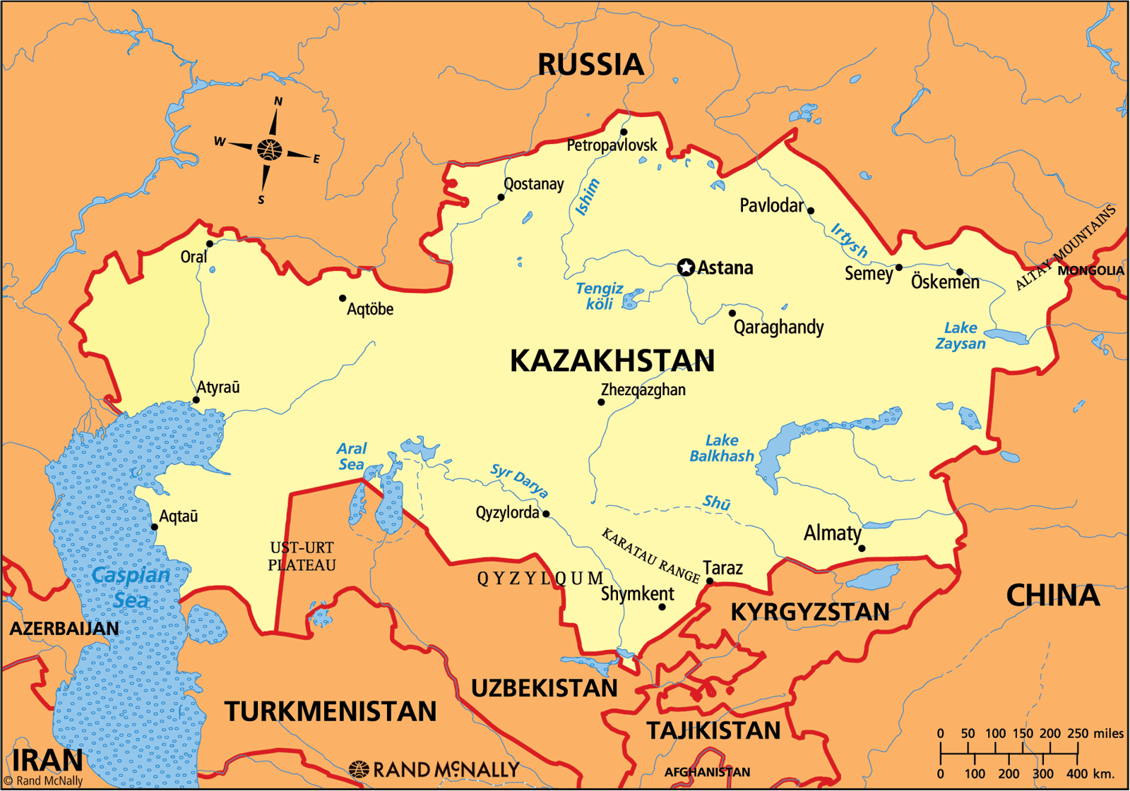
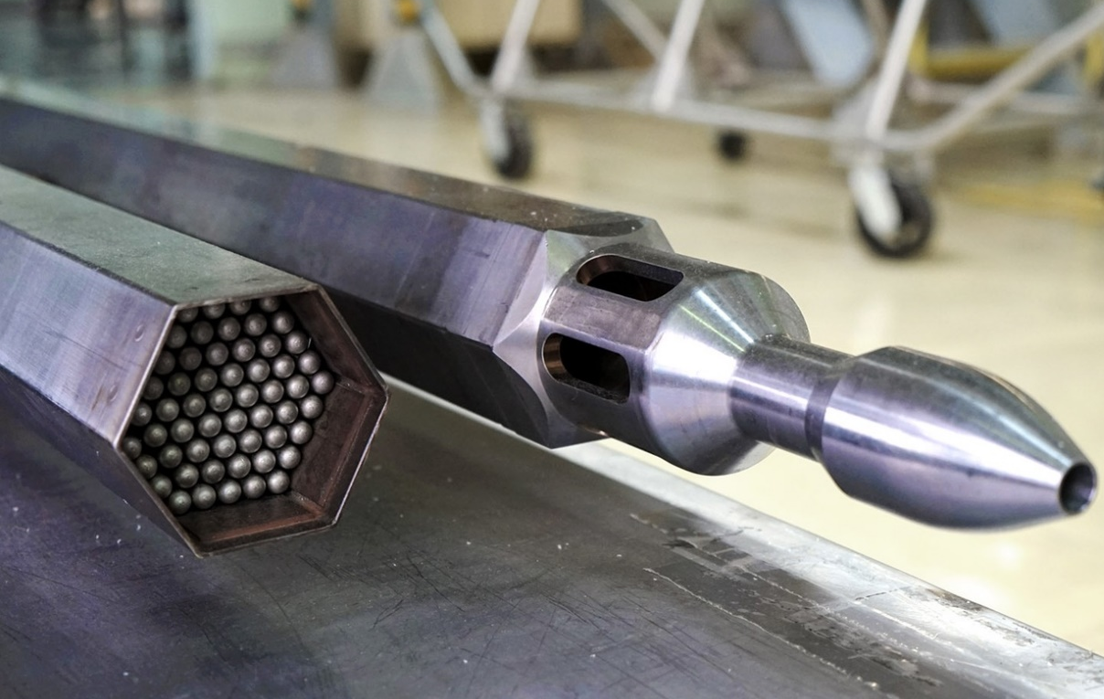
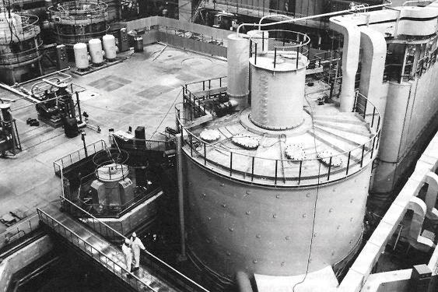
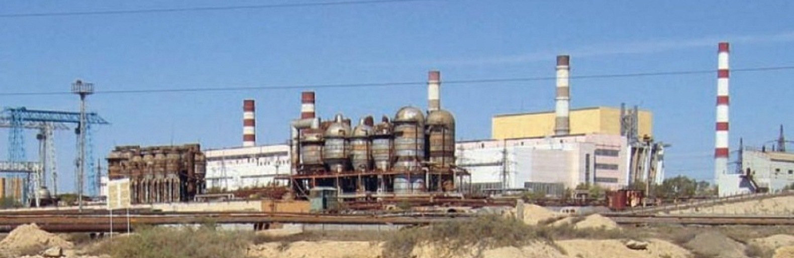
https://mavink.com/explore/Spent-Fuel-Rods
https://commons.wikimedia.org/wiki/File:Сравнение_активных_зон_реакторов.svg
Fuel assembly wrapper
Fuel assembly
BN-350 reactor
7
28th International Scientific Conference of Young Scientists and Specialist

Slide 8
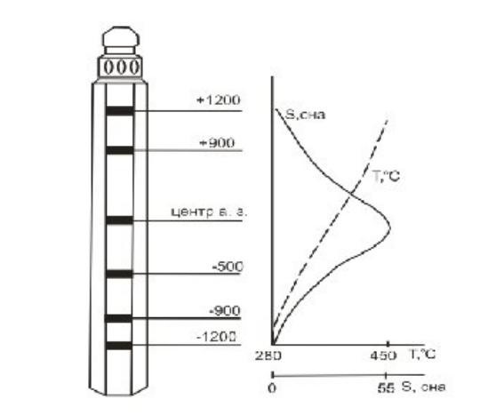
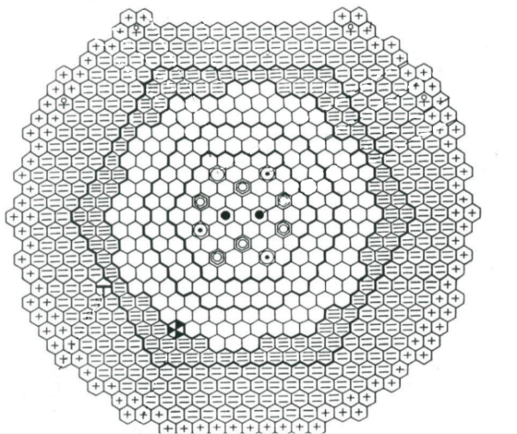
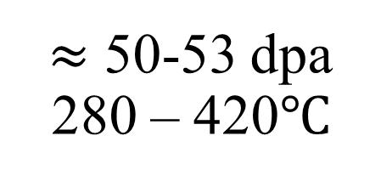
C-1
181
$≈$ 50-53 dpa
280 – 420$℃$
C-1 сп
201
8
28th International Scientific Conference of Young Scientists and Specialist

Slide 9
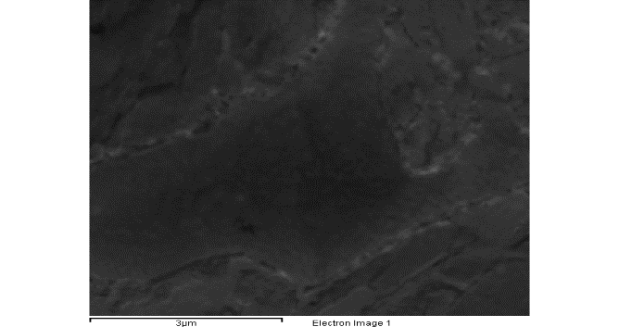
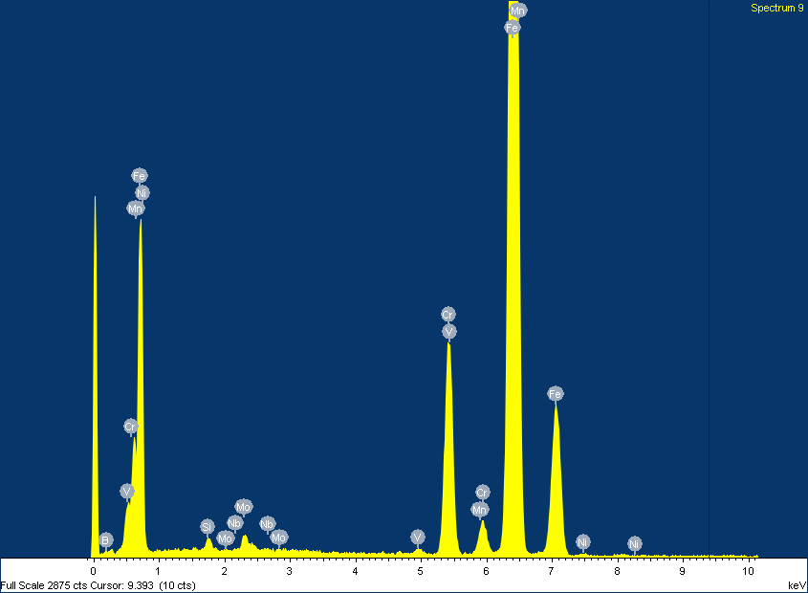
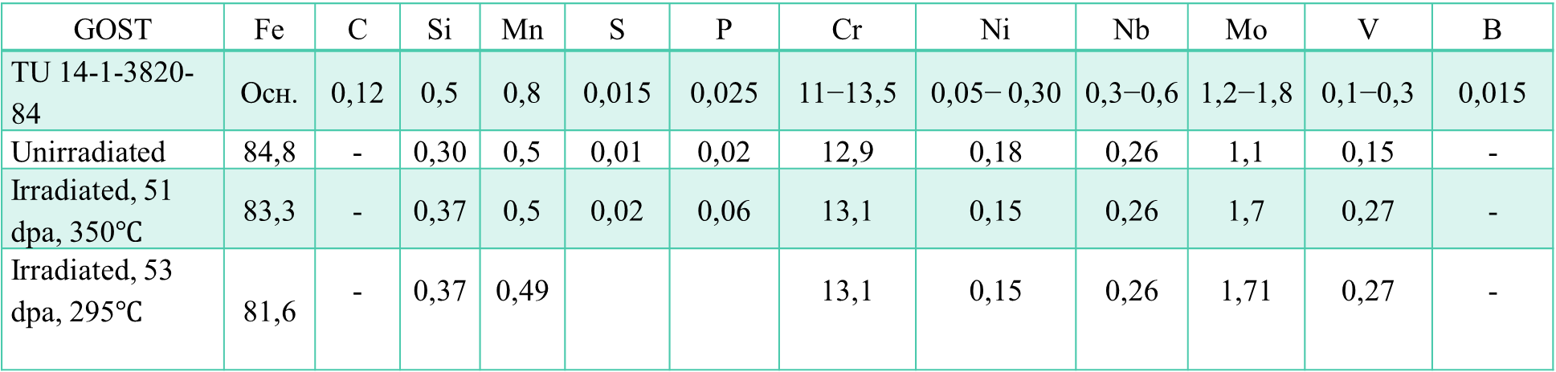
Characteristics of EP-450 steel
Chemical composition, % mass.
GOST | Fe | C | Si | Mn | S | P | Cr | Ni | Nb | Mo | V | B
TU 14-1-3820-84 | Осн. | 0,12 | 0,5 | 0,8 | 0,015 | 0,025 | 11−13,5 | 0,05− 0,30 | 0,3−0,6 | 1,2−1,8 | 0,1−0,3 | 0,015
Unirradiated | 84,8 | - | 0,30 | 0,5 | 0,01 | 0,02 | 12,9 | 0,18 | 0,26 | 1,1 | 0,15 | -
Irradiated, 51 dpa, 350$℃$ | 83,3 | - | 0,37 | 0,5 | 0,02 | 0,06 | 13,1 | 0,15 | 0,26 | 1,7 | 0,27 | -
Irradiated, 53 dpa, 295$℃$ | 81,6 | - | 0,37 | 0,49 |  |  | 13,1 | 0,15 | 0,26 | 1,71 | 0,27 | -
Heat treatment
1050 ℃ - 30 minutes
720 ℃ - 60 minutes
The specified heat treatment mode is necessary for degassing and cleaning the surface, as well as for regulating the ratio of ferrite and sorbite grains in steel.
9
28th International Scientific Conference of Young Scientists and Specialist

Slide 10
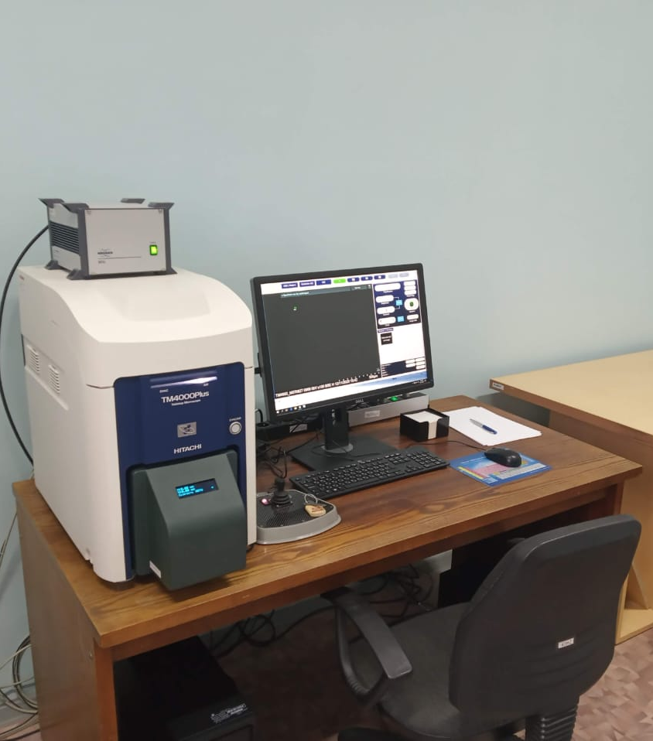
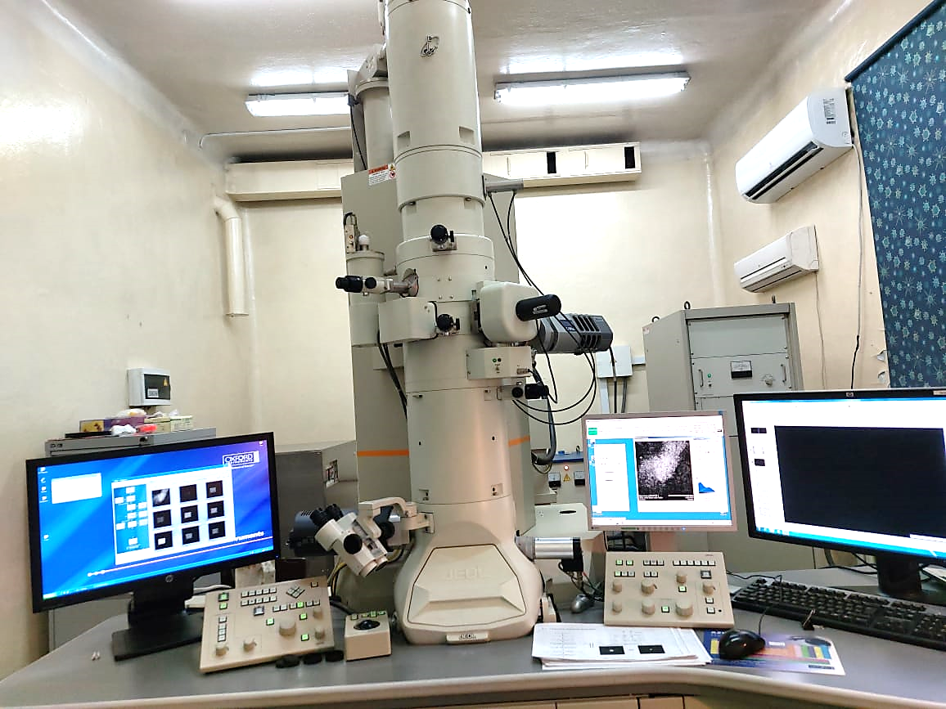
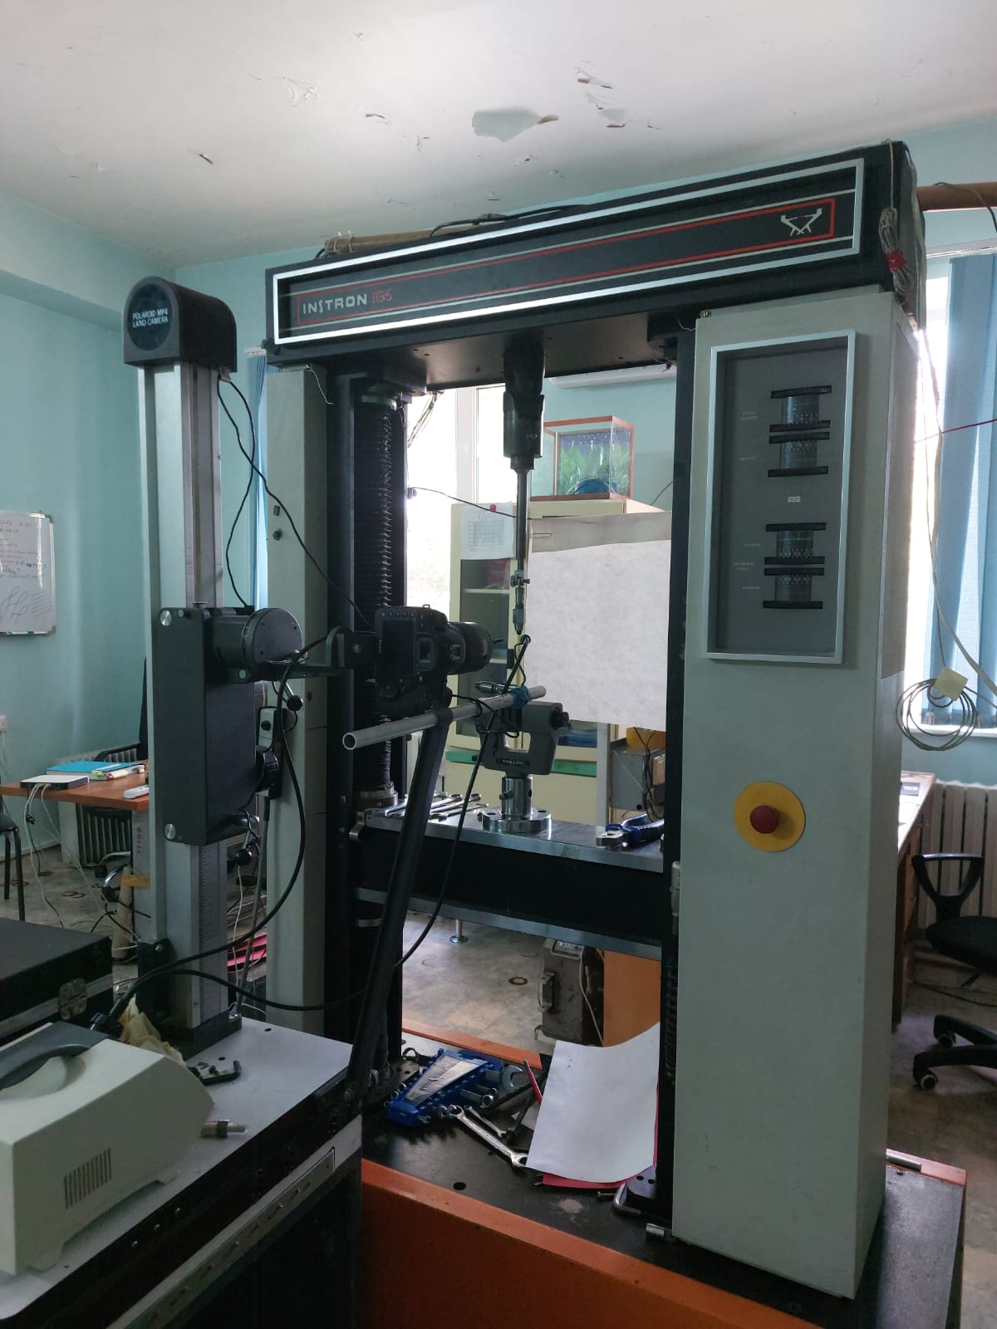
Research equipment
Scanning electron microscope
Hitachi TM-4000 PLUS
Transmission electron
microscope
JEOL JEM-2100
Tensile testing machine
Instron 1195
10
28th International Scientific Conference of Young Scientists and Specialist

Slide 11
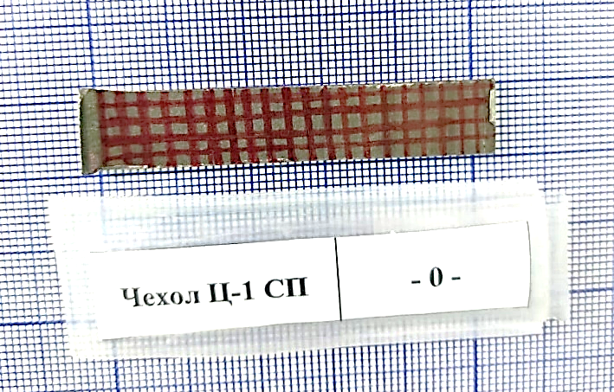
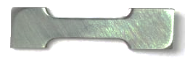
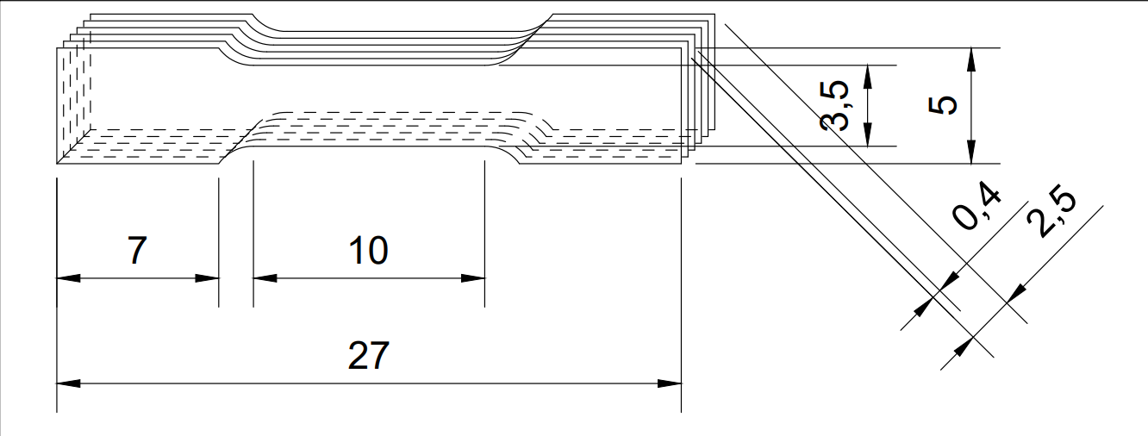
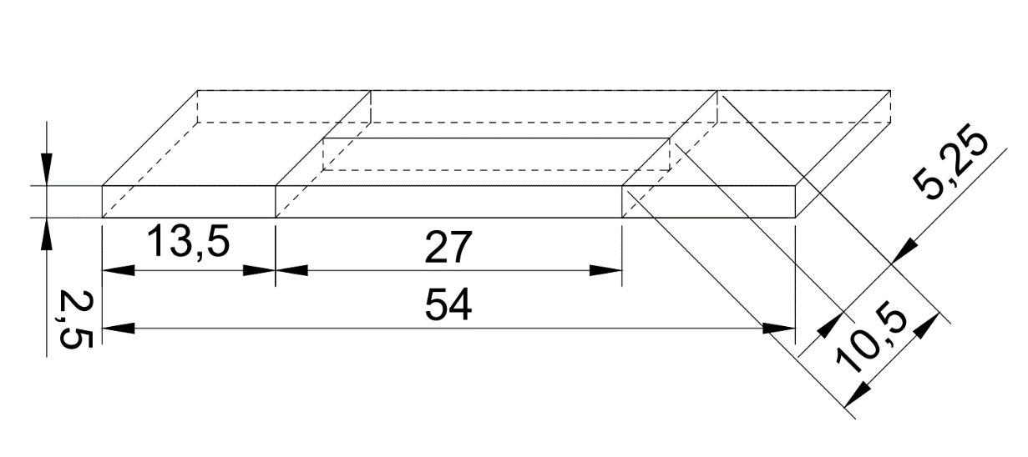
Irradiated sample parameters
11
28th International Scientific Conference of Young Scientists and Specialist

Slide 12
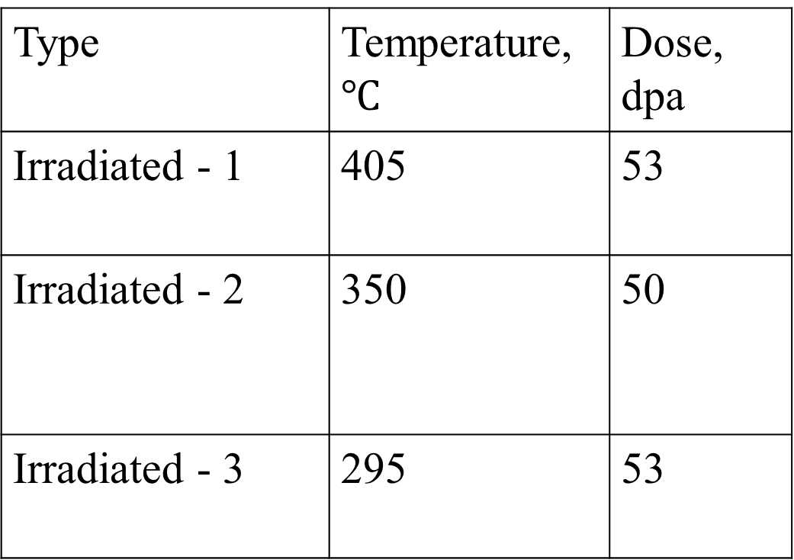
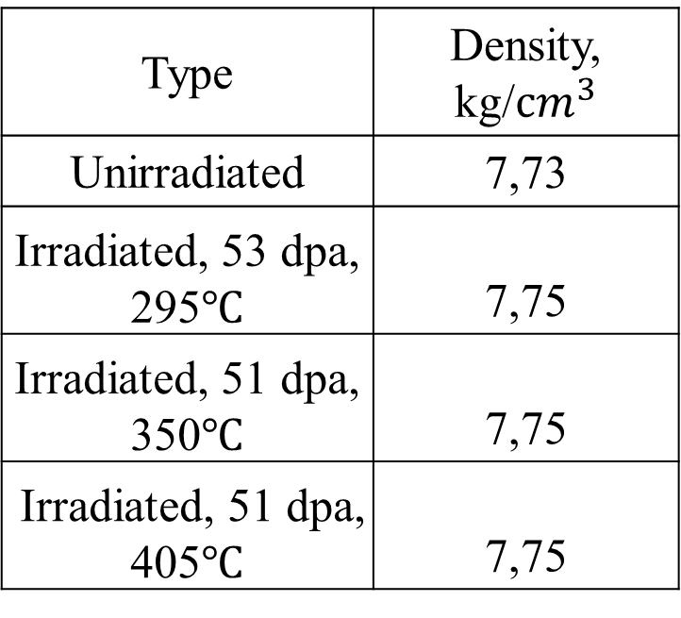
Irradiated sample parameters
Type | Temperature, $℃$ | Dose, dpa
Irradiated - 1 | 405 | 53
Irradiated - 2 | 350 | 50
Irradiated - 3 | 295 | 53
Type | Density, kg/${сm}^{3}$
Unirradiated | 7,73
Irradiated, 53 dpа, 295$℃$ | 7,75
Irradiated, 51 dpa, 350$℃$ | 7,75
Irradiated, 51 dpа, 405$℃$ | 7,75
12
28th International Scientific Conference of Young Scientists and Specialist

Slide 13
Engineering diagrams
The fragments of the diagrams characterized by strengthening and corresponding to neck formation in some cases turned out to be unusually large. In such cases, to calculate the value of the total elongation, the tensile diagrams were cut off to the point where the load was reduced to 10% of the maximum load.
13
Standard test methods for tension testing of metallic materials
28th International Scientific Conference of Young Scientists and Specialist

Slide 14
Engineering diagrams
The fragments of the diagrams characterized by strengthening and corresponding to neck formation in some cases turned out to be unusually large. In such cases, to calculate the value of the total elongation, the tensile diagrams were cut off to the point where the load was reduced to 10% of the maximum load.
13
Standard test methods for tension testing of metallic materials
28th International Scientific Conference of Young Scientists and Specialist

Slide 15
Engineering diagrams
The fragments of the diagrams characterized by strengthening and corresponding to neck formation in some cases turned out to be unusually large. In such cases, to calculate the value of the total elongation, the tensile diagrams were cut off to the point where the load was reduced to 10% of the maximum load.
13
Standard test methods for tension testing of metallic materials
28th International Scientific Conference of Young Scientists and Specialist

Slide 16
Engineering diagrams
The fragments of the diagrams characterized by strengthening and corresponding to neck formation in some cases turned out to be unusually large. In such cases, to calculate the value of the total elongation, the tensile diagrams were cut off to the point where the load was reduced to 10% of the maximum load.
13
Standard test methods for tension testing of metallic materials
28th International Scientific Conference of Young Scientists and Specialist

Slide 17
Mechanical characteristics
15
28th International Scientific Conference of Young Scientists and Specialist

Slide 18
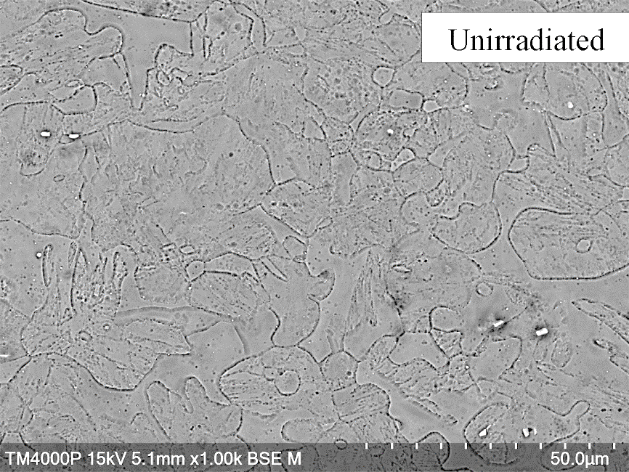
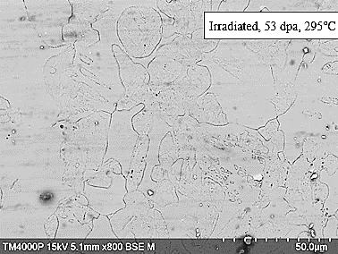
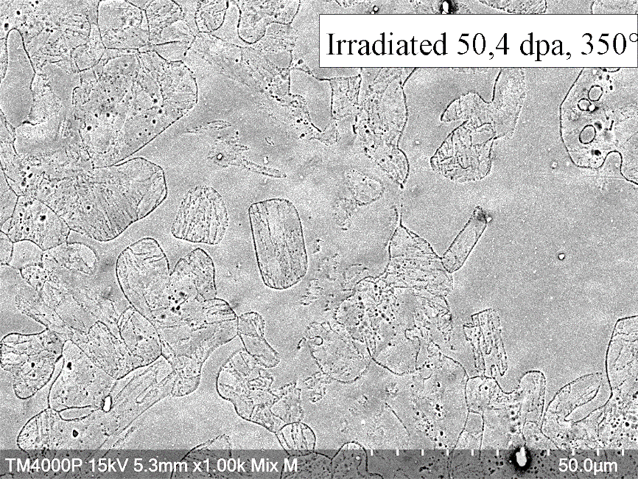
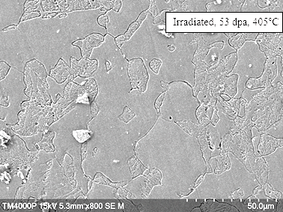
Microstructure of EP-450 steel
The steel is characterized by a two-phase structure, which is preserved even after neutron irradiation
16
28th International Scientific Conference of Young Scientists and Specialist

Slide 19
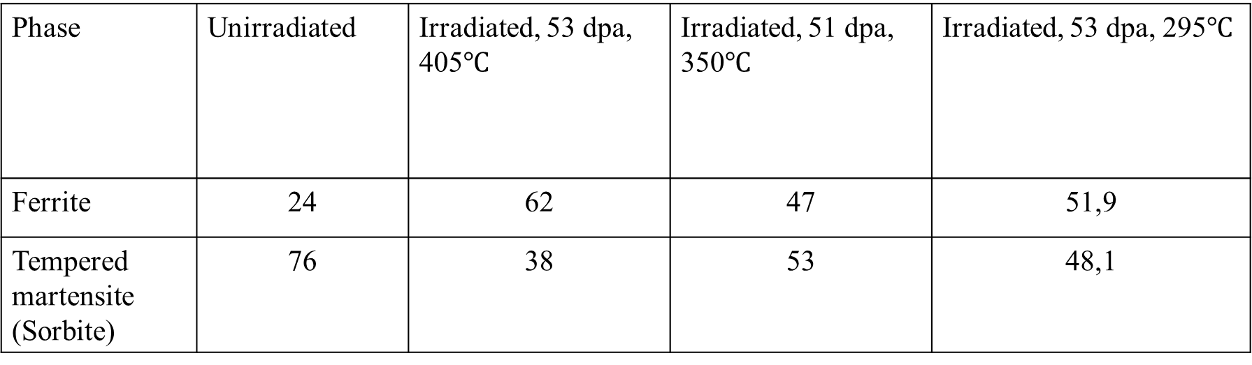
Correlation of two phases
Phase | Unirradiated | Irradiated, 53 dpa, 405$℃$ | Irradiated, 51 dpа, 350$℃$ | Irradiated, 53 dpa, 295$℃$
Ferrite | 24 | 62 | 47 | 51,9
Tempered martensite (Sorbite) | 76 | 38 | 53 | 48,1
With increasing irradiation temperature, the quantity of ferrite phase becomes greater compared to martensite phase.
17
28th International Scientific Conference of Young Scientists and Specialist

Slide 20
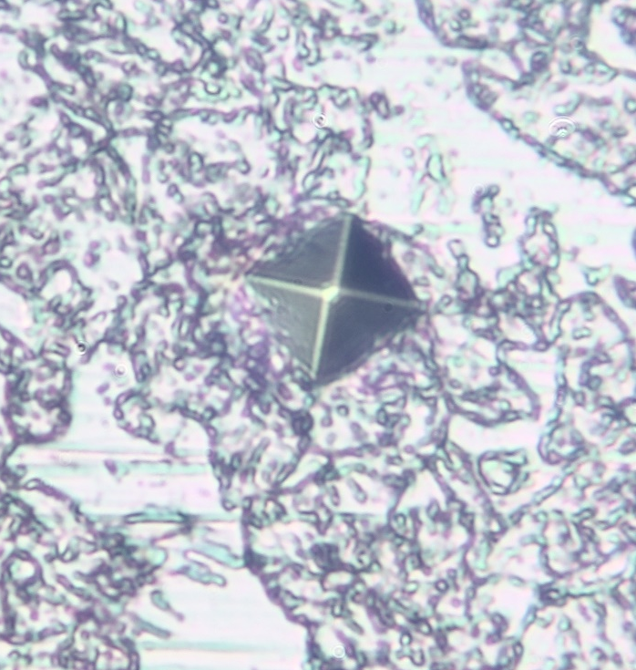
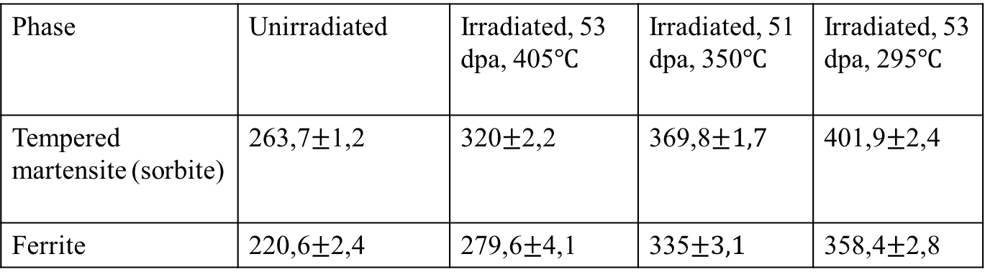
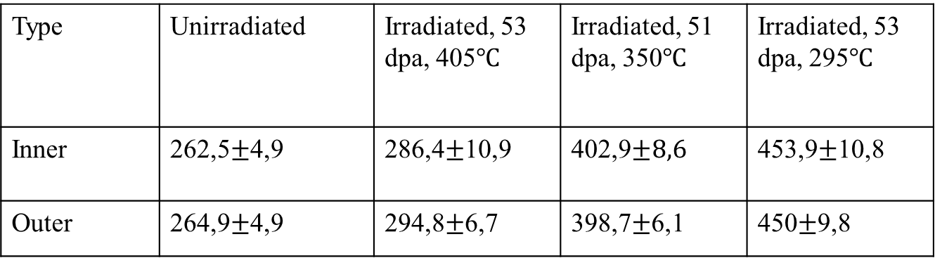
Microhardness
Type | Unirradiated | Irradiated, 53 dpa, 405$℃$ | Irradiated, 51 dpa, 350$℃$ | Irradiated, 53 dpa, 295$℃$
Inner | 262,5$±$4,9 | 286,4$±$10,9 | 402,9$±8,6$ | 453,9$±$10,8
Outer | 264,9$±$4,9 | 294,8$±$6,7 | 398,7$±$6,1 | 450$±$9,8
Microhardness by phases
Phase | Unirradiated | Irradiated, 53 dpa, 405$℃$ | Irradiated, 51 dpа, 350$℃$ | Irradiated, 53 dpa, 295$℃$
Tempered martensite (sorbite) | 263,7$±$1,2 | 320$±$2,2 | 369,8$±1,7$ | 401,9$±$2,4
Ferrite | 220,6$±$2,4 | 279,6$±$4,1 | 335$±3,1$ | 358,4$±$2,8
18
28th International Scientific Conference of Young Scientists and Specialist

Slide 21
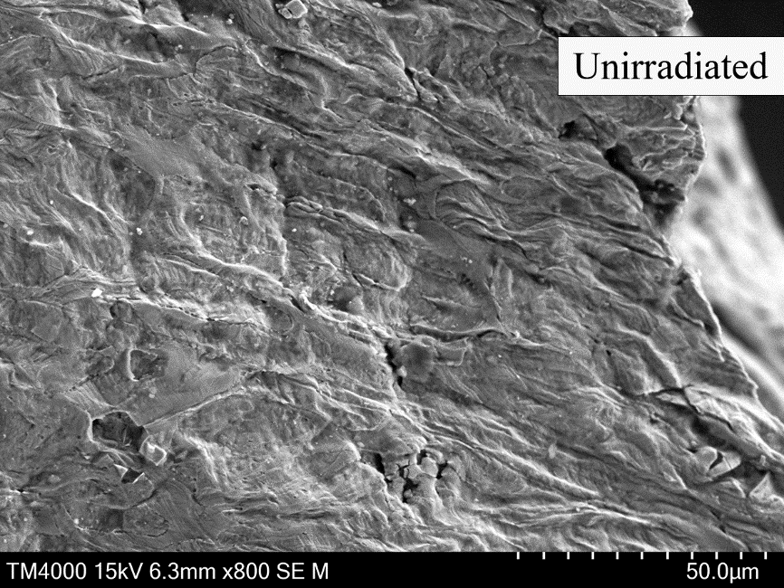
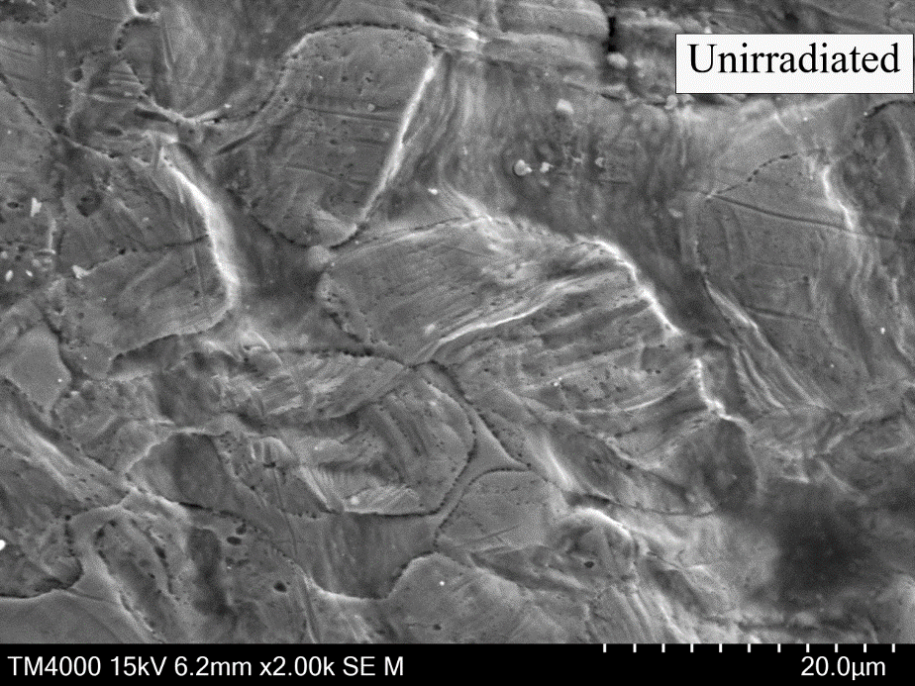
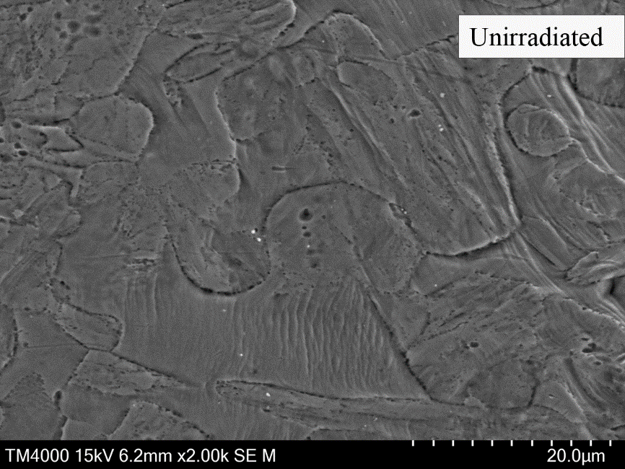
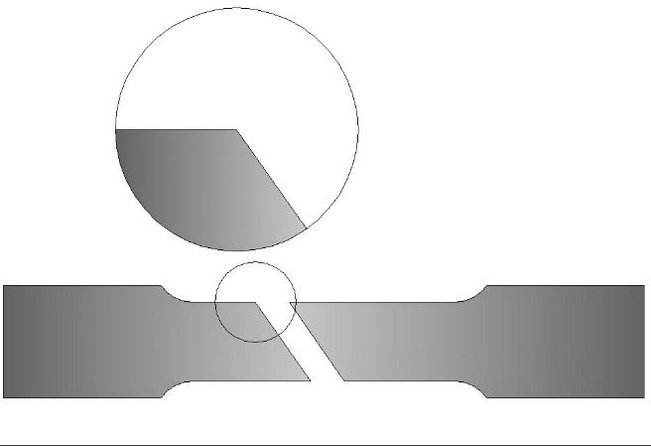
Structure of EP-450 steel after mechanical testing
Unirradiated
19
28th International Scientific Conference of Young Scientists and Specialist

Slide 22
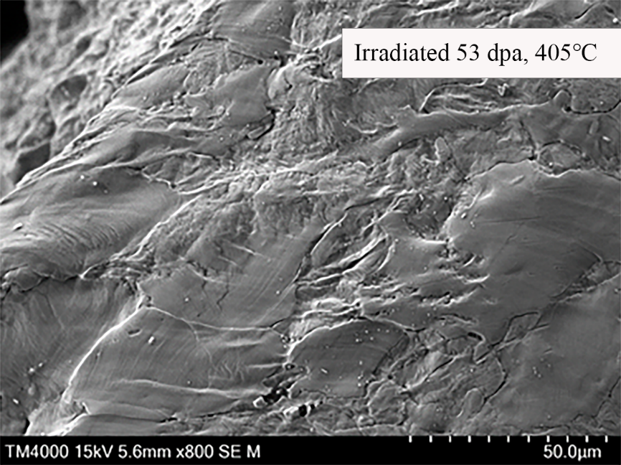
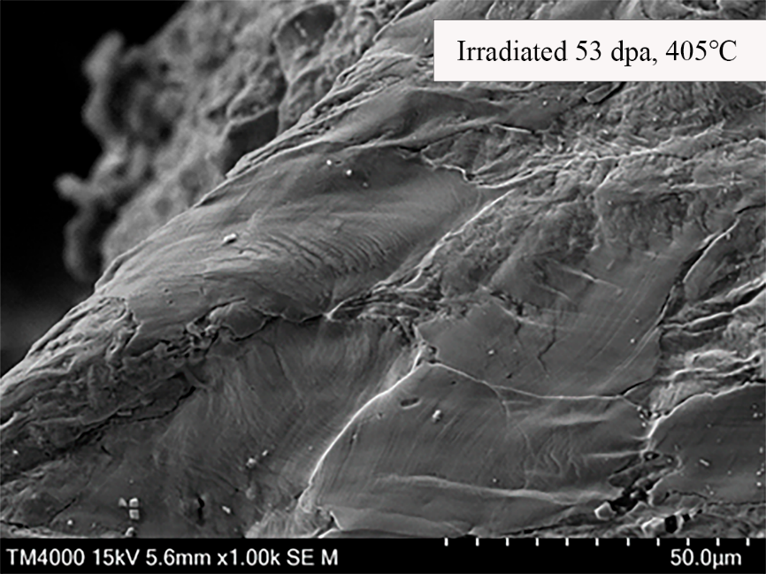
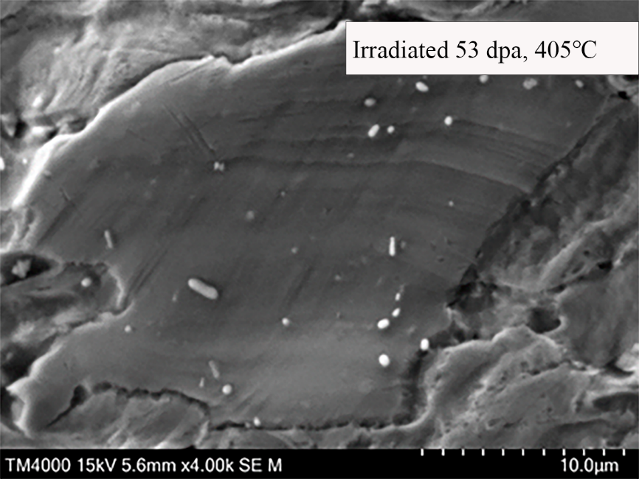
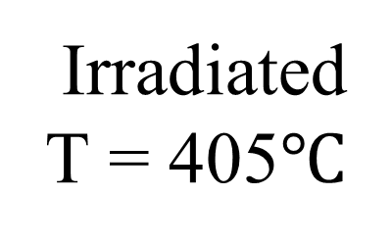
Structure of EP-450 steel after mechanical testing
Irradiated
Т = 405$℃$
20
28th International Scientific Conference of Young Scientists and Specialist

Slide 23
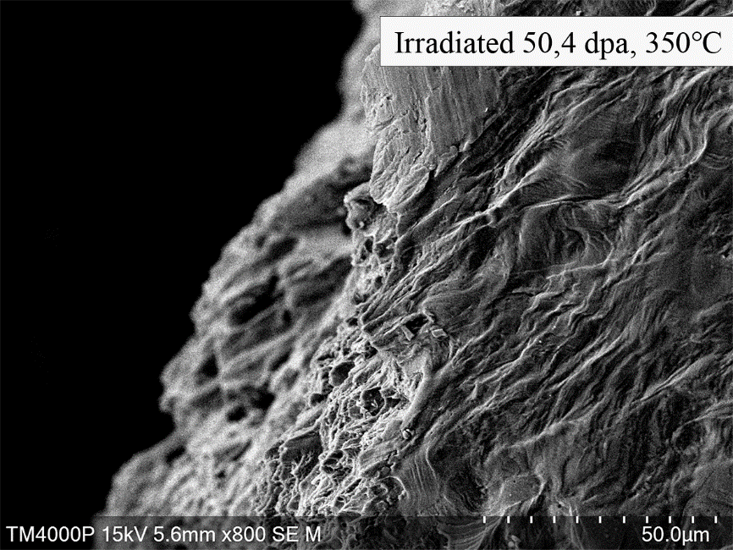
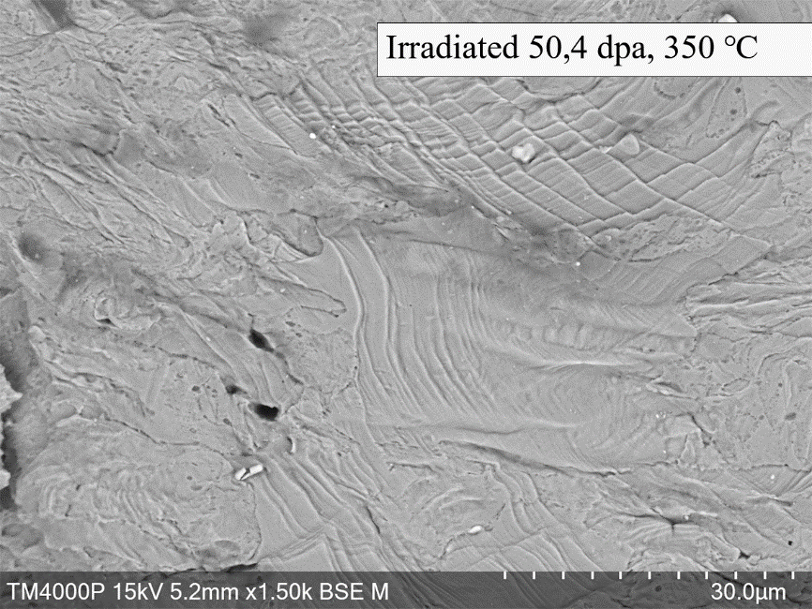
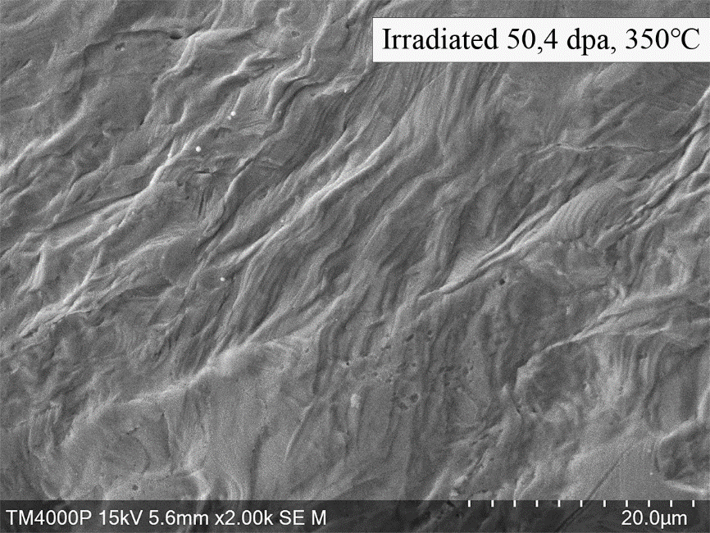
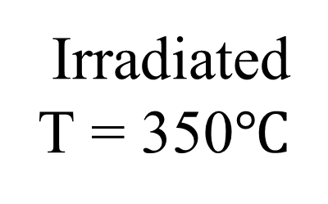
Structure of EP-450 steel after mechanical testing
Irradiated
Т = 350$℃$
21
28th International Scientific Conference of Young Scientists and Specialist

Slide 24
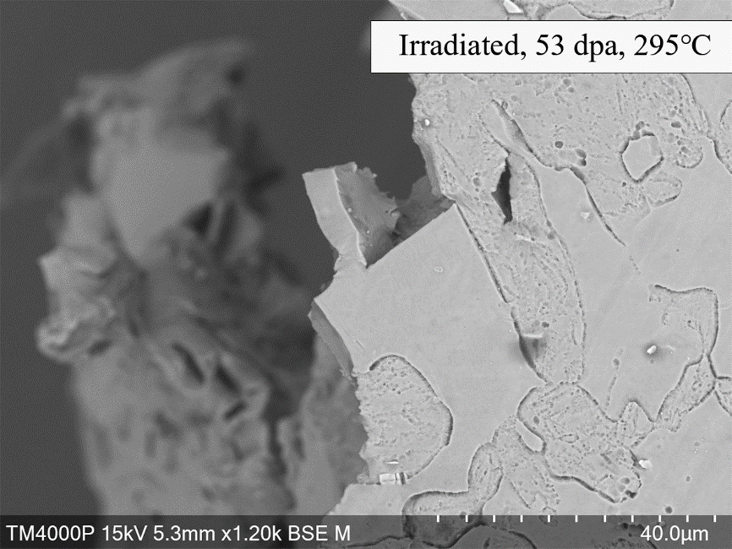
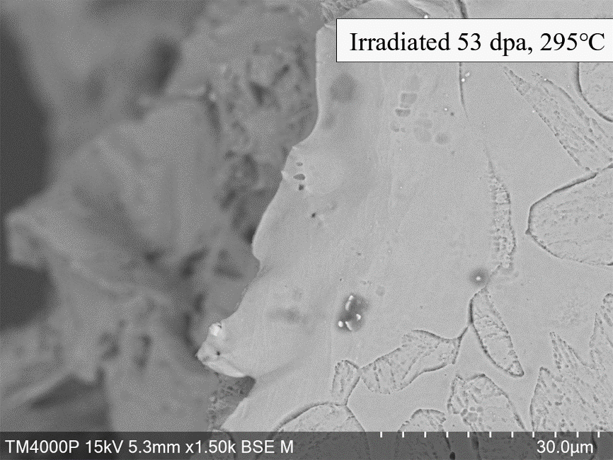


Structure of EP-450 steel after mechanical testing
Irradiated
Т = 295$℃$
22
28th International Scientific Conference of Young Scientists and Specialist

Slide 25




Fractography
For the unirradiated sample, the fracture pattern is ductile and fibrous. In orientation, it is oblique fibrous-scaly pits formed by the fusion of micropores. Fracture cups are visible, elongated downwards towards the sample. As the irradiation increases and the irradiation temperature changes, the fracture pattern changes to brittle, indicating low-temperature radiation embrittlement.
23
28th International Scientific Conference of Young Scientists and Specialist

Slide 26


The initial structure of EP-450 steel
(а) fraction of the ferrite grain and phase boundaries, (b) tempered martensite (sorbite) secondary precipitation of carbide phases of the type M₂₃C₆ and MC.
(а) | (b)
24
28th International Scientific Conference of Young Scientists and Specialist

Slide 27






Microstructure of EP-450 steel irradiated by Т = 405$℃$
(а) The ferrite grain and phase boundaries, (b) Secondary phase reflexes , (c) χ-phase particles, (d) dislocation structure of ferrite with χ -phase particles
(а) | (b) | (c) | (d)
$$Particles of \text{М}\text{23}\text{С}\text{6} \left(fcc lattice, = 1.064 nm\right), NbC \left(fcc lattice, a = 0.444 nm\right), VC \left(fcc lattice, a = 0.415 nm\right) were present in the steel.$$
$$Particles of the \text{χ}−phase have a globular shape − spheroidal for small sizes and close to ellipsoidal for large$$
$$particles. Particles of the \text{χ}−phase are formed mainly$$
$$in ferrite. The density of\text{χ}−precipitations is \text{1.9}\text{×}\text{10}\text{21}\text{м}\text{−3}$$
25
28th International Scientific Conference of Young Scientists and Specialist

Slide 28





Microstructure of EP-450 steel irradiated by Т = 350$℃$
(а) Tempered martensite – ferrite grain, (b) secondary precipitates at phase boundaries and
subgrain boundaries,
(c) dislocation loops, (d) α′-phase particles on dislocations
(а) | (b) | (c) | (d)
Vacancy pores are present in steel in very small quantities. The pore sizes are 1.6 – 3.4 nm. The average pore diameter is 2.7 nm. The particles of the α′-phase have sizes of 5-16 nm, the average size is 9 nm. The particle density is (1 – 3)×10²³м⁻³. The particles are formed on dislocations and grown dislocation loops.
26
28th International Scientific Conference of Young Scientists and Specialist

Slide 29






Microstructure of EP-450 steel irradiated by Т = 295$℃$
(а) The ferrite grain and phase boundaries, (b) radiation pores, (c) dislocation structure of ferrite and α′-phase particles on dislocations, (d) dislocation loops
(а) | (b) | (c) | (d)
Vacancy pores have a spherical shape and sizes in the range of 2.5 – 10 nm. The average pore size is 5.4 nm. The average pore density is ~1×10²²м⁻³. Swelling in some areas reaches ~ 0.1%.
Particle sizes are 2.5 – 6 nm, average size is 3.8 nm. Minimum particle density is ~ 2.4×10²³м⁻³. Moire contrast (d) was obtained on the particles at 600k magnification, which confirms the nature of secondary emissions.
O.V.Borodin, V.V.Bryk, V.N.Voyevodin, I.M.Neklyudov, V.K.Shamardin, Investigation of microstructure of ferritic-martensitic steels containing 9 and 13% Cr irradiated with fast neutrons, J. Nucl. Mater. 207 (1993) 295–302. doi:10.1016/0022-3115(93)90272-Z.
27
28th International Scientific Conference of Young Scientists and Specialist
(e)

Slide 30
Conclusion
As a result of tensile tests, the strength and ductility characteristics were obtained, and the value of the deformation work was calculated.
It was shown that irradiation of EP-450 steel with fast neutrons leads to a decrease in ductility and an increase in the strength of the material, while the uniform deformation of the material irradiated to 51 dpa decreases catastrophically - to 1-2% due to the effect of low-temperature radiation embrittlement. In this case, the deformation is limited within several ferrite grains favorably oriented to the loading axis. According to fractographic studies of the fracture zone, in unirradiated steel, the destruction is viscous, and in irradiated to 51 dpa - brittle-viscous or brittle, depending on the irradiation temperature.
28
28th International Scientific Conference of Young Scientists and Specialist

Slide 31

Thank you for your attention!
Kim Yelena
Junior Researcher of
Laboratory of Radiation Material Science
Institute of Nuclear Physics
Kazakhstan
Yelenakimr@gmail.com

