Slide 1
Modelling polarized atomic beam source (PABS)
PNPI - NRC KI
V. Larionov, A. Vasilyev, L. Kochenda,
P. Kravtsov, P. Kravchenko, A. Rozhdestvenskij, V. Trofimov, V. Fotyev
Petersburg Nuclear Physics Institute Gatchina, Russia
K. Ivshin, A. Solovev, V. Fimushkin
Joint Institute for Nuclear Research
Dubna, Russia

Slide 2
Objective and Tasks
Objective:
Creating software for PABS modeling
Tasks:
1. Development of an atomic beam initial condition generator based on the Monte Carlo method.
2. Creation of a numerical model of a multipolar magnetic system
3. Modelling of radio frequency transition blocks

Slide 3
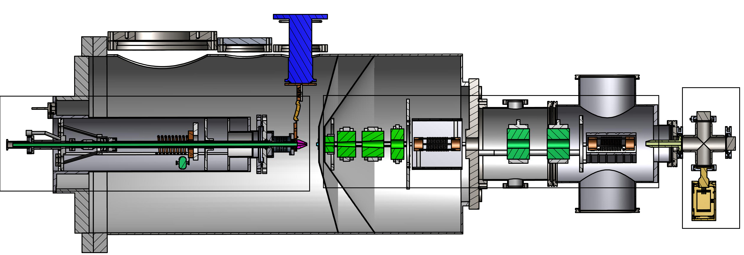
Polarized atomic beam source (PABS)
1
2
1
SPI polarized atomic beam source
PolFusion polarized atomic beam source
2
Radio frequency dissociator
Polarizer

Slide 4
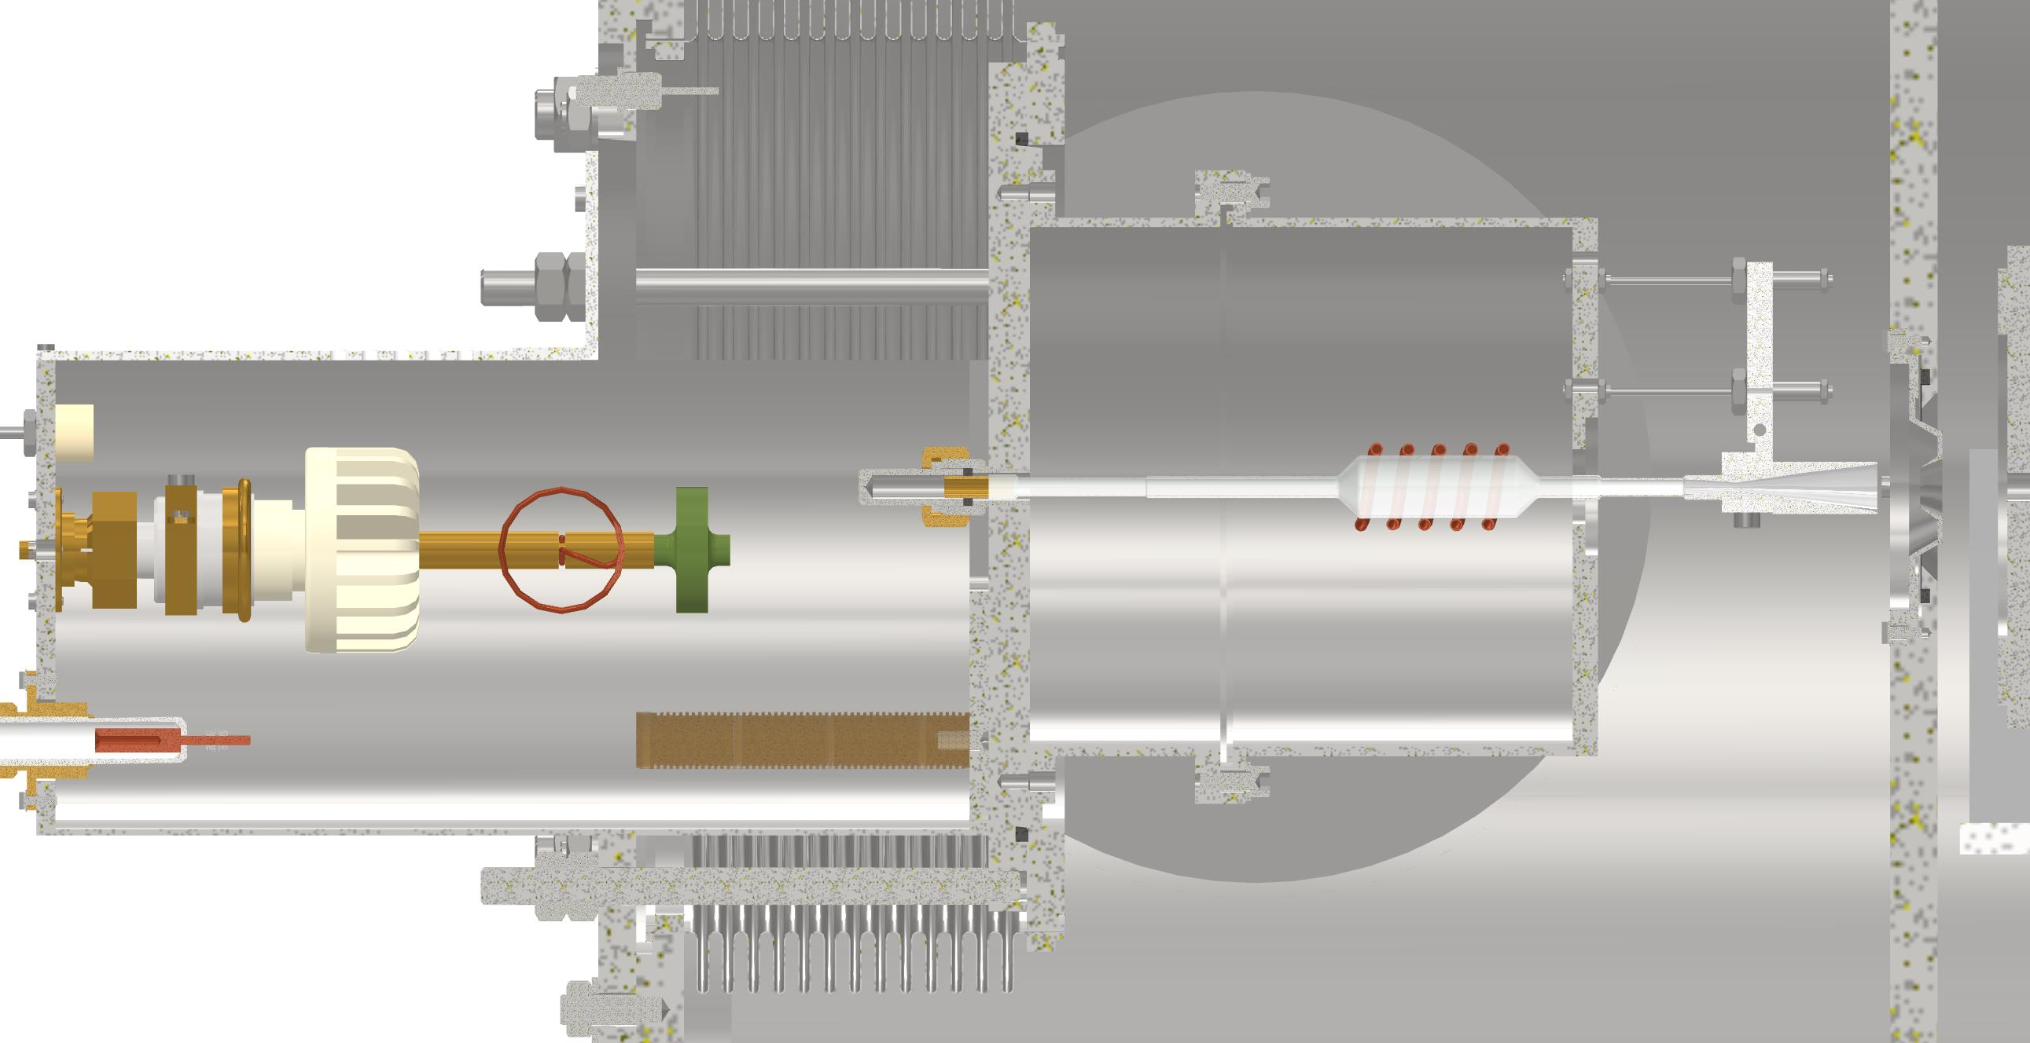
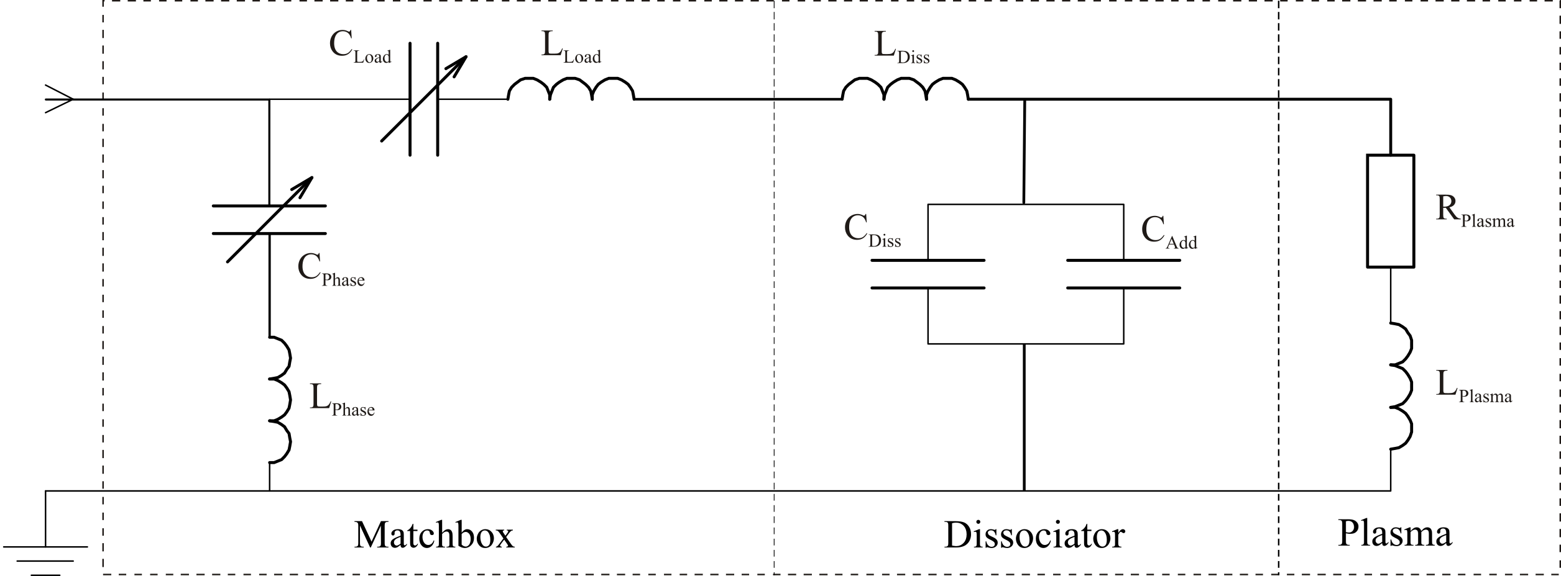
RF - dissociator
PolFusion dissociator
$$f=13.56MHz$$
SPI dissociator
$$f=70 MHz$$

Slide 5
Multipolar magnetic system
${\frac{d^{2}\vec{r}}{dt^{2}}}^{1}=\frac{1}{m}B_{0}\left(\frac{N}{2}−1\right)\frac{\left(μ_{e}+ μ_{d}\right)}{r_{0}^{\frac{N}{2}−1}} r^{\frac{N}{2}−2}$
2.${ \frac{d^{2}\vec{r}}{dt^{2}}}^{2}=\frac{1}{2m}\left(μ_{d}− \frac{−A_{d}μ_{c}+μ_{c}^{2}B }{\sqrt{9A_{d}^{2}− {2A_{d}μ_{c}B+μ_{c}}^{2}B^{2}}}\right)B_{0}\left(\frac{N}{2}−1\right)\frac{r^{\frac{N}{2}−2} }{r_{0}^{\frac{N}{2}−1}}$
3.${ \frac{d^{2}\vec{r}}{dt^{2}}}^{3}=\frac{1}{2m}\left(−μ_{d}− \frac{A_{d}μ_{c}+μ_{c}^{2}B }{\sqrt{9A_{d}^{2}+ {2A_{d}μ_{c}B+μ_{c}}^{2}B^{2}}}\right)B_{0}\left(\frac{N}{2}−1\right)\frac{r^{\frac{N}{2}−2} }{r_{0}^{\frac{N}{2}−1}}$
${\frac{d^{2}\vec{r}}{dt^{2}}}^{4}=−\frac{1}{m}B_{0}\left(\frac{N}{2}−1\right)\frac{\left(μ_{e}+ μ_{d}\right)}{r_{0}^{\frac{N}{2}−1}} r^{\frac{N}{2}−2}$
${ \frac{d^{2}\vec{r}}{dt^{2}}}^{5}=\frac{1}{2m}\left(−μ_{d}+ \frac{A_{d}μ_{c}+μ_{c}^{2}B }{\sqrt{9A_{d}^{2}+ {2A_{d}μ_{c}B+μ_{c}}^{2}B^{2}}}\right)B_{0}\left(\frac{N}{2}−1\right)\frac{r^{\frac{N}{2}−2} }{r_{0}^{\frac{N}{2}−1}}$
${\frac{d^{2}\vec{r}}{dt^{2}}}^{6}=\frac{1}{2m}\left(μ_{d}+ \frac{−A_{d}μ_{c}+μ_{c}^{2}B }{\sqrt{9A_{d}^{2}− {2A_{d}μ_{c}B+μ_{c}}^{2}B^{2}}}\right)B_{0}\left(\frac{N}{2}−1\right)\frac{r^{\frac{N}{2}−2} }{r_{0}^{\frac{N}{2}−1}}$
A sextuple magnet used in ABS. An atom flying into a magnet with r = 0 at an angle $α_{0}$ is shown on the left; several lines of force are shown on the right

Slide 6
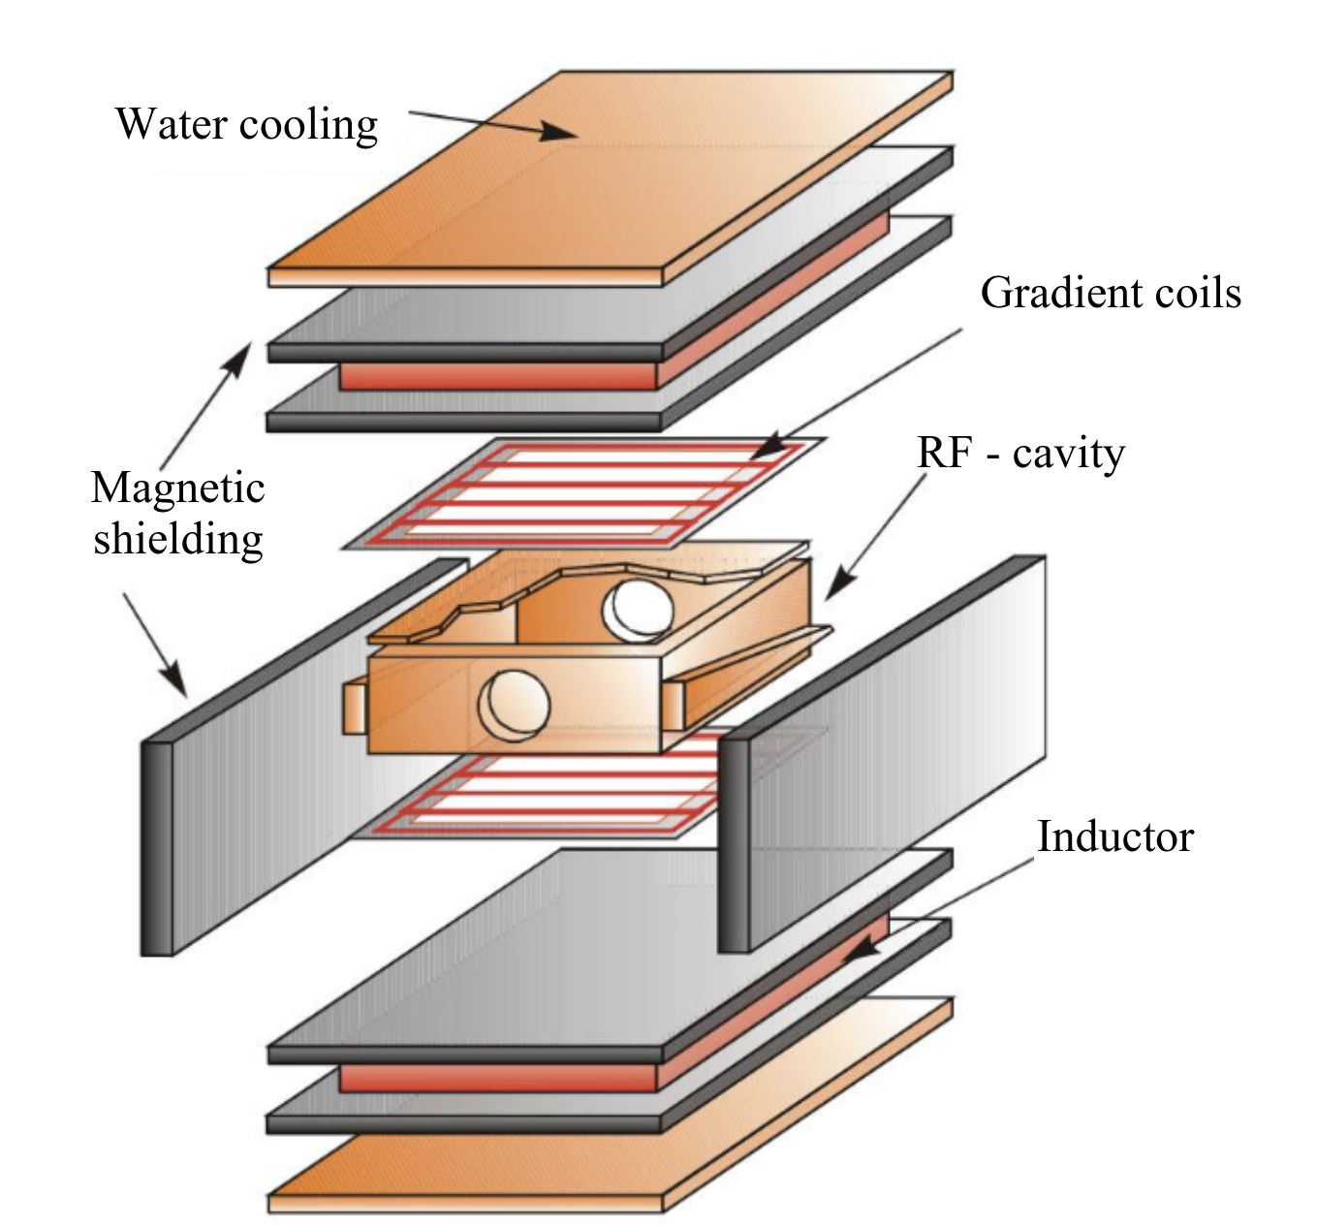
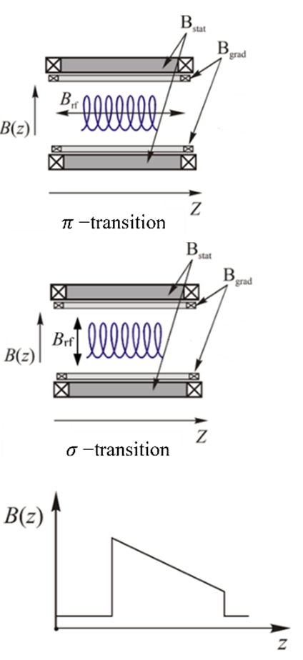
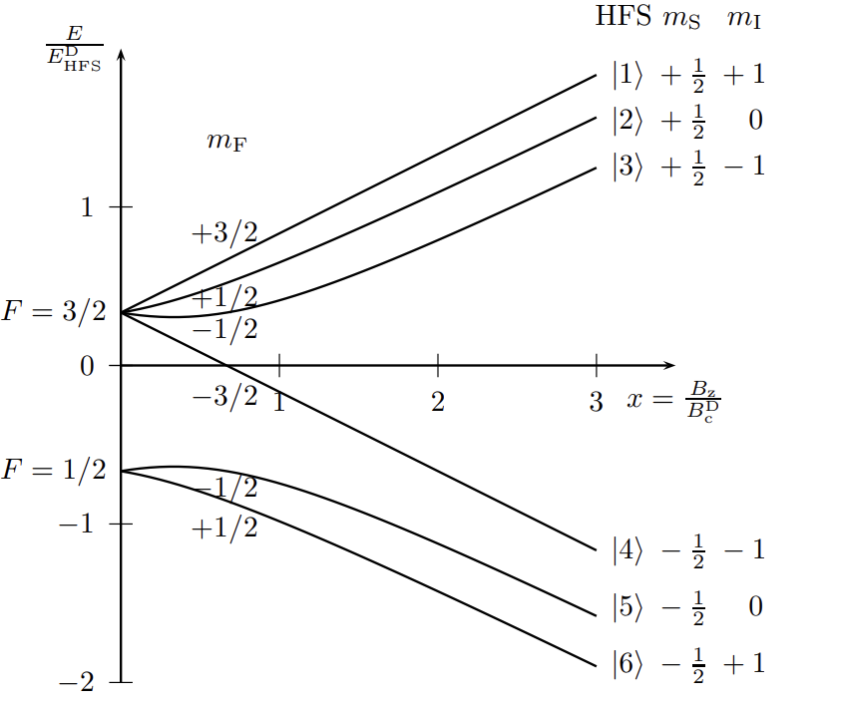
Radio - frequency transition cells
F_{in} - F_{out} = ΔF = ±1,0 and Δm = ±1,0

Slide 7
Polarization of the gas target
P_{z} | P_{zz} | Multipolar magnetic system 1 |  | MFT1 After | Multipolar magnetic system 2 |  | MFT2 After | m_{i}
 |  | Before | After |  | Before | After
0 | +1 | $$|1⟩$$ $$|2⟩$$ $$|3⟩$$ $$|4⟩$$ $$|5⟩$$ $$|6⟩$$ | $$|1⟩$$ $$|2⟩$$ $$|3⟩$$ | On 2 $↔$4 $$|1⟩$$ $$|3⟩$$ $$|4⟩$$ | $$|1⟩$$ $$|3⟩$$ $$|4⟩$$ | $$|1⟩$$ $$|3⟩$$ | Off $$|1⟩$$ $|3⟩$ | +1 -1
-2/3 | 0 | $$|1⟩$$ $$|2⟩$$ $$|3⟩$$ $$|4⟩$$ $$|5⟩$$ $$|6⟩$$ | $$|1⟩$$ $$|2⟩$$ $$|3⟩$$ | On $$|1⟩$$ $$|2⟩$$ $$|3⟩$$ | $$|1⟩$$ $$|2⟩$$ $$|3⟩$$ | $$|1⟩$$ $$|2⟩$$ $$|3⟩$$ | Off 1 $↔$4 $$|2⟩$$ $$|3⟩$$ $$|4⟩$$ | 0 -1 -1

Slide 8
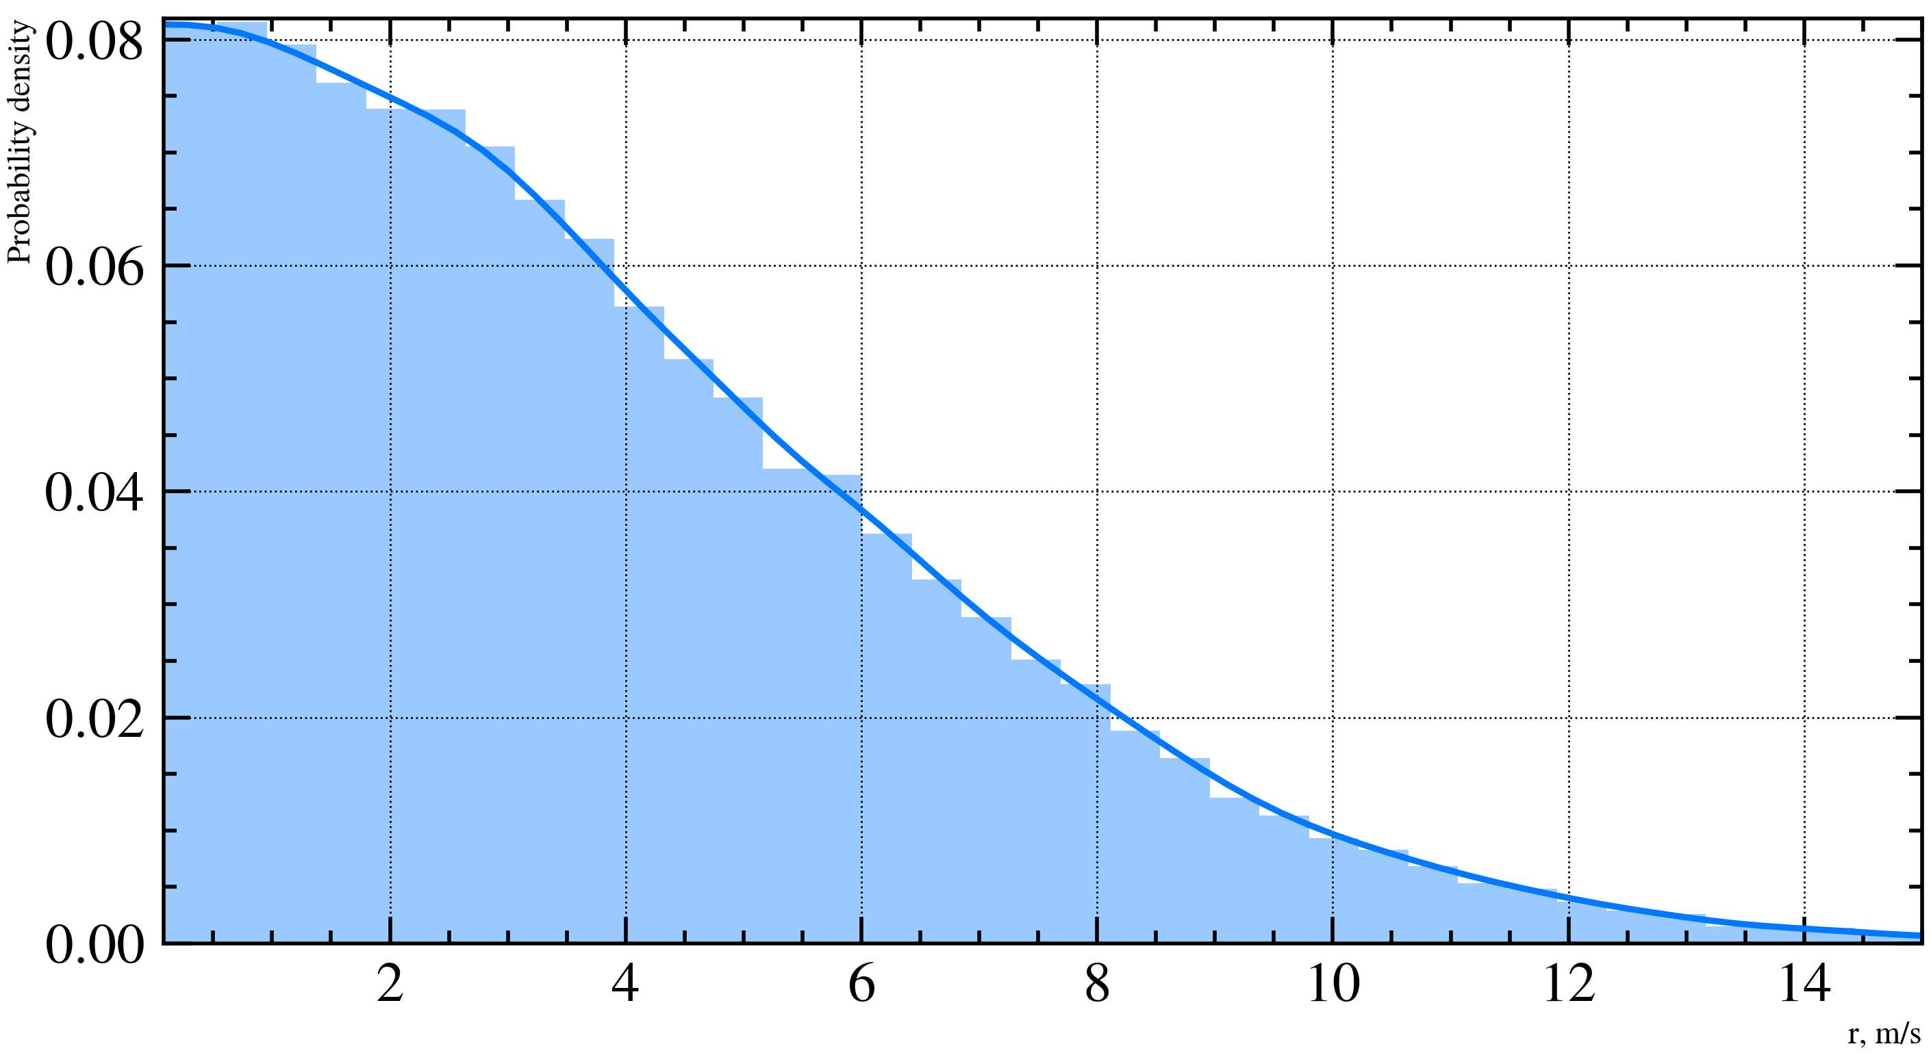
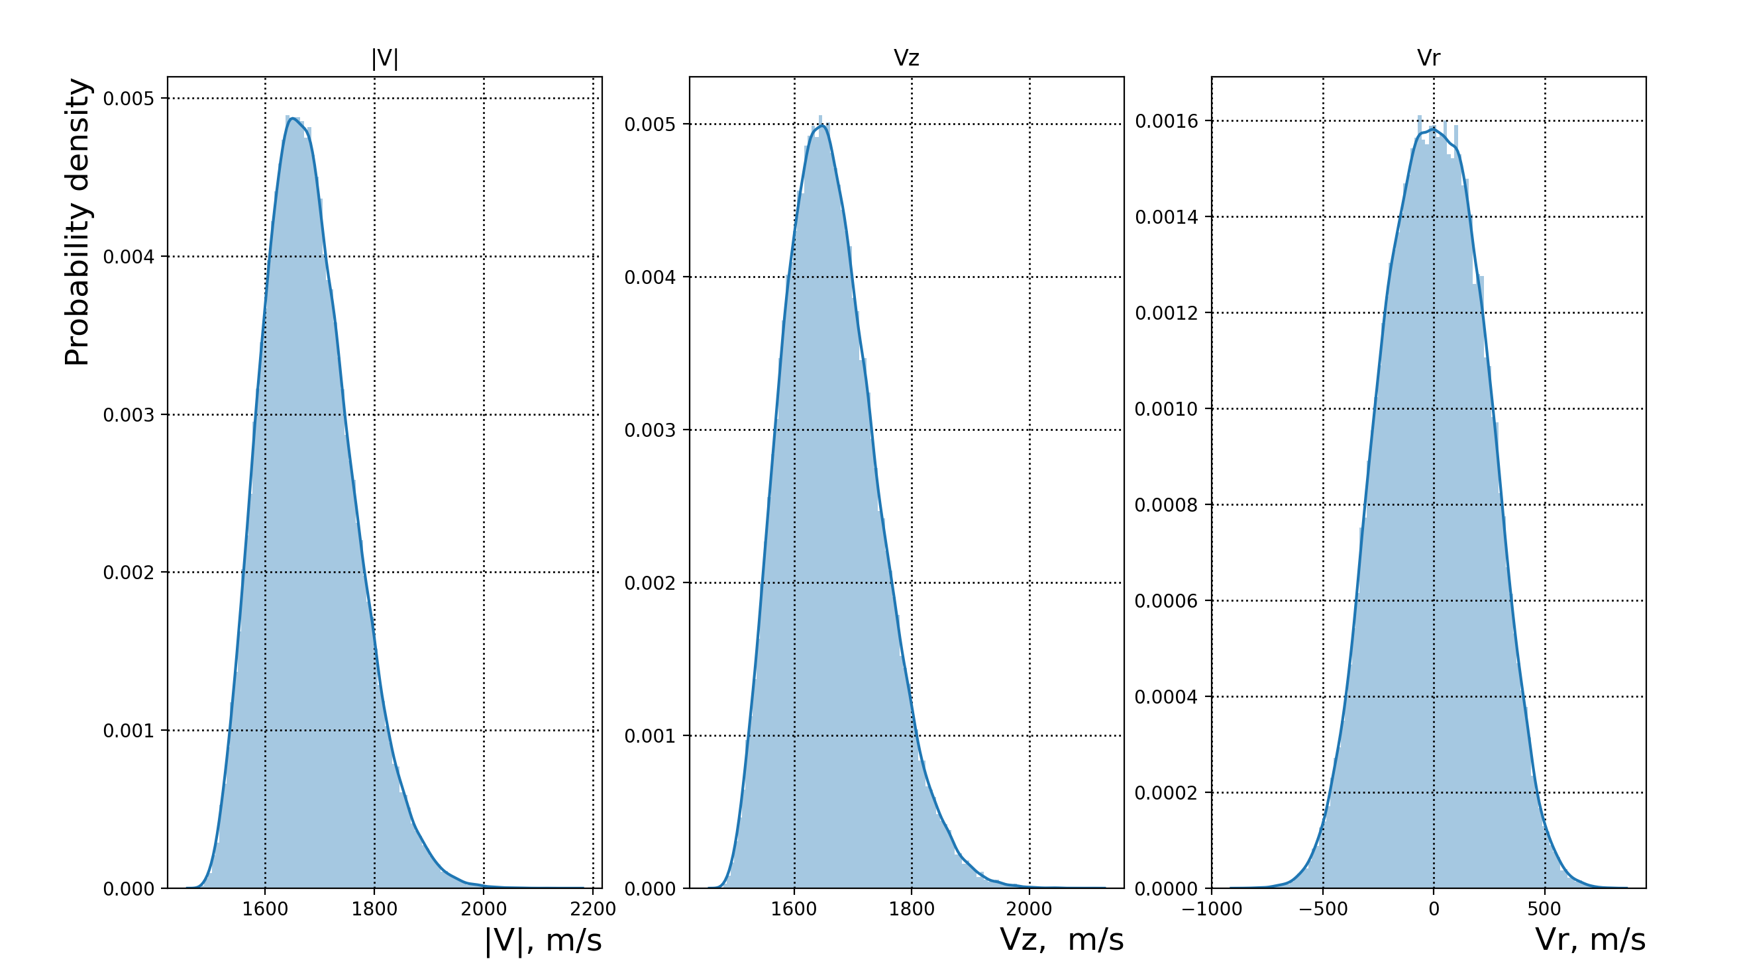
Initial data generator
The atomic beam is defined by an event generator that produces a particle with the following parameters:
1. Particle coordinates (z, r)
3. The velocity of the particle along the OZ axis, $v_{r}$, and the velocity along the Or axis, $v_{z}$
Velocity distributions
Beam profile
μ = 0
σ = r₀.
2. The projection of the total atomic spin
The polarization of the particle is defined according to a uniform distribution, so that the initial atomic beam is unpolarized.

Slide 9
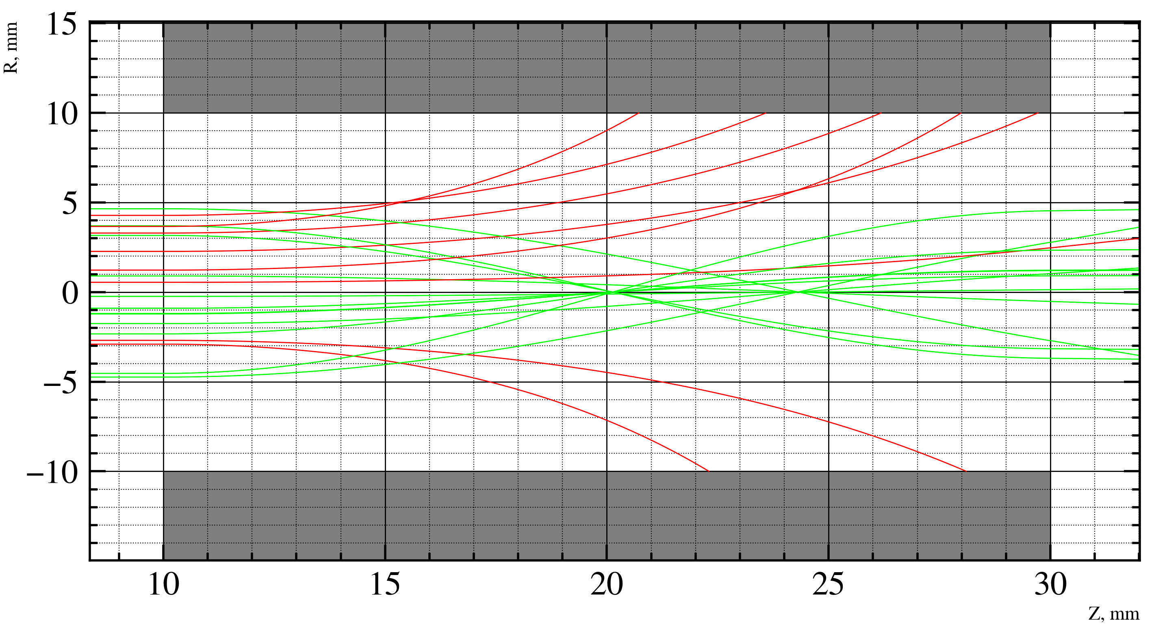
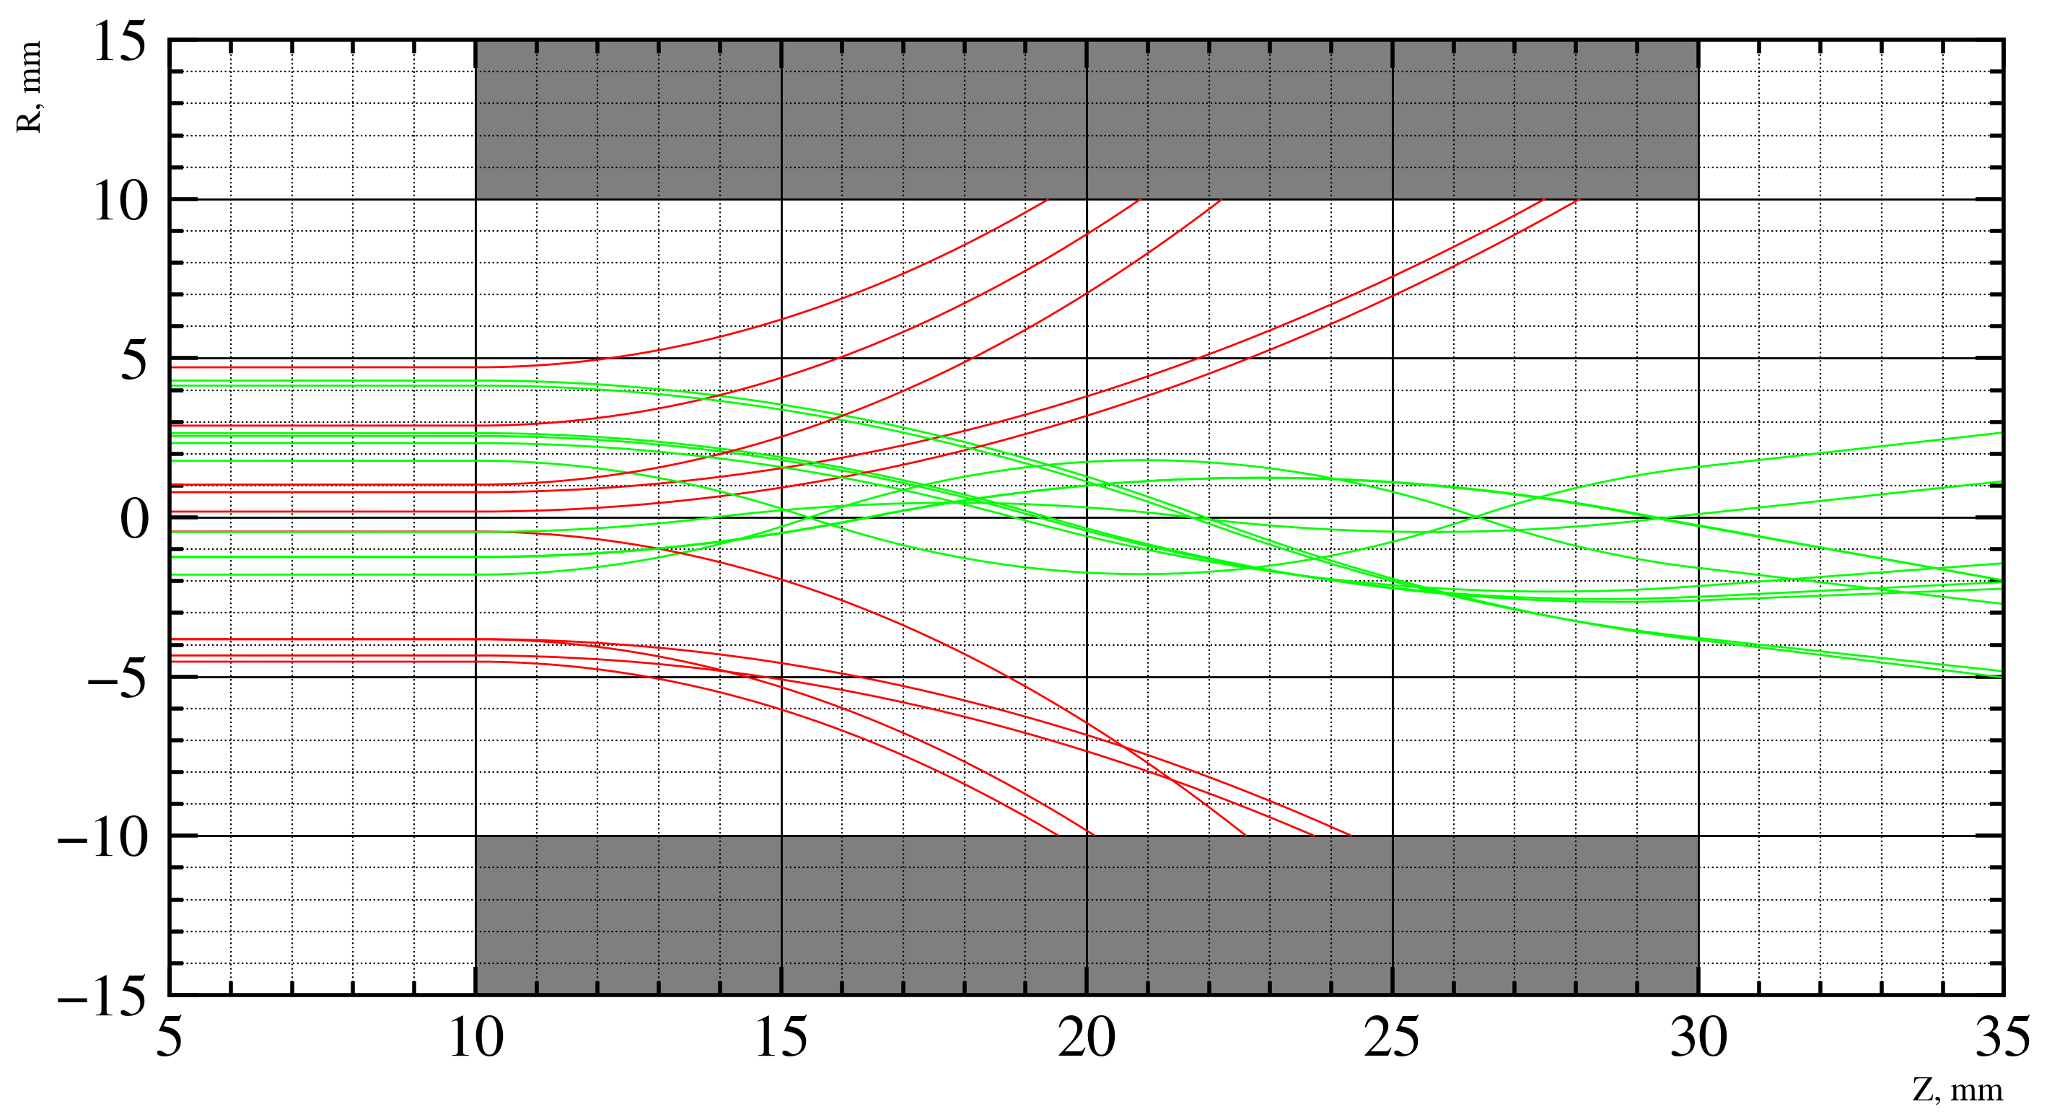
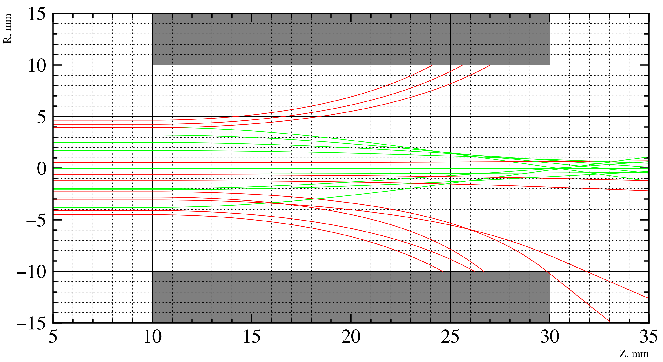
Modelling multipolar magnetic system
a
b
c
a - Sextupole magnetic lens, b - Quadrupole magnetic lens, c - Octupole magnetic lens. Atoms with a negative projection of the electron spin are indicated in red, while atoms with a positive projection of the electron spin are indicated in green.

Slide 10
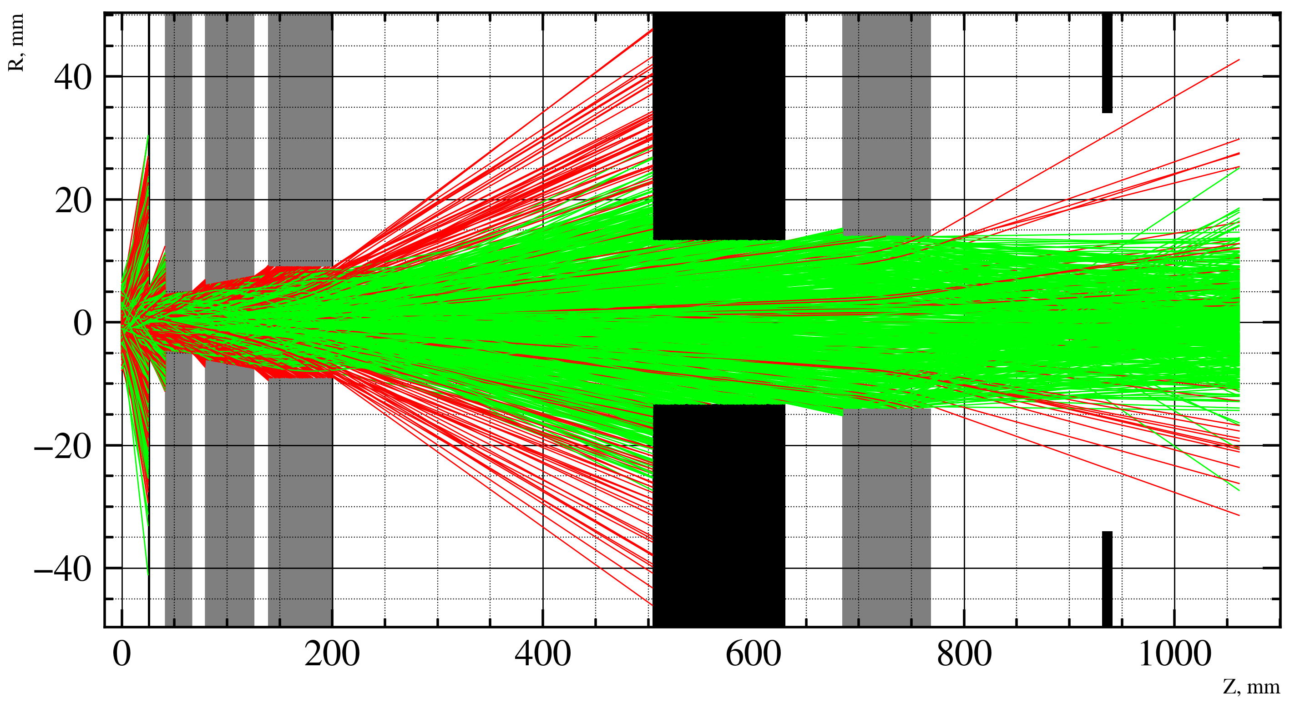
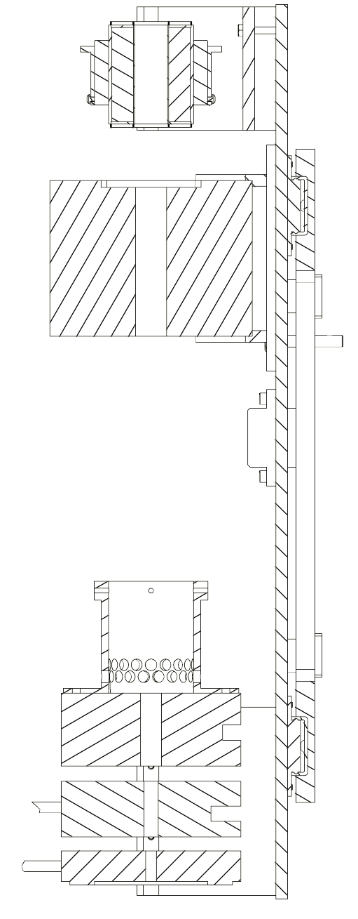
Modelling multipolar magnetic system (SPI ABS)
1
2
3
3
2
$$P_{+\frac{1}{2}}=\left(91.3±1.4\right)\%$$
1 - the first three sextupole lenses,
2 - the wall,
3 - the sextupole lens
1
Intensity = $\frac{N_{end}}{N_{start}}∗100\%$
Intensity = $\left(0.36±0.04\right)\%$

Slide 11
Modelling polarizer (PolFusion ABS)
$P_{z}\left(I=1\right)= \frac{N_{(m_{i} = +1)}− N_{(m_{i} = −1)}}{N_{(m_{i} = +1)}+N_{(m_{i} = 0)}+ N_{(m_{i} = −1)}}$,
$$P_{zz}\left(I=1\right)= \frac{1− 3N_{\left(m_{i} = 0\right)}}{N_{\left(m_{i} = +1\right)}+N_{\left(m_{i} = 0\right)}+ N_{\left(m_{i} = −1\right)}}$$
Color | State
Blue | $$|1⟩$$
Green | $$|2⟩$$
Red | $$|3⟩$$
Cyan | $$|4⟩$$
Purple | $$|5⟩$$
Yellow | $$|6⟩$$
Intensity 0.17% Vector polarization -0,9
Tensor polarization 0,86

Slide 12
Checking the performance of the polarizer simulation
 | P_{z, meas.} | P_{zz, meas.} | P_{z, sim.} | P_{zz, sim.}
ANKE PABS | +0.88 ± 0.01 | +0.88 ±0.03 | +0.89 ± 0.03 | +0.90 ± 0.03
 | -0.91 ±0.01 | +0.85 ±0.2 | -0.91 ±0.03 | +0.89 ± 0.03
 | +0.005 ±0.003 | +0.90 ±0.02 | -0.06 ± 0.08 | +0.90 ± 0.04
 | +0.005±0.003 | -1.71 ± 0.03 | -0.08 ± 0.03 | -1.58 ± 0.07
HERMES PABS | +0.92 ±0.01 | +0.88 ± 0.02 | +0.94 ±0.021 | +0.89 ± 0.03
 | -0.91 ±0.01 | +0.94± 0.02 | -0.92 ±0.011 | +0.95± 0.01
 | -0.02± 0.01 | +0.99 ± 0.02 | -0.05± 0.08 | +0.96 ± 0.05
 | -0.02±0.01 | -1.77 ±0.02 | -0.03±0.02 | -1.64 ±0.04

Slide 13
Choosing the optimal PABS design (PolFusion)
 | P_{z. theor} | P_{zz, theor} | P_{z, sim.} | P_{zz, sim.} | Intensity, %
Design №1 (6666 66) | 0 | +1 | +0.06 ±0.08 | +0.89 ±0.02 | 0.20 ±0.02
 | - 1/3 | +1 | -0.26 ±0.06 | +0.92 ±0.03 | 0.21 ±0.02
 | -1 | +1 | -0.92 ±0.02 | +0.92 ±0.02 | 0.16 ±0.01
Design №2 (6646 46) | 0 | +1 | -0.46±0.06 | +0.86±0.04 | 0.13±0.01
 | - 1/3 | +1 | -0.63 ±0.05 | +0.94 ± 0.03 | 0.14 ± 0.01
 | -1 | +1 | -0.95±0.02 | +0.95±0.04 | 0.14 ±0.01
Design №3 (8888 88) | 0 | +1 | -0.50 ± 0.05 | +0.86 ± 0.05 | 0.22 ± 0.01
 | - 1/3 | +1 | -0.58 ± 0.07 | +0.88±0.03 | 0.20±0.01
 | -1 | +1 | -0.89±0.03 | +0.89±0.04 | 0.21 ± 0.01

Slide 14
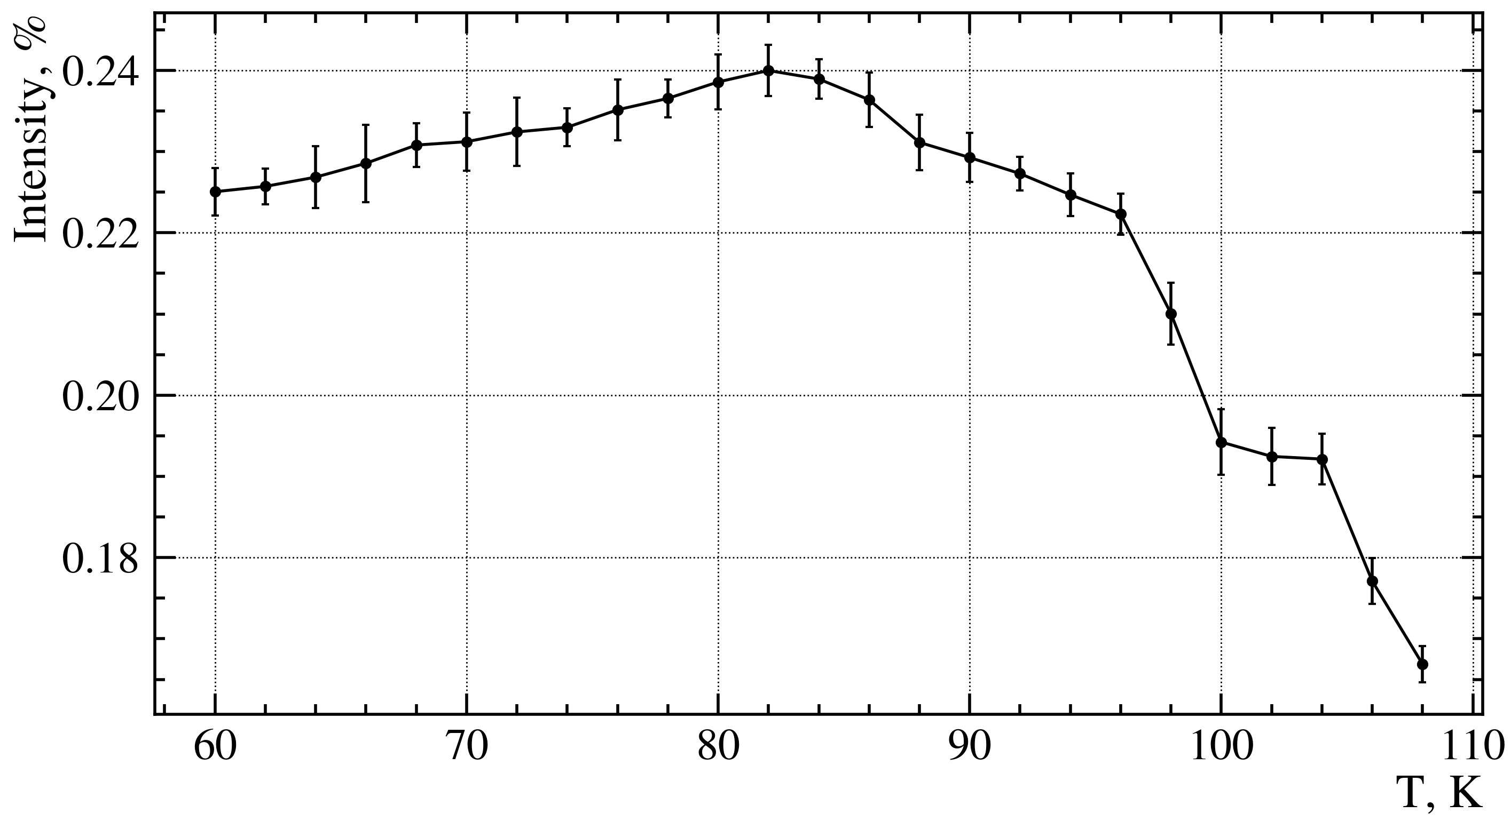
PABS optimization based on nozzle temperature
P, mBar
a
T, K
P, mBar
b
Graph of the dependence of intensity on nozzle temperature (calculated)
Graph of the dependence of pressure in the compression tube on the nozzle temperature:
a - in the range from 70 to 110 K,
b - in the range from 0 to 310 K.
T, K

Slide 15
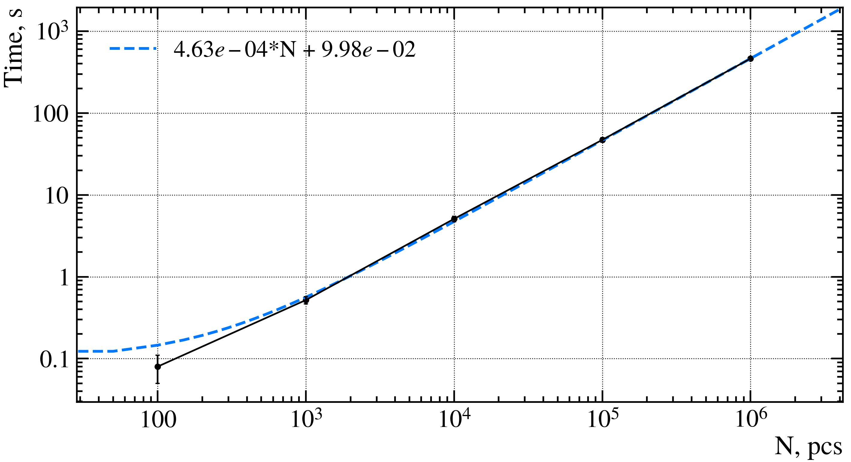
Conclusion
Assumptions
When calculating the passage through the magnet, the following assumptions were made:
1. There are no edge effects at the boundary of the magnet, meaning that the particles travel uniformly and in a straight line towards the magnet.
2. The magnet is infinitely tall.
3. The change in the velocity of the atomic beam along the Z-axis is negligible: $v_{z}=const$.
1. The intensity calculated during the simulation aligns very closely with the intensity measured in experimental setups.
2. The degree of polarization calculated during the simulation, taking into account the margin of error, falls within the range of experimental data.
3. The runtime complexity of the program is O(n).

Slide 16
Thank you for your attention!
PNPI - NRC KI

Slide 17
PABS

Slide 18
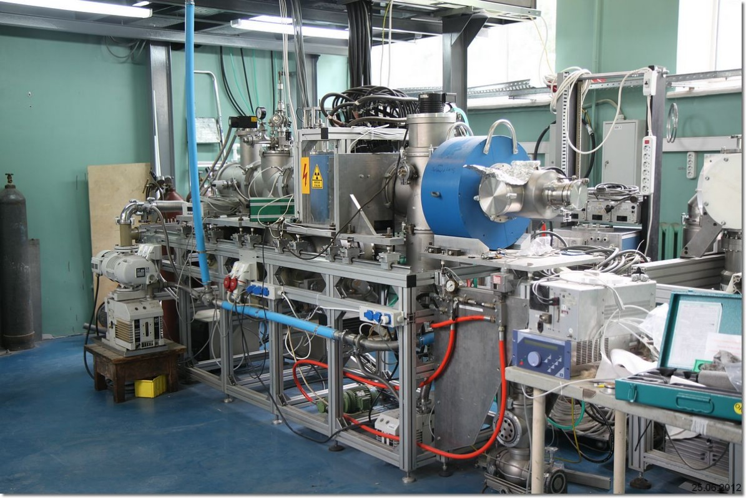
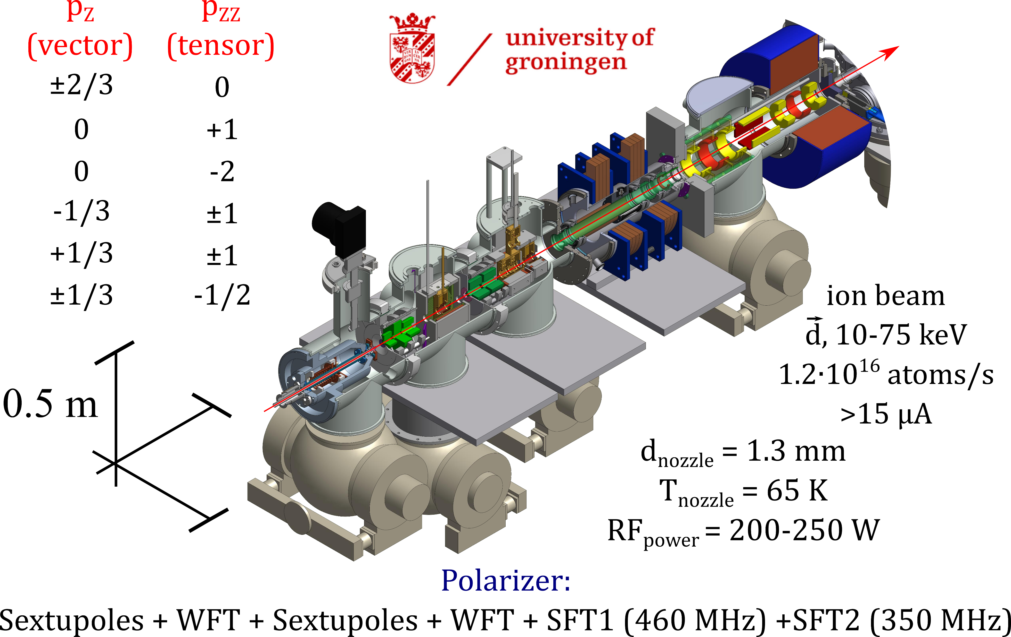
POLIS

Slide 19
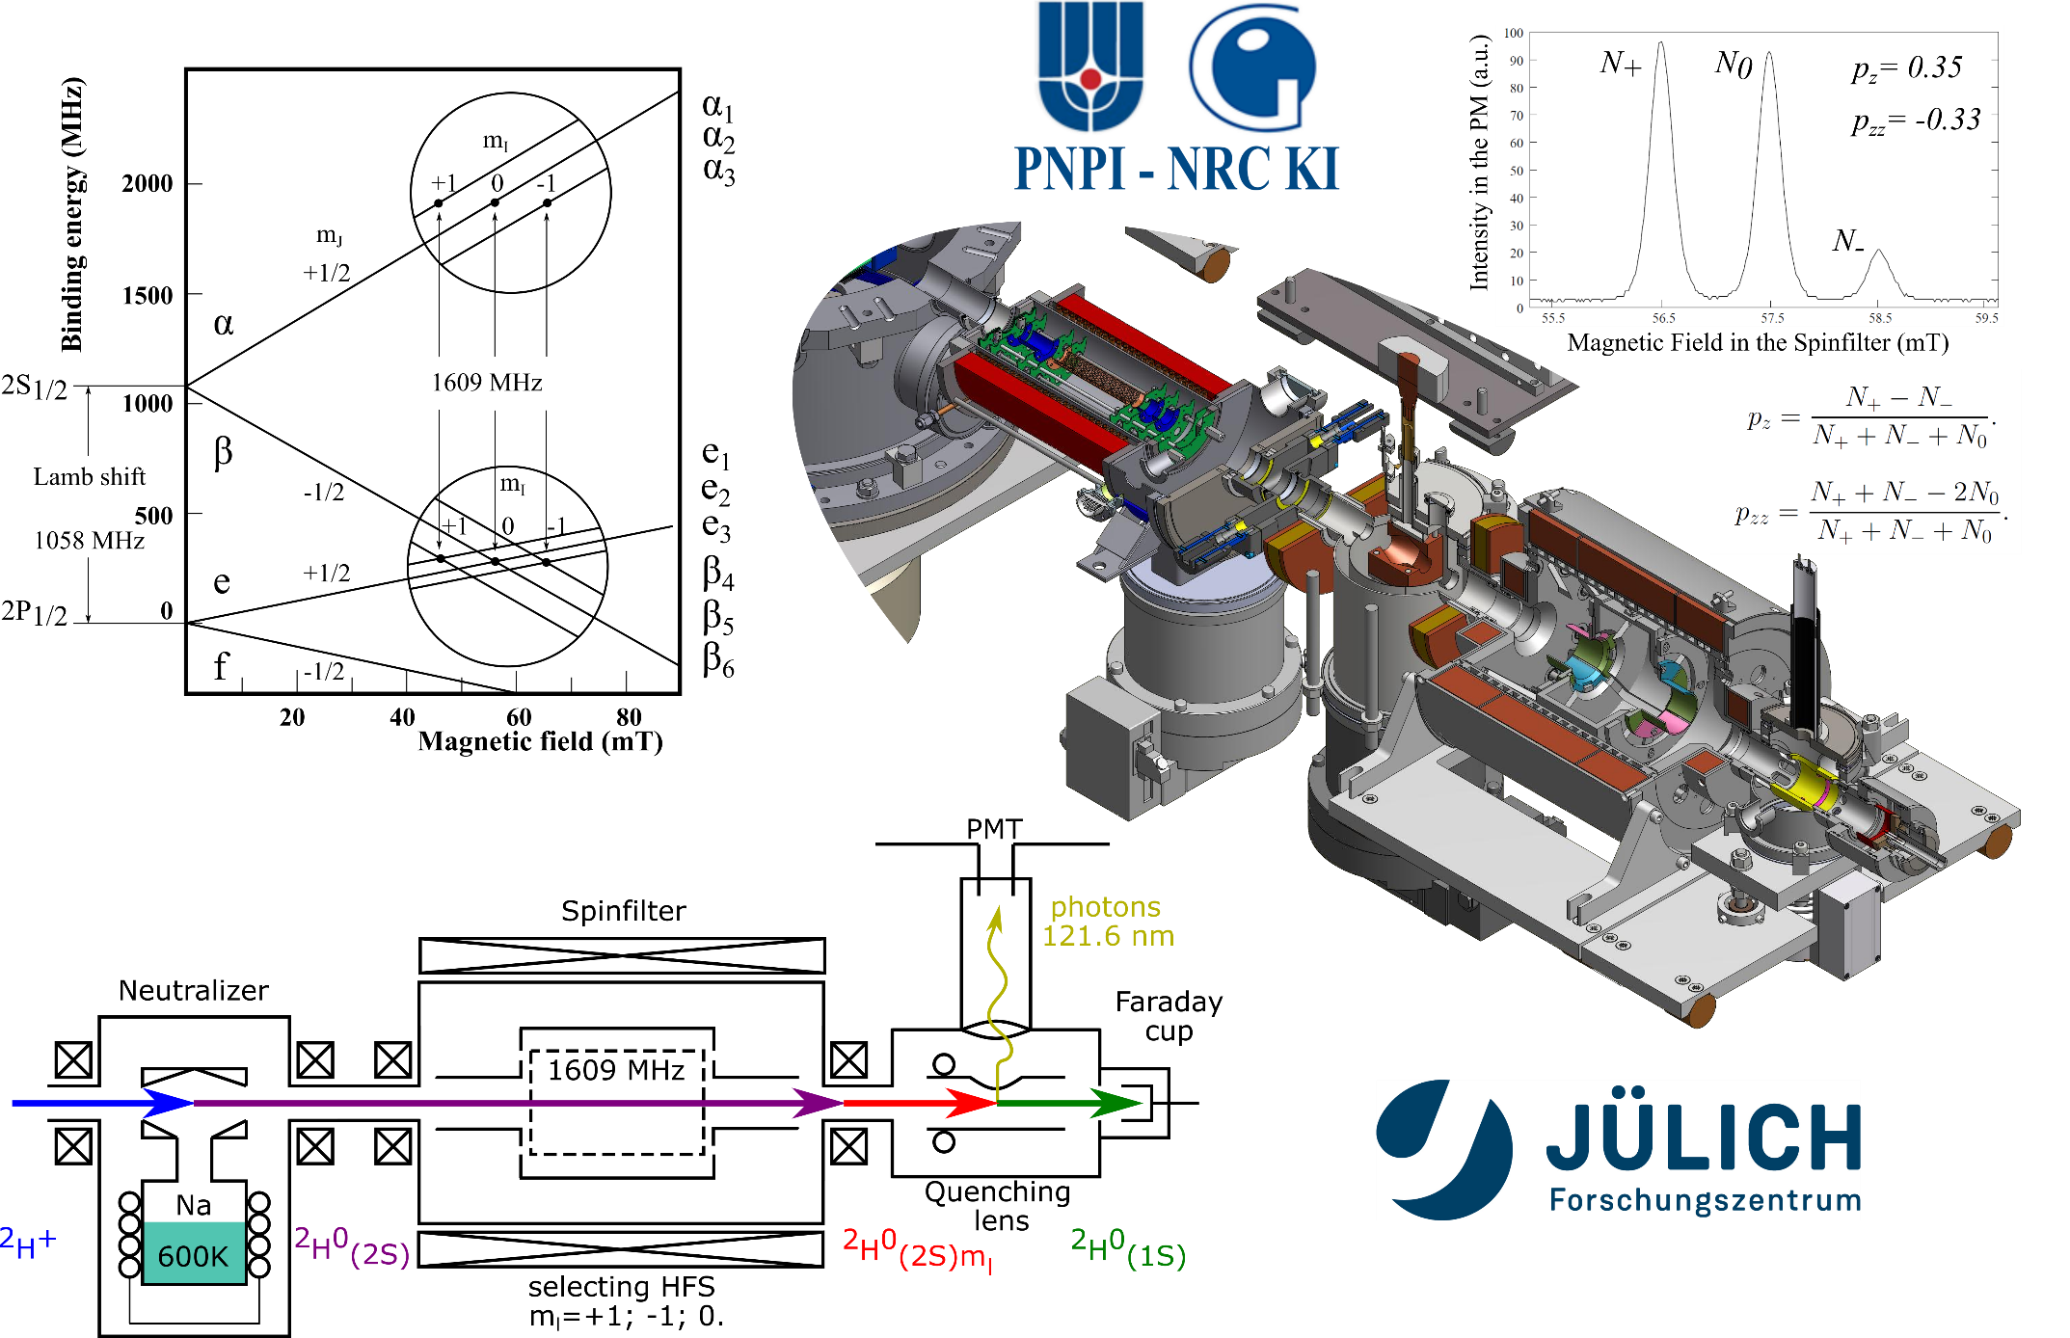
LSP

Slide 20
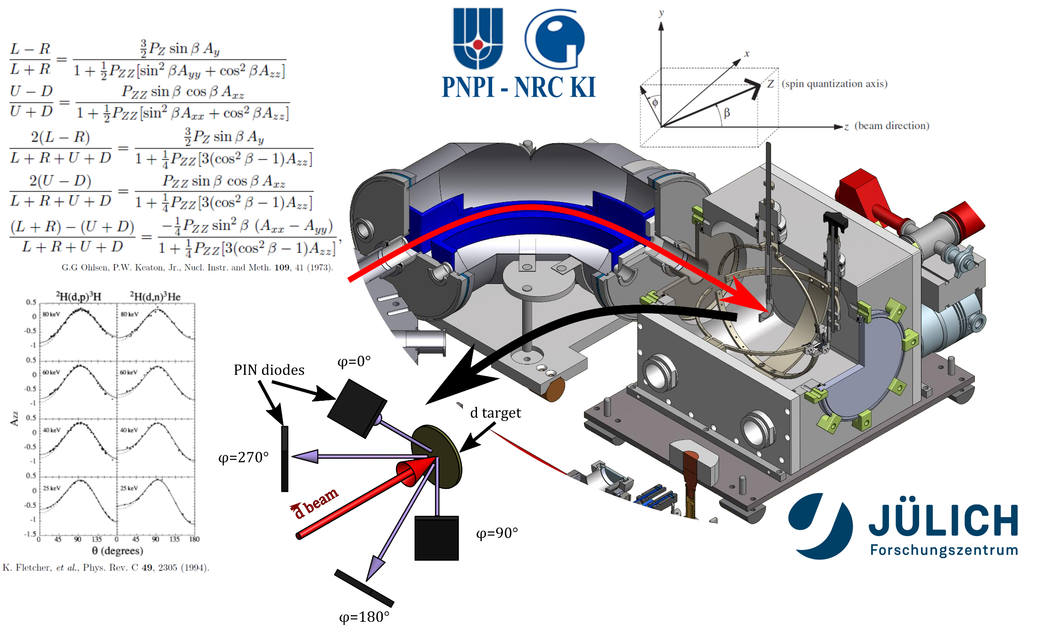
NRP

Slide 21
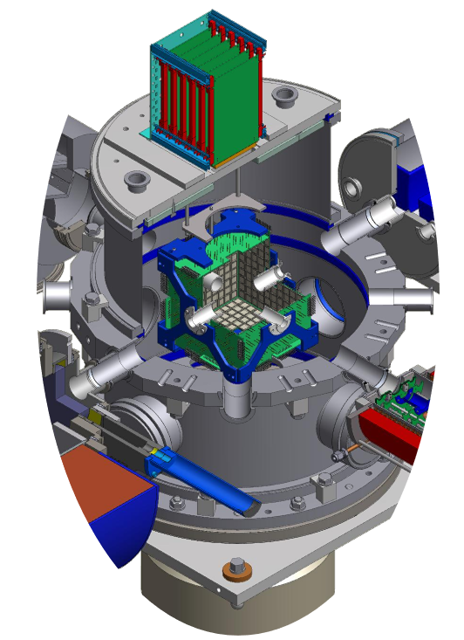
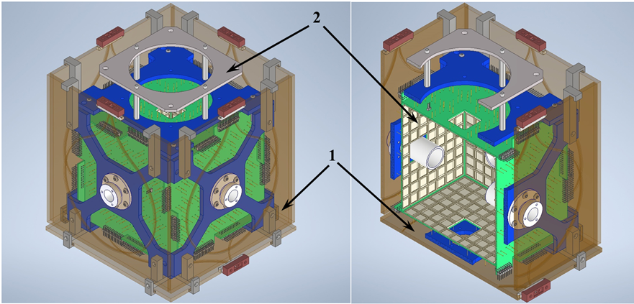
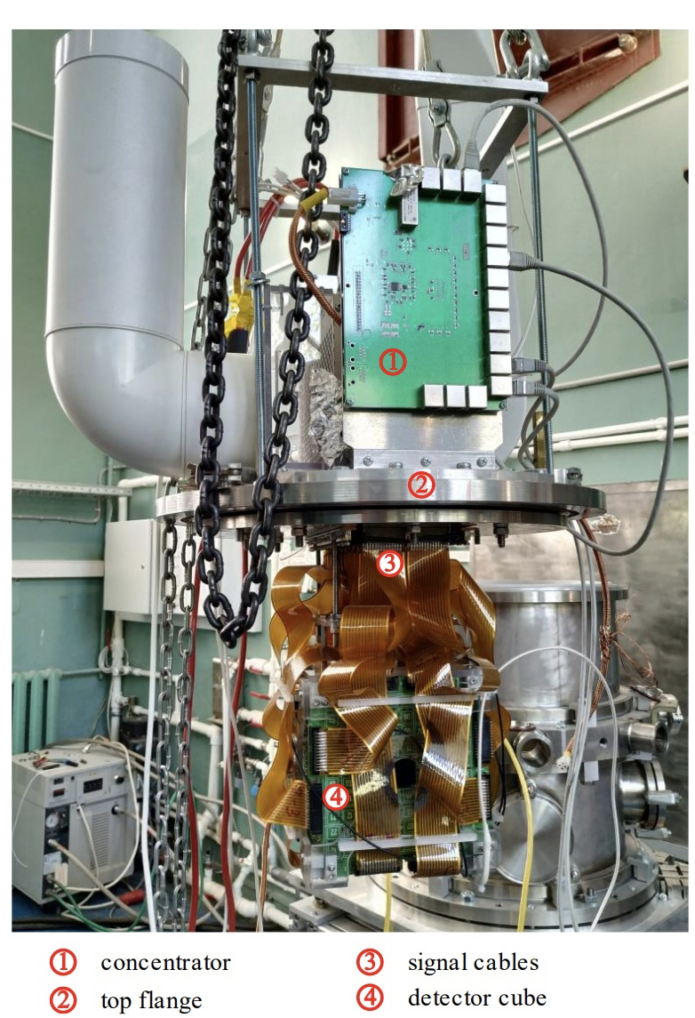
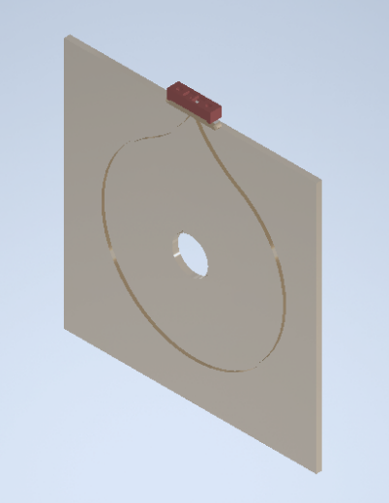
4π - детектор

Slide 22
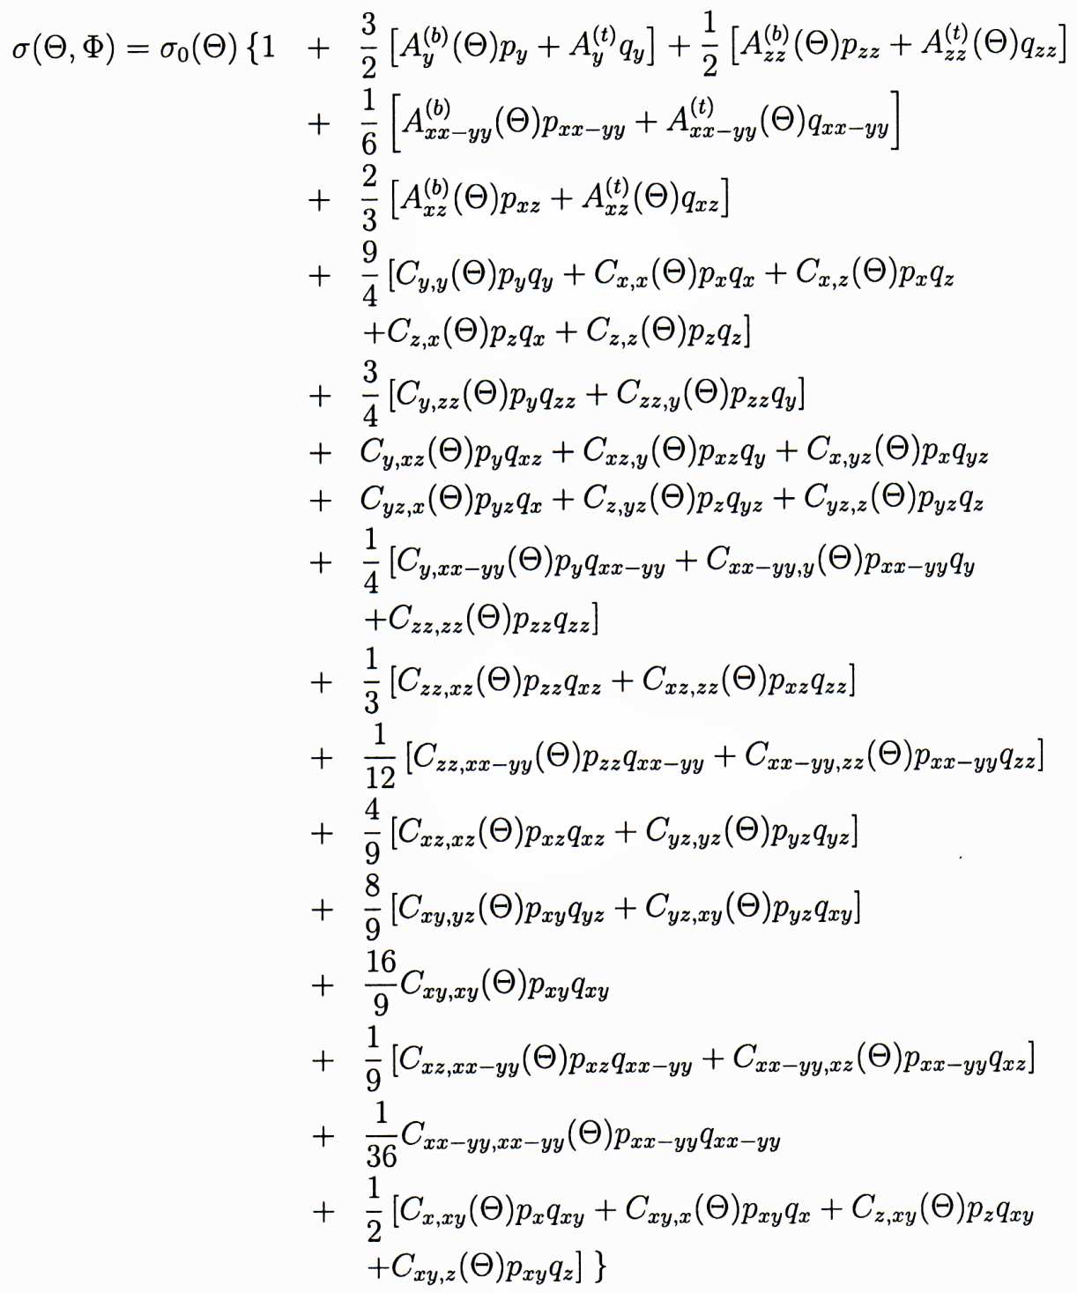
Сечение реакции
p_{z}(q_{z}), p_{zz}(q_{zz}) ≠ 0
(p_{i,j} ≠ 0, q_{i,j} = 0):
σ(ϴ,Φ) = σ₀(ϴ) · {1 + 3/2 A_{y}(ϴ) p_{y} + 1/2 A_{xz}(ϴ) p_{xz}
+ 1/6 A_{xx-yy}(ϴ) p_{xx-zz}
+ 2/3 A_{zz}(ϴ) p_{zz} }

Slide 23
Мотивация
Астрофизика
Big bang
Термоядерная энергетика
Использованиеe поляризованного топлива
Прикладные аспекты
Наработка трития и гелия-3
Увеличение сечения
Управление угловым распределением вылета продуктов реакции
Реакторы с малым выходом нейтронов
3He-ориентированная технология газоразрядных детекторов
Источник нейтронов для наработки медицинских изотопов 100Mo(n,2n)99Mo
Hydrogen burning
Helium burning
Advanced burning
(carbon/neon/oxygen/silicon)
s-process (neutron sources)
p-process
Теория ядерного взаимодействия
Широкий спектр моделей
Сложности при описании прямых/непрямых измерений

Slide 24
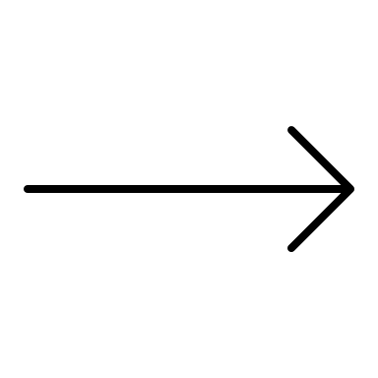
Астрофизика
Big Bang нуклеосинтез
Первичное распределение изотопов D/H
Необходимы более точные данные по dd-синтезу!
Улучшено благодаря LUNA
Global BBN Analysis: Tsung-Han Yeh, Keith Olive, Brian Fields (2021)

Slide 25
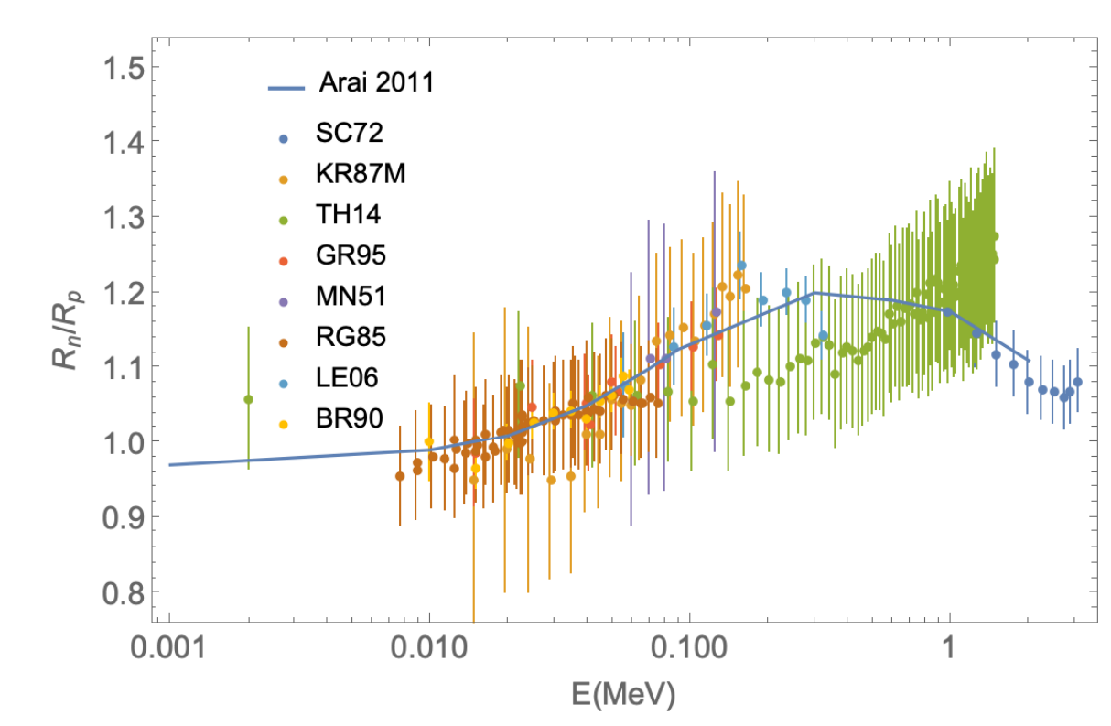
Астрофизика
Отношения сечений процессов d(d, n)³He к d(d, p)³H из экспериментов (точки) и теории (сплошная линия).
Необходимы новые измерения сечения реакции неполяризованного dd-синтеза по обоим каналам!
Теоретическое предсказание: K. Arai, S. Aoyama, Y. Suzuki, P. Descouvemont, and D. Baye Phys. Rev. Lett. 107, 132502 (2011)
Ofelia Pisanti, Gianpiero Mangano, Gennaro Miele, and Pierpaolo Mazzella
Primordial Deuterium after LUNA: concordances and error budget (2020)

Slide 26
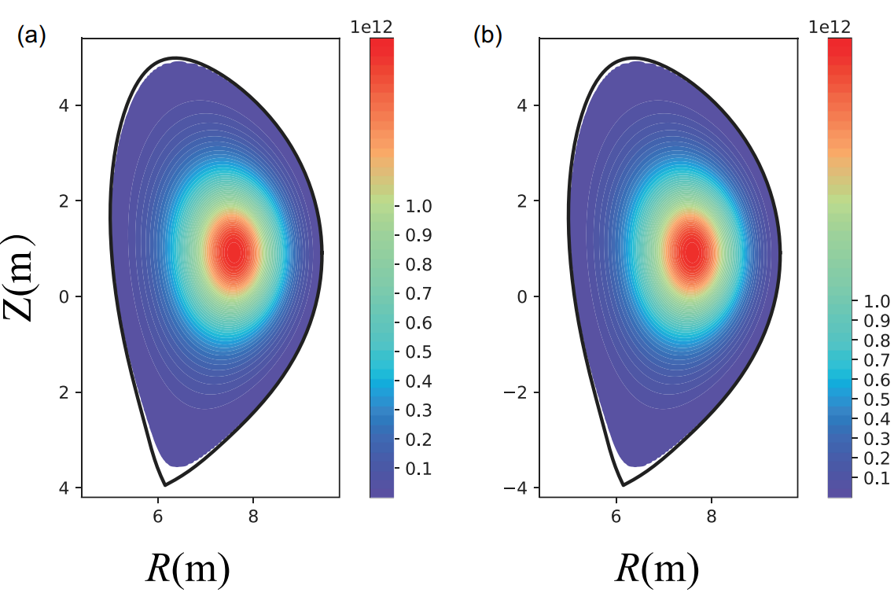
Термоядерный синтез и прикладные аспекты
Увеличение сечения реакции
Контроль над направлением разлета продуктов реакции
Подавление нейтронного канала
Распределения источников нейтронов в координатах (R, Z) для (а) неполяризованного случая и (б) случая полной параллельной поляризации.
W.Yang, G.Li, X.Gong, X.Gao, X.Li, H.Li… Effect of the Fusion Fuels’ Polarization on Neutron Wall Loading Distribution in CFETR (2021)
https://doi.org/10.1080/15361055.2021.1969064 (China Fusion Engineering Test Reactor (CFETR))
Exp.: Ch. Leemann et al., Helv. Phys. Acta 44, 141 (1971)
Theor.: G. Hupin et al. Nature Com. 10, 321 (2019)

