Slide 1
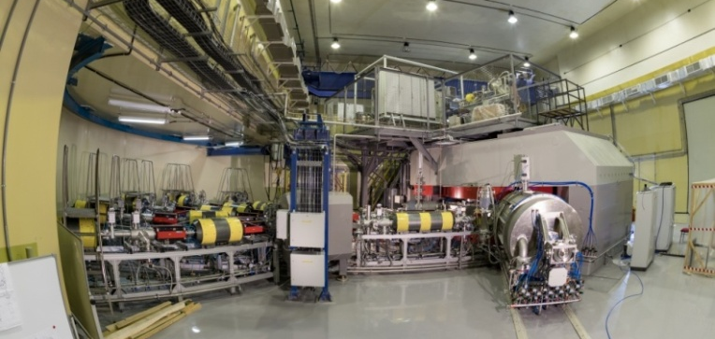
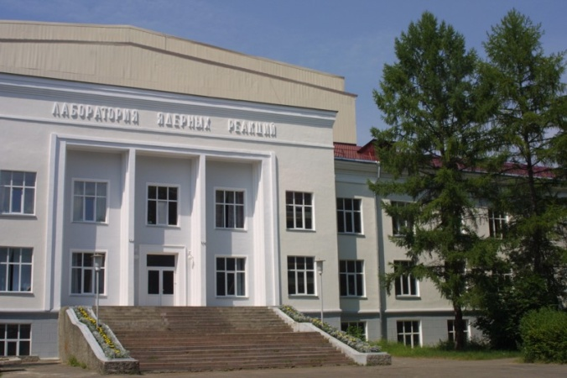
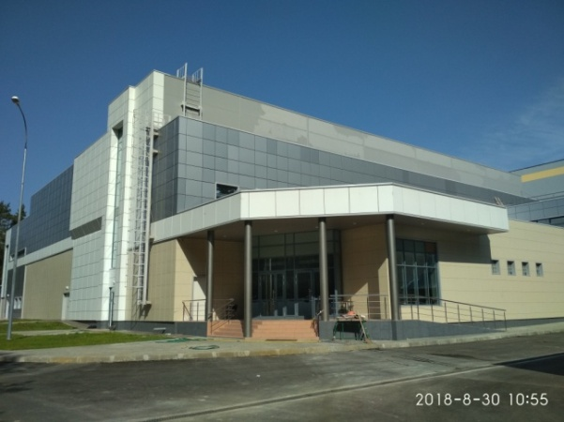
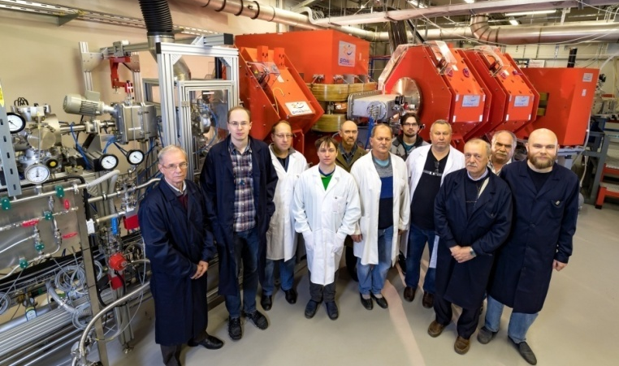
Synthesis and study of the decay properties of isotopes of superheavy element Lv in Reactions ²³⁸U + ⁵⁴Cr and ²⁴²Pu + ⁵⁰Ti
Dastan Ibadullayev
DC280
DGFRS-2
28th International Scientific Conference of Young Scientists and Specialists (AYSS-2024), Dubna, Russia

Slide 2
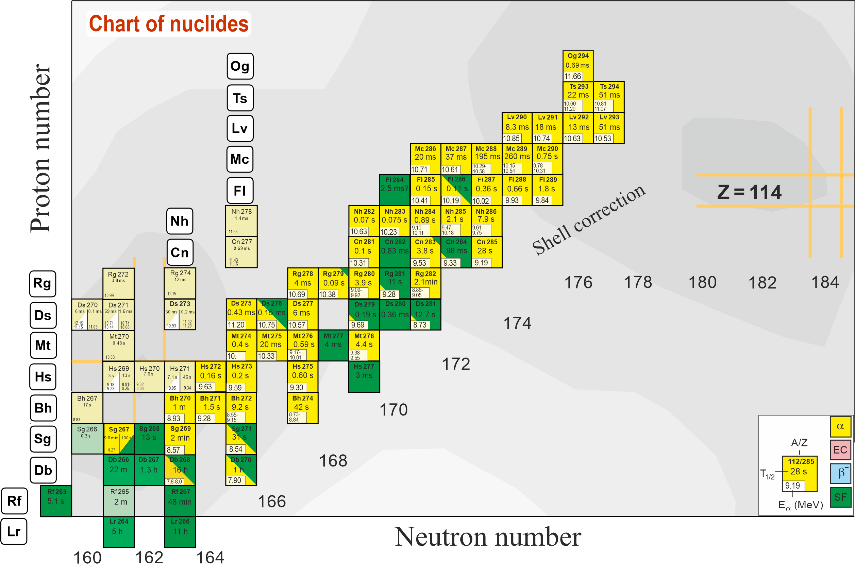
Area of known superheavy isotopes
Production of new isotopes and synthesis of new elements 119, 120…
⁵⁰Ti, ⁵⁴Cr…
²³⁸U – ²⁴⁹Cf + ⁴⁸Ca
Light isotopes
2n channel
Notes:
A new accelerator(CAFE2) and gas-filled recoil separator(SHANS2) have been built at IMP. The detectors and rotating target are shown.

Slide 3
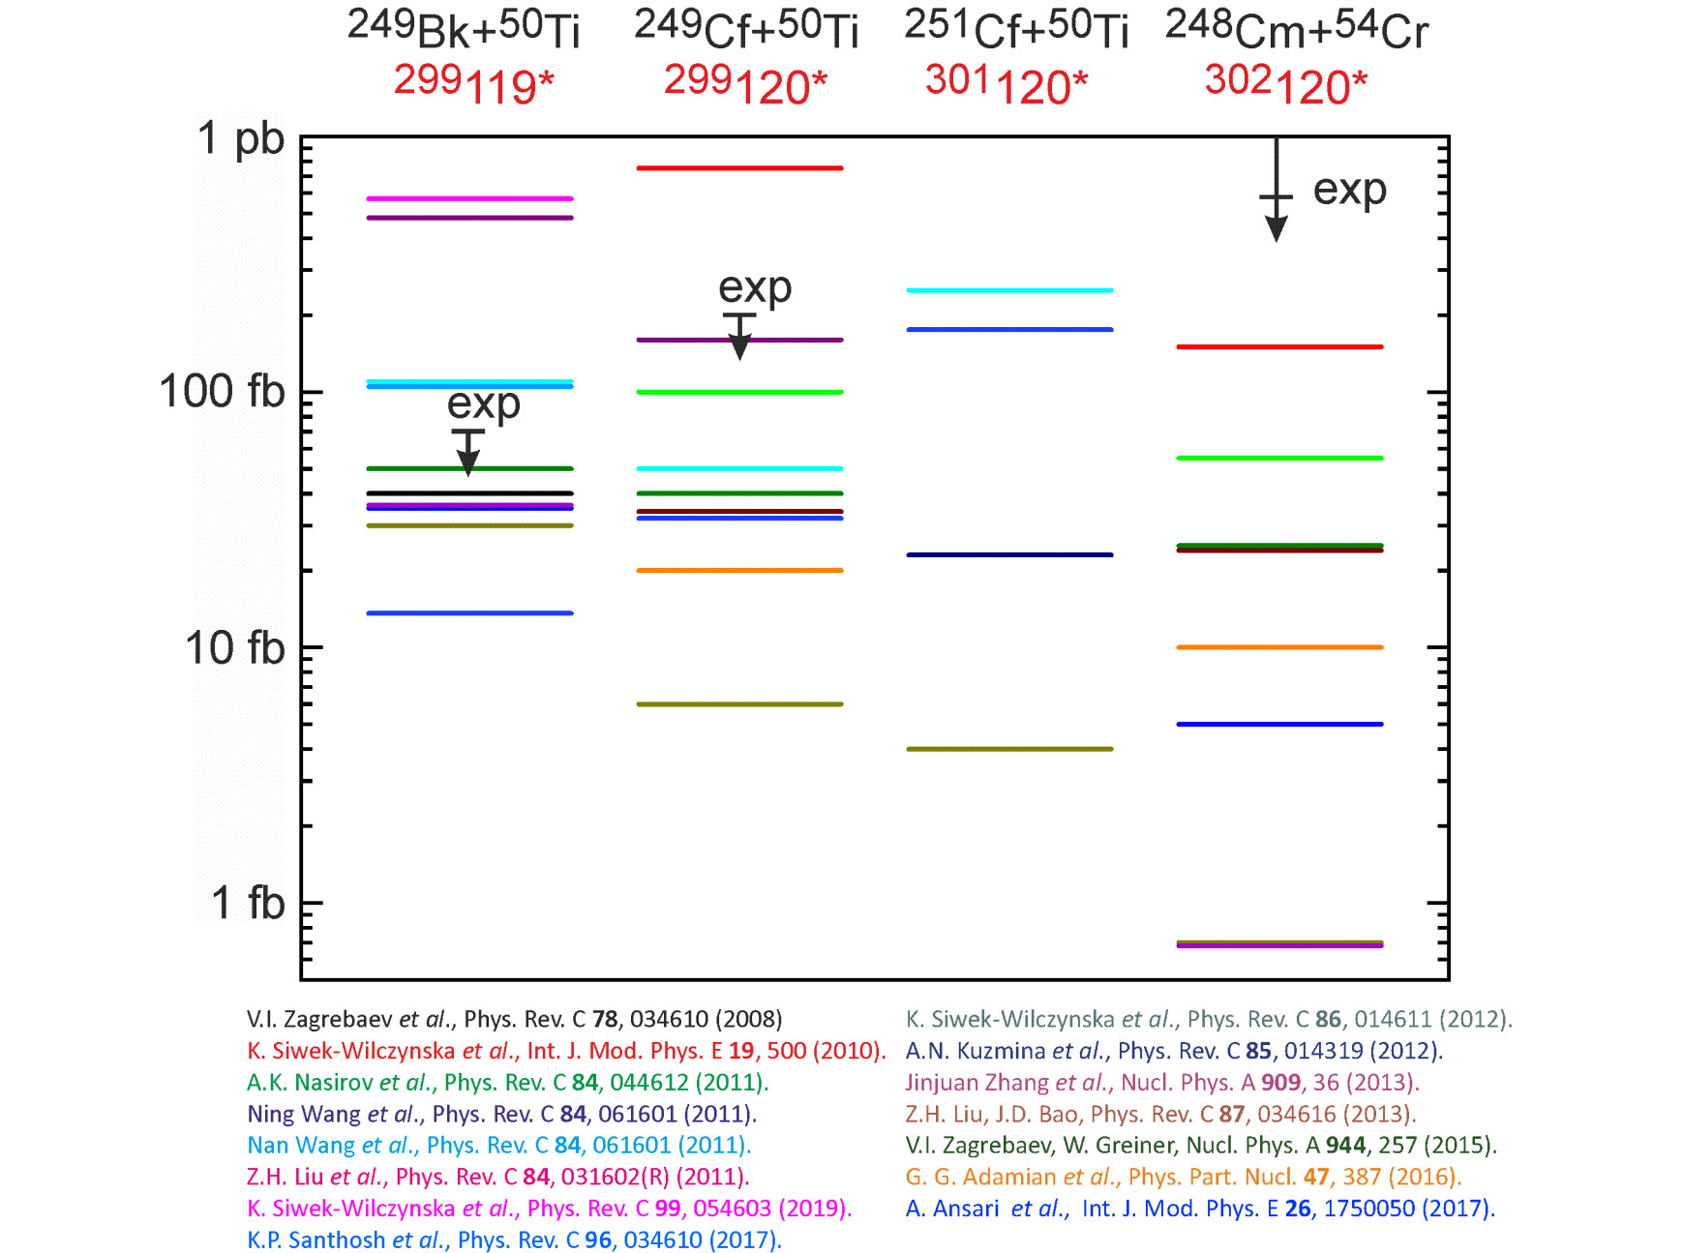
Predictions of production cross-sections of element 119 and 120 isotopes in ²⁴⁹Bk+⁵⁰Ti, ²⁴⁹⁻²⁵¹Cf+⁵⁰Ti , ²⁴⁸Cm+⁵⁴Cr reactions
(difference by 2-3 orders of magnitude)

Slide 4
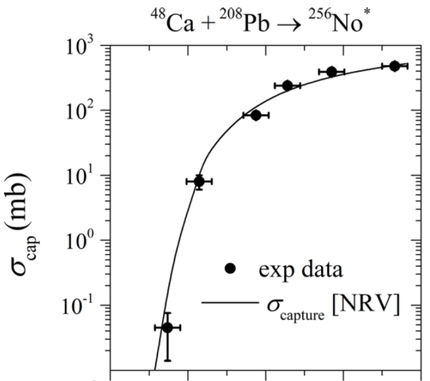
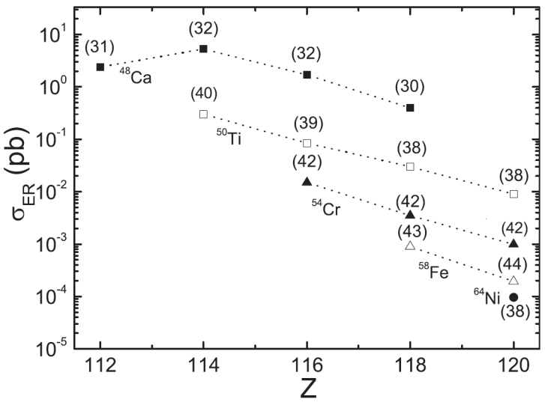
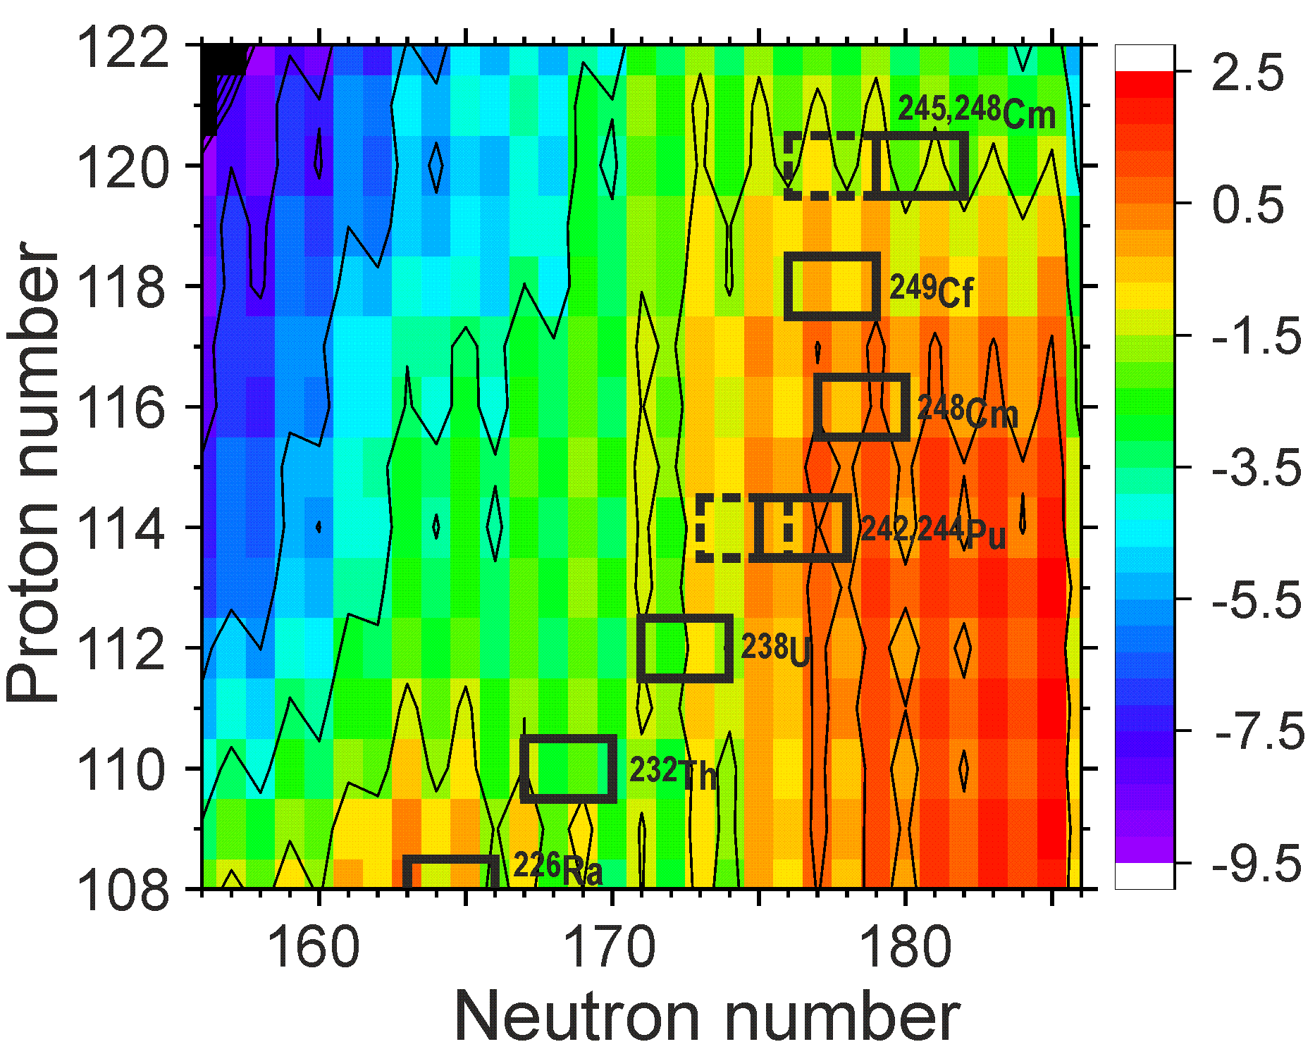
Cross-section of complete fusion reactions
σ_{ER}(E_{c.m.}) = σ_{c}(E_{c.m.}, J) x P_{CN}(E_{c.m.}, J) x W_{sur}(E_{c.m.}, J)
Capture cross section
probability of compound nucleus formation
survival probability of compound nucleus
⁴⁸Ca
⁵⁰Ti
⁵⁴Cr
⁴⁸Ca ⁵⁰Ti ⁵⁴Cr
²⁴⁵Cm + ⁴⁸Ca ²⁹³Lv*
²⁴²Pu + ⁵⁰Ti ²⁹²Lv*
²³⁸U + ⁵⁴Cr ²⁹²Lv*
experiment
calculation
W_{sur} ~ exp(B_{f} – B_{n})
synthesis of the same compound nucleus in different reactions
investigation of cross sections of nuclei at the minimum stability
M.G. Itkis et al., 2022
G.G. Adamian et al., 2020
P. Jachimowicz et al., 2021

Slide 5
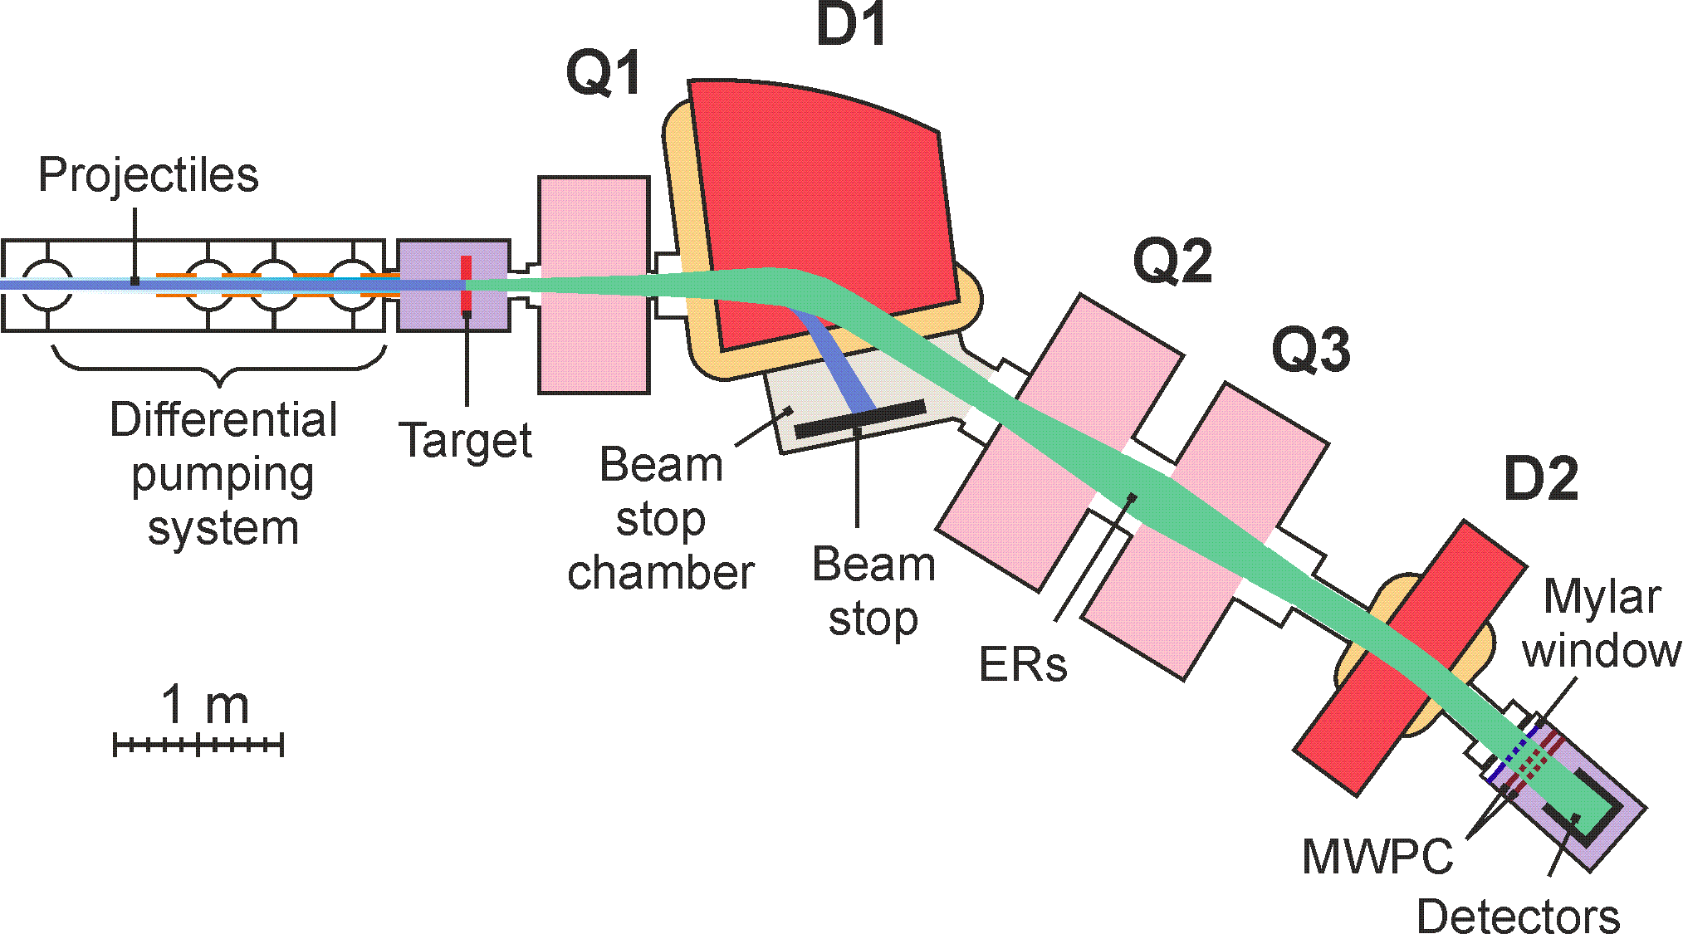
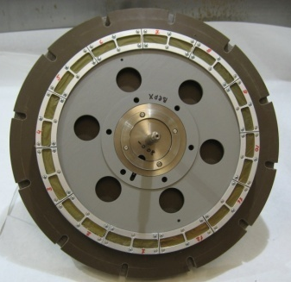
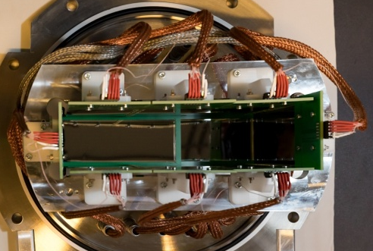
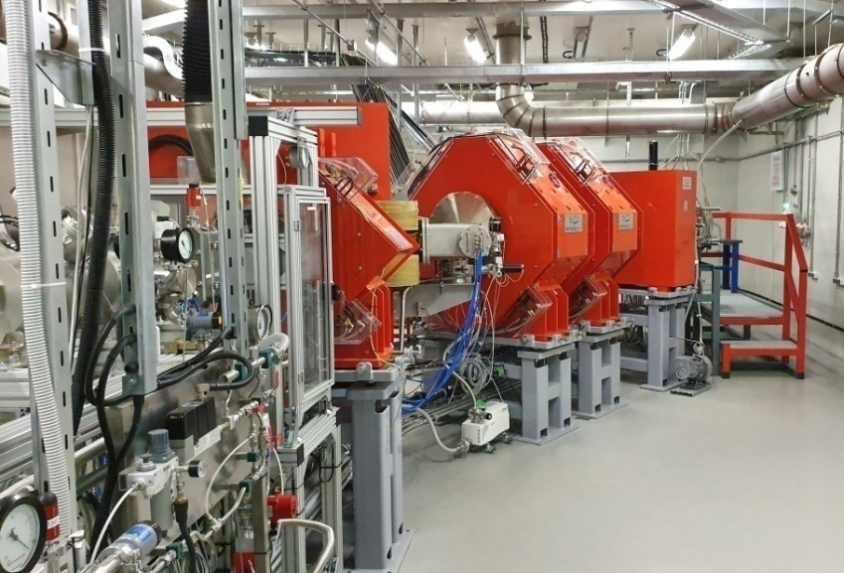
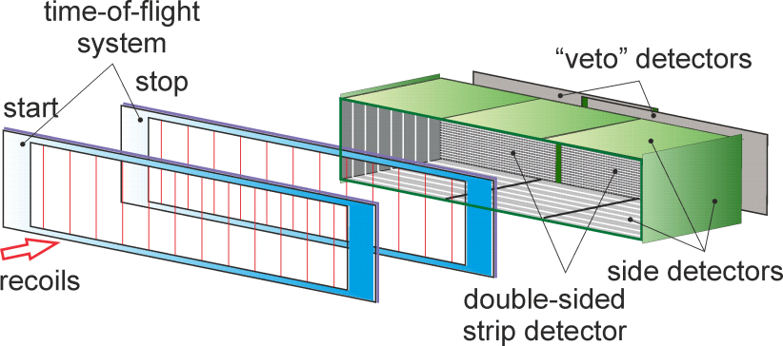
SHE Factory
Dubna Gas-Filled Recoil Separator DGFRS-2
DC280
Rotating target, magnets (Q1, D1, Q2, Q3, D2), beamstopper, detector chamber.
24-sm target, 12 sectors
48×220 DSSD & 60×120 SSSD
Digital and analog electronics

Slide 6
The ²⁴²Pu and ²³⁸U target thicknesses; reaction-specific laboratory-frame projectile energies E_{lab} in the middle of the target layers; resulting excitation energy E* intervals (with use of mass tables); total beam doses; the numbers of observed decay chains of ²⁸⁹Lv (3n) and ²⁸⁸Lv (4n) and the cross sections s of their production.
Reaction | Target thickness (mg/cm²) | E_{lab} ª (MeV) | E* (MeV) | Beam dose ×10¹⁹ | No. of chains 3n/4n | s_{3n} (fb) | s_{4n} (fb)
²⁴²Pu+⁵⁰Ti | 0.73 | 267.6 | 38.6-42.6 | 1.5 | 3/2 | 320$\begin{matrix}+340 \\ −180\end{matrix}$ | 220$\begin{matrix}+270 \\ −150\end{matrix}$
²³⁸U+⁵⁴Cr | 0.70 | 289.9 | 39.5-44.1 | 7.2 | 0/2 | – | $$36\begin{matrix}+46 \\ −24\end{matrix}$$
ª The beam energy was measured with a systematic uncertainty of 1 MeV.

Slide 7
Experiment ²³⁸U + ⁵⁴Cr
Target ²³⁸U: 0.72 mg/cm²
Dose: 7.2 x 10¹⁹
Excitation energy: 42 MeV
For the first time:
Actinide + ⁵⁴Cr
New isotope ²⁸⁸Lv
Confirmation of ²⁸⁴Fl
Cross-section ~36 (12-82) fb
Notes:
For a more accurate estimation of the cross sections of reactions leading to the synthesis of new elements 119 and 120 in the fusion of 54Cr with Am and Cm isotopes, we performed a test experiment to obtain Lv nuclei in the 238U+54Cr reaction. The thickness of the target, the beam dose, the excitation energy and the distribution of the beam intensity over time are shown. The interval between the dates is one week. Two decay chains of 288Lv were registered, the alpha decay of which ended with spontaneous fission of the known isotope 284Fl. In the first chain, the energy and decay time of 288Lv corresponds well to the decay from the ground state to the ground state. In the second chain, the decay times in both cases are consistent with the times in the first chain. But the energy of the alpha particle is 1.45 MeV lower than in the first case. The data is preliminary. One of the reasons for the low energy may be incomplete registration of the particle, for example, the escape of alpha particle from the focal detector at a small angle to its surface or the nucleus got between the detector strips. Another reason may be the level structure of the nuclei. Data analysis continues.
Thus, for the first time in this experiment, a nucleus was obtained in the fusion reaction of a particle heavier than 48Ca with the nucleus of an actinide element, a new isotope was synthesized, and the decay properties of 284Fl were confirmed.
The reaction cross-section was 0.1 pb.

Slide 8
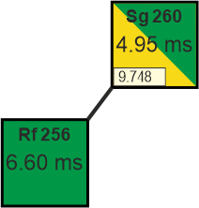
Experiment ²³⁸U + ⁵⁴Cr
Possible reasons: 4. It’s product of multi-transfer nucleon reactions:
Possible reasons: 1. Temporary change in the gain of the recording equipment - could not be confirmed or refuted. 2. α-particle deposited energy only in focal detector and escaped from it at the small angle.
3. Decay to excited state of ²⁸⁴Fl – seems very unlikely during large differences between α-decay energies and close decay times.

Slide 9
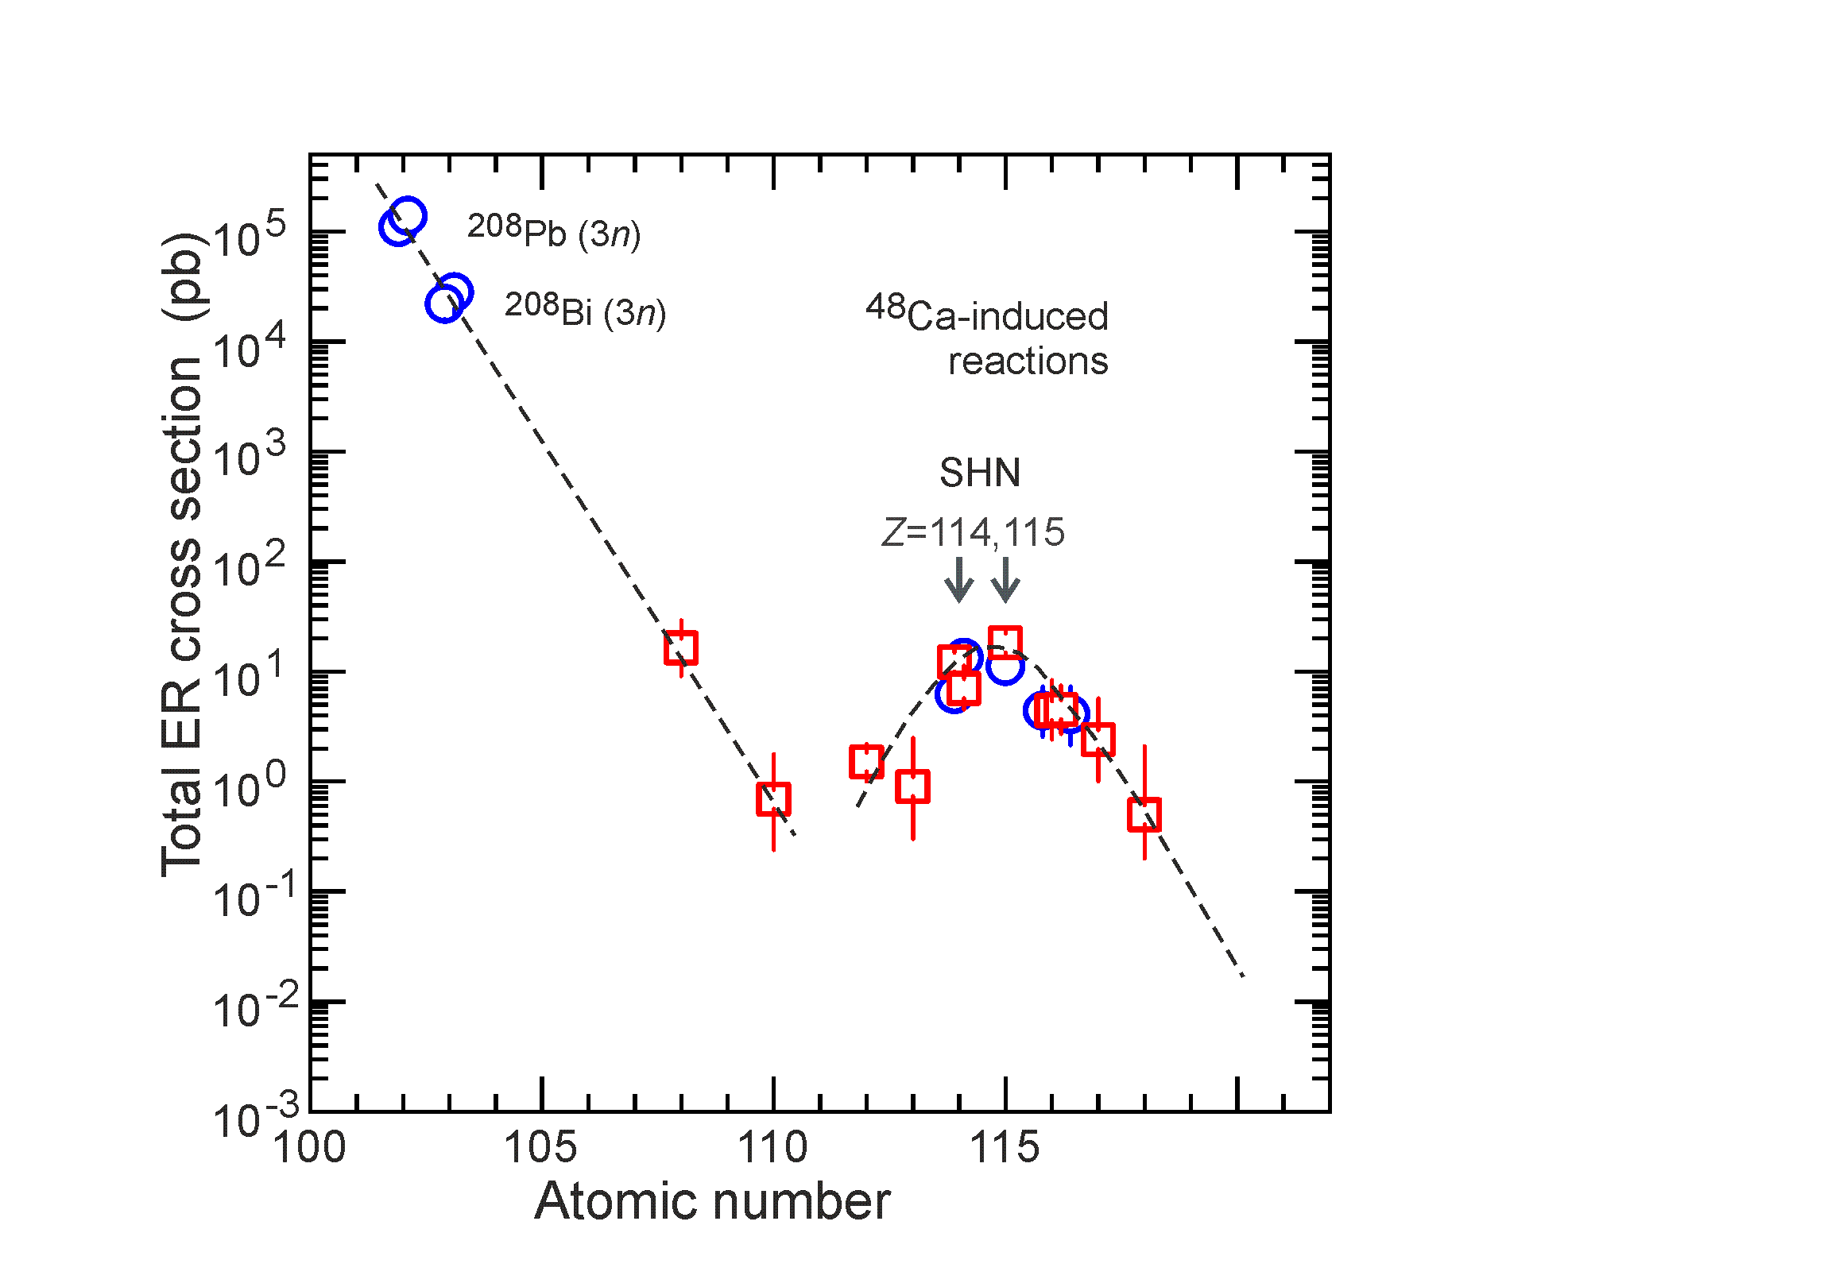
Next steps
Synthesis of new elements 119 and 120

Slide 10
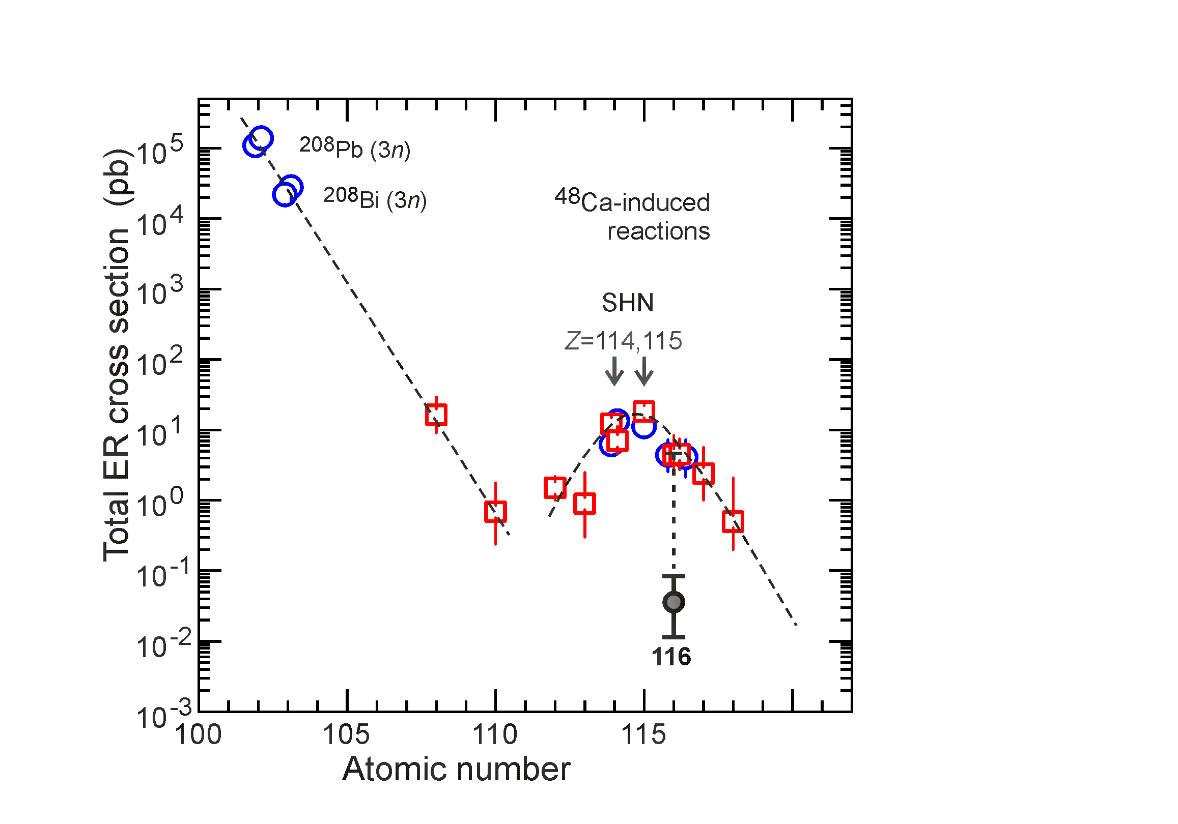
Next steps
Synthesis of new elements 119 and 120

Slide 11
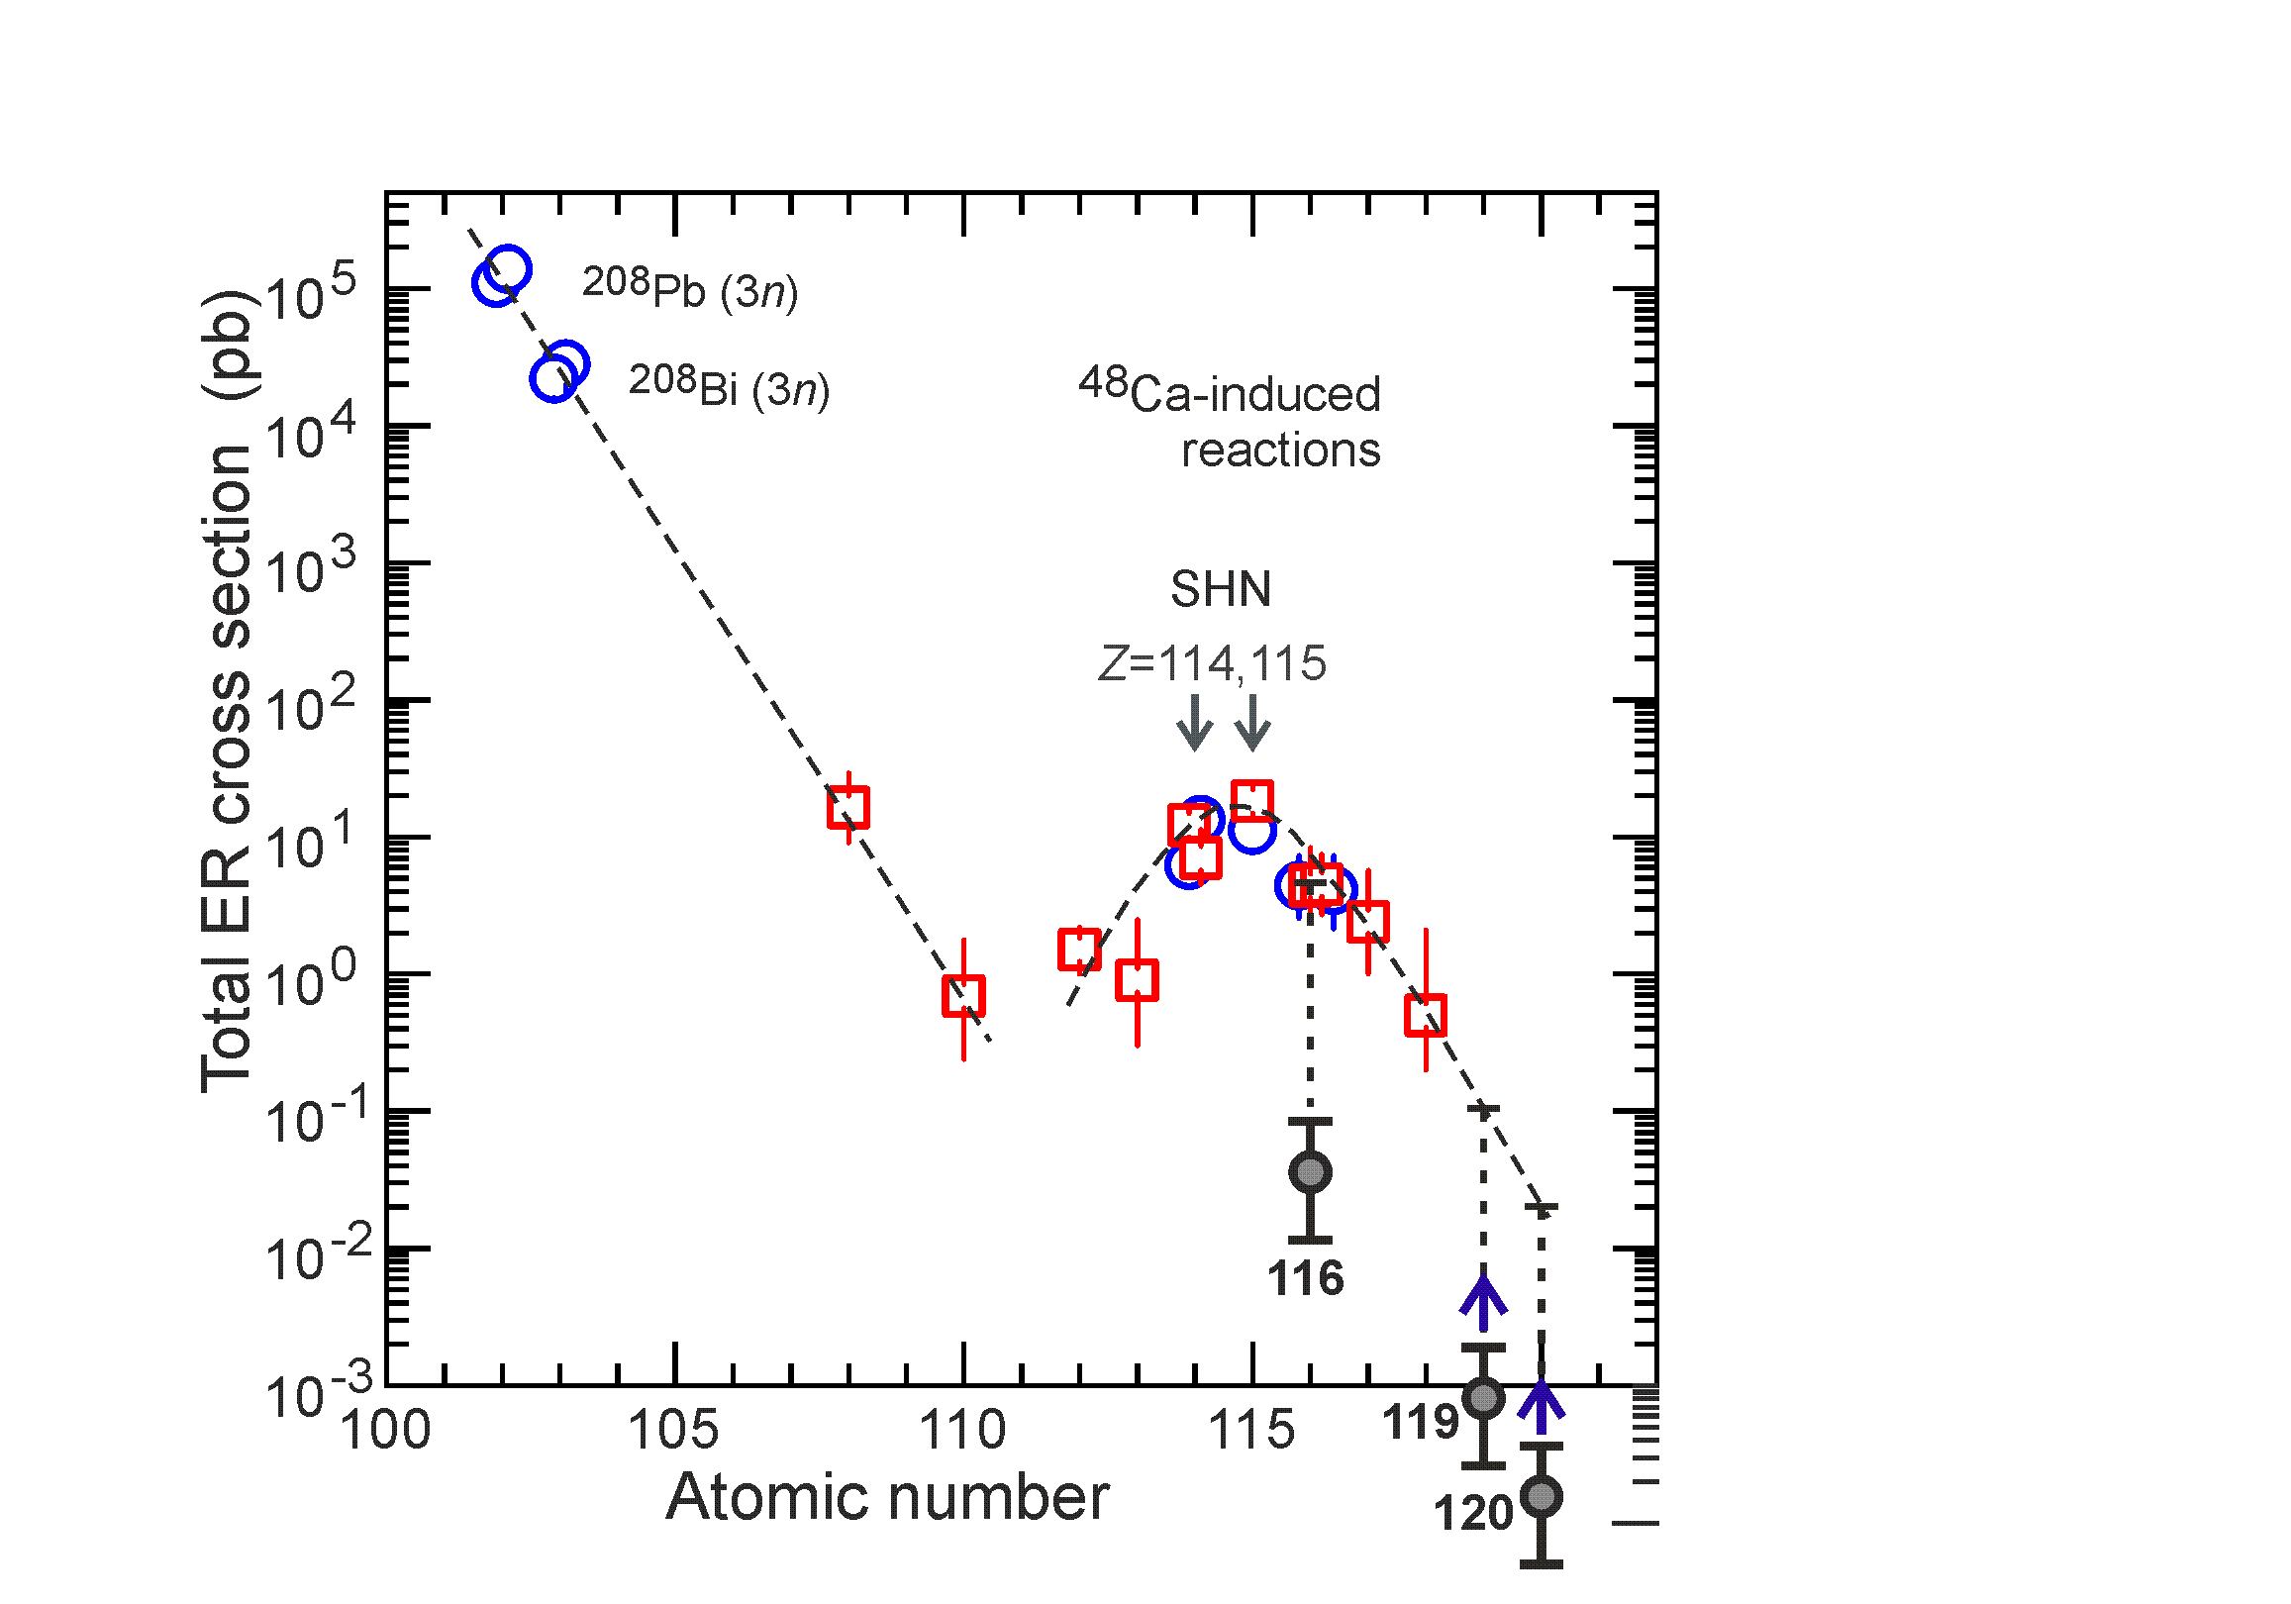
Next steps
Synthesis of new elements 119 and 120
σ=1 fb, h_{t}=0.7 mg/cm², I_{beam}=4 pμA → ≈1 / 3 year
Z_{mag} = 120 – 126?
119:
Cross section ~1 fb

Slide 12
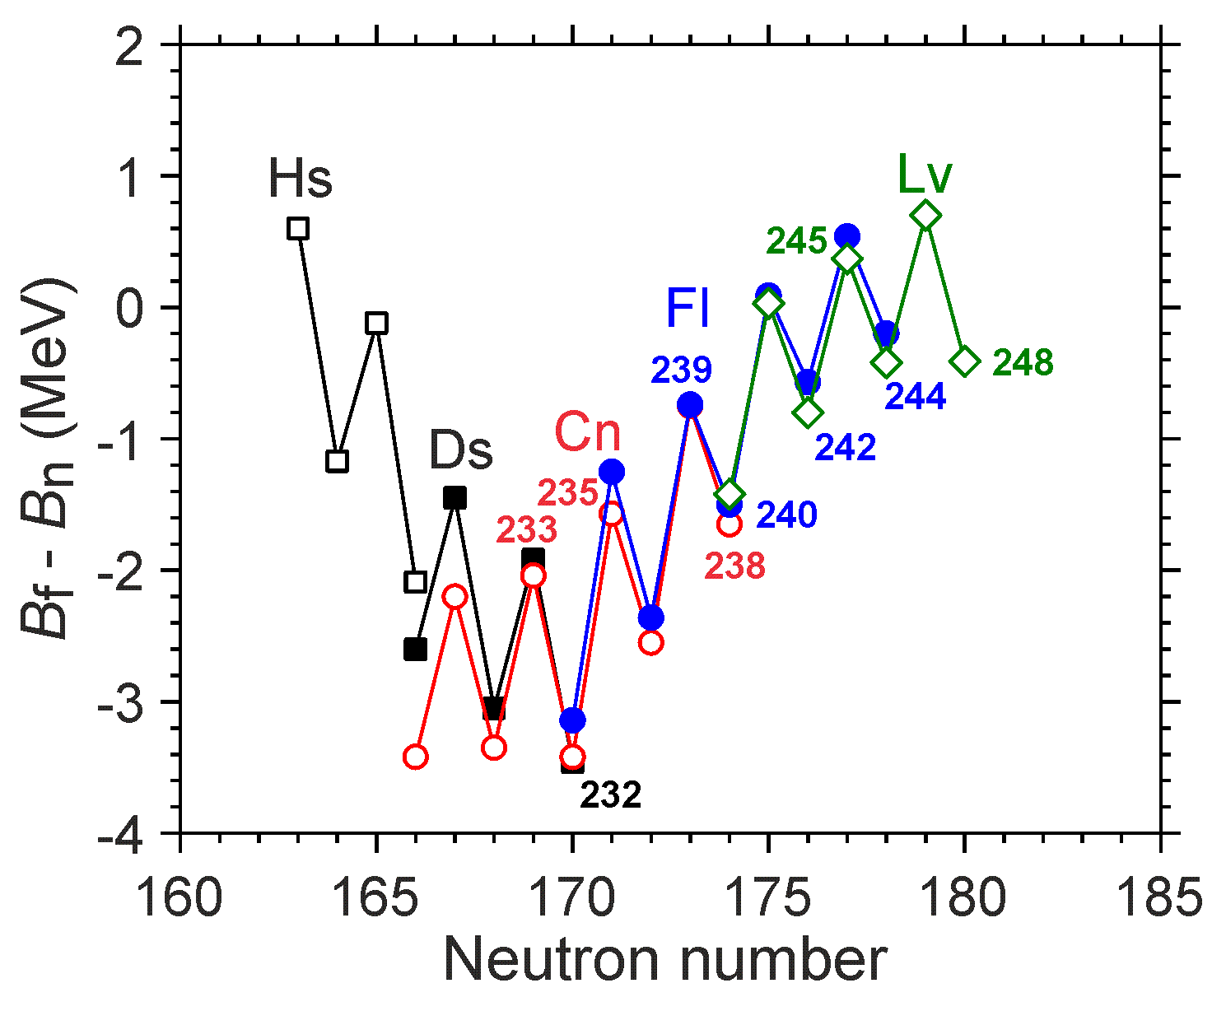
Next steps
Synthesis of new elements 119 and 120
σ=1 fb, h_{t}=0.7 mg/cm², I_{beam}=4 pμA → ≈1 / 3 year
119:
Cross section ~1 fb
Estimation accuracy:
experiment
²⁴⁸Cm + ⁴⁸Ca → ²⁹⁶Lv (N=180)
²⁴⁵Cm + ⁴⁸Ca → ²⁹³Lv (N=177)
²³⁸U + ⁵⁴Cr → ²⁹²Lv (N=176)
176
Theoretical predictions:
Less survivability –
Larger formation probability of compound nucleus
P. Jachimowicz et al., 2021

Slide 13
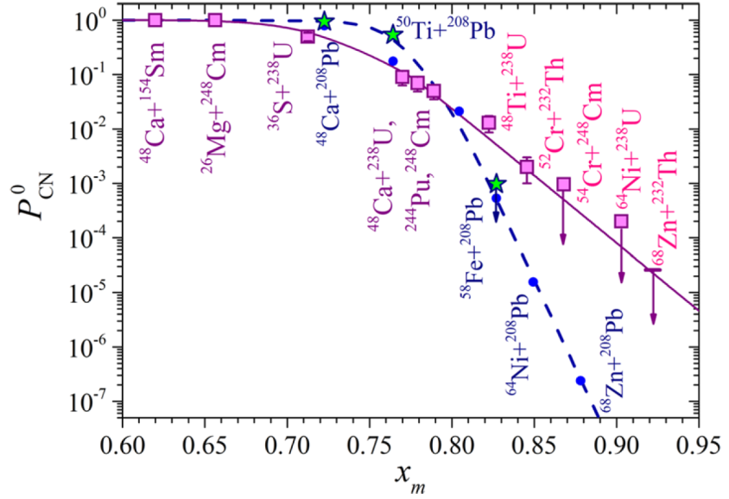
Next steps
Synthesis of new elements 119 and 120
⁴⁸Ca ⁵⁰Ti ⁵⁴Cr
²⁴⁵Cm + ⁴⁸Ca ²⁹³Lv*
²⁴²Pu + ⁵⁰Ti ²⁹²Lv*
²³⁸U + ⁵⁴Cr ²⁹²Lv*
~8
⁴⁸Ca
⁵⁰Ti
~4
⁵⁴Cr
~10
⁵⁸Fe
G.G. Adamian et al., PRC 101, 034301 (2020)
M.G. Itkis et al., EPJ A 58, 178 (2022)

Slide 14
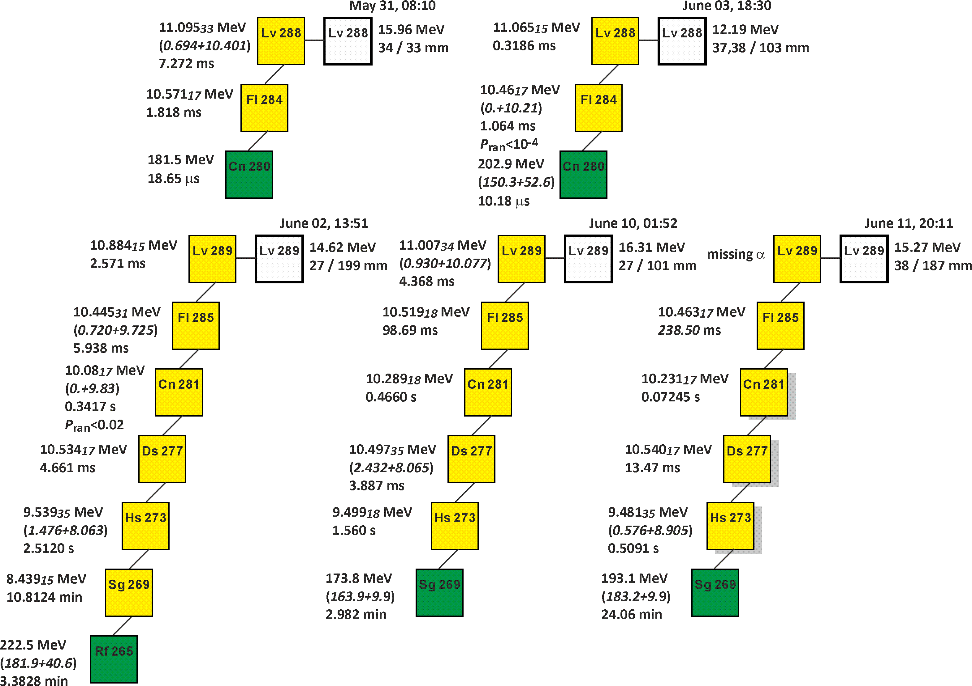
Experiment ²⁴²Pu + ⁵⁰Ti
For the first time:
Actinide + ⁵⁰Ti
New isotopes ²⁸⁹Lv and ²⁸⁰Cn
α-decay of ²⁸⁴Fl
Target ²⁴²Pu: 0.72 mg/cm²
Beam dose: 1.5 x 10¹⁹
Excitation energy: 41 MeV

Slide 15
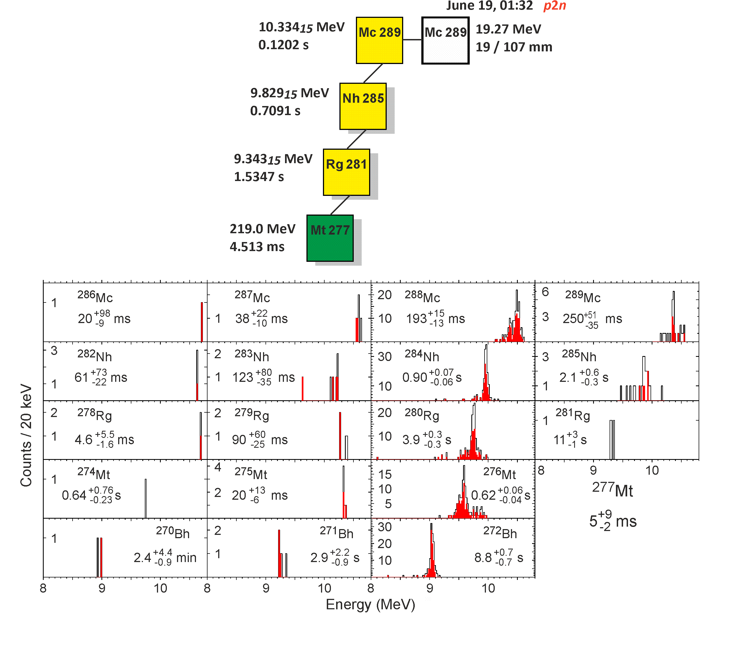
Experiment ²⁴²Pu + ⁵⁰Ti
For the first time:
pxn channel
Actinide + ⁴⁸Ca, ⁵⁰Ti, ⁵⁴Cr
Target ²⁴²Pu: 0.72 mg/cm²
Beam dose: 1.5 x 10¹⁹
Excitation energy: 41 MeV

Slide 16
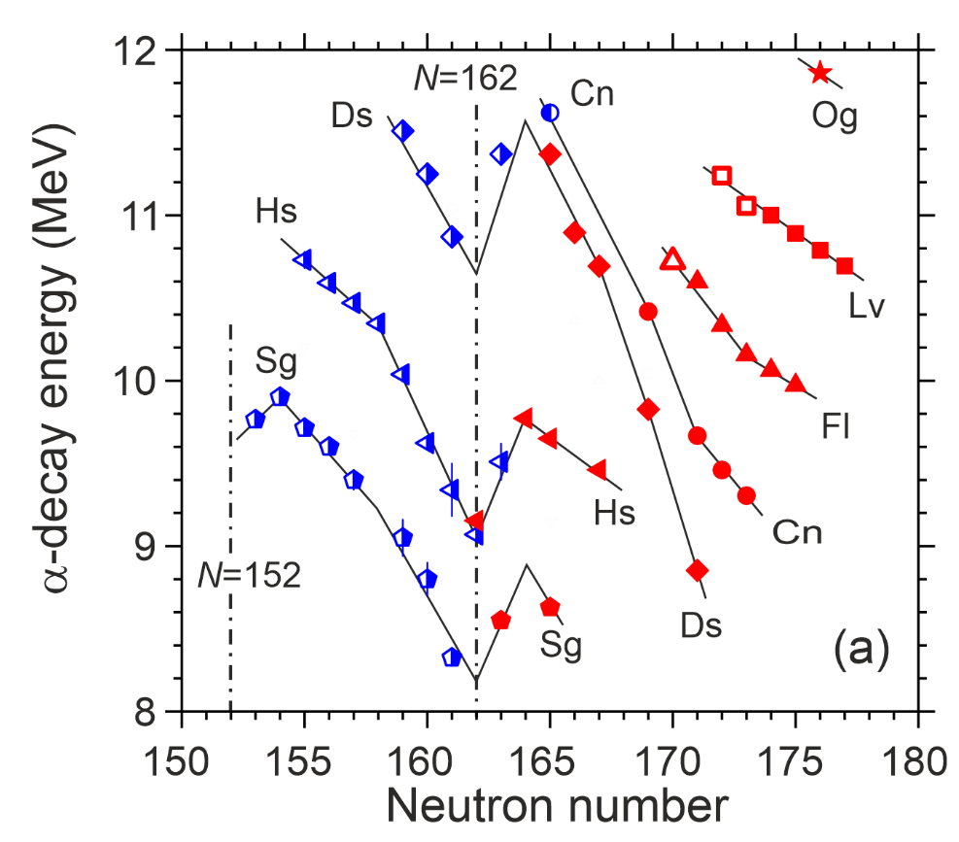
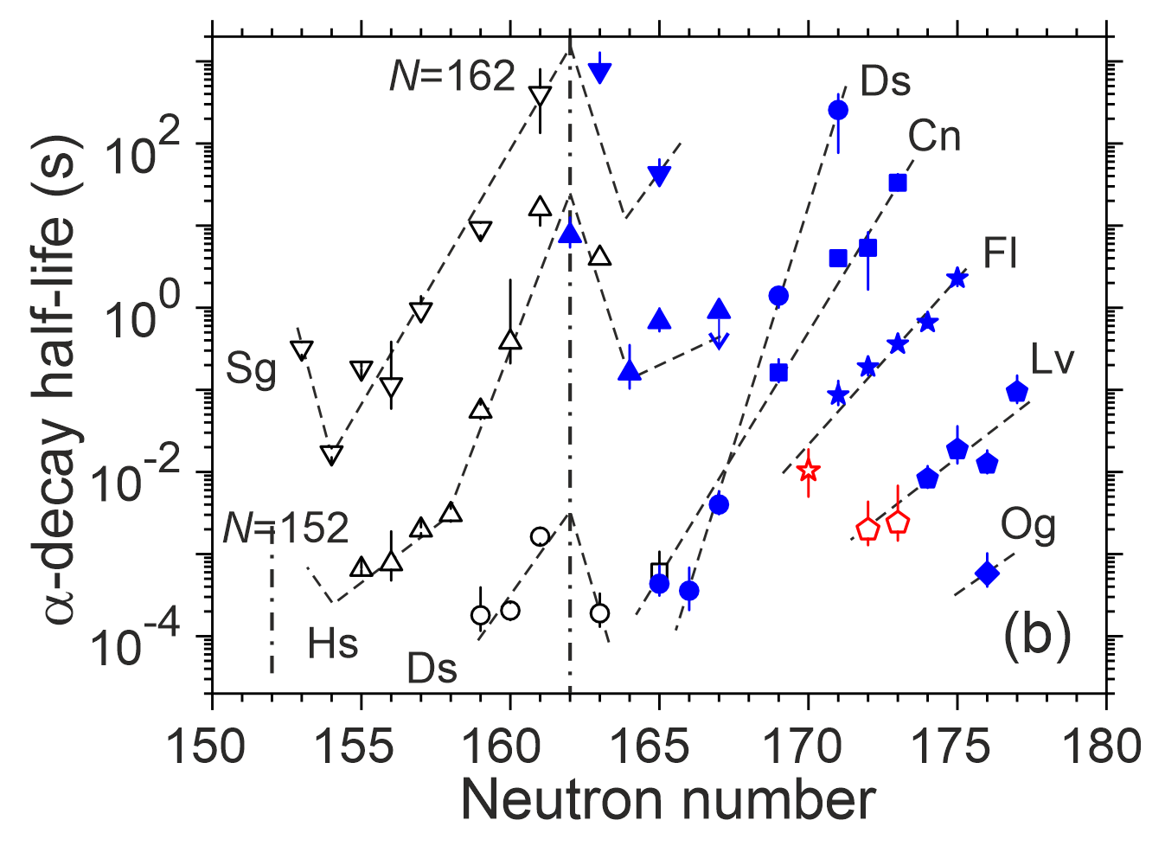
Decay properties of observed isotopes

Slide 17
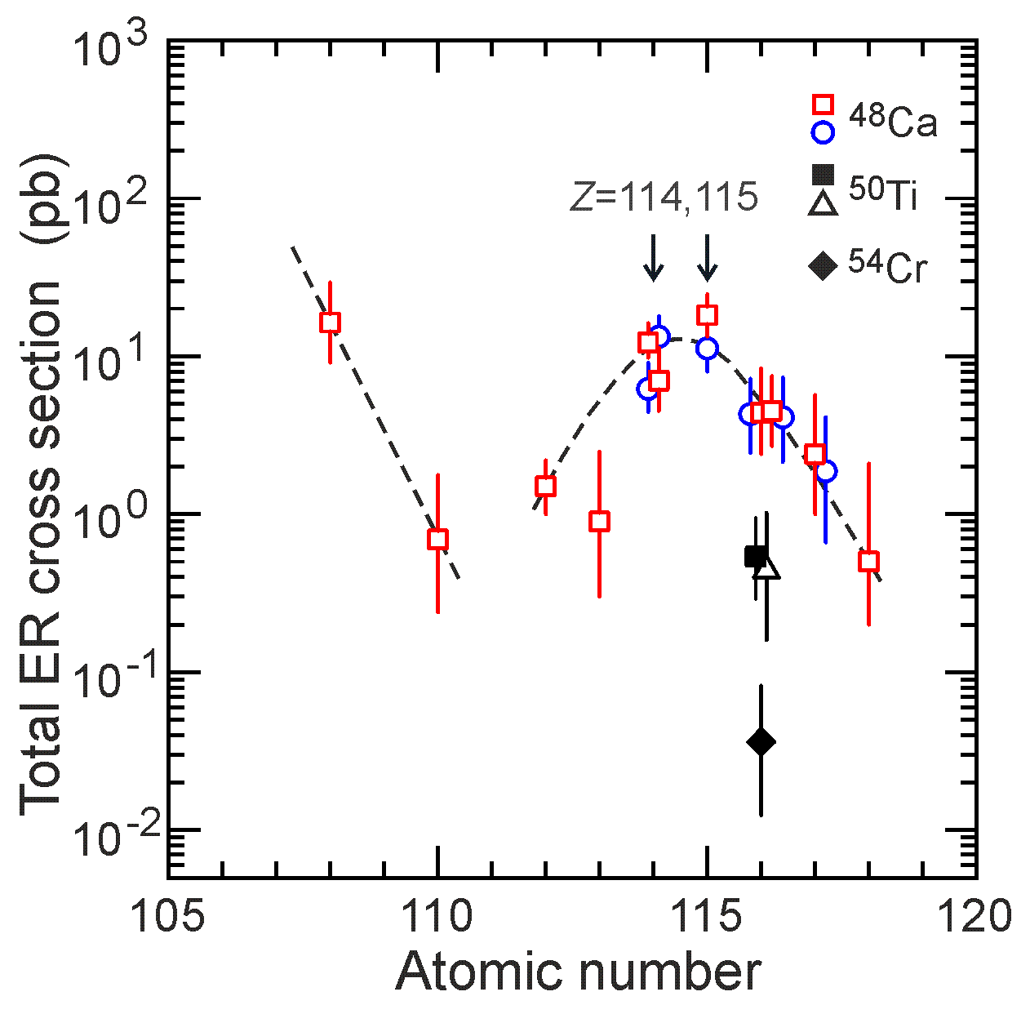
Production cross-sections of superheavy elements
⁵⁰Ti + ²⁴⁴Pu J.M. Gates et al.
PRL 133, 172502 (2024)

Slide 18
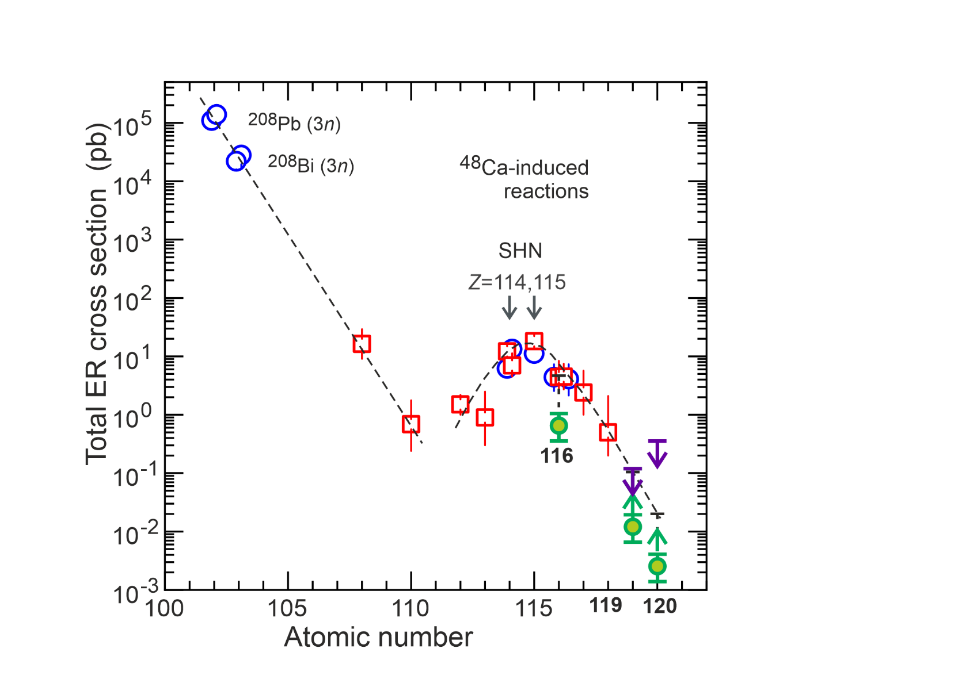
Production cross-sections of superheavy elements
119: ~10 fb
120: ~2.5 fb

Slide 19
DGFRS-2: Results of experiments
²³⁸U+⁵⁴Cr
Cross section of the actinide + ⁵⁴Cr reaction (decrease by ~150)
Synthesis of new isotope ²⁸⁸Lv
Confirmation of ²⁸⁴Fl
²⁴²Pu+⁵⁰Ti
Synthesis of new isotopes ²⁸⁹Lv and ²⁸⁰Cn
α-decay of ²⁸⁴Fl
First observation of pxn-evaporation channel

Slide 20
Thank you for attention!

Slide 21
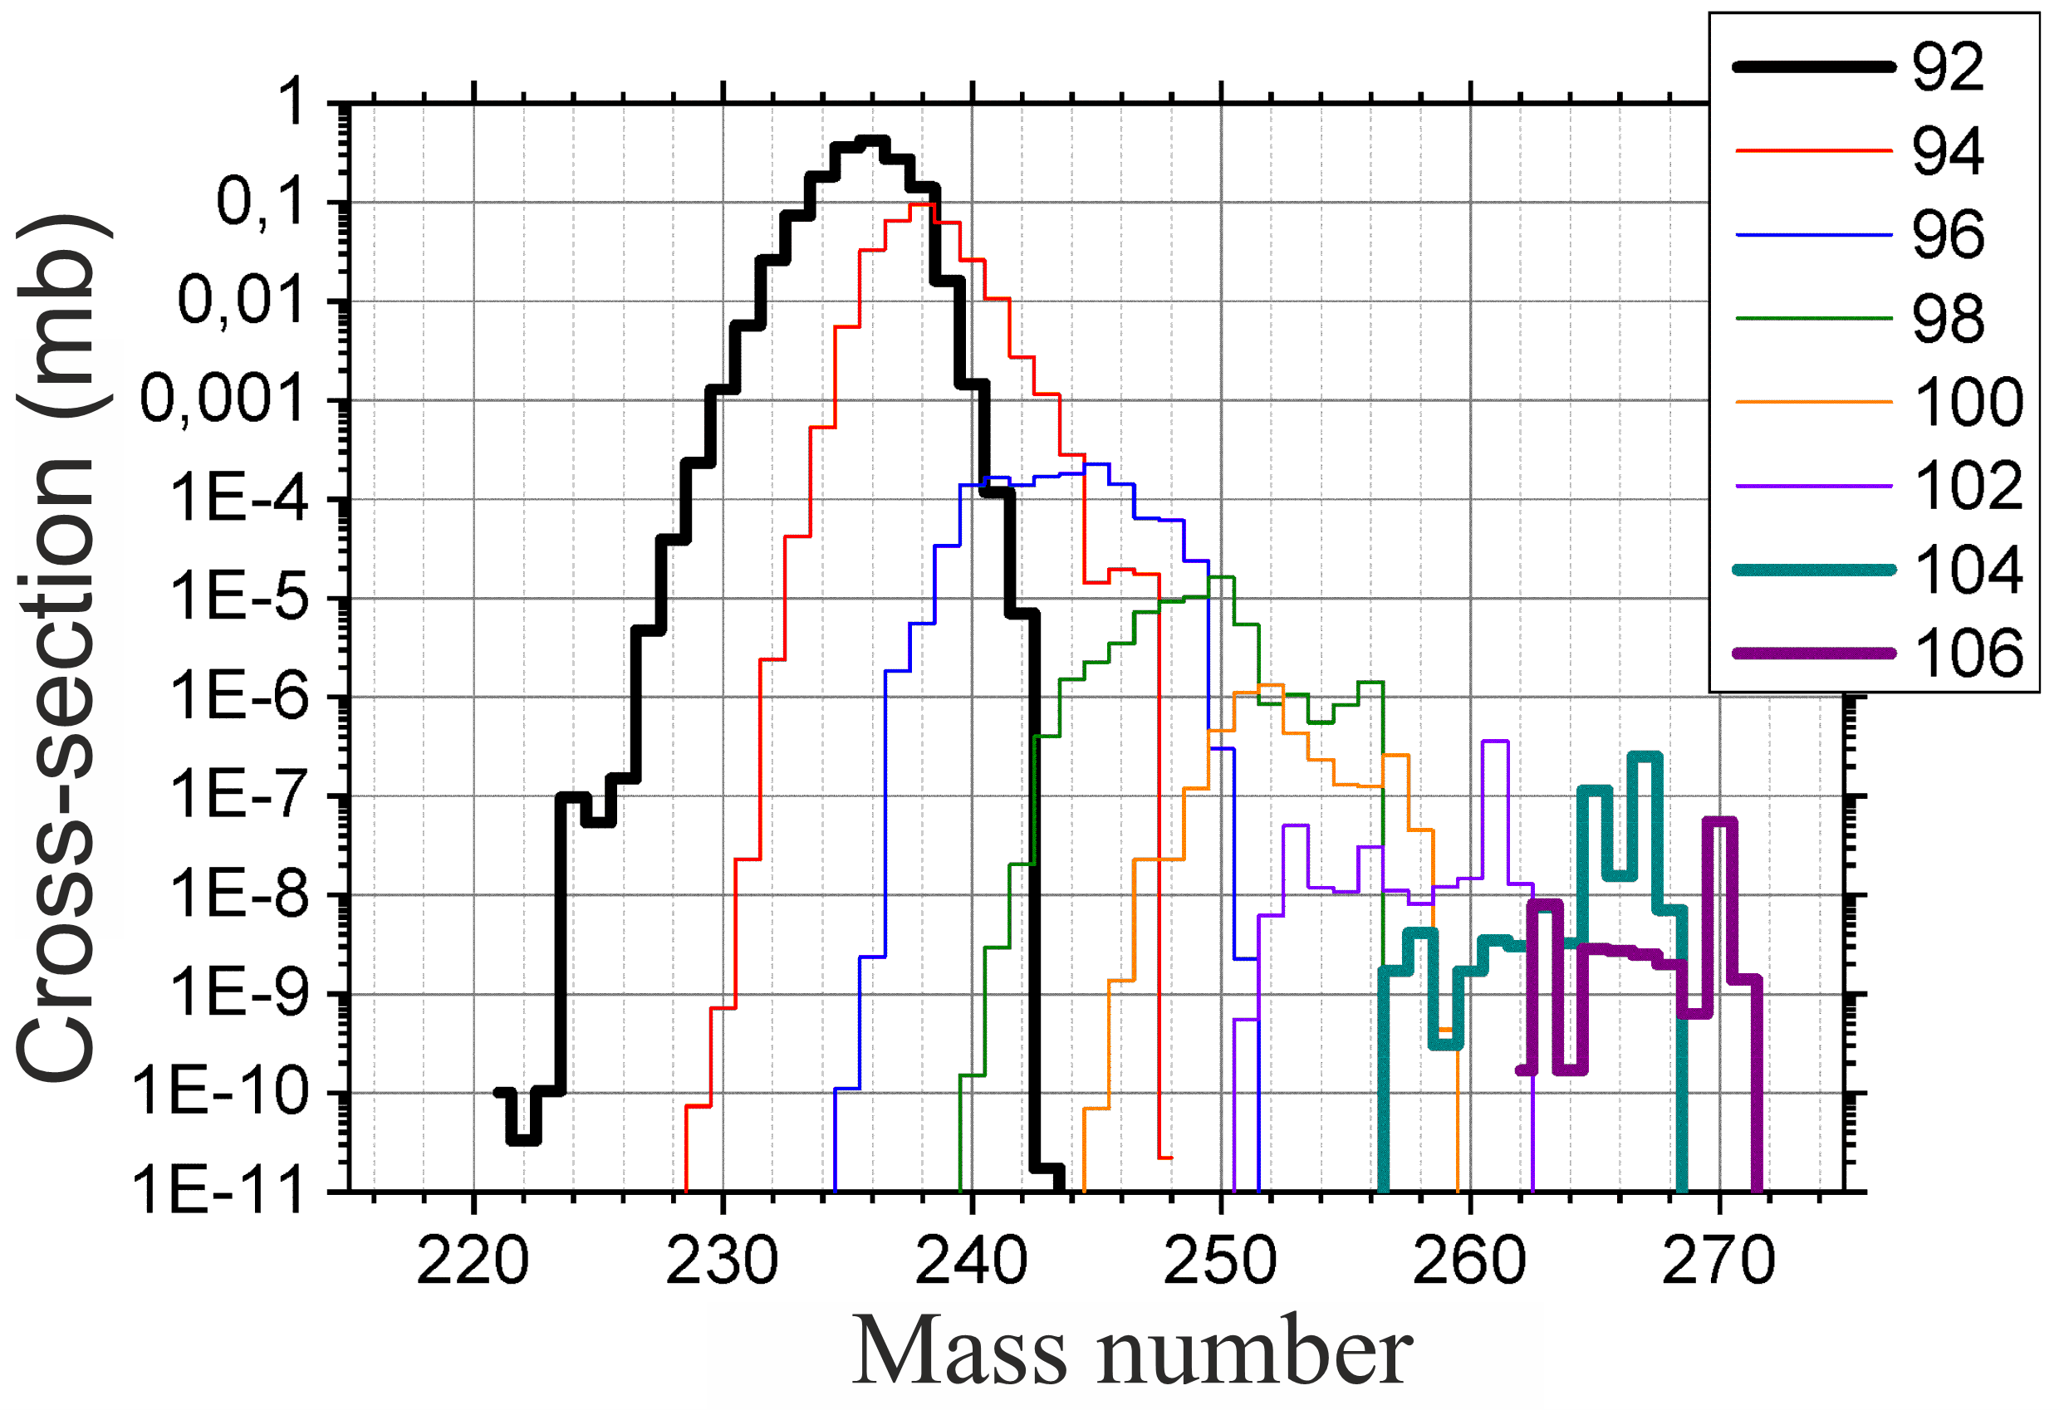
Y (²⁶⁰Sg / ^{262,264,266}Sg) < 1/20
Y (²⁶⁰Sg / ^{262,264,266}Sg + ^{256,258,260,262}Rf) < 1/70
Y (²⁶⁰Sg / ^{235mf}U) < 1/300

Slide 22
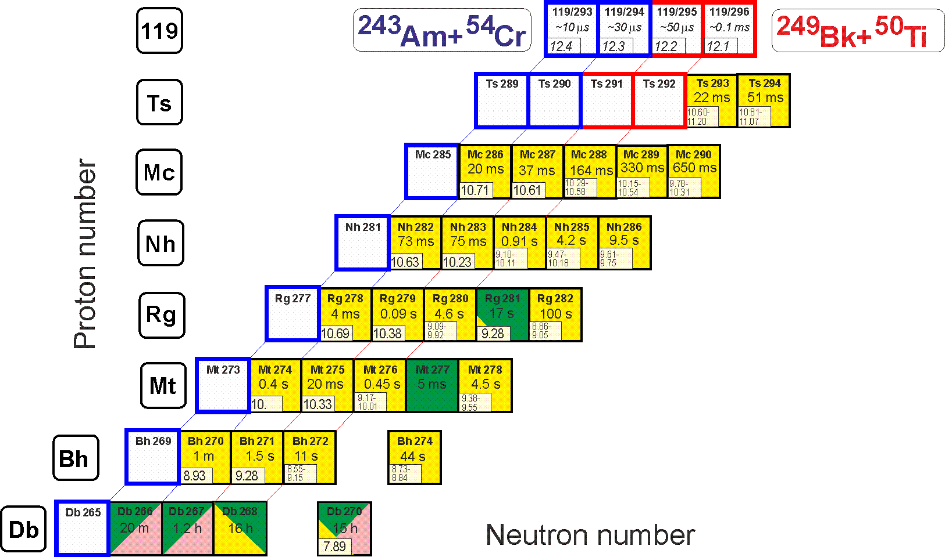
Perspectives
Synthesis of new element 119
²⁴³Am(⁵⁴Cr,3-4n)^{293,294}119 ²⁴⁹Bk(⁵⁰Ti,3-4n)^{295,296}119
²³⁷Np(⁴⁸Ca,3-4n)^{281,282}Nh
Identification by correlation method

Slide 23
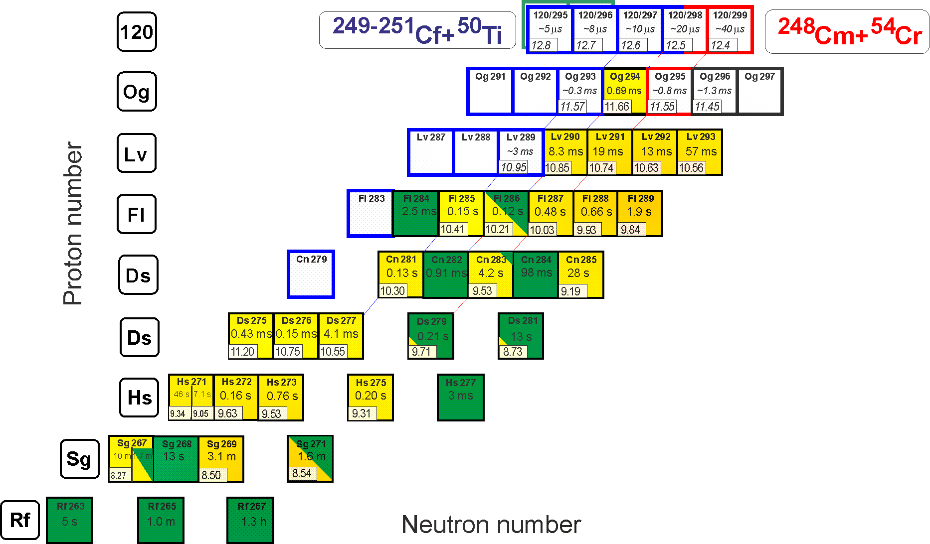
Perspectives
Synthesis of new element 120
²⁴⁹⁻²⁵¹Cf(⁵⁰Ti,3-4n)²⁹⁵⁻²⁹⁸120 ²⁴⁸Cm(⁵⁴Cr,3-4n)^{298,299}120
²⁴⁵Cm(⁵⁴Cr,3-4n)^{295,296}120
Known decay properties

