Slide 1
DEVELOPMENT OF A NEW METHOD FOR OBTAINING A RADIOPHARMACEUTICAL BASED ON RA-223 FOR MEDICAL PURPOSES USING ALUMINUM OXIDE (III) AS A SUBSTANCE WITH HIGH SORPTION PROPERTIES
Sergei Andreevich Konarev

Slide 2
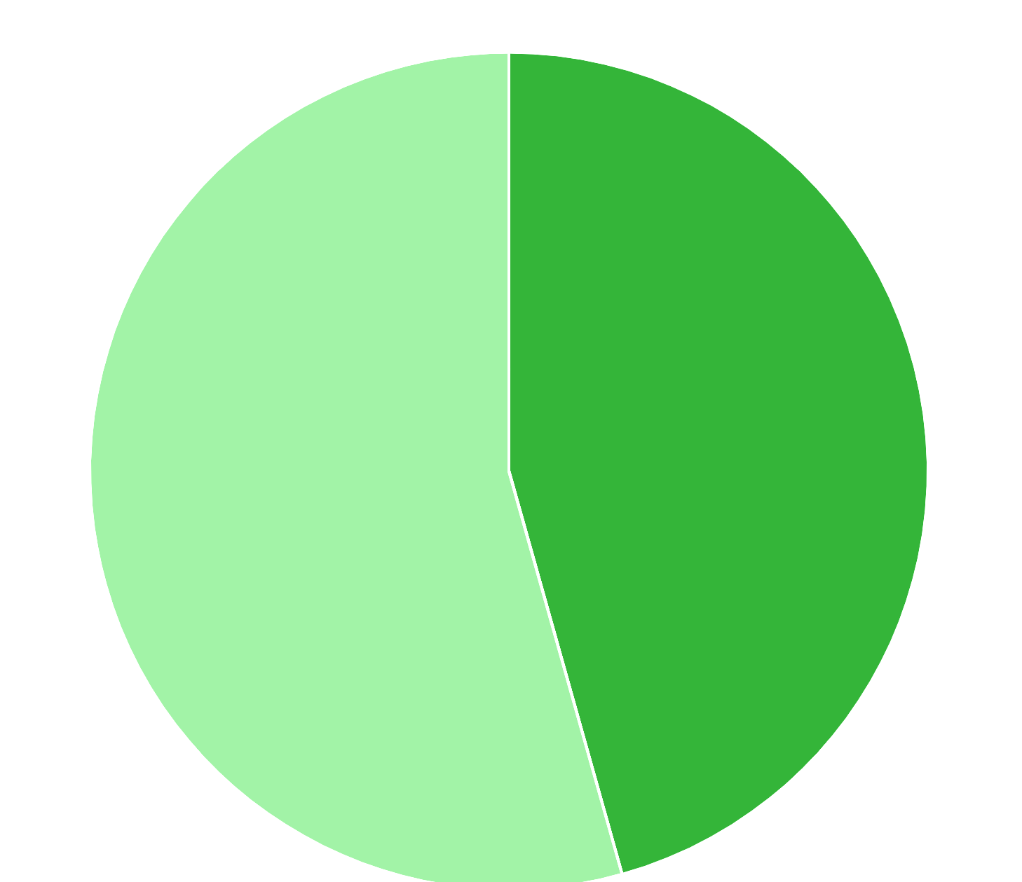
Malignant neoplasma cases in Russia in 2023
Female
54.36%
(366 678)
Male
45.64%
(307 909)
674 587 cases of malignant neoplasms were detected in the Russia in 2023.
2

Slide 3
The structure of incidence of malignant neoplasms in the male population of Russia in 2023
Prostatic gland
19.1%
Encephalon 1.4%
Other 10.1%
Cutaneous melanoma 1.7%
Throat 2%
Esophagus 2%
Hepar 2.1%
Weasand,
bronchus,
lungs
14.5%
Pancreas gland 4.4%
Urocyst 4.4%
Hematopoietic tissue
4.7%
Derm
11.2%
Nephros 4.8%
Straight intestine
5.6%
Middle intestine
7.1%
Gaster
6.3%
2
3

Slide 4
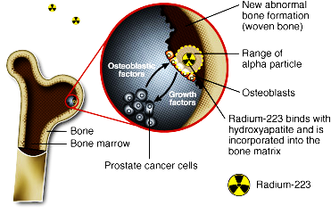
For what purposes is radium-223 used?
One of the promising isotopes for radionuclide therapy of osseal metastases in castration-native prostate cancer is the isotope Ra-223.
4

Slide 5
Relevance
The generator method of obtaining radium-223 from actinium-227 is widely used. Due to the huge demand for this radionuclide, new promising methods for its production are being developed.
²²⁷Ac(β 98,9 %) → ²²⁷Th(α 100 %) → ²²³Ra
5

Slide 6
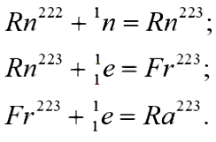
PURPOSE
THEORY OF NEW TECHNOLOGY
To develop a new and promising method for producing a radiopharmaceutical based on Ra-223 using aluminum oxide (III) as a substance with high sorption properties.
6

Slide 7
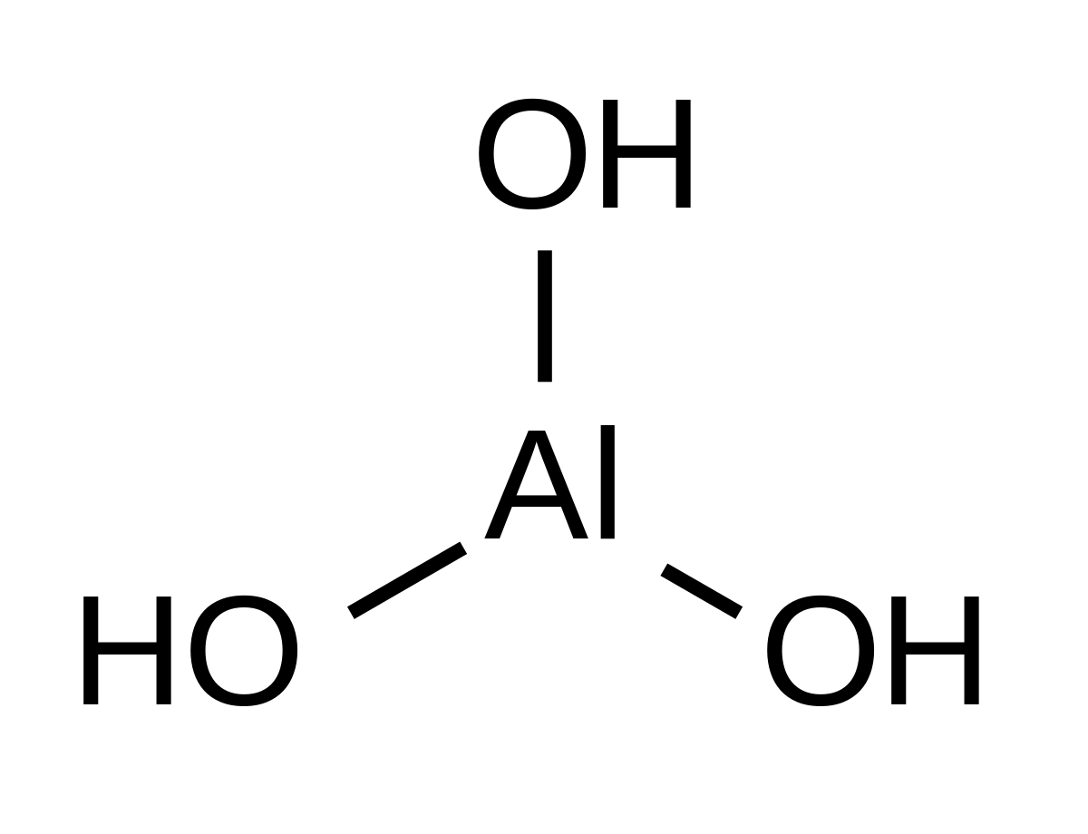
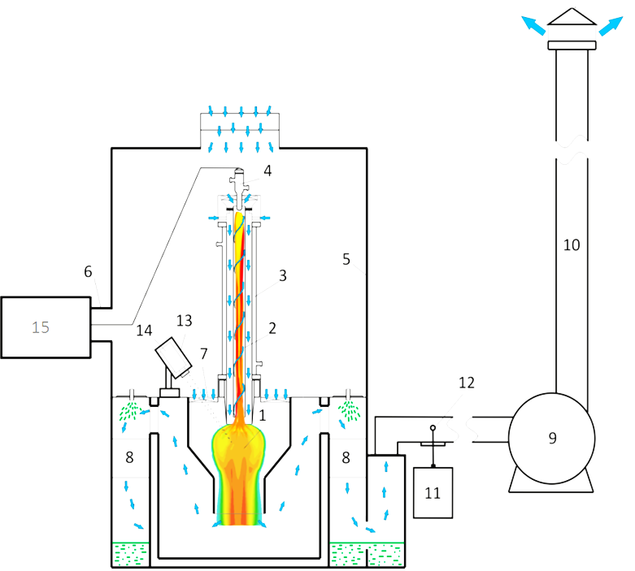
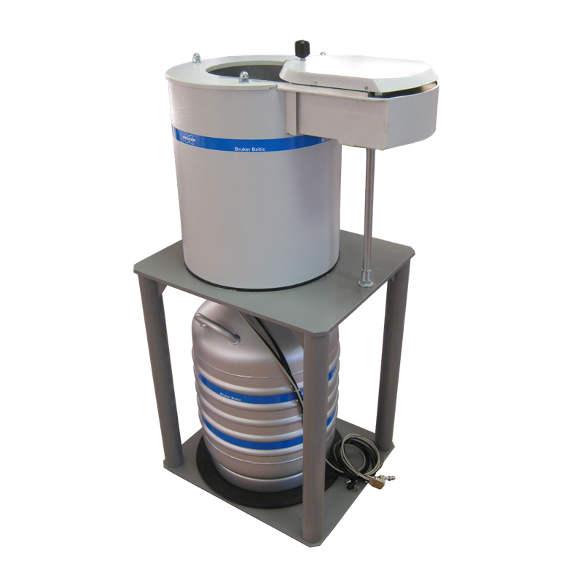
Stages of the experiments
Preparation of the sorbent;
Plasma-chemical synthesis;
Creation of the target;
Irradiation with a high-energy neutron flux;
Gamma-spectrometric analysis;
Sorption of the desired isotope;
Pic. 1 - Chemical structure of aluminium oxide (III)
Pic. 2 - The scheme of plasma-chemical synthesis
Pic. 3 - Gamma-ray spectrometer
6

Slide 8
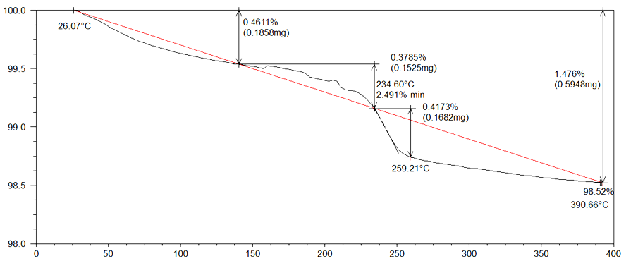
A derivatographic analysis
A dry sorbent with high sorption properties was taken as a result of this stage.
Mass variation, %
Temperature, °C
7

Slide 9
Plasma-chemical synthesis
After undergoing plasma-chemical treatment sorbent will serve as raw material for the formation of a target unit.
The scheme of plasma-chemical synthesis
8

Slide 10
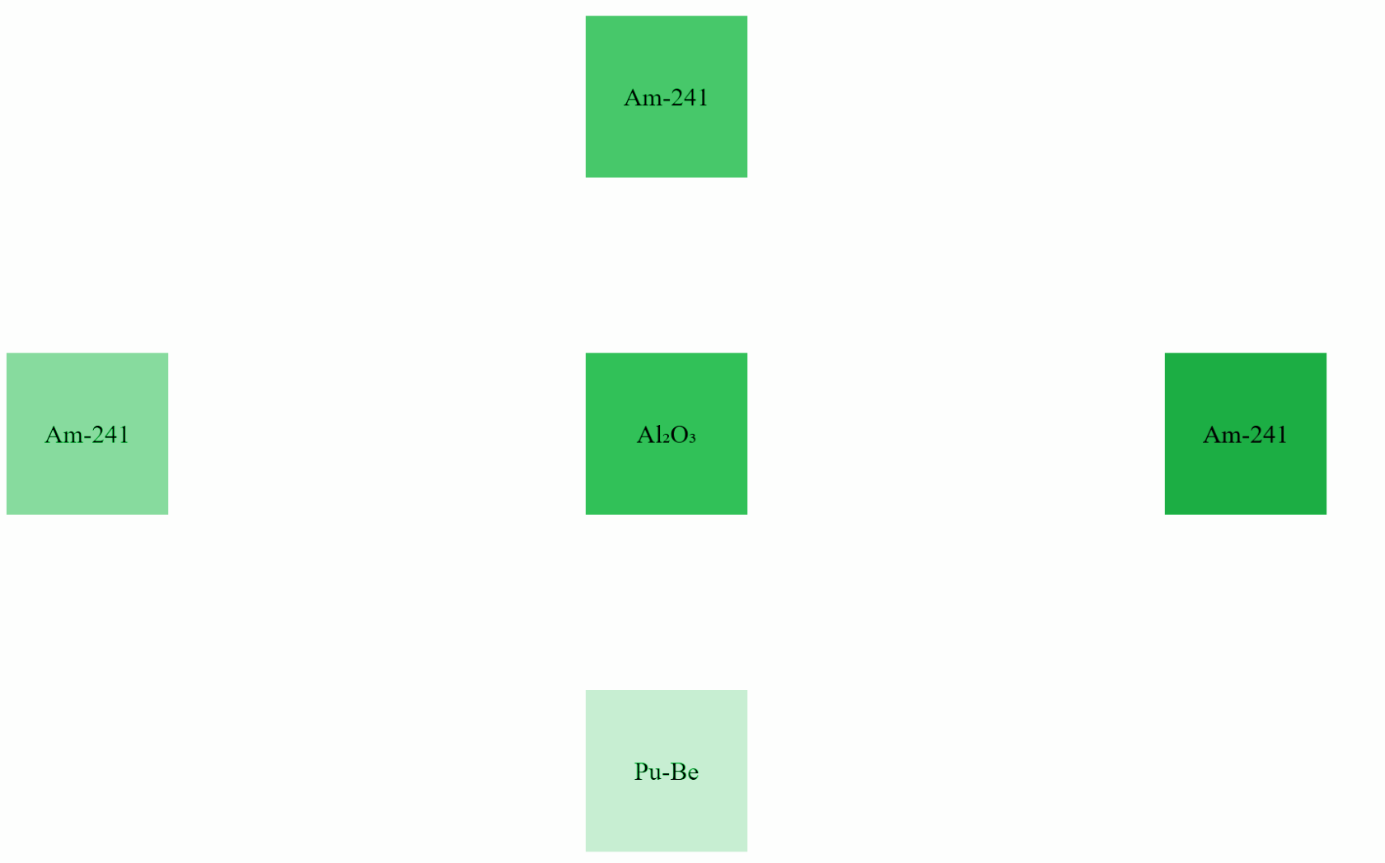
Experiments in unique module
Target Aluminium oxide (III)
9

Slide 11
The result of gamma-spectrometric analysis
Pb-214 (351 keV)
Pb-214 (242 keV)
Bi-214 (609 keV)
Ra-223 (81 keV) (*X-ray)
Pb-214 (295 keV)
Bi-214 (1764 keV)
Bi-214 (1238 keV)
Bi-214 (1120 keV)
Bi-214 (keV)
keV
10

Slide 12
Experimental results
Radium-226 with gross activity about 0,83 Bq and thorium-227 with gross activity about 0,21 Bq, which is a parent nucleus of the decay of radium-223, were identified in low concentration during the gamma-spectrometric analysis.
Isotope | Activity, Bq
BI-214 | 3167.27
PB-214 | 2162.59
RA-226 | 0.83
TH-227 | 0.21
11

Slide 13
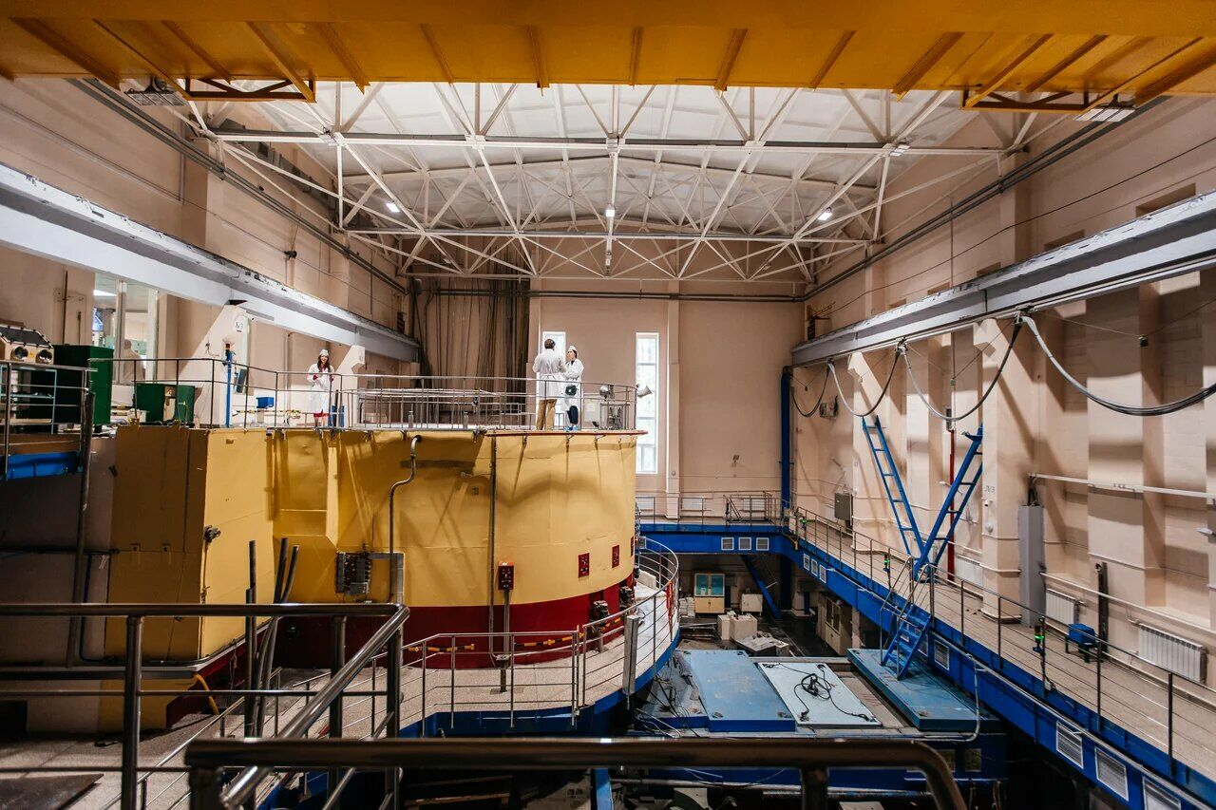
Plans for technology development
It’s necessity to conduct similar experiments with a higher neutron flux density to produce a higher concentration of the isotope radium-223 at the operating nuclear reactor located at Tomsk Polytechnic University.
Pic. 5 - Tomsk Research Nuclear Reactor
12

Slide 14
DEVELOPMENT OF A NEW METHOD FOR OBTAINING A RADIOPHARMACEUTICAL BASED ON RA-223 FOR MEDICAL PURPOSES USING ALUMINUM OXIDE (III) AS A SUBSTANCE WITH HIGH SORPTION PROPERTIES
Sergei Andreevich Konarev

