Slide 1
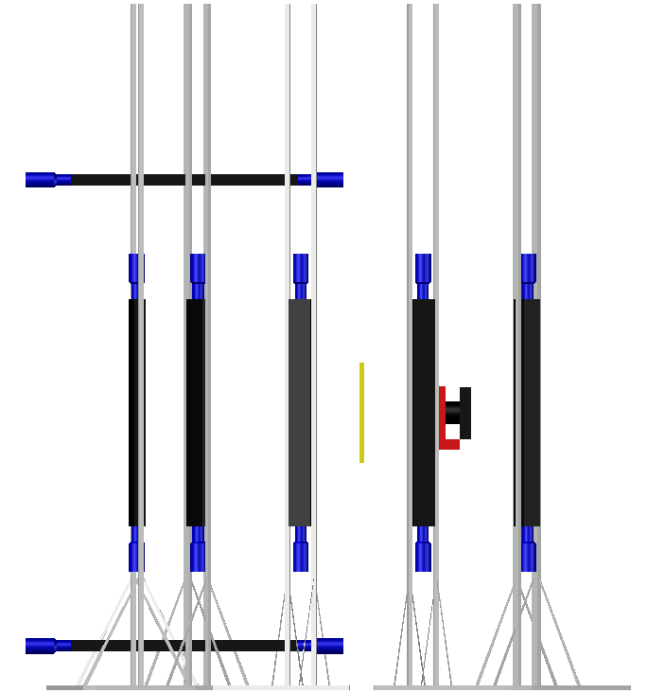
(n,γ) and (n,n'γ) – correlations in reaction of
neutron inelastic scattering on ¹²C
P.G. Filonchik, A.L. Barabanov and TANGRA collaboration
AYSS-2024

Slide 2
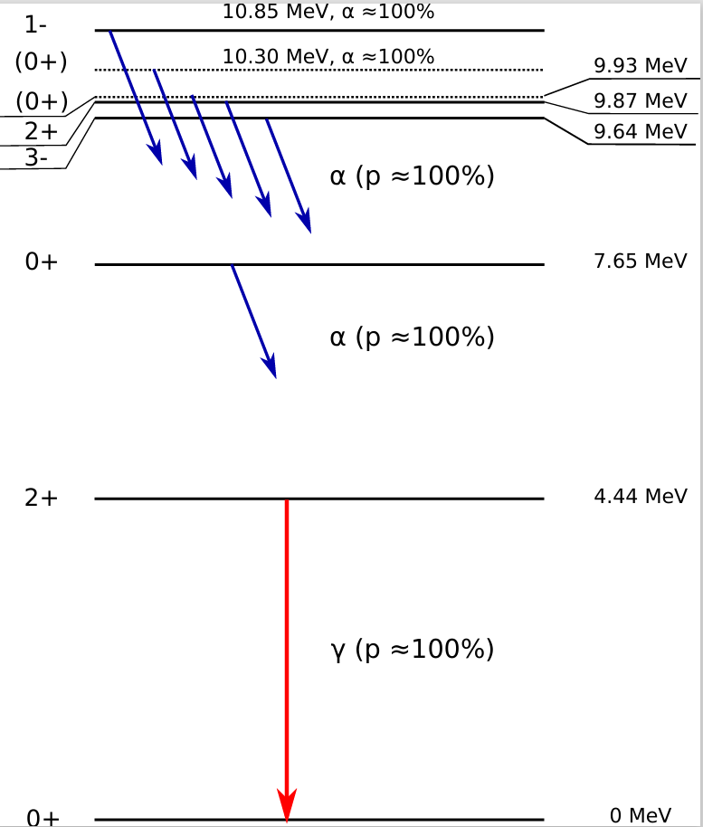
Outline
Considered reaction:
$12C\left(n,n^{′}γ\right)12C$
Motivations of studying $\left(n^{′},γ\right)$-correlations
Theory
Experiment
Tagged Neutron Method (TNM)
Setup
Calibration
Experiment
Comparison with other works
Conclusions and plans
Levels of ¹²C

Slide 3
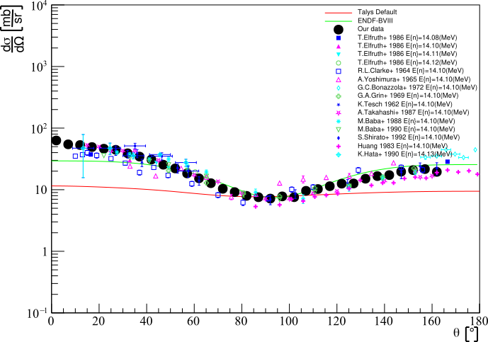
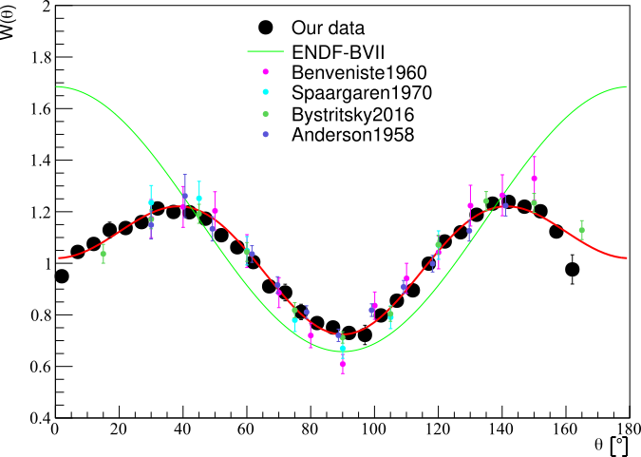
Types of angular correlations
Kelly at al. 2021
Anysotropy of neutrons inelastically scattered on 1st level of ¹²С.
double correlations
triple correlations
Anisotropy of $γ$with energy 4,43 MeV in result of neutron inelastic scattering on ¹²С
Correlated n’-$γ$ distribution

Slide 4
Theoretical approach of angular correlations
Double differential cross-section depended on direction of inelastically scattered neutron and $γ$-quanta
$$φ_{β}$$
$$φ_{γ}$$
S-matrix coefficients from TALYS

Slide 5
TANGRA и Tagged Neutron Method (TNM)
TAgged Neutrons and Gamma RАys (TANGRA)

Slide 6
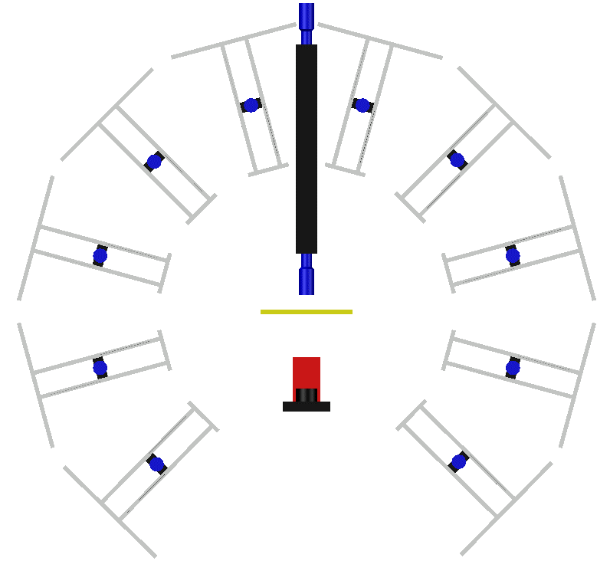
Experiment for searching angular correlations
2 long detectors above and below of the target
10 long (1 m) plastic scintillator detectors with 2 PMT made by EPIC CRYSTALL
Detectors are placed at angles from 15° with step 30° (max 135°)
2 long detectors above and below of target
Length resolution – 23,7 cm
Experimental setup

Slide 7
Experimental setup for studying $\left(n^{′},γ\right)$-correlations
Up view
Side view

Slide 8
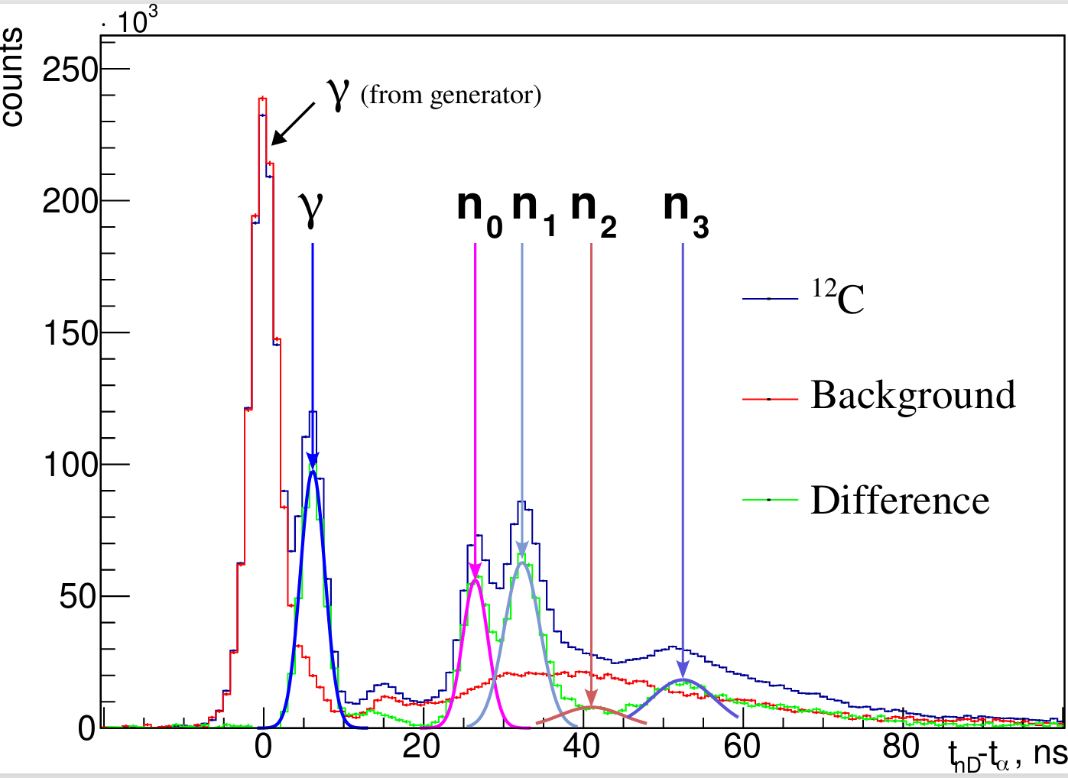
Data processing: TOF (Time-of-Flight)
Defining peaks position by kinematics
50 hours of measurements

Slide 9
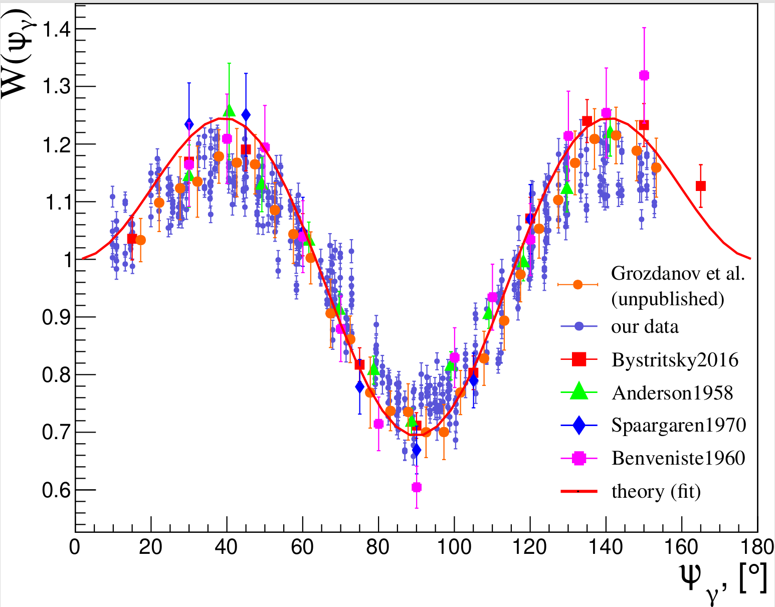
Comparison of experimental angular distribution with theoretical calculations
$$W\left(ψ_{γ}\right)=1+\sum_{l=2,4}^{2J}{a_{l}P_{l}\left(\cos{ψ_{γ}}\right)}$$
Work | $$a_{2}$$ | $$a_{4}$$
Theory | $$0,35$$ | $$−0,35$$
Bystritsky | $$0,34±0,02$$ | $$−0,33±−0,02$$
Anderson | $$0,29±0,02$$ | $$−0,28±0,02$$
Benvensite | $$0,37±0,05$$ | $$−0,39±0,07$$
Spaargaren | $$0,39±0,01$$ | $$−0,37±0,01$$
Angular distribution of $γ$

Slide 10
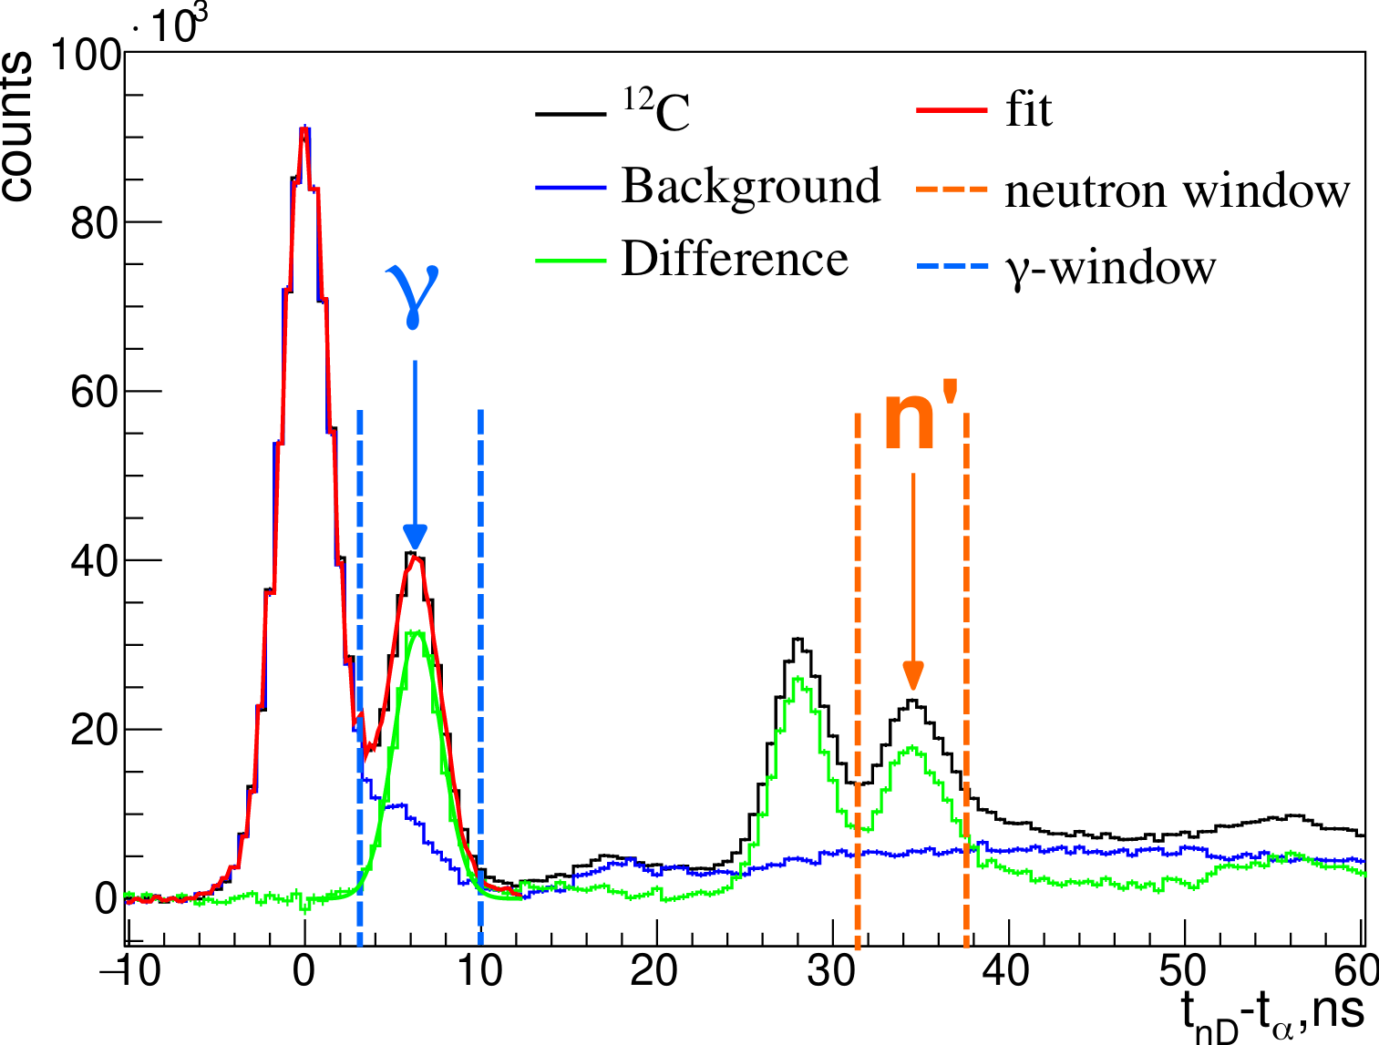
$(n,n′γ)$-correlations
Choosing windows on TOF spectra for searching (n’,$γ$)-correlations
Plane of reaction

Slide 11
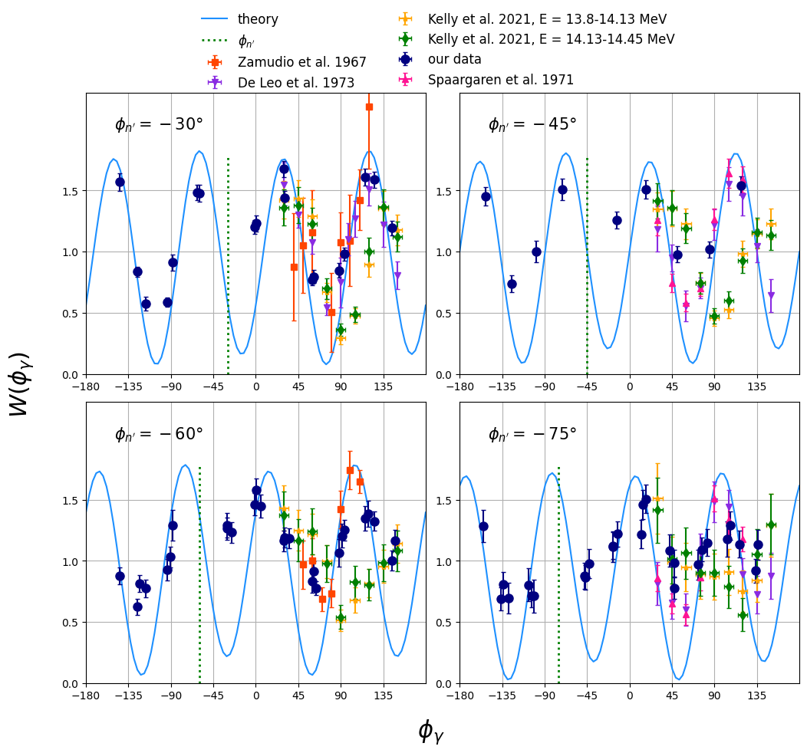
Comparison of experimental correlated angular distributions with theory

Slide 12
Comparison of experimental correlated angular distributions with theory

Slide 13
Plans
Conclusions
Research on (n,n′γ)-correlations in reaction of inelastic scattering of neutrons on carbon was made from experimental and theoretical side.
Experimental data were obtained in wide angular range and are in good agreement with most of previous work.
Theoretical approach based on using the S-matrix elements was developed and compared with experimental data. For some angles of scattered neutrons theory describes experiments, but one needs to make more detailed calculation of reaction in TALYS program to obtain S-matrix.
Use of spatial resolution of detectors for searching (n,n’$γ$)-correlations.
To calculate angular uncertainty.
Use of spatial resolution of detectors for searching (n,n’𝛾)-correlations.
To calculate angular uncertainty.
To find correct parameters of optical potential for calculation of reaction by TALYS program.

Slide 14
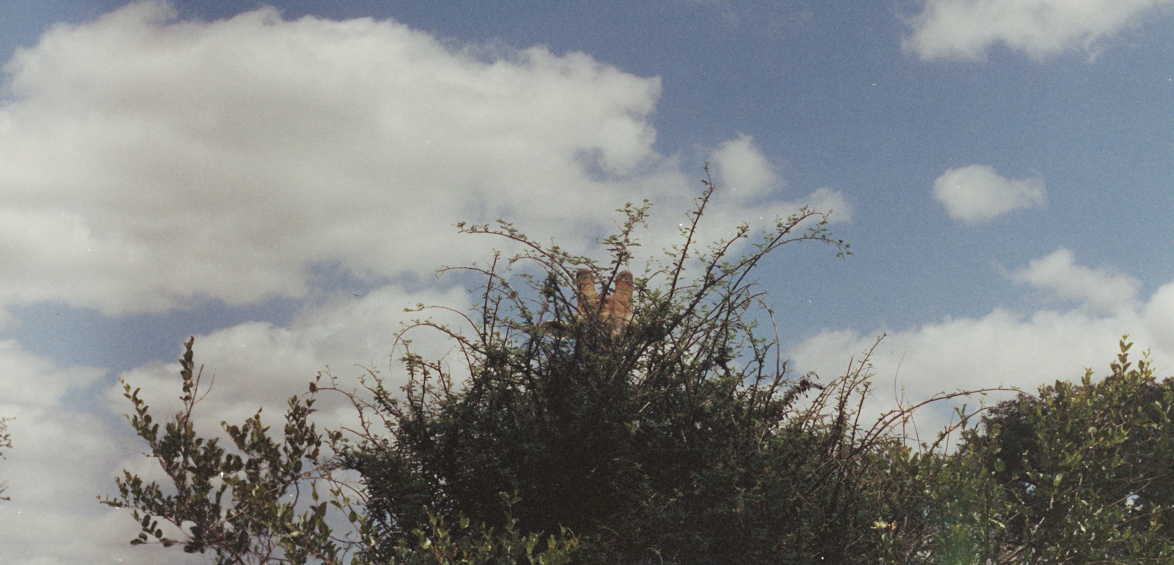
Thank you for your attention!

Slide 15
Literature
B.A. Benetskii, I.M. Frank. Angular correlation between gamma rays and 14-MeV neutrons scattered inelastically by carbon. Soviet Physics JETP, vol. 17, n. 2 (1963) p. 309
E. Sheldon. Rev. Mod. Phys. 1963. V.35 P. 795.
A.B. Clegg and G.R. Satchler. Nucl. Phys. 1961. V. 27. P. 431.
N.A. Fedorov. Studying of 14.1 MeV neutrons scattering on light nuclei. Master thesis. MSU, Moscow, 2017.
J. Zamudio, L. Romero, R. Morales. Nuclear Physics. 1967. V. A96. P. 449.
Kelly, K. J., Devlin, M., O’Donnell, J. M., & Bennett, E. A. (2021). Correlated n−γ angular distributions from the Q=4.4398 MeV C12(n,n′γ) reaction for incident neutron energies from 6.5 MeV to 16.5 MeV. Physical Review. C, 104(6).

Slide 16
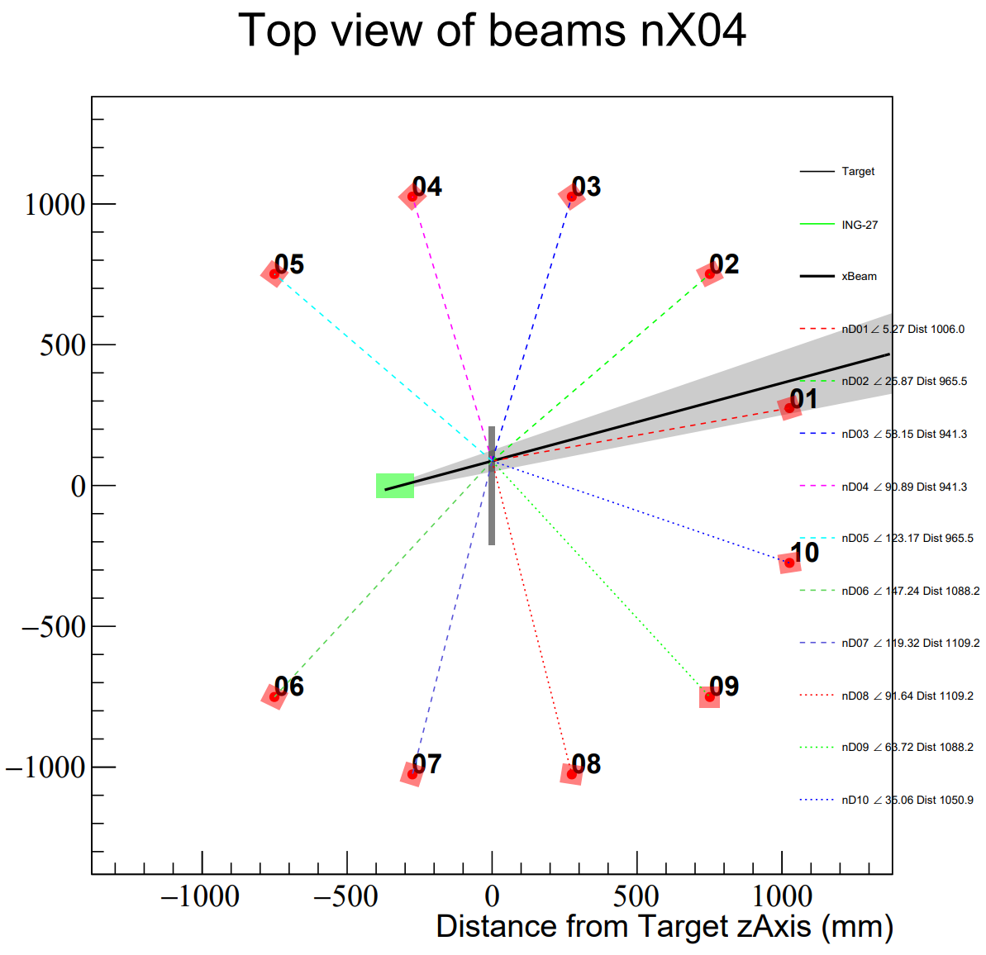
How to choose angles?
16×16 = 256 pixels 16 strips
Plane of reaction

Slide 17
Neutron scattering
Elastic
Inelastic
/
$$12C\left(n,n_{0}\right)12C$$
$$12C\left(n,n^{′} \right)12C^{∗}$$

