Slide 1
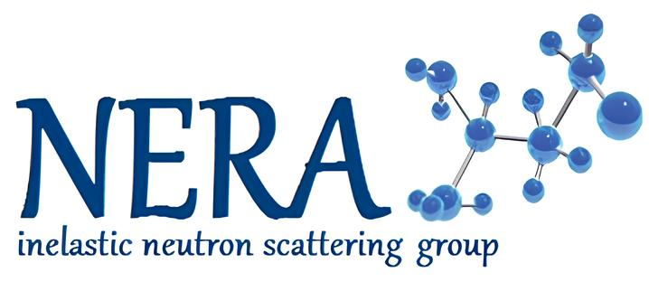
Structure and dynamics investigation of ibuprofen dimers by DFT method
Gergelezhiu Polina
1st year Master's student of Branch of M.V. Lomonosov MSU in Dubna
laboratory assistant, FLNP, JINR
AYSS - 2024, JINR, Dubna

Slide 2
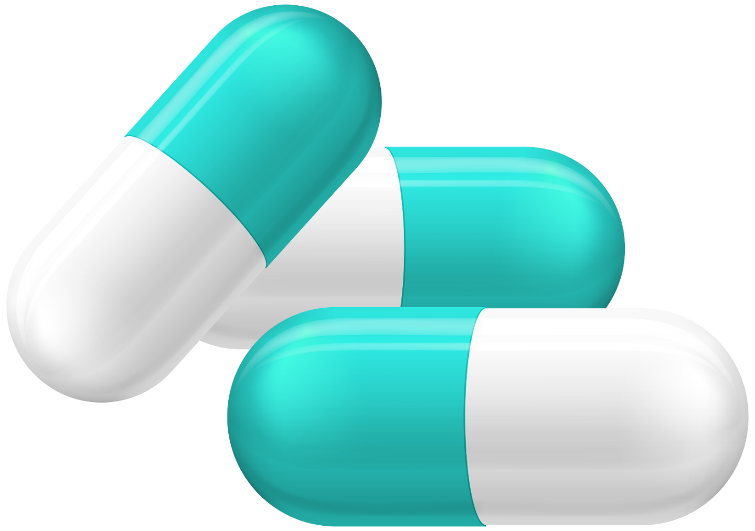
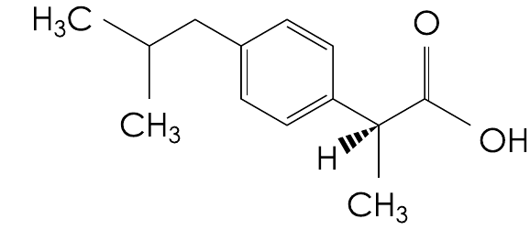
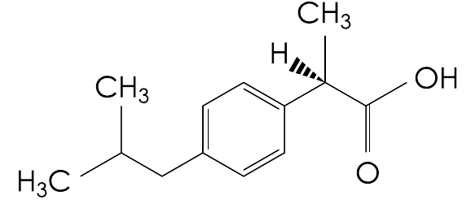
Ibuprofen is a vital medicine
Racemic mixture
S-enantiomer
active
50%
Relief of symptoms of diseases
50%
R-enantiomer inactive
S-enantiomer active
R-enantiomer
inactive
The main experimental methods for studying the effect of intermolecular interactions on the dynamics of organic compounds in condensed matter:
Inversion
Ibuprofen is included in the list of essential medicines of the Russian Federation [1]
IR spectroscopy
Raman spectroscopy
Neutronography
2/15
[1]Распоряжение Правительства РФ от 12.10.2019 N 2406-р (ред. от 09.06.2023) «Об утверждении перечня жизненно необходимых и важнейших лекарственных препаратов…»

Slide 3
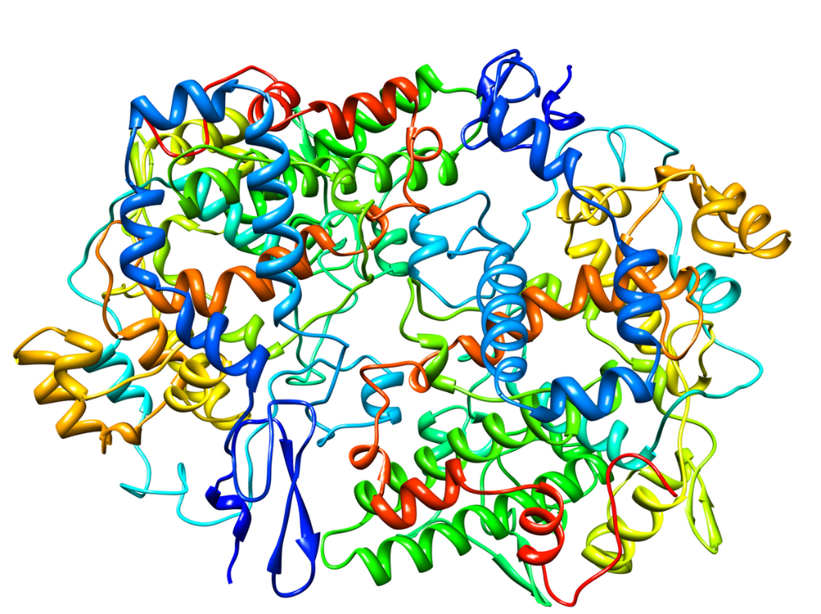
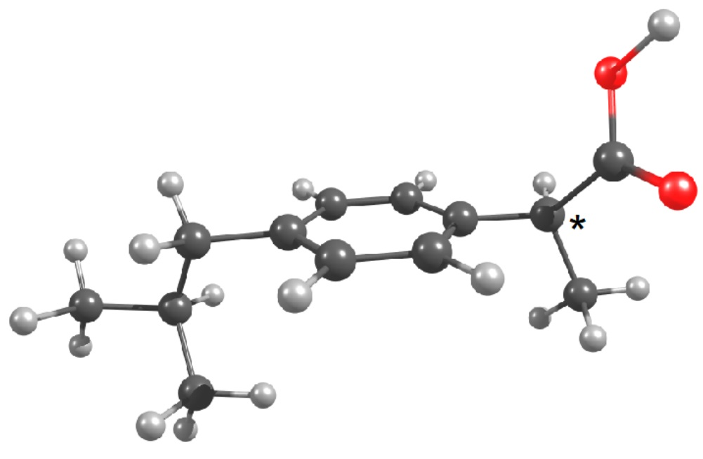
For what?
Investigation of intermolecular interactions in condensed matter
?
Detailed mechanism of the ibuprofen binding to enzymes has not been fully studied
+
=
Cyclooxygenase
Design and development of new drug formulations
based on ibuprofen
New medicines are made on the basis of already known ones (for example, ibuprofen). One of the stages is the study using IR and Raman spectroscopy.
It is necessary to correctly characterize the experimental vibrational spectra.
Vibrational
Spectroscopy
3/15

Slide 4
Purpose and tasks
Purpose: to study the effect of intermolecular interactions in the associates of ibuprofen enantiomers on the features of its structure and dynamics.
Main tasks:
To investigate the molecular mobility of the main structural fragments of ibuprofen
To model ibuprofen dimers of various types (R-R, S-S, R-S, linear and cyclic) based on its stable conformer and to optimize their molecular geometries
To evaluate the thermodynamic parameters of the reaction of formation of associates
Calculate the IR and Raman frequencies for the obtained associates
To compare the calculation results with experimental IR and Raman spectra of ibuprofen racemate
4/15

Slide 5
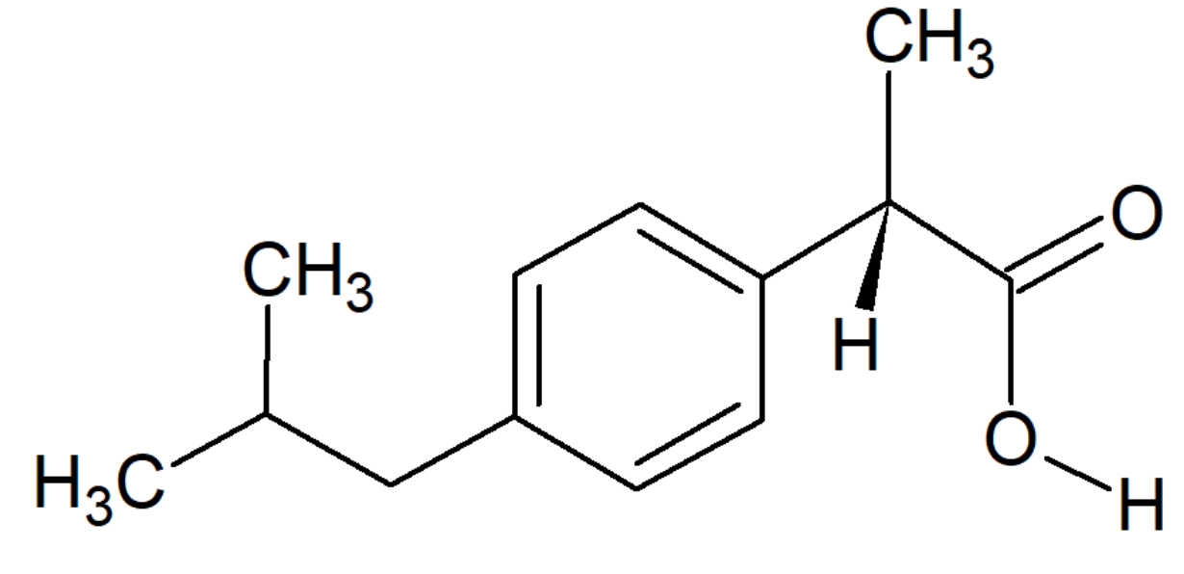
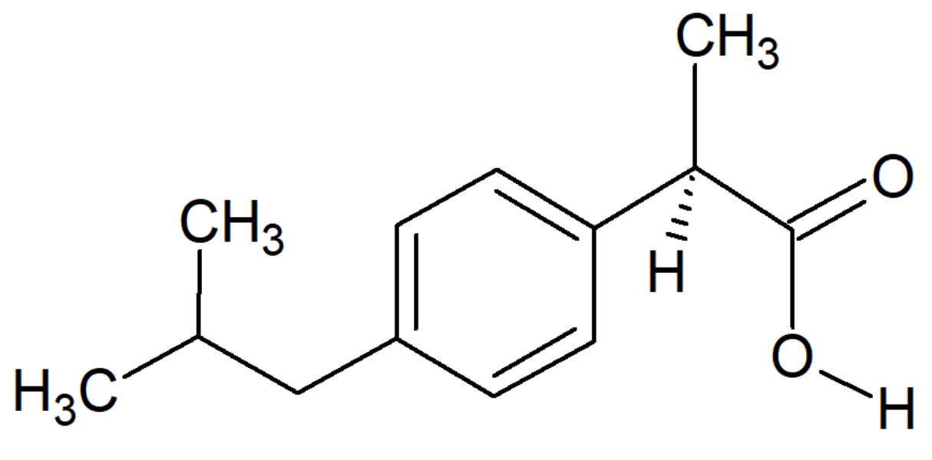
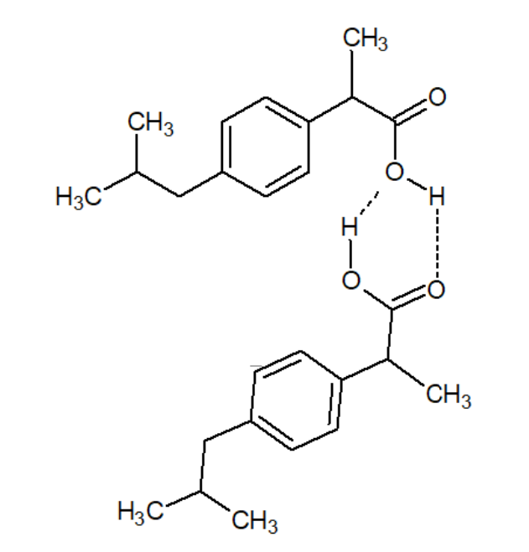
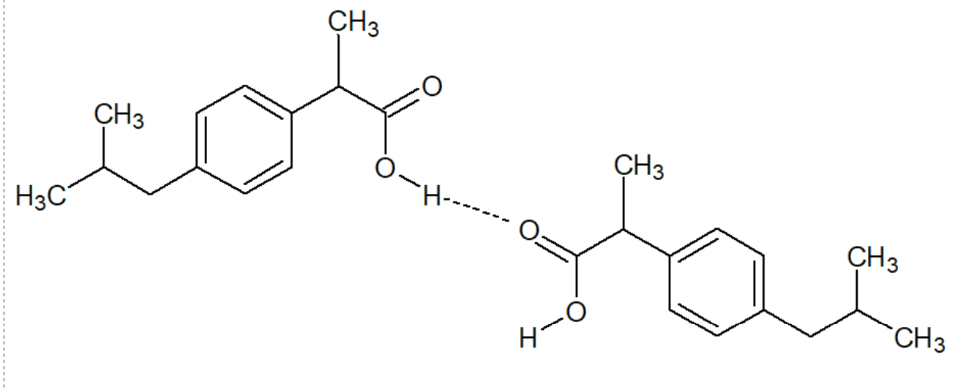
Object
+
Dimer
Cyclic-1 dimer
Cyclic-2 dimer
Ibuprofen sample
Linear dimer
5/15

Slide 6
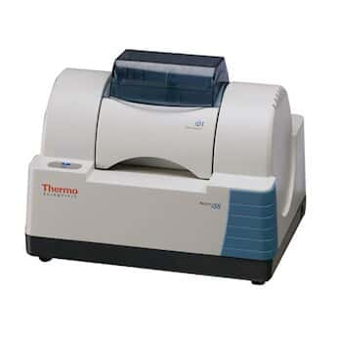
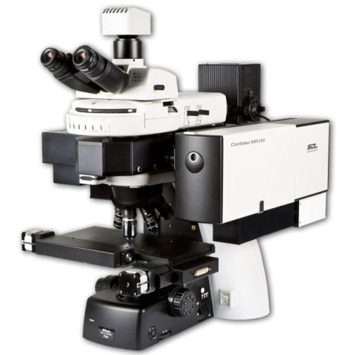
Basic research methods
DFT method: ORCA 5.0.3 software.
Theory level: BP86/def2-TZVP.
The KFU computing cluster.
IR spectroscopy: Nicolet iS50 FTIR.
The range is 400-4000 cm⁻¹.The KBr tablet. Kurchatov Institute Research Center.
Raman spectroscopy:
Confotec MR200 in combination with
NIKON Ni direct microscope.
A blue laser with a wavelength of 473 nm.
The measurement range is 400-4000 cm⁻¹.
FLNP, JINR.
6/15

Slide 7
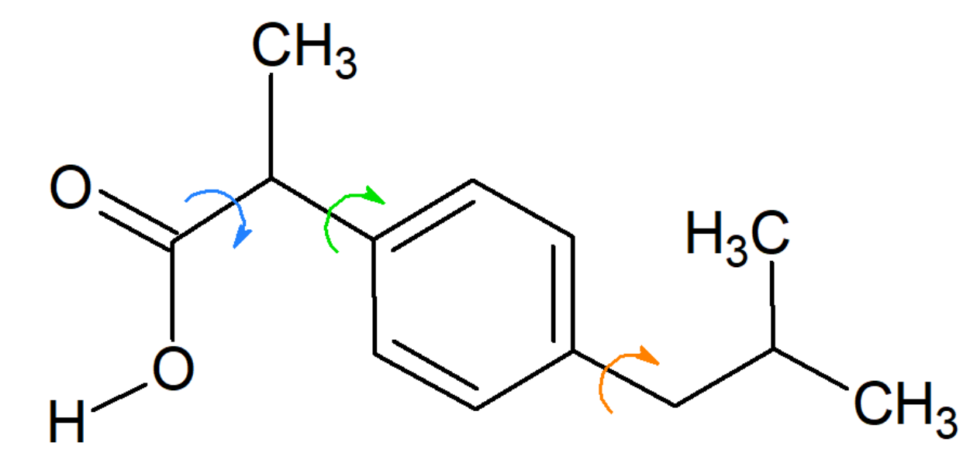
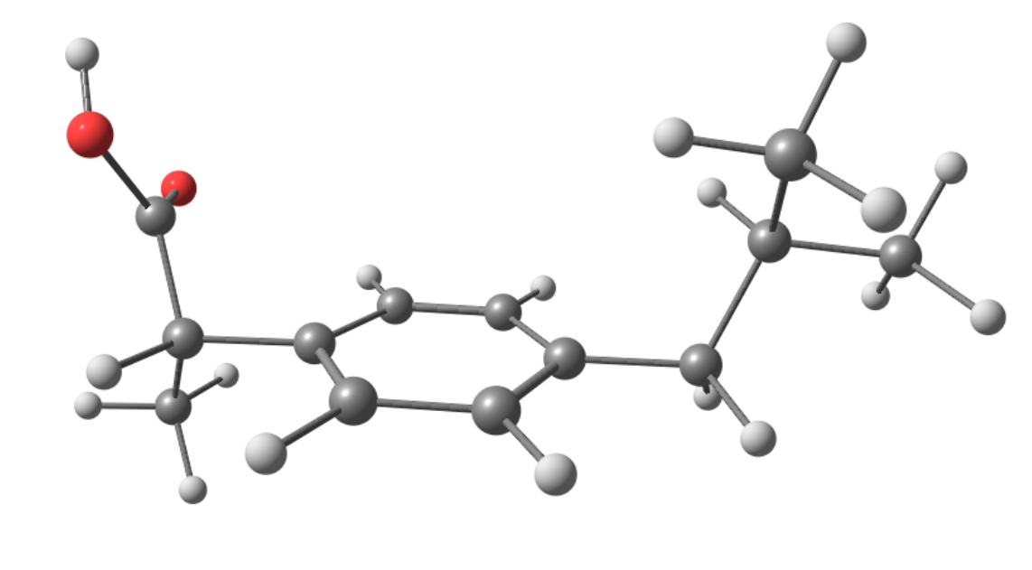
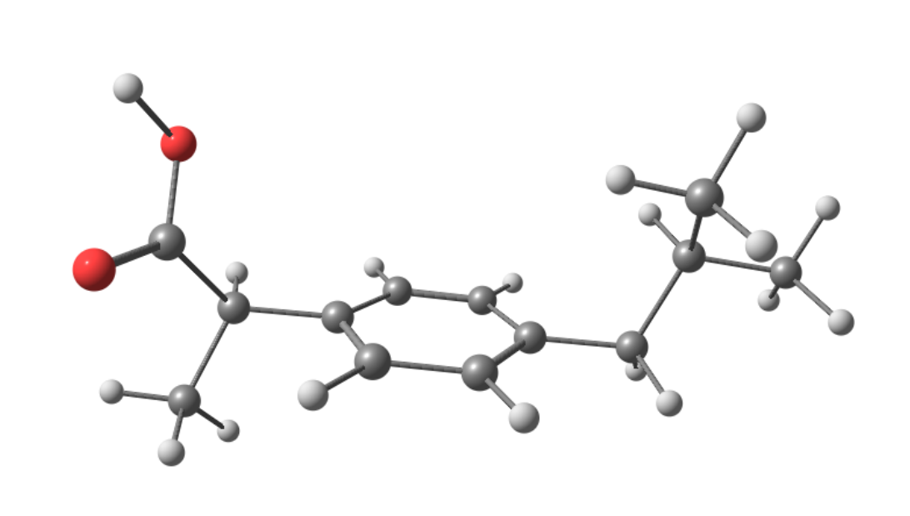
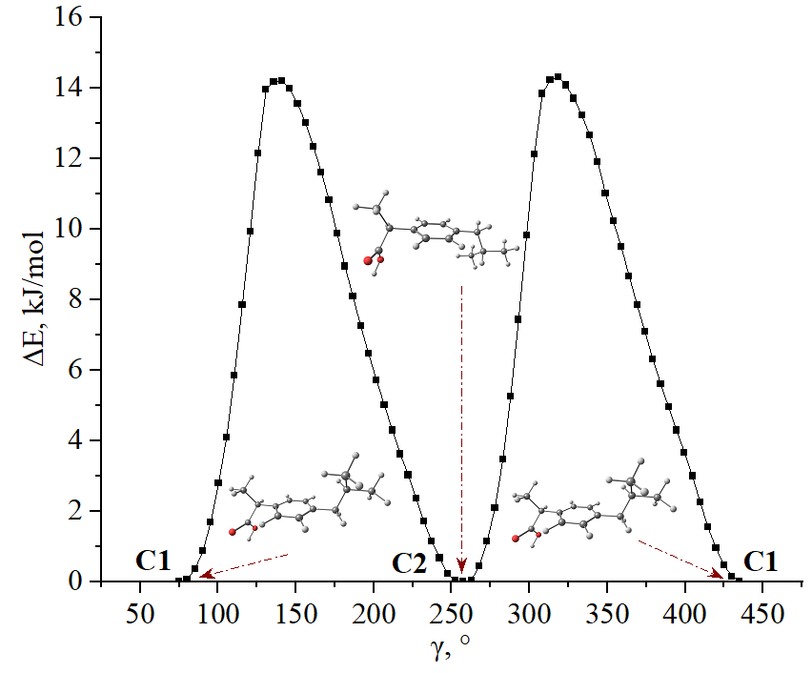
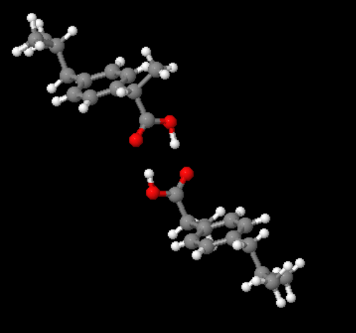
Intramolecular dynamics of the main structural fragments of ibuprofen (BP86/def2-TZVP)
Intramolecular barriers are within 4-14 kJ/mol
α
β
The most stable conformers of ibuprofen
*
S-enantiomer
R-enantiomer
α = 91.1°
β = 121.3°
γ = 253.6°
α = 87.4°
β = 58.5°
γ = 255.9°
γ
Е=-656.94901 a.m.u.
Е=-656.94897 a.m.u.
Crystal structure of ibuprofen: R-S cyclic-1 dimer [3]
7/15
[3]Derollez P. et al. Ab initio structure determination of phase II of racemic ibuprofen by X-ray powder diffraction //Acta Crystallographica Section – 2010. – Т. 66. – №. 1. – С. 76-80.

Slide 8
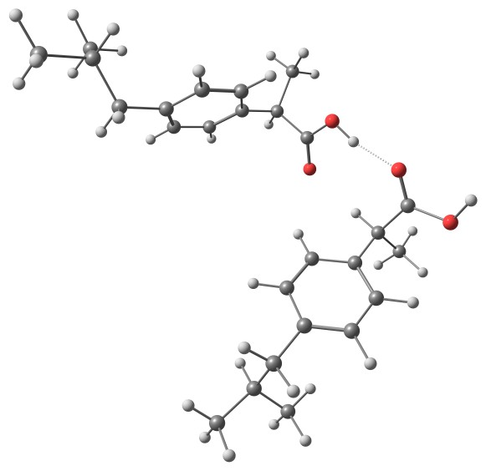
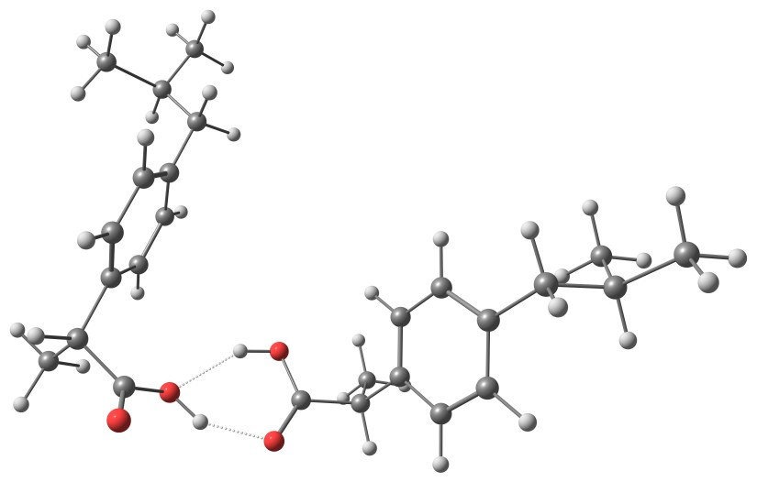
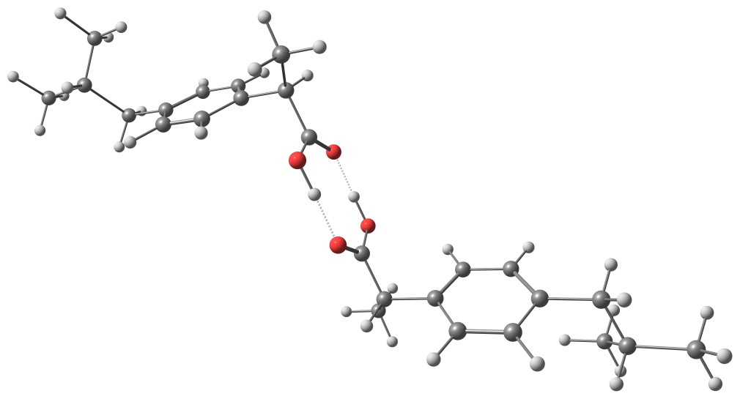
Ibuprofen dimers (BP86/def2-TZVP)
Kr-Ks linear dimer
Kr-Ks cyclic-2 dimer
Kr-Ks cyclic-1 dimer
K – crystal configuration
r – R enantiomer
s – S enantiomer
8/15

Slide 9
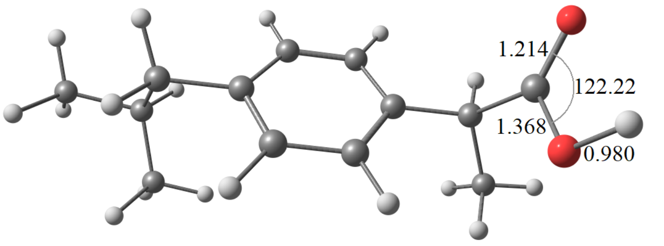
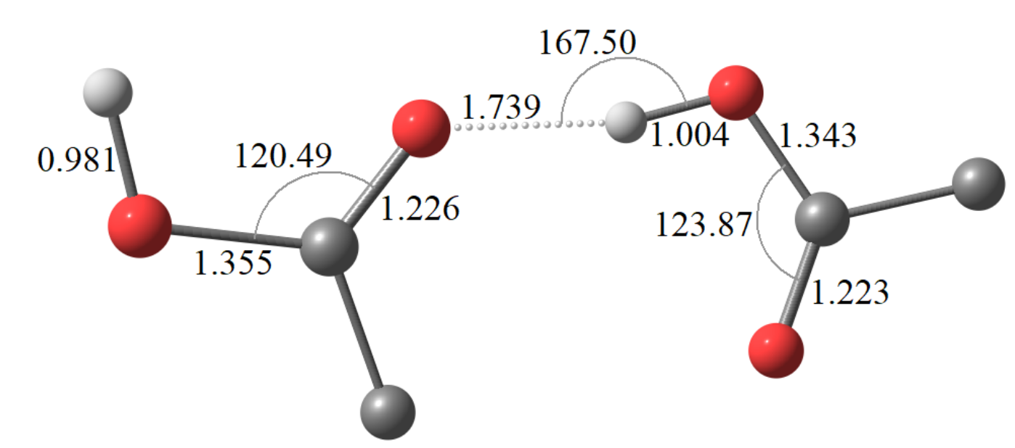
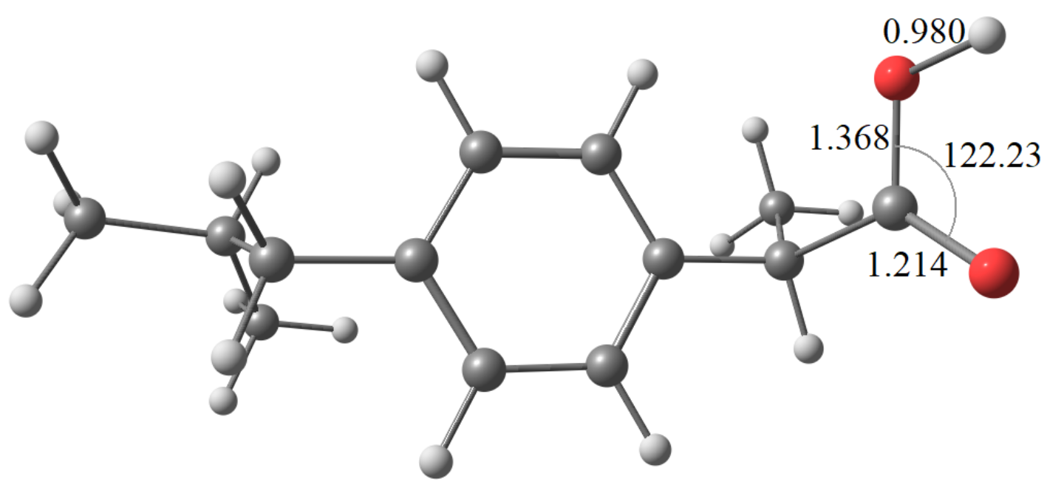
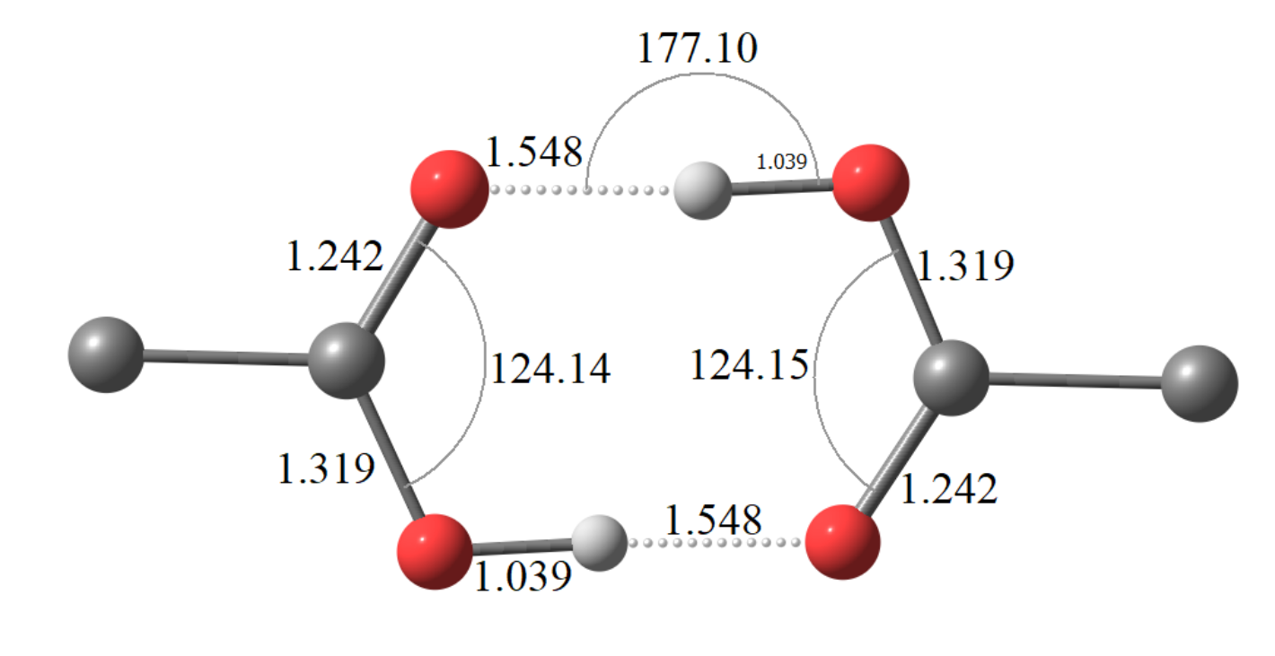
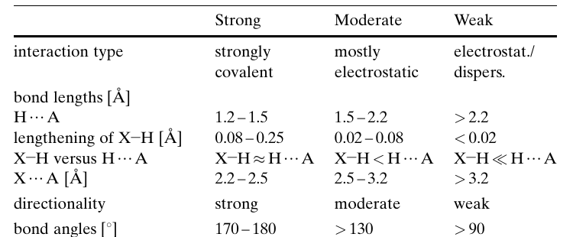
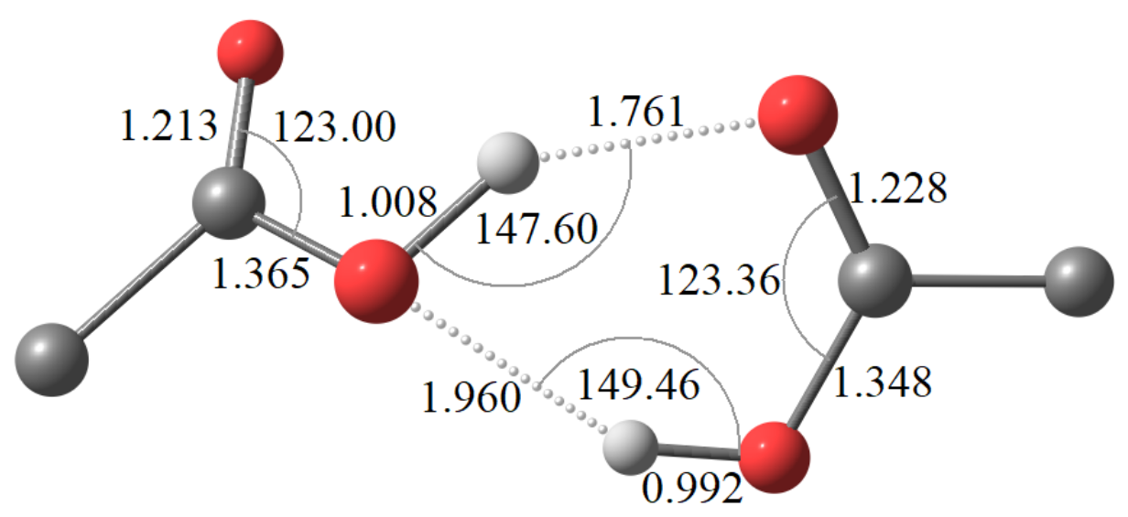
Molecular geometry parameters of the ibuprofen enantiomers and dimers (BP86/def2-TZVP)
О
Н
О
О
С
Н
Kr-Ks
linear dimer
Н
О
С
С
О
Н
О
Ks-enantiomer
О
О
Н
О
С
1.039
Kr-Ks
cyclic-1 dimer
О
С
С
Kr-enantiomer
Н
О
О
О
О
Н
С
С
Kr-Ks
cyclic-2 dimer
О
Н
О
9/15
[4] Steiner T. The hydrogen bond in the solid state //Angewandte Chemie International Edition. – 2002. – Т. 41. – №. 1. – С. 48-76.

Slide 10
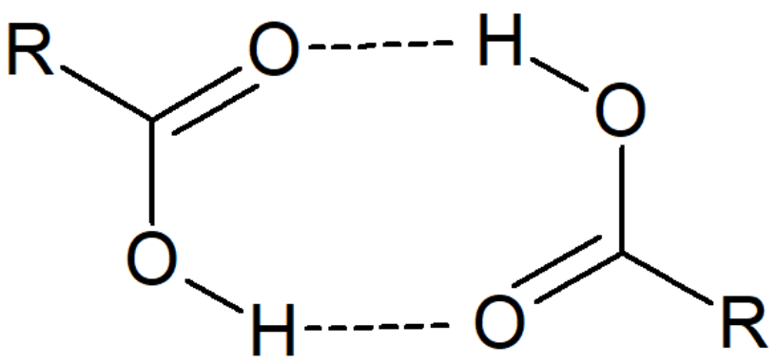
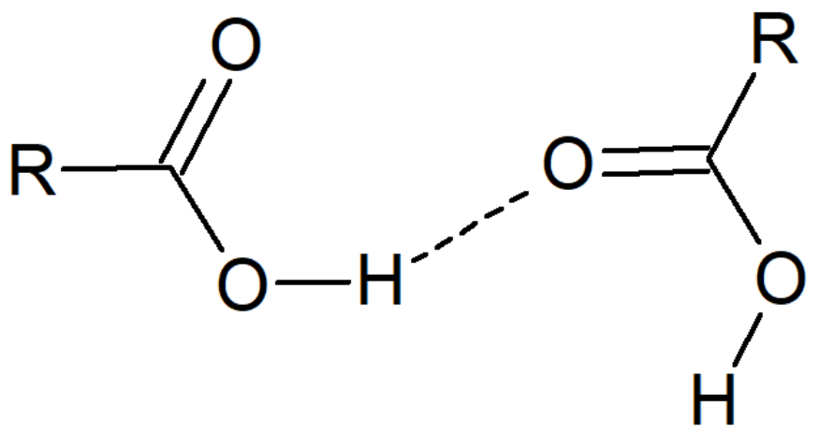
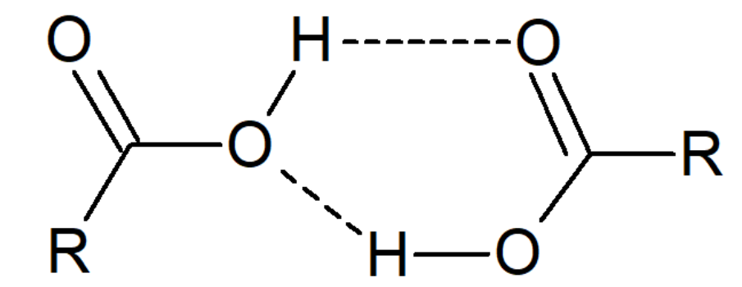
Strength of hydrogen bonds in the ibuprofen dimers (BP86/def2-TZVP)
Dimer | ∆_{r}H_{dim}, kJ/mol | ΔН per H-bond, kJ/mol
Kr-Ks C | -70,49 | -35,25
Kr-Kr C | -70.68 | -35.34
Ks-Ks C | -69.00 | -34.98
R-R C | -67.13 | -33.57
R-S C | -64.93 | -32.46
S-S C | -65.19 | -32.60
Kr-Ks L | -28,85 | -28,85
Kr-Kr L | -31.26 | -31.26
Ks-Ks L | -31.11 | -31.11
Kr-Ks C2 | -23,81 | -11,91
Kr-Kr C2 | -24.65 | -12.32
Ks-Ks C2 | -26.59 | -13.29
C – cyclic-1 dimer
L – linear dimer
C2 – cyclic-2 dimer
10/15

Slide 11
Stability of ibuprofen dimers (BP86/def2-TZVP)
Dimer | ∆_{r}G_{dim}, kJ/mol
Kr-Ks C | -10.61
Kr-Kr C | -11.16
Ks-Ks C | -9.32
R-R C | -1.60
R-S C | -6.80
S-S C | -5.57
Kr-Ks L | 25.57
Kr-Kr L | 32.14
Ks-Ks L | 32.16
Kr-Ks C2 | 31.64
Kr-Kr C2 | 36.55
Ks-Ks C2 | 35.29
C – cyclic-1 dimer, L – linear dimer
C2 – cyclic-2 dimer
The most stable are cyclic-1 dimers.
Linear and cyclic-2 dimers have ∆_{r}G_{dim} greater than zero, which indicates their instability.
The type of enantiomer has little effect on the stability of dimers.
11/15

Slide 12
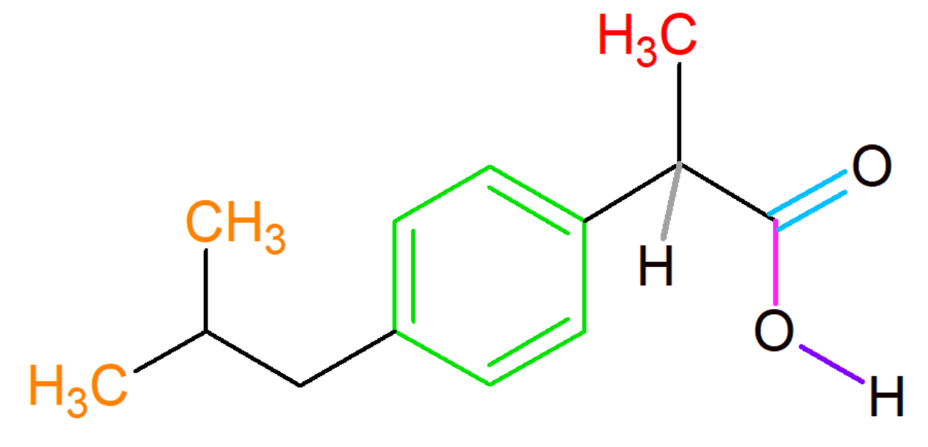
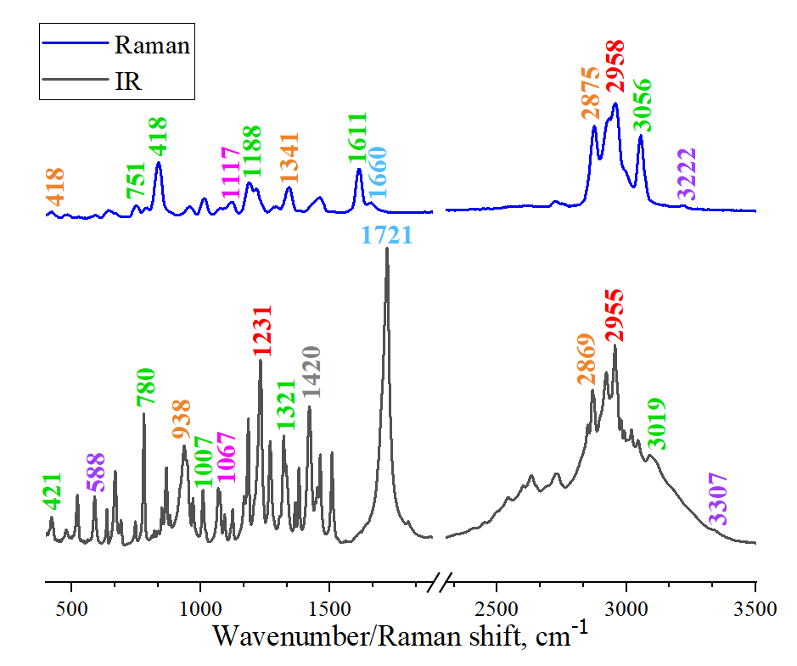
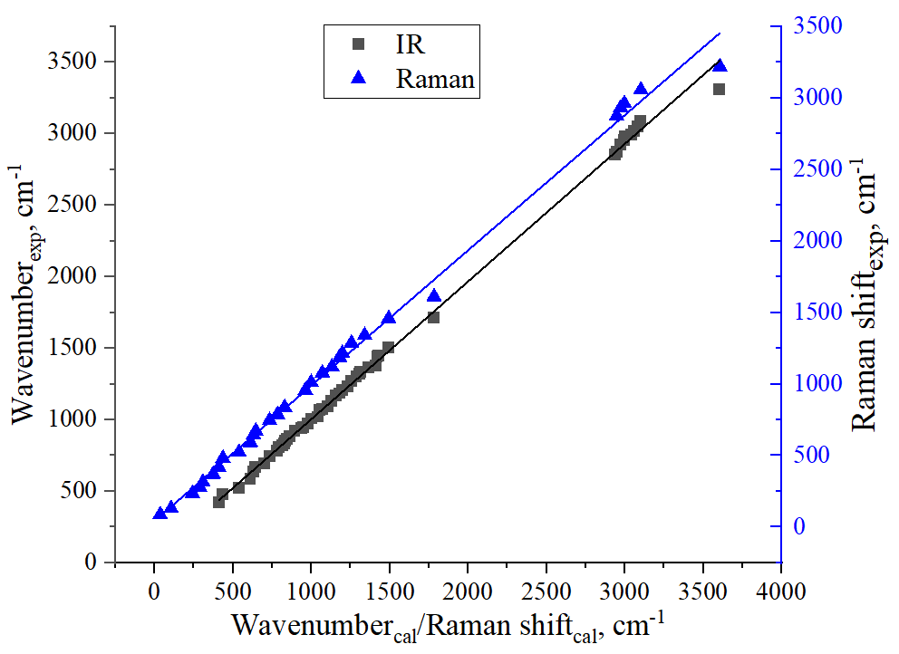
Experimental IR and Raman spectra of ibuprofen
?
Raman
ν_{exp}=(0,946±0,012)*ν_{cal}
R= 0,99793
?
IR
ν_{exp}=(0,961±0,006)*ν_{cal}
R= 0,99904
12/15

Slide 13
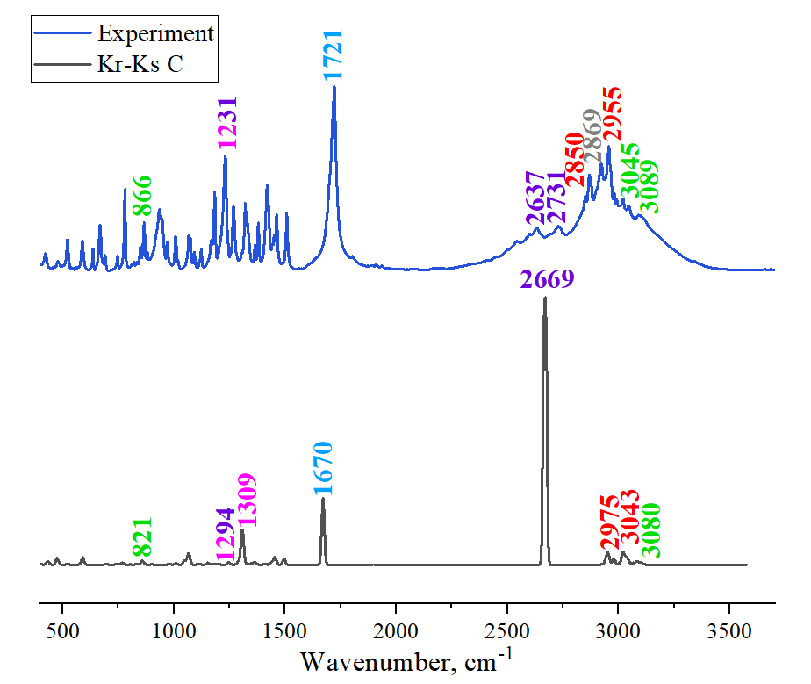
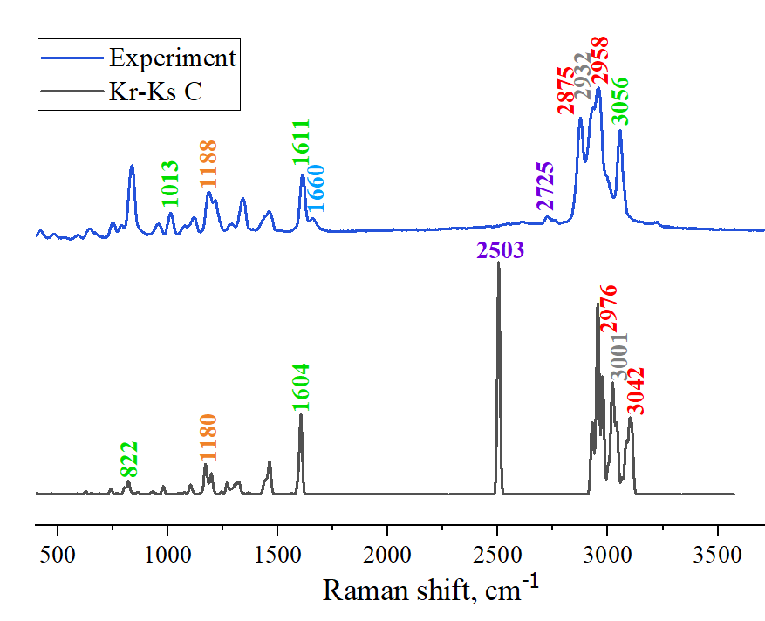
IR and Raman spectra of ibuprofen dimers (BP86/def2-TZVP)
IR-spectra
Raman-spectra
13/15

Slide 14
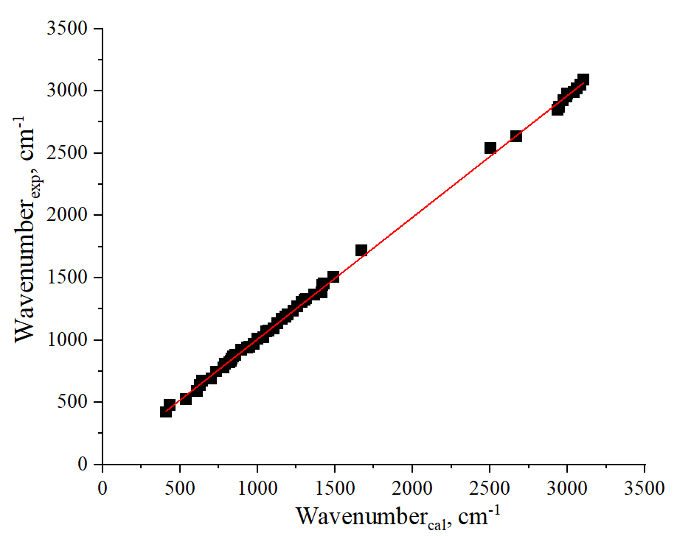
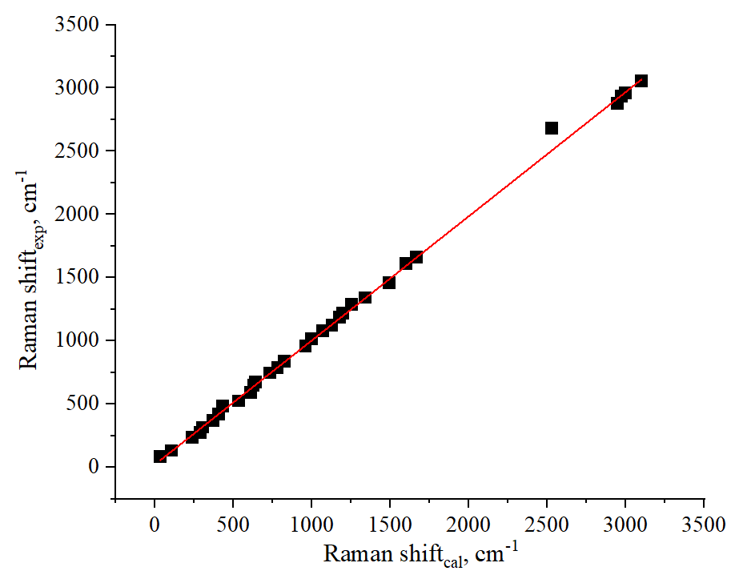
Linear correlations for ibuprofen dimers (BP86/def2-TZVP)
Linear correlation of experimental and calculated frequencies for ibuprofen
IR-spectra
Linear correlation of experimental and calculated frequencies for ibuprofen Raman-spectra
ν_{экс}=(0,978±0,004)*ν_{рас}
R= 0,99967
ν_{экс}=(0,988±0,007)*ν_{рас}
R= 0,99916
14/15

Slide 15
Conclusions
Conformational analysis (BP86/def2-TZVP) revealed that ibuprofen enantiomers are labile, since the values of intramolecular barriers do not exceed 14 kJ/mol. The equilibrium configurations of ibuprofen enantiomers, which were used to construct dimers, were also revealed.
Equilibrium configurations of ibuprofen dimers of various types (BP86/def2-TZVP) were obtained. Analysis of the parameters of the dimers molecular geometry revealed that these structures are characterized by hydrogen bonds of medium strength.
The thermodynamic parameters for the ibuprofen enantiomers association were estimated. It was shown that the strongest hydrogen bonds are observed in cyclic-1 dimers, and the weakest hydrogen bonds are in cyclic-2 dimers. The most stable are cyclic-1 dimers. The strength of hydrogen bonds and the stability of dimers does not depend on the type of enantiomers in the associates.
Based on a comparative analysis of experimental and calculated vibrational frequencies, satisfactory linear correlations have been obtained for both enantiomers (R_{IR}=0,99904, R_{Raman}= 0,99793) and dimers (R_{IR}= 0,99967, R_{Raman}= 0,99916).
Quantum chemical modeling of the intermolecular dynamics of ibuprofen enantiomers has shown that the use of structural models of associates (dimers) in calculating the vibrational frequencies of IR and Raman spectra allows one to obtain more correct results comparable to the experiment, which is evident for the vibrational frequencies of groups of atoms involved in intermolecular interactions (carboxyl group).
15/15

Slide 16
Publications
Logacheva K., Gergelezhiu P., Raksha E., et al. Vibrational Spectroscopic Features of Ibuprofen and Ketoprofen: IR and Raman Spectroscopy Combined with DFT Calculations. Physics of Particles and Nuclei Letters 21, 2024. – № 4, Pp. 839-842.

Slide 17
Acknowledgment
Savostina L.I.
Raksha E.V., Belushkin A.V., Eresko A.B., Vershinina T.N., Arzumanyan G.M.,
Ponomareva O.U., Chudoba D.M.
Malakhov S.N.

Slide 18
Thanks for your attention!

