Slide 1




Study of CuO nanostructures modified with a sequential thermal treatment (CuO STT) for photovoltaic applications
S. Fortuné Fábregas ^{a, b}, P. L. Tuan ^{b, c}, A. S. Doroshkevich ^{b}, E. Pedrero ª, A. Iribarren ª and L. Vaillant Roca ª
silviafortune@gmail.com ; silvia.fortune@imre.uh.cu ; silviafortune@jinr.ru
ª Institute of Materials Science and Technology, University of Havana, Havana, Cuba.
^{b} Frank Laboratory of Neutron Physics (FLNP), Joint Institute for Nuclear Research (JINR), Dubna, Russian Federation.
^{c} Hanoi Irradiation Center, Vietnam Atomic Energy Institute, Hanoi, Vietnam.

Slide 2
Content
Introduction
  Research solar cells efficiency
  CuO properties and heterostructure
Experimental technique
  CuO nanostructures synthesis
  CuO nanostructures sequential thermal treatment (STT)
Results and discussion
  CuO nanostructures. SEM, Raman and XRD
  CuO STT. SEM, XRD and RBS
Conclusions

Slide 3
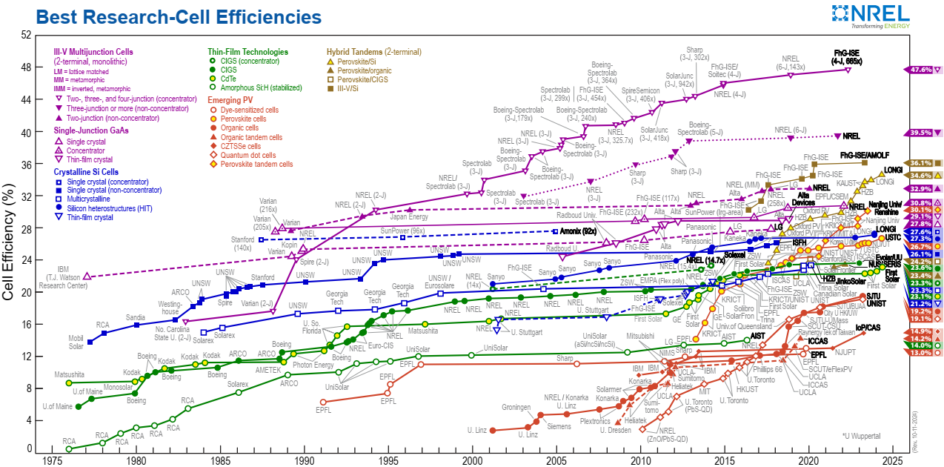
1. Introduction. Research solar cells efficiency.
Notes:
Existencia de celdas solares basadas en materiales:
con elementos no abundantes en la corteza terrestre,
tóxicos,
no estables,
obtenidos mediante técnicas de crecimiento de difícil escalado.

Slide 4
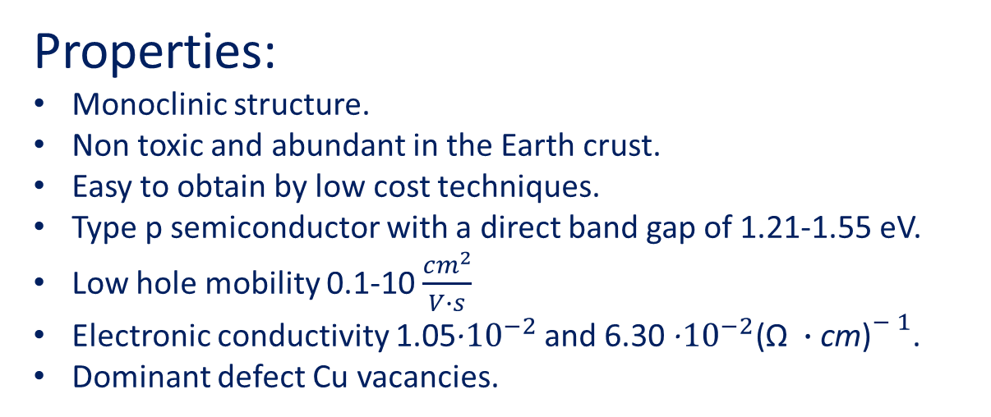
1. Introduction. CuO properties.
Properties:
Monoclinic structure.
Non toxic and abundant in the Earth crust.
Easy to obtain by low cost techniques.
Type p semiconductor with a direct band gap of 1.21-1.55 eV.
Low hole mobility 0.1-10 $\frac{{cm}^{2}}{V∙s}$
Electronic conductivity 1.05·${10}^{−2}$ and 6.30 ·${10}^{−2}{\text{(Ω }∙\text{cm}\text{)}}^{− 1}$.
Dominant defect Cu vacancies.
Excellent solar radiation absorber material.
Poor electrical properties.
Low efficiency of nanostructured CuO-based solar cells!!
Efficiency of CuO based nanostructured solar cells:
ZnO:Co/CuO/MO3 → 2.11 eV [Kaphle 2020],
ZnO/CuO → 2.88 eV [Bhaumik 2014],
CuO@Zn/Al-LDH → 1.24 eV [Bashir 2023],
ZnO/CuO → 0.08 eV [Dimopoulos 2013].
Notes:
Explicar que yo uso estas técnicas para optimizar porque quiero obtener una heteroestructura basada en CuO mediante técnicas de bajo costo, materiales sostenibles (no tóxicos, abundantes en la corteza terrestre y fáciles de obtener mediante técnicas de bajo costo)

Slide 5
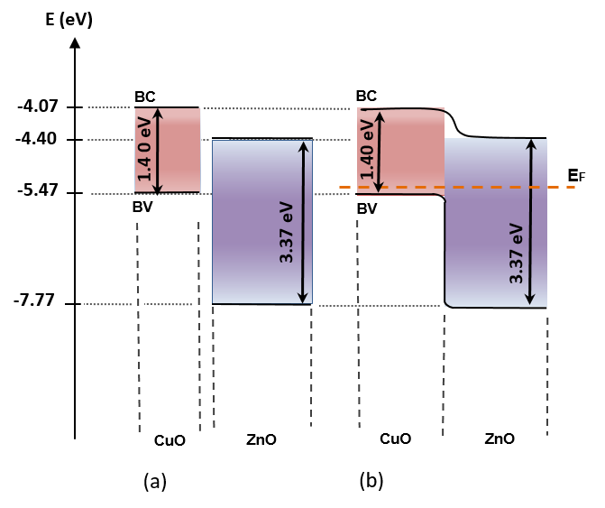
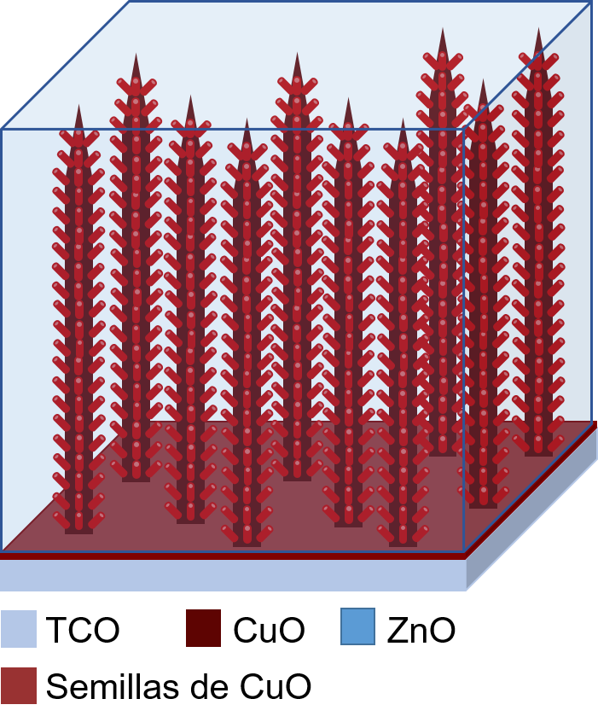
1. Introduction. CuO heterostructure
CuO heterostructures low-cost optimization:
Thermal treatments
New architectures
Doping
CuO/ZnO proposed heterostructure
CuO/ZnO Band diagram
Notes:
Explicar que yo uso estas técnicas para optimizar porque quiero obtener una heteroestructura basada en CuO mediante técnicazs de bajo costo, materiales sostenibles (no tóxicos, abundantes en la corteza terrestre y fáciles de obtener mediante técnicas de bajo costo)

Slide 6
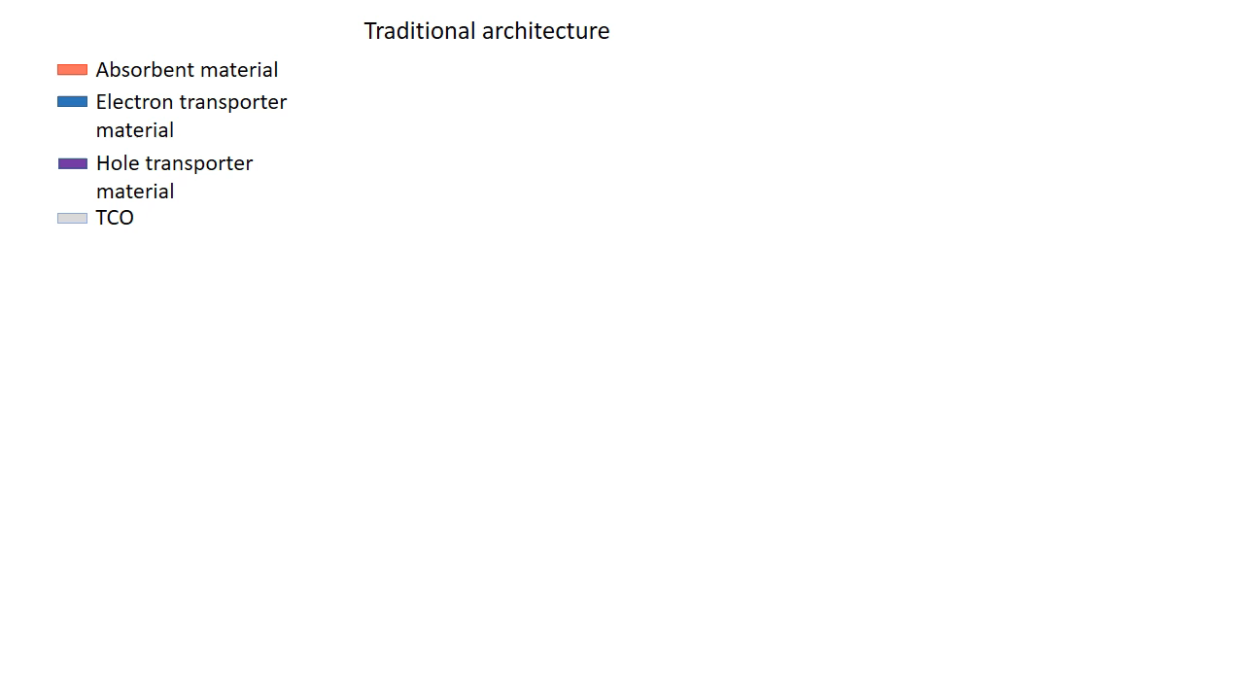
1. Introduction. Novel structure.
The primary objective of this research is to develop a heterostructure based on elongated CuO nanostructures with an inverted and branched architecture. In this heterostructure, the CuO layer serves as both, the support and the absorbing material for solar radiation. This study presents results from CuO nanostructured samples subjected to a sequential thermal treatment. This approach was chosen because it can enhance the structural, electrical and optical properties more effectively than standard thermal treatments by optimizing each step of the thermal cycle.

Slide 7
2. CuO nanostructures synthesis and sequential thermal treatment

Slide 8
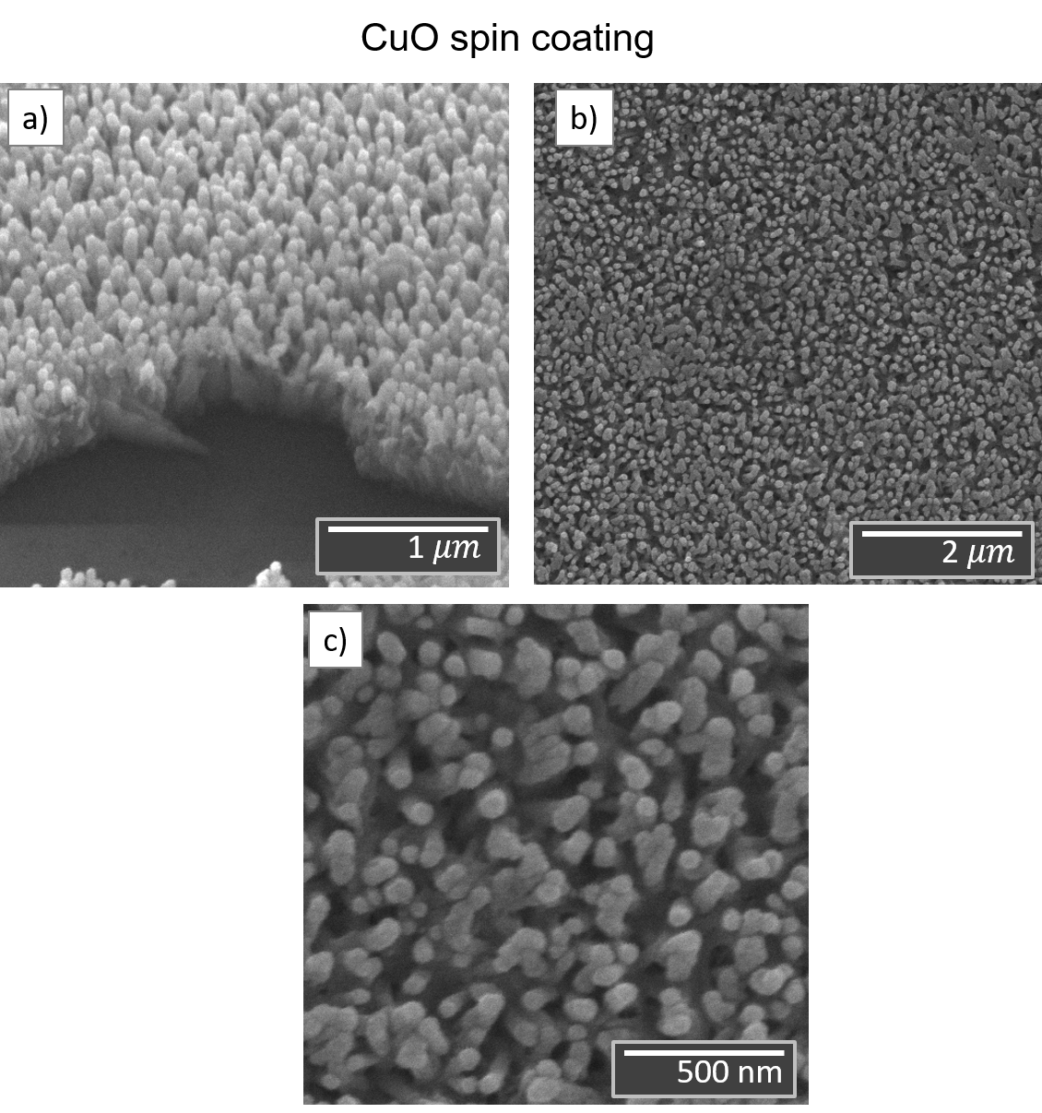
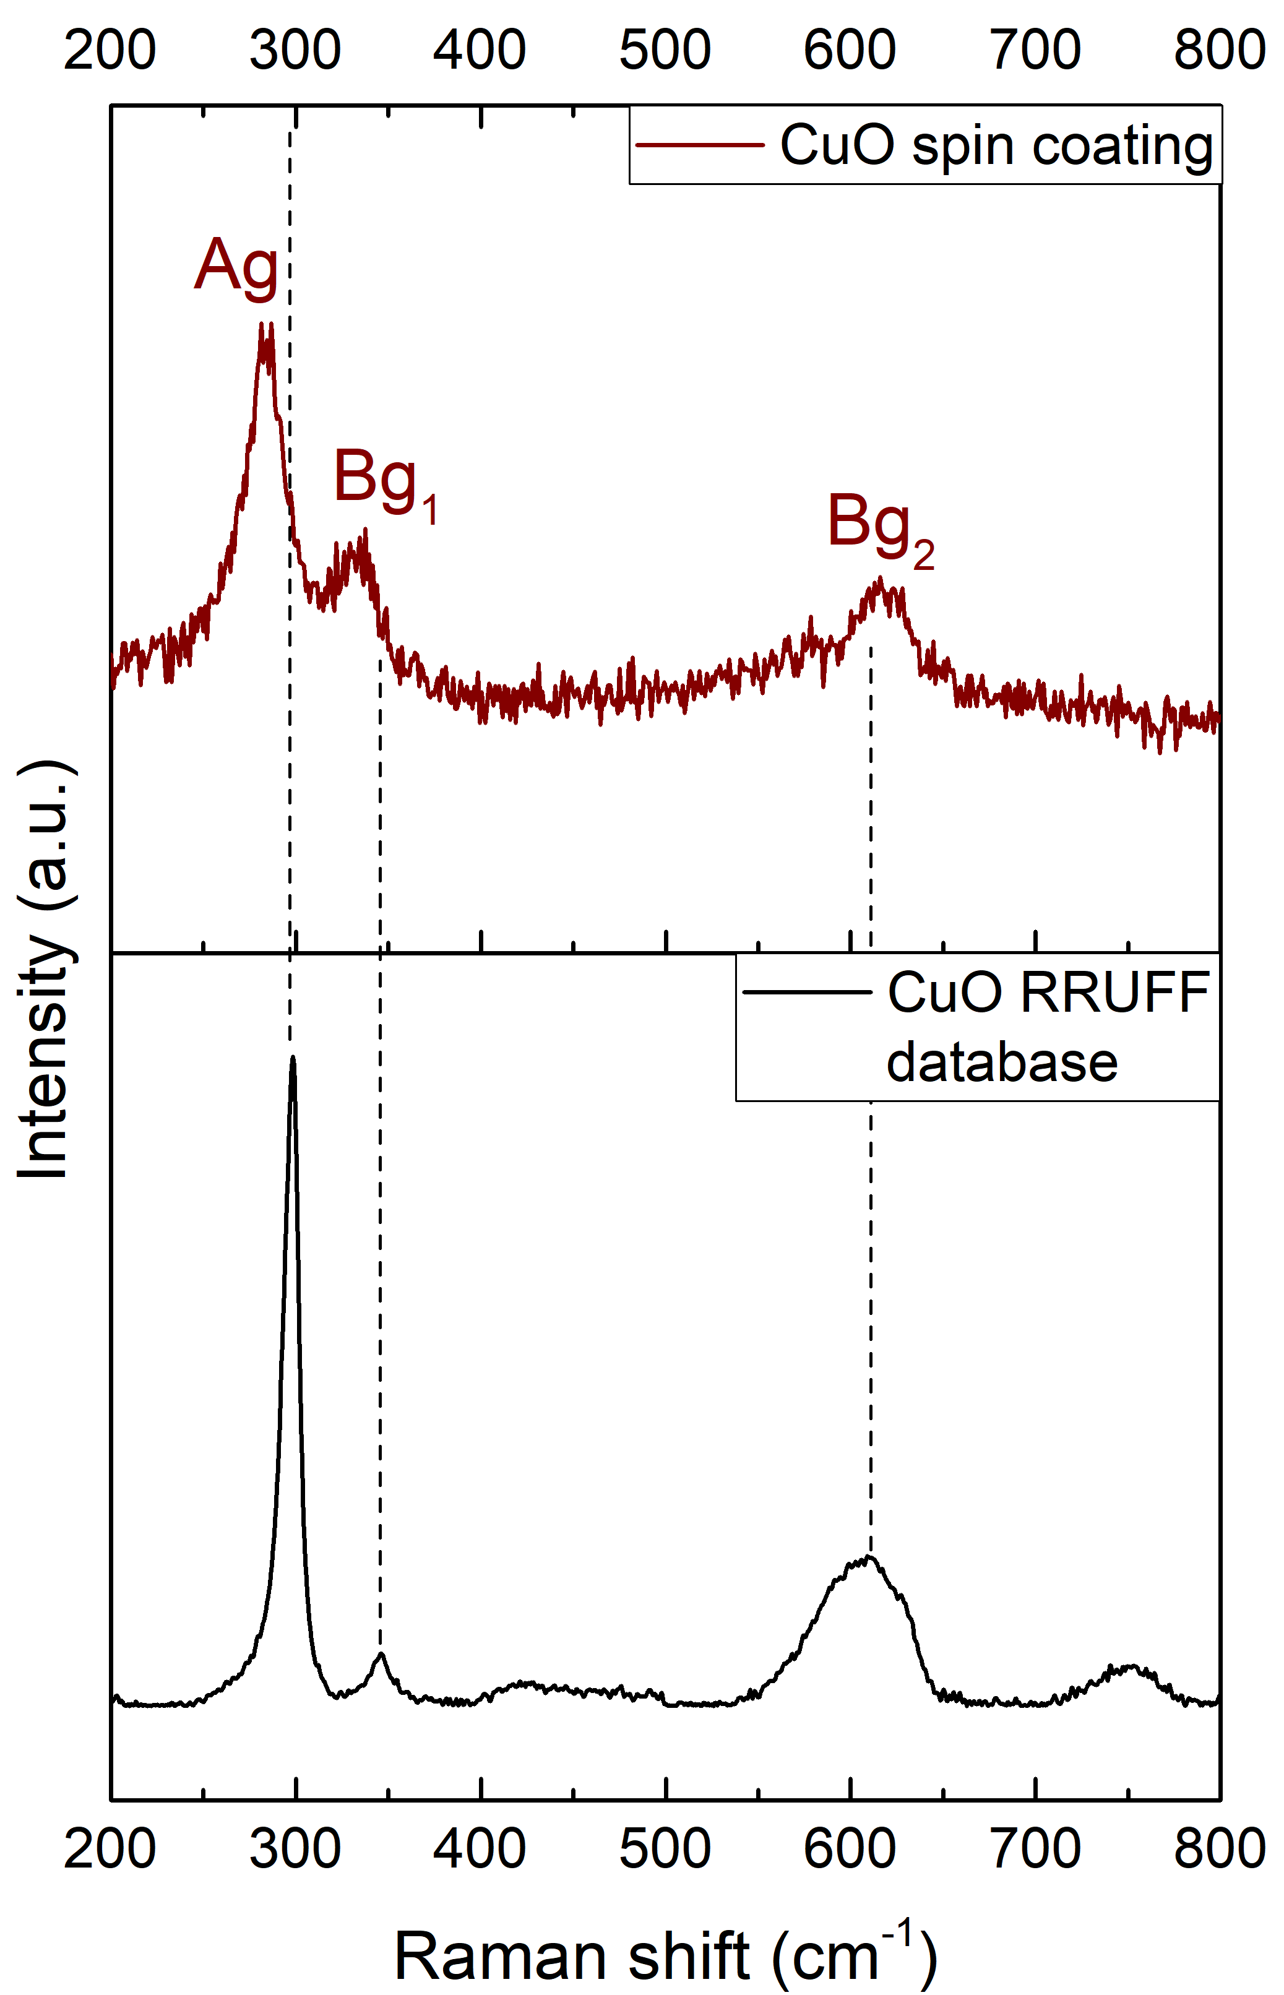
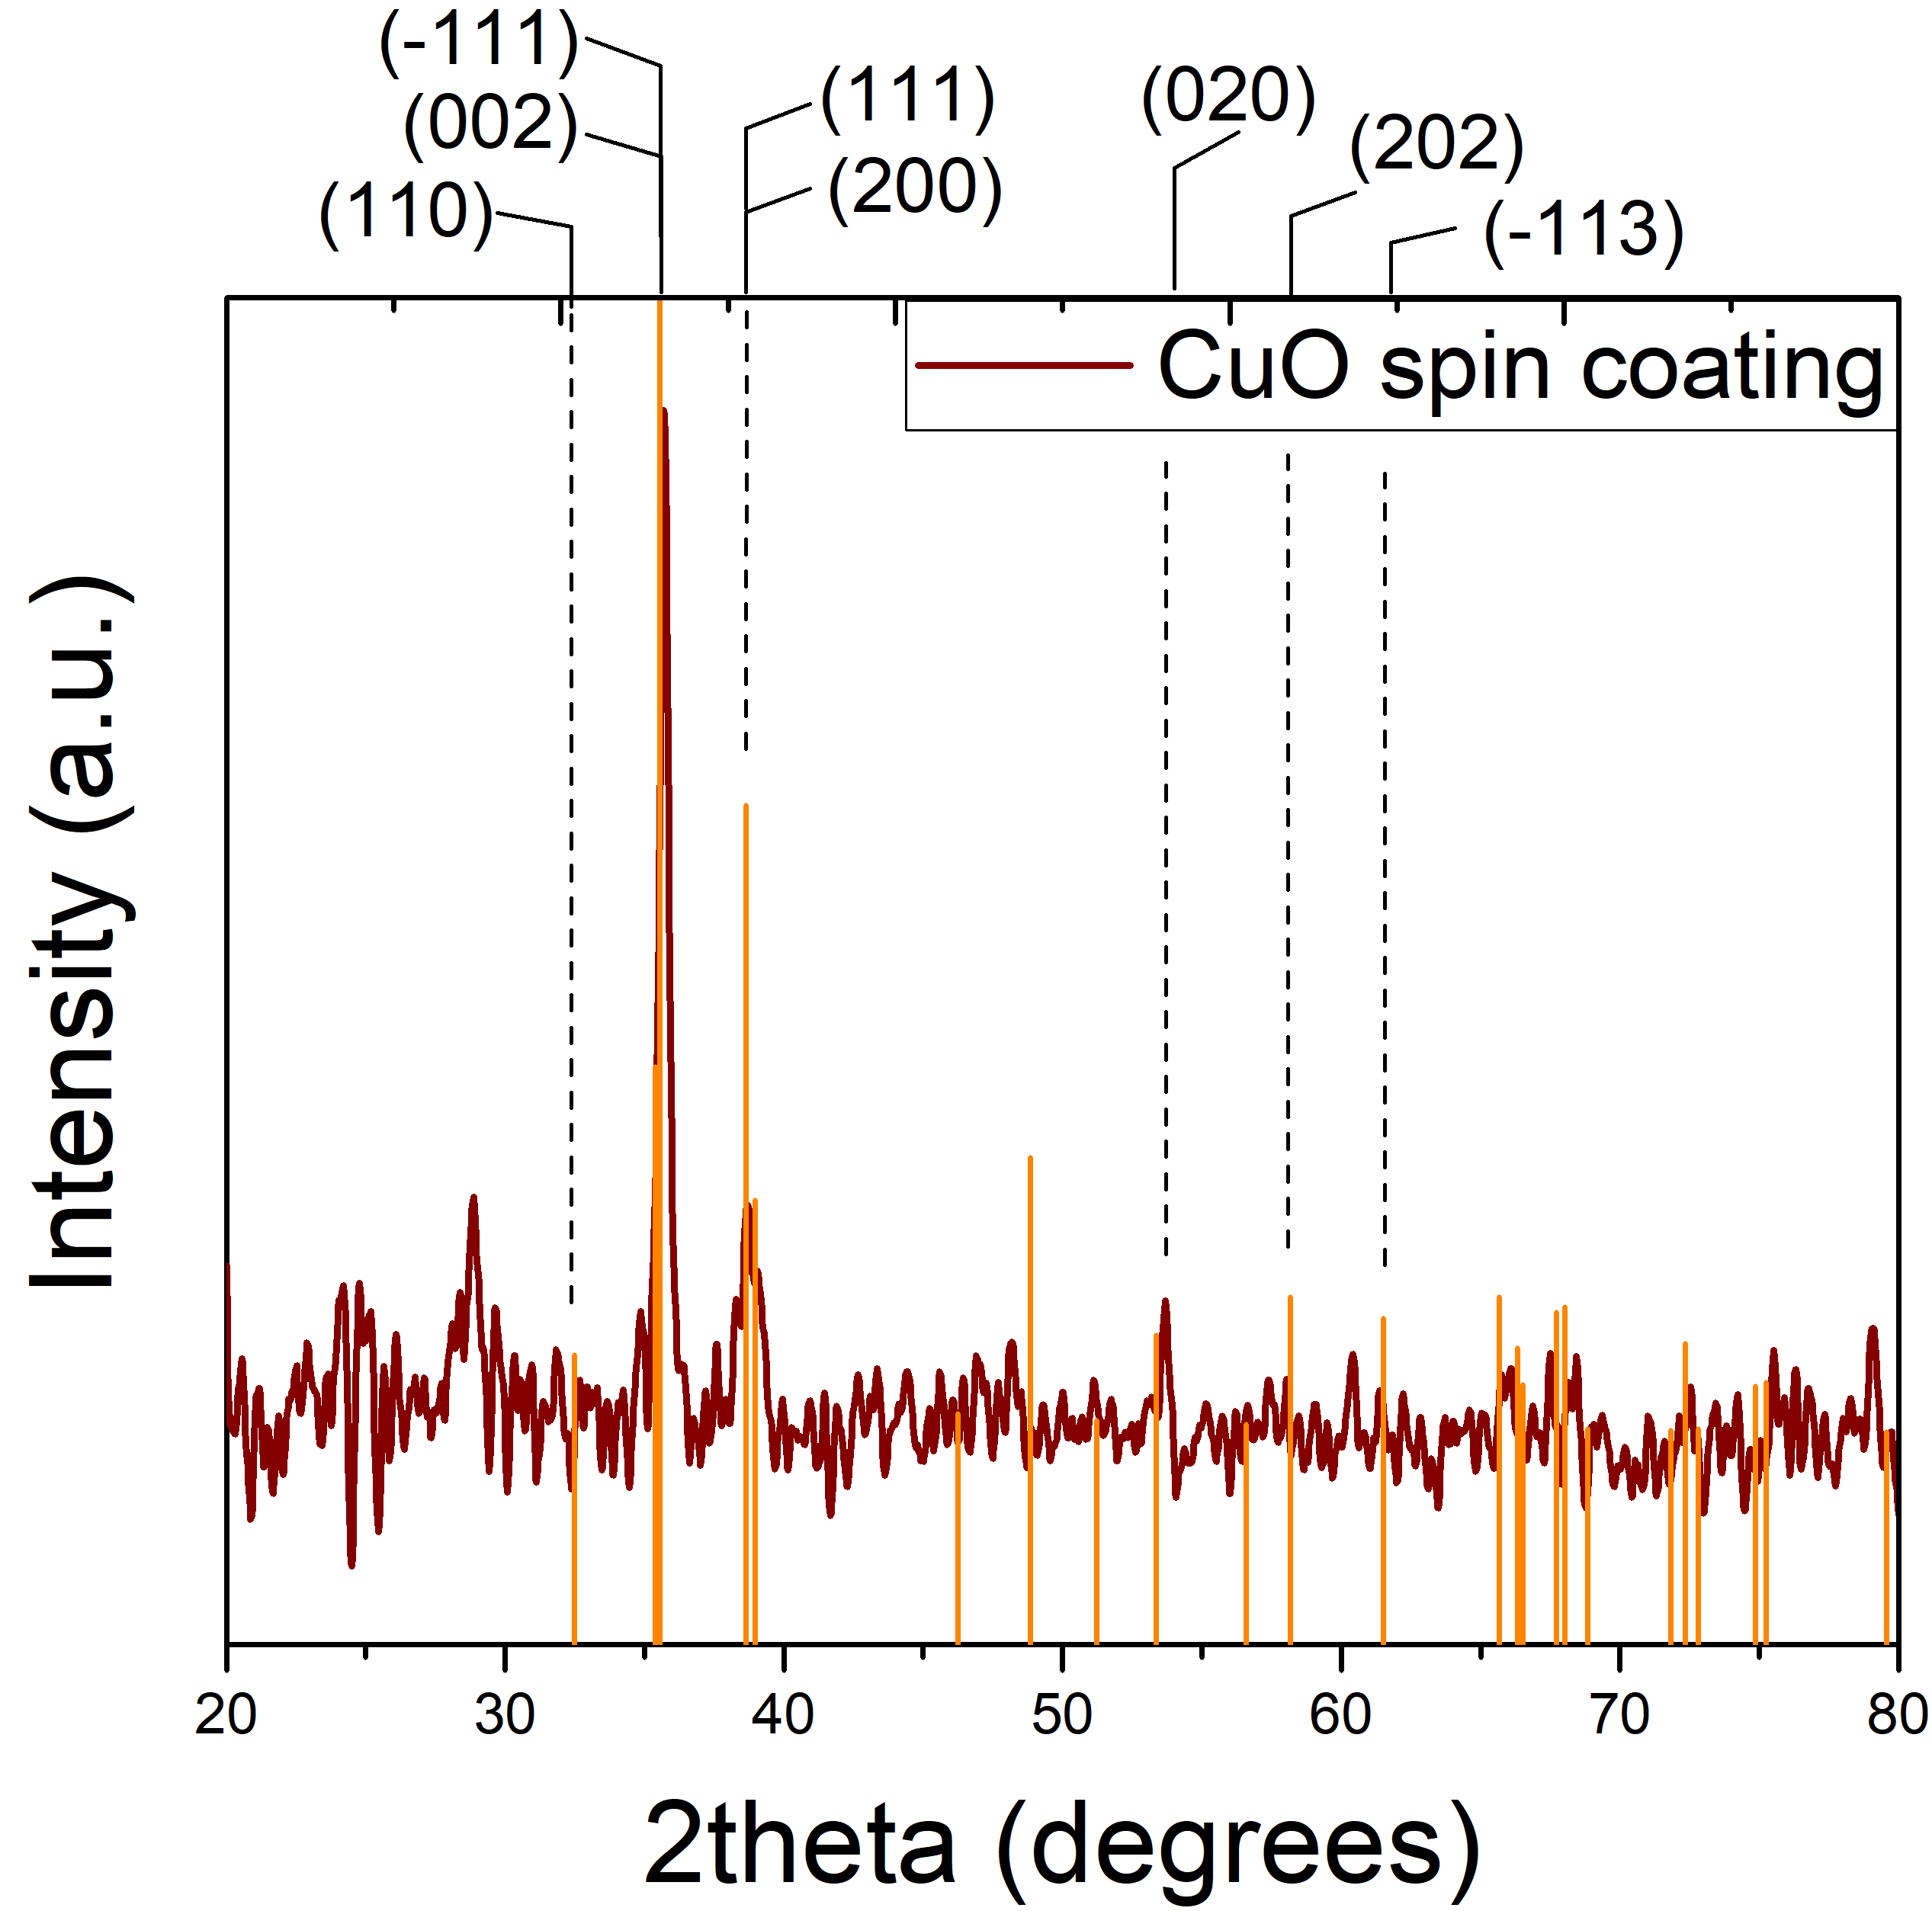
3.1. CuO nanostructures
SEM
Raman spectroscopy
XRD
CuO nanostructures with elongated morphology.
CuO Nanorods (CuO NRs) tips width and length are 64 and 430 nm, respectively.
Raman spectroscopy and XRD corroborates that the CuO layer have a monoclinic structure.
XRD shows a remarkable preferential orientation along [001] direction.
Notes:
-Spin higher verticality.
-Spin higher apparent porosity.
-Spin higher crystalline quality.

Slide 9






3.2. CuO with sequential thermal treatment: SEM
Sequential thermal treatment affects morphology, density and nanostructures orientation.
The CuO 200+300+400 °C sample have the best morphological properties to form a heterostructure.
$ω$ = 64 nm
$ω$ = 72 nm
$ω$ = 81 nm
$ω$ = 74 nm
$ω$ = 64 nm
$ω$: width of CuO nanorods tips

Slide 10
3.2. CuO with sequential thermal treatment: XRD
CuO with monoclinic structure type tenorite.
The most intense diffraction maximum correspond to (002) and (200).

Slide 11
3.2. CuO with sequential thermal treatment: XRD
Relative intensities of (200) and (002)
Crystallite size and width
Angular position
FWHM
Estimated cristallite size
Microstrain
Thermal treatment up to 400 °C significantly improves the crystallinity of the CuO layer.
The variations of this parameters suggest that a recrystallization process occurs in the CuO layer subjected to sequential thermal treatment.
Starting from 300 °C, the elongated nanostructures, begin to be composed by fewer crystallites, fewer boundaries and fewer defects in those regions.
Lattice distortions experienced by this nanostructured layer are minimal for samples treated up to 400 °C
Notes:
Decrease in relative intensity → increase of the vertical orientation.
La posición angular correspondiente a (002) muestra la contracción de la red cristalina de 200 a 400 °C. La contracción de la red puede estar asociada con la presencia de defectos como las vacancias.
El proceso de recristalización produce el descenso del tamaño de cristalita para los 300 °C.
Las microtensiones disminuyen de 200 a 400 °C, indicando que las distorsiones de la red que experimenta esta capa nanoestucturada son mínimas para las muestras tratadas hasta 400 °C.
Starting from 300 °C, the structures are formed by increasingly larger crystallites, but the tips of the structures become progressively larger. This means that the elongated nanostructures, with the increase in temperature, begin to be composed of fewer crystallites, fewer boundaries, and fewer defects in those regions

Slide 12
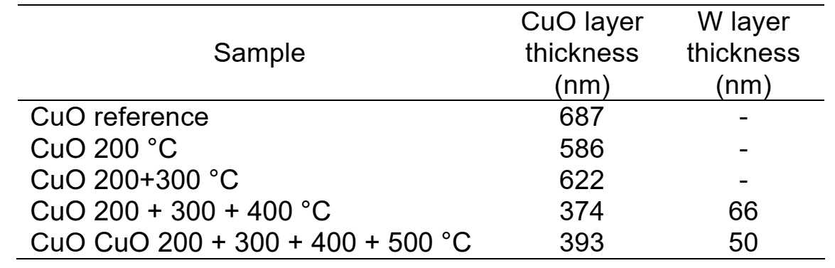
3.3. CuO with sequential thermal treatment: RBS
Spectrum
Cu concentration profile
Cu atoms diffusion towards the glass substrate.
Samples treated until 400 °C and 500 °C are more homogeneous.
CuO and Tungsten layers thickness

Slide 13
3.3. CuO with sequential thermal treatment: RBS

Slide 14
3.4. CuO with sequential thermal treatment: Resistivity
Improvement of the electrical properties due to thermal treatment.

Slide 15
4. Conclusions
We present the results of the structural, morphological analysis, elemental profile composition and the evolution of defects in copper (II) oxide (CuO). The CuO nanostructured layers were modified through a sequential thermal treatment up to 500 °C. During this process, the diffusion of Cu ions towards the glass substrate was observed. At temperatures above 300 °C, crystallite size increase forming grains with larger dimensions and with fewer defects. This results indicates that the sequential thermal treatment improves the structural and electrical properties of the CuO nanostructured layer.

Slide 16
5. Acknowledgements
B. Sc. Nicolás Sirgado from Laboratorio de Luces Estructural at Instituto de Ciencia y Tecnología de Materiales of the University of Havana, Cuba for the SEM measurements.
Technical team of the EG-5 Group from the Frank Laboratory of Neutron Physics (FLNP), Joint Institute for Nuclear Research (JINR), Dubna, Russian Federation.
Project PN211LH008-018 from Cuban National Program of Nanoscience and Nanotechnology (PN3, by its initials in Spanish), Cuba.
Project PN223LH010-58 from Cuban National Program of Basic Sciences (PNCB, by its initials in Spanish), Cuba.
Cooperation project Serbia-JINR № 50 2024 items 7 and 8.
Cooperation project Serbia-JINR № 51 2024 items 4 and 5.
Cooperation project Belarus-JINR № 289 2024 items 16 - 18.

Slide 17
6. References
S. Fortuné-Fábregas, J. Benavides, A. M. Díaz-García, Y. González, A. Ruediger and L. Vaillant-Roca, Influence of the dip and spin coating methods on the seeding for the growing of CuO nanorods by a hydrothermal technique”, Revista Cubana de Física. 40 (2023).
L. Vaillant-Roca, A. Peukert, M. Wittmer, O. Almora, A. Chanaewa and E. von Hauff, Temperature dependent seeding effects on hydrothermally grown zinc oxide nanorods: Towards low temperatures and high scalability, Revista Cubana de Física. 31 (2014).
E.J. and Mittemeijer and U. Welzel, The “ state of the art ” of the diffraction analysis of crystallite size and lattice strain, Z. Kristallogr. 223 (2008) 552–560.
M. Mayer, SIMNRA, a Simulation Program for the Analysis of NRA, RBS and ERDA, in: J.L. Duggan, I.L. Morgan (Eds.), Proceedings of the 15th International Conference on the Application of Accelerators in Research and Industry, American Institute of Physics, Woodbury, New York, 1999: p. 541.

Slide 18
Study of CuO nanostructures modified with a sequential thermal treatment (CuO STT) for photovoltaic applications
S. Fortuné Fábregas ^{a, b}, P. L. Tuan ^{b, c}, A. S. Doroshkevich ^{b}, E. Pedrero ª, A. Iribarren ª and L. Vaillant Roca ª
silviafortune@gmail.com ; silvia.fortune@imre.uh.cu ; silviafortune@jinr.ru
ª Institute of Materials Science and Technology, University of Havana, Havana, Cuba.
^{b} Frank Laboratory of Neutron Physics (FLNP), Joint Institute for Nuclear Research (JINR), Dubna, Russian Federation.
^{c} Hanoi Irradiation Center, Vietnam Atomic Energy Institute, Hanoi, Vietnam.

Slide 19
3. Experimental technique. Equipment
Characterization technique | Equipment | Institute | Country
SEM | Tescan Vega | IMRE | Cuba
Raman spectroscopy | Horiba Jobin-Yvon LabRAM Nd:YAG λ = 514 nm, Horiba (iHR320) | IJL, INRS | France, Canada
XRD | Diffractometer PANanalytical EMPYREAN Co K_α1=1.78892 nm | JINR | Russia
RBS | Van der Graaff accelerator | JINR | Russia

Slide 20
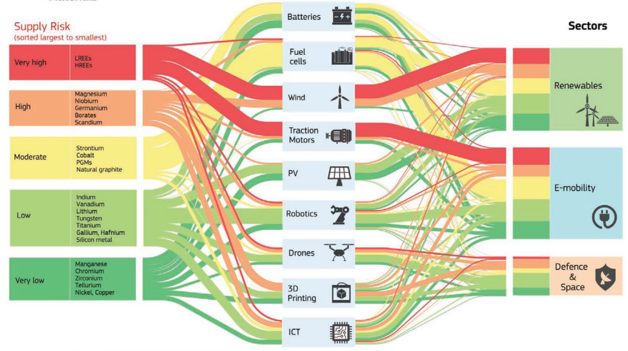
1. Introduction. Scientific problem.
Technologies
Materials
Sectors
[Gatti 2021]
Notes:
Existencia de celdas solares basadas en materiales:
con elementos no abundantes en la corteza terrestre,
tóxicos,
no estables,
obtenidos mediante técnicas de crecimiento de difícil escalado.

