Slide 1
Point defects in Fe₃O₄ and FeCr₂O₄ spinels: a DFT+U investigation in the light of experimental data
28th International Scientific Conference of Young Scientists and Specialists (AYSS-2024)
Gleb D. Chichevatov, Vladimir V. Stegailov
Joint Institute for High temperatures RAS
Moscow Institute of Physics and Technology
Dubna, 31 october 2024

Slide 2
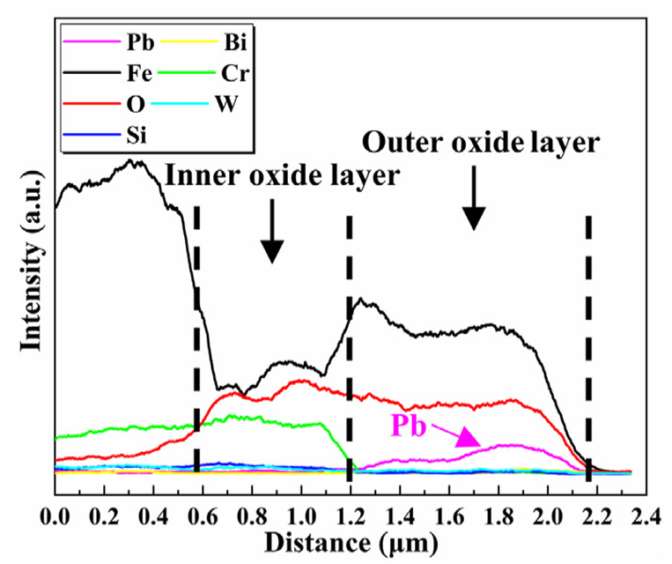
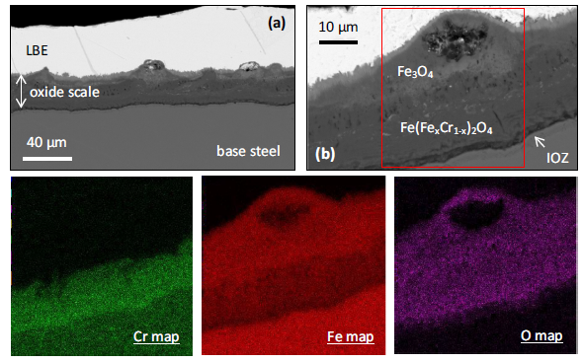
Oxide scales and corrosion of steels in liquid Pb
Fe3O4
FexCr3-xO4
Lambrinou et al., Journal of Nuclear Materials 450 (2014) 244–255
duplex oxide scale
O-poor conditions
O-rich conditions
Chen et al., Journal of Nuclear Materials 573 (2023) 154097

Slide 3
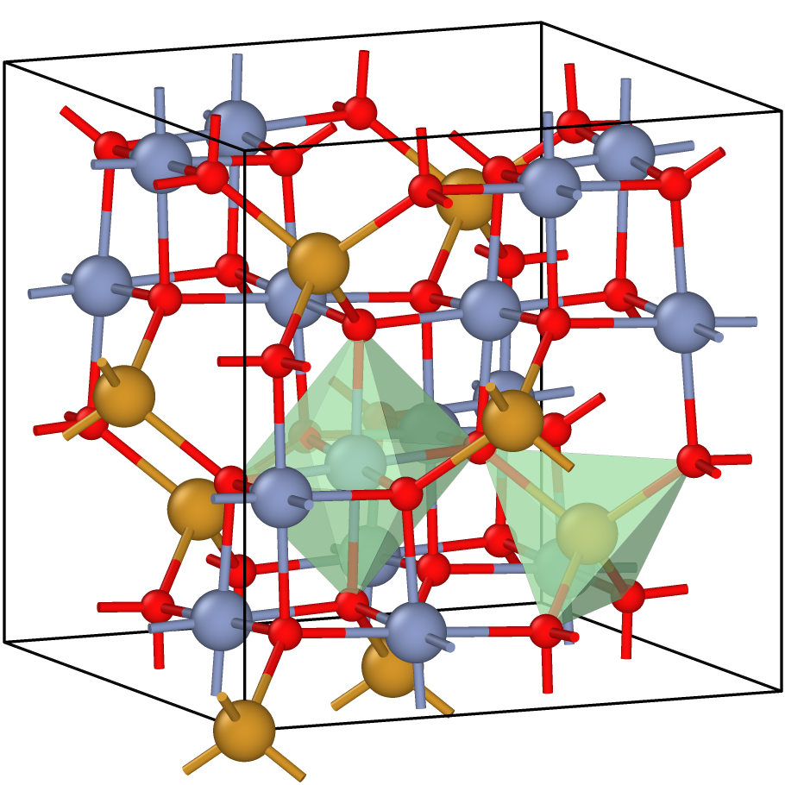
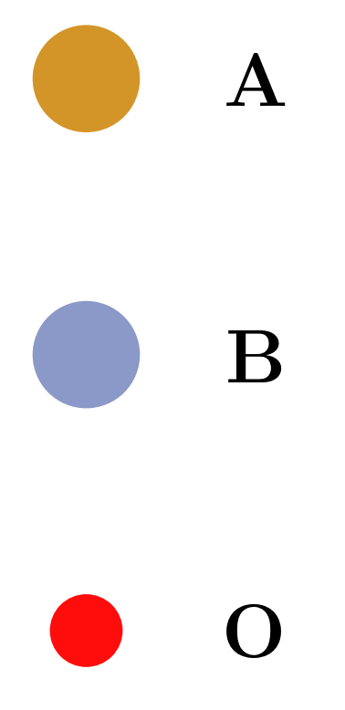
AB₂O₄ spinels (B = Fe, Cr)
Fe₃O₄: [Fe³⁺]_{A}[Fe²⁺Fe³⁺]_{B}O₄
FeCr₂O₄: [Fe²⁺]_{A}[(Cr³⁺)₂]_{B}O₄
A — tetrahedral, B — octahedral
Magnetite is an inverse mixed-valence spinel
d³, d⁵, d⁶ => strong electronic correlations

Slide 4
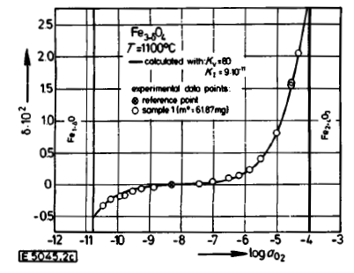
Off-stoichiometry of Fe_{3-δ}O₄ (Dieckmann et al.)
vacancies
Off-stoichiometry δ in magnetite depends on oxygen partial pressure P_{O2}
900 - 1400 ℃
interstitials
K_{v}, K_{I} - equilibrium constants =>
K_{v}*K_{I} is a Frenkel product
Dieckmann, Ber. Bunsenges. Phys. Chem. 86, 112-118 (1982)

Slide 5
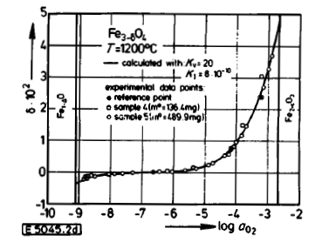
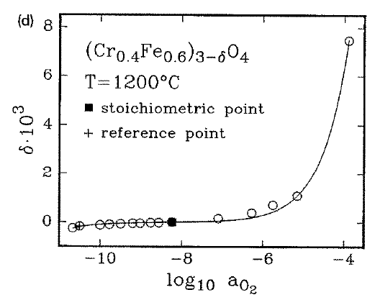
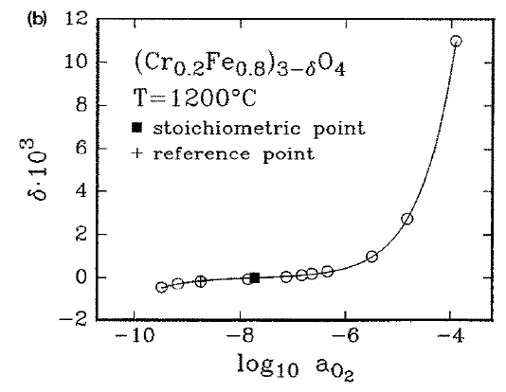
Off-stoichiometry (Fe_{x}Cr_{1-x})_{3-δ}O₄
Dieckmann, Ber. Bunsenges. Phys. Chem. 86, 112-118 (1982)
Töpfer et al., Solid State Ionics 81 (1995) 251-266

Slide 6
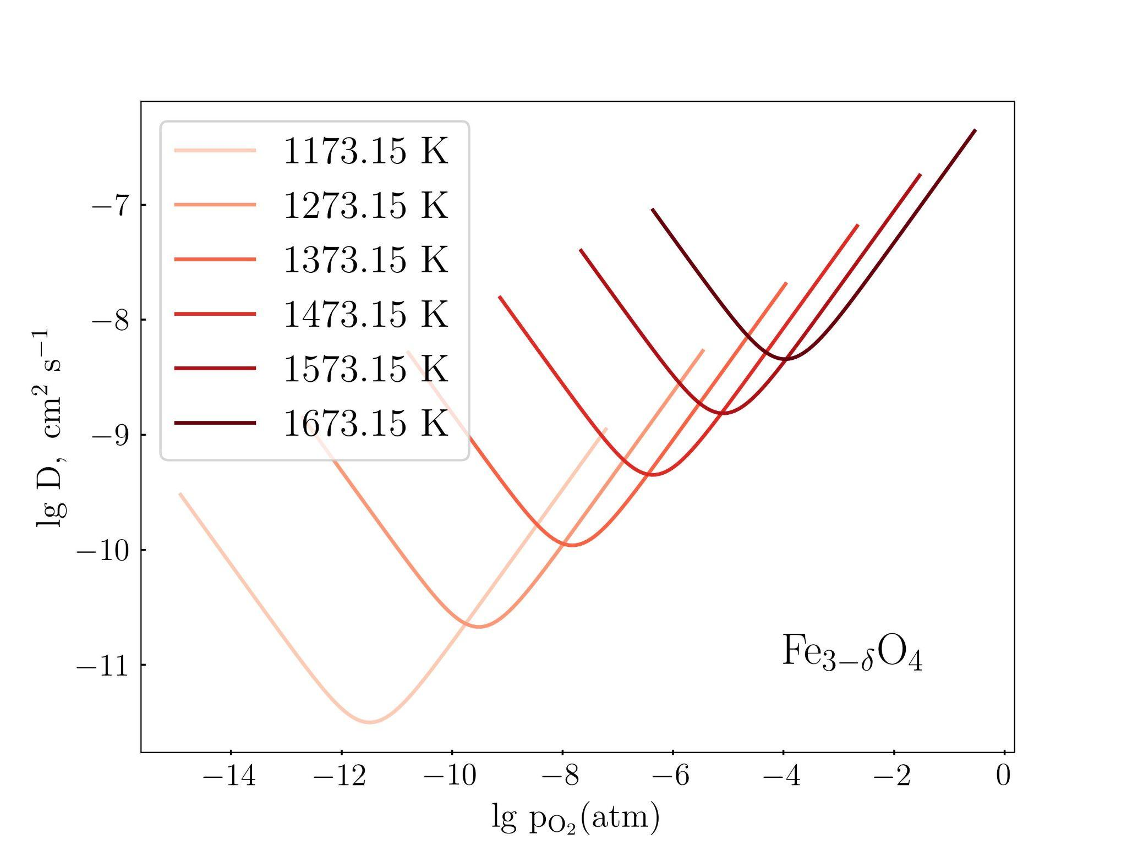
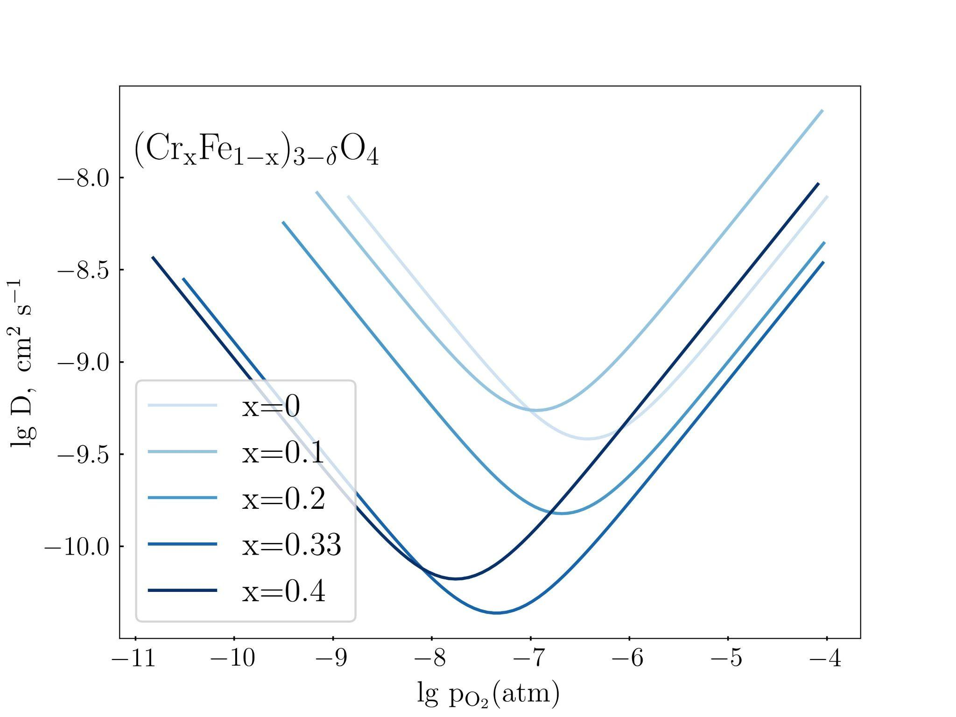
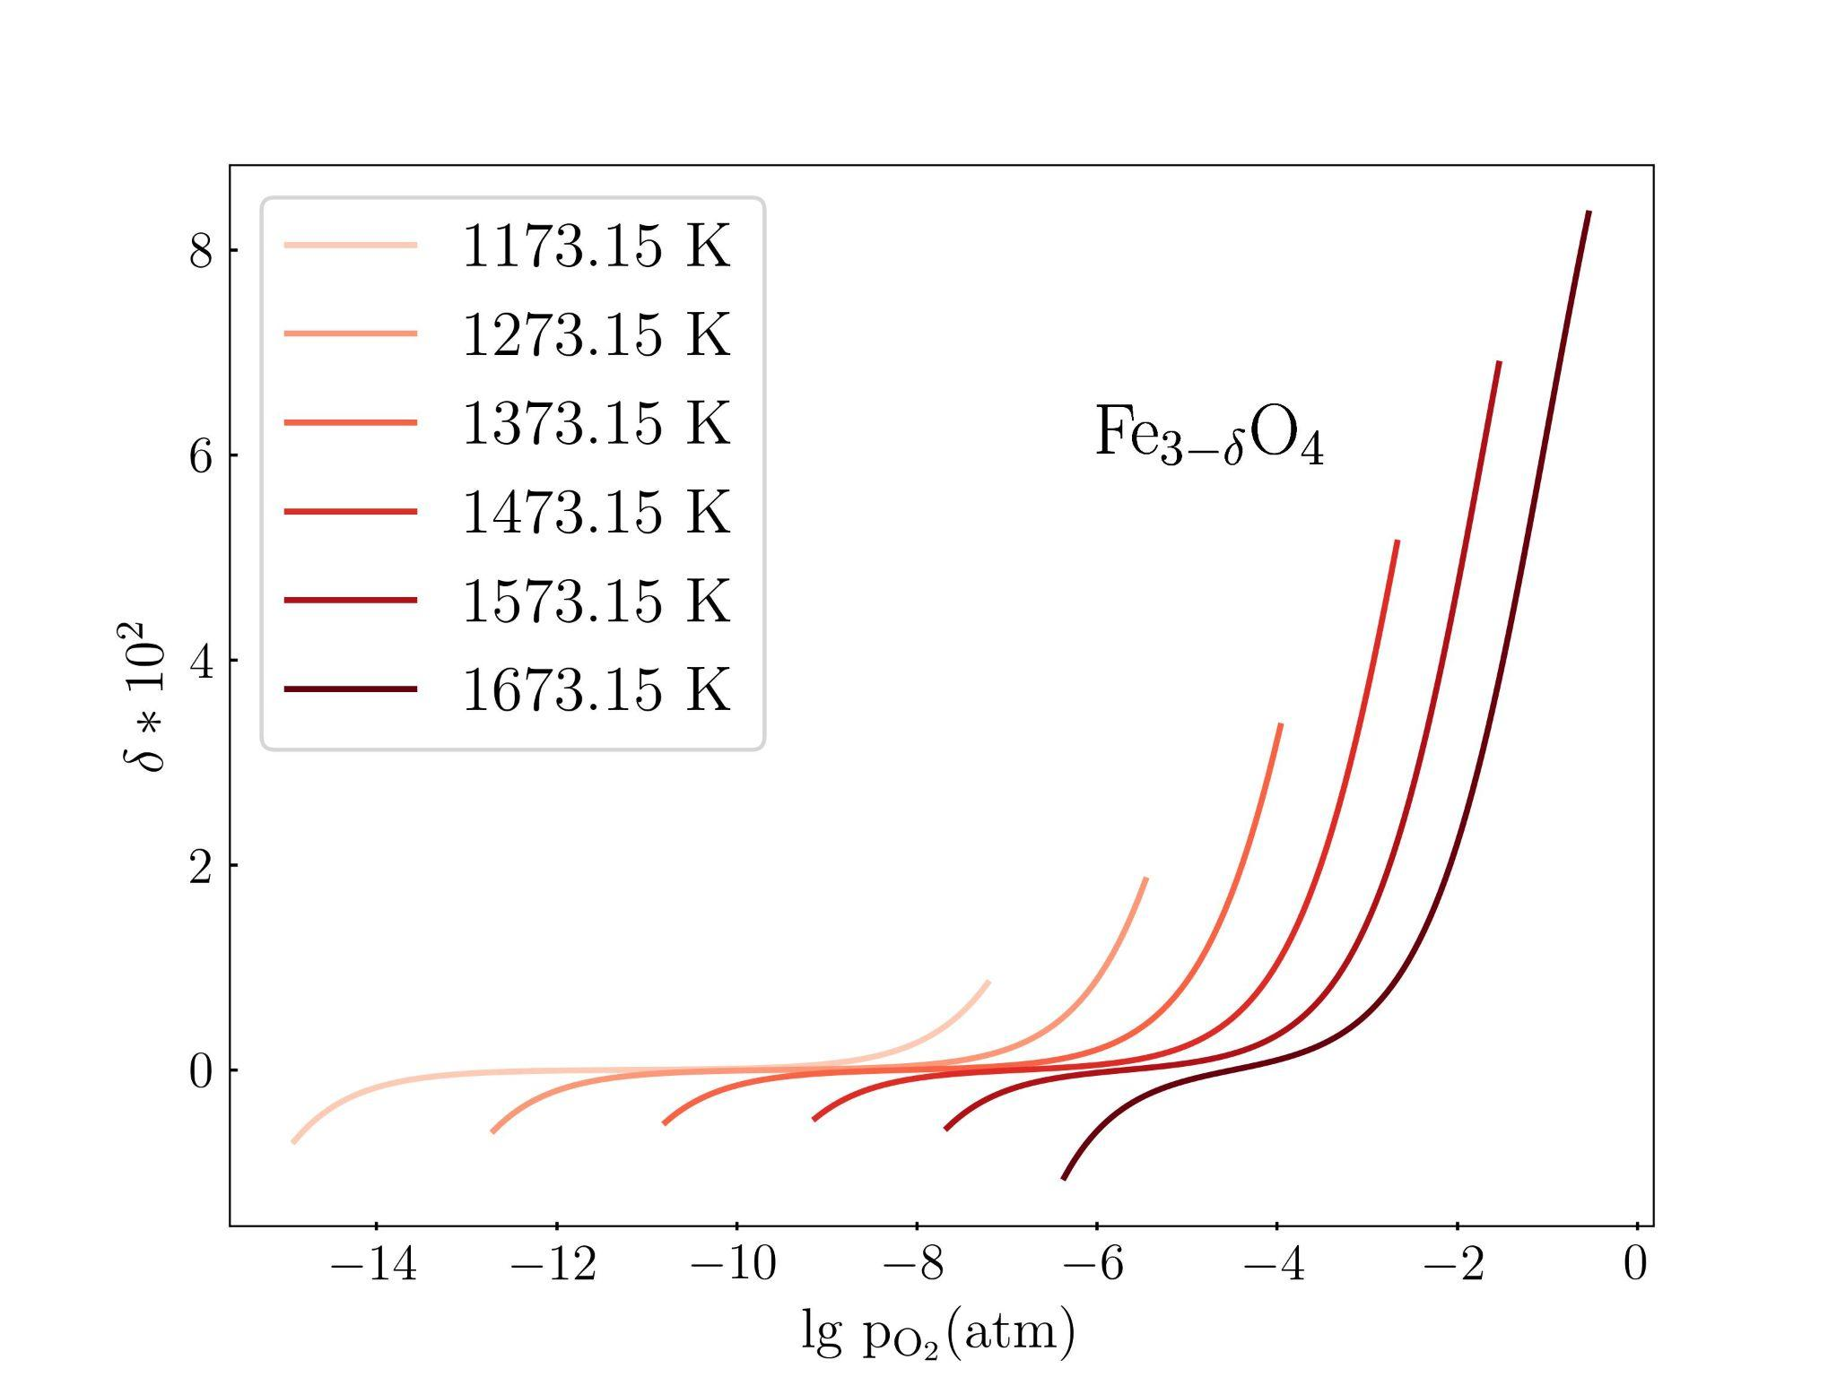
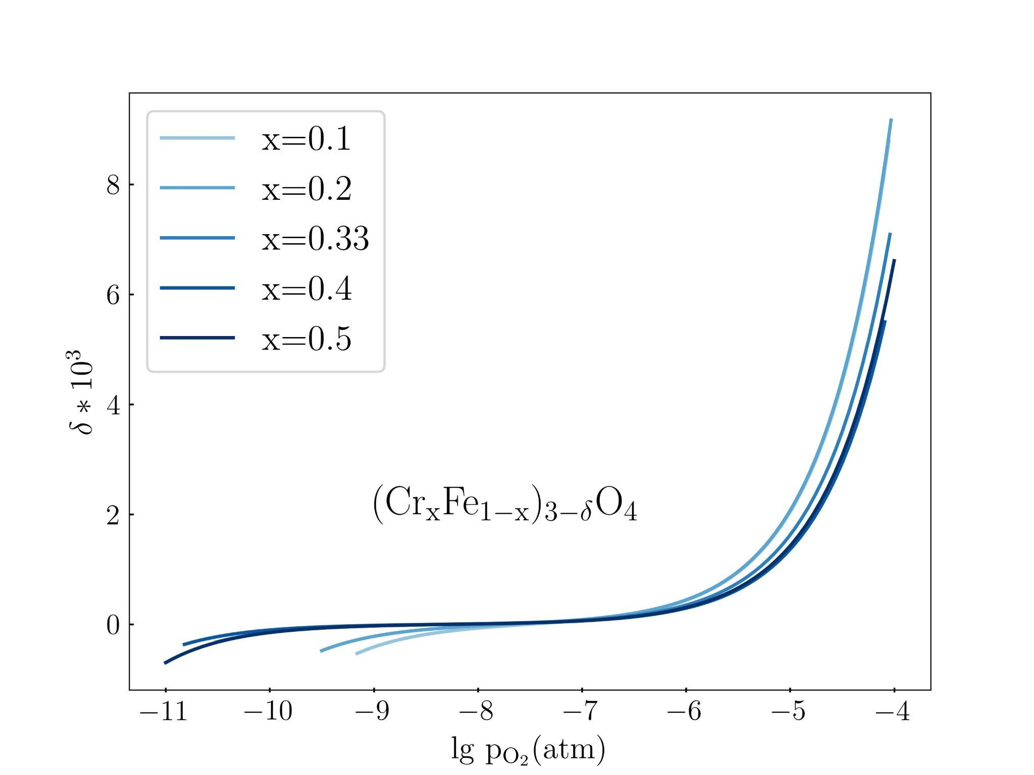
Dieckmann,diffusion, off-stoichiometry: summary

Slide 7
Problematique — 1
Lack of microscopic explanation
Defect types are poorly distinguished
Questionable extrapolation to Fe-Cr-spinels
Gap: calculating ionic transport through the oxide layers at different temperatures and oxygen activities
Dieckmann, J Phys Chem Solids 1998 59(4) 507-525

Slide 8
Oxide layer growth mechanism
Adaptation of McDonald’s point defect model
[Kolotinskii et al.,
Corrosion Science 211 (2023)
Corrosion Science 239 (2024)] — defect-mediated transport describing the duplex oxide scale growth
steel
Fe-Cr spinel
magnetite
liquid Pb
(+dissolved O)
VFe, Oint
O
Cr
?
Fe
VO, Feint
O-poor conditions
O-rich conditions

Slide 9
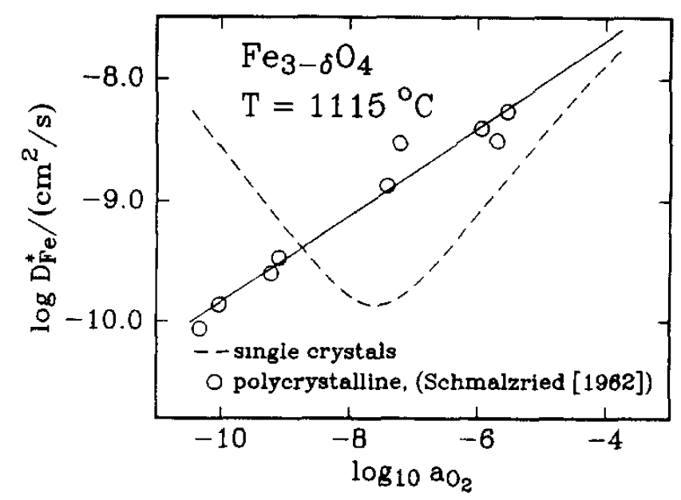
Problematique — 2
What about grain boundaries?
<<...processes other than cation bulk diffusion contribute to the overall reaction kinetics in the set of experiments (on oxidation of iron to pure magnetite) investigated…>>
S. Tinkler, R. Dieckmann, JOURNAL OF MATERIALS SCIENCE 27 (1992) 3799-3802
Dieckmann, J Phys Chem Solids 1998 59(4) 507-525

Slide 10
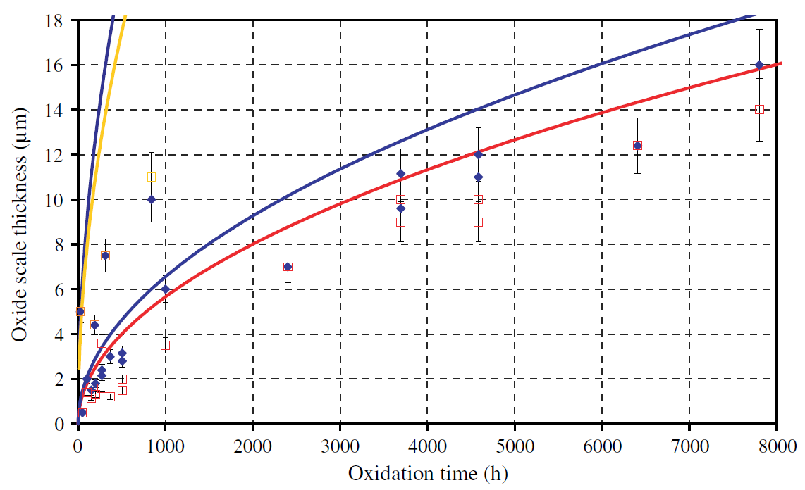
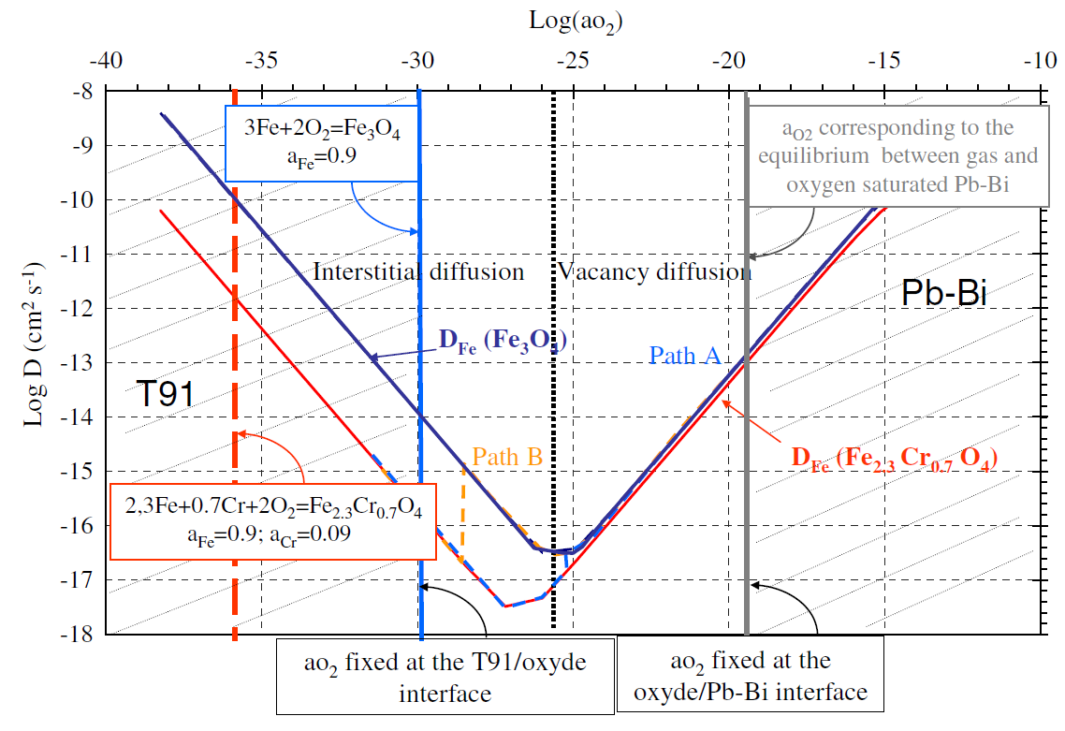
Martinelli et al., extrapolation
Fe_{2.4}Cr_{0.6}O₄, extrapolation from 1200 to 470 ℃
L. Martinelli et al. / Corrosion Science 50 (2008) 2549–2559

Slide 11
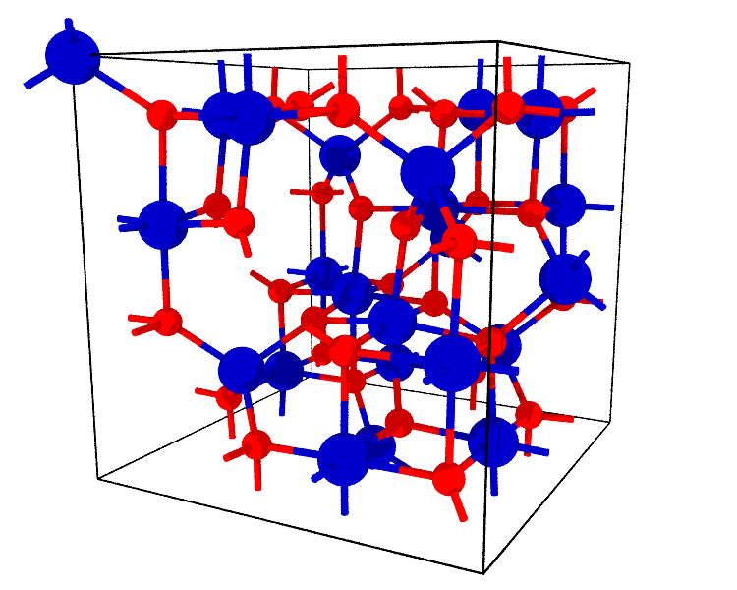
Extrapolation based on ab initio formation energies

Slide 12
Objectives and methods
a comparative study of neutral point defects in Fe₃O₄ and FeCr₂O₄
validation on experimental data
extrapolation to different T and compositions of (Cr_{x}Fe_{1-x})₃O₄
Computational methods:
DFT, PBE GGA+U (U = 3.5 эВ (Fe), 2.0 эВ (Cr))
56 atoms in a supercell, k-mesh 4x4x4

Slide 13
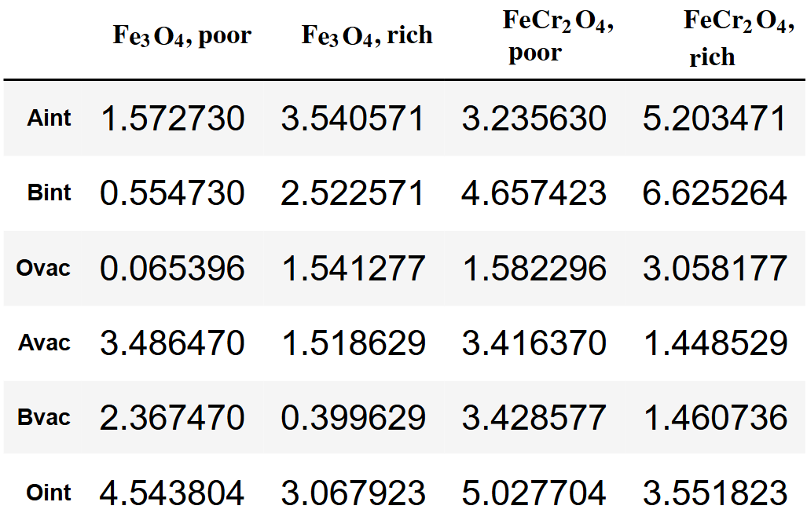
Results - defect formation energies
p_{O2} (poor) = -40 bar, p_{O2} (rich) = -20 bar, T = 470 ℃
B-vacancies and O-vacancies have the smallest formation energies

Slide 14
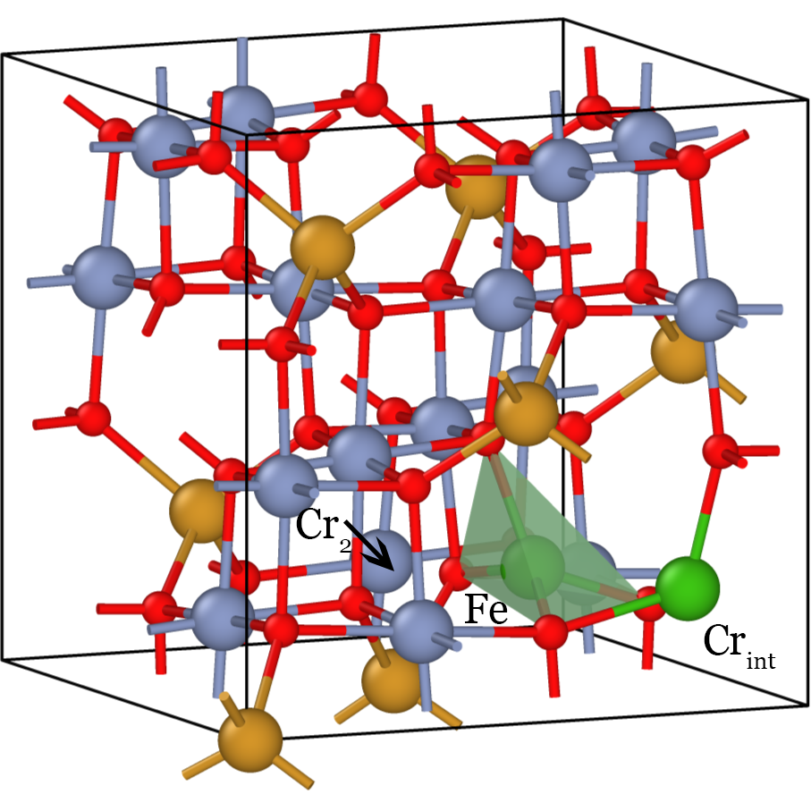
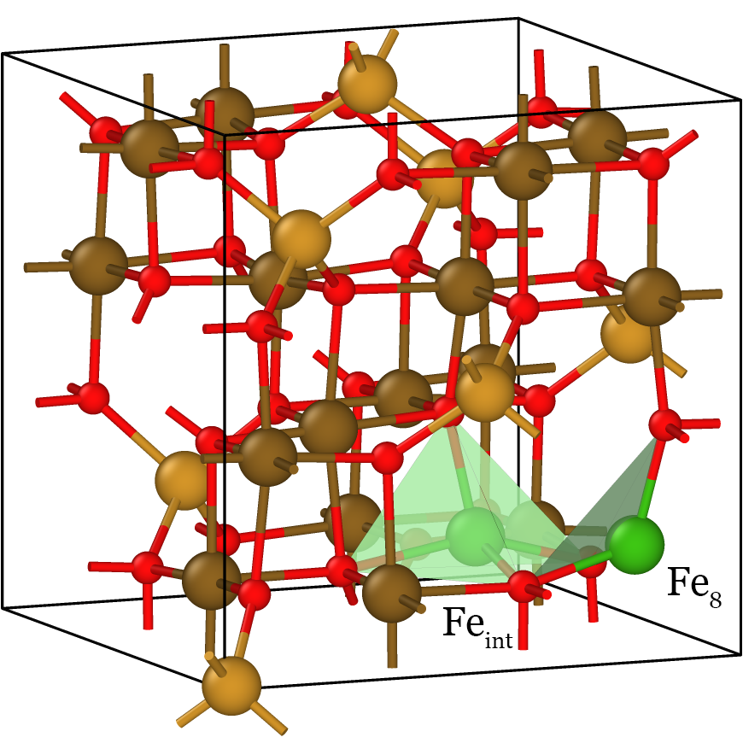
B-interstitial = 2B-interstitials + A-vacancy

Slide 15
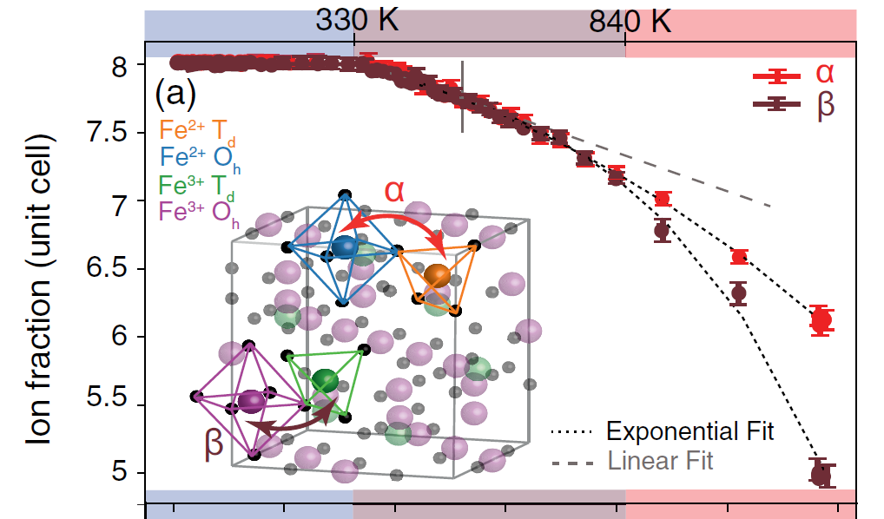
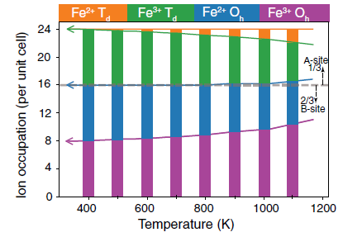
XAS of Fe₃O₄ (Elnaggar et al. [2021])
Elnaggar et al., PRL 127, 186402 (2021)
B-site self-doping

Slide 16
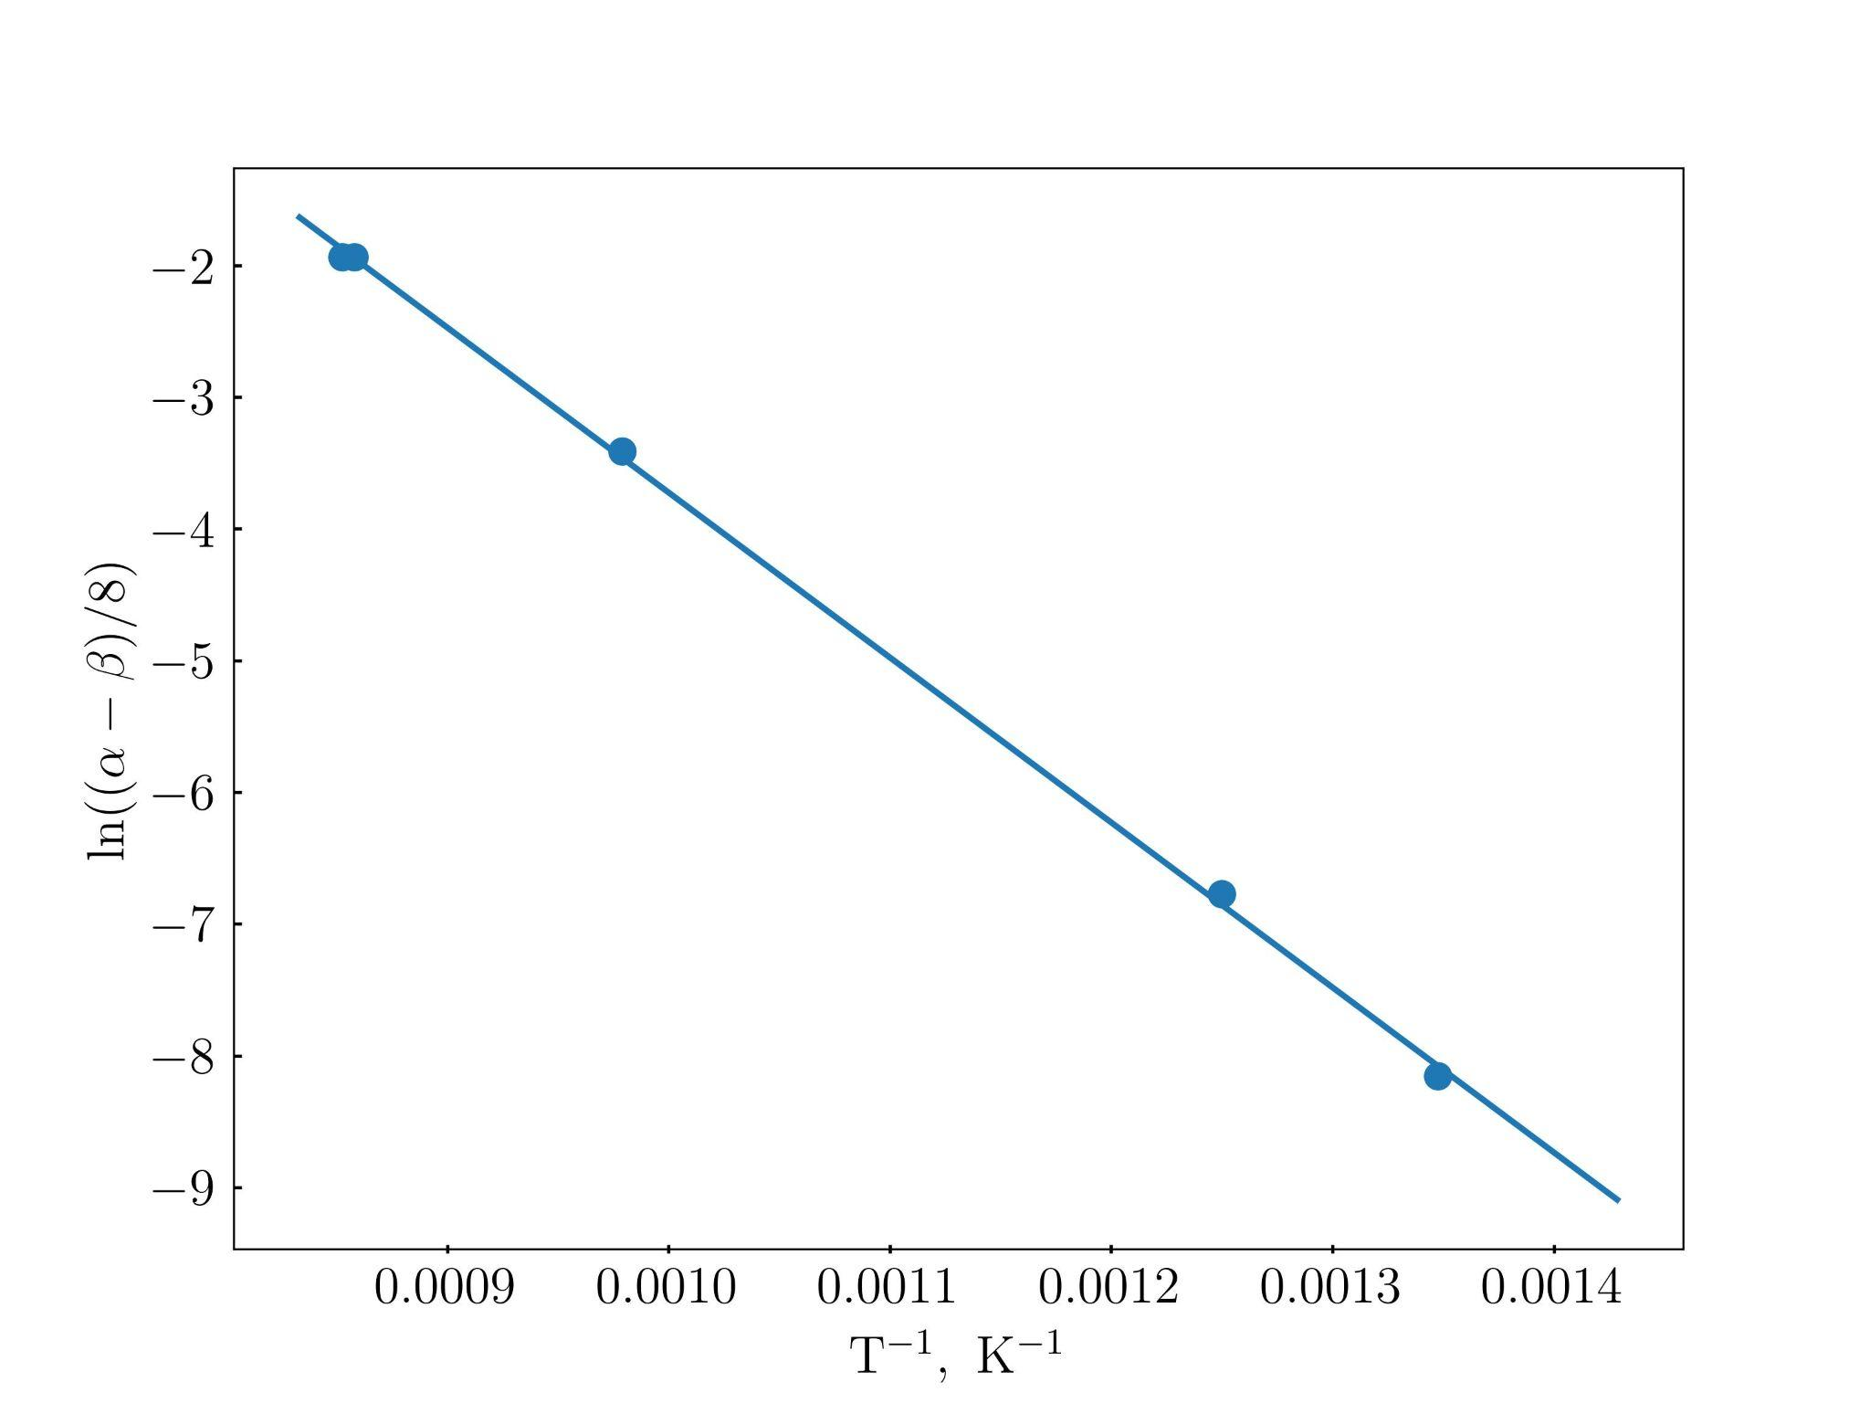
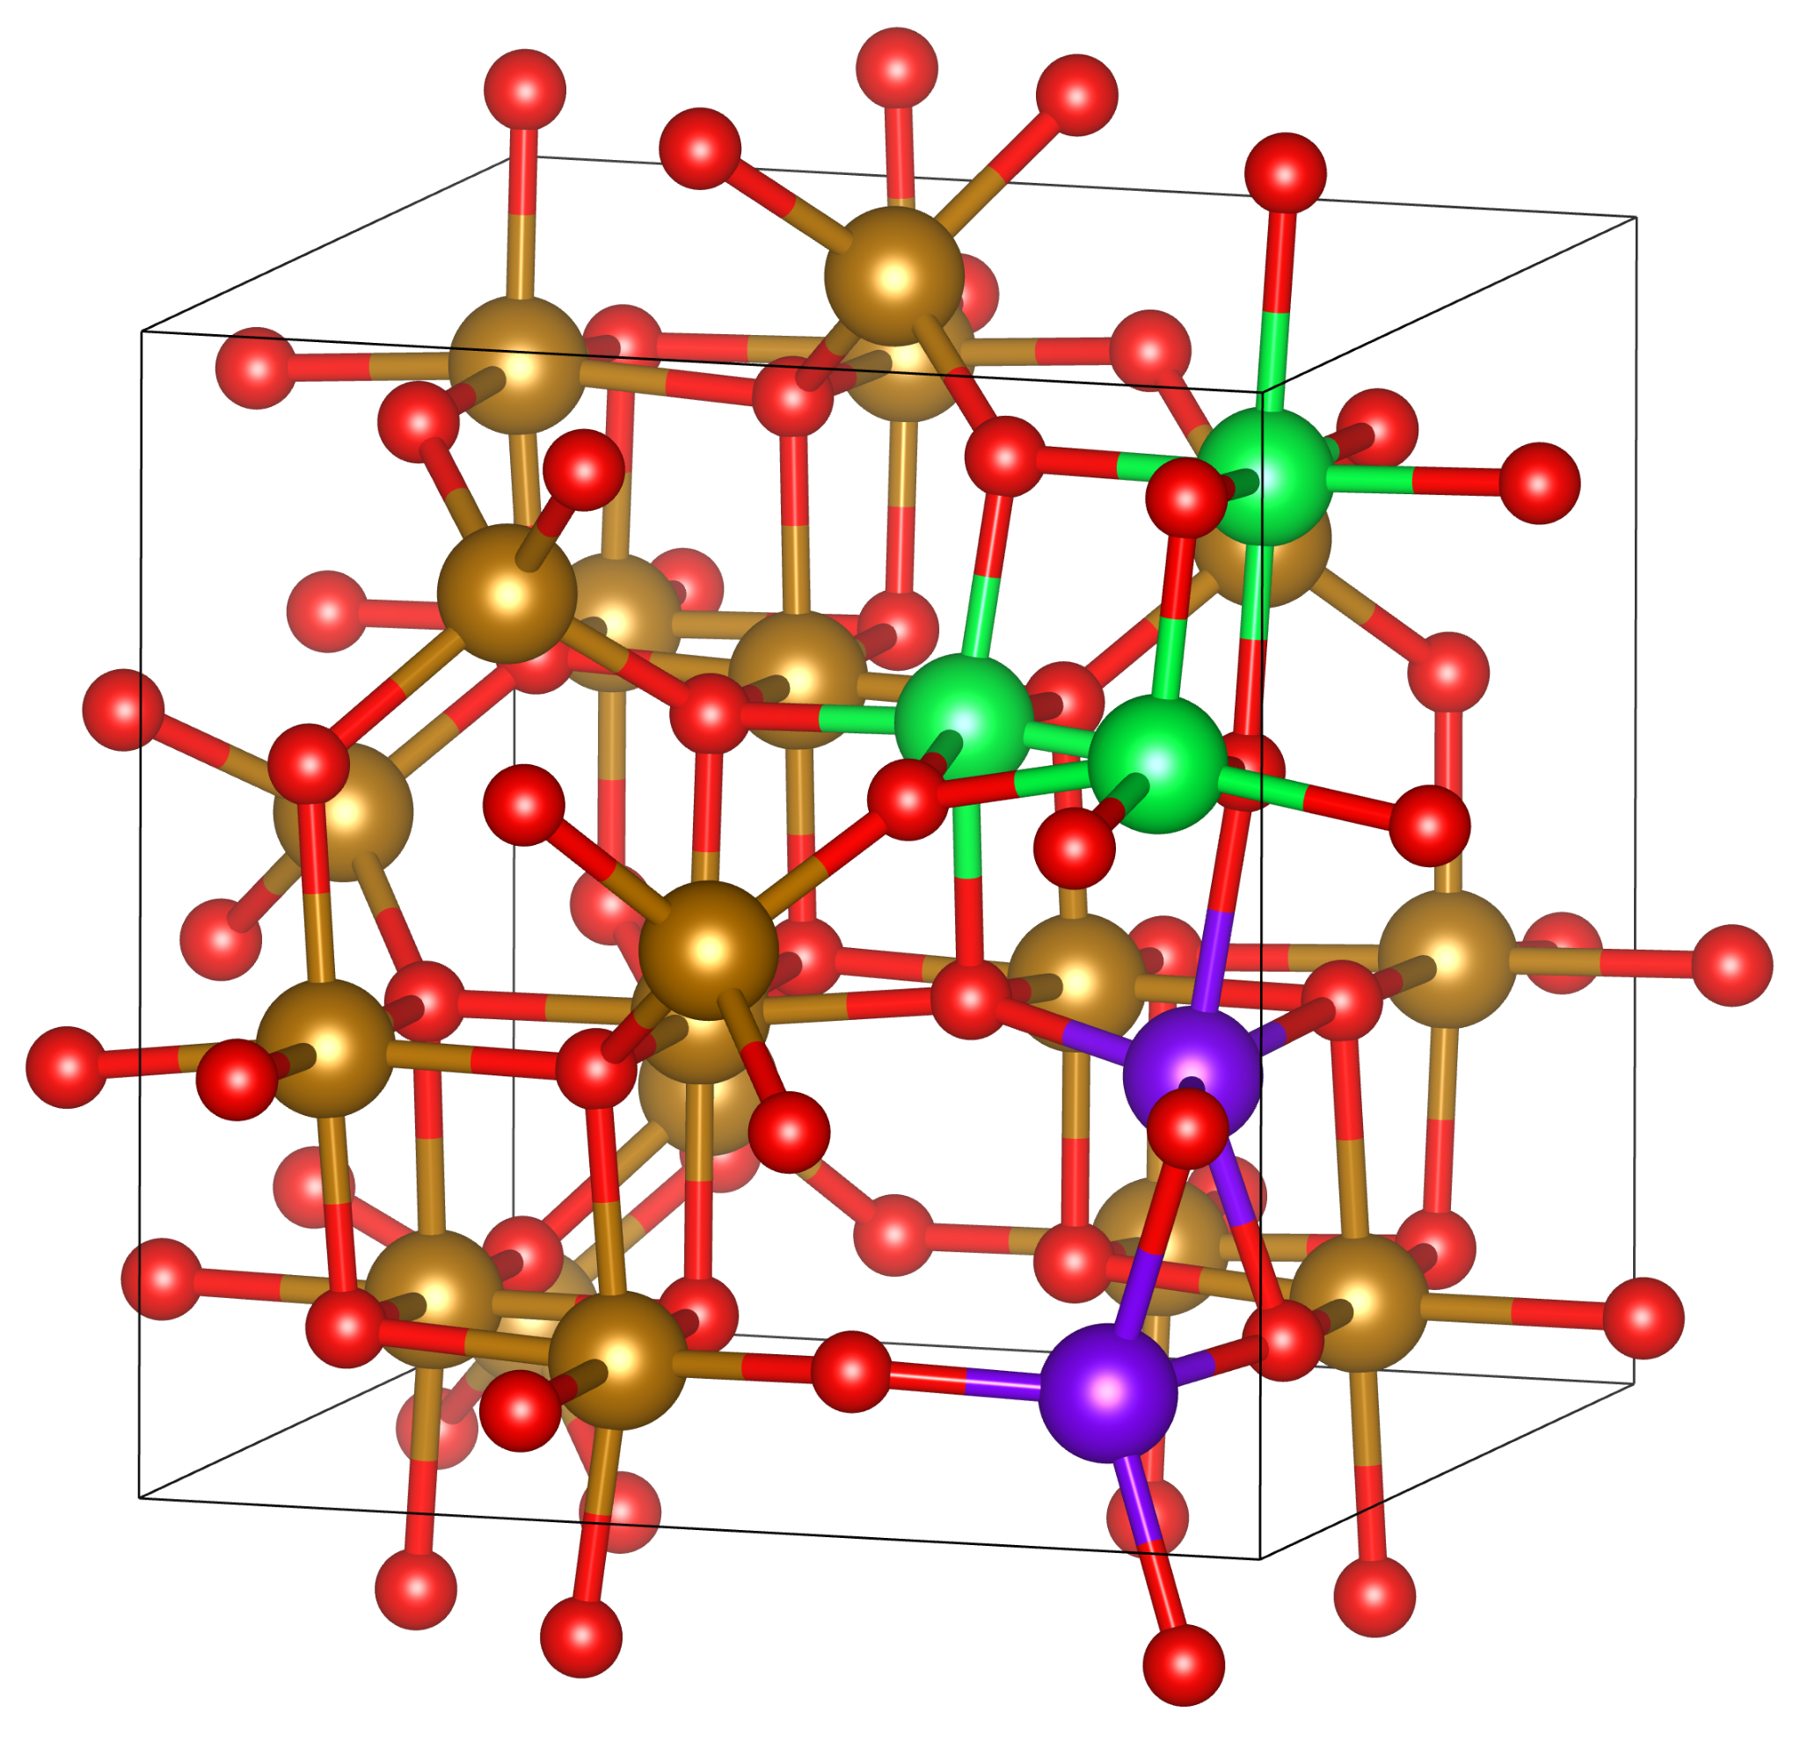
Fit of Elnaggar et al., FP formation enthalpies
Experiment (our calculations):
correlated Frenkel pair - 1.08 (2.51) eV
non-correlated (Dieckmann) - 1.39 (2.92) eV
Binding energy: 0.31 (0.41) eV (!)

Slide 17
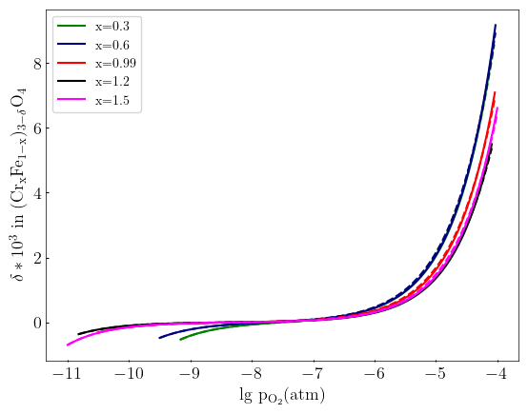
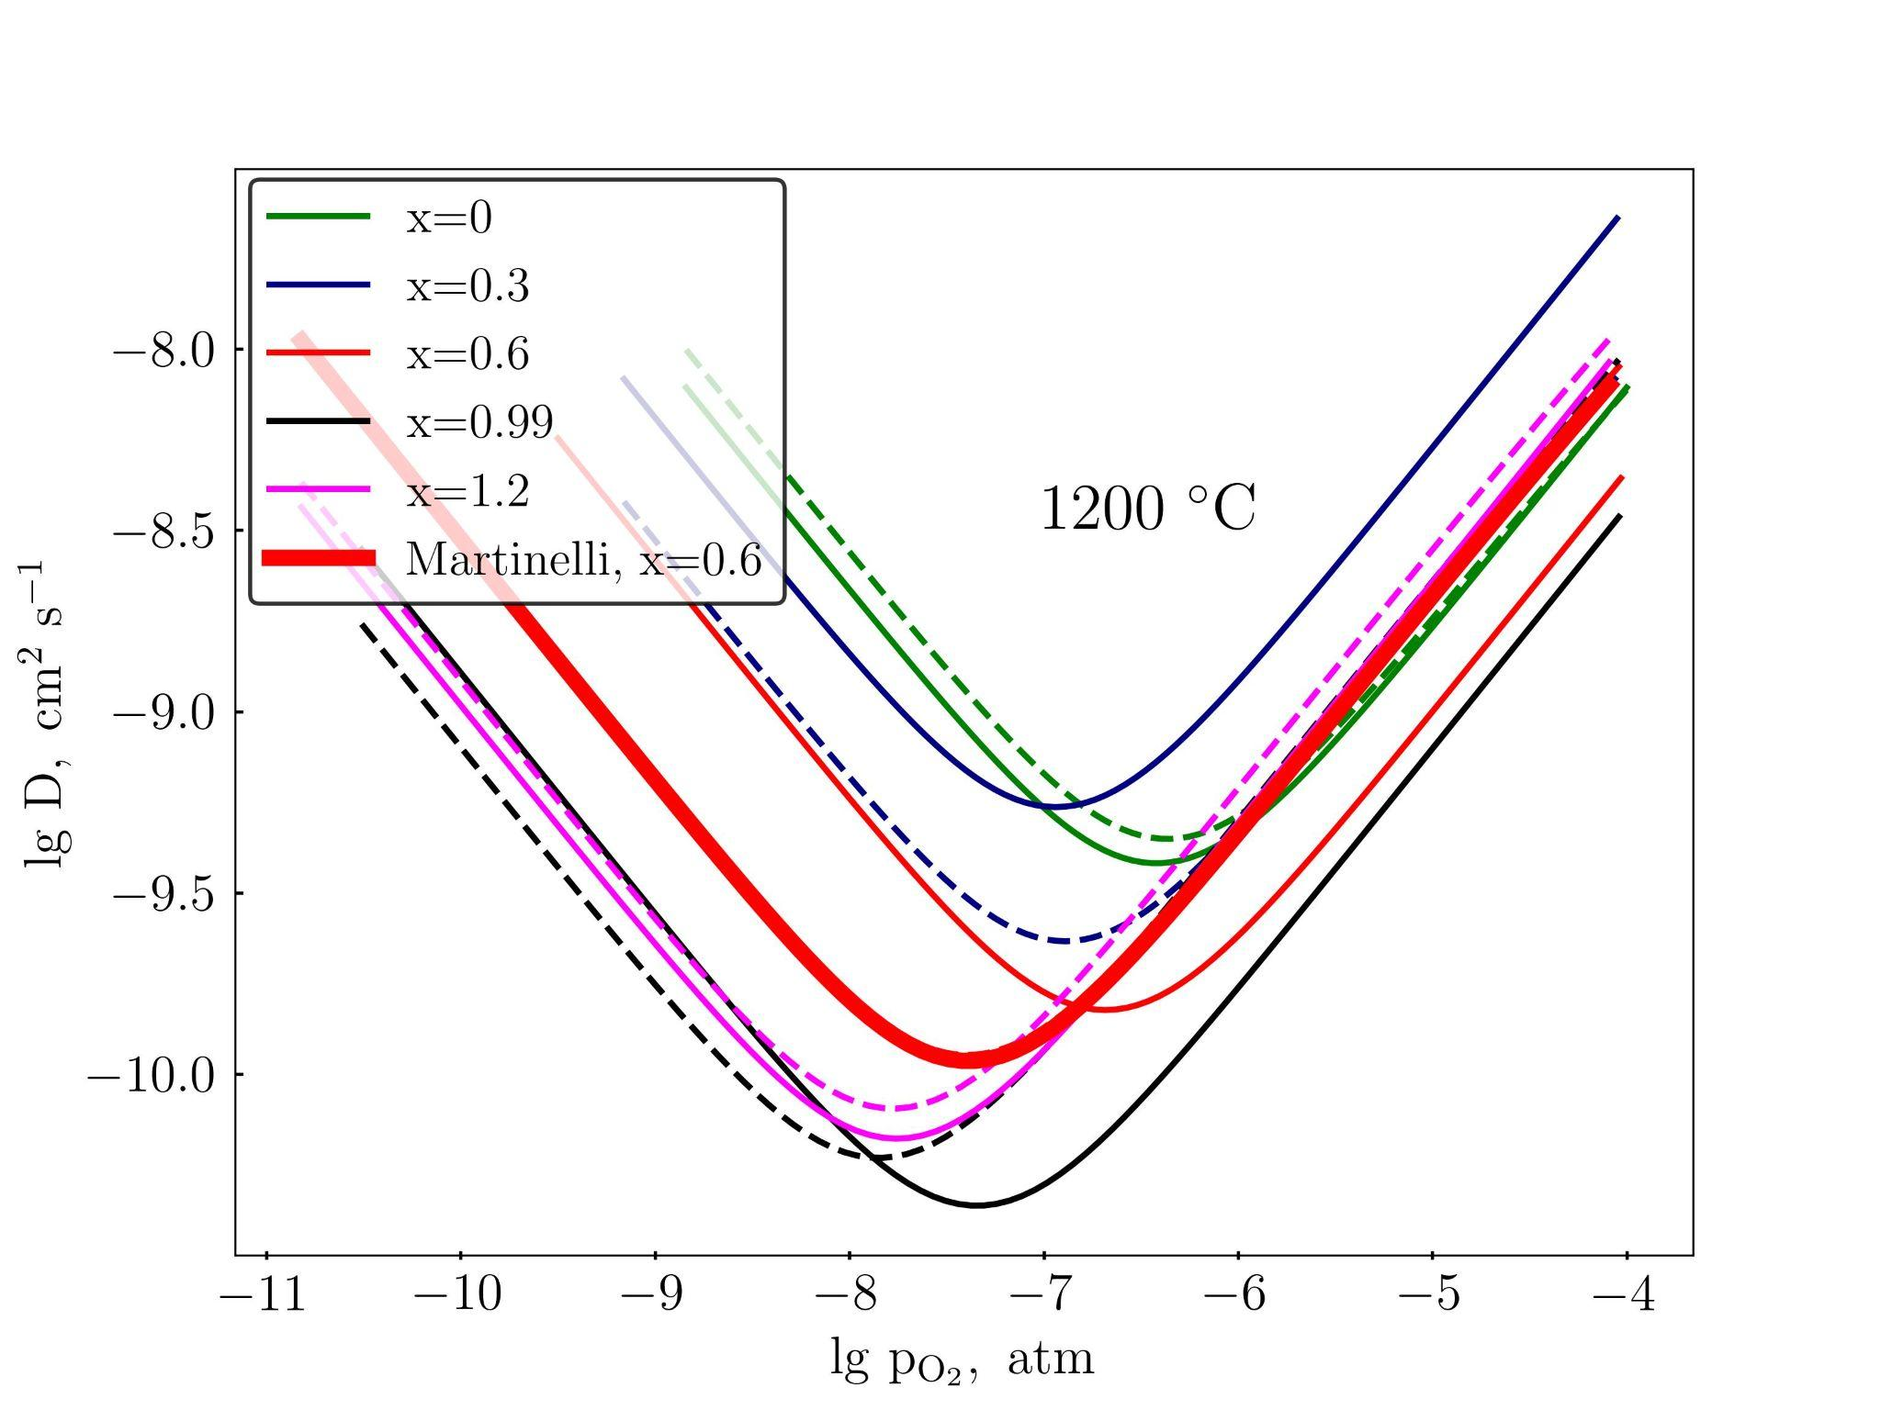
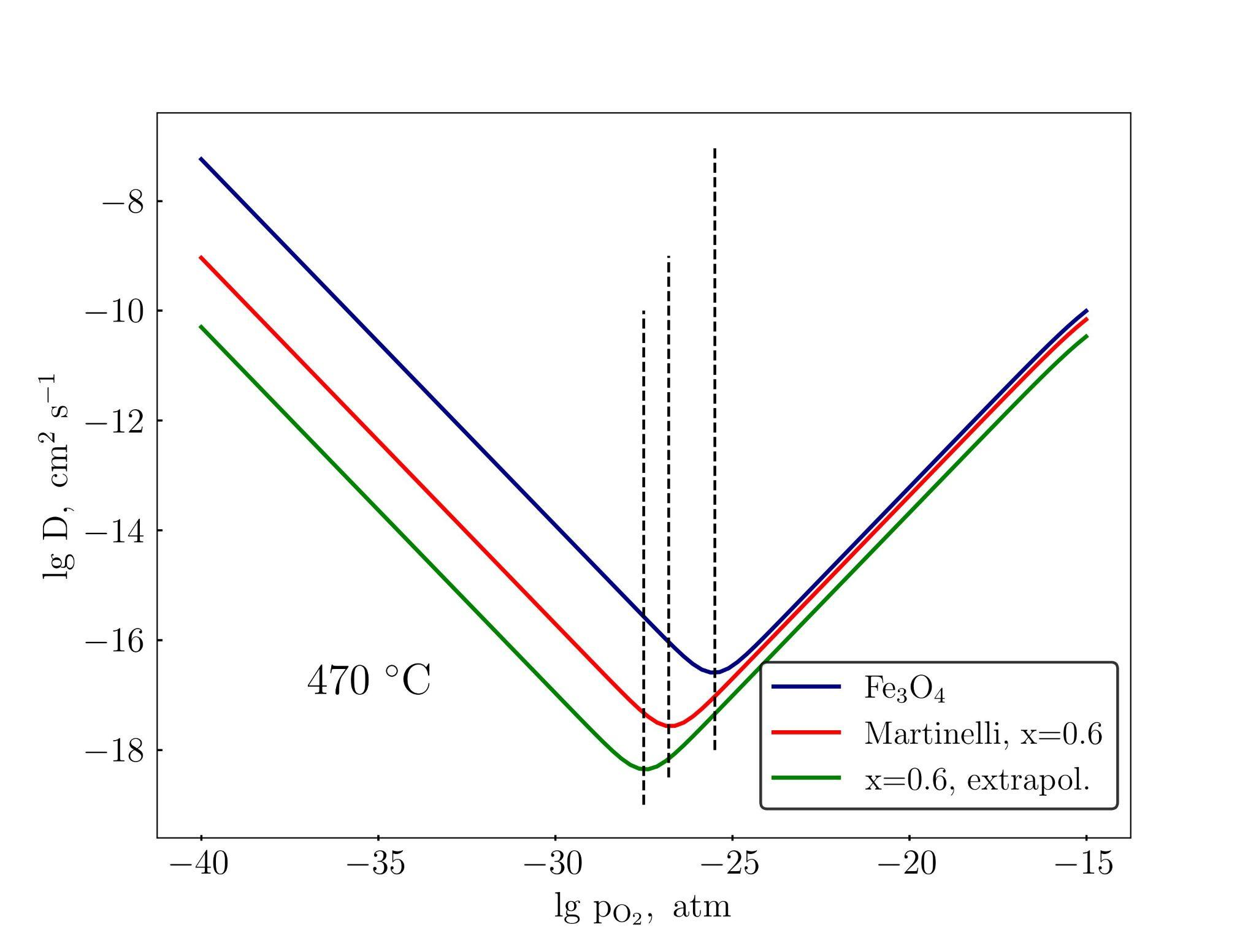
Fit of Elnaggar et al., FP formation enthalpies
Defect formation energies in chromite are corrected so that off-stoichiometry is well-reproduced. Vacancy migration barrier difference 0.3 eV

Slide 18
Conclusions
Absolute defect formation energies are not qualitative, finite-temperature effects are lacking
However, their hierarchy in magnetite and chromite is captured by our DFT+U calculations
Our Frenkel pair binding energy is close to the experimental value
A more universal extrapolation technique based on ab initio results is suggested to find diffusion coefficients in Fe-Cr spinels of different compositions

Slide 19
Thank you for your attention!

