Slide 1



Crystal and magnetic properties of Tb₂Ni₂X, (X = Al, Ga)
MSc Nanoscience (2024)
Name: Zandile Mpupa (UWC)
Supervisor: M.B. Tchoula Tchokonte (UWC)
Co-Supervisor: B.M. Sondezi (UJ)

Slide 2

Content
Introduction
Methodology
Results and discussion:
  Structural characterization
  Magnetization and magnetic susceptibility
  Heat capacity
Conclusion

Slide 3
Introduction
It is well known that rare earth (RE) based intermetallic compounds reveal various interesting magnetic properties depending on the crystallized structures and the constituent elements, paving the way for potential applications in different fields.
The study of ternary intermetallic compounds with the composition RE₂T₂X (where RE represents rare earth elements, T represents transition metals, and X represents p-block elements) in particular has garnered significant interest due to their diverse ground state properties.

Slide 4
Introduction
To probe the type of crystal structure and magnetic properties of Tb₂Ni₂X, (X =Al, Ga) compounds, we undertake to investigate the XRD, magnetic susceptibility, χ(T), magnetization, M(μ₀H), and heat capacity, C_{p}(T) measurements.

Slide 5
Methodology

Slide 6
Sample preparation.
  arc furnace
  purity of samples~9,9999%
  Ingot ~3g
XRD
  Powder XRD measurements (CuKα=1,54Å)
  Collected over 2θ (15⁰ -90⁰)
  TOPAS academic program (quantitative and qualitative)
SEM and EDS
  Morphology and homogeneity
Magnetics Proerties and heat capacity
  PPMS-Dynacool + VSM
    DC magnetic measurements were performed at the temperature range (2-300)K with the applied field of upto 7T
  PPMS-Dynacool
    Heat capacity was measured with 2𝛕 relaxation method with zero magnetic field over temperature (2-250K)

Slide 7
Results and discussion

Slide 8
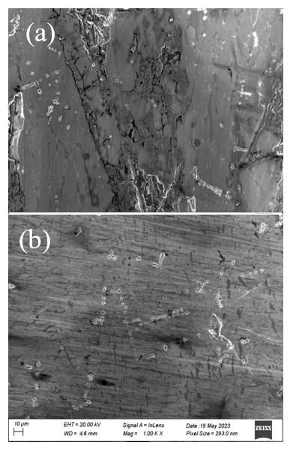
Structural characterization: SEM & EDS
Figs. (a) & (b): SEM micrograph of (a) Tb₂Ni₂Al (b) Tb₂Ni₂Ga compounds with length scales of 10μm and magnification 2000 times.
  Micro-structure of a smooth surface is observed.
  Morphologically Al compound has more stress points and the crystal points are more obvious.
  In Fig. b the apparent dark shades indicate areas that are Ga-rich in the analyzed surface which is confirmed from the EDS results.
EDS gives the atomic ratio of the elements.
  Tb₂Ni_{2.024(2)}Al_{0.925(2)} and Tb₂Ni_{2,006(2)}Ga_{1,052(2)} nominally equal to the desired 2:2:1 phase within the experimental uncertainty.

Slide 9
Structural characterization: XRD
RT powder XRD patterns for (a) Tb₂Ni₂Al and (b) Tb₂Ni₂Ga samples (green symbols) together with the full-profile LSQ refinement fits (red solid curves) to the measured data. The blue curves represent the difference between the observed and the calculated. The vertical ticks are the Bragg reflection.
  All peaks are indexed according to the W₂CoB₂-type structure with space group Immm. No evidence of impurity peaks are observed.
  The obtained lattice parameters and the unit volumes are Tb₂Ni₂Al: a = 4.1789(8) Å, b = 5.405 Å, c = 8.375 Å and V = 189.17 Å³; Tb₂Ni₂Ga: a = 4.1876(7) Å, b = 5.367(1) Å, c = 8.308 Å and V = 186.71(6) Å³.

Slide 10
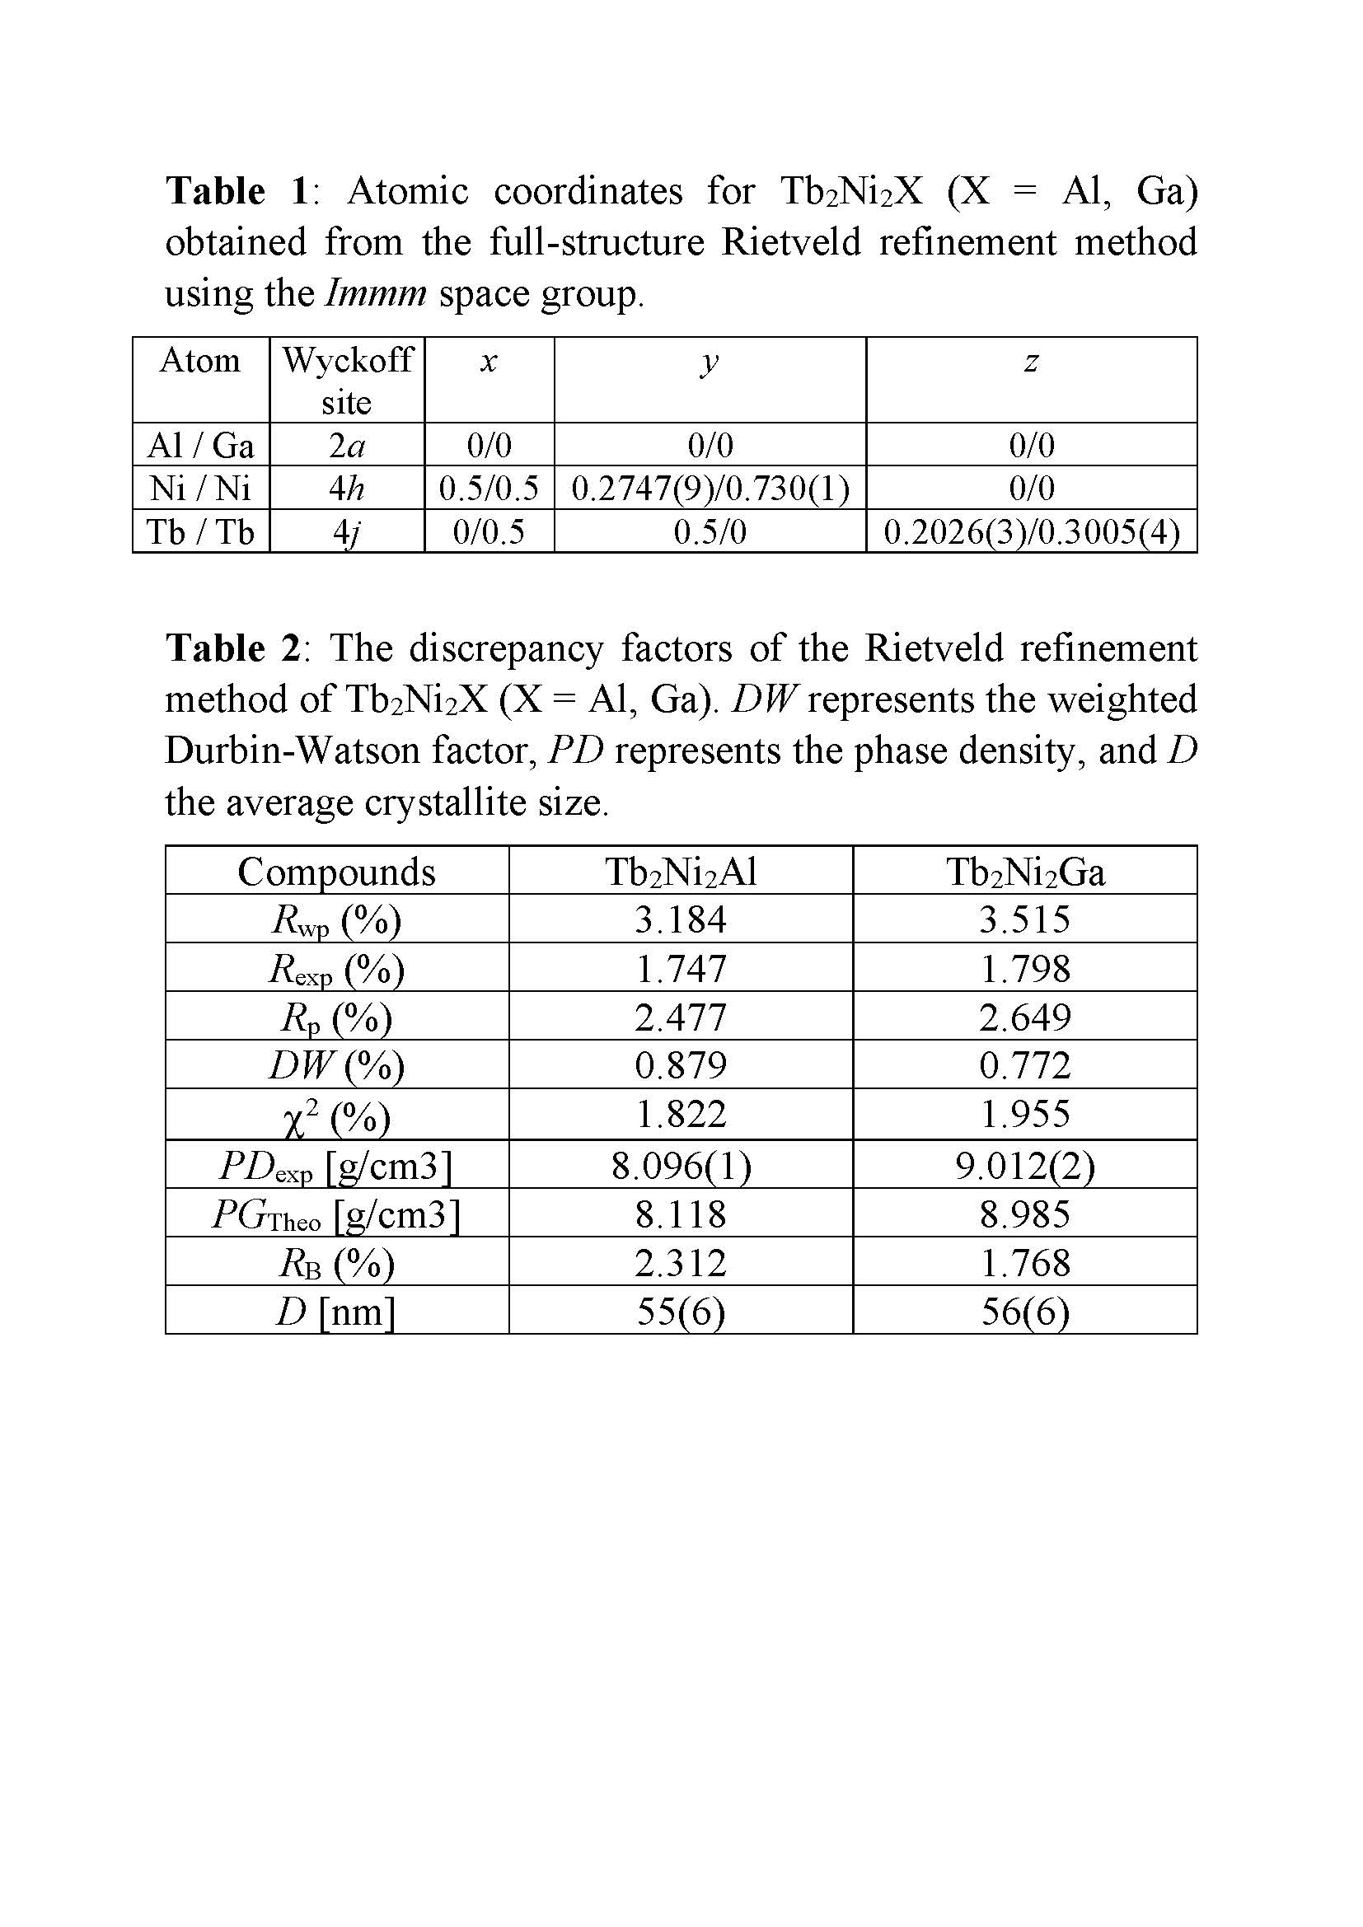
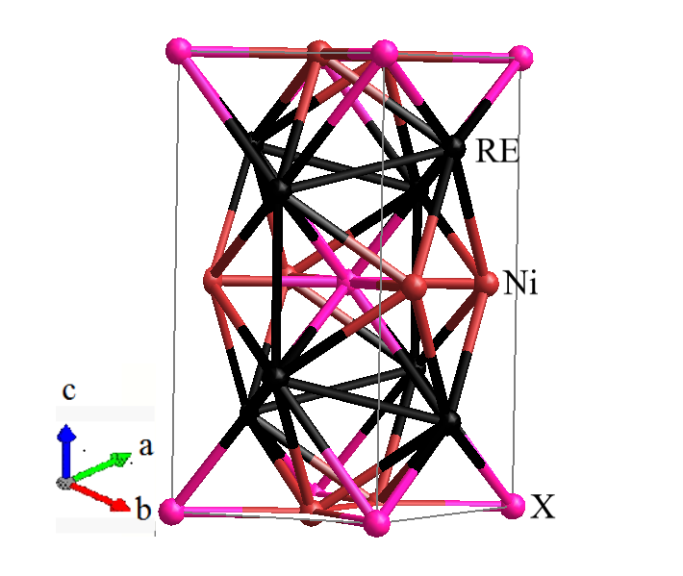
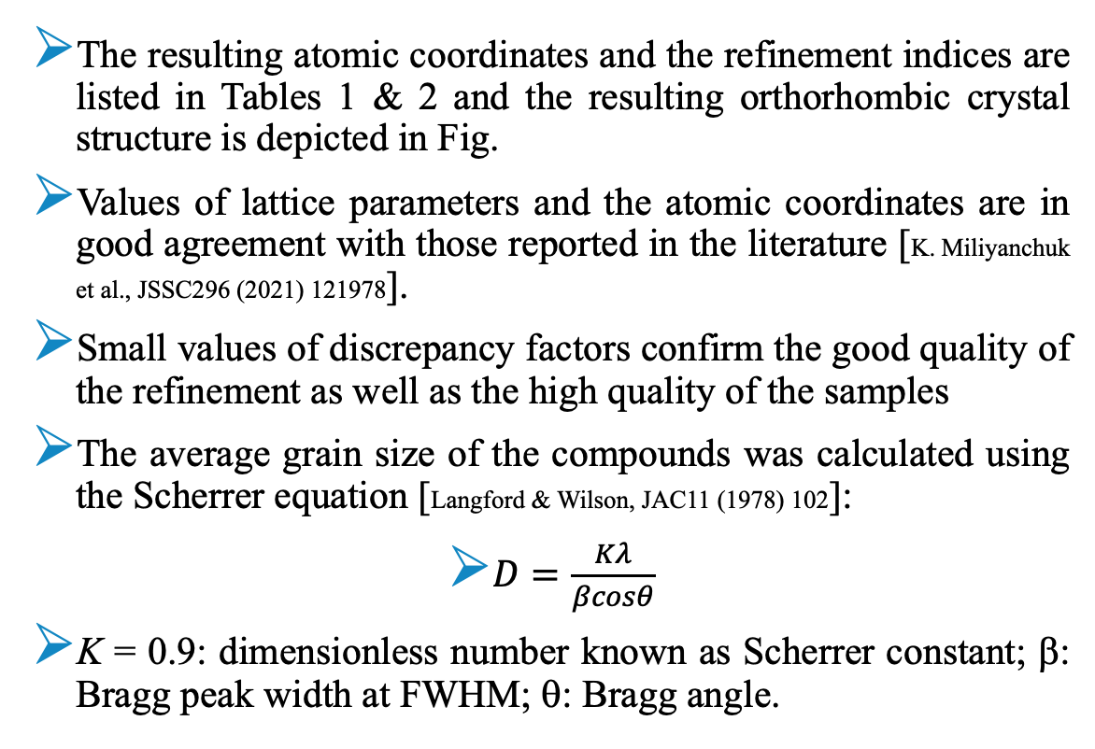
Structural characterization: XRD
The resulting atomic coordinates and the refinement indices are listed in Tables 1 & 2 and the resulting orthorhombic crystal structure is depicted in Fig.
Values of lattice parameters and the atomic coordinates are in good agreement with those reported in the literature [K. Miliyanchuk et al., JSSC296 (2021) 121978].
Small values of discrepancy factors confirm the good quality of the refinement as well as the high quality of the samples
The average grain size of the compounds was calculated using the Scherrer equation [Langford & Wilson, JAC11 (1978) 102]:
$D=\frac{Kλ}{βcosθ}$
K = 0.9: dimensionless number known as Scherrer constant; β: Bragg peak width at FWHM; θ: Bragg angle.

Slide 11
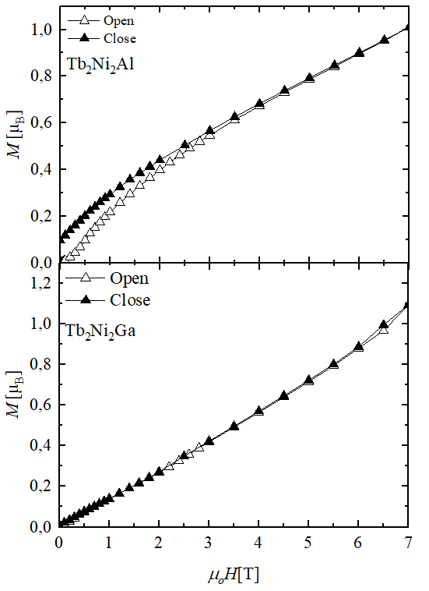
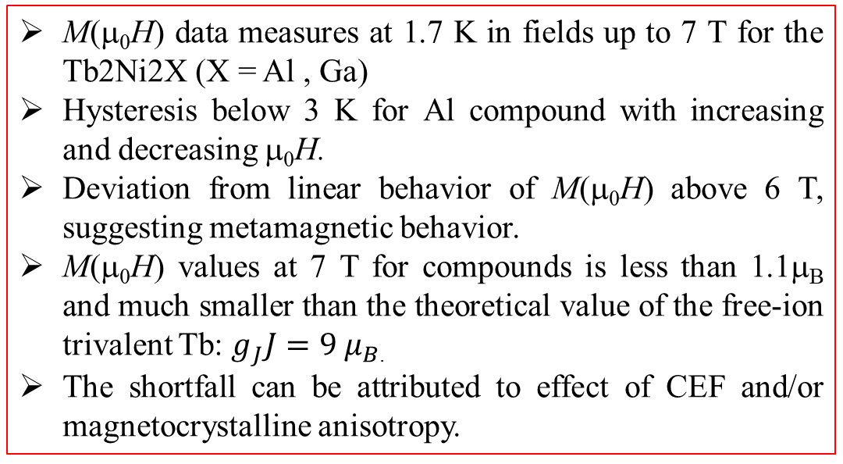
Magnetization
M(μ₀H) data measures at 1.7 K in fields up to 7 T for the Tb2Ni2X (X = Al , Ga)
Hysteresis below 3 K for Al compound with increasing and decreasing μ₀H.
Deviation from linear behavior of M(μ₀H) above 6 T, suggesting metamagnetic behavior.
M(μ₀H) values at 7 T for compounds is less than 1.1μ_{B} and much smaller than the theoretical value of the free-ion trivalent Tb: $g_{J}J=9 μ_{B}$.
The shortfall can be attributed to effect of CEF and/or magnetocrystalline anisotropy.

Slide 12
Magnetic susceptibility
χ(T) data measured in ZFC and FC modes in an applied field of 0.1 T and in the temperature range of 1.7 – 300 K. Insets show the expanded view of χ(T) at low temperatures showing a distinct maximum which hints to AFM ordering with the arrows indicating AFM phase transition T_{N}.

Slide 13
Magnetic susceptibility
χ(T) curve in ZFC mode bifurcates from the FC curve in a manner characteristic of materials with competing magnetic interaction, and materials with high anisotropy and low ordering magnetic transition temperature, where the domain wall width can be comparable to the lattice space, thus resulting in a large pinning effect [Y. Zhang et al., JPD:AP49 (2016) 145002]

Slide 14
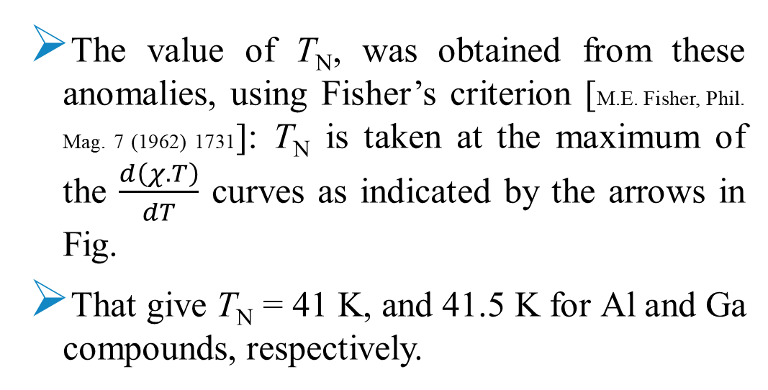
Magnetic susceptibility
The value of T_{N}, was obtained from these anomalies, using Fisher’s criterion [M.E. Fisher, Phil. Mag. 7 (1962) 1731]: T_{N} is taken at the maximum of the $\frac{d\left(χ.T\right)}{dT}$ curves as indicated by the arrows in Fig.
That give T_{N} = 41 K, and 41.5 K for Al and Ga compounds, respectively.

Slide 15
Inverse magnetic susceptibility
χ⁻¹(T) of the Tb₂Ni₂X (X = Al, Ga) compounds measured in an applied field of 0.1 T and the temperature range 1.7 ≤ T ≤ 300 K.
Above 100 K, χ⁻¹(T) data follow the CW relationship:
LDQ fit to the CW Eq. gives: θ_{p} = −21.5(4) K, μ_{eff} =10.172(2) μ_{B} for Al compound and θ_{p} = −17(1) K, μ_{eff} =10.520(4) μ_{B} for Ga compound.

Slide 16
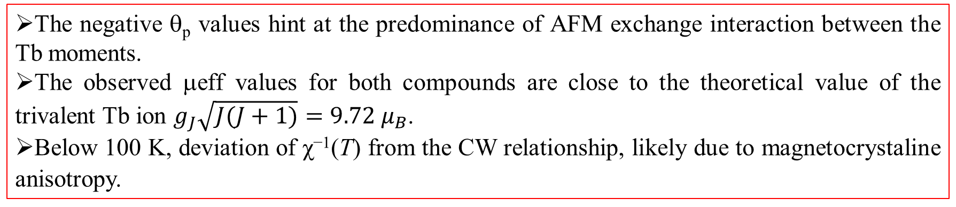
Inverse magnetic susceptibility
The negative θ_{p} values hint at the predominance of AFM exchange interaction between the Tb moments.
The observed μeff values for both compounds are close to the theoretical value of the trivalent Tb ion $g_{J}\sqrt{J(J+1)}=9.72 μ_{B}$.
Below 100 K, deviation of χ⁻¹(T) from the CW relationship, likely due to magnetocrystaline anisotropy.

Slide 17
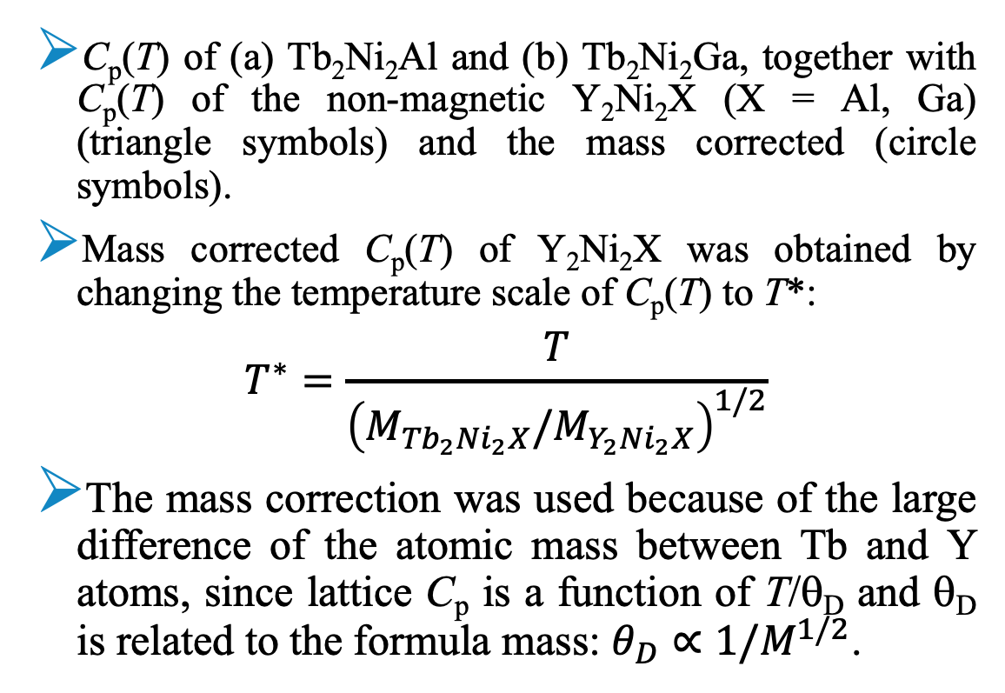
Heat capacity
C_{p}(T) of (a) Tb₂Ni₂Al and (b) Tb₂Ni₂Ga, together with C_{p}(T) of the non-magnetic Y₂Ni₂X (X = Al, Ga) (triangle symbols) and the mass corrected (circle symbols).
Mass corrected C_{p}(T) of Y₂Ni₂X was obtained by changing the temperature scale of C_{p}(T) to T*:
$$T^{∗}=\frac{T}{{\left(M_{{Tb}_{2}{Ni}_{2}X}/M_{Y_{2}{Ni}_{2}X}\right)}^{1/2}}$$
The mass correction was used because of the large difference of the atomic mass between Tb and Y atoms, since lattice C_{p} is a function of T/θ_{D} and θ_{D} is related to the formula mass: $θ_{D}∝1/M^{1/2}$.

Slide 18
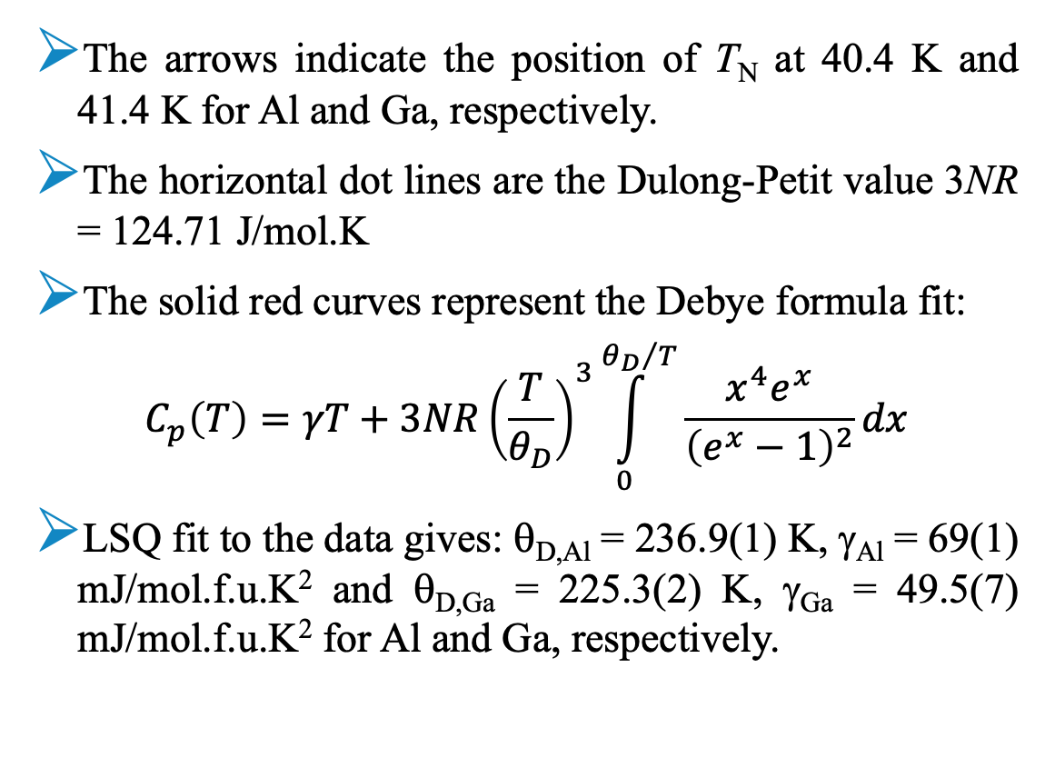
Heat capacity
The arrows indicate the position of T_{N} at 40.4 K and 41.4 K for Al and Ga, respectively.
The horizontal dot lines are the Dulong-Petit value 3NR = 124.71 J/mol.K
The solid red curves represent the Debye formula fit:
$$C_{p}\left(T\right)=γT+3NR{\left(\frac{T}{θ_{D}}\right)}^{3}\int_{0}^{{θ_{D}}/T}{\frac{x^{4}e^{x}}{{\left(e^{x}−1\right)}^{2}}dx}$$
LSQ fit to the data gives: θ_{D,Al} = 236.9(1) K, γ_{Al} = 69(1) mJ/mol.f.u.K² and θ_{D,Ga} = 225.3(2) K, γ_{Ga} = 49.5(7) mJ/mol.f.u.K² for Al and Ga, respectively.

Slide 19
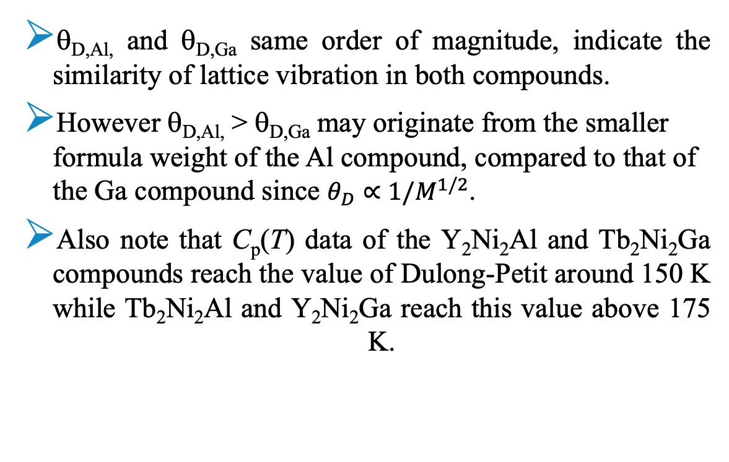
Heat capacity
θ_{D,Al,} and θ_{D,Ga} same order of magnitude, indicate the similarity of lattice vibration in both compounds.
However θ_{D,Al,} > θ_{D,Ga} may originate from the smaller formula weight of the Al compound, compared to that of the Ga compound since $θ_{D}∝1/M^{1/2}$.
Also note that C_{p}(T) data of the Y₂Ni₂Al and Tb₂Ni₂Ga compounds reach the value of Dulong-Petit around 150 K while Tb₂Ni₂Al and Y₂Ni₂Ga reach this value above 175 K.

Slide 20
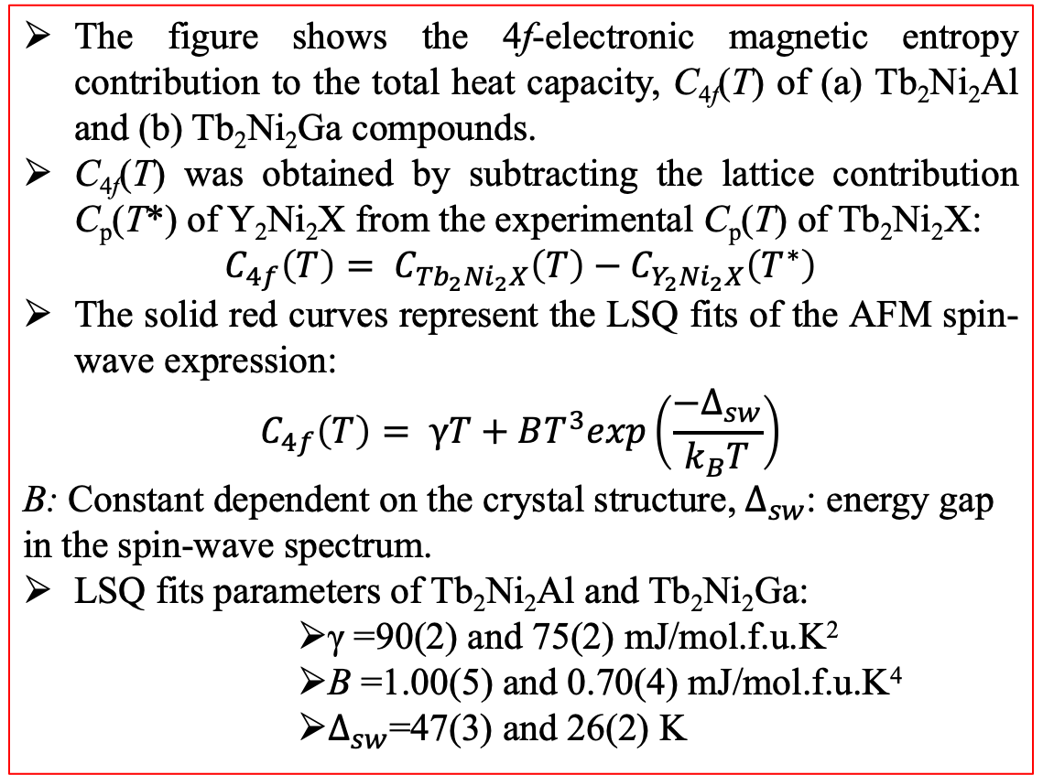
Heat capacity: Magnetic heat capacity C_{4f} (T)
The figure shows the 4f-electronic magnetic entropy contribution to the total heat capacity, C_{4f}(T) of (a) Tb₂Ni₂Al and (b) Tb₂Ni₂Ga compounds.
C_{4f}(T) was obtained by subtracting the lattice contribution C_{p}(T*) of Y₂Ni₂X from the experimental C_{p}(T) of Tb₂Ni₂X:
$$C_{4f}\left(T\right)= C_{{Tb}_{2}{Ni}_{2}X}\left(T\right)−C_{Y_{2}{Ni}_{2}X}\left(T^{∗}\right)$$
The solid red curves represent the LSQ fits of the AFM spin-wave expression:
$$C_{4f}\left(T\right)= γT+BT^{3}exp\left(\frac{−Δ_{sw}}{k_{B}T}\right)$$
B: Constant dependent on the crystal structure,${ Δ}_{sw}$: energy gap in the spin-wave spectrum.
LSQ fits parameters of Tb₂Ni₂Al and Tb₂Ni₂Ga:
        γ =90(2) and 75(2) mJ/mol.f.u.K²
        B =1.00(5) and 0.70(4) mJ/mol.f.u.K⁴
        $Δ_{sw}$=47(3) and 26(2) K

Slide 21
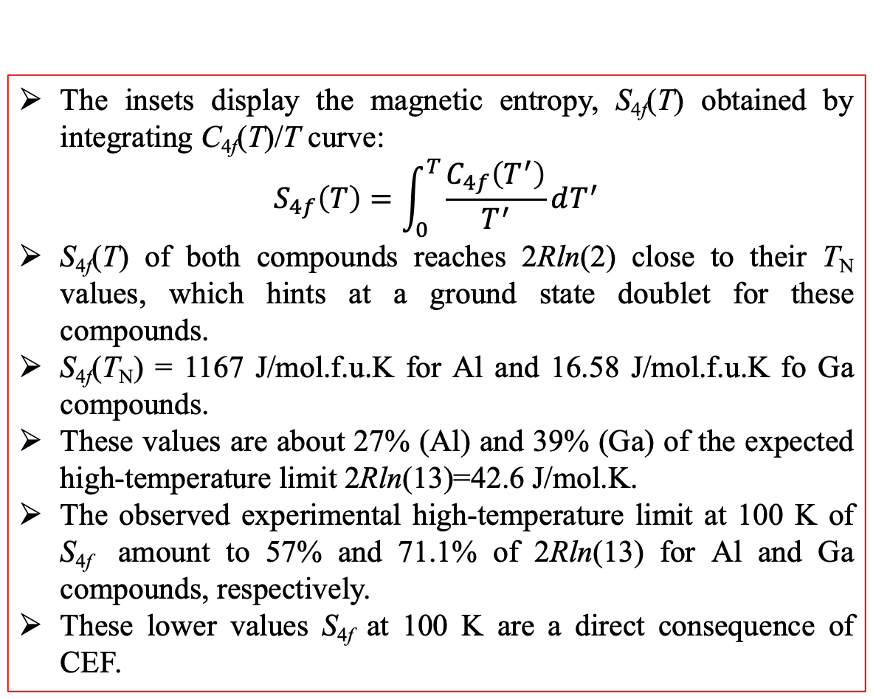
Heat capacity: Magnetic heat capacity C_{4f} (T)
The insets display the magnetic entropy, S_{4f}(T) obtained by integrating C_{4f}(T)/T curve:
$$S_{4f}\left(T\right)=\int_{0}^{T}{\frac{C_{4f}\left(T^{′}\right)}{T^{′}}dT^{′}}$$
S_{4f}(T) of both compounds reaches 2Rln(2) close to their T_{N} values, which hints at a ground state doublet for these compounds.
S_{4f}(T_{N}) = 1167 J/mol.f.u.K for Al and 16.58 J/mol.f.u.K fo Ga compounds.
These values are about 27% (Al) and 39% (Ga) of the expected high-temperature limit 2Rln(13)=42.6 J/mol.K.
The observed experimental high-temperature limit at 100 K of S_{4f} amount to 57% and 71.1% of 2Rln(13) for Al and Ga compounds, respectively.
These lower values S_{4f} at 100 K are a direct consequence of CEF.

Slide 22
Conclusion
XRD studies confirm both compounds' orthorhombic W₂CoB₂ – type with space group Immm (No. 71).
The results of χ(T), and C_{p}(T) measurements indicated that both compounds orders AFM below T_{N} = 41 K for Al and 41.5 for Ga.
χ(T) at high temperatures for both compounds follow the CW relationship.
χ(T) at low temperatures collected in FC and ZFC modes bifurcate below T_{N}.
M(μ₀H) shows hysteresis below 3 T for Al compound and metamagnetic behavior above 6 T for Ga compound.
The spin-wave spectrum describes C_{p}(T) data below T_{N}.
The Debye theory of lattice heat capacity describes C_{p}(T) data of the non-magnetic compounds.
S_{4f}(T) data indicates a ground state doublet and a CEF for both compounds.

Slide 23
Acknowlegment
Financial support from SA-NRF (81296, UID 111174)
Nanoscience Bursary,
The Research Development Office of UWC,
The University Research Committee of UJ,

Slide 24


Thank you for your attention

