Slide 1
Distribution of Atomic Radioactive
Impurities on Aerosol Particles of
Various Sizes. Exact and Numerical
Solutions
V.R. Epifanov, V.S. Nagibin N. A. Krivosheev,
V.A. Zagaynov*, A.K. Maslov, V.V. Maksimenko
National Research Nuclear University MEPhI
29.10.2024

Slide 2
Content
1 Introduction
2 Model formulation and main equations
3 Solutions and discussions
4 Conclusions

Slide 3
Introduction
Deposition of radioactive atoms on nano particles is well known problem. In this case transport properties in free atmosphere or in closed volume are defined by particles on which radioactive atoms situated. If binding energy between radioactive atoms and aerosol particle exceed kinetic energy of moving particle, then radioactive atoms are able to deposit on the particle surface.

Slide 4
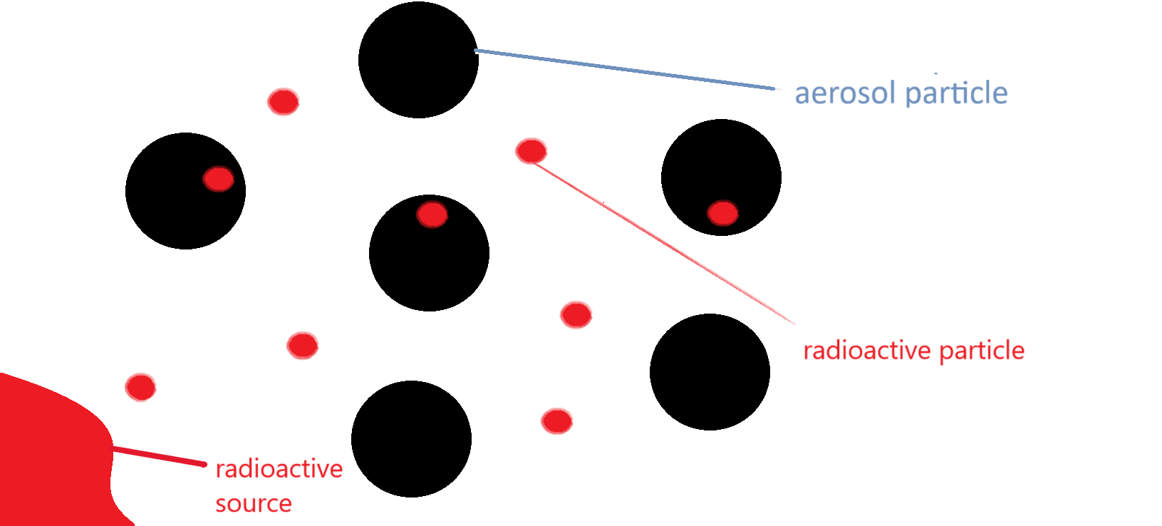
Model
Fig.1 An approximate transfer model

Slide 5
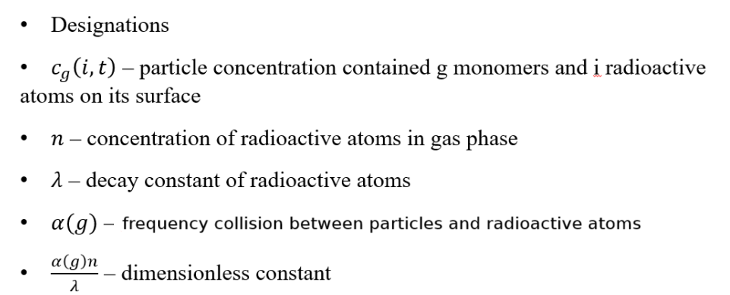
Model formulation and main equations

Slide 6
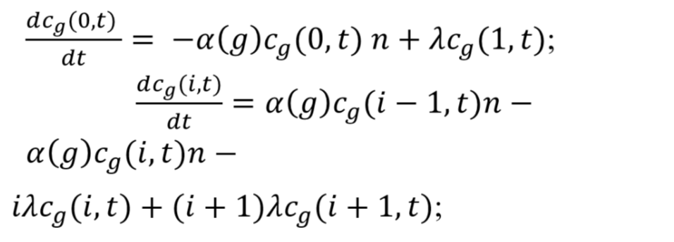
Model formulation and main equations

Slide 7
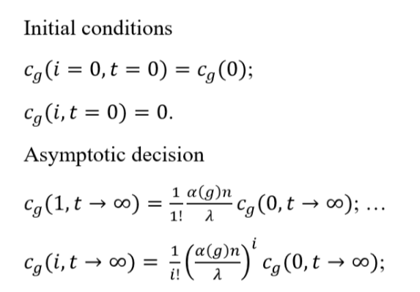
Model formulation and main equations

Slide 8
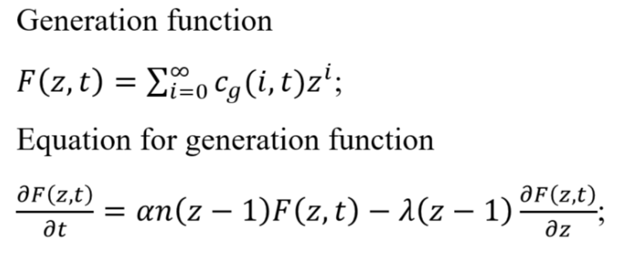
Model formulation and main equations

Slide 9
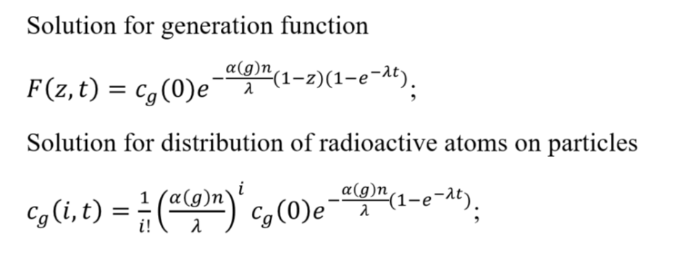
Model formulation and main equations

Slide 10
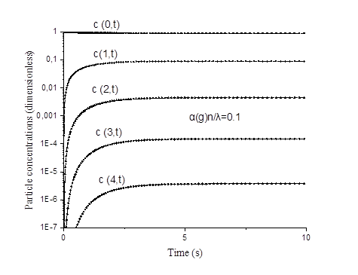
Solutions and discussions

Slide 11
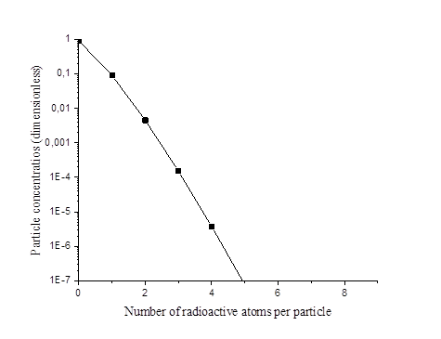
Solutions and discussions

Slide 12
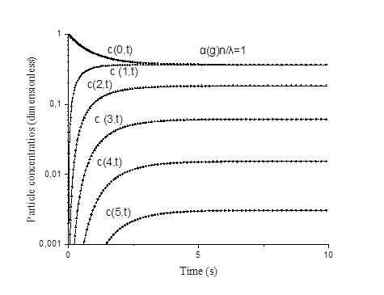
Solutions and discussions

Slide 13
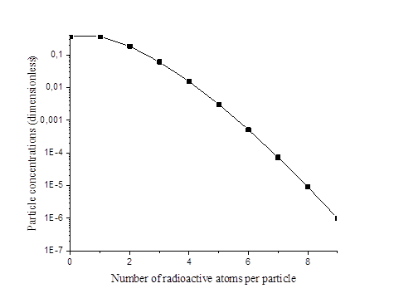
Solutions and discussions

Slide 14
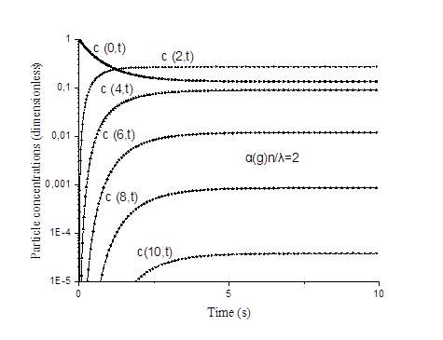
Solutions and discussions

Slide 15
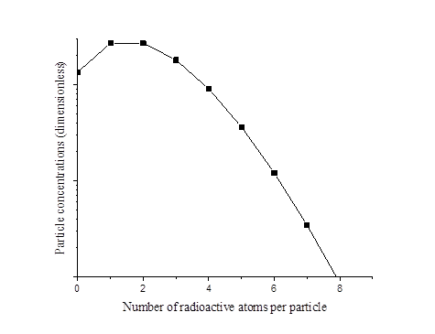
Solutions and discussions

Slide 16
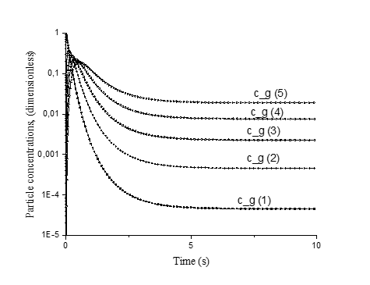
Solutions and discussions

Slide 17
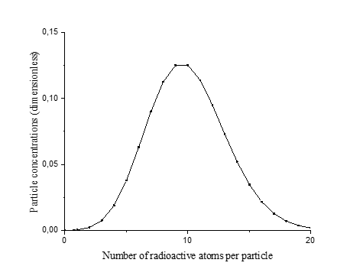
Solutions and discussions

Slide 18
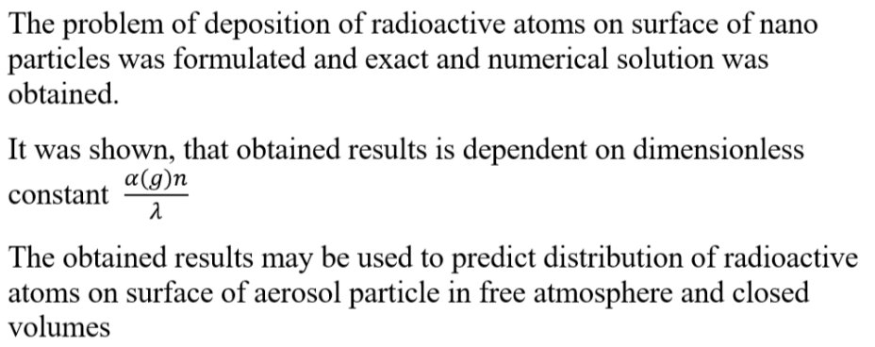
Conclusions

Slide 19
The end
Thank you for your attention

