Slide 1
EFFECT OF PROTON IRRADIATION ON THE STRUCTURE AND PROPERTIES OF THE Al₂O₃-YSZ COMPOSITE CERAMICS SYSTEM
28th International Scientific Conference of Young Scientists and Specialists (AYSS-2024)
A.V. Maletskii, A.S. Doroshkevich, R. Sh. Isaev
28 October – 01 november, 2024

Slide 2
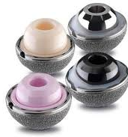
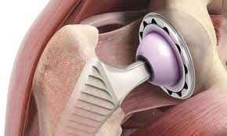
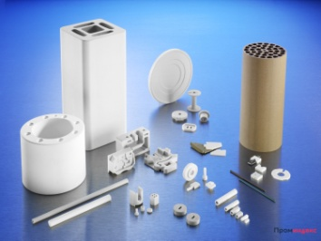
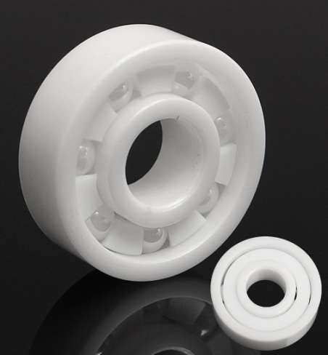
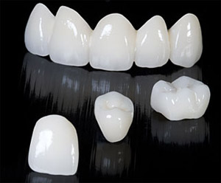
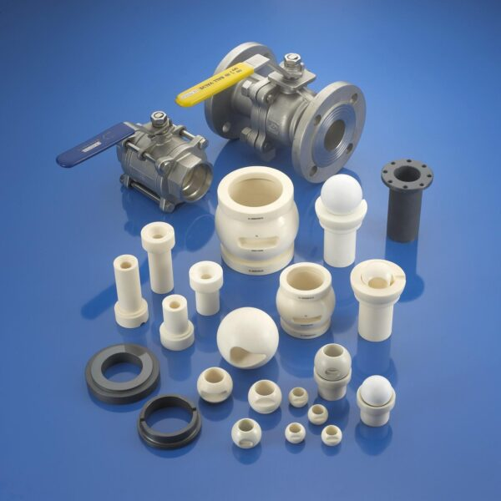
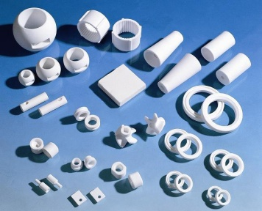
28th International Scientific Conference of Young Scientists and Specialists (AYSS-2024)
Properties of ceramic materials
ZrO₂
Al₂O₃
Maintaining strength at high temperatures;
High hardness;
Chemical inertness;
Low thermal conductivity;
Crack resistance;
Radiation resistance;
High hardness;
Good thermal conductivity;
Chemical inertness;
Low density;
Electrical insulating properties;
Low cost compared to other ceramic materials.
Application of ceramic materials
Linings for wearing equipment, bearings, grinding bodies, valve and shut-off valve elements, rollers for rolling valves, parts for oxygen sensors, plungers, endoprosthetics of the human body, rings of mechanical seals, dies, wiring, guides, crucibles, nozzles for argon-arc welding machines, electrical insulators.
1

Slide 3
28th International Scientific Conference of Young Scientists and Specialists (AYSS-2024)
Ceramic matrix composites (CMCs) are considered to improve the performance and safety of nuclear fusion and fission reactors.
The main benefit lies in their very high thermal conductivity, which dissipates the intense thermal flux generated by the plasma in a fusion reactor.
These advantages include high mechanical resistance at high temperature, chemical inertness, stability when irradiated, as well as intrinsic characteristics.
It is thought that these materials can be used for numerous applications in all generations of nuclear fission power plants as well as for structural materials in fusion power reactors that may be built in future decades if they are considered viable.
The aim of the work is to study the effect of proton irradiation on the structure and properties of α-Al₂O₃ + nYSZ (n = 0, 1, 5, 10, 15 wt.%)(ZTA) composite ceramics system.
2

Slide 4
28th International Scientific Conference of Young Scientists and Specialists (AYSS-2024)
Sample synthesis and experimental methods
TEM
Synthesis of powders by chemical coprecipitation of salt solutions
Drying of the obtained hydroxides
(≈ 150 - 200 °С)
Annealing in air at 1000 °C with holding for 1 hour.
Uniaxial compaction of powder mixtures
X-ray diffraction analysis
X-ray diffraction analysis
Processing of compacts under high hydrostatic pressure
(300 or 700 MPa)
Physical and mechanical properties (density, hardness, strength)
Sintering in air at a temperature of 1550 °C with holding for 2 hours
SEM
X-ray diffraction analysis
Physical and mechanical properties (density, hardness, strength)
Irradiation of samples with protons. The dose of irradiation with protons (D_{p}) with an energy of 2 MeV was 1·10¹⁷ units/cm²
X-ray diffraction analysis
SEM
3

Slide 5
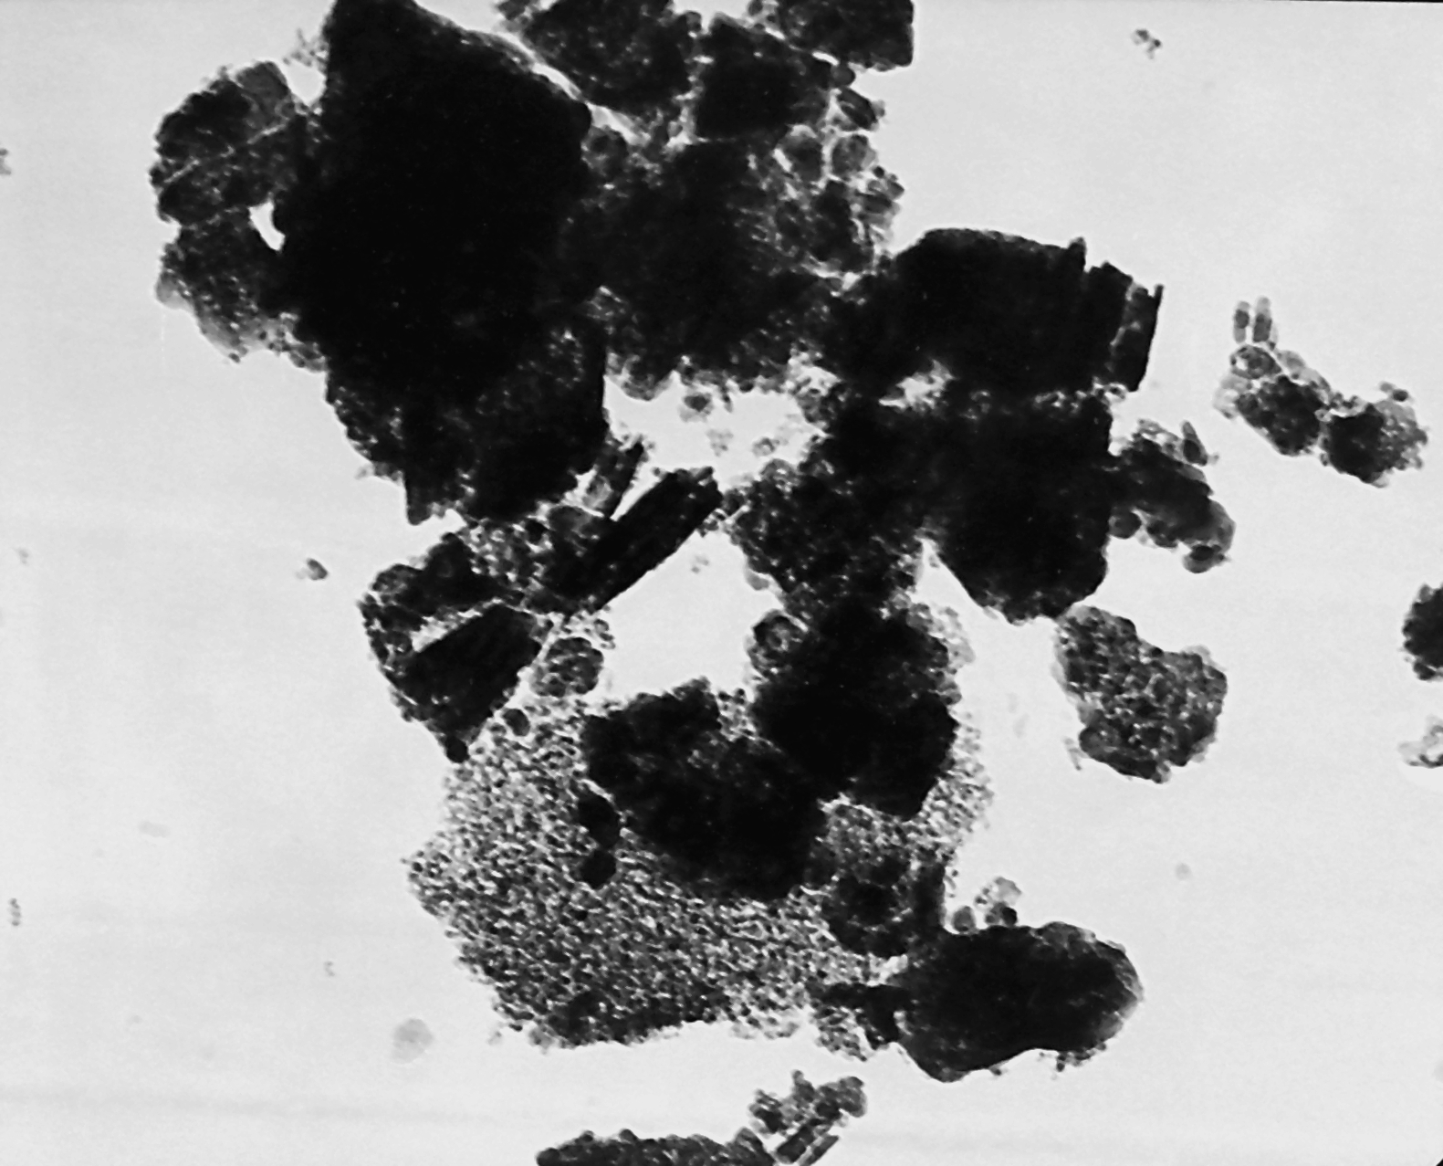
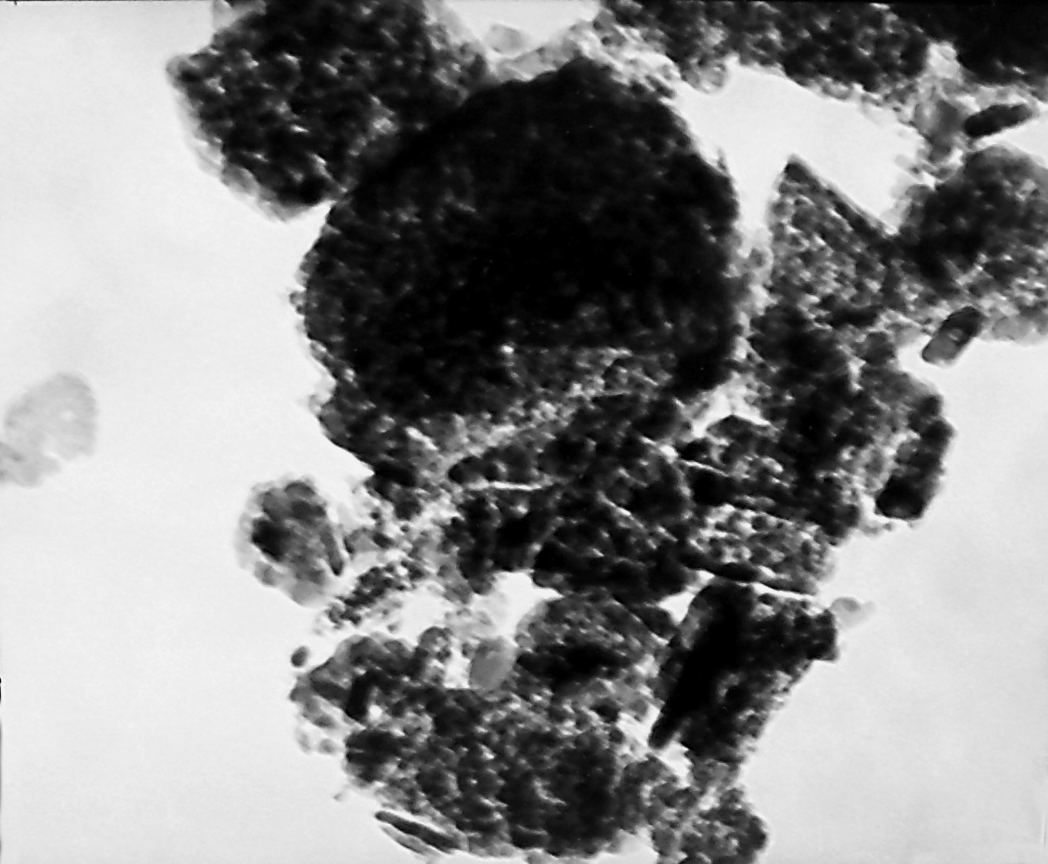
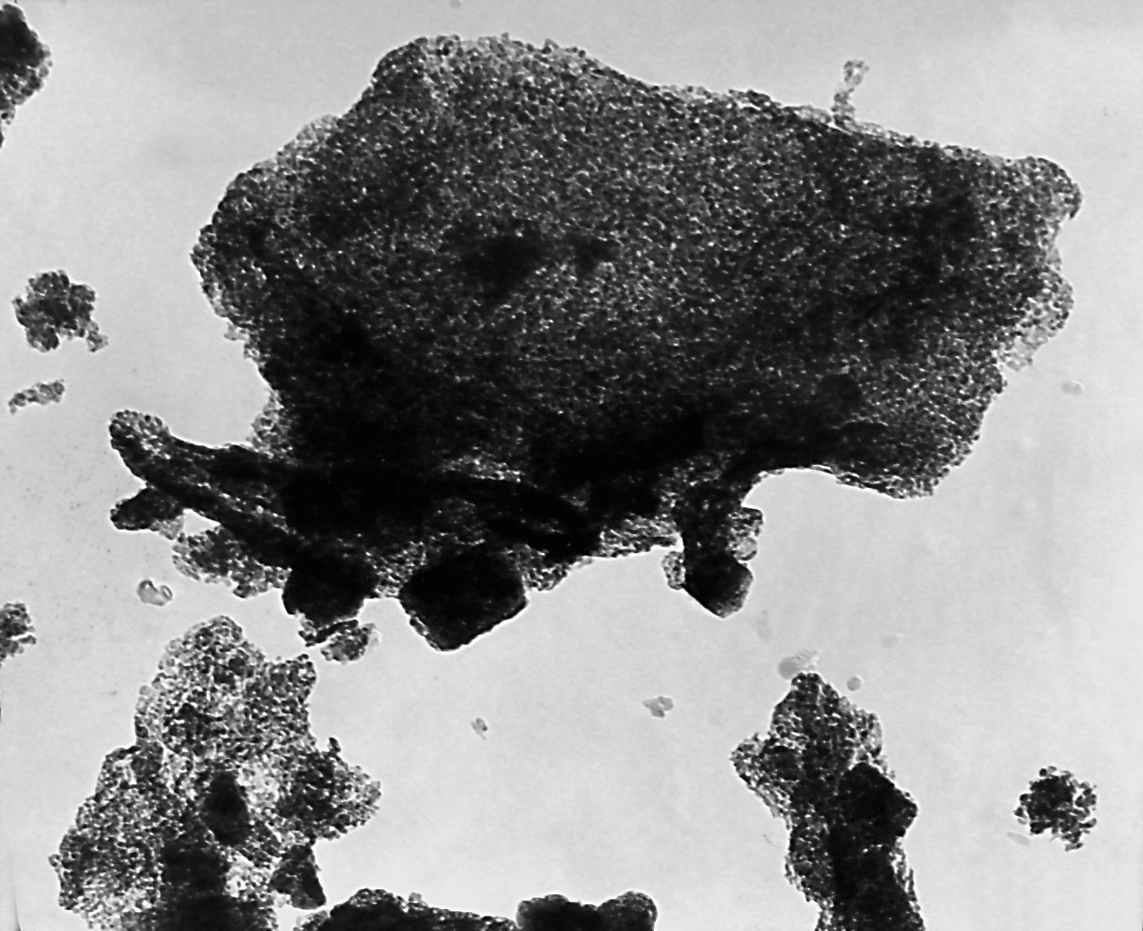
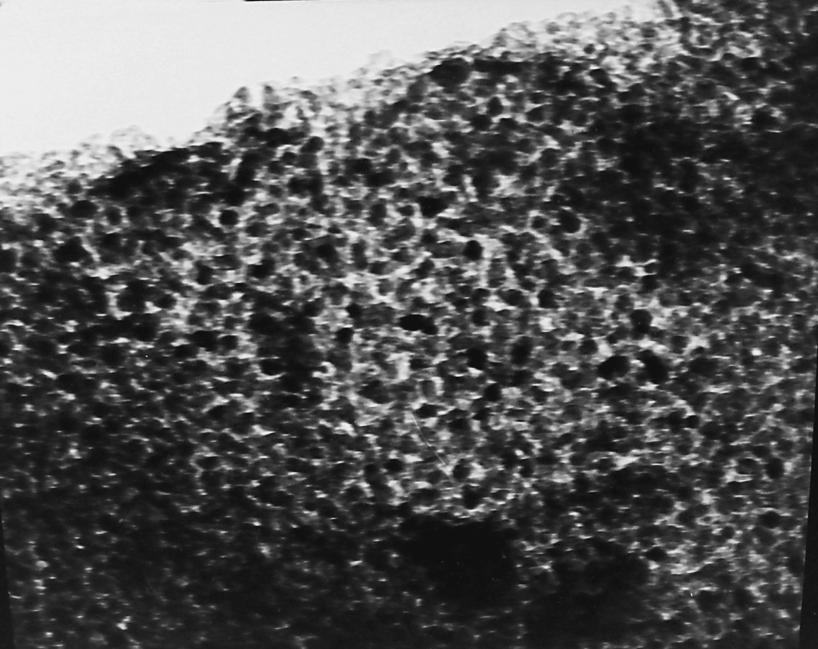
28th International Scientific Conference of Young Scientists and Specialists (AYSS-2024)
X-ray analysis and TEM data of the obtained powders
Nordstrandite
β-Al(OH)₃
200-350˚С
η or (η + γ)-Al₂O₃
850˚С
Diaspore
α-Al(OH)₃
Metastable phases of aluminum oxide were used as a basis for obtaining ceramics, which makes it possible to reduce the sintering temperature of the ZTA composite ceramics system.
300-500˚С
850˚С
1000˚С
1200˚С
390-460˚С
Bayerite
γ-Al(OH)₃
Boehmite
α-AlOOH
δ (γ)-Al₂O₃
γ-Al₂O₃
θ-Al₂O₃
Corundum
α-Al₂O₃
~180˚С
Gibbsite
α-Al(OH)₃
250-300˚С
500-800˚С
1200˚С
χ-Al₂O₃
æ-Al₂O₃
а
1μm
300 nm
b
1μm
300 nm
Fig. 1. Diffraction patterns of powder mixtures annealed at 1000˚C :
1 - Al₂O₃ + 0%YSZ, 2 - Al₂O₃ + 1%YSZ, 3 - Al₂O₃ + 5%YSZ, 4 - Al₂O₃ + 10%YSZ, 5 - Al₂O₃ + 15%YSZ
Fig. 2. TEM data of the obtained powders :
a – γ/θ-Al₂O₃, b – γ/θ-Al₂O₃+15wt.%YSZ
4

Slide 6
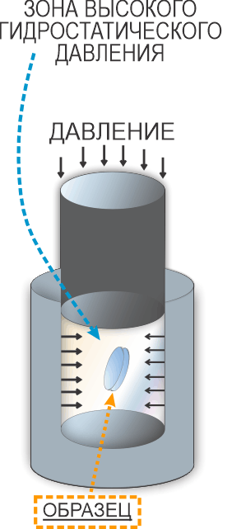
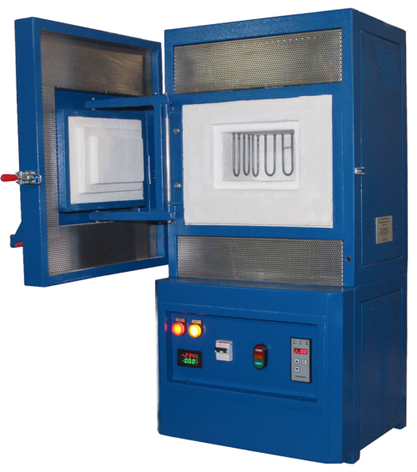
28th International Scientific Conference of Young Scientists and Specialists (AYSS-2024)
X-ray analysis of the obtained composite ceramic systems
High hydrostatic pressure zone
After processing, the compacts were sintered in air at a temperature of 1550 ° C with exposure for 2 hours.
а)
Pressure
b)
Sample
The resulting powders were compacted by uniaxial pressing, after which the compacts were treated with high hydrostatic pressure at 300 and 700 MPa.
As a result of processing and sintering of powder mixtures, two-phase composite ceramics systems α-Al₂O₃ + n YSZ (n= 0, 1, 5, 10, 15 wt.%) were formed with a matrix in the form of α-Al₂O₃ and filler YSZ
Fig.3.Diffraction patterns of composite ceramic systems obtained at HHP: a - 300 and b - 700 MPa
5

Slide 7
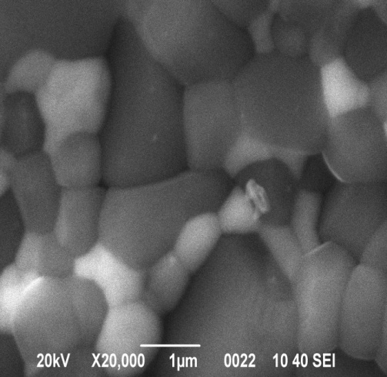
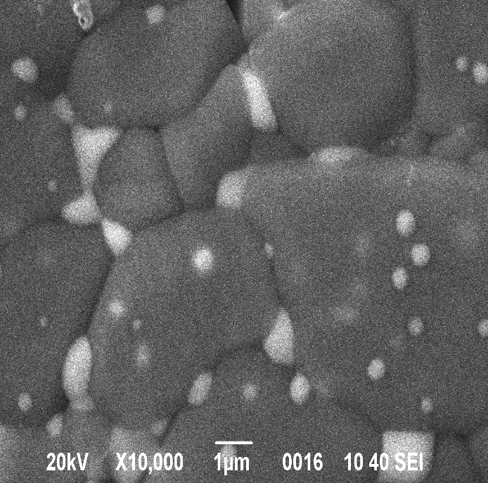
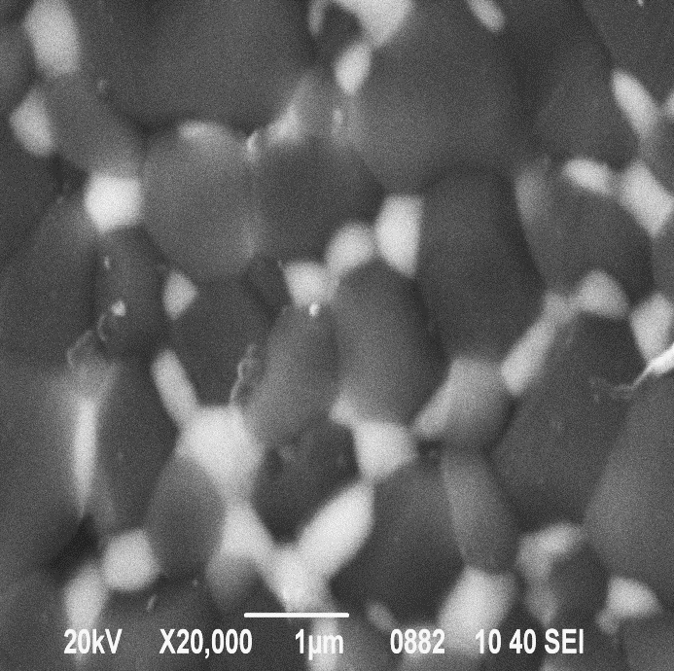
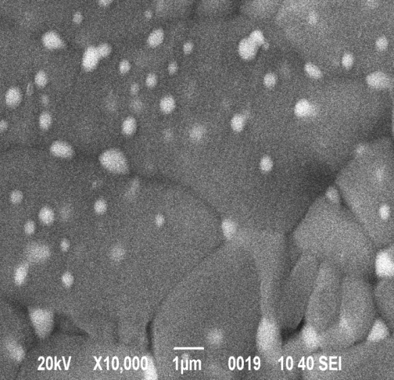
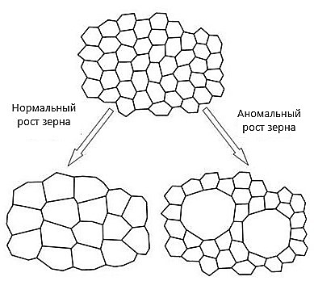
The effect of HHP on the structure of ZTA composite ceramics
28th International Scientific Conference of Young Scientists and Specialists (AYSS-2024)
Fig. 4. Surface structure of the samples :
a - Al₂O₃ + 10%YSZ (300 MPa), b - Al₂O₃ + 10%YSZ (700 MPa),
c - Al₂O₃ + 15%YSZ (300 MPa), d - Al₂O₃ + 15%YSZ (700 MPa)
a
b
1 μm
1 μm
c
d
Fig. 5. Distribution of aluminum oxide grains by size in the Al₂O₃ + 15%Z3Y system, at pressures of 300 and 700 MPa
1 μm
1 μm
Normal grain growth
Abnormal grain growth
The dispersion-hardened structure of composite ceramics corresponds to a pressure range of
600-700 MPa
The aggregate-hardened structure of composite ceramics corresponds to a pressure range of
300 – 500 MPa
4
6

Slide 8
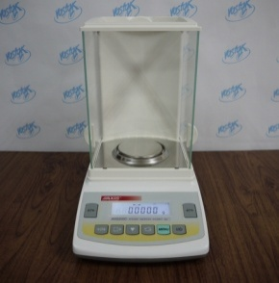
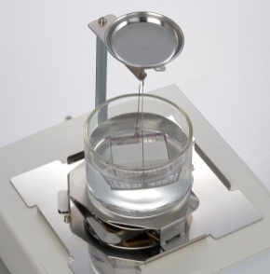
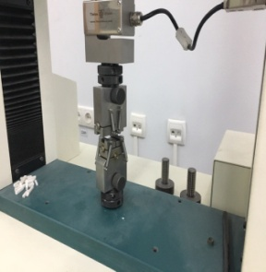
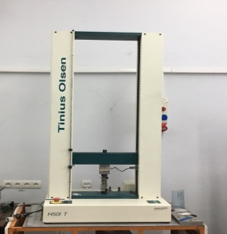
28th International Scientific Conference of Young Scientists and Specialists (AYSS-2024)
Physical and mechanical properties of ceramic composites
а)
c)
b)
Fig. 6. Dependence of density (a), hardness (b) and strength (c) of alumocirconium ceramics on the value of HHP:
1 - Al₂O₃ + 15%YSZ, 2 - Al₂O₃ + 5%YSZ, 3 - Al₂O₃ + 1%YSZ, 4 - Al₂O₃ + 0%YSZ, 5 - Al₂O₃ + 10%YSZ
It is established that the maximum values of physical and mechanical characteristics are achieved in the ceramics of the compositions Al₂O₃ + 10%YSZ (ρ = 4,1 g/cm³, Hv = 20,16 GPa, σ = 338 MPa) and Al₂O₃ + 15%YSZ (ρ = 4,09 g/cm³, Hv = 18,5 GPa, σ = 396 MPa).
7

Slide 9
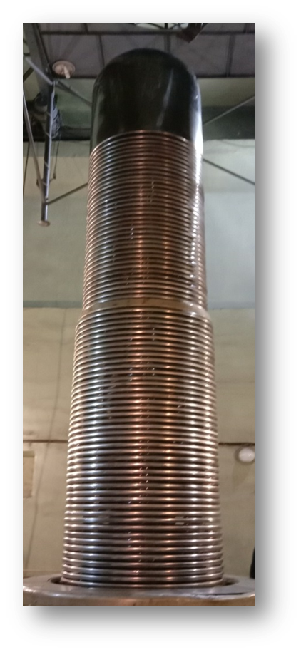
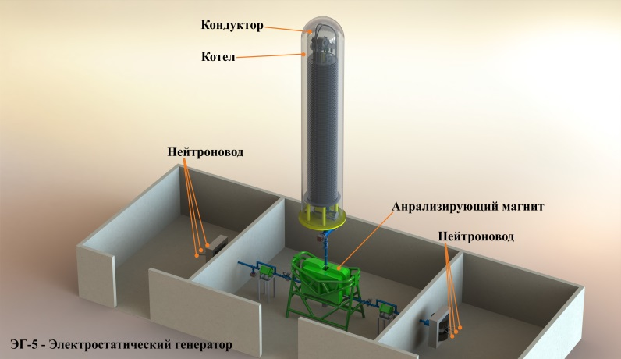
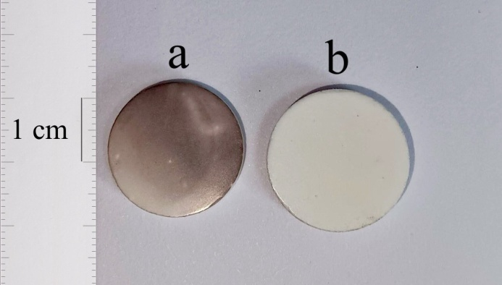
Irradiation of ceramic composites with protons at the EG-5 accelerator
28th International Scientific Conference of Young Scientists and Specialists (AYSS-2024)
conductor
The surface of the ceramic samples was sanded/polished and thermally etched at a temperature of 1450 ° C before irradiation with exposure for 30 minutes to study the surface structure of the ceramic composite immediately after irradiation.
caldron
analyzing magnet
EG-5 - electrostatic generator
Proton irradiation of ceramics of the composition α-Al₂O₃ + n YSZ (n = 0, 1, 5, 10, 15 wt.%) was carried out on an electrostatic accelerator EG-5 in the Laboratory of Neutron Physics of the Joint Institute for Nuclear Research.
The dose of proton irradiation (D_{p}) with an energy of 2 MeV was
1·10¹⁷ units/cm².
Fig.7. Samples of the system α-Al₂O₃ + 10 wt.% YSZ after proton irradiation (a) and before irradiation (b)
Electrostatic accelerator EG-5 (FLNP JINR, Dubna, Russia)
8

Slide 10
X-ray analysis of the obtained composite ceramic systems after proton irradiation
28th International Scientific Conference of Young Scientists and Specialists (AYSS-2024)
a)
b)
Fig. 8. Diffractograms of composite ceramic materials irradiated with protons, precompacted at HHP 300 (а) and 700 MPa (b):
1 - Al₂O₃ + 0%YSZ, 2 - Al₂O₃ + 1%YSZ, 3 - Al₂O₃ + 5%YSZ, 4 - Al₂O₃ + 10%YSZ и 5 - Al₂O₃ + 15%YSZ
X-ray phase analysis showed that proton irradiation of composite ceramics of the specified composition did not cause changes in the phase composition.
It was also found that irradiation did not lead to the appearance of macrostress fields on their surface (stresses of the 1st kind), as indicated by the immutability of the lattice parameters in both phases before and after irradiation.
9

Slide 11
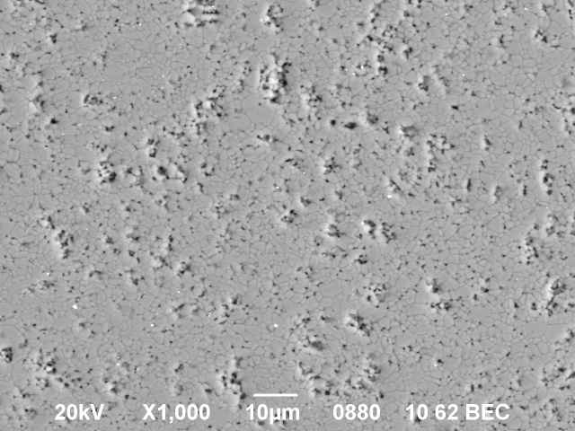
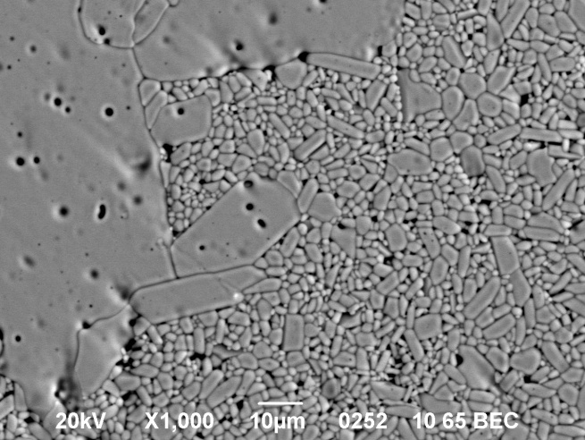
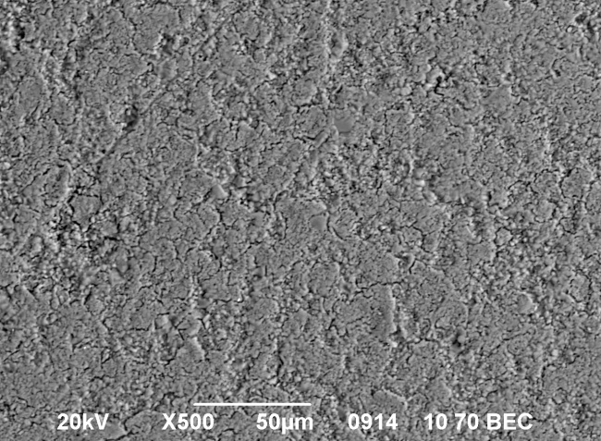
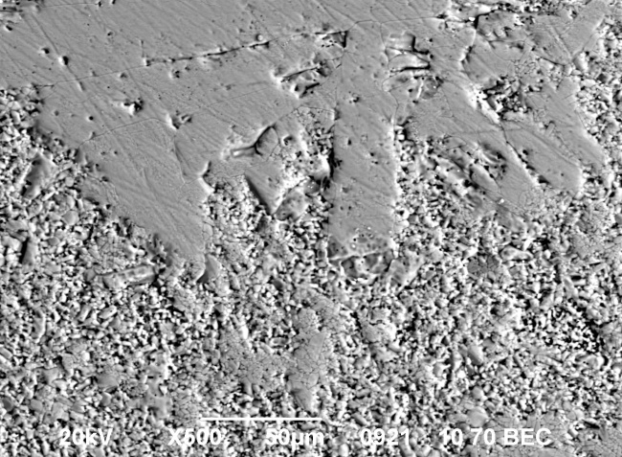
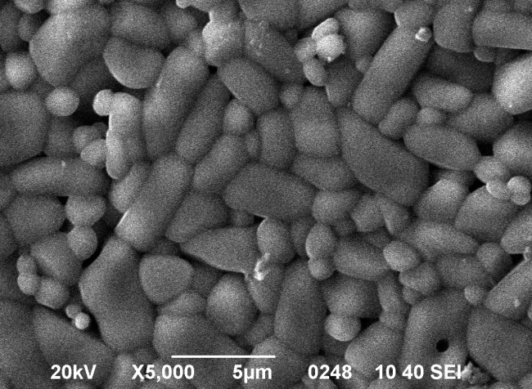
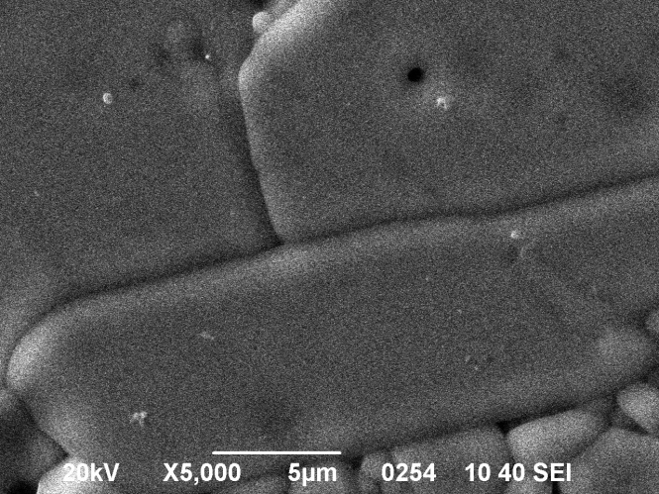
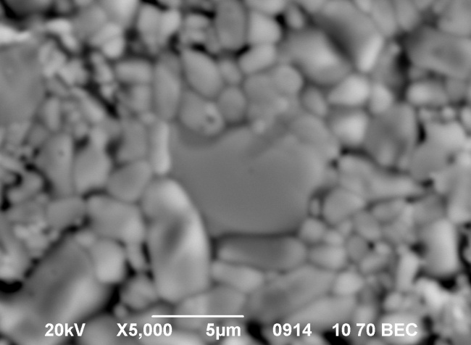
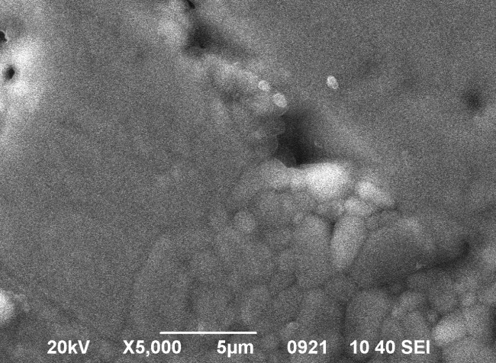
The structure of the ceramic surface after proton irradiation
28th International Scientific Conference of Young Scientists and Specialists (AYSS-2024)
Surface structure of α-Al₂O₃ ceramics before irradiation
Surface structure of α-Al₂O₃ ceramics after irradiation
300 MPa
700 MPa
300 MPa
700 MPa
pores
pores
As a result of proton irradiation, a large number of defects are formed on the ceramic surface. It is noted that in denser ceramics (700 MPa), defects in the form of pores have a larger size, and in less dense ceramics, a greater number of smaller pores are observed. Such a distribution of pores over the surface of ceramics and in size may be related to the number of grain boundaries of aluminum oxide, which are a drain and a source of point defects.
10

Slide 12
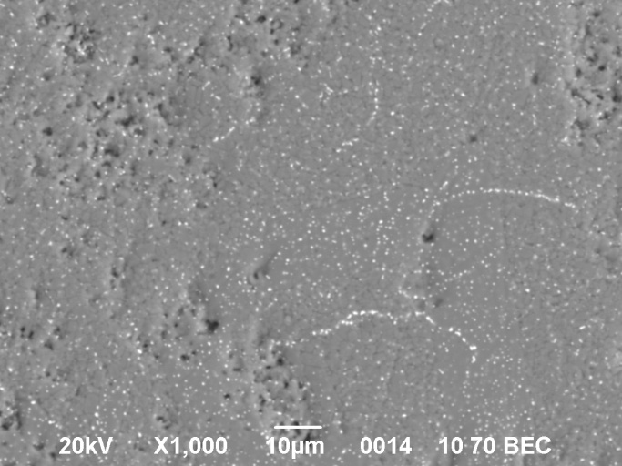
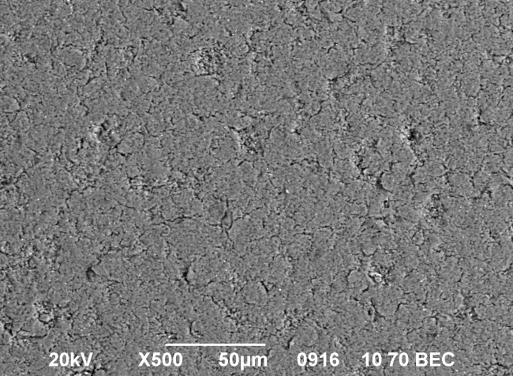
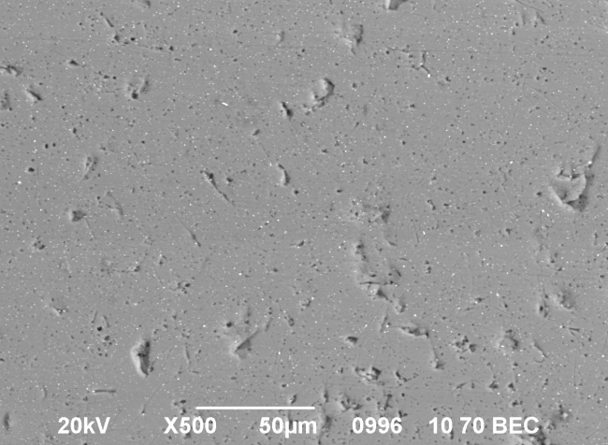
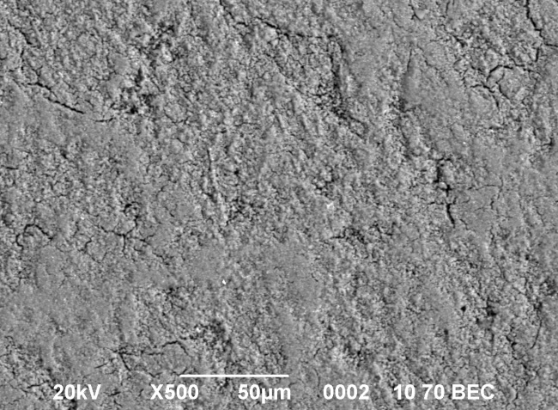
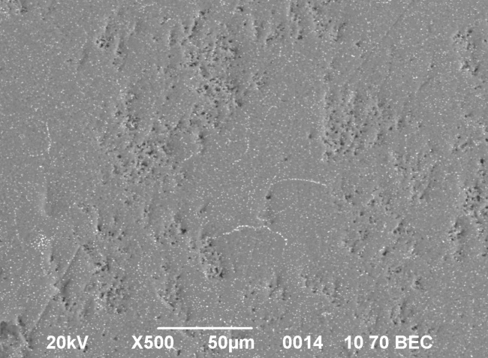
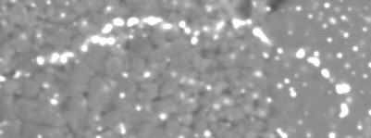
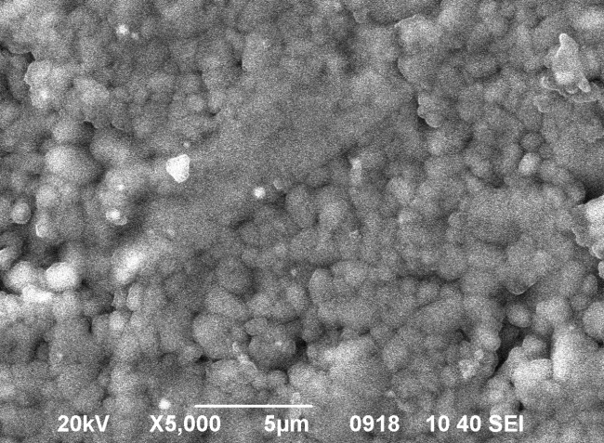
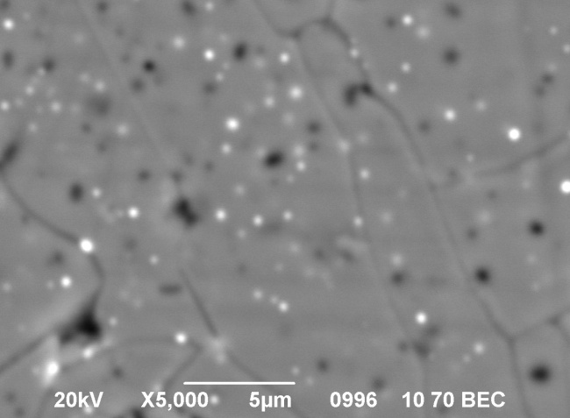
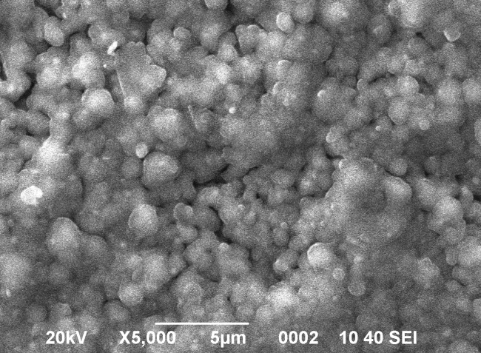
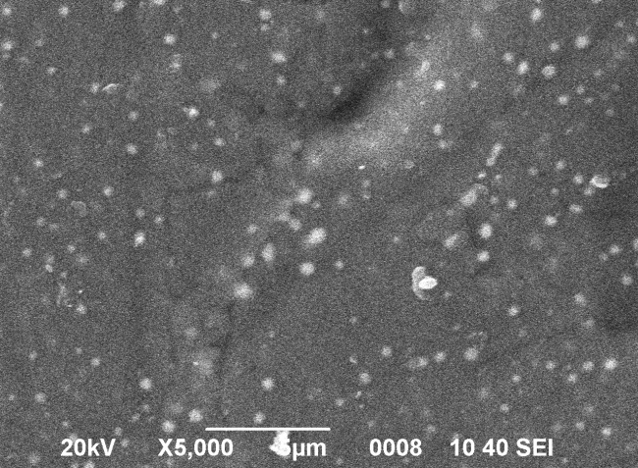
28th International Scientific Conference of Young Scientists and Specialists (AYSS-2024)
Surface structure of α-Al₂O₃ +1%YSZ ceramics after irradiation
Surface structure of α-Al₂O₃ +5%YSZ ceramics after irradiation
300 MPa
700 MPa
300 MPa
700 MPa
YSZ
pores
In the α-Al₂O₃ +1%YSZ and α-Al₂O₃ +5%YSZ system, obtained at 300 MPa as a result of proton irradiation, crushing of YSZ grains is observed with a decrease in their average size from 1 µm to 0.6 µm after irradiation.
In the α-Al₂O₃ +5%YSZ system obtained at a pressure of 700 MPa as a result of proton irradiation, the effect of radiation-stimulated diffusion of YSZ grains on the aluminum oxide matrix is observed. At the same time, crushing of YSZ grains is not observed.
11

Slide 13
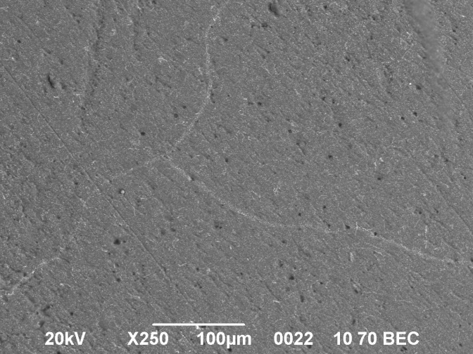
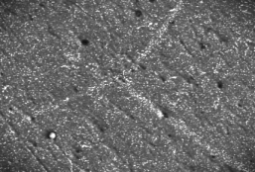
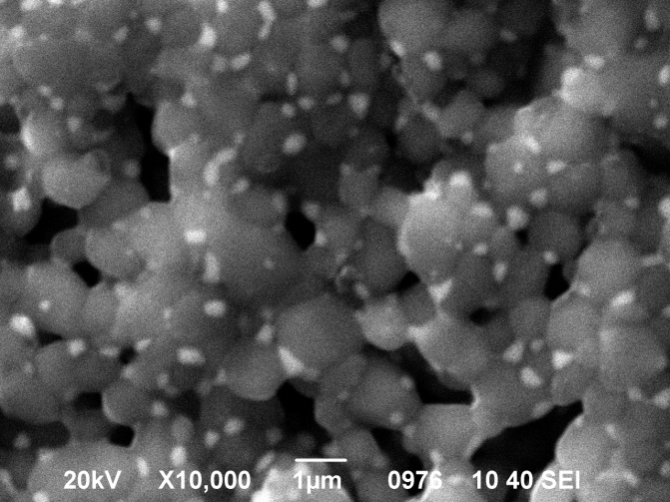
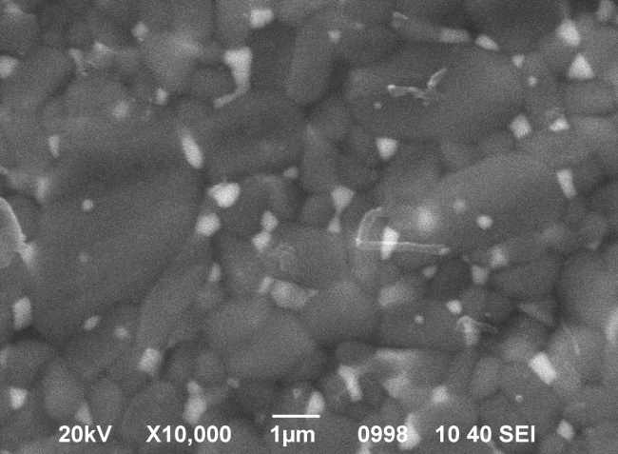
28th International Scientific Conference of Young Scientists and Specialists (AYSS-2024)
Surface structure of α-Al₂O₃ +10%YSZ ceramics before (a) and after irradiation (b)
300 MPa
700 MPa
a
a
b
b
In ceramics with a dispersed-hardened structure, a strong effect of radiation-stimulated diffusion is observed, which leads to the redistribution of zirconium dioxide grains along the aluminum oxide matrix.
In the α-Al₂O₃ +10%YSZ ceramics with an aggregate-hardened structure, crushing of zirconium dioxide grains with a decrease in their average size and the formation of a large amount of pores in the structure of the material is observed.
12

Slide 14
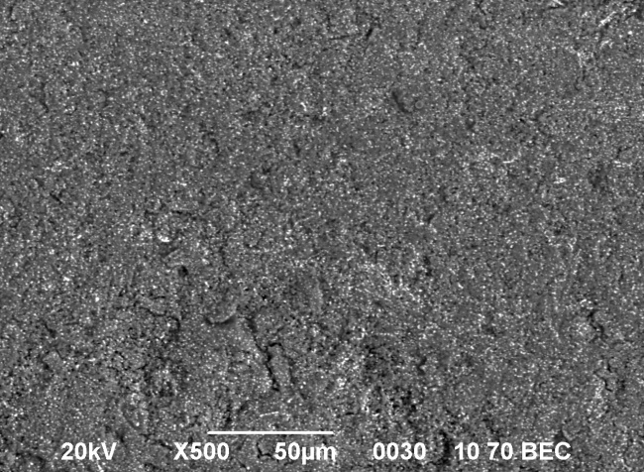
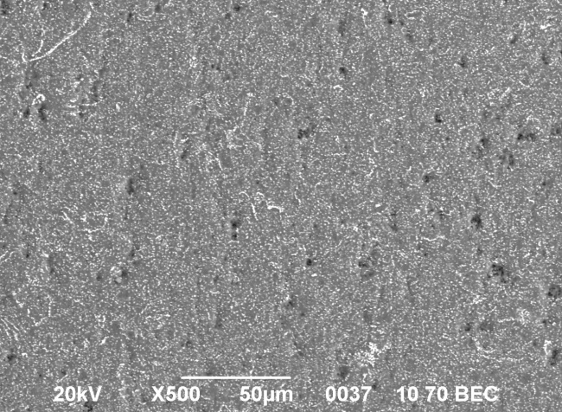
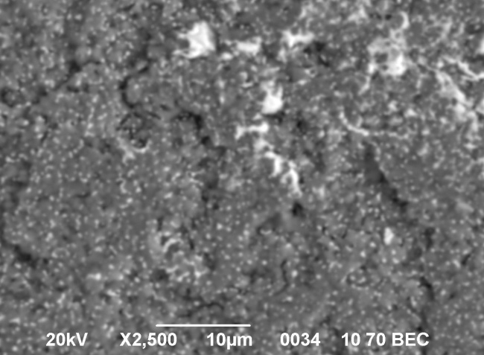
28th International Scientific Conference of Young Scientists and Specialists (AYSS-2024)
Surface structure of α-Al₂O₃ +15%YSZ ceramics before irradiation
Surface structure of α-Al₂O₃ +15%YSZ ceramics after proton irradiation
300 MPa
700 MPa
300 MPa
700 MPa
1µm
1µm
In the ceramics of the α-Al₂O₃ +15%YSZ system, the crushing of zirconium dioxide grains is also observed with the formation of a large number of defects in the structure of the ceramic composite.
Also, at this concentration and the conditions for obtaining composite ceramics (300 MPa), the formation of aglomerates of zirconium dioxide grains is observed, which lead to the hardening of ceramics and a decrease in physico-mechanical properties.
Ceramics obtained at a pressure of 700 MPa are more resistant to proton irradiation and the formation of defects in the form of pores is not observed.
13

Slide 15
Conclusions
28th International Scientific Conference of Young Scientists and Specialists (AYSS-2024)
The study established the effect of proton irradiation with a dose of 1х10¹⁷ u/cm² and with an energy of 2 MeV on the structure of the α-Al₂O₃ + n YSZ (n = 0, 1, 5, 10, 15 wt.%) composite ceramic systems.
It has been established that proton irradiation of the aggregate-hardened structure of a ceramic composite (300 MPa) leads to crushing of zirconium dioxide grains and reduction of their average size.
Proton irradiation of the aggregate-hardened structure of a ceramic composite (700 MPa) does not lead to the formation of defects in the structure of the material. The effect of proton irradiation leads to the radiation-accelerated diffusion of zirconium dioxide grains through an alumina matrix with a redistribution of the alloying impurity over the volume of the matrix.
The strongest effect of radiation-accelerated diffusion of zirconium dioxide grains is observed in a system with 10 wt.% YSZ.
14

Slide 16
28th International Scientific Conference of Young Scientists and Specialists (AYSS-2024)
Thanks for your attention!

