Slide 1
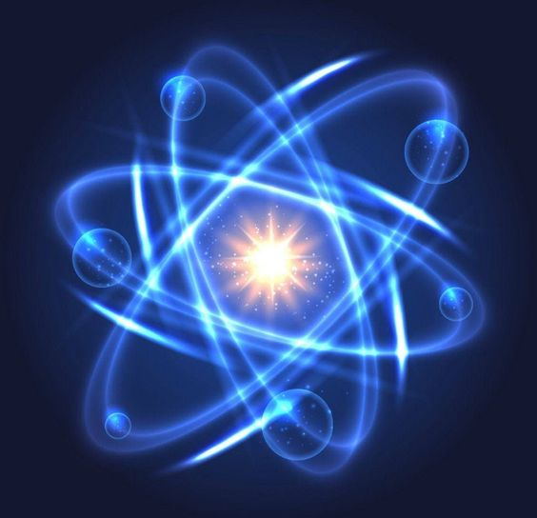


THE ROLE OF ALLOYING ELEMENTS IN THE FORMATION OF MECHANICAL PROPERTIES OF AISI 316L N STEEL, IRRADIATED BY NEUTRONS
Author: Bobrussova Yulia Alexandrovna
Engineer of the Laboratory of Radiation Materials Science of the Institute of Nuclear Physics of Almaty, Kazakhstan
Supervisors: PhD Merezhko M. S., PhD Merezhko D.A.
Institute of Nuclear Physics
The Republic of Kazakhstan
28th International Scientific Conference of Young Scientists and Specialists (AYSS-2024)

Slide 2
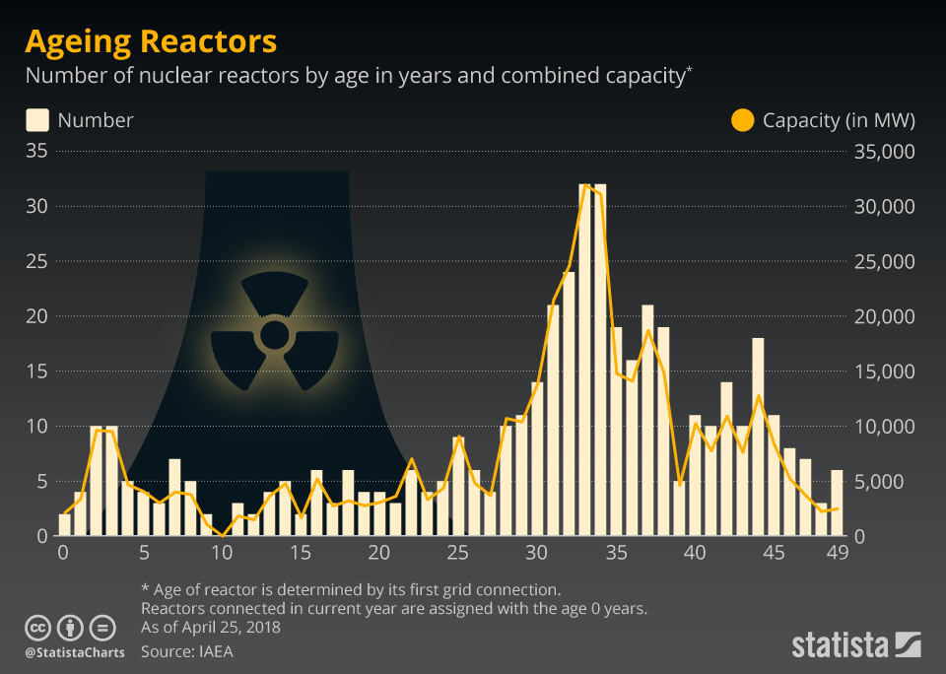
Modern nuclear power industry
Nuclear power stations on the world map

Slide 3
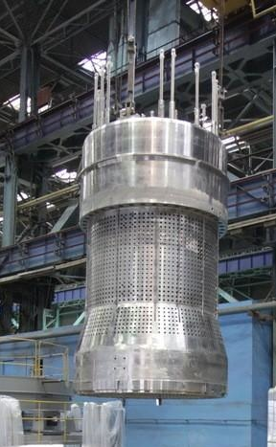
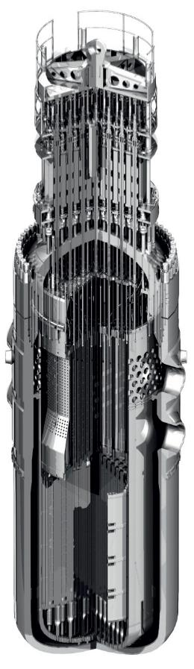
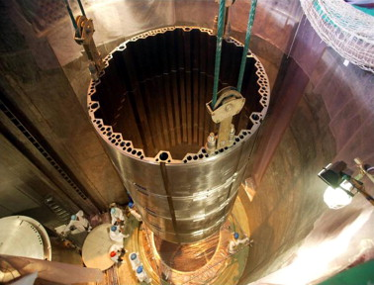
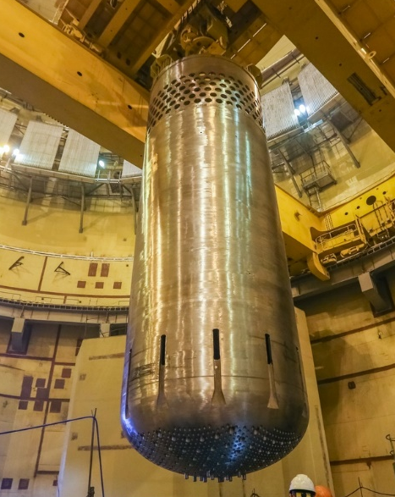
03
Austenitic steels in reactors
Protective tube unit
Secures fuel assembly heads, protects regulators and in-reactor control channels.
Weight: 68 tones
Austenitic steels are the main material of many critical components of modern nuclear reactors.
The planned service life is 40-60 years.
It is economically feasible to extend the service life of existing reactors to 80-100 years.
The baffle ring
Designed to form the core and reduce the neutron flux to the reactor vessel wall.
Weight: 38 tones
Core barrel
It contains fuel assemblies and distributes coolant flow rates at the reactor inlet and outlet.
Weight: 76 tones
WWER 1000
Конструкции твэлов, каналов и активных зон энергетических реакторов/ Г.Н. Колпаков, О.В. Селиваникова. – Томск, 2009. – 118 с.
Notes:
В ВВР – 200 тонн конструкций из аустенитки.

Slide 4
04
Modernization of existing steels by alloying
Alloying - adding of the impurity to the composition of materials to change (improve) physical and/or chemical properties of the basic material.
Promising chemical elements for alloying austenitic steels are nitrogen, manganese, copper and tungsten.
N
Nitrogen: stabilises the austenitic matrix, increases the strength of the material and enables the nickel content of the steel to be reduced;
Mn
Manganese: reduces yield strength (additionally with nitrogen), reduces chromium segregation during irradiation, improves fluidity during metal melting;
Cu
Copper: increases plasticity, improves corrosion resistance (potentially);
W
tungsten: an effective hardening element.

Slide 5
05
Chemical composition of studied steels, (weight.%)
Steels | Cr | Ni | Mn | Si | Mo | C | N | Cu | W
AISI 304 | 17,9 | 7,90 | 0,90 | 0,58 | - | 0,08 | - | - | -
AISI 316 LN | 17.5 | 12.5 | 1.8 | 0.50 | 2.5 | 0.03 | 0.07 | 0.30 | -
211L | 17.7 | 12.5 | 4.1 | 0.44 | 2.5 | 0.02 | 0.34 | 0.31 | -
212L | 17.7 | 12.6 | 5.1 | 0.44 | 2.5 | 0.01 | 0.36 | 2.8 | -
213L | 17.7 | 12.6 | 5.1 | 0.45 | 2.0 | 0.01 | 0.32 | 2.8 | 1
AISI 304
It was taken for comparison purposes
AISI 316
Basis for the alloying
Increased manganese and nitrogen concentration for stabilisation of the austenitic structure and additional hardening
211 L
212 L
The manganese content was increased to 5% in order to further stabilise austenite. Copper content was increased to 2.8% to improve corrosion properties
213 L
Additional tungsten alloying for improved corrosion resistance at high temperatures

Slide 6
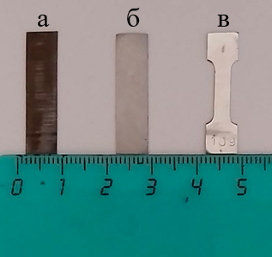
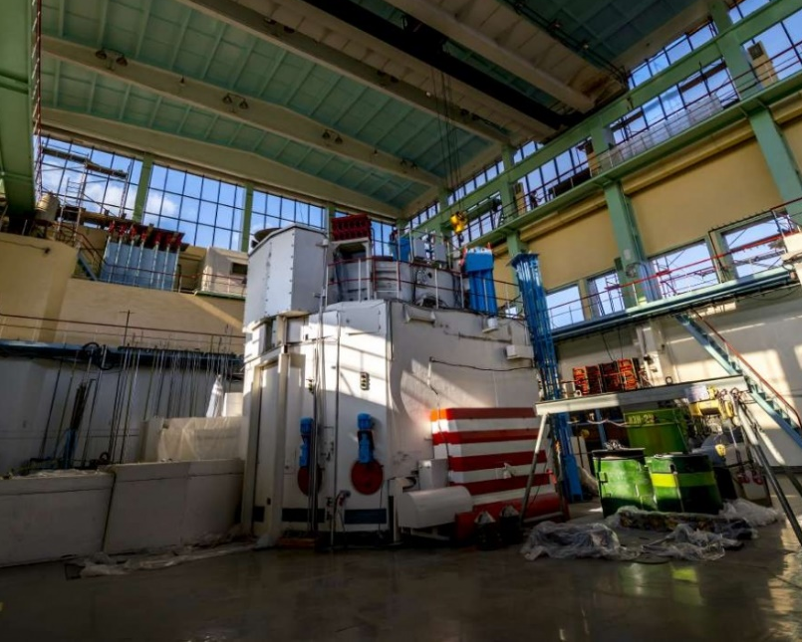
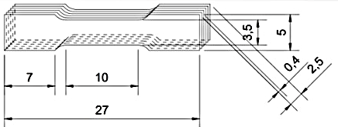
06
SAMPLE PREPARATION
Cutting and polishing
Neutron irradiation
The mechanical plates were cut;
Polished;
Samples were knocked out in the form of a ‘double blade’;
The samples were annealed at 1050 ºC;
In December 2023, samples were irradiated in the WWR-K reactor in the central channel 5-7 at level 3 in the reactor core to fluence Ft = 3.18×10¹⁸ n/cm² (thermal neutrons) ≈ 0,00022 dpa.

Slide 7
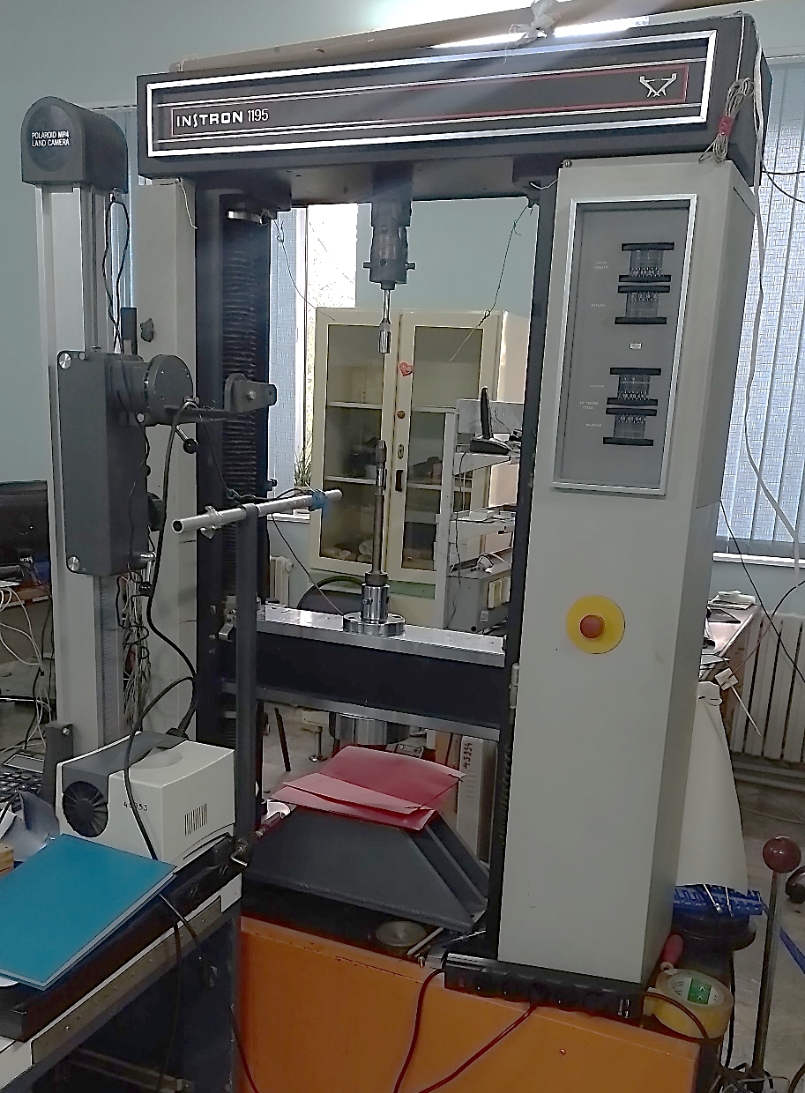
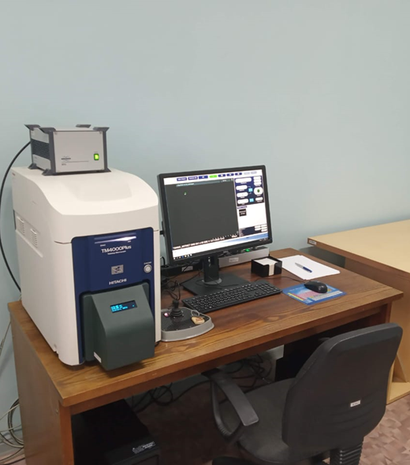
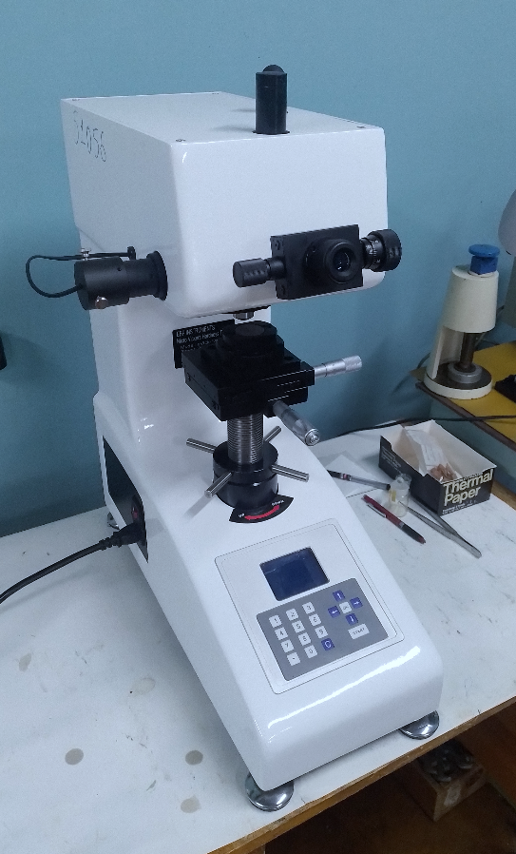
07
Used equipment
SEM
Hitachi TM-4000 PLUS
Microhardness tester
Micro Vicker Hardness Tester
Tensile breaking machine Instron 1195

Slide 8
Microhardness of steels before and after irradiation (kg/mm²):
08
38-42 (kg/mm²)
7 (kg/mm²)
22-25 (kg/mm²)

Slide 9
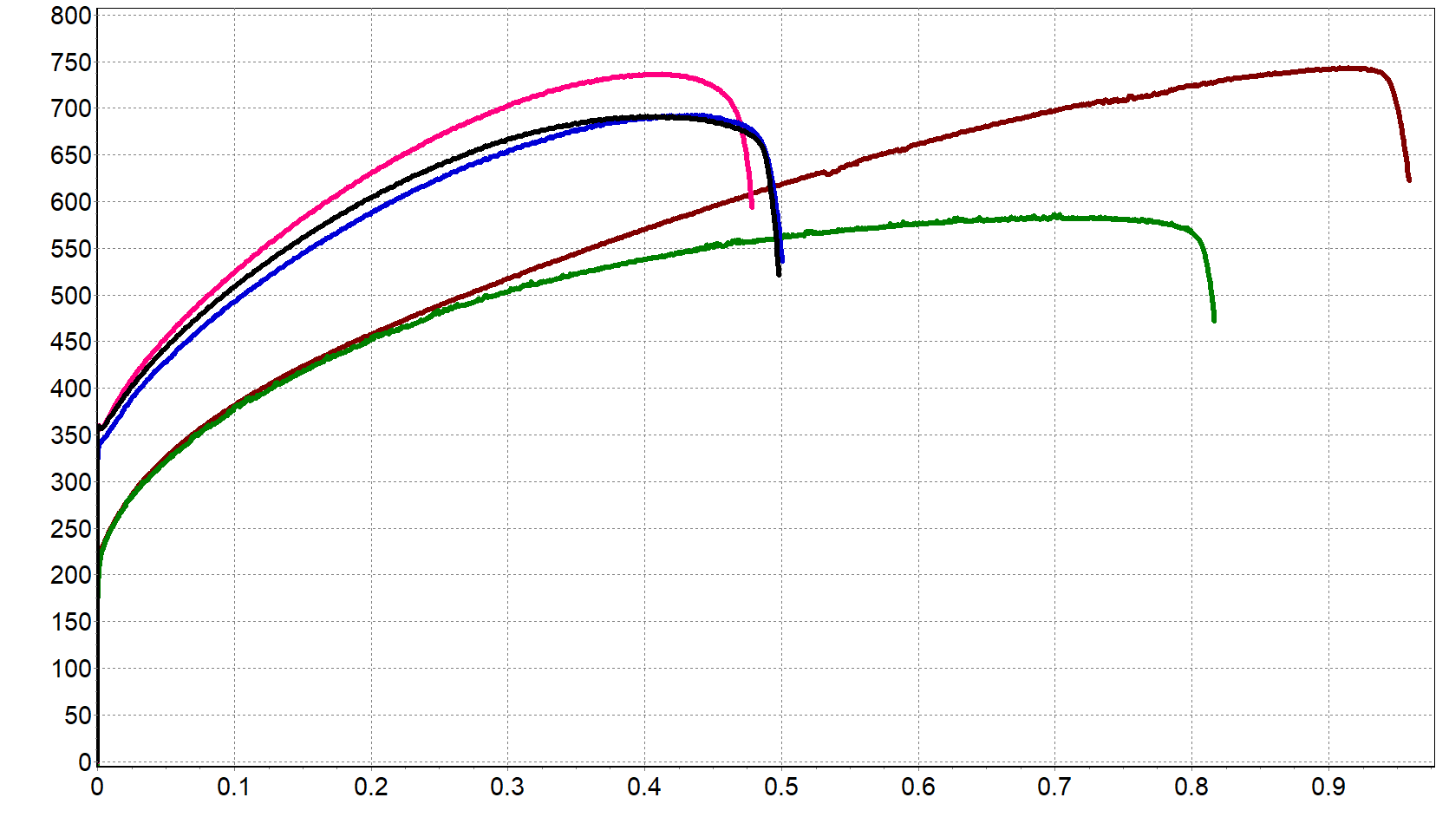
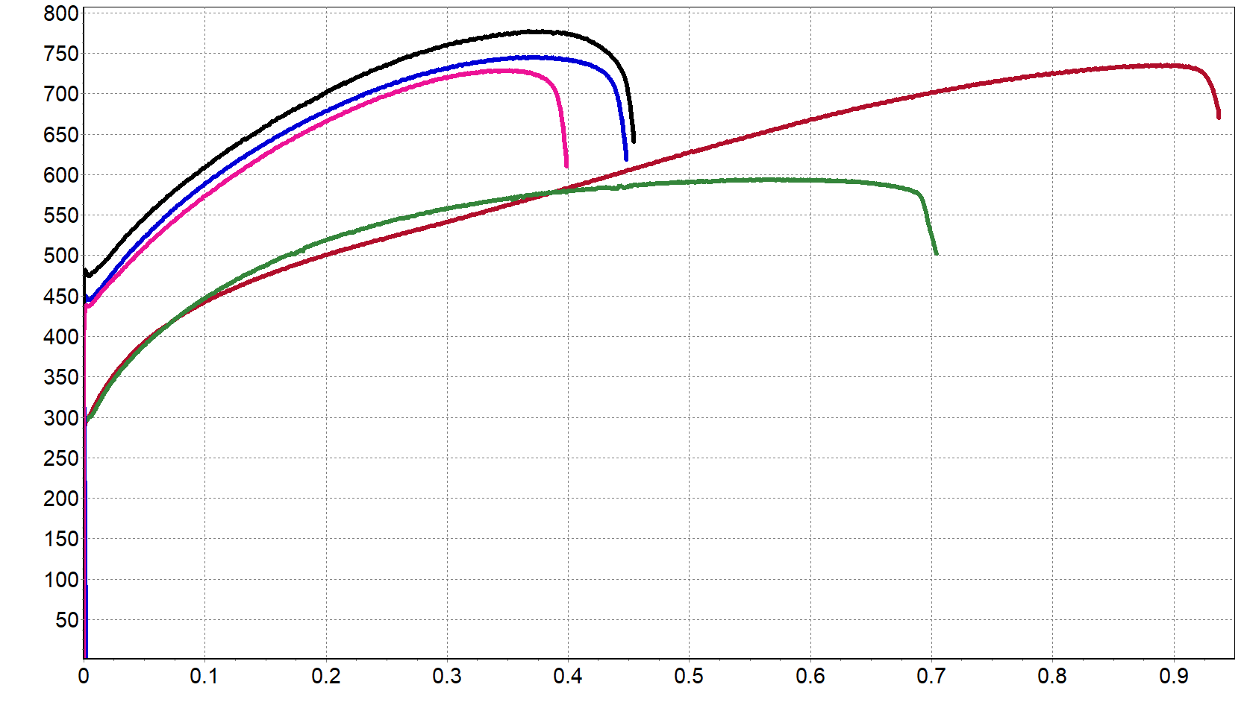
09
Engineering tensile diagrams of the steels studied
UNIRRADIATED
IRRADIATED
to fluency 3.18e18 (n/cm²)
σ, MПa
σ, MПa
213 L
211 L
AISI 304
213 L
212 L
AISI 304
211 L
212 L
AISI 316
AISI 316
Relative elongation, %
Relative elongation, %

Slide 10
10
Comparison of Mechanical Properties of Steels

Slide 11
11
Comparison of Mechanical Properties of Steels

Slide 12
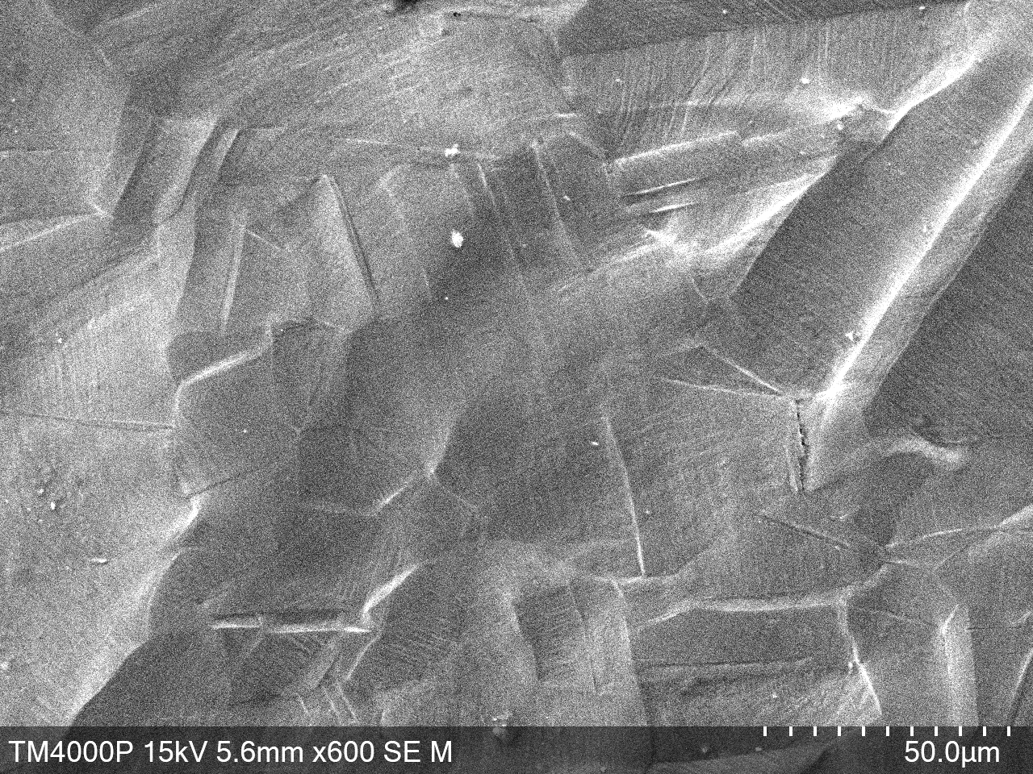
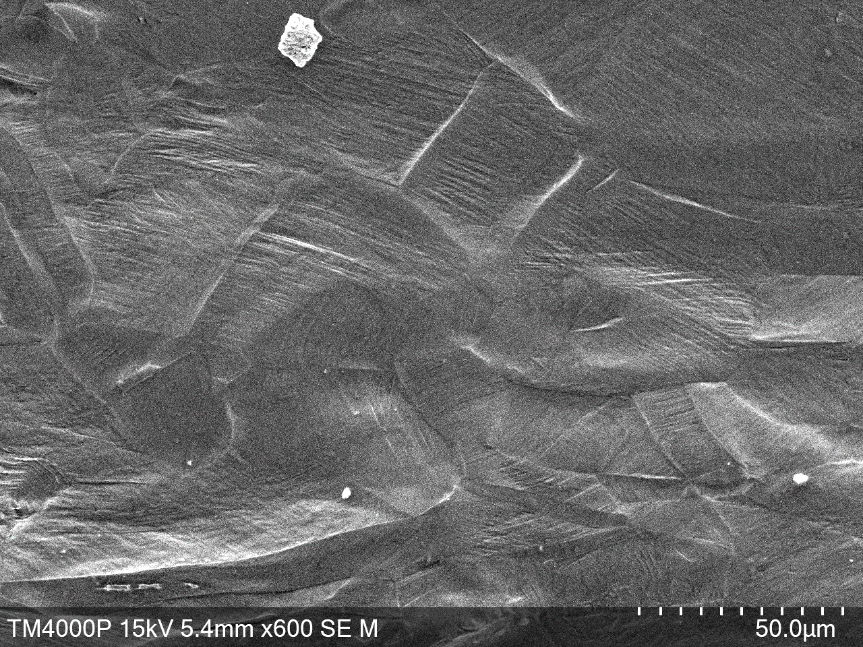
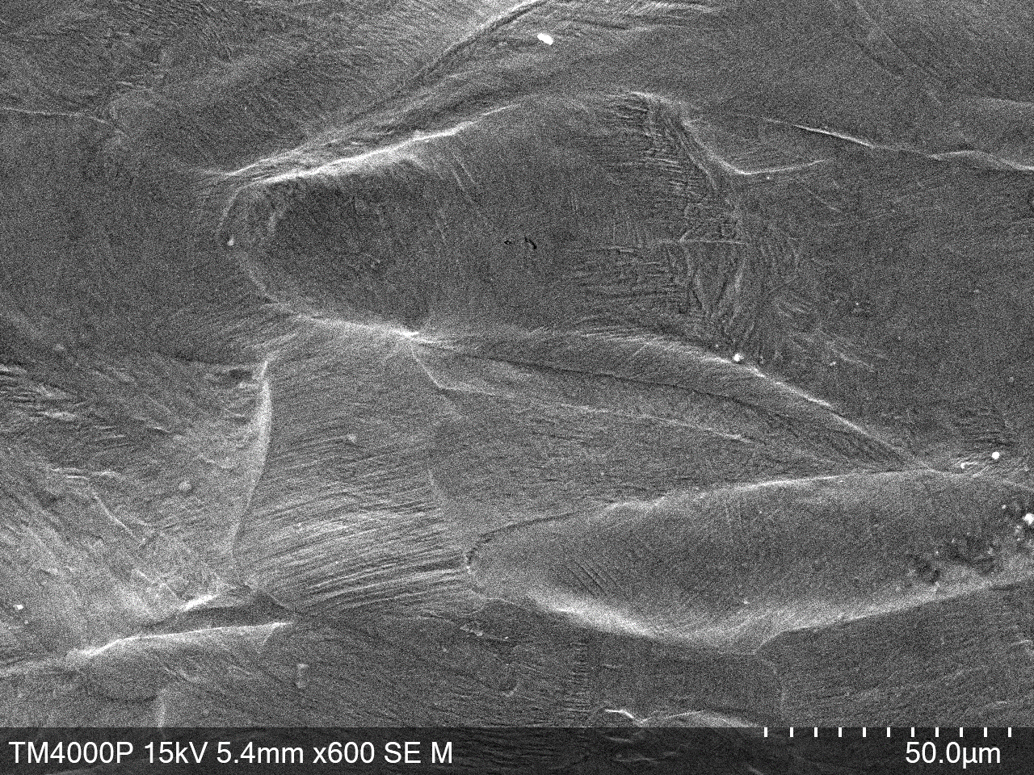
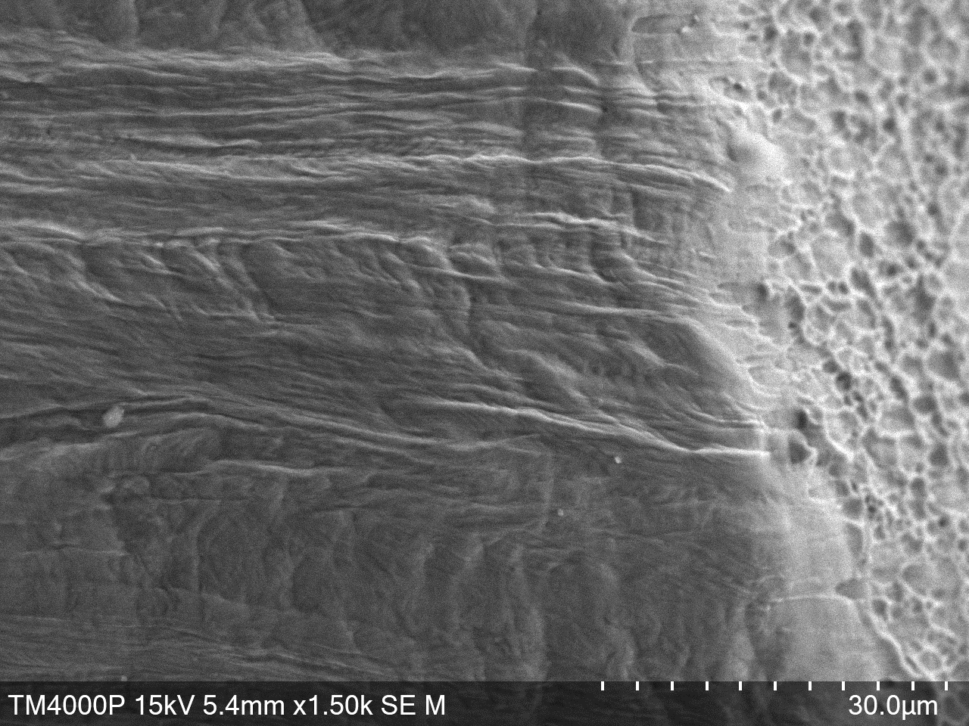
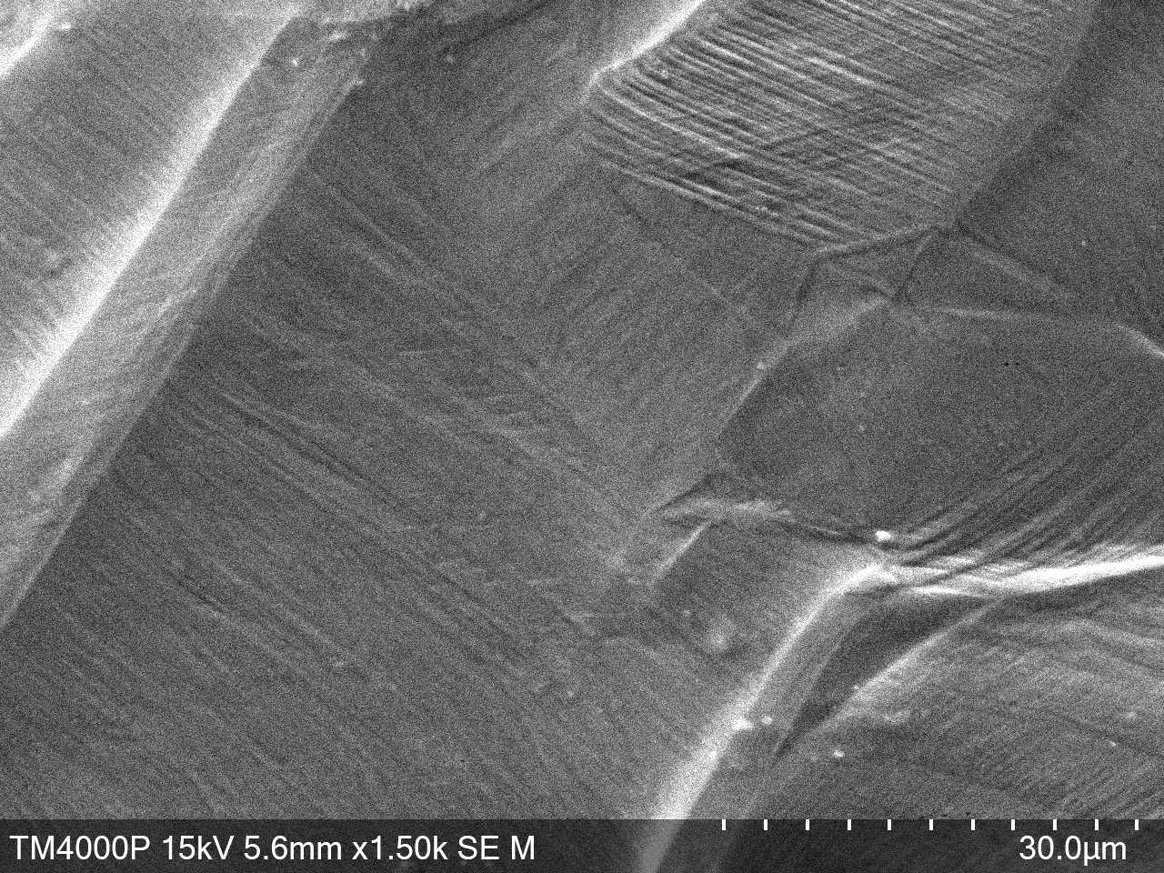
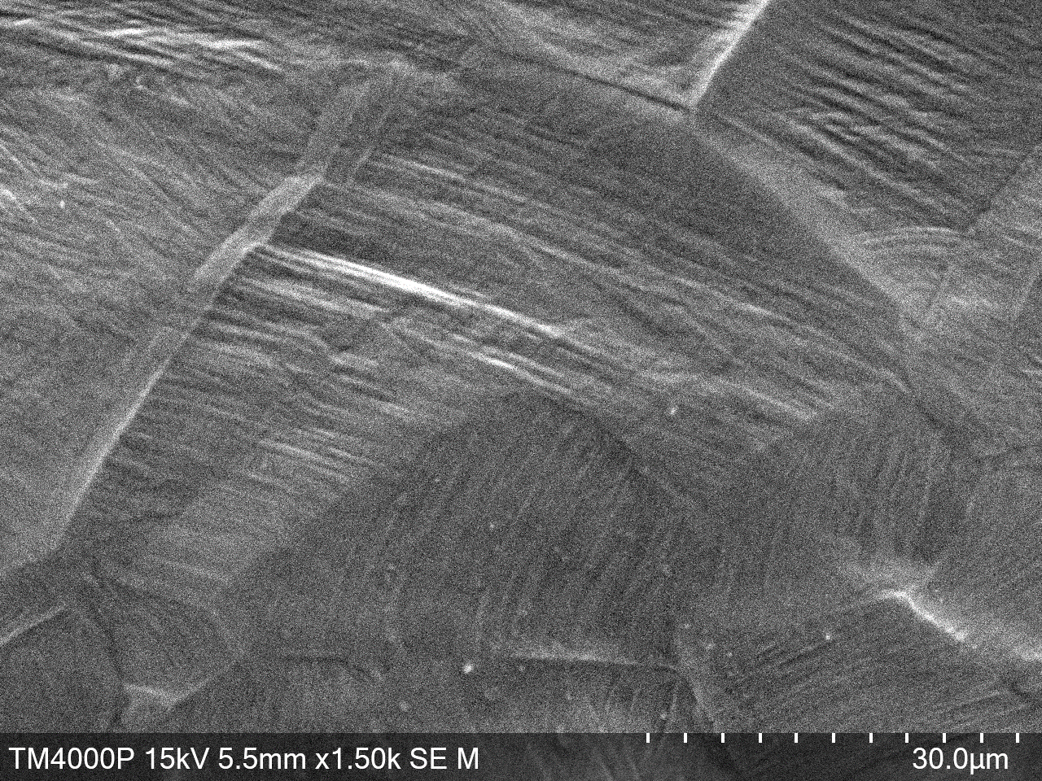
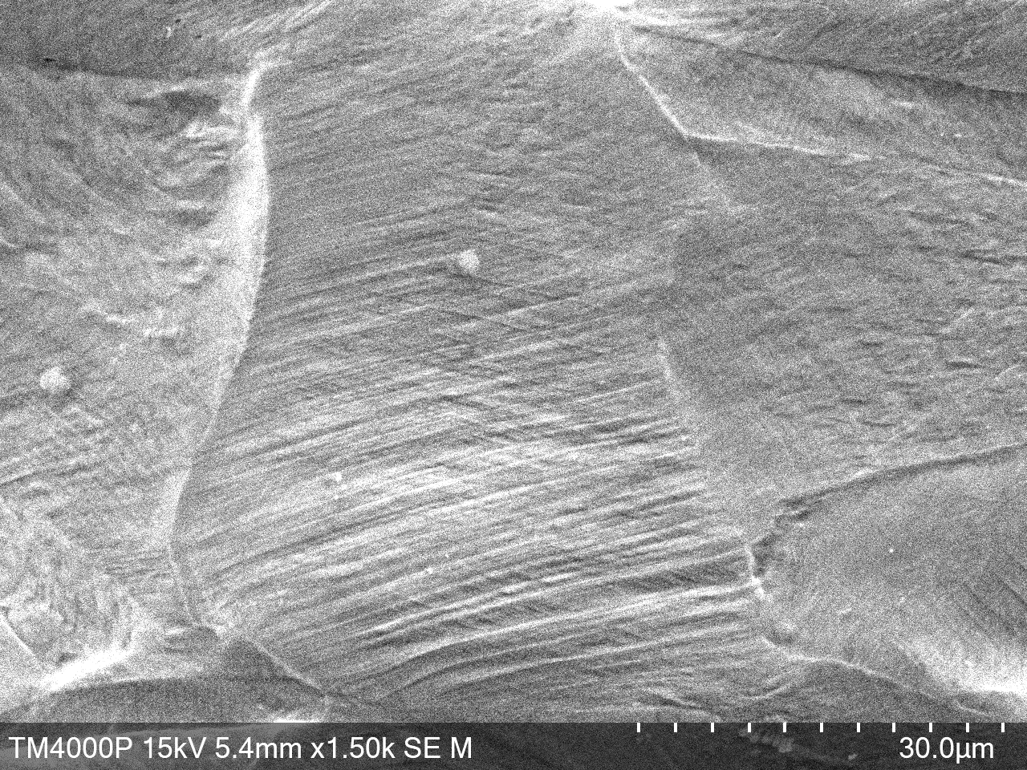
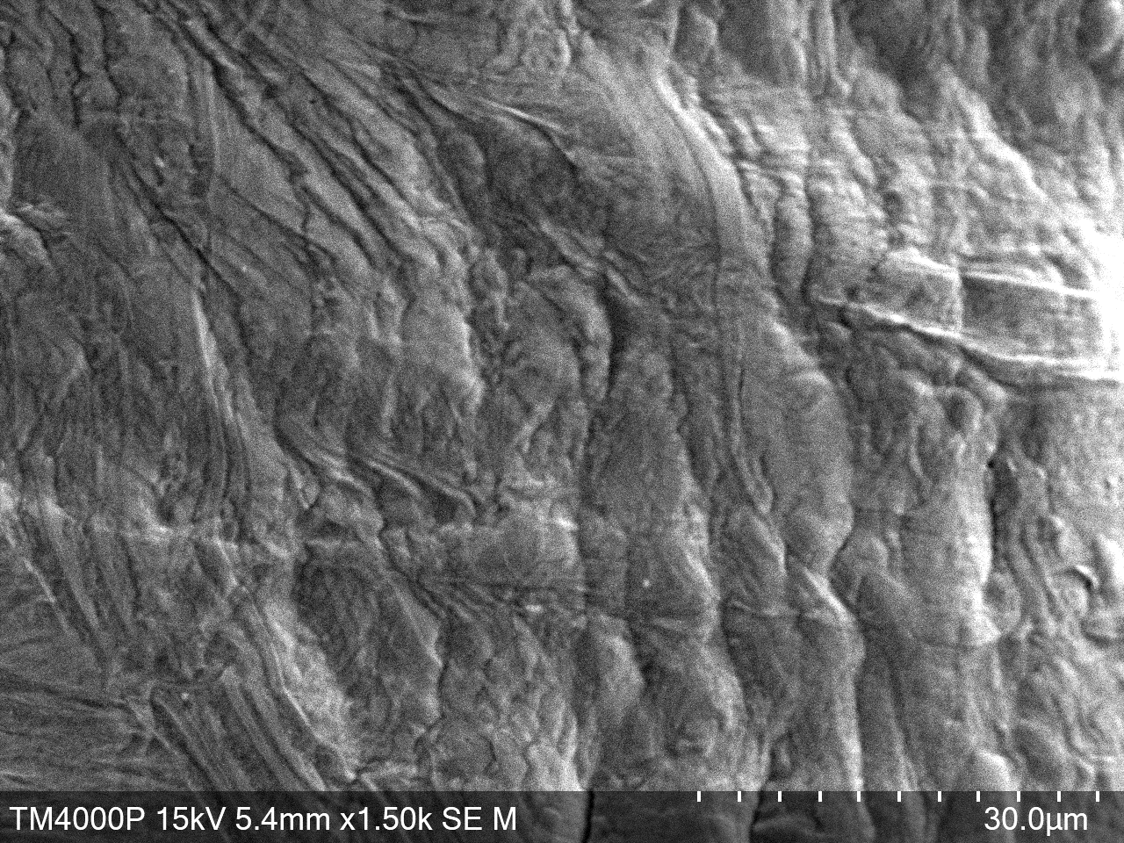
12
Microstructure of unirradiated steels after mechanical testing
Steels AISI 304
3
2
1
0
3: 4 мм
2: 3 мм
1: 1 мм
0: fracture zone
х600
Shear lanes
Larger deformation lanes near the fracture zone
Х1,5k

Slide 13
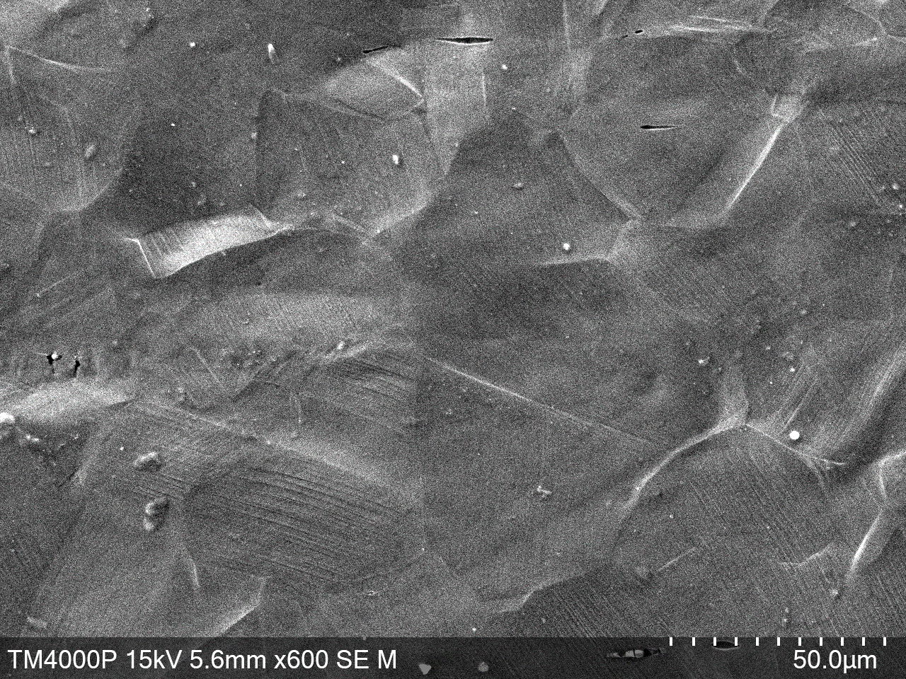
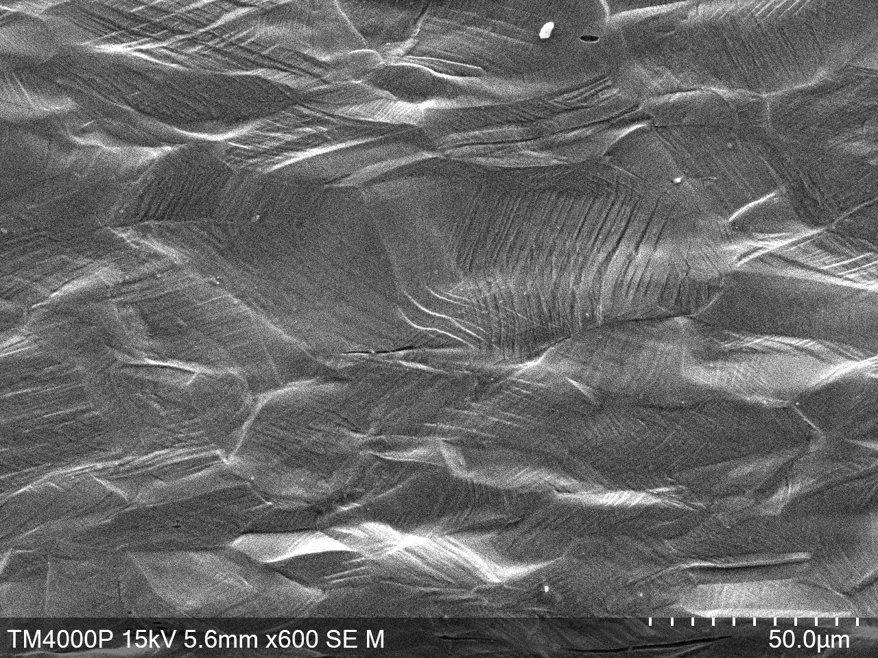
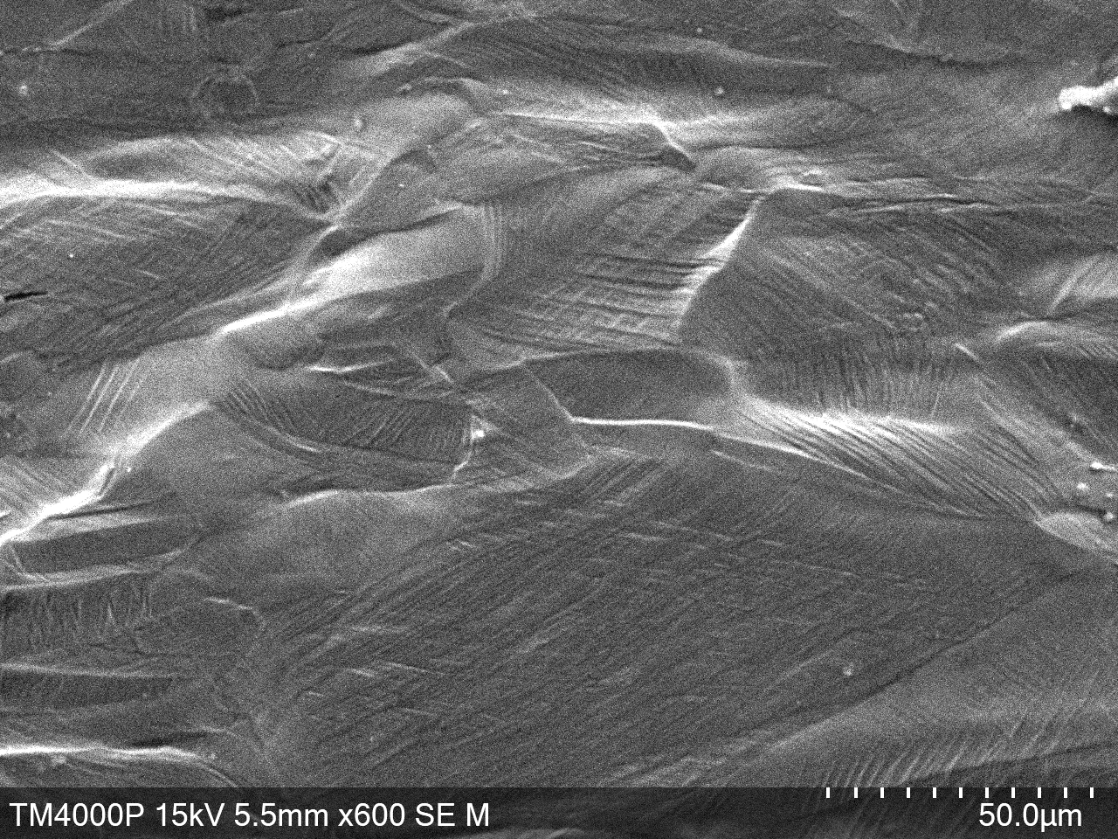
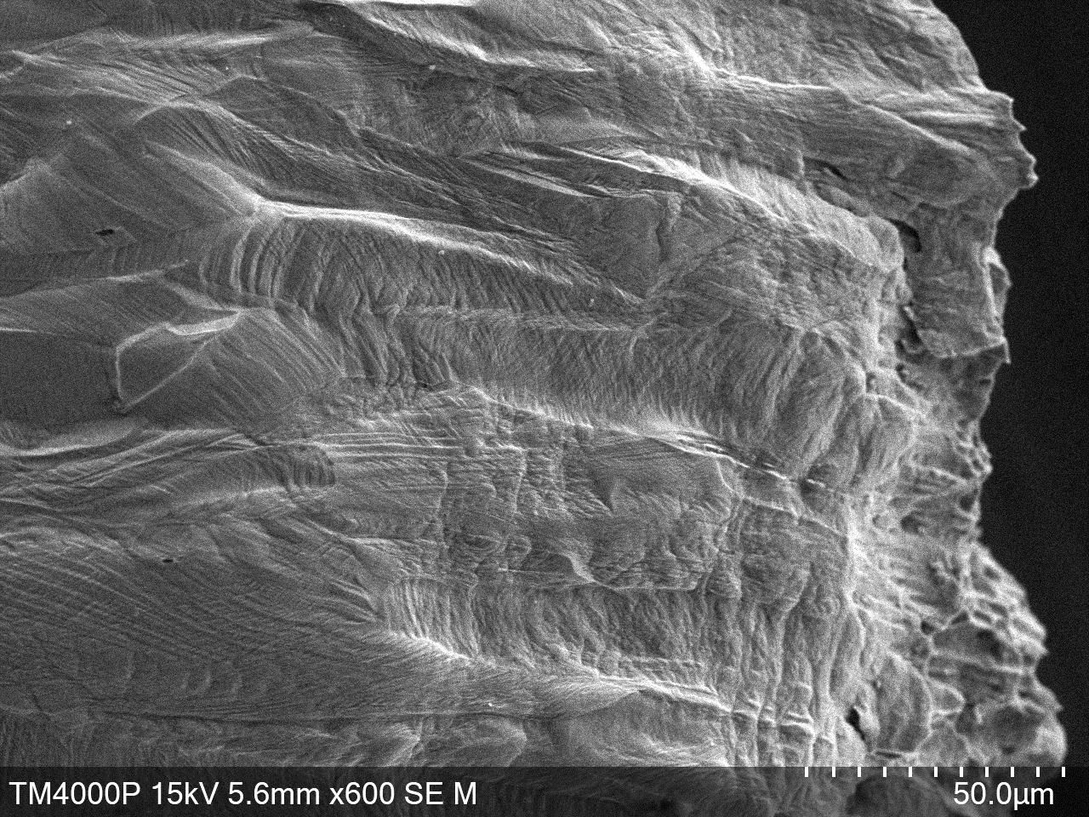
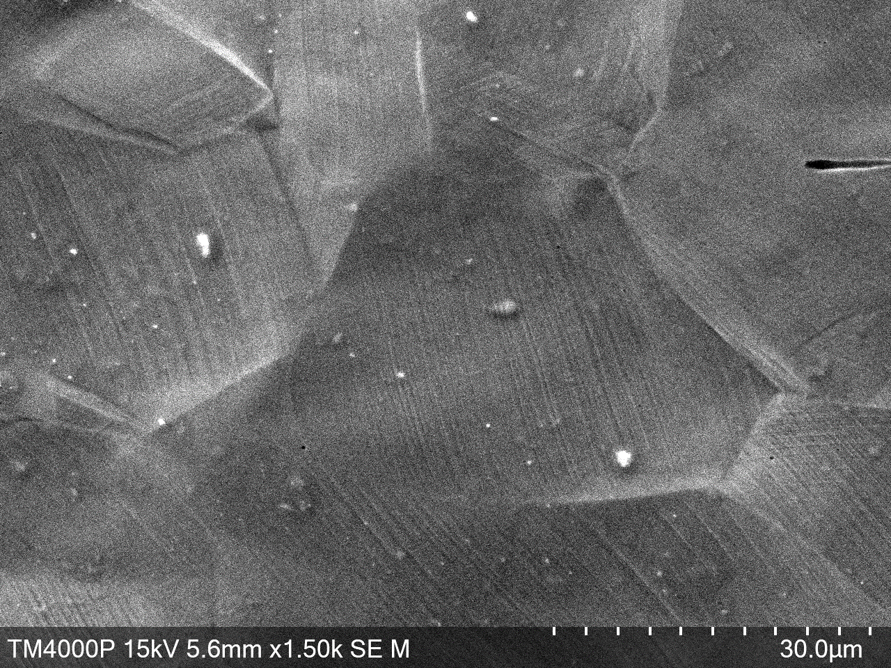
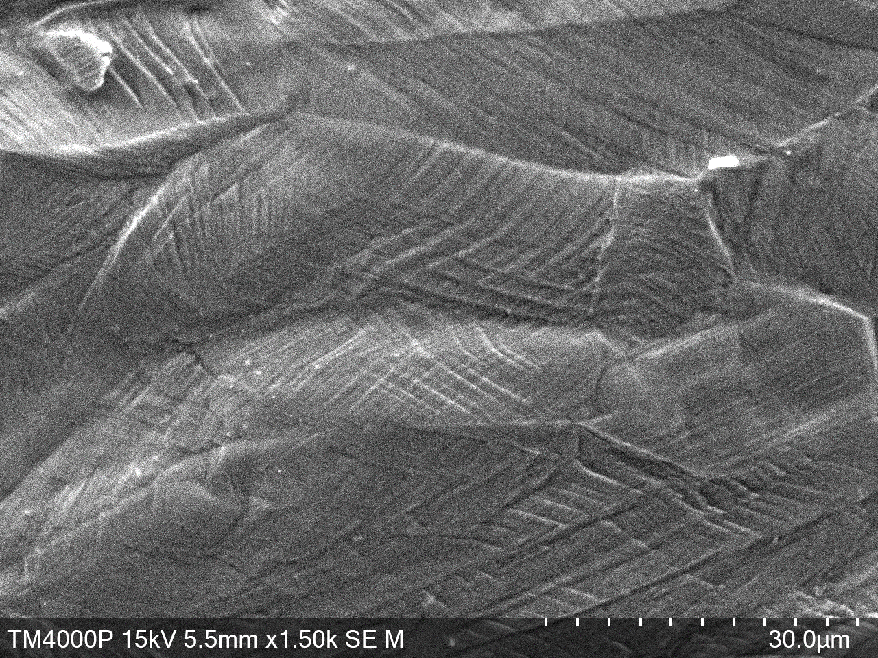
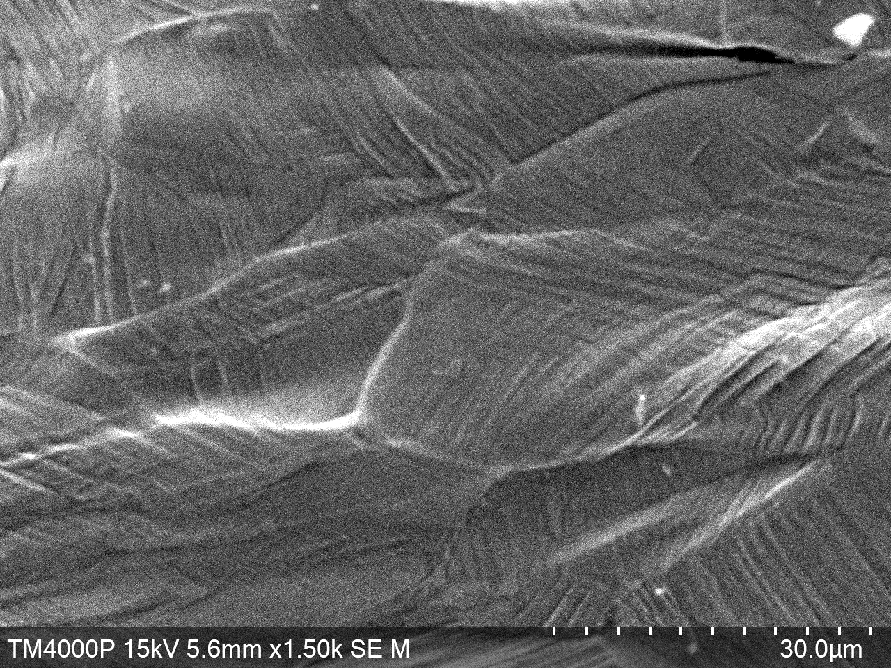
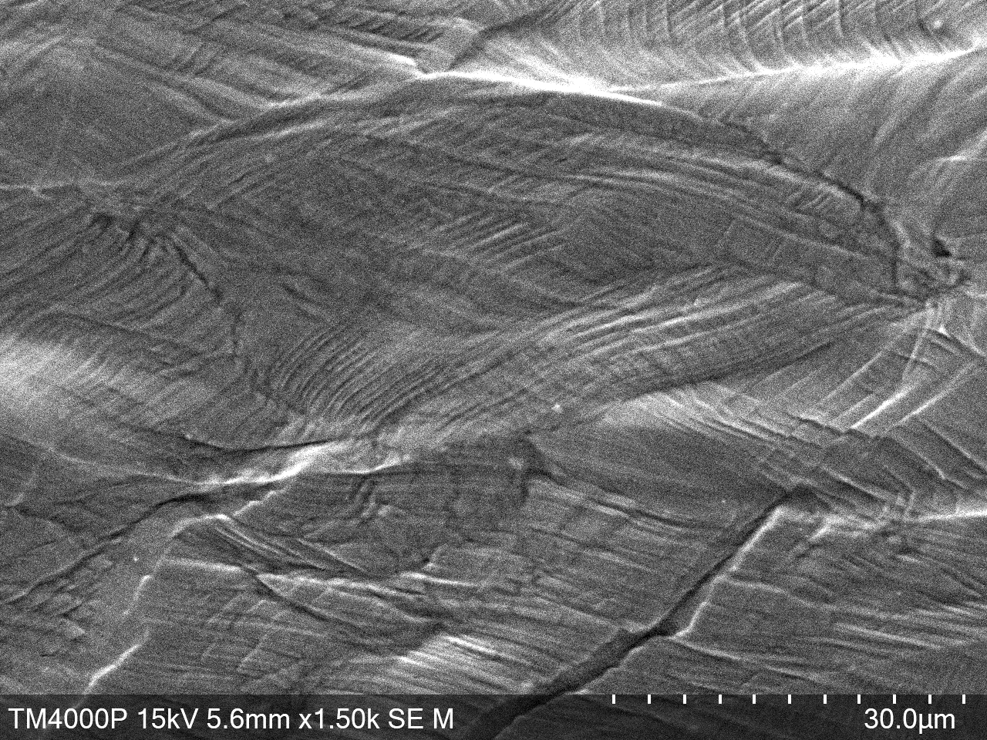
13
Microstructure of unirradiated steels after mechanical testing
Сталь AISI 316
3
2
1
0
3: 4 мм
2: 3 мм
1: 1 мм
0: fracture zone
х600
Shear lanes
Intergranular cracks are noticeable
Х1,5k

Slide 14
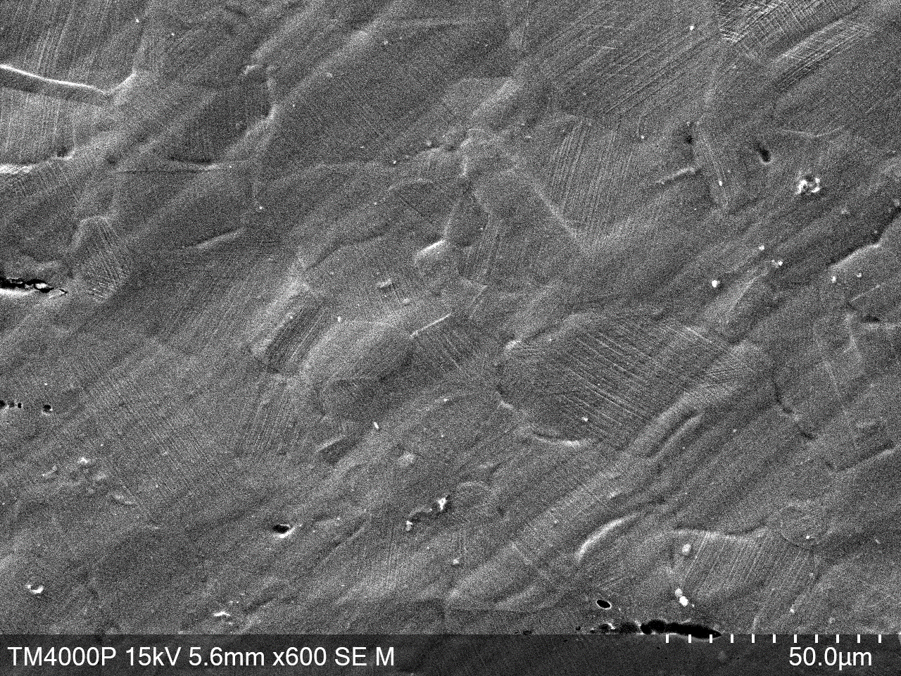
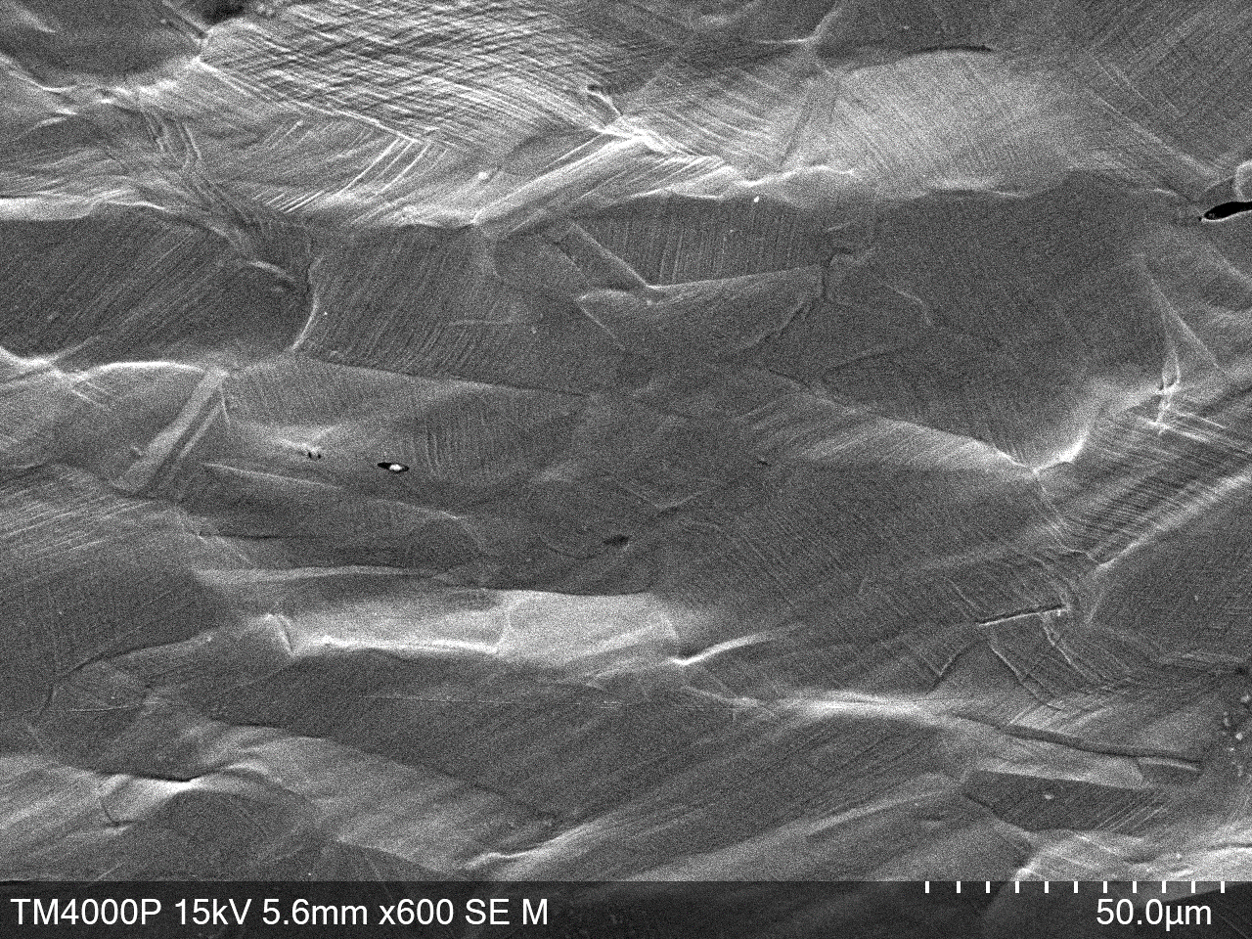
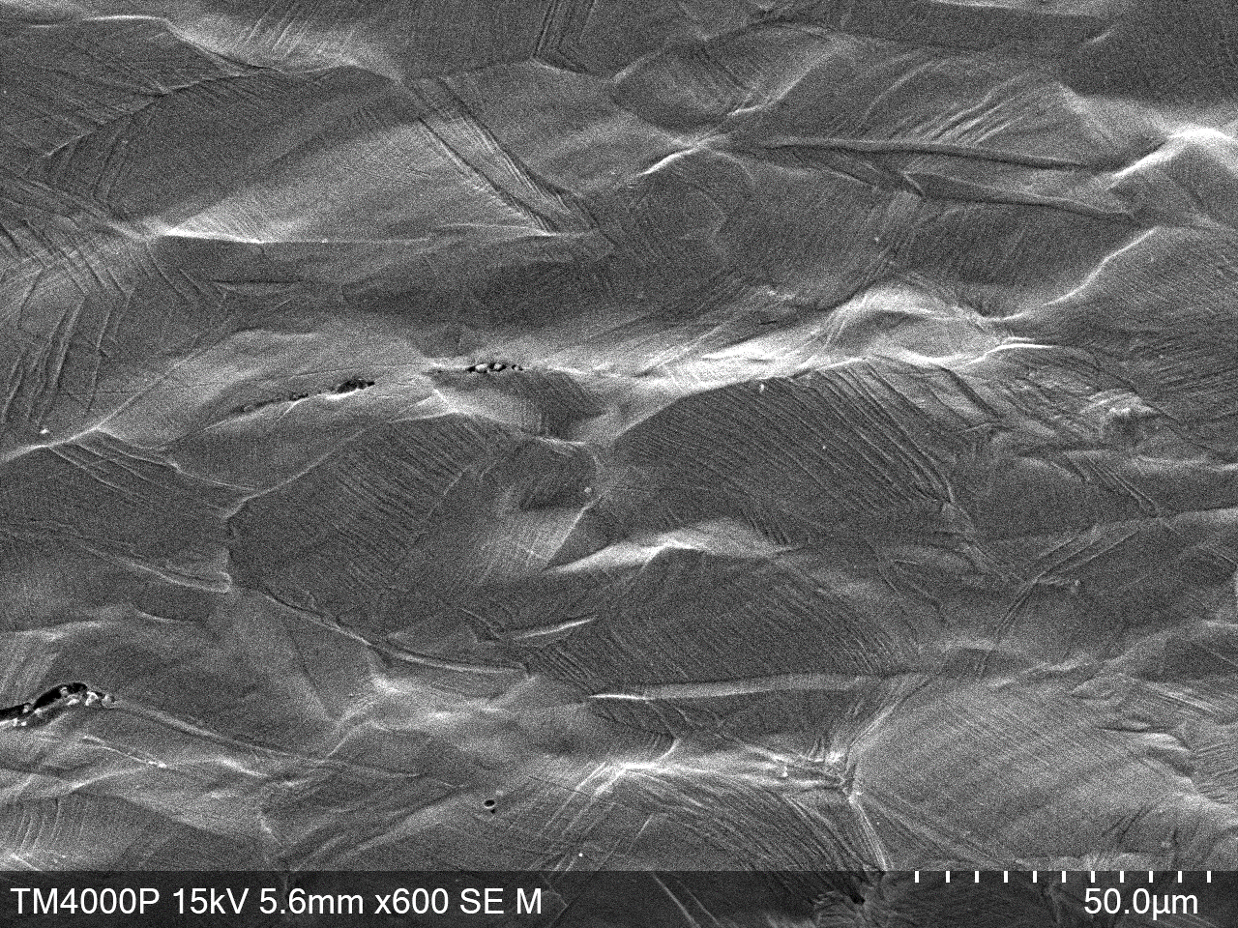
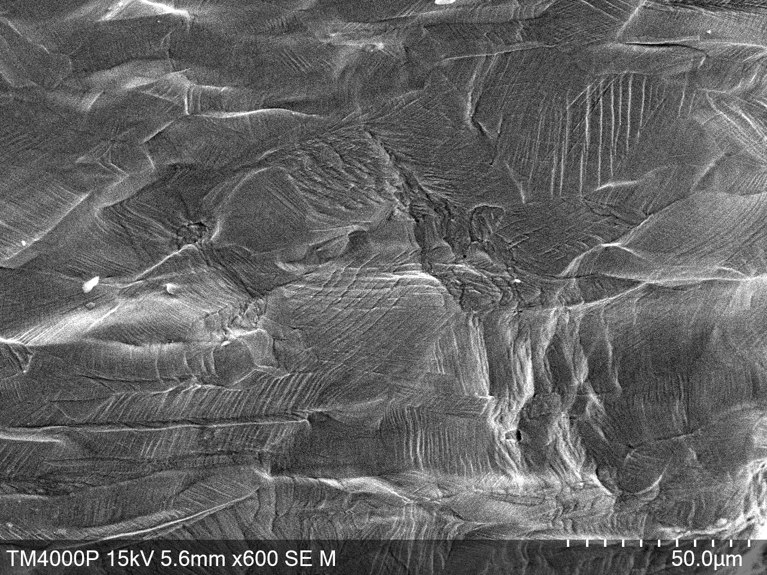
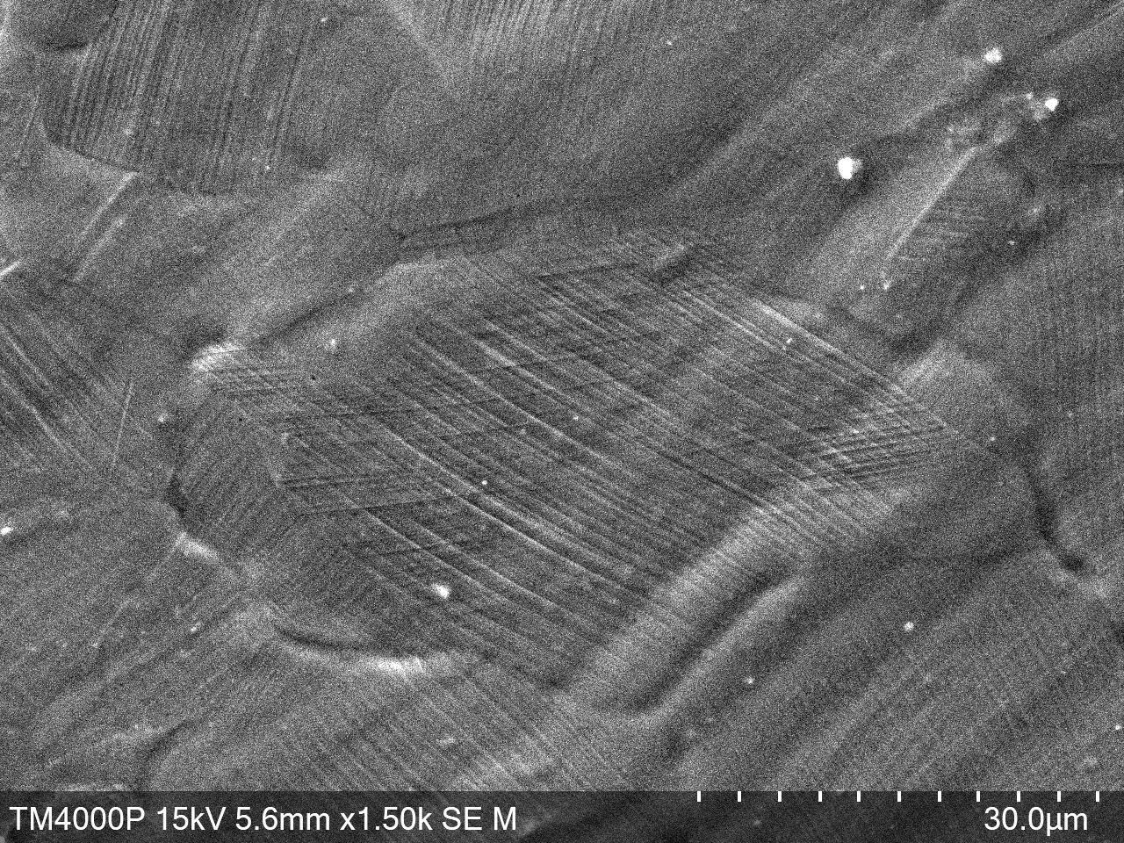
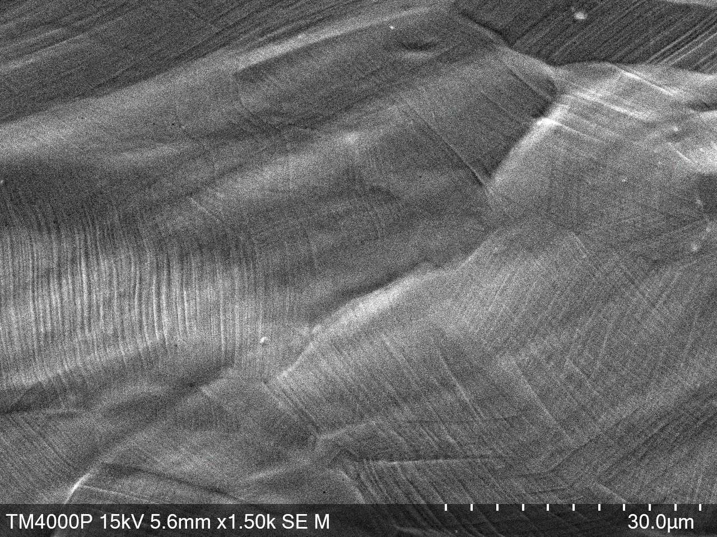
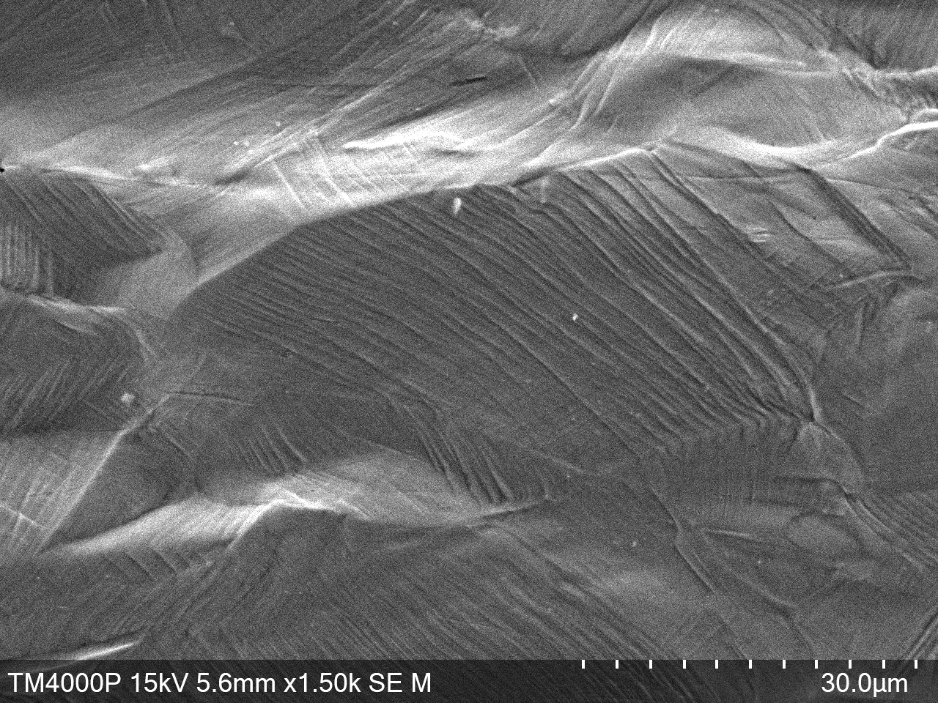
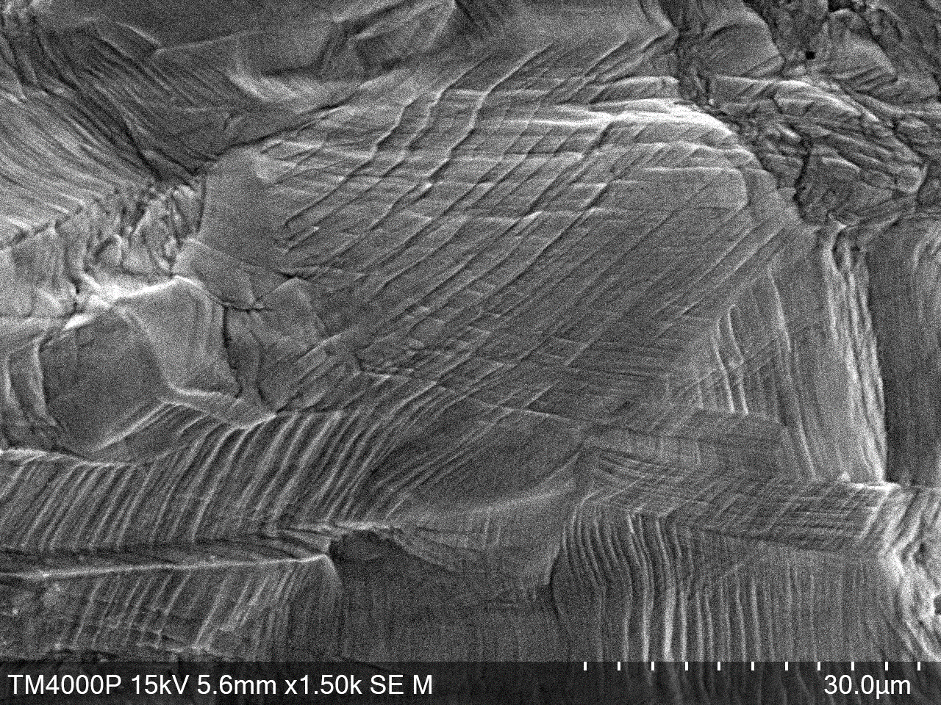
14
Microstructure of unirradiated steels after mechanical testing
Сталь 213 L
3
2
1
0
3: 4 мм
2: 3 мм
1: 1 мм
0: fracture zone
х600
The grains are showing
The deformation lanes ‘overlap’ each other
Shear lanes
Х1,5k

Slide 15
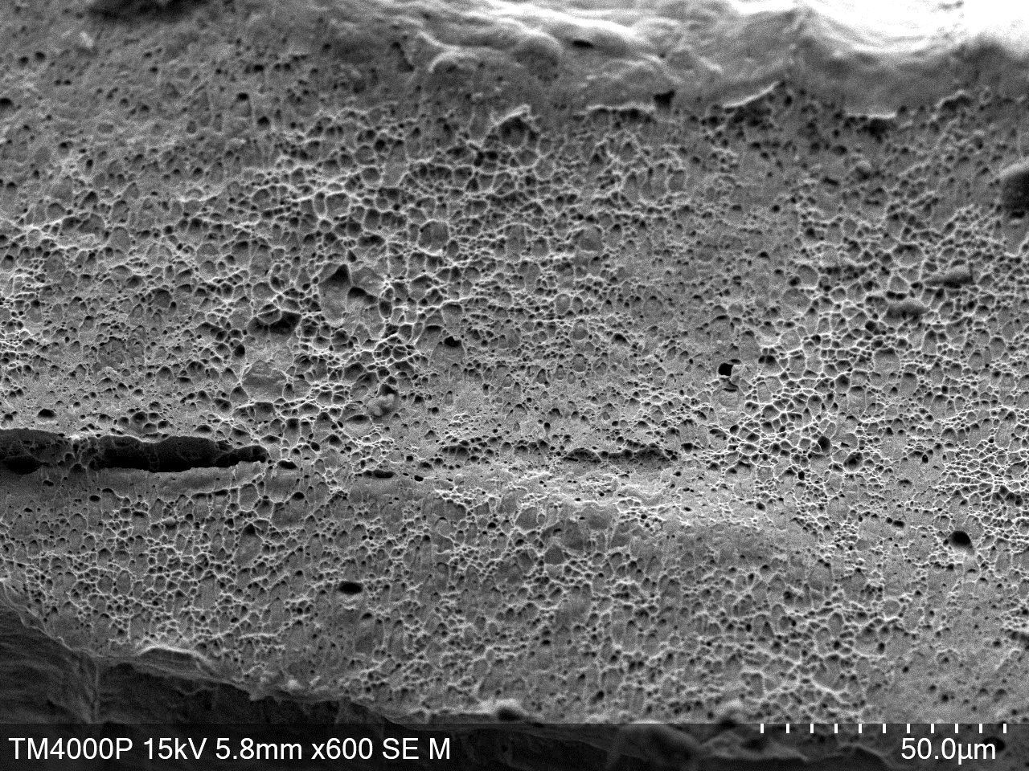
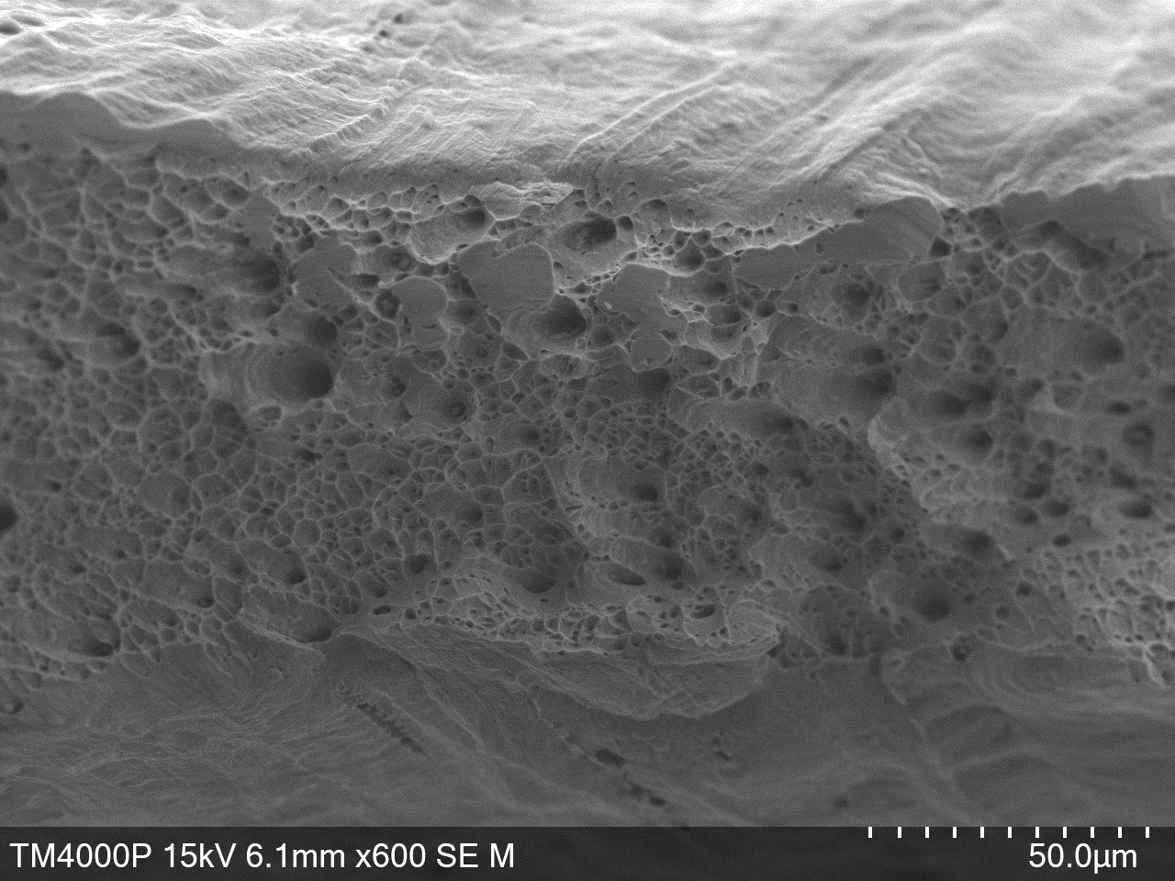
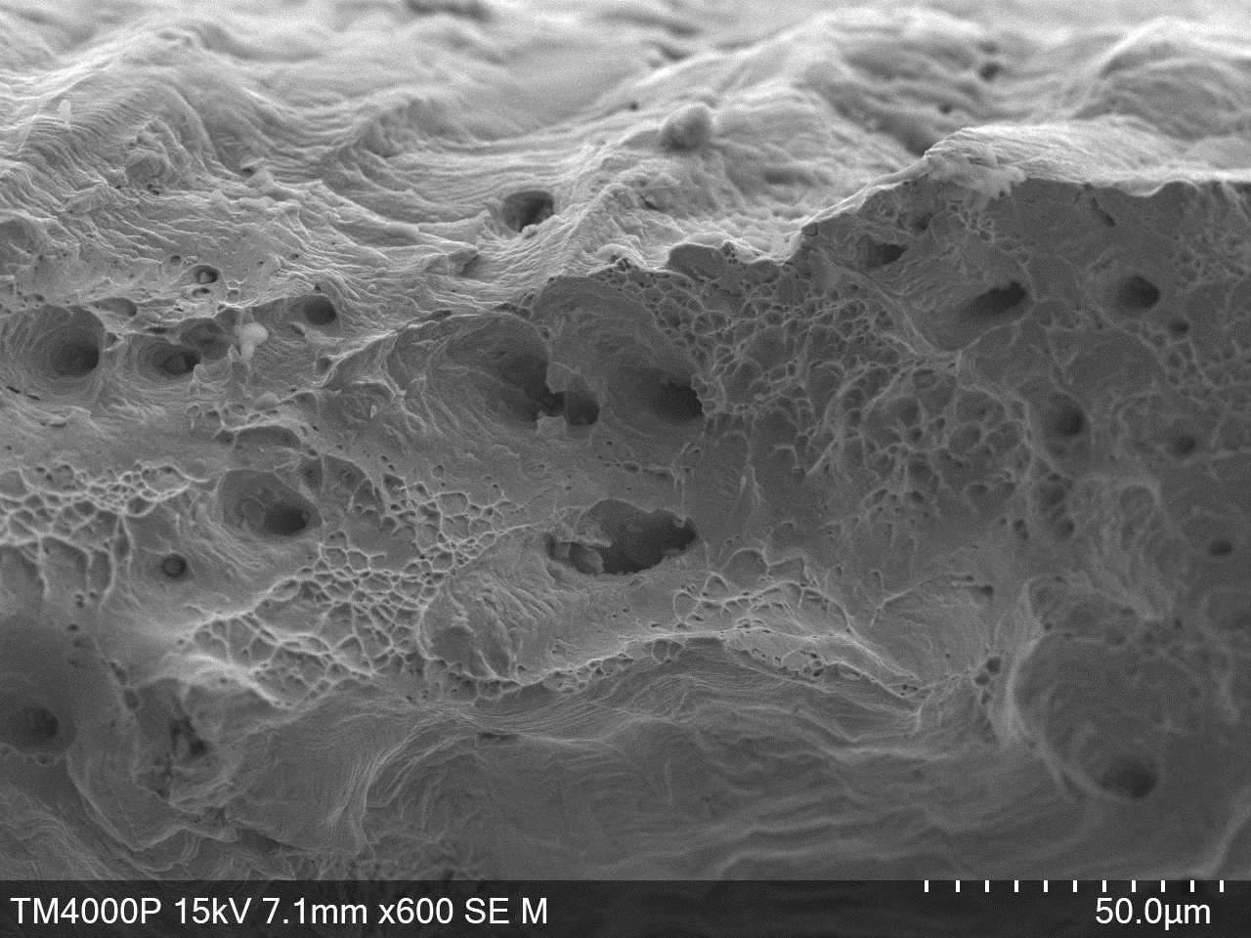
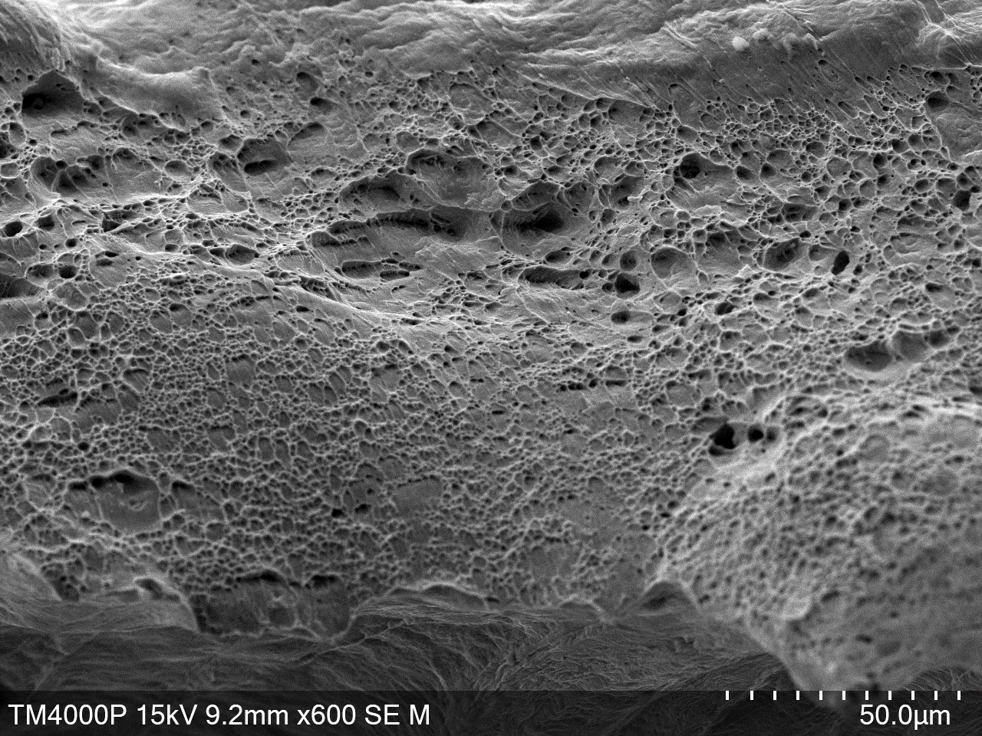
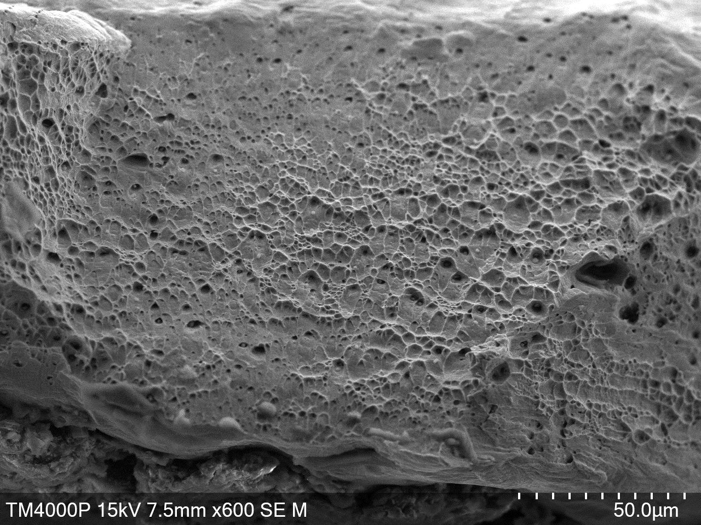
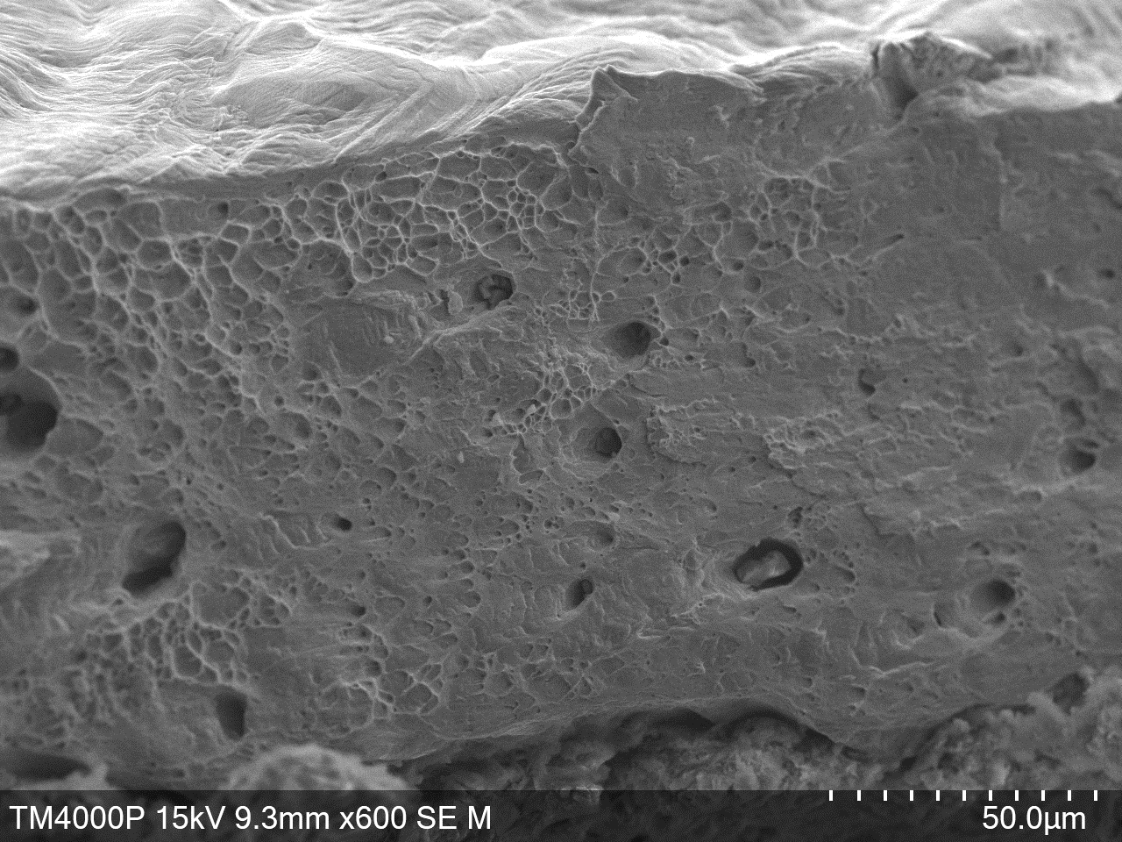
15
Fractography of the investigated steels
AISI 304
AISI 316LN
213 L
118 μm
73.5 μm
59 μm
UNIRRADIATED
103 μm
228 μm
103 μm
IRRADIATED
to 3.18e18 (n/cm²)

Slide 16
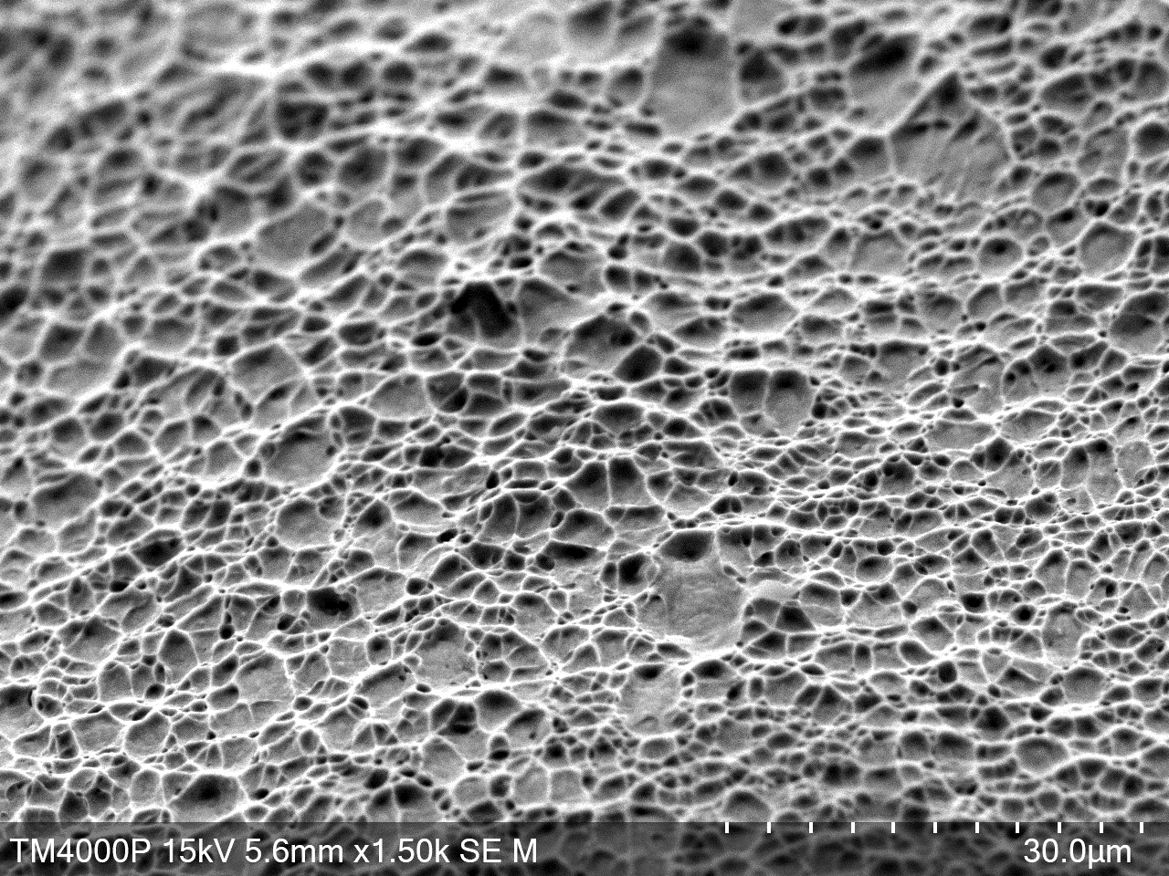
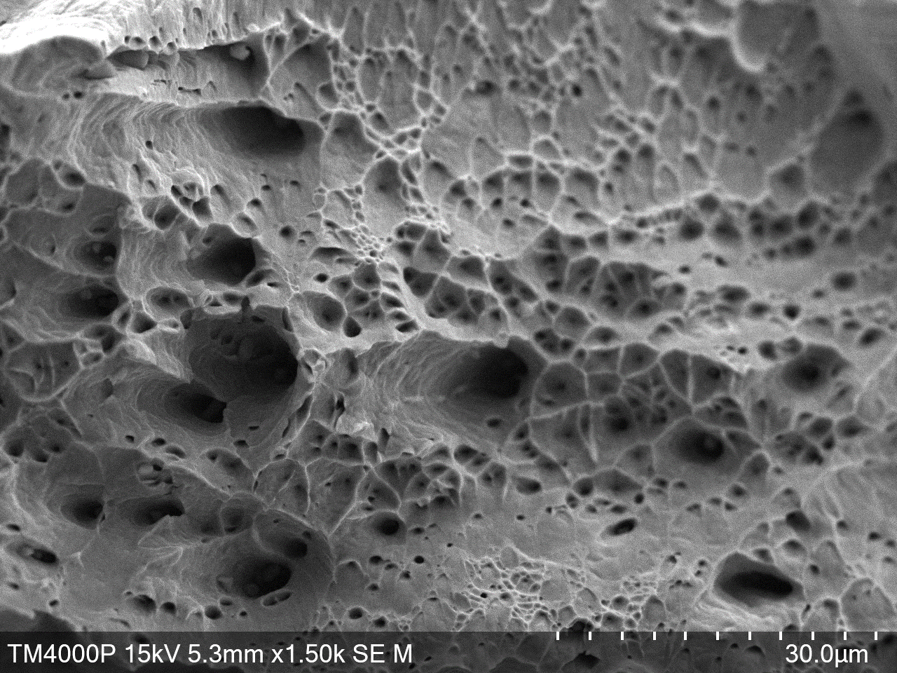
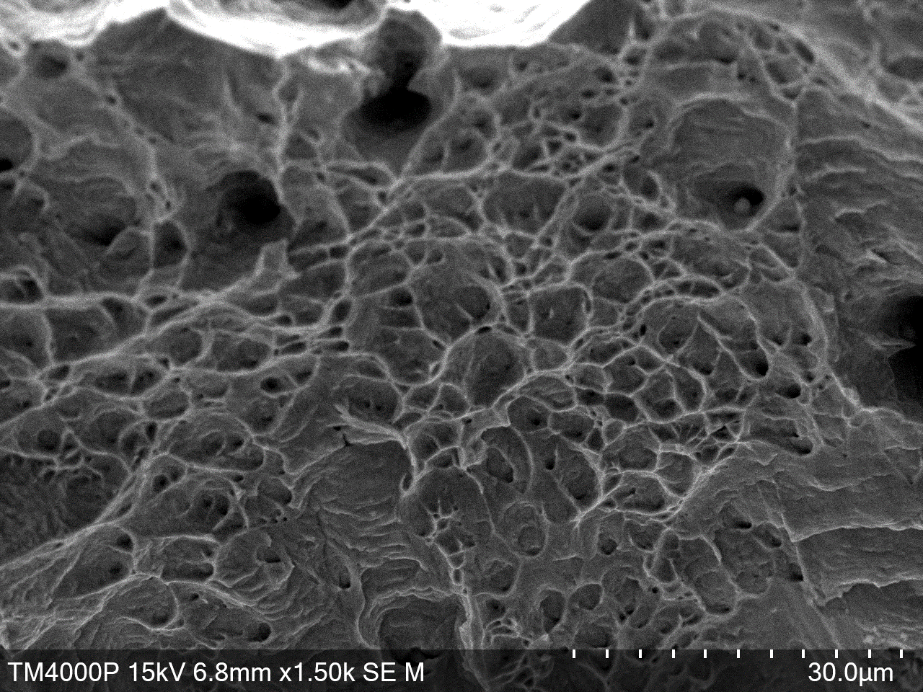
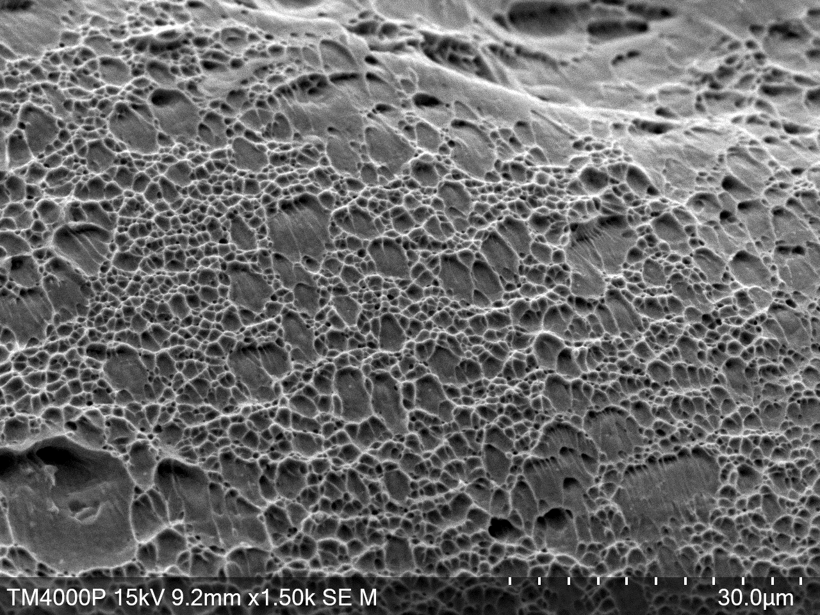
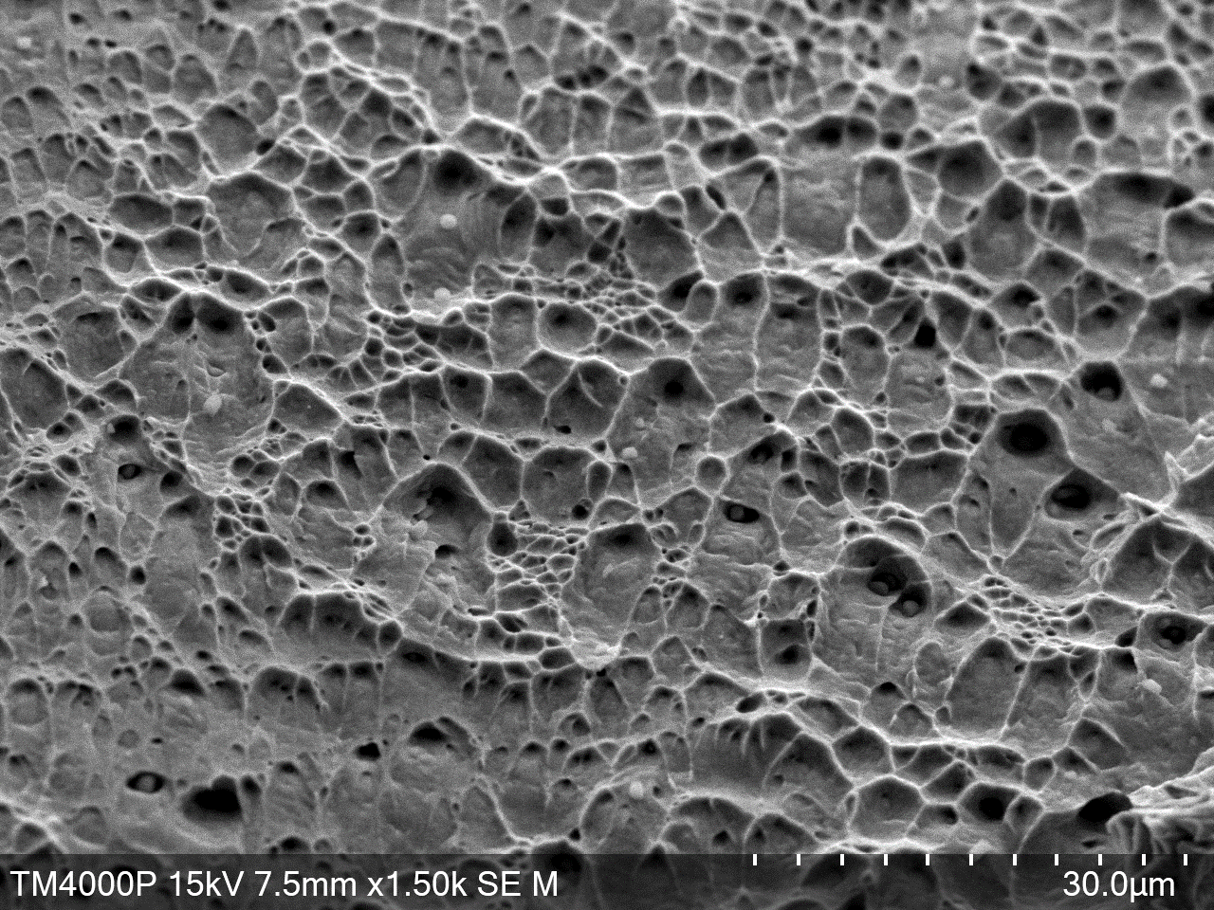
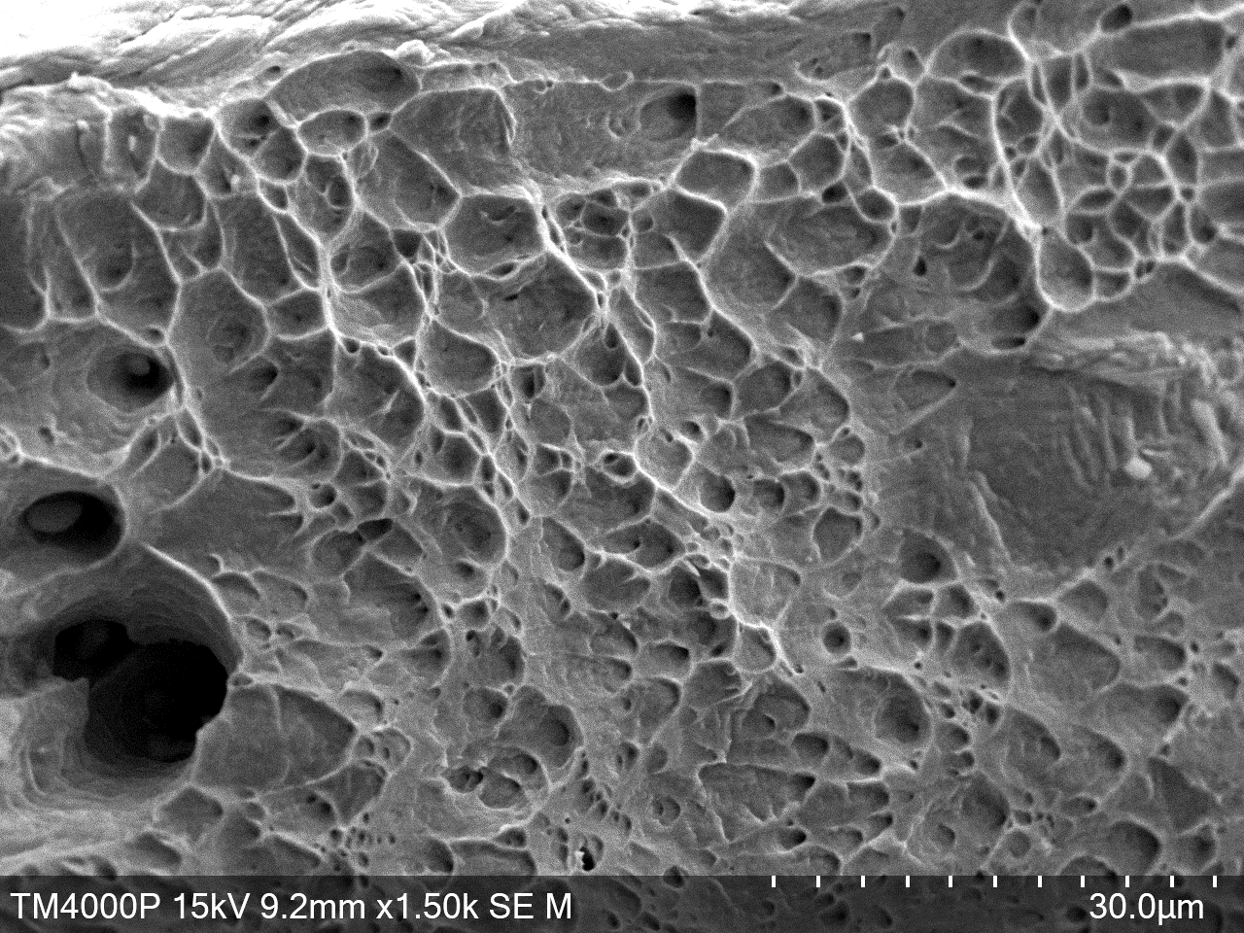
16
Fractography of the investigated steels
AISI 304
AISI 316LN
213 L
UNIRRADIATED
IRRADIATED
to 3.18e18 (n/cm²)

Slide 17
17
Conclusion
Mechanical tests of samples of stainless austenitic steels AISI 304, AISI 316LN and its modifications irradiated with neutrons in the VVR-K reactor were carried out and the effect of alloying on the strength and ductility of AISI 304 and AISI 316LN steels was analyzed. In particular, it was found that:
Nitrogen and tungsten alloying results in hardening of the steel. Steel 213 L alloyed with tungsten has the highest microhardness value and the tensile strength of this steel is comparable to that of AISI 304.
Elongation rates, both uniform and complete, decreased for all steels after neutron irradiation, except for the AISI 304 alloy;
Copper alloying affected the mechanical characteristics to a lesser extent.

Slide 18


THANK YOU FOR YOUR ATTENTION!
Do you have any questions?
Bobrusova@inp.kz

