Slide 1
Modelling the phase dynamics of long superconductor-ferromagnet-superconductor φ₀ Josephson junction
M.V. Bashashin
In collaboration with
M. Nashaat, K.V. Kulikov, I. R. Rahmonov, Yu. M. Shukrinov
The work was carried out with the financial support of Project No. 22-71-10022 of Russian Science Foundation (RSF). Yu. M. Shukrinov and M. Nashaat acknowledge the financial support from collaborative project ASRT, Egypt – JINR, Russia.
AYSS, 2024

Slide 2
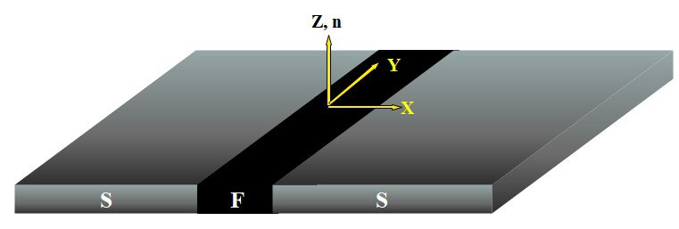
Introduction
We modified the sine-Gordon equation to describe the phase dynamics in long superconductor-ferromagnet-superconductor(SFS) φ₀ Josephson junction(LGG). In such a junction the Josephson phase and magnetic moment are coupled due to spin-orbit coupling.
This allows the manipulation of magnetic properties by Josephson current and vice versa. We investigate the effect of the spin-orbit coupling, Josephson to magnetic energy ratio, and Gilbert damping on the presence of the fluxon states. The obtained results can find applications in the field of superconducting spintronics and quantum computing.

Slide 3
Theoretical model: Current phase relation
In the dimensionless form we have:
(1)
where α is the surface loss parameter, β is the dissipation coefficient, the superscript “^{yyt}”, means ∂³/(∂_{y}∂_{y}∂_{t}), and the subscript “_{y}” means the component of magnetization in y-direction, r is the spin orbit coupling.
Using φ^{t}=V and φ^{yyt}= V^{yy}. At the boundary for φ we have:
(2)
where $J_{c}$ is Critical current density, $λ_{J}$ is Joseph. Pent. length. So at the boundary we have:
(3)
where V^{y} and φ^{y} are determined by forward finite difference, while at y=L we have:
(4)
where V^{y} and φ^{y} are determined by backward finite difference method.
In the first stage we will assume no external field.
$$αφ^{yyt}+φ^{yy}−φ^{tt}−β\left(φ^{t}−rm_{y}^{t}\right)−\sin\left(φ−rm_{y}\right)+I=0$$
$$φ^{y}|_{y=0}+ αφ^{yt}|_{y=0}={H^{ext}}/(J_{c}λ_{J})|_{y=0}$$
$$φ^{y}|_{y=L}+ αφ^{yt}|_{y=L}={H^{ext}}/(J_{c}λ_{J})|_{y=L}$$
$$V^{t}|_{y=0}=\frac{2}{\left(ΔY\right)}\left(αV^{y}+φ^{y}−H^{ext}|_{y=0}\right)$$
$$V^{t}|_{y=L}=\frac{2}{\left(ΔY\right)}\left(αV^{y}+φ^{y}−H^{ext}|_{y=L}\right)$$

Slide 4
Theoretical model: LLG equation
$$\frac{∂m}{∂t}=−\frac{Ω_{0}}{\left(1+α_{g}^{2}\right)}\left(m×H_{eff}+α_{g}\left[m×\left(m×H_{eff}\right)\right]\right)$$
(5)
Magnetic anisotropy
$E\text{: }\text{total} \text{energy}\text{.}$
V_{F}: volume of ferromagnet.
$$E_{an}=−\frac{K_{an }V_{F}}{2}{\left(\frac{M_{i}}{\left|M\right|}\right)}^{2}$$
$$i:direction of the easy axis$$
$Kan$ is Anisotropic const
M is the total magnetization
where the effective field components are:
(6) (7)
The total effective field is consisted of magnetic anistropic field and Josephson field. We assume the easy axis is in z-direction, Josephson field in y-direction.
$φ$ is the Josephson phase difference, G is Josephson energy to magnetic energy ration (G = ε_{J} /(V_{F} μM² ), r is spin-orbit coupling parameter, μ is the permeability, and $k_{an}=Kan /(μ0Ms2)$.
$\left.H_{eff}=(H_{aniso}+H_{Joseph}\right)$;
$$H_{eff}{\hat{e}}_{x}=0$$
$H_{aniso}{\hat{e}}_{i}=k_{an}m_{i}{\hat{e}}_{i}$;
$$H_{eff}{\hat{e}}_{y}=Gr sin\left(φ−rm_{y}\right)$$
$$H_{Joseph}{\hat{e}}_{y}=Gr\sin{(}φ−rmy){\hat{e}}_{i}$$
$$H_{eff}{\hat{e}}_{z}=k_{an}m_{z}$$

Slide 5
Numerical approach
For the numerical solution of the system, a uniform discrete grid is introduced along the spatial coordinate x with a step of Δx and along the time coordinate t with a step of Δt.
Five-point finite-difference formulas are used to approximate the derivatives along the spatial coordinate.
The resulting system of ordinary differential equations for the values ​​of phase differences and voltages at the nodes of the discrete grid is solved numerically using the Gauss-Legendre method.
For CVC calculation:
At each time step, the integral is calculated using Simpson method
(8)
Next, the integral is calculated based on the rectangle method
(9)

Slide 6
Parallelization
Parallelization is performed using MPI parallel programming technology.
The parallel implementation is based on the Gauss-Legendre method.
Parallelization is based on dividing the nodes of a discrete grid by the x coordinate along the length of the contact.
Initial approximations are calculated in parallel mode using the overlapping iteration method.
Parallel calculation of the coefficients of the Gauss-Legendre method, after each iteration the extreme points are exchanged between adjacent parallel processes. A custom data type is used to minimize the number of transfers.
After parallel calculation of the final coefficients, the data is sent to all processes for next iterations, also using a custom data type.
Averaging and writing of files is done in the 0-th process.

Slide 7
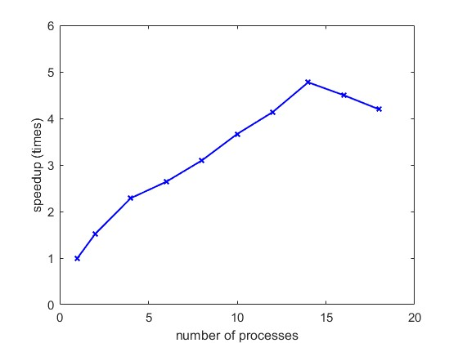
Parallelization: Speedup
The calculations were performed at: L=20, β=0.05, α=0.05, α_{g}=0, G=0.3, r=0.5, c=0, k_{an}=0.7, Ω_{F}=0.5, coordinate step Δx=0.1, time step Δt=Δx/5 , current step ΔI= 0.0005.
The calculations were performed on the HybriLIT cluster.

Slide 8
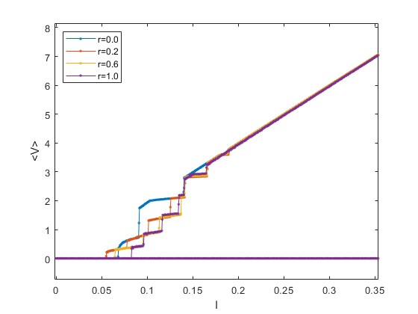
Numerical results
General view of the CVC
Enlarged area with steps
Preliminary results of the IV-curve for LJJ. Due to the coupling between Josephson phase and magnetization dynamics through the spin-orbit coupling “r”, we see that an enhanced structure of the fluxon steps is shown when r=0.2, 0.6, and 1 compared with the trivial IV for LJJ (at r=0). Currently, in collaboration with BLTP, we investigate deeply this type of junction and how ferromagnetic resonance, Gilbert damping can affect the stable solutions of sine-Gordon equation and the presence of the fluxon states.
The calculations were performed at: L=10, β=0.05, α=0.05, α_{g}=0, G=0.3, c=0, k_{an}=0.7, Ω_{F}=0.5, coordinate step Δx=0.1, time step Δt=Δx/5, current step ΔI= 0.0005.

Slide 9
Conclusions
The phase dynamics of a long SFS ϕ₀ Josephson junction described by a modified sine-Gordon equation is shown.
Parallel version of the program was developed using MPI technology.
The maximum speedup achieved was 4.77 times.
The structure of fluxon steps is shown depending on the spin-orbit coupling parameter.
Further research in this direction will continue.

Slide 10
Thanks for attention

