Slide 1
28th International Conference of Young Scientists and Specialists (AYSS-2024)
Comparison of Convolutional Neural Network Architectures for Tomographic Reconstruction from Incomplete Data
Bulat Bakirov^{1,2}
¹Frank Laboratory of Neutron Physics, Joint Institute for Nuclear Research
²Institute of Archaeology, Russian Academy of Sciences

Slide 2
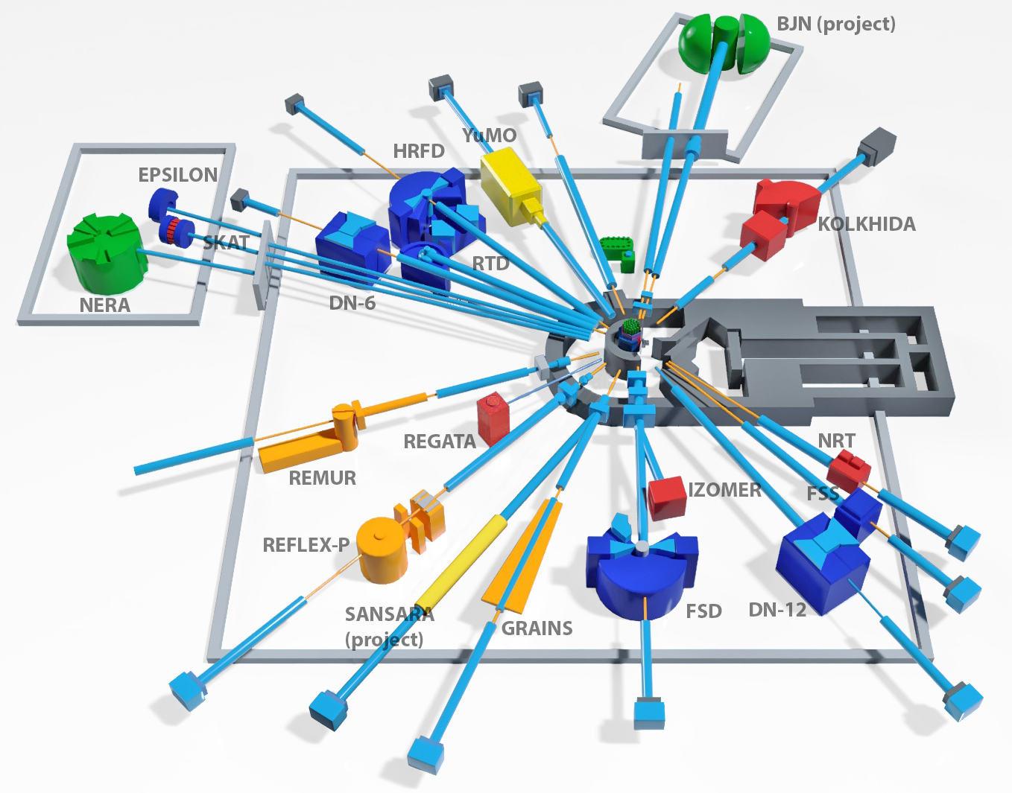
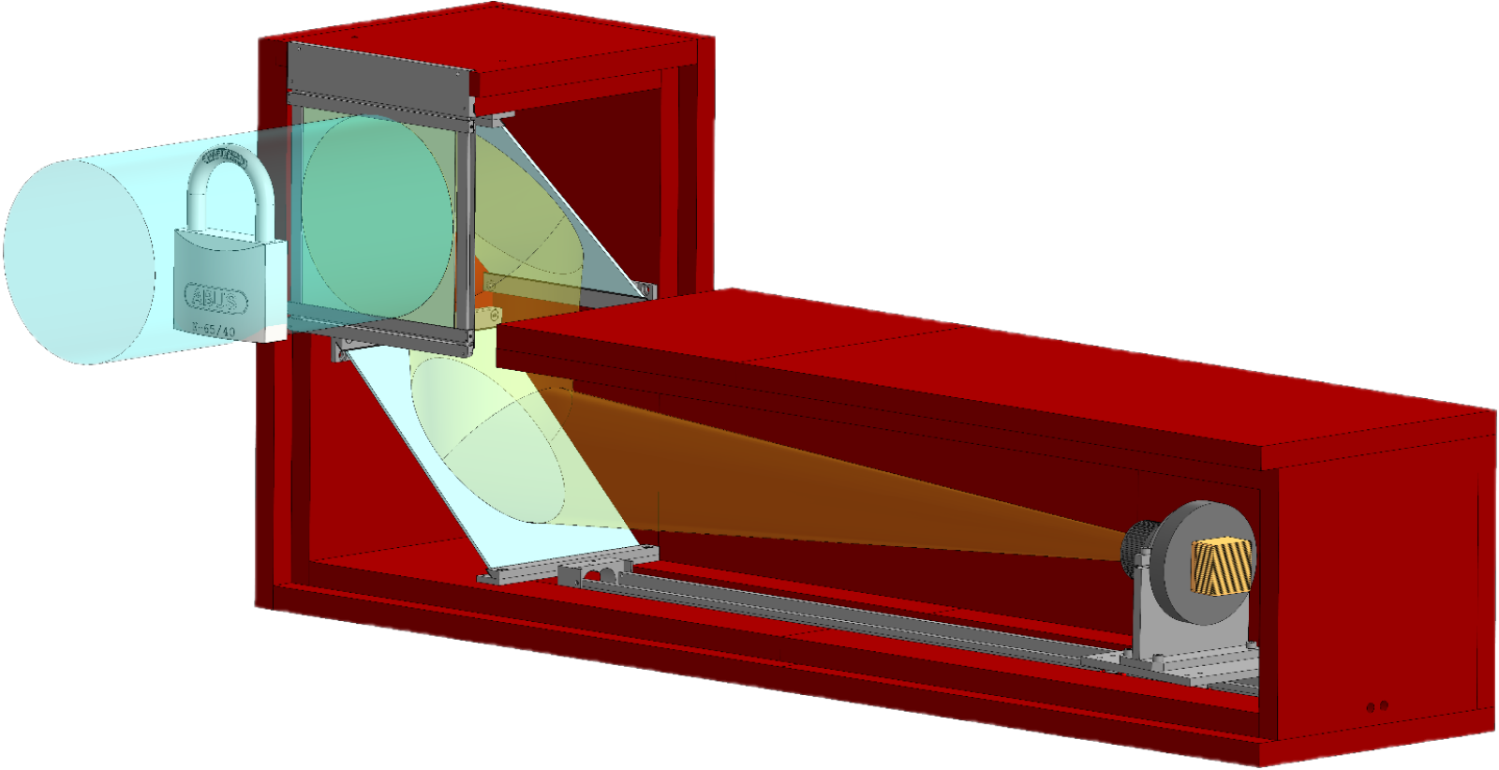
Neutron tomography at the IBR-2 reactor
14th beamline
Experimental hall of the IBR-2 reactor
Neutron radiography and tomography (NRT) experimental station
2

Slide 3
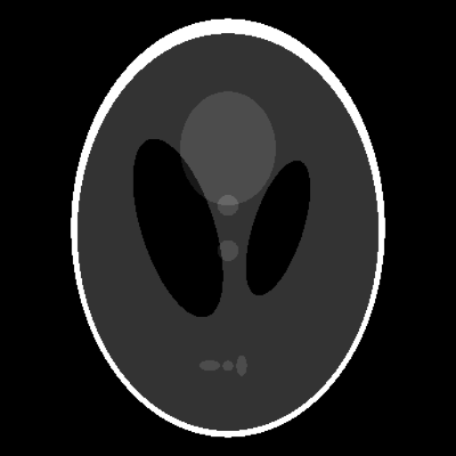
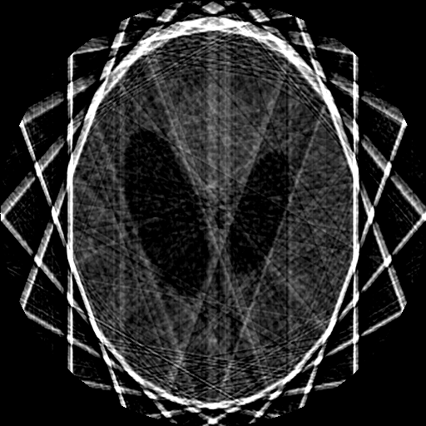
The required number of projections for reconstruction
Shepp-Logan phantom reconstructed from:
Shepp-Logan phantom – a standard test image
9 projections
72 projections
360 projections
The number of radiographic projections satisfying the Nyquist–Shannon theorem
3

Slide 4
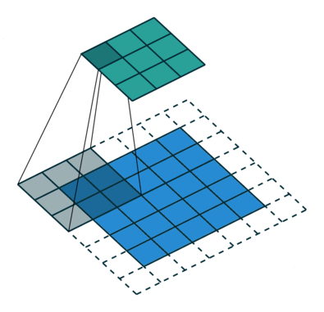
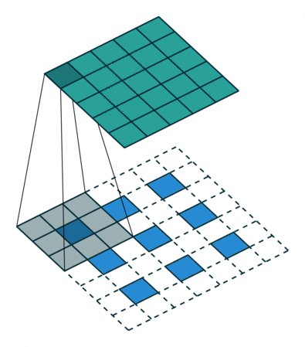
Implementation of the convolutional neural network
Building blocks of the convolution neural network.
Input
Output
Convolution
Normalization
+
Activation
Skip Connection
Visualization of convolution and deconvolution layers.
Computations were held on the basis of the HybriLIT heterogeneous computing platform (LIT, JINR).
4

Slide 5
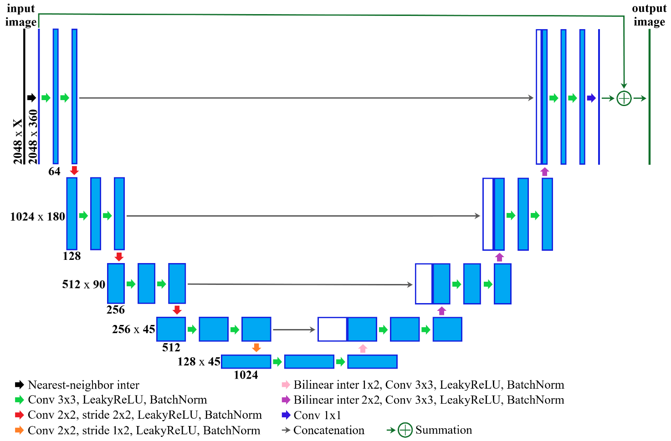
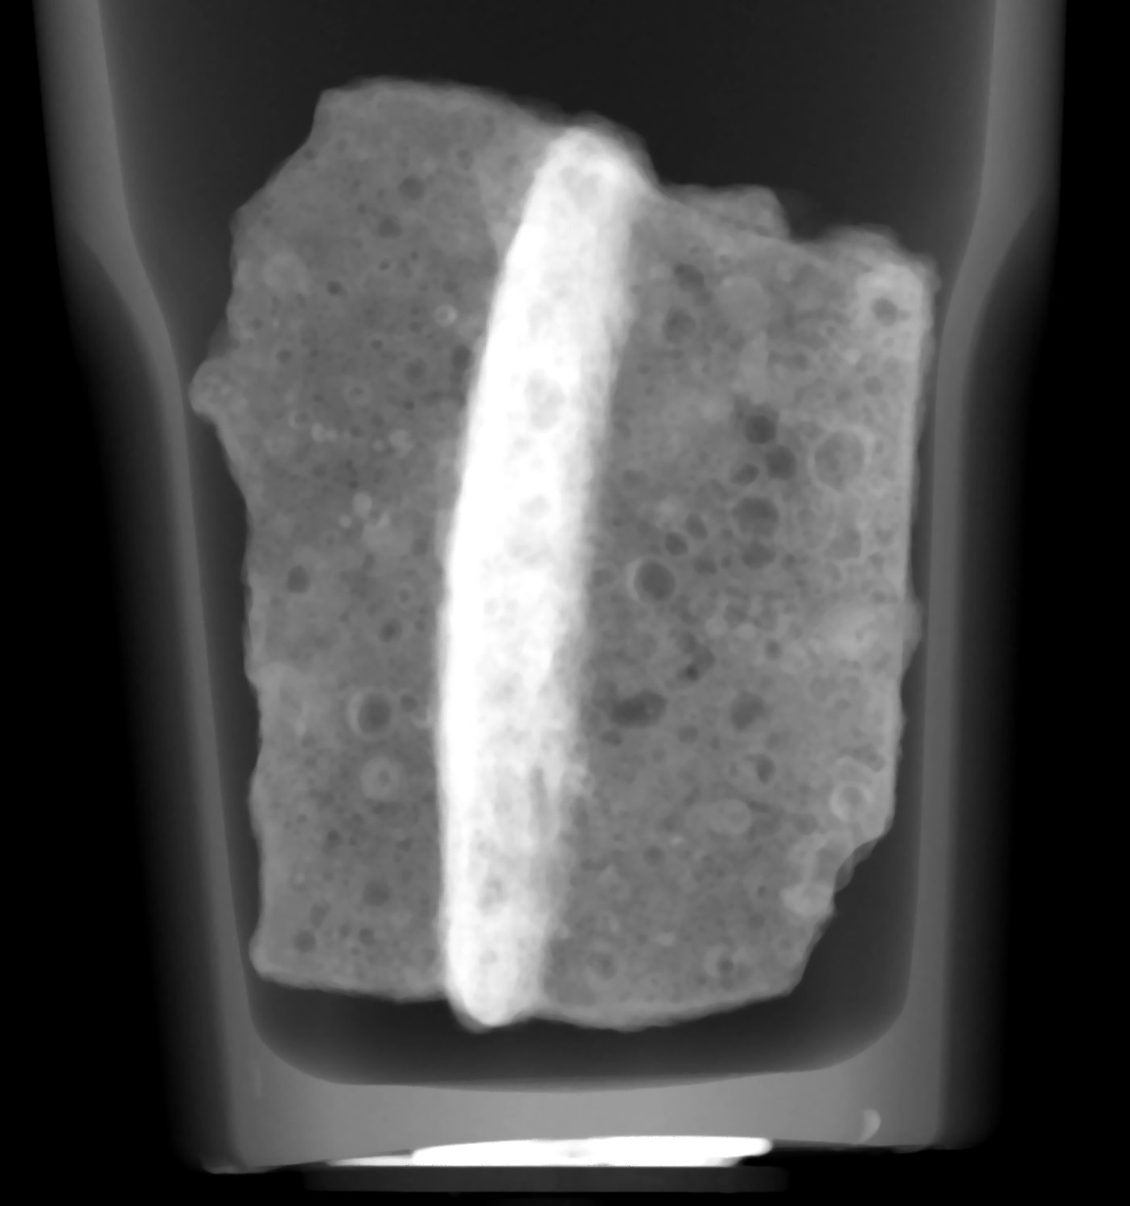
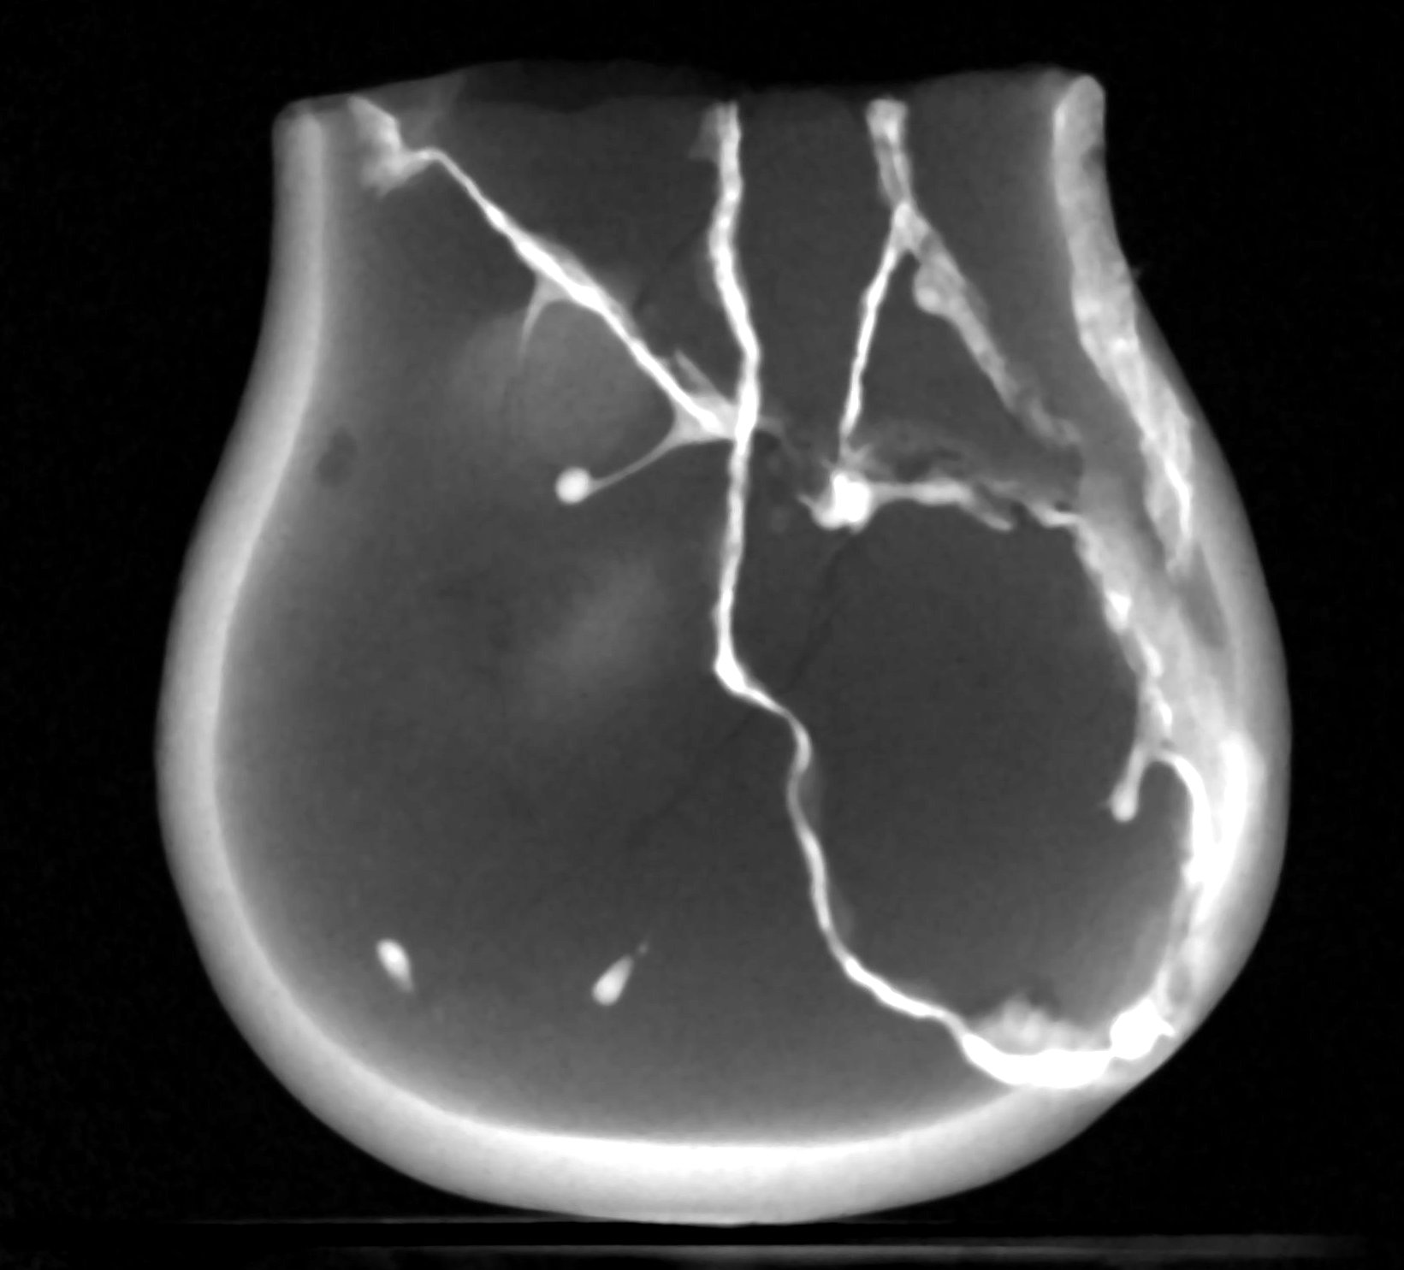
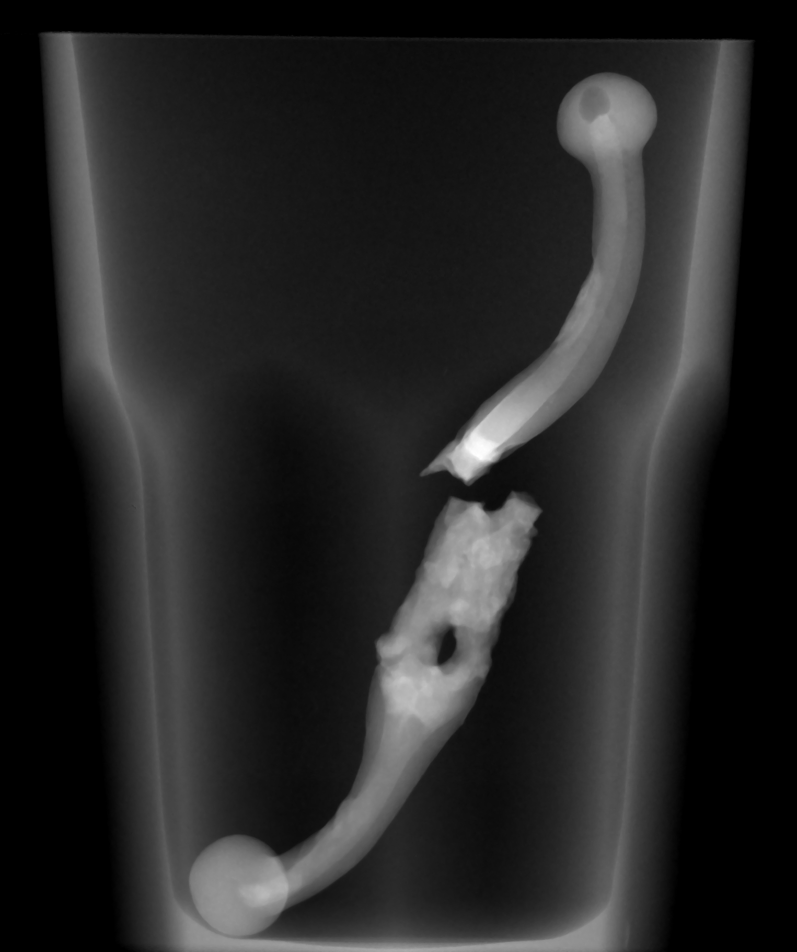
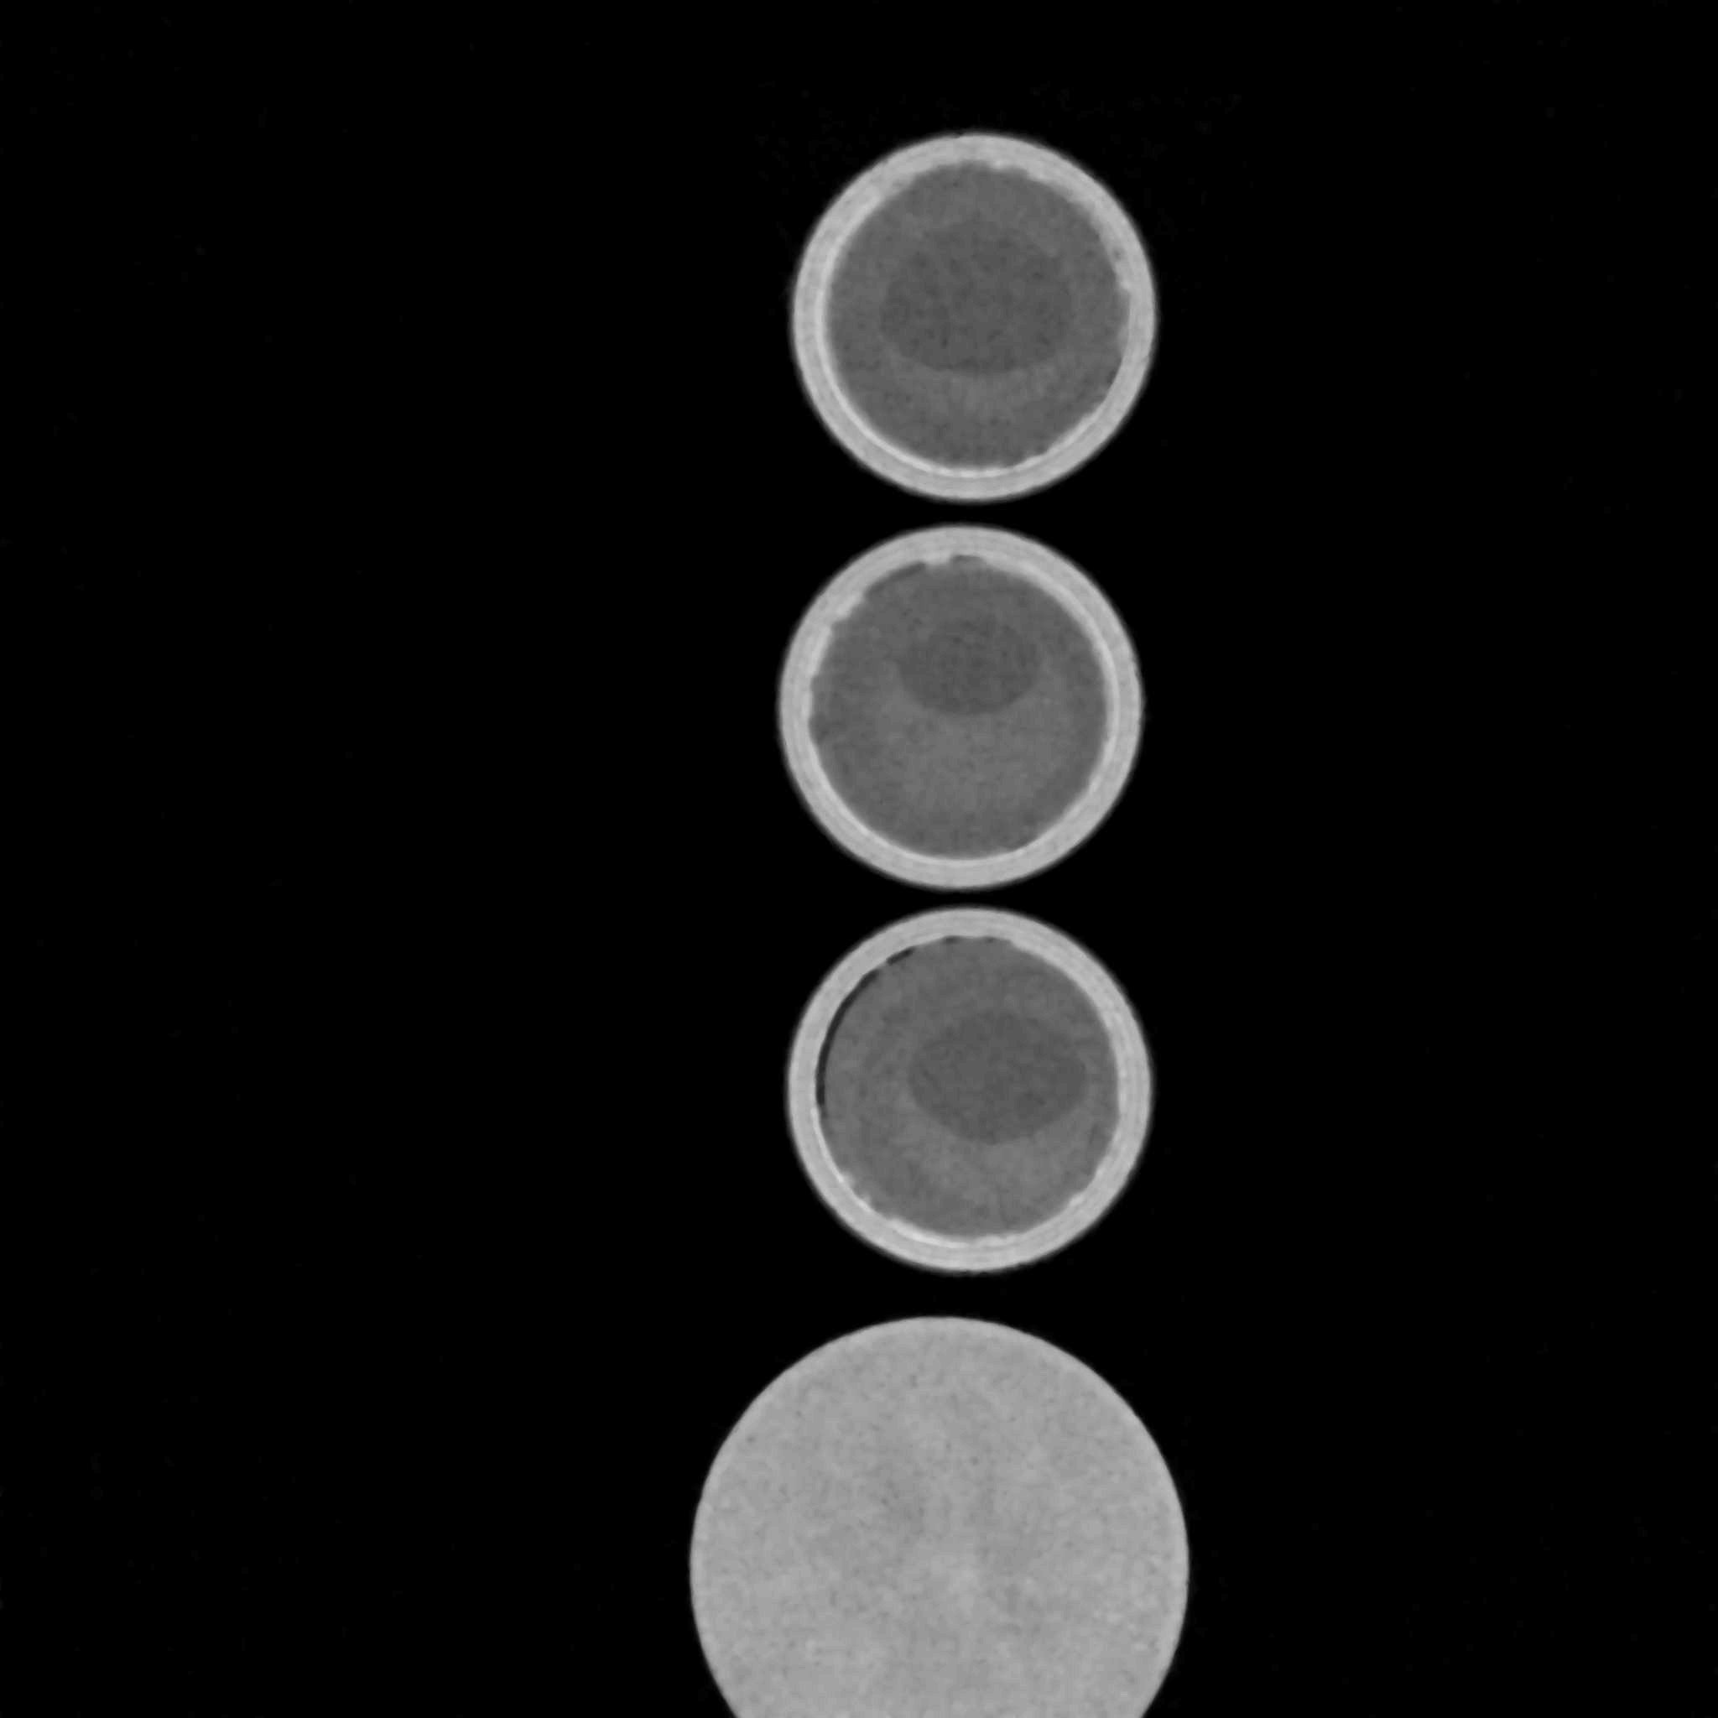
Implementation of the convolutional neural network
Training dataset
U-net
architecture
Data from 40 experiments
56000 input images
56000 target images
5

Slide 6
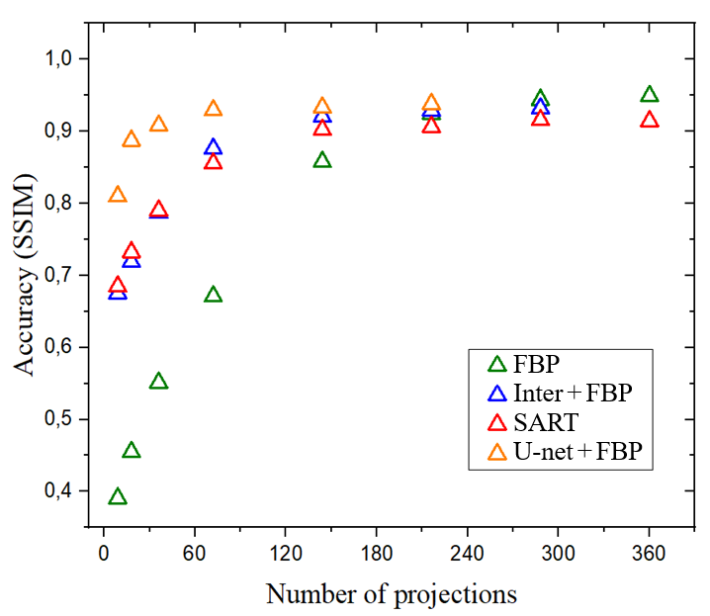
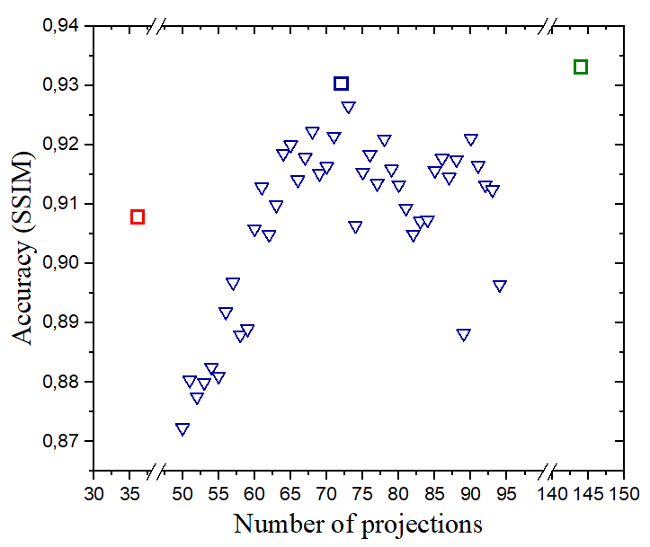
Determination of the required number of projections
– U-net trained on 36 projections
Structural similarity index measure (SSIM)
– U-net trained on 72 projections
– U-net trained on 144 projections
– unexpected number of projections is fed to the input of U-net trained on 72 projections
6

Slide 7
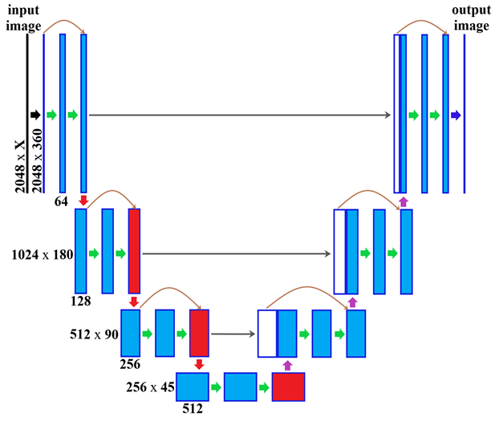
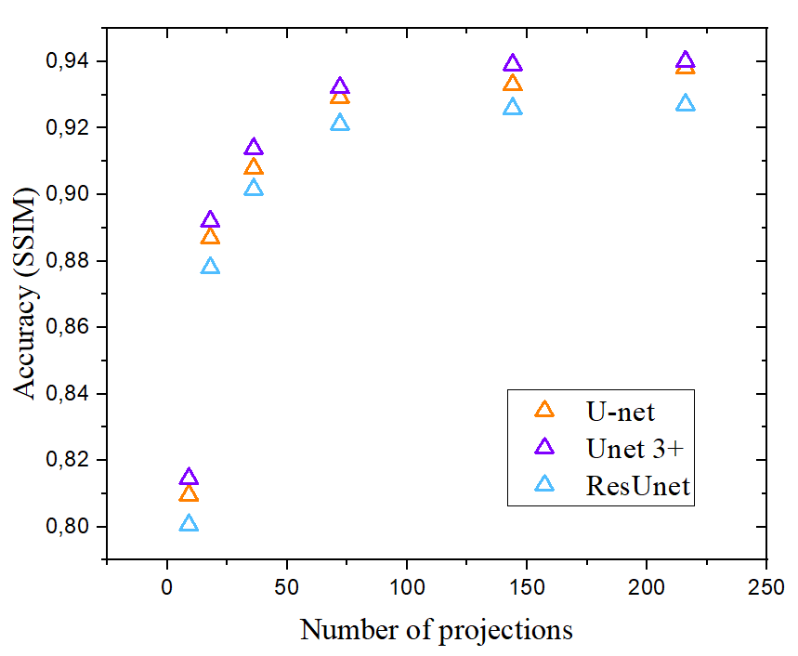
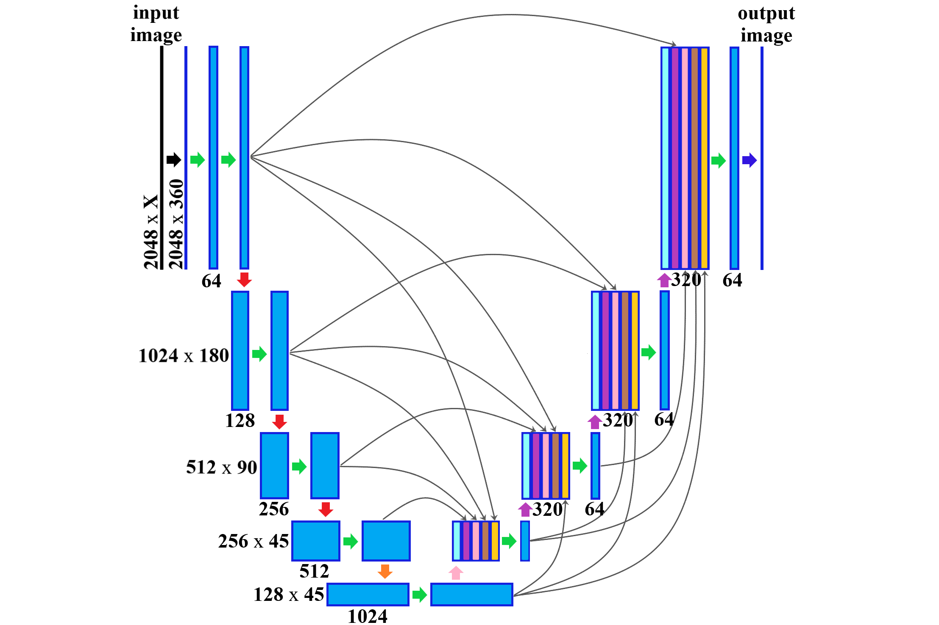
Comparison of CNN architectures
ResUnet
Unet 3+
7

Slide 8
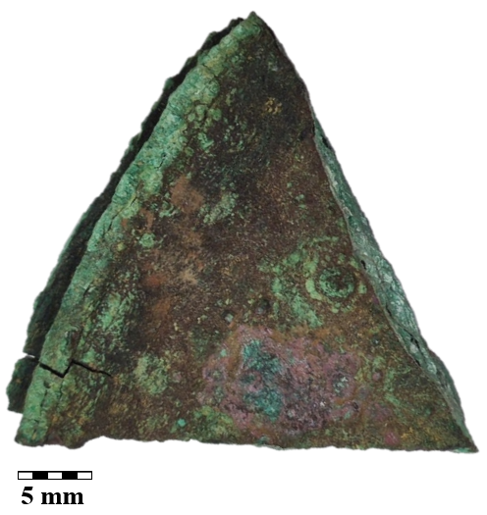
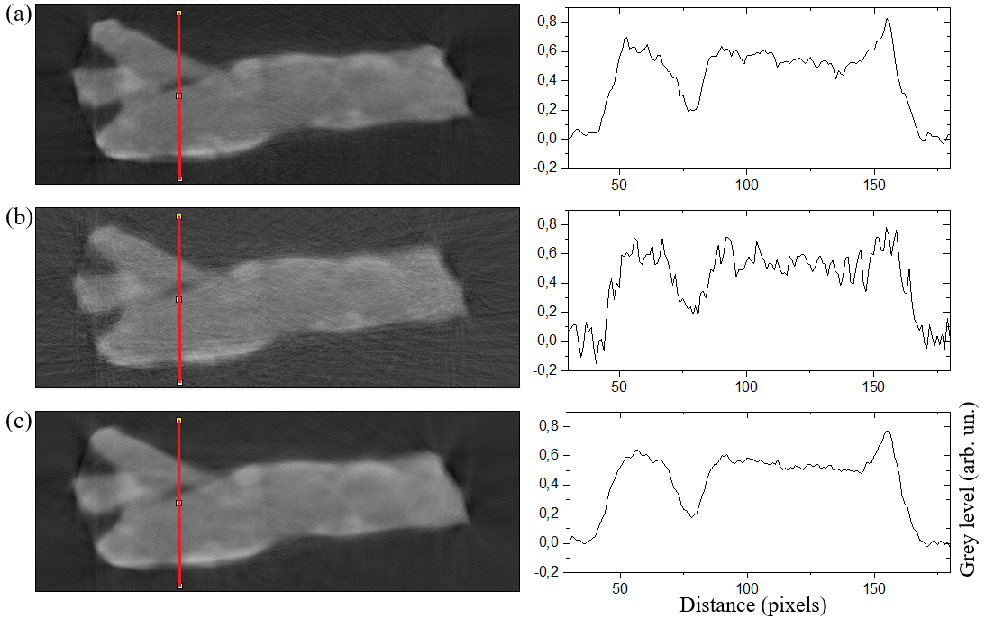
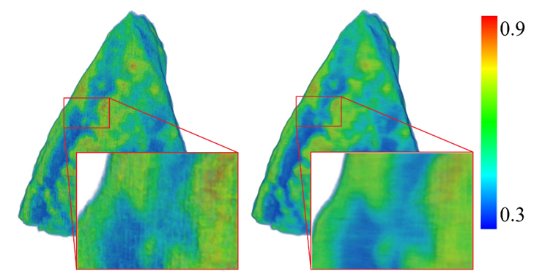
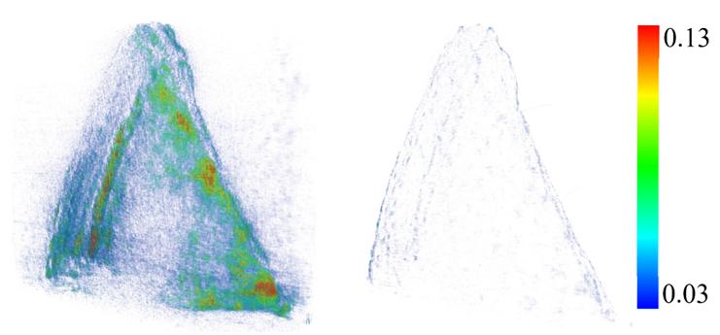
The results of training a CNN
360
projections
360
72
U-net
72
72
difference
72 + U-net
8

Slide 9
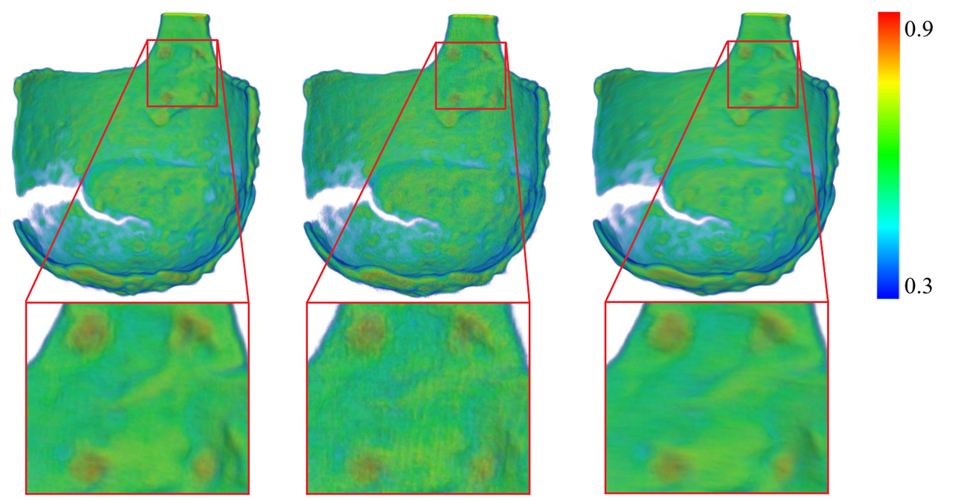
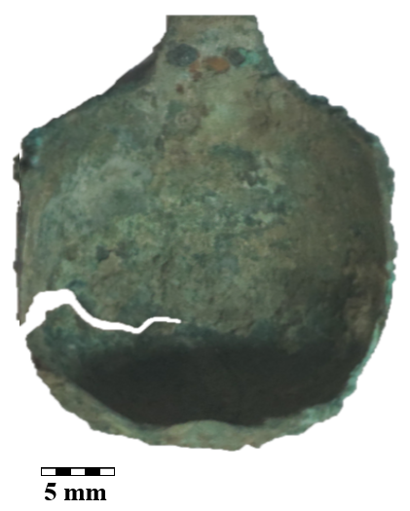
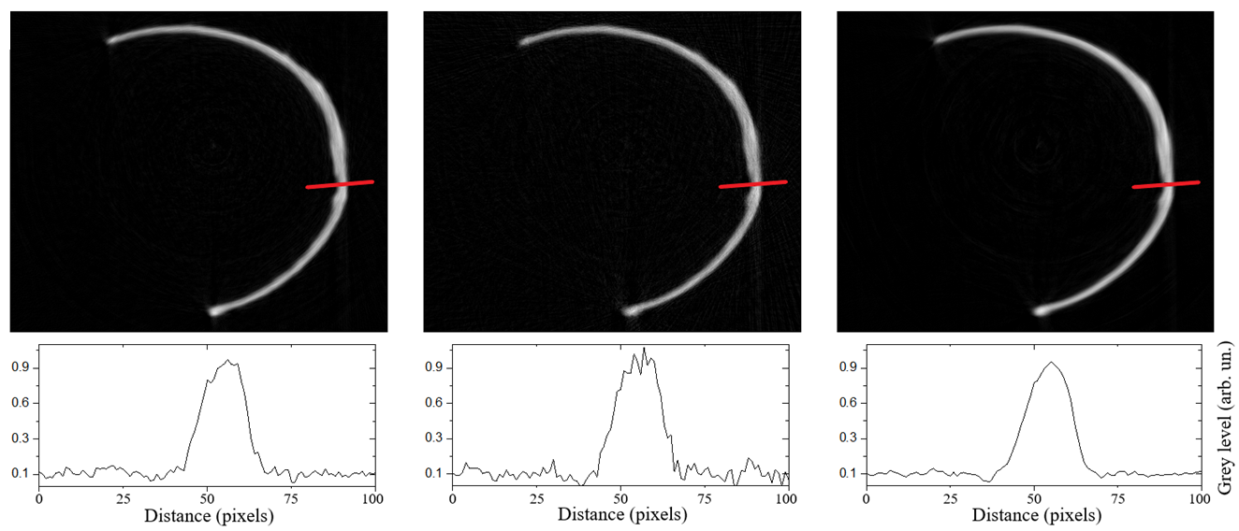
The results of training a CNN
360
72
72 + U-net
9

Slide 10
Intermediate results
A method for reconstructing three-dimensional neutron tomography data using deep learning algorithms based on convolutional neural networks was developed.
The required number of neutron radiographic projections was determined for the reconstruction of three-dimensional models using a convolutional neural network.
The influence of convolutional neural network architecture on the efficiency of tomographic reconstruction from incomplete data is determined.
Using a convolutional neural network, three-dimensional models of some cultural heritage objects were obtained from incomplete data.
10

