Slide 1


B meson decays
Aidos Issadykov
28th International Scientific Conference of Young Scientists and Specialists (AYSS-2024)

Slide 2
Outline:
Introduction – Motivation
b-s transitions
b-d(u) transitions
b-c transitions
Conclusion

Slide 3
High energy physics
The Higgs sector (2013)
Cosmology (2006, 2011, 2017, 2019, 2020)
The New Physics : confinement, exotic hadrons, etc.

Slide 4
DOES SM DESCRIBE ALL EXPERIMENTAL DATA?
The pool of the EW data

Slide 5
Outline:
Introduction – Motivation
b-s transitions
b-d(u) transitions
b-c transitions
Conclusion

Slide 6
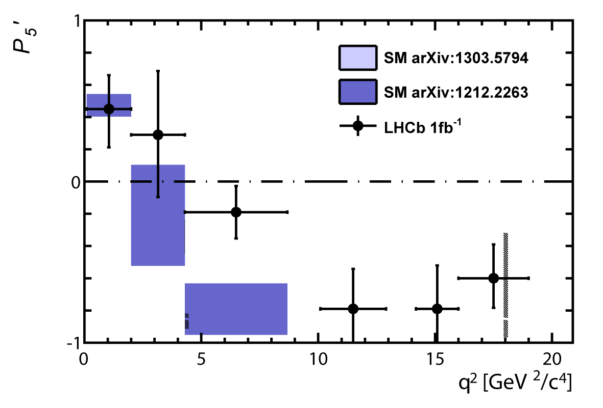
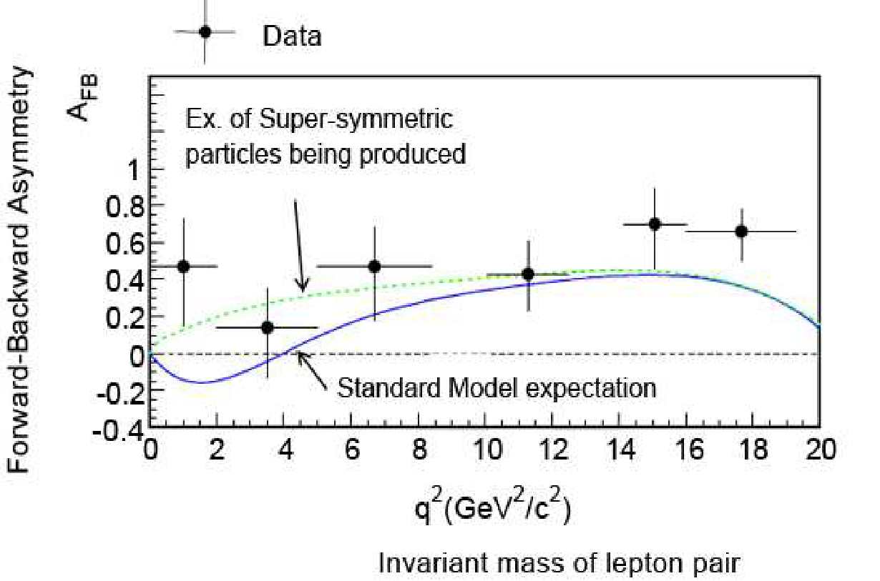
THE LHCB COLLABORATION REPORT IN 2013
3.7 σ
~ 3 σ
*Phys.Rev.Lett. 111 (2013) 191801

Slide 7
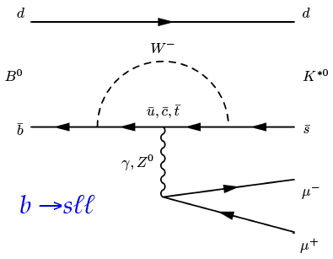
$\text{b} \text{→} \text{s} \text{transition}$
Loop-level decays b → sℓ⁺ℓ⁻:
forbidden at tree-level in SM
sensitive to NP contributions in loops

Slide 8
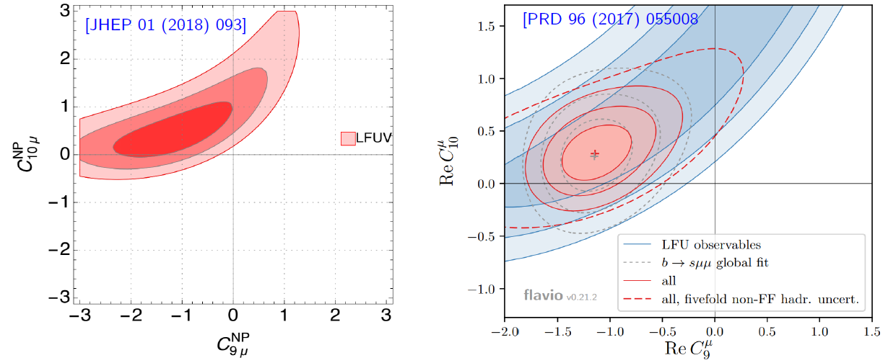
$R_{K^{∗}}$ and $R_{K^{}}$
Combination of R_{K*} , R_{K} and [PRL 118 (2017) 111801] is ~4σ from SM

Slide 9
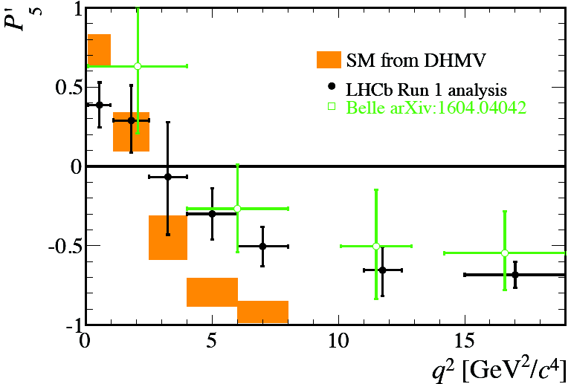
Angular observables
LHCb measurement differs by 3.4σ from the SM prediction
Can be explained by
- SM charm-loop effects (cannot explain tension in R_{K*})
- New Physics??

Slide 10
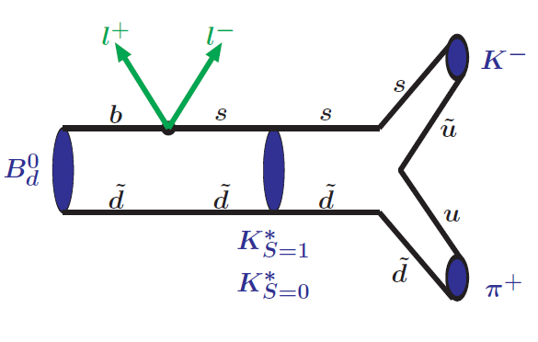
SCHEMATIC VIEW OF $\text{В→}\text{K}\text{π}\text{ + ℓ}\text{+}\text{ℓ}\text{−}$ DECAY
* Issadykov, Ivanov, Sakhiyev, Phys.Rev. D91 (2015) no.7, 074007

Slide 11

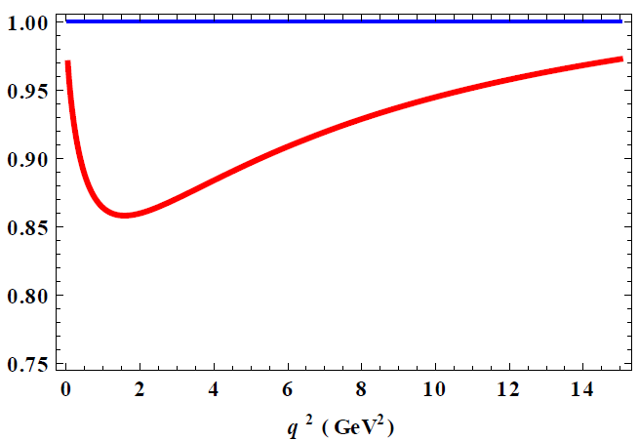
IMPACT OF S WAVE CONTRIBUTION
14 %
~ 6 %
* Issadykov, Ivanov, Sakhiyev, Phys.Rev. D91 (2015) no.7, 074007

Slide 12
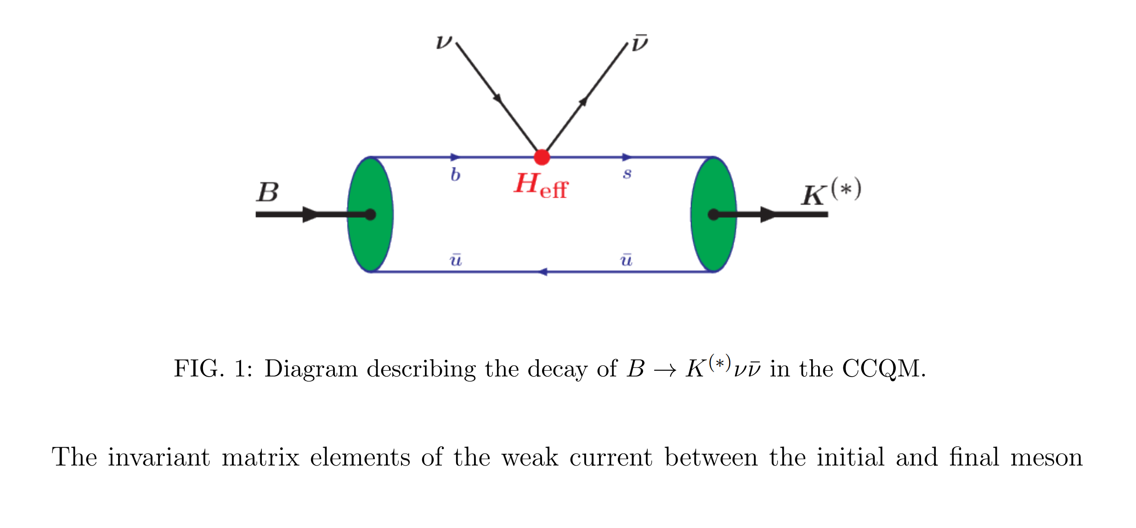

$$\text{b}\text{ → }\text{s} υ υ$$
* Issadykov, Ivanov , Modern Physics Letters A, 2023, 2350006

Slide 13
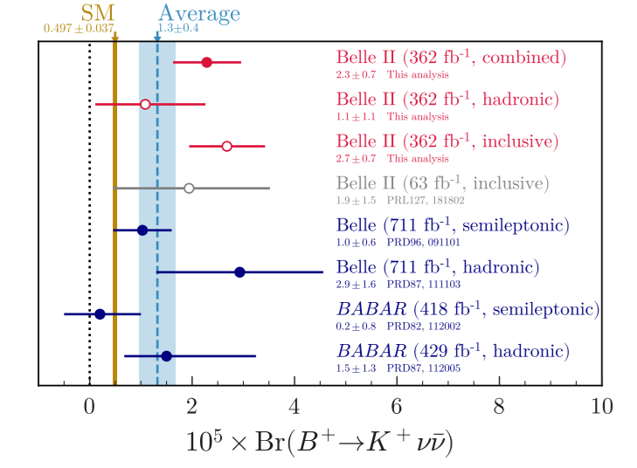
$$\text{B}\text{ → }K υ υ$$
* Belle-II Collaboration, Phys.Rev.D 109 (2024) 11, 112006, arxiv: 2311.14647

Slide 14
Outline:
Introduction – Motivation
b-s transitions
b-d(u) transitions
b-c transitions
Conclusion

Slide 15
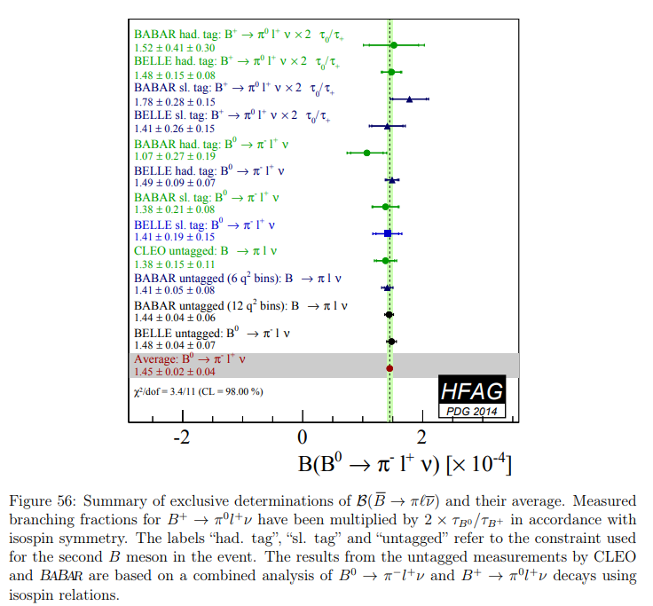
b-d transitions

Slide 16
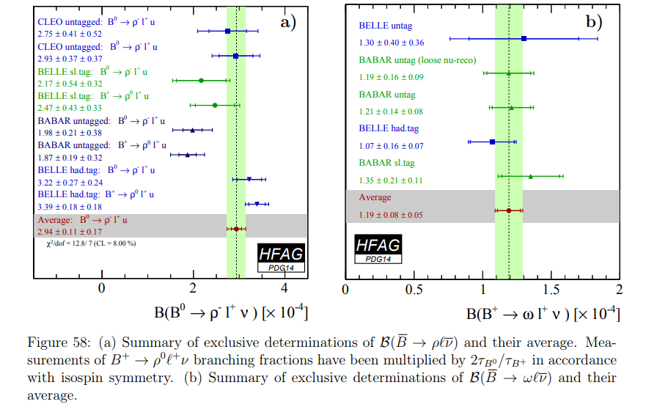
b-d transitions
* arxiv: 1412.7515

Slide 17
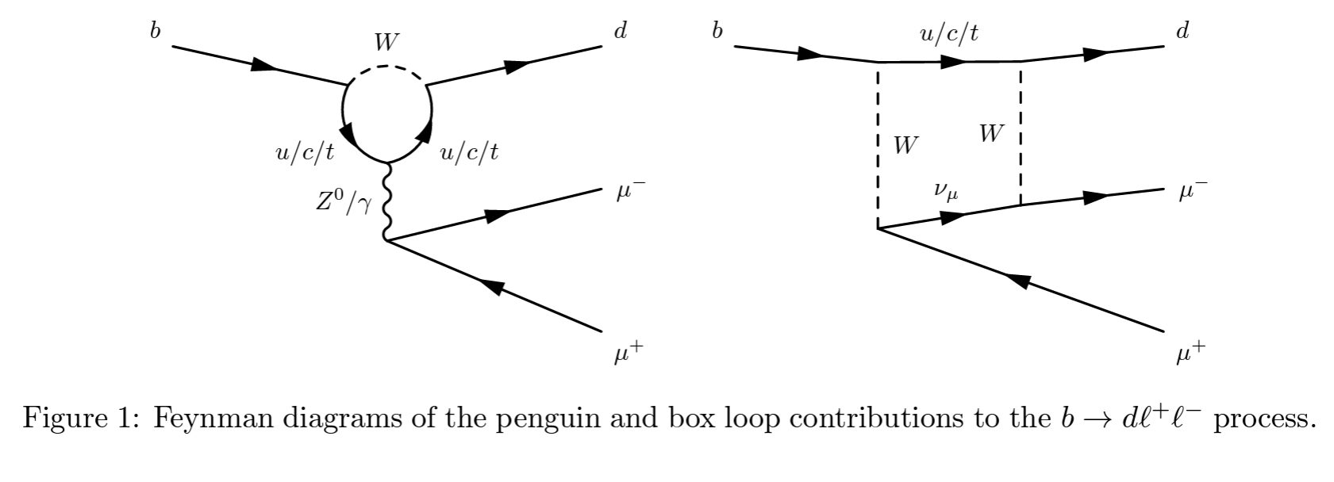

b-d transitions
*R. Aaij et al. (LHCb Collaboration), JHEP 07, 020 (2018), arXiv:1804.07167 [hep-ex].

Slide 18
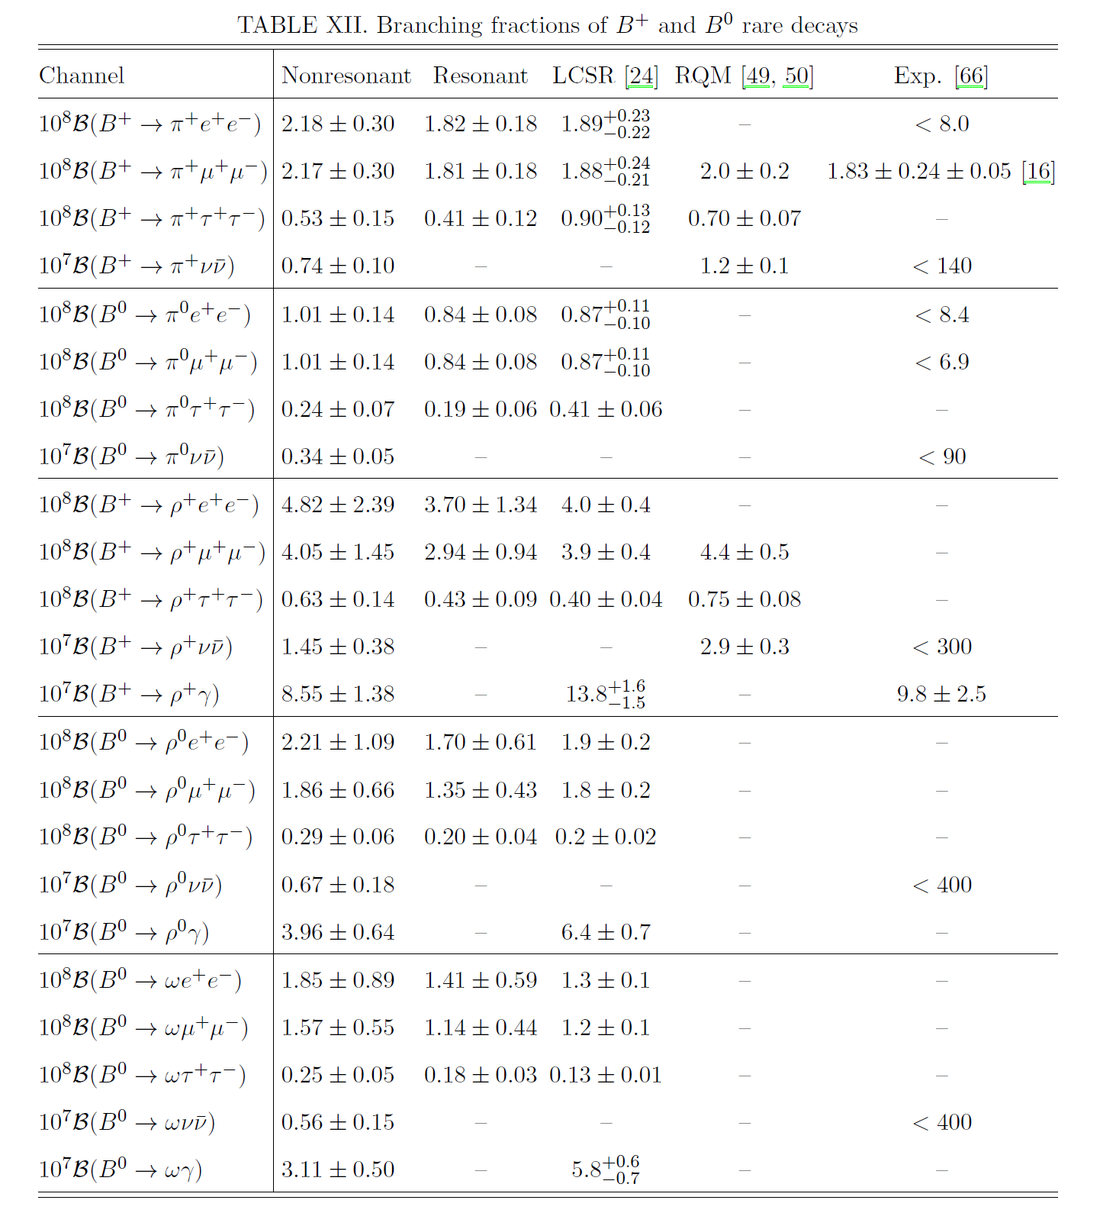

Slide 19
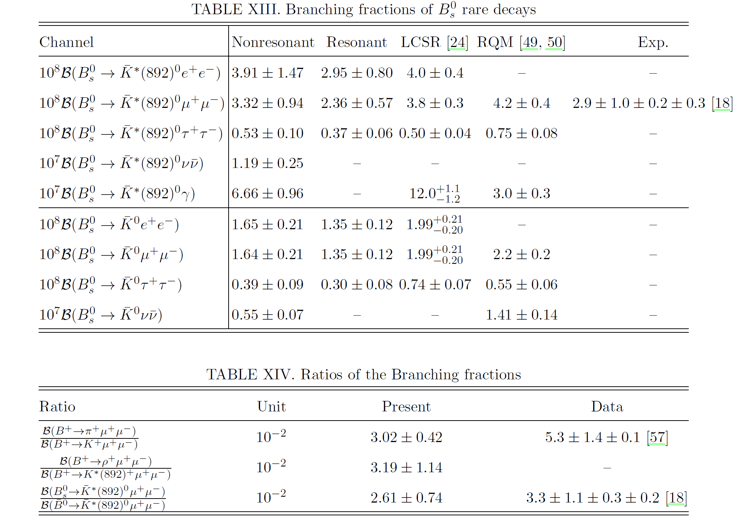
*Soni, Issadykov, Gadaria, Patel, Pandya, EPJ A 2022, 58(3), 39

Slide 20
Outline:
Introduction – Motivation
b-s transitions
b-d(u) transitions
b-c transitions
Conclusion

Slide 21
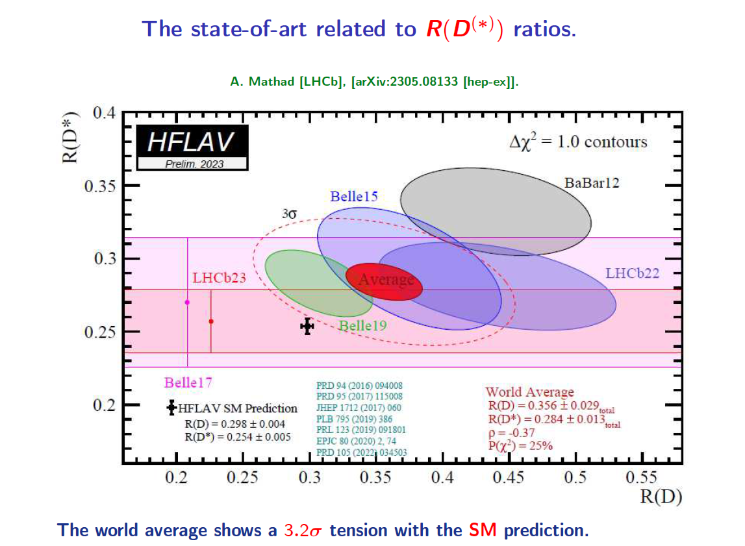
b-c transition

Slide 22
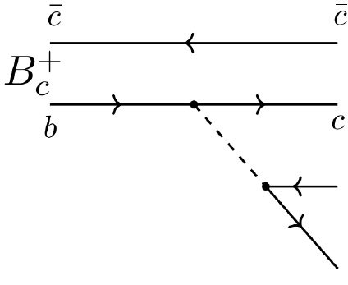


Semileptonic decays of B_{c} meson
*R. Aaij et al. Phys.Rev.Lett. 120 (2018) no.12, 121801
arXiv:1711.05623

Slide 23
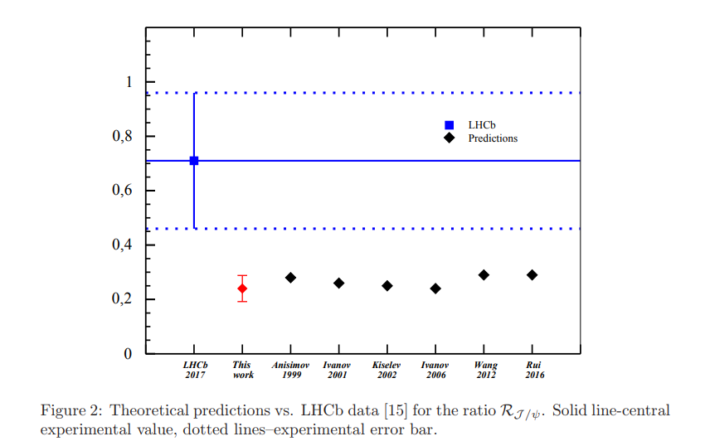
Branching ratios of semileptonic $B_{c}$ decays
*Issadykov, Ivanov, Phys.Lett. B783 (2018) 178-182

Slide 24
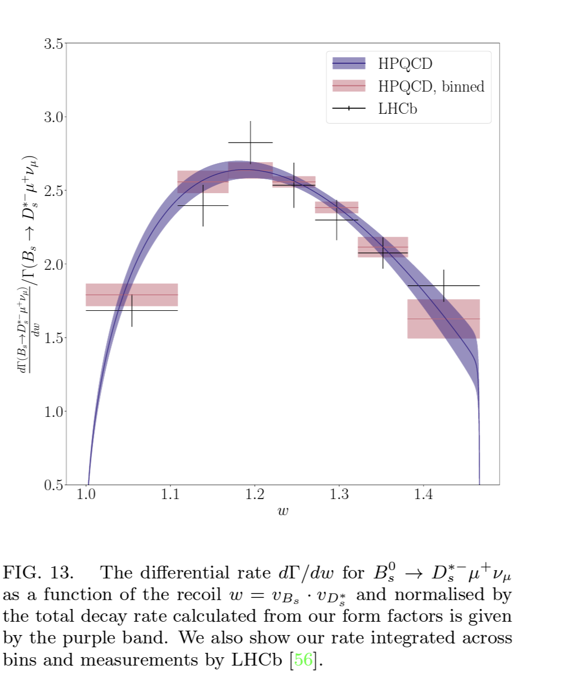
Semileptonic B_{s} →D*_{s} decay

Slide 25
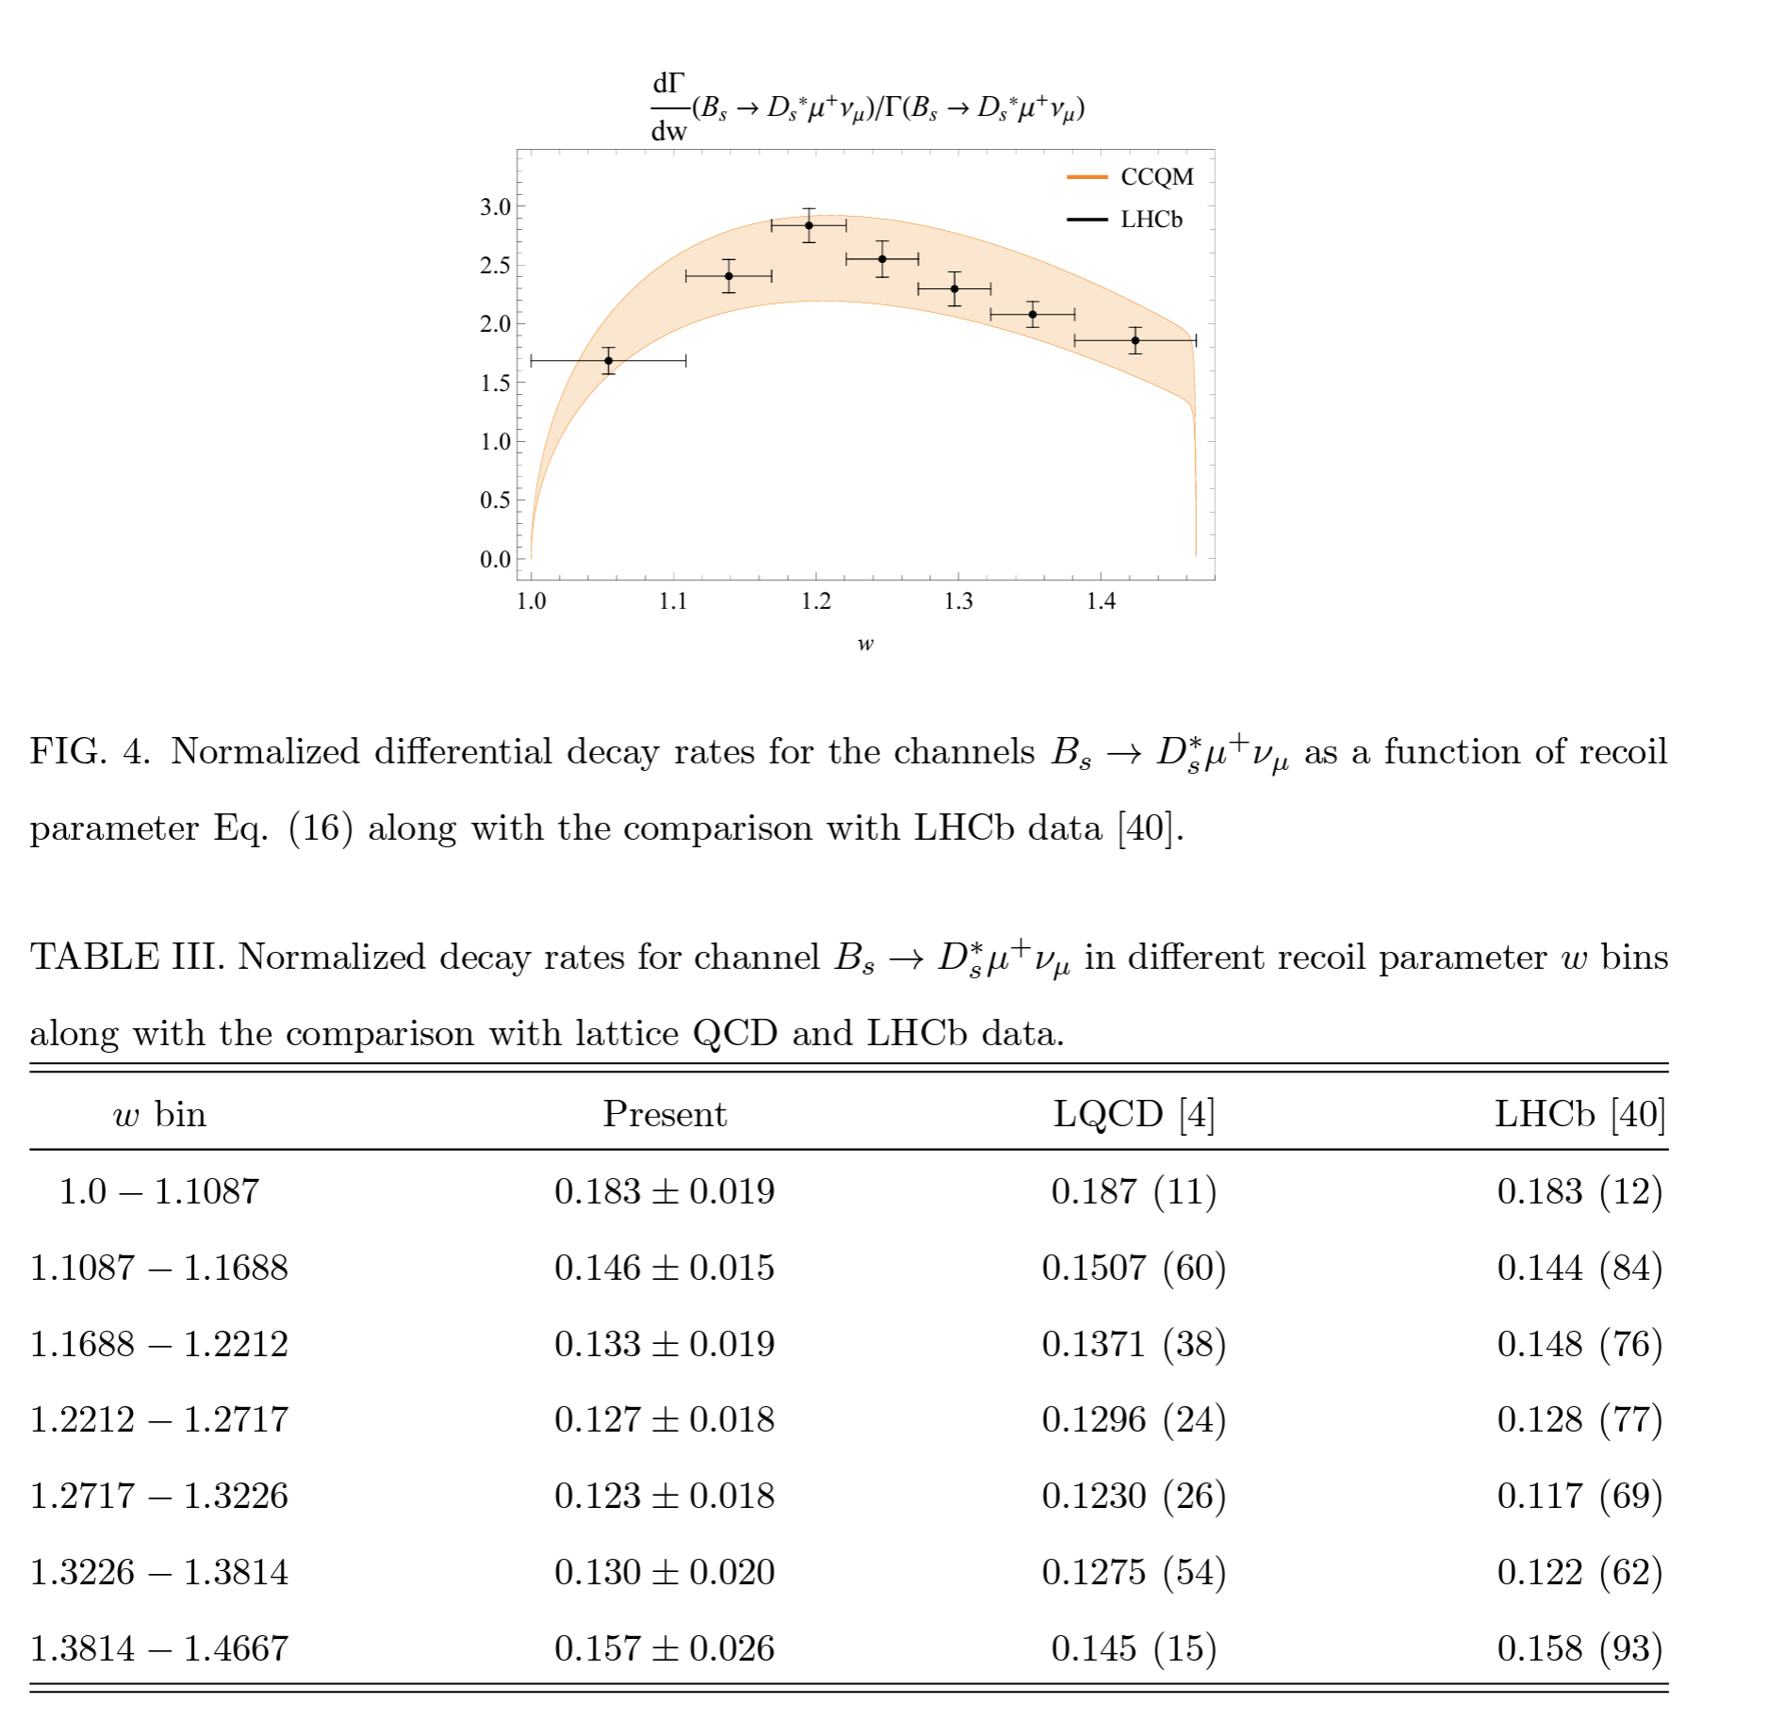

Slide 26
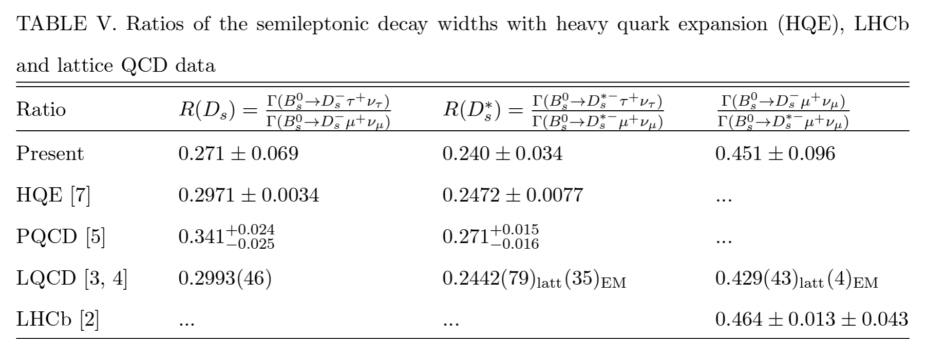
Semileptonic B_{s} →D*_{s} decay
*Soni, Issadykov, Gadaria, Patel, Pandya, European Physical Journal Plus, 2023, 138(2), 163

Slide 27
Conclusion
b-s transitions - R_{K} and R_{K*} problem
b-d(u) transitions ok!
b-c transitions R_{D} and R_{D*} , R_{J/ψ} problem

Slide 28
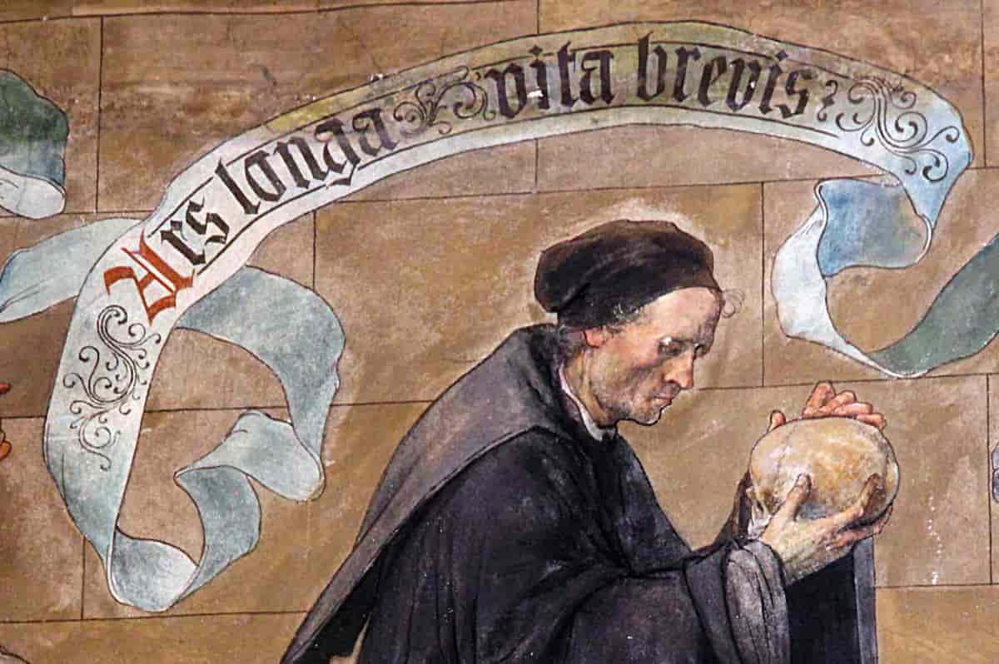
Thank you for attention!
Ars longa, vita brevis

Slide 29
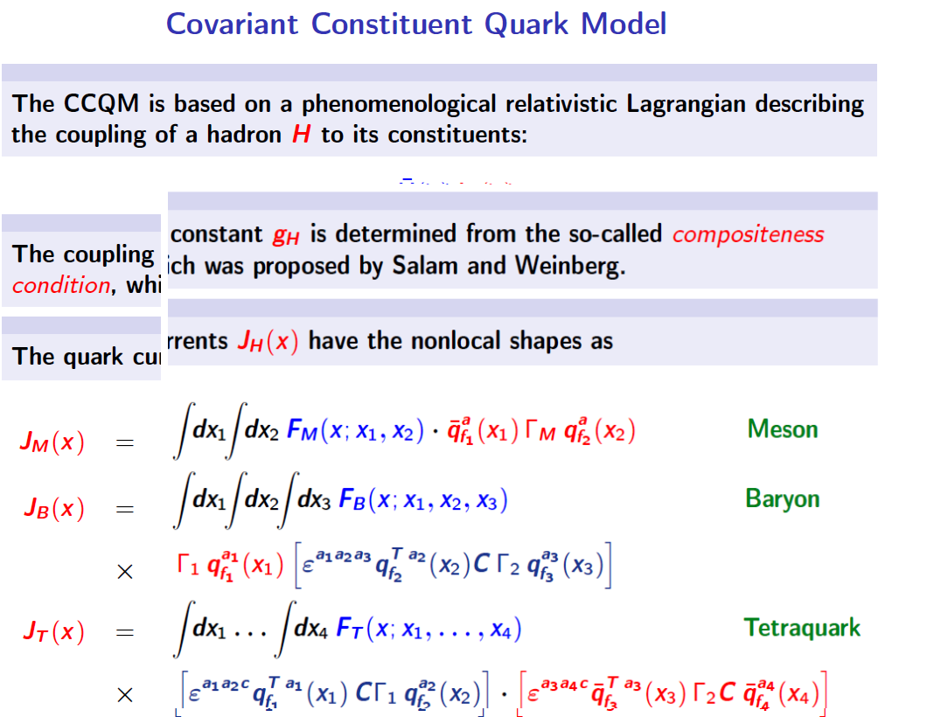

Slide 30
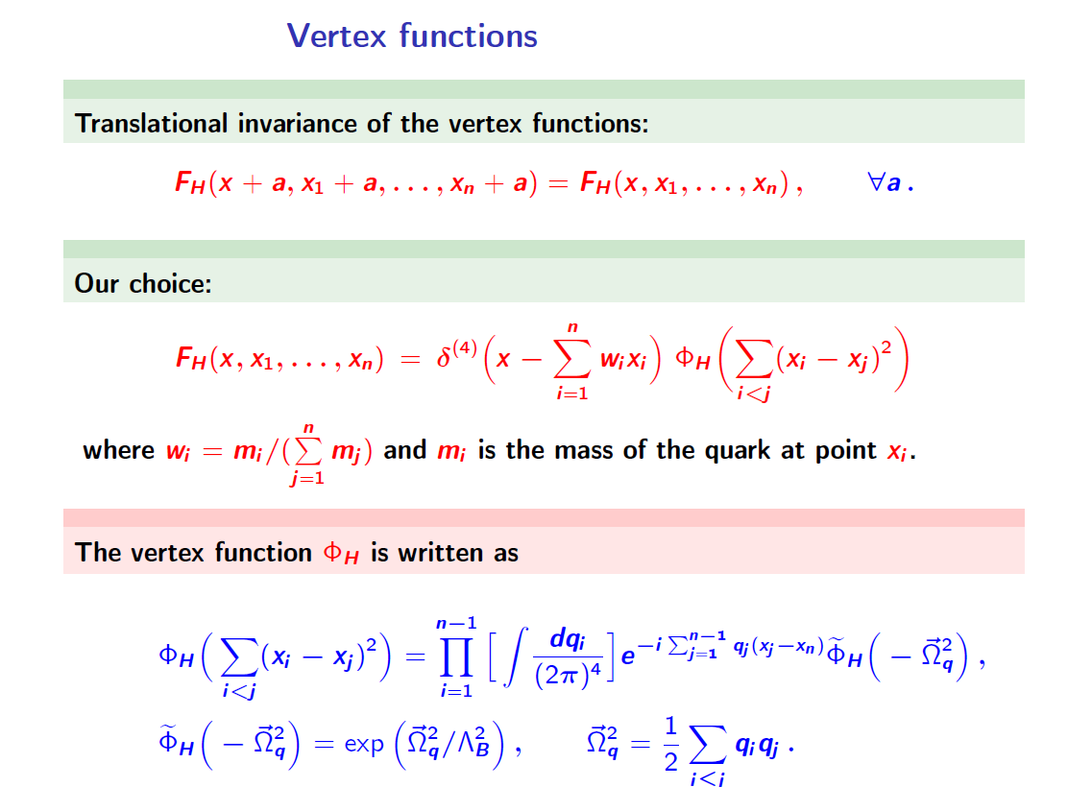

Slide 31
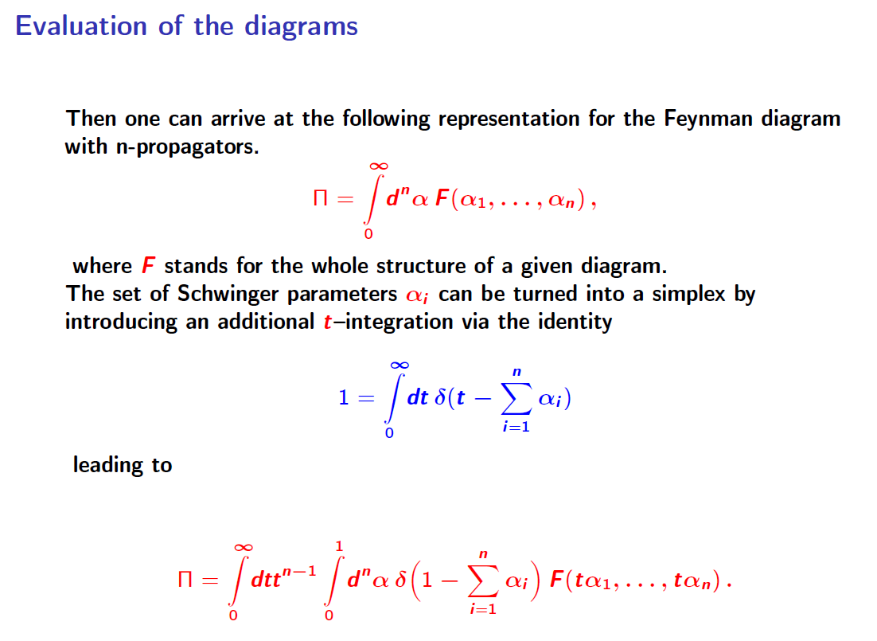

Slide 32
