Slide 1
Computer simulation of shape effects in electrostatic and magnetostatic interactions
Vladimir Savin
AYSS-2024

Slide 2
A conductive sphere and a point charge
A charged sphere and a point charge
The interaction force
$$F_{int}\left(z_{q}\right)=−q^{2}\frac{R}{z_{q}}\left(\frac{1}{{\left(z_{q}−\frac{R^{2}}{z_{q}}\right)}^{2}}−\frac{1}{{z_{q}}^{2}}\right)≤0$$
Usually an uncharged conductor attracts charged bodies due to electrostatic induction.

Slide 3
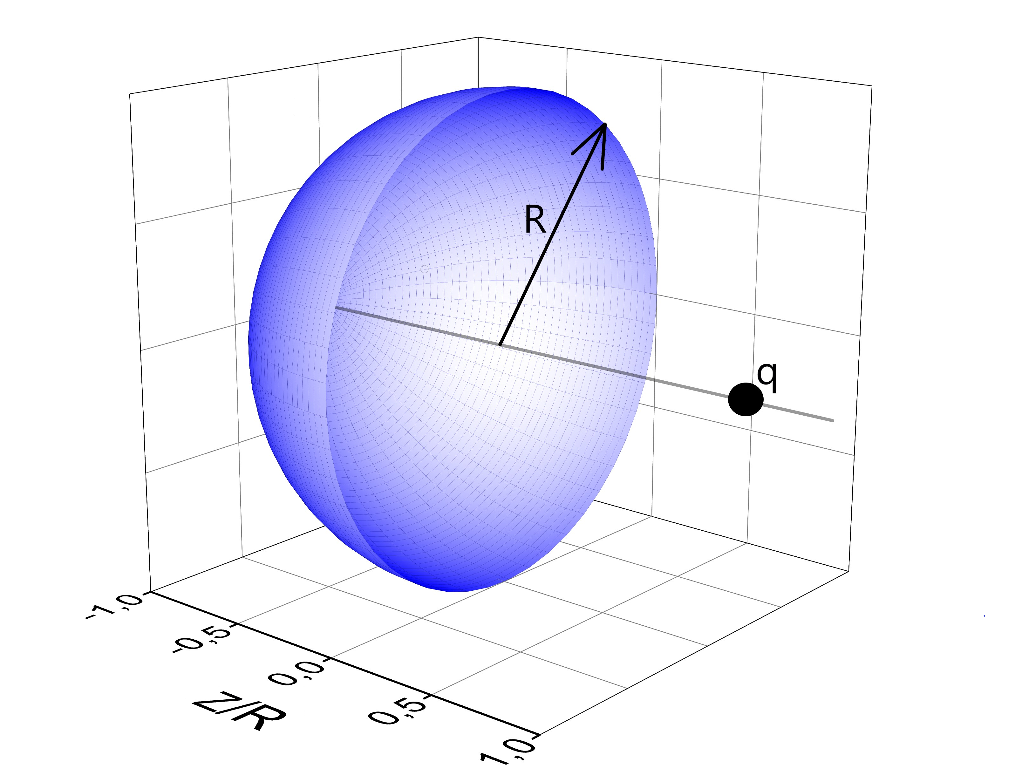
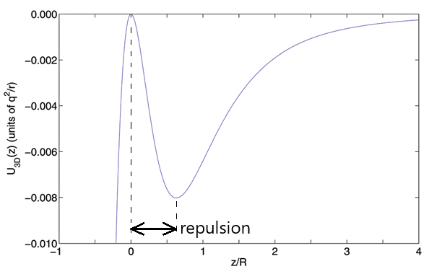
The opposite simple example
An uncharged hemisphere and a point charge
The dependence of the interaction energy on the coordinate of the point charge
M. Levin, S. G. Johnson (2011), «Is the electrostatic force between a point charge and a neutral metallic object always attractive?», American Journal of Physics, 79(8), 843–849

Slide 4
Questions that need to be answered
Questions:
Does the repulsion effect disappear if the hemisphere transforms into a semi-ellipsoid?
Can this effect be observed in the case of conductors of a different shape – a truncated sphere, cone, cylinder, etc.?
How important is the electroneutrality of the conductor for this effect?
Is it possible to observe the discussed repulsion effect in systems without axial symmetry?
Is it possible to detect a similar effect in a similar problem of magnetostatics, where a magnet is used instead of a conductor, and a permanent magnet (magnetic dipole) instead of an electric point charge?

Slide 5
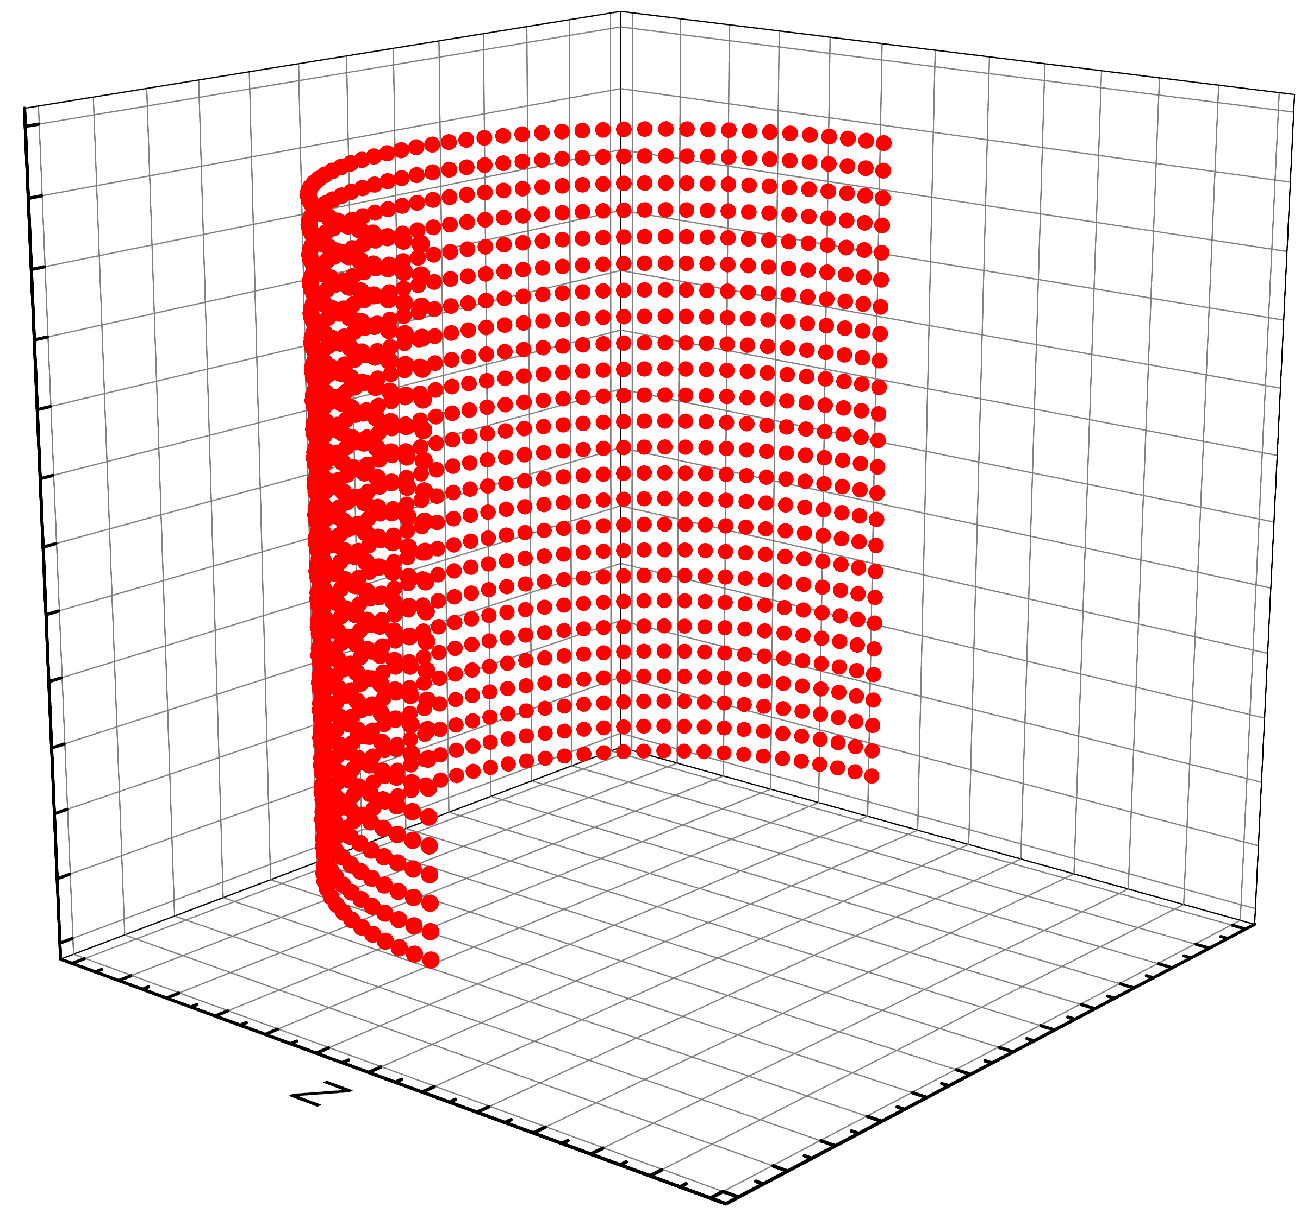
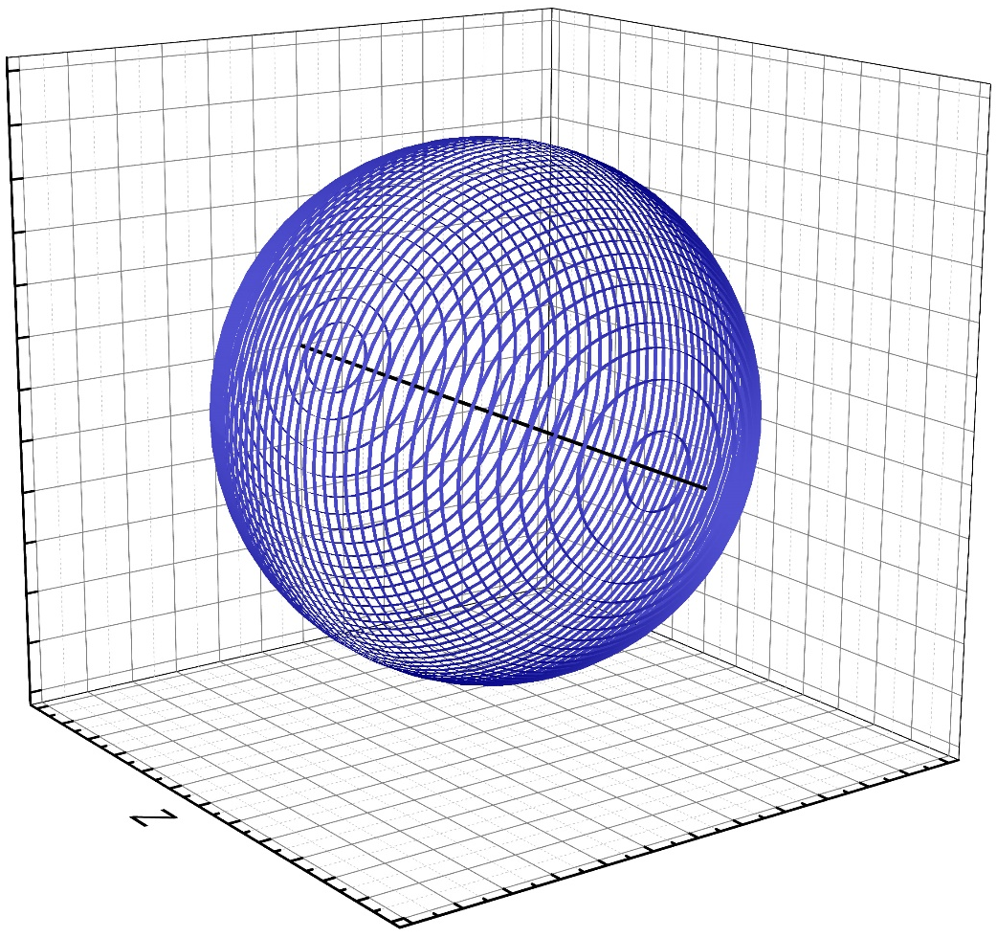
The physical model
The investigated system:
Conductor + point charge (electric dipole);
Magnetic + magnetic dipole;
The representation of a conductor, magnet, or dielectric in the form of a large number of uniformly charged thin rings.
The representation of a conductor, magnet, or dielectric in the form of a large number of point charges.
No
Does the system have axial symmetry?
Yes

Slide 6
The calculation scheme
Representation of a conductor or magnet as a system of N uniformly charged rings
Conductor
Magnet
Equipotential condition of the conductor surface
$$φ=const$$
The minimum of electrostatic energy (Thomson's theorem).
Achievement of boundary conditions ${μ_{1}H}_{n1}={μ_{2}H}_{n2}$
Conditional extremum task
Minimization of deviations of the normal induction components on the surface of a magnet using the dynamic trajectory method
Minimizing potential deviations from a constant value using the dynamic trajectory method
Solving a system of equations using LU decomposition
The equilibrium distribution of charges (fictitious magnetic charges) of rings or points. Calculation of energy and force.

Slide 7
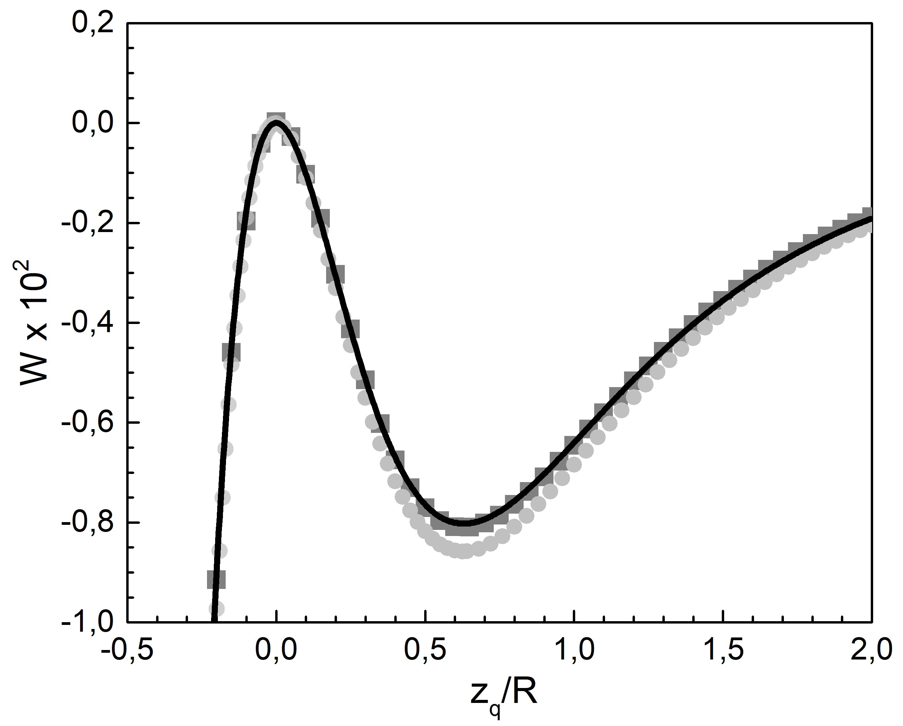
Checking the algorithm on a problem with a known analytical solution An electroneutral hemisphere and a point charge
An uncharged hemisphere and a point charge
The interaction energy W versus the
point charge coordinate $z_{q}$

Slide 8
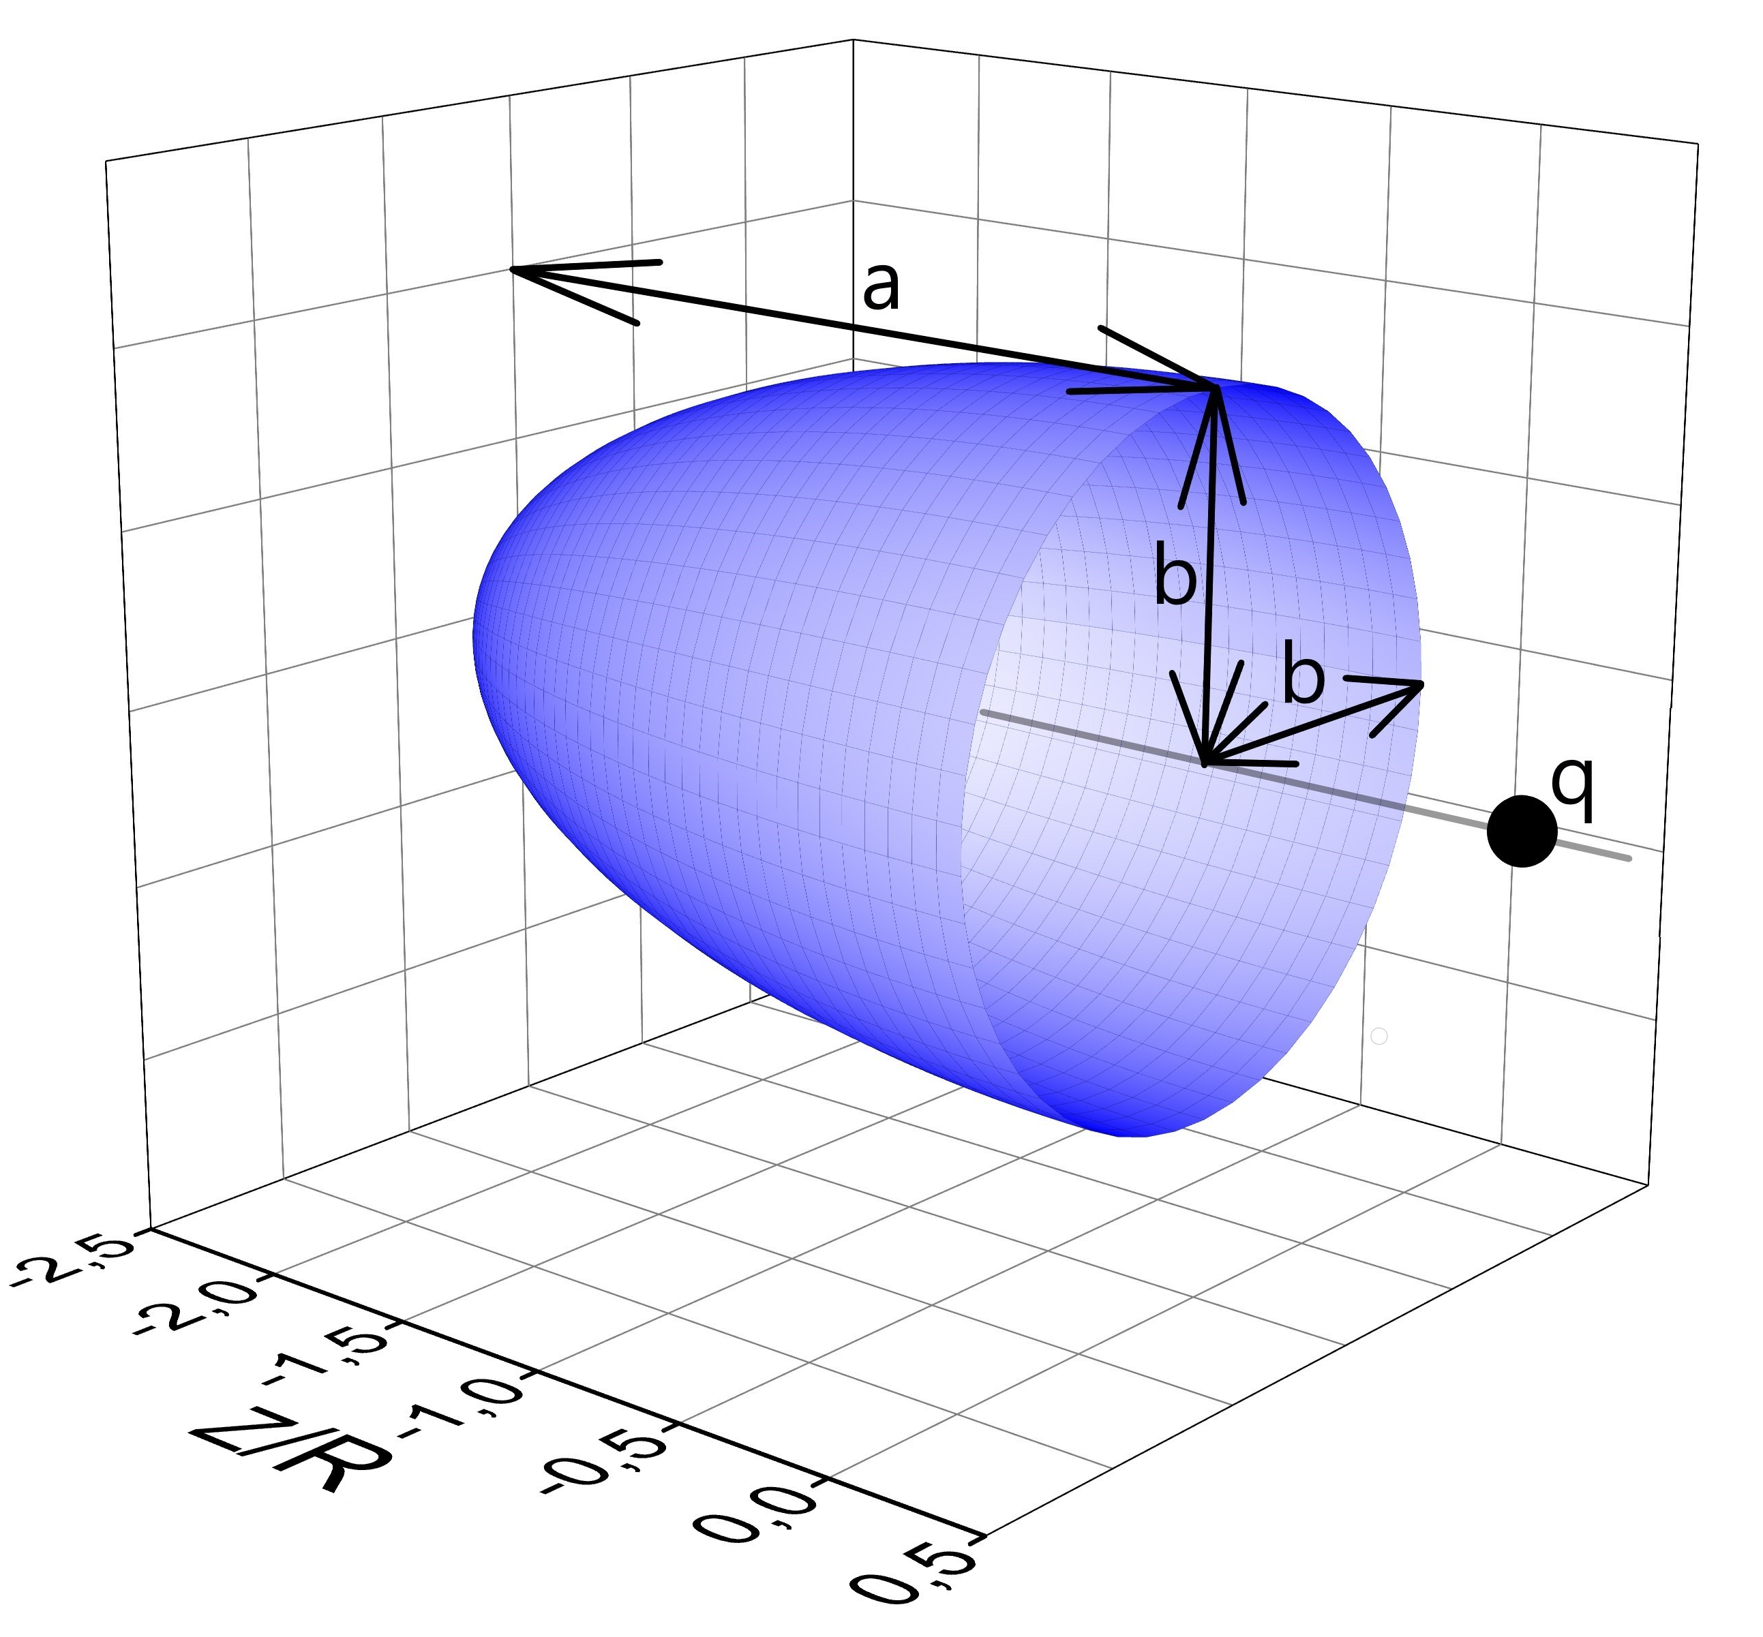
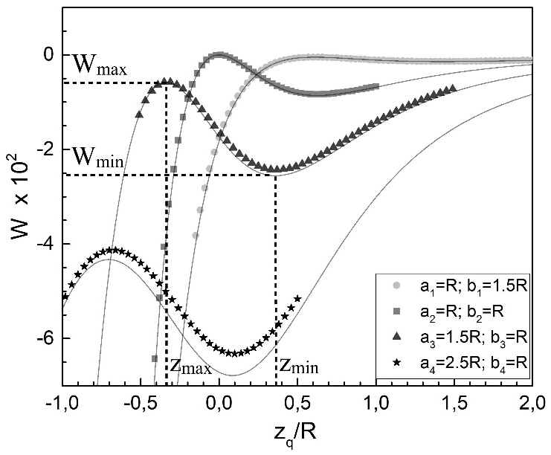
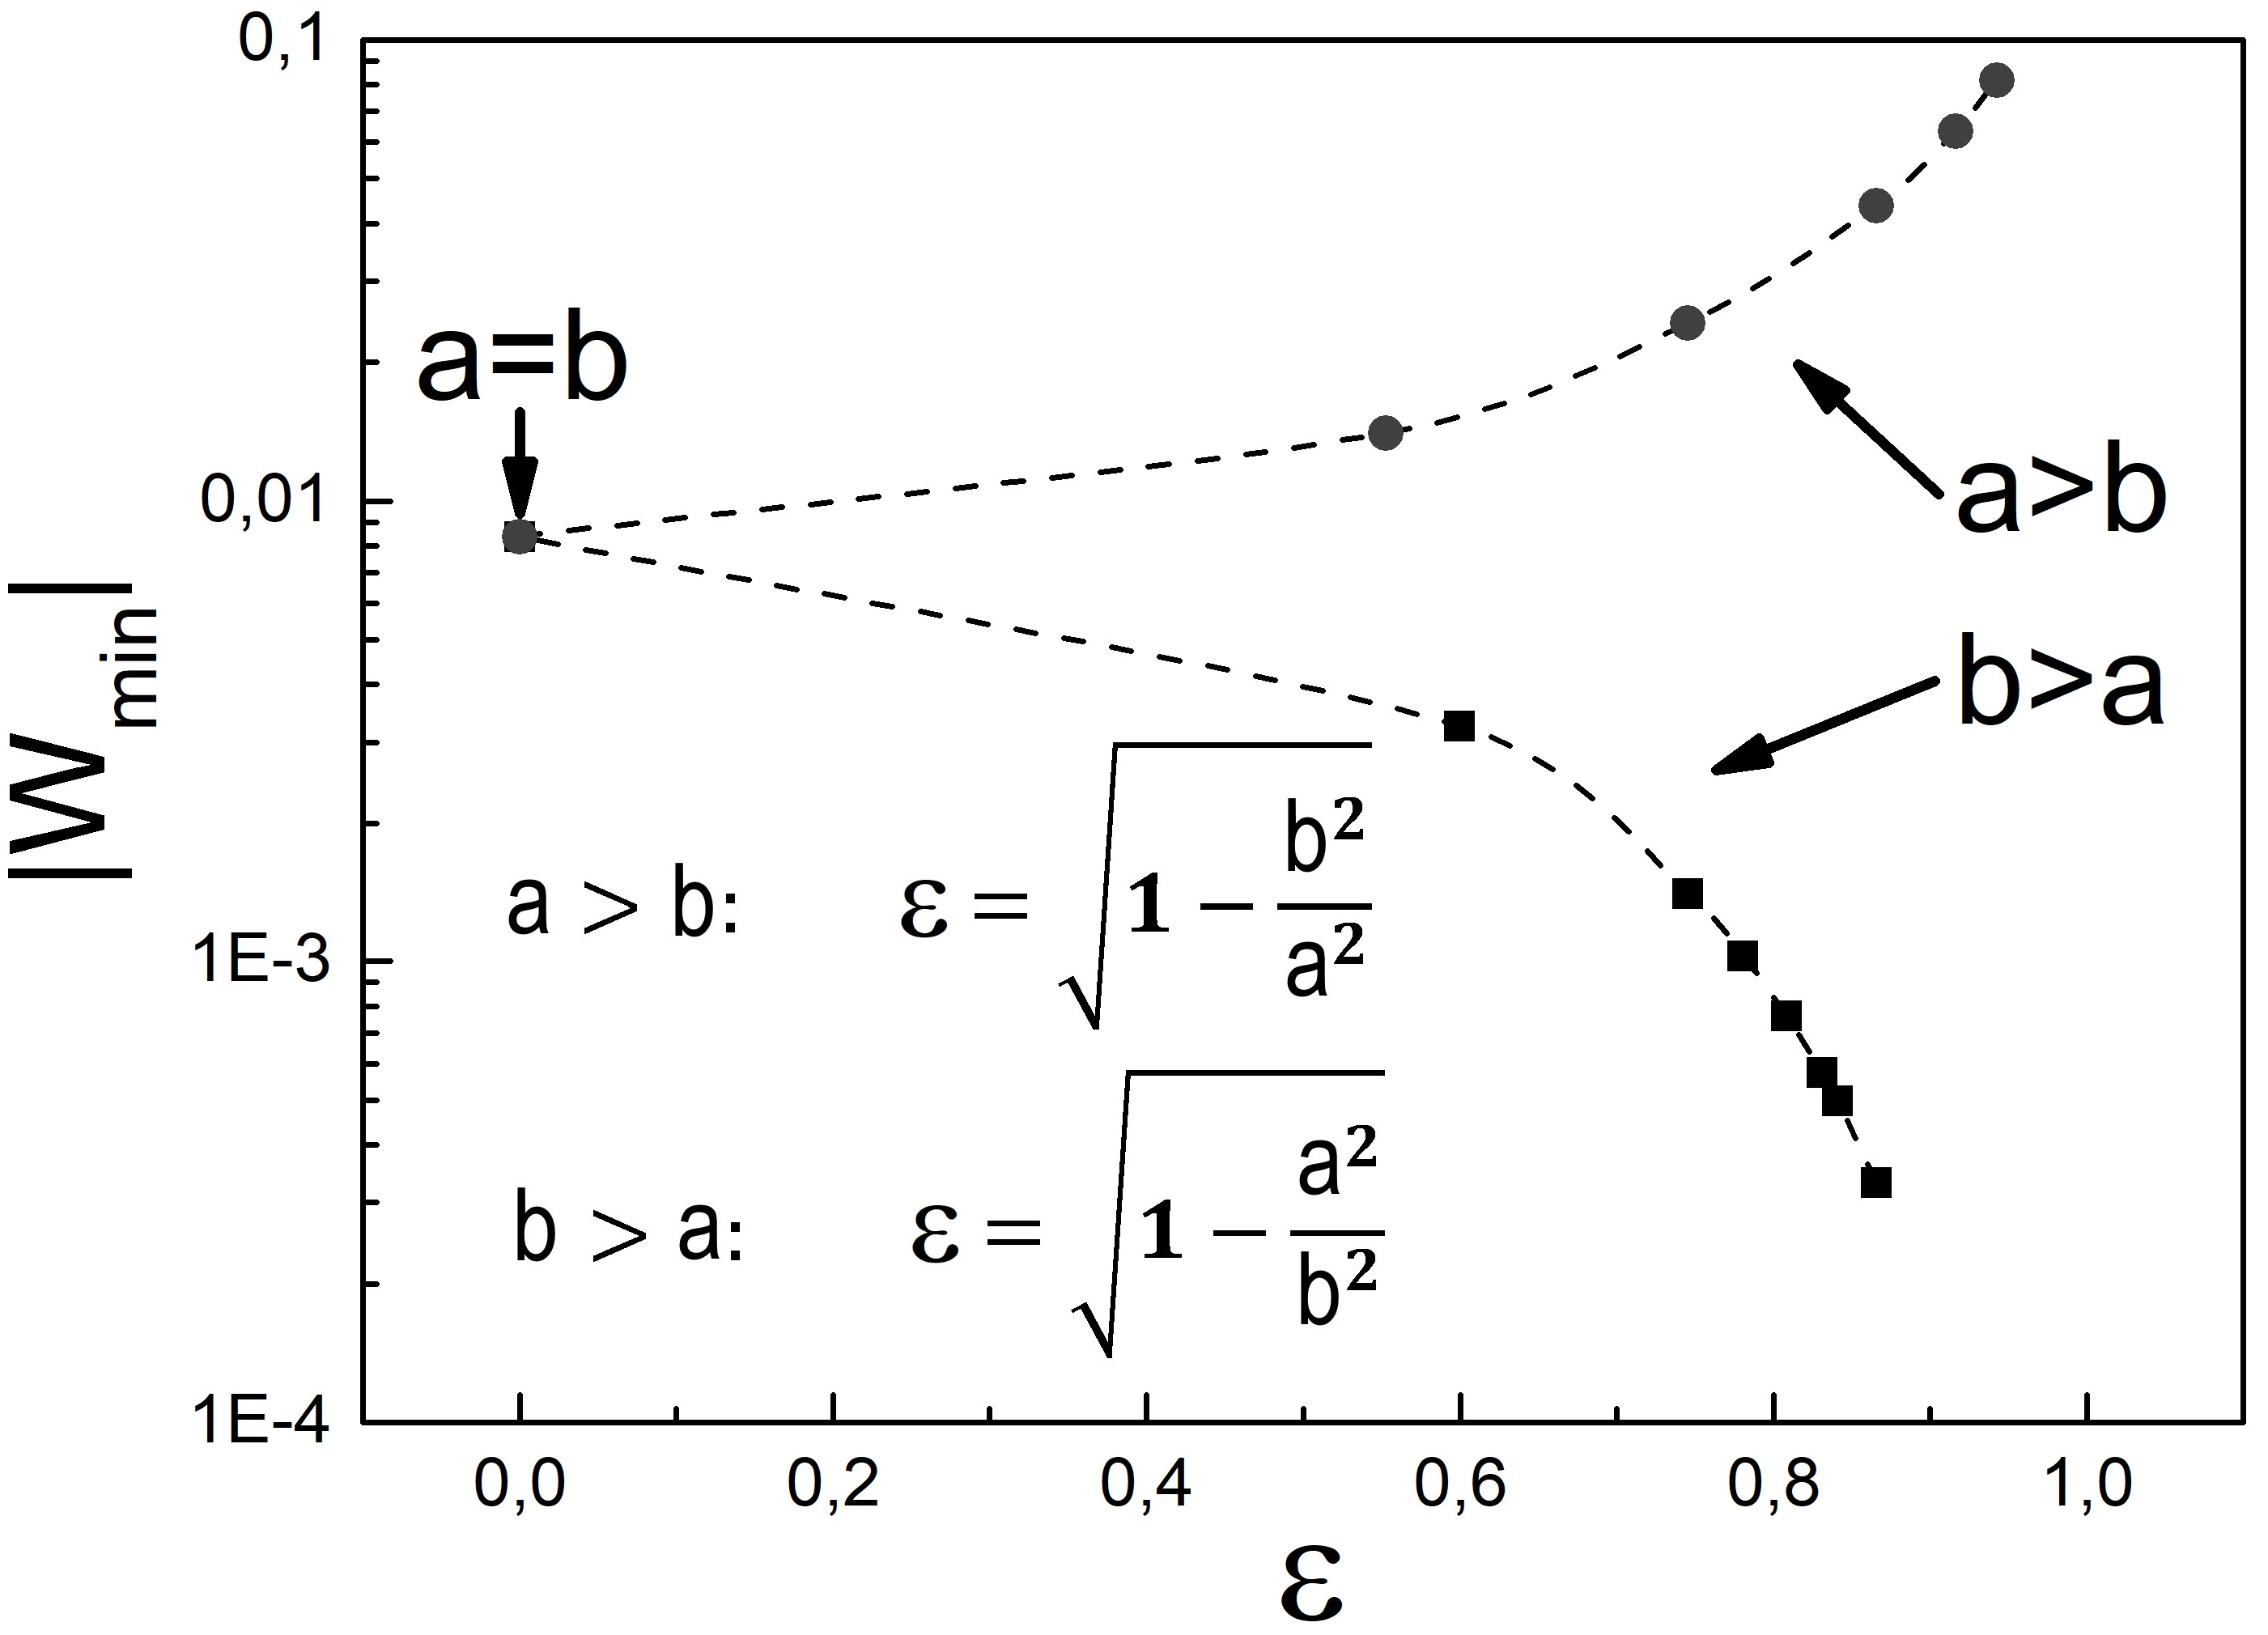
The disappearance of the repulsion effect during the transformation of the hemisphere into a semi-ellipsoid
A semi-ellipsoid and a point charge
The interaction energy W versus the
point charge coordinate $z_{q}$
The dependence of the depth of the local minimum on the eccentricity $ε$

Slide 9
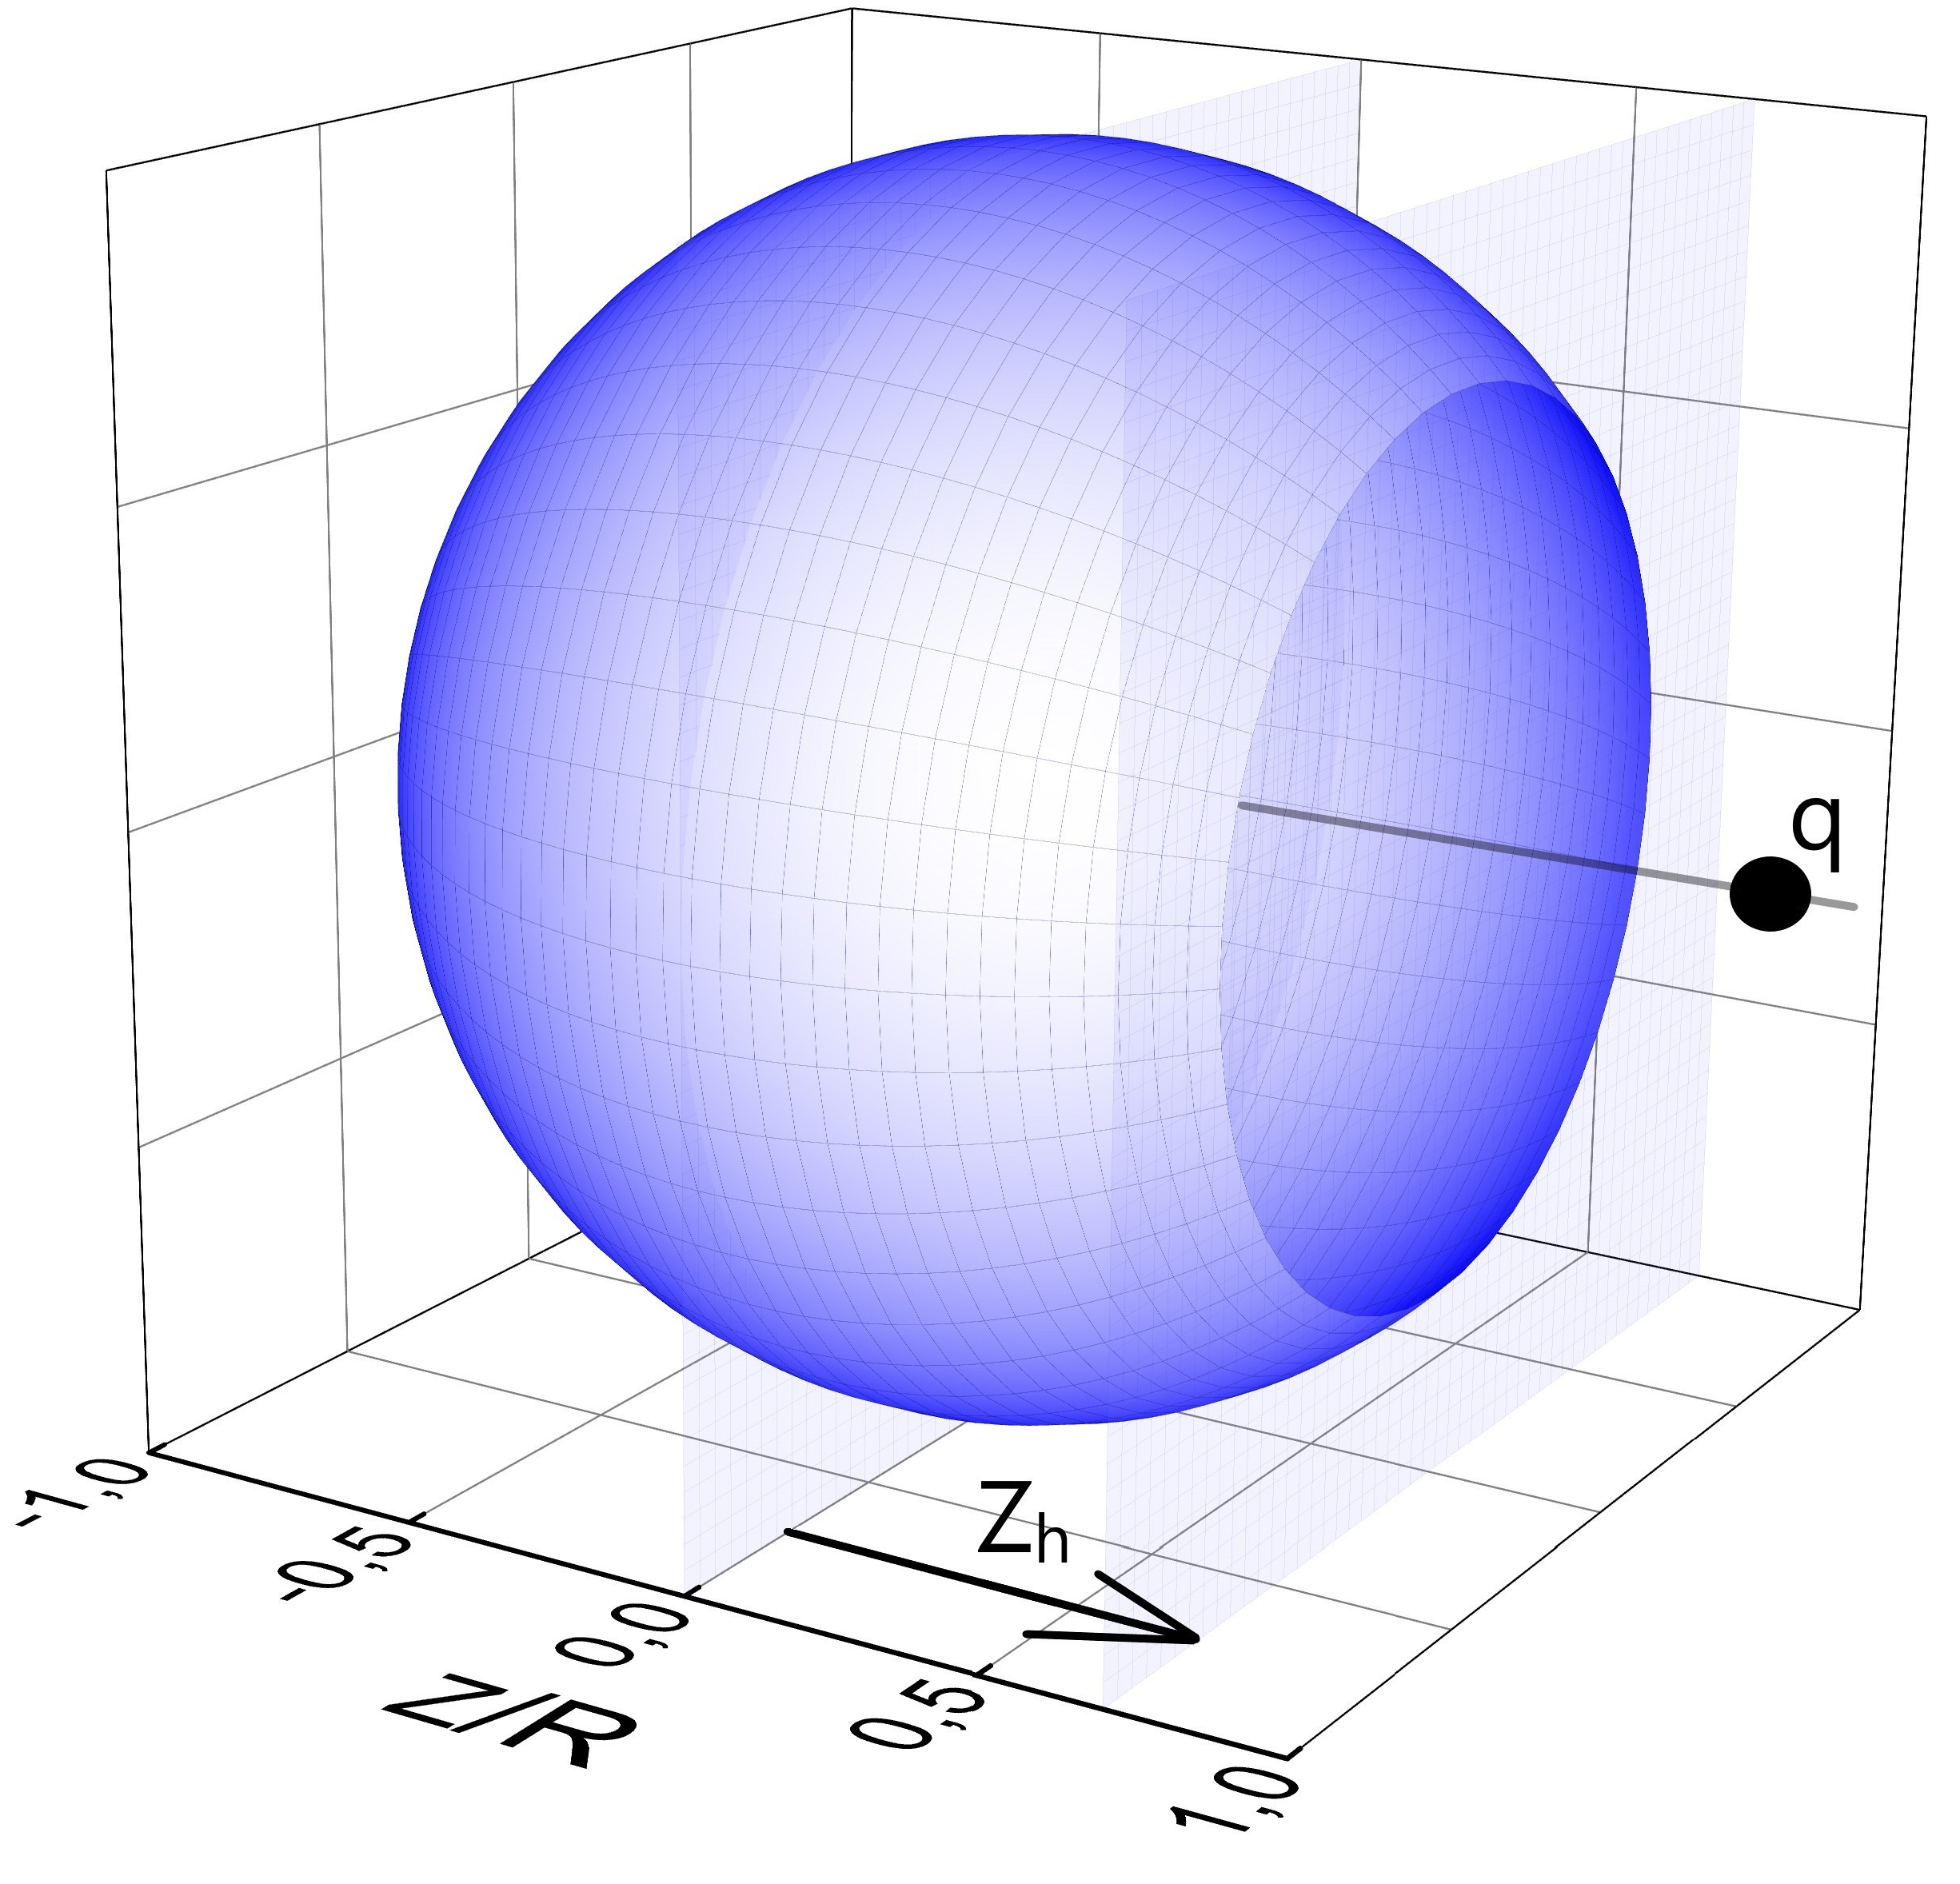
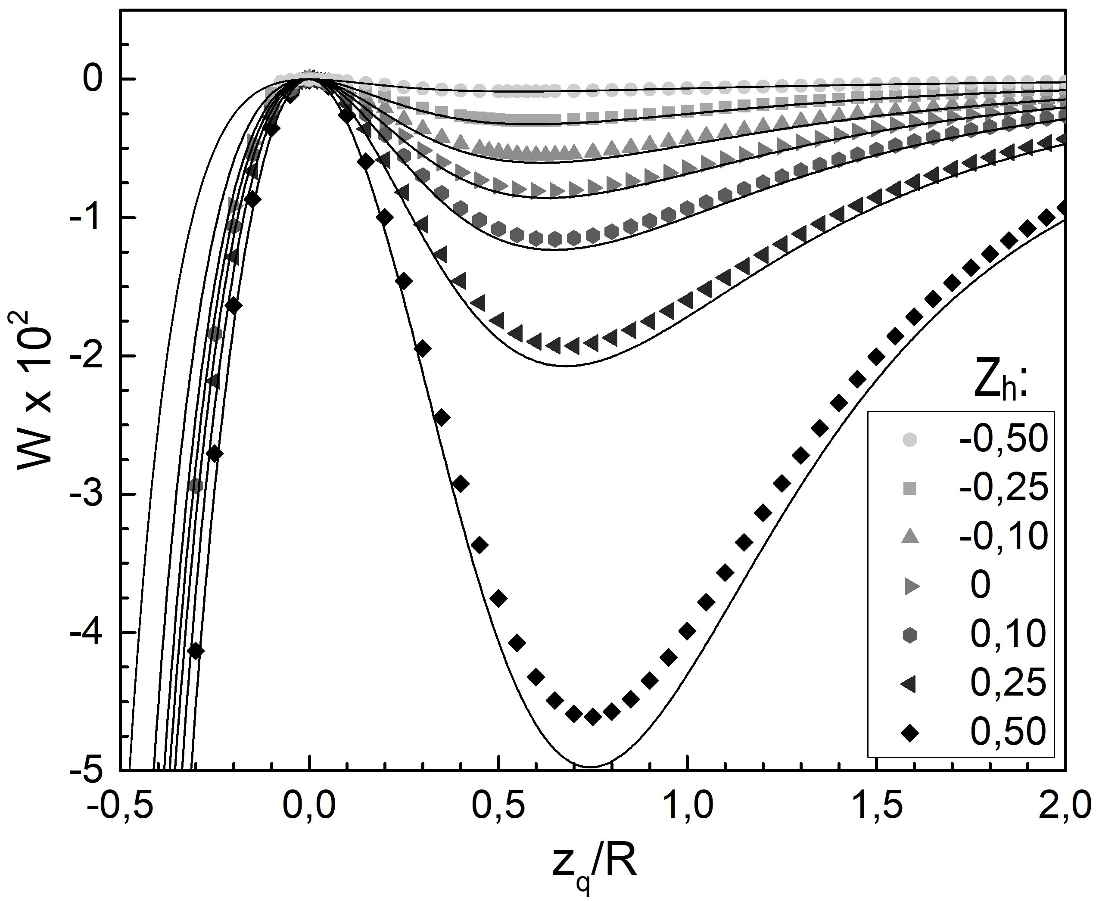
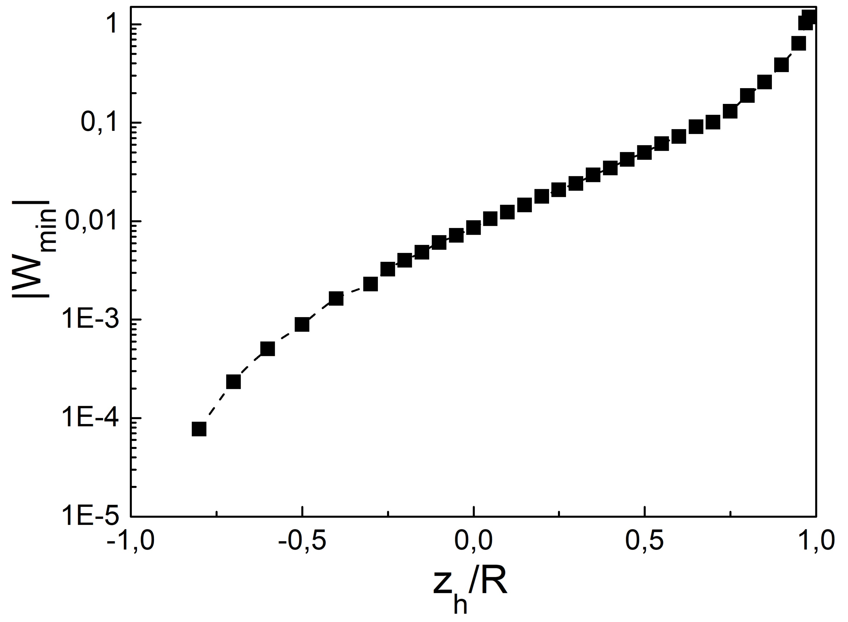
A sphere with a hole in the field of a point charge
The neutral
conducting truncated open sphere and the point
charge q
The interaction energy W versus the
point charge coordinate $z_{q}$
The dependence of the depth of the local minimum on the coordinate of the hole $z_{h}$

Slide 10
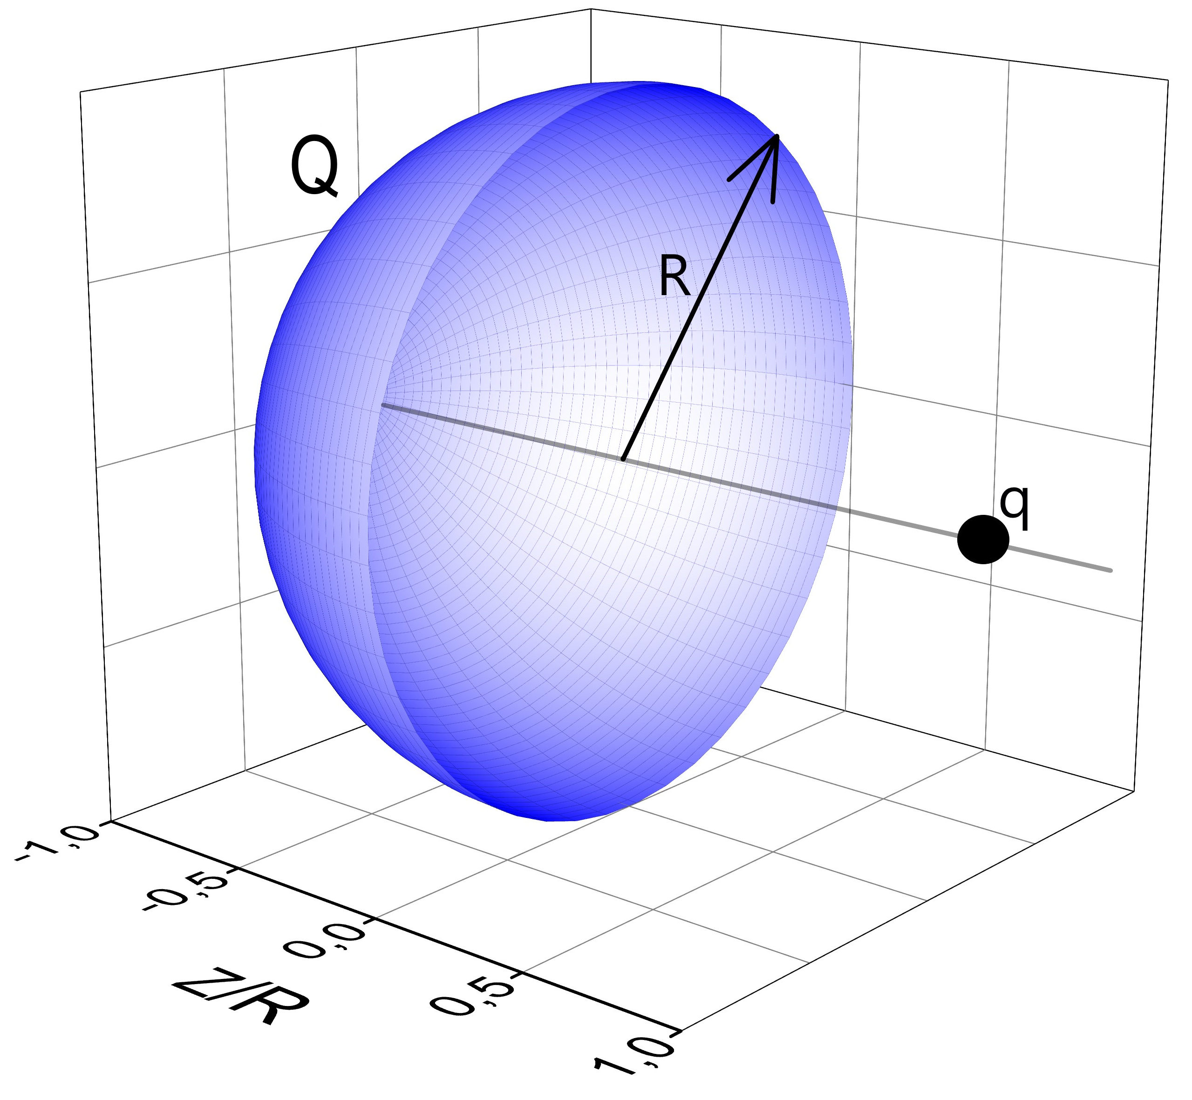
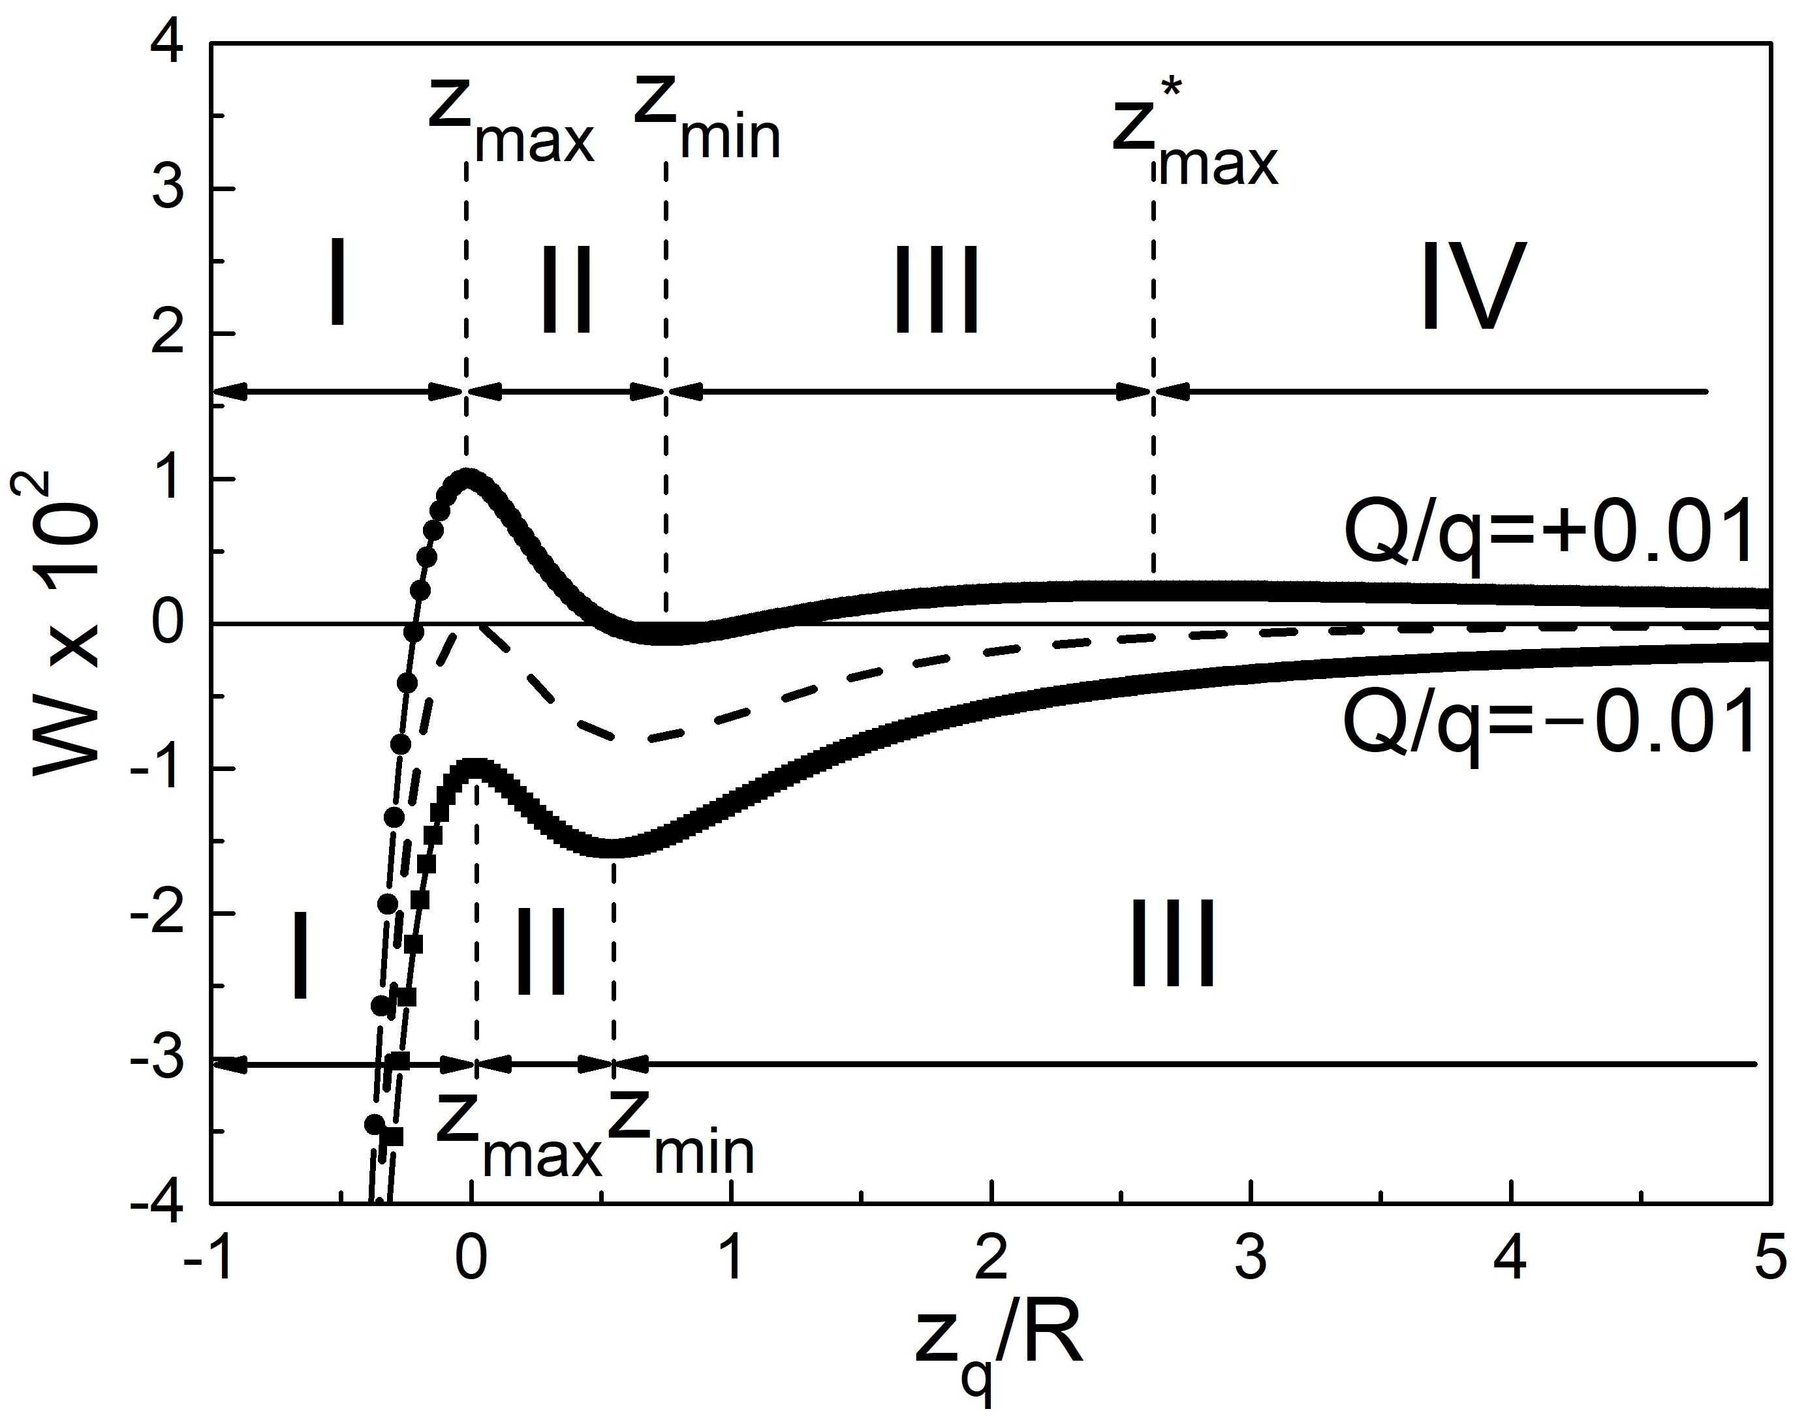
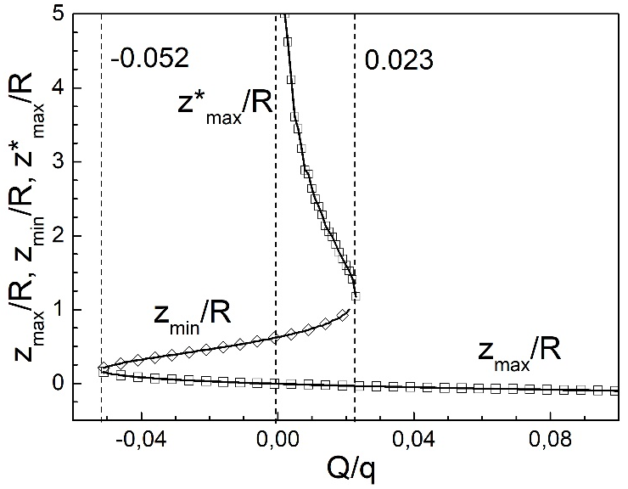
Features of attraction and repulsion for a charged hemisphere
A charged hemisphere and a point charge. Q is the total charge of the hemisphere
The energy W of the interaction between the charged hemisphere and the point charge q as a function of $z_{q}$
Variations of $z_{max}$, $z_{min}$ and $z_{max}^{∗}$ versus Q

Slide 11
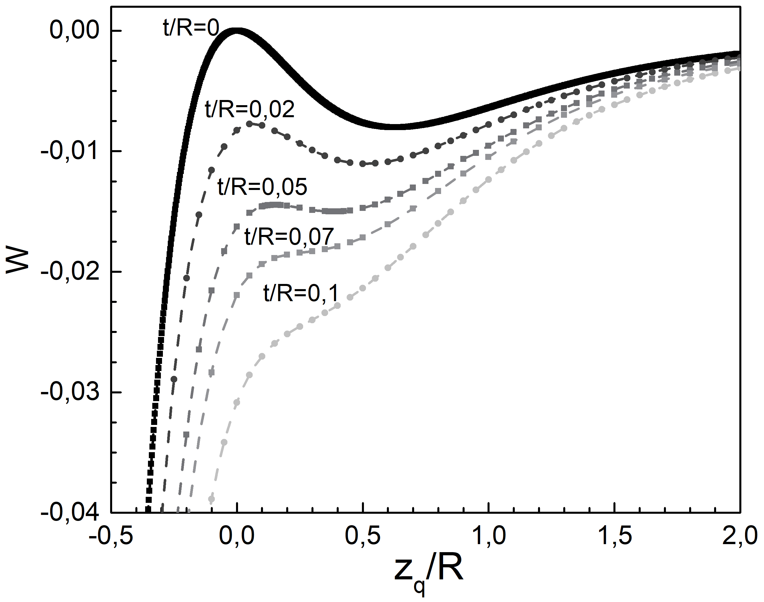
The effect of conductor thickness on the repulsion effect
A hemisphere of finite thickness t and a point charge q.
The energy W of the system as a function of coordinate $z_{q}$ of the point charge at various values of ratio t/R

Slide 12
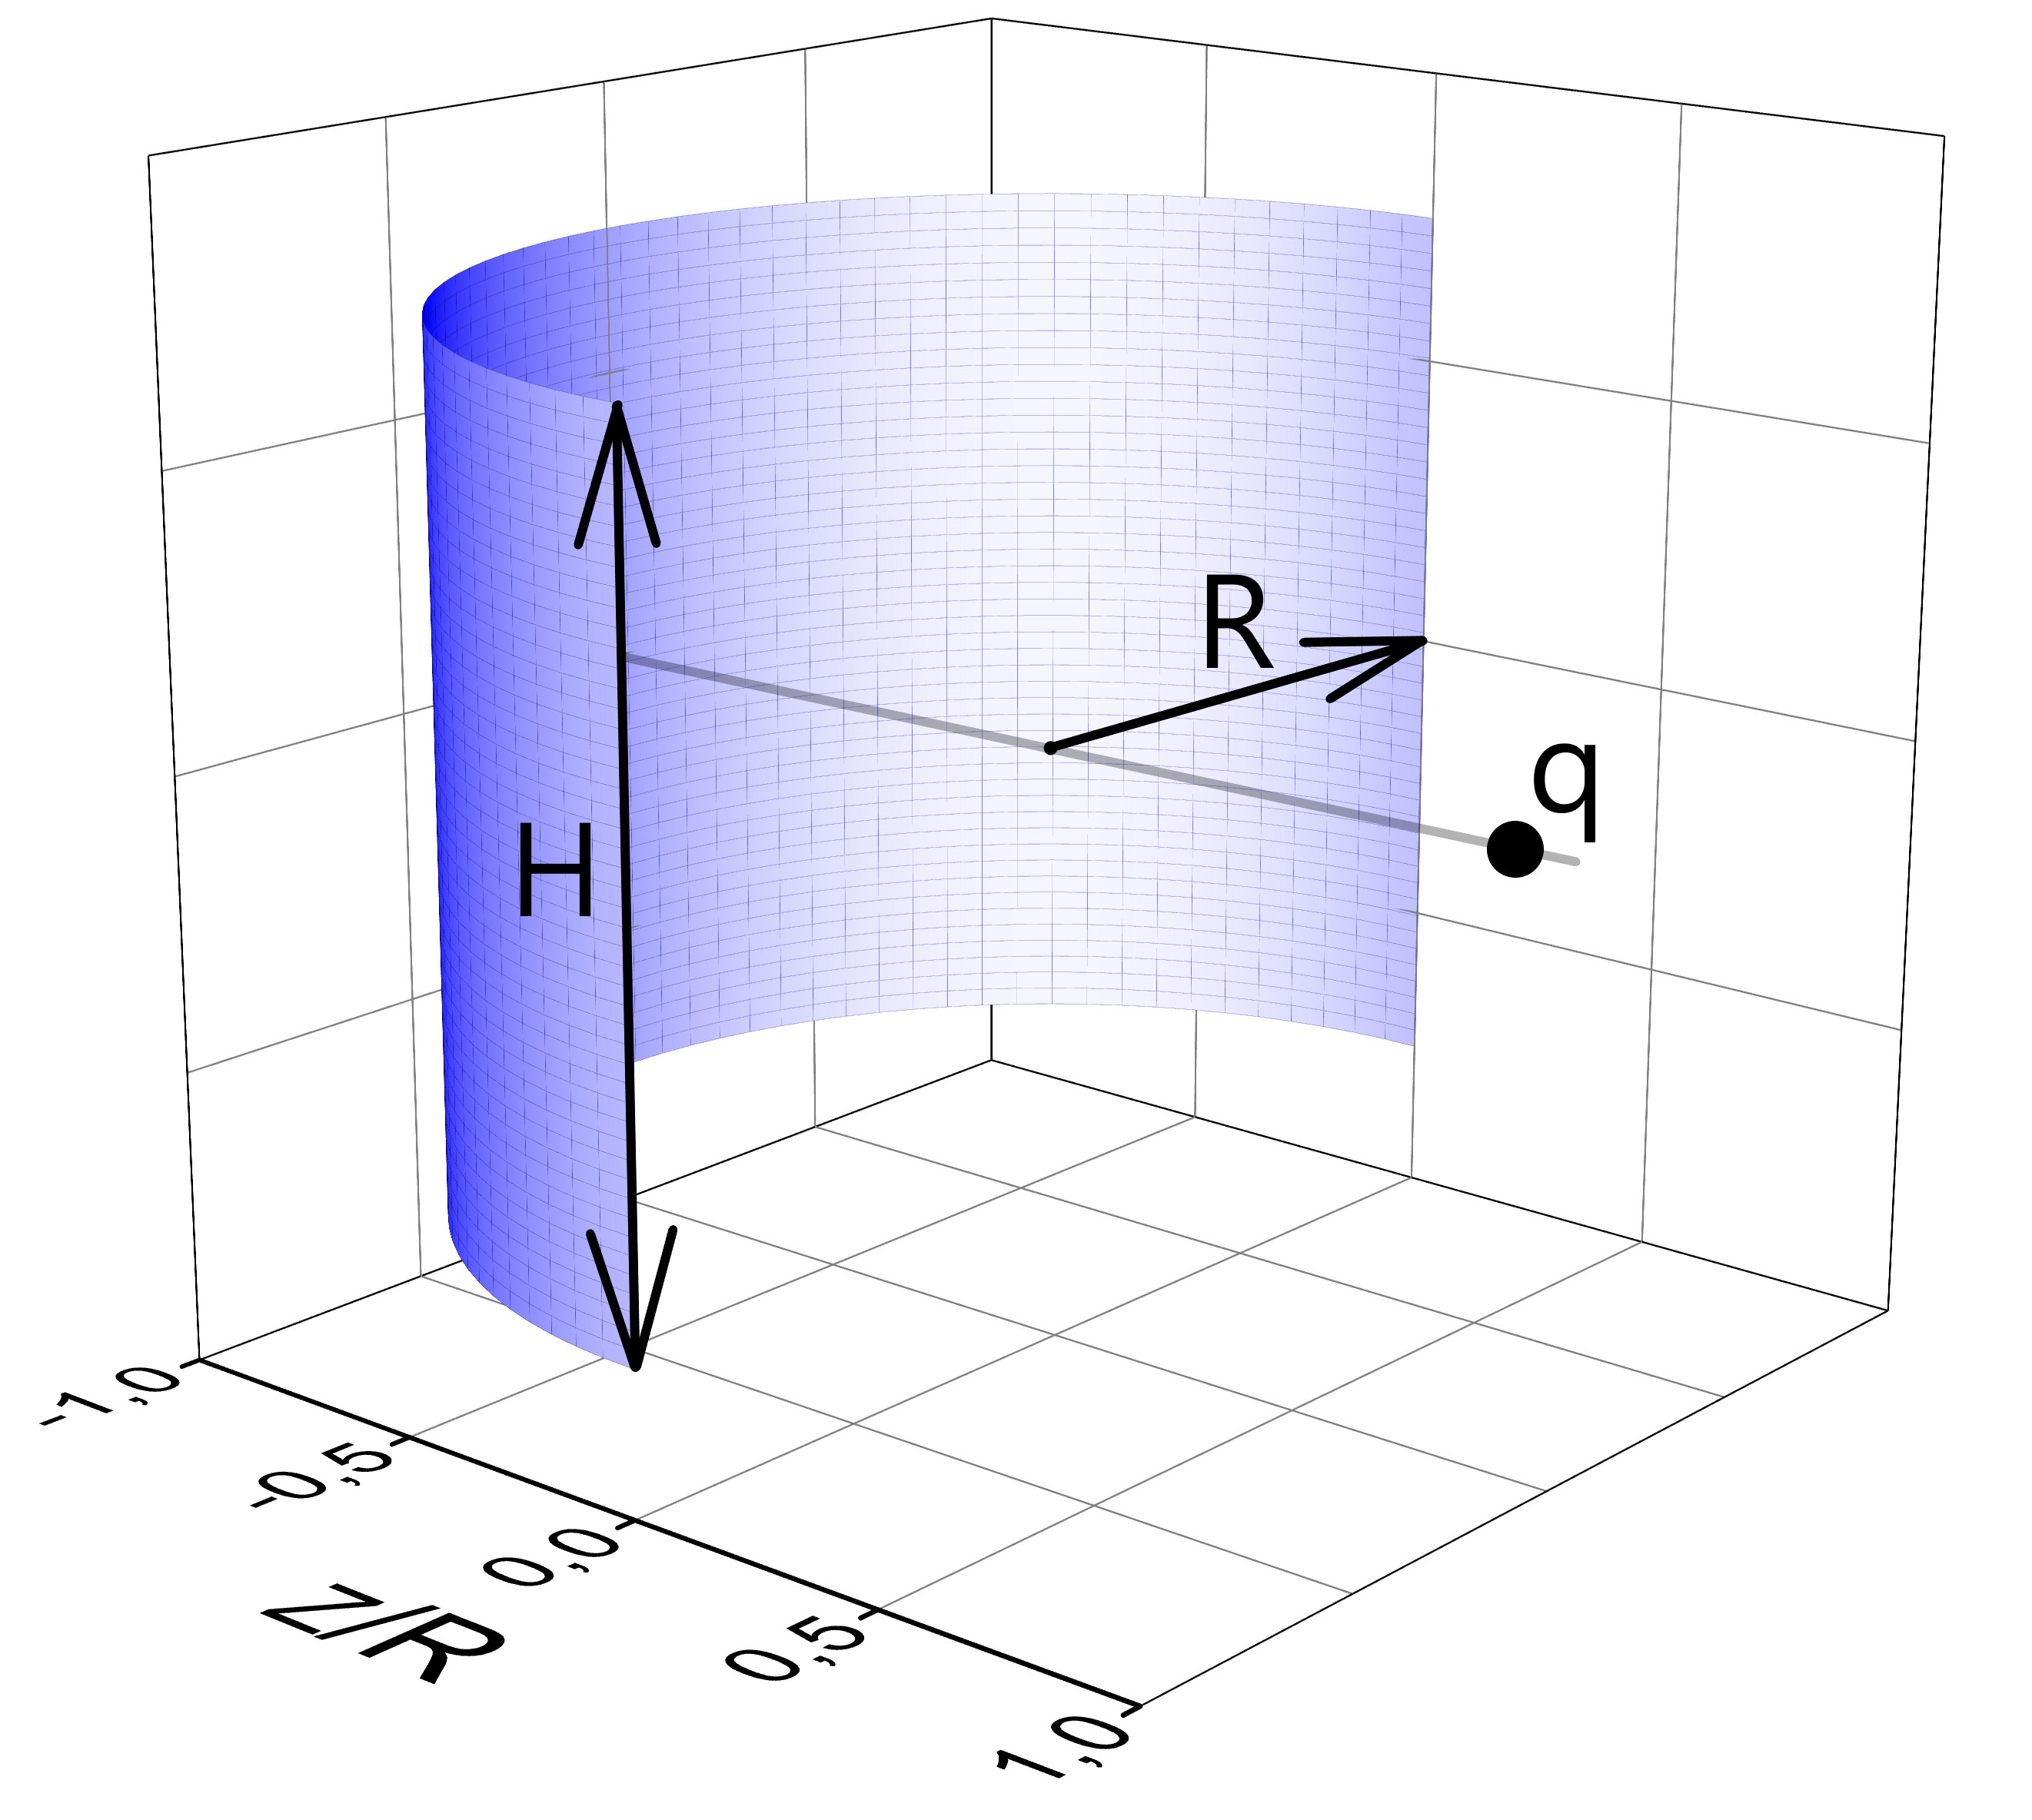
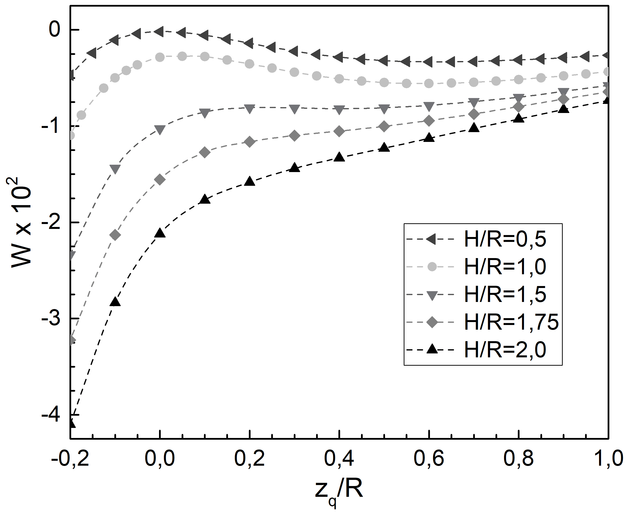
The effect of repulsion in a system with a cavity without axial symmetry.
An electrically neutral conductive cylindrical segment and point charge q
The energy W of the system as a function of coordinate $z_{q}$ of the point charge at various values of ratio H/R

Slide 13
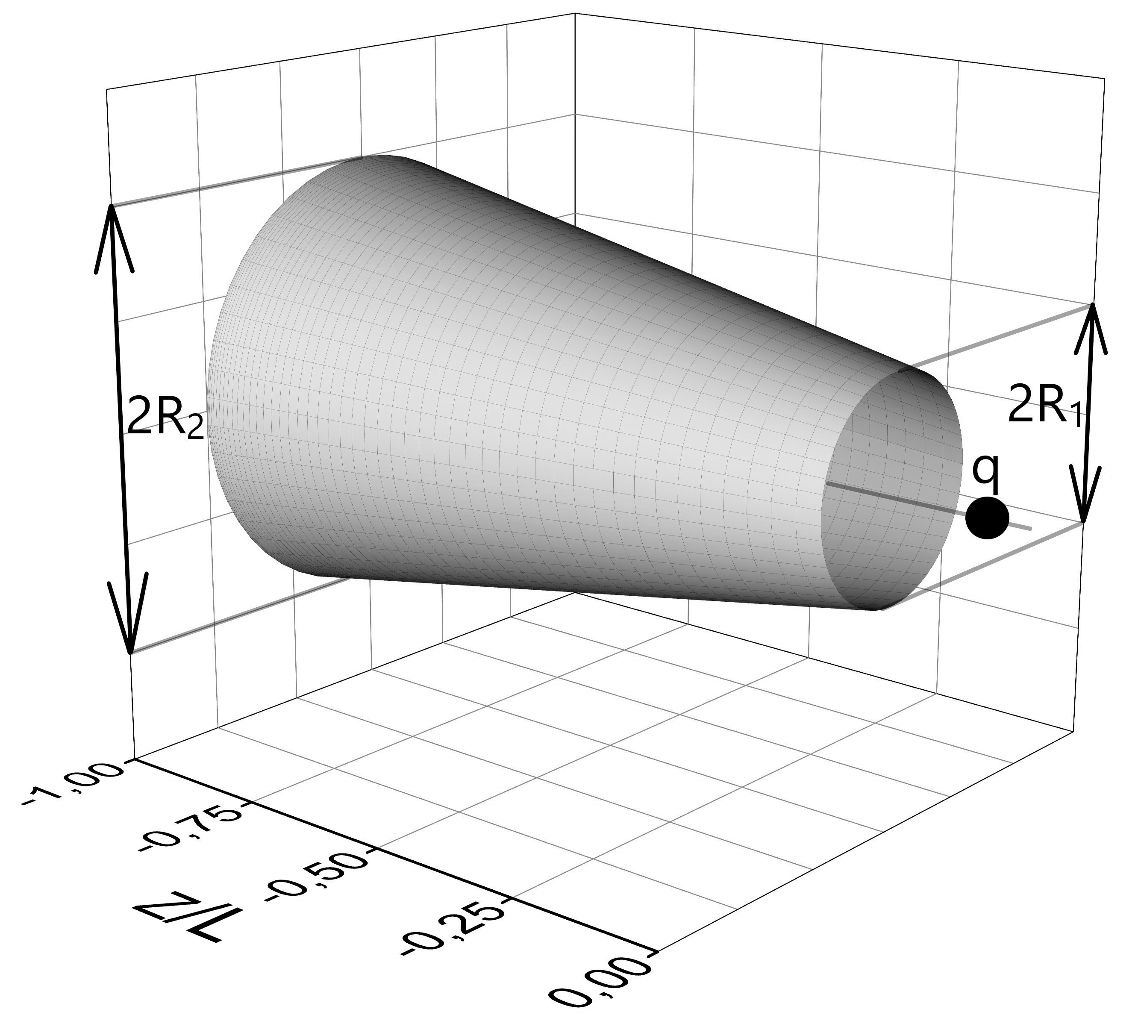
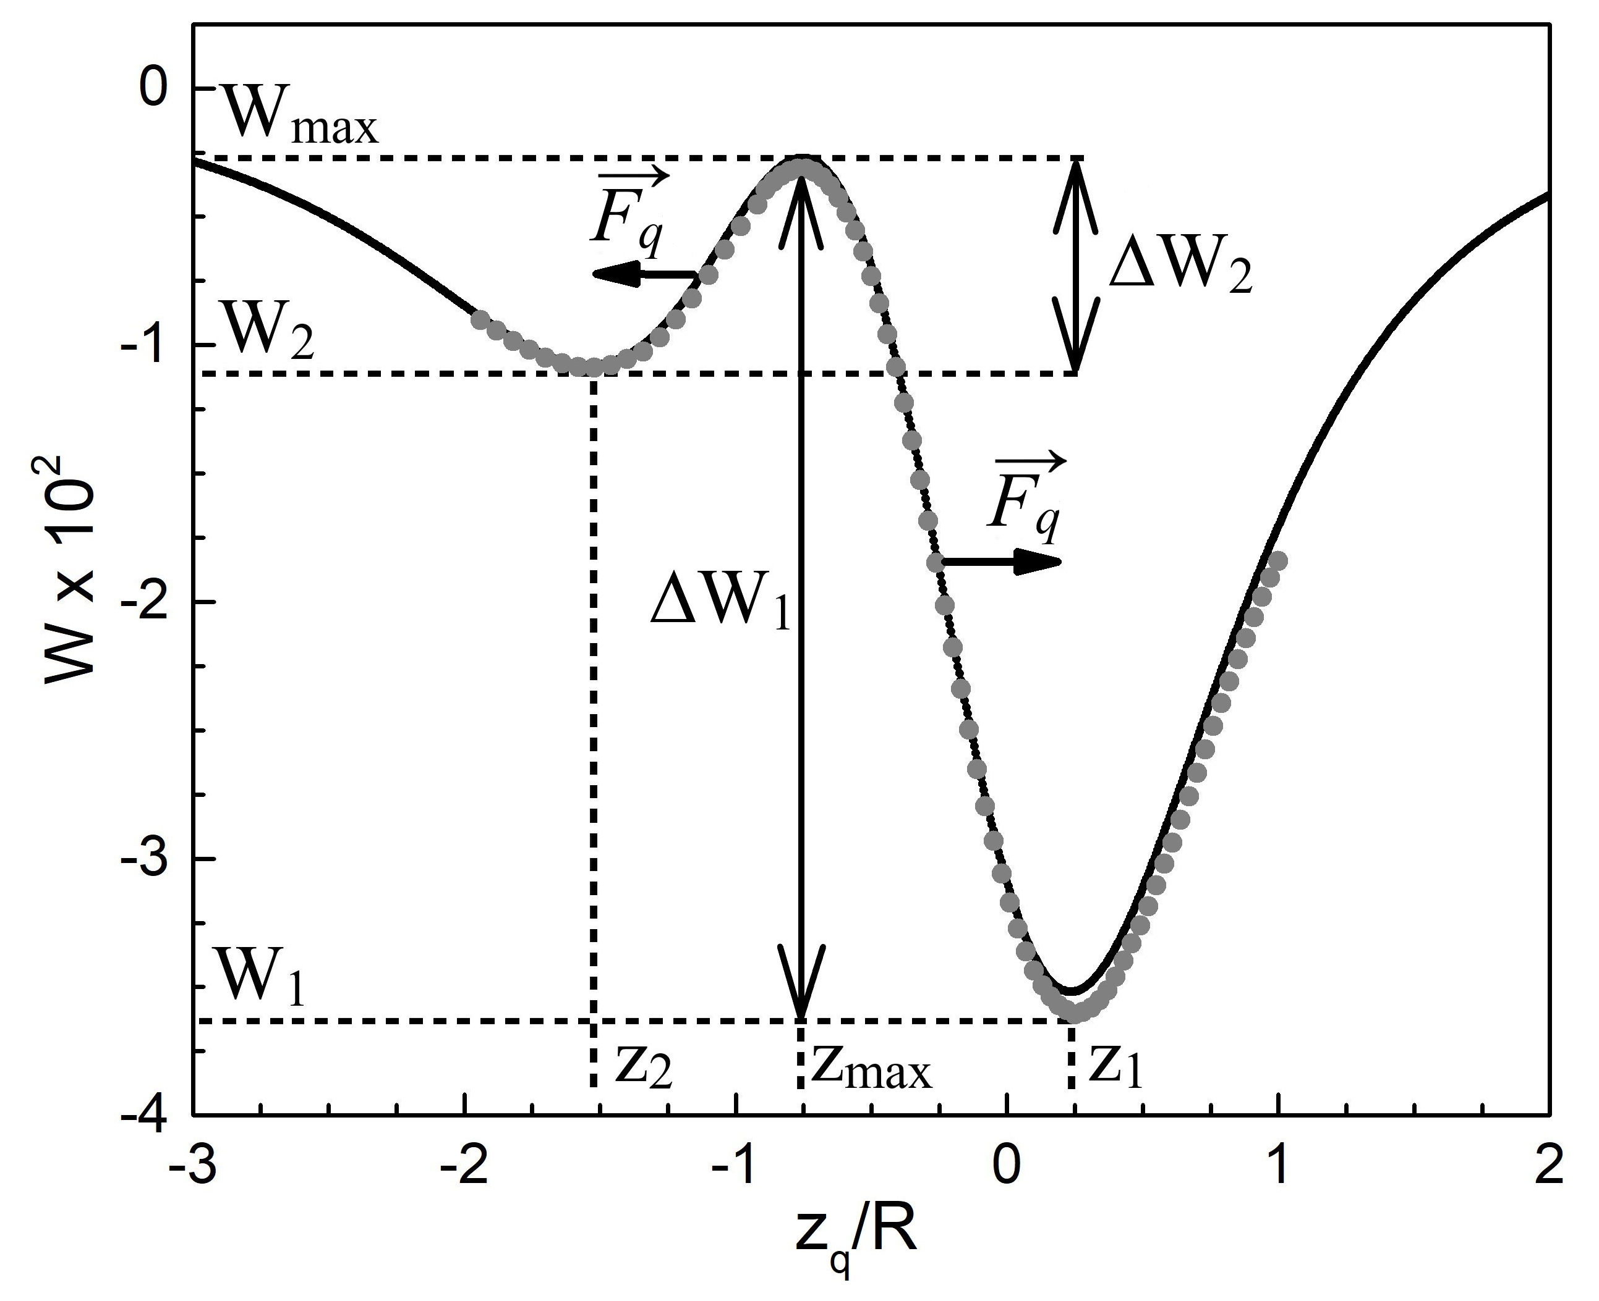
Conical conductors
A conical electrically neutral conductor and a point charge q
The energy W of the system as a function of coordinate $z_{q}$ of the point charge

Slide 14
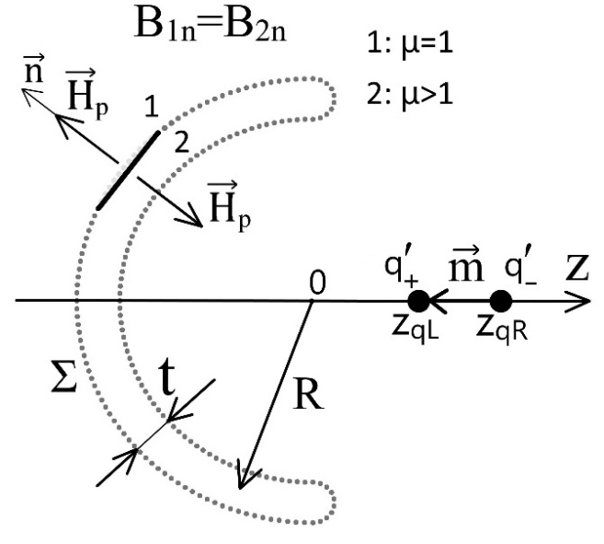
The effect of repulsion in magnetostatics
The scheme of the system
The fictitious magnetic charges approach
$$rot \vec{H}=j_{c}=0$$
$$\vec{H}=−grad φ′$$
$$div \vec{M}=−ρ′$$
$div \vec{H}=$ $ρ′$

Slide 15
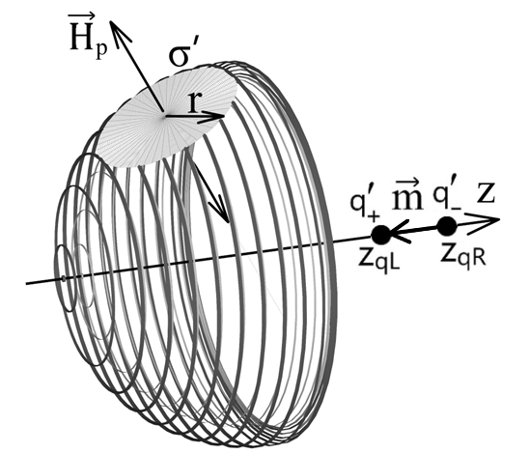
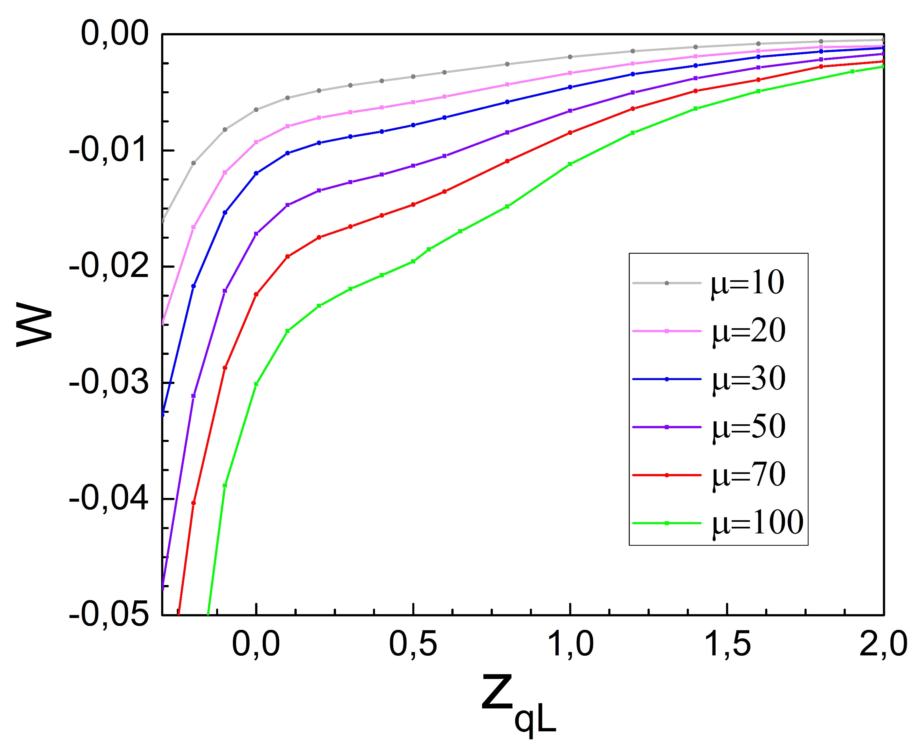
The effect of repulsion in magnetostatics
The scheme of the system
The dependence of the interaction energy on the coordinate of the point charge

Slide 16
Conclusion
In the present work the "repulsion effect" were numerically investigated for various types of uncharged conductors. The following results were obtained:
The common requirement for the manifestation of the "repulsion effect" in electrostatics is the presence of a cavity in the conductor.
The "repulsion effect" is possible for conductors with a through cavity.
The axial symmetry of the conductor is not necessary for the manifestation of the effect.
An increase in the thickness of the conductor with a cavity leads to the disappearance of the "repulsion effect".
If the conductor is slightly charged, then equally charged bodies can attract, and oppositely charged bodies can repel.
The possibility of the "repulsion effect" in magnetostatics was also investigated by considering the interaction of a soft magnetic hemisphere with a magnetic dipole. No repulsion effect in magnetism was found for the magnetic system under consideration.

Slide 17
Thank you for your attention

Slide 18
Supplementary materials

Slide 19
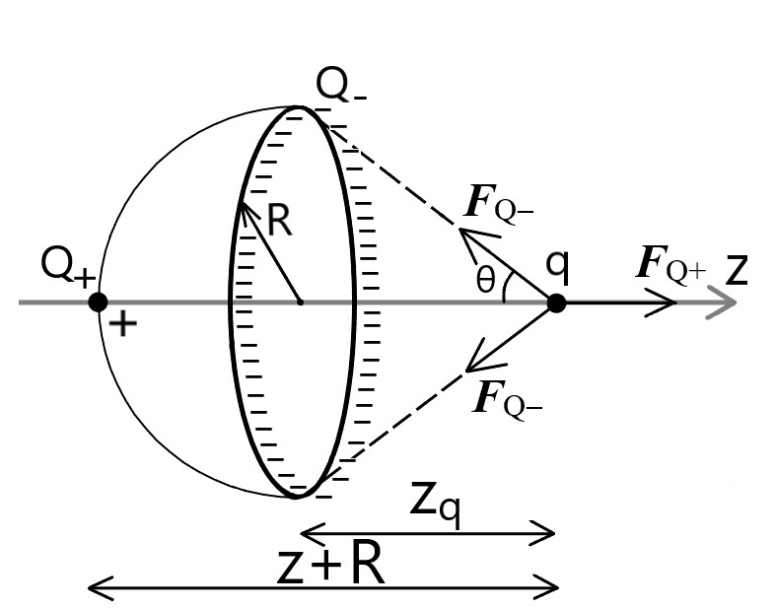
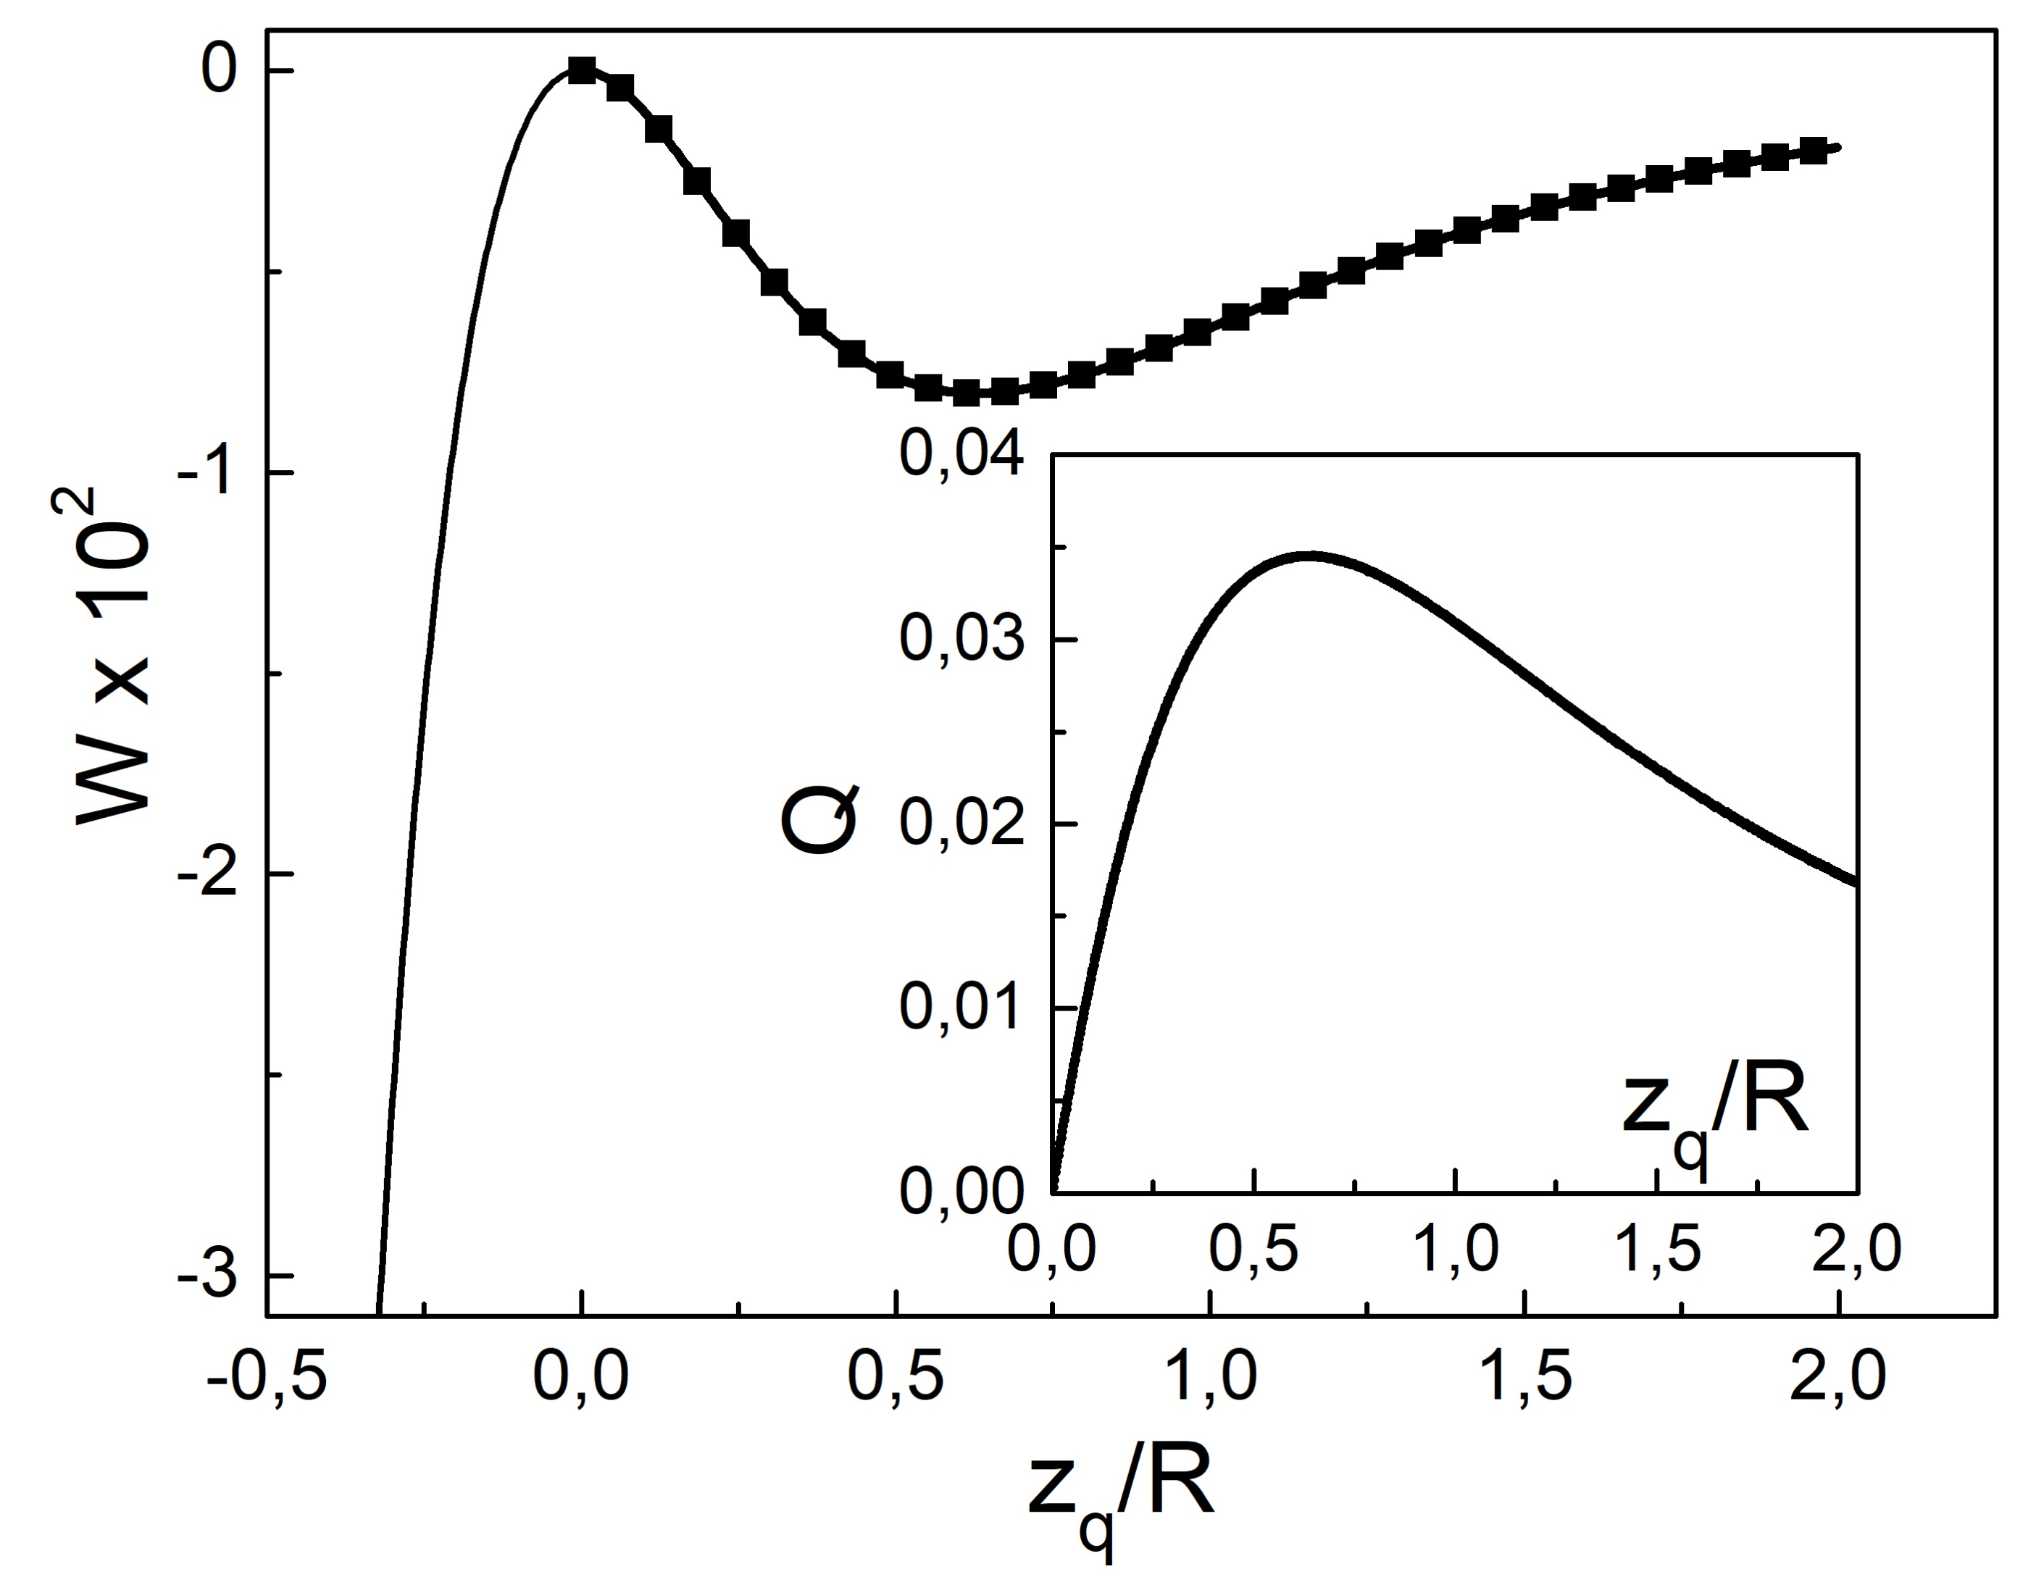
The simple model of equivalent charges
A diagram representing a conductive hemisphere in the form of a uniformly charged ring $Q_{−}$ and a point charge $Q_{+}$
Comparison of the result of the analytical solution with the result of applying the model of equivalent charge
$$W(z_{q})=\frac{{qQ}_{−}}{\sqrt{{z_{q}}^{2}+R^{2}}}+\frac{{qQ}_{+}}{z_{q}+R}$$

Slide 20
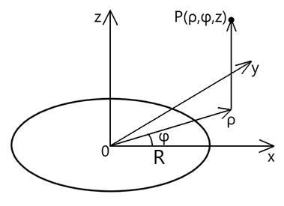
Thin ring electrostatics[Zhu, 2005]
Electric field strength
$$\vec{E}=\frac{τk\sqrt{R}}{4πε_{0}\sqrt{ρ^{3}}}\left\{K\left(k\right)−\frac{E(k)}{(1−k^{2})}\left[1−\frac{\left(ρ+R\right)k^{2}}{2R}\right]\right\}\vec{e_{ρ}}+\frac{τk^{3}zE(k)}{8πε_{0}\sqrt{ρ^{3}R}(1−k^{2})}\vec{e_{z}}$$
Electric potential
$$φ=\frac{τR}{πε_{0}\sqrt{z^{2}+{\left(ρ+R\right)}^{2}}}K(k)$$
Notations
$K\left(k\right)=\int_{0}^{π/2}{\frac{dβ}{\sqrt{1−k^{2}\sin^{2}{β}}}}−$the elliptic integral of the first kind$\text{,}$
$E\left(k\right)=\int_{0}^{π/2}{\sqrt{1−k^{2}\sin^{2}{β}}dβ}$ - the elliptic integral of the second kind;
$$k^{2}=\frac{4ρR}{z^{2}+{(ρ+R)}^{2}}.$$
P. Zhu, Field distribution of a uniformly charged circular arc, Journal of Electrostatics 63 (2005) 1035–1047

Slide 21
The representation of real and fictitious charges for conductor and magnet
A conductor in an electrostatic field
A magnet in a magnetic field
$$W=\frac{1}{2}Qφ+\frac{1}{2}qφ_{c}$$
$$W=−\frac{1}{2}\int_{V}^{ }{\left(\vec{M}\vec{H_{0}}\right)dV}$$

Slide 22
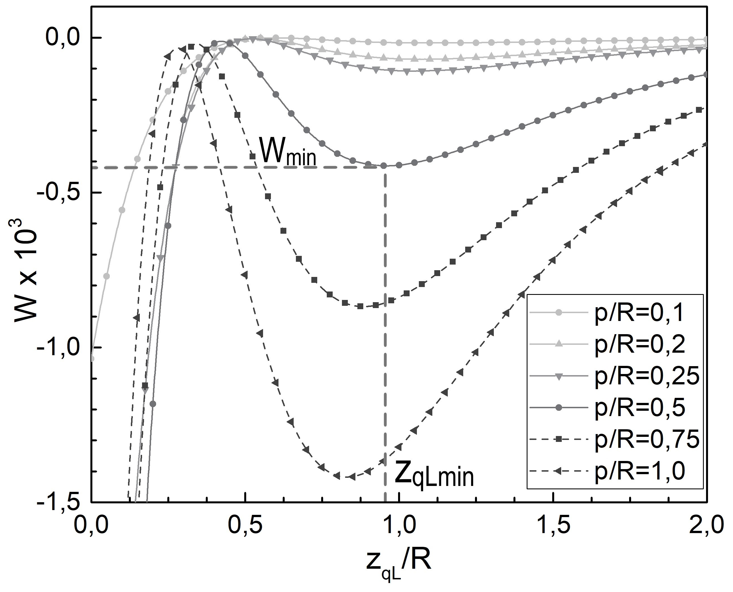
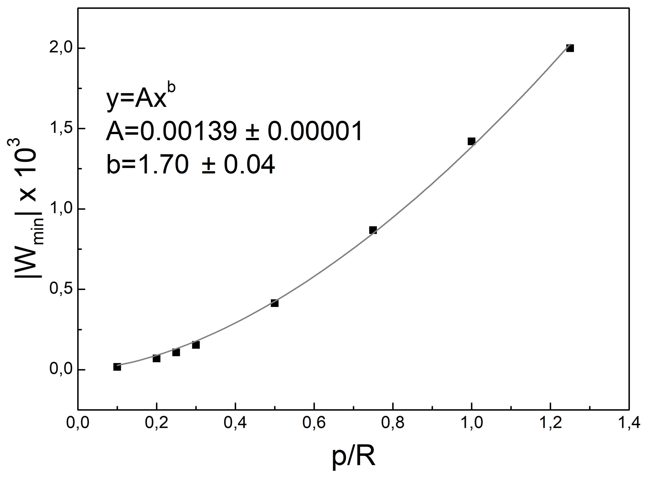
The repulsion effect for a conducting hemisphere in the dipole field
A hemisphere and an electric dipole p
The energy W of the system as a function of coordinate $z_{q}$ of the point charge at various values of ratio p/R
The depth of the local minimum $W_{min}$ as a function of the length of the dipole p

Slide 23
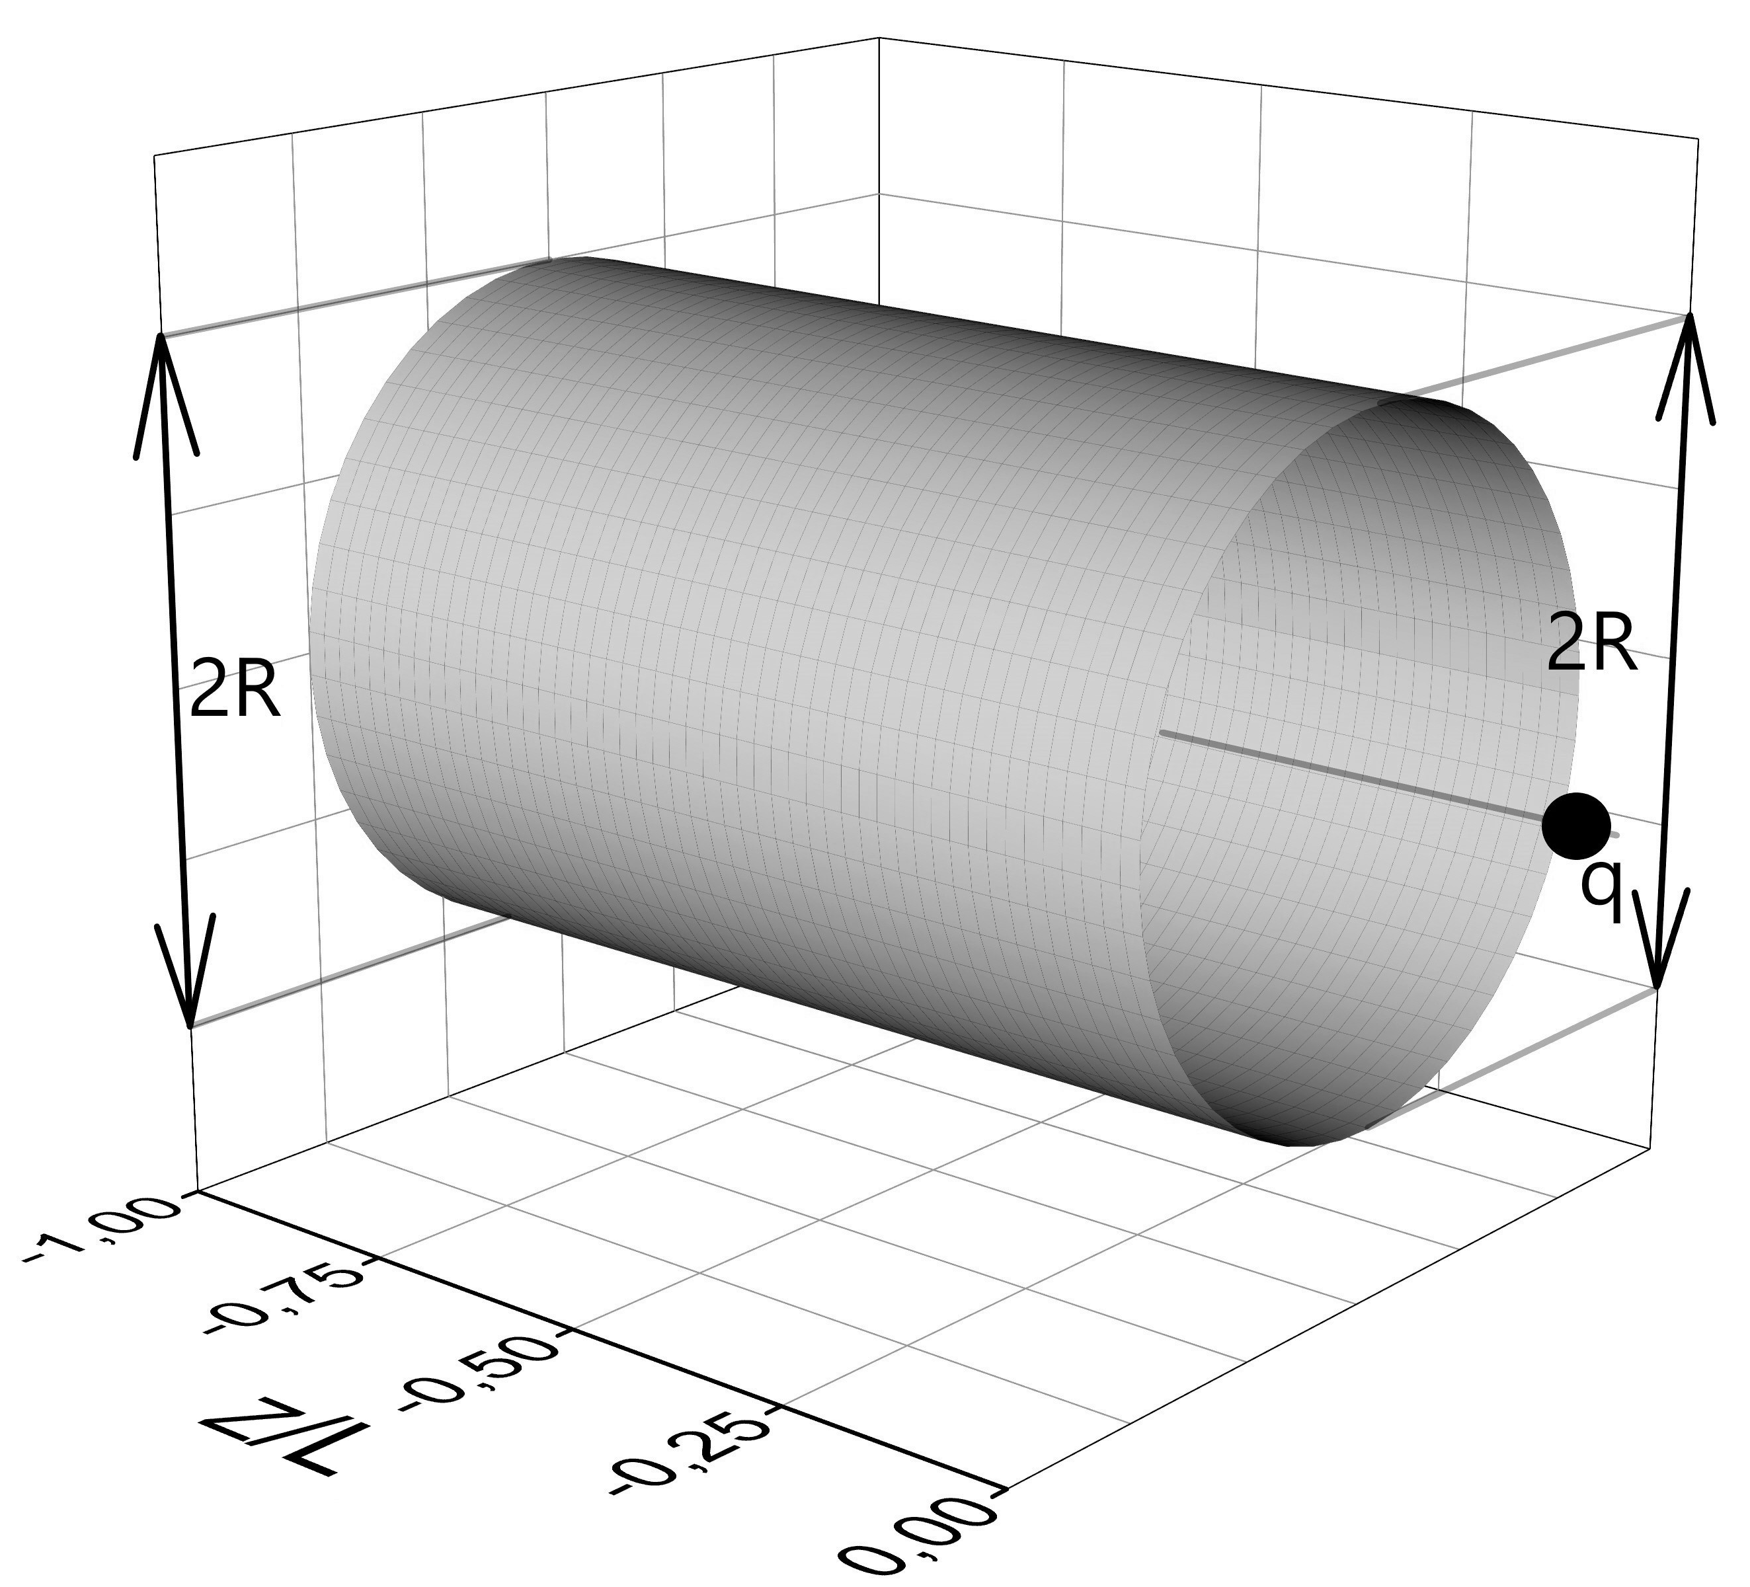
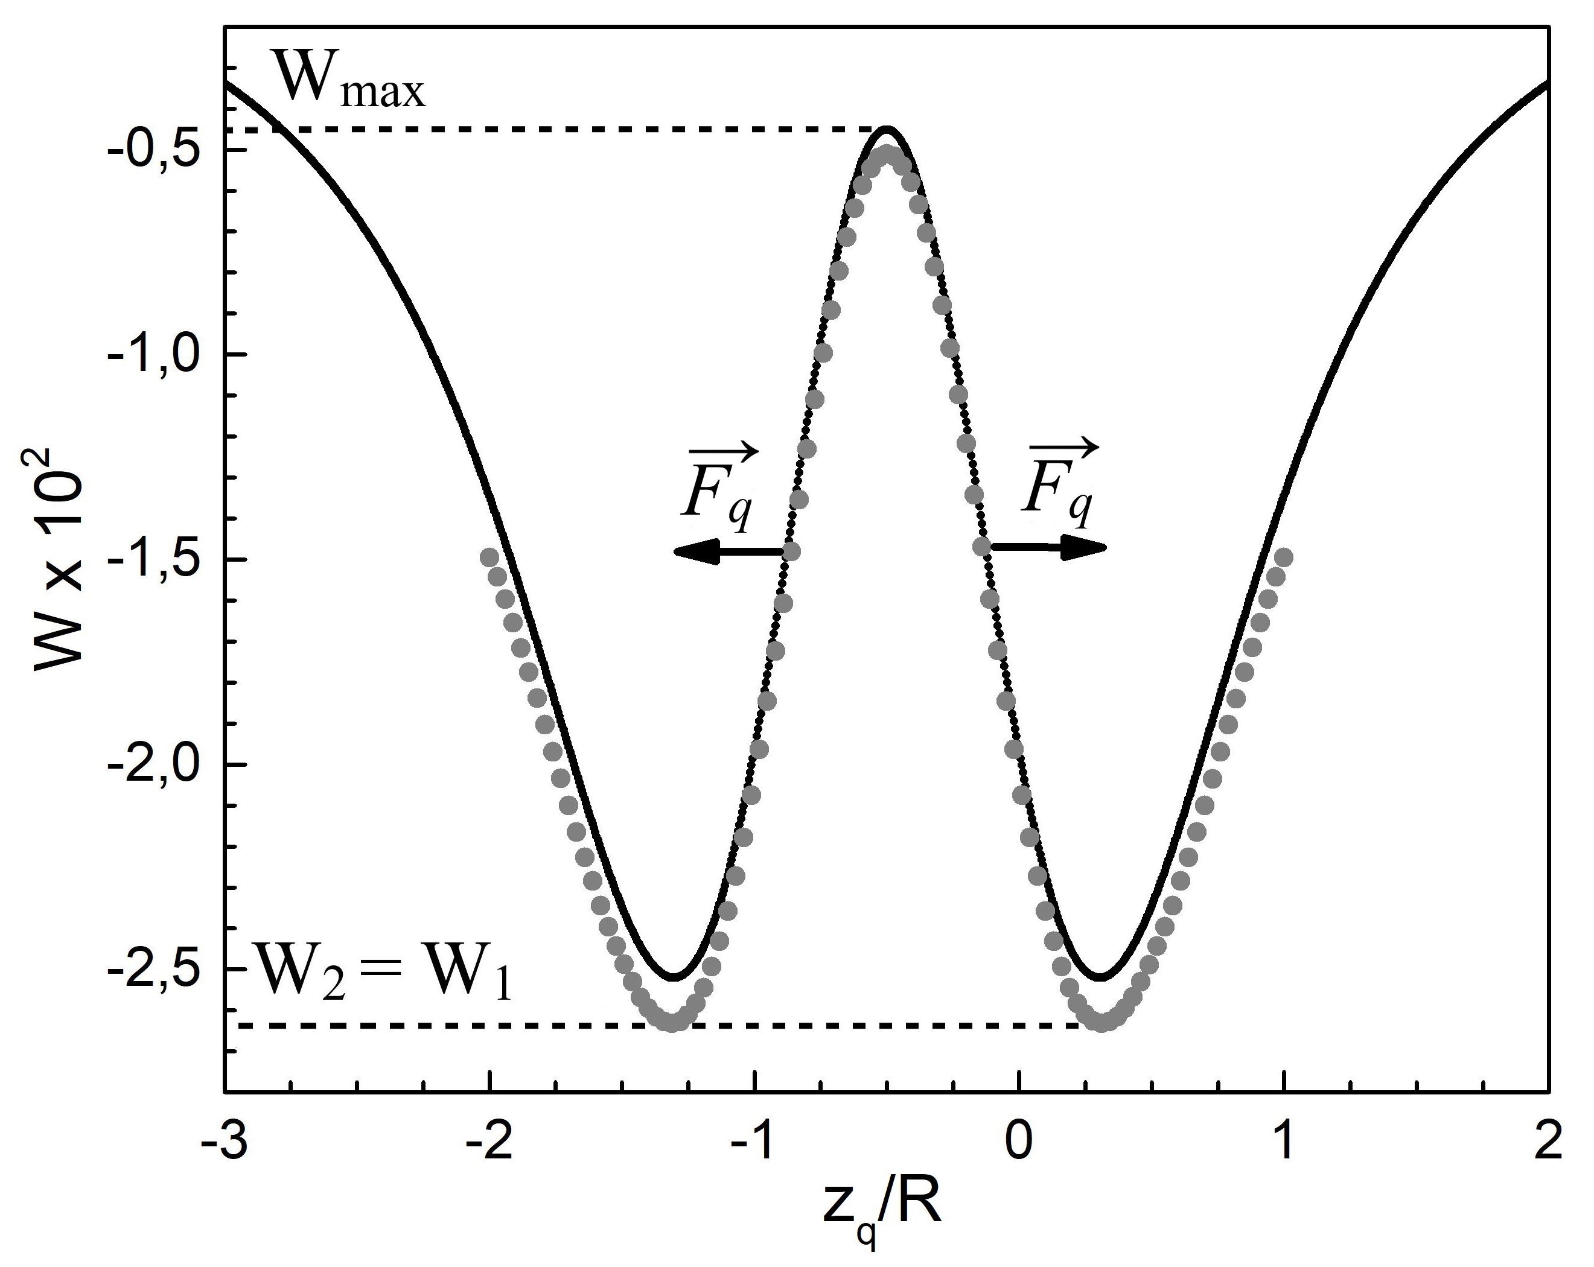
Cylindrical conductor
A cylindrical electrically neutral conductor and a point charge q
The energy W of the system as a function of coordinate $z_{q}$

Slide 24
Calculation of the magnetic field strength
Helmholtz's theorem
Maxwell's equations
$$\vec{H}\left(x,y,z\right)=\frac{1}{4π}\int_{∞}^{ }{\frac{ρ′\left(x^{′},y^{′},z^{′}\right)\vec{r}}{r^{3}}dV^{′}}+\frac{1}{4π}\int_{∞}^{ }{\frac{{\vec{j}}_{c}\left(x^{′},y^{′},z^{′}\right)×\vec{r}}{r^{3}}dV^{′}},$$
where $r=\sqrt{{\left(x−x′\right)}^{2}+{\left(y−y′\right)}^{2}+{\left(z−z′\right)}^{2}}$
$$\vec{H}\left(x,y,z\right)=\frac{1}{4π}\int_{∞}^{ }{\frac{ρ′\left(x^{′},y^{′},z^{′}\right)\vec{r}}{r^{3}}dV^{′}}$$
$${\vec{j}}_{c}=0$$
since the hemisphere is uniformly magnetized $ρ′=0$; $σ′≠0$:
$$\vec{H}\left(x,y,z\right)=\frac{1}{4π}\int_{Σ}^{ }{\frac{σ′\left(x^{′},y^{′},z^{′}\right)\vec{r}}{r^{3}}dS^{′}}$$
analogue
$$\vec{E}\left(x,y,z\right)=\frac{1}{4πε_{0}}\int_{Σ}^{ }{\frac{σ\left(x^{′},y^{′},z^{′}\right)\vec{r}}{r^{3}}dS^{′}}$$

Slide 25
References
Savin V. P., Koksharov Y. A. Еlectrostatic repulsion between an uncharged or slightly charged conductor and a point charge //Journal of Electrostatics. – 2022. – Т. 120. – С. 103769.
Savin V. P., Koksharov Y. A. Several Features of the Electrostatics of Uncharged Thin-Walled Cylindrical and Conical Conductors //Bulletin of the Russian Academy of Sciences: Physics. – 2023. – Т. 87. – №. 11. – С. 1723-1728.

