Slide 1
National Research Nuclear University MEPhI Joint Nuclear For Nuclear Research
Study of nuclei structure in alpha-cluster model by hyperspherical functions using cubic spline interpolation
Bazhin Anton Sergeevich, Samarin Viacheslav Vladimirovich
E-mail: bazhin@theor.jinr.ru

Slide 2
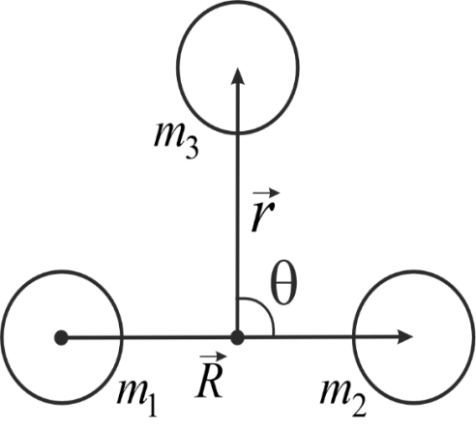
Hyperspherical functions method for three body problem
Jacobi’s vectors
(2)
(1)
x₀ = 1 fm, m₀ = 1 a.u.m.
Hyperspherical coordinates
Replacing wave function for the ground state ψ₀ by a series of hyperspherical functions,
l_{x} = 0,2,4,…; n = 0,1,2,…; K = 2l_{x}+2n;
Coefficient m_{i} of the cubic spline equals to the second derivative of hyperradial wave function
(5)
(6)
(3)
The system of equations for the cubic spline
(7)
Functions are found from system of hyperradial equations l_{max} = 12, n_{max} = 12
Matrices A and H can be found in
[Marchuk G.I. Methods of Numerical Mathematics. –Springer NY, 1982]
The problem is reduced to the problem of eigenvalues and eigenvectors of matrix B
(4)
(8)
[Джибути Р.И., Шитикова К.В. Метод гиперсферических функций в атомной и ядерной физике. 1993 г.]
[V.V. Samarin. Study of spatial structures in α-cluster nuclei, Eur. Phys. J. A (2022) 58,117.]

Slide 3
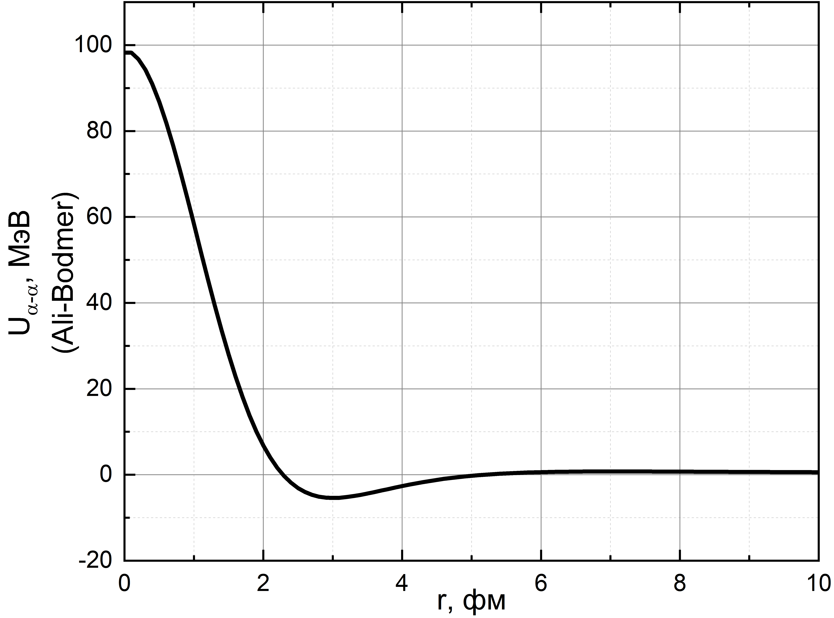
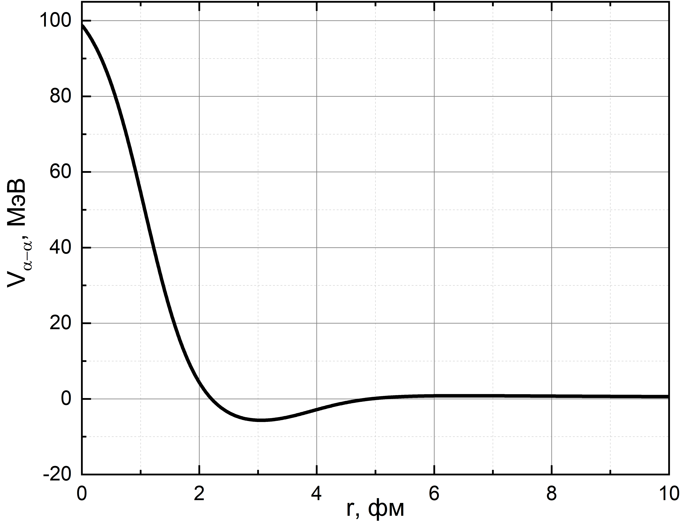
Interaction potential of alpha-particles
The potential of strong interaction V_{α-α} is
based on data of alpha-alpha scattering,
known as Ali-Bodmer (AB) potential [1]
[1]
[3]
Ali-Bodmer (AB)
2WS
(1)
Coulomb interaction obtained from [1,2].
(2)
Potential with two Woods-Saxon’s functions
(2WS) has more parameters. It is important when describing experimental data [3]
Alpha-alpha scattering potentials AB (left) and 2WS (right) are almost the same.
(3)
It is known that potential AB doesn’t fit for describing bound energy of alpha-cluster nuclei, for example ¹²C.
Because of that, potential 2WS was used for describing interaction of alpha-clusters.
Wood-Saxon’s type function f(r,B,a)
(4)
[1] S. Ali, A.R. Bodmer, Nucl. Phys. 80, 99 (1966).
[2] H. Suno, Y. Suzuki, P. Descouvemont, Phys. Rev. C 91, 014004 (2015).
[3] V.V. Samarin, Study of spatial structures in α-cluster nuclei, Eur. Phys. J. A, 58, 117 (2022).

Slide 4
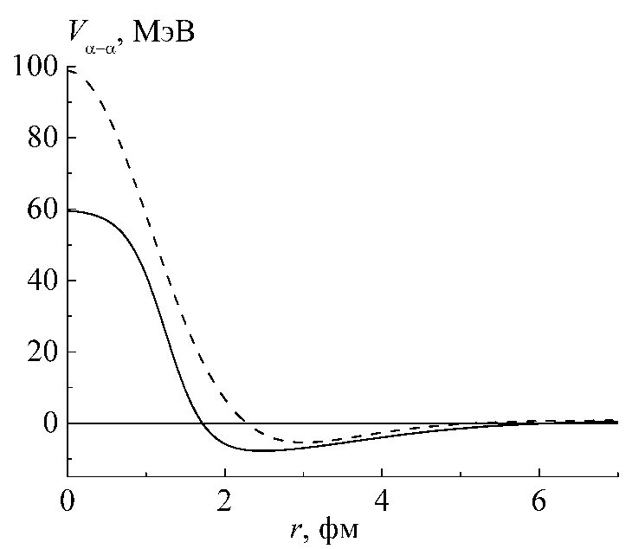
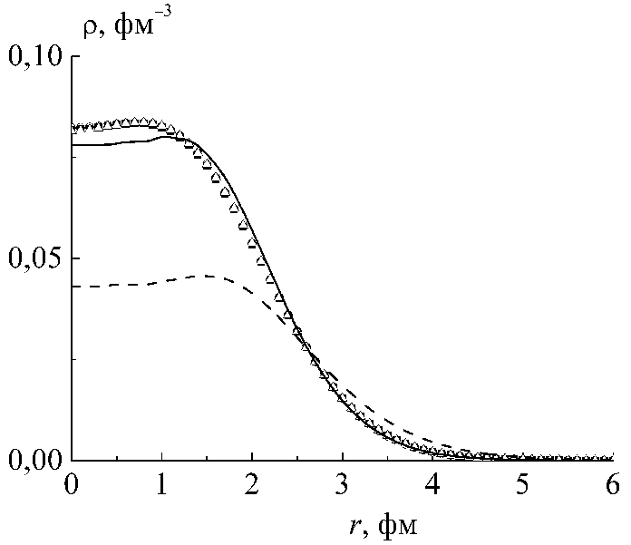
Selection of parameters of α‒α interaction potential for making an agreement with experimental properties of alpha-cluster nucleus ¹²C (3α)
V_{α‒α}, MeV
Interaction potentials V_{α‒α}
AB
1. To get an agreement with experimental data parameters of potential 2WS of ¹²C were modified. Obtained charge distribution and separation energy into 3α-particles of ¹²C are close to the experimental one.
Potential 2WS has more soft repulsive core unlike AB potential.
2WS
2. After α-particle separation in ¹²C, unbound nucleus ⁸Be is formed. Because of that, the ground state energy was obtained E₀=-7.272 MeV that is close to experimental value of α-particle separation of ¹²C E_{s}=7.366 MeV [1] (E₀≈-E_{s}).
r, fm
ρ, fm⁻³
Charge distribution of ¹²C.
3. Calculated root-mean-square (rms) charge radii is also close to the experimental one
Experimental data
2WS
The agreement with experimental charge distribution was obtained using 2WS potential unlike AB potential.
AB
The difference occurs because of the errors in calculation the charge distribution at the region of large radii, where the charge density is low.
r, fm
[1] Nuclear Reaction Video. Low Energy Nuclear Knowledge Base. http://nrv.jinr.ru

Slide 5
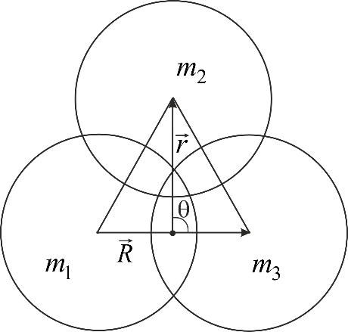
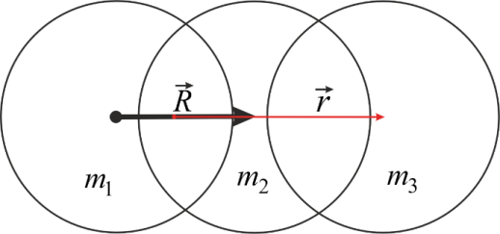
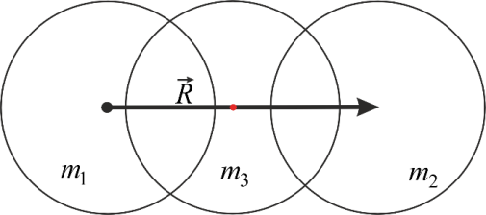
The probability density for the ground state of alpha-cluster nucleues ¹²C
Positions of alpha-clusters, radii of alpha-clusters was chosen as rms radii of ⁴He - 1.67 fm.
$θ=π/2$
r, фм
(logarithmic scale)
3
In different positions of Jacobi’s vectors
Triangular configuration
3
1
2
The most probable configuration is triangular, when alpha-clusters are located at the vertices of equilateral triangle with length of sides ~2.6 fm.
1
2
$θ=0$
The softening of the repulsive core leads to overlapping of pure alpha-cluster structure.
Charge distribution and rms radii calculated as average for all positions of vectors $\vec{R}$ and $\vec{r}$.
2
r, фм
3
1
Linear configuration
3
2
1
Less probable configurations

Slide 6
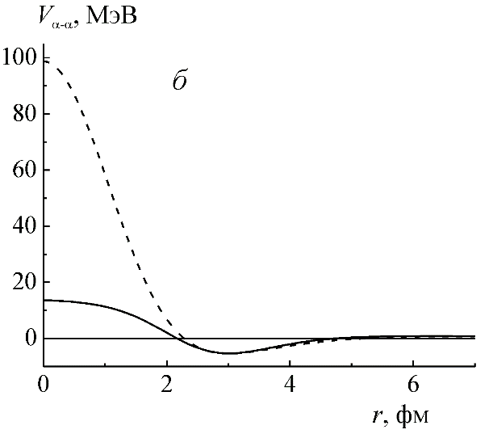
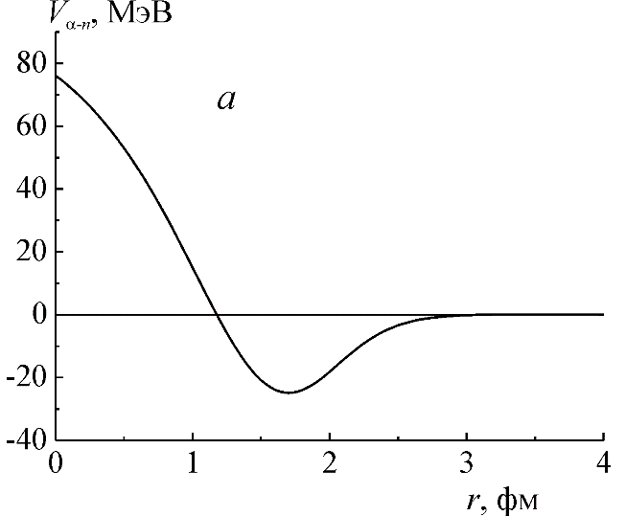
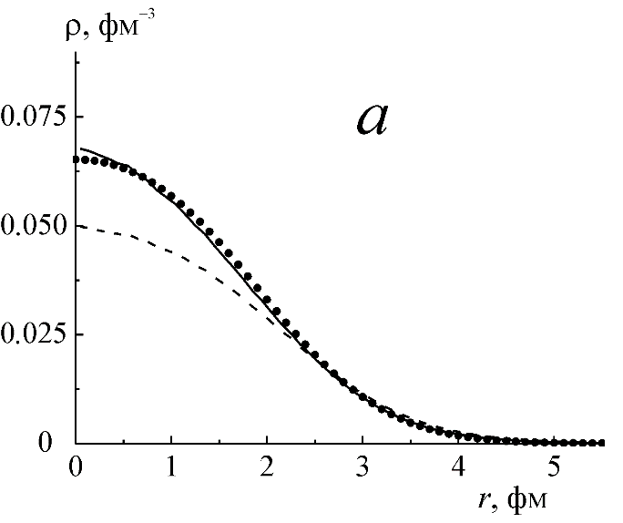
Selection of parameters of α‒α interaction potential for making an agreement with experimental properties of alpha-cluster nucleus ⁹Be (α-n-α). Potential V_{α‒n}
Potential of
interaction
Interaction α-n пis represented by pseudopotential of strong interaction between alpha-cluster and nucleon.
It gives correct description for neutrons outside of alpha-cluster (doesn’t take into account neutrons scattering on alpha-clusters)
AB
2WS
Experimental value of neutron separation for ⁹Be E_{s}=1.664 MeV [1]. After neutron separation, unbound nucleus ⁸Be is formed.
As a result of the selection, the value of the ground state energy was obtained E₀=-1.663 MeV. Thus, agreement with experimental data was obtained E₀≈-E_{s}.
At the same time, charge distribution was obtained, which is close to the experimental data.
Charge distribution of ⁹Be.
Experimental data
2WS
AB
For
and
Calculated rms charge radii also is close to the experimental value [1].
[1] NRV. http://nrv.jinr.ru

Slide 7
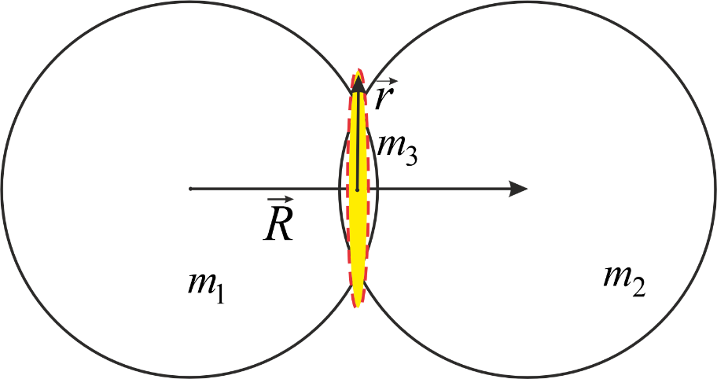
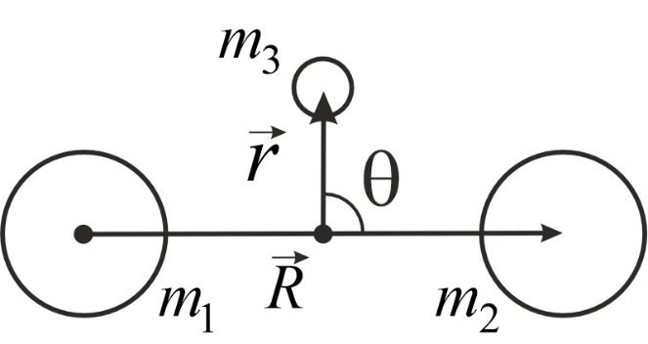
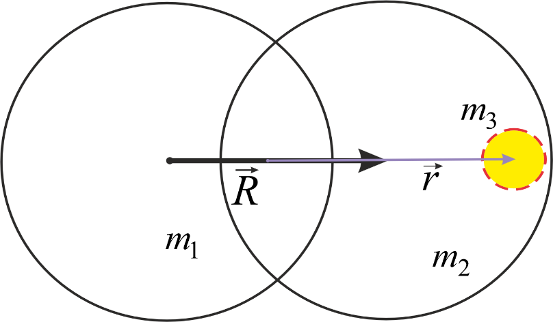
The probability density for the ground state of alpha-cluster nucleues ⁹Be
$θ=π/2$
(logarithmic scale)
In different positions of Jacobi vectors
The most probable is “nuclear molecule”, when neutron is located beteween alpha-clusters.
$θ=0$
Less probable configuration
⁴He+⁵He.

Slide 8
Selection of parameters of α‒α interaction potential for making an agreement with experimental properties of alpha-cluster nucleus ⁶Li (α-n-p)
The parameters of the SX variant [1] of the A-T-potential
The nuclear part of the nucleon–nucleon interaction may be described by the effective pairwise central soft-core Afnan-Tang (A-T) potential [7] for a triplet state (t) and for a singlet (s) state
We using effective nucleon-nucleon pseudopotentials V_{α-n} and V_{α-p} in calculations [1]. The pseudopotentials do not take into account the data on phase shifts, but their forms are similar to α–α and nucleon–nucleon potentials. The parameters of the pseudopotentials were determined from the condition of equality of the calculated and experimental values of the ground state energies for systems α-cluster + nucleons.

Slide 9
The probability density for the ground state of alpha-cluster nucleues ⁶Li
The ground state J=1:
Esep =3.725 MeV (to 3 paticles a, p and n).
The calculated energy of the ground state with the triplet state of (p+n) subsystem is -3.7 MeV.
The excited state J=0:
with E_{exc}=3.563 MeV, E_{sep} =0.162 MeV (to 3 paticles a, p and n) may be presented as the ground state with the singlet state of (p+n) subsystem, calculated energy is -0.3 MeV.

Slide 10
Thank you for your attention!

