Slide 1
Laboratory of Radiation Biology, Joint Institute Nuclear Research
Enhancement of X-ray imaging via contrast media
Togtokhtur T., Dushanov E.B, Batmunkh M., Bugay A.N.
2024
Notes:
Hello everyone, I am going to introduce the contribution of some contrast media used in CT and their radio enhancement effect has demonstrated by the Monte Carlo method.
First of all, I would like to say several background contents. I hope you it will easily to understand our topic. Let’s talk about one basic thing.

Slide 2
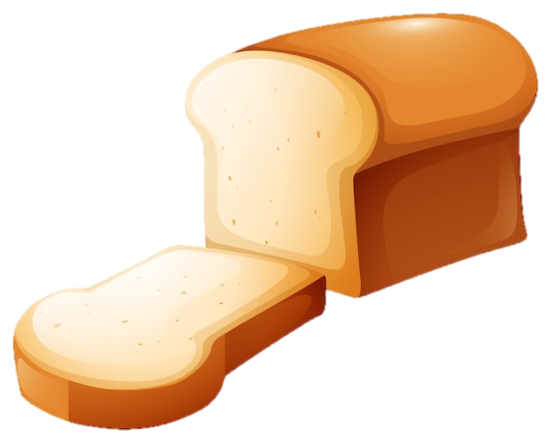
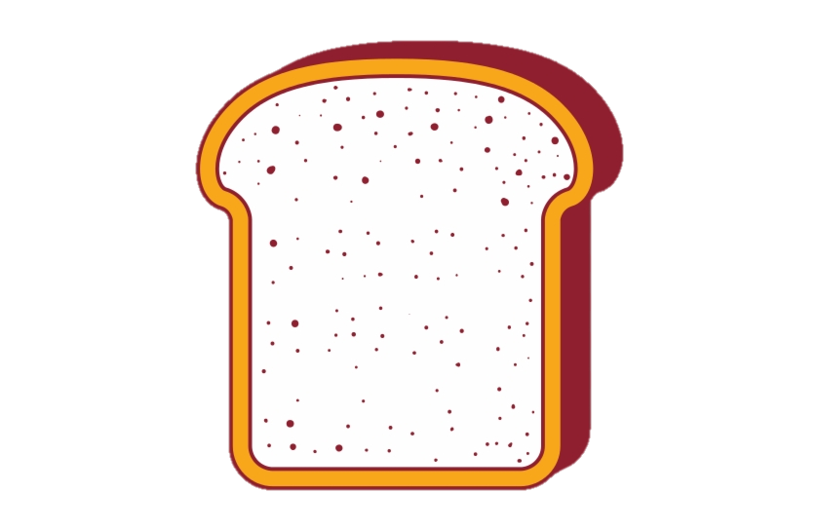
Searching key points …
Identifying moldy part inside a bread
Disease
biological
CT
Medical
Surgical
Radiation treatment
+ something
Cut
X-ray imaging (2D)
X-ray imaging (3D)
Notes:
Let’s imagine as you have bread like this but the bread getting moldy. So how can we find the origin of the infection? best ways is just to cut off them. Then we can see bacterial growth distribution and sizes on every single slice. This is simple example of detection and diagnosis method. For a biological object, it will be used in different way. That is 3D tomography. A CT scan can see nearly all parts of the body and it is used to diagnose disease or injury as well as to plan medical, surgical, or radiation treatment.
Nevertheless, the technology has been some disadvantages. Normal CT doesn’t work well if the difference between biological materials density and chemical structure is slight. For example, soft tissue and tumor like parts look very similar. Someone who has found the approach that can distinguish them using some substance. From here we jumped to two dimensional X-ray imaging. It is easier way for some prediction gives to radiologists.

Slide 3
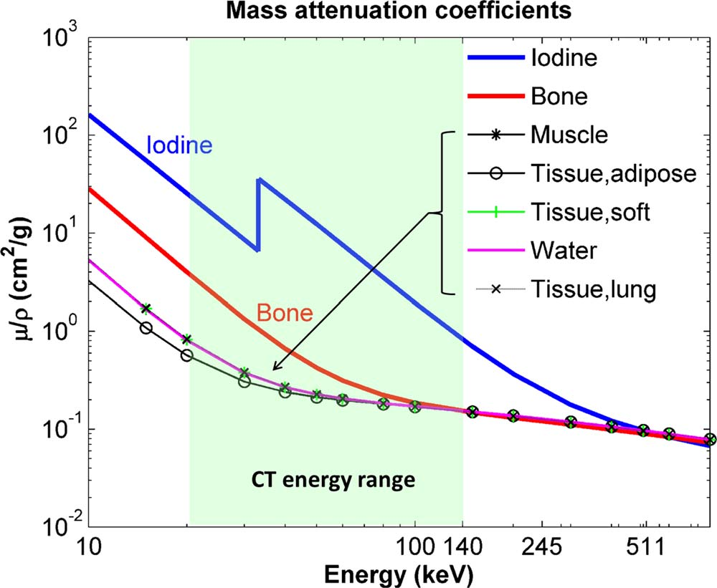
Background
Contrast media is substance used to improve pictures of inside parts of the body produced by X-rays. Iodine, Gadolinium, Bismuth, … etc.
a)
No interaction
Photoelectron
Absorption
127I atom
The concept
b)
K-characteristic photon
recoil e⁻
c)
Incident energy, E₀
Xia, T. (2013)
E₁ <E₀
No process
Photoelectric effect
Compton scattering
Attenuation is the reduction of the force
Interaction processes are determined by mass attenuation coefficient
Notes:
S2- Contrast media is substance. But main agent is metallic elements such as iodine and gadolinium. Well, what exactly going on behind x-ray imaging? Let’s considering the concept. There are main two physic processes. Assumed that no process happened in part A. it is called transmitted photon. Process B is the inelastic scattering of energetic photons on an electron-localized inner atomic shell. It is triggered by the absorption of photon energy equal to inner shell electrons. After that secondary electron is emitted from an inner shell. And process C is does not goes frequently for x-ray imaging. These interaction processes are measured by mass attenuation defined in different materials. For example, bone contains some metallic atoms a lot. Calcium atom absorbs photon greater than hydrogen, oxygen and carbon so one. A material with several types of metallic atoms is performed at a higher attenuation value. The idea is directed to how to use these metallic compounds in X-ray imaging.

Slide 4
Aim
To estimate enhanced two dimensional x-ray imaging for iodine and gadolinium contrast media using Monte-Carlo method
Notes:
S3- In this study, we focused on enhanced two dimensional x-ray imaging for iodine and gadolinium contrast media

Slide 5
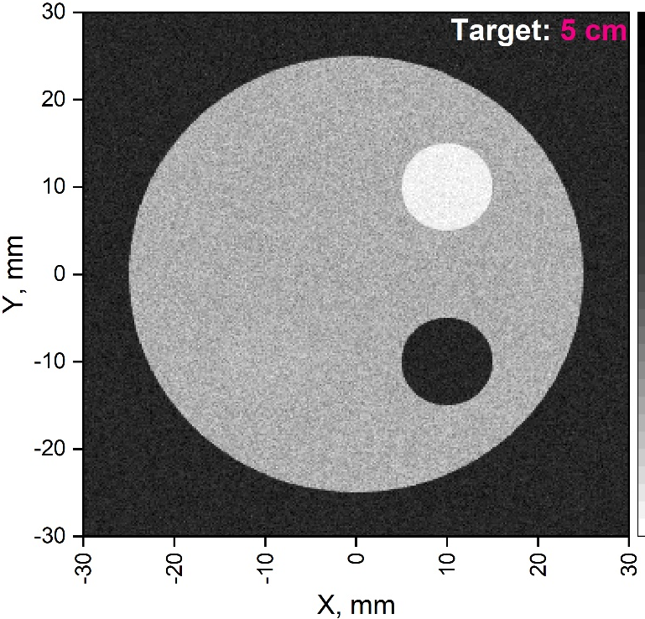
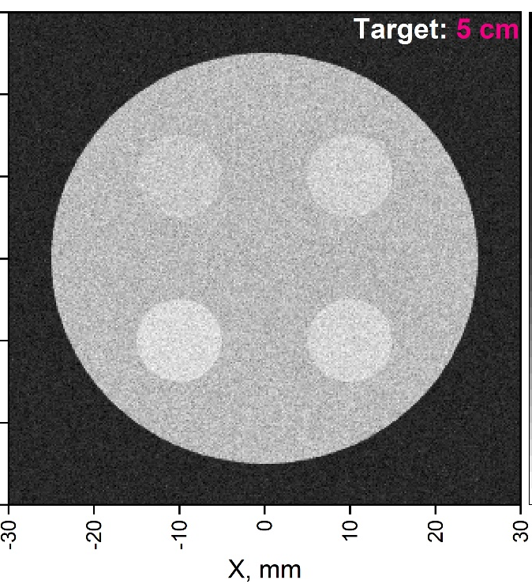
X-ray imaging technique
Schematic imaging phantom
How does it work?
The projection images were calculated in GEANT4
X-ray source
I
II
target
Z
A
B
2.0
4.0
Soft tissue
6 cm
Enhanced
5 cm
C
D
8.0
6.0
X
Y
¹²⁷I mg/ml
phantom
1 cm
Front of view
detector
I. type of material
II. Iodine concentration
A - Soft tissue
B - Bone cortical
C - Blood
D – No target (Air)
accumulating transmitted beam
To create projection image
The imaging phantom was adapted through the experimental setup ^{[2]}.
Above 7-9 I mg/ml is toxic
[2] source: Steven Wayne Tilley II et al 2018 Phys. Med. Biol.
Notes:
I am sorry I have detailed lot of things not common way in this slide. It looks like poster. There are Monte-Carlo method and some results. we modeled imaging phantom which is used in preclinical experiments by default way. This one is front of view. And simulation procedure, then we obtained following projection images. the first image is depending various material and obtained for testing our method. the X-ray image on the detector with different tolerances each materials, and the brightest part matches on the bone cortical. Let’s turning attention to the second image 4 different concentrations of iodine. The highest tolerance corresponds to 8 mg/g iodine in the rod. In this case. Also they could not be brighter than bone. Here the optimal dose of iodine corresponds to 8 mg/g. Let’s see the next part of this simulation.

Slide 6
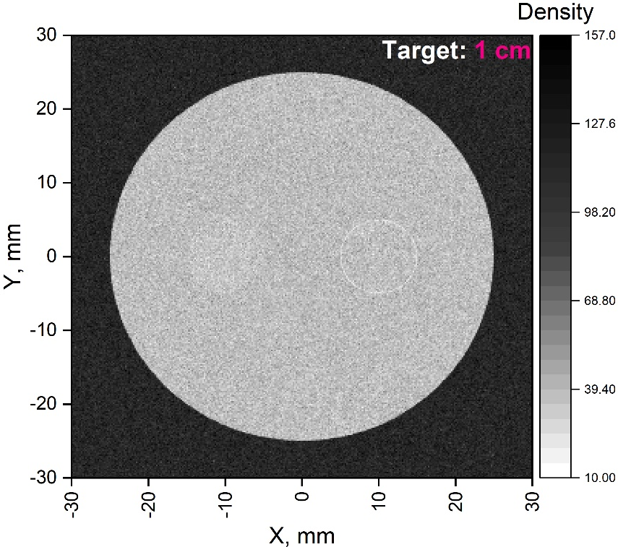
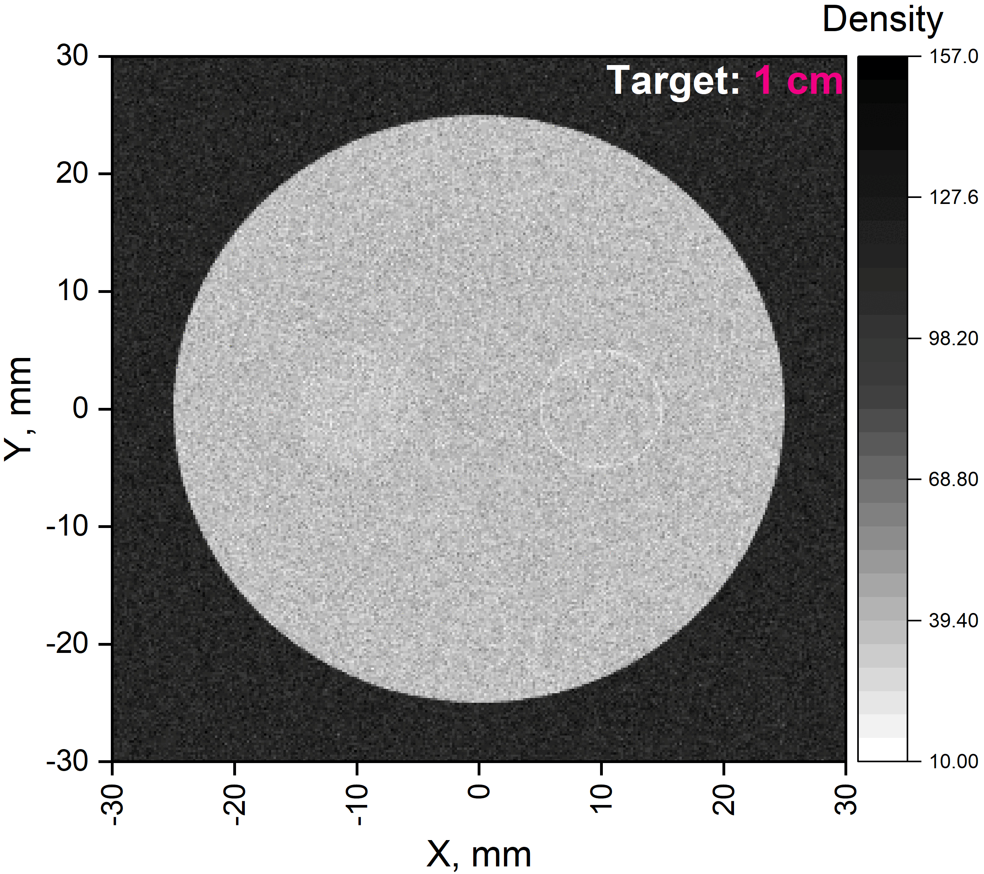
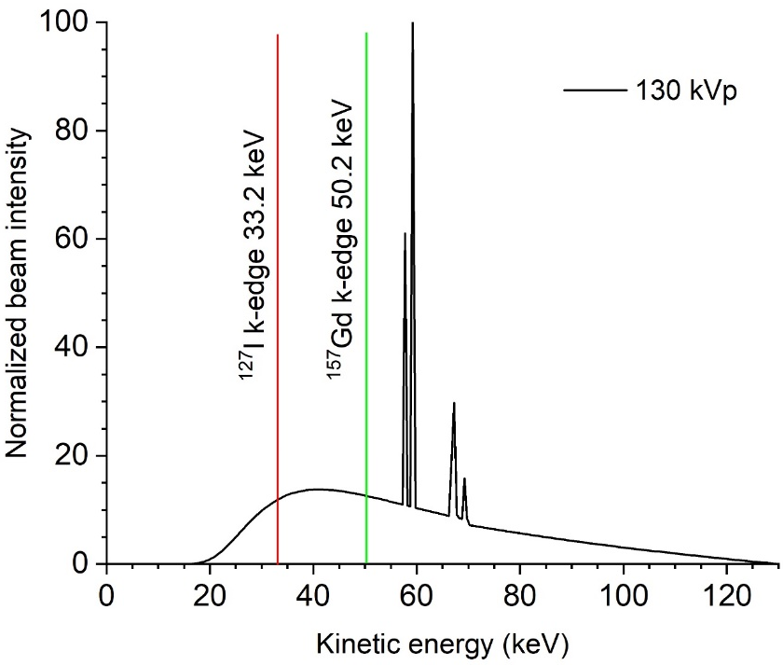
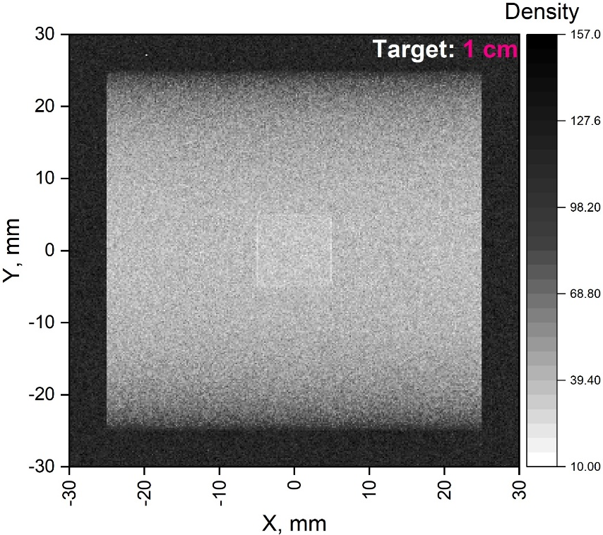
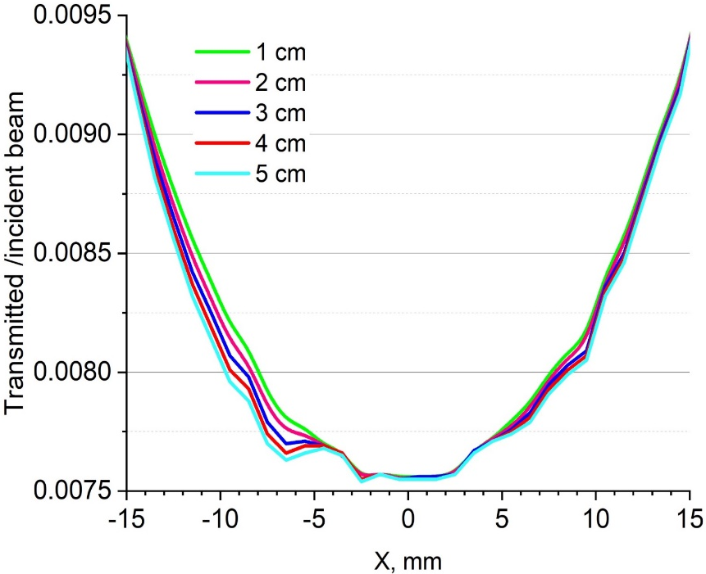
X-ray imaging technique
Comparison for two contrast agents
Different distribution
Various thickness
8.0
8.0
8.0
8.0
¹²⁷I
157Gd
mg/ml
127I area mg/ml
8.0 mg/ml iodine
Reduction effect
0.1 mm thick shell
Z, mm
Notes:
S5- Here are shown our obtained images from the second scenario of the simulation. In this case, we modified the previous phantom model and simplified it in this way. Then we compared the two different contrast media at optimal concentration of them. The contrast difference is very slight for this X-ray spectrum. By the way, it depends on x-ray intensity and is related to the threshold energy of interaction between them. Nevertheless, we did not consider the dual-energy method in this work. Well, in the second column assuming a smaller target has been illustrated it contains two different iodinated targets. Both targets are located fully inside and centered in the phantom. On the right side, iodine is uniformly distributed in the rod. In other cases, iodine distribution is imagined as a shell outside of the rod. On the other hand, iodine media could not penetrate every single cell of the tissue or something in clinical or experimental conditions. Hence it can be better prediction for biological medium after injected by contrast media. As you can see Surface tolerance will be higher at the iodine accumulation being the surface area of the target than inside accumulation. Here down there is a side projection of the image. As last column the contrast effect corresponding to material thickness at 8 mg/g iodine is shown. As plot photon transmission through in phantom obtained from reproduced image data. As you can see, the transmitted photon intensity decreases when increases material depth. That means attenuation is related to material thickness.

Slide 7
Summary
In this work, we demonstrated effect of radio enhancement for X-ray imaging using some contrast media on the imaging phantom with different attenuation sites by a Monte Carlo method. The optimal contrast effect has been performed on the target with iodine at 8.0 mg/ml concentration. However, it could not be demonstrated well in the modified imaging phantom. Nevertheless, the image tolerance on the target with iodine shell was brighter than uniform distribution due to increased iodine volume density. Finally, this study indicates the possibility to obtaining enhanced X-ray images for some biological target in potential concentration below the toxic limit of iodine.

Slide 8
References
[1] Tilley II, S. W., Zbijewski, W., & Stayman, J. W. (2018). Model-based material decomposition with a penalized nonlinear least-squares CT reconstruction algorithm. Physics in Medicine and Biology. doi:10.1088/1361-6560/aaf973
[2] Xia, T., Alessio, A. M., & Kinahan, P. E. (2013). Dual energy CT for attenuation correction with PET/CT. Medical Physics, 41(1), 012501. doi:10.1118/1.4828838
[3] Hainfeld, J.F.; Ridwan, S.M.; Stanishevskiy, Y.; Smilowitz, H.M. Iodine Nanoparticles (Niodx™) for Radiotherapy Enhancement of Glioblastoma and Other Cancers: An NCI Nanotechnology Characterization Laboratory Study. Pharmaceutics 2022, 14, 508.

Slide 9
The end
Notes:
Thank you for your time

