Slide 1
Templated electrodeposition of indium nanowires and measuring their electrical resistance
Lomonosov Moscow State University
Department of chemistry
Shashkov A.V., Noyan A.A., Napolskii K.S.
e-mail: shashkovav@my.msu.ru
Dubna – 2024

Slide 2
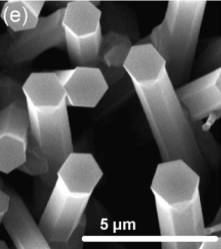
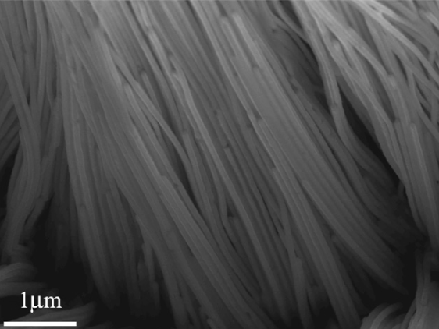
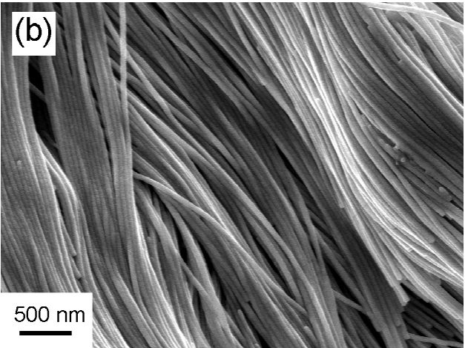
Nanowires
(ZnO) Wang N. et al.//Mater. Sci. Eng. R. 2008. V. 60. № 1–6
(In) Xu S. H. et al.//Phys. Lett. Sect. A Gen. At. Solid State Phys. 2011. V. 375. № 16
(Rh) Leontiev A.P. et al.//Electrochim. Acta. 2015. V. 155.
(Ag) novarials.com

Slide 3
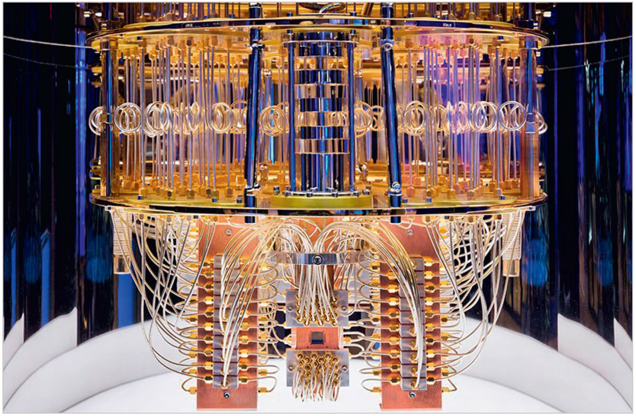
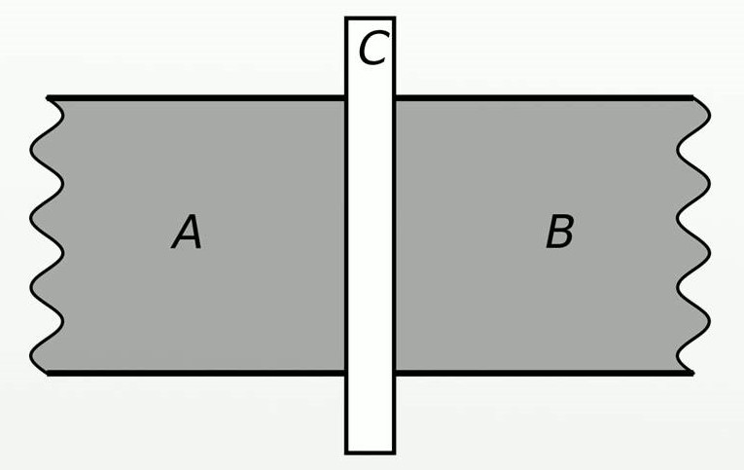
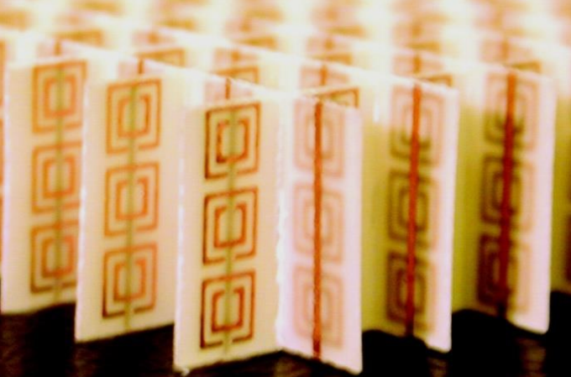
Application of nanowires
A, B – superconductors,
С – non-superconducting layer

Slide 4
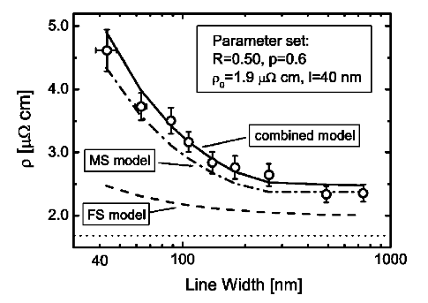
Differences in physical properties
Dependence of melting temperature on the diameter of In nanowires:
Dependence of electrical resistance on the diameter of Cu nanowires:
Xu S. H. et al.//Phys. Lett. Sect. A Gen. At. Solid State Phys. 2011. V. 375. № 16
Steinhögl W. et al.//Phys. Rev. B Condens. Mater. Mater. Phys. 2002. V. 66. № 7

Slide 5
Purpose of the study
Development of a method for obtaining arrays of In nanowires and measuring the electrical resistance of individual In nanowires of different diameters

Slide 6
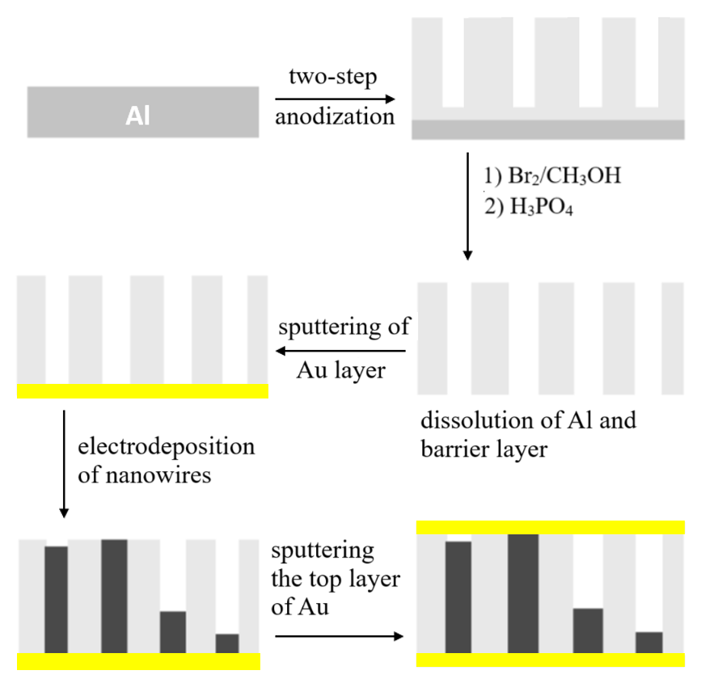
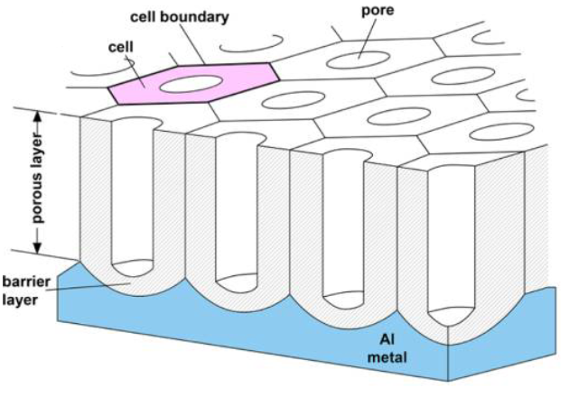
Obtaining a template for electrodeposition
Anodizing conditions and parameters of the resulting pores¹:
Electrolyte | Voltage (V) | Temperature (°C) | Pore diameter (nm)
0,3 M H₂C₂O₄ | 40 | 0 | 30
0,1 M H₃PO₄ | 195 | 0 | 160
Structure of porous film of anodic aluminum oxide (AAO)^{2:}
¹Nielsch K. et al.//Nano Lett. 2002. P. 677-680
²Lee W. et al.//Chem. Rev. 2014. V. 114. № 15

Slide 7
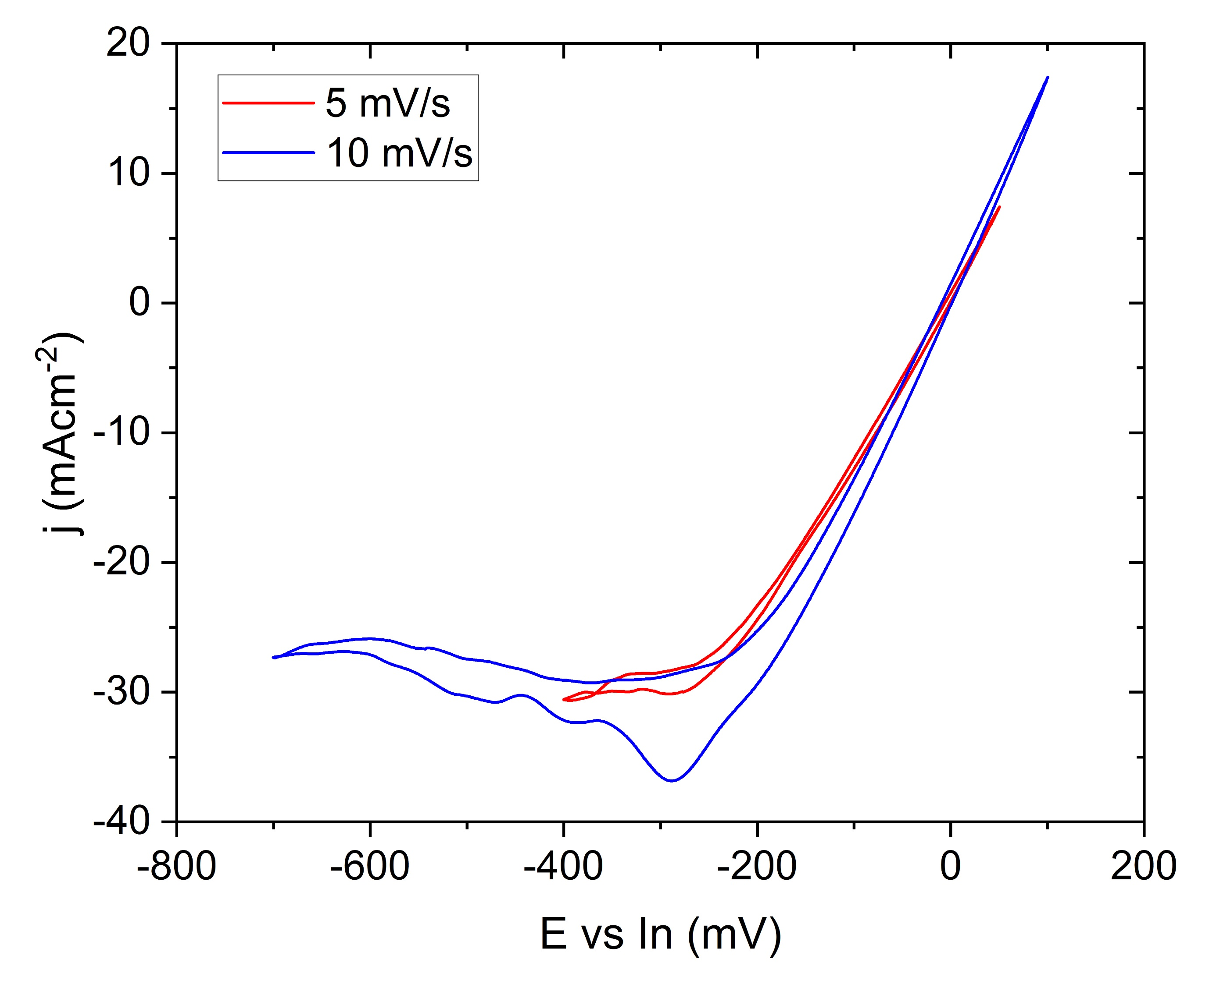
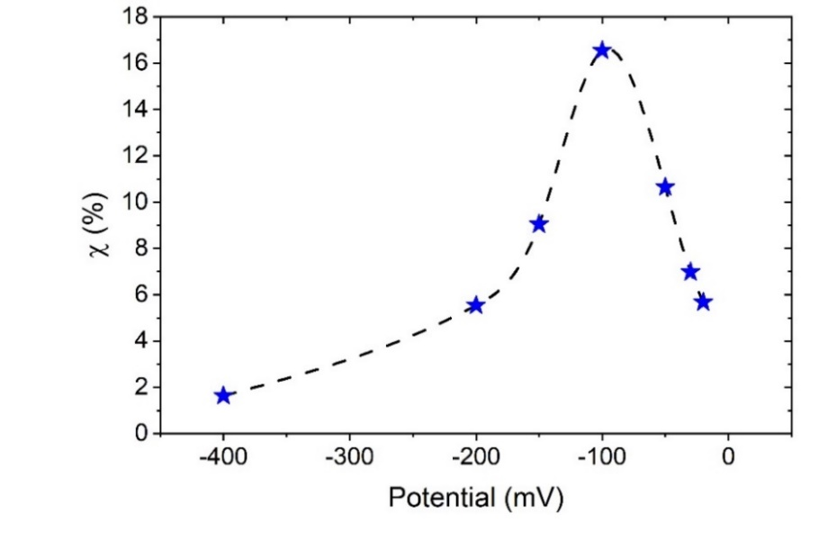
Selection of electrodeposition conditions
CV for smooth electrode without IR compensation:
Dependence of pore filling (χ) on deposition potential:

Slide 8
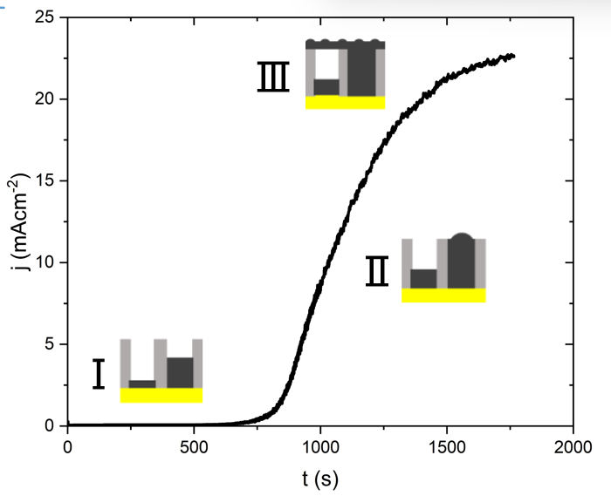
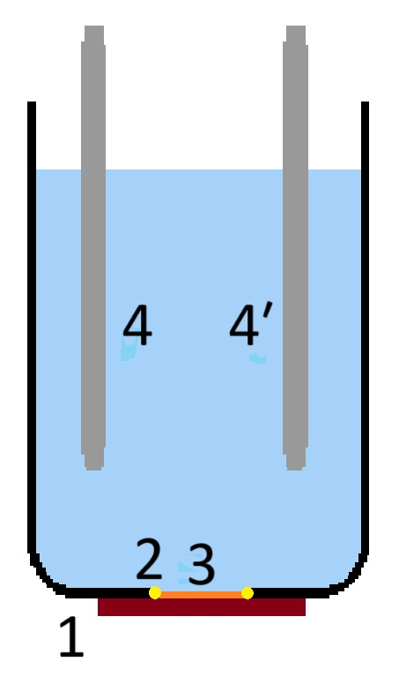
Electrodeposition of In nanowires
Full composition of indium plating electrolyte:
[In³⁺] | 0,25 M
[NH₂SO₃⁻] | 2,15 M
[Na⁺] | 2,35 M
[Cl⁻] | 1,00 M
pH | 1,99
Typical electrodeposition current transient:
Electrodeposition cell:
1 – Cu plate
2 – O-ring
3 – Sample
4 – In counter electrode
4′ – In reference electrode

Slide 9
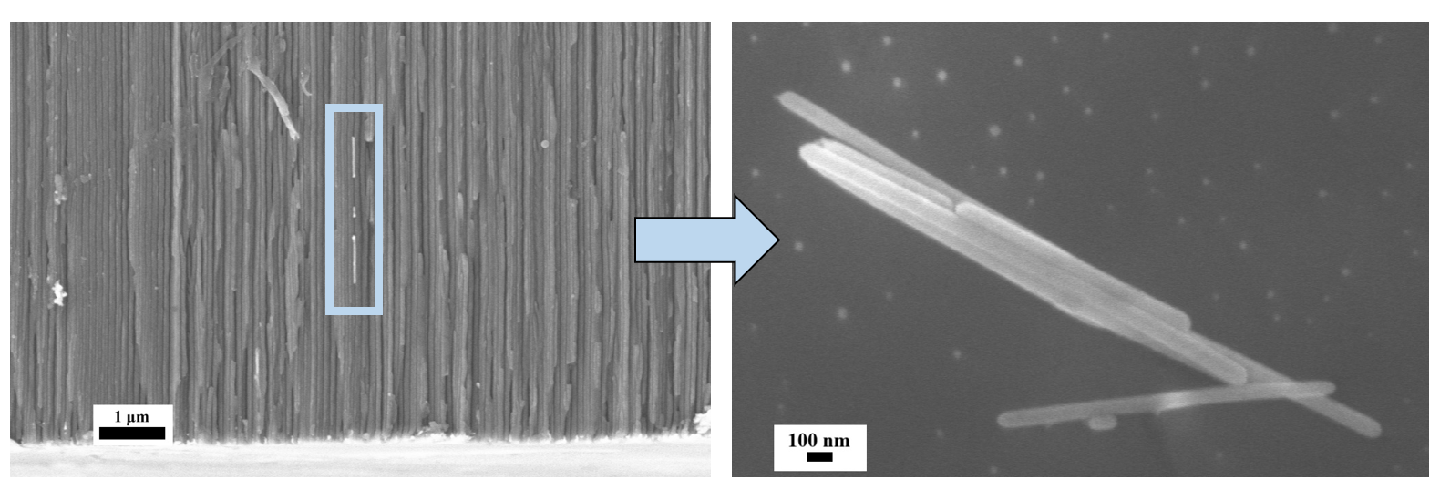
SEM
Lateral cleavage of In/AAO nanocomposite
Nanowires extracted from the template

Slide 10
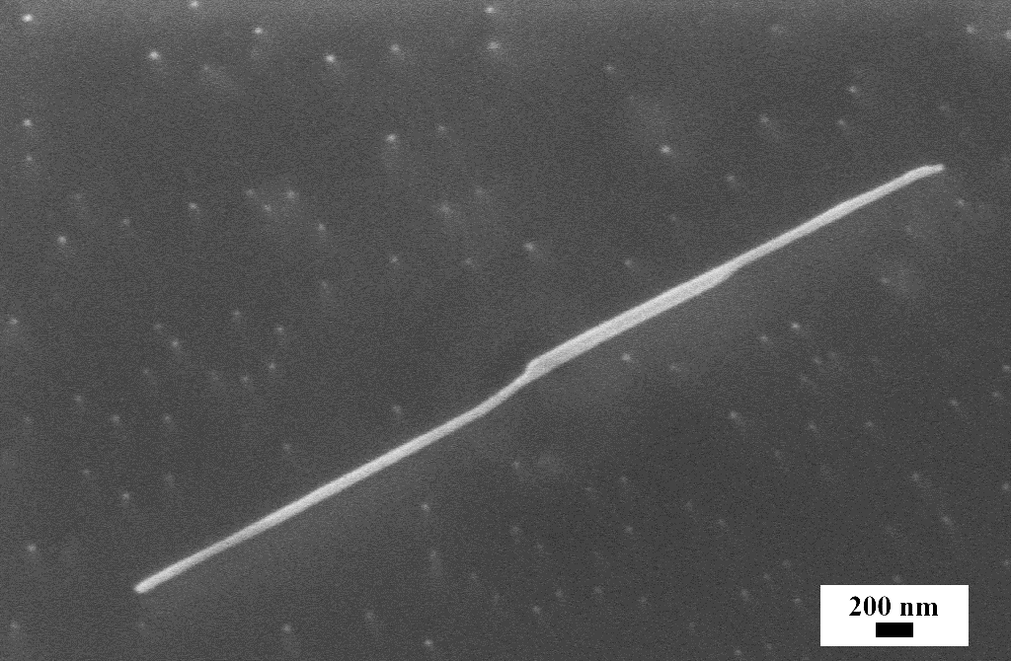
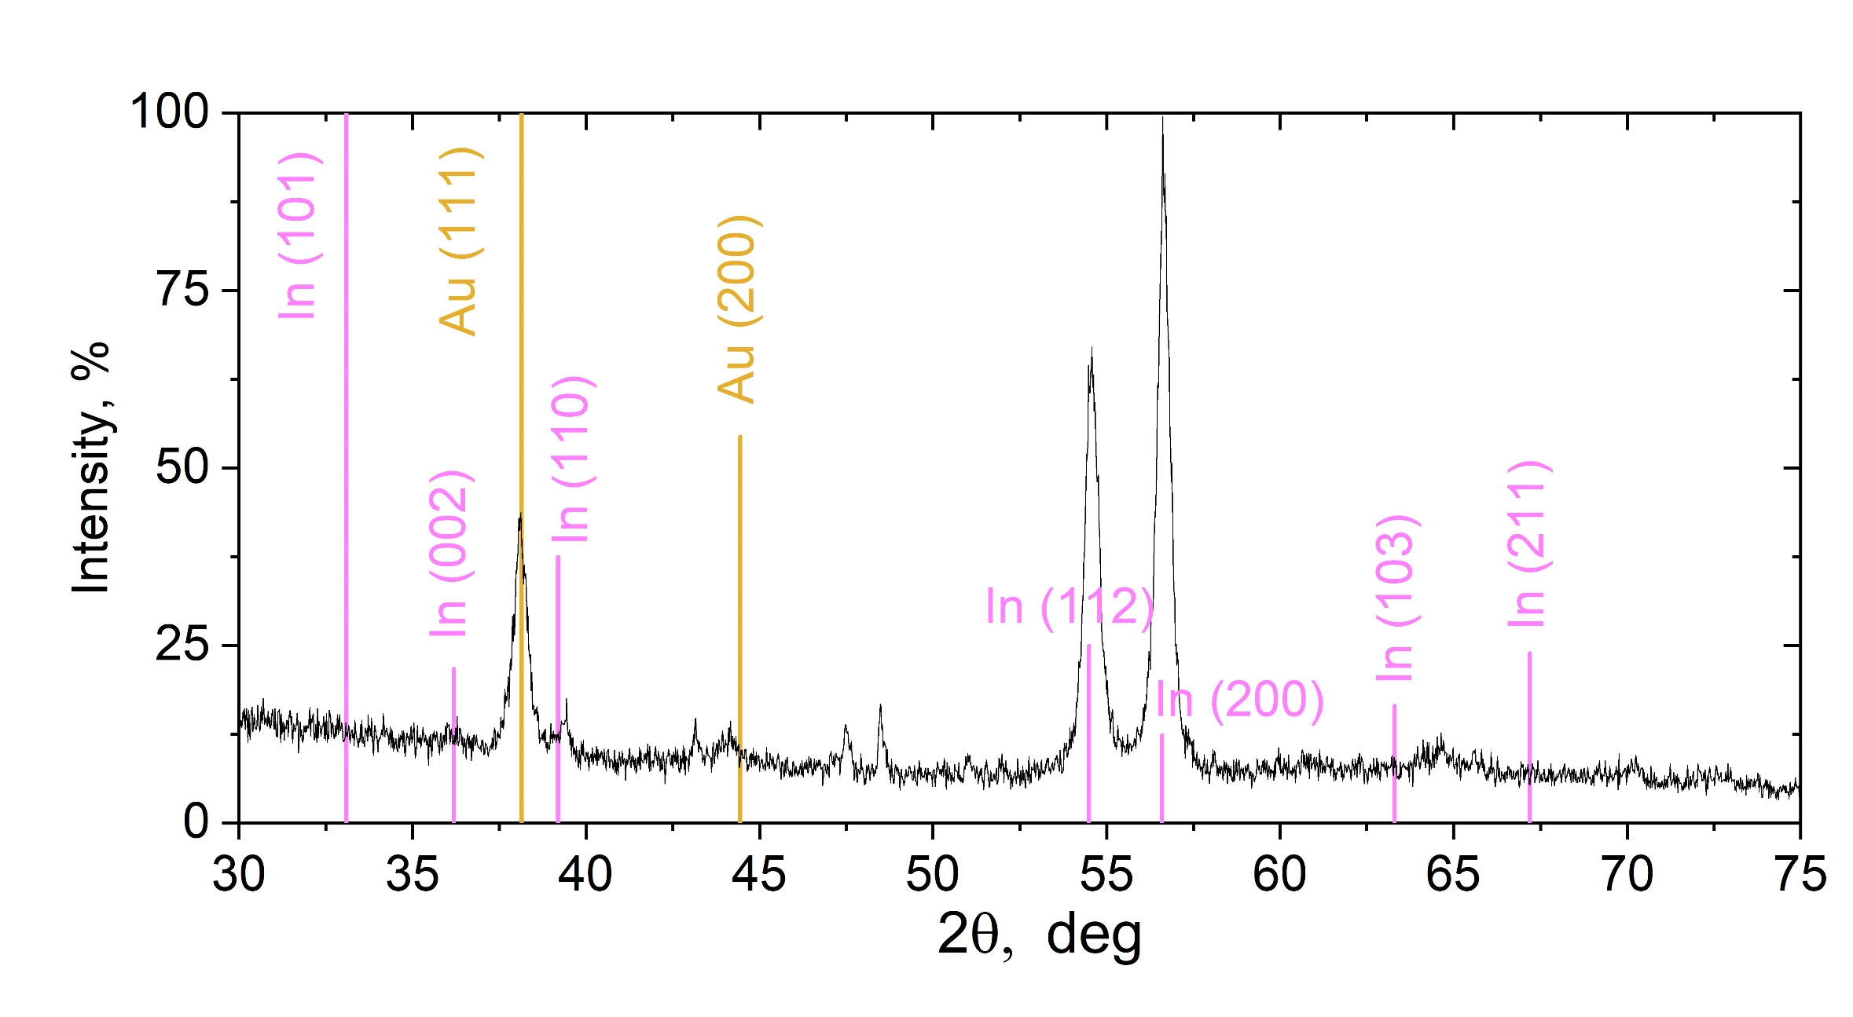
XRD of In/AAO
In (2 0 0)
Harris index calculation:
2θ, deg | (h k l) | T (h_{i})
54,477 | (1 1 2) | 2,17
56,592 | (2 0 0) | 6,83
$I\left(h_{i}\right)$ – reflex intensity$h_{i}$ for the sample, $R\left(h_{i}\right)$ – reflex intensity$h_{i}$from literature, n – number of reflexes considered
$$T\left(h_{i}\right)=\frac{I{\left(h_{i}\right)}/R\left(h_{i}\right)}{\frac{1}{n}\sum_{j}^{n}{I{\left(h_{j}\right)}/R\left(h_{j}\right)}}$$

Slide 11
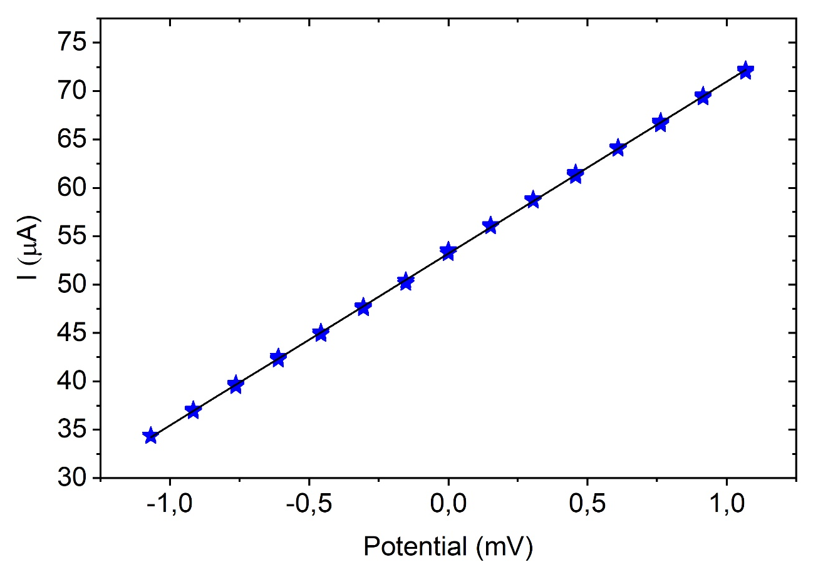
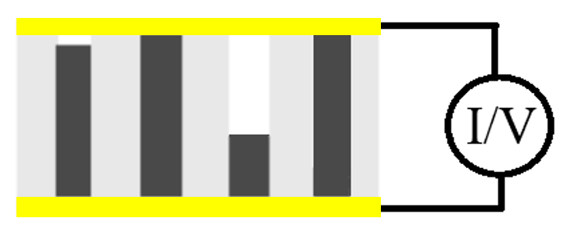
Results of resistance measurements of nanowire arrays
$$I= \frac{U}{R}$$
№ | D (nm) | Part of the sample | R (Ω)
1 | 200 | 1 | 3030 ± 80
2 | 50 | 1 | 668 ± 4
3 | 50 | 1 | 487,7 ± 1,8
4 | 50 | ½ | 421,9 ± 1,2
5 | 40 | 1 | 42,35 ± 0,06
6 | 40 | 1 | 12,47 ± 0,01
7 | 40 | ½ | 56,24 ± 0,08
8 | 40 | ¼ | 101,2 ± 0,1
Slope = 0,01778 ± 0,00003
Measured section of the circuit:

Slide 12
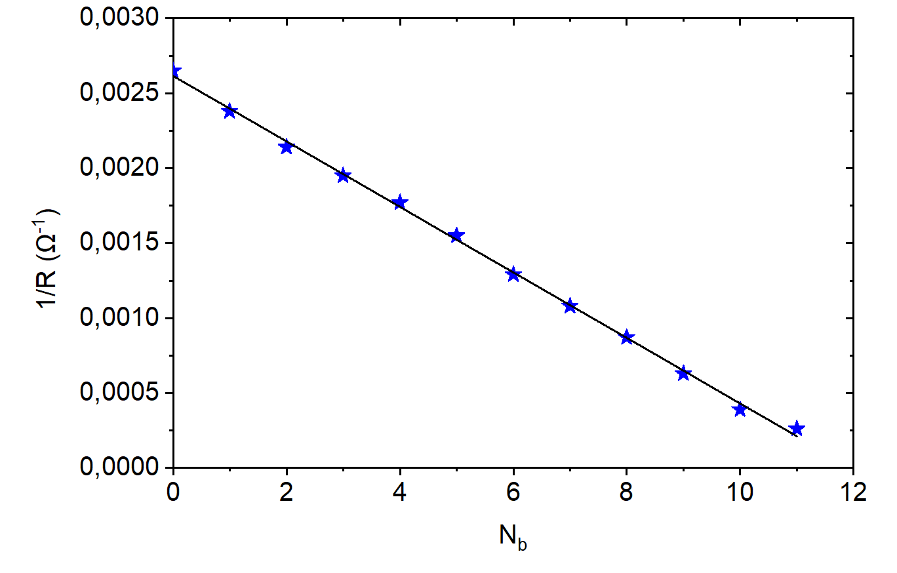
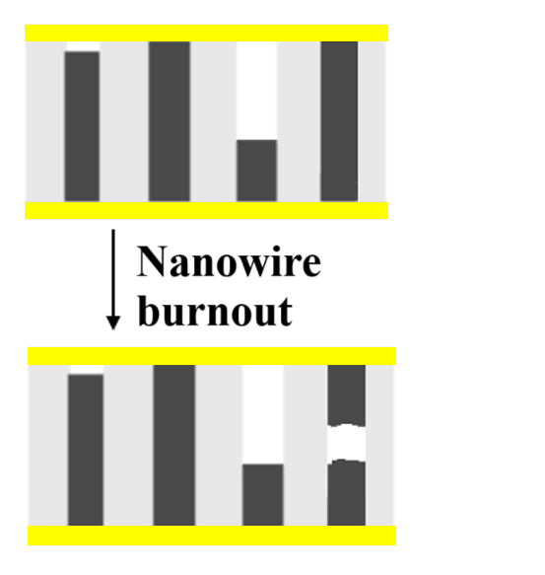
Measuring the resistance of single nanowires
$R_{0}^{40}$ = 4560 ± 50 Ω
$$\frac{1}{R}=−\frac{1}{R_{0}}N_{b}+ \frac{N_{sum}}{R_{0}}$$
D (nm) | $R_{0}$ (Ω) | l (cm) | ρ (µΩcm)
40 ± 3 | 4620 ± 20 | 0,00435 | 13,4 ± 2,0
50 ± 3 | 2550 ± 30 | 0,00440 | 11,4 ± 1,4
200 ± 5 | 155 ± 6 | 0,00525 | 9,3 ± 0,5
R – resistance of the entire array
R₀ – resistance of single nanowire
N_{b} – number of burned nanowires
N_{sum} – total number of nanowires

Slide 13
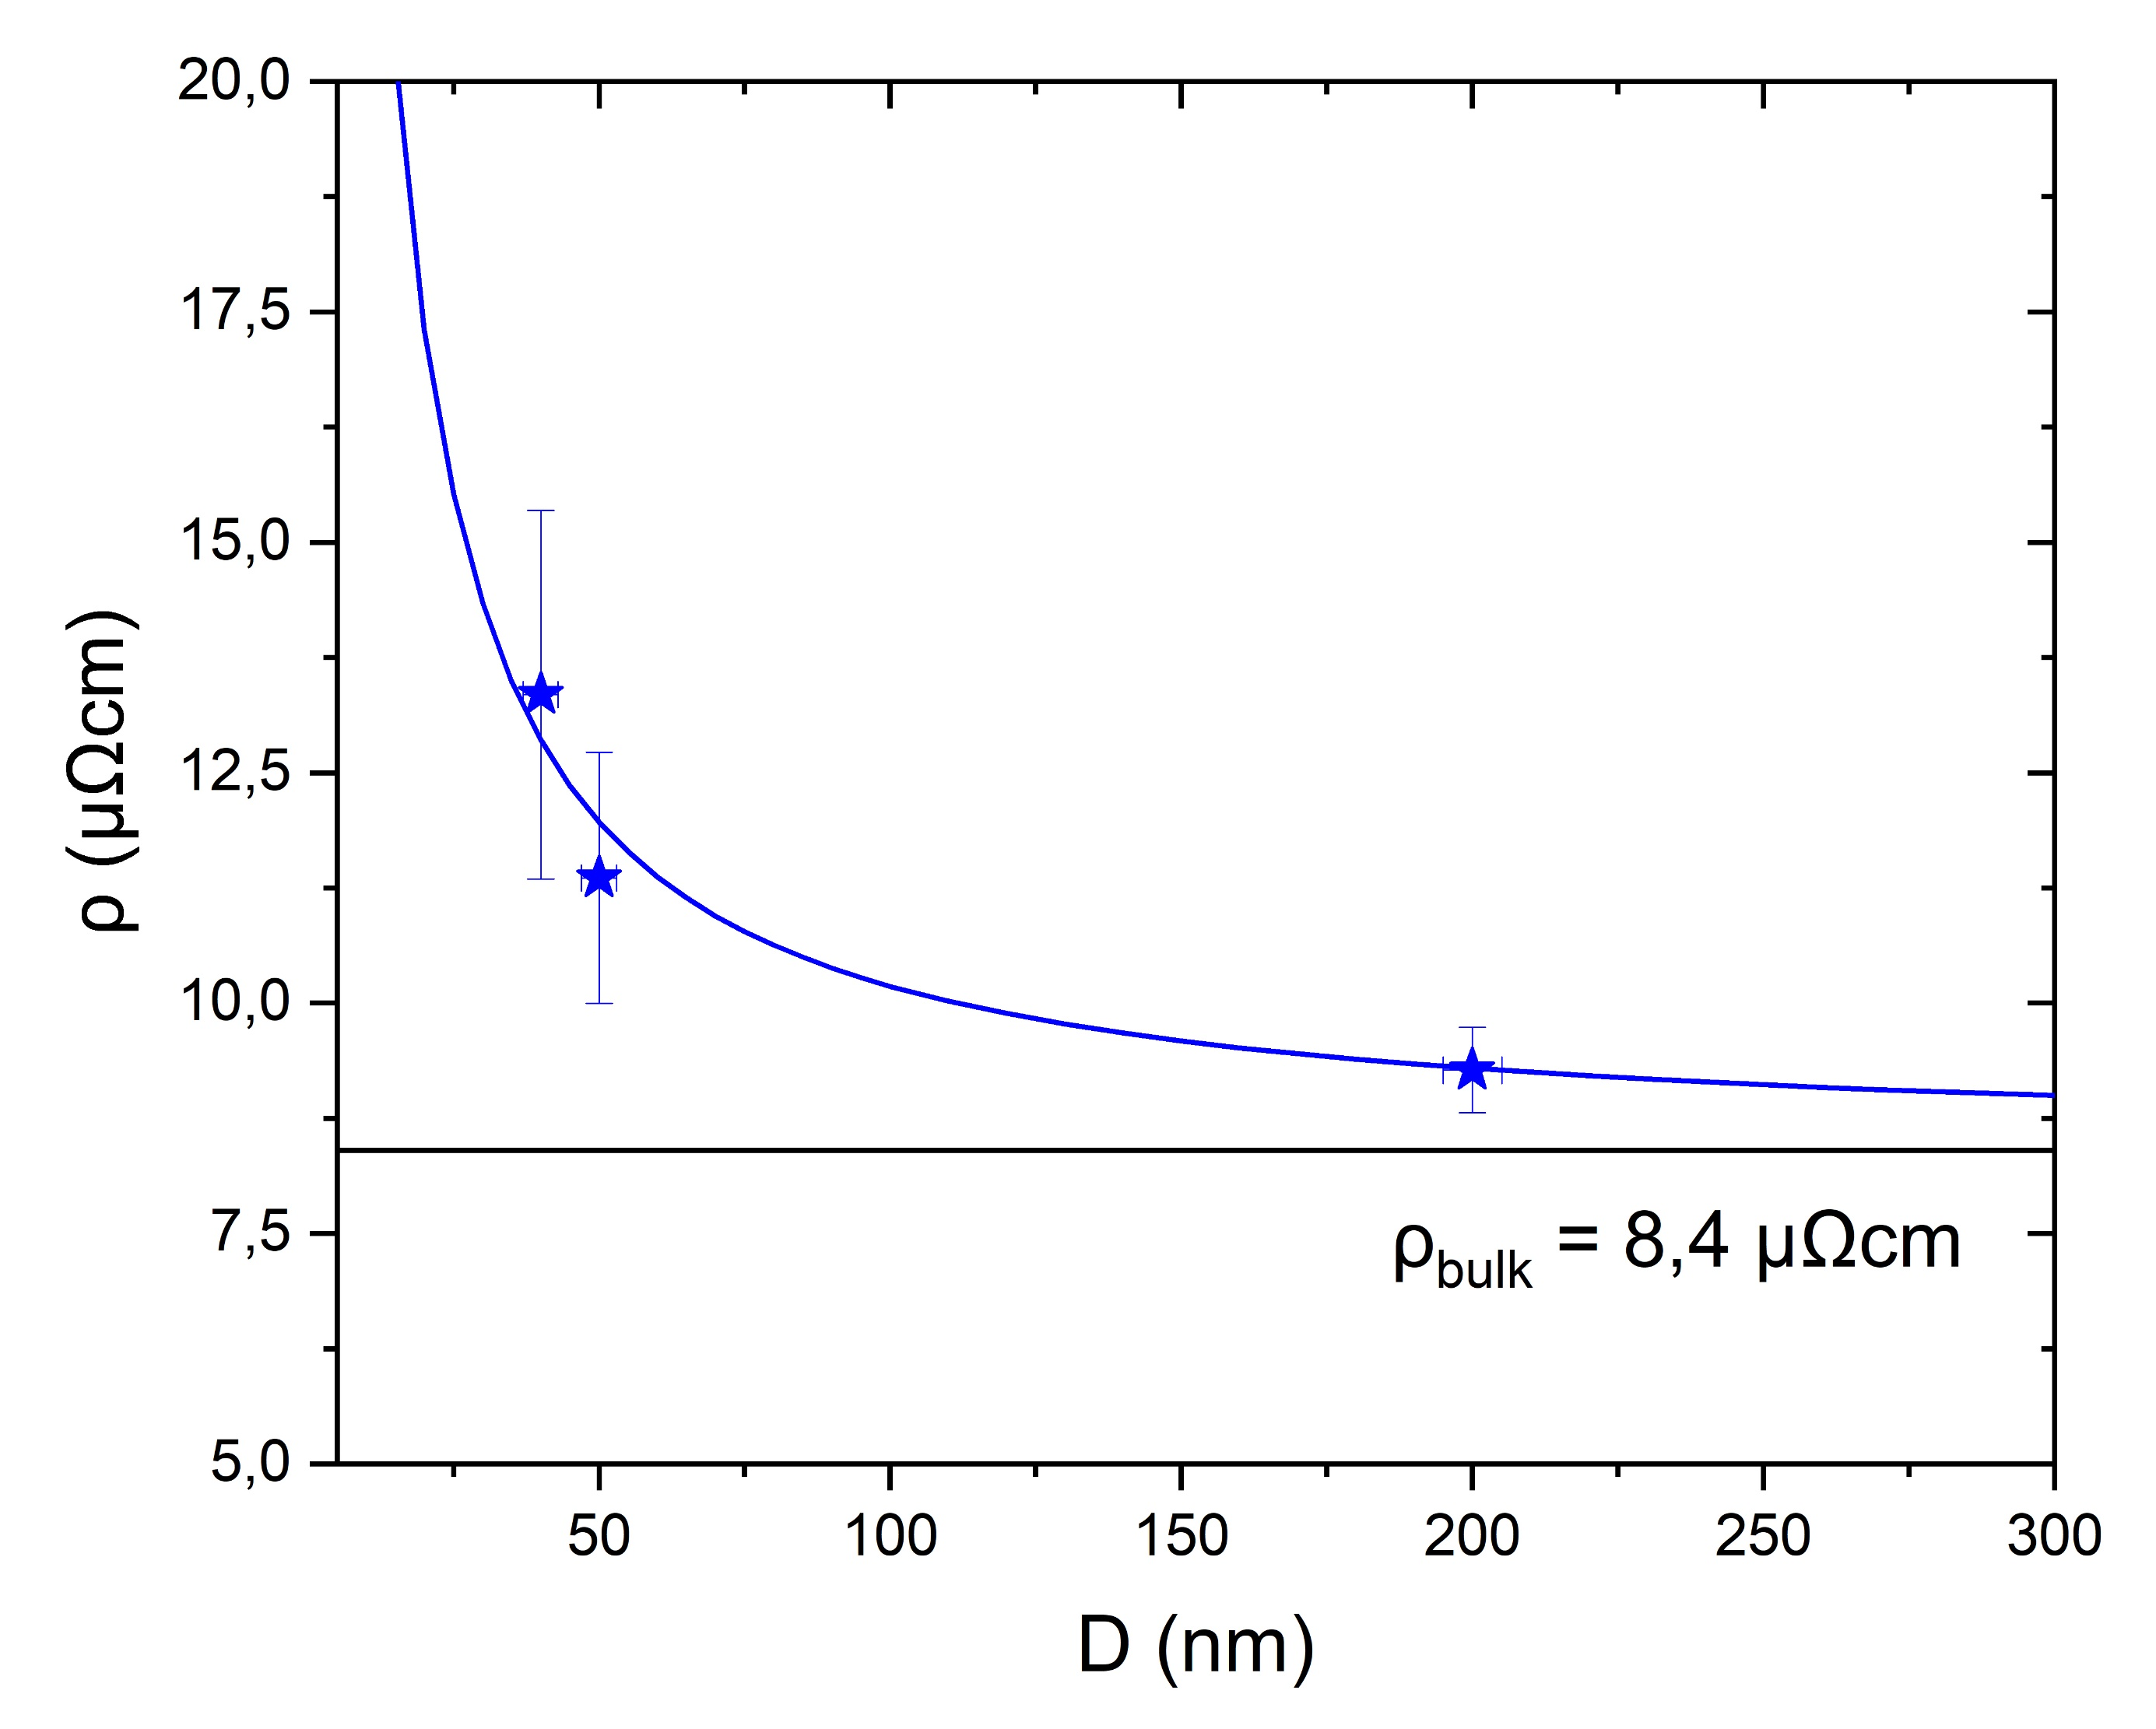
Theoretical calculation of resistance
According to the model Fuchs-Sondheimer*:
l_{e} = 57 ± 5 nm
p = 0,5
$$\frac{ρ}{ρ_{0}}=1+\frac{3}{4}\left(1−p\right)\frac{\text{l}\text{e}}{d}$$
l_{e} – mean free path of an electron in a bulk material
d – nanowire diameter
p – specular reflection coefficient
ρ – electrical resistance of nanowire
ρ₀ – electrical resistance in a bulk In
*Sondheimer E. H.// Adv. Phys. 1952. V. 1. № 1. P. 1–42

Slide 14
Conclusions
Textured In nanowires of different diameters were obtained by electrochemical deposition of metal from a sulfamate-chloride electrolyte into anodic aluminum oxide template
In situ method for measuring the electrical resistance of an array of nanowires has been developed
A method for determining the resistance of a single nanowire has been proposed and developed
The influence of size effects on the value of specific electrical resistance In of nanowires has been shown for the first time

Slide 15
Additional slides

Slide 16
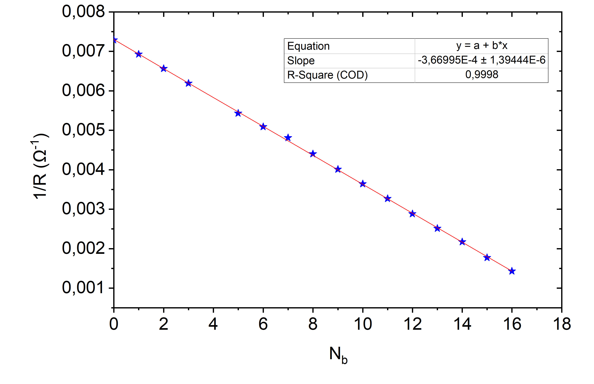
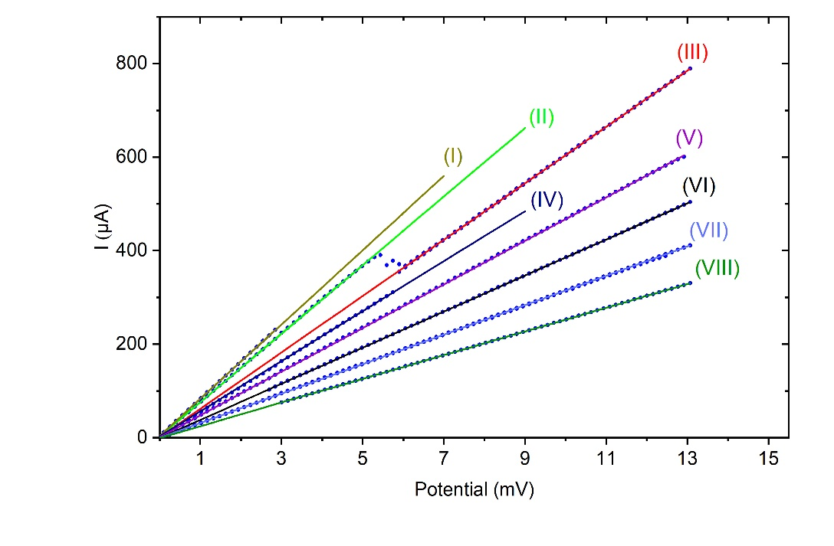
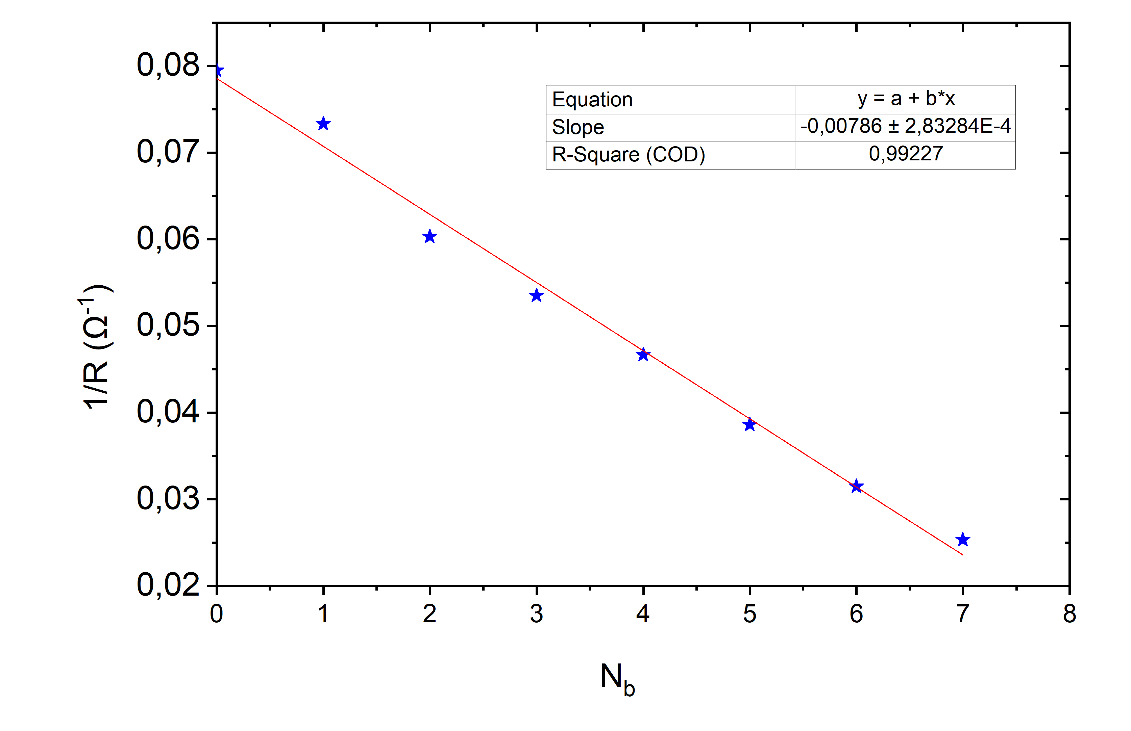
Burn-off graphs for nanowires of different diameters
${\text{<}R}_{0}^{40}$> = 2550 Ω
$R_{0}^{40}$ = 2540 Ω
${\text{<}R}_{0}^{200}$ > = 155 Ω
$R_{0}^{200}$ = 127 Ω

Slide 17
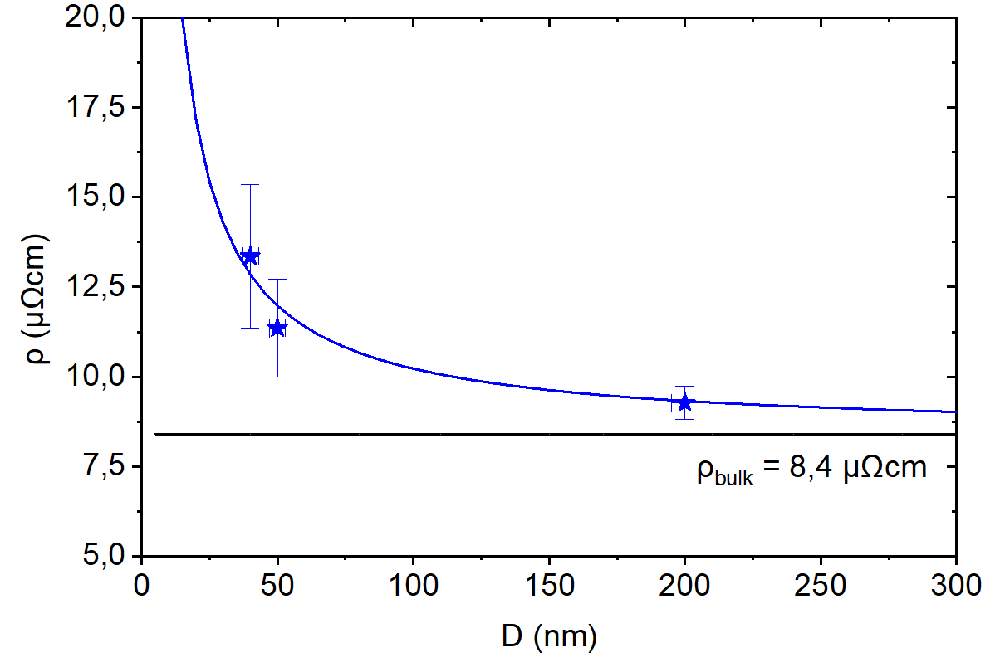
Calculation by Mayadas-Shatzkes model*
$$\frac{\text{ρ}\text{0} }{ρ}=3\left[\frac{1}{3}−\frac{α}{2}+α^{2}−α^{3}ln\left.\left(1+\frac{1}{α}\right)\right],\right.$$
$$\text{α}= \frac{\text{l}\text{e}}{d}\frac{R}{1−R}$$
l_{e} = 15,0 ± 1,5 nm
R = 0,5
l_{e} – mean free path of an electron in a bulk material
d – nanowire diameter
R – reflection coefficient
ρ – electrical resistance of nanowire
ρ₀ – electrical resistance in a bulk In
*Mayadas A. F., Shatzkes M.// Phys. Rev. 1970. V. 1. P. 1382

