Slide 1
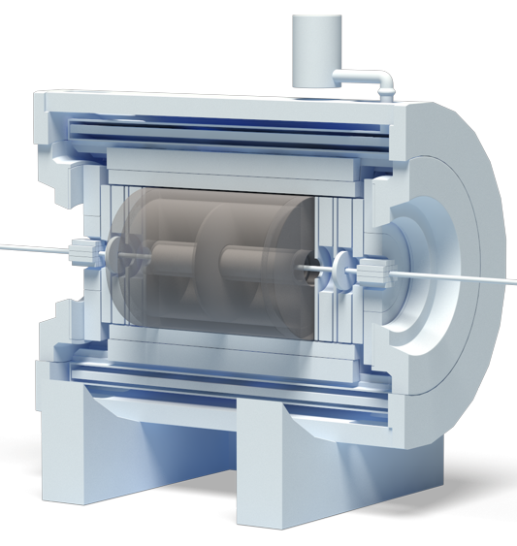
28th International Scientific Conference of Young Scientists and Specialists (AYSS-2024) Remote reconfiguration, debugging, testing and synchronization system of Electronics Cards for the TPC/MPD Detector of the NICA project
Denis Potapov, an engineer of the
TPC/MPD group, VBLHEP, JINR
Dubna, 2024

Slide 2
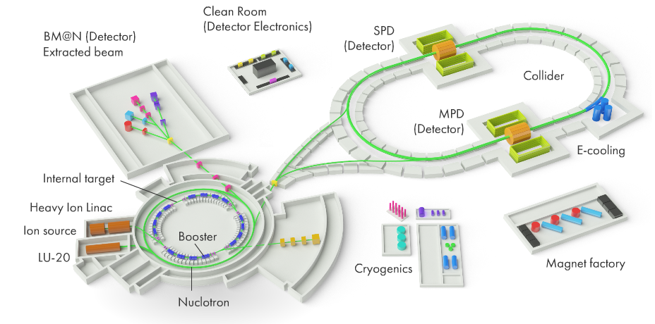
NICA Complex
Multi Purpose Detector (MPD) Hall
General scheme and photo of the NICA complex
https://nica.jinr.ru/
https://mpd.jinr.ru/

Slide 3
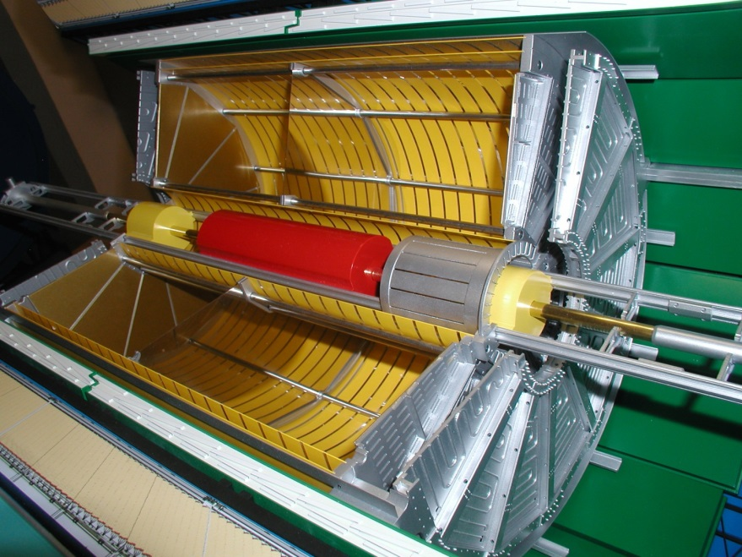
TPC/MPD Detector of NICA Complex
1. Front-End Cards (FECs) position;
2. End cap thermal screen;
3. Read-Out Chamber (ROC) based on MWPC;
4. High Voltage (HV) electrode;
5. Field cage position.
3
4
5
2
1
MPD mockup
Time-Projection Chamber (TPC)

Slide 4
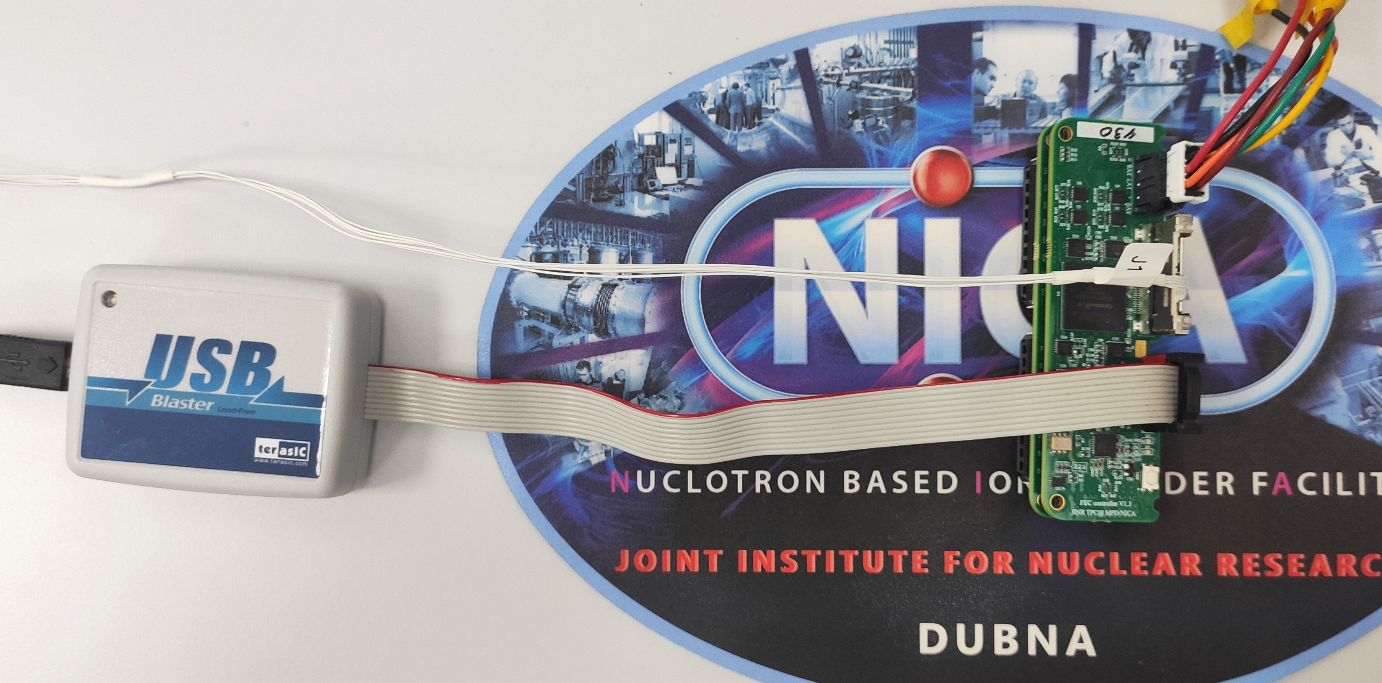
FECs integration on ROC
FEC connection for access & synchronization
Micro coaxial cables assemblies
24 ROCs –
1488 FECs –
95 232 ch.
JTAG programmer
FEC assembly
Test setup of 62 FECs on 1 ROC
SAMPA FEC
FEC controller

Slide 5
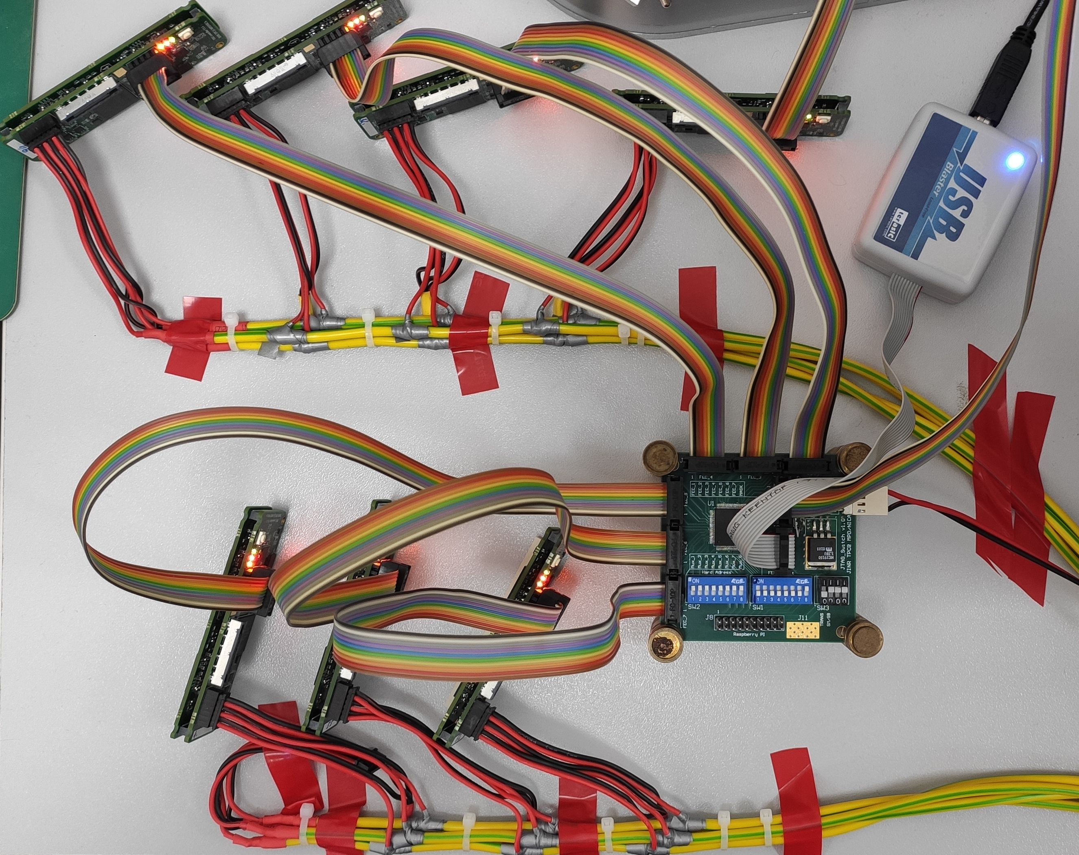
Prototype of remote access unit
Tested prototype
This remote access prototype unit uses JTAG (up to x7 FECs) for:
FPGA reprogramming;
FPGA debugging;
An additional channel for accessing the digital part of the Data acquisition subsystem (DAQ).
Test setup for remote access prototype unit

Slide 6
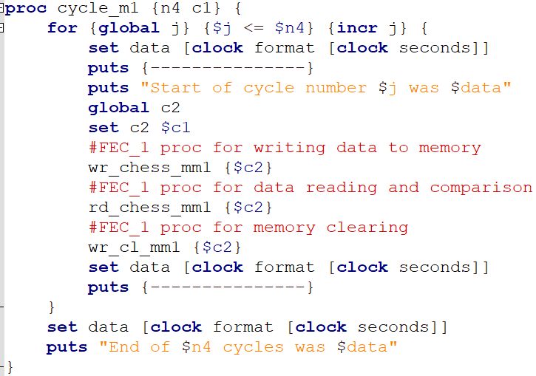
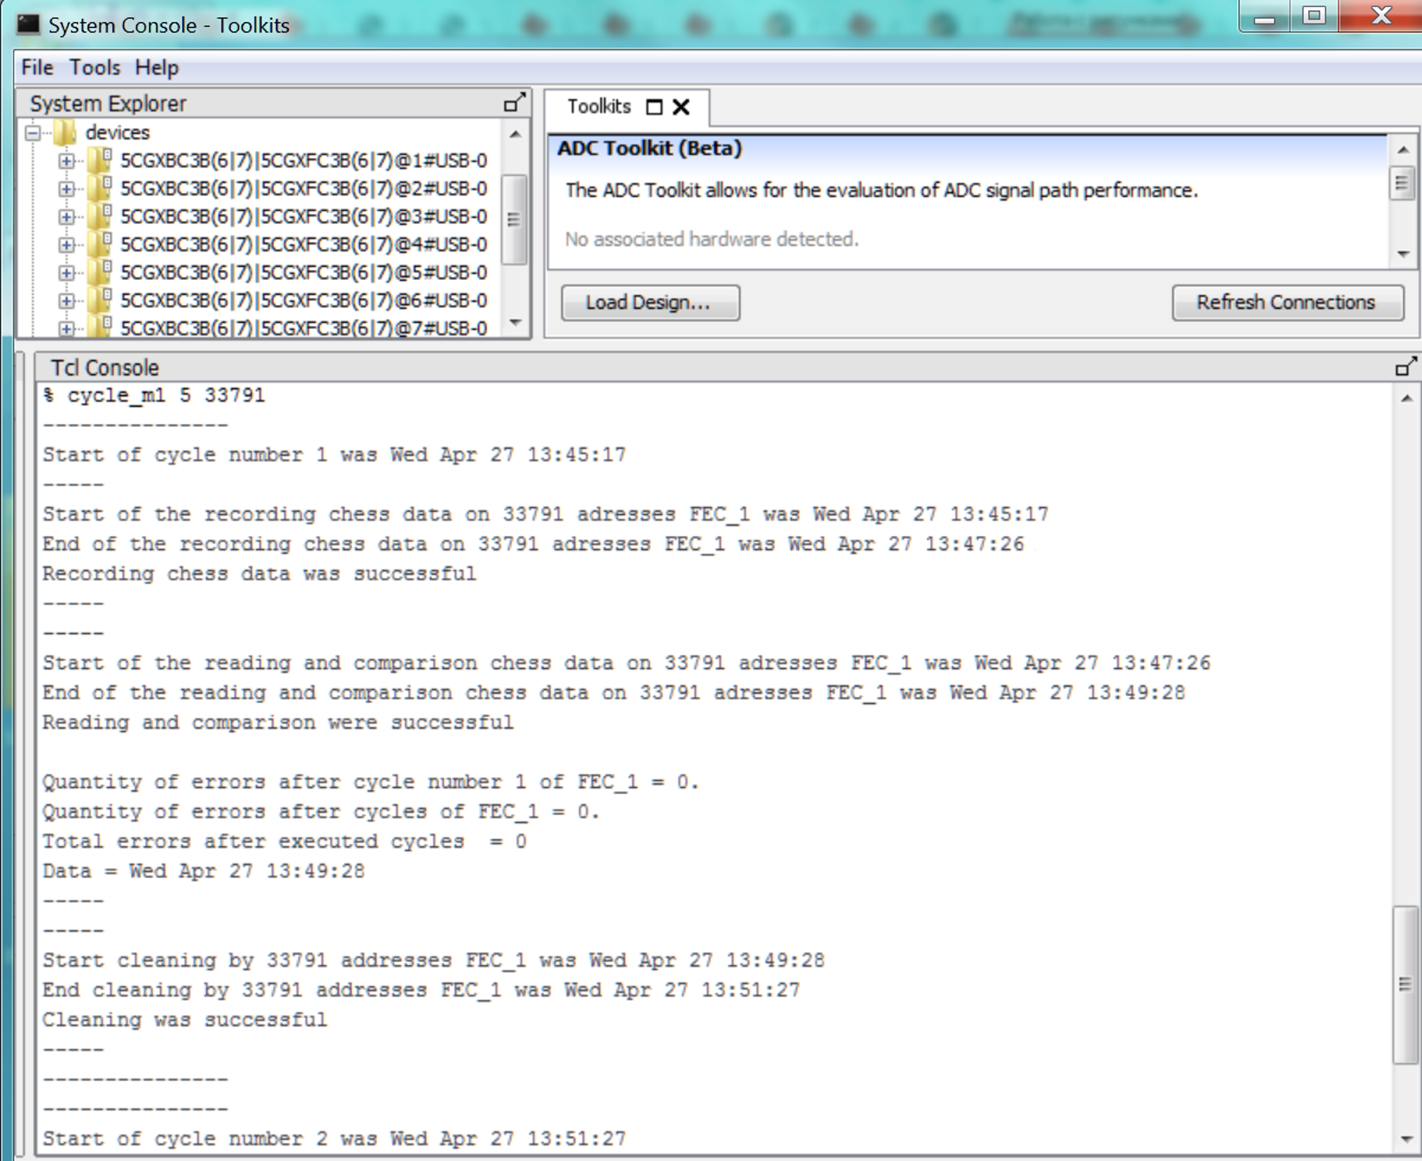
Testing of prototype remote access unit
Procedure for verifying the data in RAM memory of FPGA
System Console window in Quartus

Slide 7
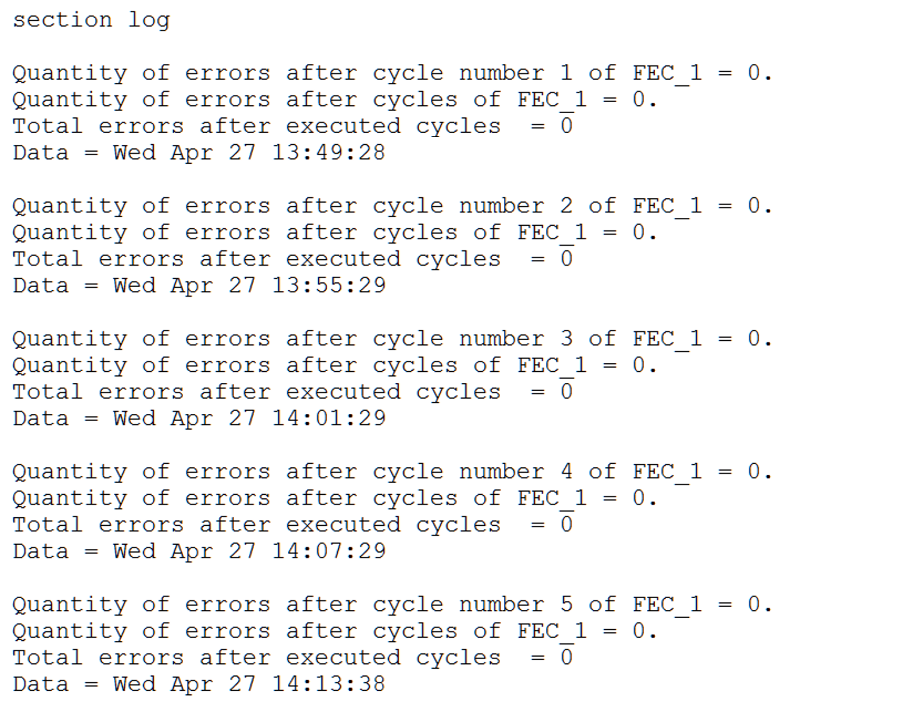
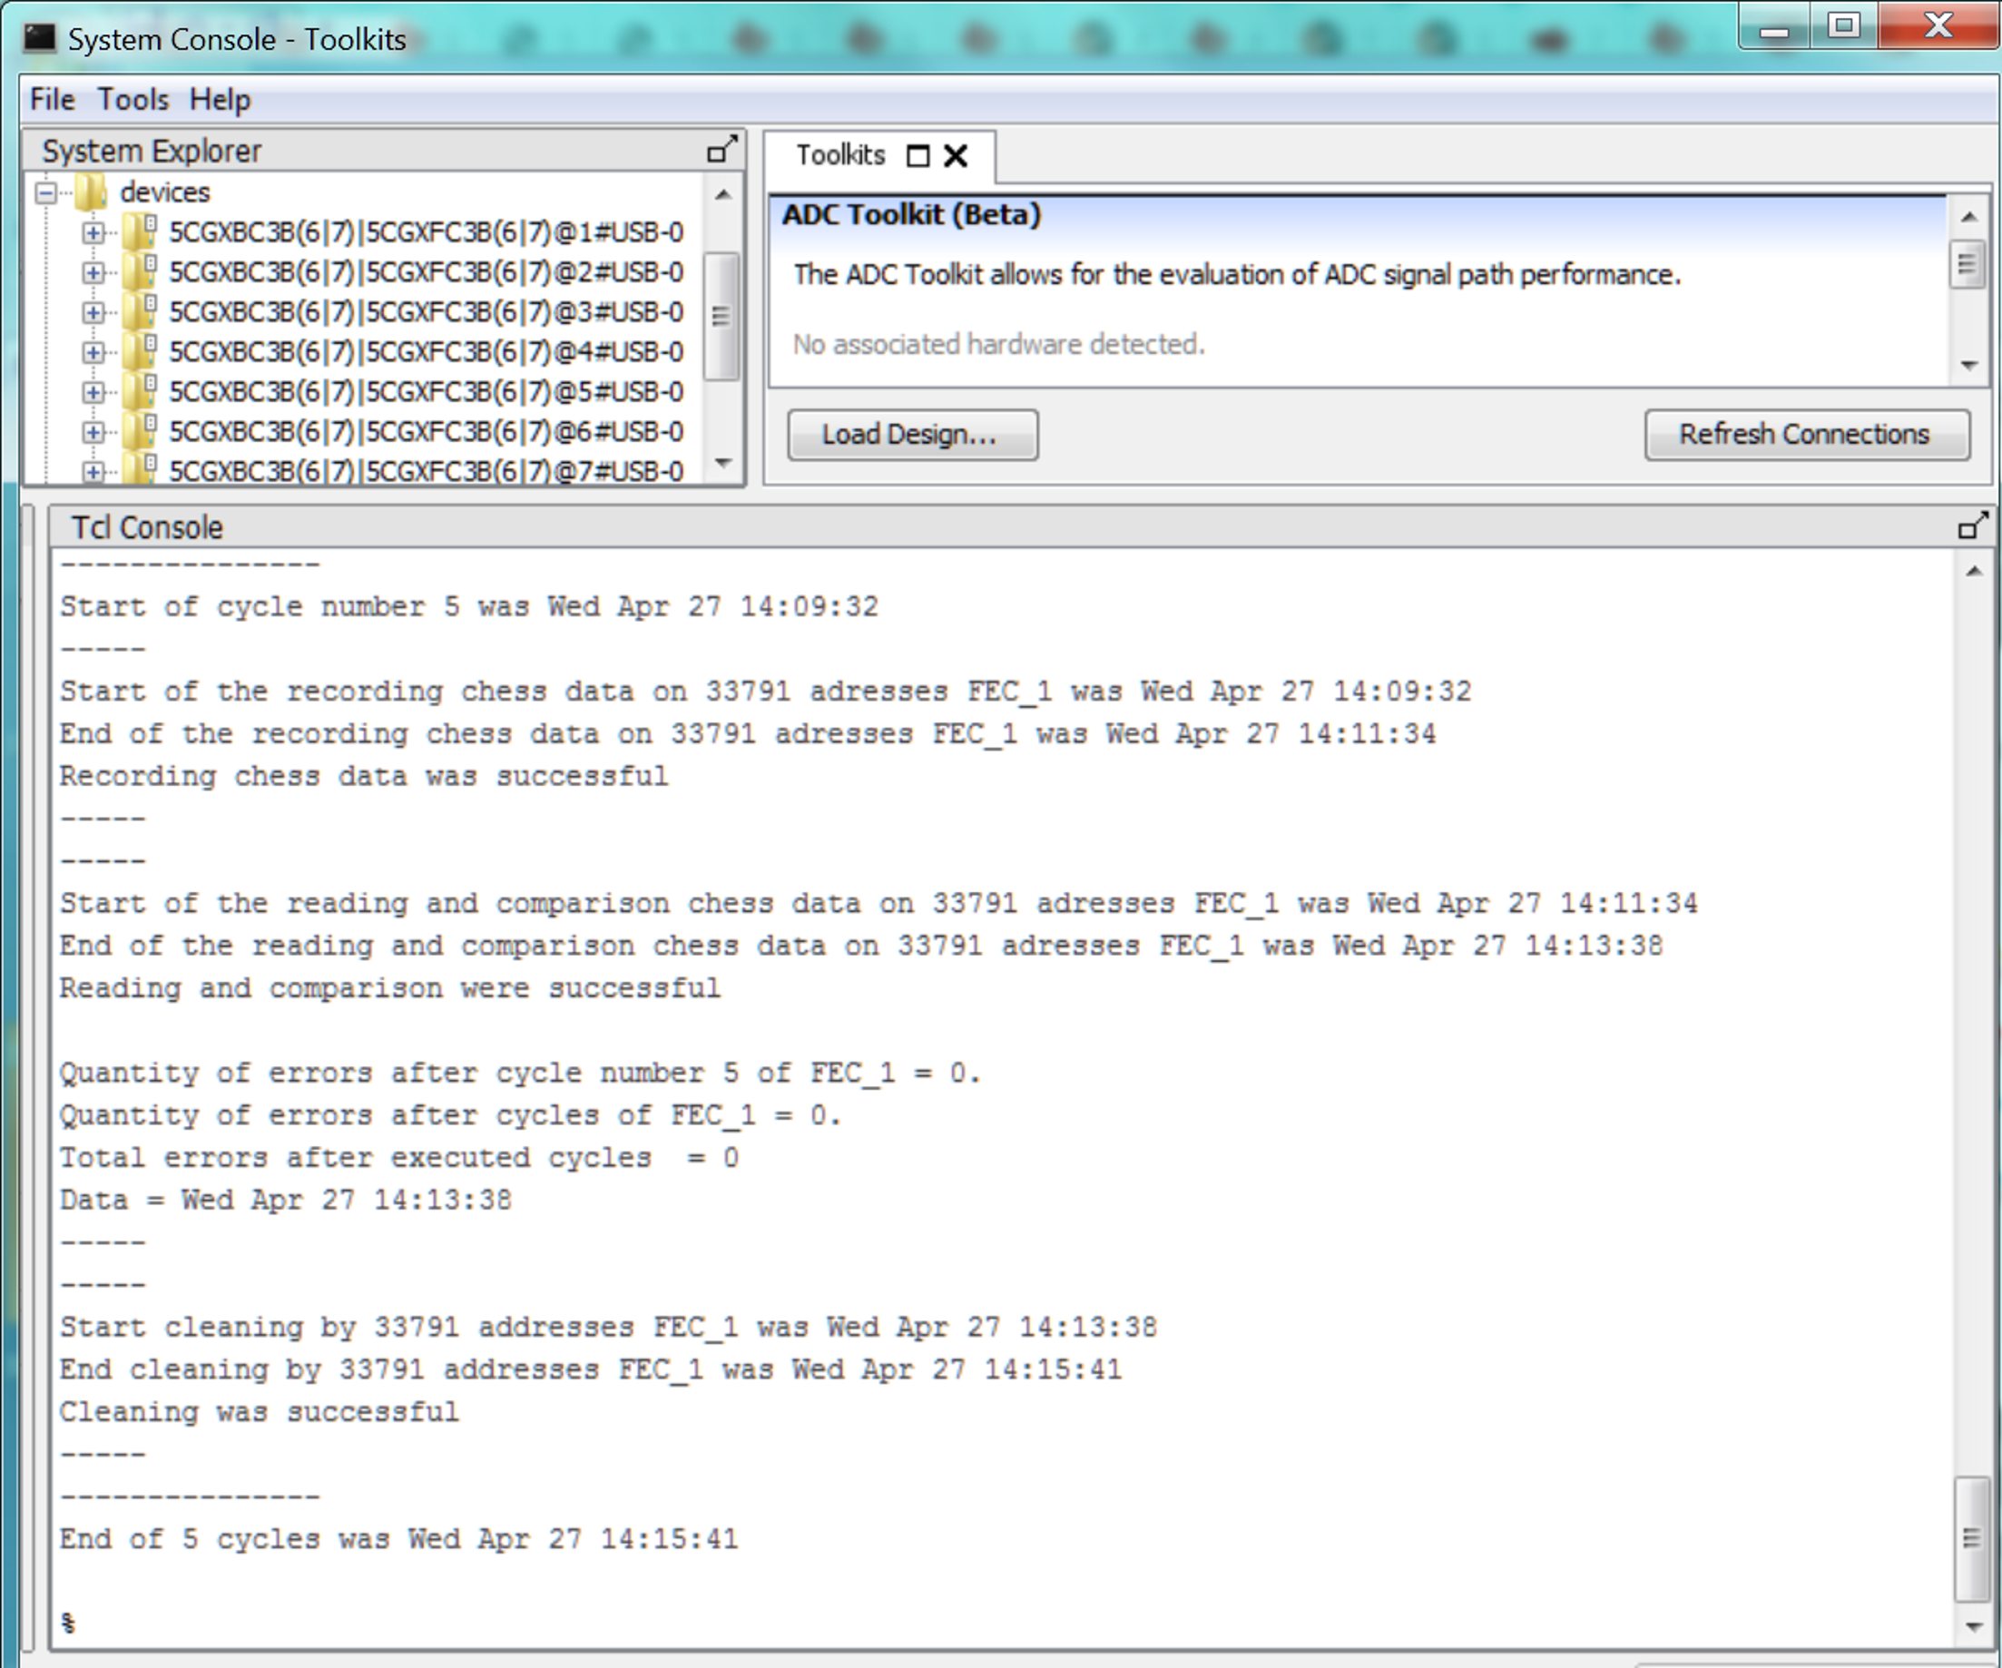
Testing of prototype remote access unit
Errors recording file
during the procedure execution
System Console window in Quartus

Slide 8
Block diagram of remote access unit for Control & Synchronization System
JTAG via LVDS
JTAG
FEC_1 (Cyclone V)
JTAG
Out con. (JTAG)
JTAG via LVDS
JTAG
master
Avalon
bus
In con. (JTAG)
SCANSTA112
Slaves
JTAG programmer
…
6
6
…
JTAG Switch
Out con. (JTAG)
FEC_6 (Cyclone V)
JTAG
JTAG
JTAG
master
Avalon
bus
Slaves
Tested prototype
Same chips
11
…
FEC_61 (Cyclone V)
JTAG
Out con. (JTAG)
JTAG via LVDS
JTAG
master
Avalon
bus
Slaves
Remote access unit
for each ROC
JTAG
…
6
6
SCANSTA112
…
RCU (Arria 10)
Inside
MPD magnet
JTAG Switch
Out con. (JTAG)
Control &
Synchronization System
JTAG
master
Avalon
bus
JTAG
Slaves

Slide 9
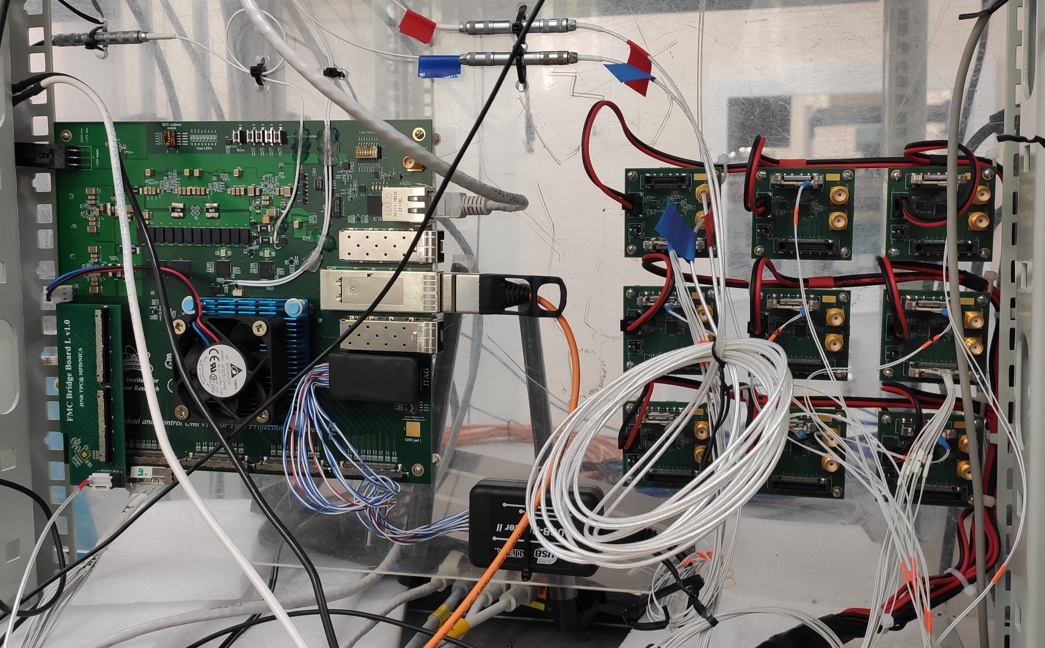
Prototype of synchronization unit
Readout and Control Unit (RCU)
Tested prototype
This synchronization prototype unit fanout transceiver reference clock to 62 FECs from 1 RCU (1 ROC sync.)
Synchronization unit of System will fanout 5 external signals to FECs:
3 types reference clocks;
Data trigger;
Reset.
Test setup for synchronization prototype unit

Slide 10
Block diagram of synchronization unit for Control & Synchronization System
In con. (LVDS)
5
RCU_1
ZL40226
LVDS
Out con. (LVDS)
FEC_1
LVDS
8
…
LVDS
FEC_8
5
5
MAIN
ZL40226
Same chips
8
External
sync. unit
…
Optical links
24
5
…
LVDS
ZL40226
LVDS
Out con. (LVDS)
FEC_57
LVDS
8
5
Control &
Synchronization System
…
5
FEC_64
RCU_24
Synchronization
unit for each ROC
Outside MPD magnet
Inside
MPD magnet
Tested prototype

Slide 11
Control & Synchronization System is designed
3D model of device Control & Synchronization System(top/bottom view). Size is 810 x 60 mm
JTAG over LVDS. Сable length is about 2m
Location of control & synchronization system on TPC

Slide 12
Conclusion
Comprehensive tests of prototypes of remote access and synchronization units have been carried out;
Electrical scheme of control & synchronization system has been developed;
Tracing of PCB control & synchronization system has been completed.
Future plans:
Accompany production of device;
Perform full-featured device testing;

Slide 13
28th International Scientific Conference of Young Scientists and Specialists (AYSS-2024) Remote reconfiguration, debugging, testing and synchronization system of Electronics Cards for the TPC/MPD Detector of the NICA project
Denis Potapov, an engineer of the
TPC/MPD group, VBLHEP, JINR
Dubna, 2024

