Slide 1
SEARCH FOR THE LOW-ENERGY STATE OF THE ISING MODEL USING NEURAL NETWORKS
Ternovoy Nikita Konstantinovich,
Scientific supervisor Nefedev K.V.
FEFU. Department of Theoretical Physics and Intelligent Technologies.

Slide 2
Introduction
Spin glasses are disordered systems with random competing interactions [1]
The Ising model is a set of discretely given magnetic moments arranged on a periodic lattice. And the exchange constants are given
The Ising model contains a set of n spins, or binary variables Si each of which can take the value “up” (Si = 1) or “down” (Si = -1). And Jij =+1 or =-1 [2]
Energy functions: Magnetic moments interact with each other with a certain interaction energy, calculated by the corresponding formula. We consider a close-interaction model, i.e., we only consider nearest neighbors.
$E=−\sum_{i,j}{J_{ij}}S_{i}S_{j}$ (1)
$min\sum_{i,j}{E}$ (2)
The energy (cost) function of the Hamiltonian,
for given interaction forces Jij.
Finding the ground state means finding the
values of spin variables minimizing the energy
(cost) of the Ising Hamiltonian (2)
This is a nonlinear discrete optimization problem
Fig. 1 Spin lattice
2

Slide 3
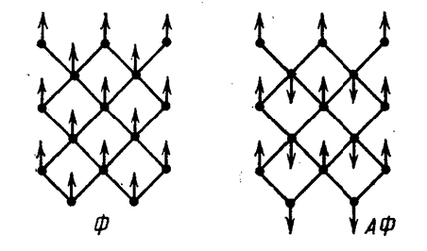
Lattice types
When Jij is positive, the interactions are called
ferromagnetic. In this case, there is a trivial solution:
all spins are aligned, i.e., have the same sign.
When Jij is negative, the interactions are called
antiferromagnetic.
And we consider a lattice in which half of the randomly determined interaction constants take values +1 and the other half -1
Fig. 2 lattice types
3

Slide 4
Analyzing the quartet
We consider a spin system with randomly determined half of the values J +1 and half with -1
To give an example, let me give a lattice with a configuration of interaction constants of three pluses and one minus. If we arrange the spins so that three pairs are negative energy.
There will always be one pair with positive energy in any configuration. Let us call quartets in which such a pair is unavoidable - frustrated.
$E=−\sum_{i,j}{J_{ij}}S_{i}S_{j}$ (1)
$min\sum_{i,j}{E}$ (2)
Figure 3 Quartet type
4

Slide 5
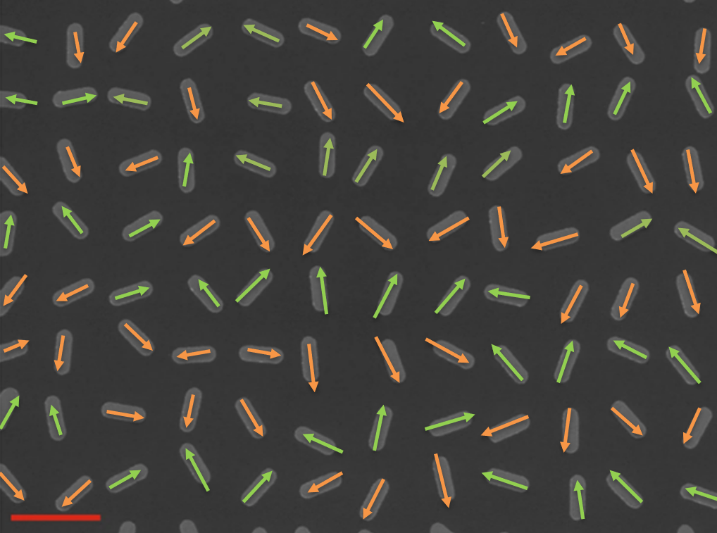
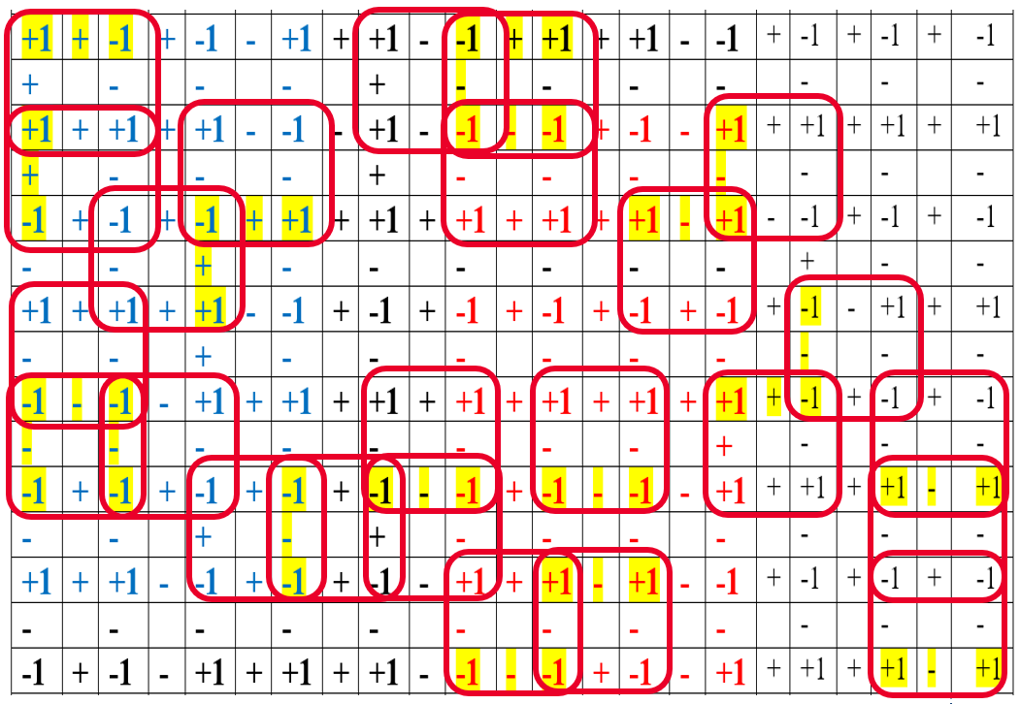
If we allocate all such quartets on the experimentally obtained by scientists from Los Alamos National Laboratory lattice [3].
It will appear that they overlap and influence each other, separately each quartet is favorable to one arrangement of pairs, and together - another. And we still need to take into account all these effects to choose such a configuration of spins that the total interaction energy was minimal.
Figure 4 Direct observation of a dynamical glass transition in a nanomagnetic artificial Hopfield network. Nat. Phys.
5

Slide 6
Relevance
The ground state search of the Ising model can be used to solve many combinatorial optimization problems. [4]
For example, the Hopfield lattice as a subset of the Ising model.is a classical model of associative memory used in machine learning [3].
Memorized images in the Hopfield lattice correspond to stable (low-energy) states of the spin system.
These are states in which the system self-organizes and remains in them without external influence Nanomagnetic systems (e.g., magnetic nanoparticles) exhibit properties similar to the Hopfield network.
They also have multiple stable states and the ability to recover to a given state after perturbation by an external magnetic field. Advantages of nanomagnetic systems.
They have great potential for use in memory devices due to their small size, low power consumption and high information storage density.
Figure 5. Hopfield spin lattice
6

Slide 7
Existing methods
Brute–forcing [5]: Guarantees finding a global minimum
Disadvantages: Exponential complexity: The computation time grows exponentially as the number of spins increases (2 to a power of N, where N is the number of spins). This makes the method impractical for systems with more than a few spins. Most of the configurations searched are not optimal, so a lot of computation time is spent.
Monte Carlo methods [6]: Can be applied to systems with a large number of spins.
On average, Monte Carlo methods take less time than a full brute force search, especially for large systems.
Disadvantages: Risk of getting stuck in local minima: The method may get stuck in a configuration with relatively low energy, but not the lowest energy (global minimum).
Neural Network [7]: Can be used for systems with a large number of spins. When trained on a sufficiently large amount of data, a neural network can achieve high accuracy in predicting optimal configurations. Can be adapted to different types of interactions and configurations.
Disadvantages: Neural network needs to be trained on data from other methods, such as brute force or Monte Carlo methods. The choice of network architecture, training parameters and optimizer requires some knowledge and experimentation.
7

Slide 8
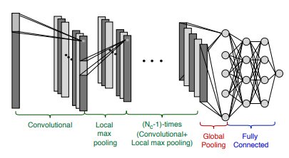
Apply neural networks
The tasks are:
1. Classifications of configurations on 27000 examples
2. plotting the dependence of heat capacity on temperature in order to fix the transition between phases at a sharp jump in heat capacity [8]
3. determination of energy as a function of spin lattice configuration. [7]
Convolutional architectures are mainly used for this purpose
We set out to find a low energy state by changing the spin configuration while leaving the interaction constants unchanged. I was just starting to dive into this field and it was realized that the choice of architecture should be subject to a certain logic linking spin configurations and their energies.
Figure 6. Schematic representation of the scalable convolutional network with the global pooling layer. The
input layer (on the left) is followed by Nc convolutional layers with Nf filters, which create filtered maps of the input.
The maps are organized in depth. Local pooling layers are
inserted between the convolutional layers, reducing the number of neurons. The convolutional layers are connected to the
dense layers (on the right) via the global pooling layer.
8

Slide 9
The architectures we plan to use and their characteristics
1. Fully Connected Neural Network (FCNN)- A network with multiple hidden layers where each neuron in each layer is connected to all neurons in the previous layer. Ease of implementation and customization. Ability to learn nonlinear dependencies between inputs and outputs.
Disadvantages: May have learning problems if the number of neurons in the layers is too large. Do not take into account the spatial structure of the spin lattice. High computational complexity for large lattices due to full connectivity between layers.
2. Convolutional Neural Network (CNN) - Uses convolutional layers that apply filters to the input data to extract local features. Effective for processing data with spatial structure - spin lattice
Disadvantages: May be more difficult to tune.
3. Recurrent Neural Network (RNN)- Can be used to model the dynamics of an Ising system.
Disadvantages: Less efficient than CNNs for tasks involving spatial structures.
4. Generative Adversarial Network (GAN)- Consists of two neural networks: a generator and a discriminator. The generator creates new data and the discriminator tries to distinguish the generated data from the real data.
Disadvantages: May require a large amount of data to achieve good results.
9

Slide 10
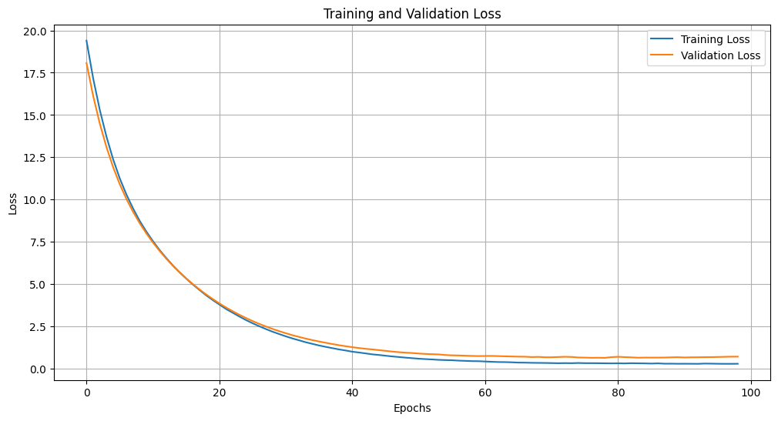
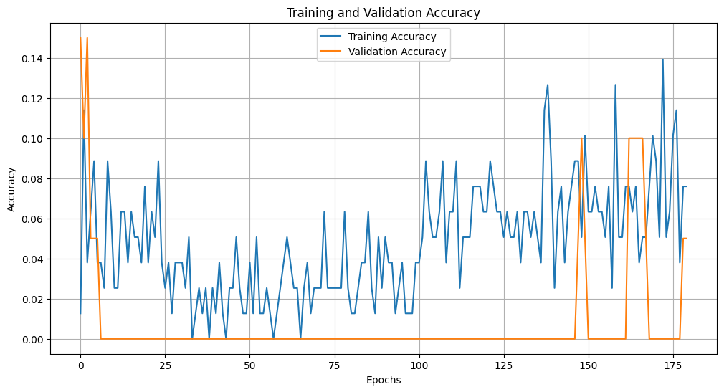
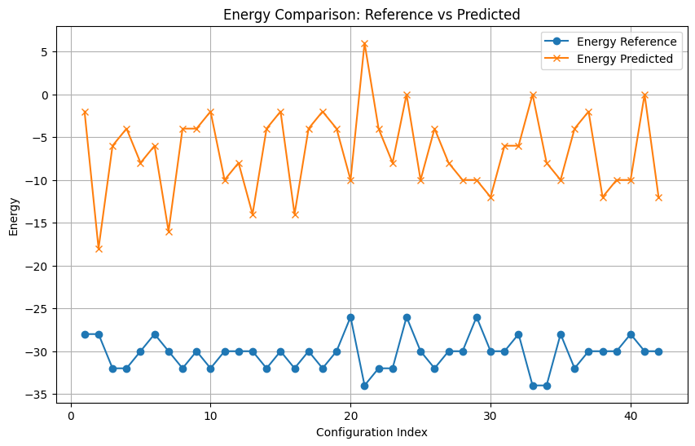
Graphs - Learning accuracy to differences in epochs, scales, architectures
- Prediction results compared to the available ones
To begin with, I tried training a fully connected neural network by combining the number of layers and parameters. In order for it to generate configurations. But as you can see, due to the limited dataset of only 700 pairs, the neural network did not get stable training. The accuracy is extremely low and also not stable
10

Slide 11
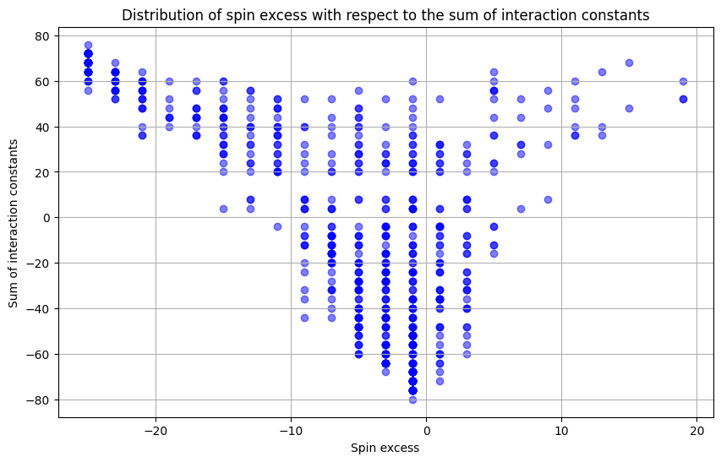
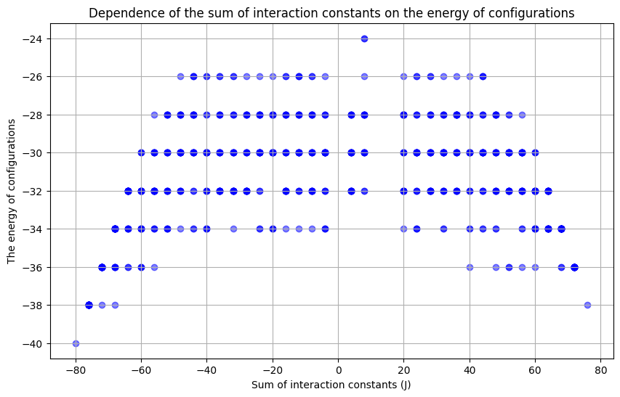
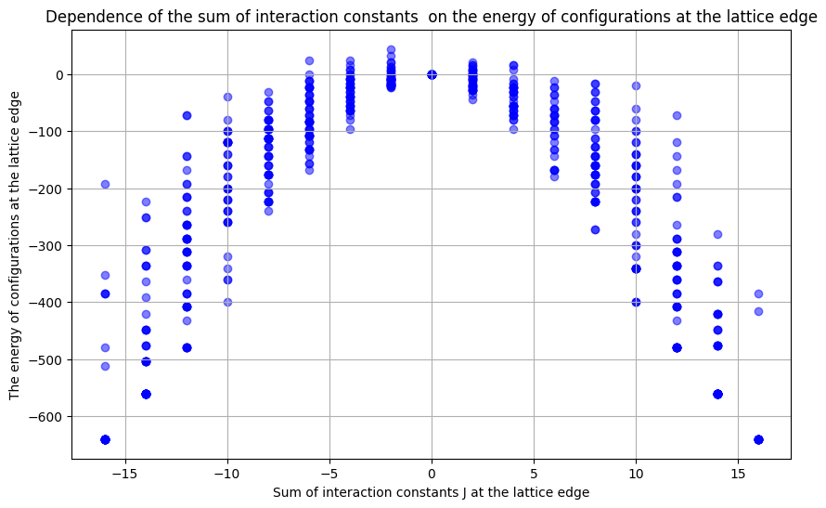
I decided to analyze a set of features characterizing a set of interaction constants and spin configurations in order to identify common features on the basis of which machine learning can be built
1. Most of the spin excess is negative. And we can notice a correlation - the smaller is the spin excess, the larger is the sum of interaction constants
2. On the graph of the dependence of the minimum energy for the matrix of interaction constants on the sum of their values we can observe a similarity of the Gauss bell, which I plan to investigate in the future
11

Slide 12
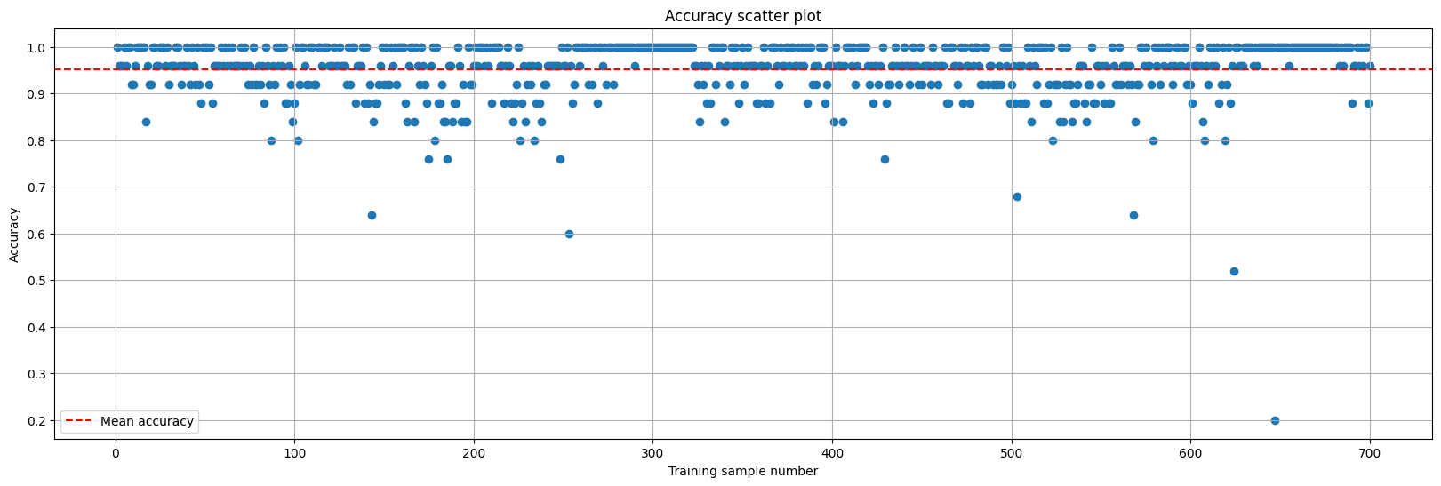
On a narrow set of parameters, I tried to build machine learning and we got some outliers and overtraining. In this graph you can see the accuracy of the neural network for each pair of 700 in the dataset. The outliers and 100 percent solution tells me that there are not enough parameters for good performance at this time
Average value of 95%
12

Slide 13
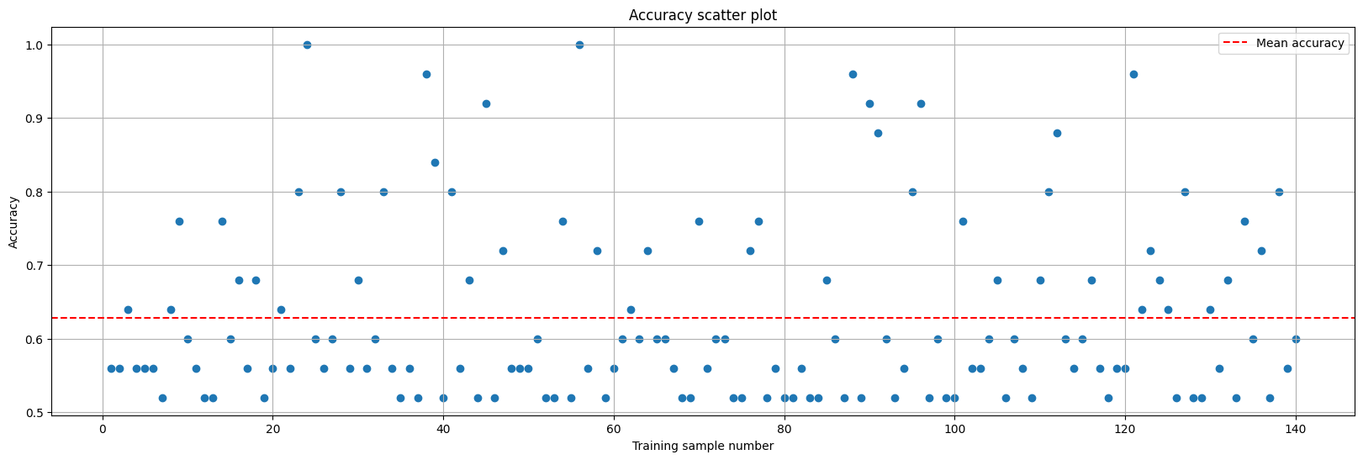
Accuracy averages 63% and exceeds 50% for the entire test sample
However, a rather large variation suggests that additional parameters for training are needed
The number of all possible combinations for a particular matrix J
Number of configurations/energy/spin surplus” ratio

Slide 14
Conclusion:
1. The presented neural network demonstrates the ability to find low-energy states in systems with interactions. But at the moment it shows a large difference between predicted or reference values, which is not good
2. Training the network requires adapting the number of cycles and parameters to the specific problem.
3. Future work is planned to extend the dataset with a new dataset including J interaction matrices represented as a set of three parameters: degeneracy, energy, and spin excess.
4. Comparative analysis of different lattices including Hopfield, Kagome 3D and other
5. The most efficient architecture for solving problems with different types of interactions.
6. Special attention will be paid to investigating the scalability of the approach to systems with a large number of spins that cannot be analyzed by traditional methods.

Slide 15
Thank you for your attention!

Slide 16
J.A. Mydosh 2015 Rep. Prog. Phys. 78 052501 DOI 10.1088/0034-4885/78/5/052501
Kobe, Sigismund, and Jarek Krawczyk. "Ground States, Energy Landscape, and Low-Temperature Dynamics of±J Spin Glasses." (2006): 141-158.
Saccone, M., Caravelli, F., Hofhuis, K. et al. Direct observation of a dynamical glass transition in a nanomagnetic artificial Hopfield network. Nat. Phys. 18, 517–521 (2022). https://doi.org/10.1038/s41567-022-01538-7
Cen, Yunuo, Debasis Das, and Xuanyao Fong. "A tree search algorithm towards solving Ising formulated combinatorial optimization problems." Scientific Reports 12.1 (2022): 14755.
Jałowiecki, Konrad, Marek M. Rams, and Bartłomiej Gardas. "Brute-forcing spin-glass problems with CUDA." Computer Physics Communications 260 (2021): 107728.
Okuyama, Takuya, Masato Hayashi, and Masanao Yamaoka. "An Ising computer based on simulated quantum annealing by path integral Monte Carlo method." 2017 IEEE international conference on rebooting computing (ICRC). IEEE, 2017.
Zhang, Wenxuan, et al. "Ground state search by local and sequential updates of neural network quantum states." Physical Review B 107.16 (2023): 165149.
Saraceni, N., S. Cantori, and S. Pilati. "Scalable neural networks for the efficient learning of disordered quantum systems." Physical Review E 102.3 (2020): 033301.
16

