Slide 1
Birdcage resonator for a gradient spin flipper in strong magnetic fields
V.A. Kurylev, G.V. Kulin

Slide 2
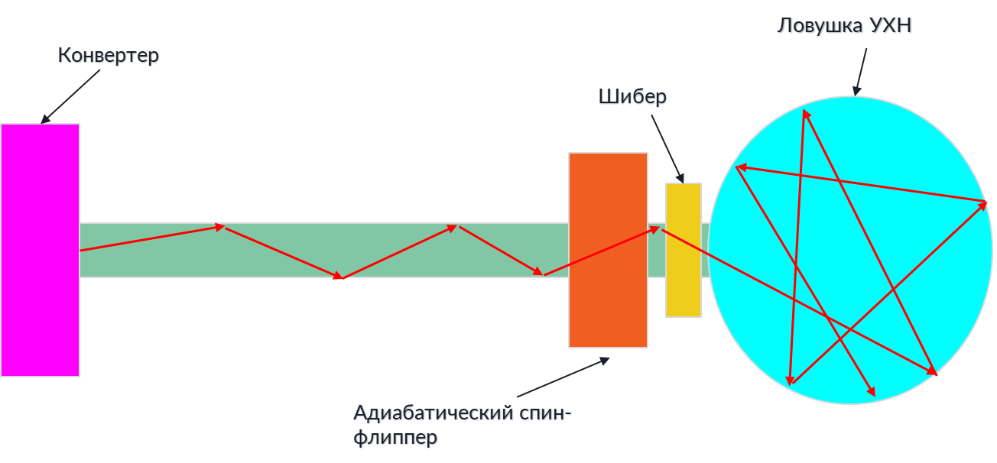
Pulsed UCN source
1
UCN storage
Moderator
Biological protection
Valve
ρ
Neutron density in the storage
τ
Adiabatic spin-flipper
T
t
Average neutron density

Slide 3
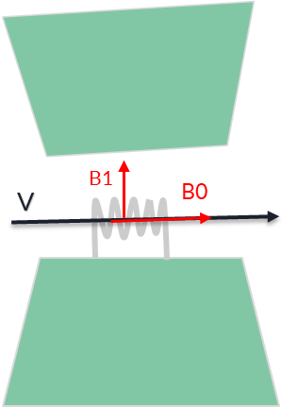
Adiabatic spin flipper
2
G. M. Drabkin. Production of Supercold Polarized Neutrons/G. M. Drabkin and R. A. Zhitnikov//Журнал Экспериментальной и Теоретической Физики, 38(1013), 1960
B
Spin flip zone graph
Bres+ΔB
Bres
Bres-ΔB
X
$$B_{0}\text{=ħ}\text{ω}\text{/}\text{2}\text{μ}$$
Diagram of the magnetic sistem
ΔB≫|B1|
ΔE=2μBres

Slide 4
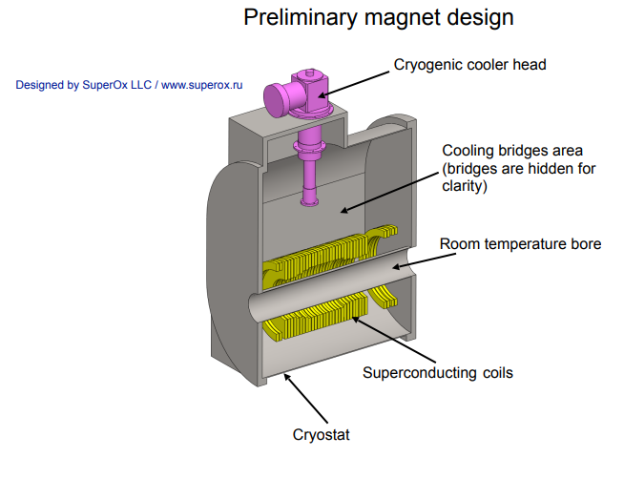
Superconducting magnet
3
G = 2cm
R = 5.5cm
r = 3.5cm
Design of the solenoid magnet made of superconducting tape

Slide 5
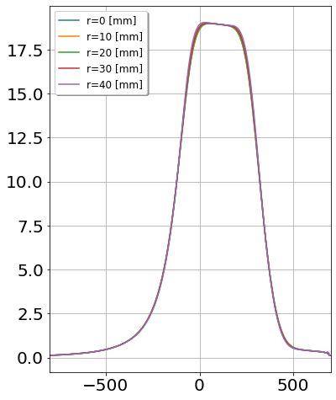
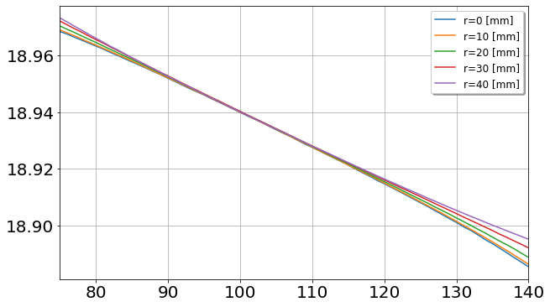
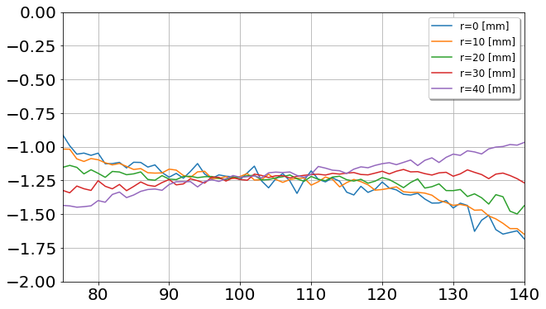
Spin flip zone
4
B_{res}∈ [18.90; 18.96] T
B, T
L = 0.05 m
B, T
1 T/m < < 1.5 T/m
∂B/∂z, T/m
ΔB≫|B1|
z, mm
z, mm
5

Slide 6
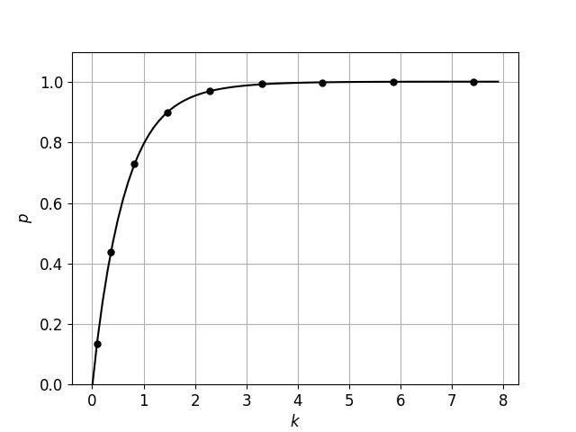
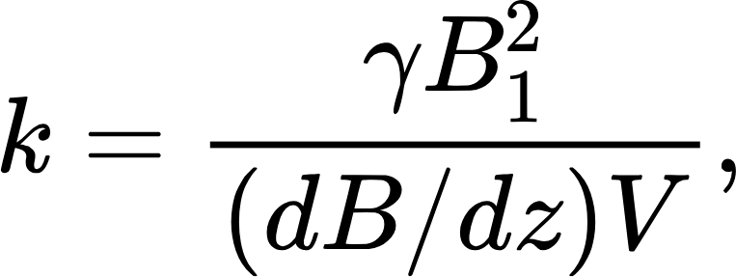
Adiabaticity parameter
5
γ - gyromagnetic ratio (1.83*10^8[1/(T*s)]),
B₁- amplitude of alternating magnetic field,
dB/dz - gradient of constant field in the spin flip region,
V - speed of a neutron when it enters a spin-flipper field (~15 [m/s])
Spin flip probability, p(k)
Adiabatic coefficient, k

Slide 7
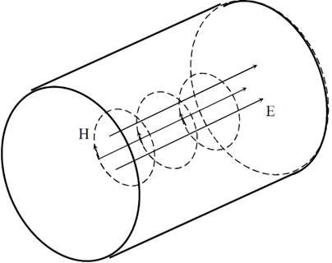
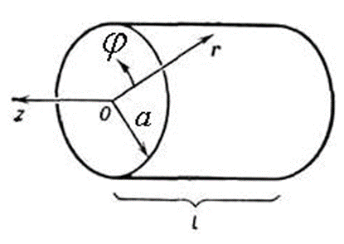
Volumetric resonator
6
Calculation of resonator dimensions
$$l=\frac{λ}{2}=\frac{c}{2f}=\frac{3}{10}=0.3 m$$
Field pattern E010 inside the volume of a cylindrical resonator
$$ω_{010}=\frac{1}{\sqrt{εμ}}∗\frac{ν_{01}}{a},ν_{01}=2\text{.4048}$$
$a=$ $\frac{ν_{01}}{(2π\sqrt{εμ}\text{)}}=0.28m=28cm$
$$a>5.5cm (R)$$

Slide 8
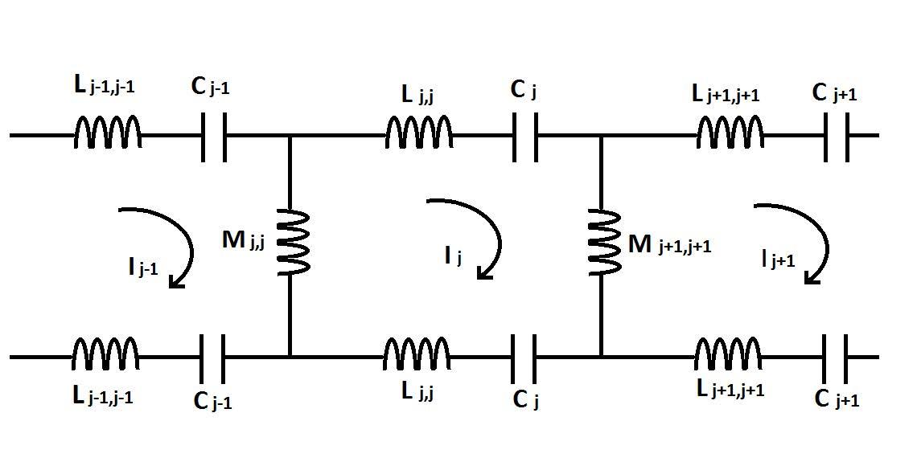
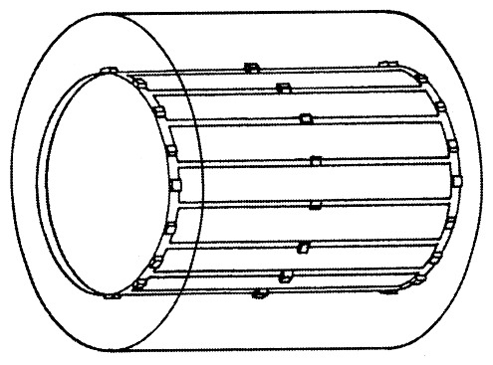
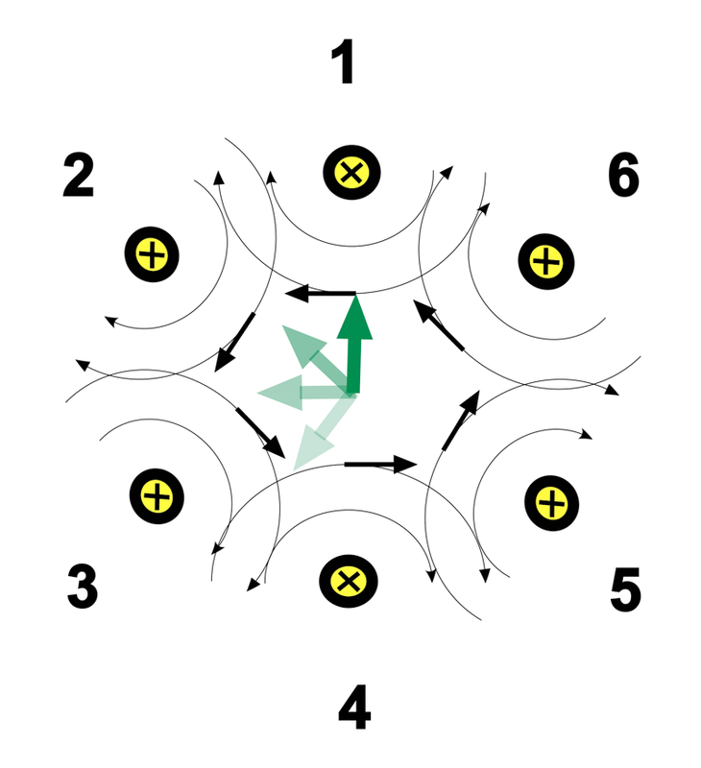
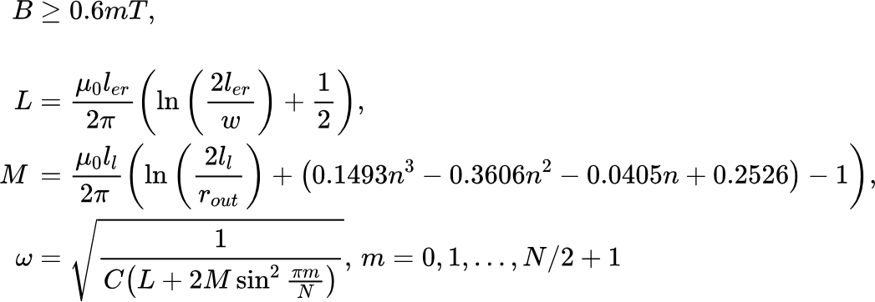
Birdcage coil
7
General view of the "Birdcage"
Field type B1
Equivalent circuit

Slide 9
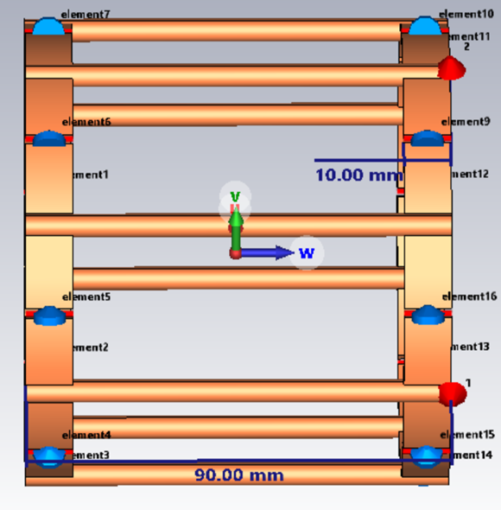
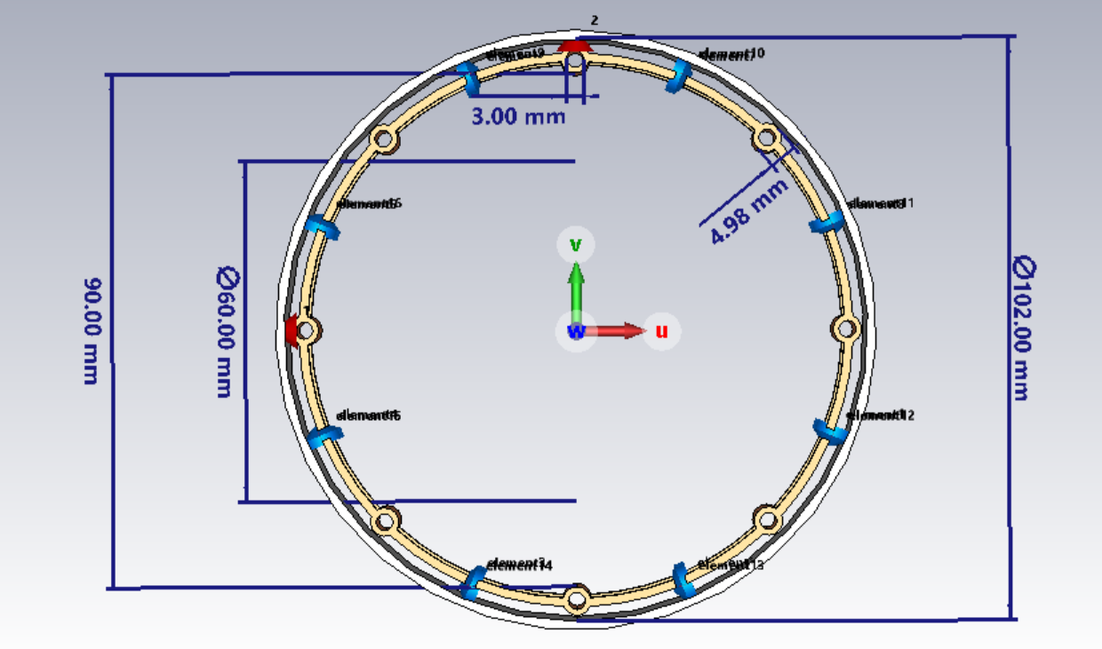
Resonator model
8

Slide 10
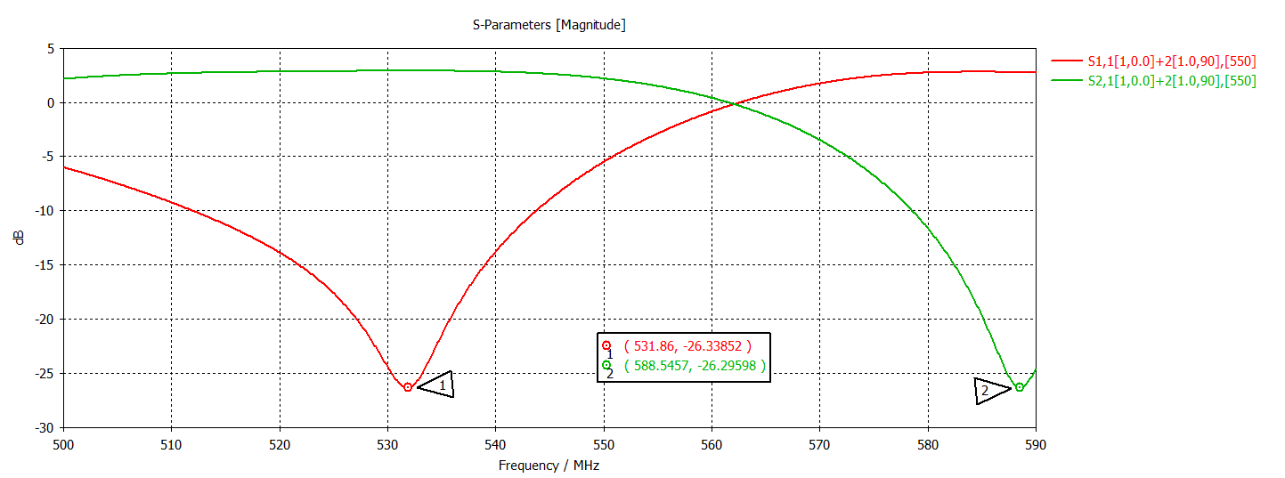
Optimization
9
dB
MhZ

Slide 11
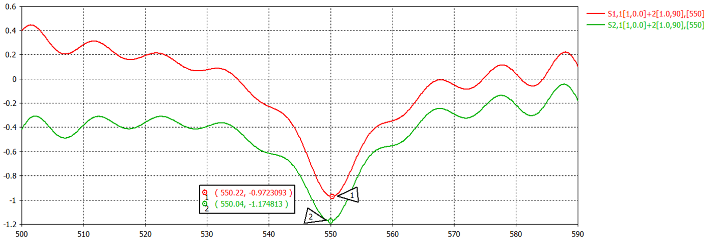
Loss parameters (S-parameters), at C = 7.29 pF
10
dB
MhZ

Slide 12
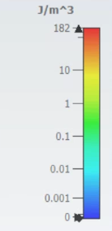
Distribution of magnetic energy
11
Distribution of magnetic field energy in the resonator cross section
Magnetic field energy distribution profile

Slide 13
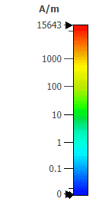
Precession of the magnetic field B₁
12
Useful volume
Field in the cross section of the resonator
Field in the resonator volume

Slide 14
_{Power calculation}
13
$$Q=ω∗\frac{E}{P}=\frac{ωL}{R};Q=\frac{ω_{0}}{Δω}=40.5639$$
$$R=4Ω$$
$$Δω$$
$$J_{m}=\frac{2R_{er}B_{1}}{μ_{0}}=43 A$$
$$ω_{0}$$
$$\left.\begin{matrix}P=J_{m}^{2}∗R=5.5 kW \\ P=\frac{2π}{3}μ_{0}Λ_{1}^{2}\frac{ω^{4}}{c^{3}}R_{er}^{2}l_{l}^{2}=5.2 kW, Λ_{1}=\frac{J}{2πR_{er}} \end{matrix}\right\}$$
$$P≈5.5 kW$$

Slide 15
Summary
14
The geometric parameters of a hollow round resonator were obtained, from which it follows that it is impossible to install it in the light of an adiabatic spin-eraser without significant changes in the design of the superconducting magnet.
The required resonator capacity, suitable geometric and frequency conditions of installation were calculated.
A resonator model was created, simulation and fine-tuning were carried out in the CST Studio Suite program environment. A primary calculation of the stationary mode power was made.
A concept of an RF resonator suitable for further use in an adiabatic spin-flipper device in a strong magnetic field was developed.

Slide 16
Thank you for your attention!

Slide 17
Spin precession
B₀= B₀^{start} + z ∂B/∂z - gradient stationary field (∂B/∂z < 0)
B₁=B₁ - alternating RF field with constant amplitude and rotation frequency ω, B₁丄B₀
B_{ω}= - ω/γ – fictive field
B_{eff}=B₀+B_{ω}+B₁- effective field
S - polarization
B₀
B₀
B₀
B_{eff}= B₀
B₀
S
B_{eff}
B₁
B_{ω}
B_{ω}
B_{ω}
B_{ω}
B_{eff}
B_{ω}
S
B₁
B_{eff}= B₁
S
Before the RF field zone
RF field zone before resonance
RF field zone after resonance
After the RF field zone
Resonance

Slide 18
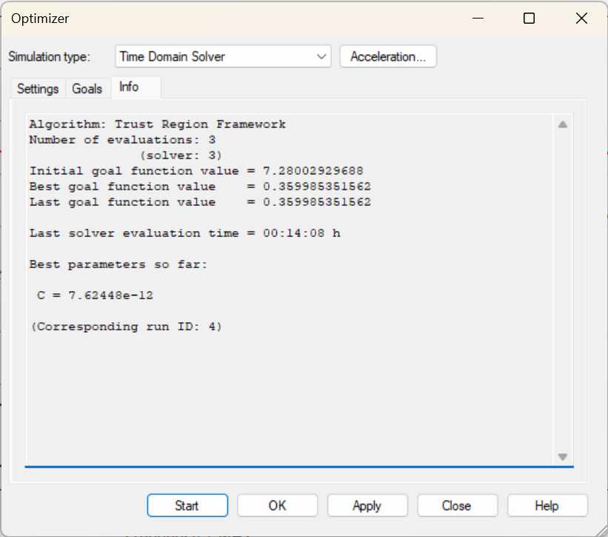
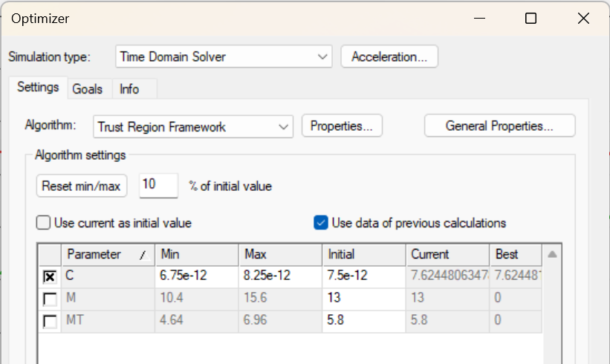
Optimization

Slide 19
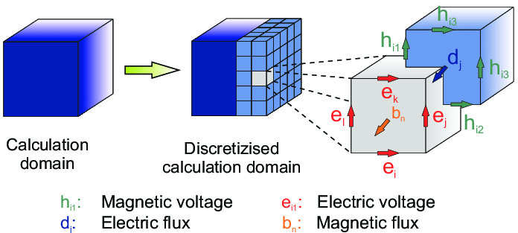
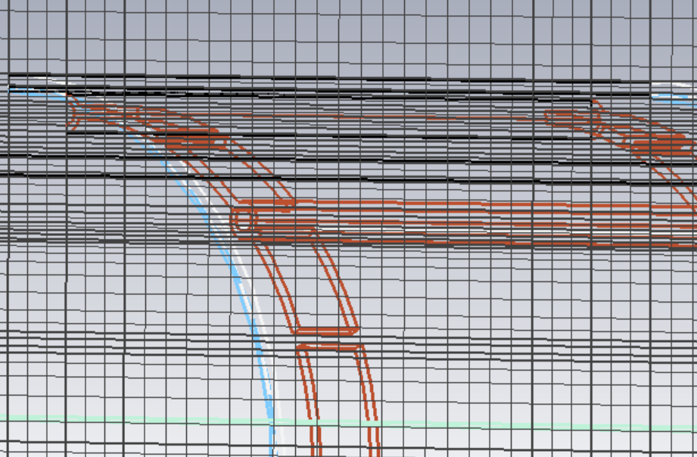
CST studio suite
Finite integration method
$$\oint{\vec{E}\left(\vec{r}, t\right)d\vec{s}=−\iint{\frac{δ}{δt}\vec{B}\left(\vec{r}, t\right)d\vec{A} ∀ A∈ℜ^{3}}}$$
Faraday's law in integral form

