Slide 1
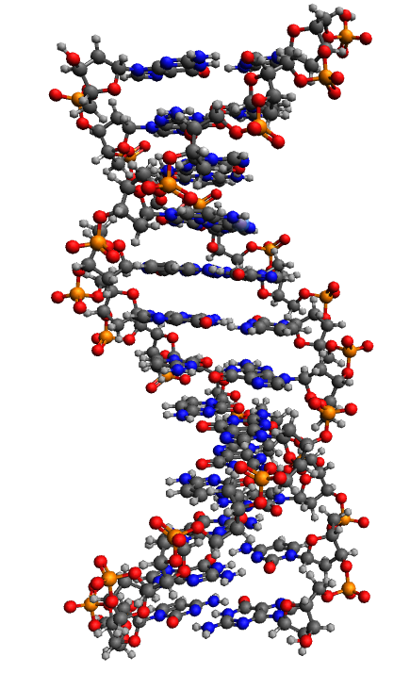
The symmetry method as a way to visualize the interaction of an ultrashort pulse with matter, using the example of RNA molecules, DNA and diamond crystals
Anastasia A. Kharlamova
Higher School of Natural Sciences and Technologies
Northern (Arctic) Federal University named after M.V. Lomonosov
Kharlamova.anastasya2015@yandex.ru

Slide 2
Introduction
Theory of calculation of the polyatomic structure
The model under study
Parameters of the mathematical model
Simulation results - Spectrum graphs
Conclusions
2

Slide 3
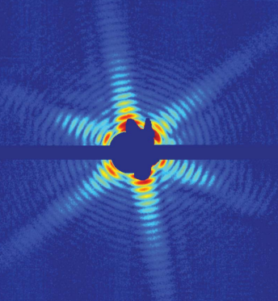
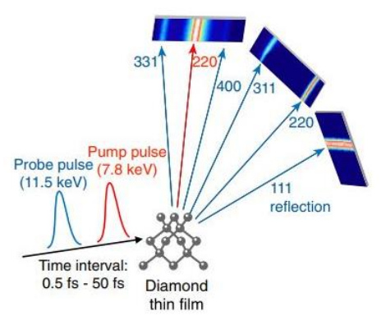
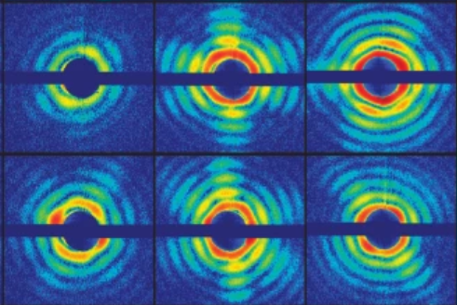
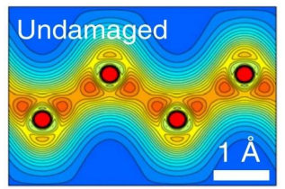
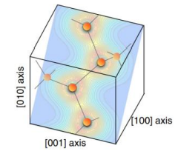
Modern experiments
3

Slide 4
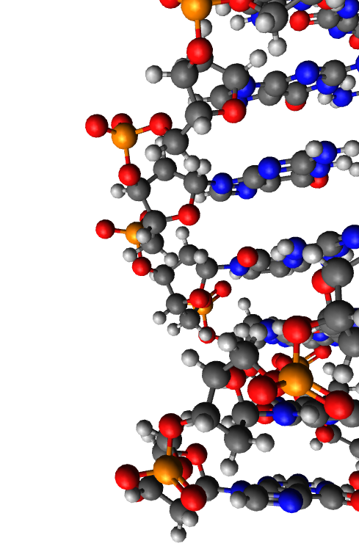
Theory
electromagnetic field strength USPs
interference factor
number of electrons in the atom of the i - grade
number of atoms of the i - grade
form factor of the atom of the i - grade with the corresponding electron density
D.N.Makarov, A.A.Kharlamova, “Scattering of X-ray Ultrashort Pulses by Complex Polyatomic Structures,” International Journal of Molecular Sciences, Vol 163, December 2021.
4

Slide 5
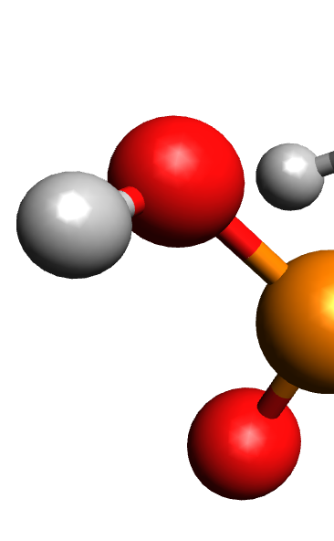
Theory
number of atoms of the i - grade
radius vector specifying the position of the atoms of the corresponding variety
momentum vector of the USPs falling on the multi-atom system
5

Slide 6
Theory
some asymmetry in the system
the number of symmetries in the system
radius is a vector specifying the position of the symmetry α or β
momentum vector of the USPs falling on the multi-atom system
radius is a vector specifying the position of atoms of grade i in symmetry
6

Slide 7
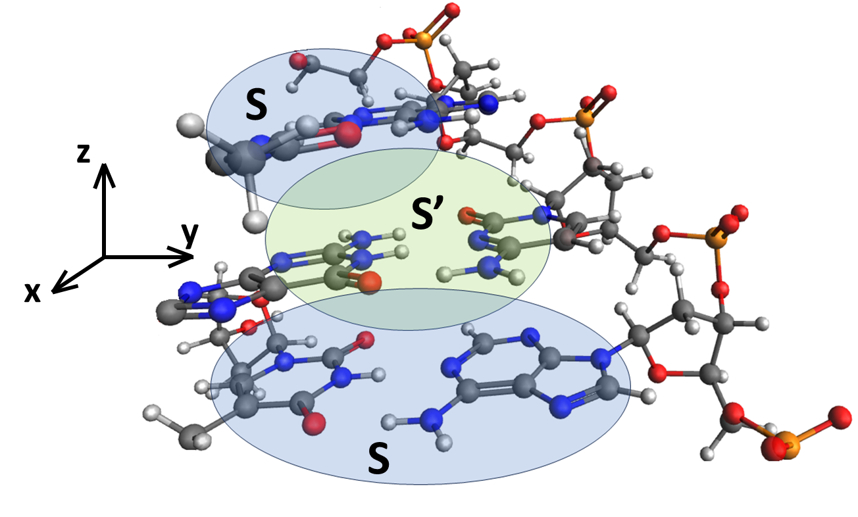
Theory
7

Slide 8
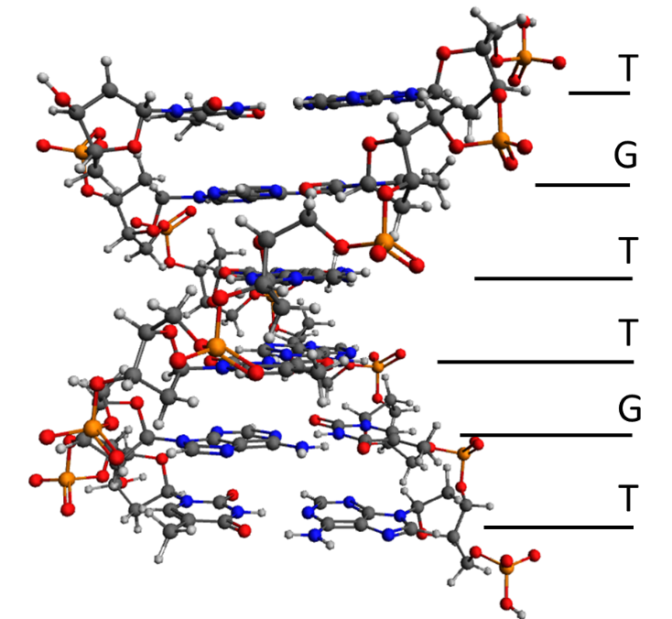
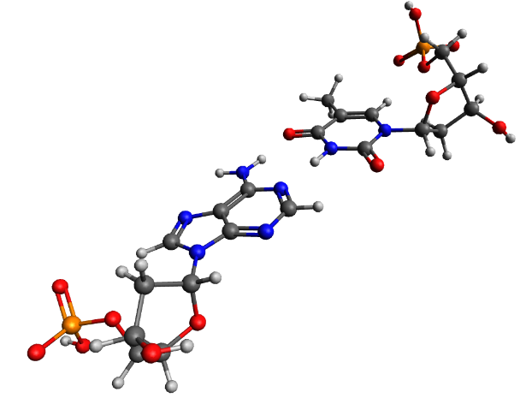
Theory
Escherichia coli str. K-12 substr. MG1655
8

Slide 9
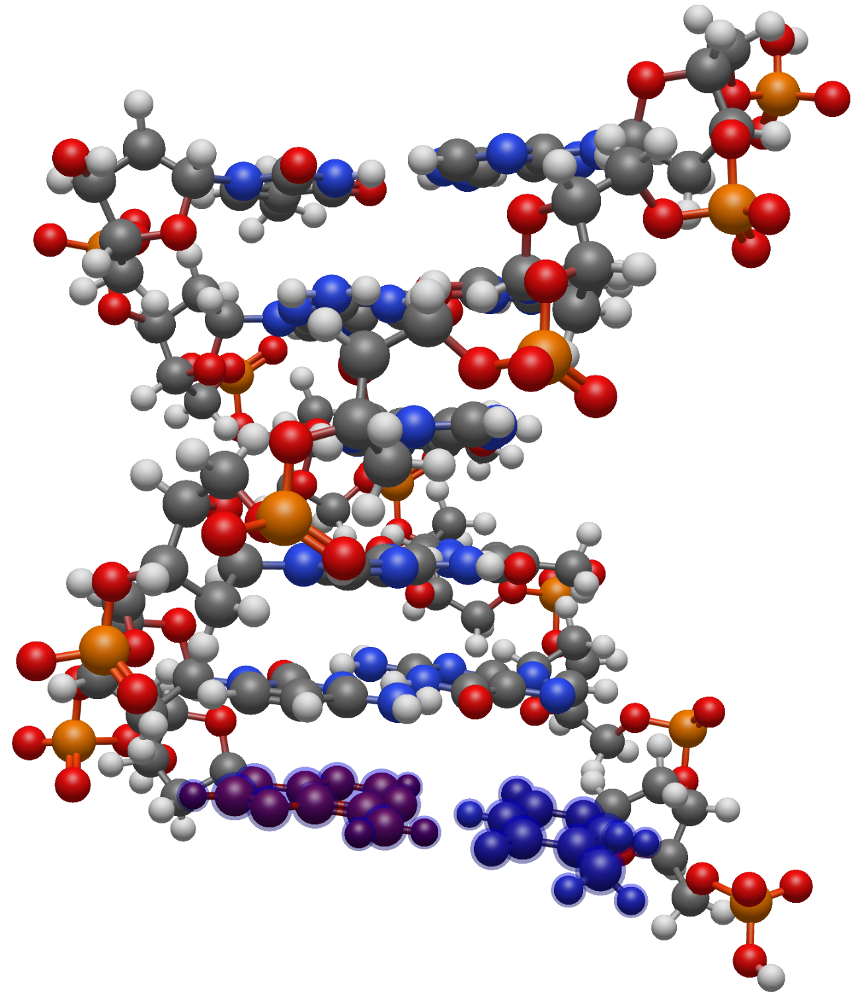
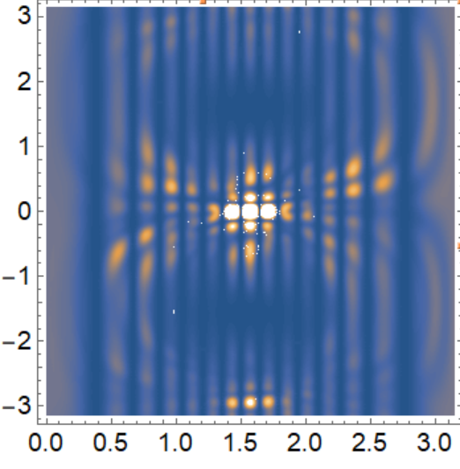
Object for Modeling
0.0
0.1
9

Slide 10
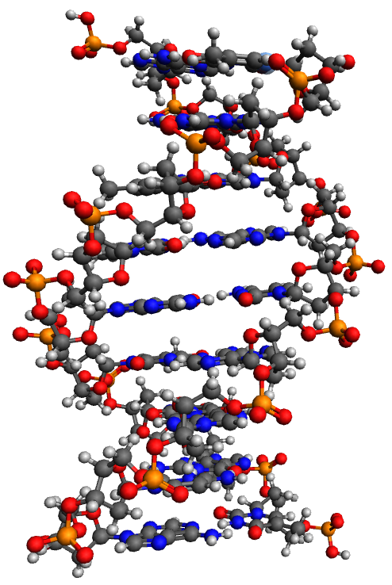
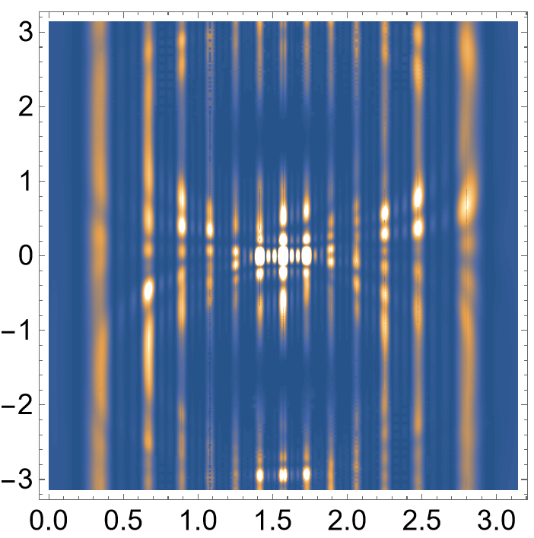
Object for Modeling
DNA
0.0
0.1
10

Slide 11
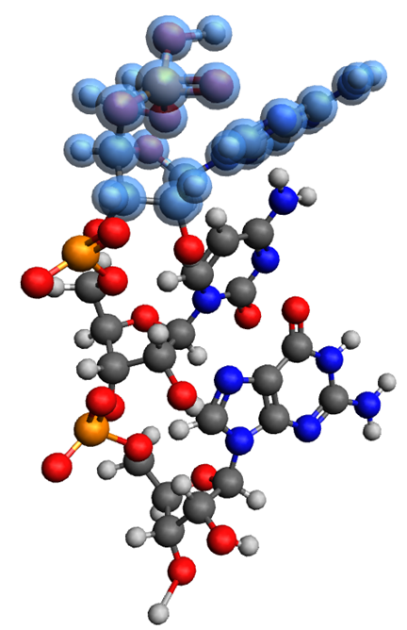
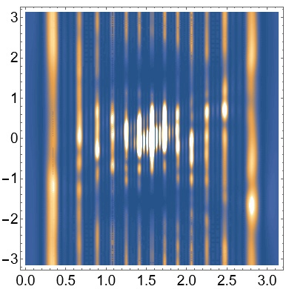
Object for Modeling
RNA
11

Slide 12
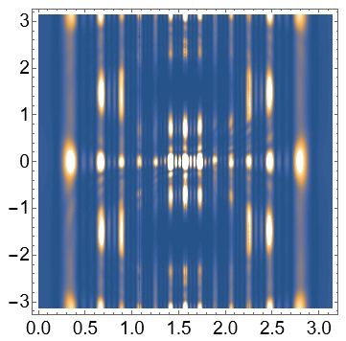
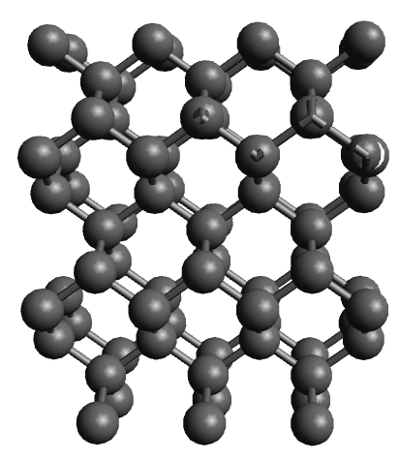
Object for Modeling
Diamond plate
12

Slide 13
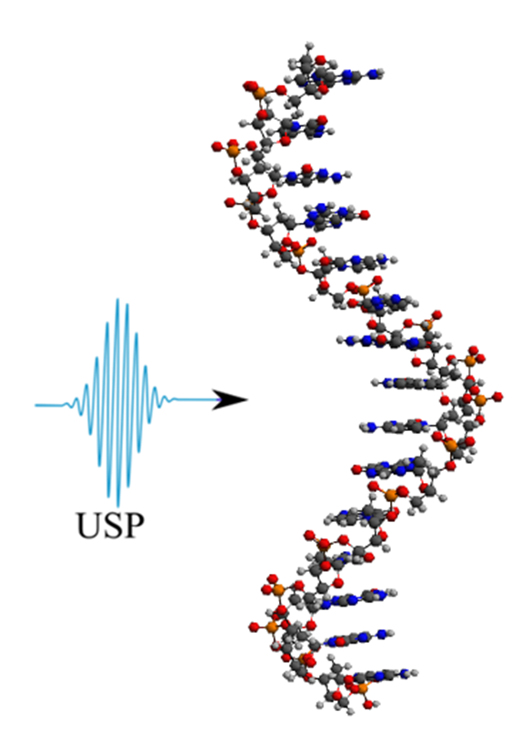
Object for Modeling
The following parameters were used in the simulation:
The main axis of DNA runs along the molecule, perpendicular to its bases
The pulse falls on the system at an angle of 90 degrees to the main axis, system parameter
ϴ angle between the helix axis and the scattering direction
ɸ angle between the x-axis and the projection on the plane perpendicular to the helix axis, the calculations were performed in spherical coordinates
The results in all figures are normalized to the maximum value of the scattering spectrum.
The value = 2c, which corresponds to the photon energy 7.46 keV
13

Slide 14
Conclusions
The scattering spectra of ultrashort laser pulses are mathematically modeled based on the theory of sudden disturbances.
An analytical formula is presented and the principle of calculating a polyatomic structure using atomic coordinates is explained.
As a result, mathematical models of USPs spectra were performed for three types of models.
The results show that the models give an idea of the structure of the sample, and the graphs obtained differ from each other.
14

Slide 15
Thanks for your attention
15

