Slide 1
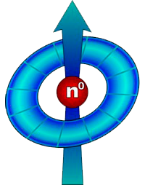
Investigation of the fractal structure of deciduous and coniferous trees using small-angle neutron scattering simulation experiments
O. D. Shnyrkov^{1, 2}, E. G. Iashina^{1, 2}, K. A. Pshenichnyi¹ and S. V. Grigoriev^{1, 2}
¹Petersburg Nuclear Physics Institute, NRC “Kurchatov Institute”, Gatchina, Russia
²Saint Petersburg State University, Saint Petersburg, Russia

Slide 2
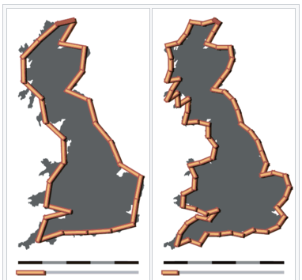
Hausdorff measure
The length of the British coastline depends on the chosen length of measuring segments.
100 km
50 km
Hausdorff measure:
2800 km
3400 km
$$μ=\lim_{ε→0}{N\left(ε\right)∙γ\left(d\right)∙ε^{D}}=const$$
Fig. 1. The coastline paradox.
where:
N(ε) is number of elements, size ε, required to cover the object.
$D$ – Hausdorff-Besikovich dimension, can be integer or fractional.
$γ\left(d\right)$ is a constant that depends on the dimension of space 𝑑.

Slide 3
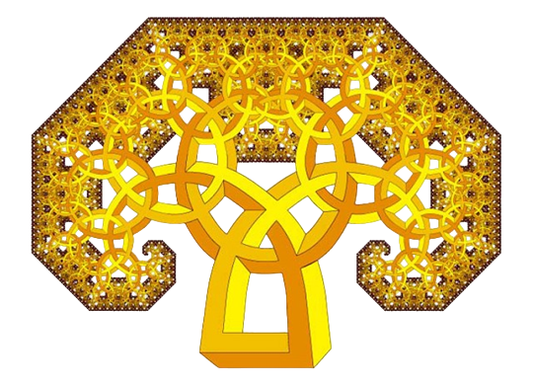
Definition of fractals
Objects whose Hausdorff-Besikovich dimension is greater than their topological dimension are called fractals.
The Hausdorff-Besikovich dimension D is called the fractal dimension.
B. Mandelbrot, The Fractal Geometry of Nature, New York: Freeman, 1983.

Slide 4
Logarithmic measure
There are objects characterized by more complex measures, for example, logarithmic:
$$μ=\lim_{ε→0}{N(ε)∙γ(D)∙ε^{D}∙}{\left(\ln{\frac{1}{ε}}\right)}^{∆f}$$
$∆f$ - logarithmic subdimension.
Objects described by a logarithmic measure are called logarithmic fractals. The fractal dimension can be equal to the topological one.
Such fractals have a hierarchical (branching) structure and for them the principle of equality of the amount of matter at different levels of the hierarchy is satisfied.

Slide 5
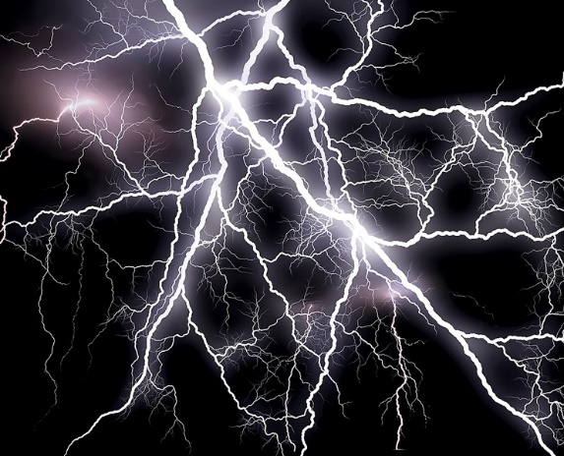
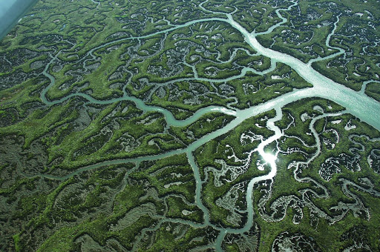
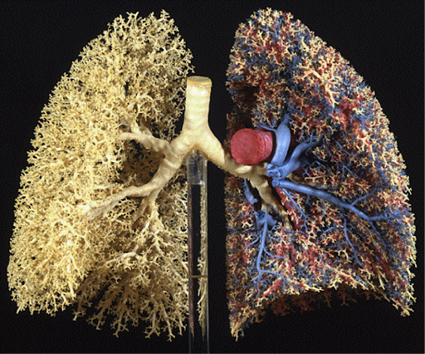
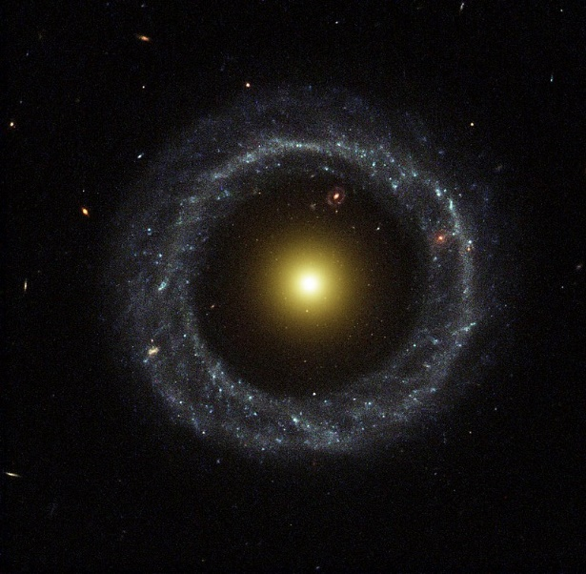
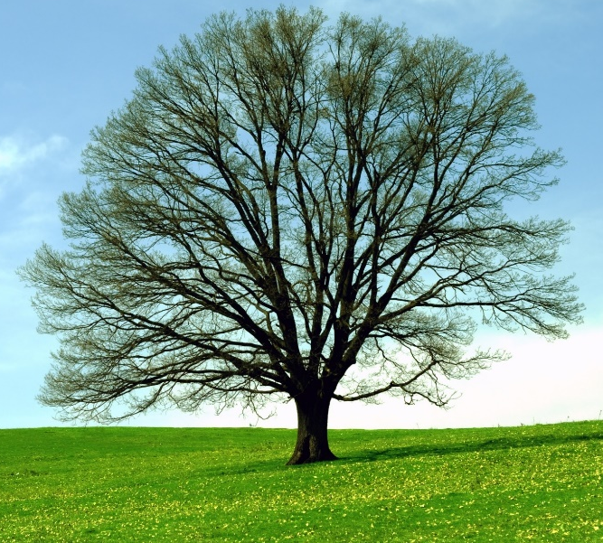
Fractals in nature
Fig. 2. lightning discharges.
Fig. 3. River beds.
Fig. 4. Vessels in the lungs.
Fig. 5. Galaxies.
Fig. 6. Tree branches.

Slide 6
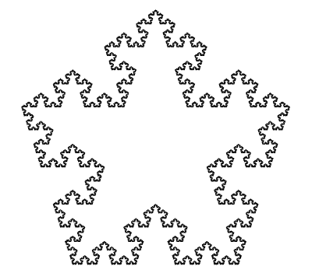
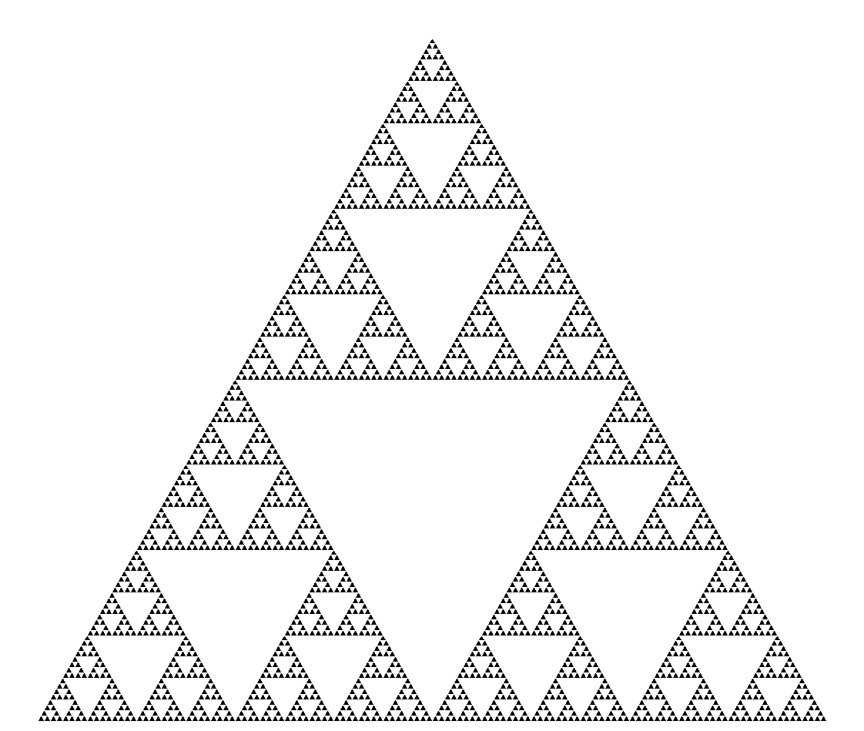
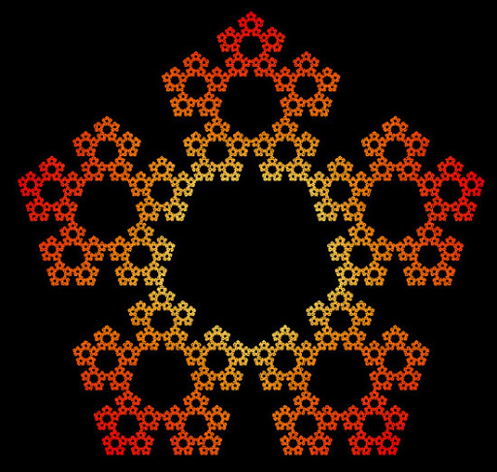
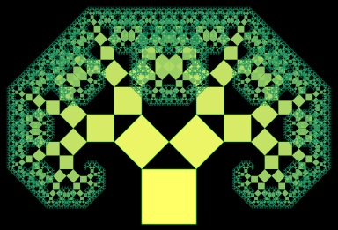
Fractals in mathematics
Fig. 7. Sierpinski carpet.
Fig. 8. Sierpinski triangle.
Fig. 9. Snowflake Koch.
Fig. 10. Dürer's Star.
Fig. 11. Tree of Pythagoras.

Slide 7
The study of fractals
Small angle neutron scattering
Synchrotron radiation
Small-angle scattering of optical radiation
-from 1 angstrom to 1 micrometer
- more than 1 micrometer
The scattering intensity depends on the transferred momentum according to a power law:
$$I\left(q\right)=Aq^{−∆}$$
Having obtained the scattering curve, you can determine the value of $Δ$ as the slope coefficient of the straight line on a double logarithmic scale and from it determine the fractal dimension of the object.

Slide 8
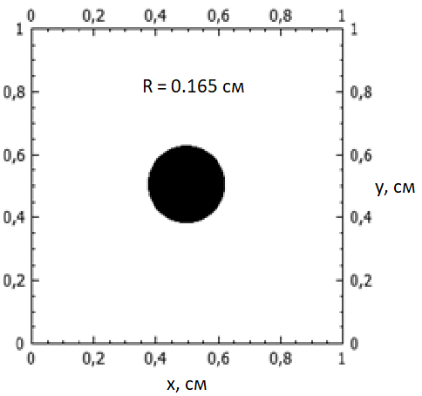
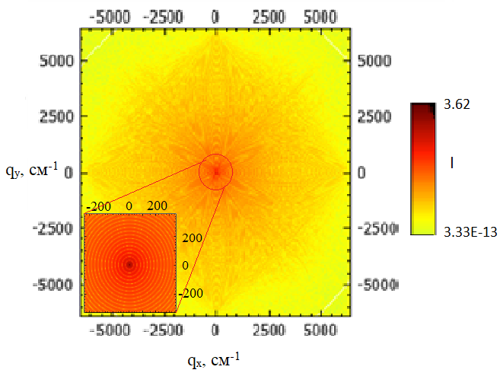
Fast Fourier Transform
The method of numerical Fourier analysis in two-dimensional space is a non-invasive method that allows you to obtain information about the fractal dimension of an object.
FFT
$${\left|F\right|}^{2}$$
Fourier image
2d object
Fourier image
Scattering intensity
2d object
Scattering intensity
Azimuth averaging
$$I\sim q^{−Δ}$$
Fractal
dimension
Fractal
dimension
Small-angle scattering curve
Small-angle scattering curve
$$Δ→D$$
Fig. 12. The scheme of Numerical Simulation of an Experiment on Small-Angle Light Scattering by Two-Dimensional Objects.

Slide 9
Fast Fourier Transform
Fig. 13. The object of study is a circle with a radius R = 0.165 cm cm in a square with a side of 1 cm.
Fig. 14. The model intensity pattern is the squared modulus of the Fourier transform of a circle, obtained using the program fractal.
Fig. 15. Dependence of the squared modulus of the Fourier image (intensity) for a circle on the transferred momentum on a double logarithmic scale.
https://github.com/tre3k/fractal

Slide 10
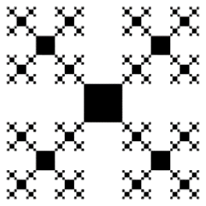
Classification of fractals in 2-dimensional space
Fractals
Mass
Boundary
Logarithmic
Fig. 16. Sierpinski carpet.
Fig. 17. Snowflake Koch.
1 < Δ < 2
2 < Δ < 3
Fig. 18. Da Vinci tree.
Δ = 2
Logarithmic fractals correspond to the law of equality of volume (area).
Pustovoit P.M et al., Surface. X-ray, synchrotron and neutron studies, № 12, pp. 3-11, 2020.

Slide 11
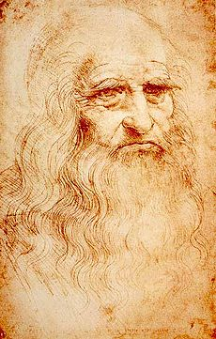
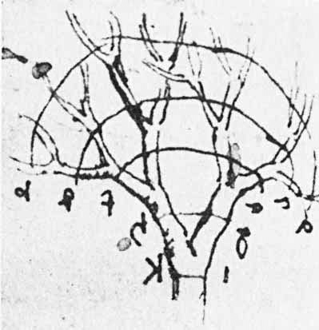
Leonardo da Vinci's rule: example of LF
The total cross-sectional area of ​​all tree branches at each height is the same.
$$d_{i}^{2}=n∙d_{i+1}^{2}$$
Fig. 20. “Turin Self-Portrait” by Leonardo da Vinci.
Fig. 19. Illustration of Leonardo's law.

Slide 12
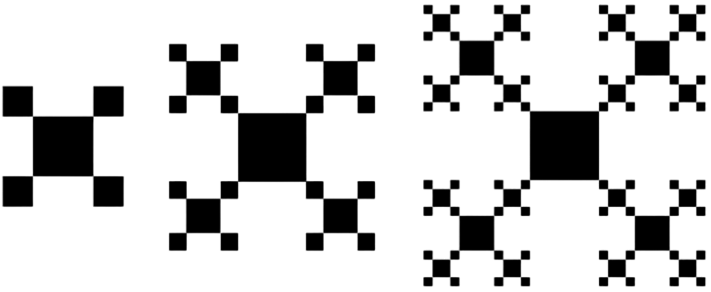
Da Vinci tree
Fig. 21. Scheme of constructing the fractal “Da Vinci Tree”: 2nd, 3rd and 4th generations.
Indekeu J.O., Fleerackers G., Physica A. 1998. V. 261. I. 3. P. 294-308.

Slide 13
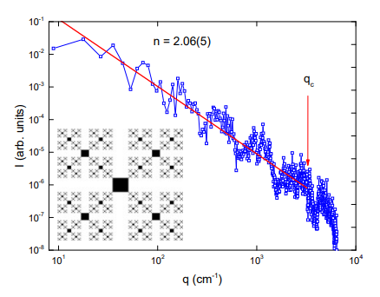
Study of the da Vinci tree fractal using the numerical Fourier analysis method
Fig. 22. Averaging intensity I depending on the transmitted momentum q for the 7th generation of the da Vinci tree

Slide 14
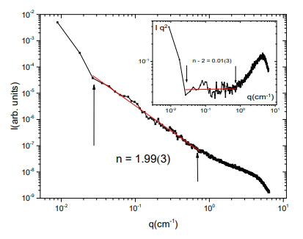
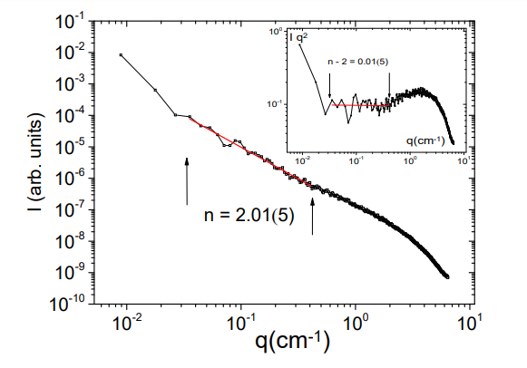
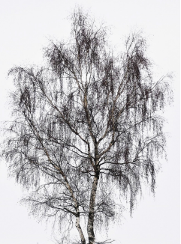
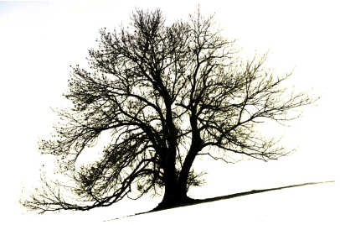
Trees image study
Fig. 23. The scatter curve for birch image.
Fig. 24. Scatter curve for oak image.
The images of birches and oaks is a logarithmic fractal.
S. V. Grigoriev, O. D. Shnyrkov, P. M. Pustovoit, E. G. Iashina, and K. A. Pshenichnyi, Phys. Rev. E 105, 044412

Slide 15
New tree growth rule
The lateral surface area is conserved
$$d_{i}∙l_{i}=n∙d_{i+1}∙l_{i+1}$$
The volume of a tree is not preserved when moving from one level of branching to another, therefore a tree as a three-dimensional object is not a logarithmic fractal. But its two-dimensional projection is a logarithmic fractal.
$d$ is the diameter of the branch;
$n$ is the number of branches coming out of the branch point;
$l$ is the length of the branch.
S. V. Grigoriev, O. D. Shnyrkov, P. M. Pustovoit, E. G. Iashina, and K. A. Pshenichnyi, Phys. Rev. E 105, 044412

Slide 16
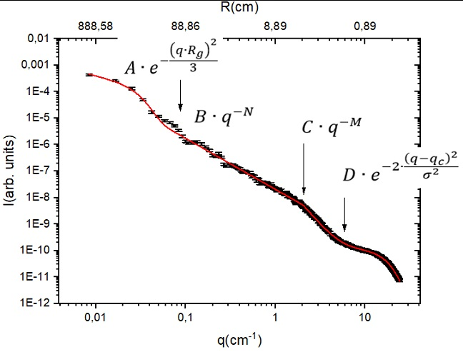
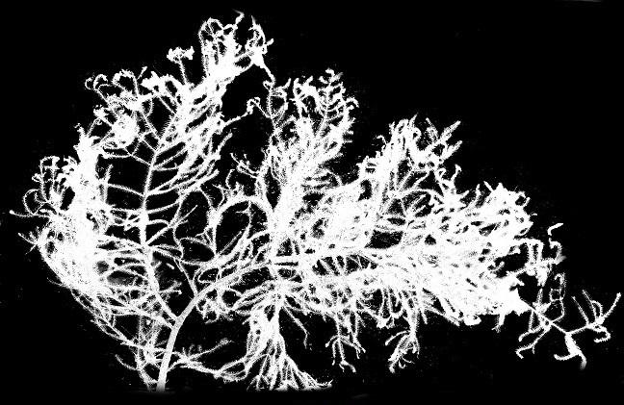
Spruce branch image study
Fig. 25. Small-angle scattering curve obtained by studying a spruce branch from a height of 830 cm using numerical Fourier analysis.

Slide 17
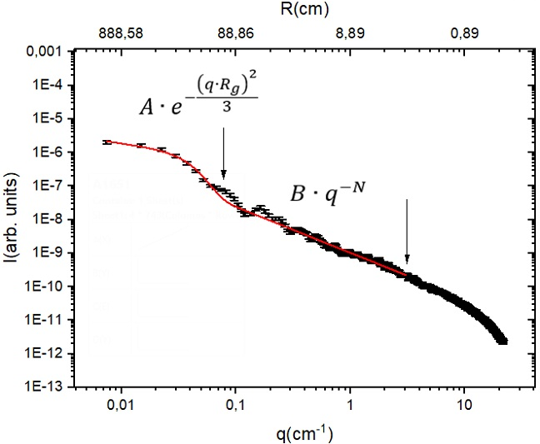
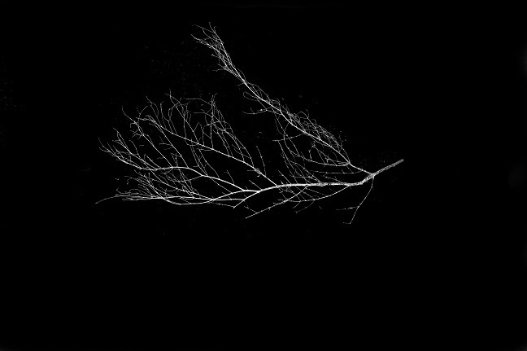
Study of photographs of spruce branches without needles
Rice. 26. Small-angle scattering curve obtained by studying a spruce branch without needles using numerical Fourier analysis.

Slide 18
Conclusion
Photographs of deciduous trees contain logarithmic fractal structure over a wide range of scales. This means that deciduous trees develop according to the principle of equality of lateral surface area at different levels of branching.
In the case of spruce branches, needles play a important role in the formation of a logarithmic fractal structure; therefore, it is directly involved in the uniform distribution of matter between different levels of branching. The structure of a spruce branch does not significantly depend on the height of growth.

Slide 19
Acknowledgments
S.V. Grigoriev (PNPI, SPBU), E.G. Yashina (PNPI , SPBU), K.A. Pshenichny (PNPI), Chetverikov Yu.O. (PNPI)
Thank you for your attention!
This work was supported by the Russian Science Foundation grant 20-12-00188

