Slide 1
Algorithm for Material Analysis by the K-edges for Photon-Counting Computed Tomography
JINR
28th International Scientific Conference of
Young Scientists and Specialists
(AYSS-2024)
Sotenskii Rostislav
JINR, Dubna
sot.rostislav@gmail.com
29 October 2024, Dubna

Slide 2
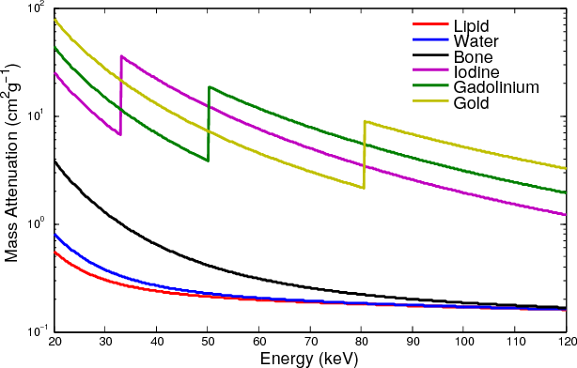
Multi-energy tomography
$$I=I0\exp\left(−\text{μ} \text{ρ} x\right),$$
where $\text{μ} \sim C\frac{ Z4}{E3}$ - mass attenuation
Multi-energy CT
Bateman, Christopher & Rajendran, Kishore & Ruiter, Niels & Butler, Anthony & Butler, Philip & Renaud, Peter. (2015). The Hidden K-edge Signal in K-edge Imaging.
Anderson, Nigel G. et al. “Spectroscopic (multi-energy) CT distinguishes iodine and barium contrast material in MICE.” European Radiology 20 (2010): 2126-2134.
Sotenskii R./AYSS-2024/29.10.24
2/17

Slide 3
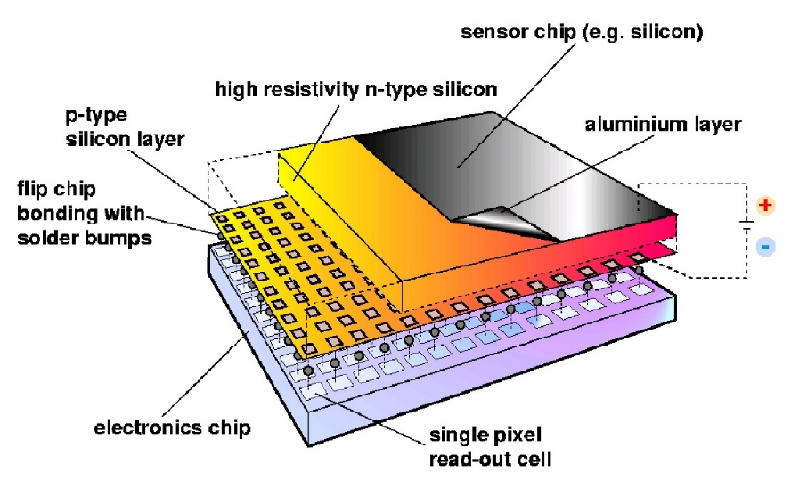
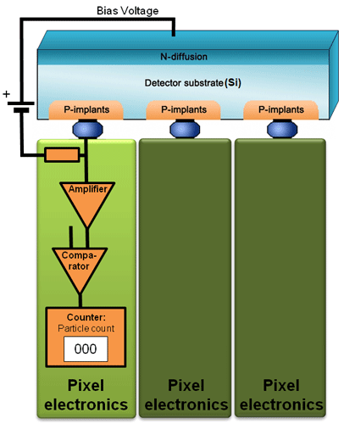
Medipix detectors
Medipix series detectors are hybrid semiconductor pixel detectors;
Developed by Medipix collaboration (https://medipix.web.cern.ch/);
Consist of a semiconductor sensor and a readout integrated circuit;
Photons are detected by their transferring energy to electrons. The appeared free electrons move to the pixel contact pads, causing a signal.
The signal is digitized and compared with the threshold in a pixel. Pixels operate independent.
Sotenskii R./AYSS-2024/29.10.24
3/17

Slide 4
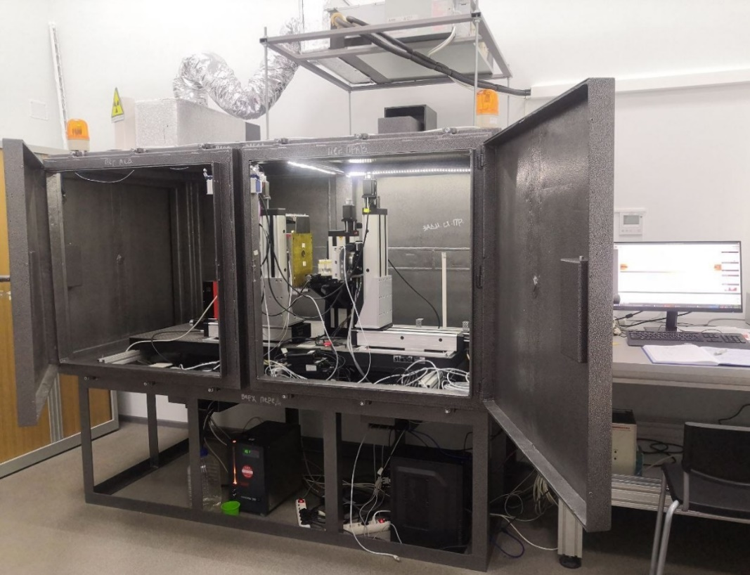
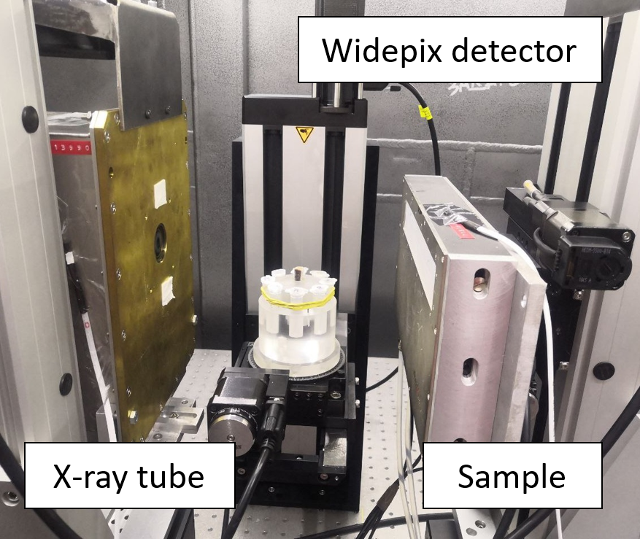
Experimental Microtomograph “Kalan”
Widepix detector:
15 Medipix3RX in one row
256х3840 pixels
Size of pixel - 55x55 mkm
Si sensor
Several of our goals on this installation:
• Separate materials that differ in composition. In particular, select a contrast agent that has an absorption edge in the working energy range;
• Determine the main element of the contrast agent;
• Determine the concentration of the contrast agent.
In this case, it is necessary to use as little number energies as possible to reduce the scanning time.
Sotenskii R./AYSS-2024/29.10.24
4/17

Slide 5
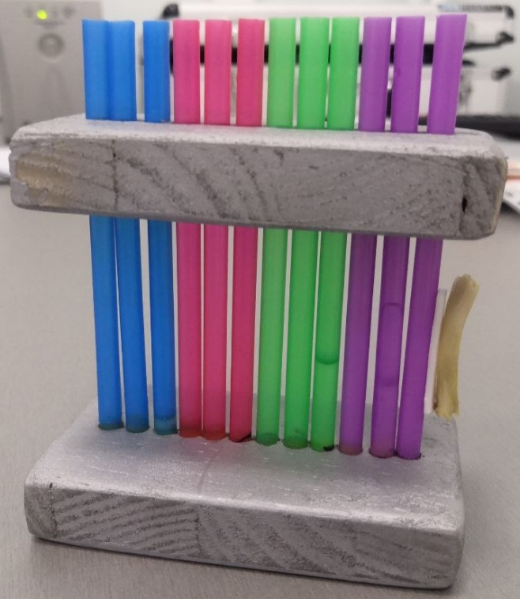
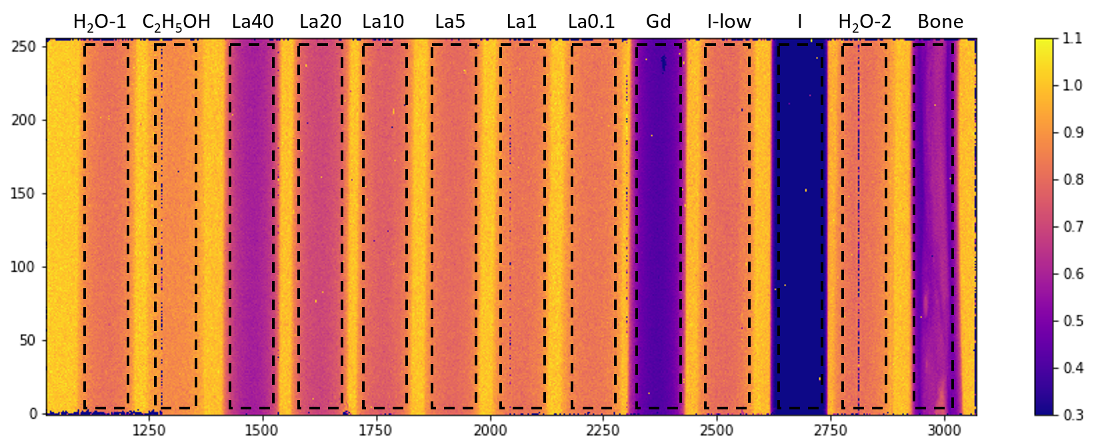
2D phantom for studying the "spectrum" obtained from the detector
RoI – Region of Interest
Y, pixel
FFC pixel value
X, pixel
Flat Field Correction:
FFC = F(object) / F(flat field)
FFC $\sim exp⁡(−\text{μ} \text{ρ} x)$
Frame received from the detector in the form of a 2D histogram.
Sotenskii R./AYSS-2024/29.10.24
5/17

Slide 6
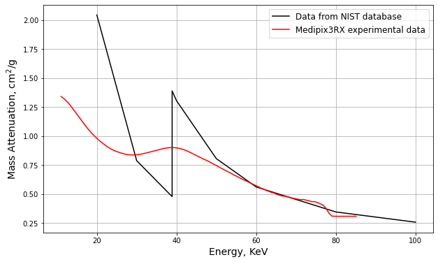
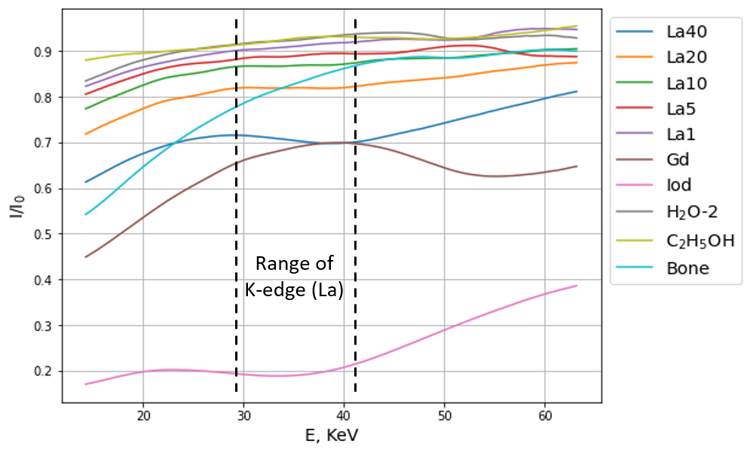
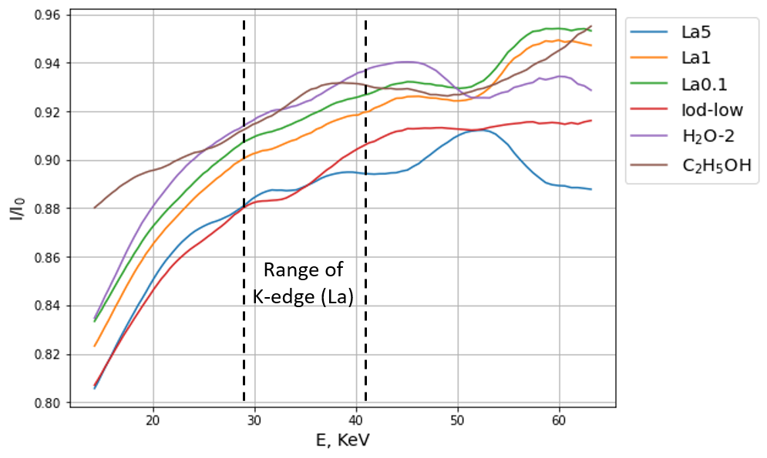
Study of the "spectrum" obtained from the detector
The spectrum is the average pixel values ​​in the RoI after the FFC, depending on the threshold.
In samples with a low concentration of Lanthanum the K-edges are almost invisible. The character of their spectra is the same as that of water, ethanol, and a iodine solution with low concentration. It is difficult to distinguish them.
Sotenskii R./AYSS-2024/29.10.24
6/17

Slide 7
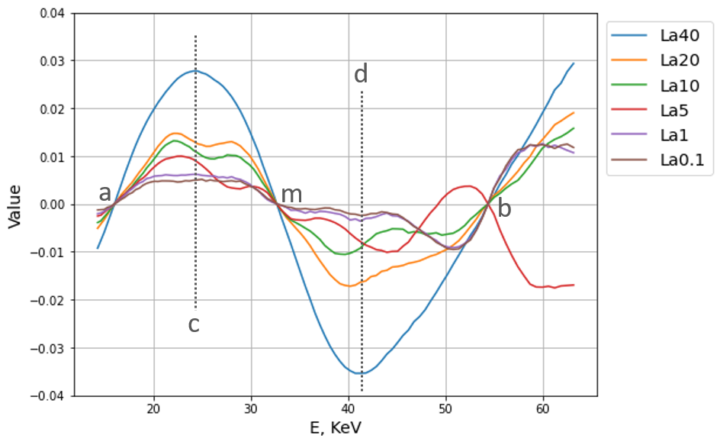
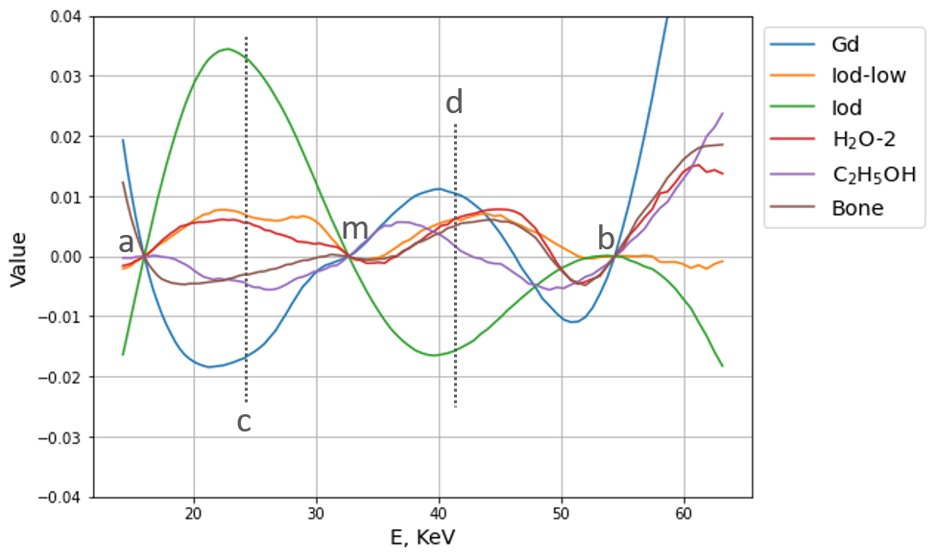
The criterion for the identification of contrast agents
Spectrum after normalization to trends.
We define:
Conditions for the fulfillment of the criterion;
Contrast agent concentration.
a, b, c, d, m – energy thresholds for target CA
Sotenskii R./AYSS-2024/29.10.24
7/17

Slide 8
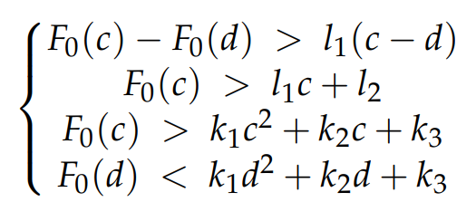
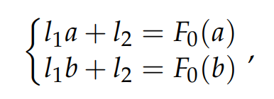
The criterion for the identification of contrast agents
Conditions for fulfilling the criterion, written in general form through the primary spectrum $F0$:
(1)
где l₁, l₂, l₃ – solution of a system of equations describing a linear trend(1);
k₁, k₂, k₃ – solution of a system of equations describing a parabolic trend(2)
(2)
Contrast agent concentration:
Parameters a, b, c, d, m – equivalent to energy; differs for each type of contrast agent.
Sotenskii R./AYSS-2024/29.10.24
8/17

Slide 9
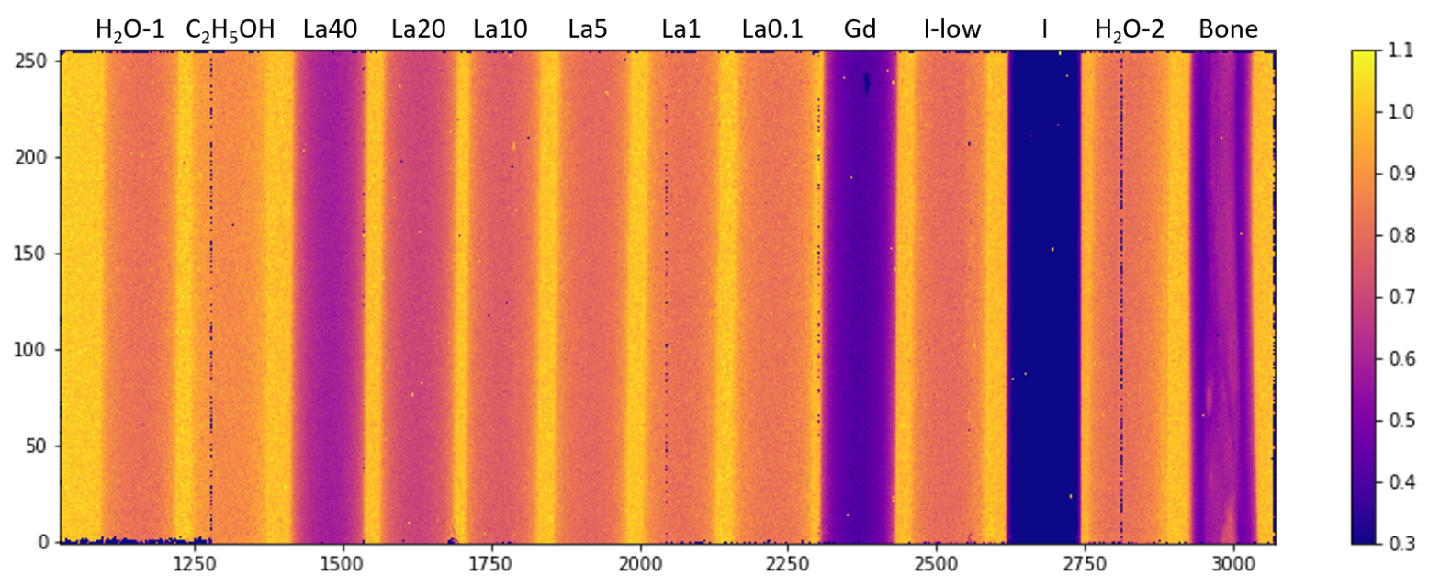
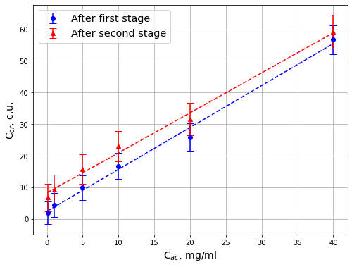
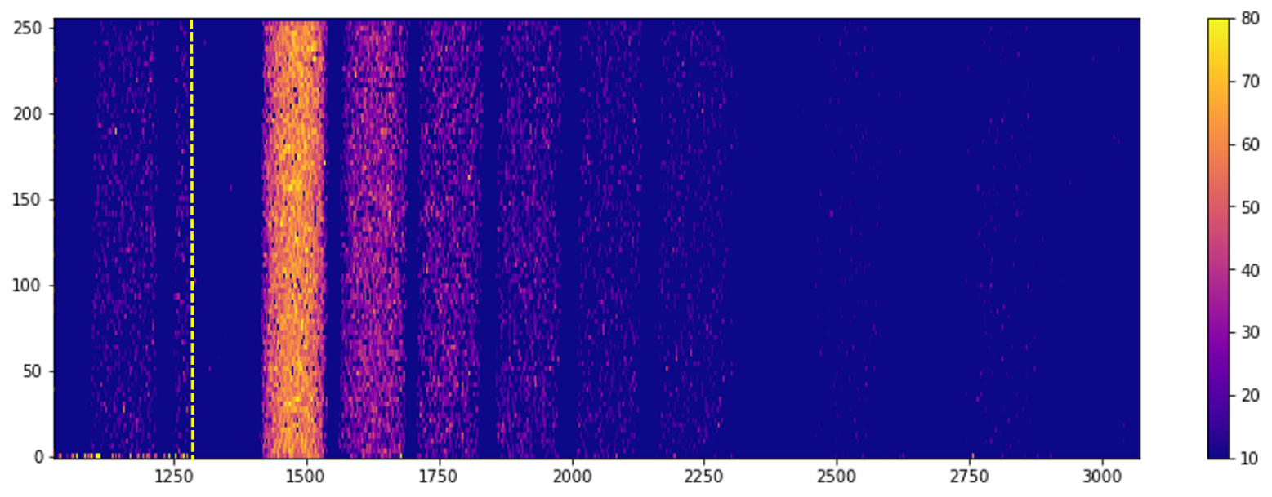
Results of applying the criterion in 2D-CT (on the example of La)
FFC pixel value
Criterion value
The ROI for each sample was not determined in advance
Sotenskii R./AYSS-2024/29.10.24
9/17

Slide 10
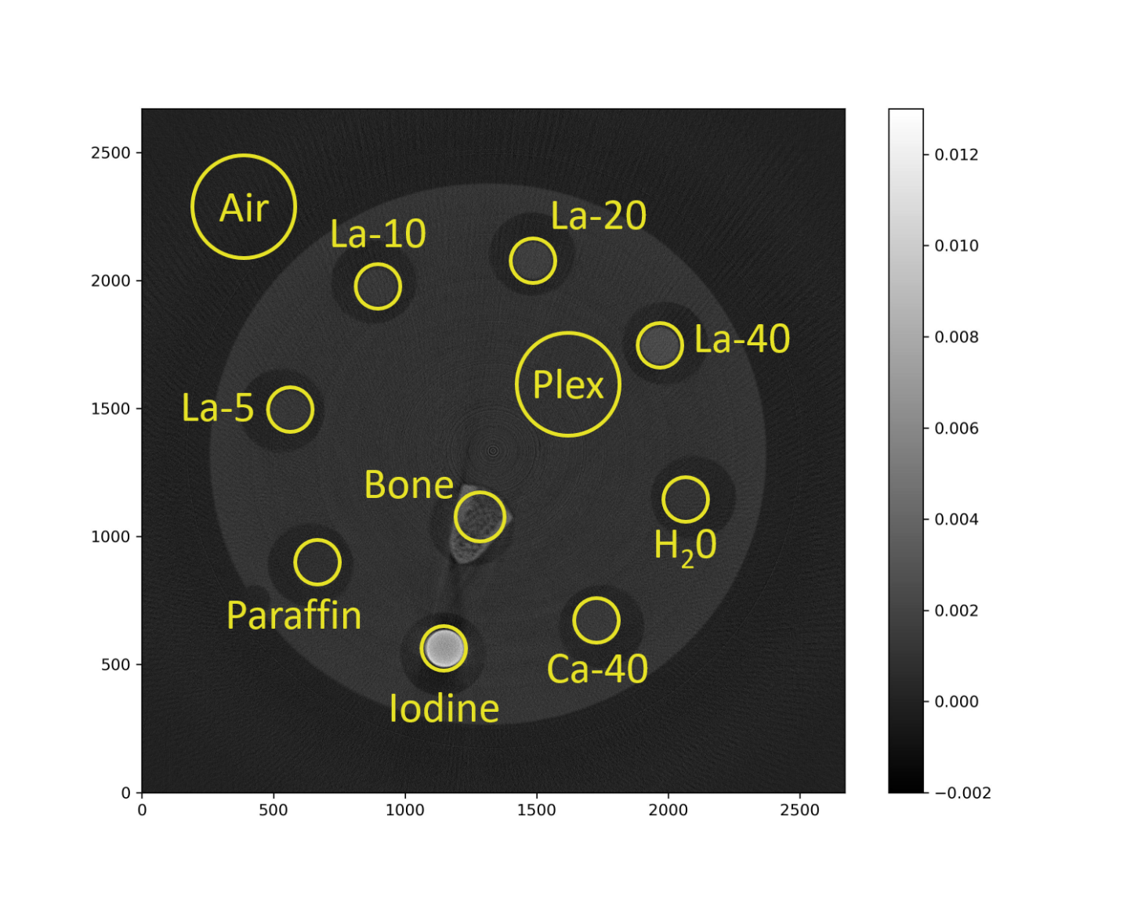
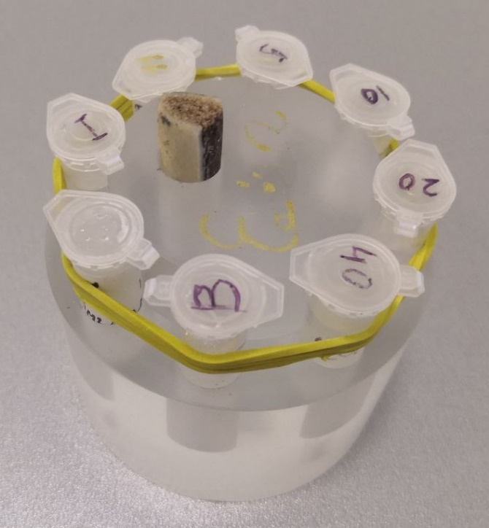
Results of applying the criterion in 3D-CT
Phantom «Eva»
Ø 70 mm
Reconstructed slice of the phantom
Sotenskii R./AYSS-2024/29.10.24
10/17

Slide 11
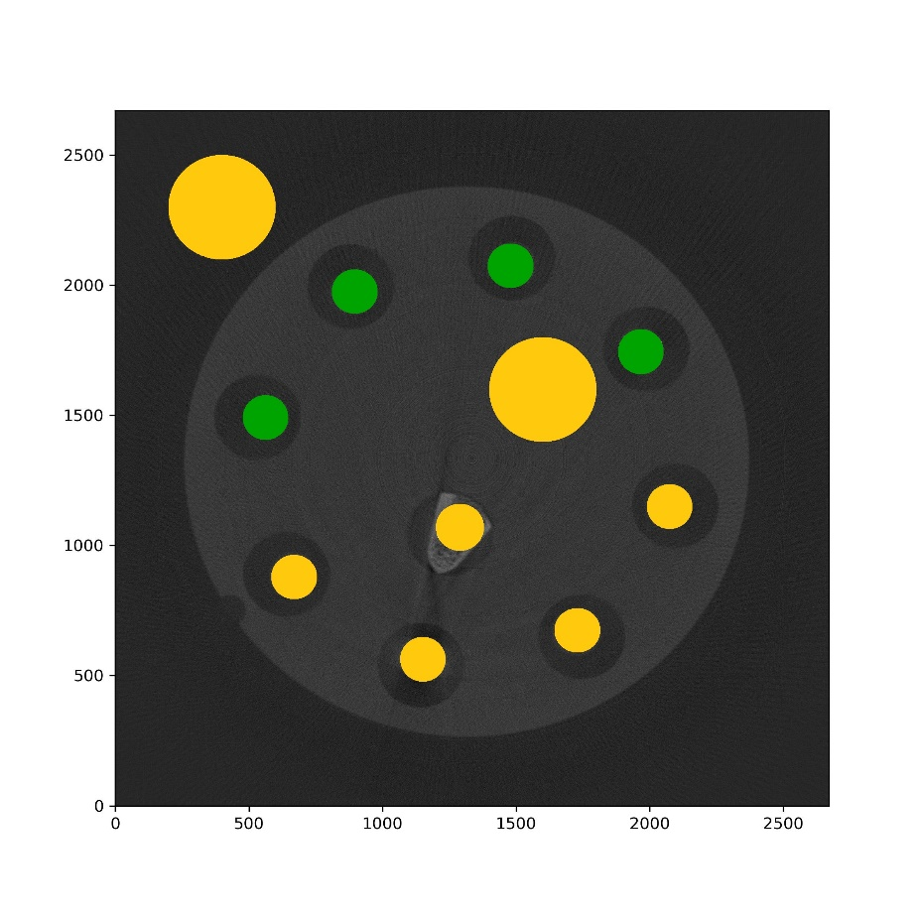
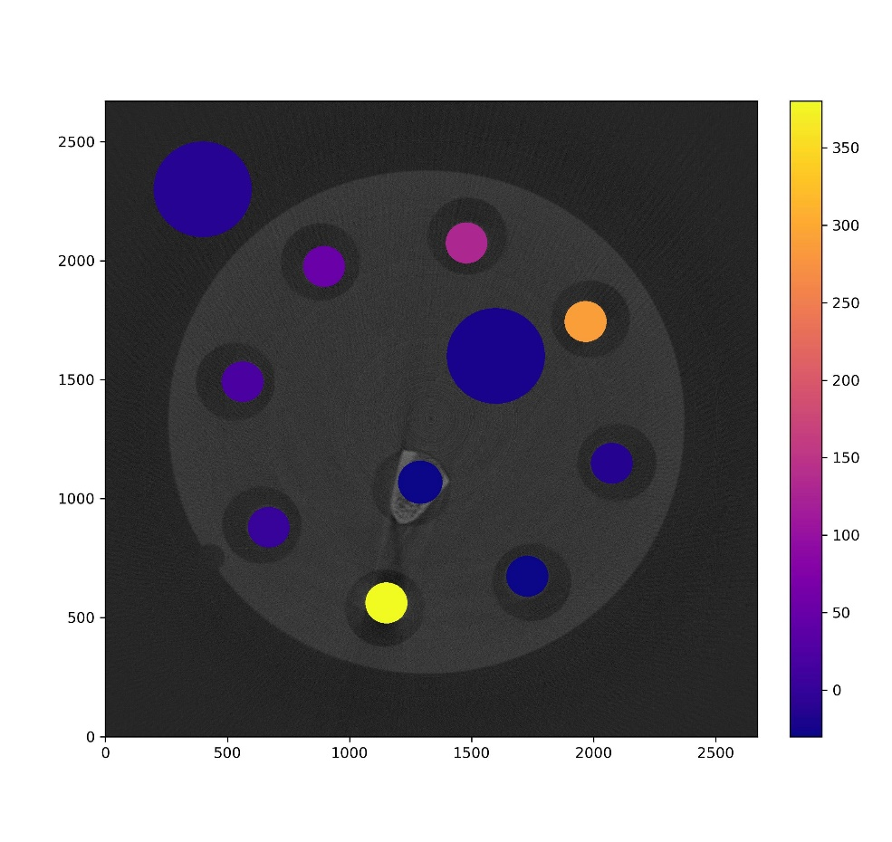
Result of applying the criterion on a 3D phantom (La)
Phantom study with water solutions of lanthanum (La(NO₃)₃·6H₂O) and additional samples (water, iodine, calcium, bone, paraffin)
Slice of the phantom
Fulfilment of the conditions of La.
Green – samples that have satisfied the conditions of the criterion.
Yellow – samples that have not satisfied the conditions of the criterion.
Concentration of La calculated by the criterion
Sotenskii R./AYSS-2024/29.10.24
11/17

Slide 12
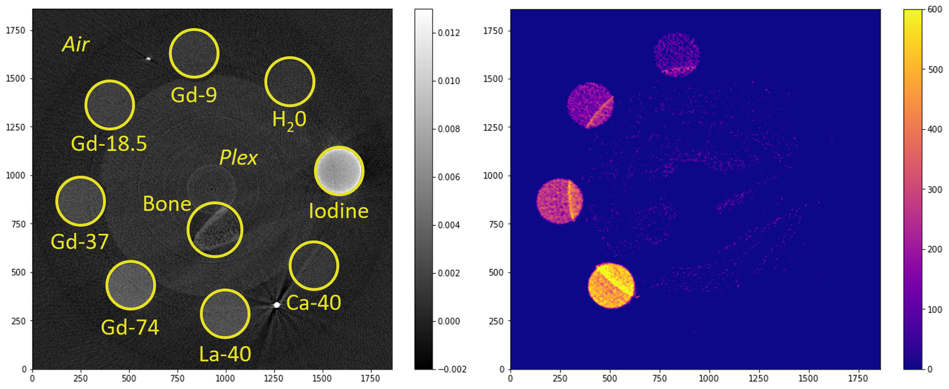
Result of applying the criterion on a 3D phantom (Gd)
Phantom study with water solutions of gadolinium (C₁₄H₂₀GdN₃O₁₀) and additional samples (water, iodine, calcium, bone, La solution)
Slice of the phantom
Concentration of Gd calculated by the criterion
The criterion was applied in each voxel and without selecting regions of interest
Sotenskii R./AYSS-2024/29.10.24
12/17

Slide 13
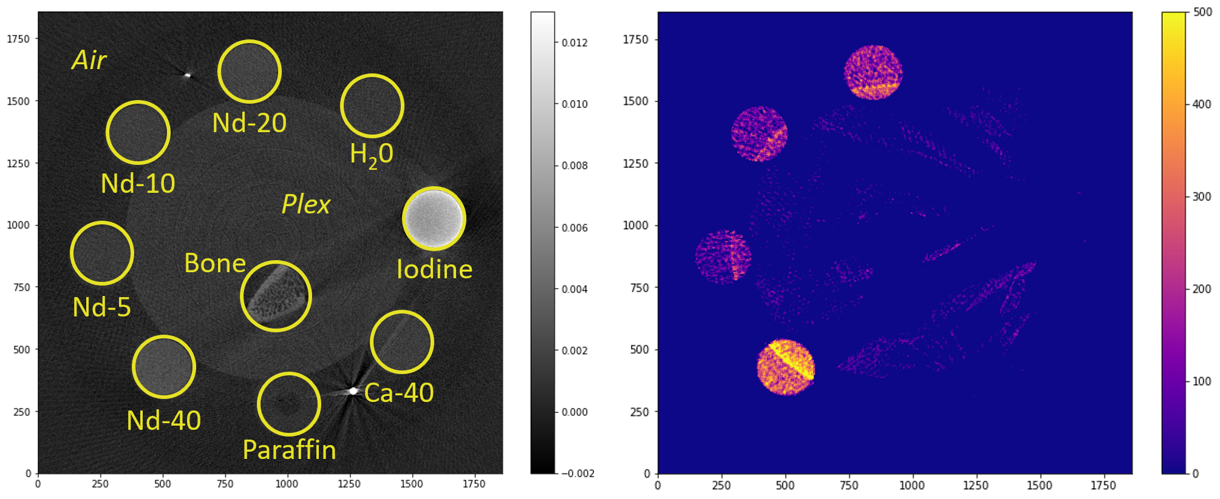
Result of applying the criterion on a 3D phantom (Nd)
Phantom study with water solutions of neodinium (Nd(NO₃)₃·6H₂O) and additional samples (water, iodine, calcium, bone, paraffin)
Slice of the phantom
Concentration of Nd calculated by the criterion
The criterion was applied in each voxel and without selecting regions of interest
Sotenskii R./AYSS-2024/29.10.24
13/17

Slide 14
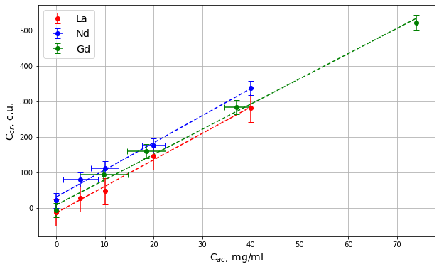
Result of applying the criterion on a 3D phantom
Dependence of the concentration calculated by the criterion on the actual concentration of contrast agents (La, Nd, Gd)
The values ​​at the zero point are taken to be the values ​​calculated for a sample with water, since the contrast agents under consideration are aqueous solutions.
Sotenskii R./AYSS-2024/29.10.24
14/17

Slide 15
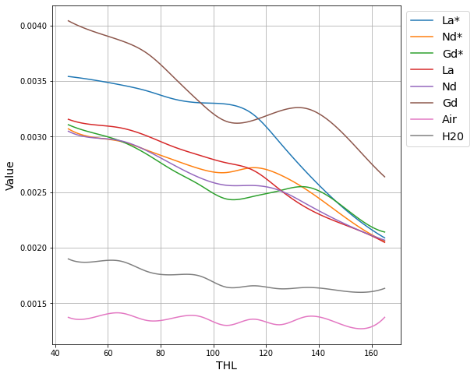
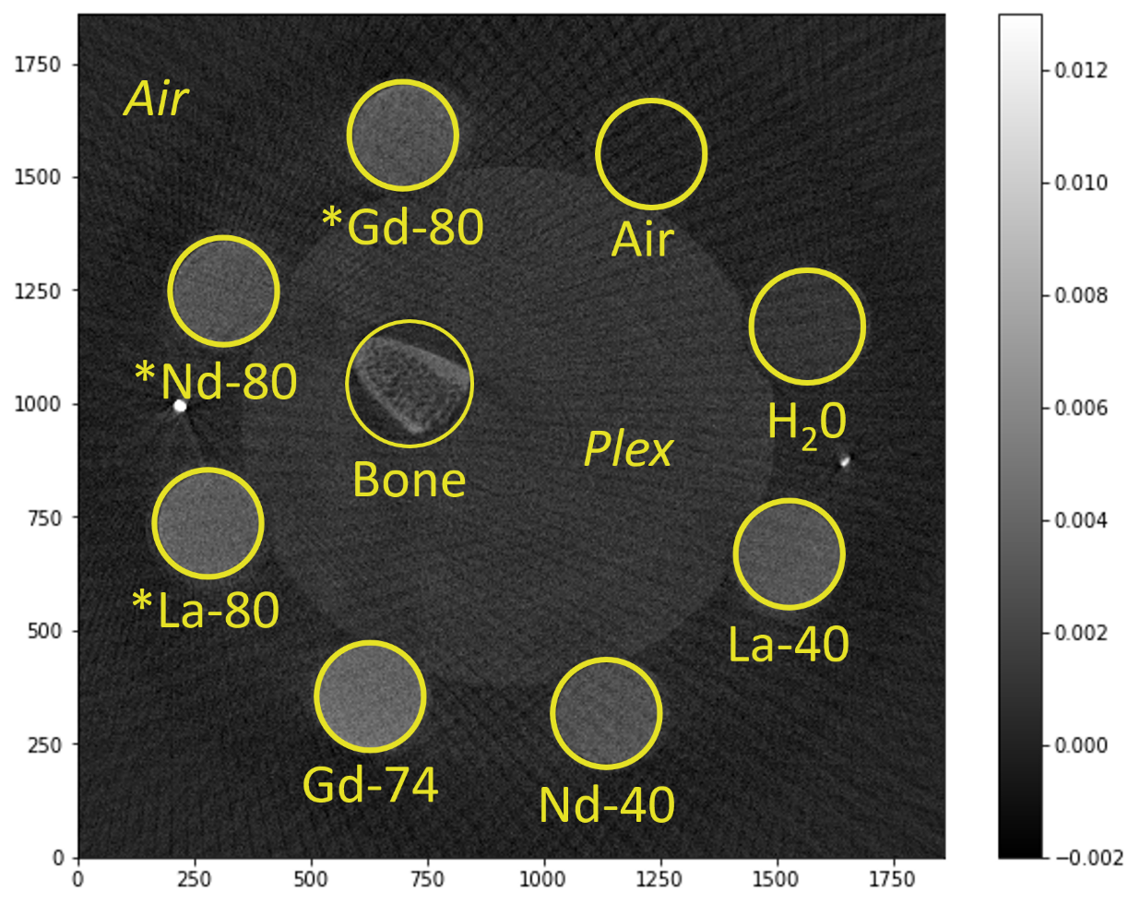
Separation of several contrast agents in one object
Phantom composition:
La-40, Nd-40, Gd-74 – samples of aqueous solutions;
*La-80, *Nd-80, *Gd-80 – samples based on graphite flakes;
H2O, Bone, Air, Plex – additional samples.
12 energy thresholds were used to identify and separate multiple contrast agents simultaneously
Dependence of gamma photon absorption on energy (detector threshold) for specific regions of interest
Slice of phantom
Sotenskii R./AYSS-2024/29.10.24
15/17

Slide 16
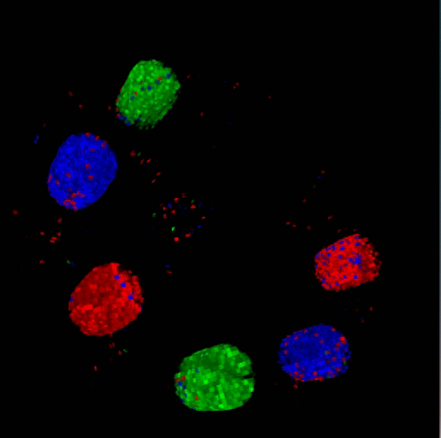
Separation of several contrast agents in one object at the same time
Phantom composition:
La-40, Nd-40, Gd-74 – samples of aqueous solutions;
*La-80, *Nd-80, *Gd-80 – samples based on graphite flakes;
H2O, Bone, Air, Plex – additional samples.
3D CT images of phantom with CAs.
La – red
Nd – blue
Gd – green
Slice of phantom
Sotenskii R./AYSS-2024/29.10.24
16/17

Slide 17
Conclusions
• The proposed method makes it possible to separate the contrast agent from other materials and classifying them;
• The developed criterion can be used to estimate the concentration of the contrast agent;
• The criterion was developed for lanthanum contrast agents, but it can be used for other contrast agents based on high-Z elements;
• This criterion can be used in 2D-CT and 3D-CT;
• 5 energies are required to separate one contrast agent;
• Multiple contrast agents can be separated at the same time.
Other methods for identifying and classifying contrast agents are also being tested. For example – machine learning.
This work has been supported by the Russian Science Foundation under grant № 22-15-00072.
Sotenskii R./AYSS-2024/29.10.24
17/17

Slide 18
Thank you!

Slide 19
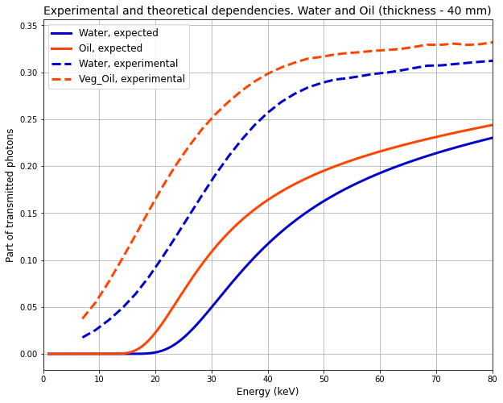
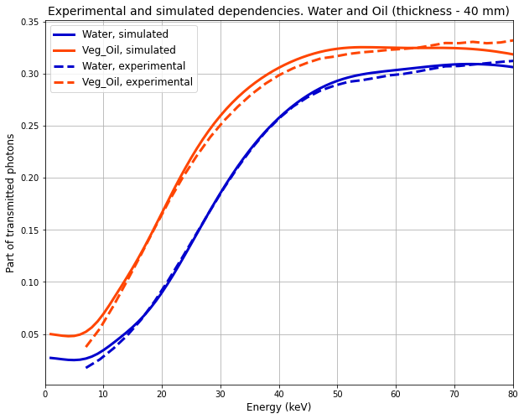
Study of the "spectrum" obtained from the detector
$$I=I0\exp\left(−\text{μ} \text{ρ} x\right) → \text{I}\text{ = ∫…∫}\text{D} \text{I}\text{0} \text{exp}\text{(−}\text{μ}\text{(}\text{E}\text{) }\text{ρ} \text{x}\text{)(}\text{H}\text{(}\text{E}\text{, }\text{a}\text{1}\text{, }\text{a}\text{2}\text{…}\text{an}\text{)) }\text{dE} \text{da}\text{1}\text{ … }\text{dan}$$
Sotenskii R./AYSS-2024/29.10.24
7/19

Slide 20
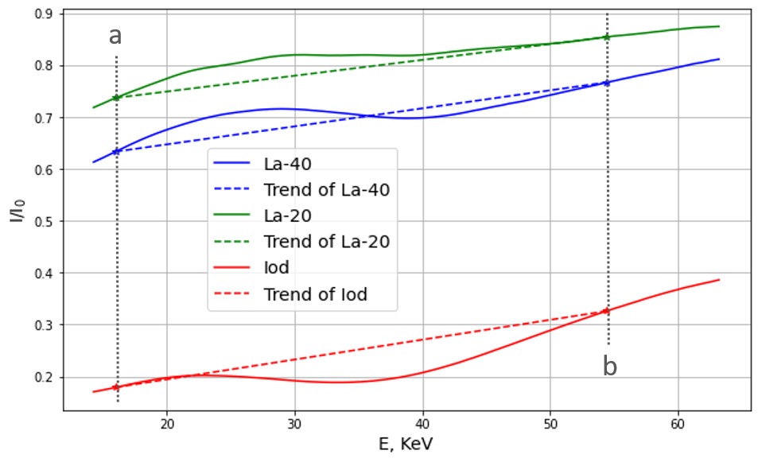
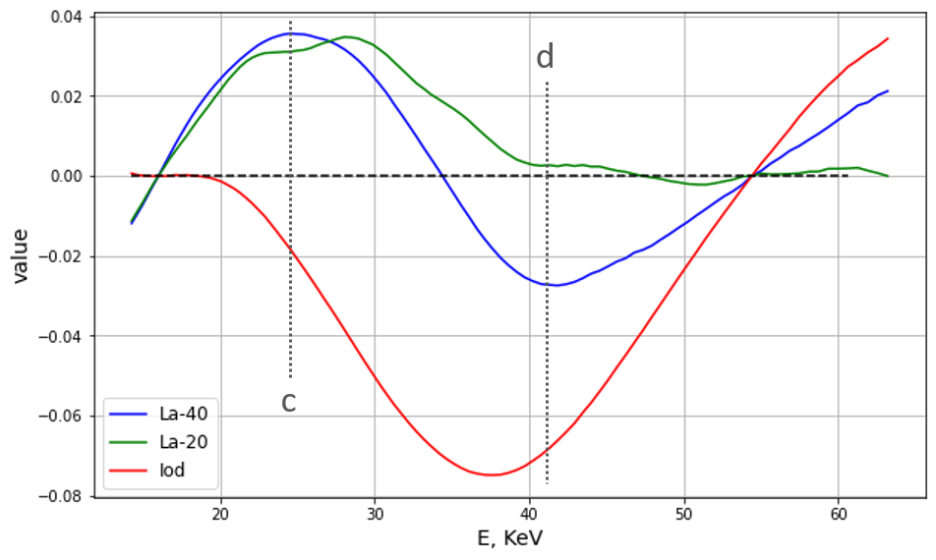
The criterion for the identification of contrast agents
First step: Normalization to a linear trend.
The first condition for fulfilling the criterion:
$F1\left(c\right)>$ 0
$F1\left(c\right)>F1\left(d\right)$,
Contrast agent concentration:
С_{cr} = 1000( F₁(с) – F₁(d) )
where F₁ – spectrum after normalization to a linear trend.
Sotenskii R./AYSS-2024/29.10.24
8/19

Slide 21
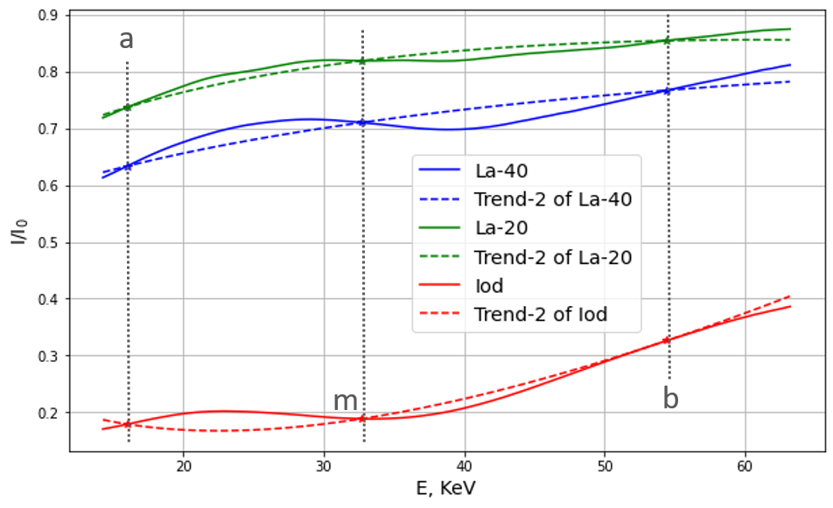
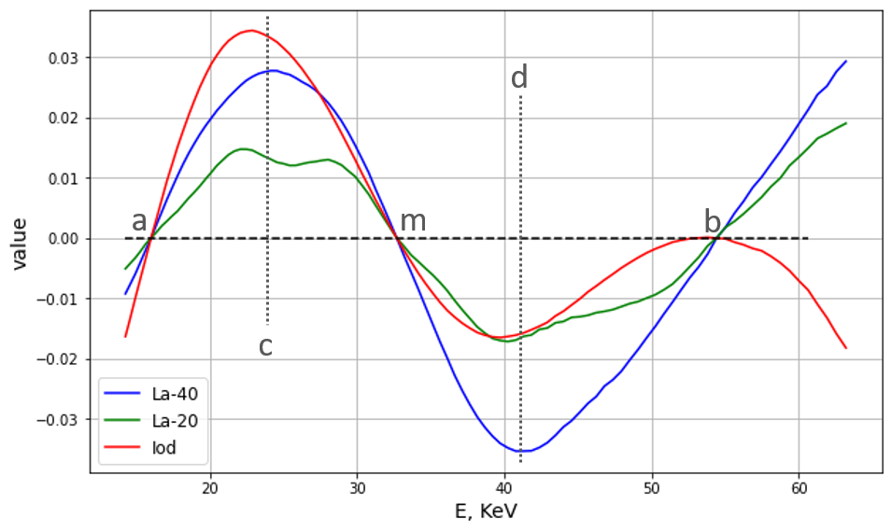
The criterion for the identification of contrast agents
Second step: Normalization to a Parabolic trend.
Sotenskii R./AYSS-2024/29.10.24
9/19

Slide 22
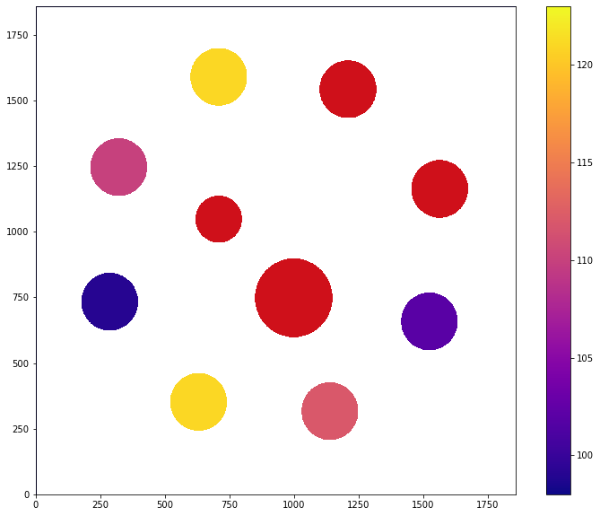
Разделение нескольких контрастных веществ в 3D-КТ
Срез фантома
Энергия К-края (thl) в областях интереса.
Красный цвет – положение K-края не найдено.
16/19

Slide 23
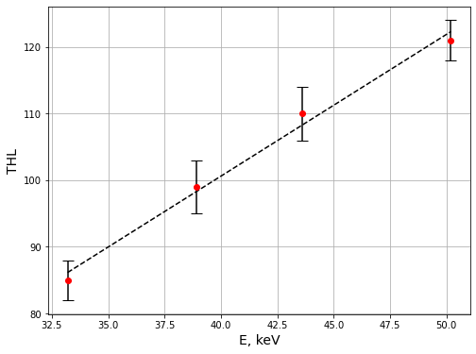
Разделение нескольких контрастных веществ в 3D-КТ
RoI | Iodine | La | Nd | Gd
K-edge, thl | 85 | 99 | 110 | 121
K-edge, keV | 33.2 | 38.9 | 43.6 | 50.2
Зависимость энергии К-края, определенной по критерию, от экспериментальной энергии К-края
17/19

Slide 24
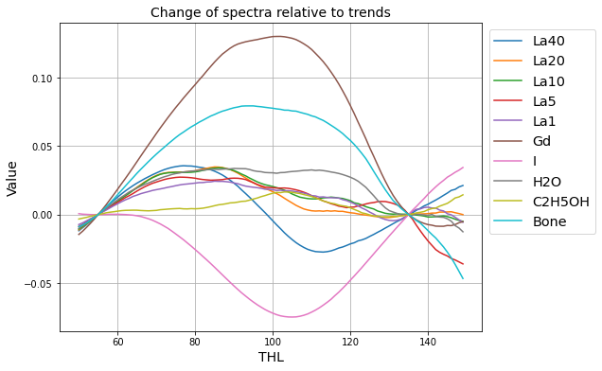
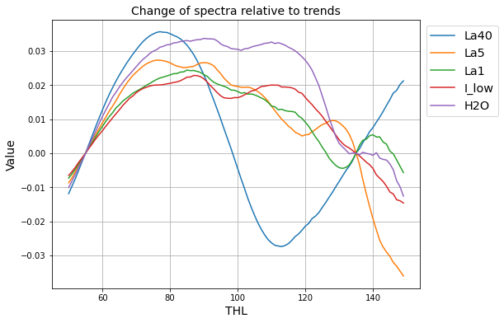
The criterion for the identification of contrast agents
c
d
c
m
m
d
The first conditions for the fulfillment of the criterion:
F₁(c) > F₁(d)
F₁(c) > 0

Slide 25
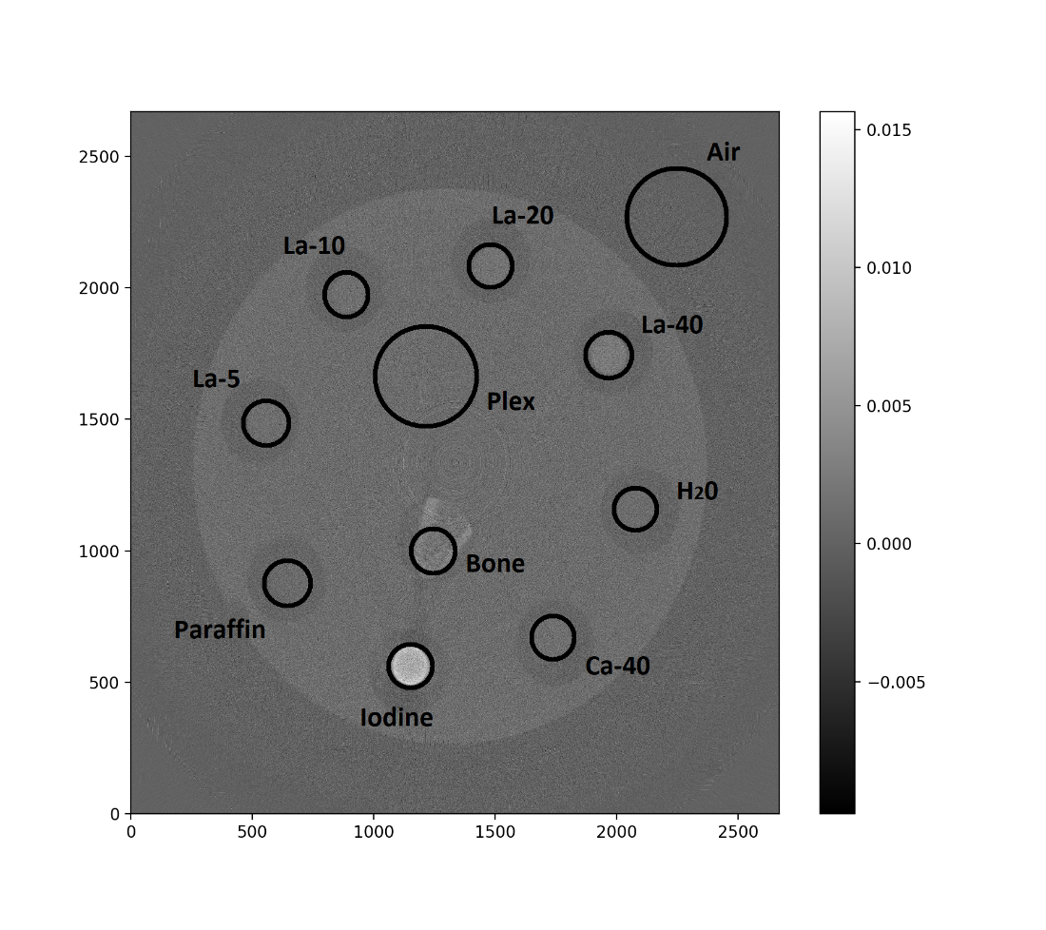
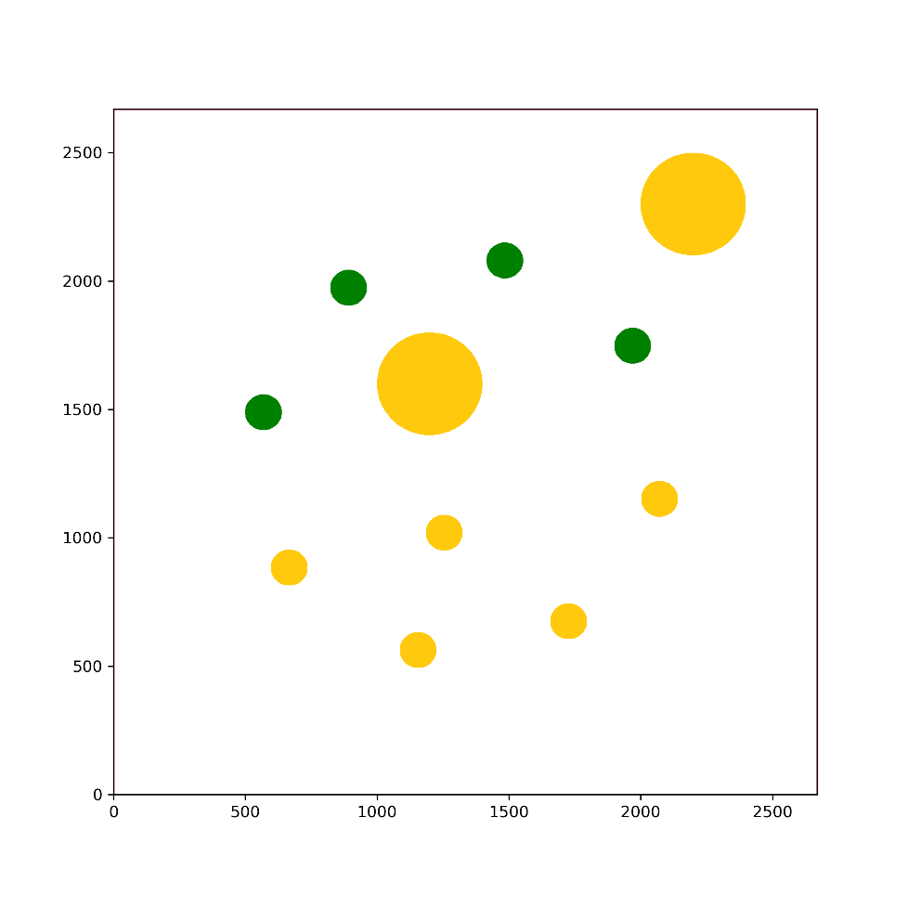
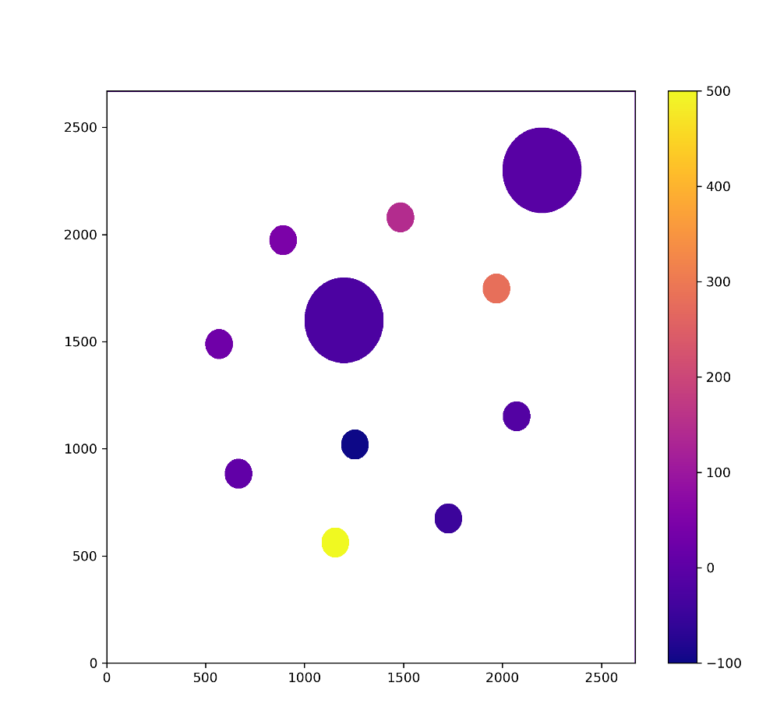
Results of applying the criterion in 3D-CT (on the example of La)
Investigated phantom with water solutions of La(NO3)3·6H2O and also the standard samples (water, iodine, paraffin, bone and plex)
CT image of slice of the phantom
The fulfillment of the conditions for the content of lanthanum in the RoI.
Green color - samples that meet the condition of the criterion.
Yellow color - samples that do not meet the criterion.
The estimation of molar concentration of La calculated by the criterion

Slide 26
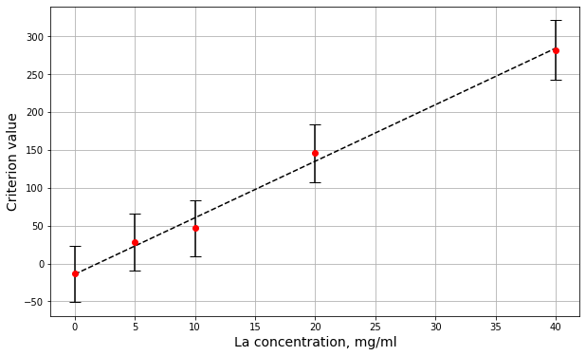
Results of applying the criterion in 3D-CT (on the example of La)
RoI | La-40 | La-20 | La-10 | La-5 | Paraffin | Iodine | Ca-40 | H20 | Bone | Plex | Air
Criterion | Yes | Yes | Yes | Yes | No | No | No | No | No | No | No
Value | 281.5 | 145.7 | 46.8 | 27.7 | 5.6 | 725.9 | -48.2 | -13.6 | -157.8 | -22.9 | -7.6
Error | 39.3 | 37.9 | 37.2 | 37.6 | 37.6 | 55.6 | 38.3 | 37.0 | 42.5 | 13.9 | 11.9

Slide 27
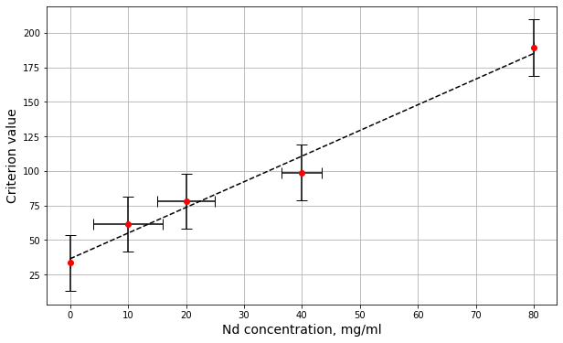
Results of applying the criterion in 3D-CT (on the example of Nd)
RoI | Nd-80 | Nd-40 | Nd-20 | Nd-10 | Paraffin | Iodine | Ca-40 | H20 | Bone | Plex | Air
Criterion | Yes | Yes | Yes | Yes | No | No | No | No | No | No | No
Value | 189.0 | 98.9 | 83.3 | 78.0 | 61.4 | -124.9 | 48.8 | 33.4 | 40.9 | -1.5 | -1.6
Error | 20.5 | 20.2 | 19.6 | 19.9 | 20.2 | 24.4 | 20.6 | 20.2 | 32.3 | 13.7 | 11.6

Slide 28
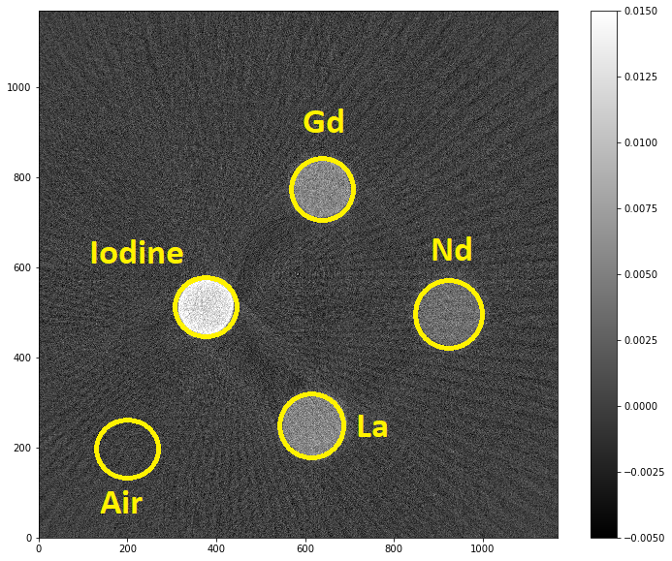
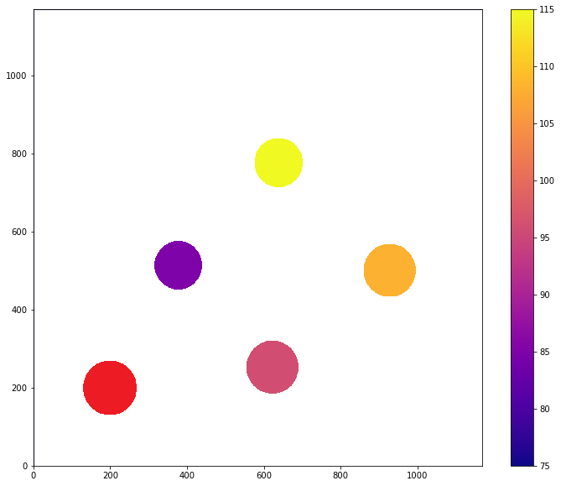
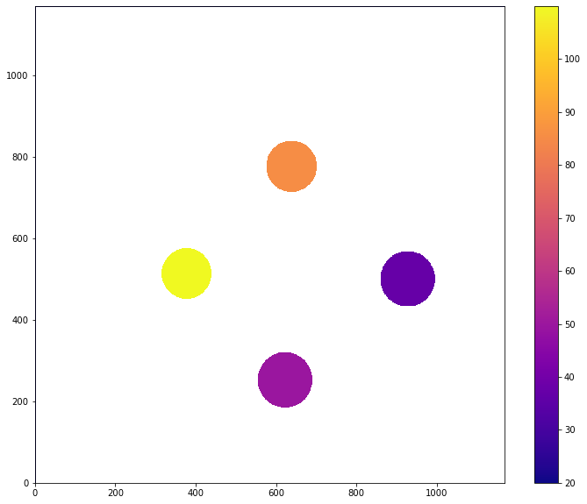
Results of applying the criterion in 3D-CT
Slice of the phantom
Положение К-линии поглощения (thl)
The concentration of lanthanum calculated by the criterion.

Slide 29
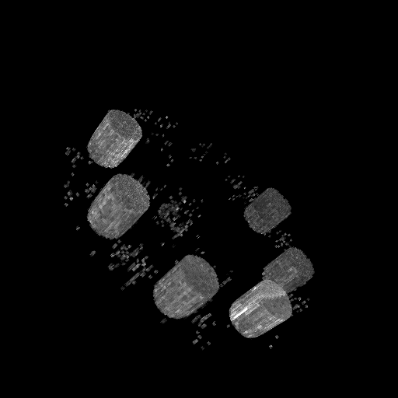
Separate several different CAs in 3D-CT
3D CT images of phantom with CAs and color division of La (red),
Nd (blue), and Gd (green)
Evaluation of the molar concentration of the CAs

Slide 30
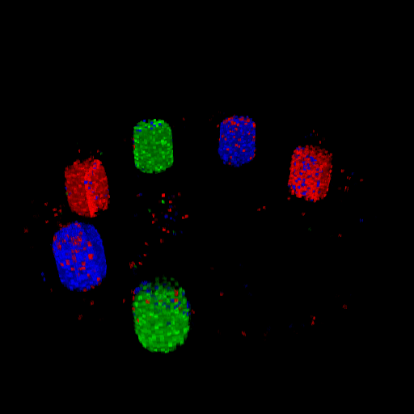

Slide 31
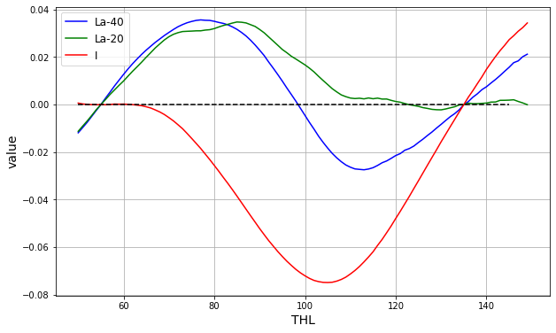
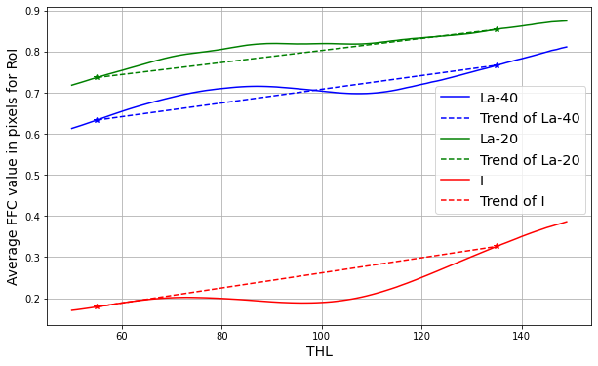
d
a
c
Range of
K-edge (La)
b

Slide 32
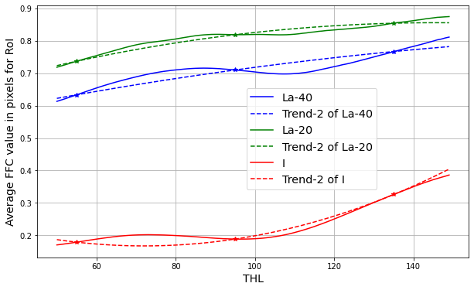
a
d
m
c
b

Slide 33
d
a
b
c

Slide 34
d
a
m
b
c

Slide 35
d
a
m
b
c

