Slide 1
Effect of thermal annealing on structure and conductivity of hafnium oxide thin films
Speaker: Phd student Kuchumov Ivan
2024

Slide 2
Content
Introduction
Experimental
Results and Discussion
Structural properties of HfOx films
Electrical properties of HfOx films
4. Conclusions

Slide 3
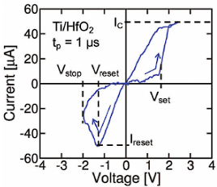
Introduction
Hafnium oxide, as a high-k dielectric material, is widely used to create capacitors, transistors and other microelectronic devices. In addition, it can be used as a resistive type sensor to detect molecules of various gases.
The presence of resistive switching effect makes it a candidate for memristive applications. But memory devices and computing systems based on memristors to this day face the problem of switching stability and their limiting number.
To improve the characteristics of memristors, approaches are used aimed at modifying the properties of the dielectric layer and metal electrodes through the use of various additives and physical effects, for example, thermal annealing.
Figure1: Measured I–V curves of the HfO₂ memristor
A. Mehonic. Adv. Mat. 30. 1801187 (2018)
Thus, our work is devoted to studying the effect of thermal annealing on the electrical properties of HfOx films deposited by electron beam evaporation, as well as their relationship with the structural changes occurring as a result of annealing.

Slide 4
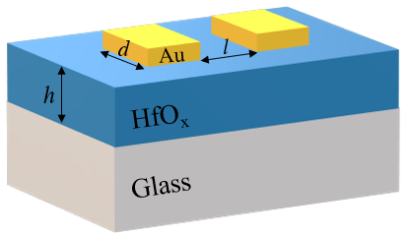
Experimental
Sample | Temperature of annealing
1 | Pristine
2 | 400 °C
3 | 500 °C
4 | 600 °C
h = 40 nm
d = 3 mm
l = 150 μm
The current-voltage measurements were carried out in the voltage range from -50 to 50V in a vacuum at a pressure of ∼ 10⁻⁵ Torr.
Figure 2: schematic representation of the sample

Slide 5
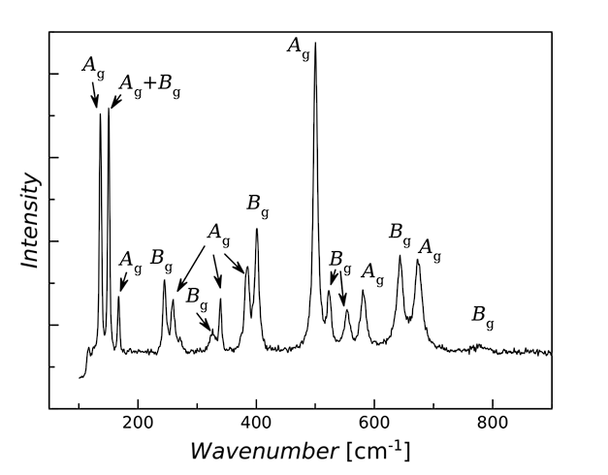
Structural properties of HfOx films
HfO₂ has 36 vibrational modes, of which 3 are acoustic, 18 optical modes appear in Raman spectroscopy, and the remaining 15 optical modes appear in IR spectroscopy.
The presented data indicate that the used source of hafnium dioxide was a monoclinic phase
Figure 3: Raman spectrum of sputtered granules

Slide 6
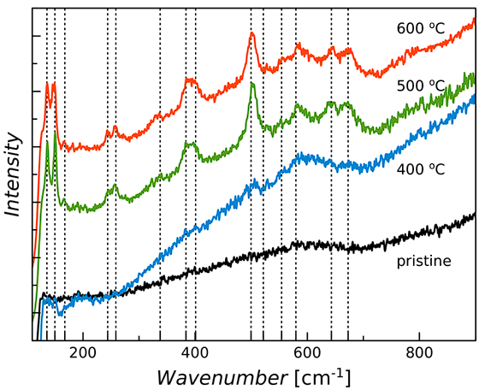
Structural properties of HfOx films
HfO_{x} film in the pristine sample does not have pronounced peaks and is initially in the amorphous phase.
Already at a temperature of ∼ 500°C nanocrystals with a monoclinic structure are formed in the sample
(the dotted lines indicate the position of the peaks of the monoclinic phase of HfO₂)
Figure 4: Raman spectra for a series of HfO_{x} films annealed at different temperatures

Slide 7
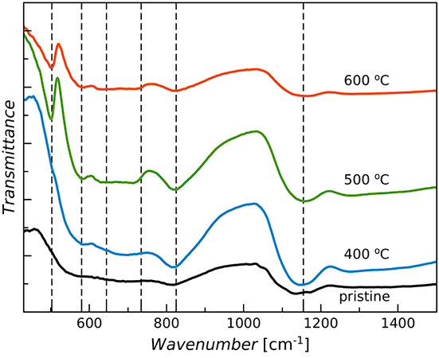
Structural properties of HfOx films
IR spectra also show that pristine sample initially in amorphous phase and at temperature of ~500 °C monoclinic crystals of HfO₂ are formed (the dotted lines indicate the position of the peaks of the monoclinic phase of HfO₂).
Figure 5: IR spectra of hafnium oxide HfO_{x} samples obtained at different annealing temperatures.

Slide 8
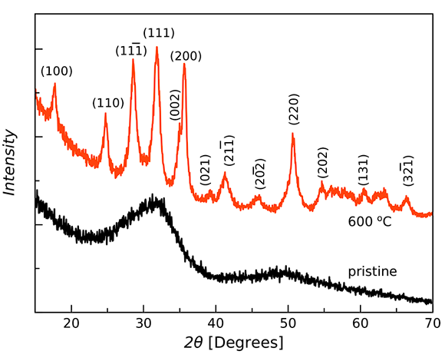
Structural properties of HfOx films
The pristine sample is X-ray amorphous. The HfO_{x} sample after annealing at 600◦C has in its structure HfO₂ crystallites with a monoclinic system, space group P21/c.
The average crystallite diameter is ≈ 15 nm. Thus, the predominant phase in the sample annealed at 600 °C is nanocrystalline. This corresponds to the IR and Raman data.
Figure 6: X-ray diffraction patterns of hafnium oxide film samples before and after annealing at 600 °C

Slide 9
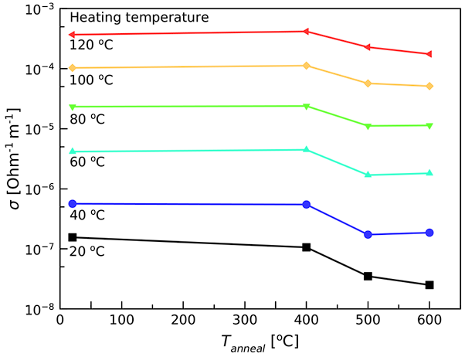
Electrical properties of HfOx films
The conductivity for each heating temperature for pristine and annealed samples at 400 °C is equal, which confirms our assumption that the sample at 400 °C is still in the amorphous phase.
Decrease in conductivity indicates that crystallization occurred at 500 °C and further annealing has little effect on the conductive properties.
$$\frac{σ_{pr}}{σ_{600}}≈6$$
$$\text{At} \text{room} \text{temperature}\text{:}$$
Figure 7: Dependence of specific conductivity on annealing temperature for a series of HfO_{x} films at different heating temperatures.

Slide 10
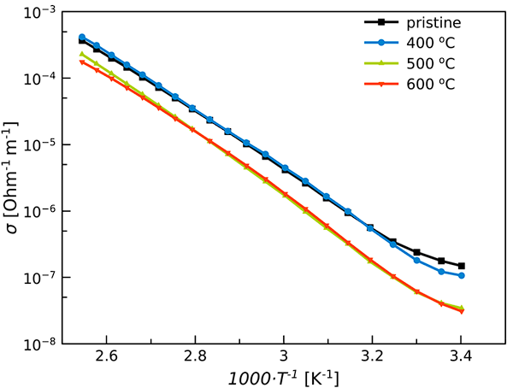
Electrical properties of HfOx films
$$σ=σ_{0}exp⁡(\frac{−E_{a}}{kT})$$
where
σ₀- constant,
E_{a} - activation energy,
k - Boltzmann constant,
T - temperature
E_{a}^{pr} = 0.86 eV
E_{a}⁶⁰⁰ = 0.93 eV
Figure 8: Dependence of the conductivity of HfO_{x} films on the reciprocal temperature at different annealing temperatures (logarithmic scale).

Slide 11
Conclusions
Annealing at a temperature of 500°C, the specific conductivity of the film can be reduced by more than 6 times compared to the initial film to a value.
With a further increase in the annealing temperature, the specific conductivity remains almost unchanged
Films have a strong dependence on the ambient temperature, which is described by the activation law.
The activation energy values were obtained, increasing during annealing from 0.86 eV to 0.93 eV
The decrease in conductivity and the increase in activation energy can be due to a decrease in the amount of oxygen vacancies, which are the main electron donors in the material, during annealing as a result of structure ordering.
Further annealing does not change the structural properties of the films, which is directly consistent with the results of studying their electrical properties.
The data obtained in the work can be used to improve the properties of memristive systems, sensors, capacitors and other electronic devices based on thin films of hafnium oxide.

Slide 12
Thank you for your attention!

