Slide 1
SYNTHESIS AND CHARACTERIZATION OF BORON & B4C NANOPARTICLES FOR BNCT
Presenter: Dikeledi Maduma
Study level: Masters
Supervisors: Prof. Malik Maaza & Prof. Mokhotjwa Dhlamini
Institution: University of South Africa
AYSS-2024 CONFERENCE (28TH OCTOBER-1ST NOVEMBER)

Slide 2
OUTLINE
I. Introduction
2. Background on BNCT
3. Aim of Study
4. Synthesis of the Nanoparticles
5. Results
6. Conclusion
7. Future Directions
8. Acknowledgement

Slide 3
INTRODUCTION
Our study focuses on the synthesis of Boron-carbide NPs using the PLAL technique for BNCT.
The physical and chemical properties of Boron and B₄C were found to be dependent on its size and morphology.
Why Boron? - distinct functional and structural properties
- non-toxicity
- Present as trace amounts in plants and in human blood
- Natural abundance isotopes: ¹⁰B at 20% and ¹¹B at 80%
BNCT is a cancer treatment that uses a binary system which combines the characteristics of biological targeting therapy and radiation therapy.

Slide 4
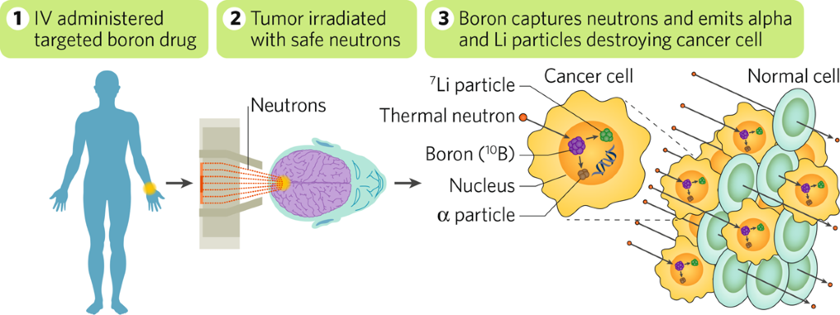
BACKGROUND
(BNCT) is based on nuclear capture and fission reactions ^{[1].}
Neutron capture occurs when ¹⁰B is irradiated by low-energy thermal neutrons or high-energy epithermal neutrons, resulting in a fission reaction.
1. Cheng et al. 29(10), 7868–7886 (2022).

Slide 5
Aim OF study
To synthesize Boron and B₄C nanoparticles using PLAL technique.
To determine the shape, size and composition of the nanoparticles.

Slide 6
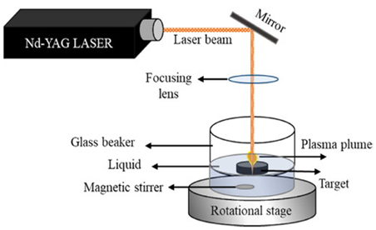
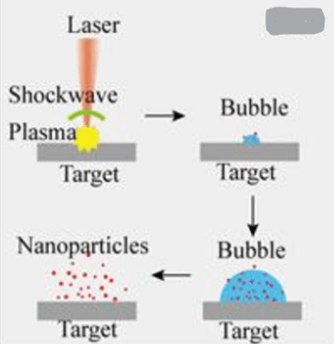
METHODS
The Pulsed Laser Ablation in Liquid (PLAL) method was done with Nd:YAG laser at λ = 1064nm, focused onto a bulk targets immersed in a (water + 0.1% PVA) solution.
The polymer PVA, was used as a dispersant.
M. F. A. AliasA.S. Abd – Alsada 2114(1):012089

Slide 7
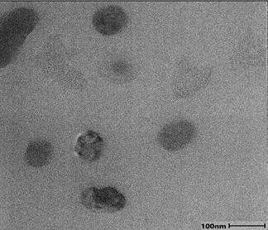
Results (B4C Morphology)
Average ~ 95 nm
Quasi –spherical shaped

Slide 8
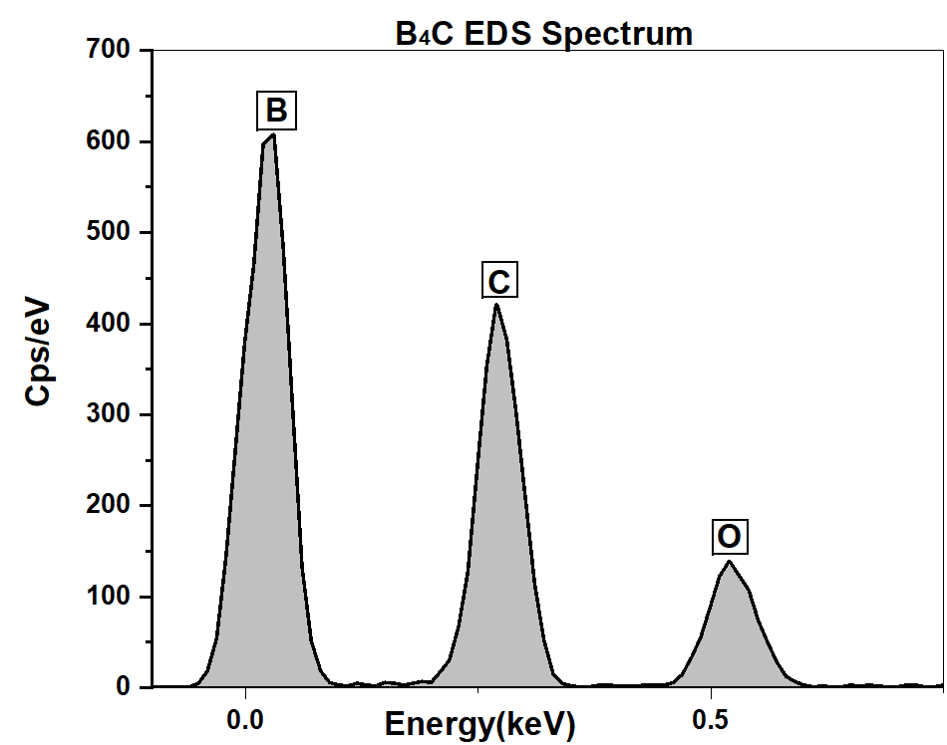
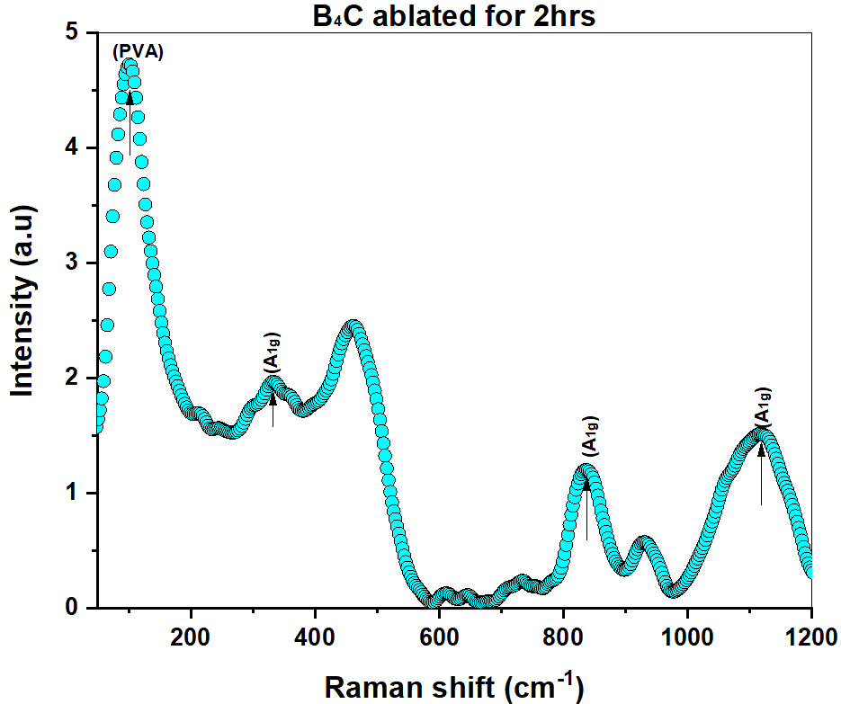
Results (B4C)

Slide 9
RESULTS CONT…
B4C nanoparticles suspended in liquid were synthesized with the use of PLAL for the application of BNCT.
Different characterization techniques were used.
The morphology analysis was done using TEM.
EDS study was done to confirm the elements present in the particles obtained.
Raman spectrum of the B4C colloid nanoparticles generated after 2hrs ablation.

Slide 10
FUTURE DIRECTIONS
To assess cytotoxicity of the nanoparticles.
Assess the stability of the nanoparticles overtime
Check the uptake of boron carbide by tumor cells by an invitro study using cultured cells.
Analyze the cells received [energy] of neutrons and livability.

Slide 11
CONCLUSION
Boron carbide nanoparticles were successfully synthesized using PLAL.
The characterization techniques used confirmed successful synthesis of the B₄C nanoparticles.
Invitro studies shall be carried out to analyze the uptake of boron by cancer cells.

Slide 12
ACKNOWLEDGEMENT
Prof. M. Moodley (UKZN)
Colleagues: T. Fakude and M. Aligholomi

Slide 13
THANK YOU FOR YOUR ATTENTION

