Slide 1
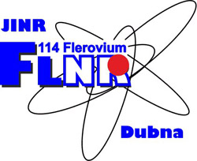

OPTIMIZATION OF THE NON-DESTRUCTIVE METHOD FOR DIAGNOSING HEAVY ION BEAM LOSSES BASED ON NEUTRON REGISTRATION
AYSS-2024
K. Timoshenko

Slide 2
Outline
Introduction
Advantages and disadvantages of diagnostic methods
Operating principle of a non-destructive diagnostic system
Optimal solutions for the system: equipment
Software
Research results
Conclusion

Slide 3
Diagnostic methods
In the field of diagnostics of heavy ion beam losses, there are two main methods: contact and non-destructive.
Contact method:
  Requires direct interaction with the beam.
  Provides direct information about the beam profile and parameters.
  Contact diagnostics methods can include measuring the beam's charge, intensity, or energy.
Non-destructive method:
  Allows assessing beam losses without direct interaction with the beam.
  Measures secondary effects caused by the beam's interaction with the environment or detectors.
  Enables the estimation of beam losses based on the intensity and distribution of the registered effects.

Slide 4
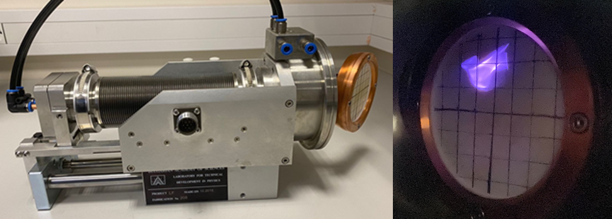
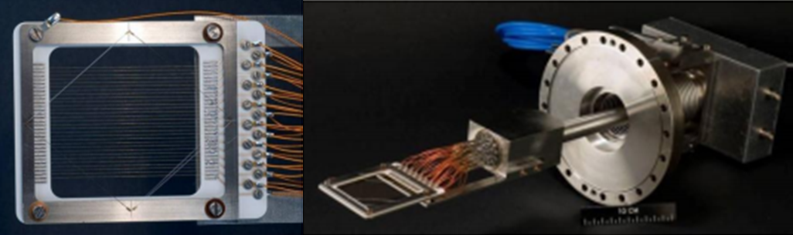
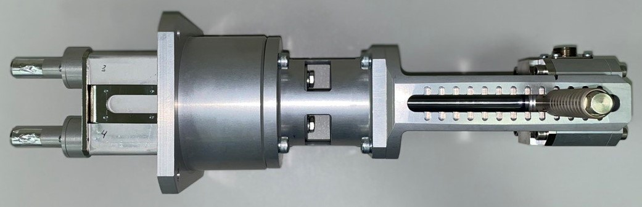
Contact sensors
Depending on the initial parameters of the accelerated heavy ion beam, its profile is measured/monitored using various methods. The most common methods include:
Faraday Cup;
Luminescent screen;
Secondary emission grid;
Strip detectors;
Ionization chamber;
Scintillation detectors.
Faraday Cup
Luminescent screen, phosphor screen
Secondary emission grid, secondary emission monitor, SEM
Scintillation detector

Slide 5
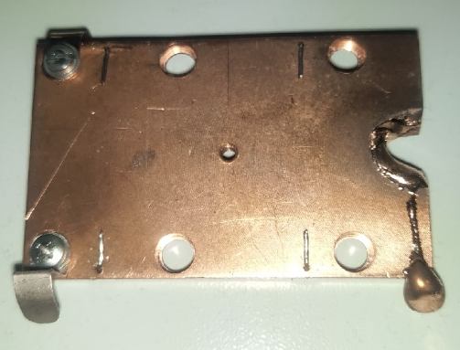
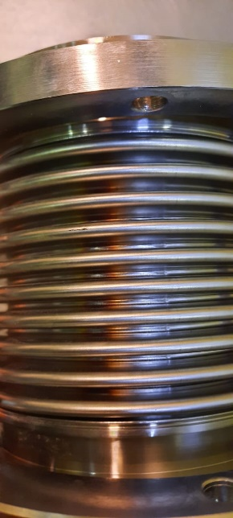
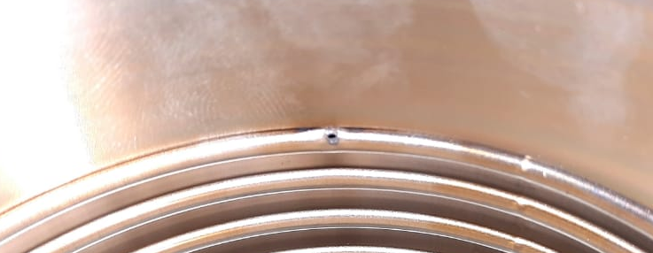
Disadvantages of contact methods
Destructive effect on the beam;
Overheating and destruction of equipment.
A high-intensity ion beam hit the bellows

Slide 6
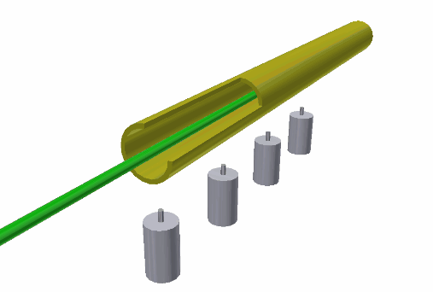
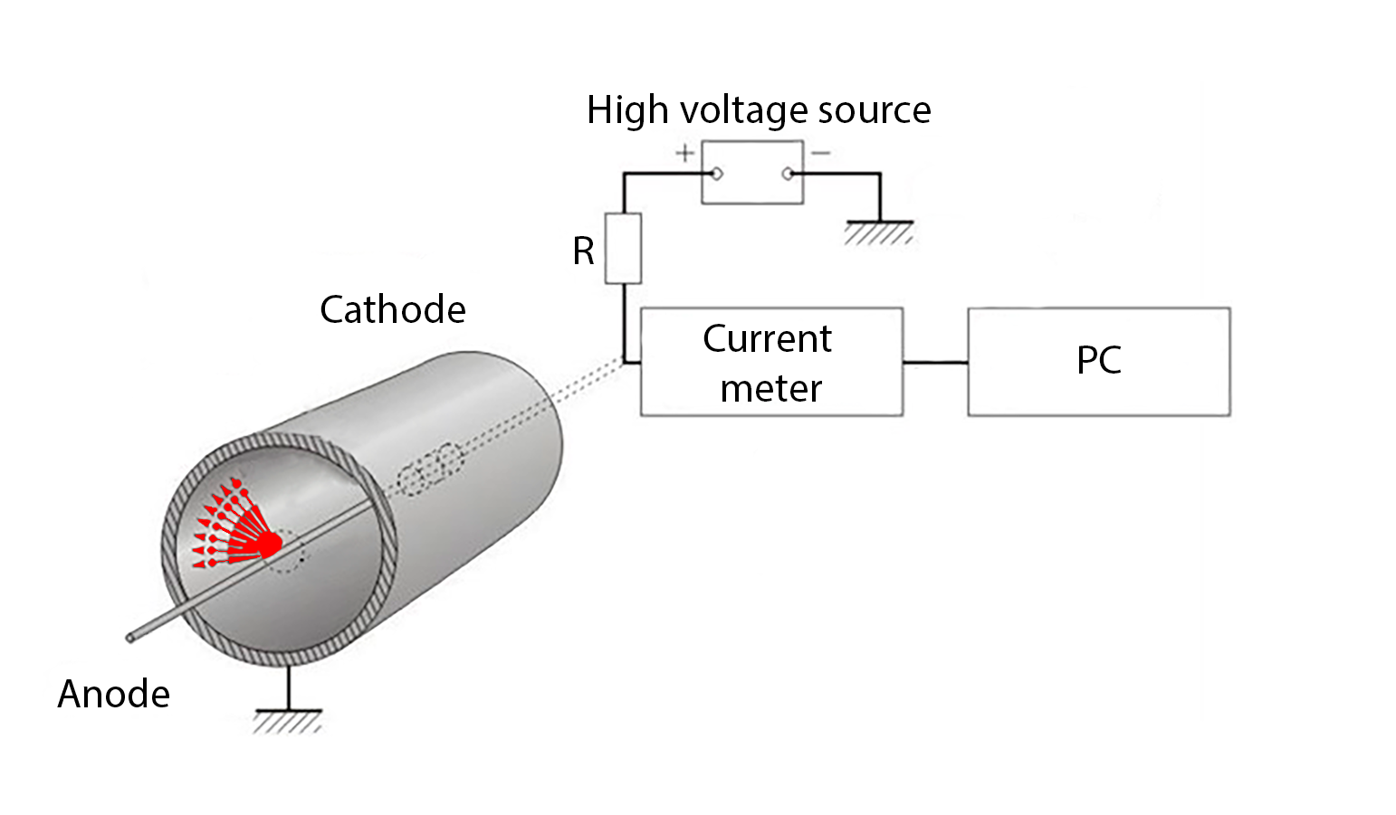
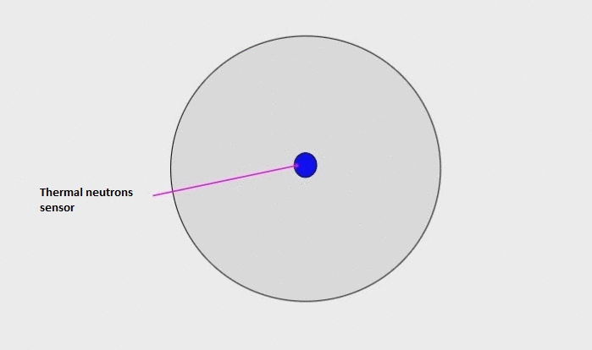
Principle of Operation of the Method
Ion beam channel
Detector 4
Beam
Detector 3
Detector 2
Detector 1

Slide 7
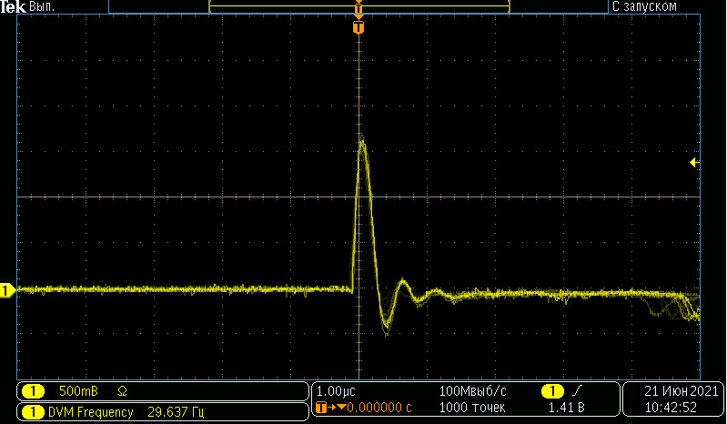
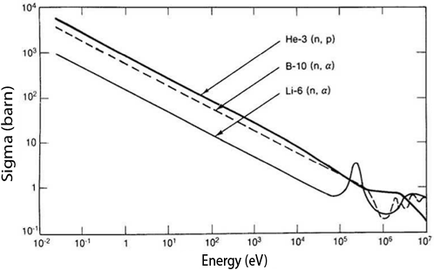
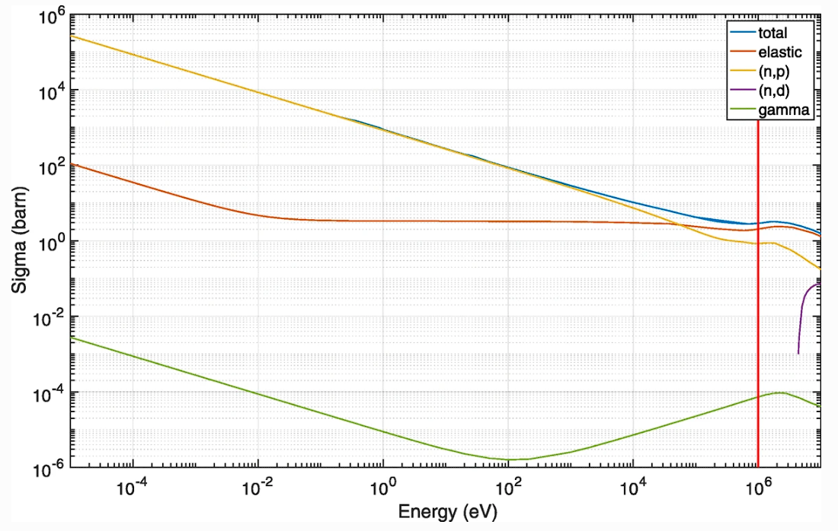
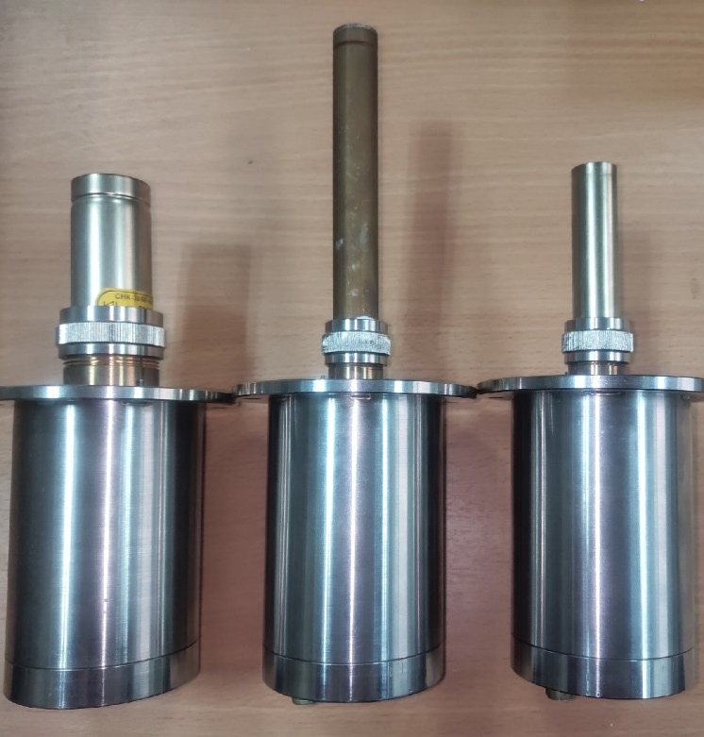
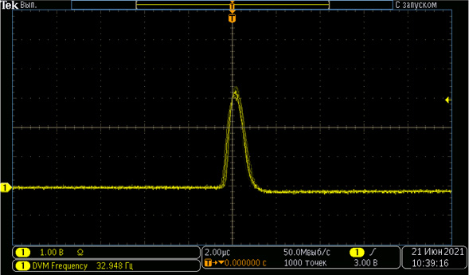
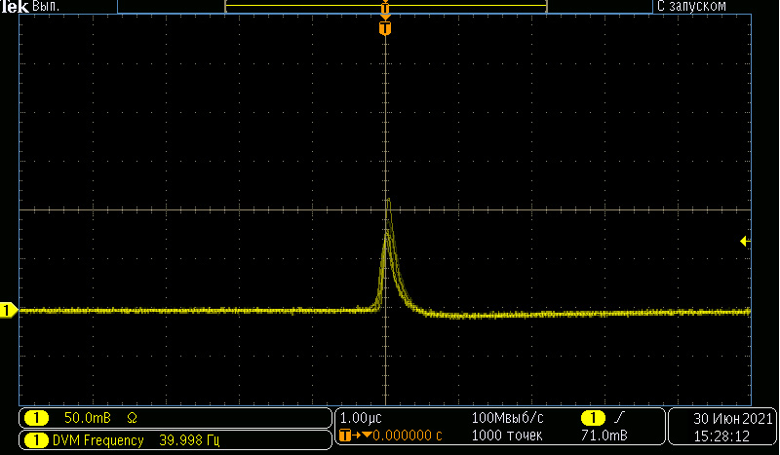
Thermal neutrons counters
SNM-16 (Corona Counters)
Rated operating voltage range, V | 2000-2800
Effective working length, mm | 105
Thermal neutron detection efficiency,% | 80
Helium-18/80-3,0/L (proportional counter)
Rated operating voltage range, V | 1150-1450
Effective working length, mm | 55
Thermal neutron detection efficiency,% | 80
SNK-30/60-4,6/L (Corona Counters)
Rated operating voltage range, V | 1900-2000
Effective working length, mm | 25
Thermal neutron detection efficiency,% | 70
Dependence of the Cross Sections of Reactions ³He(n,p), ¹⁰B(n,α), and ⁶Li(n, α) on Neutron Energy
Neutron cross section of ³He in the energy range 0-10 MeV for the 4 reactions: ³He recoil, (n,p), (n,d) and γ-rays

Slide 8
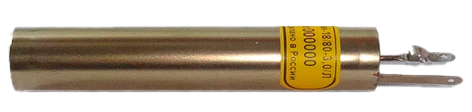
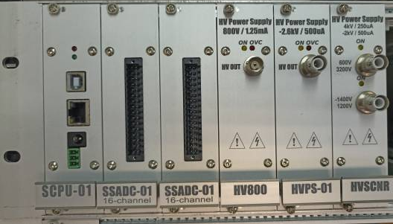
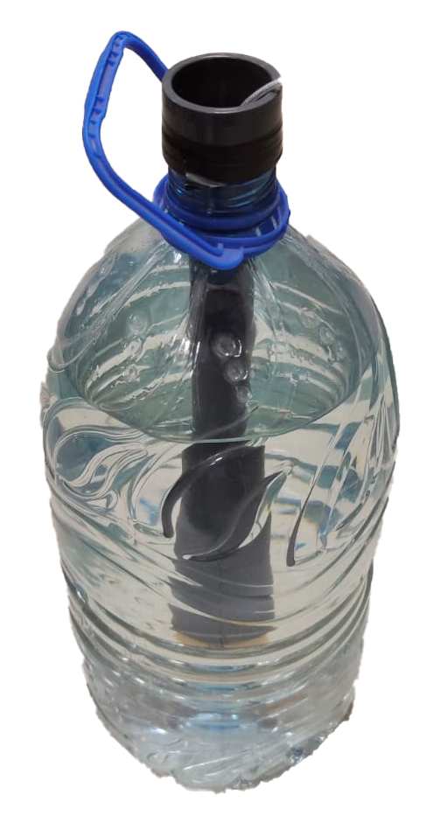

Main components of the system
Helium-18/80-3,0/L (proportional counter)
ION BEAM LOSS DIAGNOSTIC SYSTEM
PC with software
Modular control and information processing system:
Processor module
Current meter
High-voltage power supply
Moderator of neutrons: H₂O

Slide 9
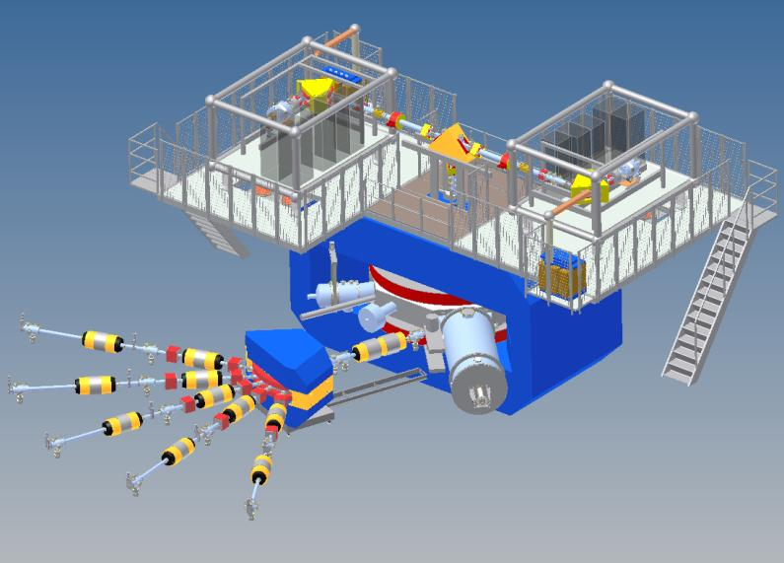
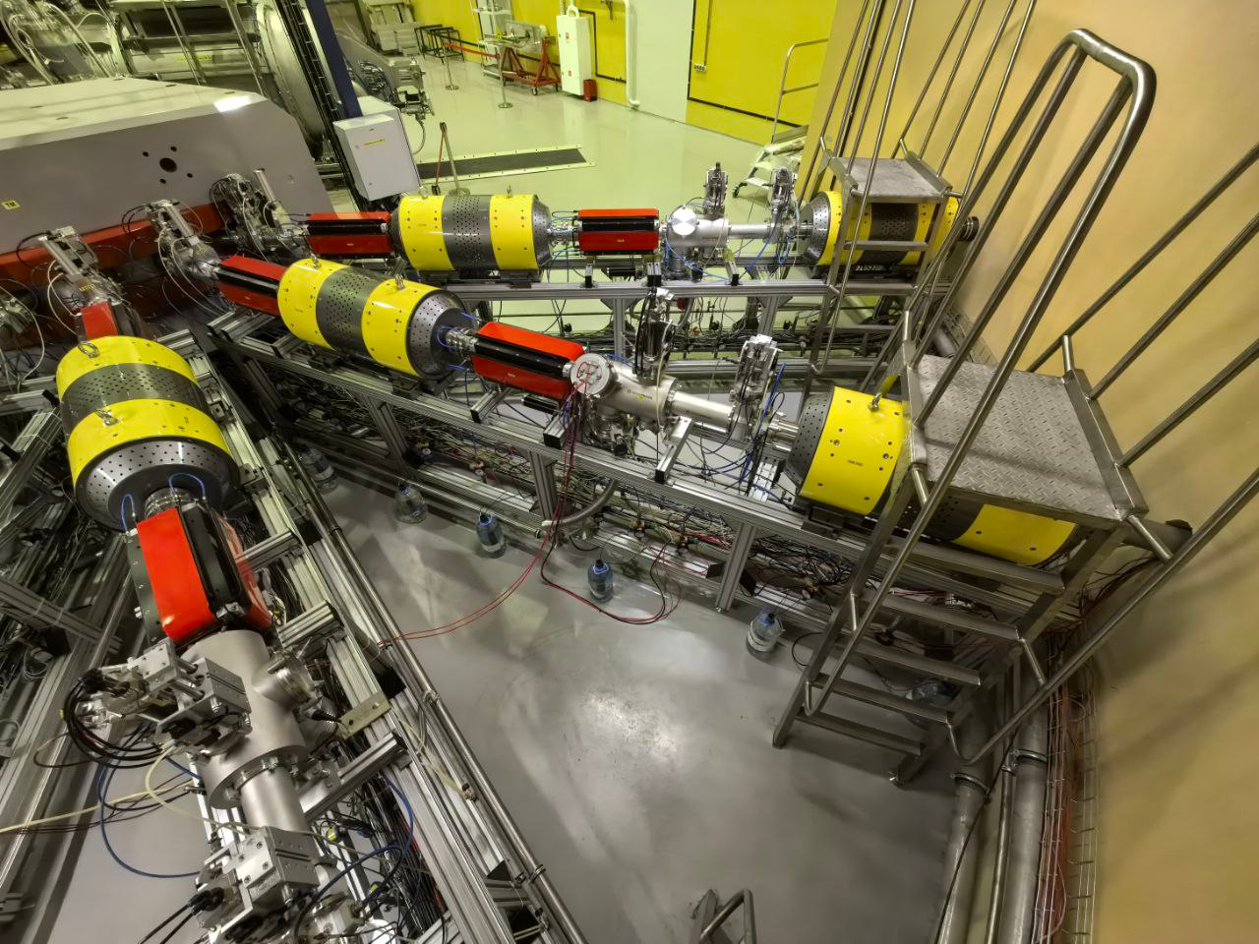
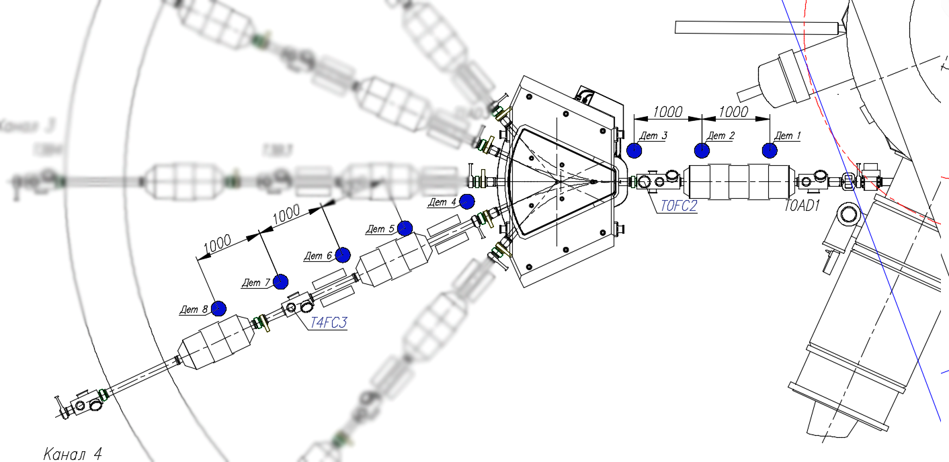
Location on the DC-280
Expected and/or obtained parameters of the DC-280 beam [1]
Ion | Z | Beam Intensity from ECR |  | Efficiency of acceleration | Beam intensities of (4÷8) MeV/n ions on targets pps
 |  | eµA | pps
²⁰Ne | 3 | 150 | 3.10¹⁴ | 50% | 1.5.10¹⁴
⁴⁰Ar | 7 | 300 | 3.10¹⁴ | 50% | 1.5.10¹⁴
⁴⁸Са | 7/8 | 160 | 1.3.10¹⁴ | 50% | 6.2.10¹⁴
⁵⁰Ti | 8/9 | 80 | 6.2.10¹³ | 50% | 3.1.10¹³
⁵⁴Cr | 9 | 125 | 8.10¹³ | 50% | 4.10¹³
⁵⁸Fe | 9/10 | 125 | 8.10¹³ | 50% | 4.10¹³
⁶⁴Ni | 10/11 | 125 | 8.10¹³ | 50% | 4.10¹³
⁷⁰Zn | 11/12 | 100 | 5.10¹³ | 50% | 2,5.10¹³
¹³⁶Хе | 22/23 | 150 | 4.10¹³ | 50% | 2.10¹³
²⁰⁹Bi | 34/35 | 15 | 2.2.10¹² | 60% | 1.10¹²
²³⁸U | 39/40 | 1 | 1,5.10¹¹ | 60% | 1.10¹¹
1. V.A. Semin, S.L. Bogomolov, K. Gikal, G.G. Gulbekyan, I.A. Ivanenko, I.V. Kalagin, N.Yu. Kazarinov, V.I. Mironov DC-280 Cyclotron for Factory of Super Heavy Elements, Experimental Results.

Slide 10
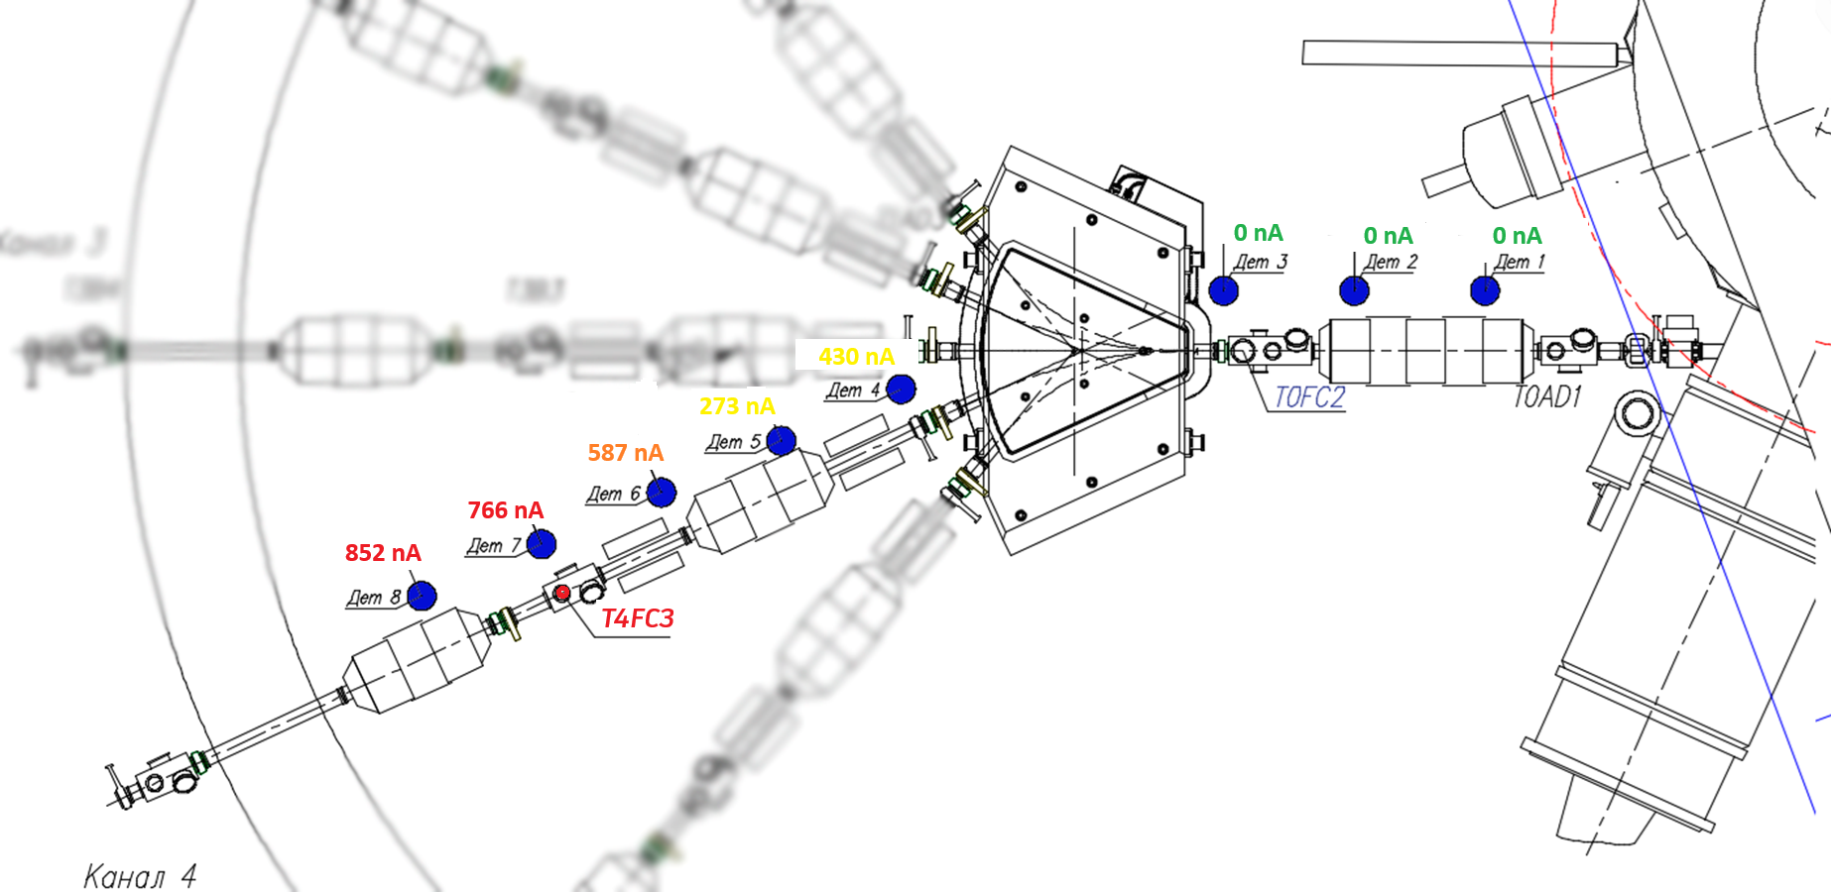
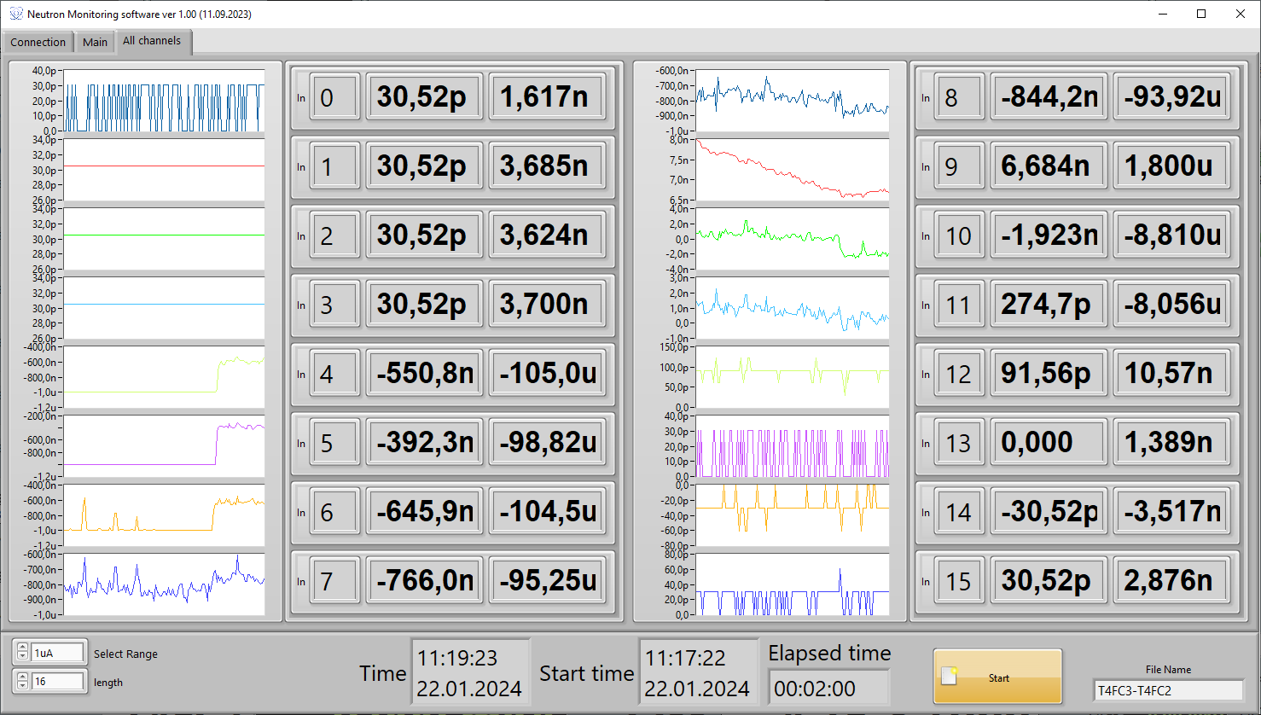
Software in LabVIEW

Slide 11
Conclusions
Experiments conducted on the heavy ion accelerator DC-280 using ⁴⁸Ca¹⁰⁺ and ⁴⁰Ar⁸⁺ ion beams confirmed the potential of the proposed diagnostic method under high-intensity beam conditions.
Based on the results obtained, it can be said that the beam loss diagnostic system is optimized and can be used at the LNR accelerator complex as an auxiliary control system.
In the future, it is planned to install and conduct a series of experiments of such systems at the U-400 cyclotron and further at all basic FLNR facilities at JINR.

Slide 12

OPTIMIZATION OF THE NON-DESTRUCTIVE METHOD FOR DIAGNOSING HEAVY ION BEAM LOSSES BASED ON NEUTRON REGISTRATION
AYSS-2024
K. Timoshenko
Email: timoshenkokd@jinr.ru

