Slide 1
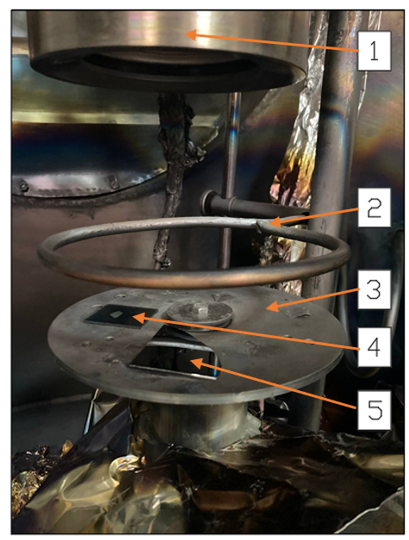
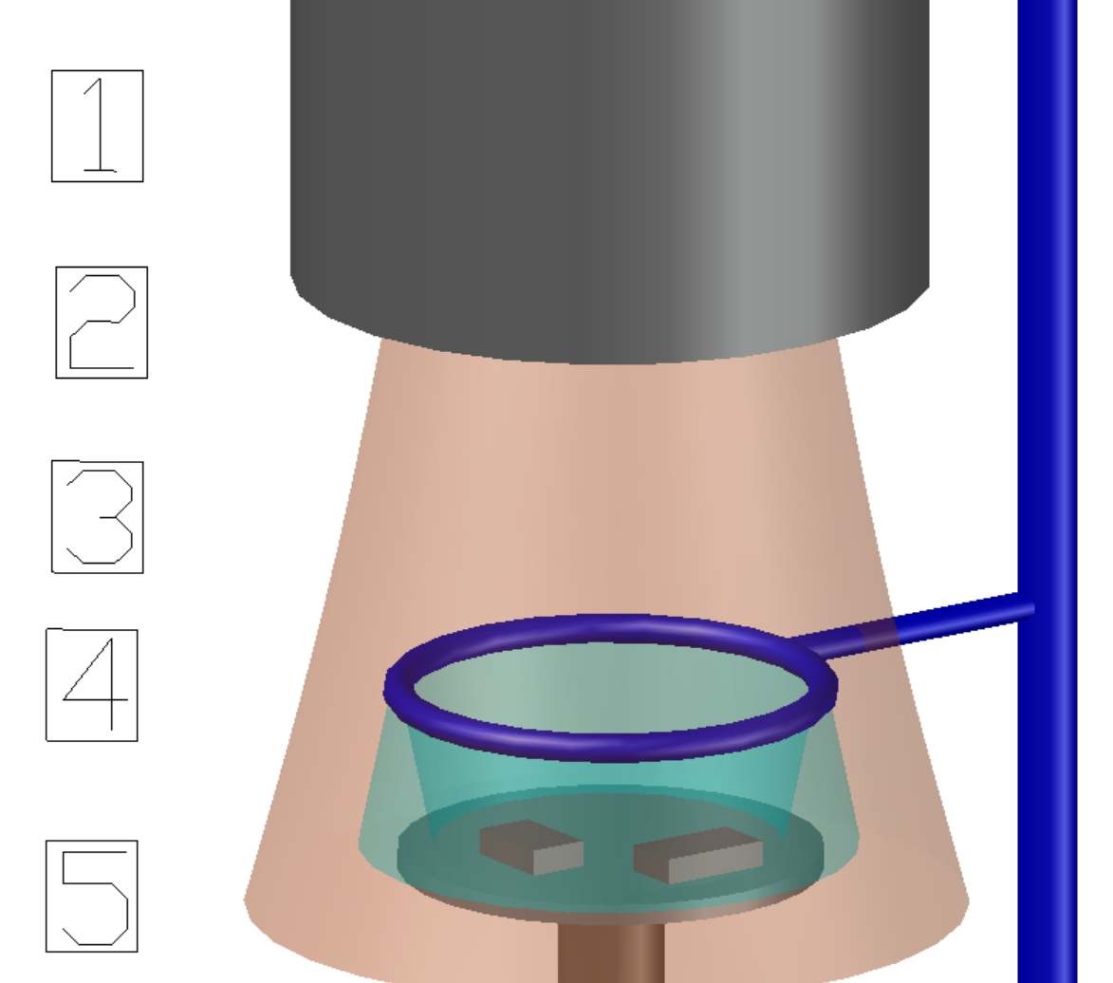
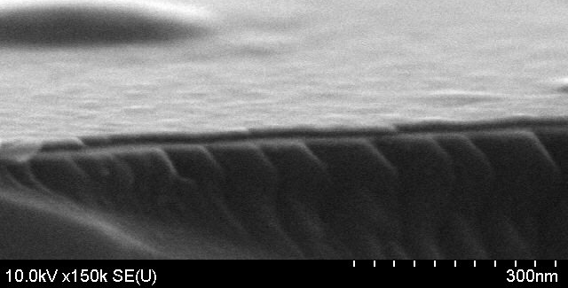
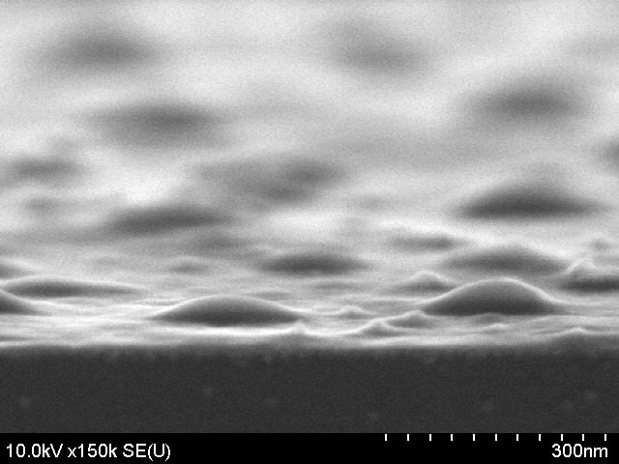
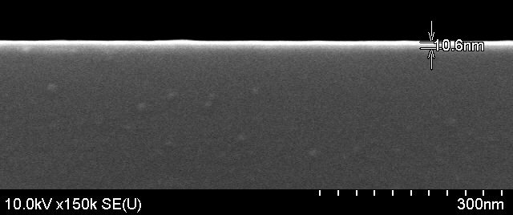
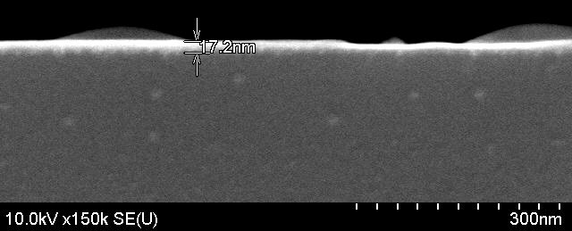
INFLUENCE OF STRUCTURE OF RESISTIVE COATINGS OF SOLID SOLUTION IN СU-N SYSTEM ON ELECTRICAL PROPERTIES
Y.E. Shmanay, I. A. Zur, J. A. Fedotova and S. A. Movchan
Motivation for the research
It has been experimentally proved that the resistivity characteristics of DLC thin films change with time, which is a critical factor for long-term detector operation (up to 5 years). For this reason, the actual task is to search for alternative coatings that meet the requirements of long-term operation in the detector without degradation of both the characteristics of the coating and the parameters of the detector itself.
Objectives of the study
Correlation between structure and electrical characteristics of resistive coatings based on Cu-N.
To propose the application of Cu-N for use as a collector in gas electron multipliers (GEM).
Tasks of the research
Study the structure of Cu-N based resistive coating and establish the resistivity as a function of $N_{2}$ flow rate.
Synthesis of Cu-N coatings
№ | Current (I_{m}), А | Time deposition (T_{напыл}), с | Flow rate Ar, l/ch | Flow rate N₂, l/ch | Nitrogen flow coefficient, Г(N₂) (Ar+ N₂/N₂)
1 | 0,1 | 60 | 0.72 | 1.8 | 0.71
2 |  |  |  | 2.4 | 0.77
3 |  |  |  | 3 | 0.81
4 |  |  |  | 3.6 | 0.83
5 |  |  |  | 4.2 | 0.85
6 |  |  |  | 4.8 | 0.87
19 |  |  |  | 5.4 | 0.88
20 |  |  |  | 6 | 0.89
The samples were synthesised by magnetron sputtering (MS) using HiPiMs technology
1 - magnetron system; 2 - isolated $N_{2}$ gas supply; 3 – substrate-holder; 4 - glass substrate; 5 - silicon substrate.
XRD results
X-ray pattern sample at flow rate $N_{2}$= 1,8 l/h
X-ray pattern sample at flow rate $N_{2}$= 6 l/h
Maximum normalised X-ray pattern at flow rates of
$N_{2}$ = 1,8 and 6 l/h;
Dependence of lattice constant on gas flow coefficient $N_{2}$
The Gaussian function was used to approximate the X-Ray picture:
$y(x)=y_{0}+\frac{1}{w\sqrt{π/2}} e^{−2\frac{{(x−x_{c})}^{2}}{w^{2}}}$ $y_{0}$ – base line, у. е.;$w$ – Reflex width, 2$θ$;$x_{c}$ – reflex center of gravity, 2$θ$.
SEM results
Resistivity results
Flow rate
$N_{2}$= 2,4 l/h
Flow rate
$N_{2}$= 5,4 l/h
SEM image of the sample at angles $80^{o}$ and $90^{o}$with respect to the normal of the plate for flow rates $N_{2}$
I-V Cu-N
Dependence of resistivity and lattice constant on gas flow coefficient $N_{2}$
Conclusion:
The results of studies indicate the possibility of using films based on solid solution in Cu-N system as resistive coatings in gas-discharge detectors. Varying the electrical resistance of Cu-N thin films will make it possible to study the operation of the resistive electrode in detectors and the mechanism of electron avalanche injection.
The research was performed within the framework of the contract ‘Development of new types of erosion-resistant coatings for increasing the stability of gas electronic multipliers // Contract No. 100-02753 dated 11.04.2024’.

