Slide 1
A new mathematical model of electrodynamic processes in spiral high-voltage pulse generators
Paraskun Alexander
Research advisor: Dr. Palchikov Ev. Iv.
Novosibirsk State University
Lavrentiev institute of Hydrodynamics

Slide 2
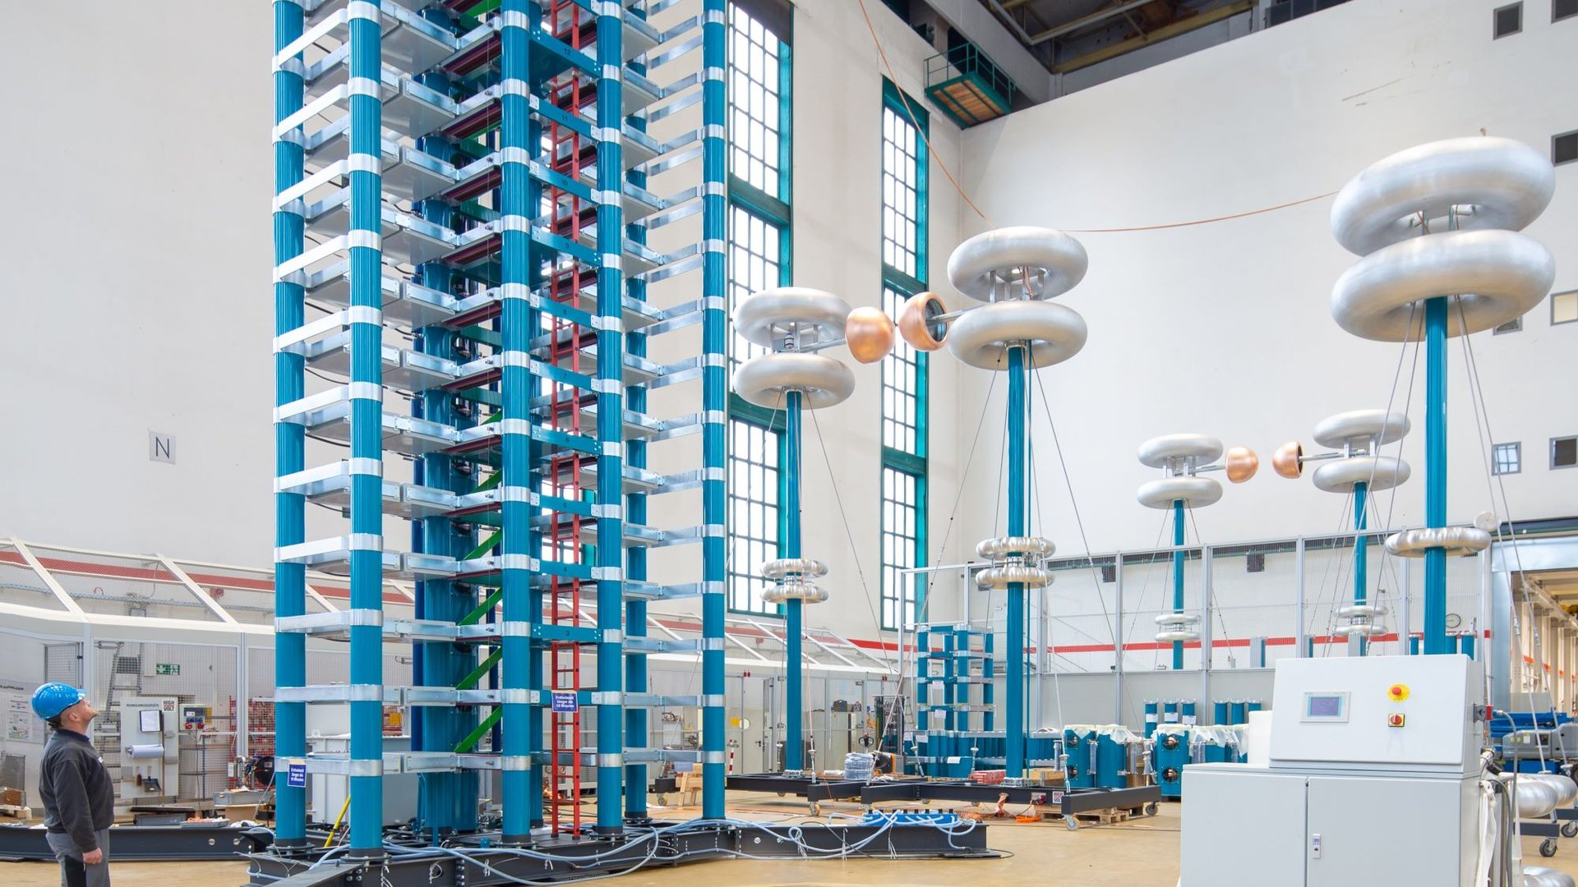
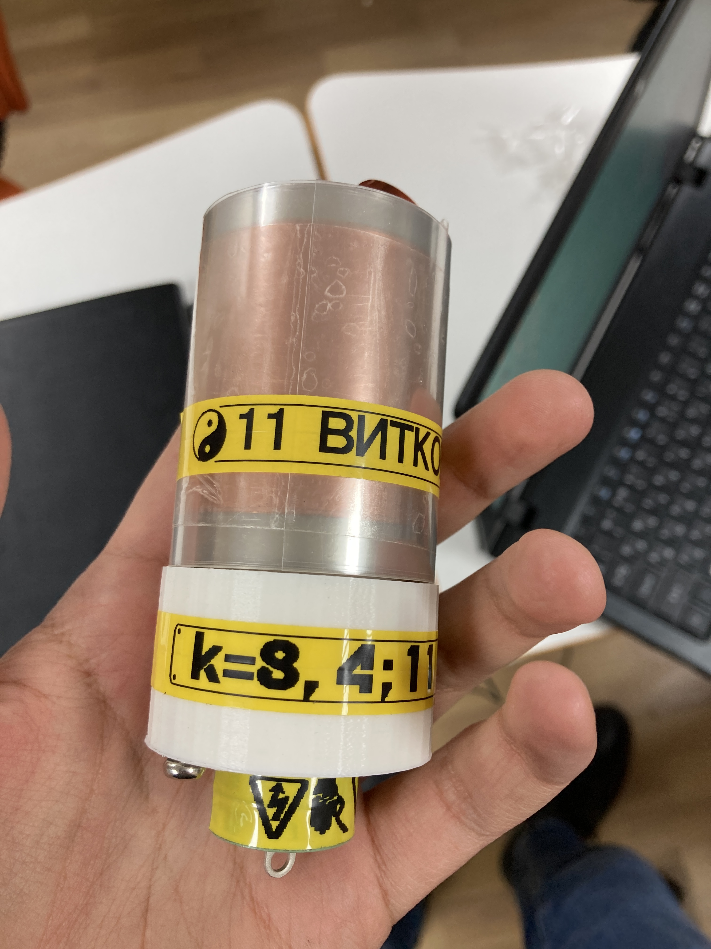
Introduction
Introduction
Motivation
Principle of operation
Research gap
Problem’s statement
Work done
Stress relief wave propagation study
Efficiency coefficients
Parameters
Magnetic field of flowing charge
Generator’s magnetic field
Actual theoretical model
Theoretical results
Spatial distribution of magnetic field
Preliminary results
Work plan
Literature
Publications
A spiral generator is a simple device that stores electrical energy at one, relatively low voltage, and discharges the stored energy in the form of a short electrical pulse with a higher voltage than the stored one.

Slide 3
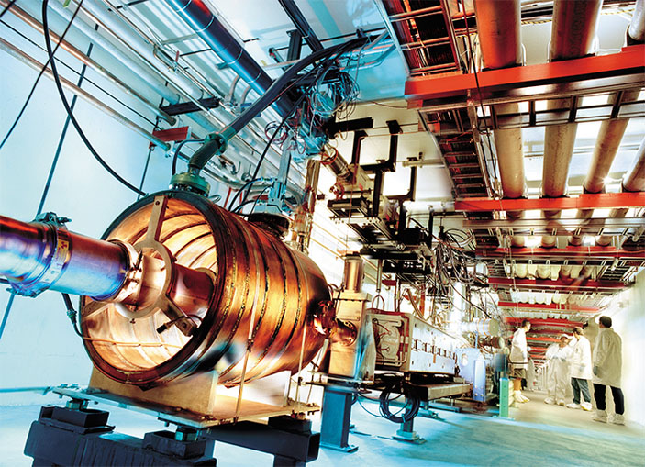
Motivation
Introduction
Motivation
Principle of operation
Research gap
Problem’s statement
Work done
Stress relief wave propagation study
Efficiency coefficients
Parameters
Magnetic field of flowing charge
Generator’s magnetic field
Actual theoretical model
Theoretical results
Spatial distribution of magnetic field
Preliminary results
Work plan
Literature
Publications
Creation of pulsed electron beams in charged particle accelerators

Slide 4
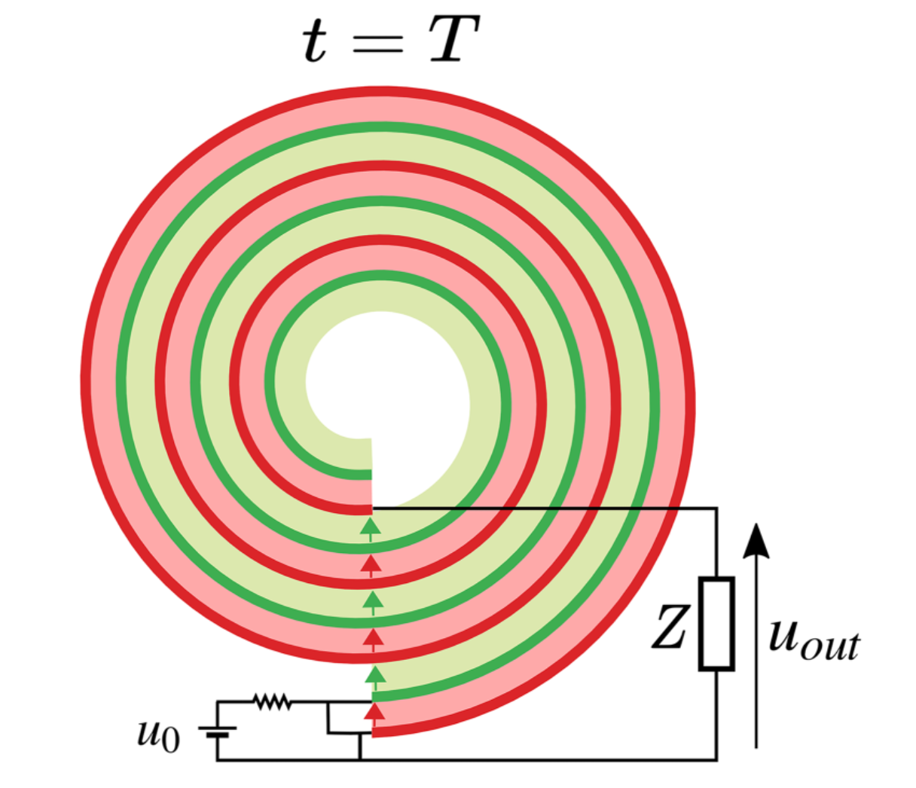
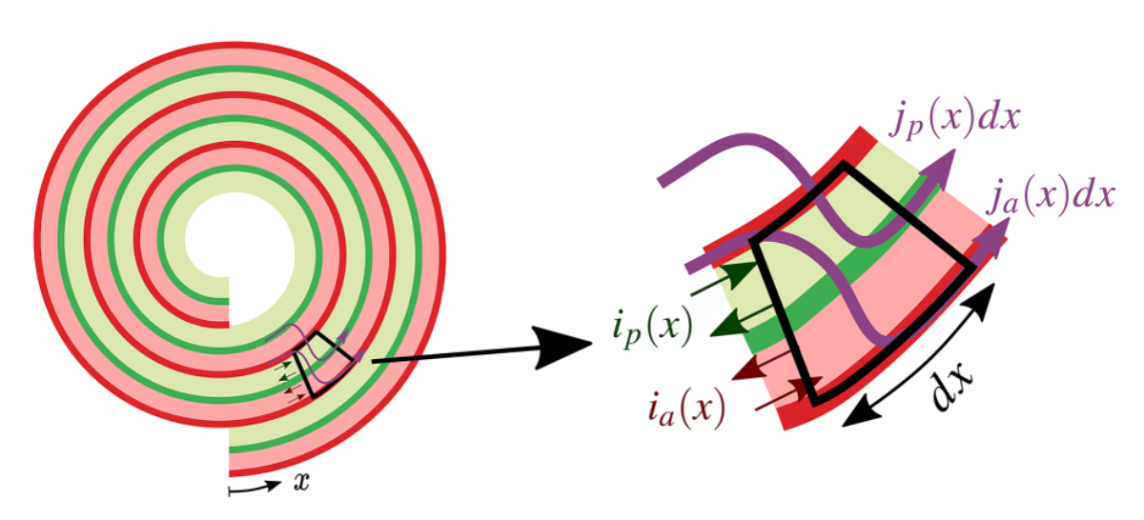
Principle of operation
Introduction
Motivation
Principle of operation
Research gap
Problem’s statement
Work done
Stress relief wave propagation study
Efficiency coefficients
Parameters
Magnetic field of flowing charge
Generator’s magnetic field
Actual theoretical model
Theoretical results
Spatial distribution of magnetic field
Preliminary results
Work plan
Literature
Publications

Slide 5
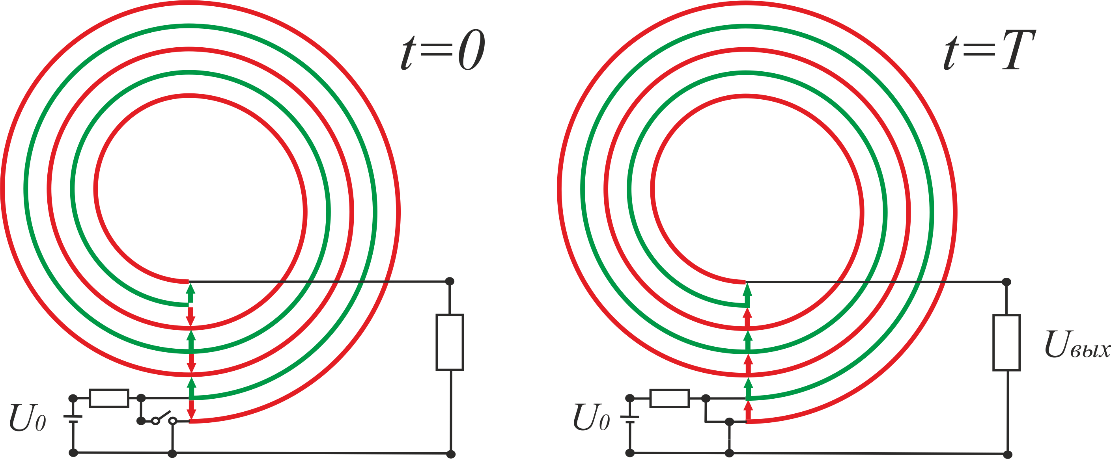
Principle of operation
Introduction
Motivation
Principle of operation
Research gap
Problem’s statement
Work done
Stress relief wave propagation study
Efficiency coefficients
Parameters
Magnetic field of flowing charge
Generator’s magnetic field
Actual theoretical model
Theoretical results
Spatial distribution of magnetic field
Preliminary results
Work plan
Literature
Publications

Slide 6
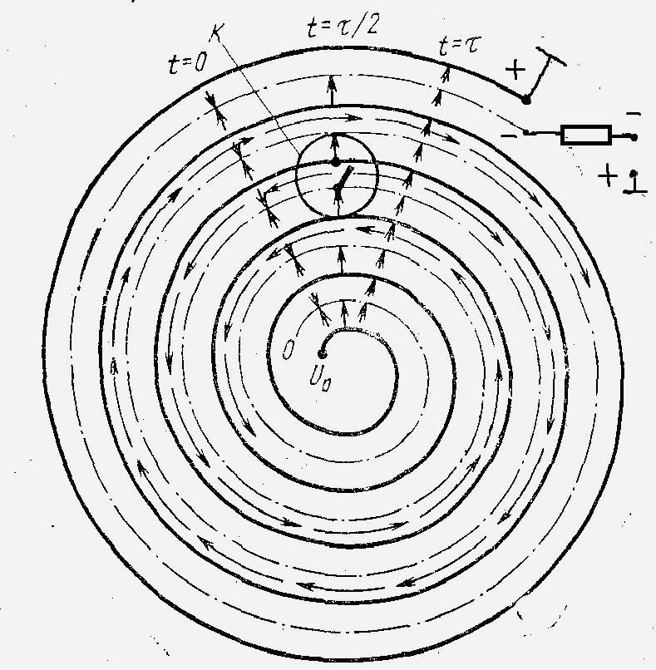
Research gap
Introduction
Motivation
Principle of operation
Research gap
Problem’s statement
Work done
Stress relief wave propagation study
Efficiency coefficients
Parameters
Magnetic field of flowing charge
Generator’s magnetic field
Actual theoretical model
Theoretical results
Spatial distribution of magnetic field
Preliminary results
Work plan
Literature
Publications
$$T=\frac{πnD\sqrt{ε}}{c}$$
$$Umax=2nE$$
$$U\left(t\right)=2\frac{t}{τ}E, t∈(0, τ)$$
$U\left(t\right)=2\left(n−\frac{t−T}{τ}\right)E$, $t∈(τ, 2τ$)
$$Cout≈{\left(\frac{1}{2n}\right)}^{2}C$$
$$U\left(t\right)=Ulx[1−exp⁡(−\frac{t}{Tk})]$$
$$Ut\left(lx\right)=Ut\{1−exp⁡[−(l−lx)\frac{\sqrt{ε}}{cTk}]\}$$
Fitch R.A., Howell V.T.S. // Patent. Appl. 1961. P. 18 136.

Slide 7
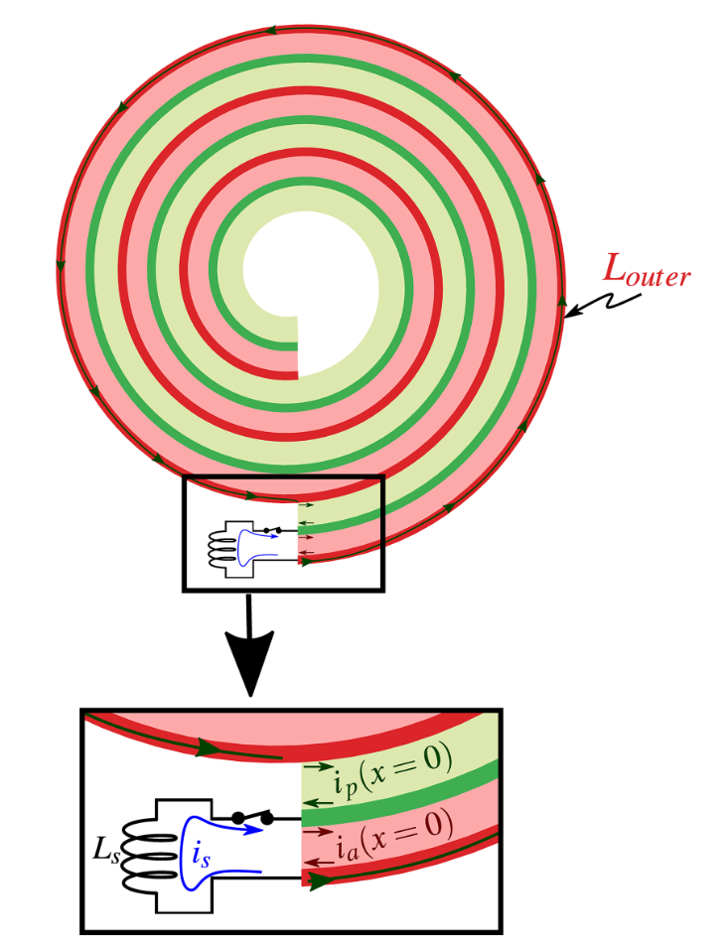
Research gap
Introduction
Motivation
Principle of operation
Research gap
Problem’s statement
Work done
Stress relief wave propagation study
Efficiency coefficients
Parameters
Magnetic field of flowing charge
Generator’s magnetic field
Actual theoretical model
Theoretical results
Spatial distribution of magnetic field
Preliminary results
Work plan
Literature
Publications

Slide 8
Problem’s statement
Introduction
Motivation
Principle of operation
Research gap
Problem’s statement
Work done
Stress relief wave propagation study
Efficiency coefficients
Parameters
Magnetic field of flowing charge
Generator’s magnetic field
Actual theoretical model
Theoretical results
Spatial distribution of magnetic field
Preliminary results
Work plan
Literature
Publications
Creation of spiral generators with busbars profiled in the form of a meander
Experimental study and analysis of spiral generators of a new, improved type
Comparison of the characteristics of spiral generators with different configurations of the spiral line and magnetic circuit
Analysis of magnetic field distribution for various magnetic core configurations
Creation of a theoretical model consistent with the experimental data obtained

Slide 9
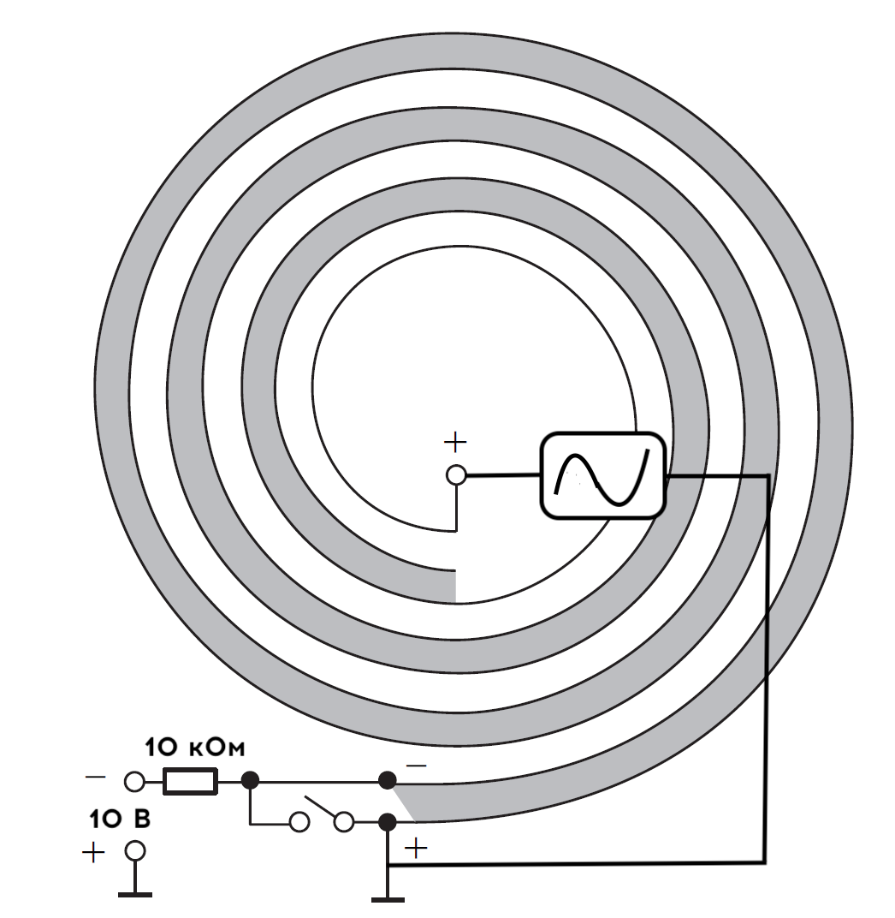
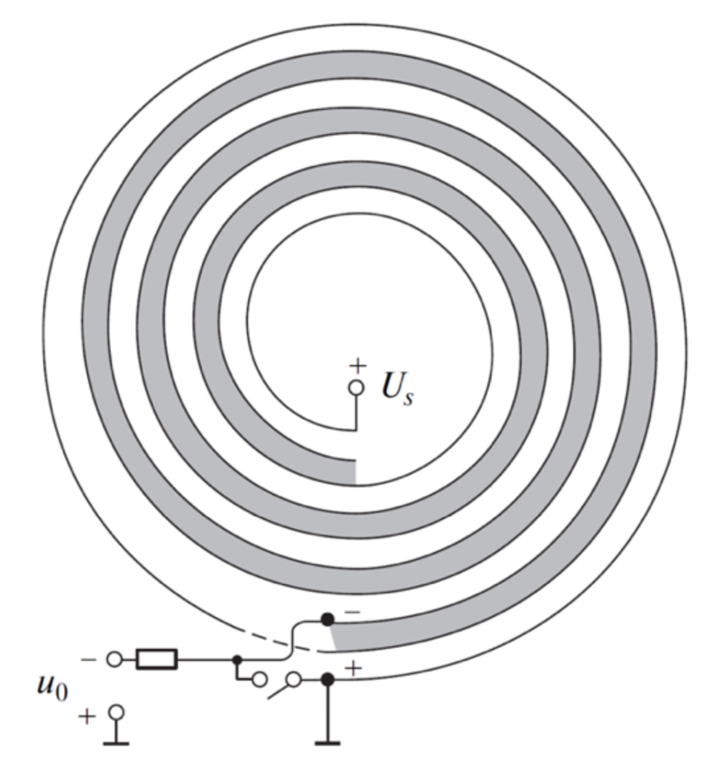
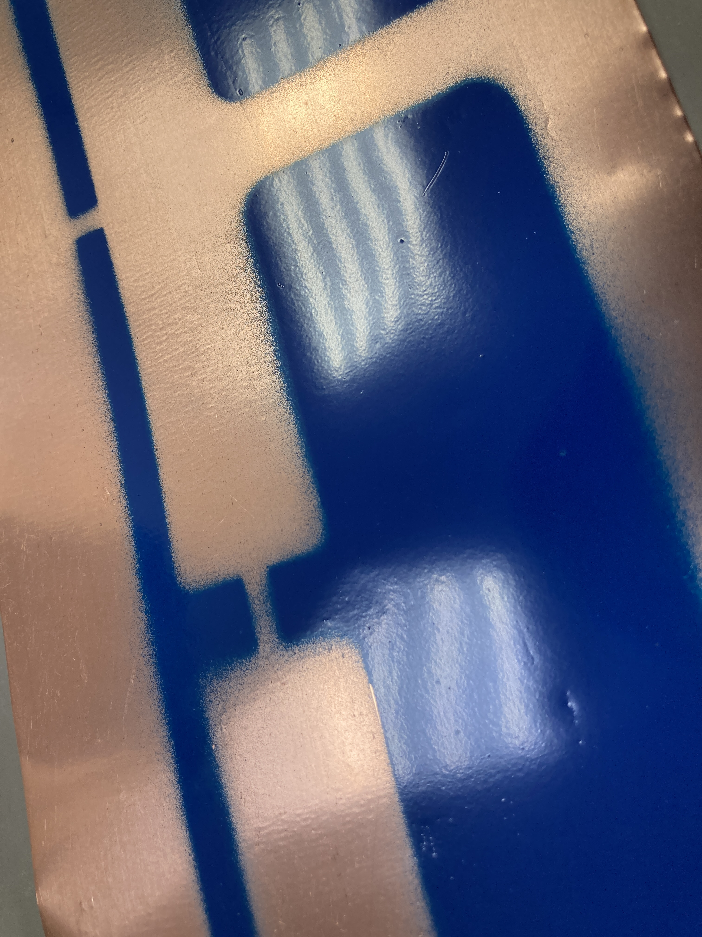
Problem statement
Introduction
Motivation
Principle of operation
Research gap
Problem’s statement
Work done
Stress relief wave propagation study
Efficiency coefficients
Parameters
Magnetic field of flowing charge
Generator’s magnetic field
Actual theoretical model
Theoretical results
Spatial distribution of magnetic field
Preliminary results
Work plan
Literature
Publications
Inductive part
Capacitive part
Spiral generator
Generator with an extra turn

Slide 10
Problem statement
Introduction
Motivation
Principle of operation
Research gap
Problem’s statement
Work done
Stress relief wave propagation study
Efficiency coefficients
Parameters
Magnetic field of flowing charge
Generator’s magnetic field
Actual theoretical model
Theoretical results
Spatial distribution of magnetic field
Preliminary results
Work plan
Literature
Publications

Slide 11
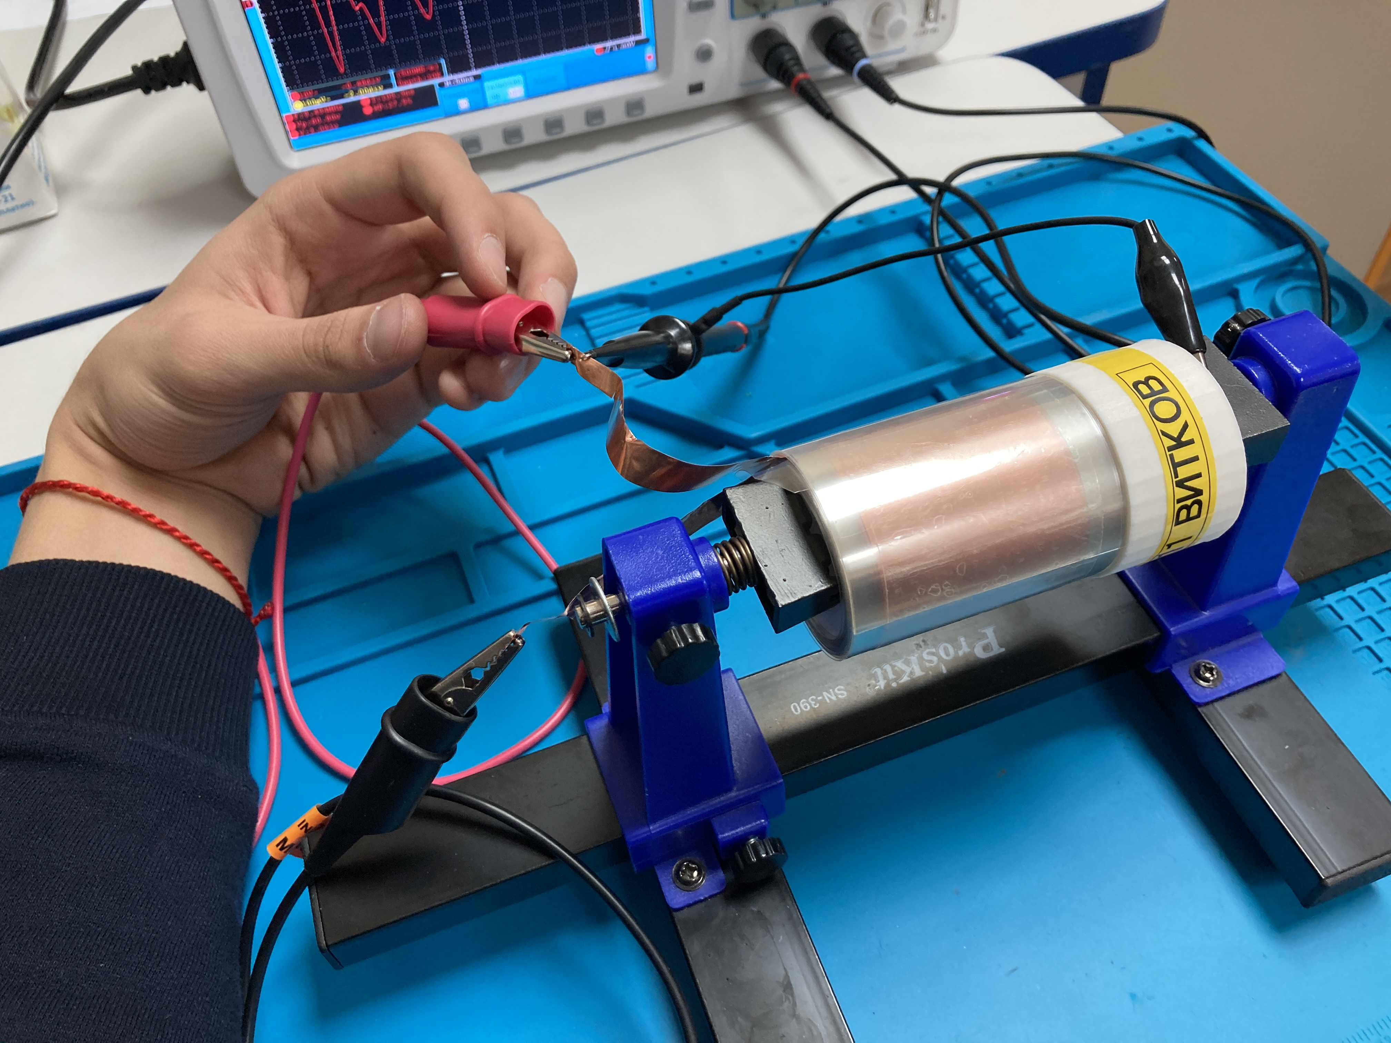
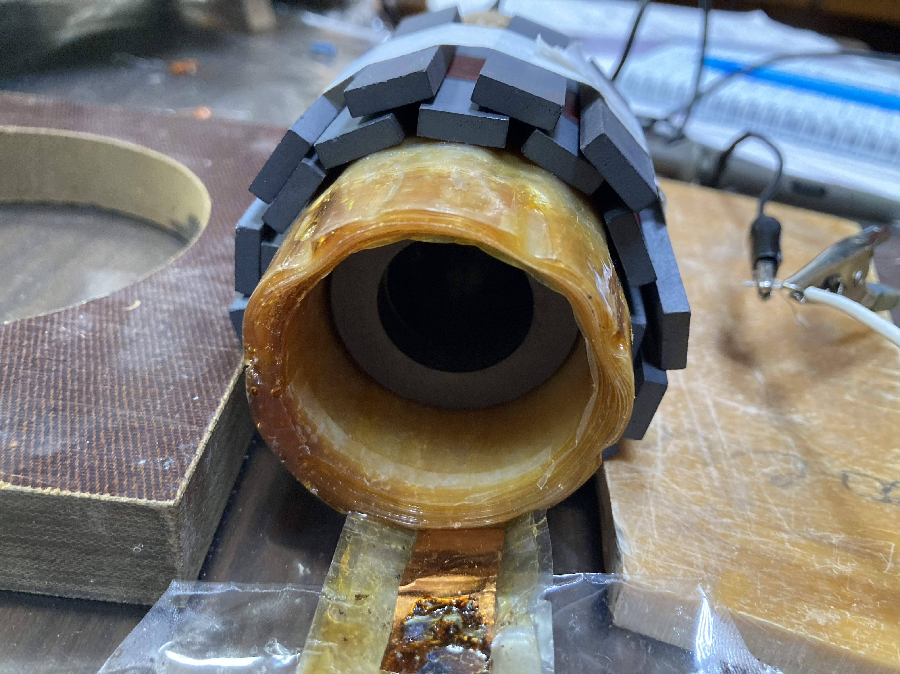
Work done
Introduction
Motivation
Principle of operation
Research gap
Problem’s statement
Work done
Stress relief wave propagation study
Efficiency coefficients
Parameters
Magnetic field of flowing charge
Generator’s magnetic field
Actual theoretical model
Theoretical results
Spatial distribution of magnetic field
Preliminary results
Work plan
Literature
Publications

Slide 12
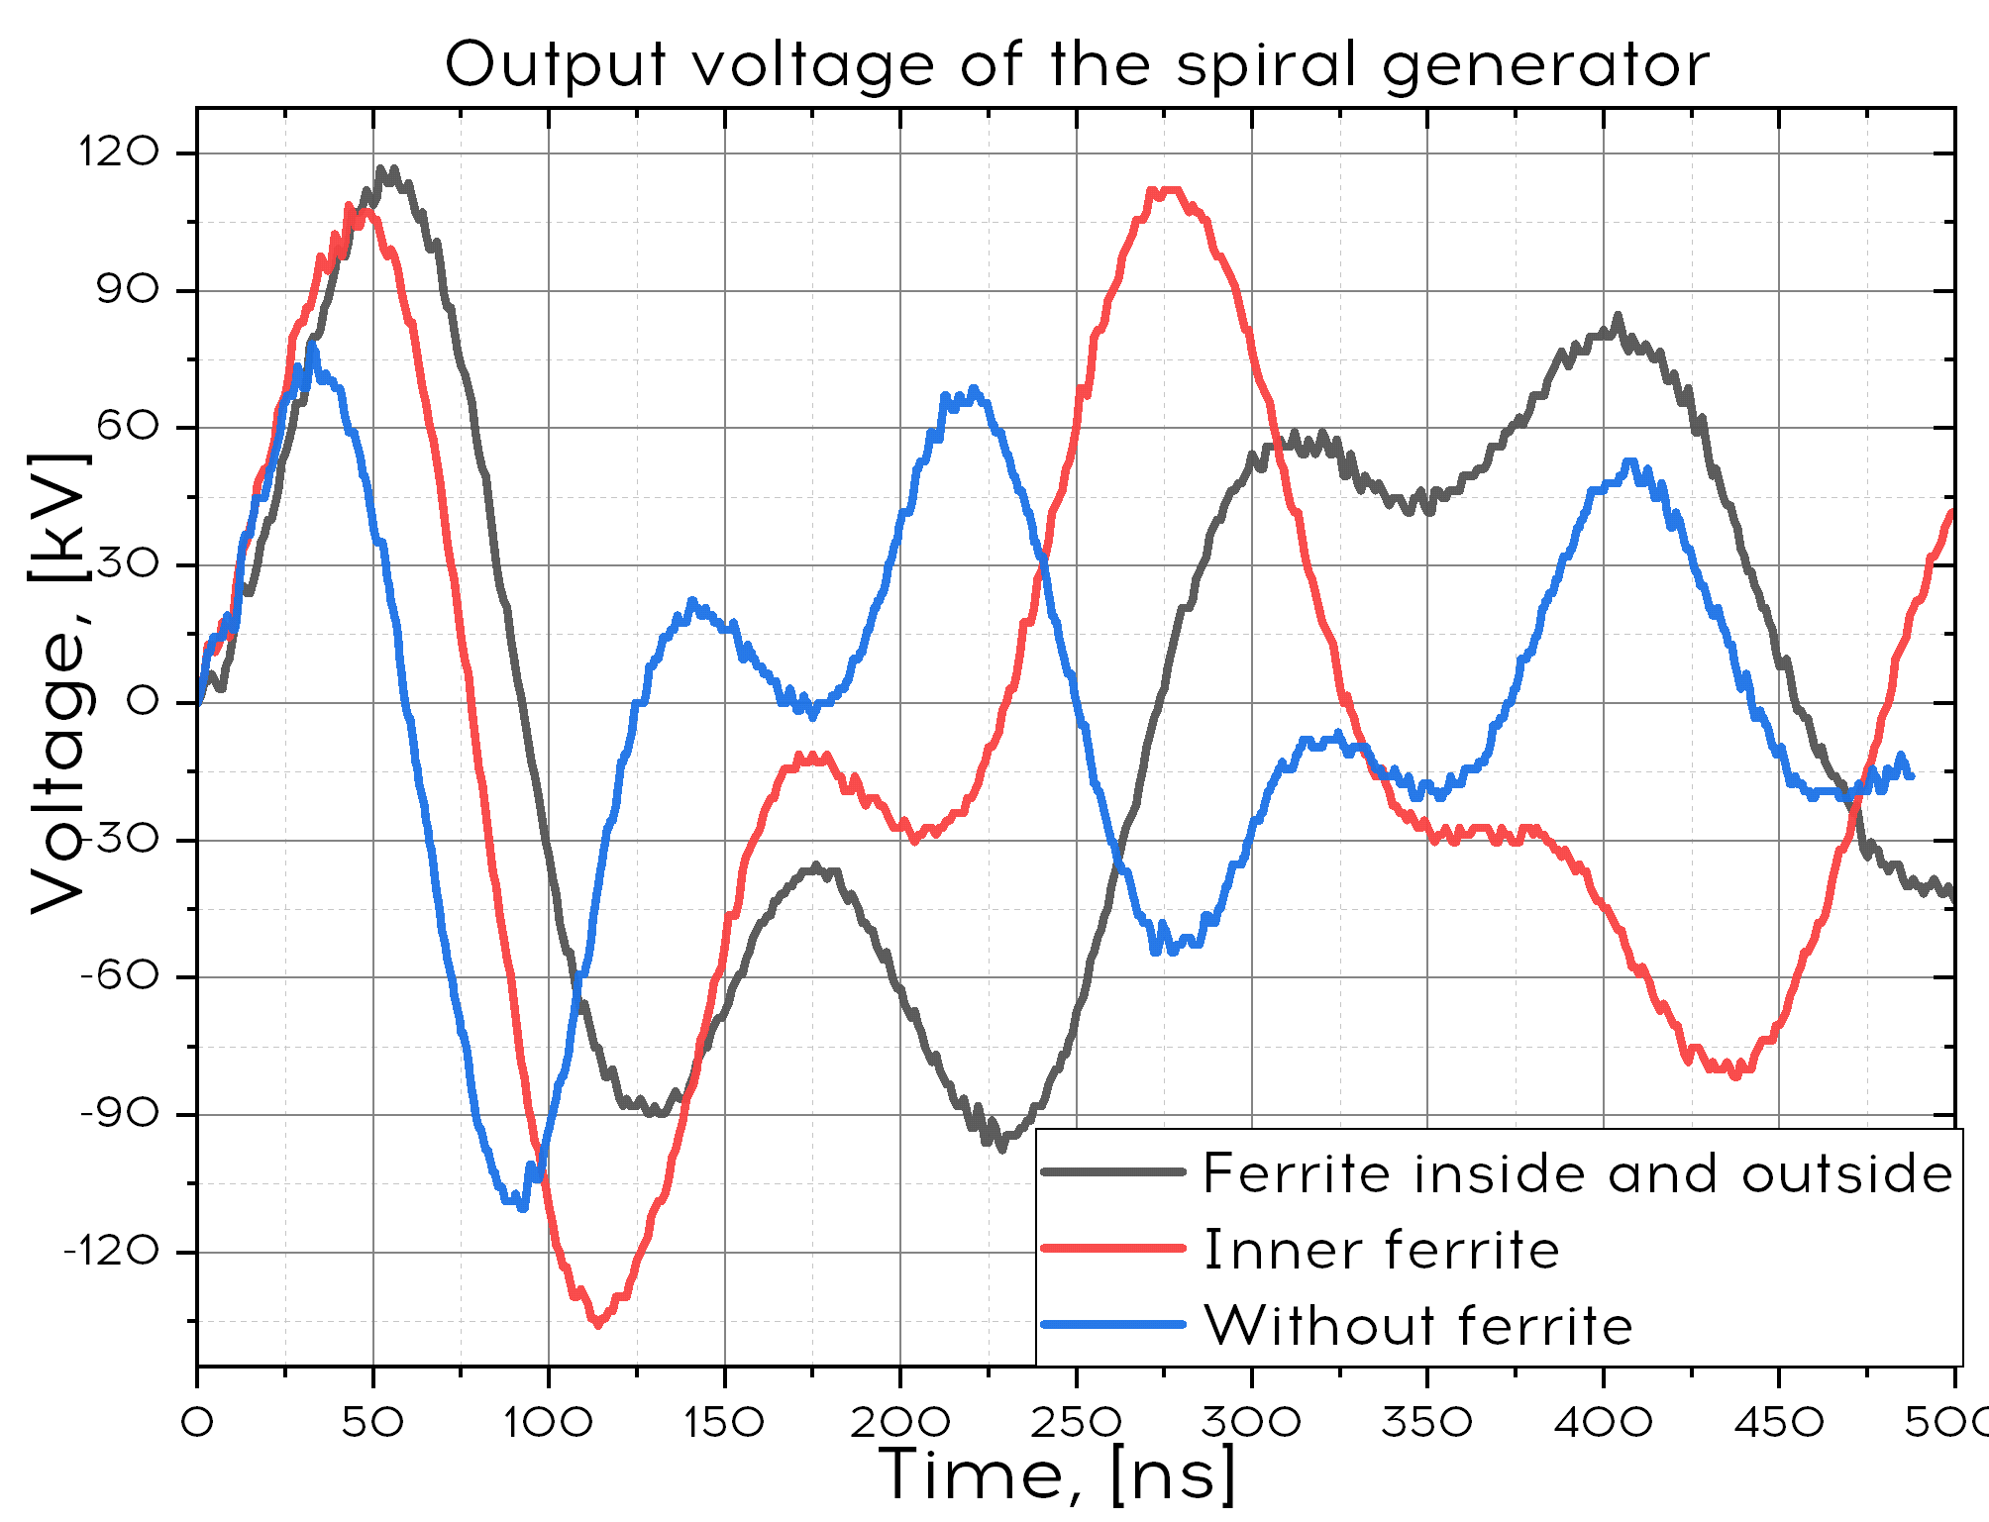
Stress relief wave propagation study
Introduction
Motivation
Principle of operation
Research gap
Problem’s statement
Work done
Stress relief wave propagation study
Efficiency coefficients
Parameters
Magnetic field of flowing charge
Generator’s magnetic field
Actual theoretical model
Theoretical results
Spatial distribution of magnetic field
Preliminary results
Work plan
Literature
Publications

Slide 13
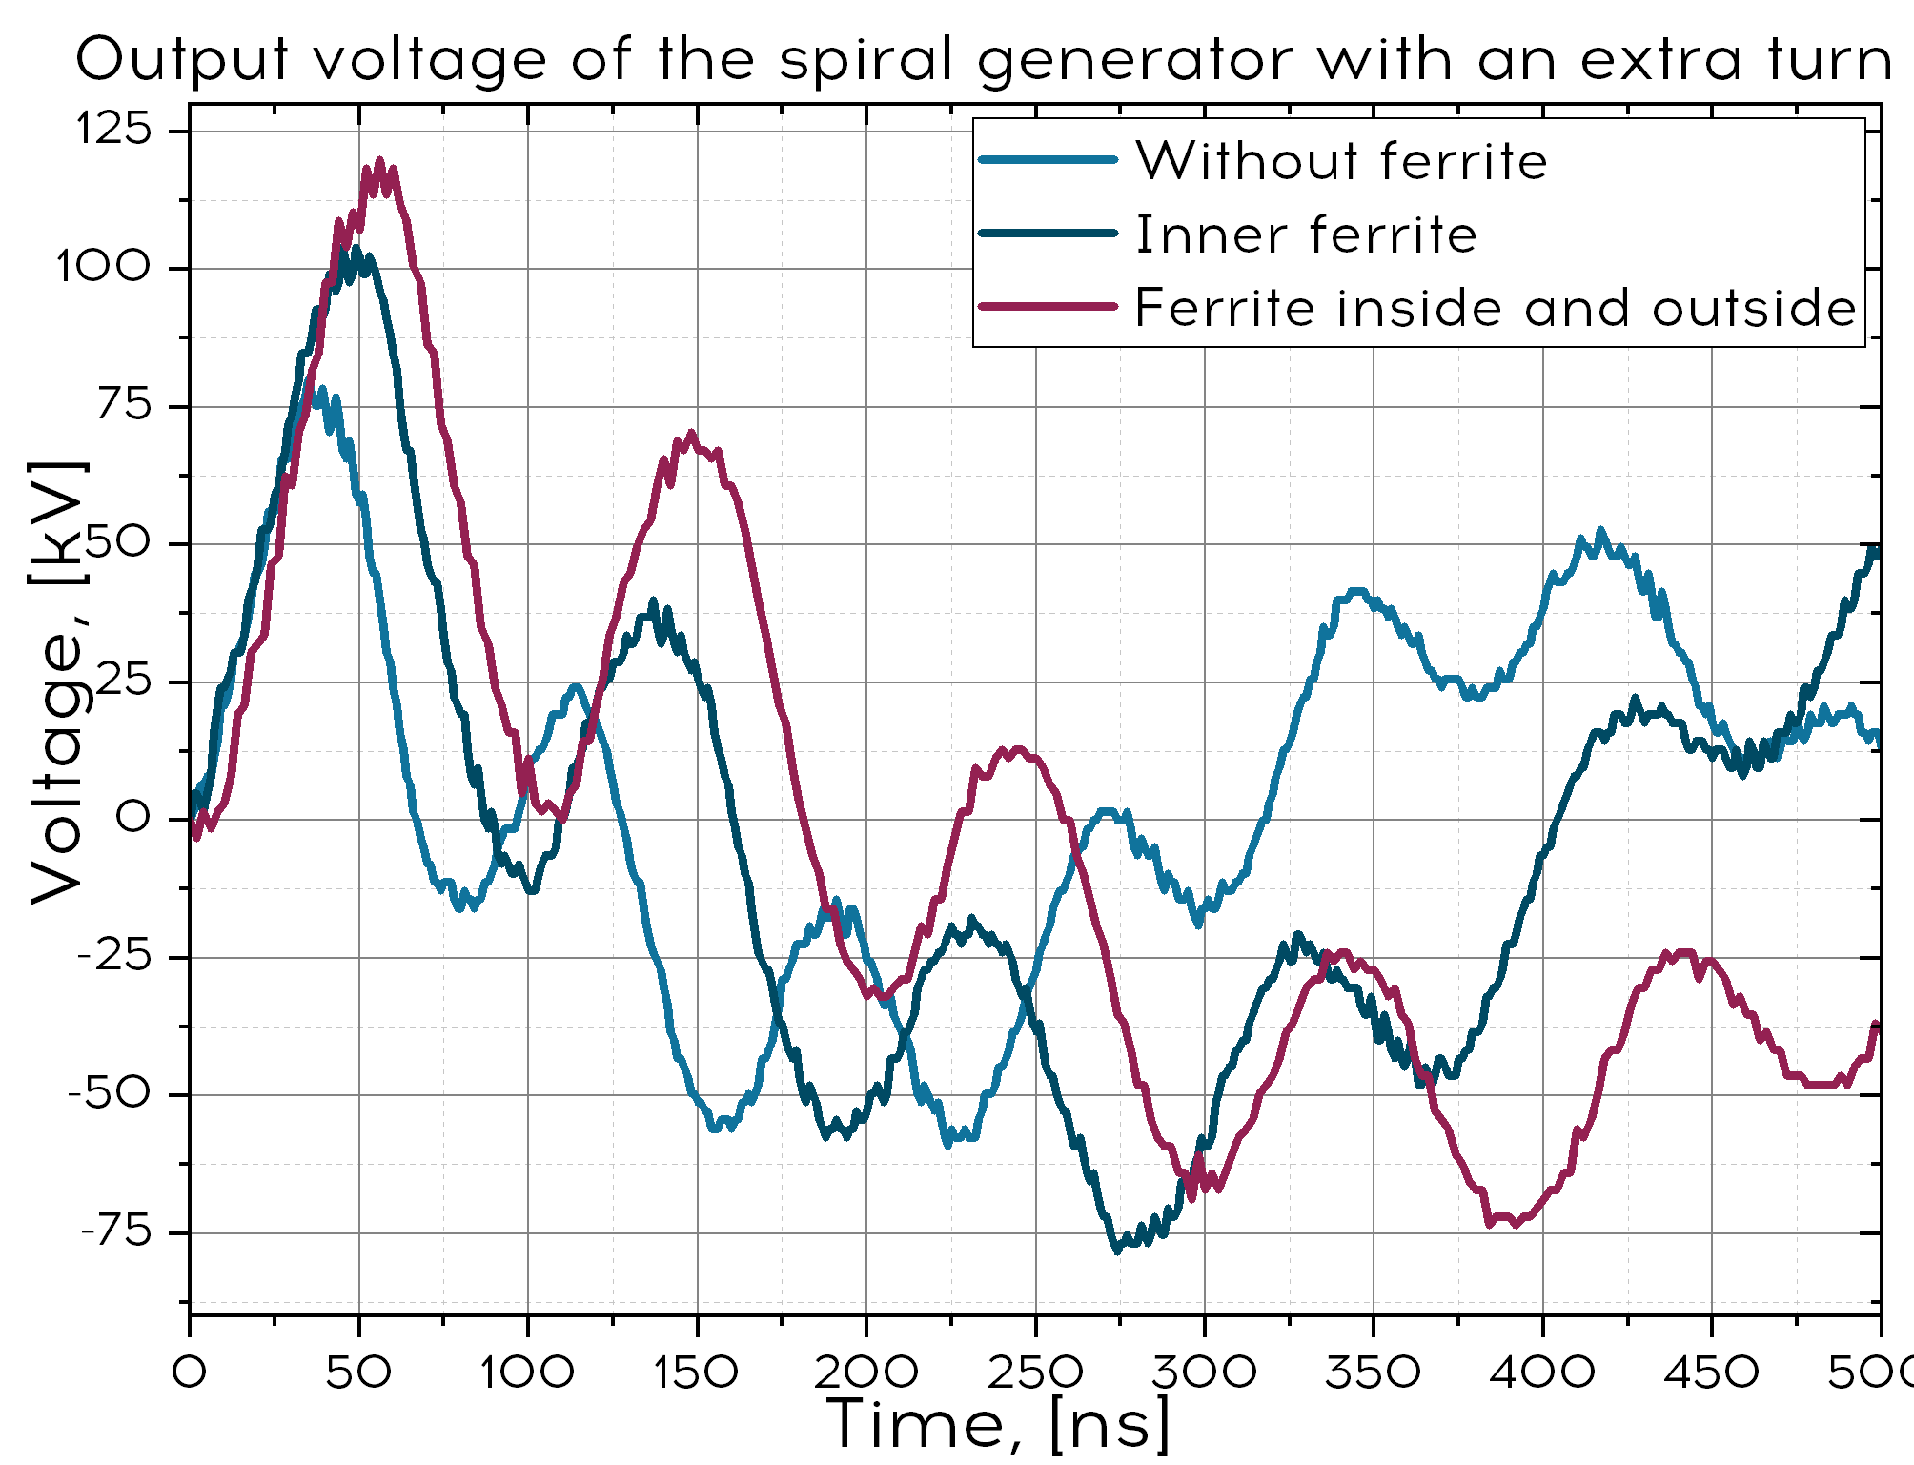
Stress relief wave propagation study
Introduction
Motivation
Principle of operation
Research gap
Problem’s statement
Work done
Stress relief wave propagation study
Efficiency coefficients
Parameters
Magnetic field of flowing charge
Generator’s magnetic field
Actual theoretical model
Theoretical results
Spatial distribution of magnetic field
Preliminary results
Work plan
Literature
Publications

Slide 14
Parameters of generators
Introduction
Motivation
Principle of operation
Research gap
Problem’s statement
Work done
Stress relief wave propagation study
Efficiency coefficients
Parameters
Magnetic field of flowing charge
Generator’s magnetic field
Actual theoretical model
Theoretical results
Spatial distribution of magnetic field
Preliminary results
Work plan
Literature
Publications
Without ferrite | Inner ferrite | Ferrite inside and outside of the generator
Spiral generator
k = 7,5 | k = 10,4 | k = 12
10,4% | 23,4% | 26,9%
Spiral generator with an extra turn
k = 8 | k = 10,5 | k = 12
12,8% | 22% | 28,8%
Inductance
8 µH | 20 µH | 35 µH

Slide 15
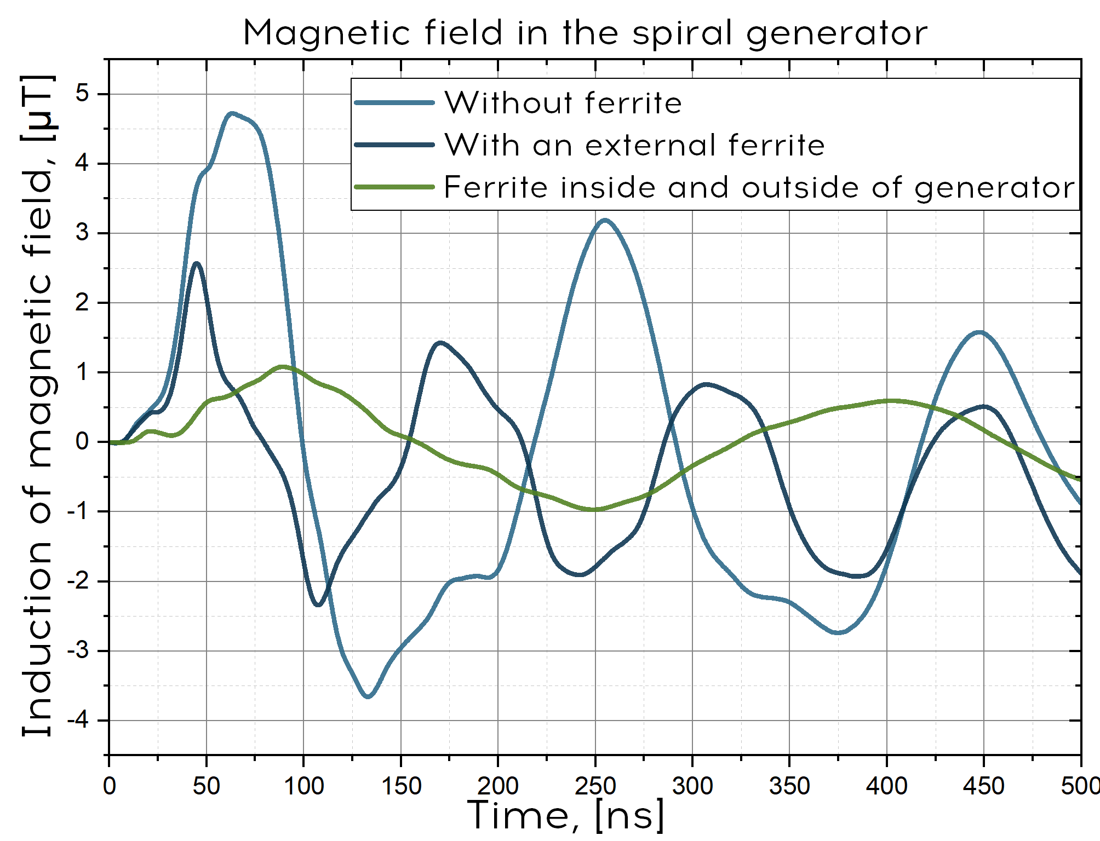
Magnetic field of flowing charge
Introduction
Motivation
Principle of operation
Research gap
Problem’s statement
Work done
Stress relief wave propagation study
Efficiency coefficients
Parameters
Magnetic field of flowing charge
Generator’s magnetic field
Actual theoretical model
Theoretical results
Spatial distribution of magnetic field
Preliminary results
Work plan
Literature
Publications

Slide 16
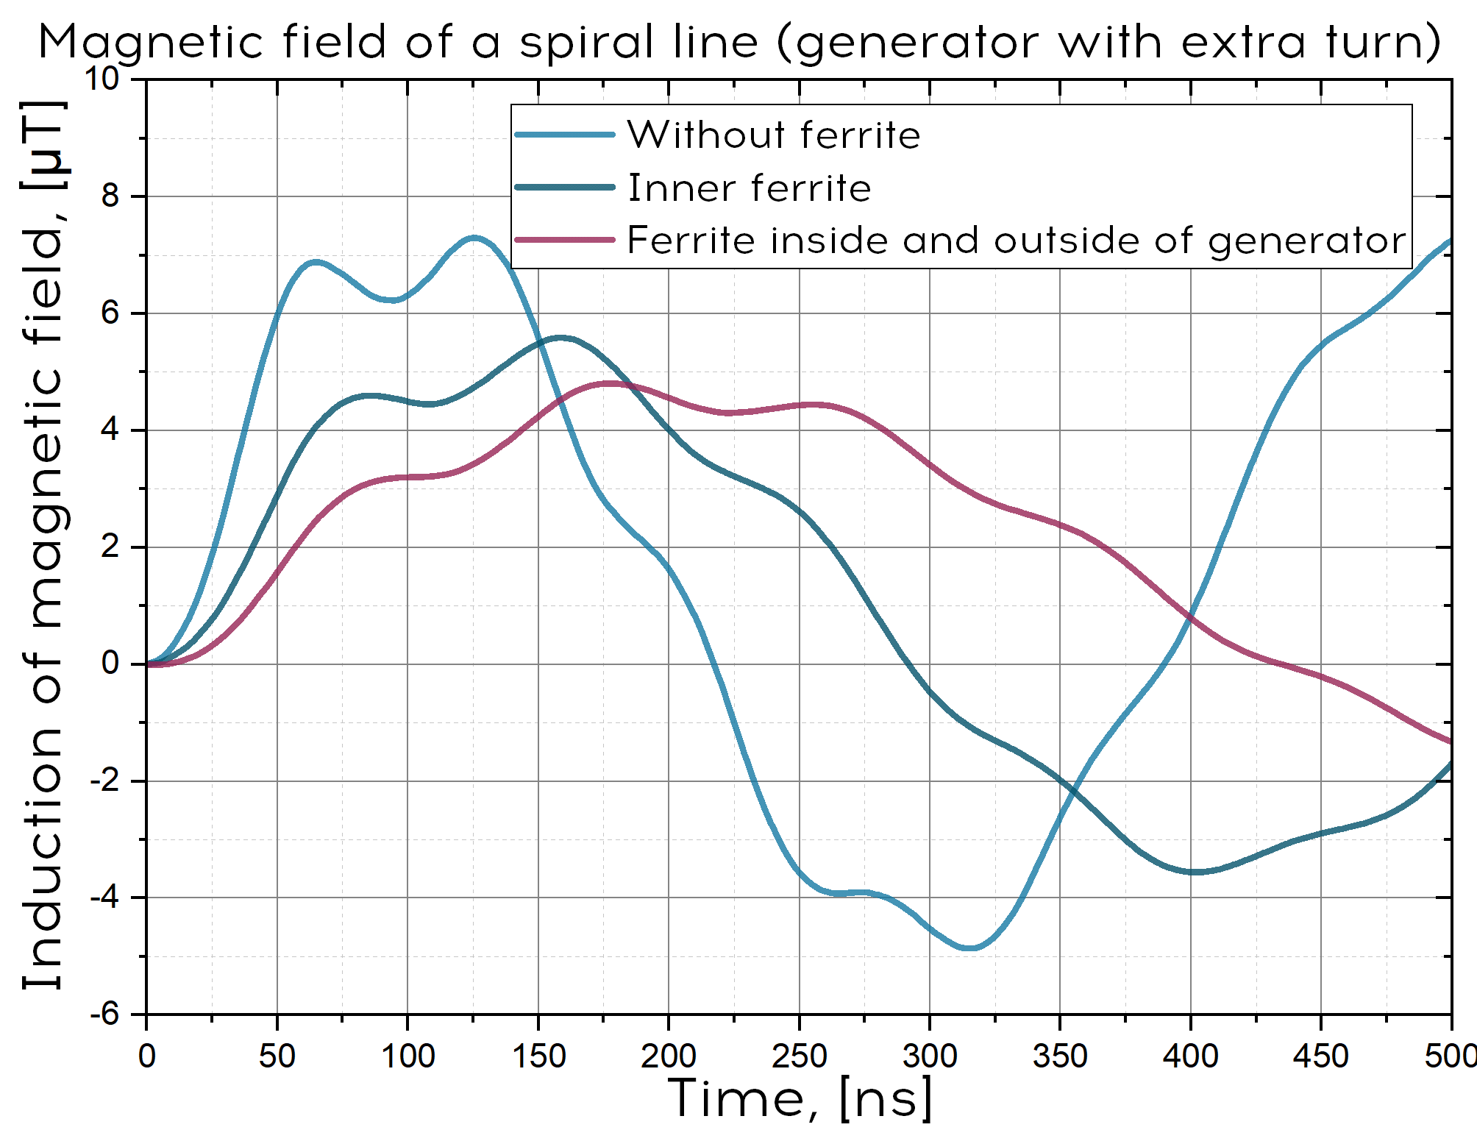
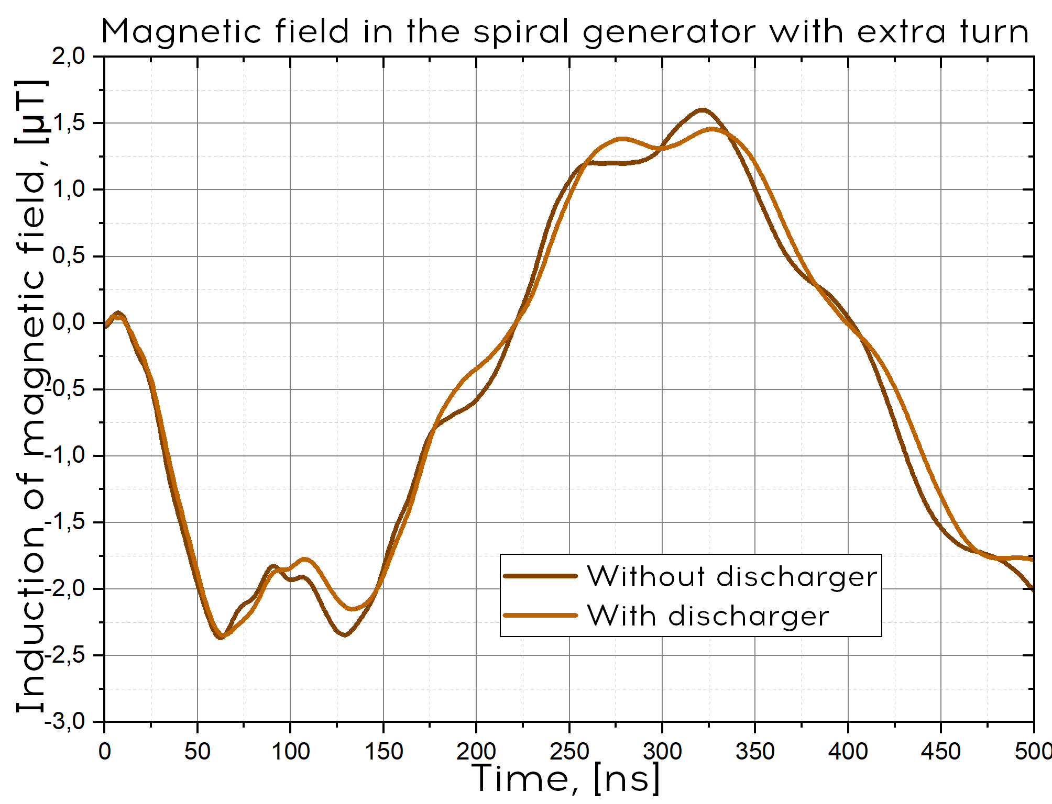
Magnetic field of a modified generator
Introduction
Motivation
Principle of operation
Research gap
Problem’s statement
Work done
Stress relief wave propagation study
Efficiency coefficients
Parameters
Magnetic field of flowing charge
Generator’s magnetic field
Actual theoretical model
Theoretical results
Spatial distribution of magnetic field
Preliminary results
Work plan
Literature
Publications

Slide 17
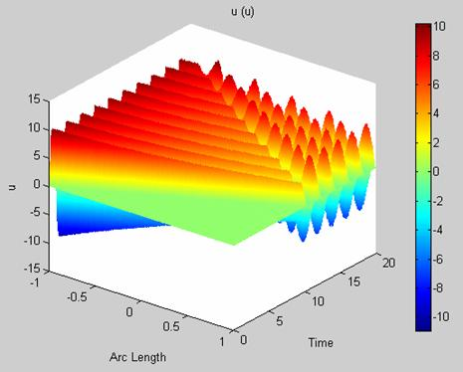
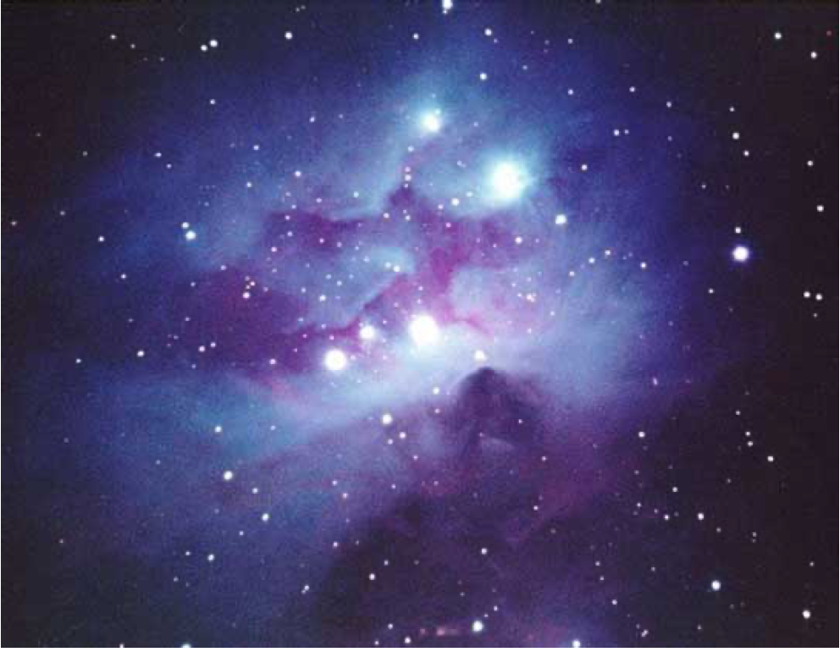
Actual theoretical model
Introduction
Motivation
Principle of operation
Research gap
Problem’s statement
Work done
Stress relief wave propagation study
Efficiency coefficients
Parameters
Magnetic field of flowing charge
Generator’s magnetic field
Actual theoretical model
Theoretical results
Spatial distribution of magnetic field
Preliminary results
Work plan
Literature
Publications
Spatio-temporal voltage distribution in the short-circuit mode at the end

Slide 18
Actual theoretical model
Introduction
Motivation
Principle of operation
Research gap
Problem’s statement
Work done
Stress relief wave propagation study
Efficiency coefficients
Parameters
Magnetic field of flowing charge
Generator’s magnetic field
Actual theoretical model
Theoretical results
Spatial distribution of magnetic field
Preliminary results
Work plan
Literature
Publications
$\frac{∂u_{a}}{∂t}=−\frac{∂i_{a}}{∂x}−Ni_{s}$, $\frac{∂u_{p}}{∂t}=−\frac{∂i_{p}}{∂x}−Ni_{s}$
$\frac{∂i_{a}}{∂t}=−\frac{∂u_{a}}{∂x}$, $\frac{∂i_{p}}{∂t}=−\frac{∂u_{p}}{∂x}$
$$u_{s}=N\int_{0}^{1}{\left(u_{a}+u_{p}\right)dx}$$
$$N^{2}\frac{di_{s}}{dt}−k_{sp}\left(n+1\right)N\frac{di_{0p}}{dt}+k_{sa}nN\frac{di_{0a}}{dt}=\frac{ω_{0}^{2}}{2}u_{s}$$
$−k_{sa}Nn\frac{di_{s}}{dt}+\left(L_{z}+k_{ap}n\left(n+1\right)\right)\frac{di_{0p}}{dt}−(L_{z}+n^{2})$ $\frac{di_{0a}}{dt}=\frac{ω_{0}^{2}}{2}u_{a}(0)$
$−k_{sp}N\left(n+1\right)\frac{di_{s}}{dt}−\left(L_{z}+{\left(n+1\right)}^{2}\right)\frac{di_{0p}}{dt}+(L_{z}+k_{ap}n\left(n+1\right))$ $\frac{di_{0a}}{dt}=\frac{ω_{0}^{2}}{2}u_{p}(0)$
Telegraph equations
Voltage on the switch
Boundary conditions

Slide 19
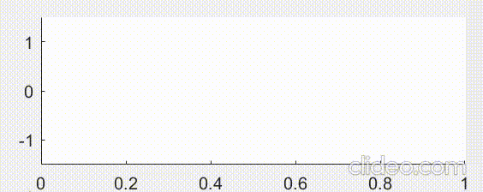
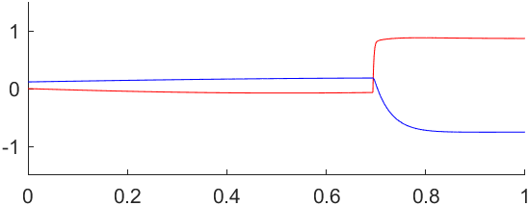
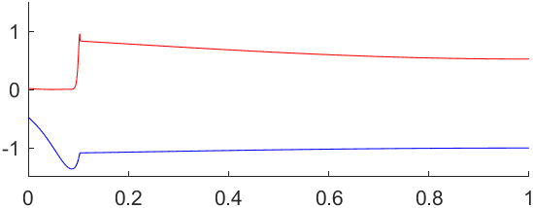
Wave propagation’s model
Waves before reflection from free end
Waves after reflection from the free end
Wave in the active line, wave in the passive line

Slide 20
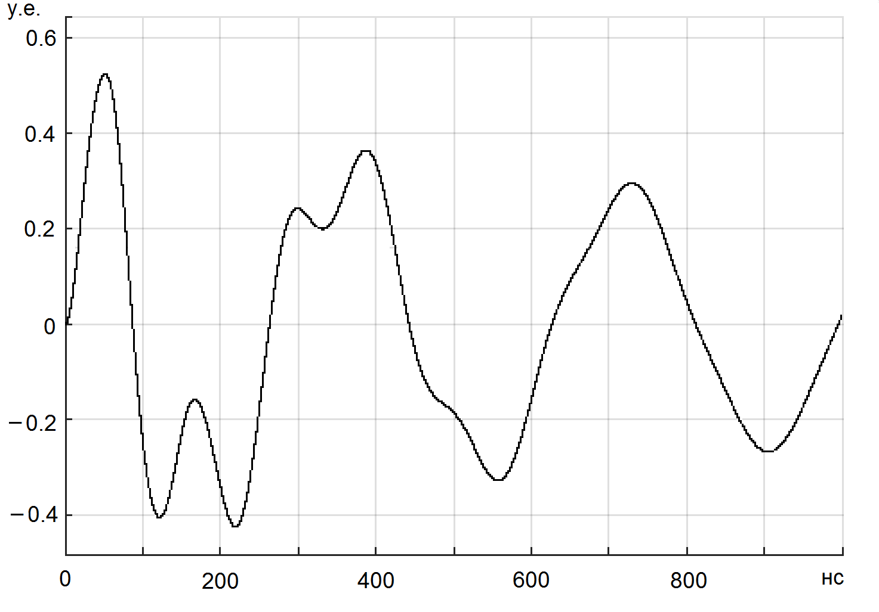
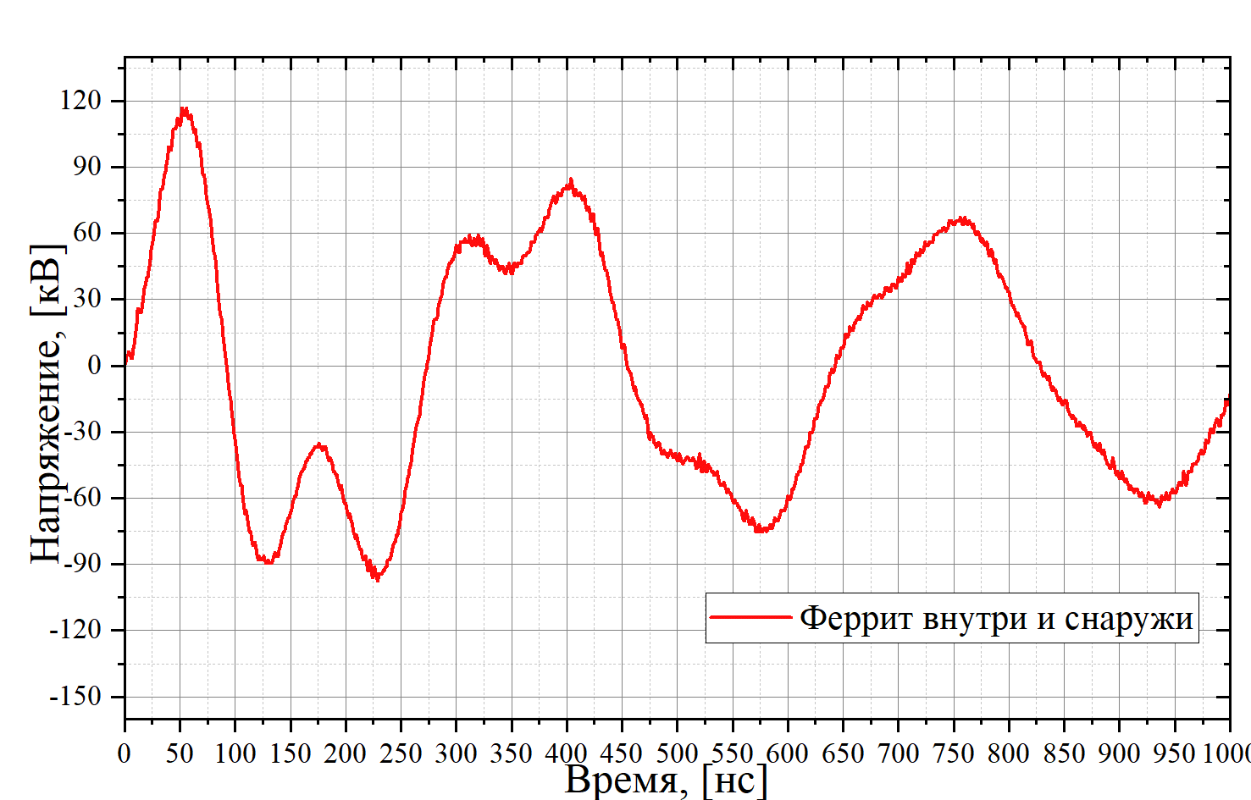
Theoretical results
Introduction
Motivation
Principle of operation
Research gap
Problem’s statement
Work done
Stress relief wave propagation study
Efficiency coefficients
Parameters
Magnetic field of flowing charge
Generator’s magnetic field
Actual theoretical model
Theoretical results
Spatial distribution of magnetic field
Preliminary results
Work plan
Literature
Publications

Slide 21
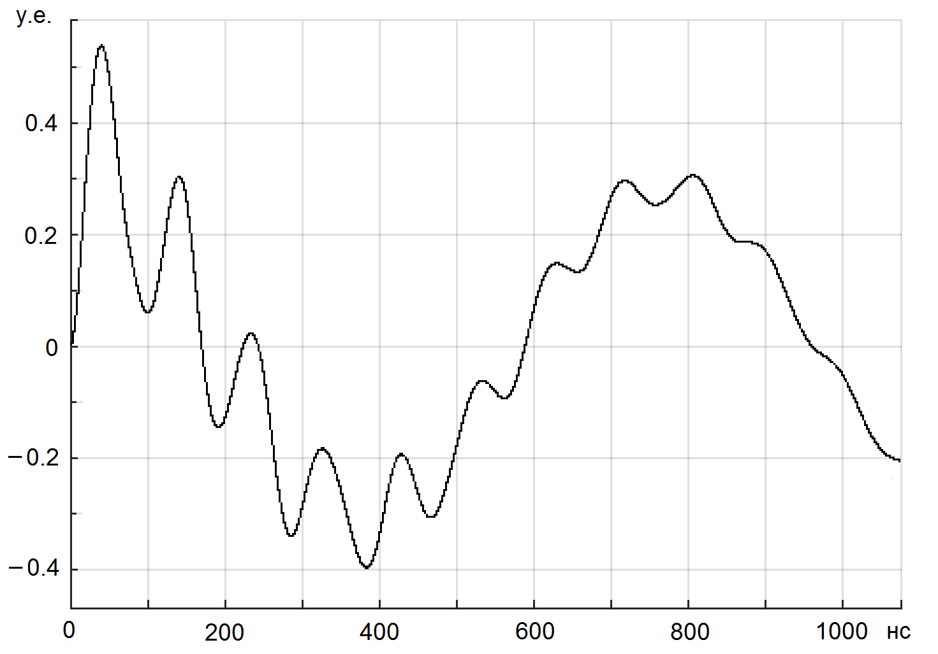
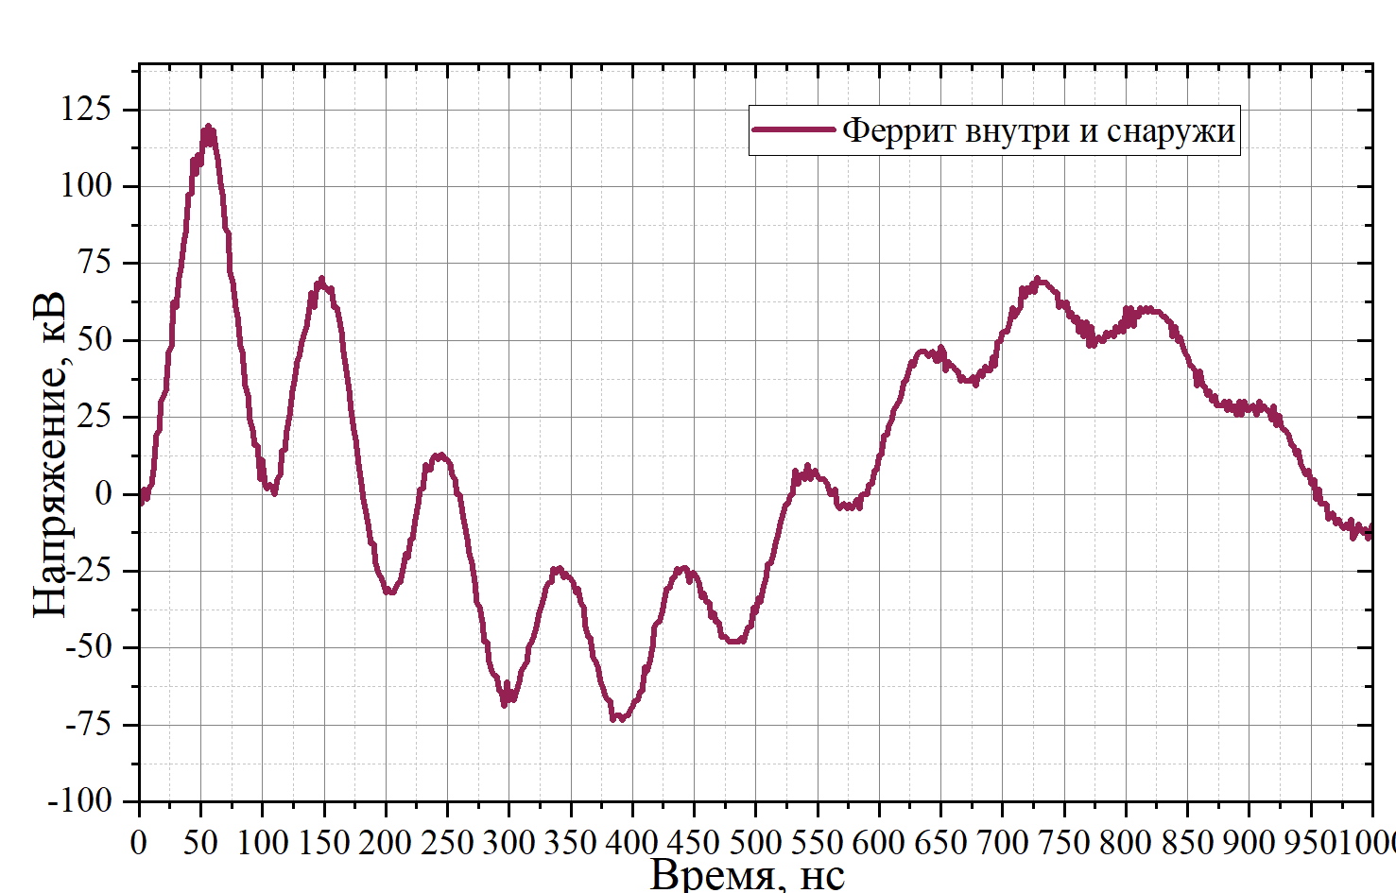
Theoretical results
Introduction
Motivation
Principle of operation
Research gap
Problem’s statement
Work done
Stress relief wave propagation study
Efficiency coefficients
Parameters
Magnetic field of flowing charge
Generator’s magnetic field
Actual theoretical model
Theoretical results
Spatial distribution of magnetic field
Preliminary results
Work plan
Literature
Publications

Slide 22
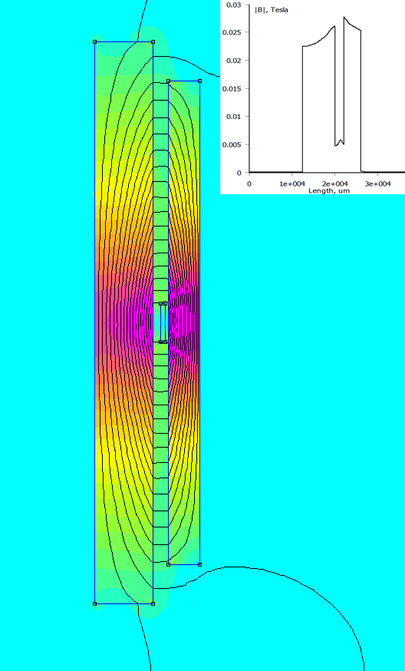
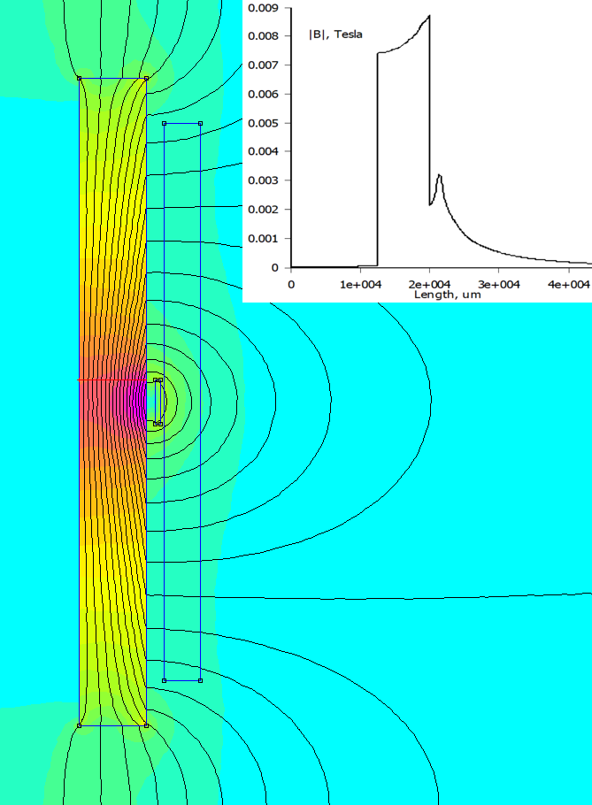
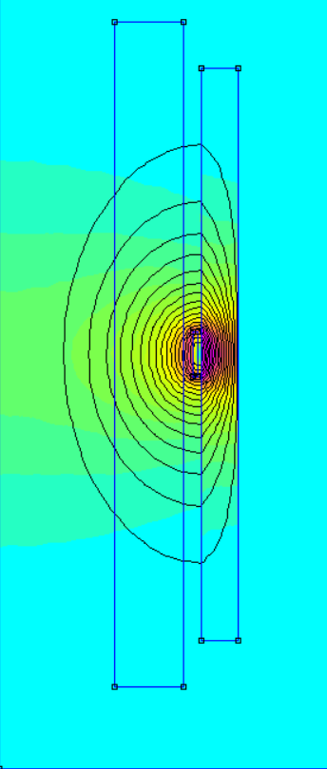
Model of spatial distribution of magnetic field
Introduction
Motivation
Principle of operation
Research gap
Problem’s statement
Work done
Stress relief wave propagation study
Efficiency coefficients
Parameters
Magnetic field of flowing charge
Generator’s magnetic field
Actual theoretical model
Theoretical results
Spatial distribution of magnetic field
Preliminary results
Work plan
Literature
Publications
Introduction
Motivation
Principle of operation
Research gap
Problem’s statement
Work done
Stress relief wave propagation study
Efficiency coefficients
Parameters
Magnetic field of flowing charge
Generator’s magnetic field
Actual theoretical model
Theoretical results
Spatial distribution of magnetic field
Preliminary results
Work plan
Literature
Publications
Ferrite inside and outside of the generator
Inner ferrite only
Outside ferrite only

Slide 23
Preliminary results
Introduction
Motivation
Principle of operation
Research gap
Problem’s statement
Work done
Stress relief wave propagation study
Efficiency coefficients
Parameters
Magnetic field of flowing charge
Generator’s magnetic field
Actual theoretical model
Theoretical results
Spatial distribution of magnetic field
Preliminary results
Work plan
Literature
Publications
Spiral generators have been created. The output characteristics of the generators were experimentally measured for various magnetic core configurations and spiral line options.
Based on experimental data, a conclusion was made about the influence of the ferrite magnetic core on the transformation ratio and efficiency of the generators.
In terms of efficiency, generators are not inferior to systems based on a Tesla transformer (usually 20-30% at the first half-wave). At the same time, the dimensions of the devices are significantly smaller. The number of parts is also less.

Slide 24
Literature review
Introduction
Motivation
Principle of operation
Research gap
Problem’s statement
Work done
Stress relief wave propagation study
Efficiency coefficients
Parameters
Magnetic field of flowing charge
Generator’s magnetic field
Actual theoretical model
Theoretical results
Spatial distribution of magnetic field
Preliminary results
Work plan
Literature
Publications
Fitch R.A., Howell V.T.S. // Patent. Appl. 1961. P. 18 136.
Fitch R.A. and Howell V.T.S., Novel Principle of Transient High-voltageGeneration. Proc. IEE, V. 111, 1964. P. 849-855.
Belkin N.V., Zharkova A.Ya. A.s. 149494 USSR, Class 21d2, 49. Pulse transformer. Declared 09/06/1961 for No. 744249/26-9. Bulletin of inventions No. 16, 1962.
Palchikov E.I. Spiral high-voltage pulse generator. Patent application, priority No. 2021120420 A dated 07/09/2021, IPC – H05G 1/24, publ. 01/09/2023 Bulletin. No1. https://www1.fips.ru/ofpstorage/Doc/IZPM/RUNWA/000/002/021/120/420/ A_20230109_2021120420/document.pdf
Mesyats G.A., Nasibov A.S., Kremnev V.V. Formation of nanosecond high voltage pulses, Moscow, 1970. pp. 70-73.
Golden et al. United States Patent. Patent number 5,442,677. Date of patent aug. 15, 1995.
Rühl F., Herziger J. Analysis of a spiral oscillator. Instruments for Scientific Research, 11, 1980. – pp. 103-110.F. Ruhl and G. Herziger. Analysis of the spiral generator. Rev. Sci. Instrum. 51(11), Nov.1980. P. 1541-1547.
Bichenkov E.I., Bashkatov T.Yu., Palchikov E.I., Ryabchun A.M. On refining the theoretical model for a high-voltage spiral generator. ZhTF, 2007, volume 77, issue 12, p. 66-72.
Palchikov E.I., Ryabchun A.M., Krasnikov IY. Modified high voltage spiral generator to power a pulsed X-ray machine. ZhTF. T. 82 Issue. 2, p. 136-146. 2012
Wasserman S.B. Tesla transformer in high-voltage charged particle accelerators: Novosibirsk. 1979 (Prev. / INP SB AS USSR No. 77 - 110. 42 p.)29
Palchikov E.I. X-ray equipment and techniques for diagnosing dynamic processes in multiphase media: Dissertation for the degree of Doctor of Technical Sciences. Novosibirsk 2009. 353 pp., 24 tables, 166 figs. Bible 228 names

Slide 25
Publications
Introduction
Motivation
Principle of operation
Research gap
Problem’s statement
Work done
Stress relief wave propagation study
Efficiency coefficients
Parameters
Magnetic field of flowing charge
Generator’s magnetic field
Actual theoretical model
Theoretical results
Spatial distribution of magnetic field
Preliminary results
Work plan
Literature
Publications
Paraskun A.G. Magnetic field configuration of spiral high-voltage pulse generator with meander-shaped busbars. The XXVII International Scientific Conference of Young Scientists and Specialists (AYSS-2023), JINR, Dubna (Eng.)
Paraskun A.G. Spiral high-voltage pulse generator with busbars profiled in the form of a meander. MNSK-2023. Section “Continuum Physics”. April 17 – 26 2023 Novosibirsk: NSU. ISBN 978-5-4437-1442-4. DOI 10.25205/978-5-4437-1442-4 (Rus.)
Paraskun A.G., Palchikov E.I., Dolgikh A.V., Samoilenko M.S. Portable ballistic stand with multi-angle X-ray and optical registration. VII All-Russian Scientific and Practical Conference of Young Scientists and Specialists “Materials and Technologies of the 21st Century. Biysk. (Rus.)
Palchikov E.I., Ryabchun A.M., Paraskun A.G. Spiral high-voltage pulse generator with inductive and capacitive parts separated in space. All-Russian conference “Physics of Explosion: Theory, Experiment, Applications”, September 18-21, 2023, IGIL SB RAS. Novosibirsk, Russia. Abstracts of reports. pp. 203-204. (Rus.)
Palchikov E.I., Ryabchun A.M., Paraskun A.G. Spiral high-voltage pulse generator with inductive and capacitive parts separated in space. Article in PMTF. Reviewed. (Rus.)
Dolgikh A.V., Palchikov E.I., Paraskun A.G., Samoilenko M.S. Portable ballistic stand with multi-angle X-ray and optical registration. // South Siberian Scientific Bulletin. – 2023. – No. 5 (51) October. - With. 128-131. (Rus.)

