Slide 1
AYSS-2024 Welcome remarks
JINR
Association of Young Scientists and Specialists
R. Kozhina and A. Madumarov
on behalf of the Organizing Committee

Slide 2
XXVIII International Scientific Conference of Young Scientists and Specialists (AYSS-2024)
October 28 - November 1.
The conference starts at 9:30 every day.
11 plenary sessions (2 each day from Tuesday).
Parallel sessions with young scientists’ presentations after or right before lunch. Each session is opened with a half an hour talk from a young but accomplished scientist as an example for his colleagues.
The poster session is on Monday (it is possible to hang your posters from 2 pm today).
Please upload your presentations to Indico timely!
Evening programme on Tuesday and Wednesday.

Slide 3
AYSS-2024 Participants
262 on-site participants: 138 external + 124 JINR young scientists.
244 presentations: 200 oral + 44 posters.
17 countries: Azerbaijan, Belarus, China, Cuba, Czech, Egypt, Georgia, India, Kazakhstan, Russia, Mongolia, Netherlands, Romania, Serbia, South Africa, Uzbekistan, Vietnam.
53 scientific institutes and universities + 7 JINR laboratories.
Participants group photo: TODAY, Conference Hall (MLIT, 5th floor), right after the lecture of the director of JINR, 10:20 am.

Slide 4
AYSS-2024 Programme Committee
Co-chairman: Sergei Nedelko
Co-chairman: Dmitry Kamanin
Co-chairman: Grigory Shirkov (JINR Directorate)
Aleksey Guskov (DLNP)
Olga Derenovskaya (MLIT)
Grzegorz Kaminski (FLNR)
Vladimir Rachkov (FLNR)
Dmitry Peshekhonov (VBLHEP)
Sergey Kulikov (FLNP)
Ekaterina Lesovaya (LRB)
Timur Shneidman (BLTP)

Slide 5
AYSS-2024 Organizing Committee
Co-chairman: Regina Kozhina (LRB)
Co-chairman: Alexander Madumarov (FLNR)
Dina Badreeva (MLIT)
Dinara Bulatova (JINR Press Office)
Ksenia Ilina (VBLHEP)
Ekaterina Kolosova (CPED)
Igor Pelevanyuk (MLIT)
Yulia Polyakova (ICD)
Anna Rybakova (UC)
Daria Shamina (LRB)
Veronika Smirnova (FLNP)
Rostislav Sotenskii (DLNP)
Alexey Vorontsov (MLIT)

Slide 6
AYSS-2024 Organizing Committee
13 members:
11 are the JINR AYSS members;
4 are the members of the JINR AYSS Council (2024/2025).
The Organizing Committee Office is upstairs (MLIT, 6th floor).
A special feature of the OC members is a badge with a red ribbon.
For participants from Russian organizations:
Alexander Madumarov
+7 (985) 112-39-32
al.madumarov@jinr.ru
For participants from foreign organizations:
Yulia Polyakova
+7 (905) 754-34-77
polyakova@jinr.ru

Slide 7
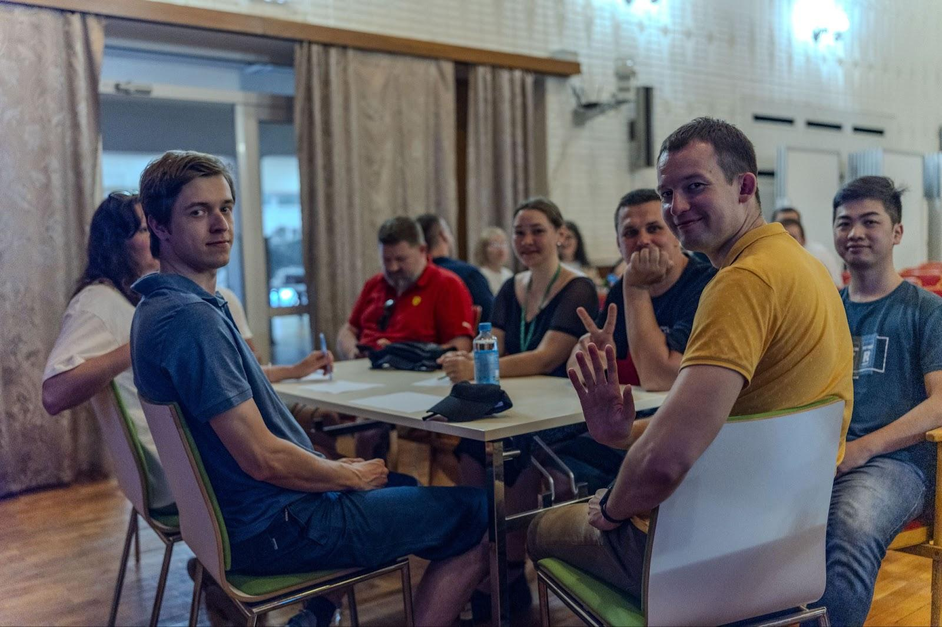
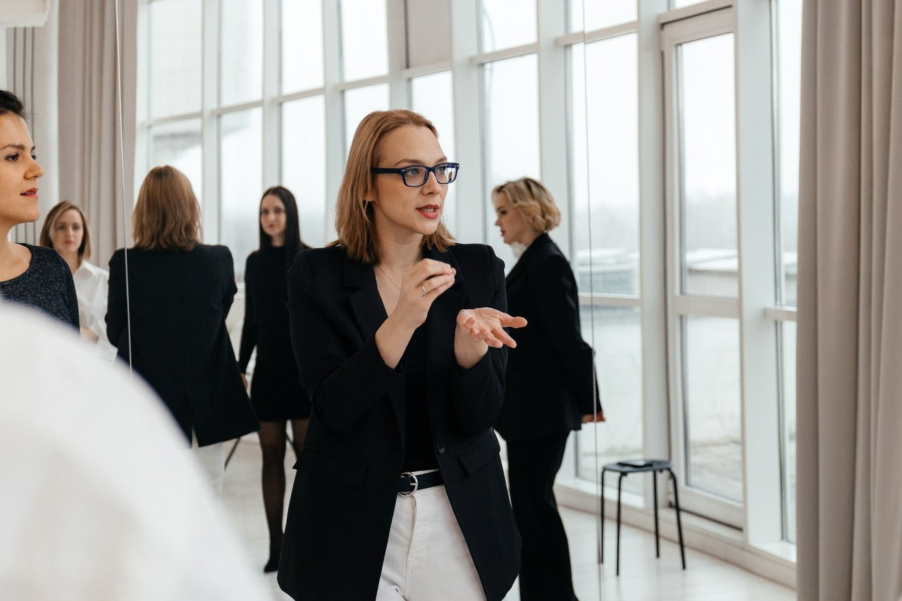
Social & Evening Events
Tuesday: the JINR Film Union/Chess tournament.
Wednesday: QUIZ/Lecture by Ekaterina Ovchinnikova.

Slide 8
Social & Evening Events
Monday: 18:30 – poster session & welcome drinks
at the JINR International Conference Centre.
Tuesday:
18:30 – the JINR Film Union at Blokhintsev library;
18:30 – Chess tournament at JINR Club of Scientists
Wednesday:
19:00 – QUIZ at Blokhintsev library
18:30 – Lecture by Ekaterina Ovchinnikova at JINR Club of Scientists;
Thursday: 19:00 – conference dinner at Baryon with live music.

Slide 9
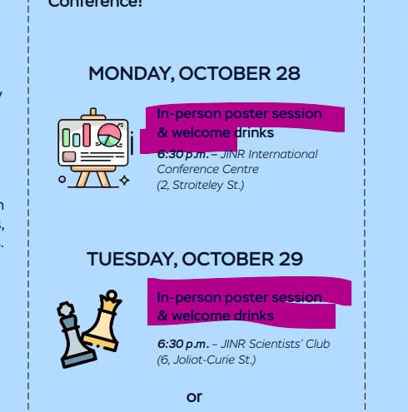
Important organizational remarks!
Due to the queue situation at the entrance to JINR
we encourage you to come earlier to the morning sessions.
Turn your attention to the booklet in your starter pack, please!
18:30 – Chess tournament at JINR Club of Scientists

Slide 10
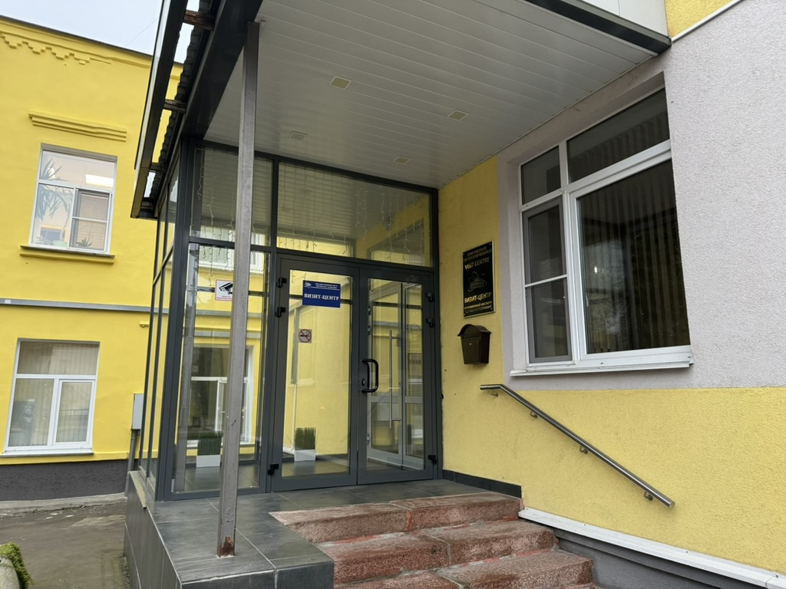
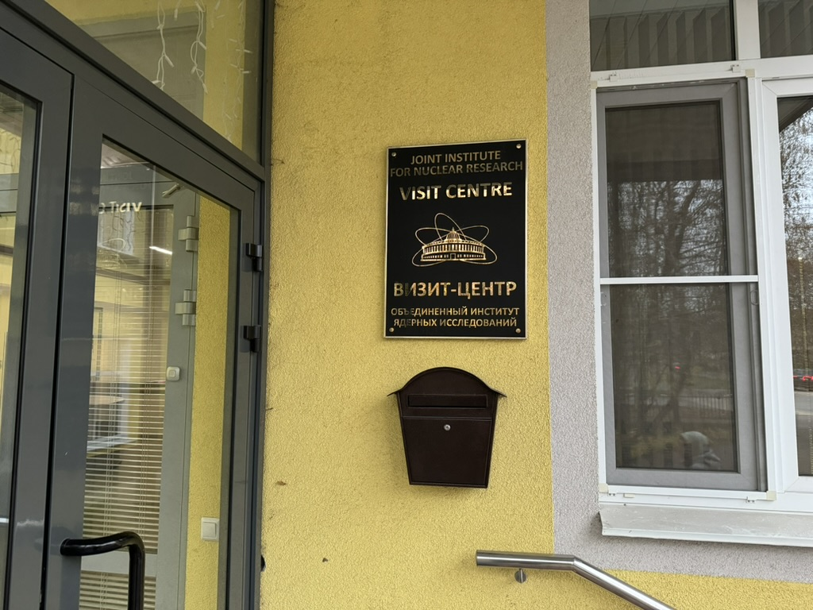
Important organizational remarks!
We created a new section Proceedings Submission yesterday on indico AYSS-2024 site, which describes sending of the abstracts procedure.
Please, return your entrance cards to the Visitor Centre, Molodyozhnaya Street, 5)

Slide 11
Usual Awarding system: The best talk at parallel sessions
Parallel sessions:
Theoretical Physics
Mathematical Modelling and Computational Physics
High Energy Physics
Particle Accelerators and Nuclear Reactors
Experimental Nuclear Physics
Information Technology
Condensed Matter Physics
Applied Research
Life Sciences
As usual, we will award the best talks at parallel sessions chosen by respectful juri.

Slide 12
Path towards collaboration
This conference is a first step on the way to creating interdisciplinary, inter-institutional collaborations.
As part of the conference, participants can take a closer look at the place where their theses can be written and start looking for scientific supervisors or places to work.
If you are interested in some JINR group or topic, please reach out to the organizers; we’ll get you in contact with the corresponding people to have a personal excursion and a conversation on possible cooperation.

Slide 13
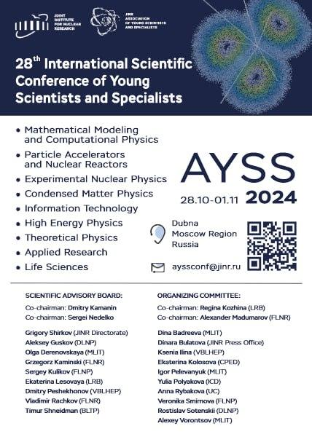
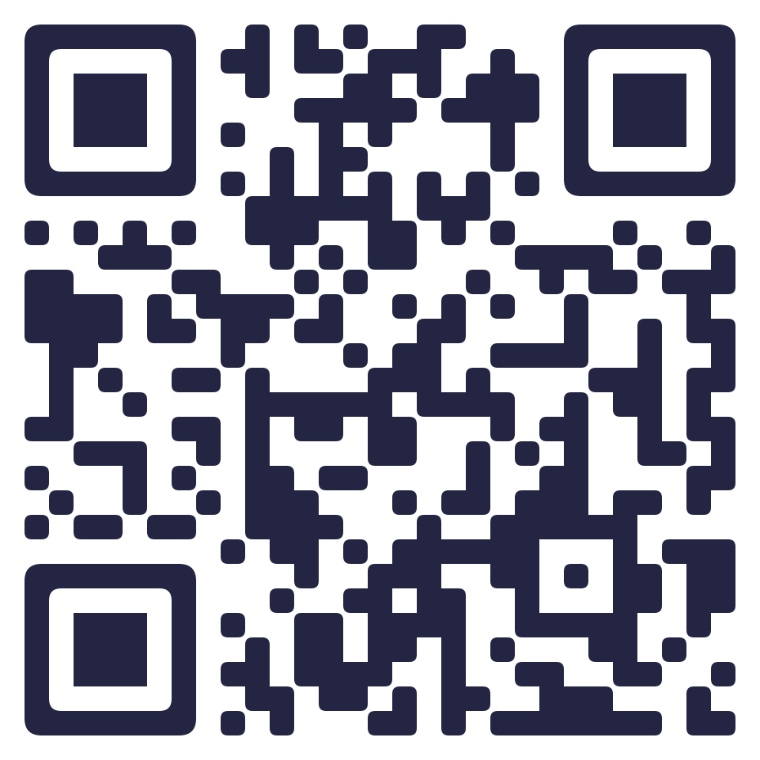
Contact info
The information bulletin you collected during registration contains important information on all locations with maps, as well as the program, contacts, lunch places, etc.
If you have issues or questions, don’t hesitate to contact the organizers.
And join the conference
participants Telegram chat
for prompt communication!

Slide 14
Gratitude for the help to organize AYSS-2024 Сonference
Meshcheryakov Laboratory of Information Technologies, University Centre (conference rooms)
PC, all the laboratories, and JINR Directorate (financial support of the participants)
JINR press office
The International Conference Centre
JINR Scientist’s club
Blokhintsev Library

Slide 15
The organizers wish all of you a fruitful and memorable conference!
AYSS-2024 Chat
JINR AYSS Channel
JINR AYSS Group

