Slide 1
Investigation of the cathode materials for metal-ion batteries
N.Yu. Samoylova
Frank Laboratory of Neutron Physics, Joint Institute for Nuclear Research, Dubna, Russia
rny03@nf.jinr.ru

Slide 2
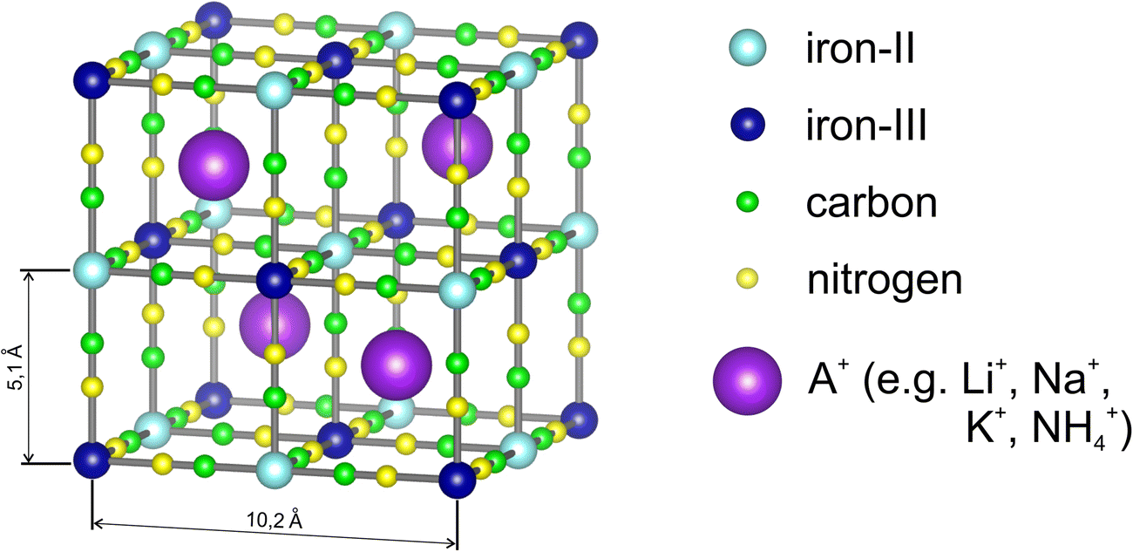
The Prussian blue systems
Structure of Prussian blue according to the Keggin and Miles, 1936

Slide 3
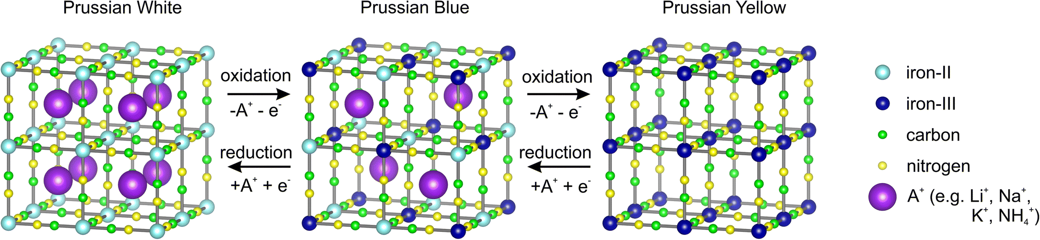
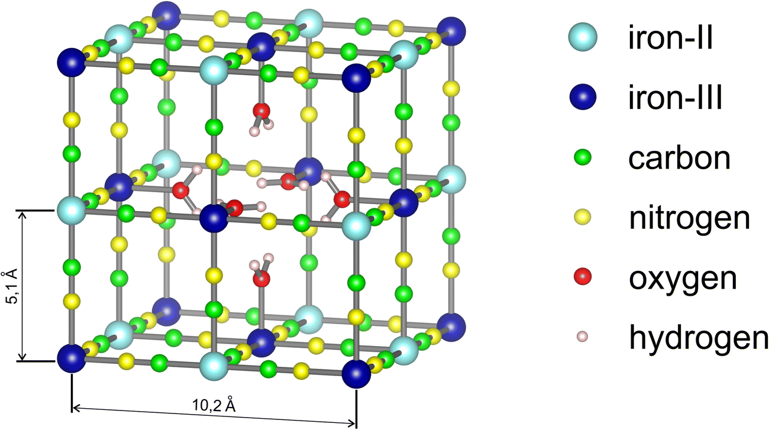
Na₂Fe^{II}[Fe^{II}(CN)₆] NaFe^{III}[Fe^{II}(CN)₆] Fe^{III}[Fe^{III}(CN)₆]
Na₂Fe[Fe(CN)₆]_{1-y∙}□_{∙y}∙mH₂O
□ - Fe(CN)₆ vacancies,
y - their number

Slide 4
The origin aim is to study:
the structural evolution of the PW material under dehydration during heating;
the effect of the electrode annealing temperature on the PW structure and structural phase transitions during sodiation/desodiation (discharge/charge) processes, as well as the electrochemical properties of the material;
the structural aspects of capacity loss during long-term cycling.

Slide 5
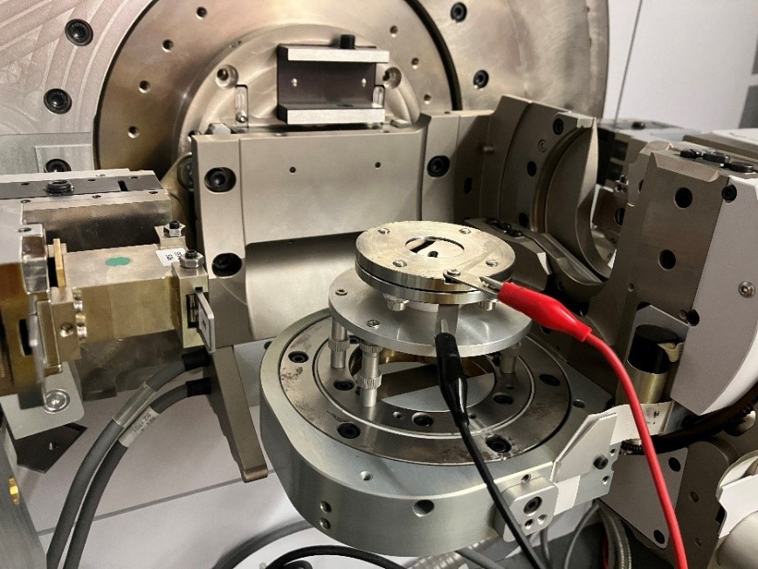
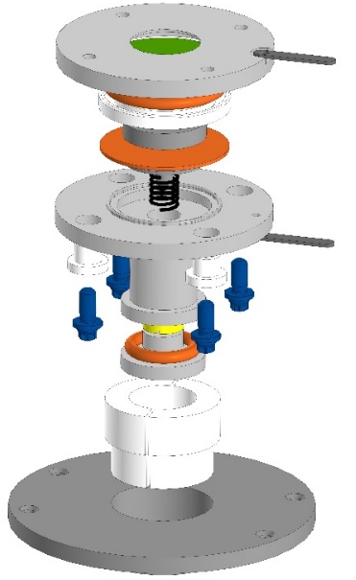
Material
Commercial Prussian White, Fennac (Altris, Uppsala)
Operando X-ray diffraction measurements
XRD electrochemical cell
XRD experiment at Empyrean PANalytical diffractometer

Slide 6
Crystal structure of Prussian White
X-ray diffraction pattern of the PW powder at room temperature fitted with Fm-3m and R-3 structures
Neutron diffraction pattern of the PW powder at room temperature fitted with
Fm-3m structure

Slide 7
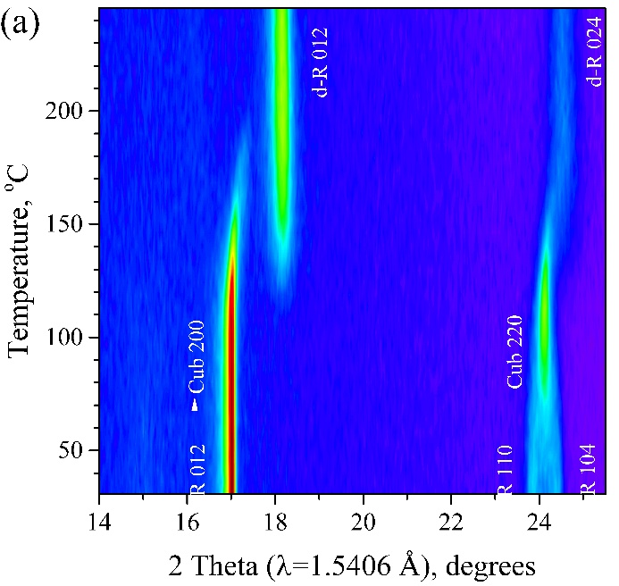
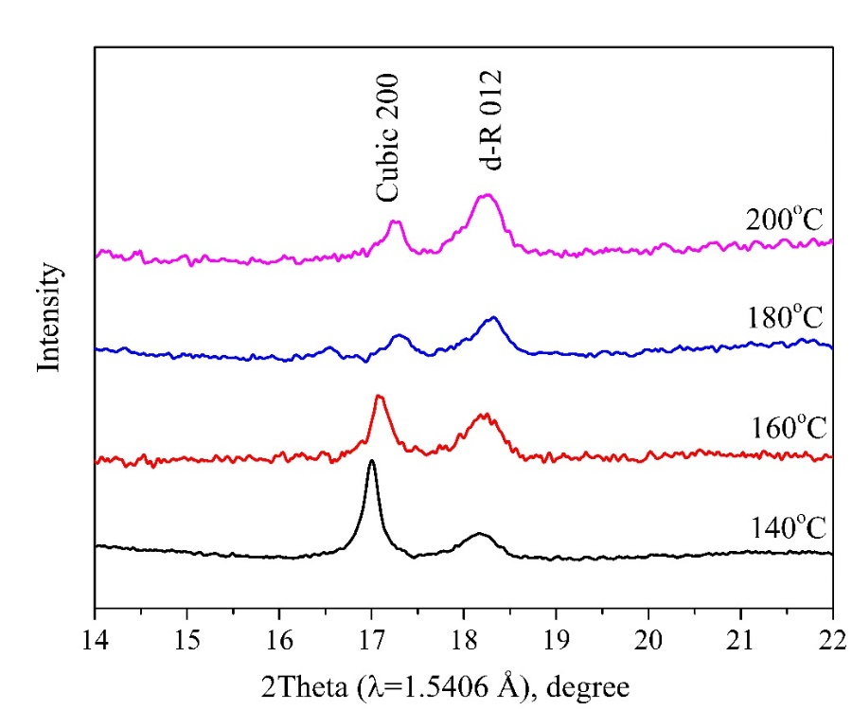
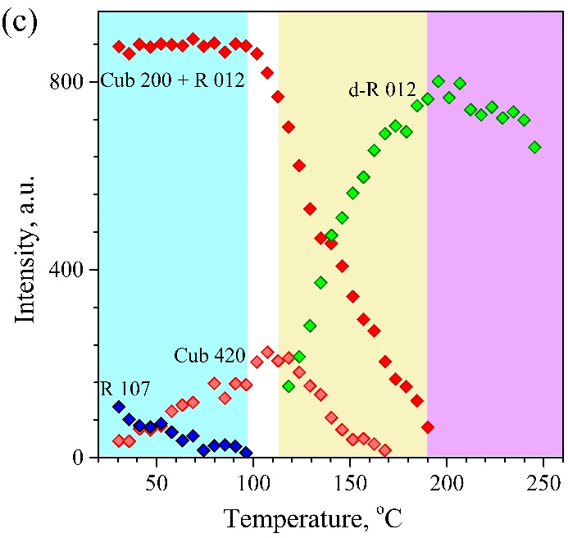
Phase transitions in the PW material during dehydration
hydrated rhombohedral (R)
(sp. gr. R-3, a = 7.4682 Å, c = 17.683 Å) →
cubic (Cub)
(sp. gr. Fm-3m, a = 10.4322 Å) →
dehydrated rhombohedral (d-R)
(sp.gr. R-3, a = 6.5395 Å , c = 18.933 Å )
N.Yu. Samoylova et al., Peculiarities of charge-discharge processes in Prussian white electrodes with different level of dehydration, J. Alloys Compd. 983 (2024) 173849.

Slide 8
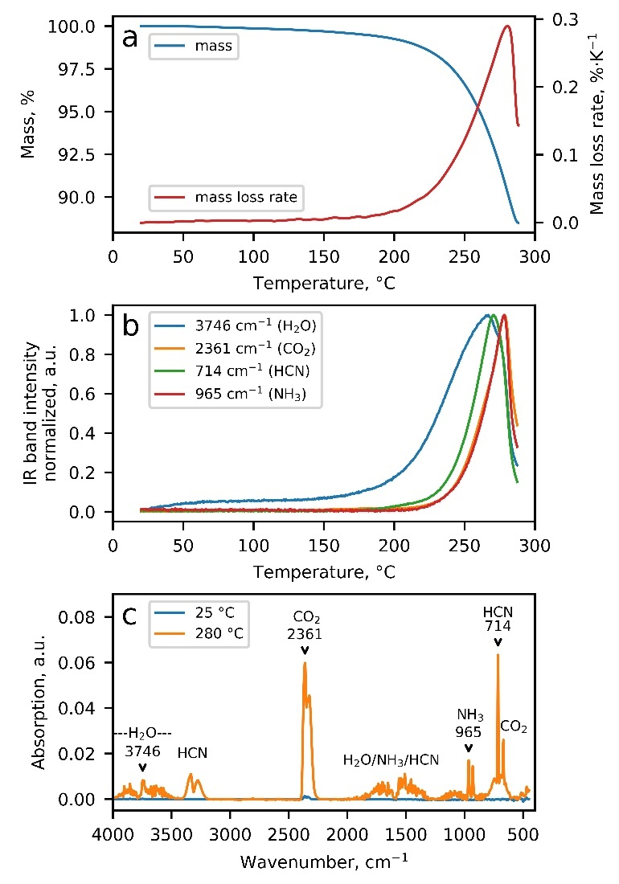
TGA curve
kinetics of gas evaporation under heating of the PW powder in N₂ atmosphere
FTIR spectra of the gaseous PW decomposition products
N.Yu. Samoylova et al., Peculiarities of charge-discharge processes in Prussian white electrodes with different level of dehydration, J. Alloys Compd. 983 (2024) 173849.

Slide 9
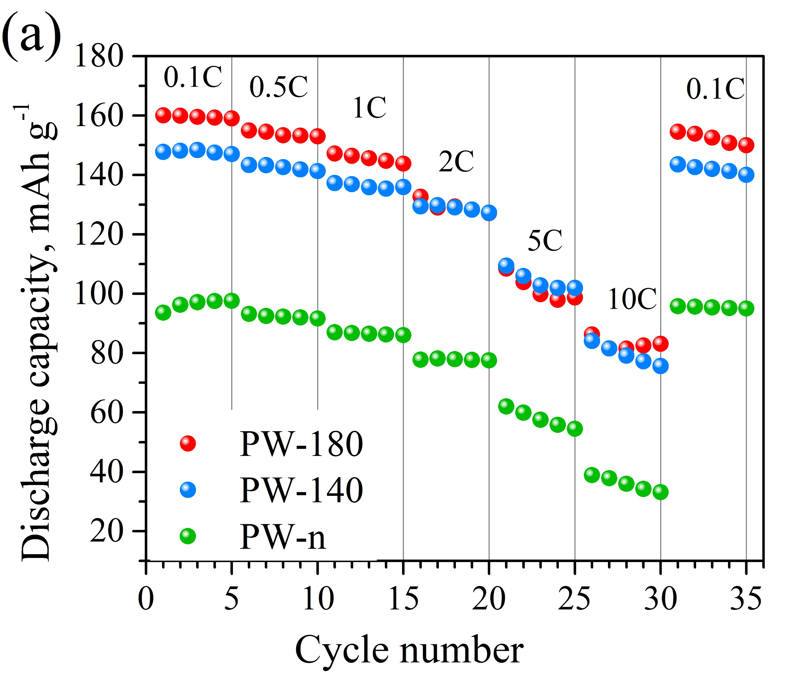
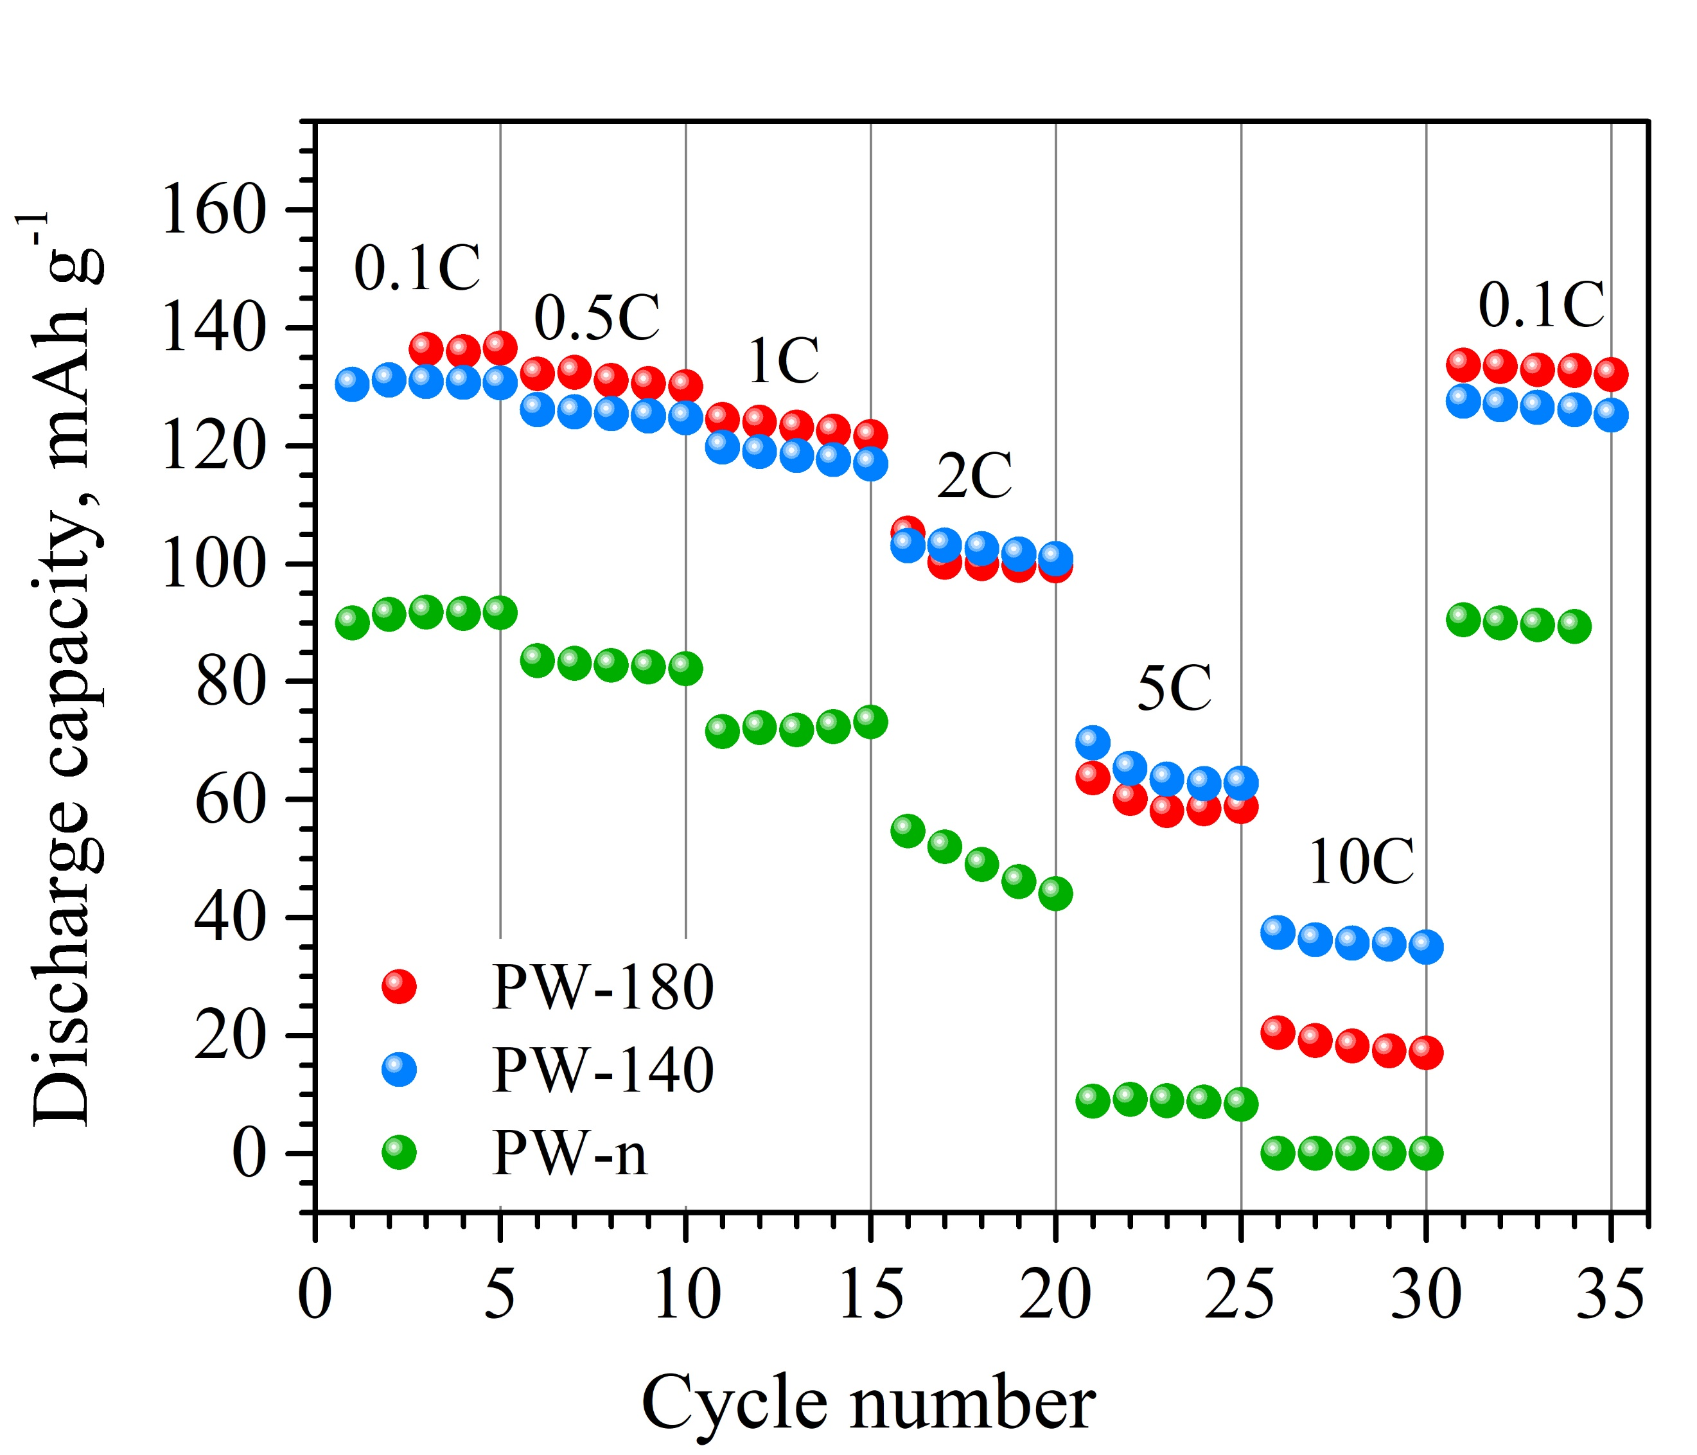
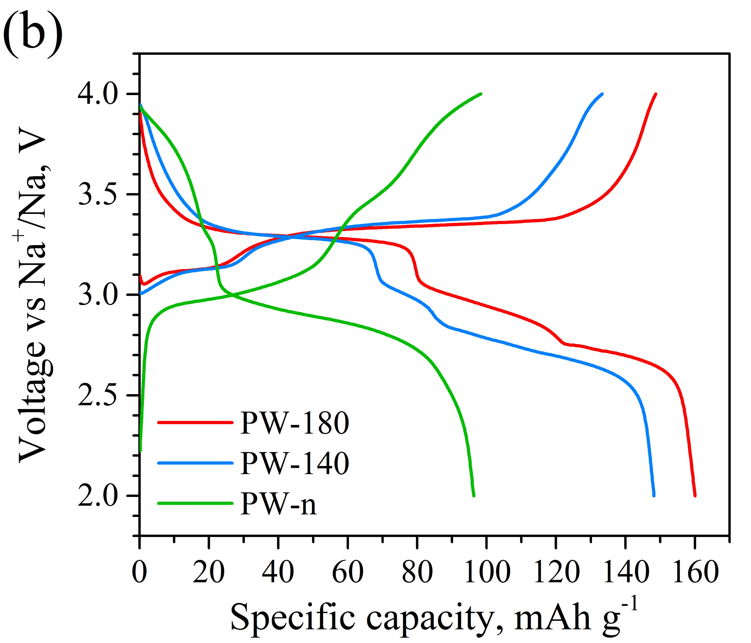
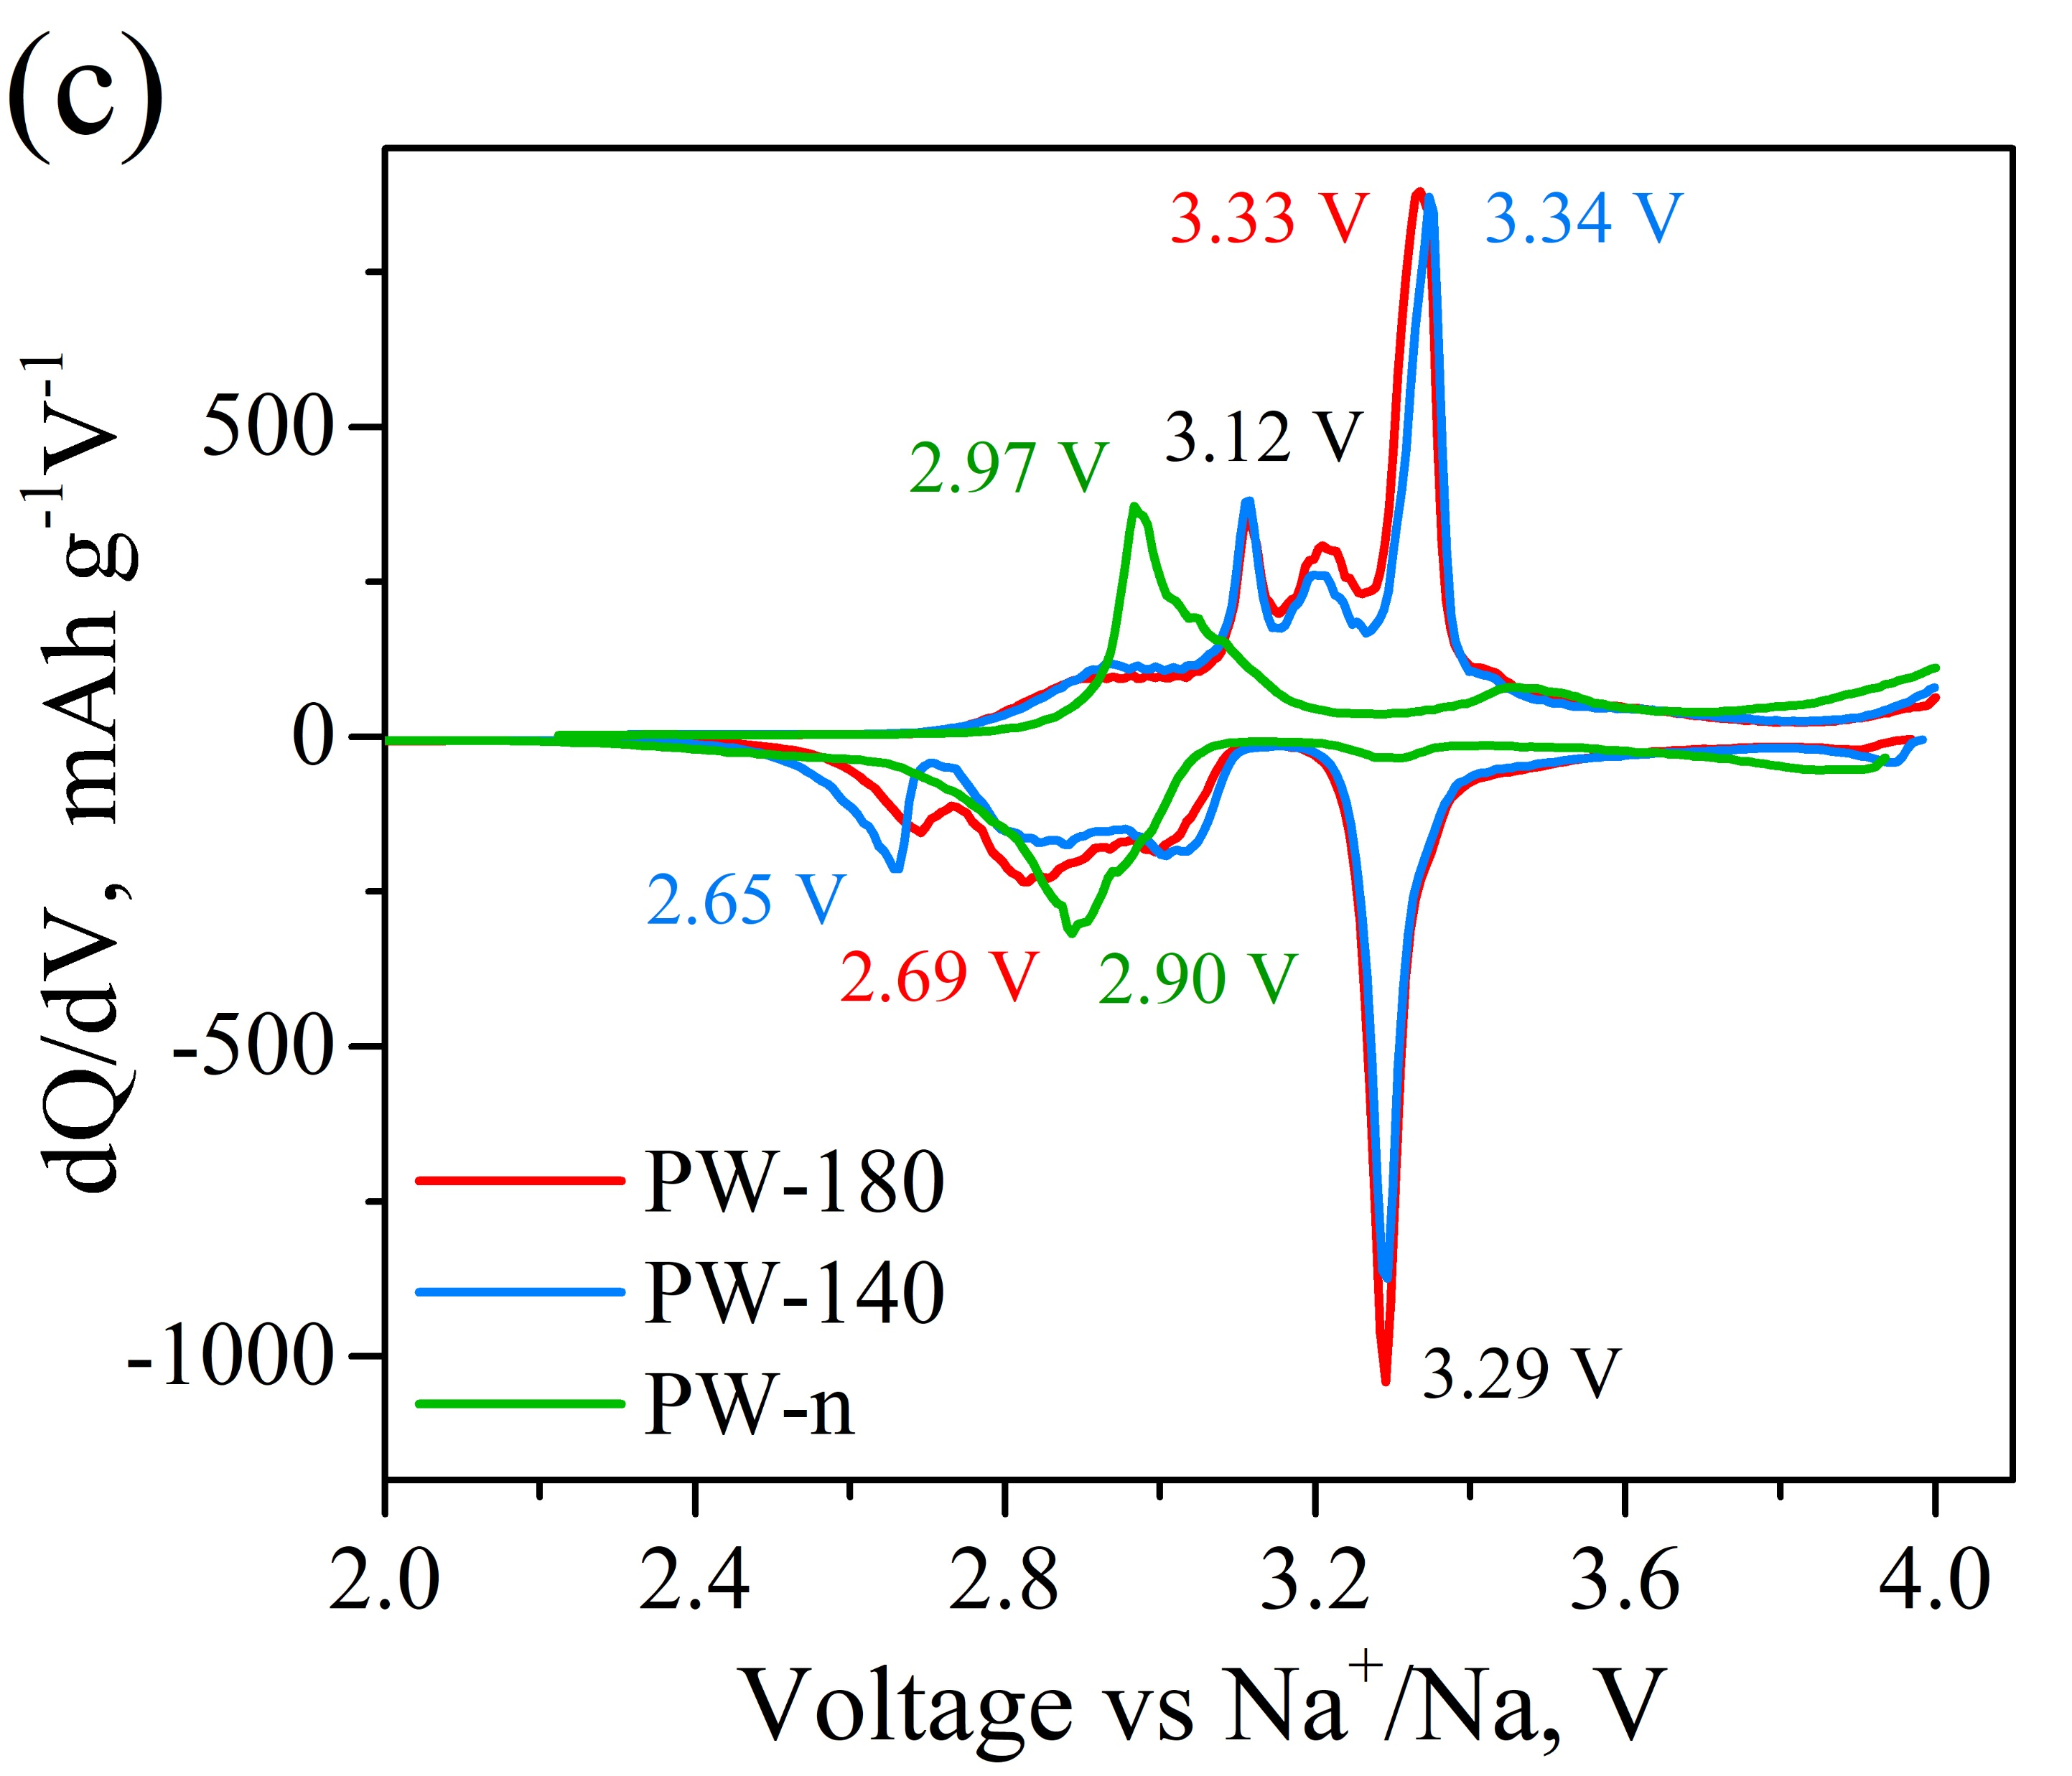
1C = 170 mAhg^{–1}
PW/Ketjenblack/PVdF is 70/15/15
PW/Ketjenblack/PVdF is 80/10/10
N.Yu. Samoylova et al., Peculiarities of charge-discharge processes in Prussian white electrodes with different level of dehydration, J. Alloys Compd. 983 (2024) 173849.

Slide 10
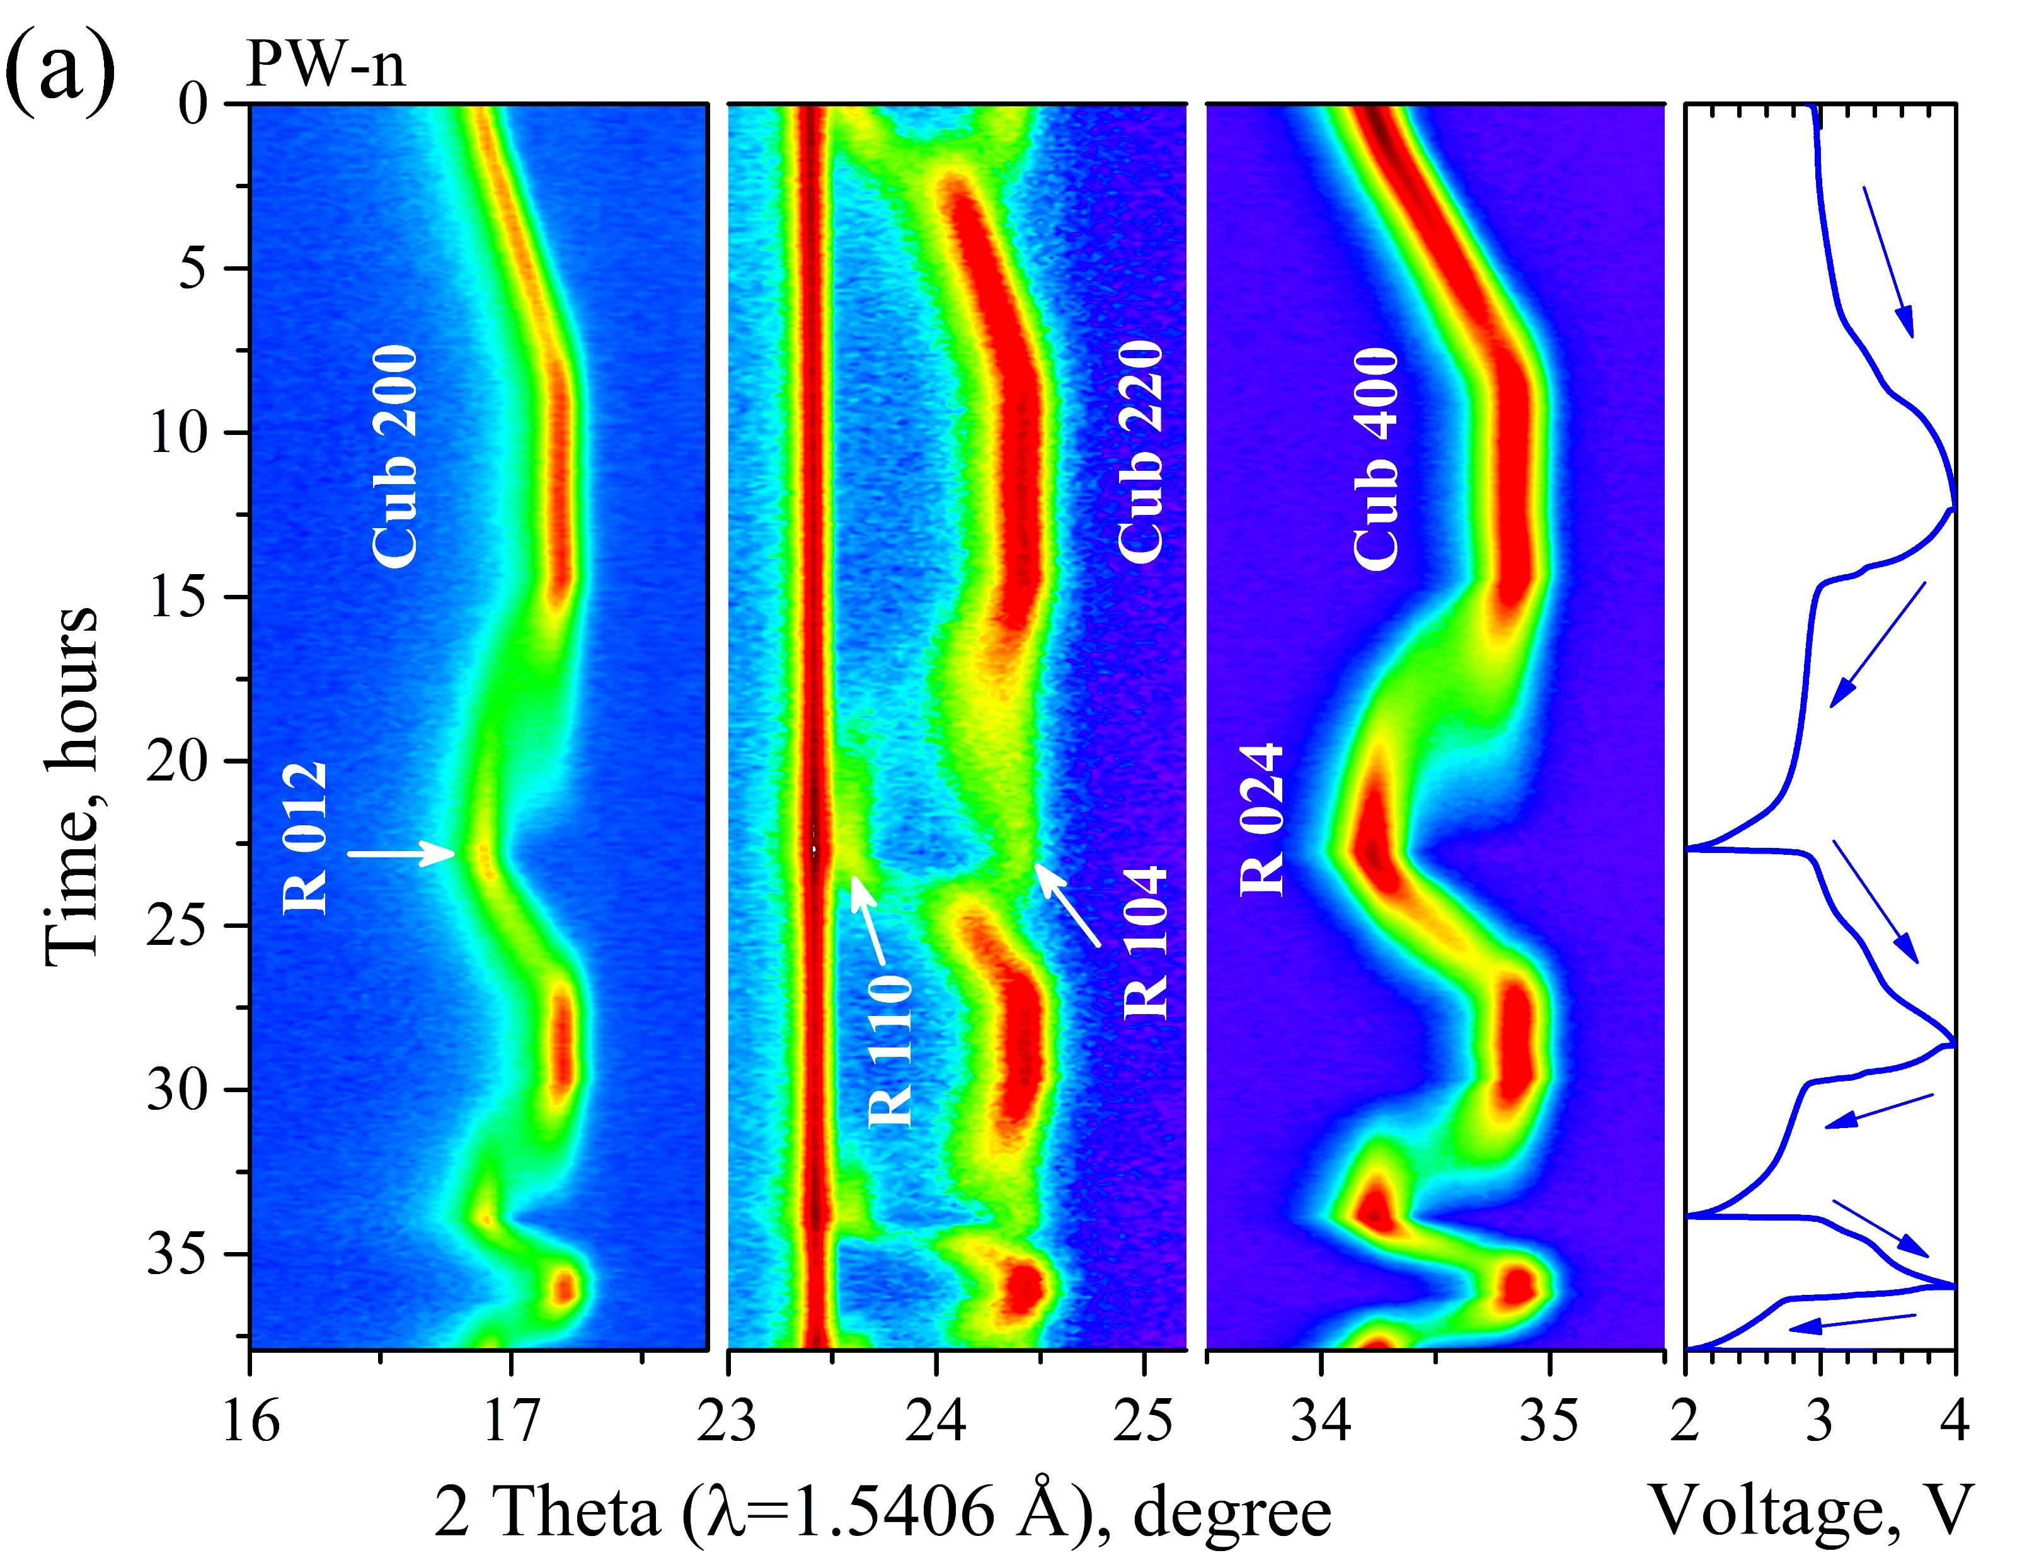
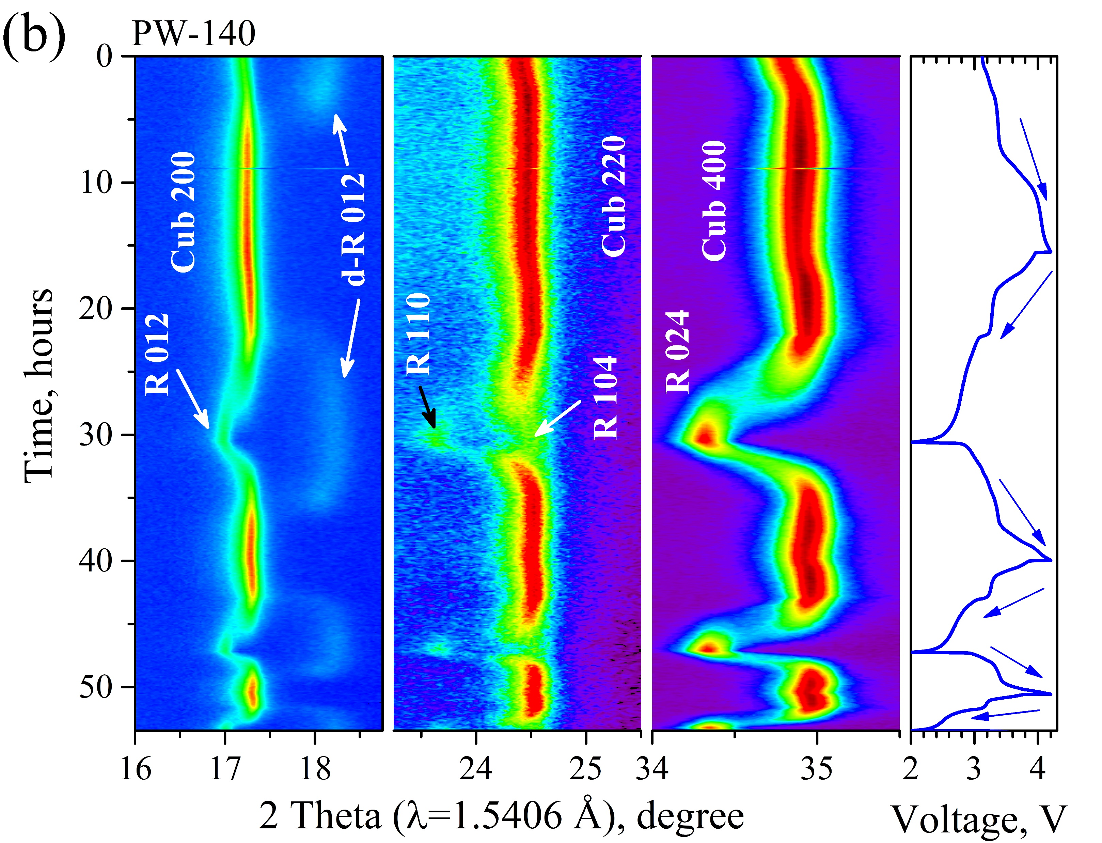
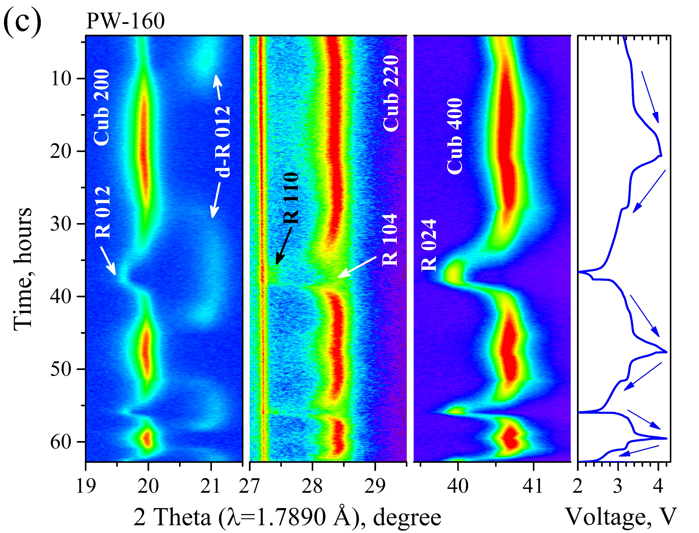
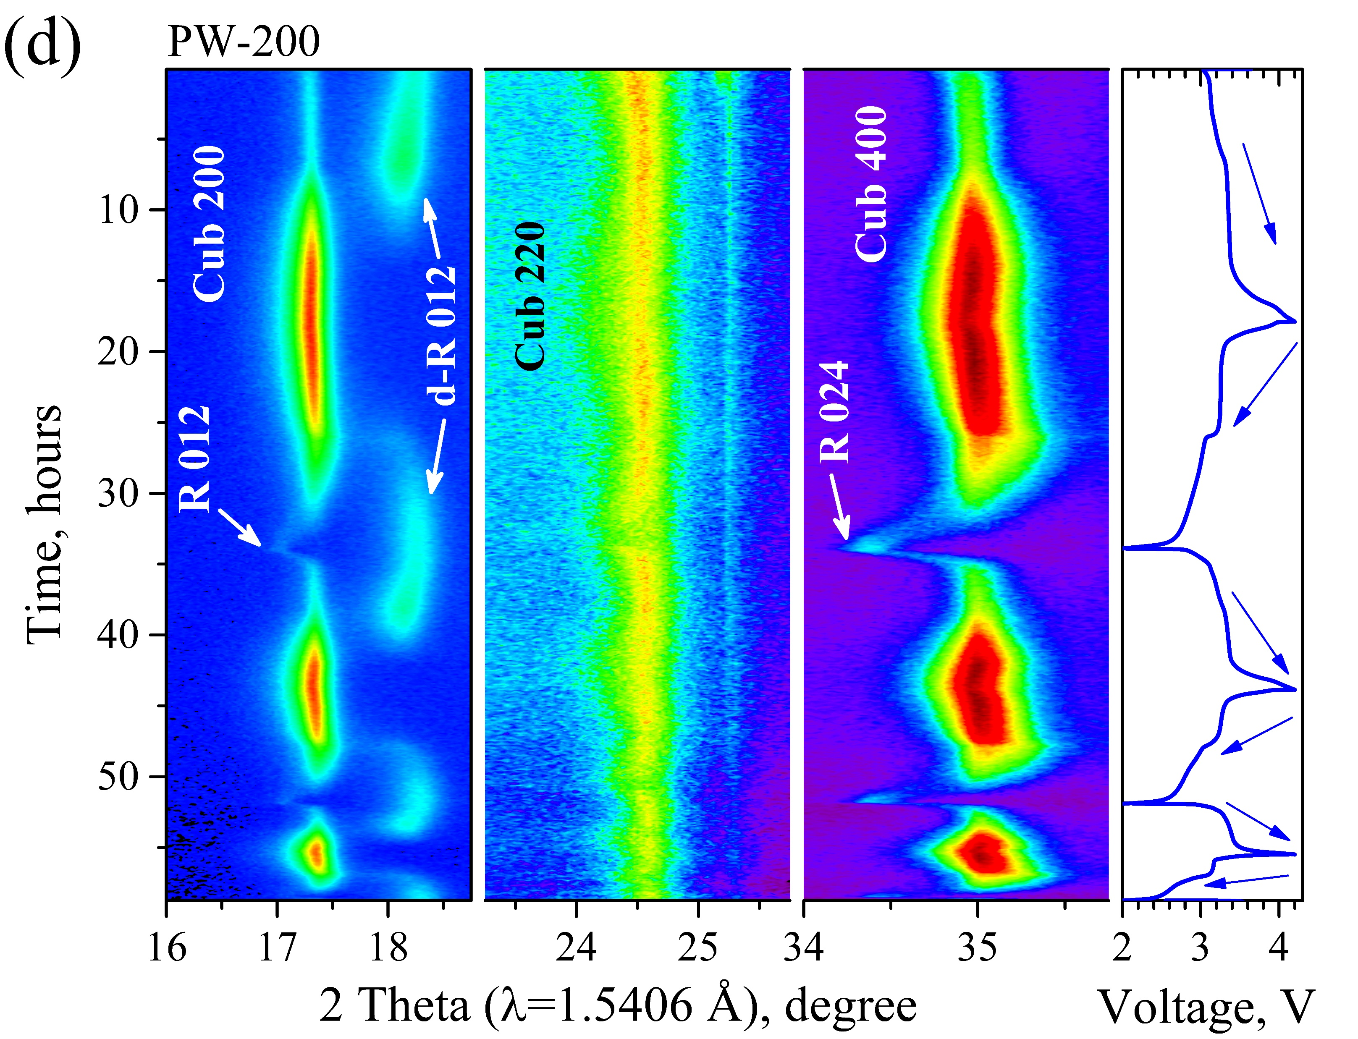
Preheating effect on the phase transitions in PW during cycling
with a current rate of 0.05C, 0.1C, 0.25C in a range between 2 and 4.2 V versus sodium

Slide 11
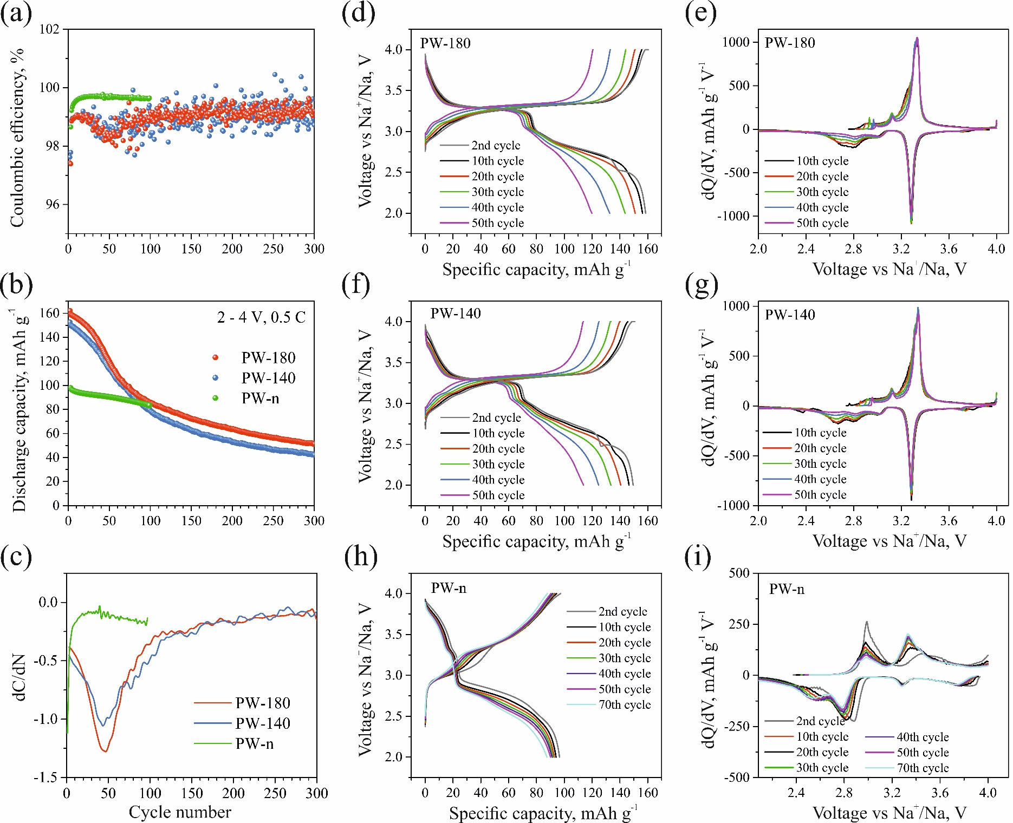

Slide 12
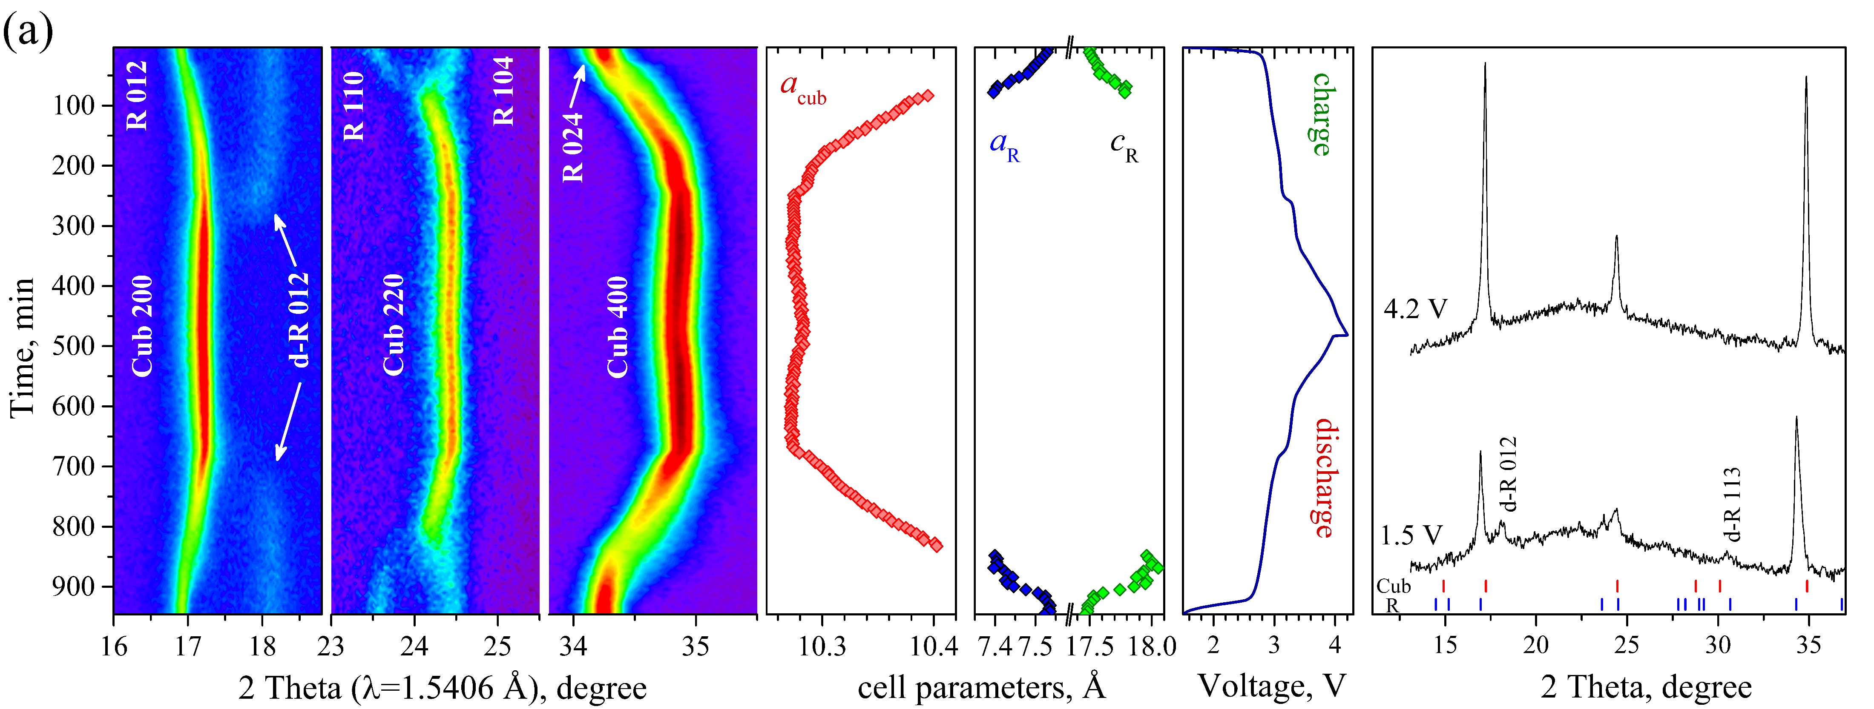
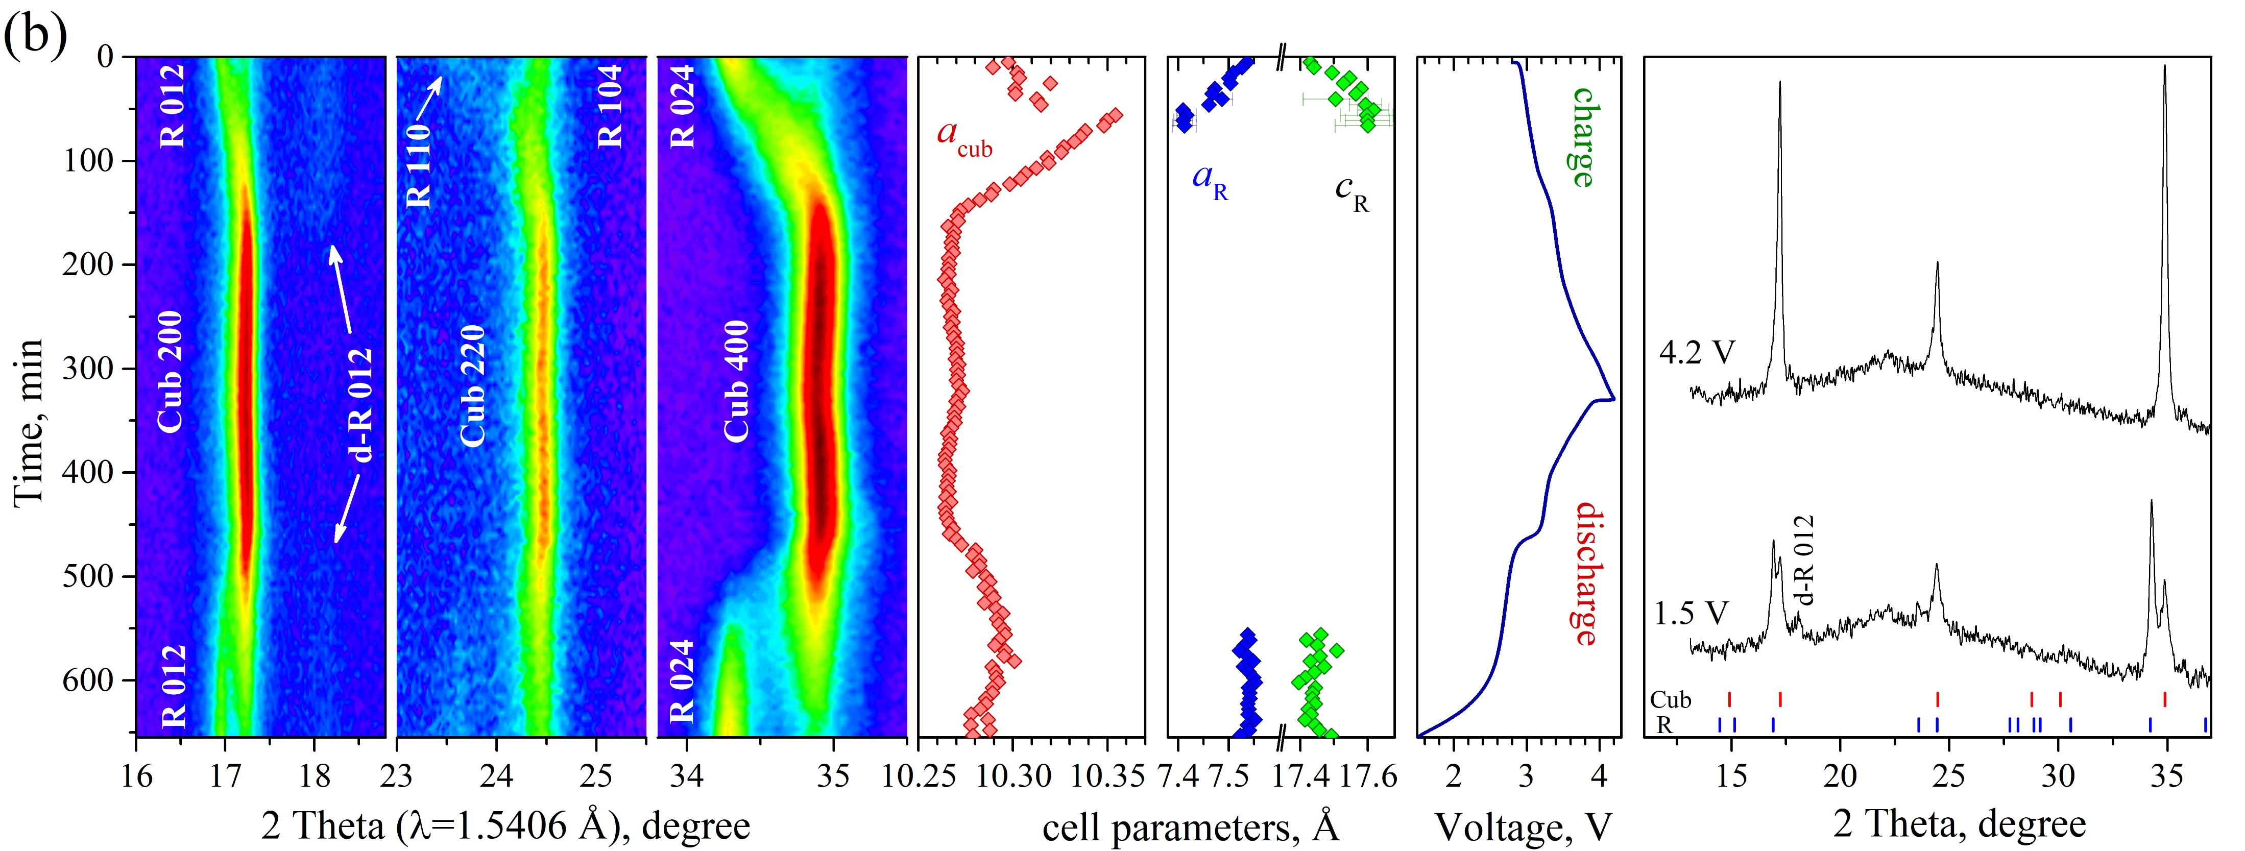
    Structural degradation of the electrodes
    PW, 140ºC
2nd cycle
rate 0.1C
after
350 cycles
rate 0.1C

Slide 13
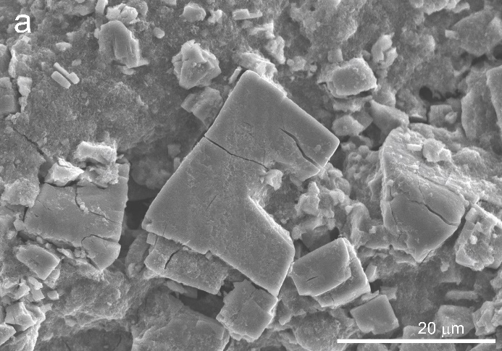
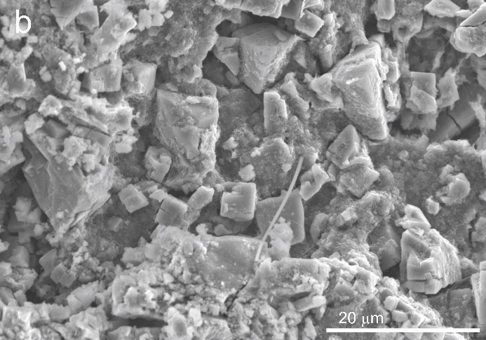
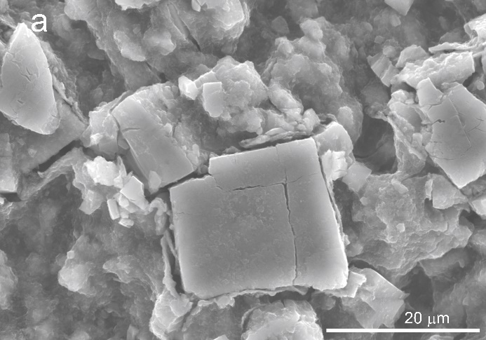
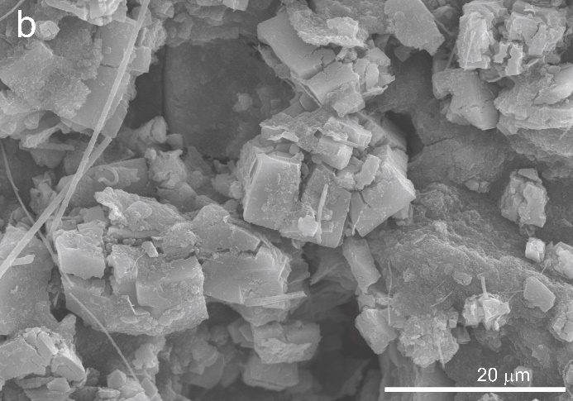
PW_140, initial state PW_140, after 350 cycles
PW_180, initial state PW_180, after 350 cycles
N.Yu. Samoylova et al., Peculiarities of charge-discharge processes in Prussian white electrodes with different level of dehydration, J. Alloys Compd. 983 (2024) 173849.

Slide 14
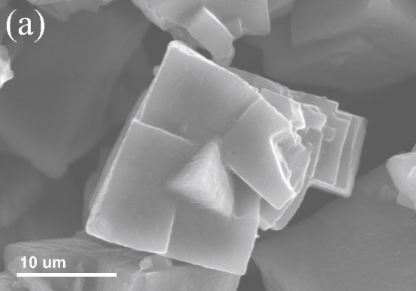
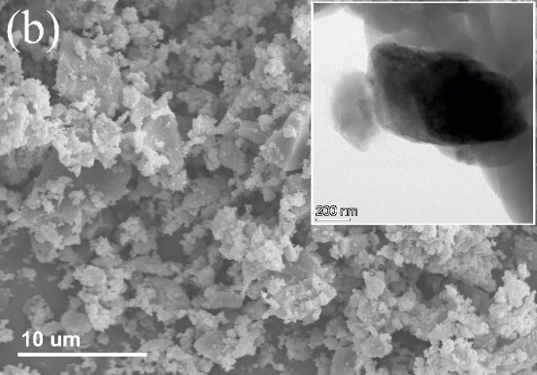
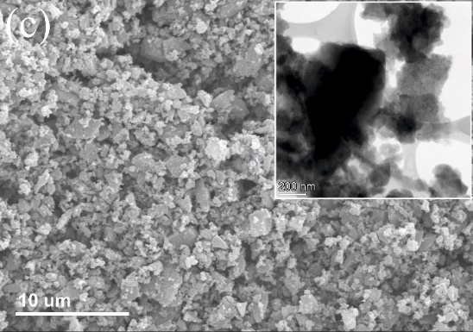
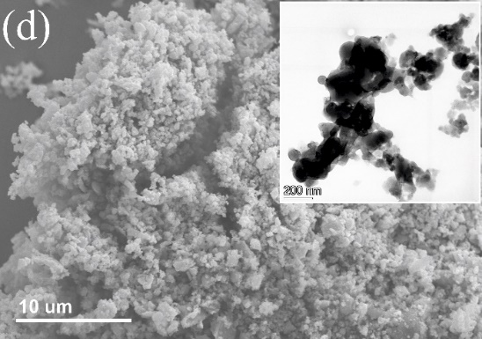
Ball milling effect on the structure and electrochemical properties of PW
1h
3h
6h
Pristine PW powder was milled (600 rpm) using a planetary ball mill during 1h, 3h and 6h

Slide 15
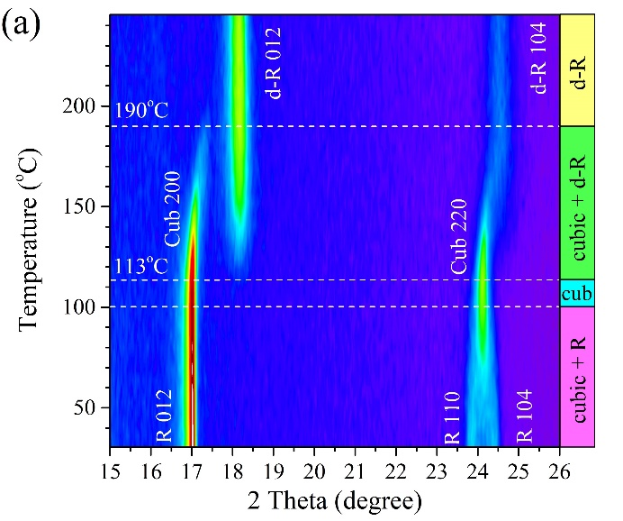
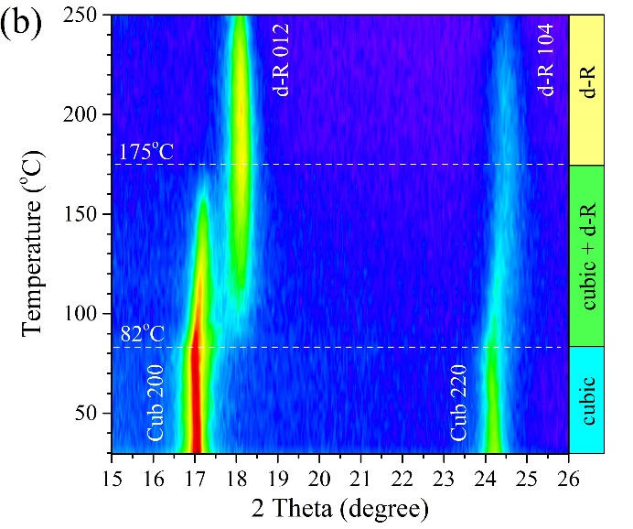
Phase transitions in the milled PW material during heating
pristine powder
6-h milled powder
Ball milling decreases the temperature of phase transitions during heating

Slide 16
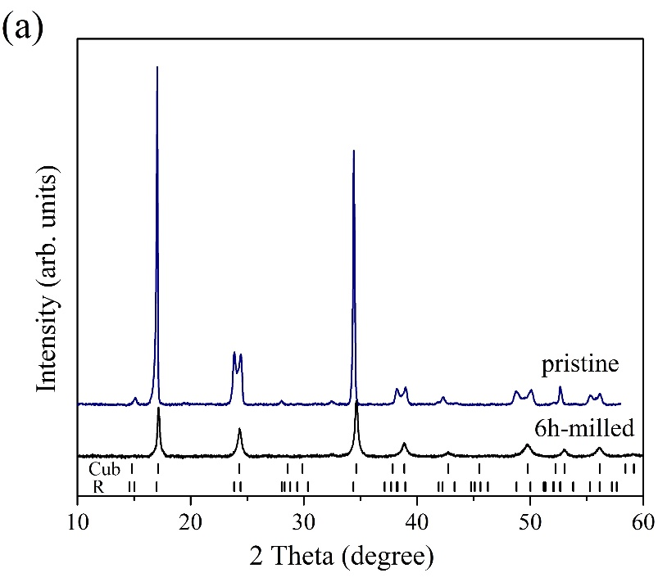
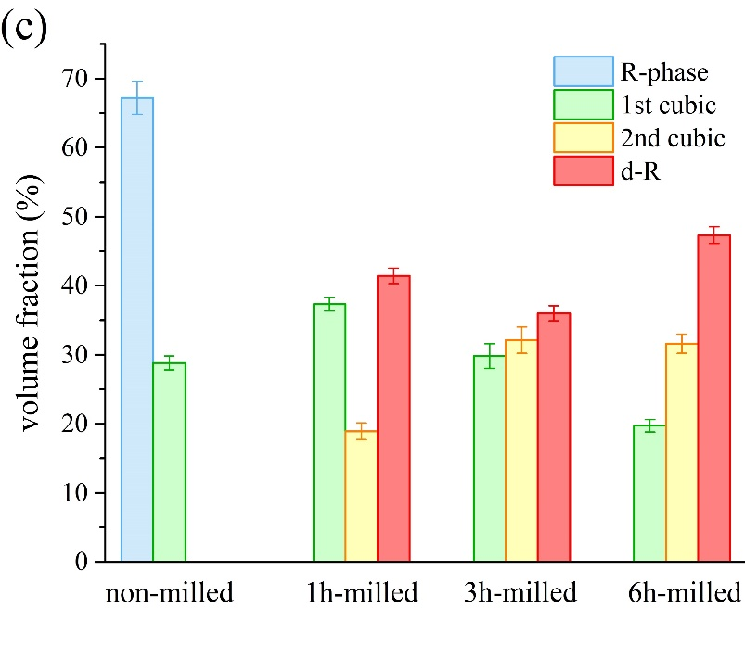
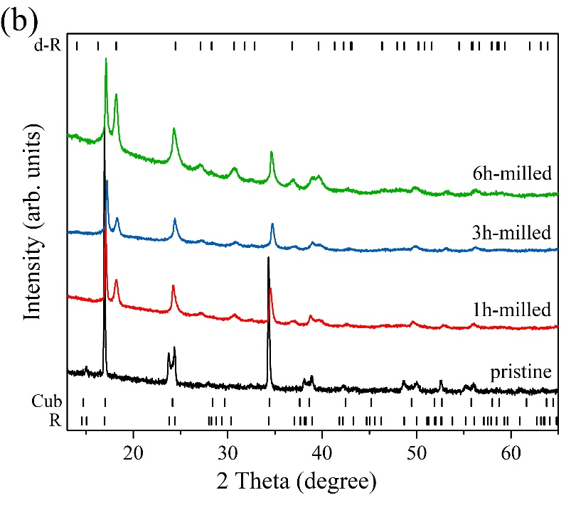
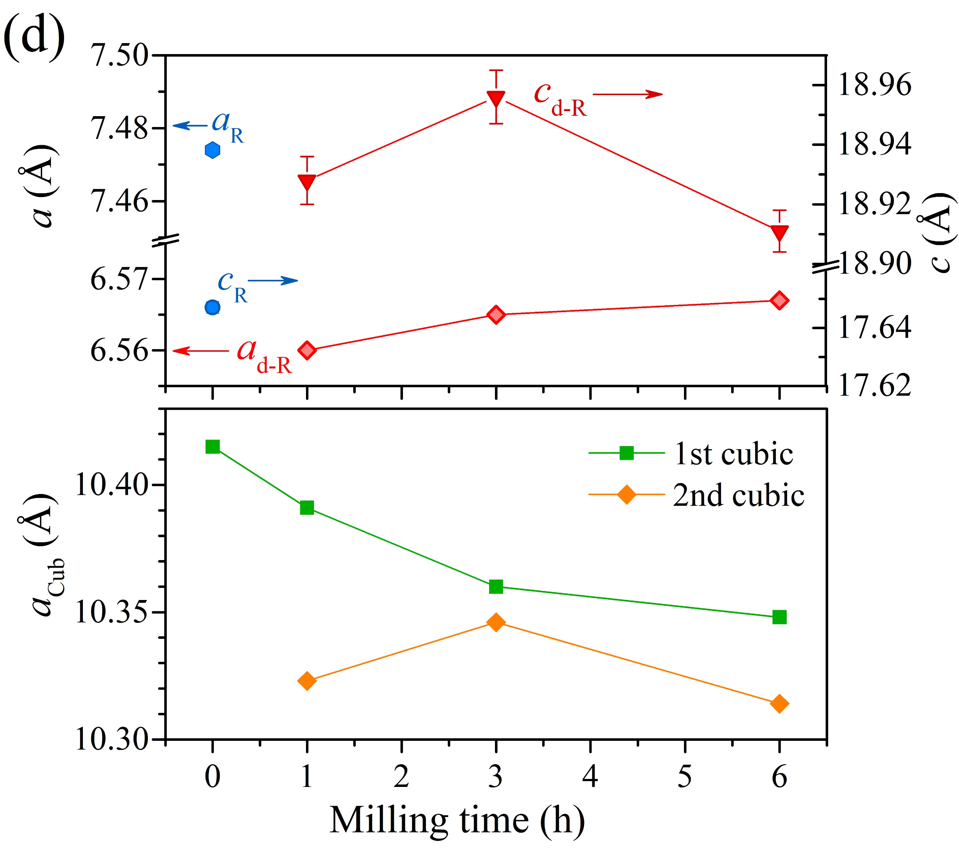

Slide 17
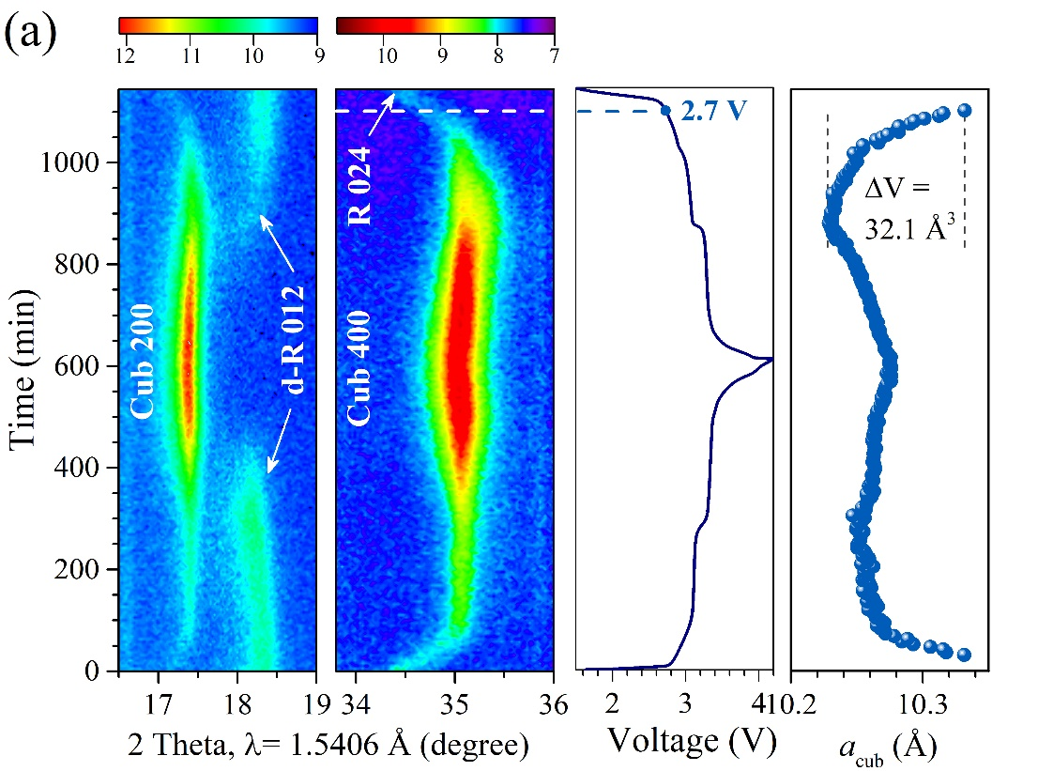
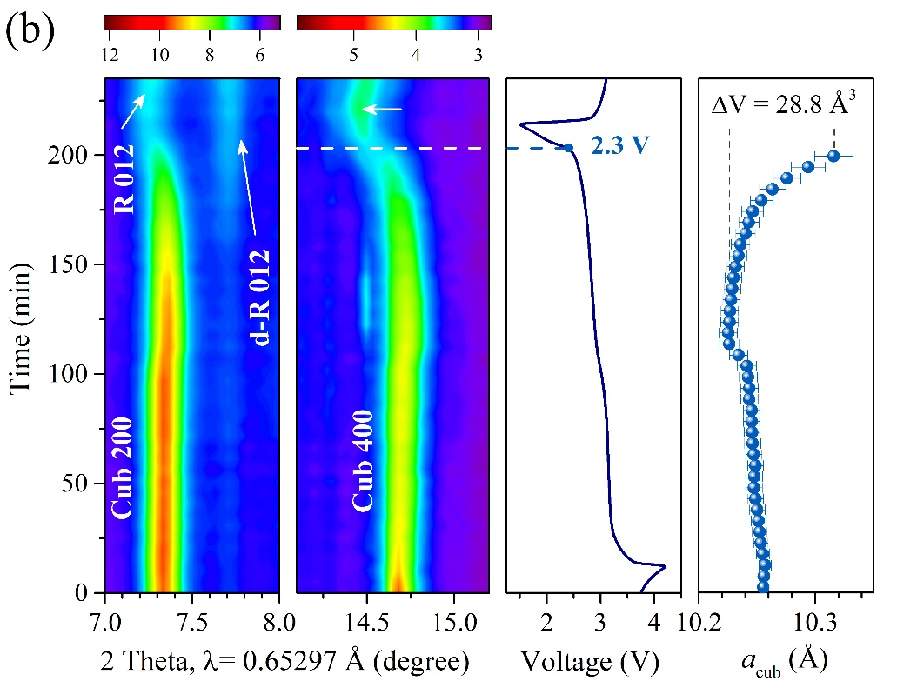
Phase transitions in the milled PW material during cycling
electrode based on pristine powder
electrode based on 6-h milled powder

Slide 18
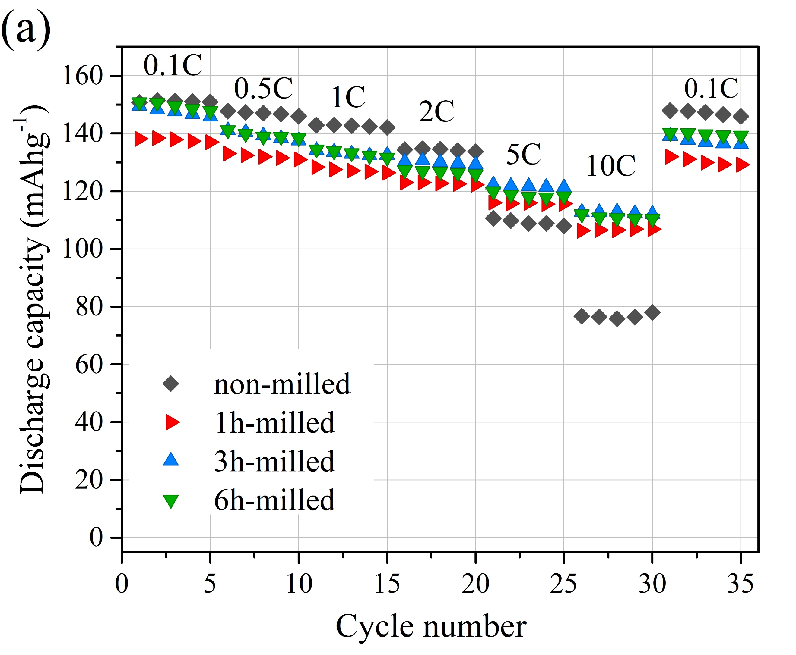
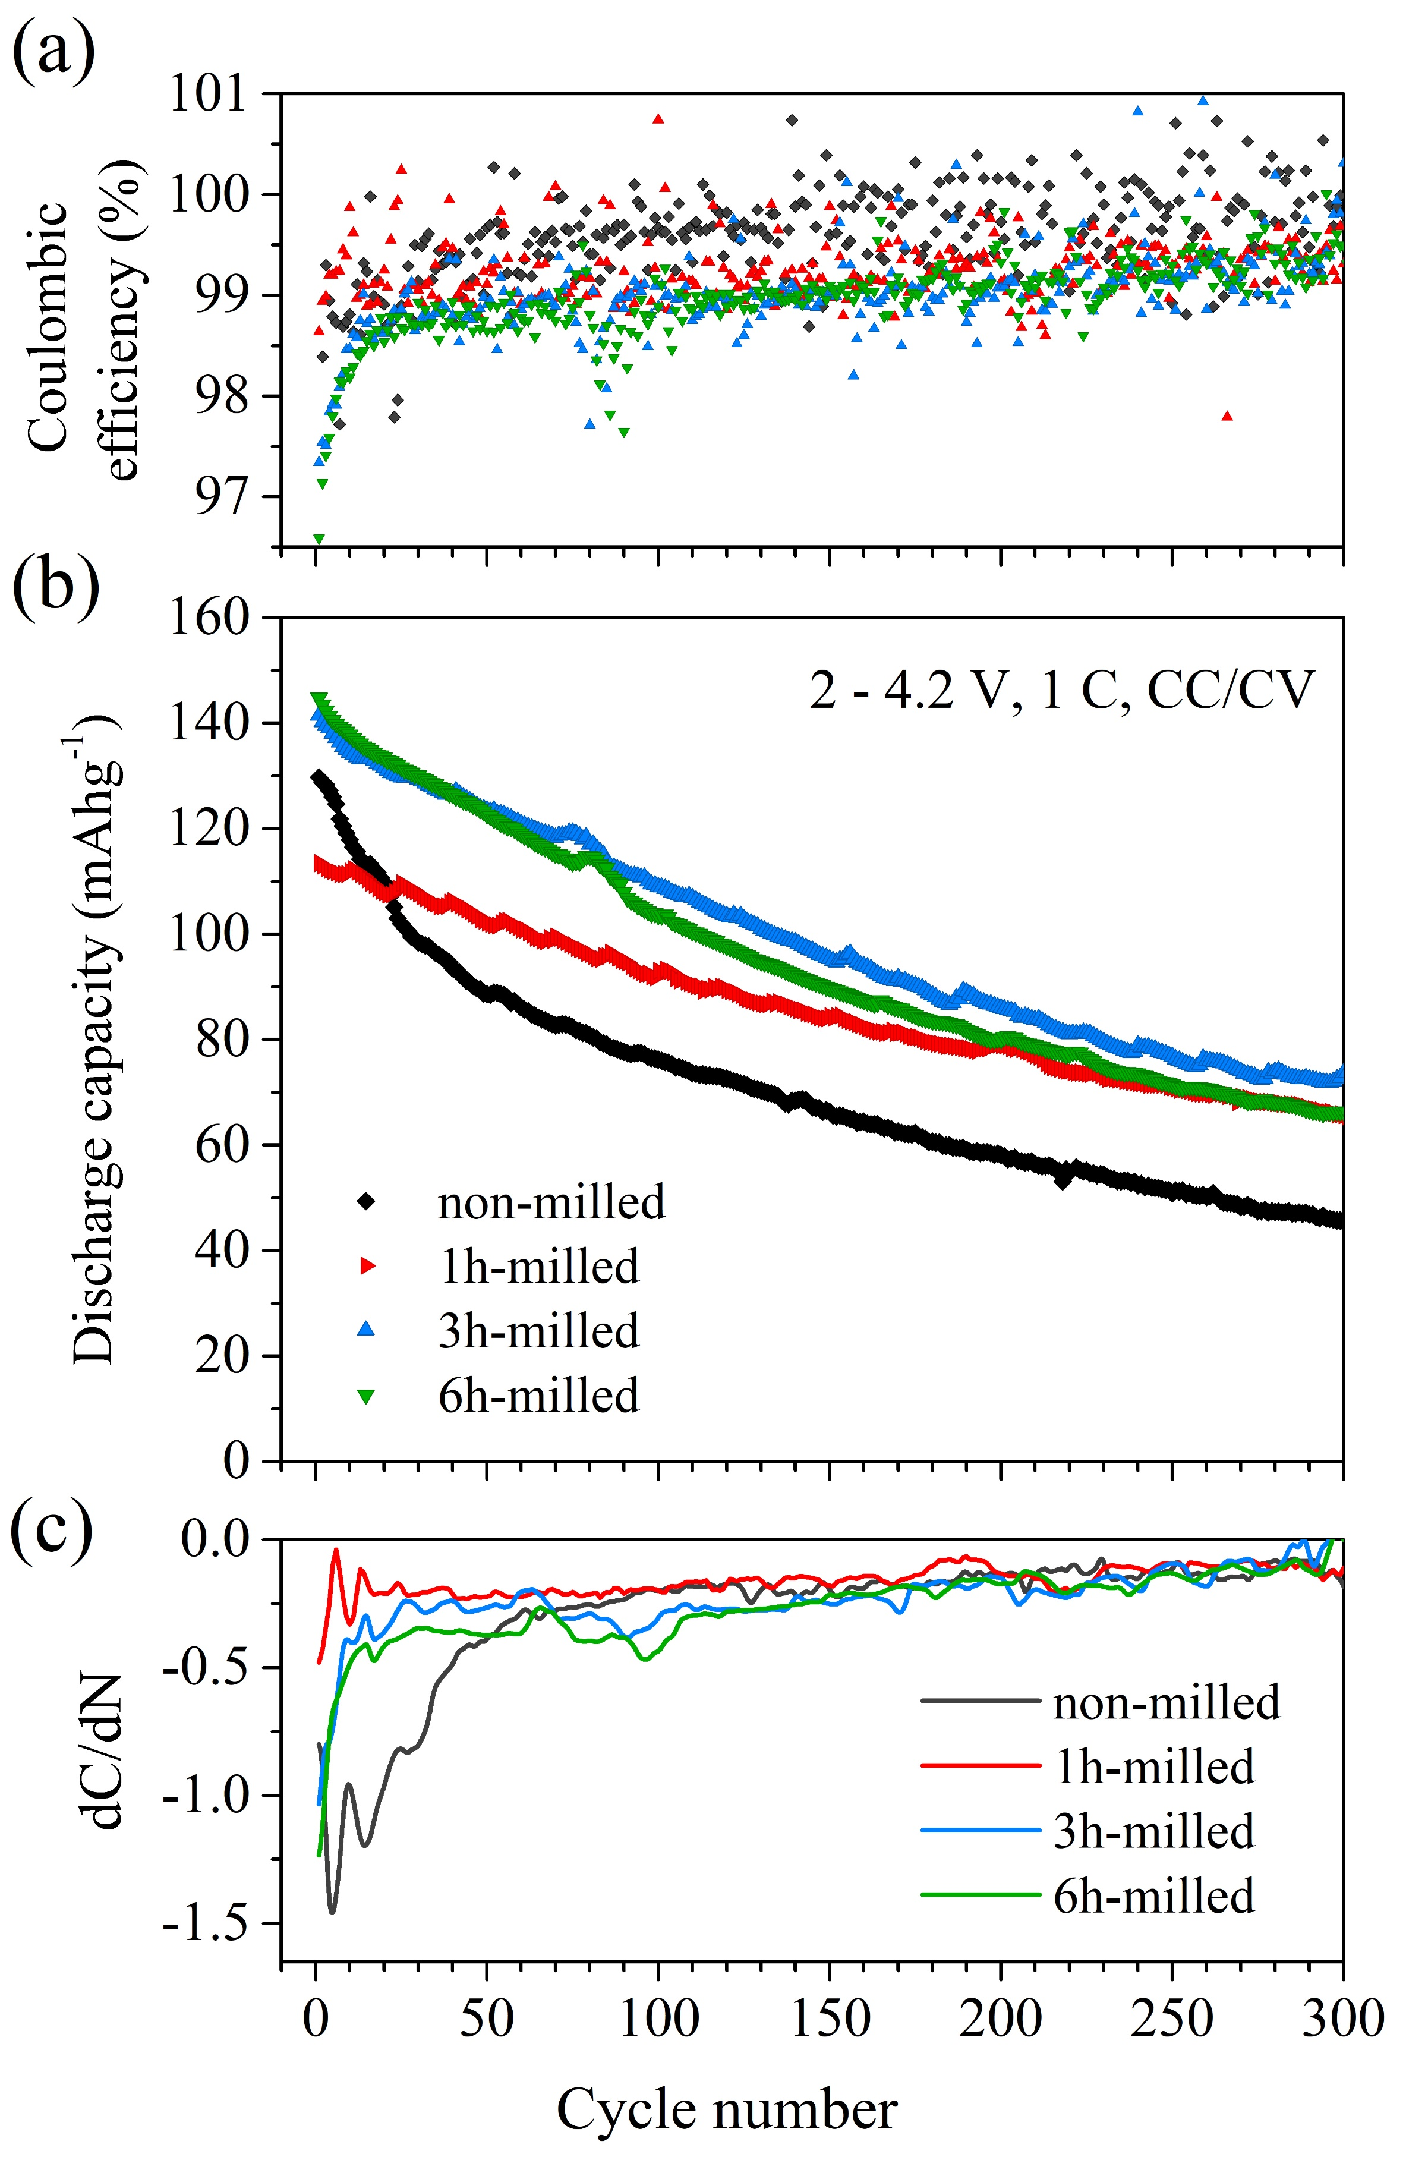
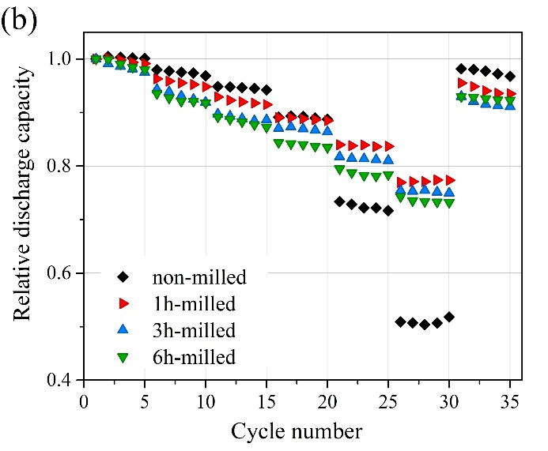

Slide 19
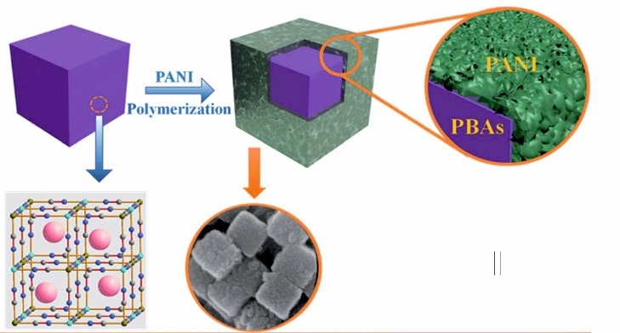
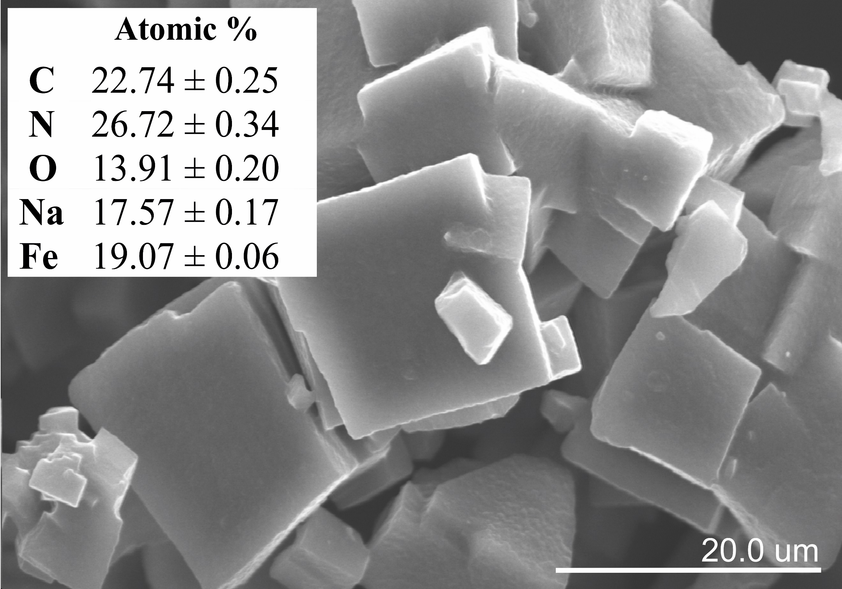
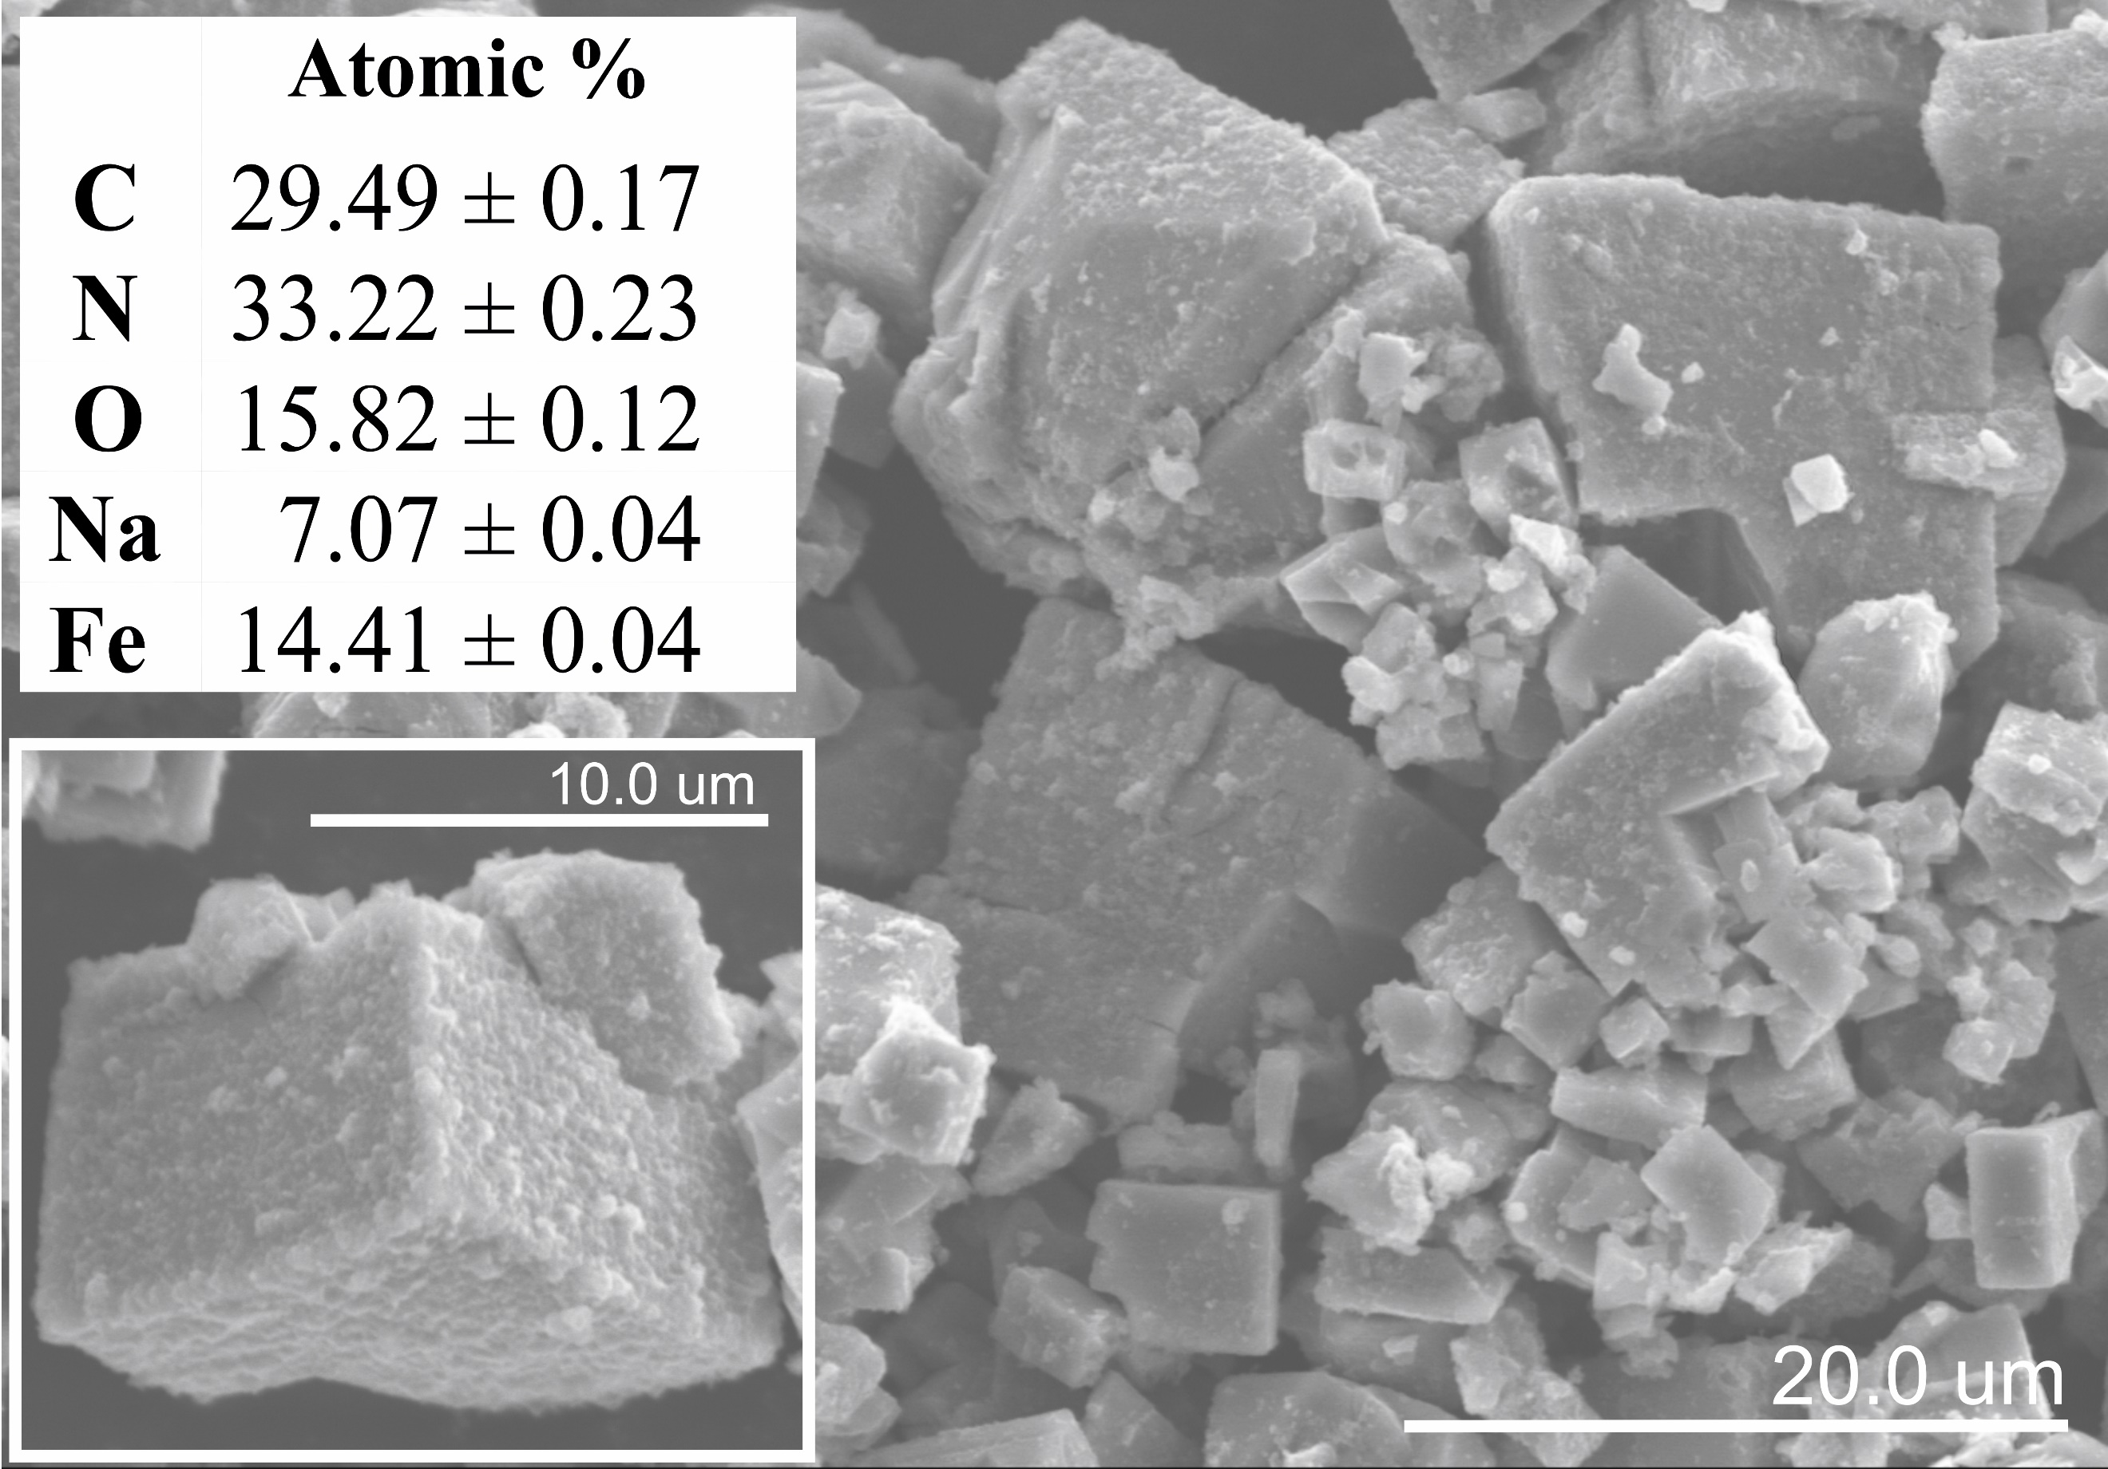
Polyaniline-coated Prussian white cathode material
PW
PW@PANI

Slide 20
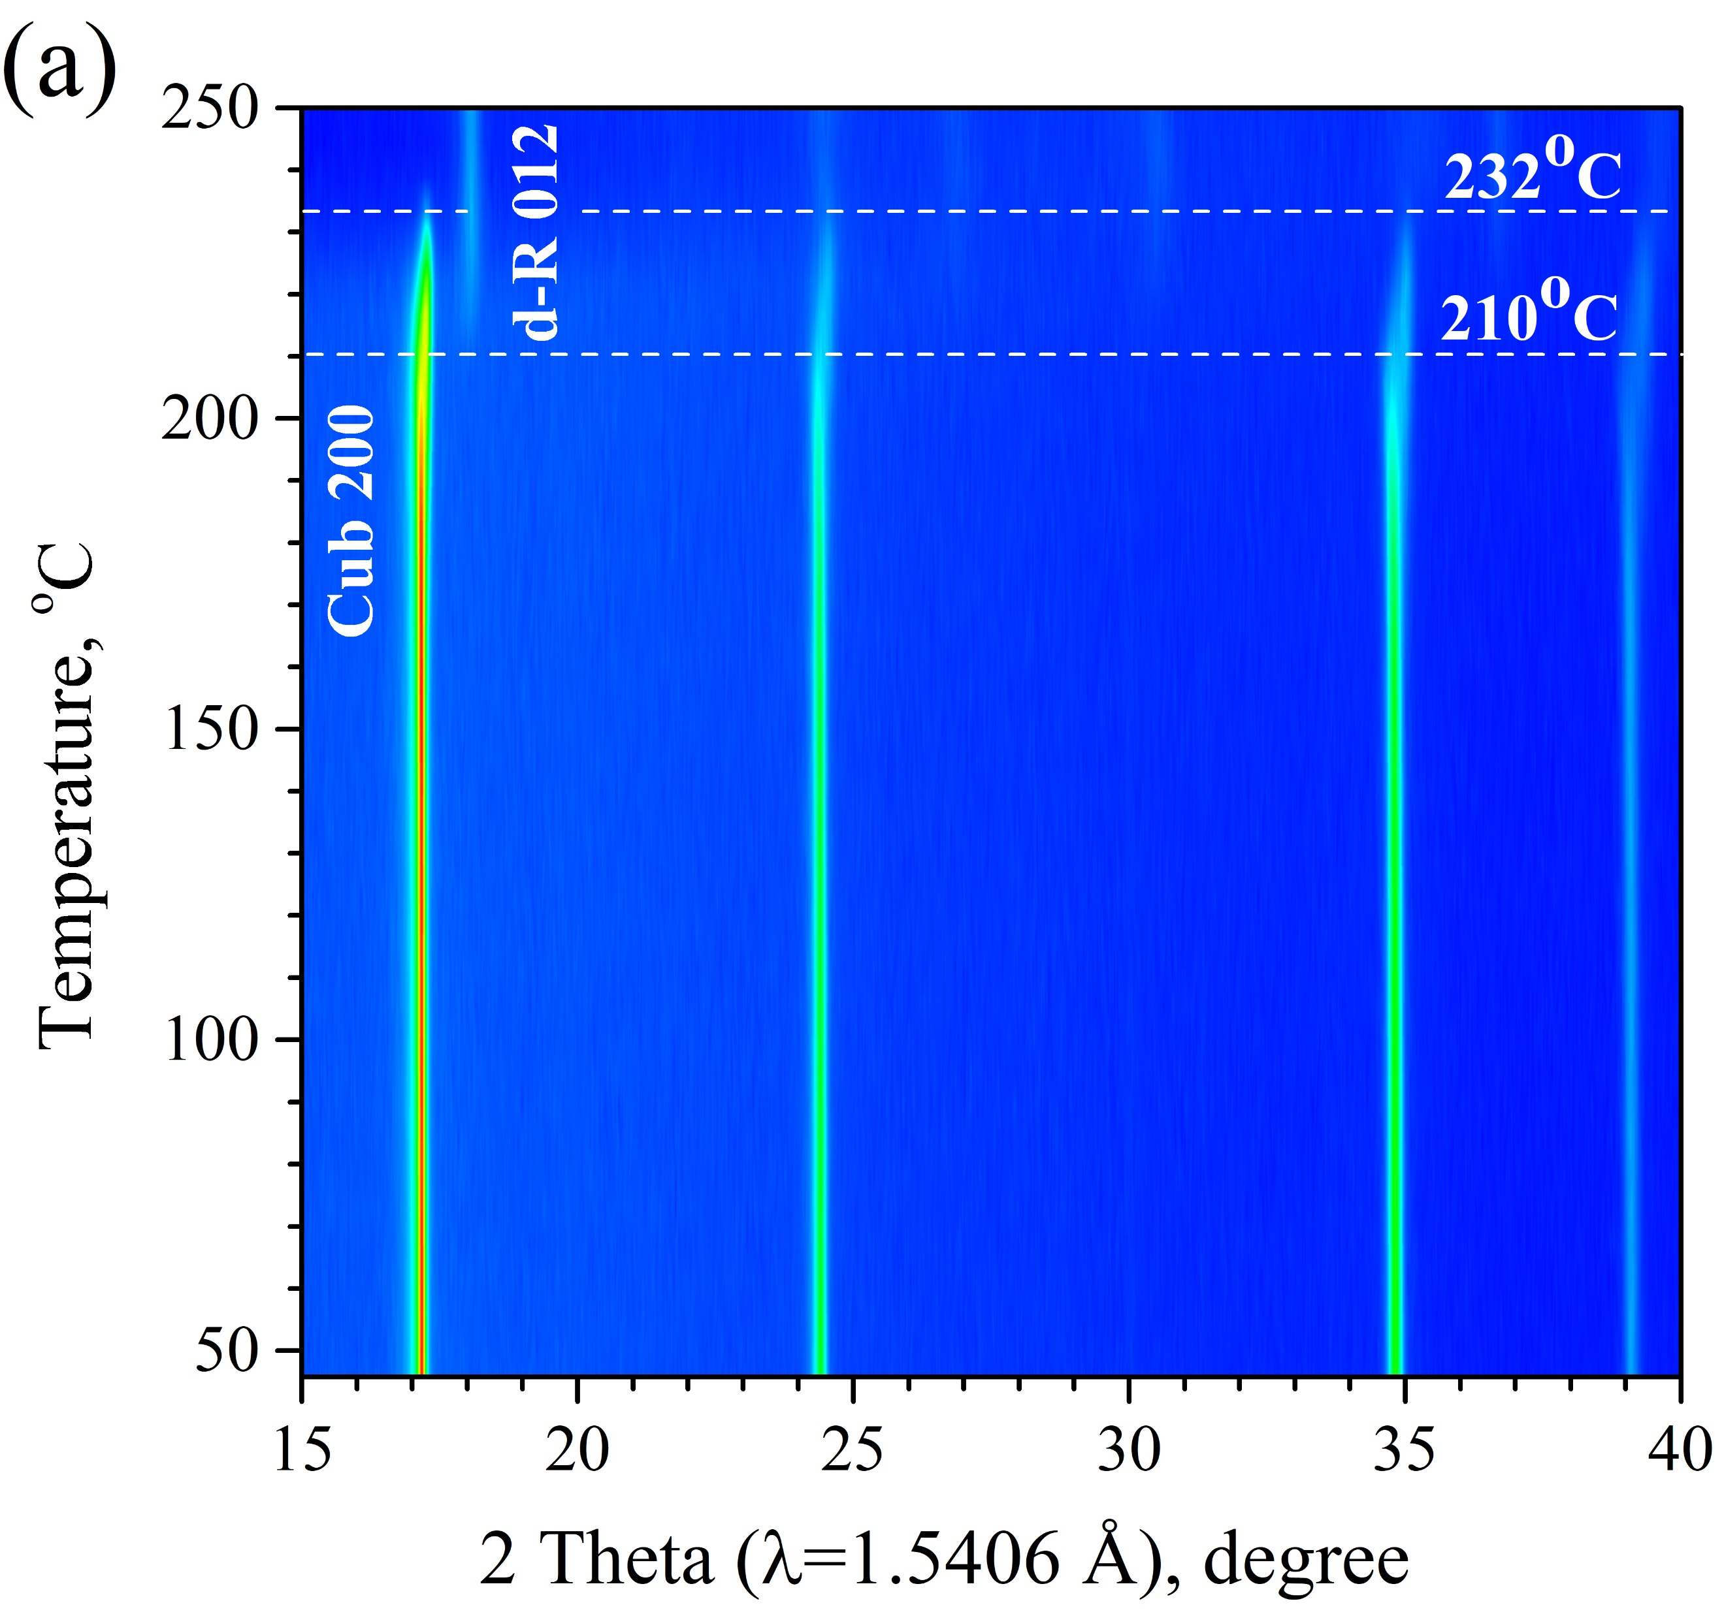
Phase transitions in the PW@PANI material during heating
PW@PANI powder
pristine PW powder
PANI increases the temperature of phase transitions during heating

Slide 21
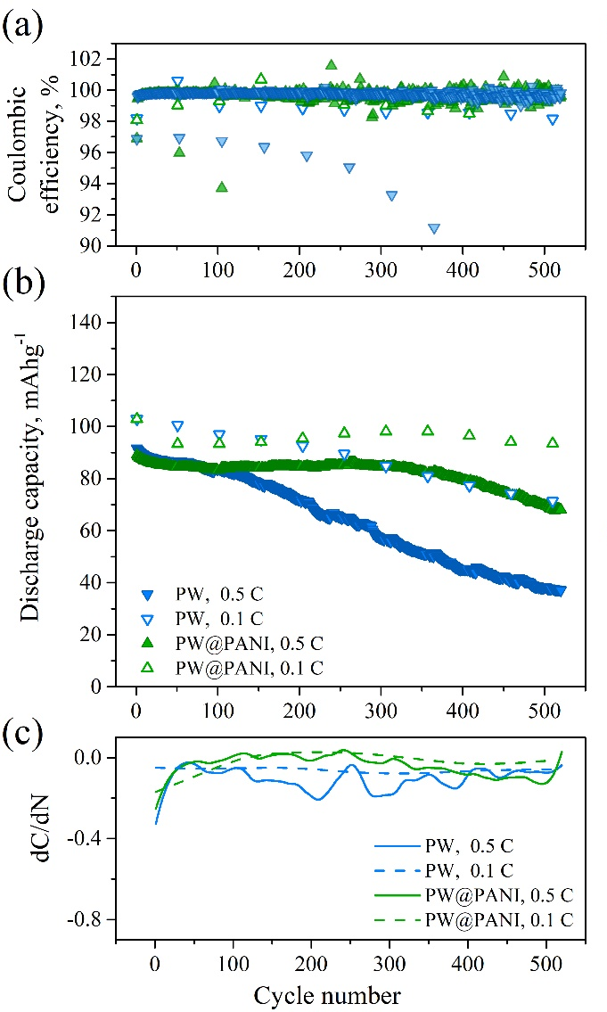
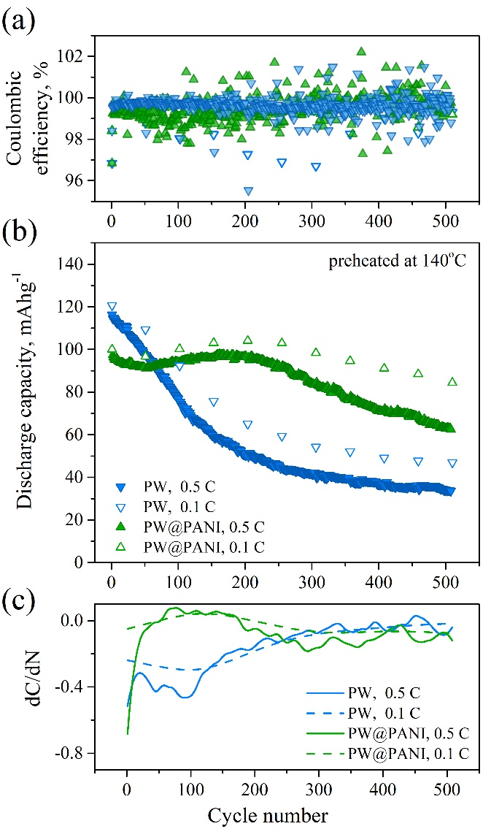
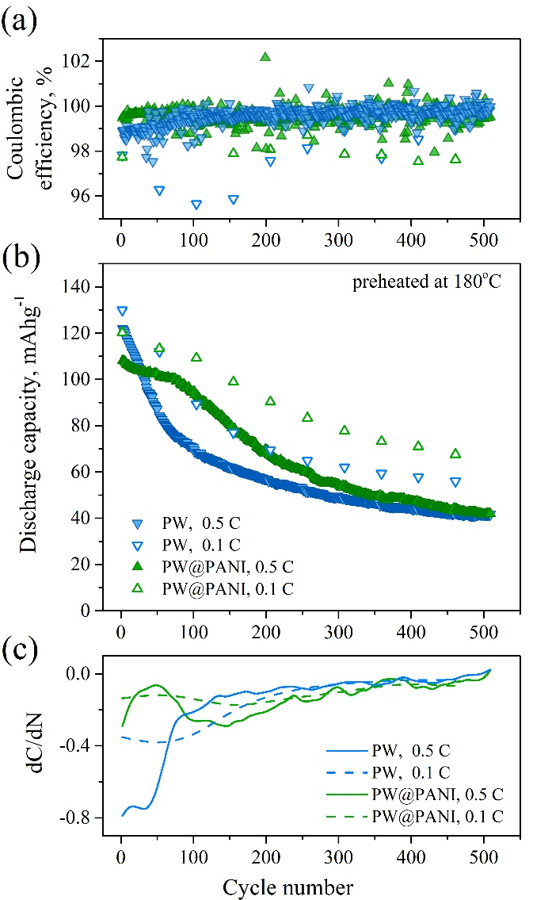
without drying
drying at 140ºC
drying at 180ºC

Slide 22
    Conclusions
Preheating of the electrode at temperatures from 140 up to 200ºC promotes formation of a larger fraction of the dehydrated rhombohedral phase, which is proportional to the temperature of preheating, and results in higher capacity.
The heating process not only removes water from the structure, but also decomposes the PW material at temperature above 180ºC.
Operando XRD experiments demonstrate that the PW material degradation during continuous electrochemical cycling occurs in both electrodes, preheated at 140ºC and 180ºC.
The amount of carbon additive has a more pronounced impact on the capacity of the PW electrodes than a variation of preheating temperature. The electrode with 15 wt.% of carbon has specific capacity values of 160 mAh g^{–1} and 83 mAh g^{–1} at 0.1 C and 10 C cycling rates, exceeding the capacity values previously reported for the same PW material.
Particle fragmentation due to milling leads to more effective dehydration during heating, shifts the phase transition from the cubic phase into the dehydrated rhombohedral phase during heating to lower temperatures, and decreases a number of phase transformations in the material during electrochemical performance. Compared to the pristine PW, the milled material shows a much higher capacity at high cycling rates (110 mAh g^{–1} at 10C) and a smaller capacity drop after long-term cycling.
Summing up, the development of conductive and protective coatings for PW particles and the design of particles (form, size) seem to be more perspective for further investigations aimed at improving the characteristics of PW-based rechargeable batteries.

Slide 23
Thank you for your attention!

