Slide 1


Event Reconstruction in High-Energy Physics Experiments
Nikolay Voytishin
Meshcheryakov Laboratory of Information Technologies,
^{JINR}
AYSS-2024
29/10/24

Slide 2
HEP Experiments: Collider and Fixed-Target

Slide 3
What just happened?
HEP experiments can produce O(10) petabytes of data per year (LHC case).
Data is processed to the stage of physics papers → measurements and discoveries.
Many steps involved
Each step has computing costs, varying inefficiencies, often in large backgrounds.

Slide 4
Data Flow
Data reconstruction generally involves several steps of processing and reduction:
This talk

Slide 5
Event Reconstruction
Triggered detector collision data → particle interactions.
Seek the following information as input for physics analysis
  What particles were created?
  Where were they produced?
  What were the parent particles?
To find this, perform
Tracking: Reconstruct particle trajectories into tracks.
Vertexing: Group particles into vertices.
Particle ID: Find the particle identification of each track (e.g. a muon, electron etc.).
Requirements for reconstruction algos:
Fast
Good quality (enough for physics analysis)
Trigger Bias (not everything depends from reco-algo)
Data sets from triggers inevitably biased by trigger. E.g. experiment finds deficit Higgs candidates with ET < 5 GeV (unsurprising if ETTrig = 5 GeV).
Can be accounted for:
  Comparisons with simulation, many factors (detector performance, collider conditions).
  Comparison with non-triggered data: Far lower rate! Have to extrapolate.

Slide 6
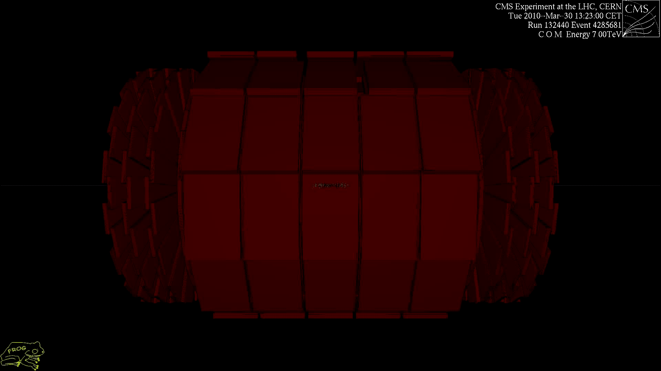
Animation of a real collision

Slide 7
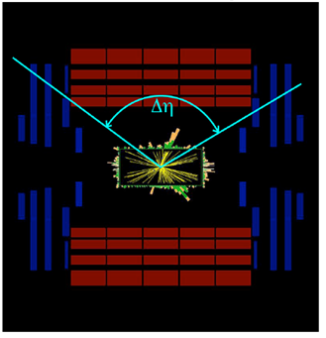
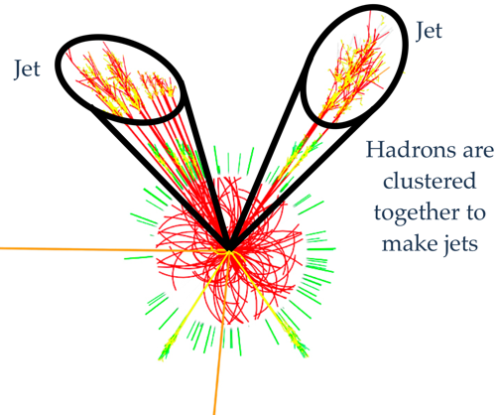
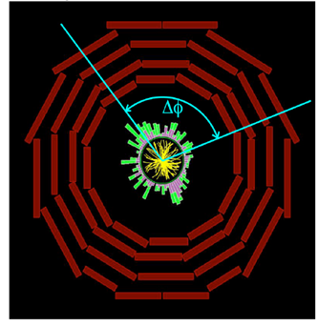


Physics Objects
Muons (transverse momentum p_{T})
Electrons (energy and tr. momentum p_{T})
Photons (energy)
Jets (energy and coordinates )
Unstable Particles
Missing energy and p_{T}
  vectorial sum of all transverse momentum
Kinematic Variables
Transverse momentum p_{T} (energy)
  particles that escape detection have p_{T}=0
  total visible p_{T} = 0
p
p_{T}
θ
Longitudinal momentum p_{Z} and energy E_{Z}
  particles that escape detection have p_{T}=0
  visible p_{Z} is not conserved (not so usefull variable)
Angles
  azimuthal and polar angles
  polar angle θ is not Lorenz invariant ⇒
  rapidity y
  or (or m=0) pseudorapidity η
4π-experiments cover
360⁰ over φ and large
pseudorapidity range,
|η| ≤ 5.0 (0.8⁰)

Slide 8
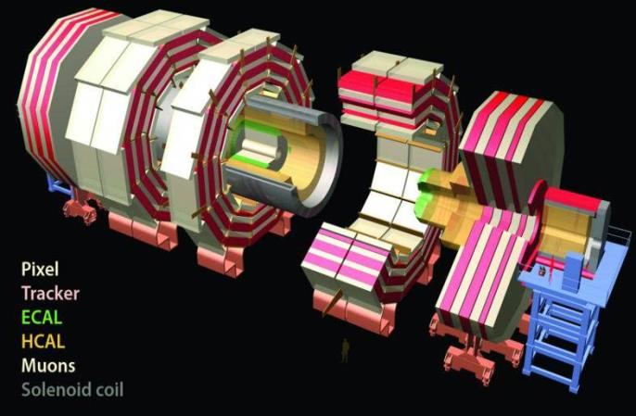
The CMS detector
Took ~2000 scientists and engineers more than 20 years to design and build
Is about 15 meters wide and 21.5 meters long
Weighs twice as much as the Eiffel Tower – about 14000t
Uses the largest, most powerful magnet of its kind ever made

Slide 9
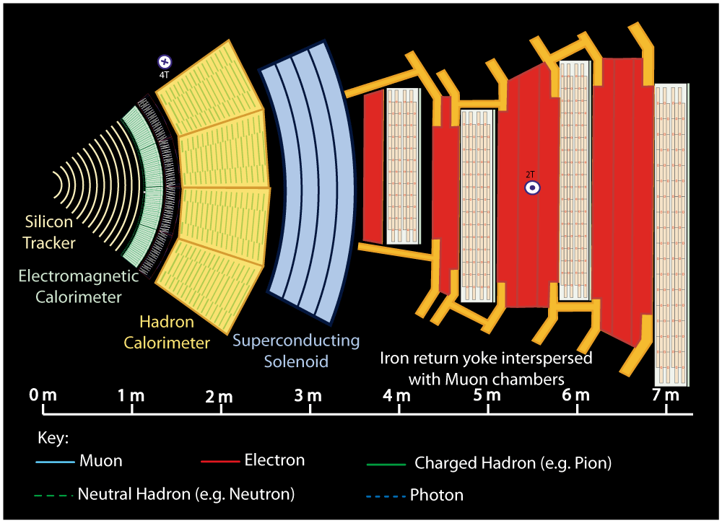
A slice through the CMS detector
Notes:
Buttons. Click on any particle type to display the relevant slide with animations. Clicking again will return to this slide.
Recommend putting this slide in the middle of your presentation and putting the other 5 slides at the end.
If you have any difficulties, contact David.Barney@cern.ch

Slide 10
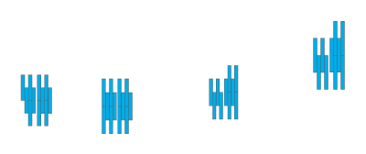


Notes:
Muon: passing through CMS, bending in the field (both ways, depending on when it is inside or outside of the solenoid) leaving hits in the Tracker layers and the muon chambers before escaping completely

Slide 11



Notes:
Electron: Bending in the magnetic field, leaving hits in the tracker layers and being “stopped” by the electromagnetic calorimeter

Slide 12
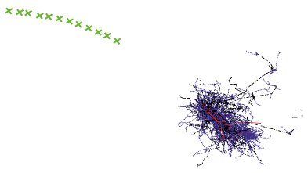


Notes:
Charged hadron: Bends in the magnetic field and leaves signals in the tracker layers; passes through the electromagnetic calorimeter leaving essentially no signal, and is “stopped” by the hadron calorimeter

Slide 13
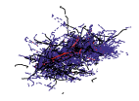

Notes:
Neutral hadron: Does not bend in the magnetic field and does not leave any signal in the tracker layers; passes through the electromagnetic calorimeter leaving essentially no signal, and is “stopped” by the hadron calorimeter

Slide 14



Notes:
Photon: passes through the tracker without bending in the magnetic field or leaving hits, is “stopped” by the electromagnetic calorimeter

Slide 15

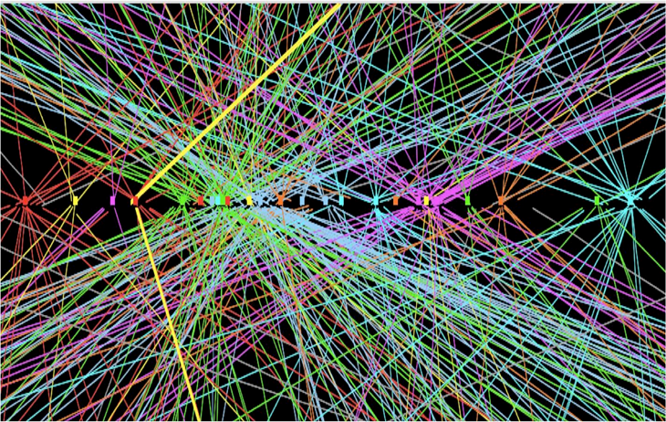
Tracking Algorithms
Tracking particles through detectors involves two step
Pattern recognition: identifying which detector hits belong to the a track.
Track fit: approximate the path of the particle with an equation.
There is no universal solution.
Many detectors use different combinations of algorithms (e.g. LHCb uses 4 different algorithms for different combinations of sub detectors, but basic ideas are the same). Usually a trade off between
  Efficiency: fraction of real tracks found
  Purity: fraction of tracks that are real
  Computational speed.
Reconstruction conditions:
high multiplicity and density of flying charged particles
high collision rate
high data flow density
the presence of massive layers of matter – calorimeters, magnetic yoke...
pile-up

Slide 16
Challenge

Slide 17
Tracking - Pattern Recognition

Slide 18
Pattern Recognition Algorithms
Recall three main factors in choosing such algorithms:
Efficiency: fraction of real tracks found
Purity: fraction of tracks that are real
Computational speed
Toy simulation for LHCb VELO:
Typically use a combination of these algorithms

Slide 19
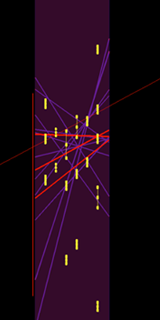
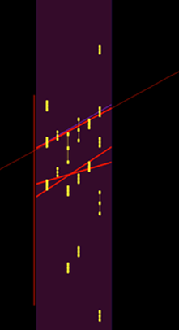
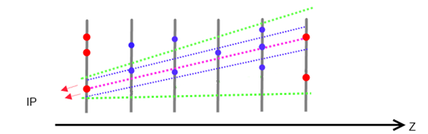
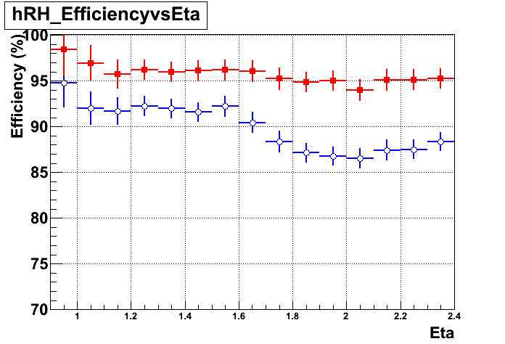
Reconstruction of high pT muon trajectories
84 hits in chamber
Old
RU
Muon trajectory
High pT muon passing through the CMS endcap muon system
15 track-segments
4 track-segments
Blue – old algorithm
Red – new algorithm
RoadUsage(RU) segment reconstruction algorithm
Reconstruction efficiency vs. pseudorapidity

Slide 20
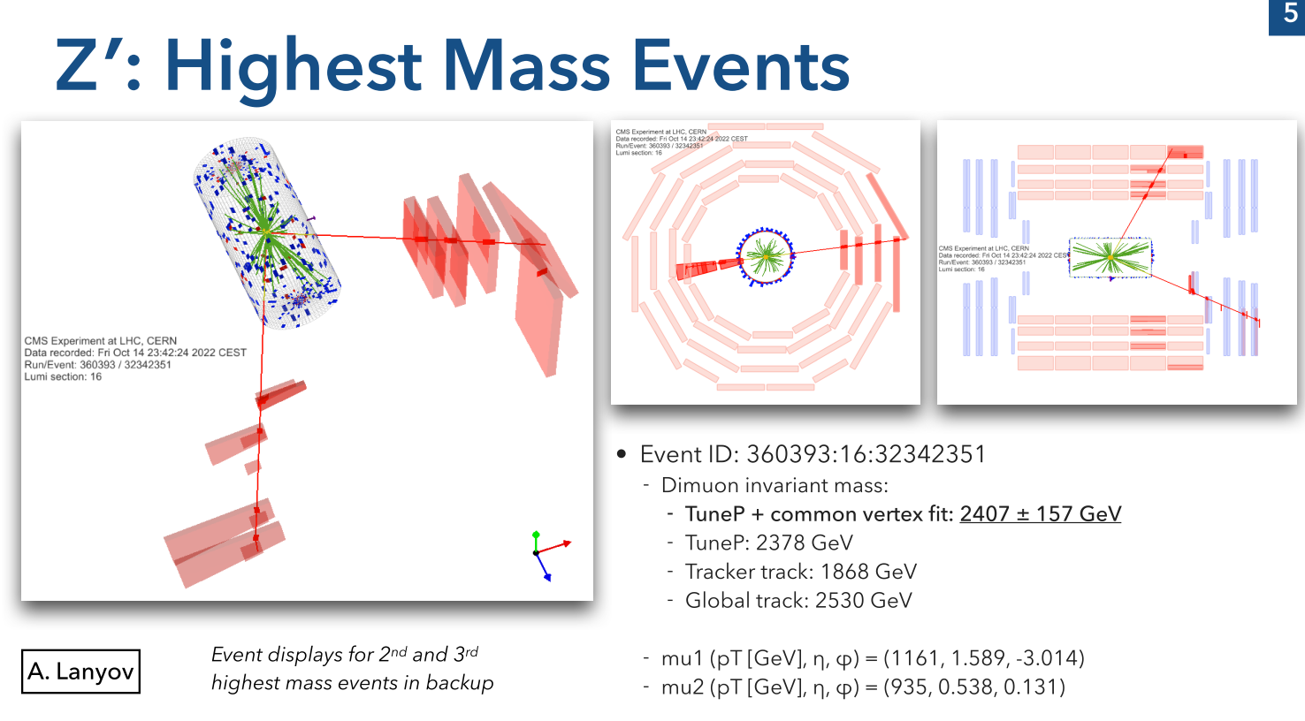
Highest di-muon mass event at CMS (so far)
CSC
20
Notes:
На данном слайде можно видеть визуализацию события в детекторе CMS с ди-мюоном максимальной массы (на сегодняшний день) зарегестрированного в эксперименте. Заметим, что из двух мюонов первый с поперечным импульсом в 1161 гэв был реконструирован в CSC. Обнаружение столь уникального объекта стало возможным лишь благодаря использованию предложенного алгоритма RU

Slide 21
Methods for Track Finding

Slide 22
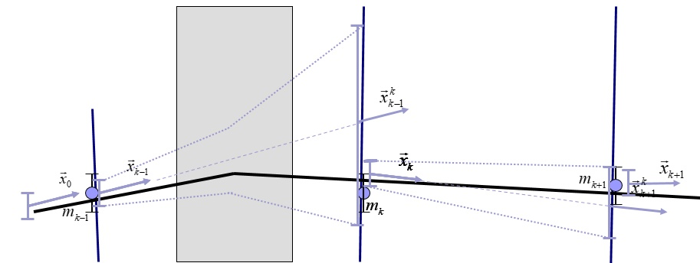
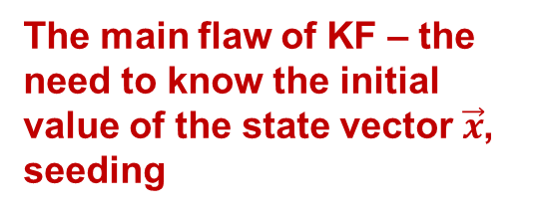
Kalman filter
Among the many tracking methods, the most effective was the method using the Kalman filter, since it allows one to easily take into account the non-uniformity of the magnetic field, multiple scattering and energy losses.
Kalman Filter (KF) – an efficient recursive filter that estimates the state of a linear dynamic system using a series of imprecise measurements.
State vector is iteratively evaluated to predict the track position on the next coordinate plane, taking into account the change in the covariance matrix and error corridors.
The main flaw of KF – the need to know the initial value of the state vector$\vec{x}$, seeding
22

Slide 23
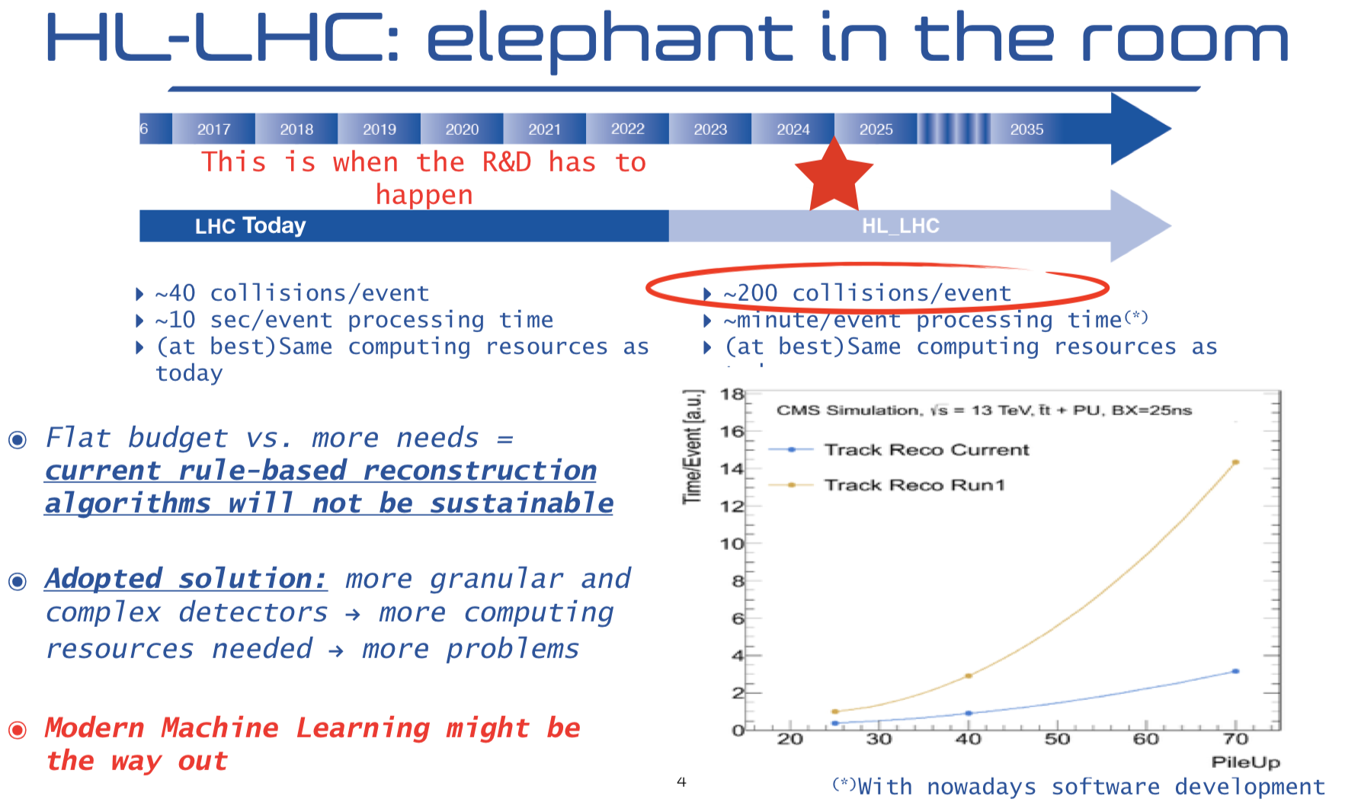
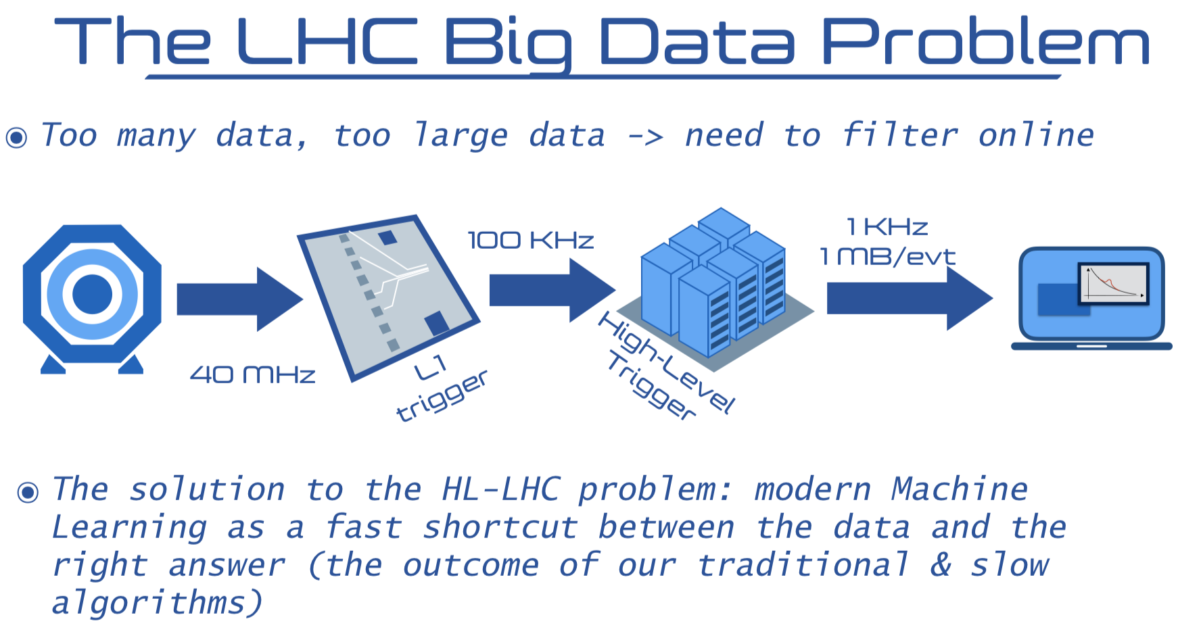
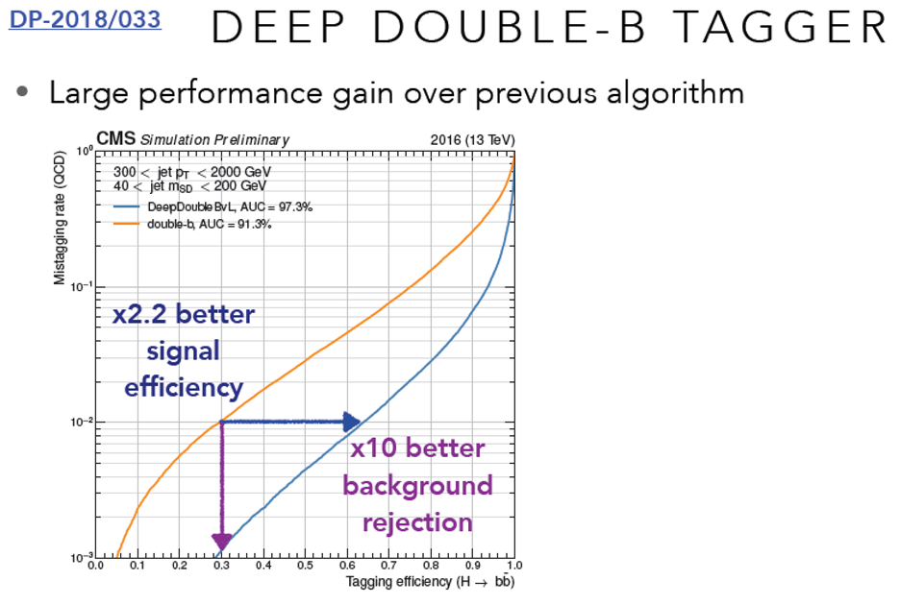
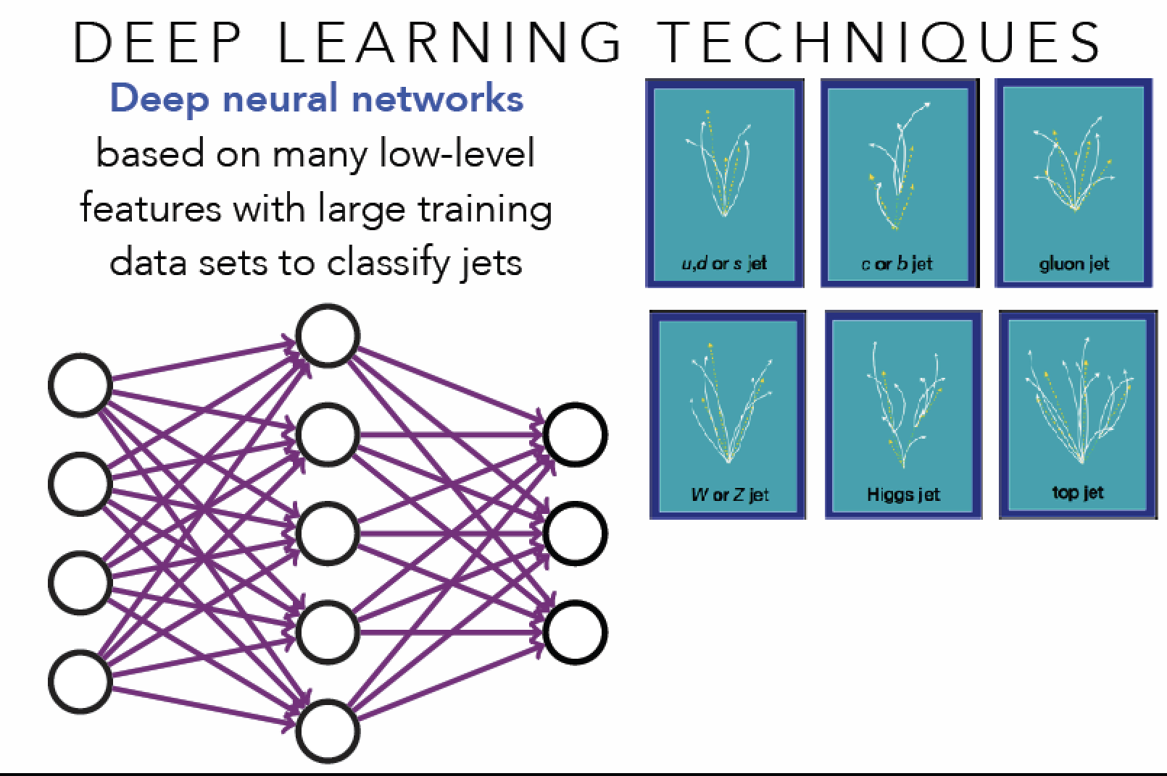
Machine Learning

Slide 24
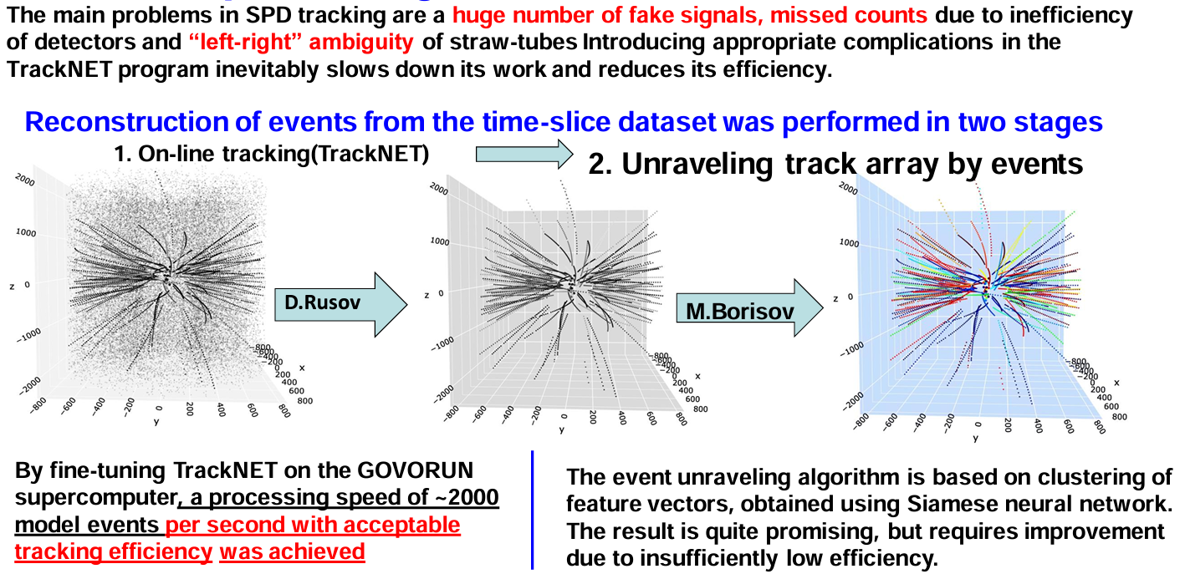
Deep tracking for SPD experiment
SPbU
SPbU
ML Team leader: Ososcov G.A (MLIT)

Slide 25
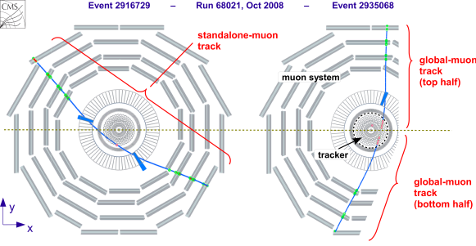
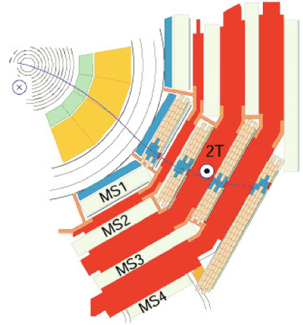
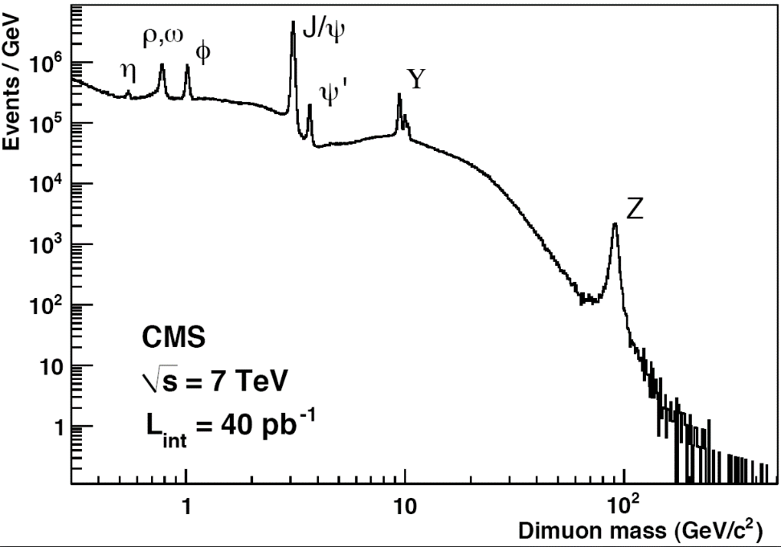
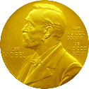

Muon Track and Dimuons Reconstruction
CMS Muon System shows a excellent performance to detect different resonances
Dec 2010
sagitta calculation
https://twiki.cern.ch/twiki/bin/view/CMSPublic/PhysicsResultsMUO

Slide 26
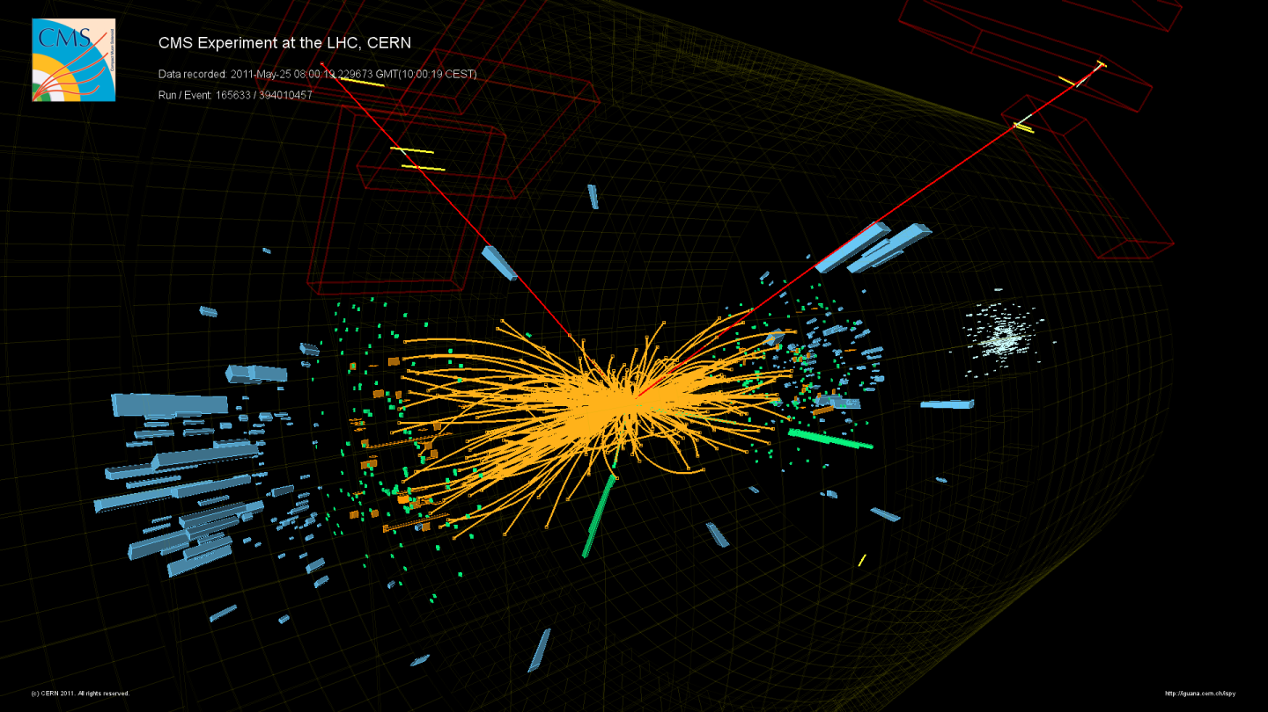
Example of h → ZZ → 2e 2μ

Slide 27
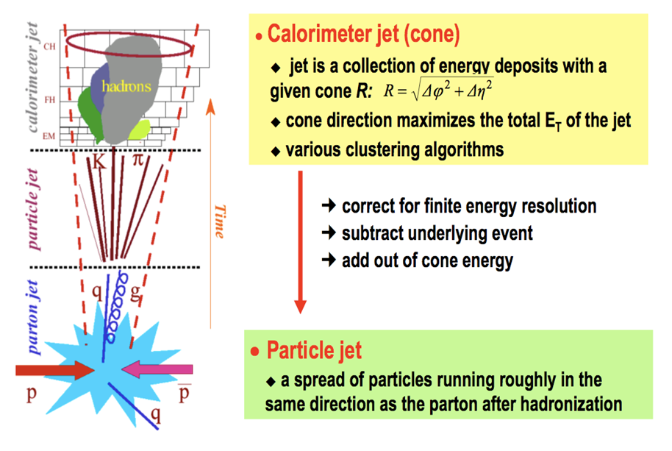
Jet Finding

Slide 28
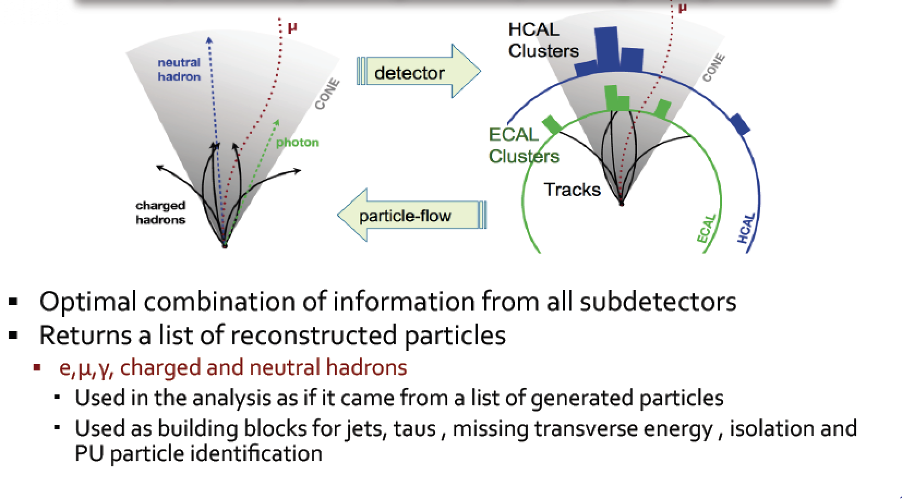
Global Event Reconstruction
Using all information of the detector together for optimal measurement

Slide 29
Event Reconstruction Implementation
Hit and seed finding

Slide 30
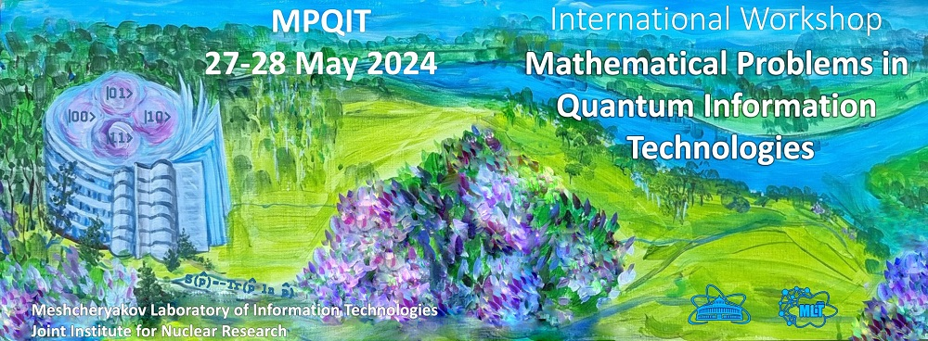


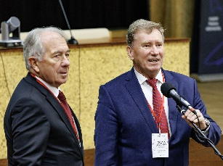
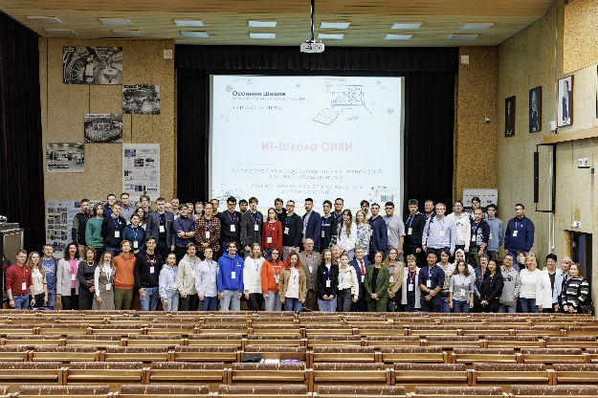
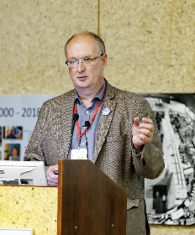
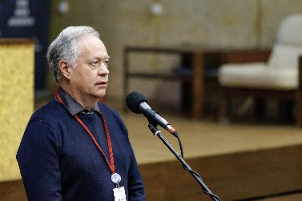
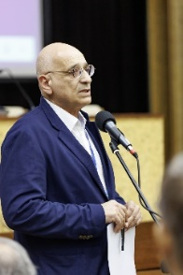
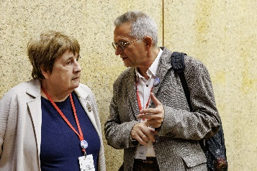
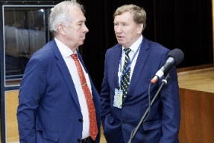
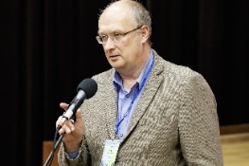
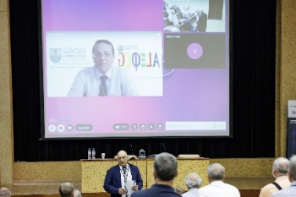
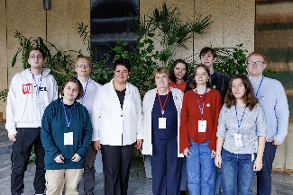
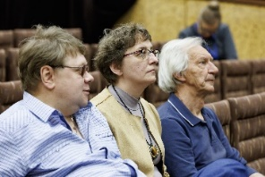
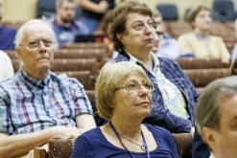
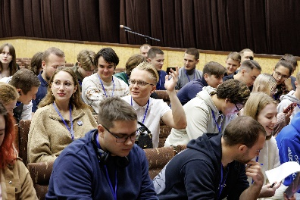
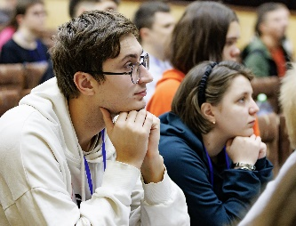
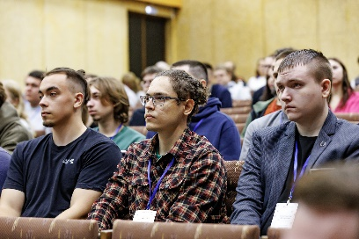
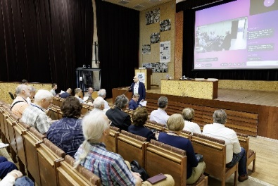
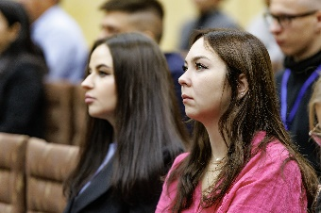
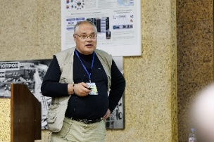
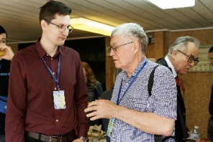
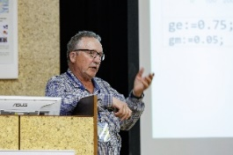

IT School @ JINR
JINR School of Information Technologies
7-11 October 2024
58 students from Russian universities
The main focus was on the mathematical aspects of diverse problems in fundamental and applied quantum technologies, such as
quantum information theory,
quantum communications,
quantum computing, simulation, and quantum algorithms.
Distributed and high-performance computing for experimental and theoretical research at JINR;
Mathematical modeling and numerical methods;
Modern methods and technologies for information processing and analysis;
JINR Digital EcoSystem;
Support and development of the JINR Multifunctional
Information and Computing Complex (MICC);
Engineering infrastructure: automation and monitoring.
More than 60 participants from
Armenia,
Belarus,
Bulgaria,
Great Britain, Georgia,
Egypt,
India,
Kazakhstan,
Moldova,
Romania,
Serbia,
the Czech Republic
Russia was represented by specialists from Voronezh, Kazan, Moscow, St. Petersburg, Tver, Chelyabinsk and Dubna.
32 reports (9 from JINR)
Notes:
27-28 мая в Лаборатории информационных технологий им. М.Г. Мещерякова проходило двухдневное рабочее совещание по математическим проблемам квантовых информационных технологий (MPQIT-2024). Основное внимание участников совещания было уделено математическим аспектам различных проблем фундаментальных и прикладных квантовых технологий, таких как квантовая теория информации, квантовые коммуникации, квантовые вычисления, моделирование и квантовые алгоритмы.
С 7 по 11 октября 2024 года в ЛИТ прошла Осенняя Школа по информационным технологиям (https://indico.jinr.ru/event/4735). Главная цель - вовлечение молодых специалистов в решение задач, стоящих перед ОИЯИ, с применением современных информационных технологий. В Осенней Школе приняли участие более 58 студентов, преимущественно старших курсов, из 11 университетов России, в том числе из вузов, где действуют информационные центры ОИЯИ. Программа Школы была разделена на несколько тематических блоков: «Распределенные и высокопроизводительные вычисления для подготовки, реализации и поддержки экспериментальных и теоретических исследований, проводимых в рамках крупных инфраструктурных проектов ОИЯИ», «Математическое моделирование, численные методы и алгоритмы для решения прикладных задач ОИЯИ», «Современные методы и технологии обработки и анализа информации». Отдельные тематические блоки были посвящены Цифровой экосистеме ОИЯИ и поддержке и развитию МИВК, включая инженерную инфраструктуру. Соревновательный дух в программу Школы добавили Хакатоны по математическому моделированию и аналитике Больших данных. По результатам работы Школы студенты выбрали темы ВКР и кураторов от ОИЯИ для их написания. Во время второго этапа, на Весенней Школе по информационным технологиям ОИЯИ, которая запланирована на апрель 2025 года, студенты будут представлять результаты совместных работ с сотрудниками Института по выбранным темам ВКР.
Оn 27-28 May, a two-day workshop on mathematical problems of quantum information technologies (MPQIT-2024) was held at the Meshcheryakov Laboratory of Information Technologies. The main focus of the workshop participants was on the mathematical aspects of diverse problems in fundamental and applied quantum technologies, such as quantum information theory, quantum communications, quantum computing, simulation, and quantum algorithms.
On 7-11 October 2024, MLIT hosted the Autumn School of Information Technologies (https://indico.jinr.ru/event/4735). The main goal is to involve young specialists in solving tasks that face JINR using state-of-the-art information technologies. Over 58 senior students from 11 Russian universities, including those ones where JINR Information Centers operate, participated in the event. The School’s program was divided into several thematic blocks: “Distributed and High-performance Computing for the Preparation, Implementation and Support of Experimental and Theoretical Research Carried out within JINR Large Research Infrastructure Projects”, “Mathematical Modeling, Numerical Methods and Algorithms for Solving JINR Applied Tasks”, “Modern Methods and Technologies of Information Processing and Analysis”. Separate sessions were devoted to the JINR Digital EcoSystem and the support and development of the MICC. The Parallel Computing Hackathon and Big Data analytic Hackathon added the competitive spirit to the School’s program. Based on the results of the School, the students selected theses’ topics and JINR supervisors. During the second stage, namely, at the JINR Spring School of Information Technologies, which is planned for April 2024, the students will present the results of joint work with the Institute’s specialists.

Slide 31

THANK YOU FOR YOUR ATTENTION!
Thank you for your attention!

Slide 32
What just happened?

Slide 33

Particles in Detectors
Electromagnetic Calorimeter
Muon Spectrometer
Hadron Calorimeter
Inner Tracker
Magnet
Return flux

Slide 34

Example of h → 2γ

