Slide 1
'24
28 October -
1 November
AYSS-2024
Closing Remarks
Regina Kozhina and Alexander Madumarov
on behalf of the Organizing Committee
DUBNA

Slide 2
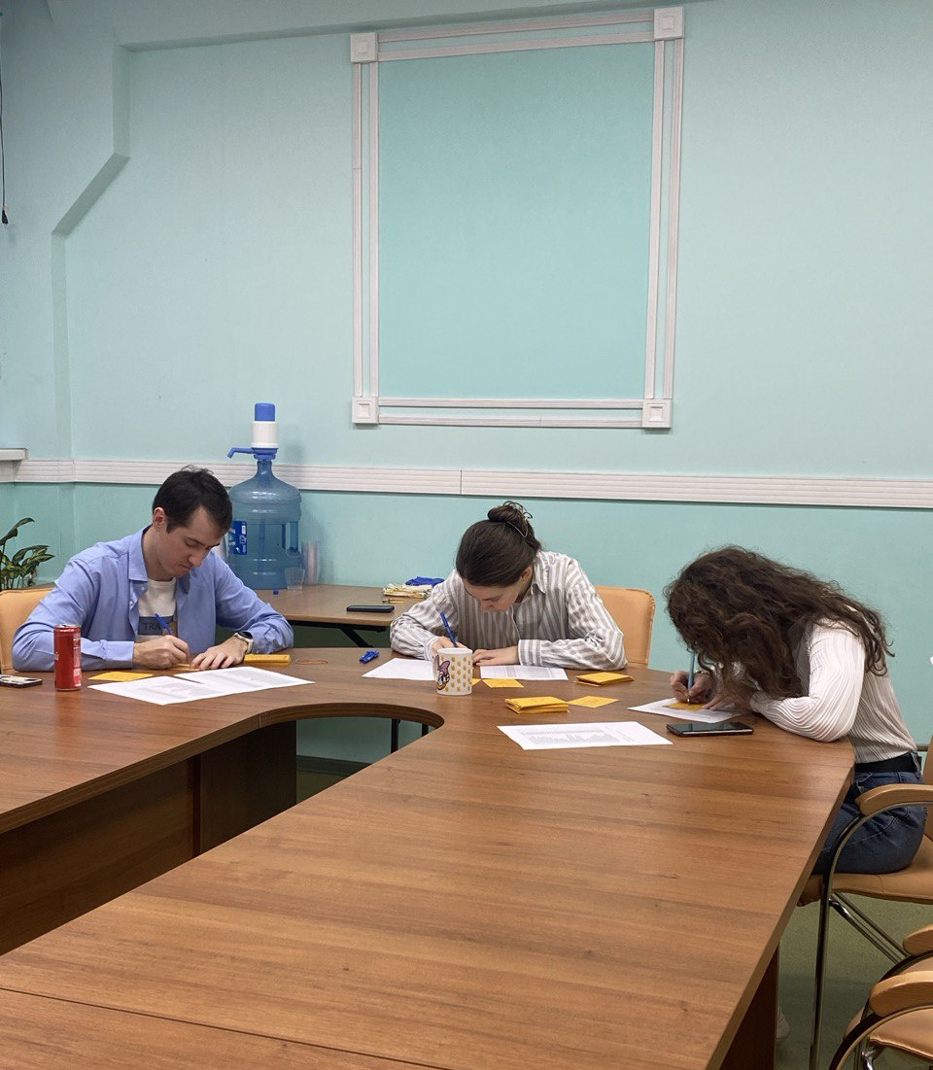
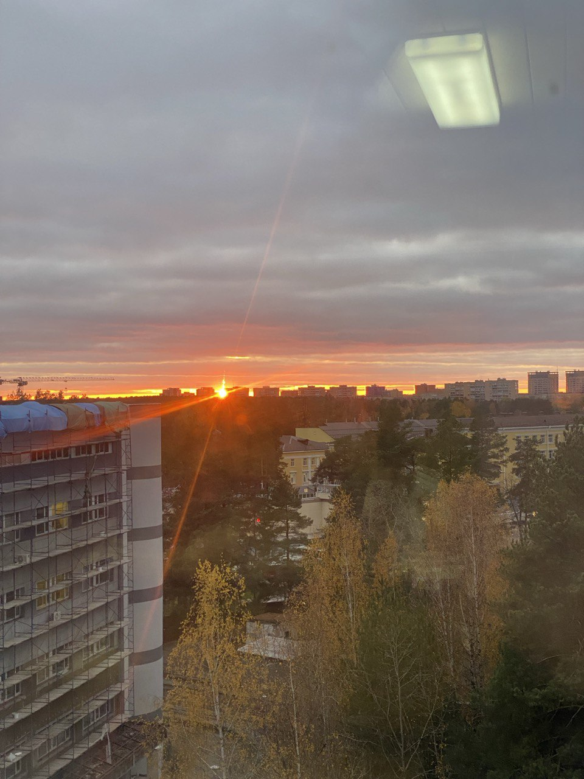
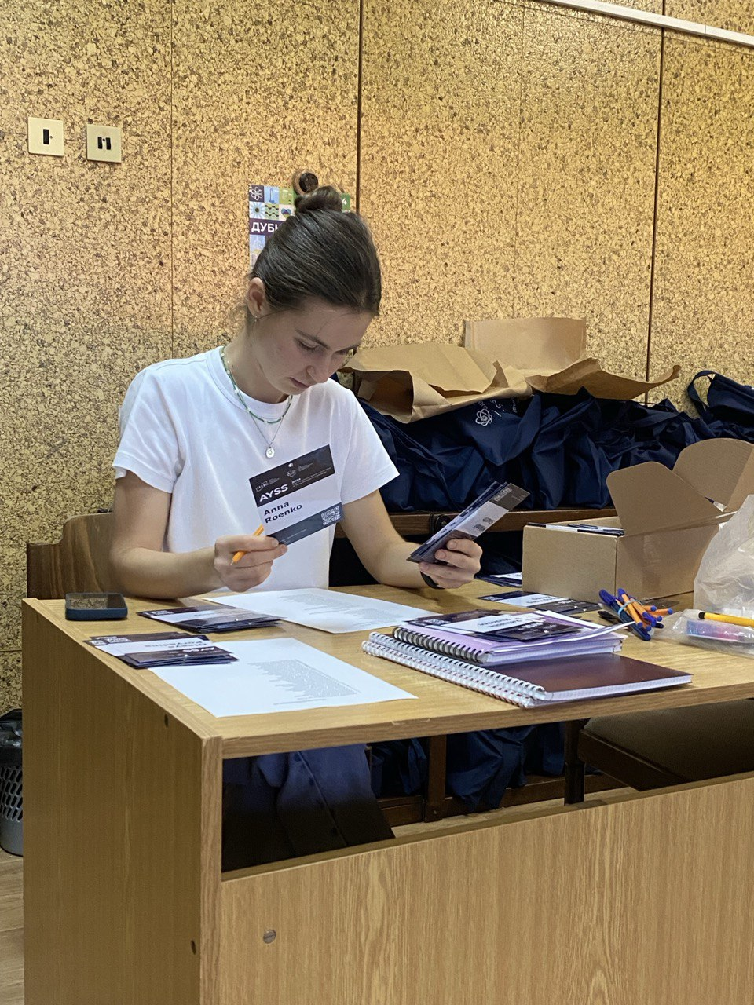
Days Before Start…

Slide 3
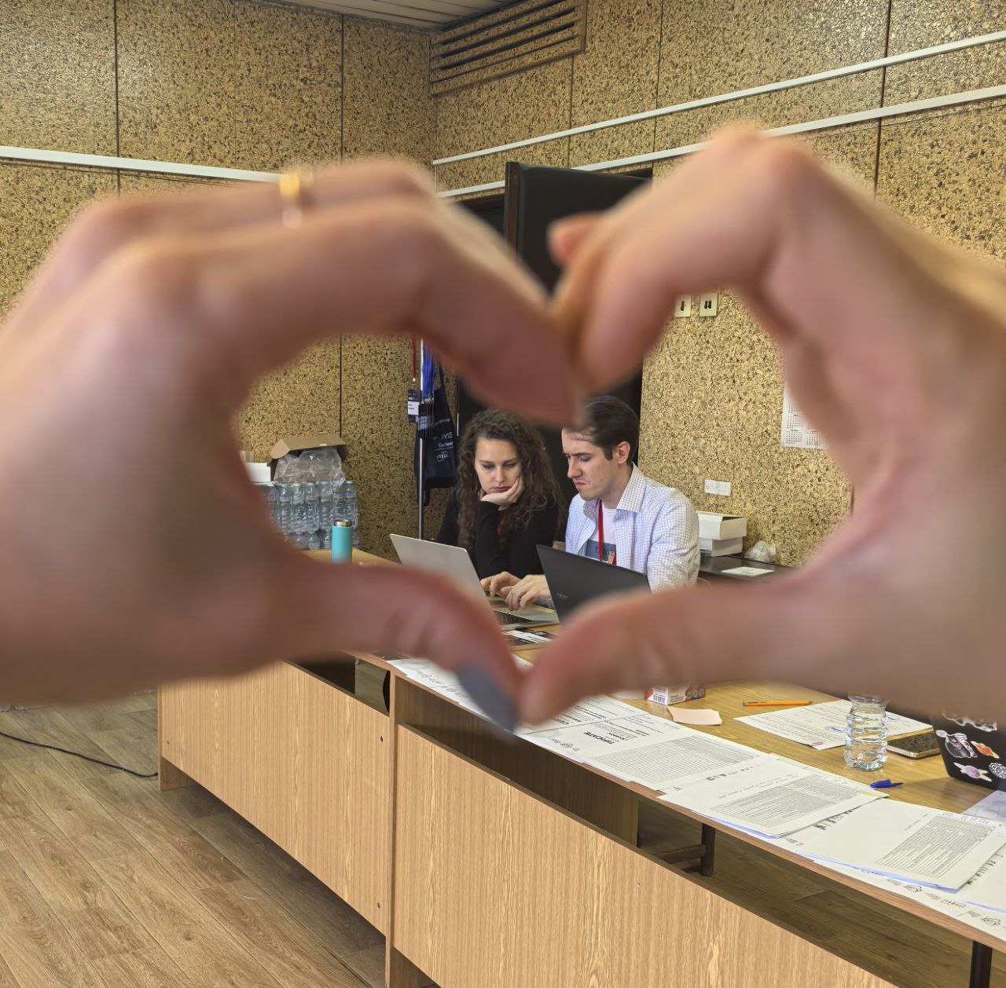
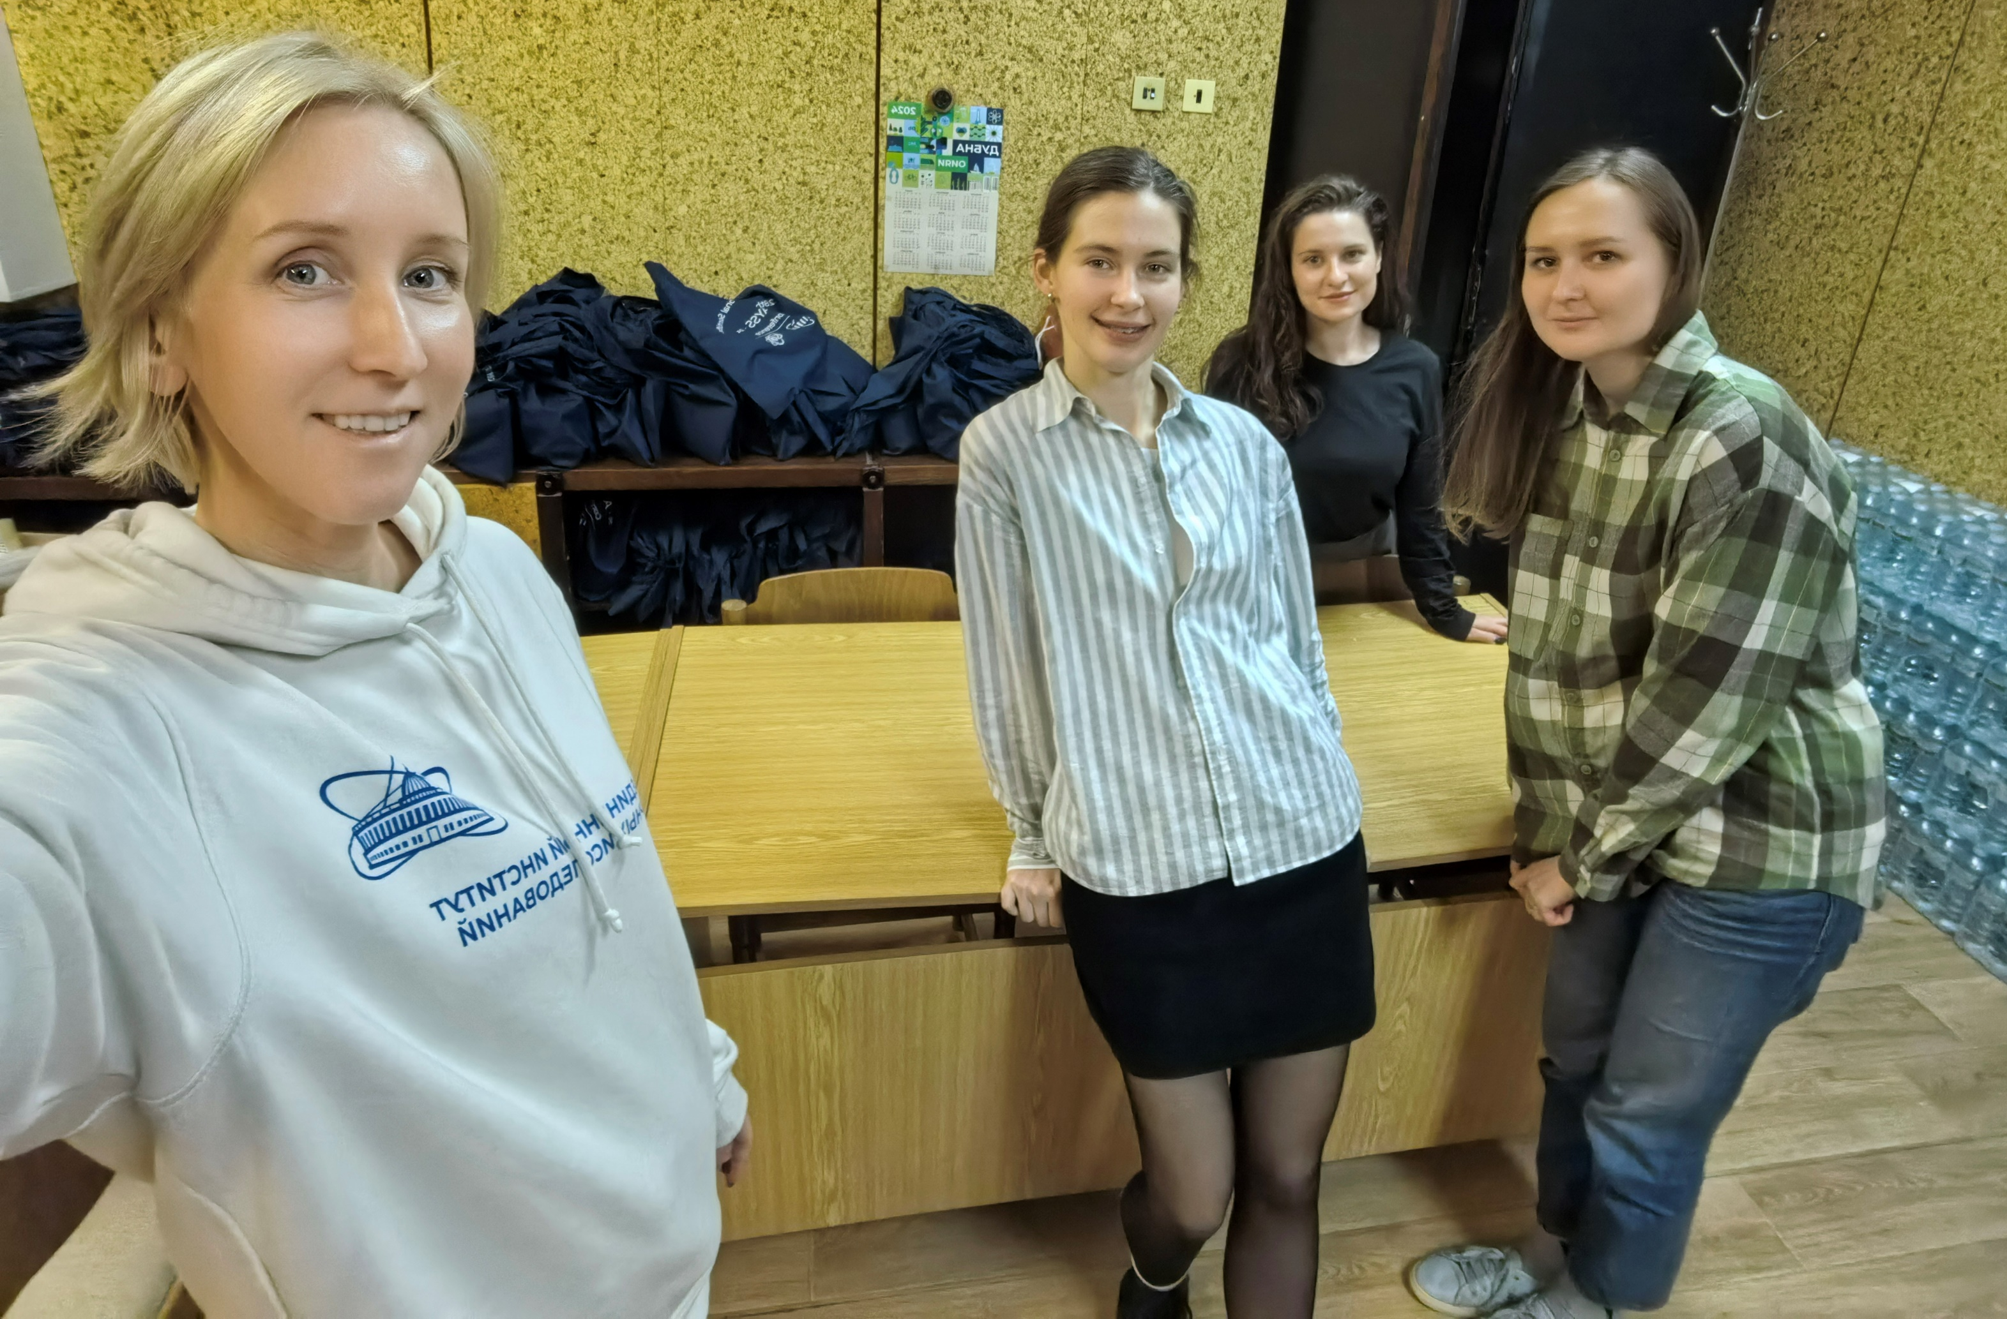
Days Before Start…

Slide 4
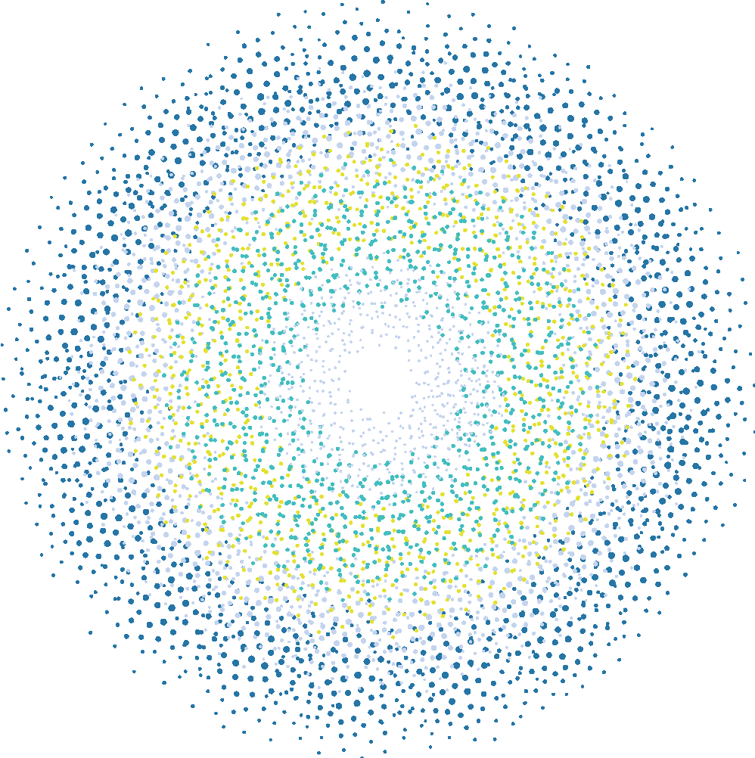
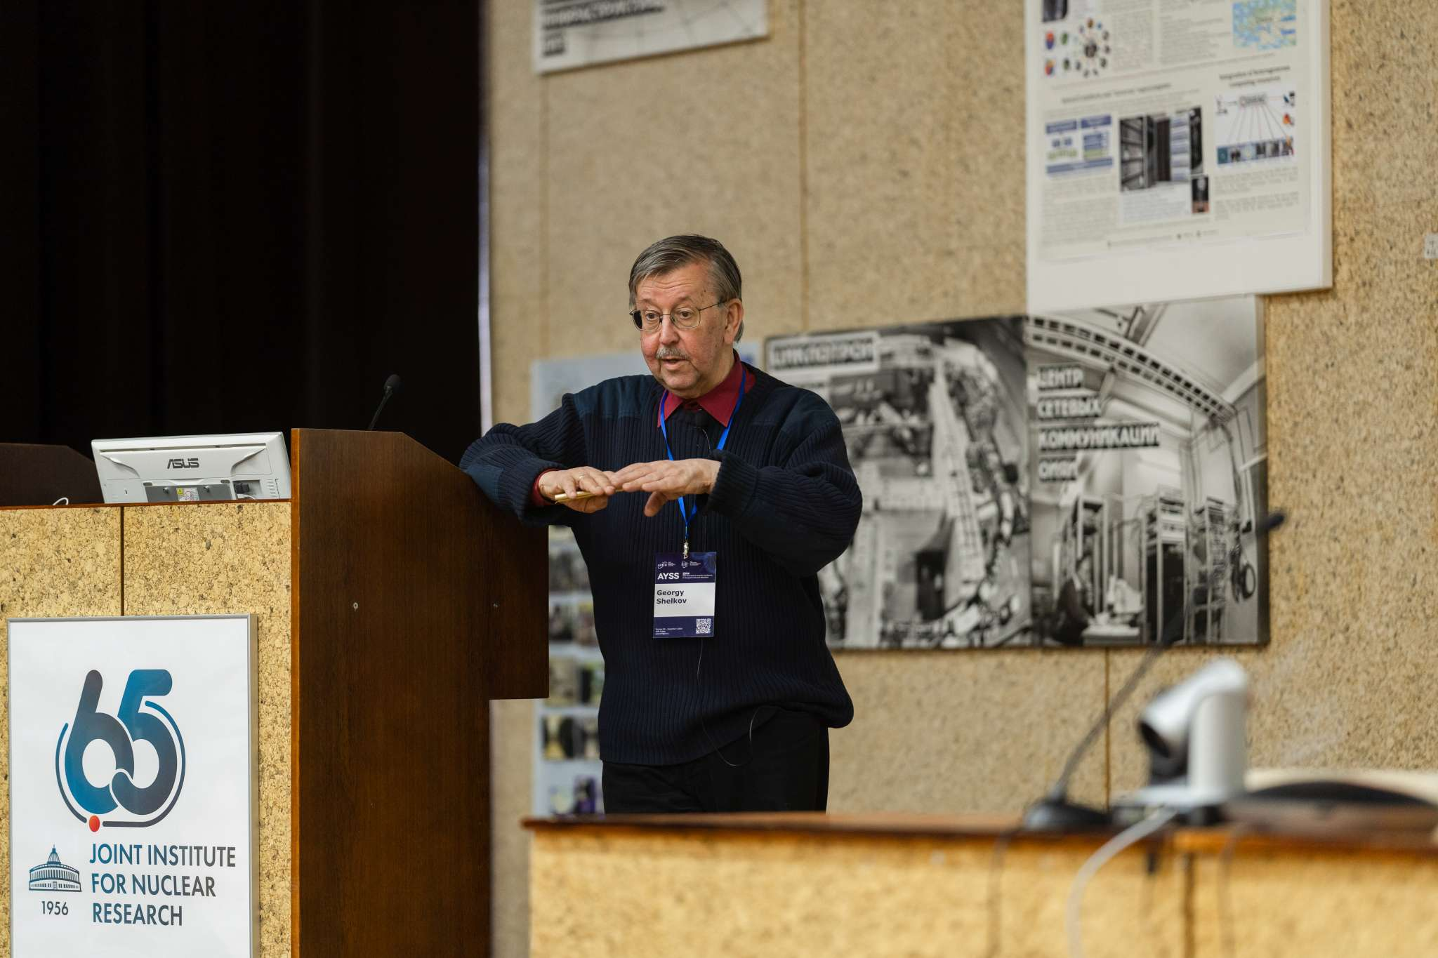
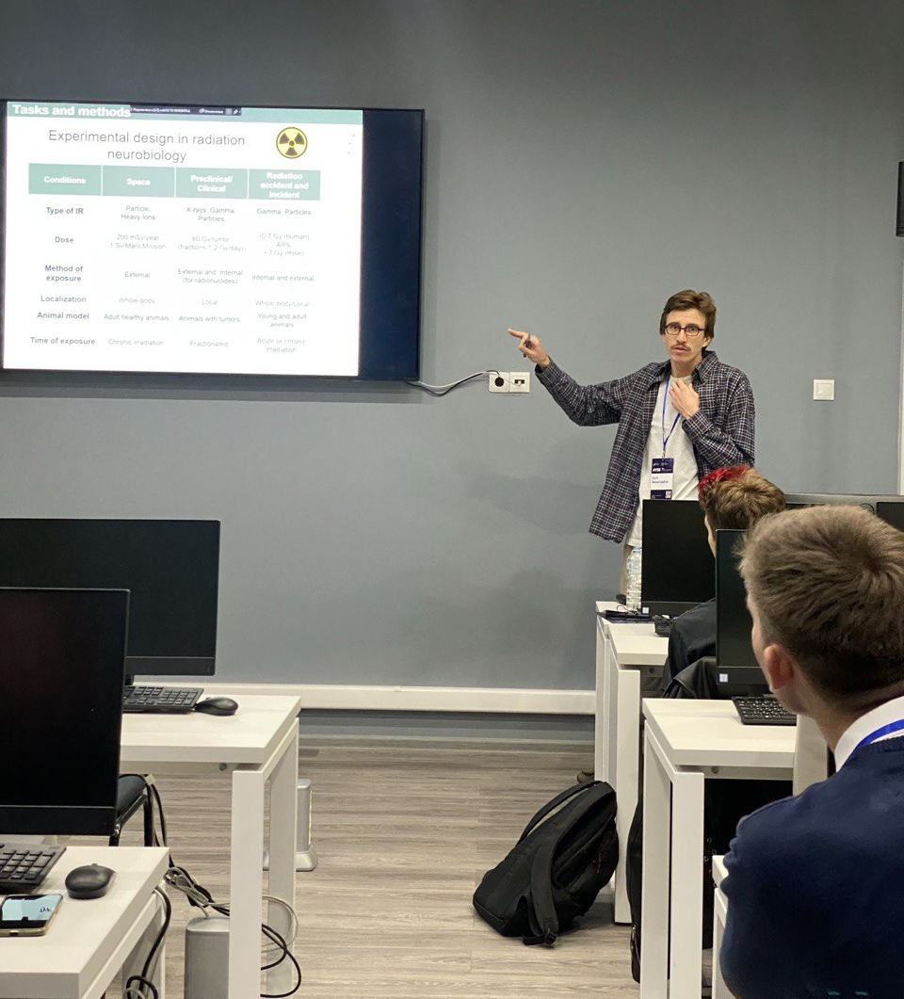
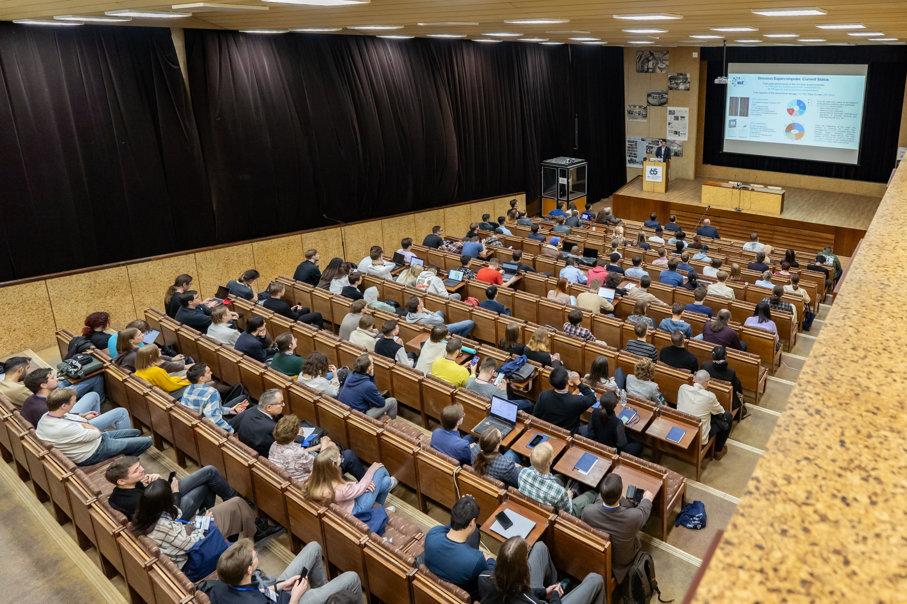
Important Events
11 Plenary talks
9 Invited opening sections talks

Slide 5
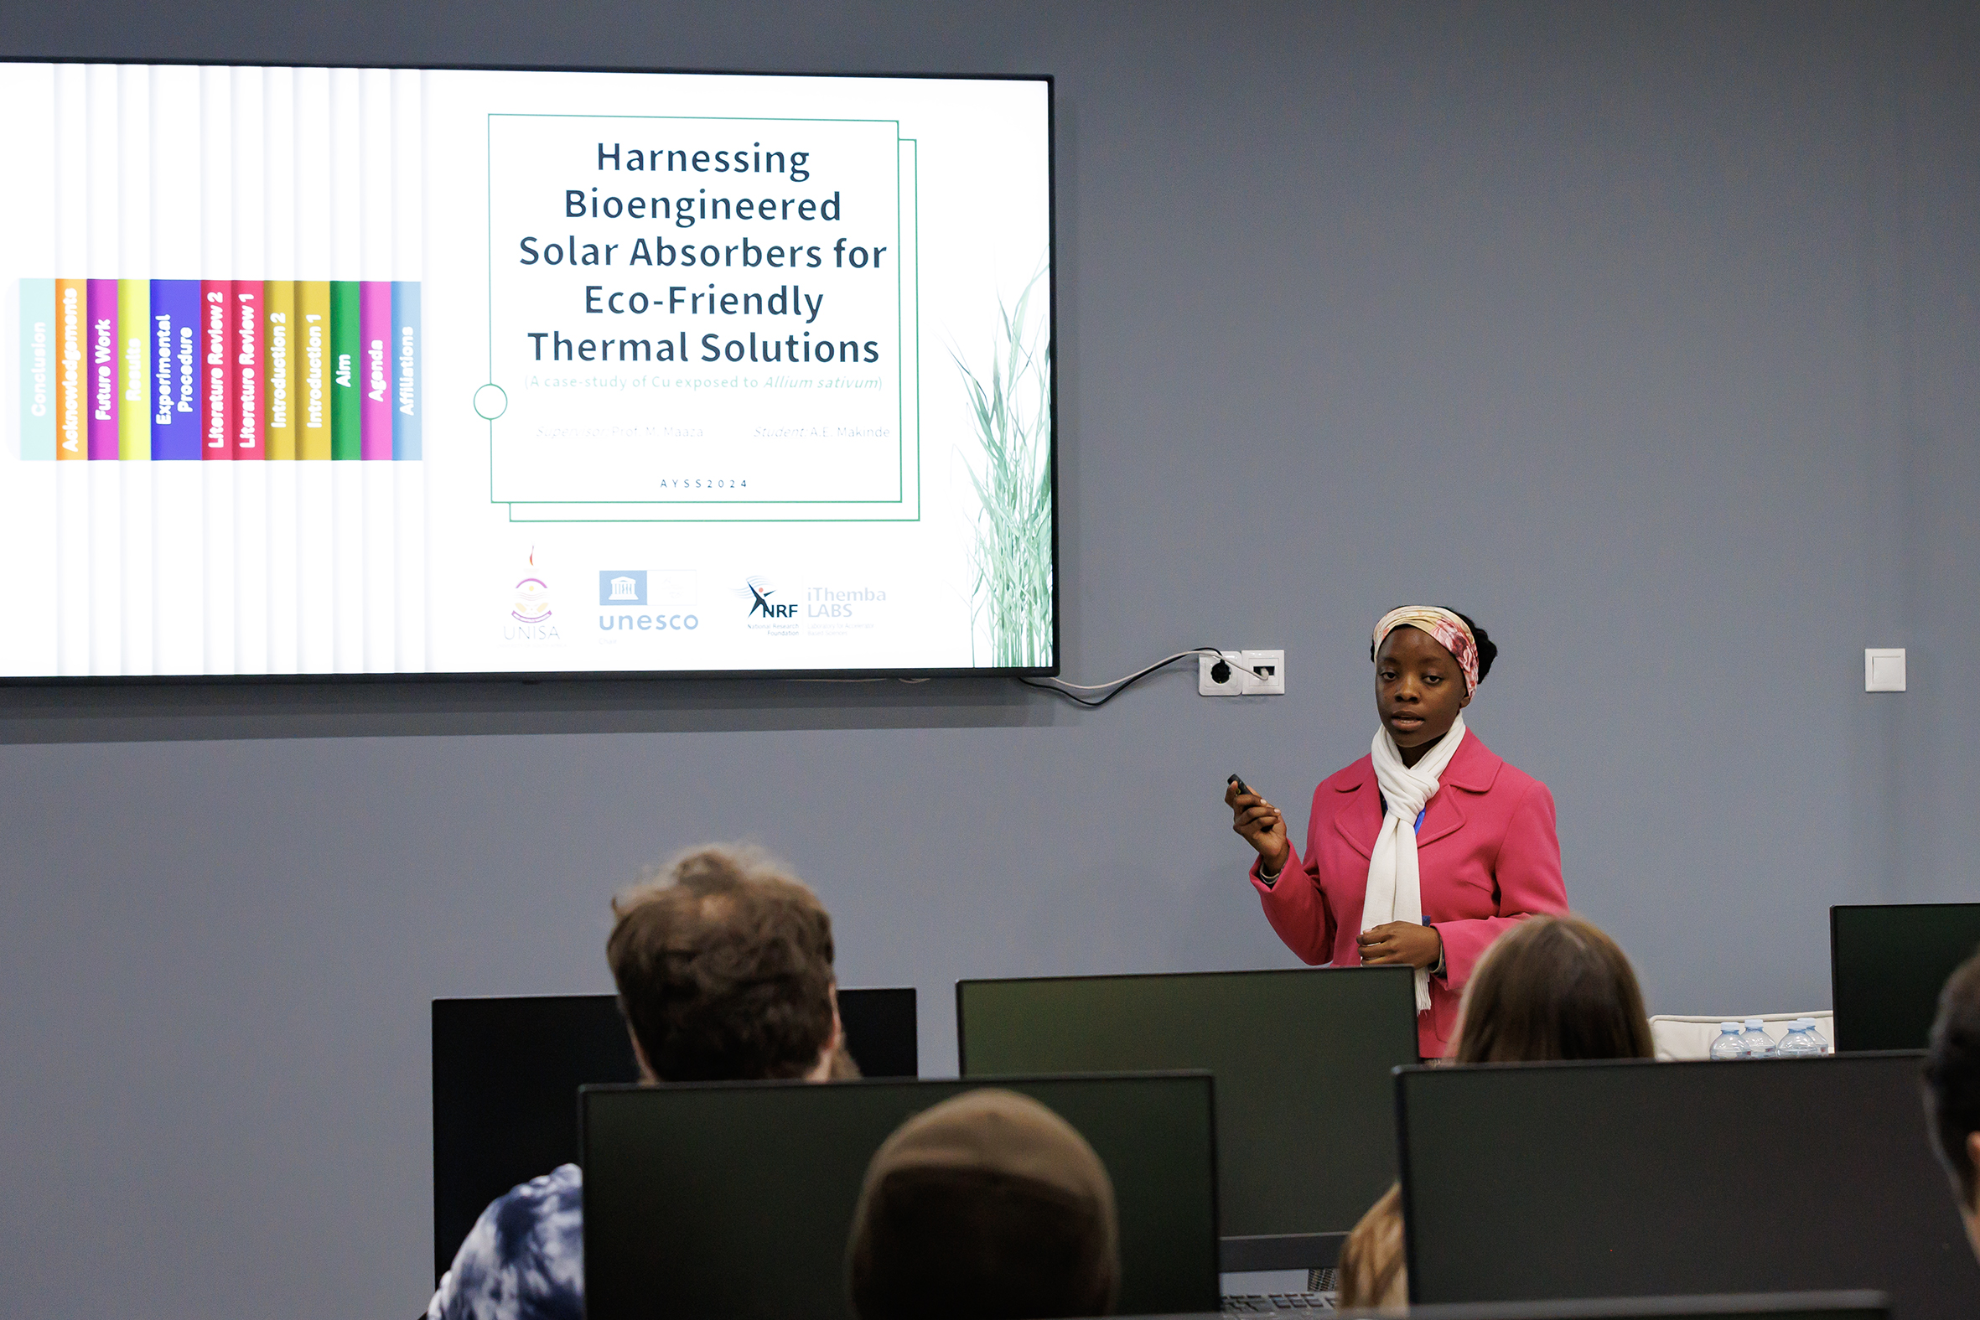
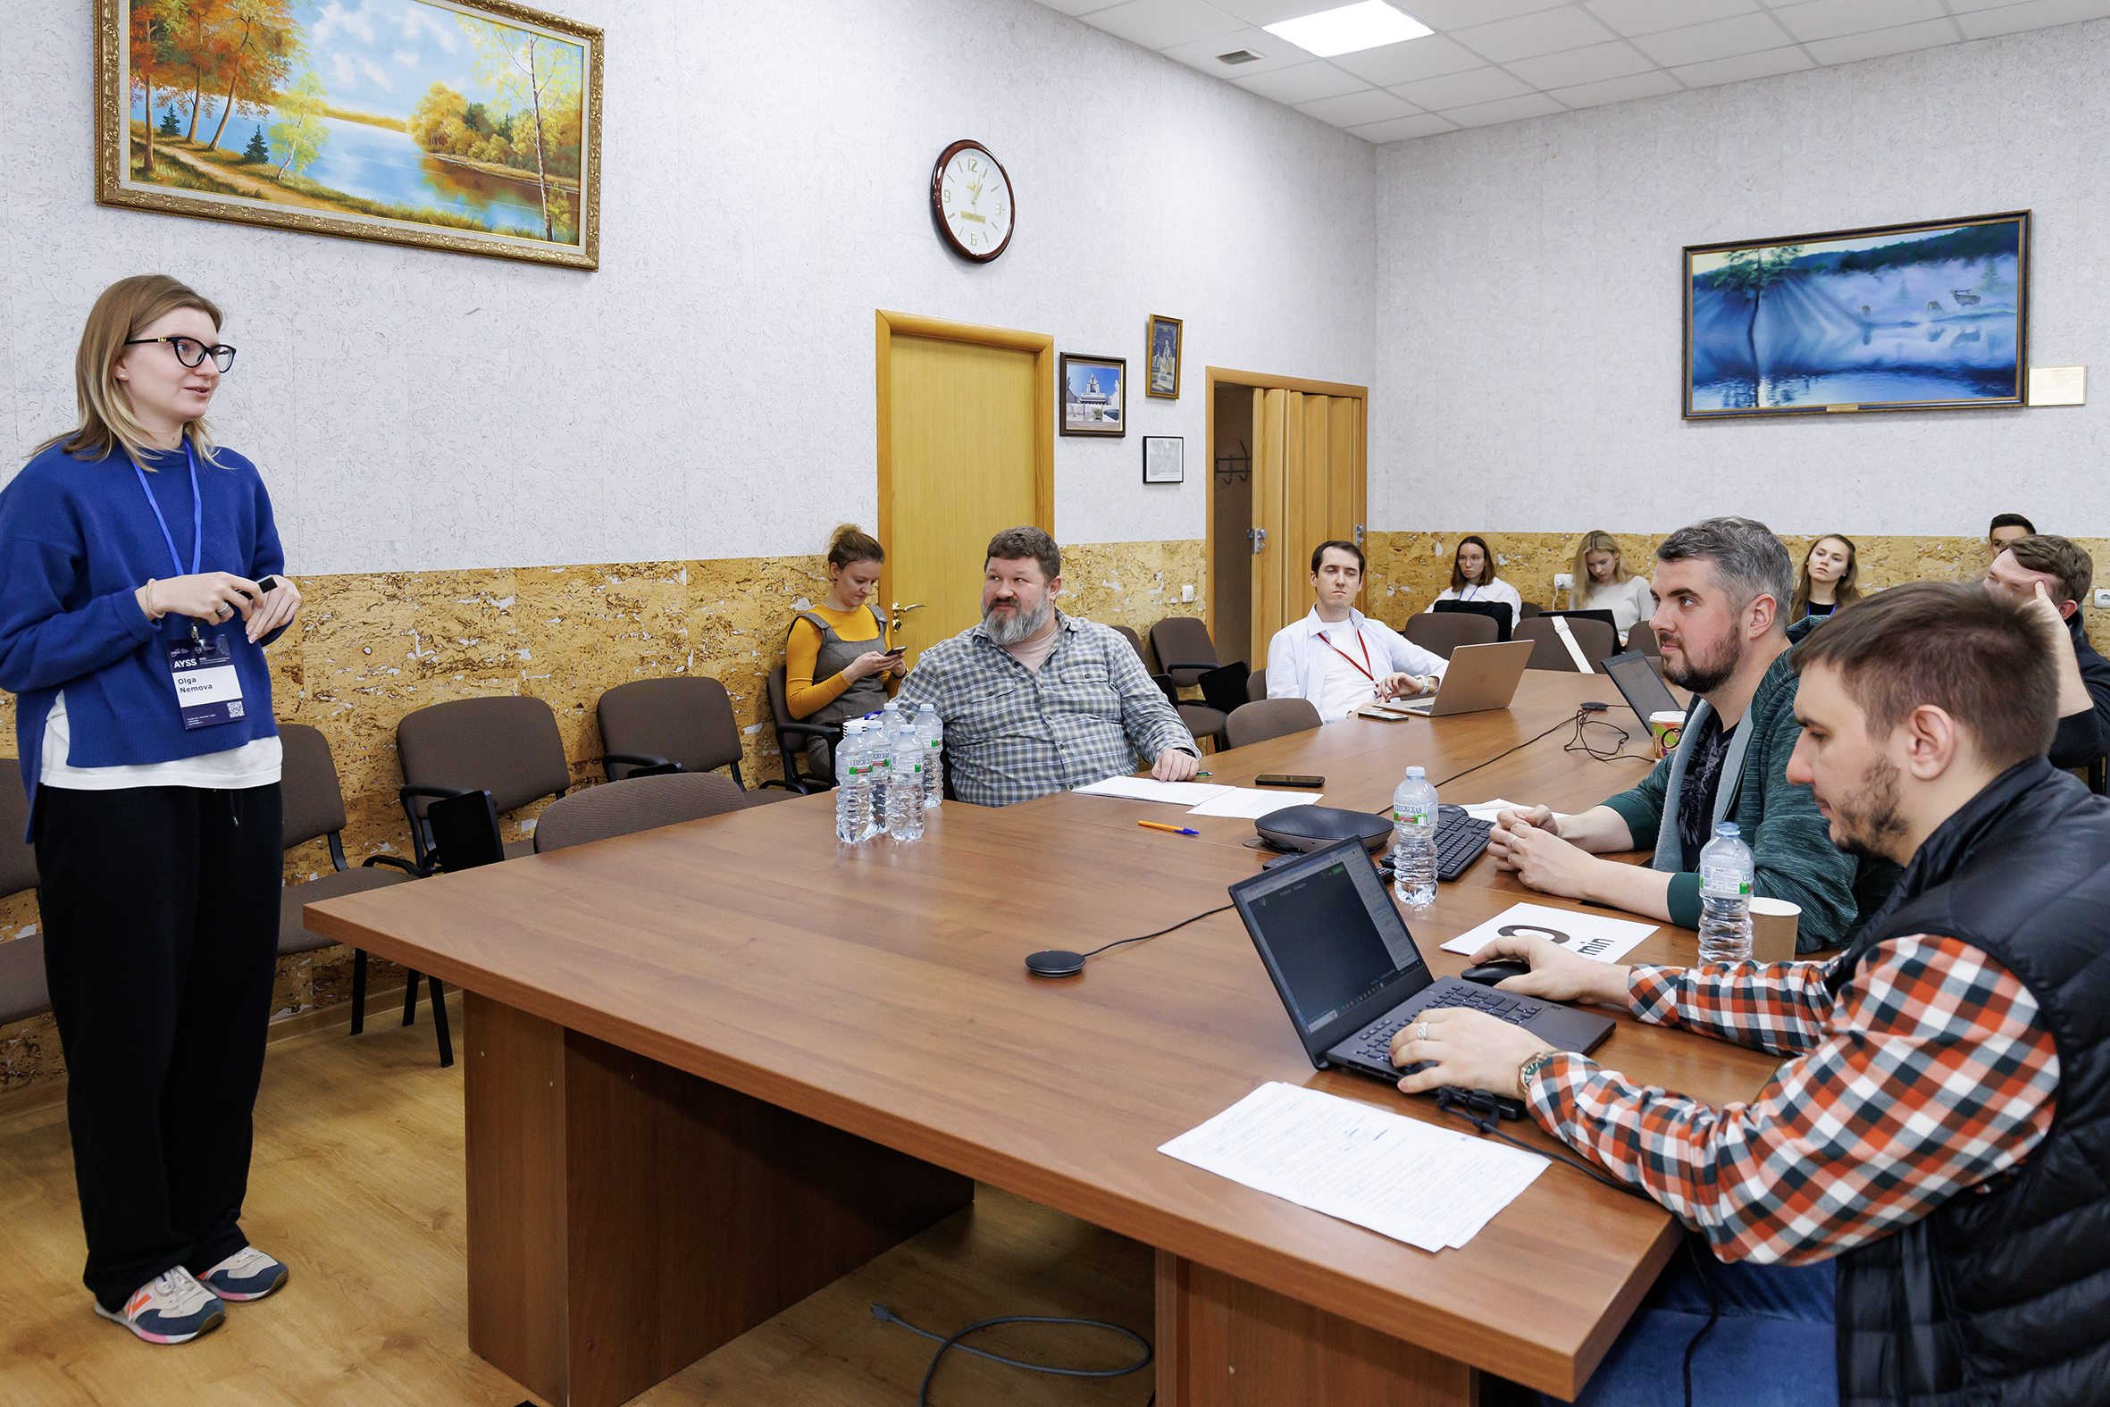
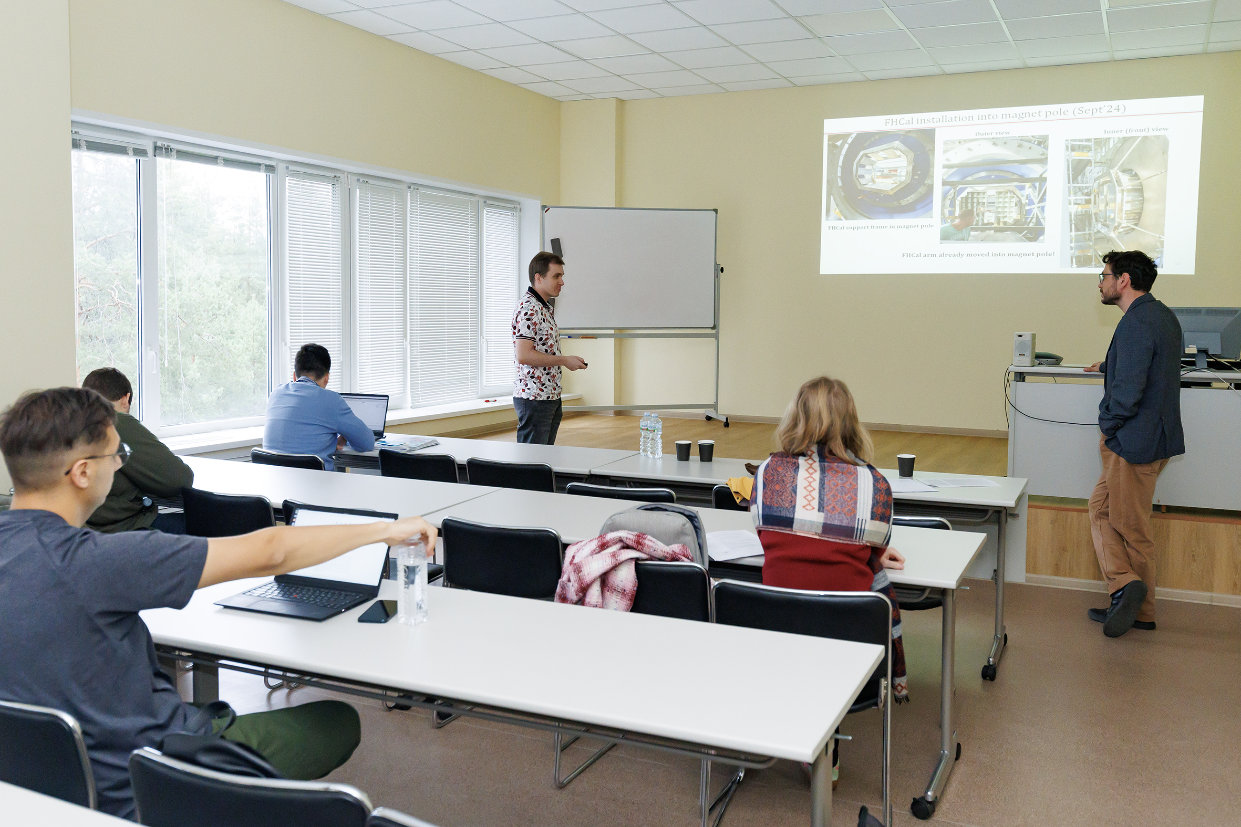
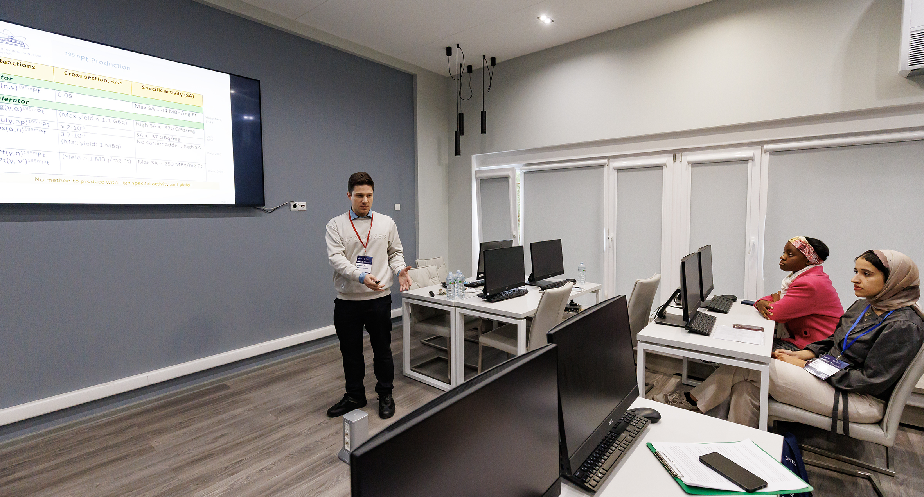
Important Events
185 Sectional talks

Slide 6
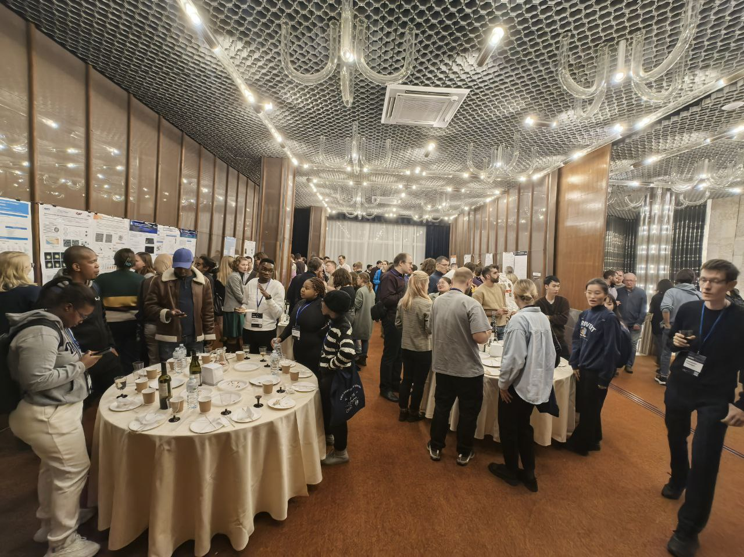
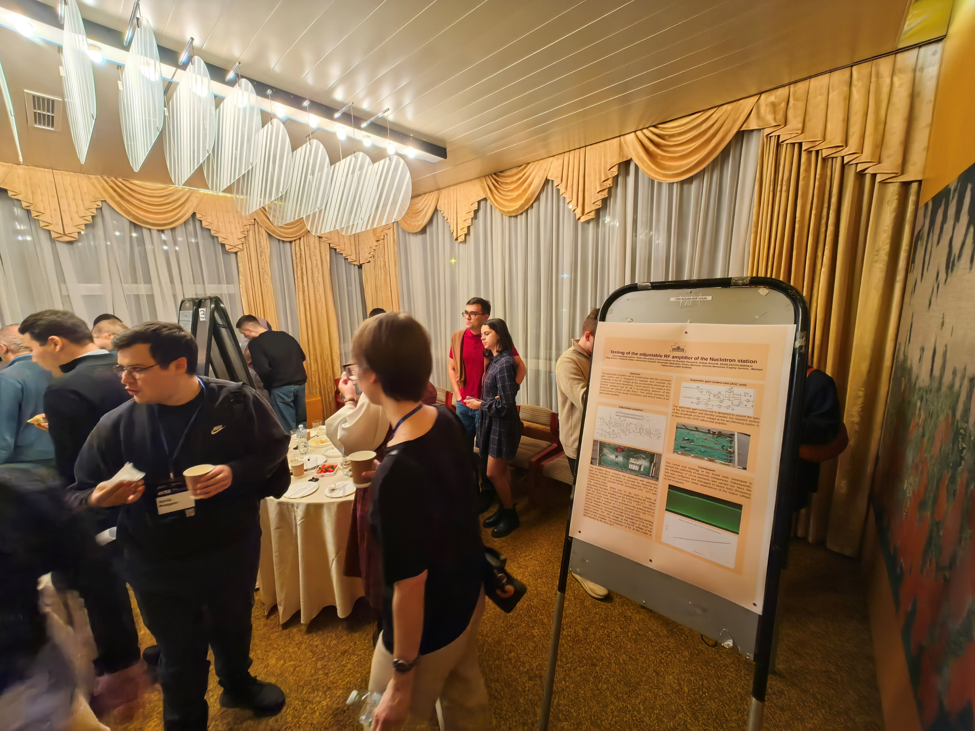
Important Events
42 Posters

Slide 7
Program Сommittee
Co-chairmen: Dmitry Kamanin (JINR) and Sergei Nedelko (JINR)
Grigory Shirkov (JINR Directorate)
Olga Derenovskaya (MLIT)
Aleksey Guskov (DLNP)
Grzegorz Kaminski (FLNR)
Sergey Kulikov (FLNP)
Ekaterina Lesovaya (LRB)
Dmitry Peshekhonov (VBLHEP)
Vladimir Rachkov (FLNR)
Timur Shneidman (BLTP)
Notes:
Co-chairman: Co-chairman:

Slide 8
Gratitude
Plenary Talks
Invited opening sections talks
Grigory Trubnikov
Dmitrii Каmanin
Victor Braguta
Alexey Guskov
Nikolay Voytishin
Georgy Shelkov
Valeri Lebedev
Norbert Kucerka
Elena Nasonova
Oleg Belov
Arkadiy Taranenko
Ekaterina Korneeva
Azam Rahmati Nejad
Priakhina Daria
Sergei Merts
Batmunkh Munkhbaatar
Iurii Severiukhin
Mereigul Tezekbayeva
Nataliya Samoylova
Tatiana Dikova
Notes:
Co-chairman: Co-chairman:

Slide 9
Gratitude
The Jury
The moderators
Gheorghe Adam
Sanda Anca Adam
Andrej Arbuzov
Anton Baushev
Maxim Bulavin
Vladimir Chausov
Dorota Chudoba
Tatiana Dikova
Alan Dzhioev
Kirill Gikal
Evgenii Mardyban
Bagdaulet Mukhametuly
Irina Pirozhenko
Danila Oleynik
Dmitry Soloviev
Anh Mai
Alfiia Mukhaeva
Bulat Bakirov
Polina Filonchik
Mariia Mardyban
Nikita Tsegelnik
Ramin Barak
Maxim Zuev
Ivan Sokolov
Varvara Chausova
Marina Donets
Notes:
Co-chairman: Co-chairman:

Slide 11
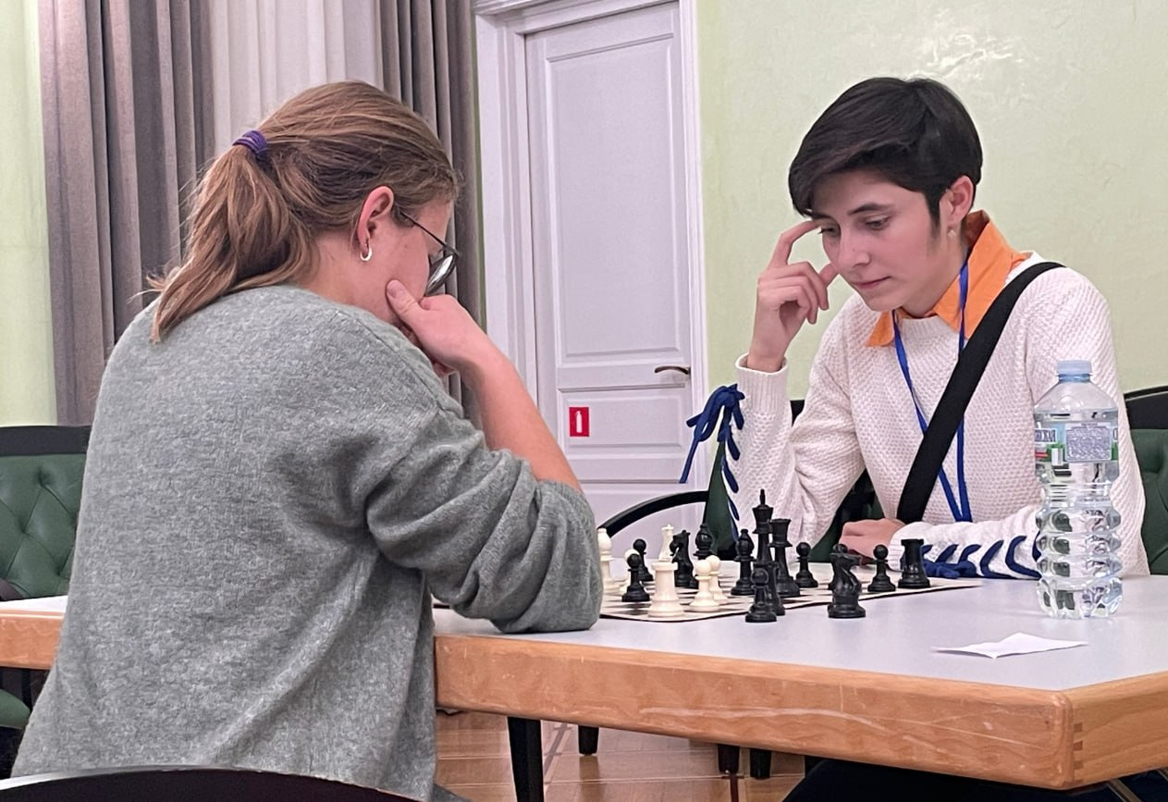
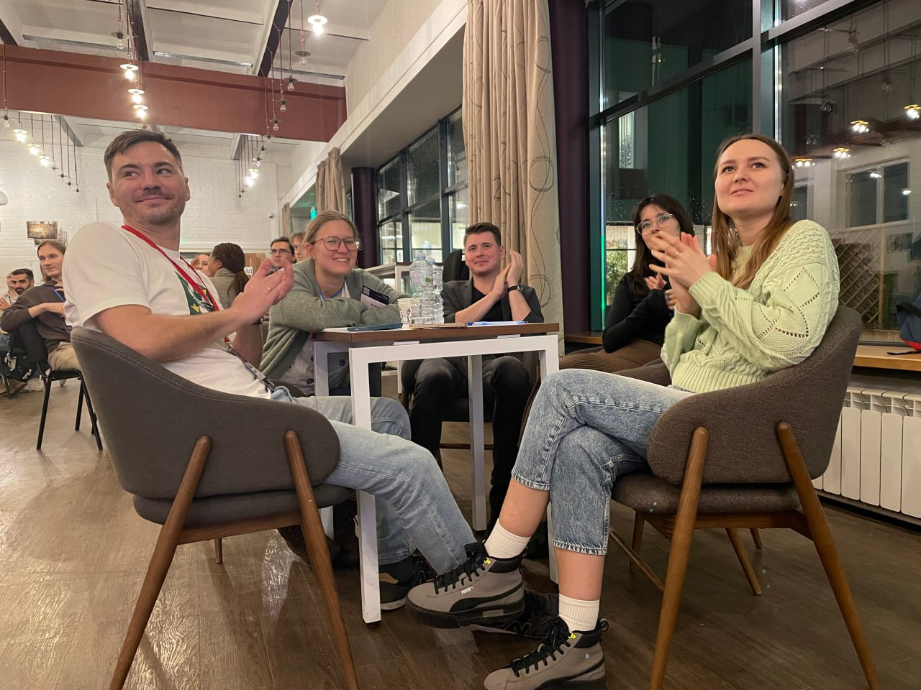
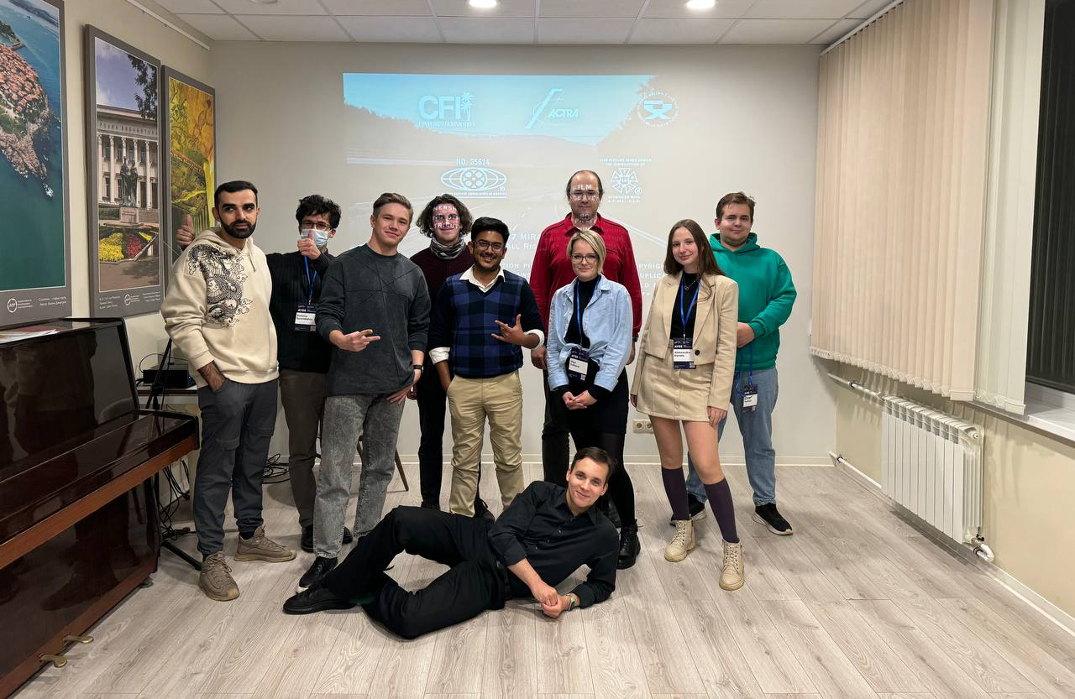
Chess Tournament
The JINR Film Union
Quiz
Notes:
Обложка фильма

Slide 12
Gratitude
Alexander Baydatsky (UC)
Olesia Chepurchenko (JINR Press Office)
Evgenyi Goryachkin (FLNR)
Ilya Kalagin (MLIT)
Elena Puzynina (JINR Press Office)
Ilya Veselov (JINR Press Office)
Eugenii Alexandrov
Maxim Podlesnyy
Kirill Petukhov
MLIT & all other JINR laboratories
Press Office
Publishing Department
International Cooperation Department
University Centre
JINR Directorate
Club of Scientists
The Blokhinka library
Hotel and Restaurant Complex Management Office
JINR International Conference Centre
And everyone who might be missed!
Notes:
Co-chairman: Co-chairman:

Slide 13
Organizing Committee
Co-chairmen: Regina Kozhina (LRB) and Alexander Madumarov (FLNR)
Dina Badreeva (MLIT)
Dinara Bulatova (JINR Press Office)
Ksenia Ilina (VBLHEP)
Ekaterina Kolosova (CPED)
Igor Pelevanyuk (MLIT)
Yulia Polyakova (ICD)
Anna Rybakova (UC)
Daria Shamina (LRB)
Veronika Smirnova (FLNP)
Rostislav Sotenskii (DLNP)
Alexey Vorontsov (MLIT)
Notes:
Regina Kozhina (LRB) Co-chairman: Co-chairman Dinara Bulatova (JINR Press Office) Ekaterina Kolosova (CPED) Igor Pelevanyuk (MLIT) Yulia Polyakova (ICD) Anna Rybakova (UC) Daria Shamina (LRB) Veronika Smirnova (FLNP) Rostislav Sotenskii (DLNP) Alexey Vorontsov (MLIT)

Slide 14
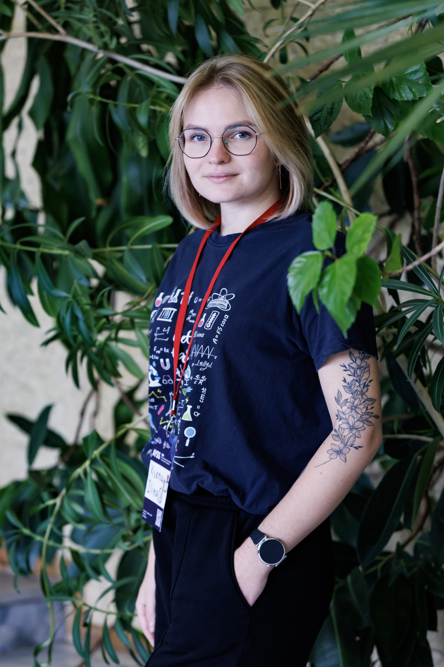
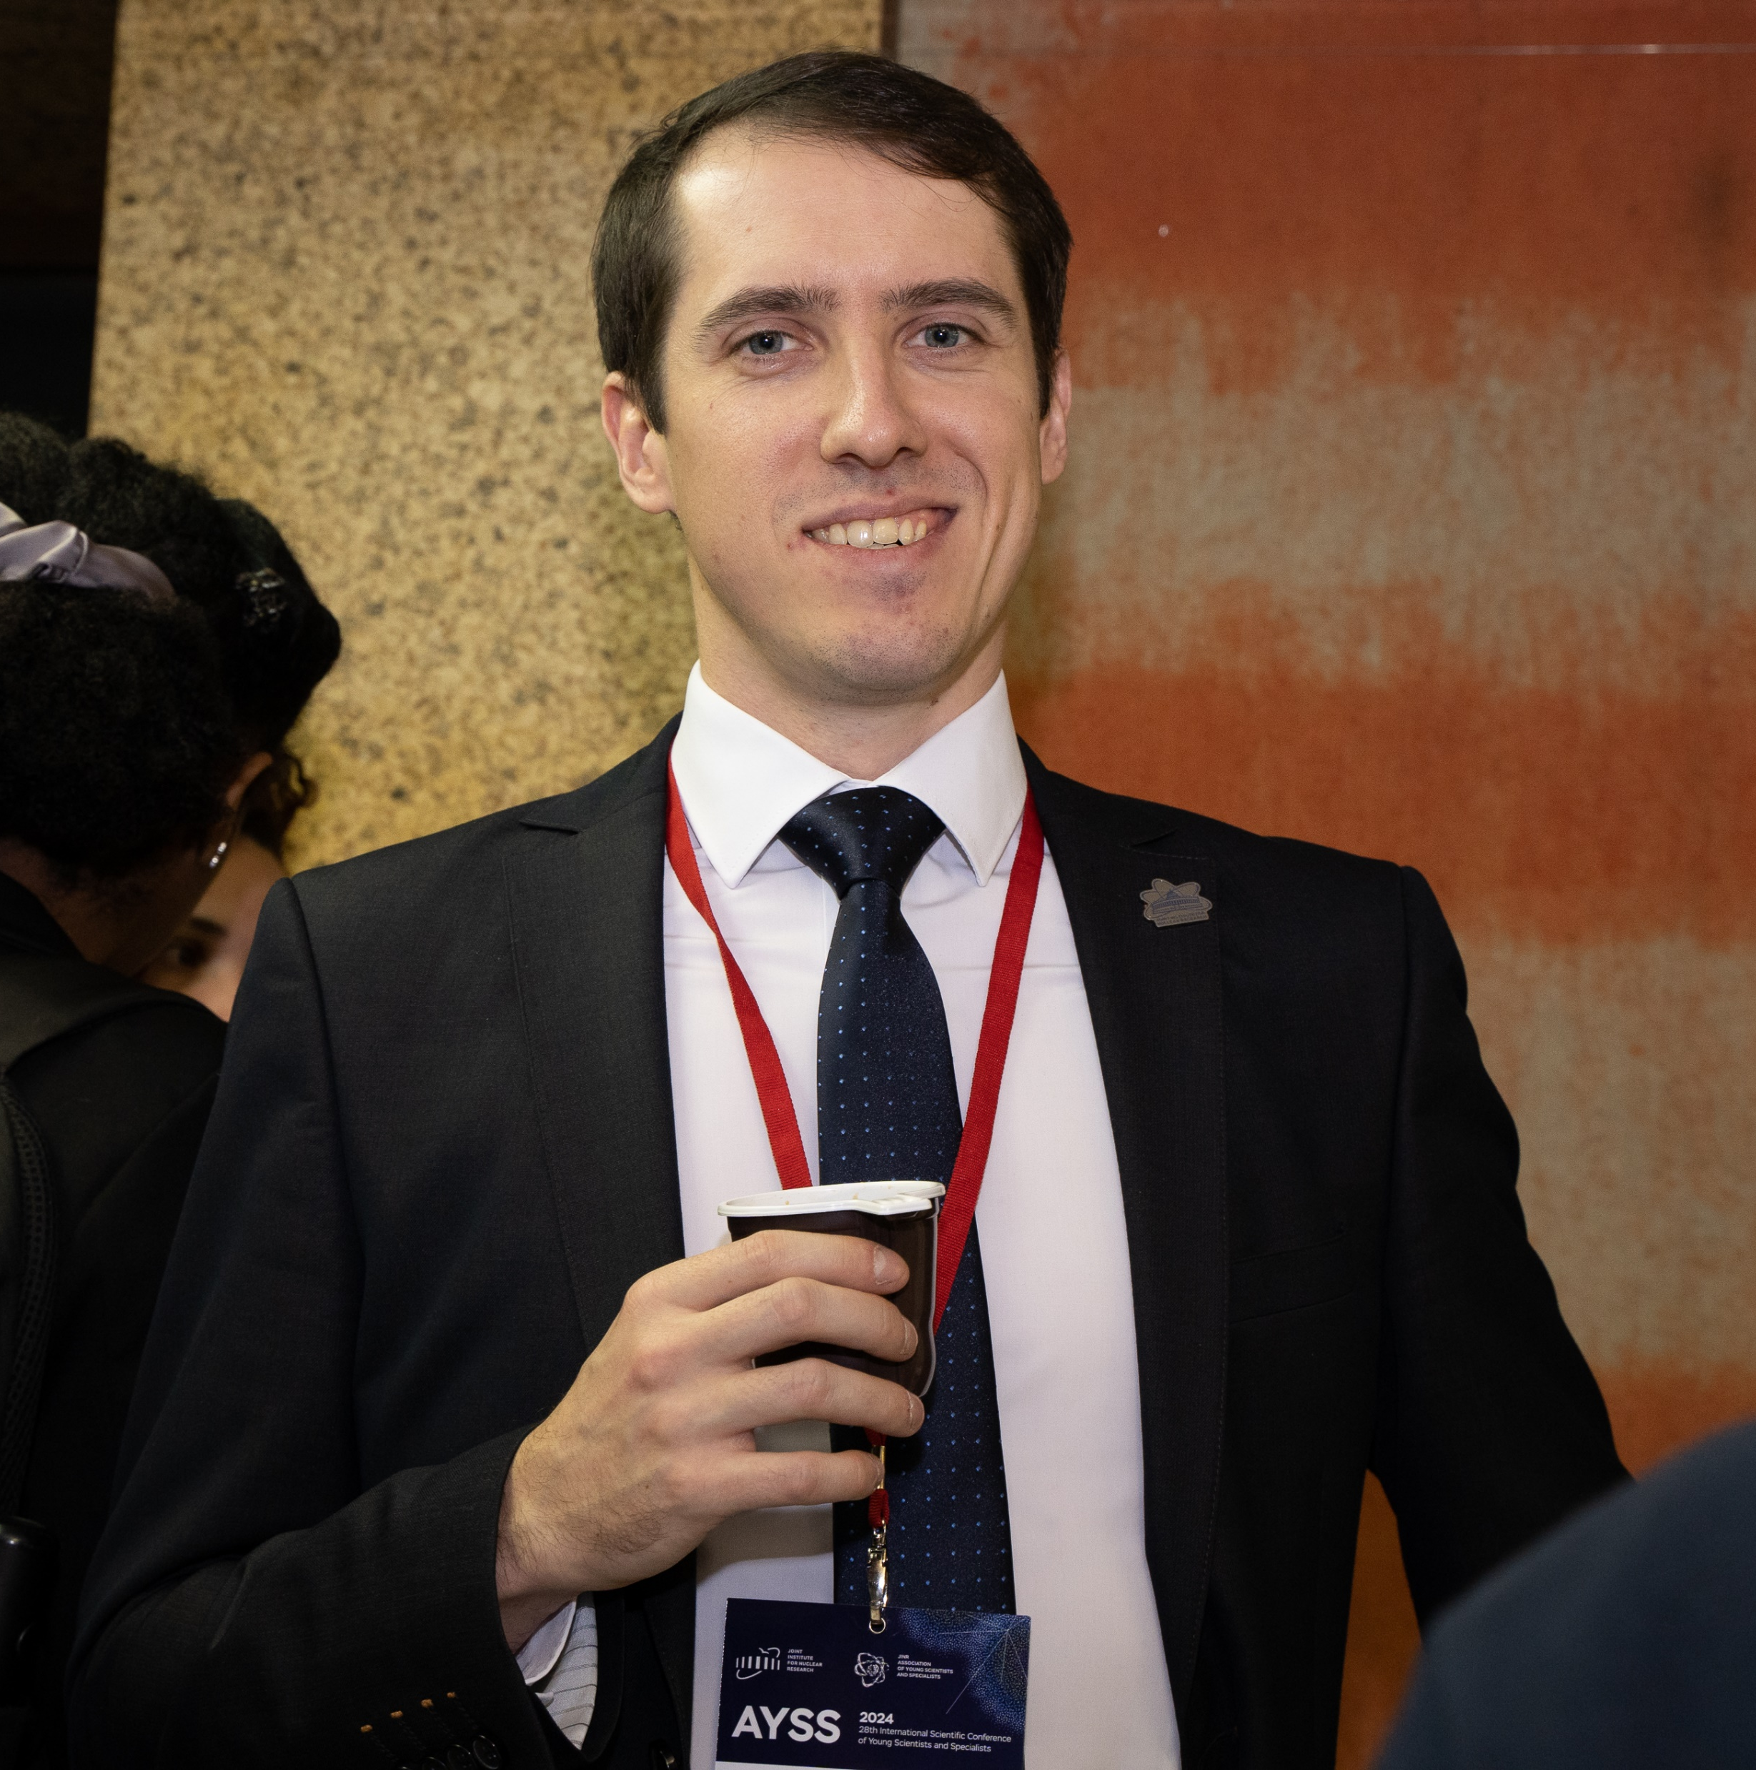
Ksenia Ilina
Igor Pelevanyuk
Veronika Smirnova

Slide 15
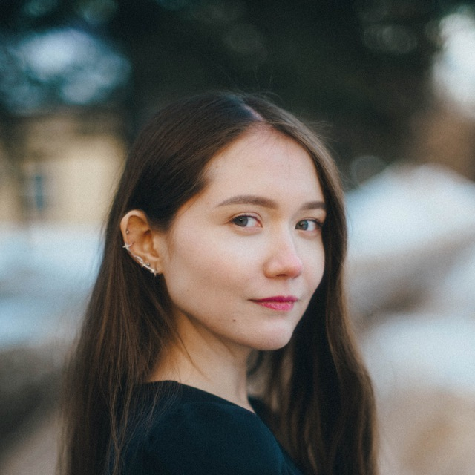
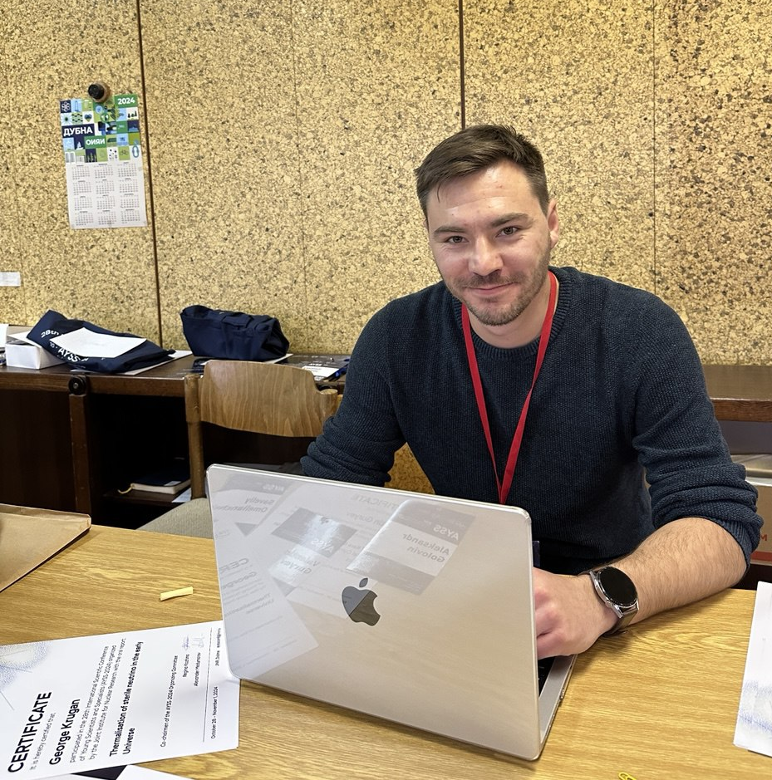
Dinara Bulatova
Rostislav Sotenskii
Alexey Vorontsov

Slide 16
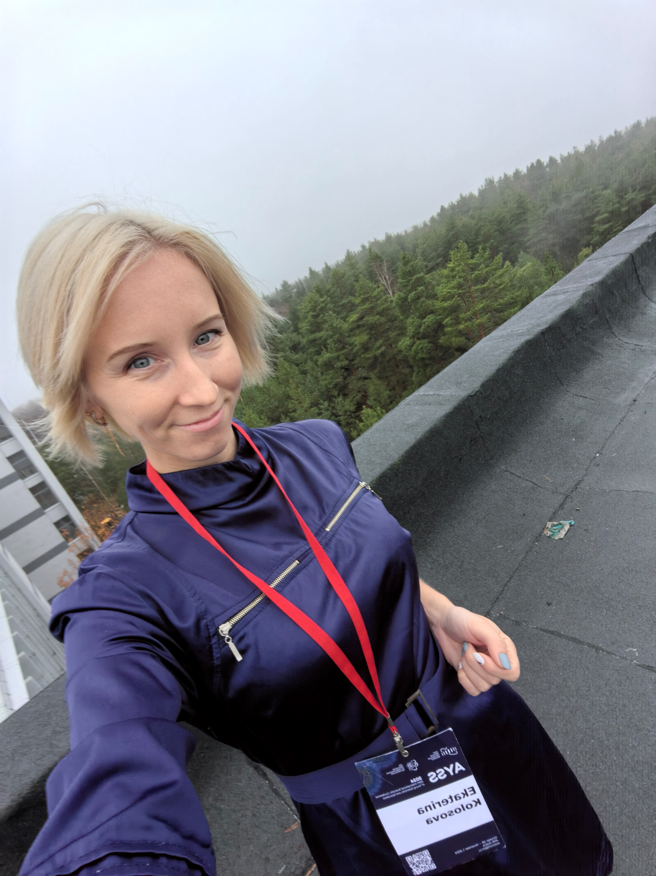
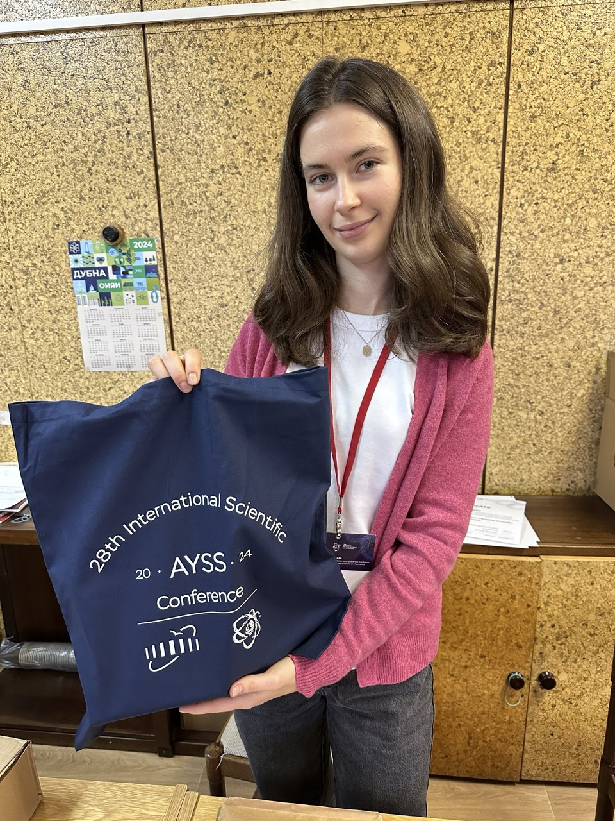
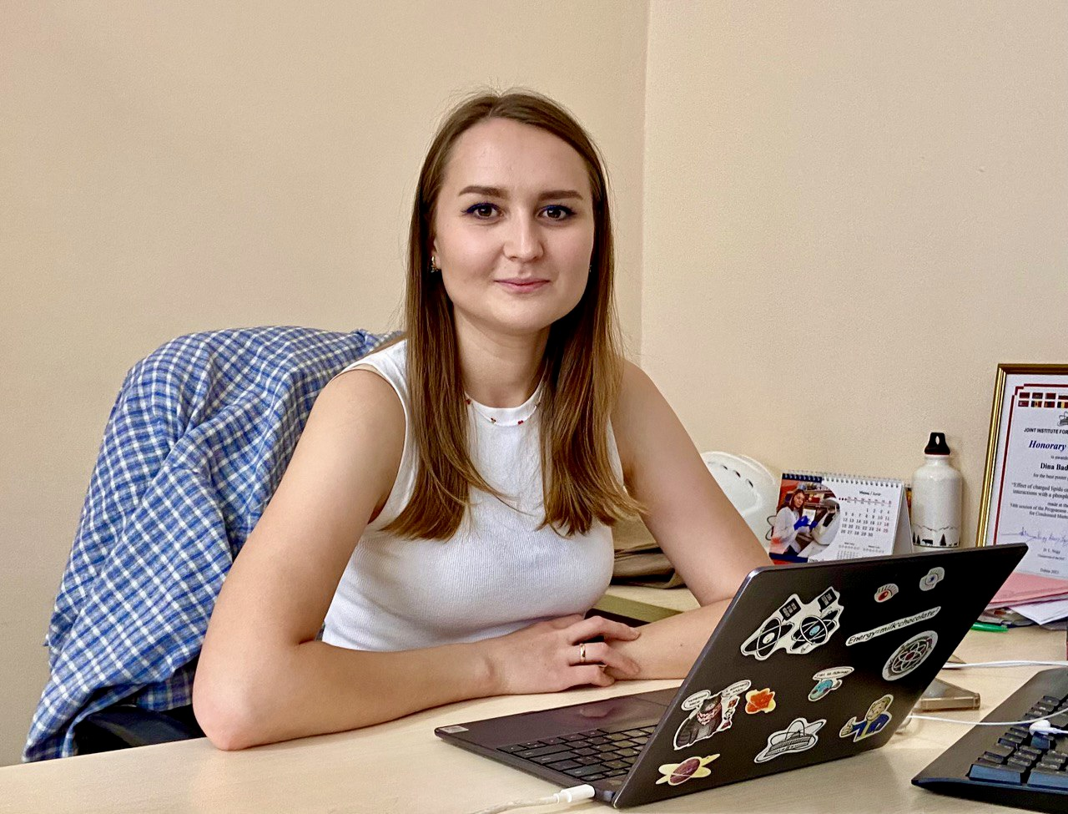
Daria Shamina
Dina Badreeva
Ekaterina Kolosova

Slide 17
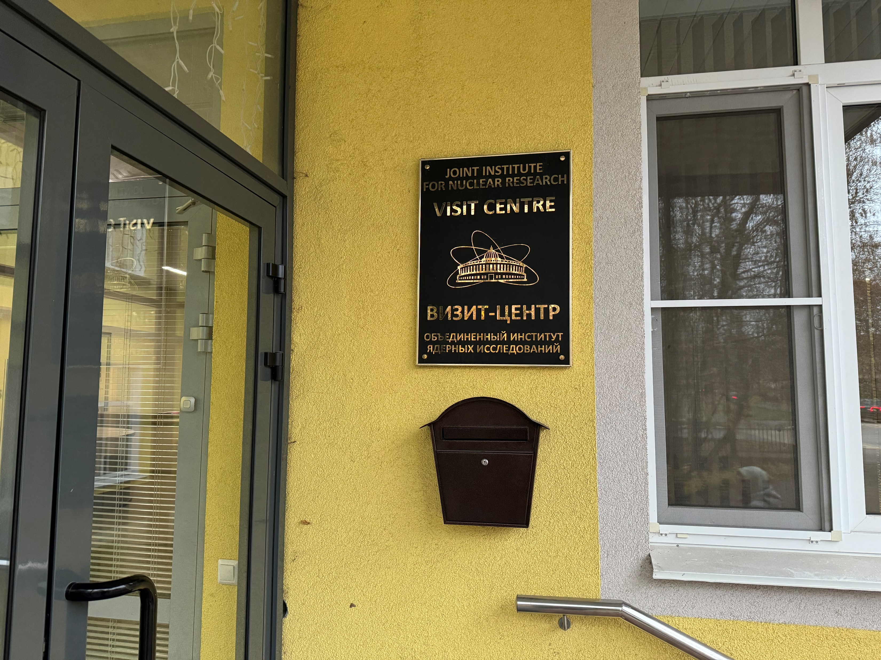
Please LEAVE your PASS at the JINR Visit Centre (5 Molodezhnaya str.)
Mailbox near the entrance

Slide 18
Proceedings Information
Proceedings will be published in “The journal of Physics of Elementary Particles and Atomic Nuclei, Letters”
All papers are subject to refereeing
Submission deadline – November 22, 2024
All proceedings are supposed to be submitted via indico page (submission, instruction)
Notes:
У всех участников есть возможность опубликовать просидинги
Сегодня открываем прием просидингов

Slide 19
Contact Info
AYSS-2024 Participants Chat
JINR AYSS Telegram Channel
JINR AYSS VK Group

Slide 20
Science brings
nations together

Slide 21
The Best Talk at Parallel Sessions

Slide 22
Theoretical Physics

Slide 23
Theoretical Physics
Sofia Klimova “Perturbative analysis of a five-parameter generalization of the teleparallel Hayashi–Shirafuji theory”
Mariia Mardyban “Low-energy spectra of nobelium isotopes”

Slide 24
Mathematical Modeling and Computational Physics

Slide 25
Mathematical Modeling and Computational Physics
Vladimir Savin “Computer simulation of shape effects in electrostatic and magnetostatic interactions”
Notes:
Computer simulation of shape effects in electrostatic and magnetostatic interactions

Slide 26
High Energy Physics

Slide 27
High Energy Physics
Vladislav Kuskov “Direct Photon Interferometry in Bi-Bi Collision at $\sqrt{{}_{}^{S}{NN}}=9.2 GeV$ with MPD”
Tahany Abdelhameid “Simulation and Optimization of Resistive Plate Chamber (RPC) Performance using Garfield++”

Slide 28
Particle Accelerators and Nuclear Reactors

Slide 29
Particle Accelerators and Nuclear Reactors
Elizaveta Bushmina
“Measurement of the electron beam profile by the multi-angle scanning method”
Andrei Martynov
“Multiple heavy ion injection into NICA Booster”

Slide 30
Experimental Nuclear
Physics

Slide 31
Experimental Nuclear
Physics
Igor Liashko “Micromegas-based Central Tracker prototype for the SPD experiment”
Aniruddha Dey “Study of fission and quasifission reaction mechanisms through mass-energy distribution measurements”

Slide 32
Information Technology

Slide 33
Information Technology
Savva Savenkov “A lightweight library prototype for Monte-Carlo simulation of relativistic nucleus-nucleus collisions based on pipeline architecture”
Ivan Sokolov “Storage Service for Scientific Documentation”

Slide 34
Condensed Matter

Slide 35
Condensed Matter
Polina Khadeeva
”Ab initio study of chemical shifts of X-ray emission spectra in ytterbium halides by the coupled cluster method”
Nikita Fominykh “Influence of point defects on charge transport in nickel ferrite NiFe2O4”

Slide 36
Applied Research

Slide 37
Applied Research
Rethabile Phokojoe “Effect of varying the chelating and precipitating agents volumes on LiNi0.8Mn0.1Co0.1O2 (NMC811)”
Sohyla Montasser Ahmed Aboudeif “Indirect Process Control Using Electrical Network Parameters for Enhanced Automation in Chemical Technologies”

Slide 38
Life Sciences

Slide 39
Life Sciences
Artem Glebov “Modeling the survival rate of a heterogeneous population of neural stem cells in response to irradiation with 56Fe particles”
Aleksandr Svetlichnyi “Calculations of the cell survival rate after irradiating with minibeams of protons and C-12”

Slide 40
The Best Poster

Slide 41
Bogdan Bombin “SuperFGD - central part of near neutrino detector of T2K experiment”
Vitalii Zavadskyi “Fast neutrino oscillation in short baseline reactor antineutrino experiments”

Slide 42
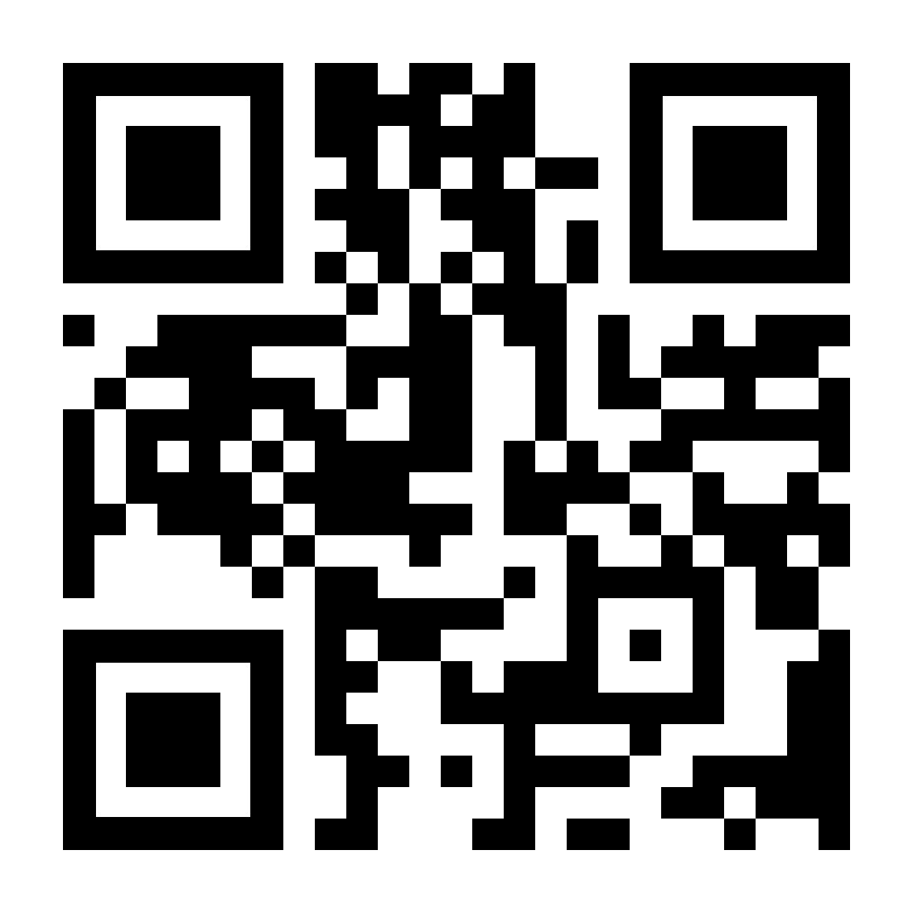
Information for Winners
We encourage you to publish your results in a new scientific journal of the JINR, the Natural Science Review - an international online peer–reviewed periodical scientific journal on natural and technical sciences. It is a platinum open access journal, free of charge to authors and readers, sponsored by the JINR.
The first issue will be published in 2024.

Slide 43
Hope to see you in future at other JINR and AYSS events!

