Slide 1
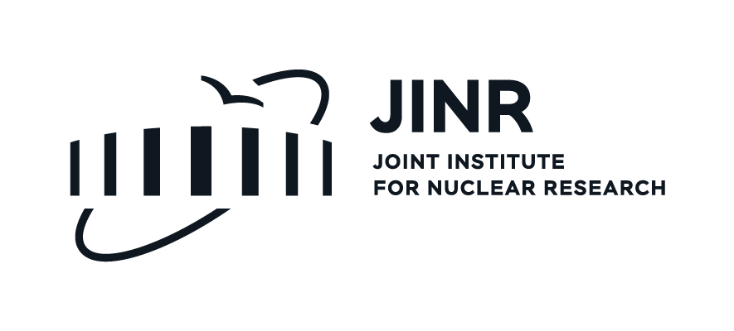
Aβ42 peptide in lipid membrane mimetics: secondary structure analysis
JINR Association of Young Scientists and Specialists
Conference Alushta-2024
Department of Raman Spectroscopy, FLNP, JINR
Yersultan Arynbek, Heba A. Esawii, Kakhramon Mamatkulov and Grigory Arzumanyan
Alushta, 9-16/June/2024

Slide 2
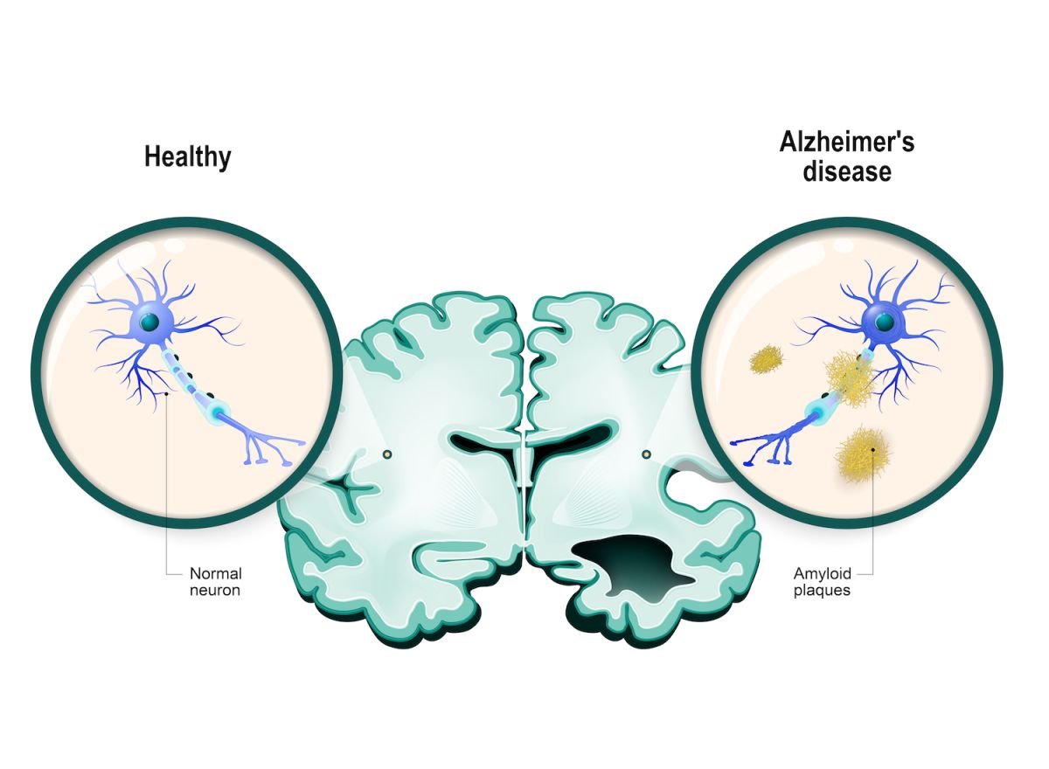
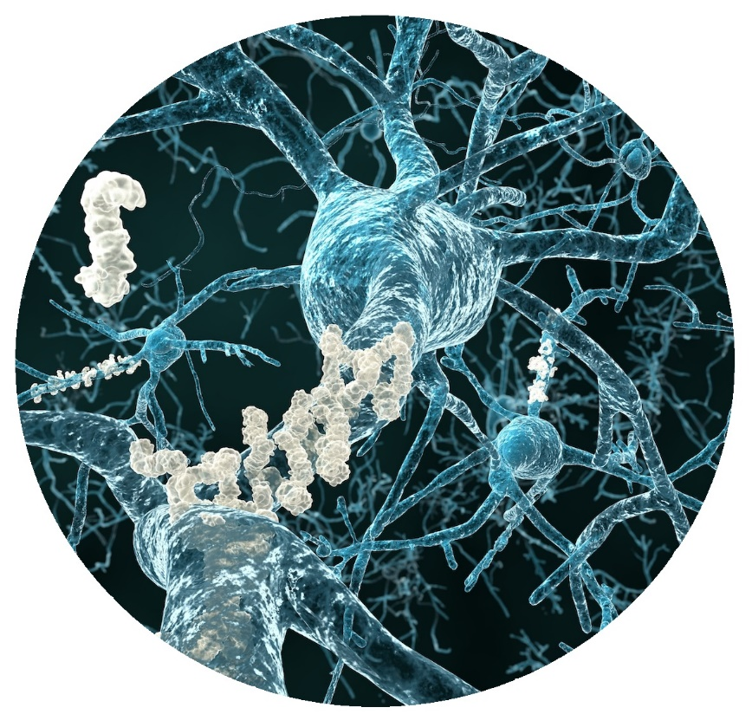
Alzheimer’s disease (AD)
Alzheimer’s disease is an irreversible, progressive brain disorder that slowly destroys memory and thinking skills and, eventually, the ability to carry out the simplest tasks.
Fig 1. Depiction of a human brain in two halves: one healthy, and one with Alzheimer’s disease.
Designua/Shutterstock.com

Slide 3
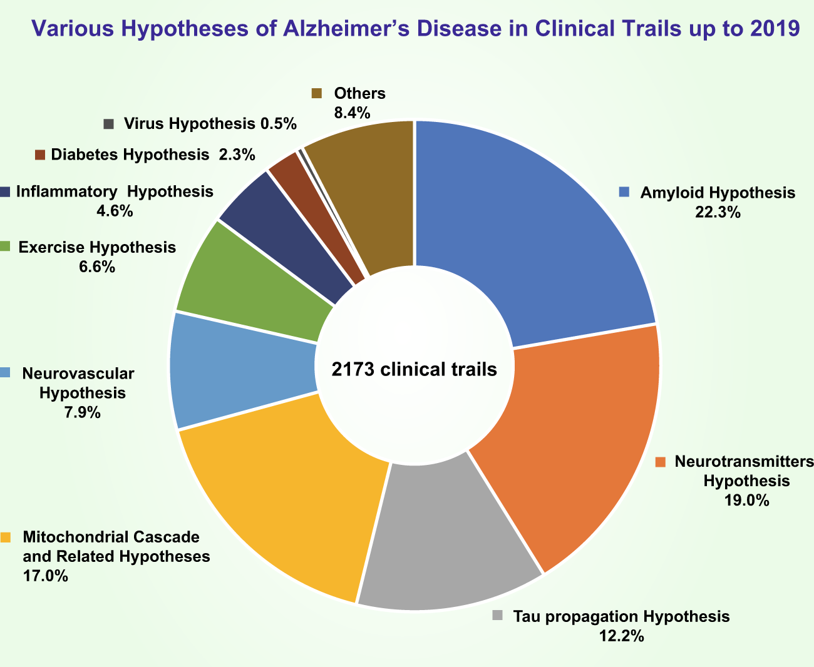
Alzheimer’s disease Hypotheses
AD is a complicated disease involving many factors. Due to the complexity of human brain, the lack of reasonable models and research tools, the detailed pathogenesis of AD is still unclear so far.
!!! Amyloid Hypothesis
Liu, PP., Xie, Y., Meng, XY. et al. History and progress of hypotheses and clinical trials for Alzheimer’s disease. Nature, Sig Transduct Target Ther 4, 29 (2019).

Slide 4
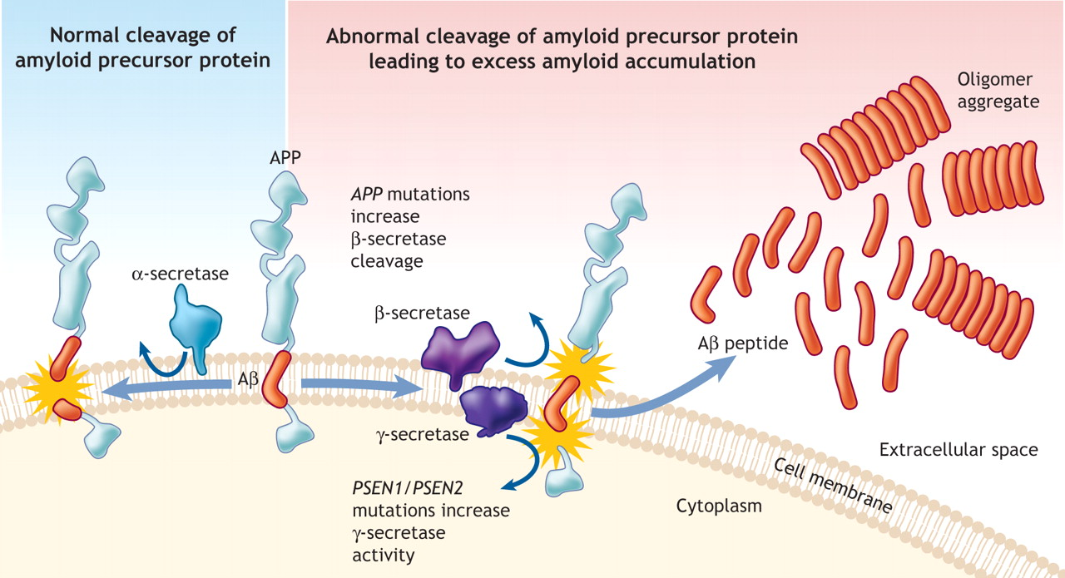
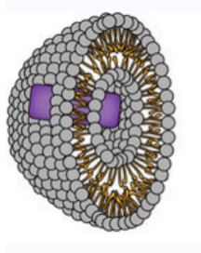
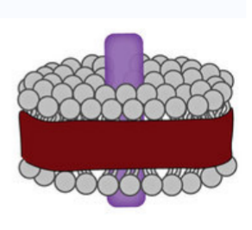
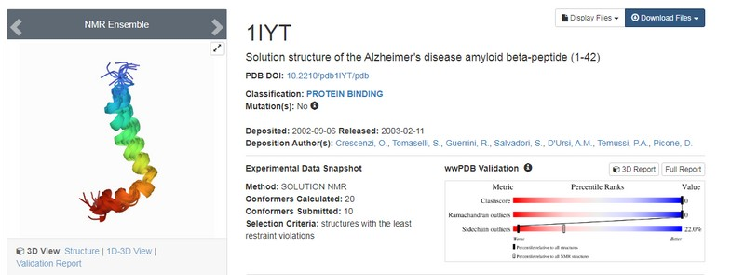
APP cleavage and lipid membrane mimetics
Investigated systems
Liposome:
Lipids(gray)
Protein(purple)
Lipodisk:
Lipids(gray)
Protein(purple)
Polymer(red)
Methods:
1. Raman Spectroscopy(Experiment)
2. Molecular Dynamics(MD) simulation
3. Density-Functional Theory(DFT)

Slide 5
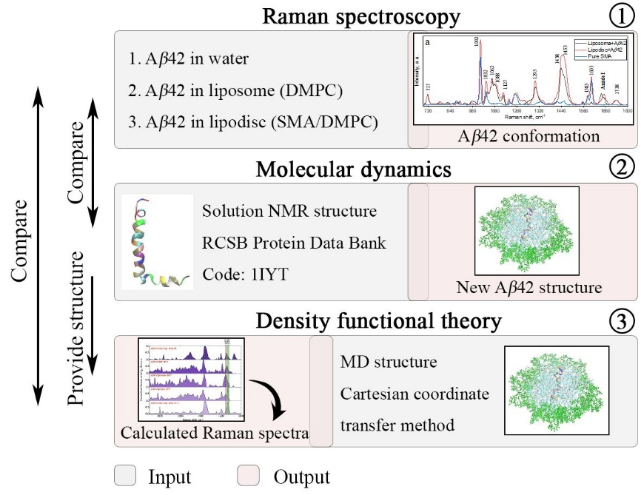
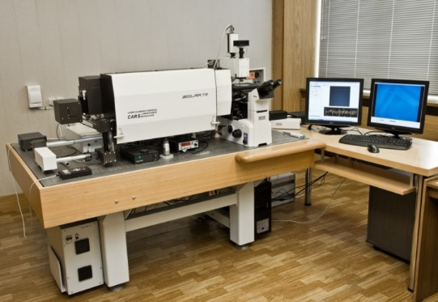
Investigation techniques
FLNP
HLIT
HLIT

Slide 6
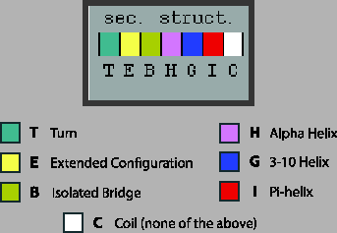
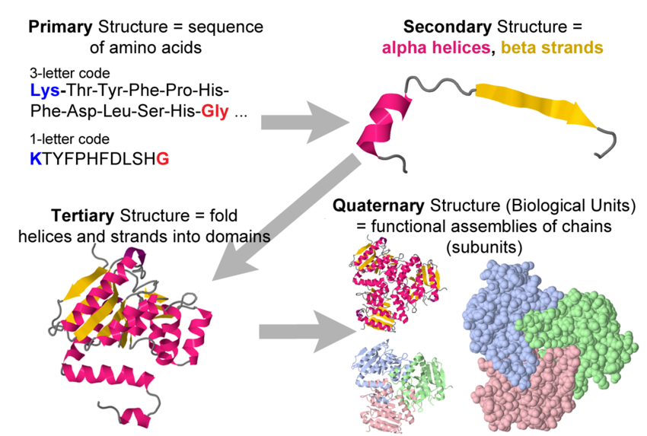
Secondary structure of protein
Amyloid fibrils are β-sheet-rich protein aggregates that are commonly found in intracellular and extracellular deposits associated with various neurodegenerative diseases, such as Alzheimer’s, Parkinson’s, and prion diseases.
More than 30% of the fibril surface is dominated by β-sheet secondary structure, further developing Dobson’s model of amyloid fibrils
(Jimenez et al. Proc. Natl. Acad. Sci. USA 2002).
Notes:
One type is the alpha (α) helix structure. This structure resembles a coiled spring and is secured by hydrogen bonding in the polypeptide chain. The second type of secondary structure in proteins is the beta (β) pleated sheet. This structure appears to be folded or pleated and is held together by hydrogen bonding between polypeptide units of the folded chain that lie adjacent to one another.

Slide 7
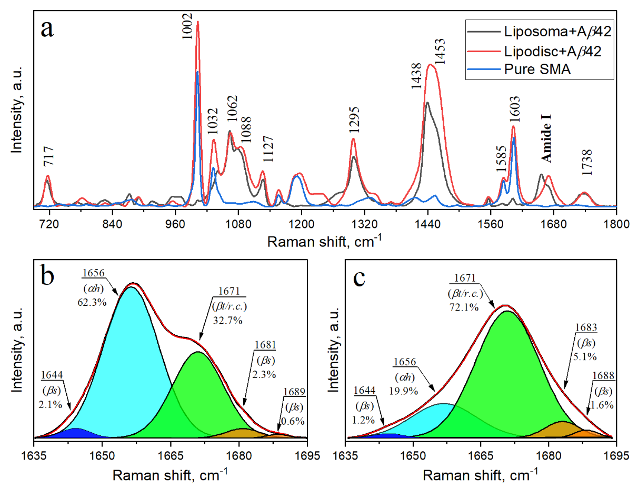
Results: Raman spectra of beta amyloid in lipid mimetics
a) Raman spectra of SMA (blue line), liposome/peptide (black line), and lipodisc/peptide (red line) with a molar ratio (SMA/DMPC) of 1.28.
Deconvolved Raman spectra of the peptide in the Amide I region:
(b) in liposome/peptide,
(c) in lipodisc/peptide.
Red line - fitted curve, filled areas - deconvolved spectra by Gaussian function. αh – α-helix, βt/r.c. – β-turn/random coil, βs – β-strand.

Slide 8
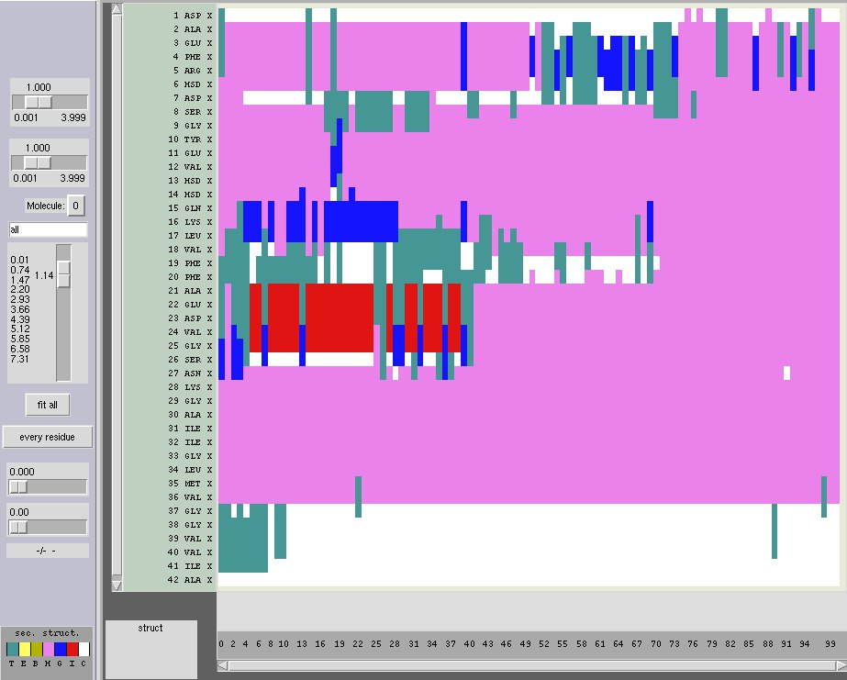
MD results: 1IYT(Aβ42) in lipid mimetics
Secondary structure | Pedtide’s initial structure, % | Peptide in liposome, % | Peptide in lipodisc, %
Random coil | 4.76 | 19.61 | 12.02
ß-turn | 21.42 | 7.94 | 71.4
ɑ-helix | 73.81 | 69.93 | 14.2
others | - | 2.52 | 2.38

Slide 9
Summary
Our findings have indicated that the secondary structure of Aβ42 in liposomes is dominated by the time-stable α-helix conformation. Interestingly, yet we have expected to observe the same peptide conformation presented in lipodisc, it has surprisingly been revealed to turn to the β-turn/random coil.
The results of the Raman, MD and DFT study have shown that Aβ42 peptides presented in liposomes maintain their native form, unlike lipodiscs.
Acknowledgements: Authors have benefited from much useful access to the HybriLIT heterogeneous computing platform kindly provided by MLIT, JINR
Journal of Biomolecular Structure and Dynamics, Published online: 23 Mar 2024

Slide 10
THANK YOU FOR YOUR KIND ATTENTION!

