Slide 1


Status of development of high-power semiconductor RF amplifiers for basic facilities of FLNR JINR
Engineer of the
HF Accelerator Systems Group
Belozerov Dmitriy

Slide 2
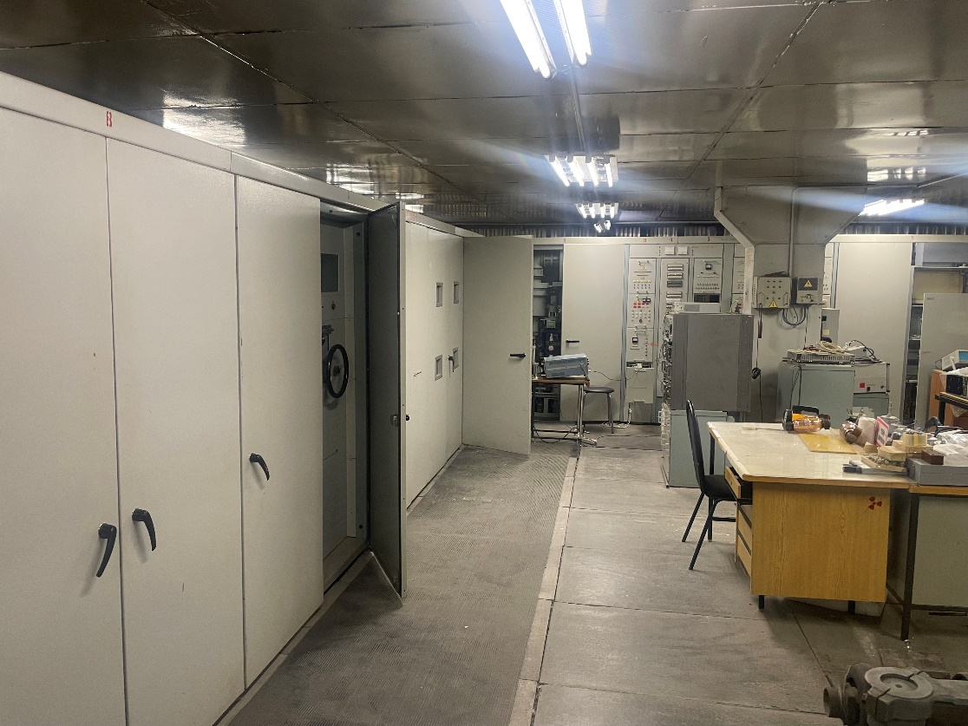

High Frequency amplifier of U400
Amplifier structure

Slide 3
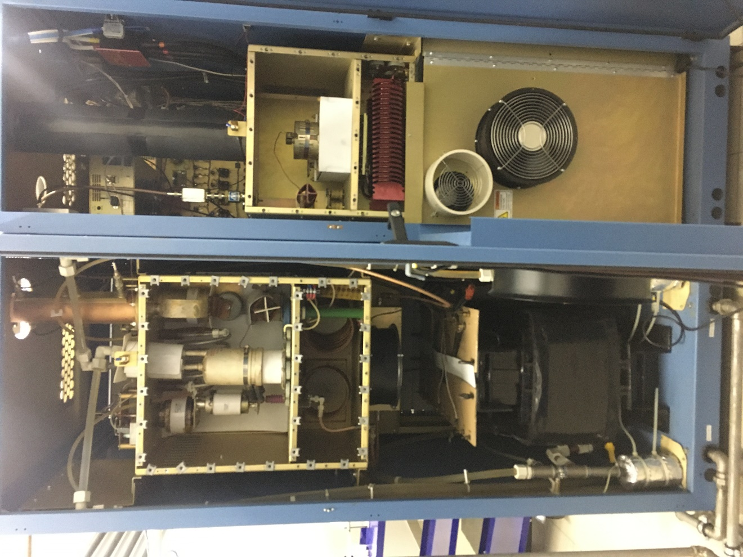
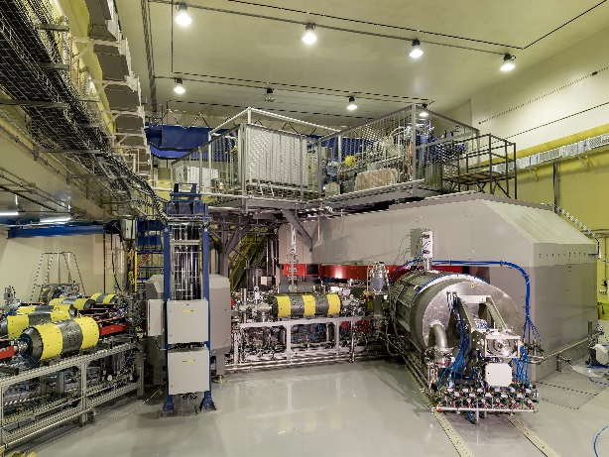
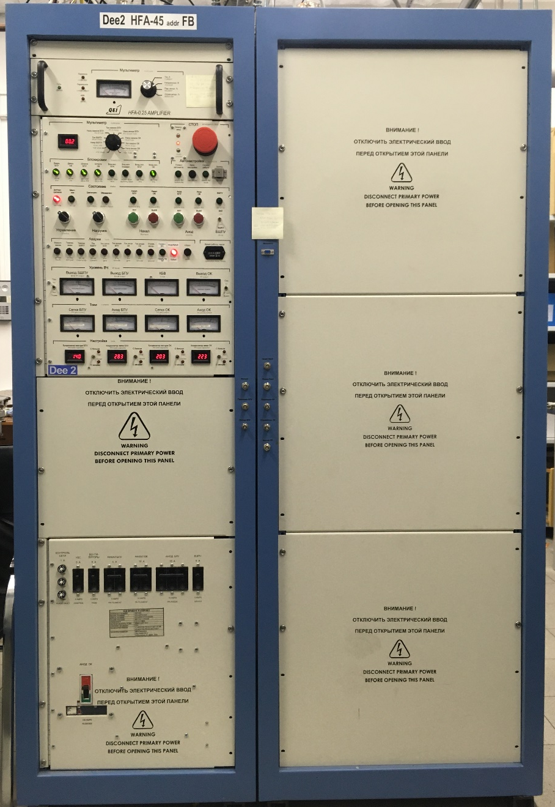
High Frequency amplifier of DC-280
Amplifier structure

Slide 4
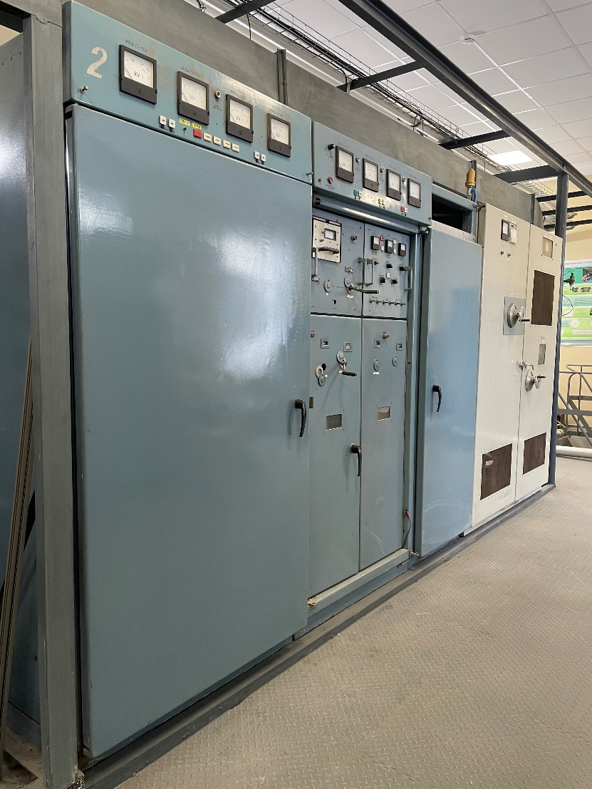
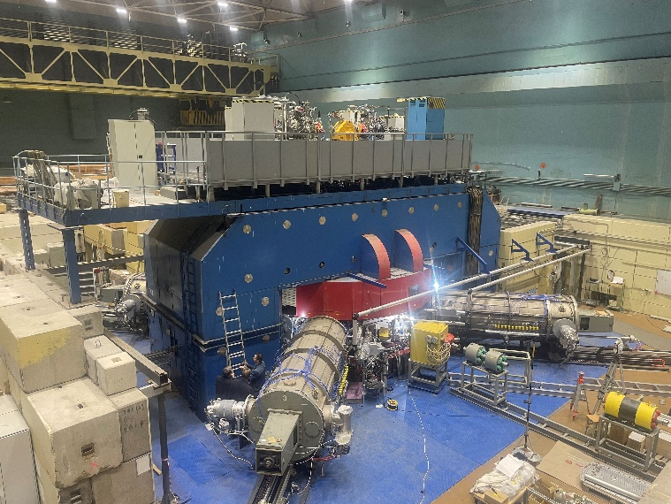
High Frequency amplifier of U400M (MC400)
Amplifier structure

Slide 5
Required power and frequency parameters
 | U400М (MC400) | U400 | DC-280
 |  |  | Main res. sys | Flat-Top res. sys
Range of operating frequencies | 11 ÷ 22 MHz | 5,9 ÷ 12 MHz | 7,2 ÷ 10,4 MHz | 21,6 ÷ 31,2 MHz
RF power for a single resonator | Up to 30 kW | Up to 35 kW | Up to 25 kW | Up to 2 kW
quantity of resonators | 4 | 2 | 2 | 2

Slide 6
Structure of a high-power semiconductor amplifier

Slide 7
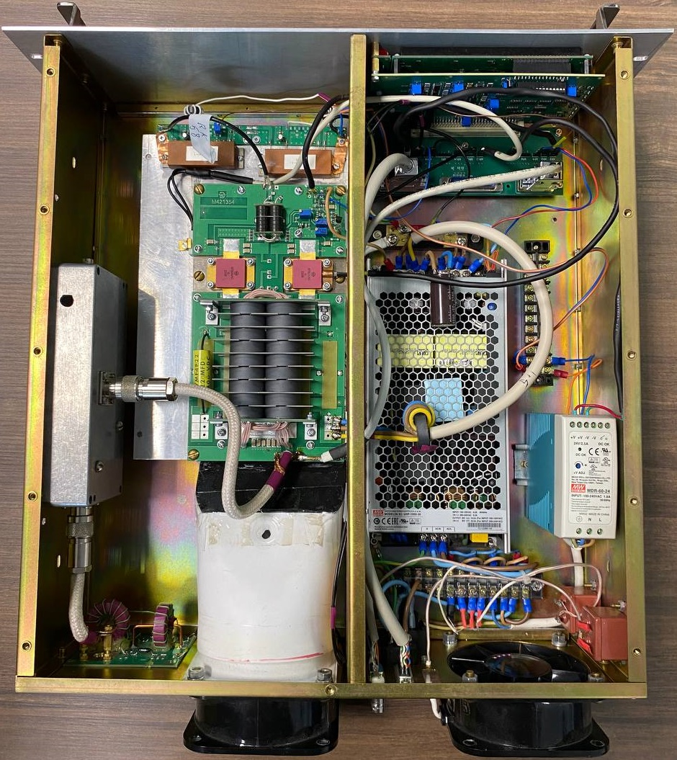
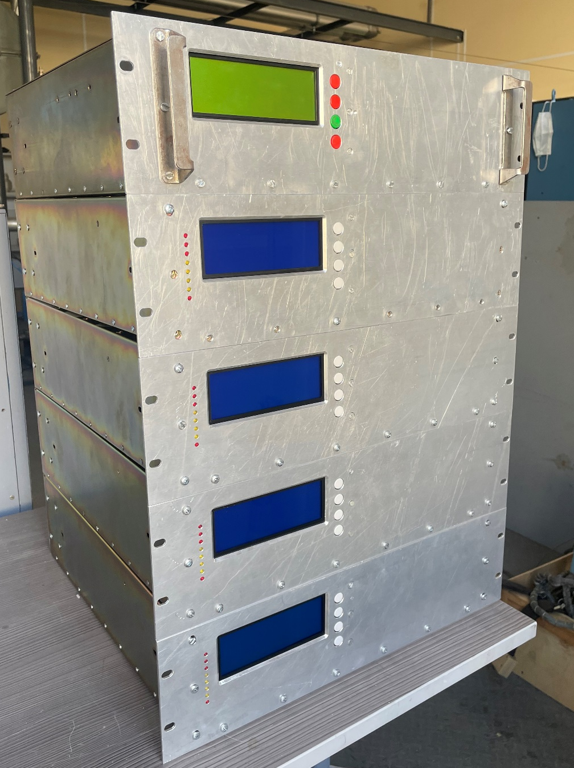
Air-cooled HF amplifier
Parameters of the amplifier:
Case (form factor 3U)
U_{supply} = 220 V
Power dissipation up to 1 kW
*F — 11 ÷ 22 MHz
HF gain by power ≥ 60 dB
HF output power up to 0,5 kW
* it is determined by the parameters of the internal filter

Slide 8
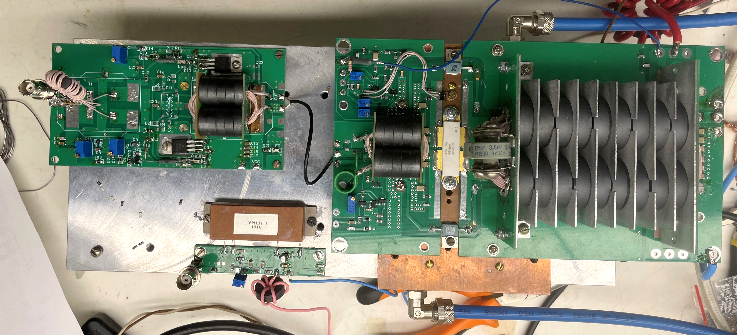
Breadboard of a new 1 kW semiconductor water-cooled HF amplifier
Preamplifier:
U_{supply} = 24 V
Power dissipation up to 60W
F — 5,5 ÷ 32 MHz
HF gain by power ≥ 40 dB
HF output power up to 30W
Powerful cascade:
U_{supply} = 48 V
Power dissipation up to 2,5 kW
F — 5,5 ÷ 32 MHz
HF gain by power ≥ 27 dB
HF output power up to 1,25 kW

Slide 9
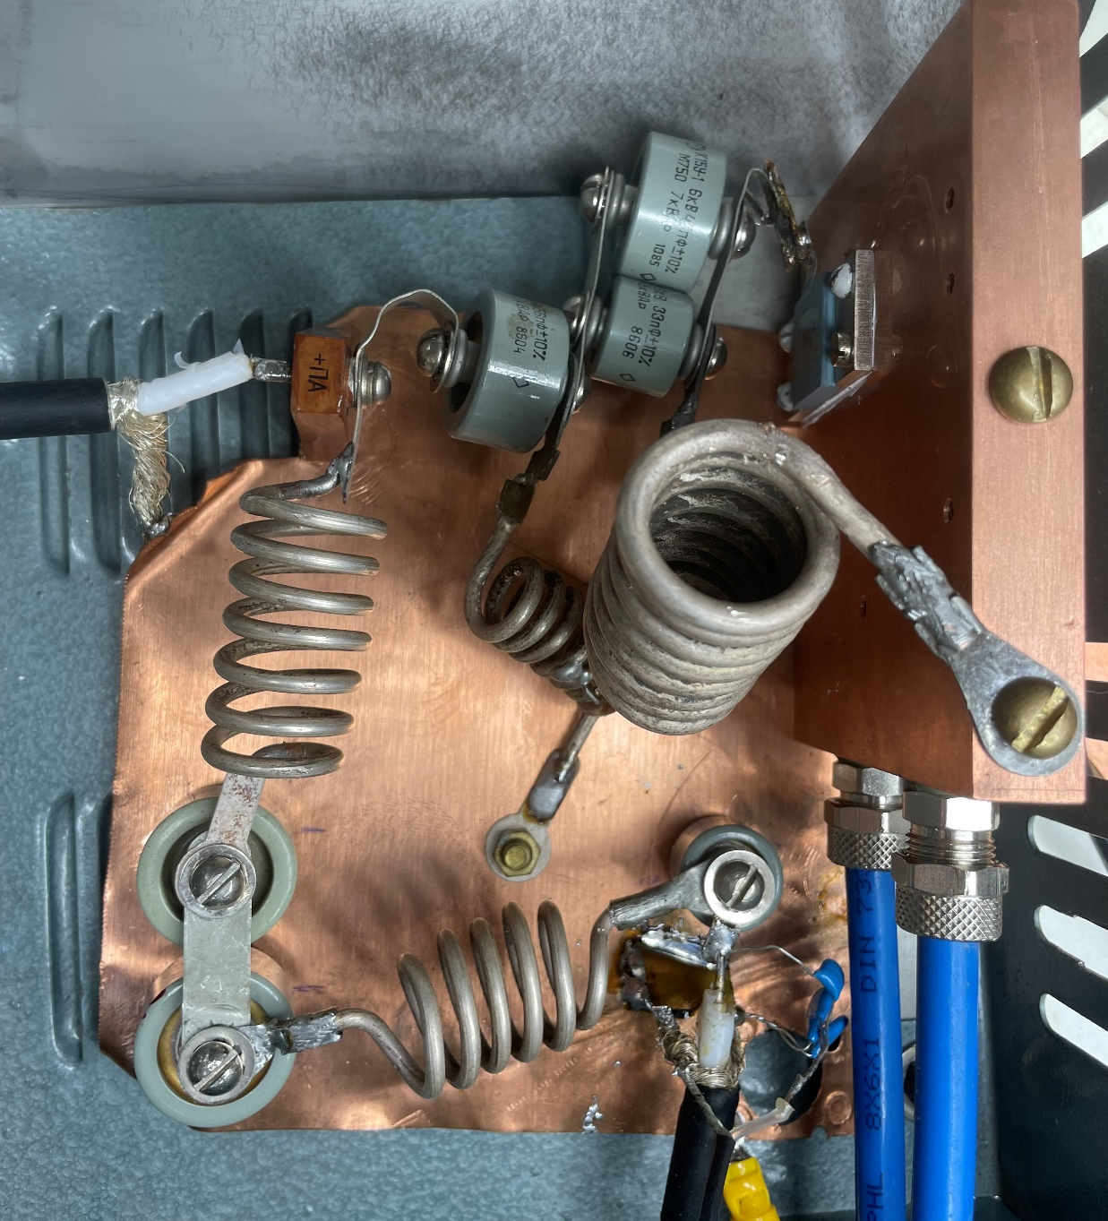
HF filter-duplexer
Input
Output
50 Ω
Filter parameters:
Bandwidth 11 ÷ 22 MHz
Power dissipation of the absorbing resistor = 150 W

Slide 10
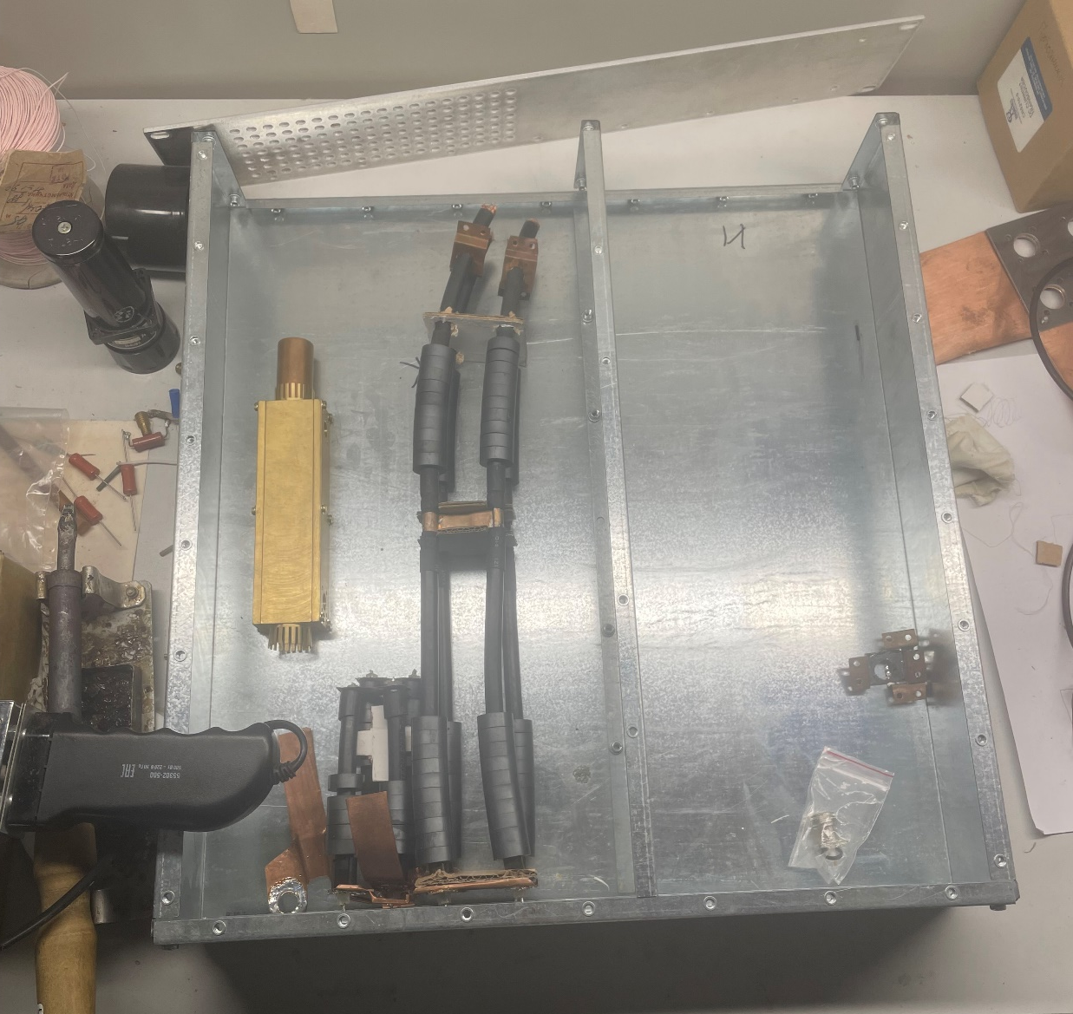
The power summing unit
Ready:
In the manufacturing process:
Device case (form factor 2U)
Power summation circuit
Measuring section
Power divider circuit
Radiator for ballast resistors
Panels for mounting connectors
Water cooling system
Air cooling system
Protection device

Slide 11
Plans for the near future
1. Finish assembling the power summing unit (in the first iteration without protection device)
2. Test the power summing unit with air-cooled HF amplifiers and dummy load
3. Improve the breadboard of the high power HF amplifier (combining the electrical circuits of pre- and powerful cascades)

Slide 12
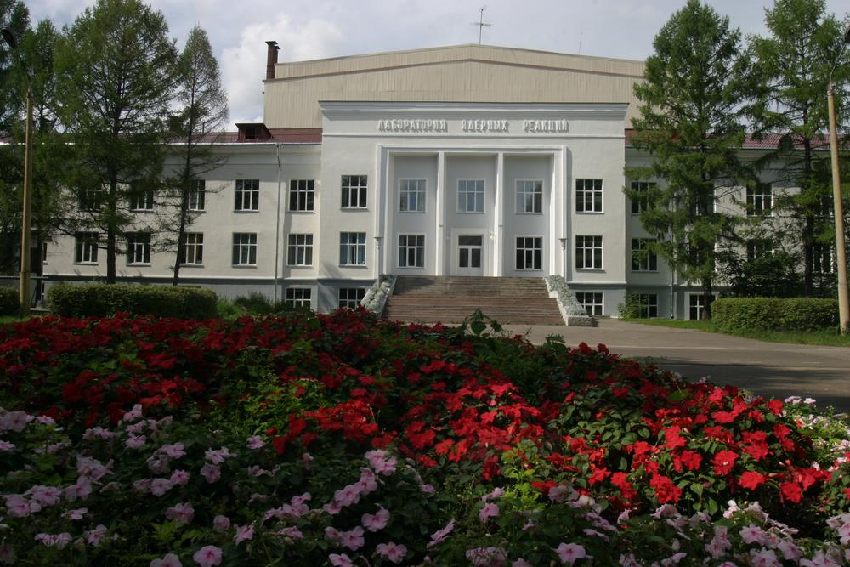
Thanks for your attention

