Slide 1
Development of GABAergic Inhibition Associated with Entorhinal Input in Granular Cells of the Dentate Gyrus
A. Frolova, A. Gainutdinov, E. Juzekaeva, L. Safeeva, G. Valeeva, and R. Khazipov,
Laboratory of Neurobiology, Kazan Federal University, Kazan, Russia*
1

Slide 2
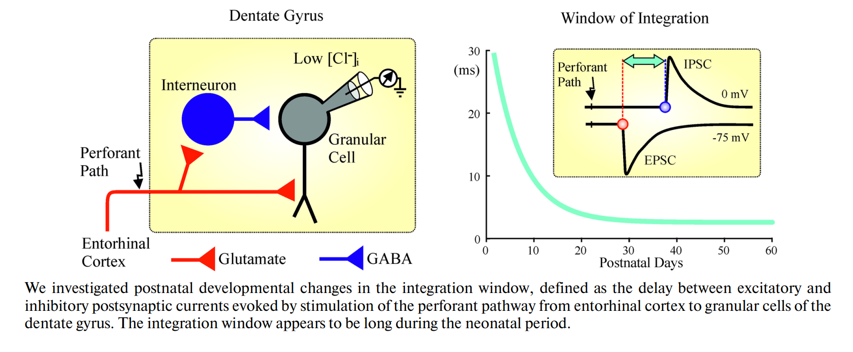
EPSC — excitatory postsynaptic currents
IPSC — inhibitory postsynaptic currents
GABA — γ-aminobutyric acid
2

Slide 3
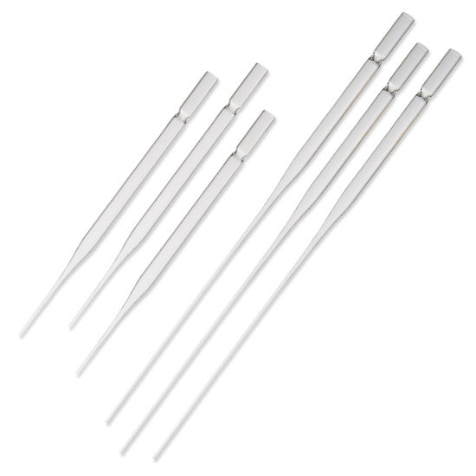
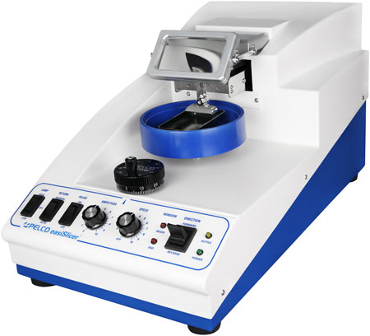
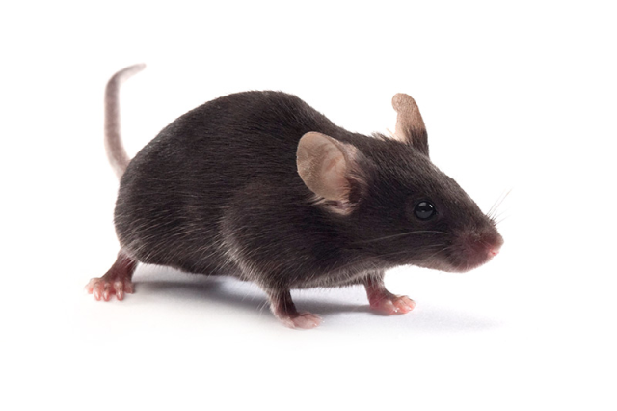
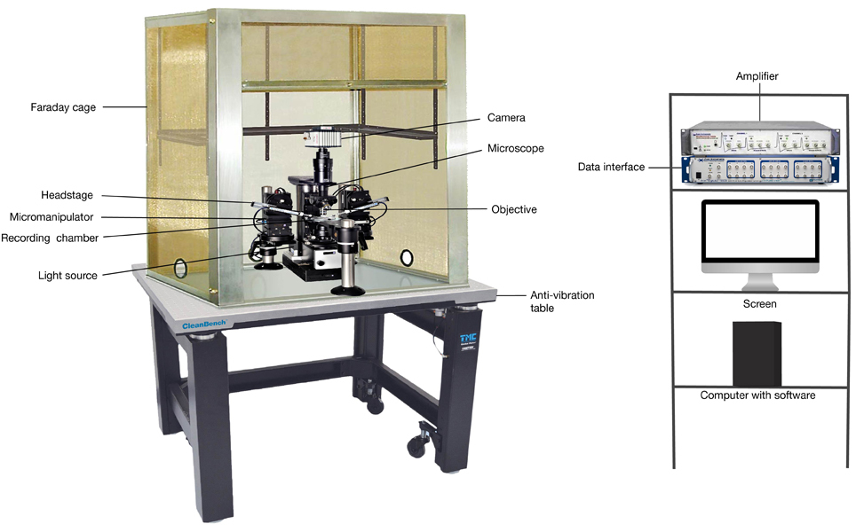
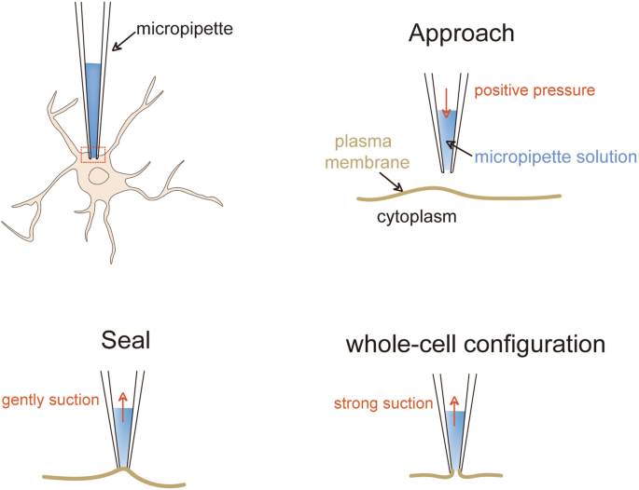
Materials and methods
C57BL/6 mice of both sexes aged from postnatal days [P] 2 to 62 were used
Composition of cerebrospinal fluid (ACSF) (in mM): NaCl 126, KCl 3.5, CaCl2 2, MgCl2 1.3, NaHCO3 25, NaH2PO4 1.2 and glucose 11 (pH 7.4)
Composition of pipette solution (in mM): CsGluconate 135, gCl2 2, CaCl2 2, EGTA 1, and HEPES 10 (pH 7.26)
PELCO easi-Slicer vibratome
Whole-cell patch
3

Slide 4
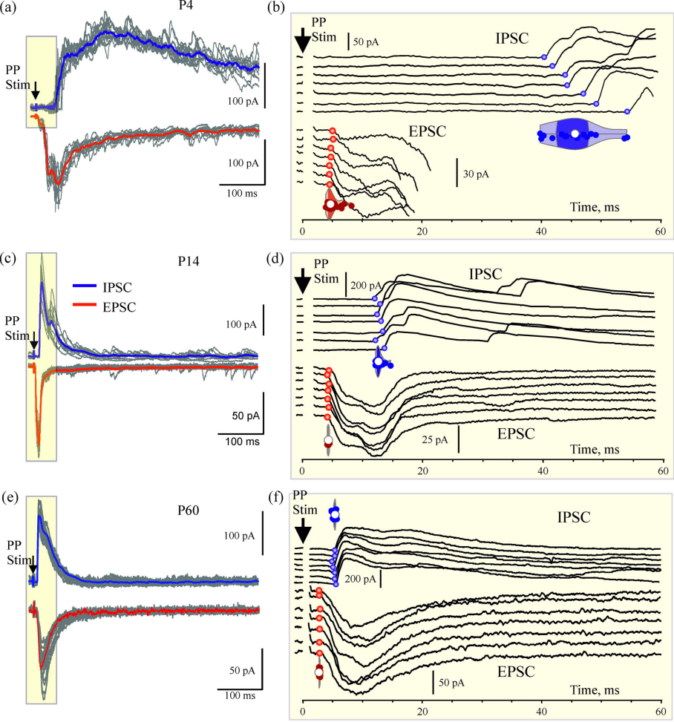
PP — perforant-path
GC — granular cells
P — postnatal day
EPSC — excitatory postsynaptic currents
IPSC — inhibitory postsynaptic currents
Fig. 1. Perforant path stimulation-evoked EPSCs and IPSCs in GCs at different postnatal ages. (a) Example traces of PP-evoked IPSCs and EPSCs in a GC from the postnatal day P4 mouse dentate gyrus. IPSCs were recorded at holding potential of 0 mV, which is a reversal potential of EPSCs, and EPSCs, vice versa, were recorded at holding potential of –75 mV, which is a reversal potential of IPSCs. Ten individual responses (grey traces) are superimposed, overlaid by average IPSC (blue trace) and average EPSC (red trace). (b) Early response fragments outlined in yellow box on panel (a) are shown at expanded time scale. Seven randomly selected individual IPSCs (top traces) and EPSCs (bottom traces), circles indicate PSC onset. Violin plots show the probability density distribution of the delays of PSCs onsets from the PP stimulus. Hereafter, violin histograms are smoothed by a kernel density estimator, white dot indicates median, dark area indicates Q1–Q3 interquartile range, each dark dot corresponds to an individual PSC. (c–d) and (e–f) show similar examples of IPSC and EPSC recordings from GCs in P14 (c–d) and P60 (e–f) mice.
4

Slide 5
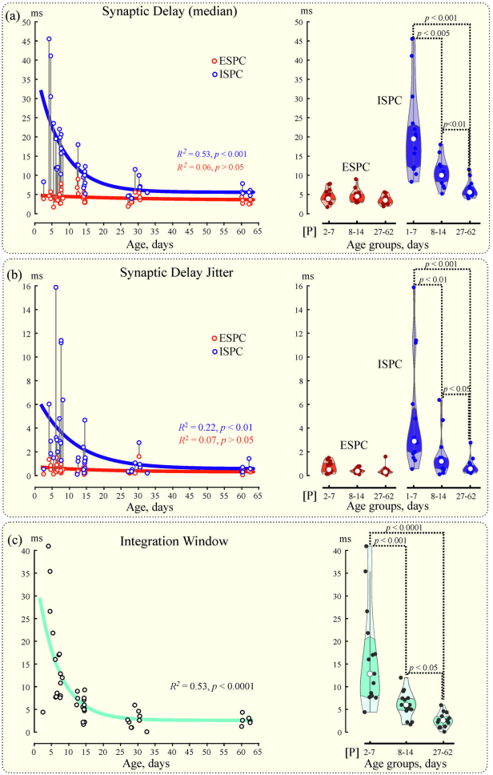
PP — perforant-path
GC — granular cells
P — postnatal day
EPSC — excitatory postsynaptic currents
IPSC — inhibitory postsynaptic currents
Fig. 2. Age-dependence of the PP-evoked EPSCs and IPCSs delays in GCs. (a) EPSCs and IPSCs delay medians in GCs as a function of animal age. Each dot corresponds to the median value in an individual GC. Right violin plots show the probability density distribution of the delays of EPSC and IPSC onsets from the PP stimulus in GCs pooled in three age groups: P27, P8-14 and P27-62. EPSC delays were not significantly different between the three age groups. (b, c) Similar group data analysis for the time jitter of the PP-evoked IPSCs and EPSCs delays, presented as a Q1–Q3 interquartile range (b), and for the temporal integration window, calculated as a delay of the PP-evoked IPSCs from EPSCs (c). (a–c): Pooled data from 45 granular cells (n = 15 cells in each age group).
5

