Slide 1
The annual scientific conference of young scientists and specialists "Alushta-24" Crimea 2024 «ENGINEERING AND TECHNOLOGICAL SYSTEMS OF THE MAGNETIC CRYOGENIC SYSTEM OF THE MULTI-PURPOSE DETECTOR MPD OF THE NICA PROJECT»
R.R. Khabibullin, K.A. Mukhin, D.A. Tereshin,
I.A. Smelyansky, R.V. Baratov, V.A. Novoselov
Joint Institute for Nuclear Research, Dubna
e-mail: habibullin@jinr.ru

Slide 2
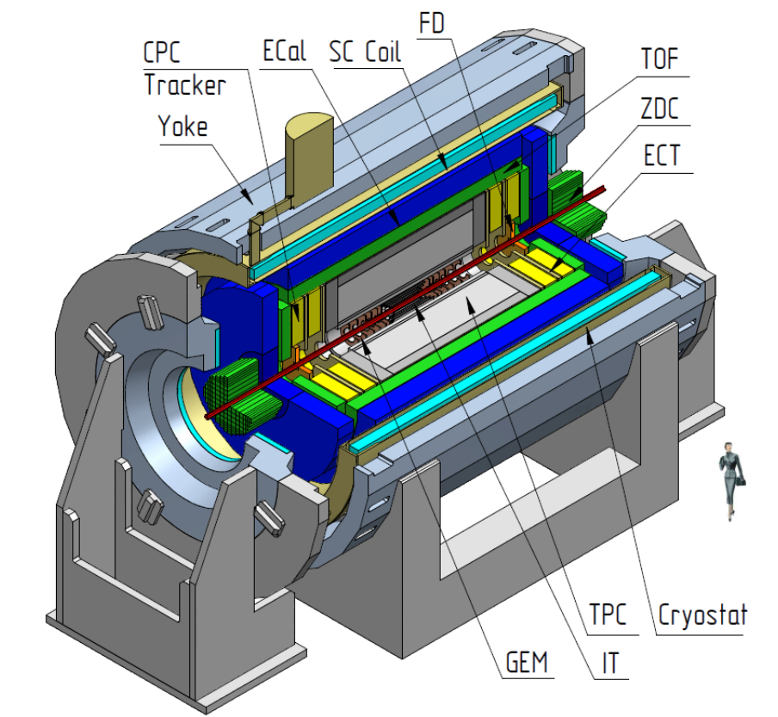
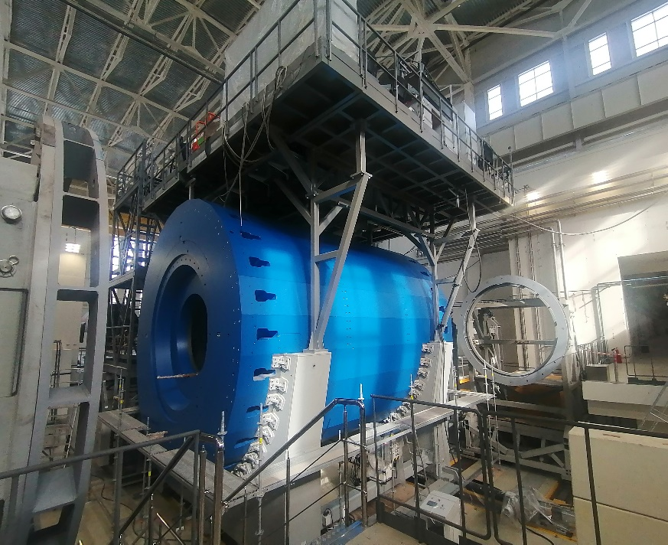
Multi-Purpose Detector
The MPD multi-purpose detector includes a three-dimensional tracking system and
a particle identification system.
Identification of charged hadrons over a wide range of velocities and up to a total
momentum of 3 GeV/c is achieved using a combination of time-of-flight measurements
and energy loss information, and also aims to solve the following problems: • Study of the equation of state of nuclear matter at high densities; • Partial restoration of chiral symmetry (invariance of the equations of quantum
field theory with respect to transformations that mix the states of particles
with different electric charges); • Phase transition, including the possibility of detecting deconfinement signals
(«cessation of quark entrapment inside hadrons»); • Study of the properties of the quark-hadron phase of matter; • Search for the critical point on the phase diagram.

Slide 3
Technical data of the MPD multi-purpose detector
Generated magnetic field | 0,57 Т
Weight and dimensions of the solenoid (diameter/length) mm | 66 tons 5443/7910 mm
The Yarmo magnetic core consists of 28 beams and two poles (diameter/length) mm | 630 tons 6583/8970 mm
Operating current Operating voltage | 1790 А 10 V
Weight of each pole with correction coil | 45 tons
Total weight of the structure | 800 tons
Working temperature | 4,5 К
Superconducting cable length | 27 km
High vacuum in the insulating volume | 10^-6 mbar

Slide 4
Control diagram of the engineering and technological system of the MPD multi-purpose detector
In addition to the stable operation of the technological system of the MPD multi-purpose detector, there are:
• Collection, monitoring and registration of basic state parameters: magnetic, cryogenic, current and vacuum systems, all sensors and auxiliary systems;
• Coordinated control of magnet operating modes in normal, warning and emergency situations;
• Exchange of information with the main NICA control system

Slide 5
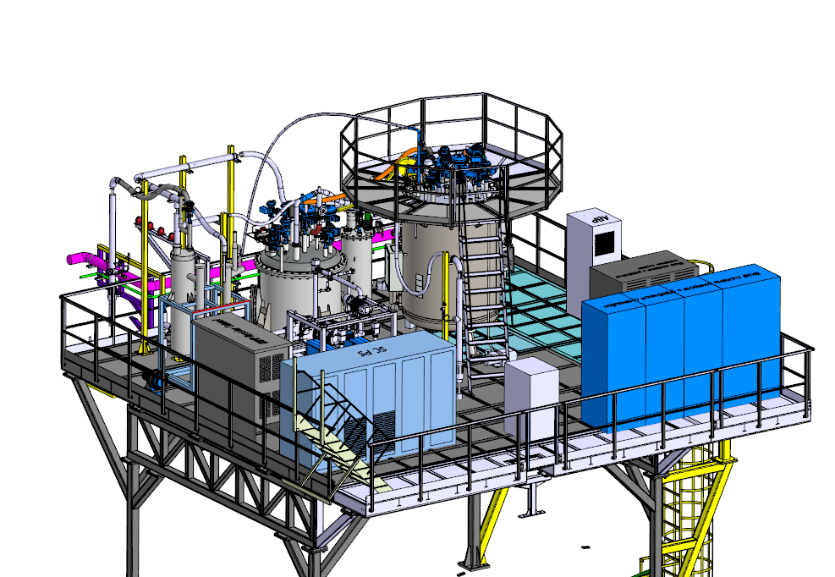
Magnetic cryogenic system of the multi-purpose detector MPD of the NICA project
Engineering and technological systems of the magnetic cryogenic system of the MPD Multi-Purpose Detector are one of the important systems in ensuring the stable operation of the MPD Multi-Purpose Detector.
The engineering and technological systems of the NICA project's MPD multipurpose detector include the following main elements:
- Superconducting multi-purpose detector MPD;
- Satellite helium refrigerator;
- Control cryostat (Dewar);
- Nitrogen Flushing Station (NFS);
- Vacuum system of the insulating volume of the MPD detector;
- Nitrogen and helium reverse flow heater;
- Main control system.

Slide 6
Schematic diagram of the technological cooling system
of the multi-purpose detector MPD of the NICA project

Slide 7
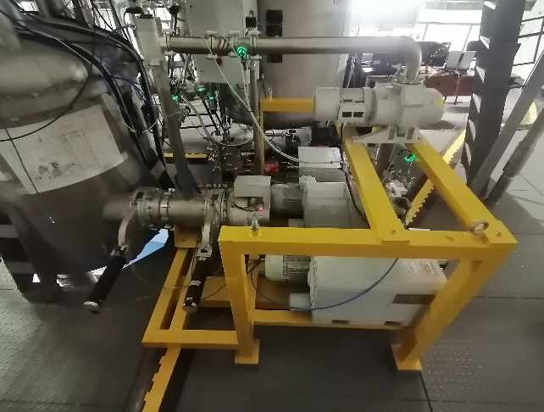
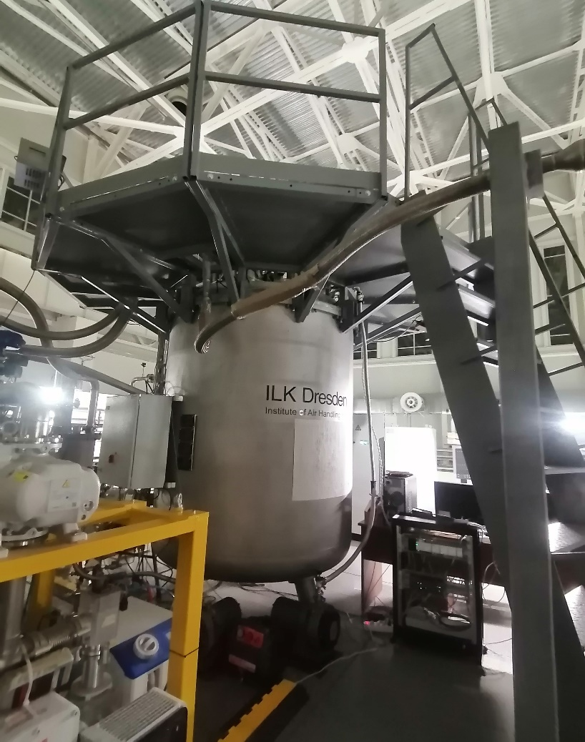
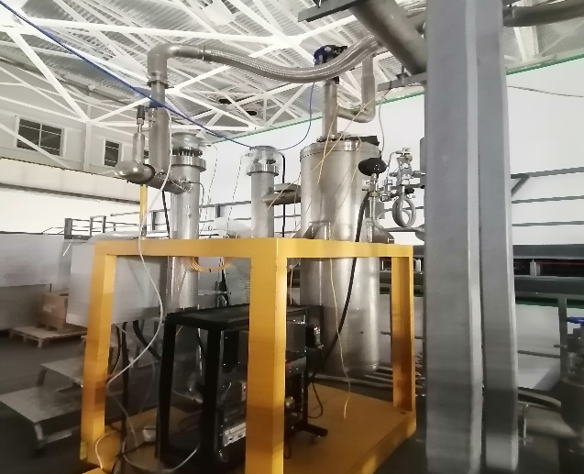
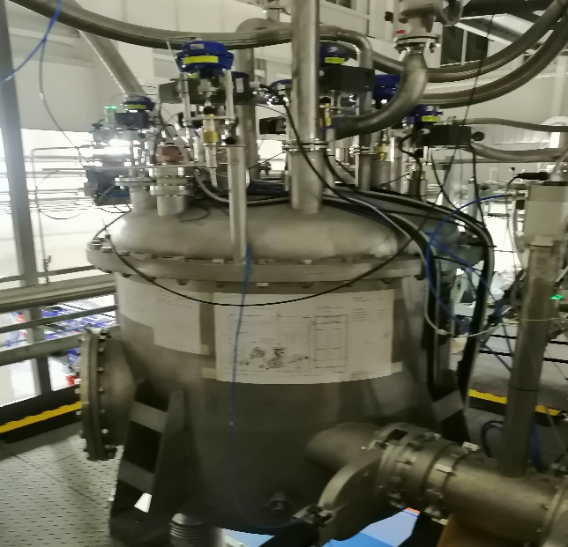
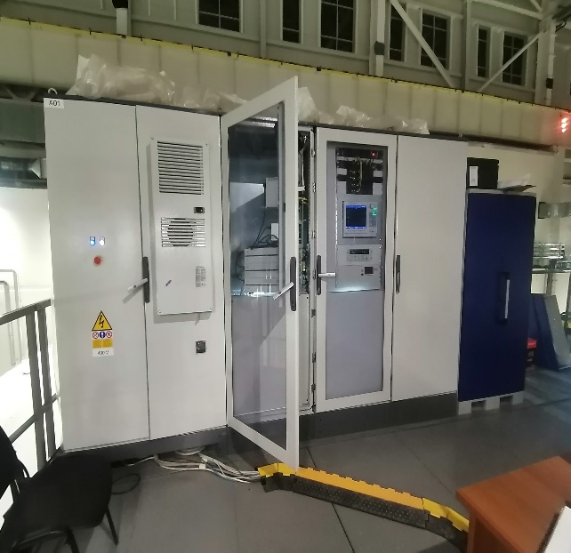
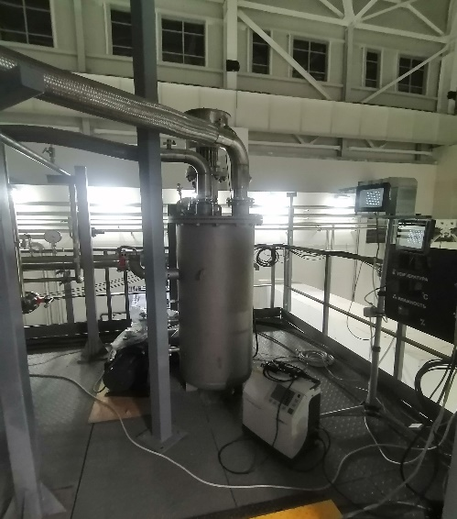
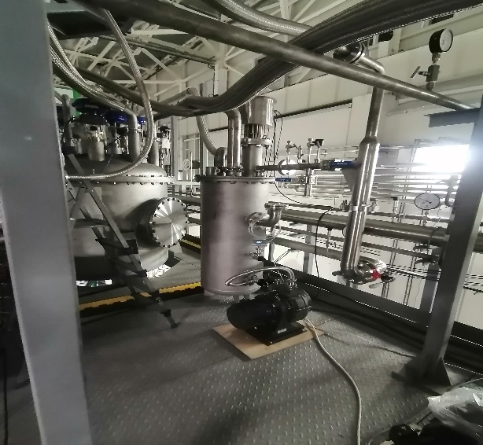

Slide 8
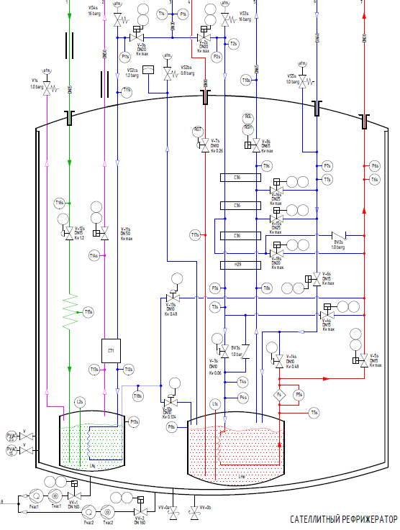
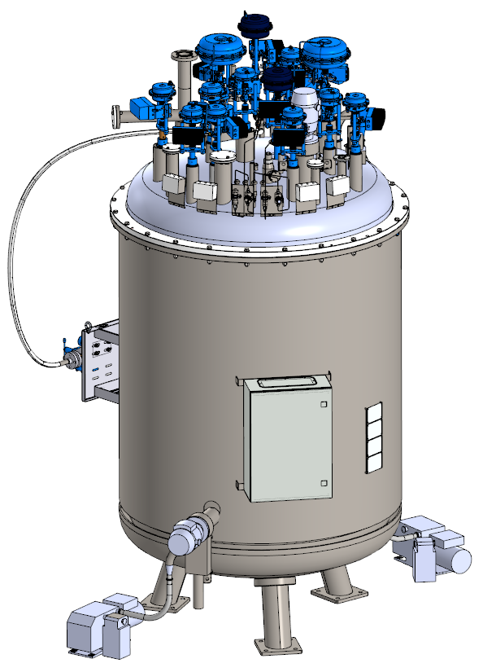
Satellite helium refrigerator
One of the main elements of the magnetic cryogenic system is the satellite helium refrigerator (SHR). The satellite helium refrigerator is designed to supply gaseous and liquid helium to the control Dewar, and then to the superconducting solenoid coil of the MPD detector.
The satellite helium refrigerator has a cooling capacity of 100 W at 4.5 K. The normal operating pressure of compressed helium at the inlet, depending on the operating mode, is 13 bar(g) (max 16 bar(a)). The satellite helium refrigerator has optimal cooling stages, ensuring the most stable cooling of the superconducting detector coils to a temperature of 4.5 K.
Cooling power (helium mass flow 5 g/s, normal operation) | 100 W at 4.5 K (liquid helium)
Forward pressure | Max 16 bar(abs)
Useful volume of helium reservoir | 160 l
Useful volume of nitrogen reservoir | 125 l

Slide 9
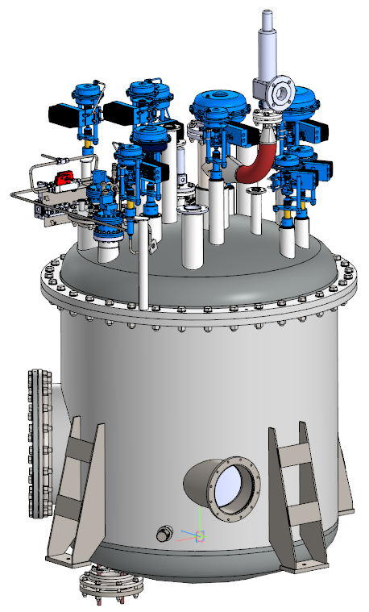
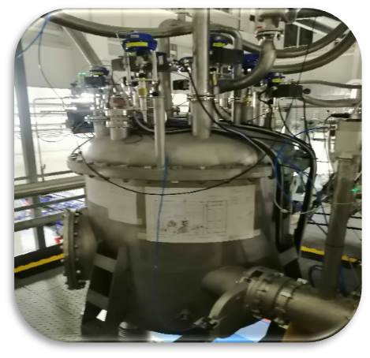
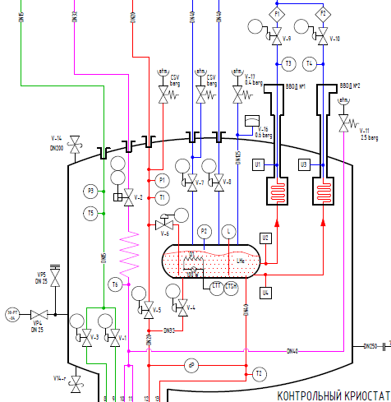
Control Dewar
The control dewar is a functional block of the MPD magnetic cryogenic system. Control Dewar regulates the supply of cryogenic liquids to the magnet under appropriate thermodynamic conditions in accordance with operating modes, as well as the stable maintenance of helium cooling of the electrical input of low-temperature current leads.
Cooling power (helium mass flow rate 5g/s depends on the satellite helium refrigerator | 100 W at 4.5 K (liquid helium)
Forward pressure | Max 16 bar(abs)
Output of the He line from the control Dewar to the heater and the recovery line in the SGR | 1.4 bar(a)
Peripherals LN2 – thermal shield | 2.5 bar(a)
Maximum pressure in the helium reservoir | 1.4 bar(a) valve 1.5 bar membrane
Low pressure line from current conductors | 1.5 bar(a)
Useful volume of helium reservoir | 250 l

Slide 10
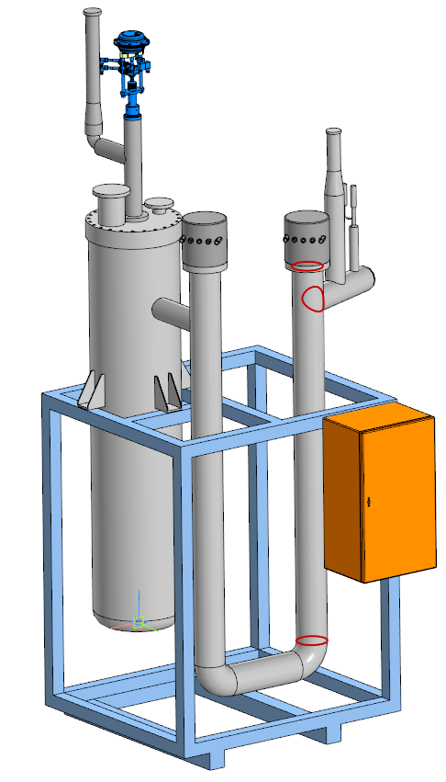
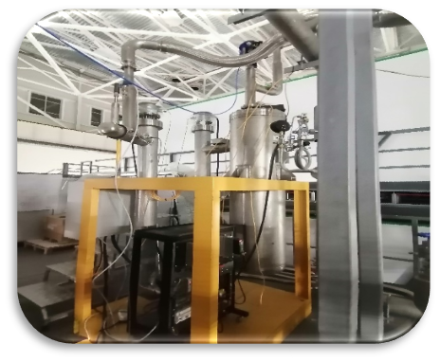
Nitrogen Flushing Station (NFS)
The Nitrogen Flushing Station (NFS) is designed to supply liquid or gaseous nitrogen at a controlled temperature to the nitrogen screens of the MPD detector solenoid. The MFS is necessary to control the required maximum temperature gradient in the solenoid during both cooling and warming.
Temperature operating conditions | 300-78К
Operating mode | Cooling/Heating
Heating element power | 5кW
The cooling/warming system of the thermal screens of the MPD multi-purpose detector is carried out using an automated control system. All sensors and actuators are connected through the control rack to a programmable logic controller (PLC).
The automatic process consists of 4 phases with subphases:
1) standby mode;
2) the beginning of filling of the MFS and evaporation;
3) pumping LN2;
4) emptying and warming the cryostat.
PID control is used to operate the heaters of the installation

Slide 11
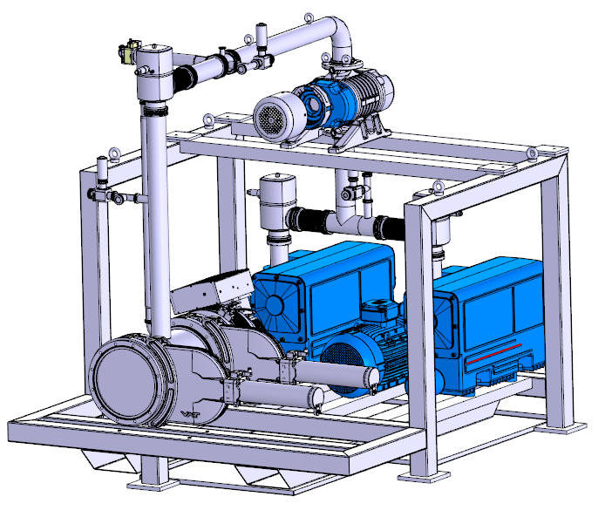
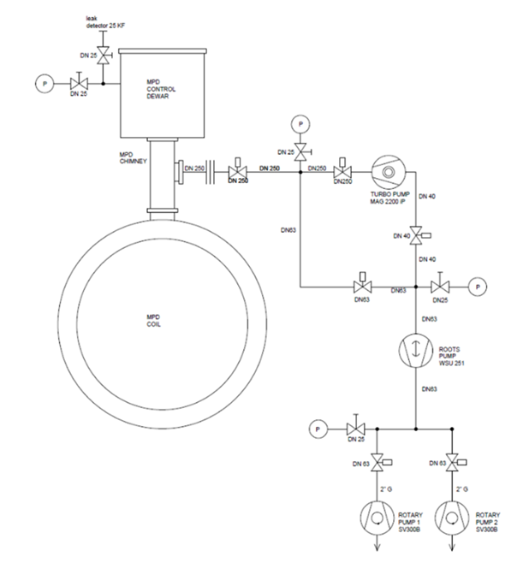
MPD Detector Vacuum System
For stable operation of the magnetic-cryogenic system of the MPD multi-purpose detector, it is necessary to maintain a vacuum level to reduce heat flow to the superconducting coil of the MPD detector solenoid.
The 10^-6 mbar vacuum of the NICA project multipurpose MPD detector provides a vacuum post for pumping out the insulating volume of the MPD solenoid and the control Dewar.
Vacuum station consists of:
Rotary vane pump – Sogevac SV 300V − 2 pcs.
Roots type vacuum pump RuVac WSU251
Turbomolecular high-vacuum pump TurboMAGiNTEGRA MAG W 2200 IP
Vacuum fittings− DN250 Gate Valve VAT ISO-F− 2pcs DN63 ISO-K Valveswith pilot valve 24V DC−3pcs DN40 ISO-K Valve with pilot valve 24V DC−1pcs DN25 Manual valves−5pcs
The pumping/maintaining vacuum system in the insulating volume of the MPD multi-purpose detector is carried out using an automated control system, where monitoring and control occurs through a control cabinet (Control System).

Slide 12
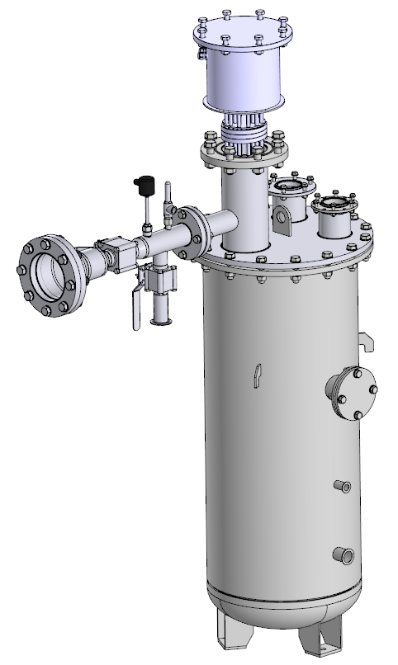
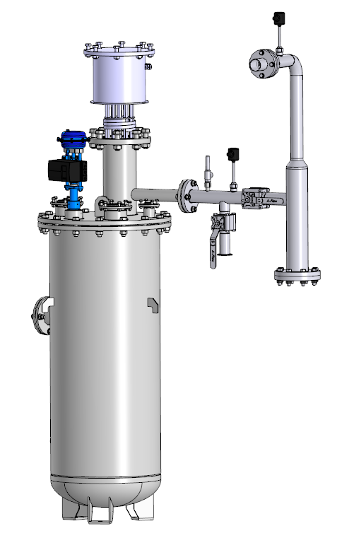
Nitrogen and Helium Reverse Flow Heater
A helium heater is necessary to heat or maintain the temperature of the return flow of helium entering the cryogenic-helium installation, as well as to reduce the formation of condensation or freezing on pipelines when there is a temperature difference between the environment and the temperature of helium gas.
Heating element power: W=20 kW.
A nitrogen heater is necessary to heat nitrogen or maintain temperature conditions, as well as to reduce the formation of condensation or freezing on pipelines when there is a temperature difference between the environment and the temperature of nitrogen gas.
Heating element power: W=10 kW.

Slide 13
Main control system
The MPD Multi-Purpose Detector will be controlled through a Monitoring and Control System (MCS) connecting all auxiliary systems to the cryostat. MCS controls all interlocks, the solenoid protection system, sets operating modes and parameter settings (for example, supplying current to the superconducting cable, setting correction coils, etc.).
The purpose of the magnet control system is: collection, monitoring of the main parameters of the state of magnetic systems, all sensors and auxiliary systems;
Coordinated control of magnet operating modes in normal, warning and emergency situations, exchange of information with the main NICA control system.
The system will be automated using a PLC and will have a SCADA computer system for electronic monitoring and control of the physical systems.

Slide 14
The main goals of the engineering and technological system of the magnetic cryogenic system of the multi-purpose detector MPD of the NICA project
Uniform cooling of the coil, screens, current leads of the MPD detector;
Providing high vacuum in the insulating volume of the solenoid;
Achieving nitrogen and helium temperatures;
Providing power supply to the MPD detector coils;
Collection, monitoring and registration of basic state parameters: magnetic, cryogenic, current and vacuum systems, all sensors and auxiliary systems;
Coordinated control of magnet operating modes in normal, warning and emergency situations;
Exchange of information with the NICA main control system

Slide 15
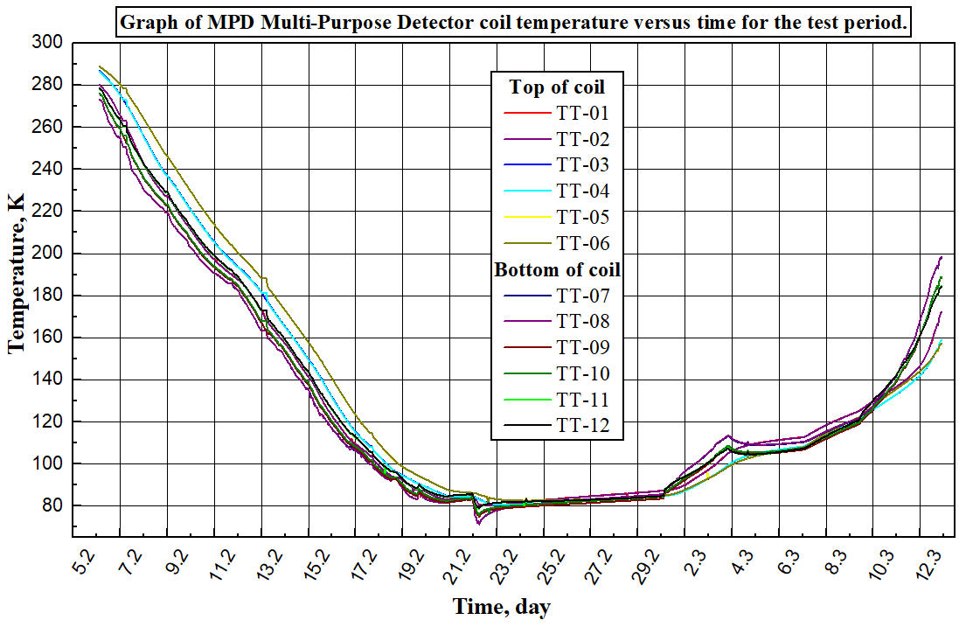
Cryogenic testing of the MPD multi-purpose detector
2024.02.05-2024.03.18
The task of cryogenic testing of a multi-purpose detector is:
Uniform cooling of the coil, MPD heat shields;
Reaching the superconducting coil to nitrogen temperatures (78 K);
Maintain a multi-purpose detector cooling rate of 1 Kelvin per hour;
Cooling of heat shields in automation mode;
Determination of heat gain at the cooling stage and at 78K mode (stationary);
Cooling the superconducting coil with liquid helium;
Determination of heat inflow when vacuum deteriorates (heating mode);
Maintaining a multi-purpose detector warming rate of 1 Kelvin per hour;

Slide 16
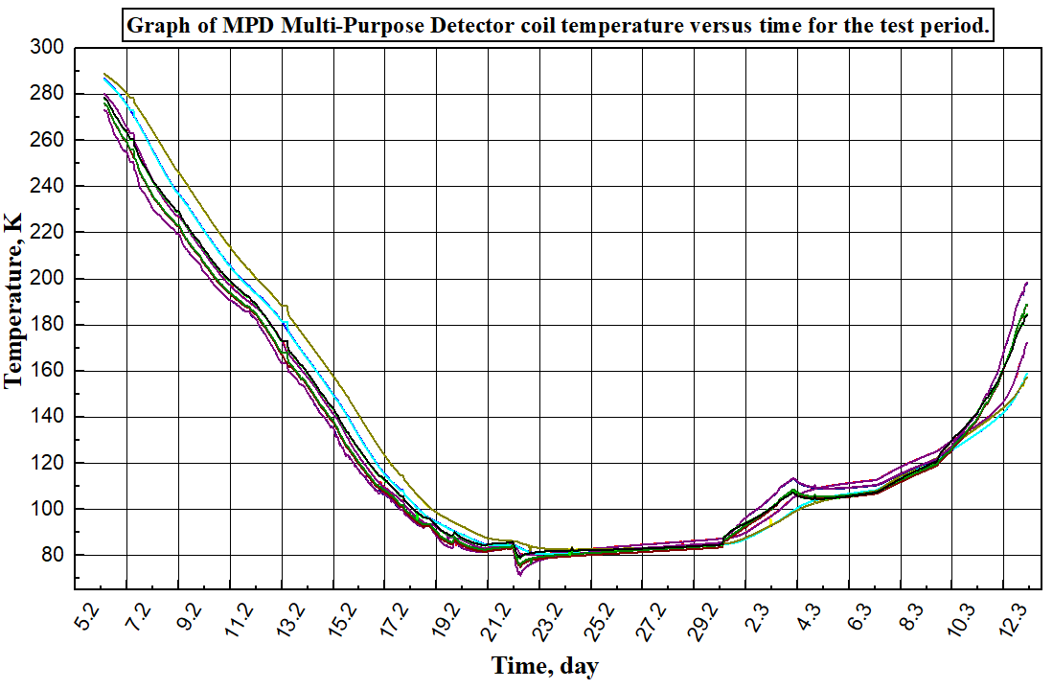
Heating the detector when the helium circulation is turned off
Cooling
the Multi-Purpose Detector MPD
Heating of the detector when cooling of thermal screens and helium circulation is turned off
Stopping helium circulation
Heating of the detector when cooling the thermal screens and turning off the helium circulation
Switching to helium mode
Heating when helium circulation is turned off and vacuum deterioration

Slide 17
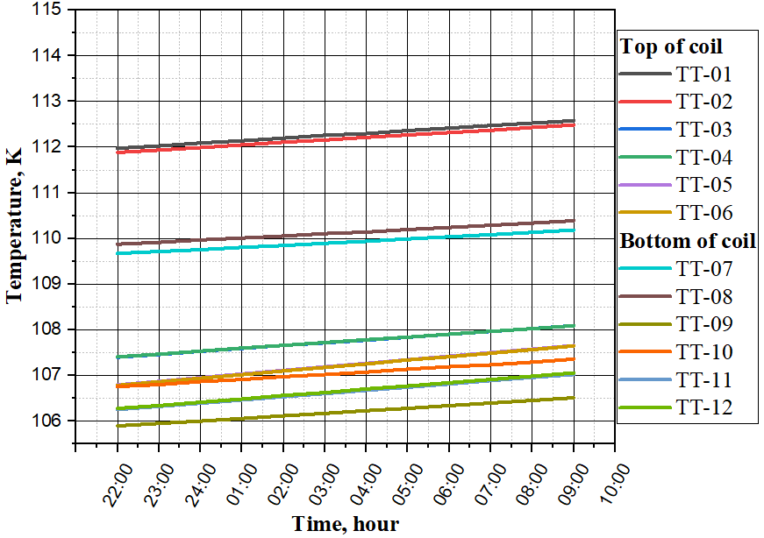
Dependence of the temperature of the coil (MPD detector) when cooling the thermal screens and switching off by helium circulation

Slide 18
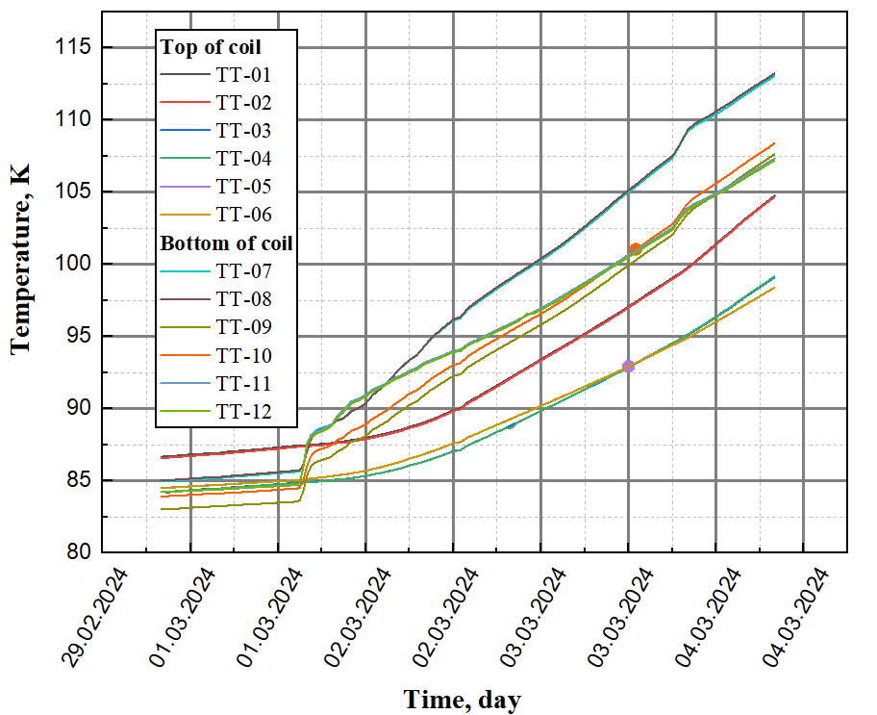
Dependence of coil temperature (MPD detector) when cooling of thermal screens and helium circulation are turned off

Slide 19
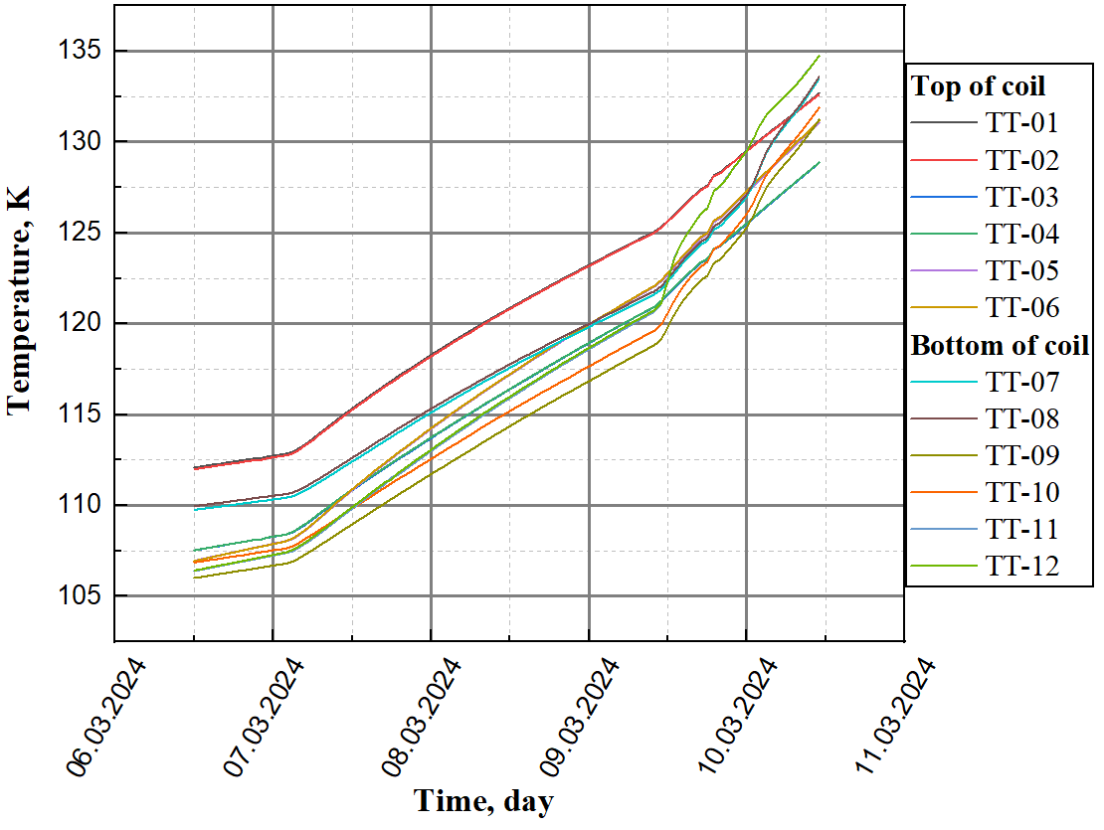
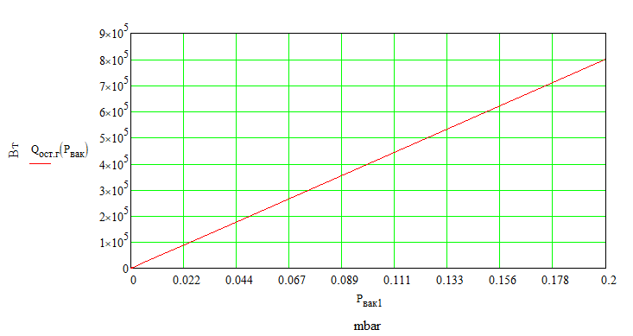
Coil temperature when the vacuum deteriorates from 4x10^-6 to 2x10^-3 mbar when the heat shields are cooled and the helium circulation is turned off
Dependence of heat flow on vacuum from casing to screen + coil

Slide 20
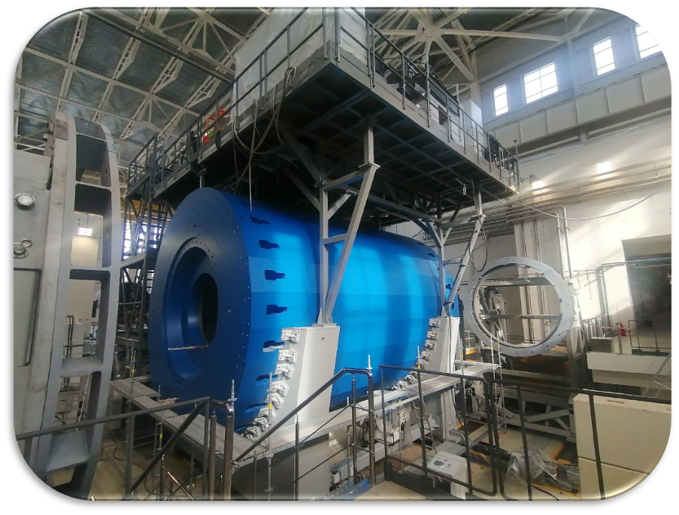
Thank you for your attention

