Slide 1
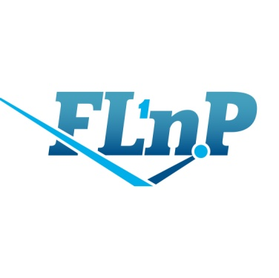
Analysis of the phospholipid transport nanosystem and vesicular nanomedicine structures.
Maslova V.A.*, Kiselev M.A.
JINR Association of Young Scientists and Specialists Conference “Alushta-2024”, 9-16.06.2024

Slide 2
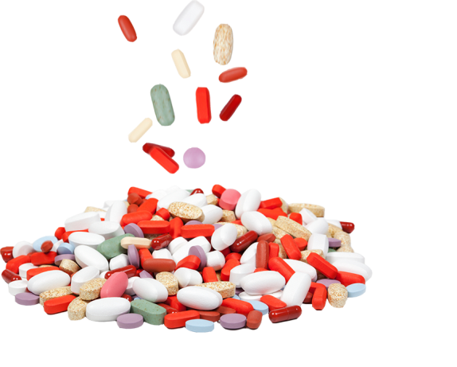
Актуальность

Slide 3
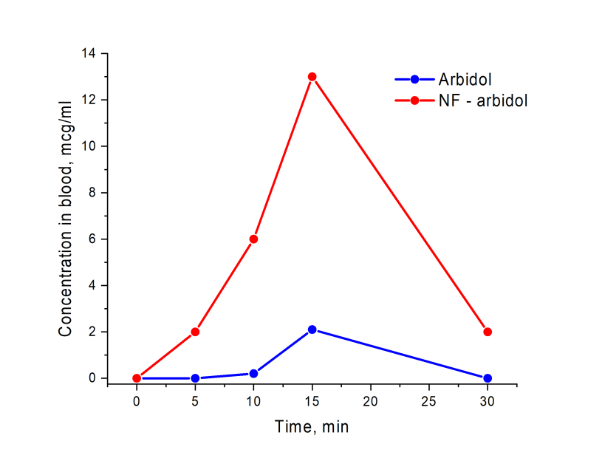
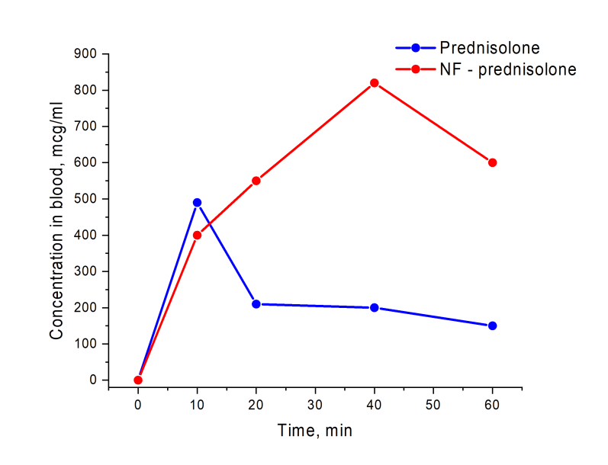
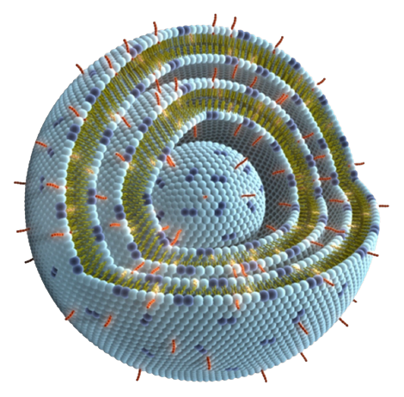
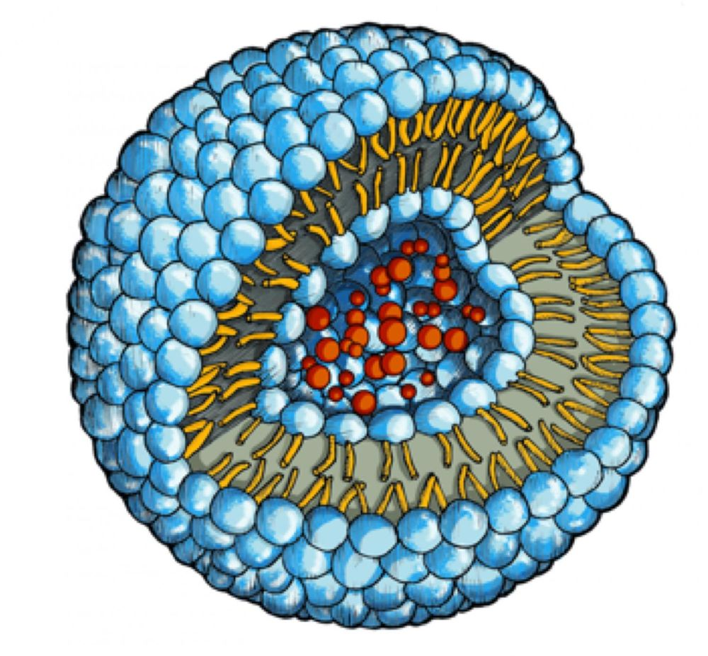
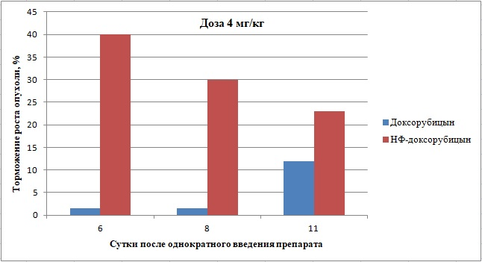
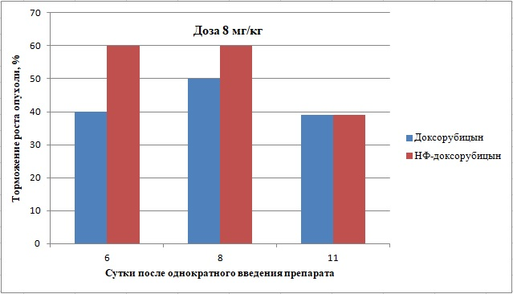
Phospholipid transport nanosystem (PTNS)
Changes in the content of arbidol and prednisolone in the blood of rats after oral administration
Antitumor efficacy of free and nanoparticle doxorubicin in mice with Lewis lung carcinoma
«NANOSYSTEM FOR DRUG TRANSPORT BASED ON PHOSPHOLIPIDS» (ibmc.msk.ru)

Slide 4
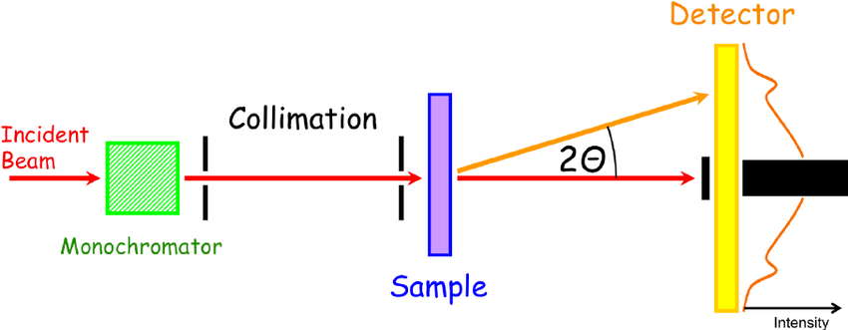
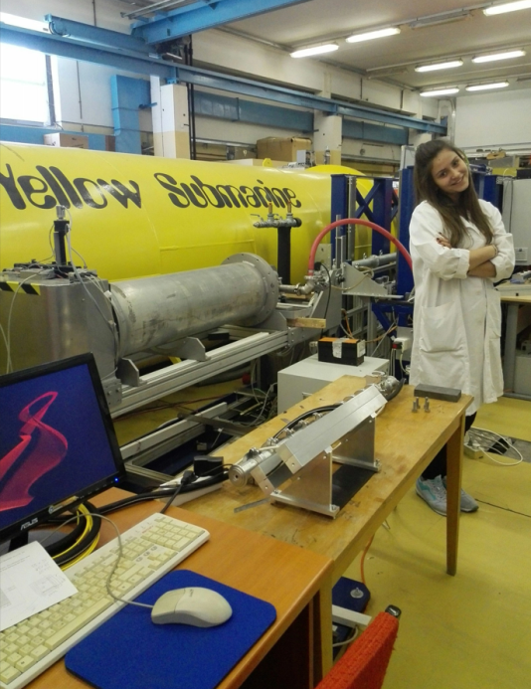
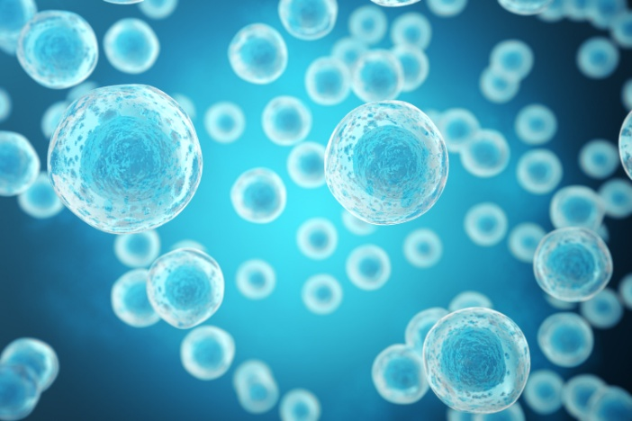
Installation and Method
The SANS Experiment scheme
H₂O D₂O

Slide 5
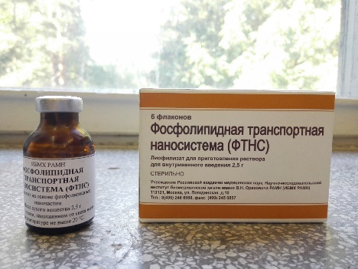
Analysis of the PTNS structure by SANS method (YuMO)

Slide 6
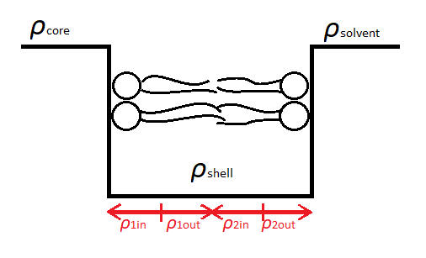
Models
Core Shell Model
Onion Model

Slide 7
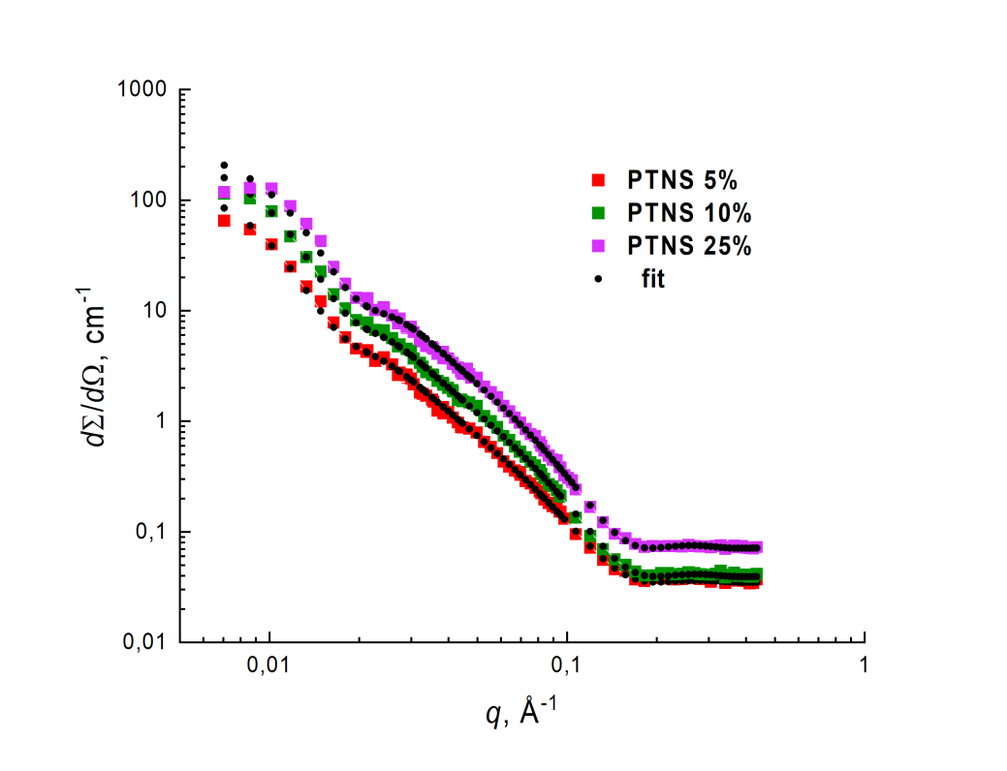
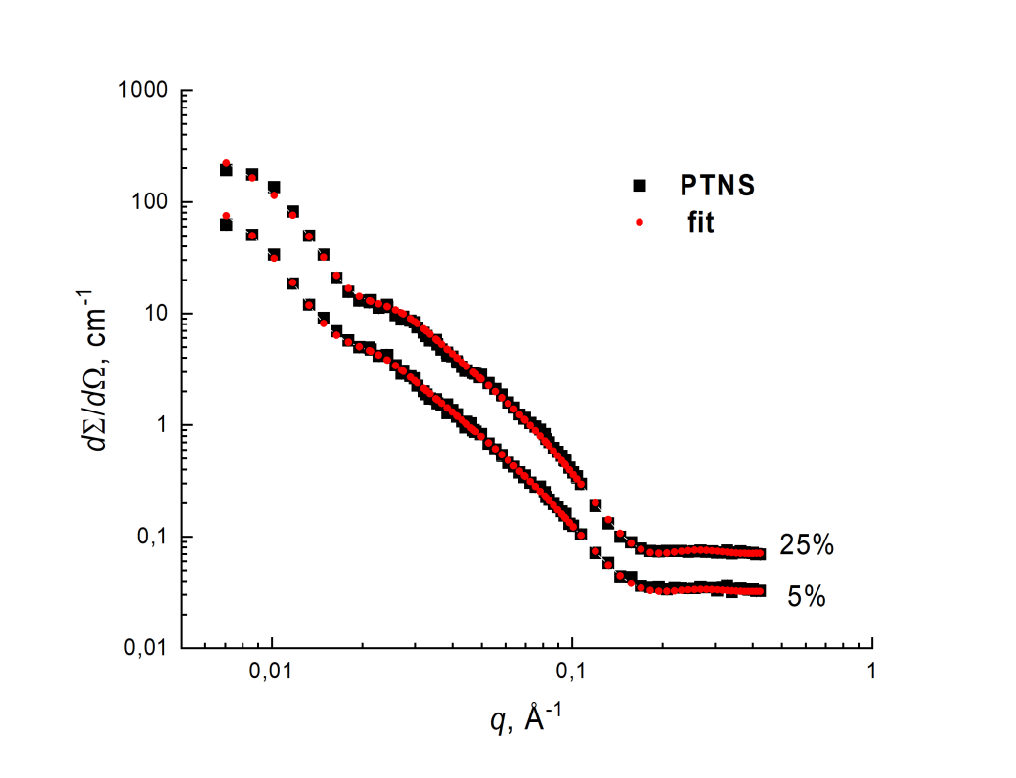
Analysis of the PTNS structure by SANS method (BNC)
Purity: S80
Purity: S100
% | Radius, Å | Thickness, Å
5 | 135.2(1.2) | 31.0(1)
10 | 133.1(1.1) | 31.8(2)
25 | 118.5(9) | 32.8(1)
% | Radius, Å | Thickness, Å
5 | 146.4(1.2) | 31.5(2)
25 | 125.7(9) | 32.3(1)

Slide 8
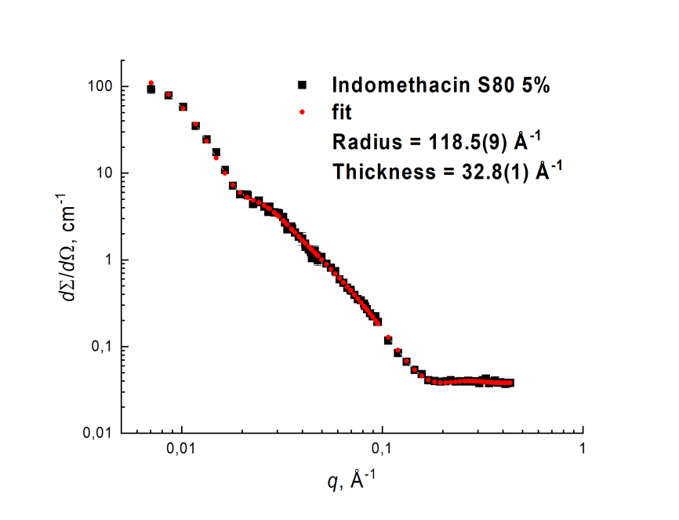
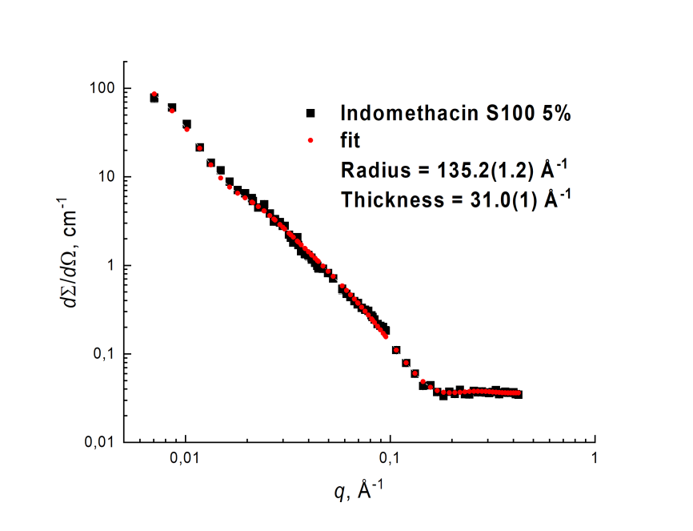
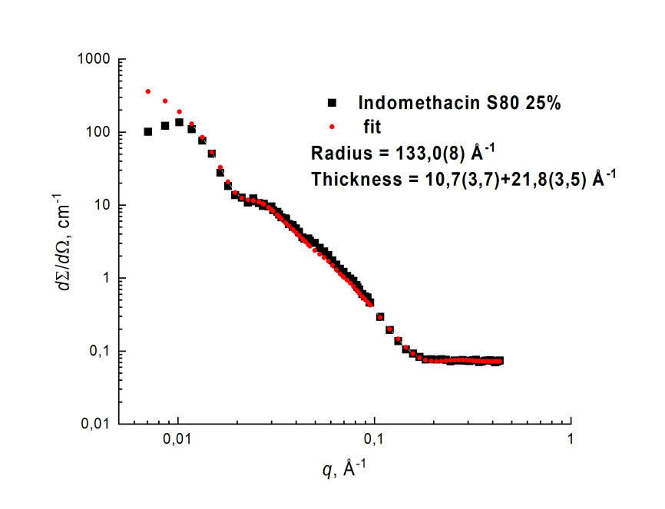
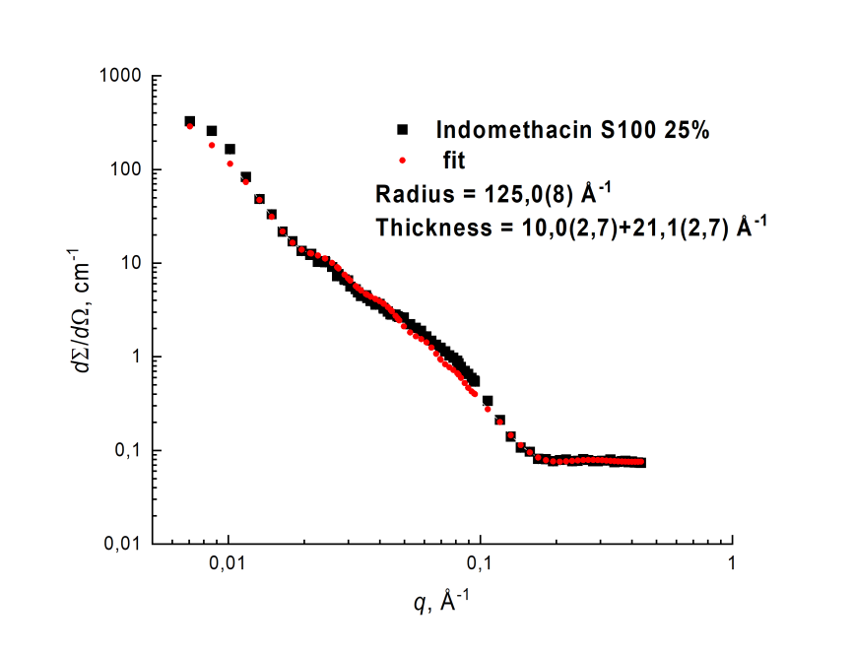
Analysis of the Indomethacin nano-form structure

Slide 9
Conclusion
Study of the structure of PTNS contributes to further developments in the field of vesicular nanomedicines;
As the concentration increases, a decrease in the radius is observed, accompanied by a leveling off of the difference in the density of the scattering length outside and inside the vesicle;
Future work needs to use more complex models.

Slide 10
Thank you for your attention! And be healthy)

