Slide 1
Model for calculating the deformation of the shell of fuel assemblies
JINR Association of Young Scientists and Specialists Conference "Alushta-2024"
M.M. Podlesnyy*, I.V. Kushnir, Y.A. Vdovin, E.P. Shabalin
Joint institute for Nuclear Research, Dubna, Russian Federation
*e-mail: podlesny@phystech.edu
June 9-16, 2024

Slide 2
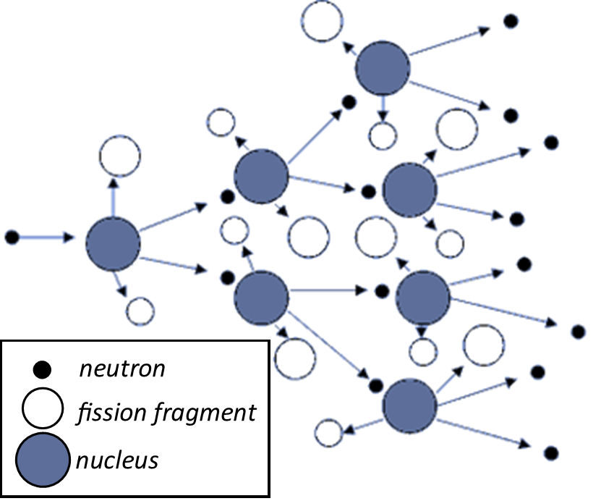
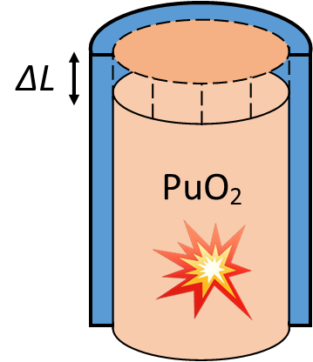
Introduction
A nuclear reactor is a device designed to provide a controlled self-sustaining chain reaction, accompanied by the energy release.
IBR-2 (FLNP, JINR) is a pulsed research reactor on fast neutrons in Dubna for conducting experiments on extracted neutron beams.
Fission chain reaction:
Thermal expansion law:
k (neutron multiplication factor) ~ σ (Nuclear cross section)
~ ρ (density of a fuel)
$$\frac{∆L}{L}=α∆T$$
ρ ~ 1/T

Slide 3
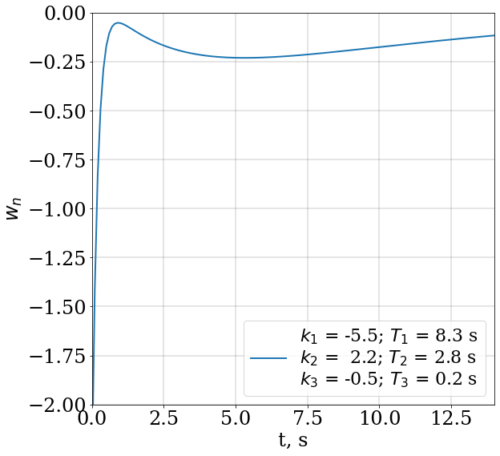
Presence of a positive component in reactivity
The Power feedback $w\left(t\right)$ ^{[1]}
$$w\left(t\right)=\sum_{i=1}^{3}{\frac{k_{i}}{T_{i}}exp\left(−\frac{t}{T_{i}}\right)}$$
^{[1]} А.К. Попов. Анализ устойчивости импульсного реактора ИБР-2 при девятипараметрической модели мощностной обратной связи. Сообщения ОИЯИ. 1996

Slide 4
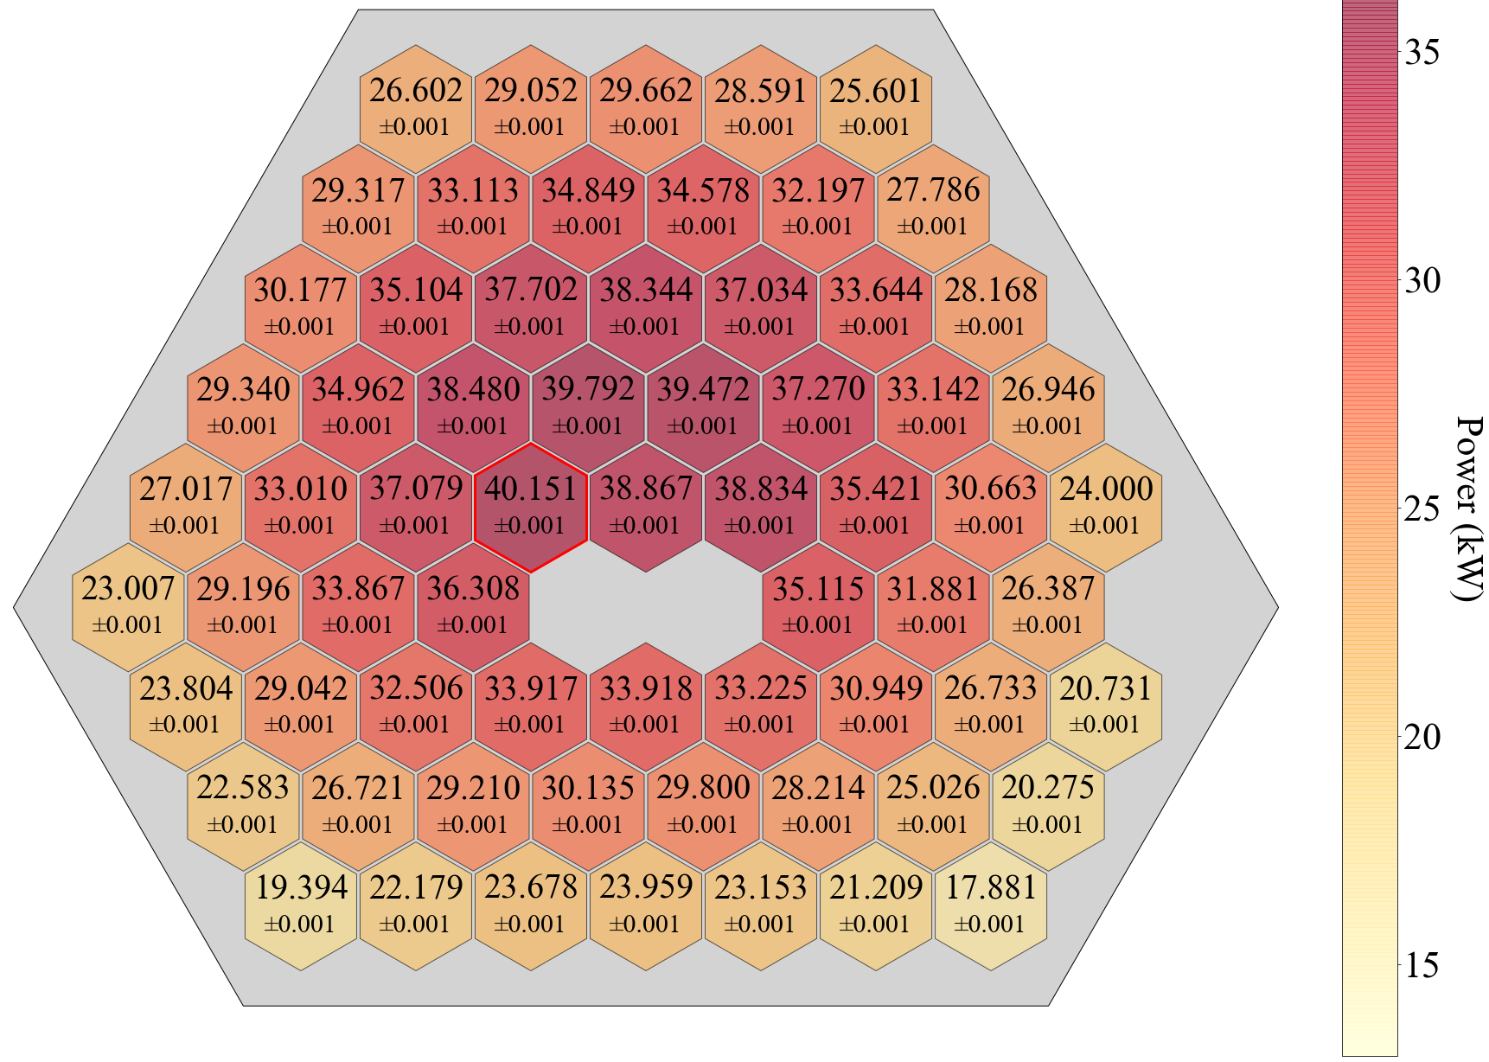
Presence of energy release gradient
Assumption: Bending of the construction elements?
Energy release in the IBR-2M core
Coefficient of unevenness of energy release by fuel assemblies = 1.71

Slide 5
Bending of the construction elements
Thermal expansion law:
T₁ < T₂
$$\frac{∆L}{L}=α∆T,$$
where $∆L$ – extension of the rod length $L$,
$α$ – thermal expansion coefficient [1/К],
$∆T$ – heating magnitude (T₁–T₀)
$${∆L}_{1}$$
$${∆L}_{2}$$
T₀
T₁
T₂
$$E⋅I⋅\ddot{y}=M\sim {(T}_{2}−T_{1})$$
y

Slide 6
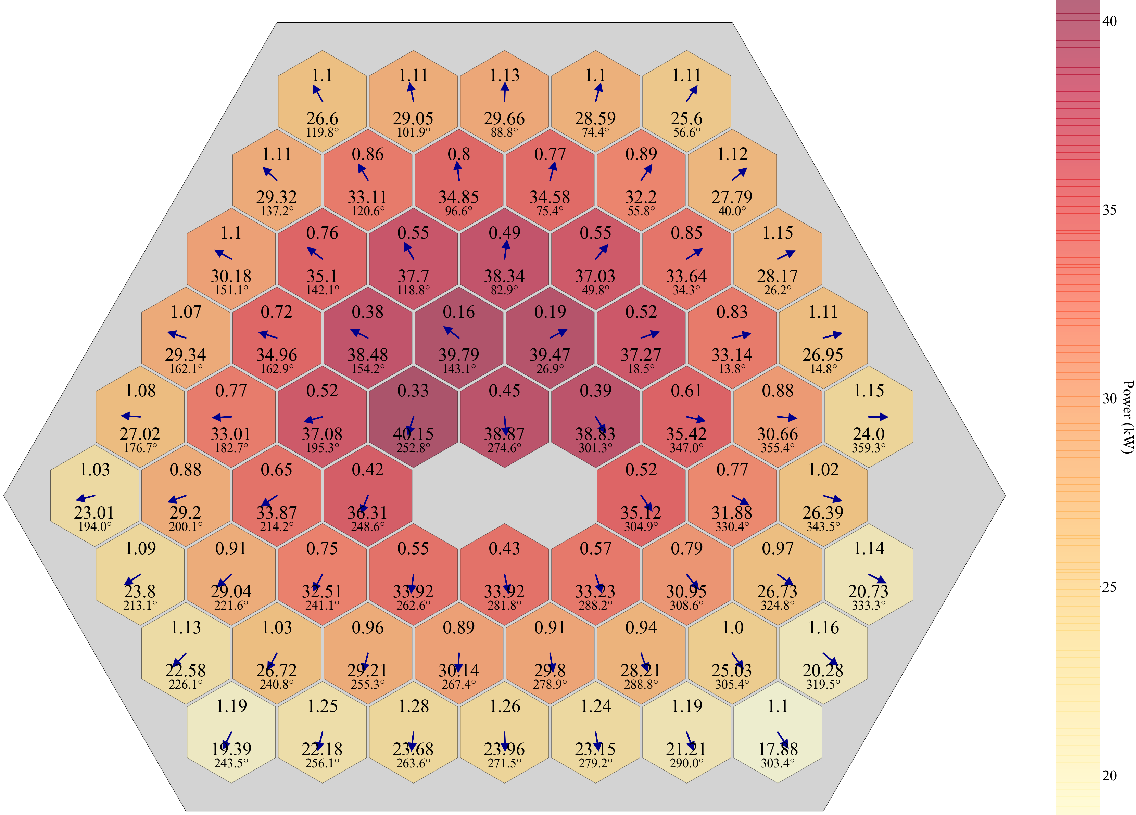
Direction of the gradient in the IBR-2M core

Slide 7
Direction of the gradient in the IBR-2M core
Assumption: direction of the bending
cross section of the core in the case of fuel assembly bending

Slide 8
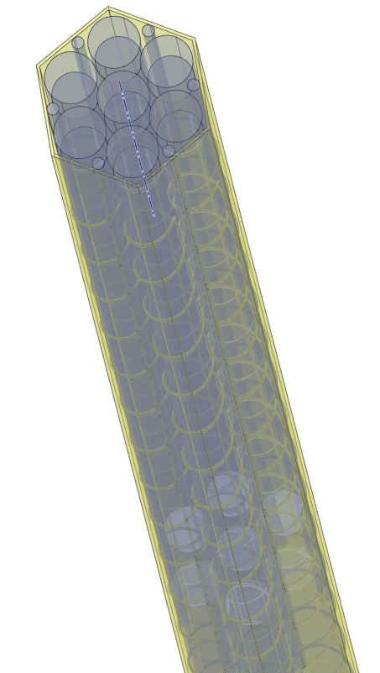
Model for calculating of the IBR-2M fuel assembly
Parameters:
69 fuel assemblies
Energy release – 2 MW (permanent)
Coolant flow – 100 m³/h
Temperature of coolant at inlet – 290 °C
Coolant flow through fuel assemblies is 95%
Temperature distribution along the fuel assembly

Slide 9
Temperature relaxation when energy release changes by 10%
2.4 sec of animation equals 6 sec;
Gradient in energy release is directed horizontally;
Temperature gradient in the fuel assembly wall is directed at an angle of 40% (depends on wire winding).
End of fuel pellets
Y=777 mm
Fuel rod fastening
Y=1100 mm
End of Fuel assembly
Y=1215 mm

Slide 10
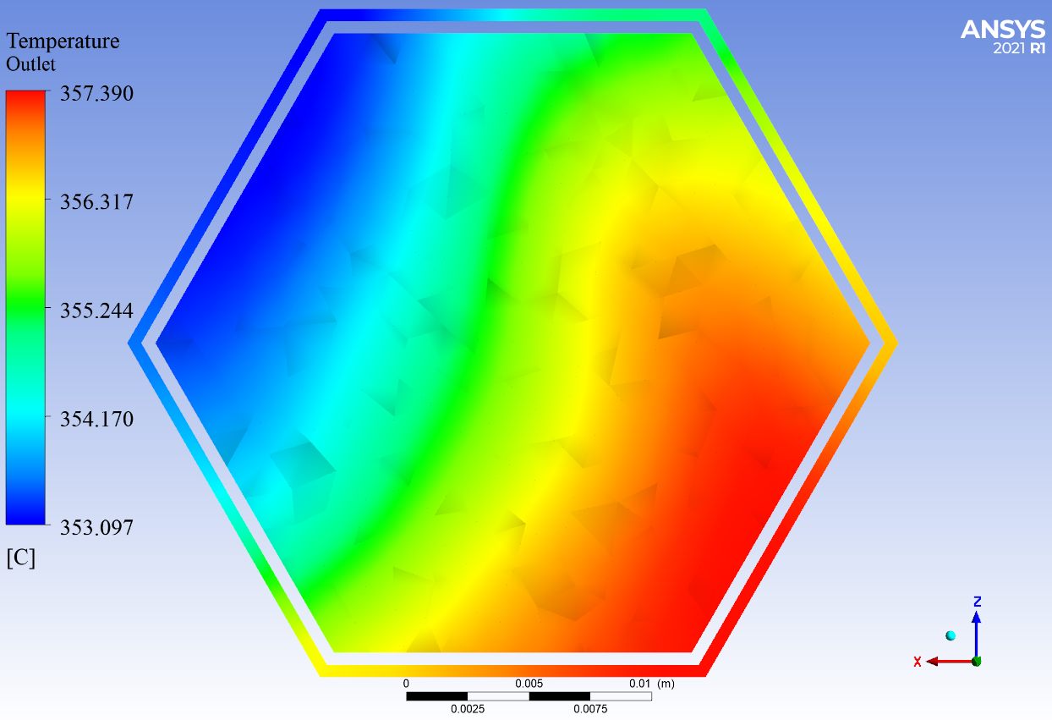
Temperature equalization at the outlet of the fuel assembly
ΔT = 4°C
End of Fuel assembly
Y=1215 mm

Slide 11
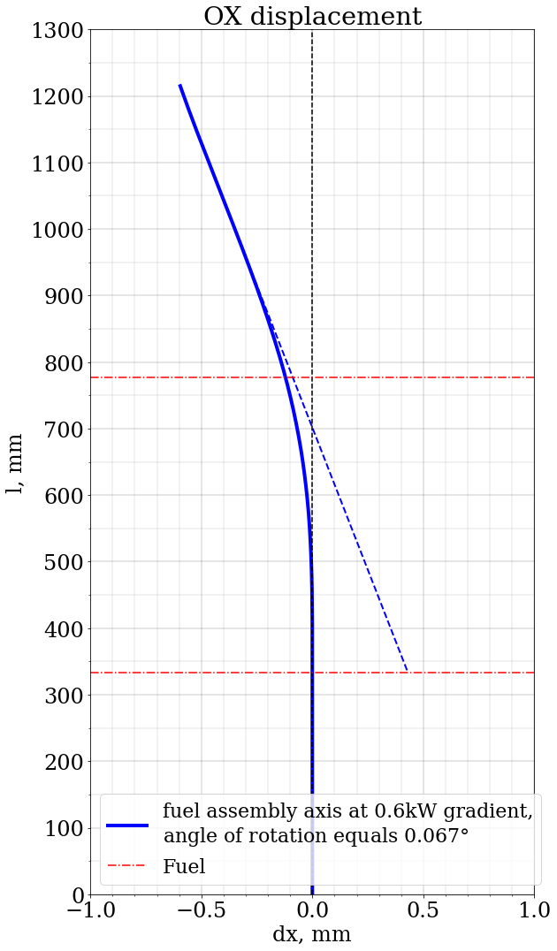
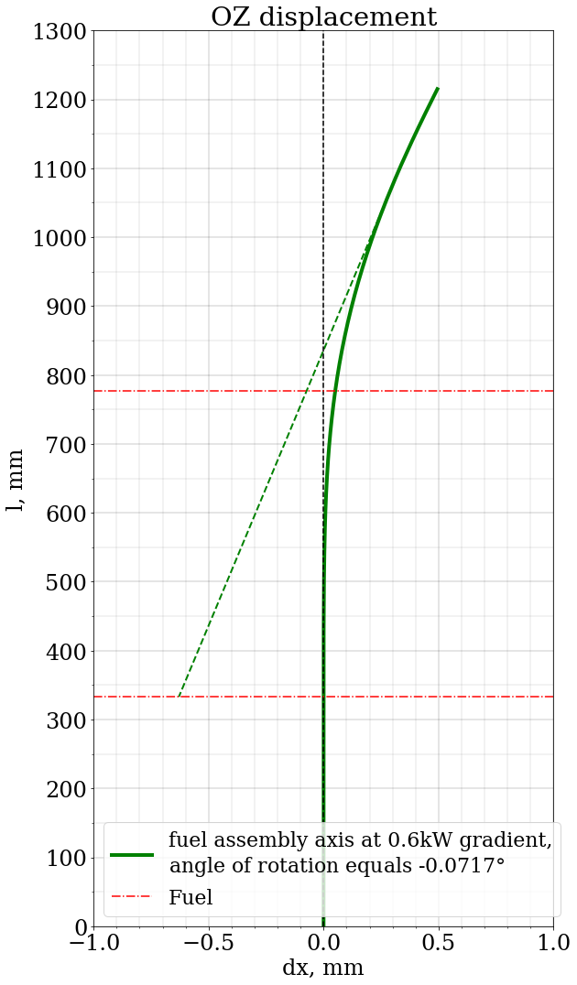
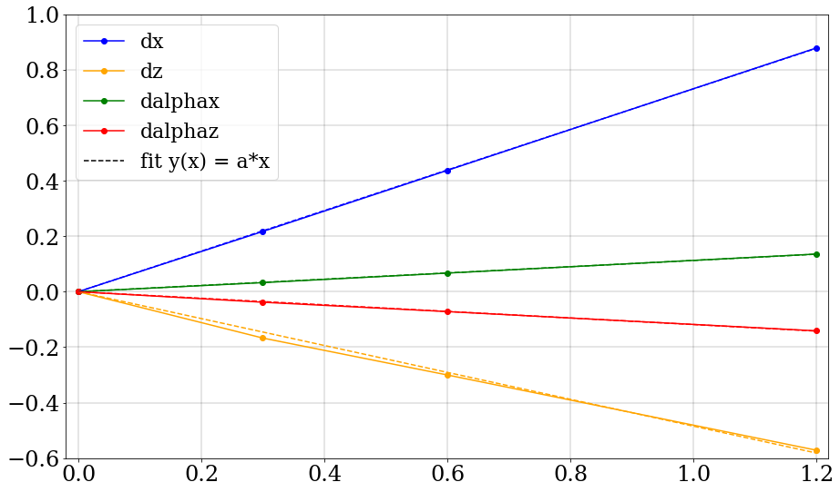
Results
approximation by a straight line of the dependence of the required coefficients on the magnitude of the energy release gradient
fuel assembly axis bending shape

Slide 12
Direction of the gradient in the IBR-2M core
Reality: direction of the bending
cross section of the core in the case of fuel assembly bending

Slide 13
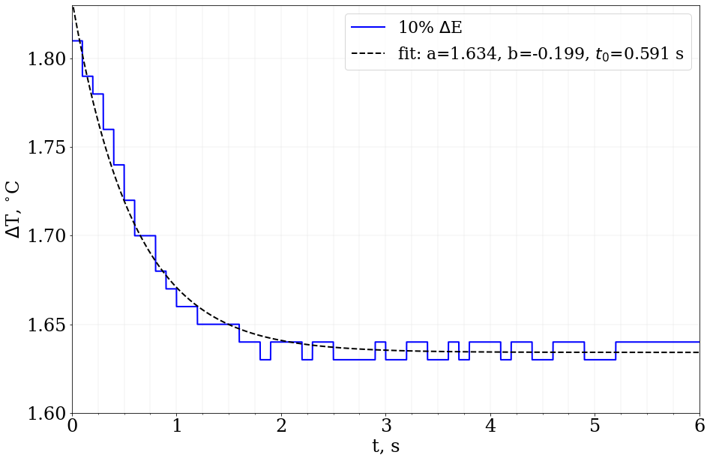
Relaxation time calculation
2.5 s?
dependence on the height-averaged temperature gradient of the fuel assembly wall

Slide 14
Future plans
Work on studying the behavior of fuel assemblies (continue)
Calculation of the influence of fuel assembly bending on reactivity
Building a dynamics model of the IBR-2 reactor taking into account bending of fuel assemblies

Slide 15
Thanks for your attention!
JINR Association of Young Scientists and Specialists Conference "Alushta-2024"
June 9-16, 2024

